Slide 1
Lesson 10.4
Prokaryotic Cell Division

Slide 2
Objectives
Describe the process of binary fission in prokaryotes.
Explain how FtsZ and tubulin proteins are examples of homology.

Slide 3
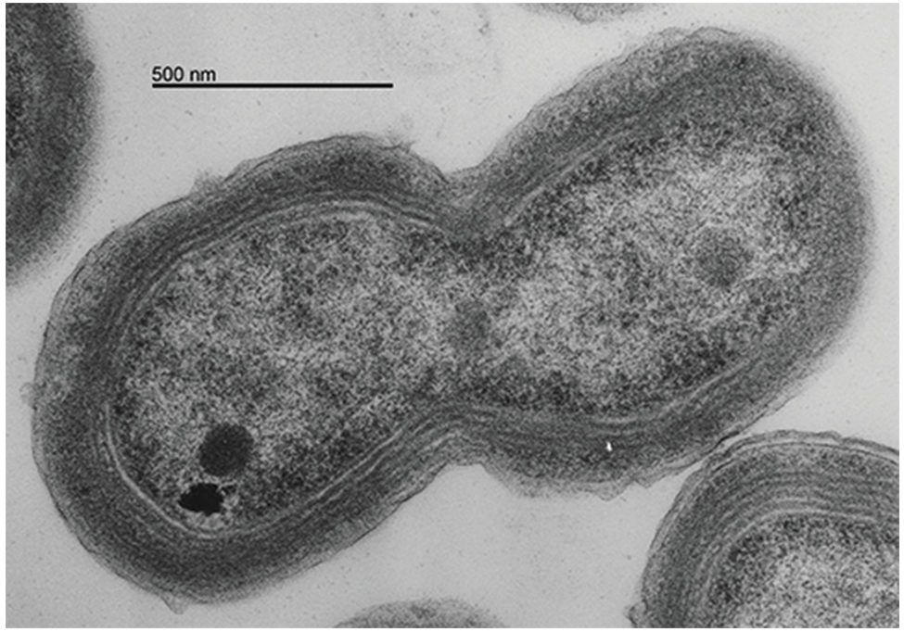
Prokaryotic Cell Division
Single-celled prokaryotes like bacteria reproduce via binary (prokaryotic) fission.
New daughter cells are genetically identical to the parent cell.
Essential steps:
  Replicate genomic DNA
  Allocate DNA copies to daughter cells
  Divide cytoplasmic contents to provide machinery for life
10.4 Figure 1
Chisholm Lab on Wikimedia Commons. "Prochlorococcus."

Slide 4
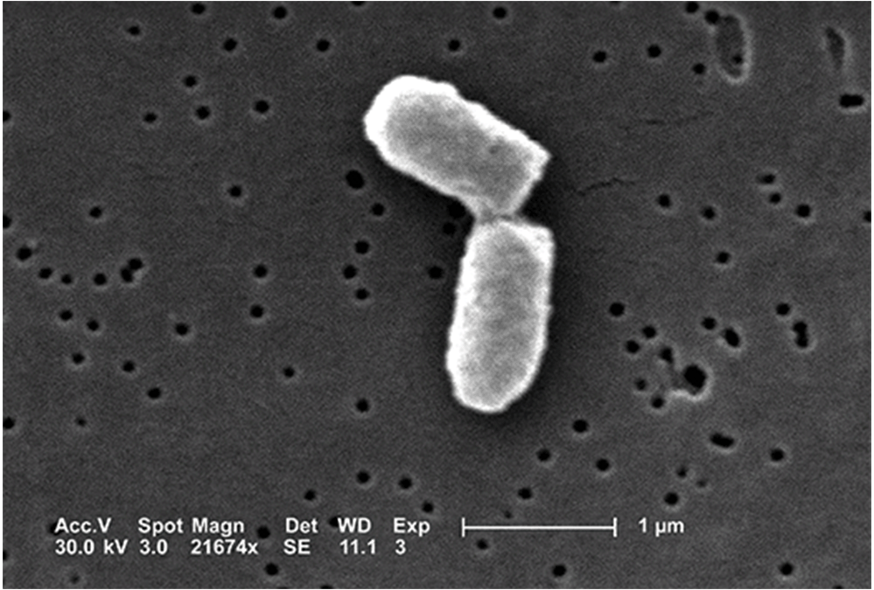
Binary Fission₁
Simpler and faster than eukaryotic cell division
Single circular DNA chromosome
Associated packaging proteins, but no nucleosomes
Attached to plasma membrane at midpoint near the origin (starting point of replication)
10.4 Figure 2
CDC on Wikimedia Commons. "E. coli binary fission."

Slide 5
Binary Fission₂
Process:
DNA replication is bidirectional from the origin.
As new DNA strands form, they segregate towards opposite cell ends.
The cell elongates and the growing membrane aids chromosome movement.
Cytoplasm separation begins after chromosomes reach opposite ends.
The FtsZ proteins form a ring that directs the partition of the nucleoids and recruit plasma membrane and cell wall materials.
These materials produce a septum (wall) between the nucleoids.
The septum splits the parent cell into two daughter cells.
The new cell walls fully form, creating two daughter cells.

Slide 6
Reflection Question
Describe a time when bacteria negatively impacted your life.
  How did the bacteria's ability to replicate quickly contribute to that situation?
Conversely, describe a way in which bacteria positively impacted your life.
Notes:
The reflection question is included here to use as a talking point or for a think-pair-share activity.

Slide 7
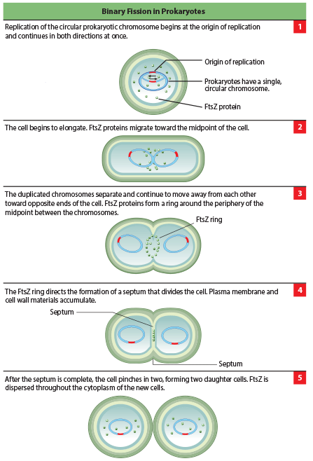
10.4 Figure 3
Mcstrother on Wikimedia Commons. "Binary fission in prokaryotes."
Notes:
These images show the steps of binary fission in prokaryotes.

Slide 8
Think It Through
What does FtsZ stand for? Explain the role of FtsZ in a dividing cell.
Notes:
Originally an On Your Own. This is included here to use as a talking point or for a think-pair-share activity.

Slide 9
Mitotic Spindle Apparatus
Mitotic spindle is critical for eukaryotic cell division but absent in prokaryotes.
FtsZ proteins are key for prokaryotic cytokinesis and have similar structure and function to tubulin.
FtsZ and tubulin form filaments and rings; both utilize GTP for assembly and disassembly.
FtsZ is the ancestral protein to tubulin; they are homologous structures.
Mitotic assembly components found in present-day unicellular eukaryotes reveals crucial intermediary steps to the complex membrane-enclosed genomes of multicellular eukaryotes.

Slide 10
Table 1: Cell Division Apparatus among Various Organisms₁
 | Structure of Genetic Material | Division of Nuclear Material | Separation of Daughter Cells
Prokaryotes | There is no nucleus. The single, circular chromosome exists in a region of cytoplasm called the nucleoid. | Division occurs through binary fission. As the chromosome is replicated, the two copies move to opposite ends of the cell by an unknown mechanism. | FtsZ proteins assemble into a ring that pinches the cell in two.
Some Protists | Linear chromosomes exist in the nucleus. | Chromosomes attach to the nuclear envelope, which remains intact. The mitotic spindle passes through the envelope and elongates the cell. No centrioles exist. | Microfilaments form a cleavage furrow that pinches the cell in two.

Slide 11
Table 1: Cell Division Apparatus among Various Organisms₂ (Cont.)
 | Structure of Genetic Material | Division of Nuclear Material | Separation of Daughter Cells
Other Protists | Linear chromosomes wrapped around histones exist in the nucleus. | A mitotic spindle forms from the centrioles and passes through the nuclear membrane, which remains intact. Chromosomes attach to the mitotic spindle, which separates the chromosomes and elongates the cell. | Microfilaments form a cleavage furrow that pinches the cell in two.
Animal Cells | Linear chromosomes exist in the nucleus. | A mitotic spindle forms from the centrosomes. The nuclear envelope dissolves. Chromosomes attach to the mitotic spindle, which separates the chromosomes and elongates the cell. | Microfilaments form a cleavage furrow that pinches the cell in two.

Slide 12
Summary
In both prokaryotic and eukaryotic cell division, the genomic DNA is replicated, and each copy is allocated into a daughter cell.
In addition, the cytoplasmic contents are divided evenly and distributed to the new cells.
Bacteria have a single, circular DNA chromosome, but no nucleus, so mitosis is not necessary.
Bacterial cytokinesis is directed by a ring composed of a protein called FtsZ.
Ingrowth of membrane and cell wall material from the periphery of the cells results in the formation of a septum that eventually constructs the separate cell walls of the daughter cells.

Slide 13


End of Hawkes Learning PowerPoint

