Slide 1
Lesson 11.1
The Process of Meiosis

Slide 2
Objectives
Describe the behavior of chromosomes during meiosis, and the differences between the first and second meiotic divisions.
Describe the cellular events that take place during meiosis.
Explain the differences between meiosis and mitosis.
Explain the mechanisms within the meiotic process that produce genetic variation among the haploid gametes.

Slide 3
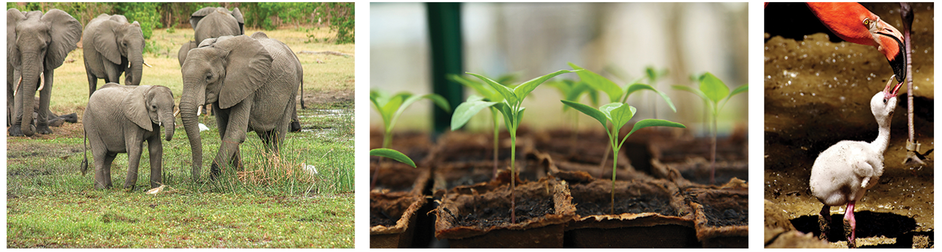
Meiosis and Sexual Reproduction
All organisms need to reproduce
Offspring may or may not resemble parents
Asexual reproduction: form of reproduction that produces offspring that are genetically identical to the parent
Sexual reproduction: mixing of genetic material from two individuals to produce genetically unique offspring
Involves the production of haploid gametes that fuse to form a diploid zygote
Haploid cell produced through meiosis
Also involves fertilization: union of two haploid cells from two individual organisms
11.1 Figure 1: Each of us, like the organisms shown here, begins life as a fertilized egg (zygote). After trillions of cell divisions, each of us develops into a complex, multicellular organism.
Micheal Siebert on Pixabay. "Elephants."
J Garget on Pixabay. "Seedlings."
Alexas_Fotos on Pixabay. "Flamingos."

Slide 4
The Process of Meiosis₁
Two gametes come together to form a zygote
Gamete: haploid reproductive cell or sex cell (sperm, pollen grain, or egg)
Haploid: cell, nucleus, or organism containing one set of chromosomes (n)
Zygote: a diploid cell formed from the fusion of two haploid gametes; a fertilized egg
Diploid: cell, nucleus, or organism containing two sets of chromosomes (2n)
Diploid cell must reduce chromosomes to produce haploid gametes
Sexual reproduction requires nuclear division that reduces # of chromosomes

Slide 5
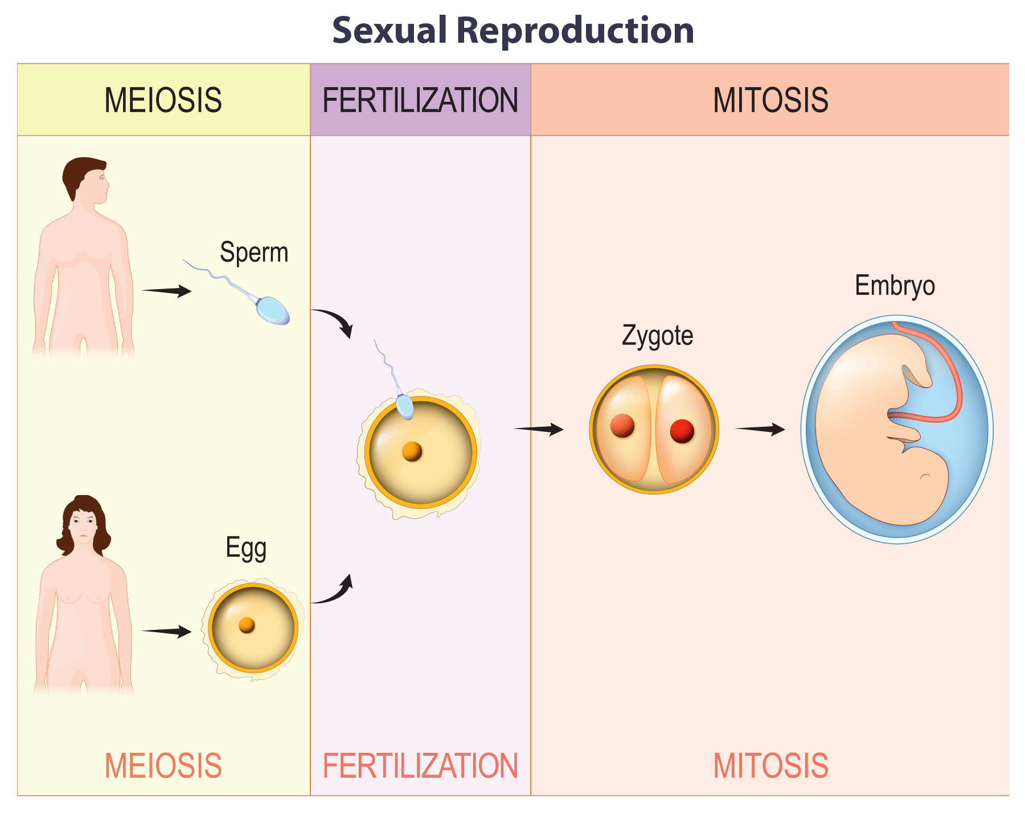
The Process of Meiosis₂
Most animals are diploid.
Each somatic cell has two copies of each chromosome (homologous chromosomes)
Somatic cell: all the cells of a multicellular organism except the gametes or reproductive cells
Diploid organisms inherit one homologous chromosome from each parent.
11.1 Figure 2: In human sexual reproduction, multicellular diploid parents each produce haploid gametes by meiosis. A haploid sperm fertilizes a haploid egg to produce a diploid zygote, which then undergoes mitosis to form a multicellular diploid embryo.

Slide 6
The Process of Meiosis₃
Meiosis: a nuclear division process that results in four haploid cells; employs the same cellular mechanisms as mitosis
Mitosis: period of the cell cycle during which the duplicated chromosomes are separated into identical nuclei; includes prophase, prometaphase, metaphase, anaphase, and telophase (also, karyokinesis)
Plants use mitosis to grow sporophytes (diploid stage of the plant life cycle) and to grow and produce eggs and sperm as gametophytes (haploid stage of the plant life cycle).
The starting nucleus in meiosis is always diploid and the daughter nuclei are always haploid.
Occurs through one round of chromosome replication and two rounds of nuclear division
Meiosis I: first round of meiotic cell division; referred to as reduction division because the ploidy level is reduced from diploid to haploid
Meiosis II: second round of meiotic cell division following meiosis I; sister chromatids are separated into individual chromosomes, and the result is four unique haploid cells

Slide 7
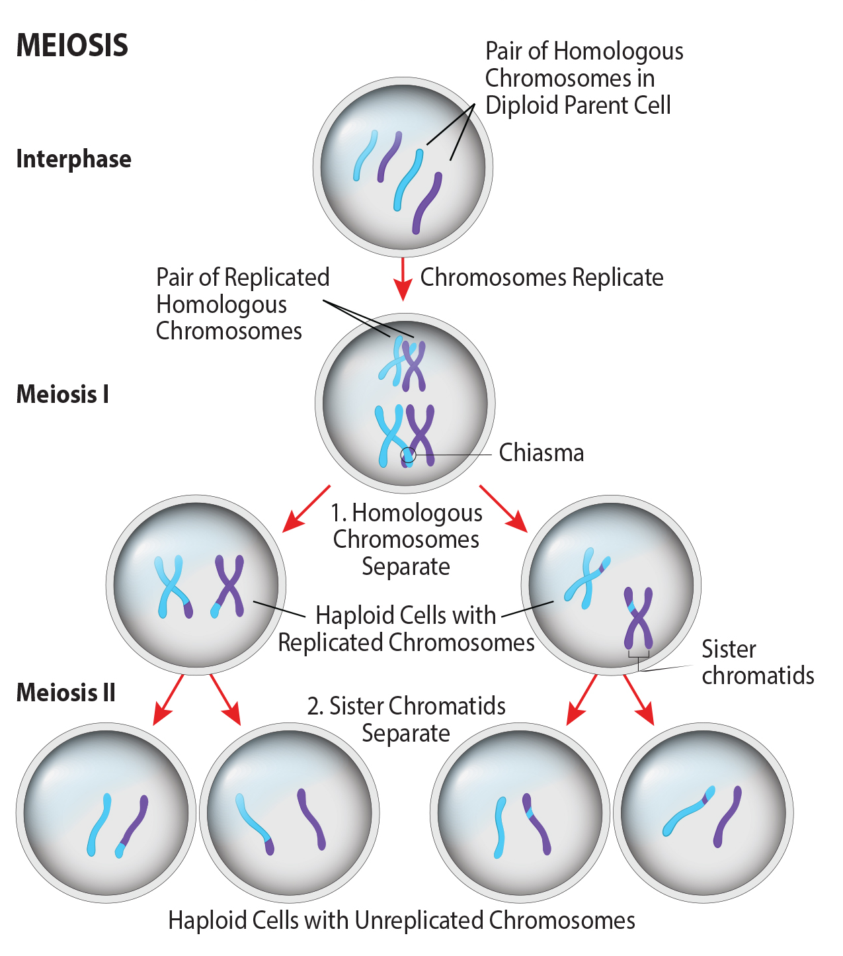
11.1 Figure 3
Notes:
Figure 3: This image is an overview of meiosis. The production of gametes is a crucial process for sexually reproducing organisms. Meiosis is the mechanism used to reduce diploid cells to haploid gametes while introducing genetic diversity. Prior to meiosis, chromosomes are replicated in the S phase of interphase to ensure the proper number of chromosomes is present in the resulting gametes. During meiosis, two successive rounds of division reduce the number of chromosomes (ploidy) of the cell by half, going from diploid cells to haploid gametes.

Slide 8
Meiosis I
Preceded by interphase (consisting of G₁, S, and G₂ phases)
G₁ phase: focuses on cell growth
S phase: cell copies (replicates) the DNA of the chromosomes
Each cell replicated to produce two identical copies (sister chromatids) held together at the centromere by cohesin until pulled apart in anaphase II
G₂ phase: cell undergoes final preparations for meiosis

Slide 9
Prophase I₁
Early on, homologous chromosomes are attached at tips to nuclear envelope by lamins
Synaptonemal complex: protein lattice that forms between homologous chromosomes during prophase I, supporting crossover
Synapsis: formation of a close association between homologous chromosomes during prophase I; the genes are precisely aligned with each other

Slide 10
Prophase I₂
Synapsis supports the exchange of genetic material between nonsister chromatids (chromatids on the opposite homologous chromosomes); process called crossing over
Crossing over: exchange of genetic material between nonsister chromatids resulting in chromosomes that incorporate genes from both parents of the organism
Chiasmata: the structure that forms at the crossover points after genetic material is exchanged

Slide 11
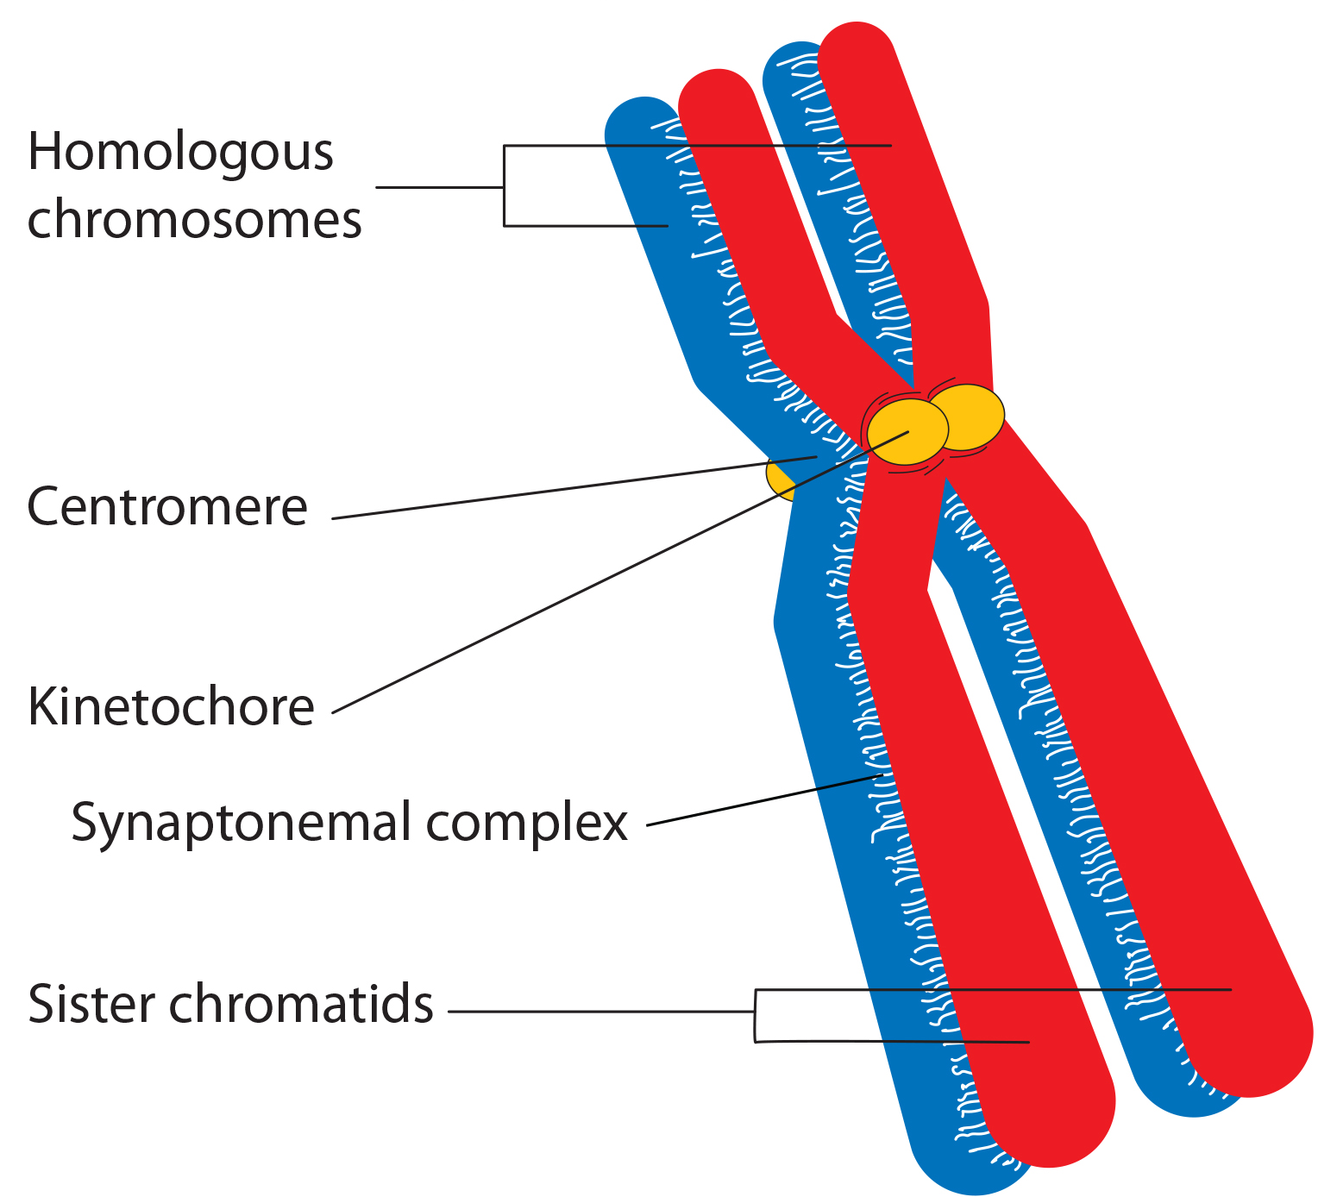
Prophase I₃
X and Y sex chromosomes are not completely homologous but have a small region of similarity, allowing them to pair up (a partial synaptonemal complex develops only between regions of homology [similarity])
11.1 Figure 4: Early in prophase I, homologous chromosomes come together to form a synapsis. The chromosomes are bound tightly together and kept in perfect alignment by a protein lattice, called a synaptonemal complex, and by cohesin proteins at the centromere.
OpenStax on Wikimedia Commons. "Homologous chromosomes."

Slide 12
Prophase I₄
Recombination nodules: protein assemblies formed on the synaptonemal complex that mark the points of crossover events and mediate the multistep process of genetic recombination between nonsister chromatids
Near here, each chromatid is cleaved, cut ends modified, and new connection made between nonsister chromatids
Synaptonemal complex then begins to break down and chromosomes begin to condense but remain attached at the centromere and chiasmata
Chiasmata remains until anaphase I
Could have 1 to 25 chiasmata depending on species and length of chromosome
At end of prophase I, pairs (now called tetrads) held together only at chiasmata
Tetrads: two duplicated homologous chromosomes (four chromatids) bound together by chiasmata during prophase I

Slide 13
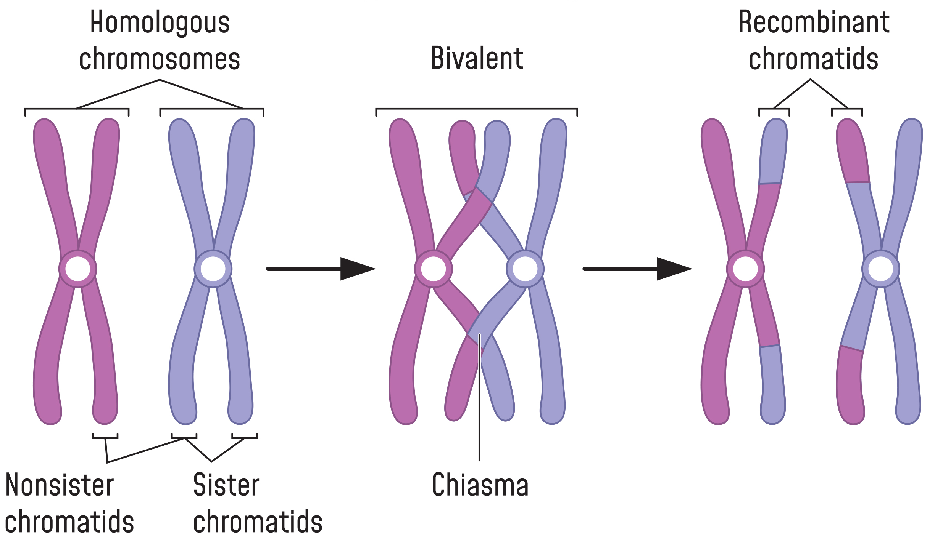
Prophase I₅
Crossover is first source of genetic variation in meiosis
One event produces two recombinant chromatids (chromatids formed by fusion of genetic material)
Can occur anywhere along the length of the synapsed chromosomes
11.1 Figure 5: Crossing over occurs between the nonsister chromatids of homologous chromosomes. The result is an exchange of genetic material between homologous chromosomes.

Slide 14
Prometaphase I
Key event is attachment of spindle fiber microtubules to the kinetochore proteins at centromeres
Kinetochore proteins: multiprotein complexes that bind centromeres to the microtubules of mitotic spindle
Microtubules grow from microtubule-organizing centers (MTOCs)
Grow from each pole toward middle of the cell and attach to one of the kinetochores of two fused homologous chromosomes
Each pair attaches to microtubule extending from opposite pole so microtubule can pull homologous pair apart later
At the end, each tetrad is attached to microtubules from both poles, one homologous chromosome facing each pole
Homologous chromosomes still held together at chiasmata
Nuclear membrane broken down entirely

Slide 15
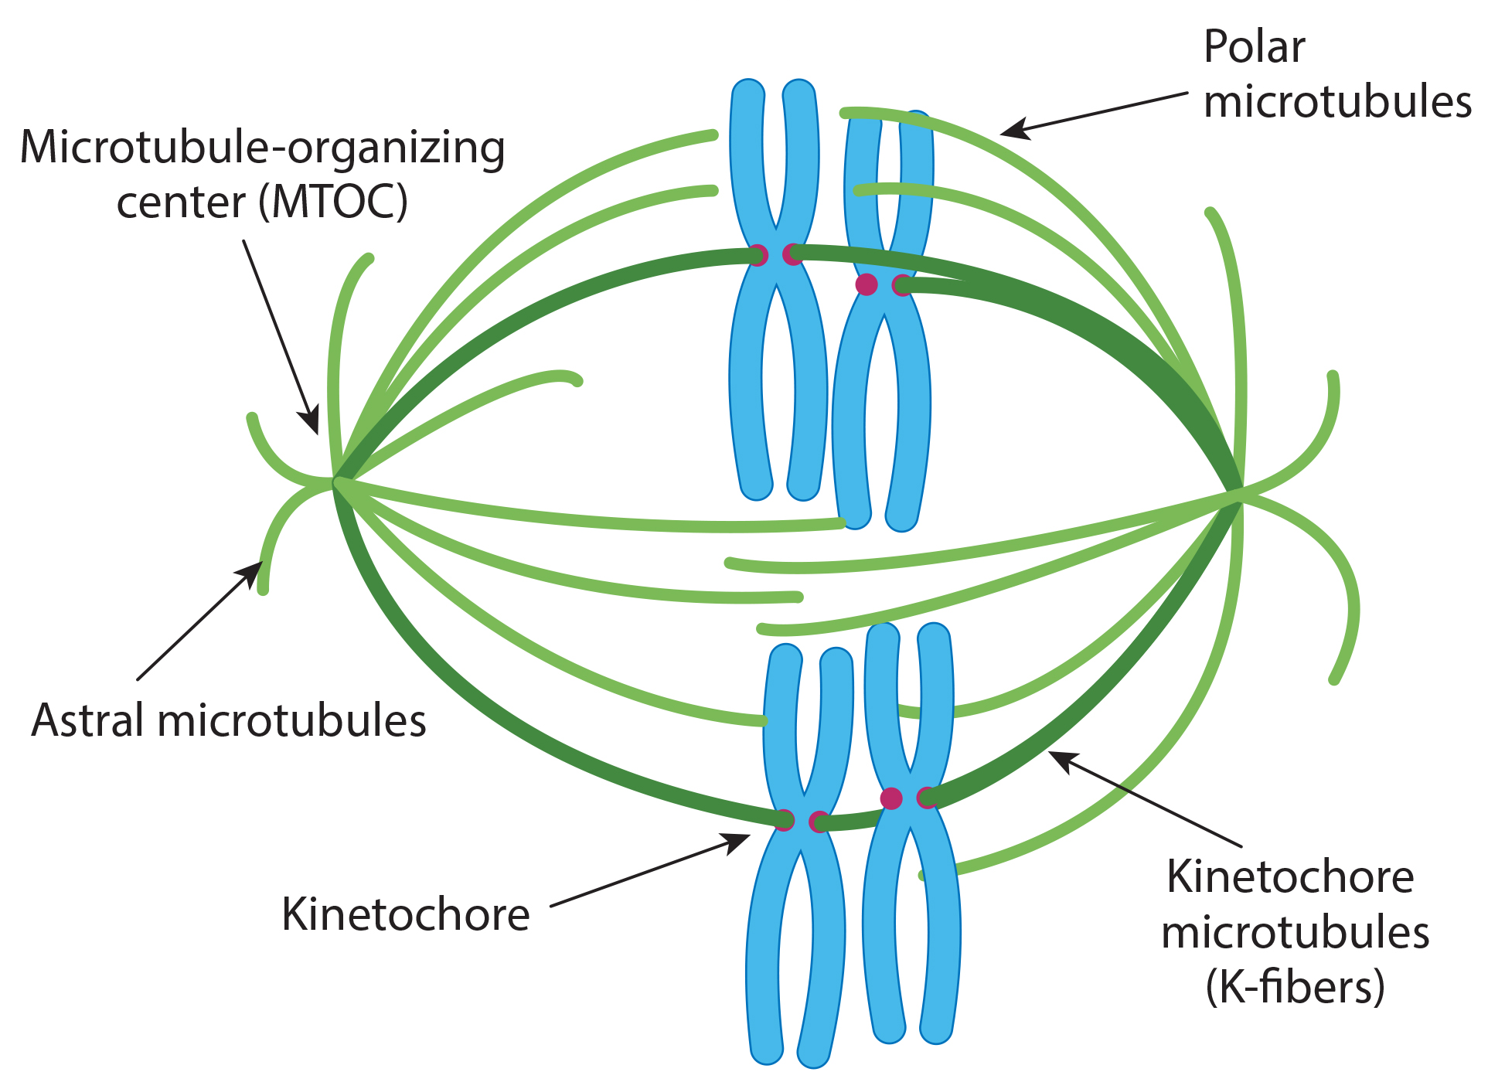
11.1 Figure 6
Quizlet. "Microtubules."
Notes:
Figure 6: In animal cells, the microtubule-organizing centers (MTOCs) are centrosomes found on opposite poles of a cell. The kinetochore microtubules are those that attach to the kinetochore proteins found at the centrosomes of tetrads; they attach to tetrads during prometaphase I. The astral microtubules do not attach to a kinetochore; instead, they aid in spindle orientation.

Slide 16
Metaphase I₁
Homologous chromosomes arrange at metaphase plate with kinetochores facing opposite poles
Metaphase plate: equatorial plane midway between the two poles of a cell where the chromosomes align during metaphase
Oriented randomly at the equator
After crossing over, sister chromatids are not identical
Responsible for genetic variation in offspring
Example: Humans each have 23 chromosomes in each gamete. In prophase I, the homologous chromosome form tetrads. In metaphase I, the pairs line up randomly at the midway point to form the metaphase plate. The orientation of each tetrad is independent of the orientation of the other 22 tetrads.

Slide 17
Metaphase I₂
Second event that produces genetic variation: independent assortment
Independent assortment: the random assortment of homologous chromosomes at the metaphase plate that, upon completion of meiosis I, introduces significant genetic variation into the resulting gametes or spores
Spore: haploid cell that can produce a haploid multicellular organism or can fuse with another spore to form a diploid cell
Two possibilities for orientation at the metaphase plate so possible number of alignments equals 2^{n} (n is the number of chromosomes per haploid set
Example: Humans have 23 chromosome pairs (2²³ possible genetically distinct gametes)
Does not include variability previously produced by crossing over between nonsister chromatids

Slide 18
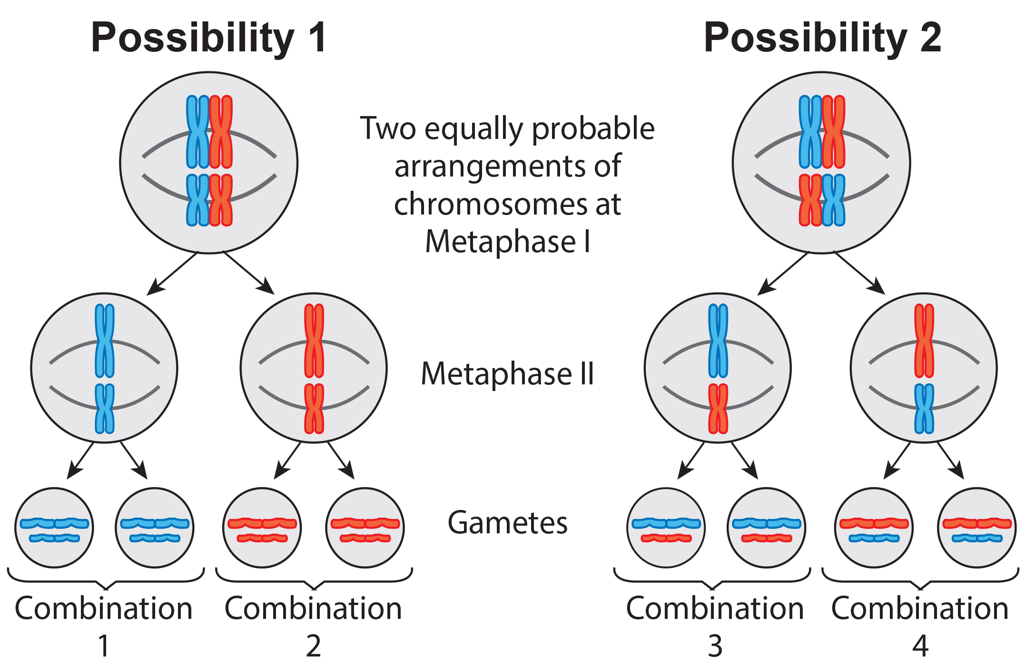
11.1 Figure 7
CNX OpenStax on Wikimedia Commons. "Independent assortment." Modified.
Notes:
Figure 7: Independent assortment during metaphase I can be demonstrated by considering a cell with a set of two chromosomes (n=2). In this case, there are two possible arrangements at the equatorial plane in metaphase I. The total possible number of different gametes is 2n, where n equals the number of chromosomes in a set. In this example, there are four possible genetic combinations for the gametes. With n=23 in human cells, there are over eight million possible combinations of paternal and maternal chromosomes.

Slide 19
Metaphase I₃
Meiosis I creates genetically diverse gametes in two ways at two stages:
During prophase I
Crossover events between nonsister chromatids of each homologous pair generate recombinant chromatids with new combinations of maternal and paternal genes
During metaphase I
Random assortment (independent assortment) of tetrads on the metaphase plate produces unique combinations of maternal and paternal chromosomes that will make their way into gametes

Slide 20
Think It Through
In a diploid cell having a haploid set of 6, how many different gametes may result from independent assortment during metaphase I?
Notes:
Originally an On Your Own. This is included here to use as a talking point or for a think-pair-share activity.

Slide 21
Anaphase I
Microtubules pull two homologous chromosomes apart
Each homologous chromosome consists of two sister chromatids (still bound at the centromere)
Chiasmata are broken when microtubules attached to fused kinetochores pull homologous chromosomes apart

Slide 22
Telophase I and Cytokinesis
Separated chromosomes arrive at opposite poles
Remaining events may or may not occur, depending on species
Chromosomes decondense and nuclear envelopes form
Cytokinesis occurs without reformation of the nuclei by a cleavage furrow (constriction of the actin ring that leads to division)
Cytokinesis: division of the cytoplasm following mitosis that forms two daughter cells
In plants, a cell plate is formed by Golgi vesicles fusing at metaphase plate
Results in two haploid cells

Slide 23
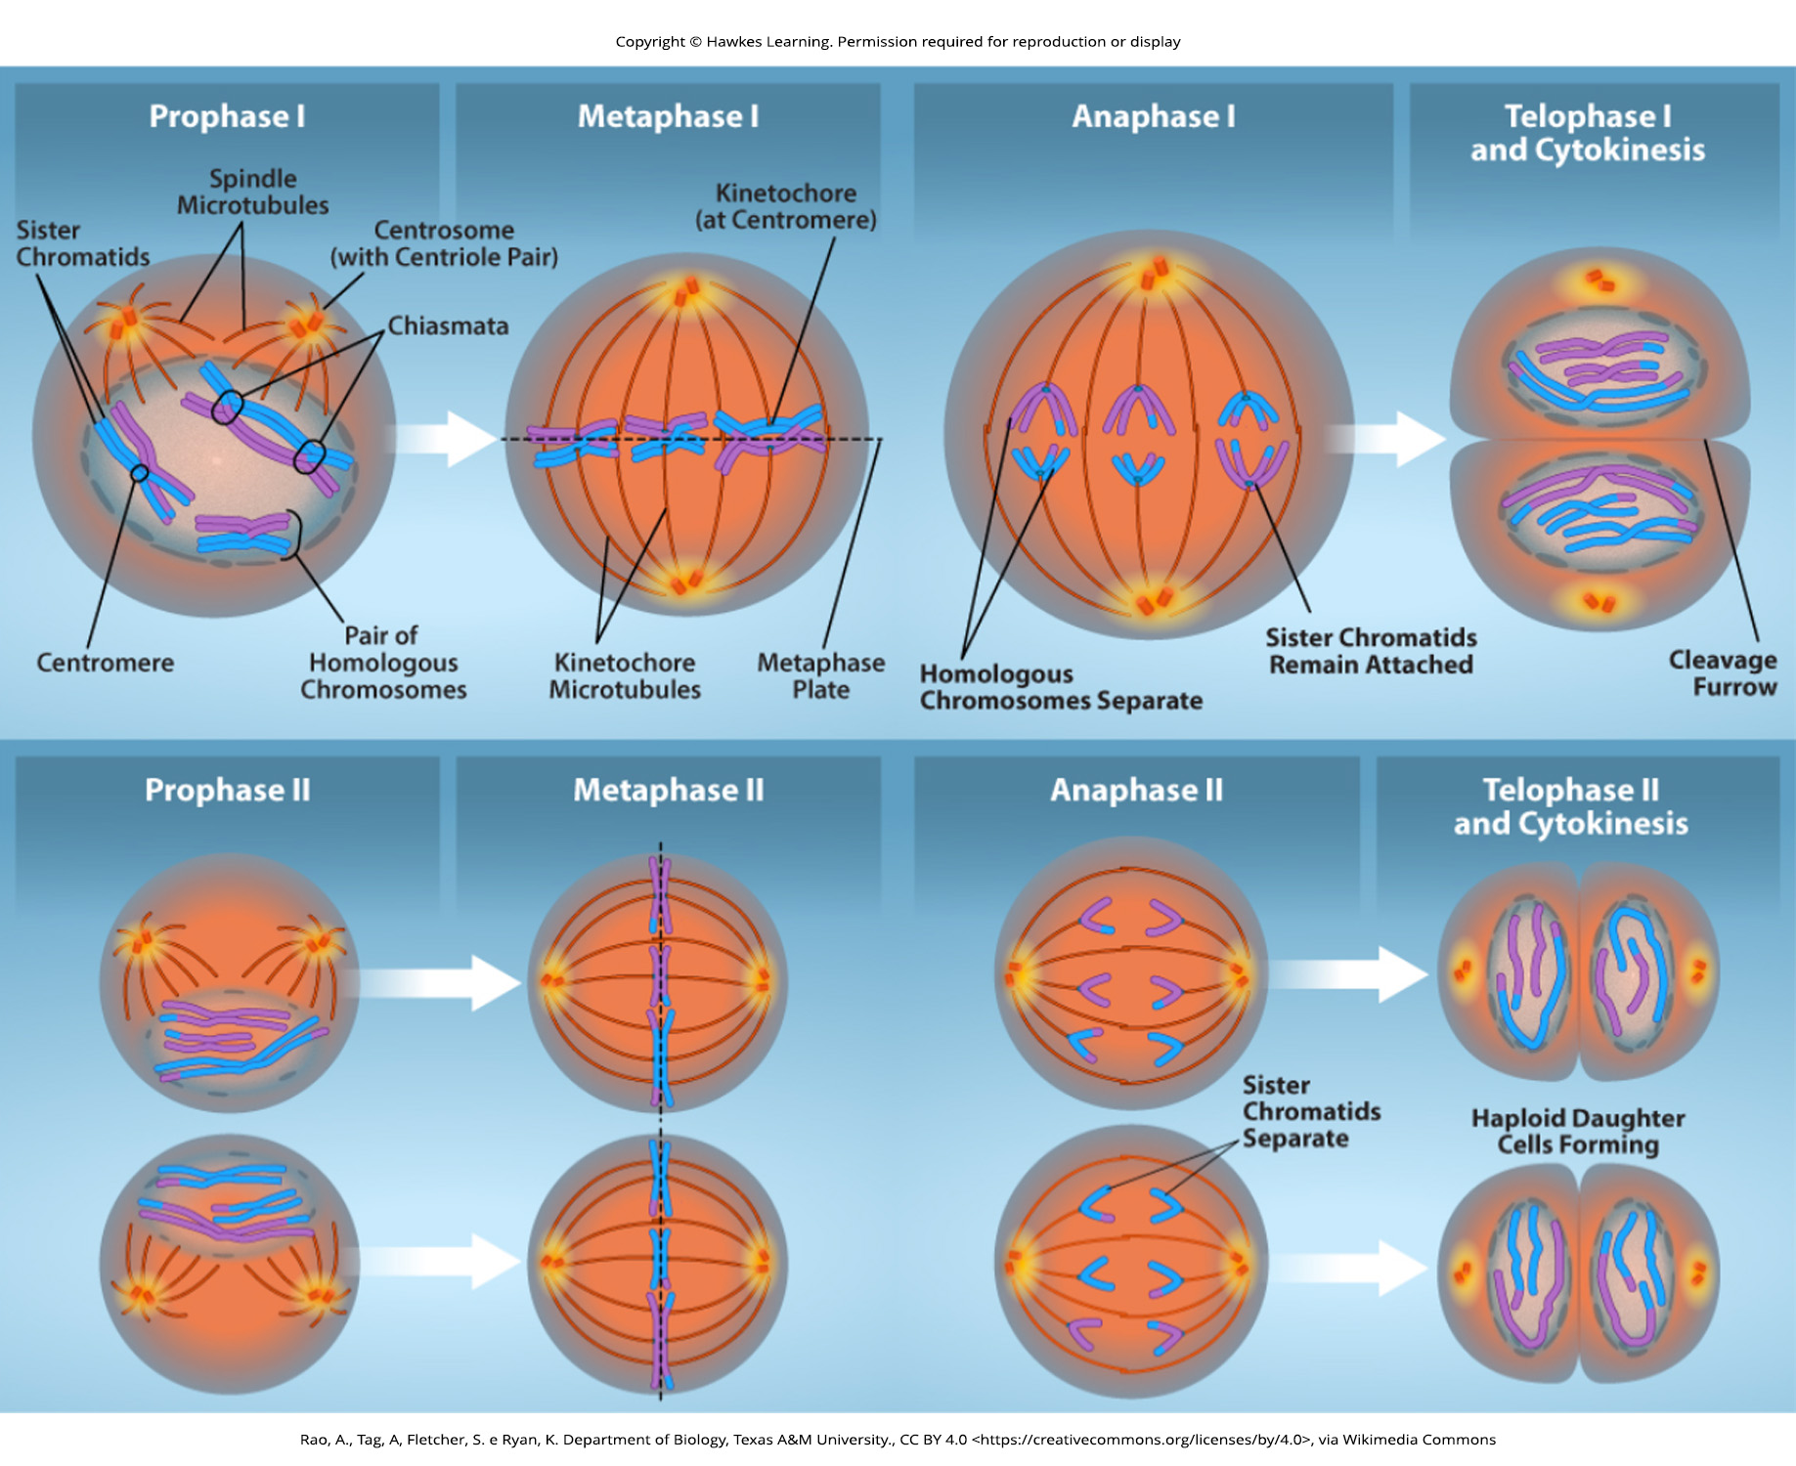
11.1 Figure 8
Rao, A., Ryan, K., Fletcher, S. and Tag, A. Department of Biology, Texas A&M University. "Meiosis I and II."
Notes:
Figure 8: The process of chromosome alignment differs between meiosis I and meiosis II. In prophase I, pairs of homologous chromosomes form chiasmata, which allow for crossing over events (genetic diversity). These pairs of homologous chromosomes arrange at the metaphase plate in metaphase I. In anaphase I, homologous chromosomes separate. Telophase I and cytokinesis result in haploid cells with two sister chromatids of each chromosome. In prophase II, spindle microtubules form and elongate, and any nuclear envelope disappears. Sister chromatids arrange at the midpoint of the cells in metaphase II. In anaphase II, the sister chromatids separate. Telophase II and cytokinesis result in haploid cells with a single copy of each chromosome.

Slide 24
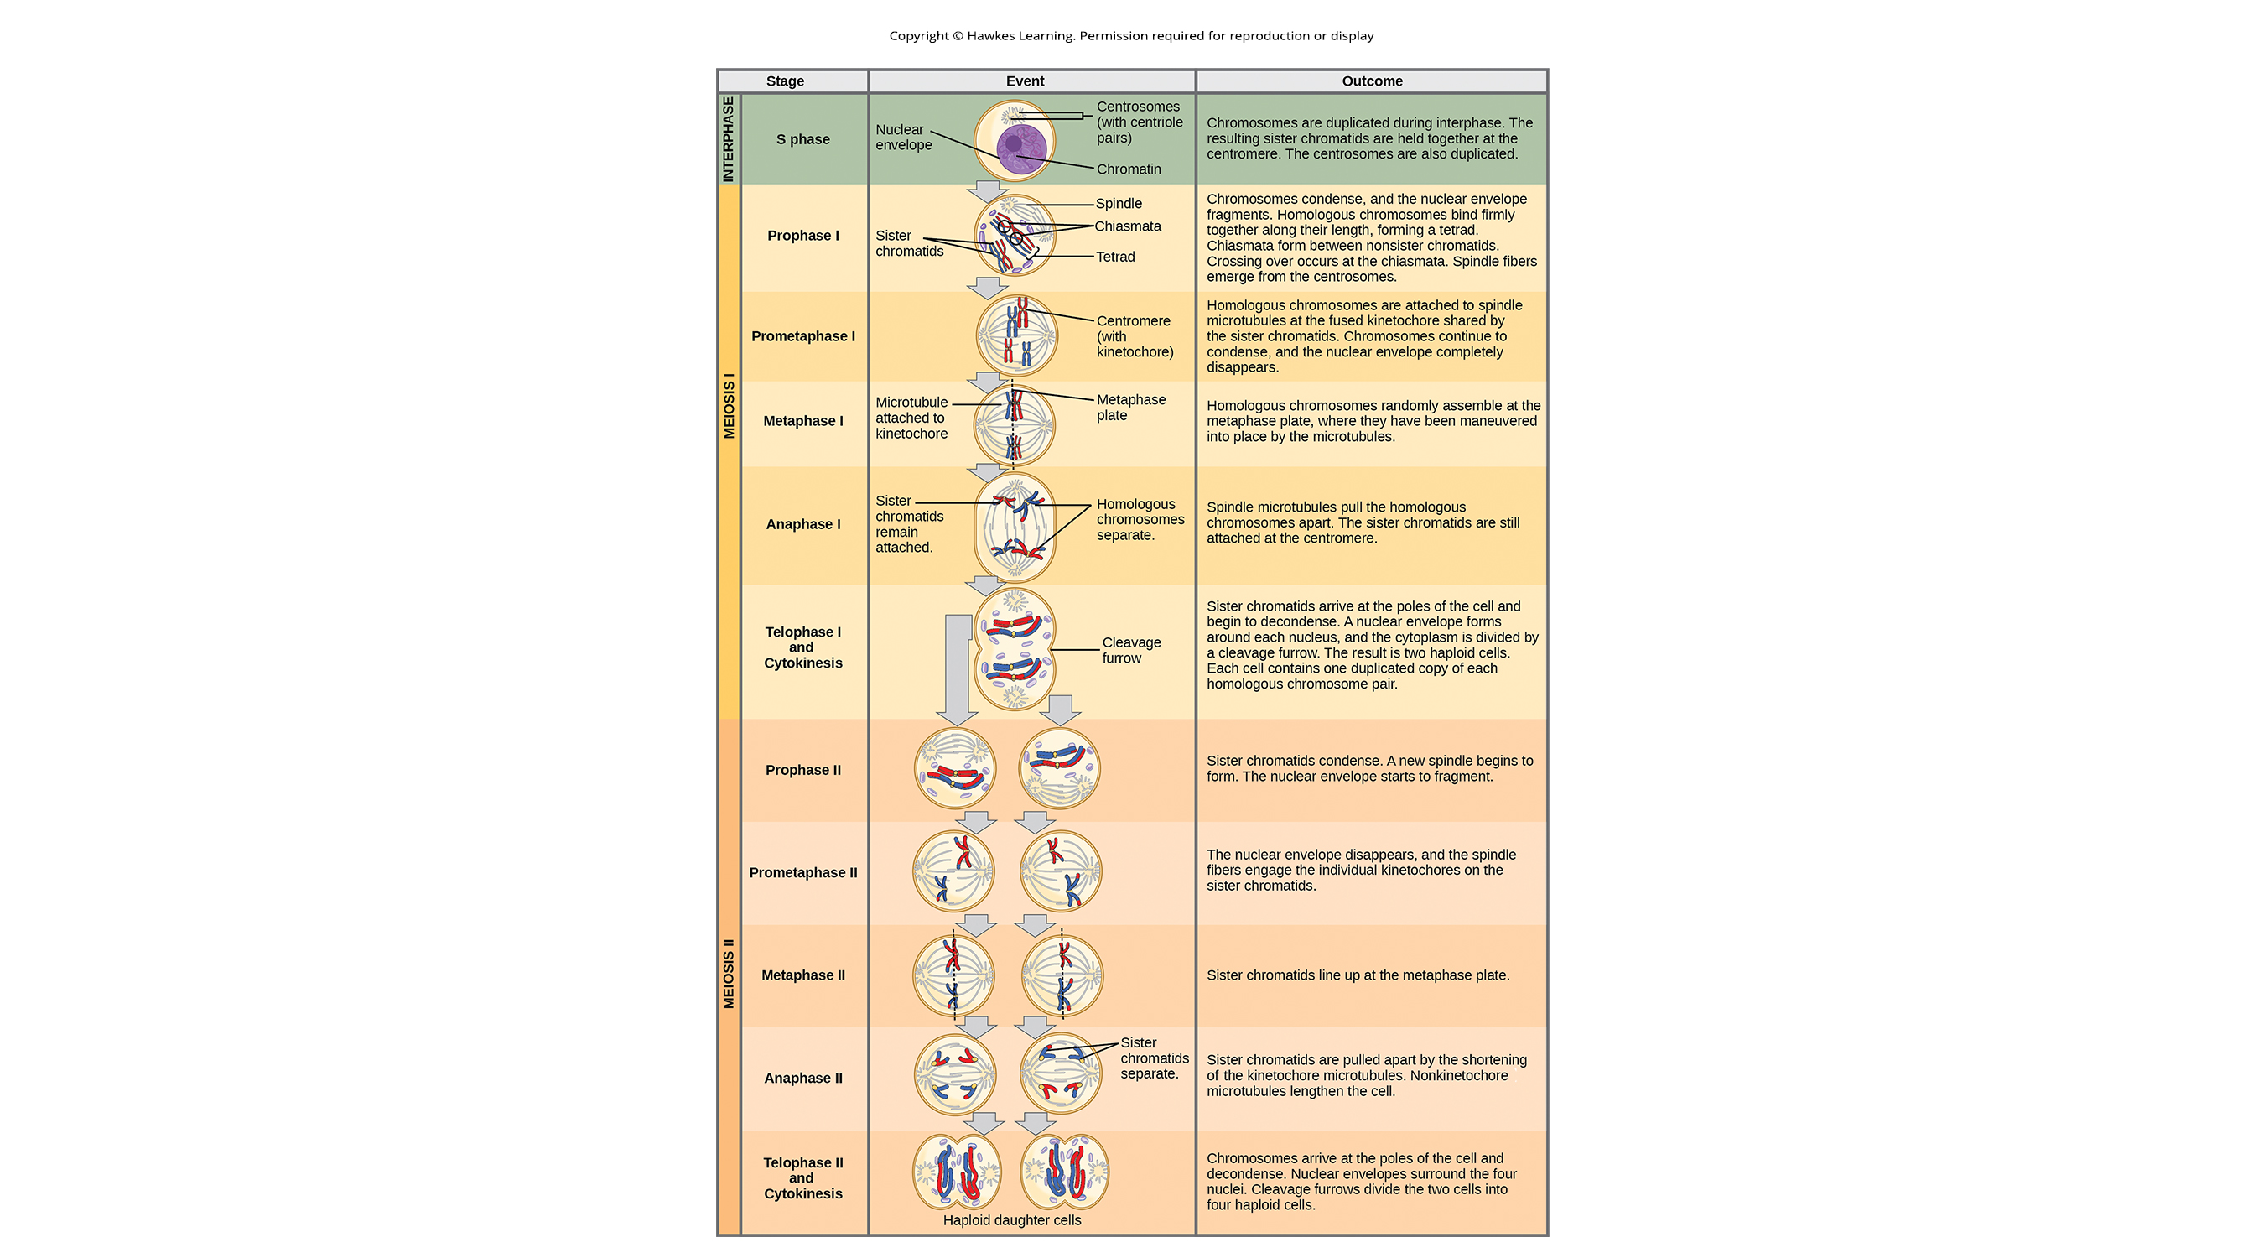
11.1 Figure 9
Notes:
Figure 9: An animal cell with a diploid number of four (2n=4) proceeds through the stages of meiosis to form four haploid daughter cells.

Slide 25
11.1 Figure 9 (continued)
Notes:
Figure 9: An animal cell with a diploid number of four (2n=4) proceeds through the stages of meiosis to form four haploid daughter cells.

Slide 26
Meiosis II
Some species enter interkinesis before meiosis II
Interkinesis: brief period of rest between meiosis I and meiosis II (also, interphase II)
Lacks S phase; chromosomes are not duplicated
Two cells produced in meiosis I go through meiosis II in synchrony
Sister chromatids within the two daughter cells separate, forming four new haploid gametes
Similar to mitosis but only one set of homologous chromosomes, each with two chromatids
Each cell has half number of sister chromatids to separate out as diploid cell goes through mitosis
Cells at start of meiosis II are similar to haploid cells in G₂, preparing to undergo mitosis

Slide 27
Prophase II and Prometaphase II
Prophase II
If chromosomes decondensed in telophase I, chromosomes re-condense
If nuclear envelopes formed, they fragment into vesicles
MTOCs that were duplicated during interkinesis move away from each other toward opposite poles, forming new spindles
Prometaphase II
Nuclear envelopes completely break down
Spindle fully forms
Each sister chromatid forms individual kinetochore that attaches to microtubules from opposite poles

Slide 28
Metaphase II and Anaphase II
Metaphase II
Sister chromatids maximally condense and align at the equator
Anaphase II
Sister chromatids pull apart by kinetochore microtubules and move toward opposite poles
Nonkinetochore microtubules elongate cell

Slide 29
Telophase II and Cytokinesis
Chromosomes arrive at opposite poles and begin to decondense
Nuclear envelopes form around chromosomes
If parent was diploid, cytokinesis separates the two cells into four unique haploid cells
Unique because of random assortment of homologous paternal and maternal chromosomes and recombination of maternal and paternal segments of chromosomes during crossover

Slide 30
Reflection Question
What do you think would happen to the genetic variation of the haploid cells resulting from meiosis if crossing over were inhibited? Would all of the haploid cells be genetically identical? Why or why not?
Notes:
The reflection question is included here to use as a talking point or for a think-pair-share activity.

Slide 31
Comparing Meiosis and Mitosis₁
Both forms of division of the nucleus in eukaryotic cells
Mitosis
Singular nuclear division that results in two nuclei partitioned into two new cells
Nuclei genetically identical to parent
One set of chromosomes in haploid cells and two sets of chromosomes in diploid cells
No reduction in ploidy level
Meiosis
Two nuclear divisions that result in four nuclei partitioned into four new cells
Nuclei are genetically distinct
One set of chromosomes in haploid cells, half the number of the parent

Slide 32
Comparing Meiosis and Mitosis₂
Meiosis
Meiosis I (only)
Homologous pairs physically meet and bound together with synaptonemal complex
Chromosomes develop chiasmata and undergo crossover between nonsister chromatids
Chromosomes line up along metaphase plate as tetrads, with kinetochore fibers from opposite spindle poles attached to each kinetochore of a homolog to form a tetrad
Chiasmata resolve and tetrad is broken up
Referred to as reduction division: nuclear division that produces daughter nuclei each having one-half as many chromosome sets as the parental nucleus

Slide 33
Comparing Meiosis and Mitosis₃
Meiosis
Meiosis II
Analogous to mitotic division
Duplicated chromosomes (one set only) line up on metaphase plate with divided kinetochores attached to kinetochore fibers from opposite poles
Anaphase II similar to mitotic anaphase
Crossover contributes to genetic variation

Slide 34
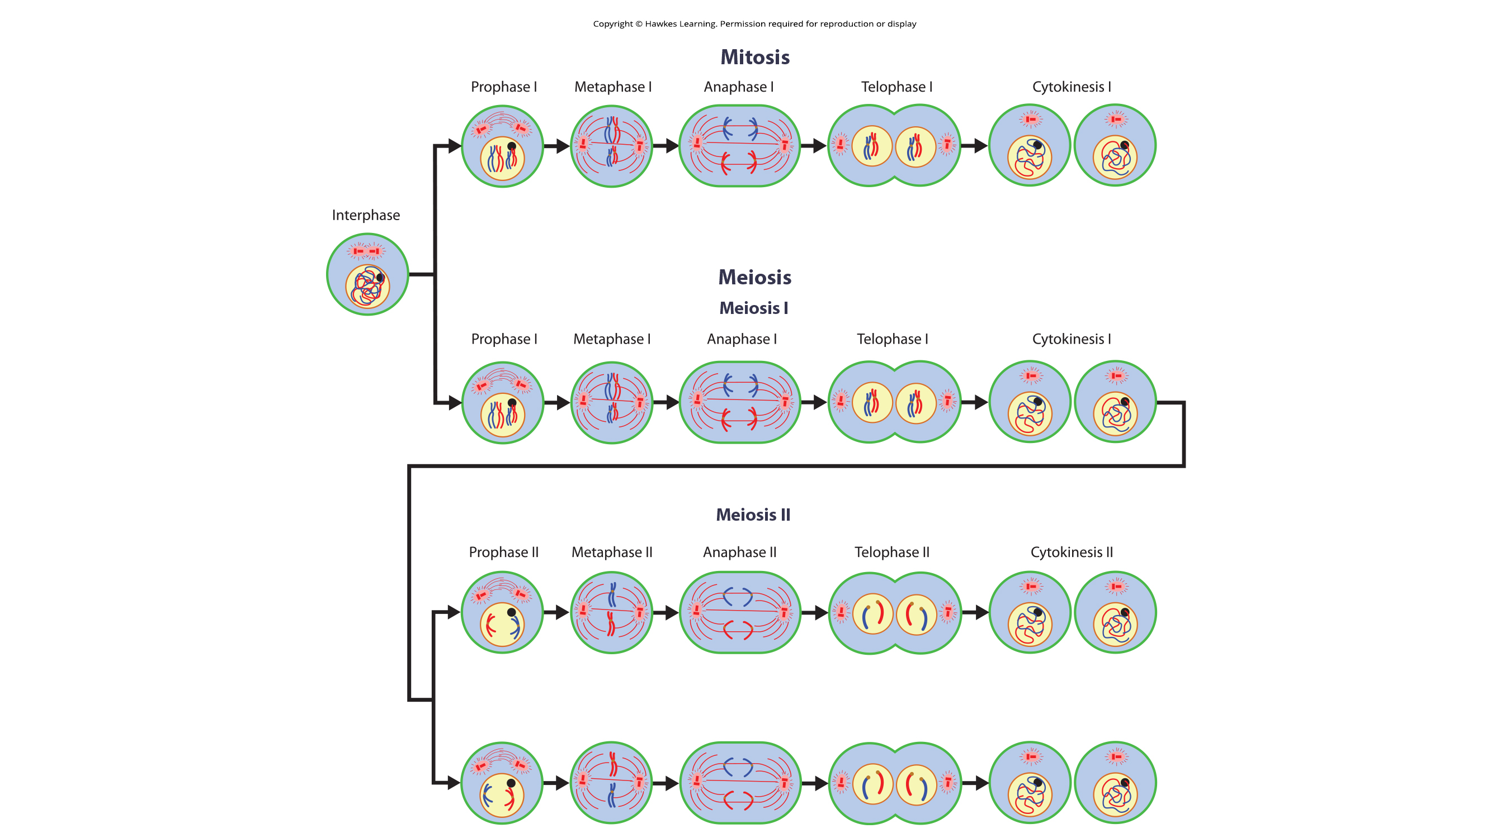
11.1 Figure 10
Notes:
Figure 10: Meiosis and mitosis are both preceded by one cycle of DNA replication; however, meiosis includes two nuclear divisions. The four daughter cells resulting from meiosis are haploid and genetically distinct. The daughter cells resulting from mitosis are diploid and identical to the parent cell.

Slide 35
11.1 Figure 10 (continued)
Notes:
Figure 10: Meiosis and mitosis are both preceded by one cycle of DNA replication; however, meiosis includes two nuclear divisions. The four daughter cells resulting from meiosis are haploid and genetically distinct. The daughter cells resulting from mitosis are diploid and identical to the parent cell.

Slide 36
Table 1: Comparing the Processes of Meiosis and Mitosis
 | Meiosis | Mitosis
DNA synthesis | occurs in S phase of interphase | occurs in S phase of interphase
synapsis of homologous chromosomes | during prophase I | does not occur
crossover | during prophase I | does not occur
homologous chromosomes line up at metaphase plate | during metaphase I | does not occur
sister chromatids line up at metaphase plate | during metaphase II | during metaphase
number and genetic composition of daughter cells | four genetically distinct haploid cells at the end of meiosis II | two identical diploid cells at the end of meiosis

Slide 37
Group Activity
As a group, each group member should choose a different animal. Using the internet, determine the haploid set number for each organism. Then, for each organism, determine the following:
The number and composition (single chromosome? duplicated chromosome? tetrad? diploid? haploid? etc.) of chromosomes in a somatic cell during G₁ of interphase
The number and composition of chromosomes in a somatic cell during G₂ of interphase
The number and composition of chromosomes in a gamete-producing cell during prophase I of meiosis
The number and composition of chromosomes of cells produced by meiosis I
The number and composition of chromosomes of cells produced by meiosis II
Based upon independent assortment alone, how many different, genetically distinct gametes can this organism make?
Compare the answers for each animal selected.

Slide 38
Evolution Connection
The Mystery of the Evolution of Meiosis
Important to separate questions of evolution of meiosis and evolution of sex
Early meiosis may have been advantageous for different reasons
Meiosis evolved from mitosis
Difficulty in the differences between meiosis I and mitosis
Genetic experiments might shed light on evolution of synapsis
Genetic experiments of different protists might shed light on evolution of meiosis
Some aspects of meiosis may have evolved later than others
Genetic comparison may show which aspects of meiosis are oldest and what cellular process may have been borrowed from earlier cells

Slide 39
Summary₁
Sexual reproduction requires organisms to produce cells that can fuse during fertilization and produce offspring
Meiosis produces haploid gametes (eggs and sperm) from diploid parent cells, while mitosis produces diploid daughter cells
DNA replication occurs prior to meiosis and mitosis during S phase
Meiosis involves two rounds of nuclear division resulting in four haploid daughter cells
Mitosis involves a single nuclear division producing two diploid daughter cells

Slide 40
Summary₂
Meiosis generates genetic variation through:
Crossover of genetic material between homologous chromosomes during prophase I
Random alignment of tetrad chromosomes at metaphase I plate (independent assortment)
Key differences between meiosis and mitosis occur in meiosis I:
Homologous chromosomes pair, crossover, and exchange nonsister chromatid segments
Homologs separate into different daughter nuclei, reducing ploidy from diploid to haploid
Meiosis I reduces ploidy by separating homologous chromosome pairs, while meiosis II separates sister chromatids
Meiosis I is a reductional division, meiosis II is an equational division like mitosis

Slide 41


End of Hawkes Learning PowerPoint

