Slide 1
Lesson 11.2
Sexual Reproduction

Slide 2
Objectives
Describe the three different life-cycle types among sexually reproducing multicellular organisms.
Explain that meiosis and sexual reproduction are highly evolved traits.
Identify variation among offspring as a potential evolutionary advantage of sexual reproduction.

Slide 3
Sexual Reproduction
An evolutionary innovation that allows genetic variation in offspring
Benefits:
Variation important to survival and reproduction
Sexually reproducing populations leave more descendants
Only variation in asexual reproduction is mutation
Also a source of variation in sexual reproduction (mutations continually reshuffled from one generation to the next)

Slide 4
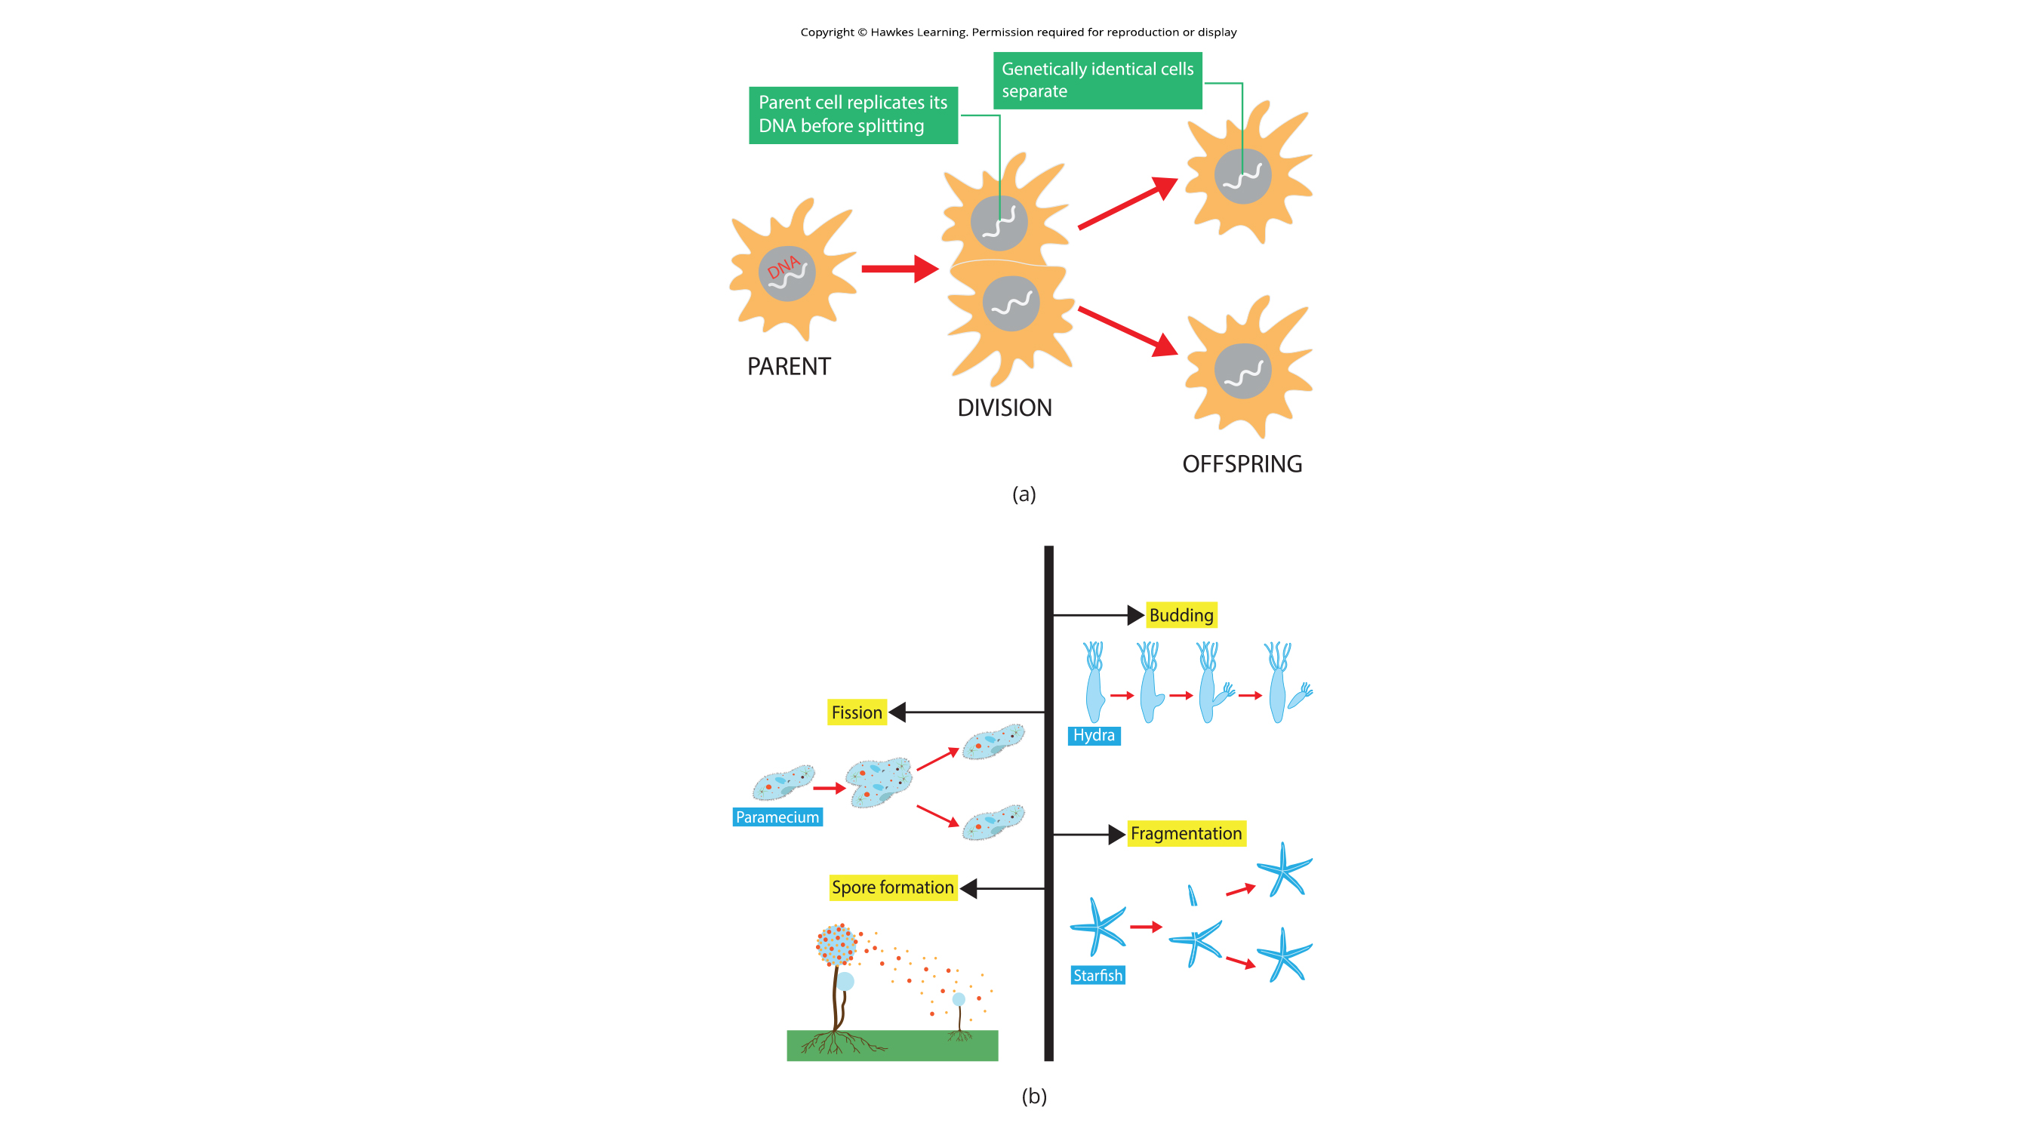
11.2 Figure 1
Notes:
Figure 1: (a) Asexual reproduction produces two offspring from a single parent that are genetically identical to each other and to the parent. (b) There are multiple forms of asexual reproduction including budding, fission, fragmentation, and spore formation.

Slide 5
Evolution Connection
The Red Queen Hypothesis
First proposed by Leigh Van Valen (1973) in reference to the Red Queen's race in Through the Looking-Glass
"It takes all the running you can do to stay in the same place."
All species coevolve (evolve together) with other organisms
Example: predators evolving with prey
Survival of any given genotype or phenotype dependent on the reproductive fitness of other genotypes or phenotypes
Fitness: capacity of some members of a species to produce more reproductively viable offspring relative to others within the species

Slide 6
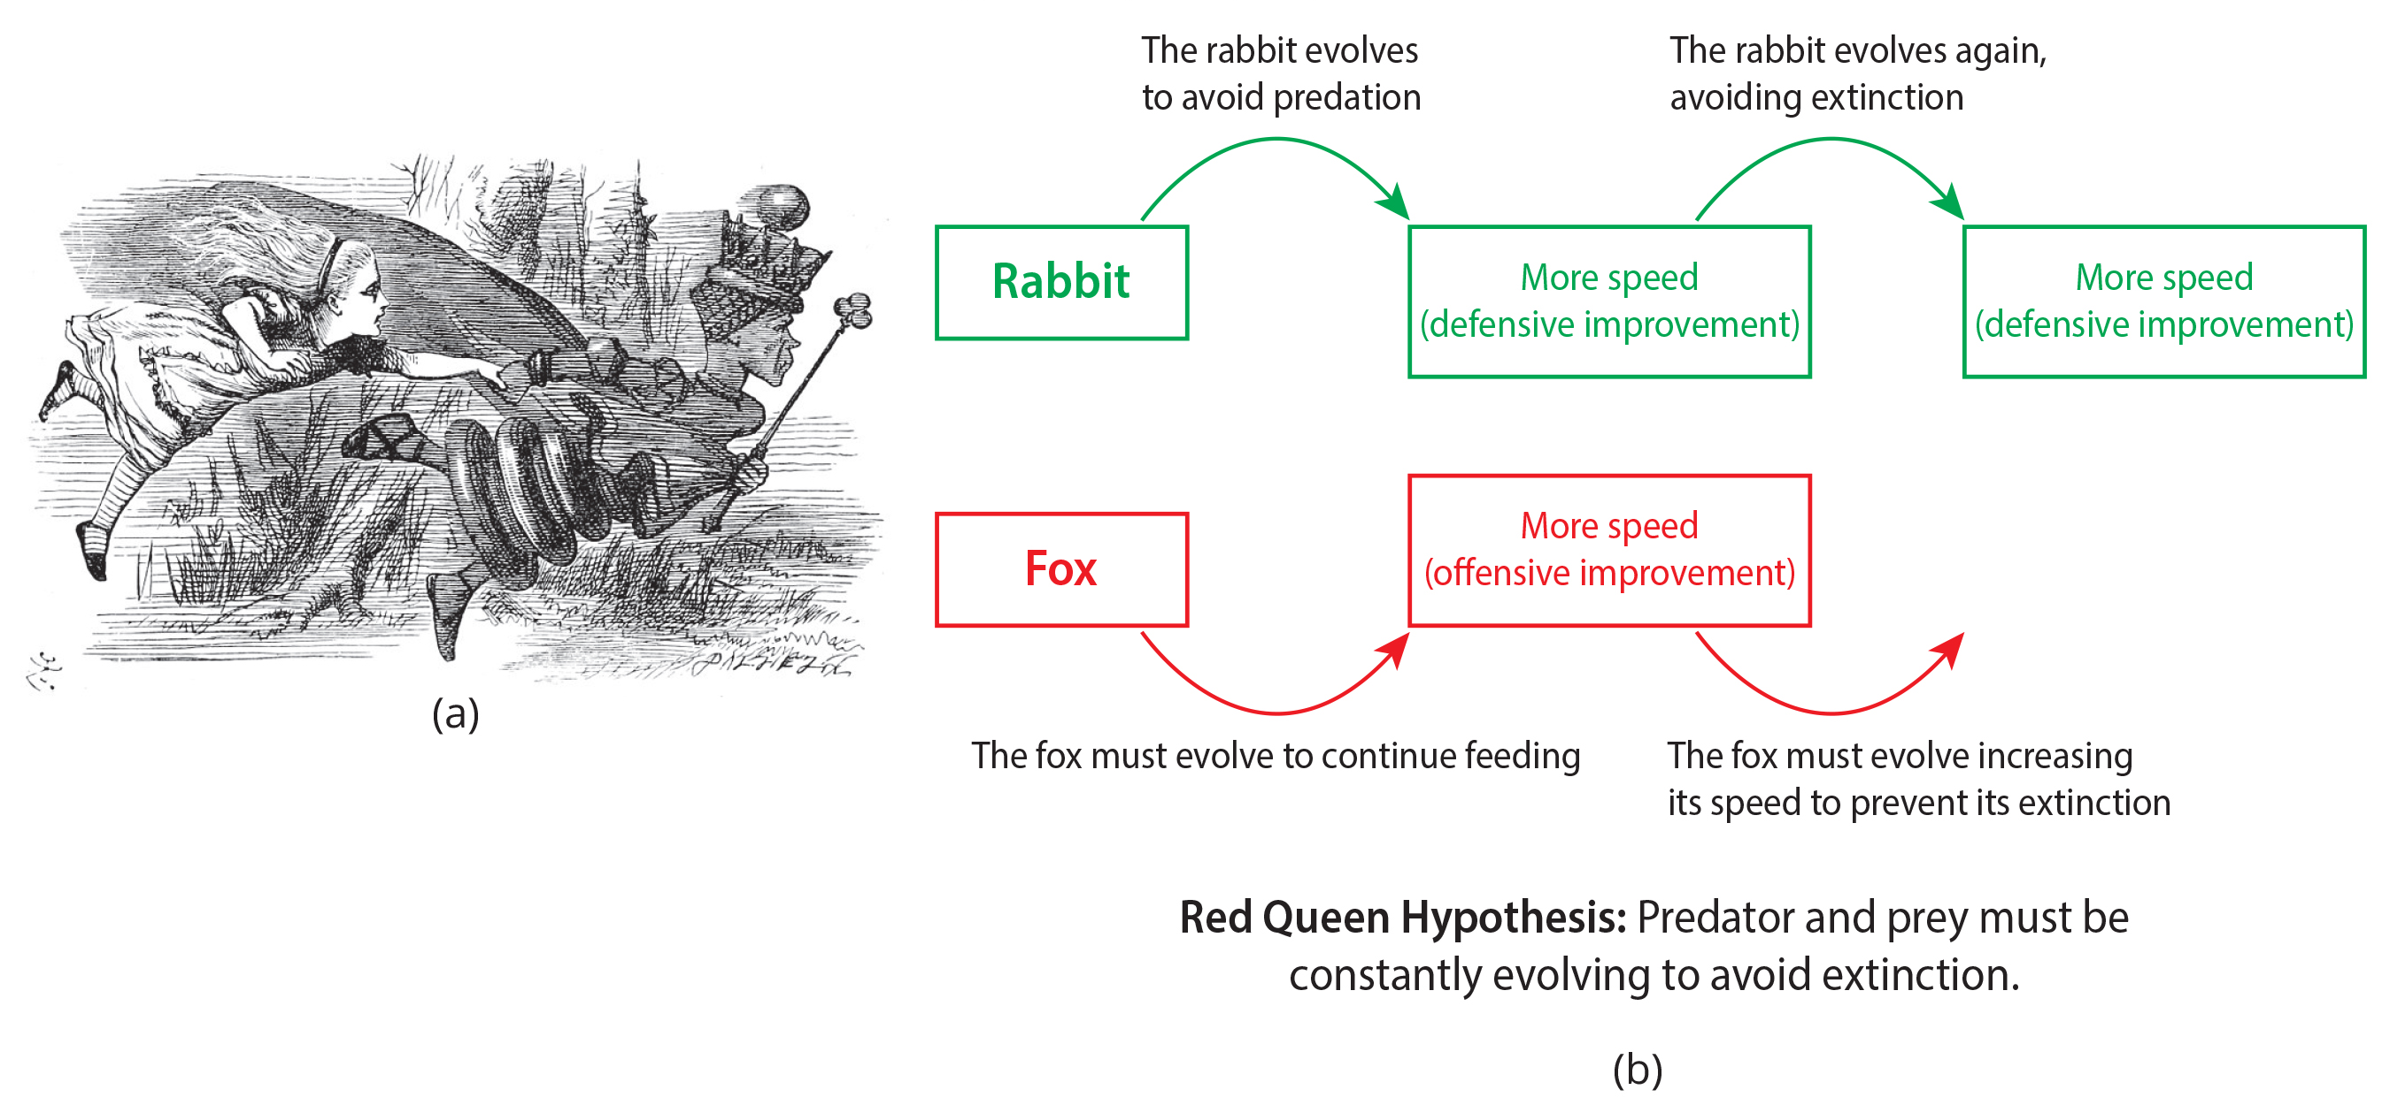
11.2 Figure 2
John Tenniel on Wikimedia Commons. "The Red Queen and Alice."
Aton Price 10 on Wikimedia Commons. "Red Queen hypothesis."
Notes:
Figure 2: The Red Queen Hypothesis is named after Lewis Carroll's Through the Looking-Glass. (a) Here is an illustration from the book illustrating how Alice is running but remains in the same spot. (b) The coevolution of rabbits and foxes provides a good example of the Red Queen Hypothesis. As the rabbit (prey) continually evolves to escape the fox (predator), the fox continually evolves to catch the rabbit.

Slide 7
Life Cycles of Sexually Reproducing Organisms₁
Fertilization and meiosis alternate during the life cycle
Life cycle: sequence of events in the development of an organism and the production of cells that produce offspring
Depends on the organism's reproductive strategy
Meiosis reduces chromosome number by half (haploid); fertilization restores to diploid
Some organisms (like humans) have multicellular diploid stage that is most obvious
Some organisms (like fungi) have multicellular haploid stage that is most obvious
Some organisms (like plants and algae) alternate between haploid and diploid as most obvious

Slide 8
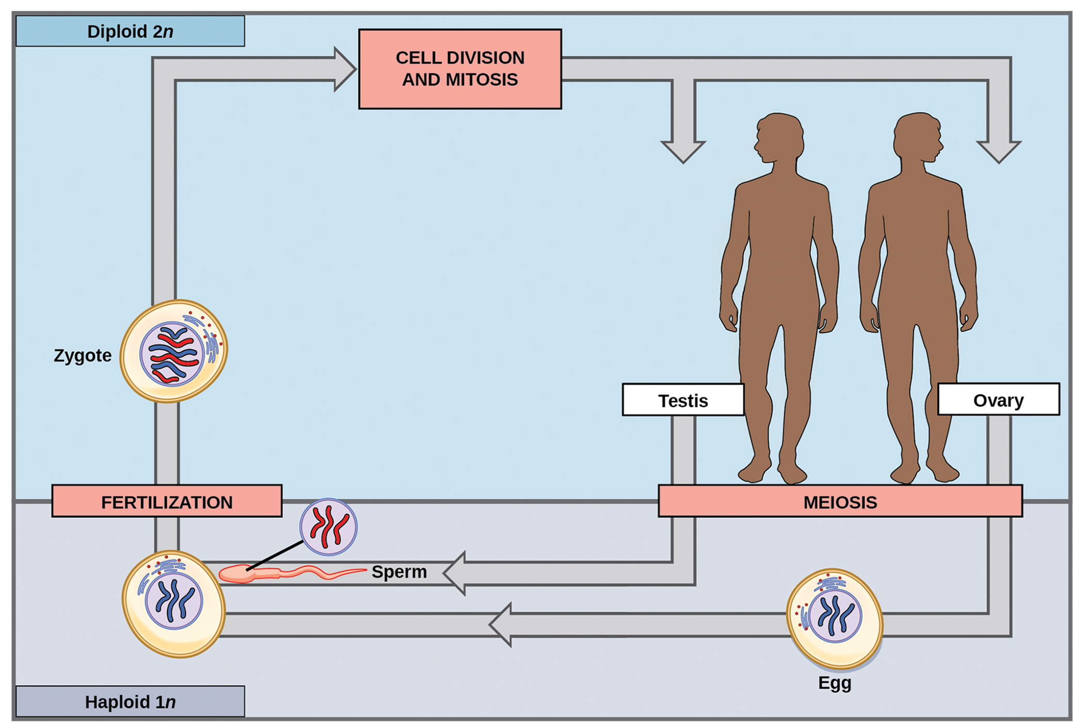
Life Cycles of Sexually Reproducing Organisms₂
Diploid-dominant organisms
Nearly all animals
Only gametes are haploid
Specialized diploid cells (germ cells) are produced in gonads
Germ cells: specialized cell line that produces gametes, such as eggs or sperm
Can undergo mitosis or meiosis
Once haploid gametes are formed, division stops
Fertilization occurs with fusion of two gametes, restoring diploid state
11.2 Figure 3
CNX OpenStax on Wikimedia Commons. "Sexual reproduction."

Slide 9
Life Cycles of Sexually Reproducing Organisms₃
Haploid-dominant organisms
Most fungi and algae
Haploid cells that make up tissues of dominant multicellular stage formed by mitosis
Sexual reproduction in fungi
Haploid cells from two individuals (+ and − mating types) join to form diploid zygote
Zygote undergoes meiosis to form four haploid cells (spores)
Spores can remain dormant until favorable time
Spores form multicellular haploid structures through mitosis

Slide 10
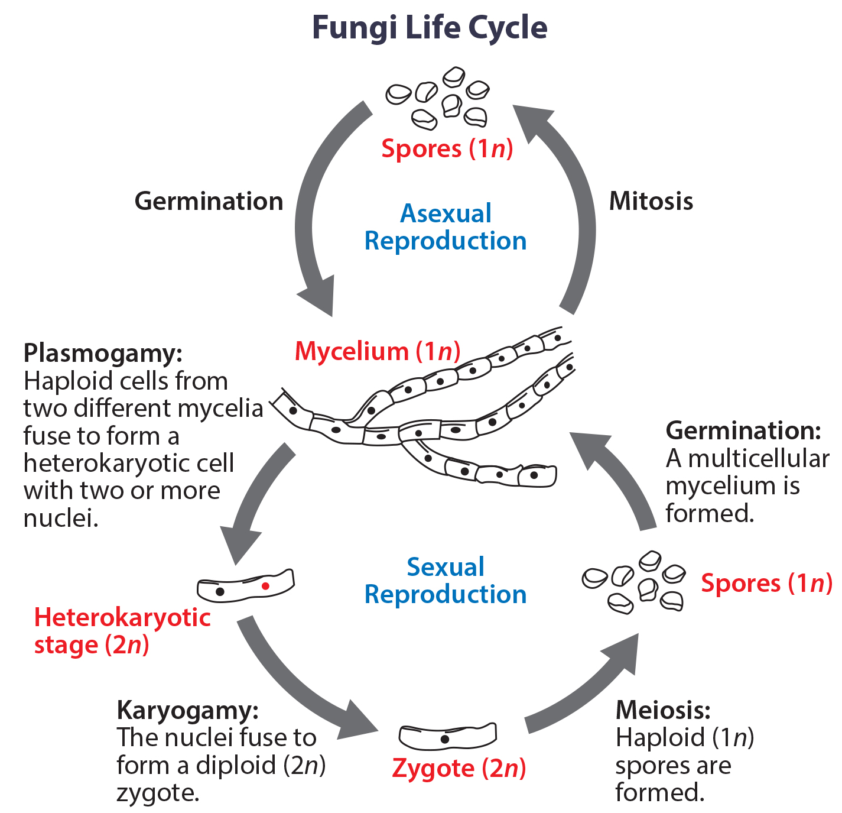
11.2 Figure 4
OpenStax. "Fungi life cycle."
Notes:
Figure 4: Fungi have a haploid multicellular stage that produces specialized haploid cells by mitosis. These haploid cells fuse first by plasmogamy (the fusion of the contents of two cells) to form a heterokaryotic cell (one having two distinct nuclei) and then undergo karyogamy (nuclear fusion) to form a diploid zygote. The zygote is short-lived and undergoes meiosis to produce haploid spores. Each spore may germinate to give rise to a multicellular haploid organism by mitosis. The haploid organism can also reproduce asexually, using mitosis to produce spores that can germinate into more haploid organisms.

Slide 11
Think It Through
If a mutation occurs so that a fungus is no longer able to produce a − mating type, will it still be able to reproduce?
Notes:
Originally an On Your Own. This is included here to use as a talking point or for a think-pair-share activity.

Slide 12
Life Cycles of Sexually Reproducing Organisms₄
Alternation of generations organisms
Alternation of generations: life-cycle type in which the diploid and haploid stages alternate
Gametophytes: multicellular stage of the plant that gives rise to haploid gametes or spores
Meiosis not directly involved in production of gametes because organism is already haploid
Fertilization between gametes forms diploid zygote, which undergoes mitosis to form a sporophyte
Sporophytes: multicellular diploid life-cycle stage that produces haploid spores by meiosis
Sporophyte undergoes meiosis to produce haploid spores which then develop into gametophytes

Slide 13
Life Cycles of Sexually Reproducing Organisms₅
Alternation of generations organisms
Relative size and relationship between sporophyte and gametophyte varies
Example: In moss, the gametophyte is free-living, and the sporophyte is physically dependent on the gametophyte.

Slide 14
Reflection Question
What cells in humans are analogous to gametophytes in plants?
Notes:
The reflection question is included here to use as a talking point or for a think-pair-share activity.

Slide 15
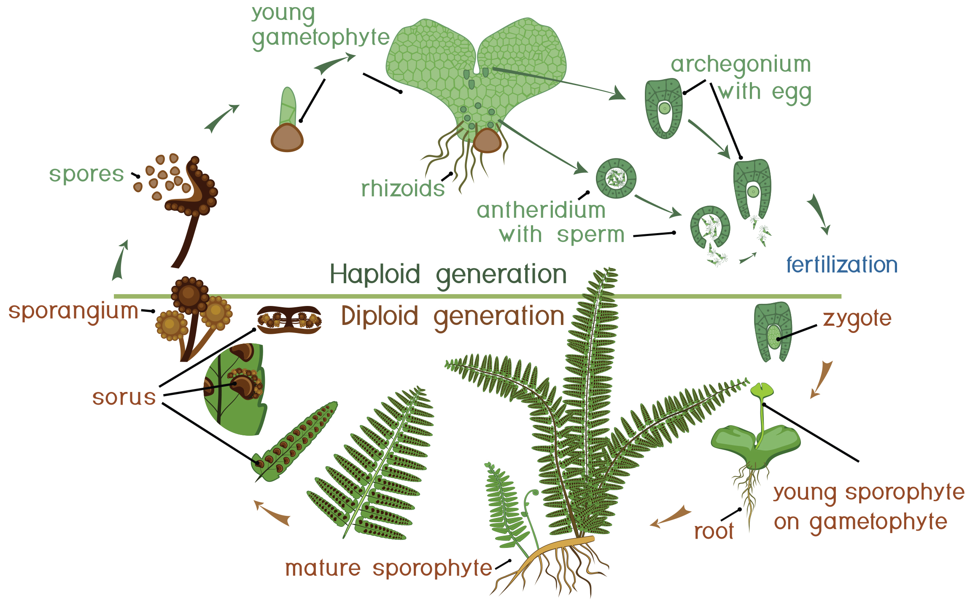
11.2 Figure 5
Notes:
Figure 5: Plants have a life cycle that alternates between a multicellular haploid organism and a multicellular diploid organism. In some plants, such as ferns, both the haploid and diploid plant stages are free-living (living on their own in the environment). In other plants, the gametophyte may live within the sporophyte, or vice versa. The diploid plant is called a sporophyte because it produces haploid spores by meiosis. The spores develop into multicellular, haploid plants that are called gametophytes because they produce gametes. The gametes of two individuals will fuse to form a diploid zygote that becomes the sporophyte.

Slide 16
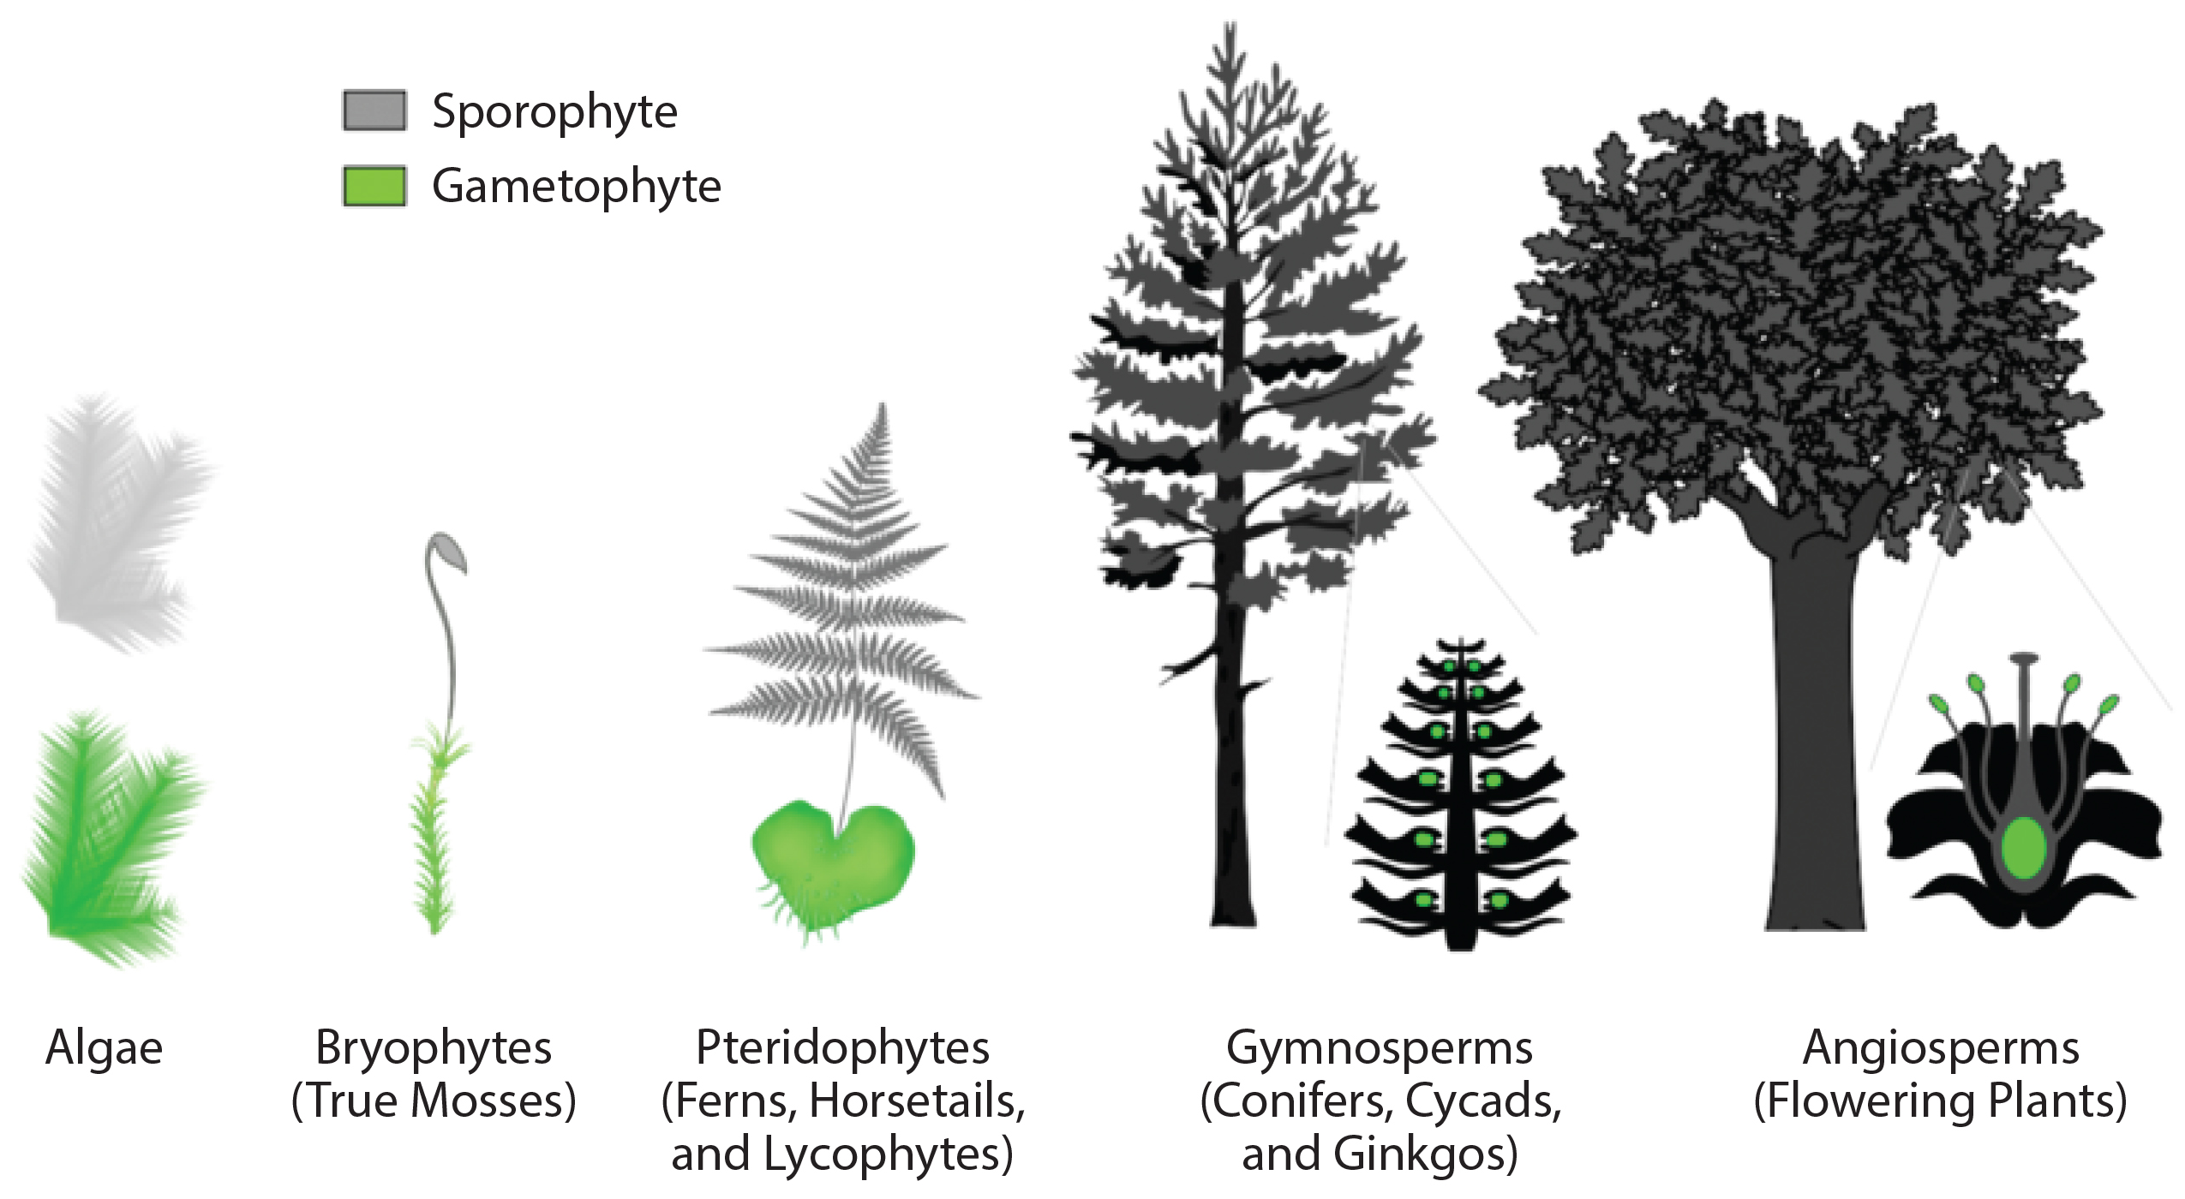
11.2 Figure 6
Marcelo Teles on Wikimedia Commons. "Sporophyte and gametophyte."
Notes:
Figure 6: The relative sizes of the sporophyte and the gametophyte differ between different types of plants. In simpler and more ancient plants, like algae, the gametophyte is larger and more dominant. However, in more recently evolved plants, the relative size of the gametophyte has been reduced.

Slide 17
Summary
Nearly all eukaryotes undergo sexual reproduction involving meiosis.
Meiosis introduces genetic variation into reproductive cells.
This variation is an evolutionary advantage for sexual reproduction.
Sexual life cycles alternate between meiosis and fertilization stages.
Meiosis produces unique reproductive cells called gametes, which have half the number of chromosomes.
Fertilization of two gametes restores the diploid condition in the zygote.
Most organisms alternate between haploid and diploid stages in their life cycles.
The specific timing and processes for producing gametes varies across organisms.

Slide 18


End of Hawkes Learning PowerPoint

