Slide 1
Lesson 12.1
Mendel's Experiments and the Laws of Probability

Slide 2
Objectives
Apply the sum and product rules to calculate probabilities.
Describe the expected outcomes of monohybrid crosses involving dominant and recessive alleles.
Describe the scientific reasons for the success of Mendel's experimental work.

Slide 3
Mendelian Genetics
Genetics is study of heredity
Mendel set framework for genetics before chromosomes or genes were discovered
Conducted methodical, quantitative analyses with large sample sizes
Revealed fundamental principles of heredity
Genes on chromosomes are basic functional units of heredity, able to be replicated, expressed, or mutated
Not entirely accurate, but a good starting point for thinking about genetics

Slide 4
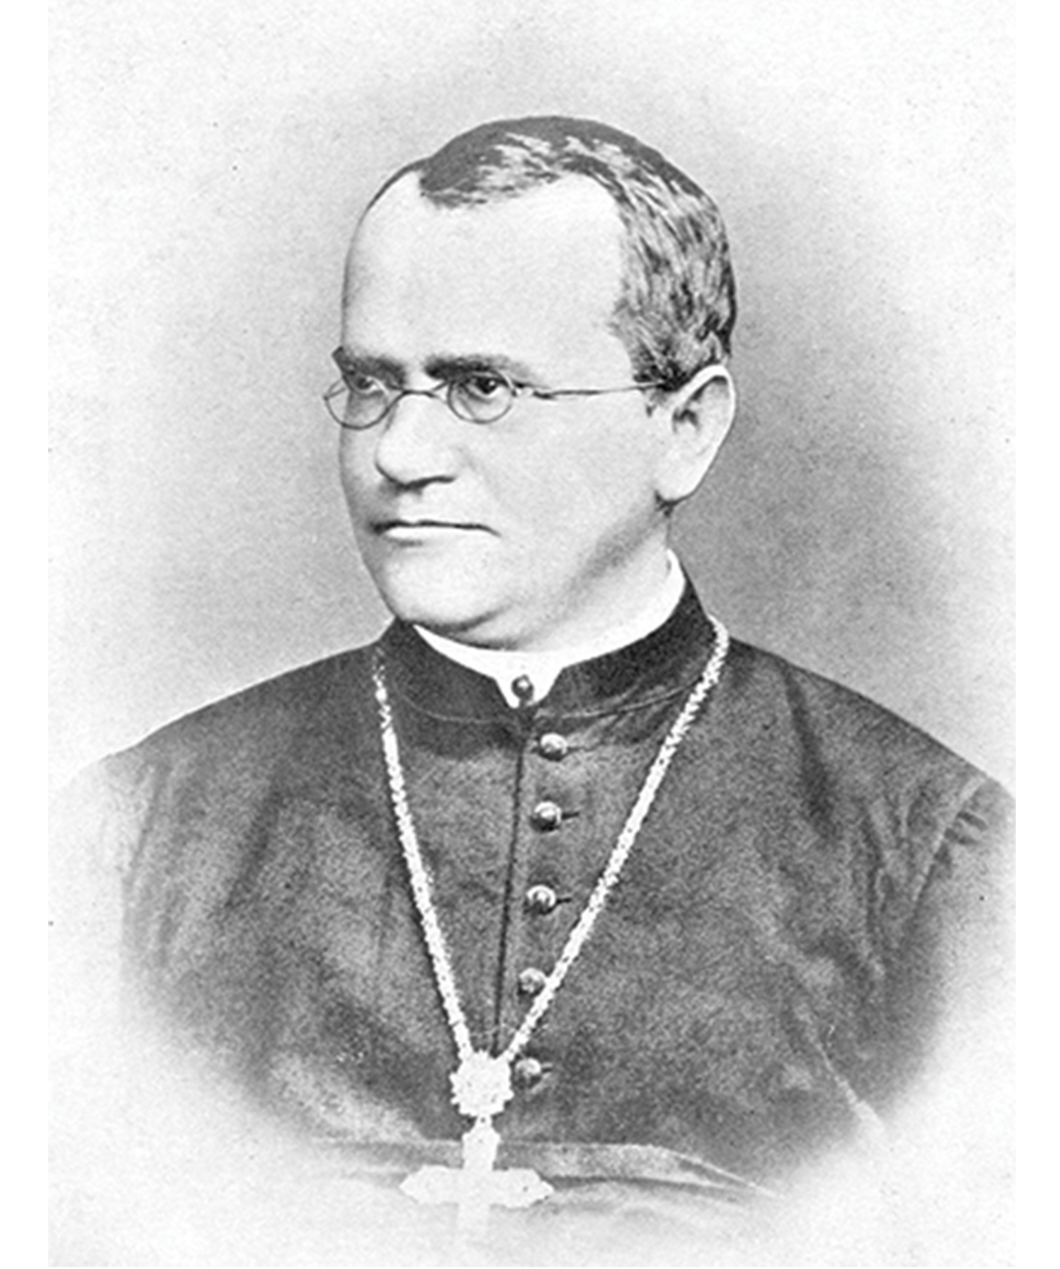
Mendel's Experiments and the Laws of Probability₁
Mendel
Educated at Augustinian Abbey of St. Thomas
Taught physics, botany, and natural sciences
Used pea plants as his model system
Model system: species or biological system used to study a specific biological phenomenon to be applied to other species
Demonstrated that traits transmitted from parents to offspring independently of other traits and in dominant and recessive patterns
Published Experiments in Plant Hybridization
12.1 Figure 1: Johann Gregor Mendel is considered the "father of genetics."
Bateson, William on Wikimedia Commons. "Gregor Mendel."

Slide 5
Mendel's Experiments and the Laws of Probability₂
Theory of the time was blending theory, which Mendel disproved
Blending theory of inheritance: hypothetical inheritance pattern in which parental traits are blended together in the offspring to produce an intermediate physical appearance
Appeared to be correct because of continuous variation
Continuous variation: inheritance pattern in which a character shows a range of trait values with small gradations rather than large gaps between them
Mendel worked with discontinuous variation
Discontinuous variation: inheritance pattern in which traits are distinct and are transmitted independently of one another

Slide 6
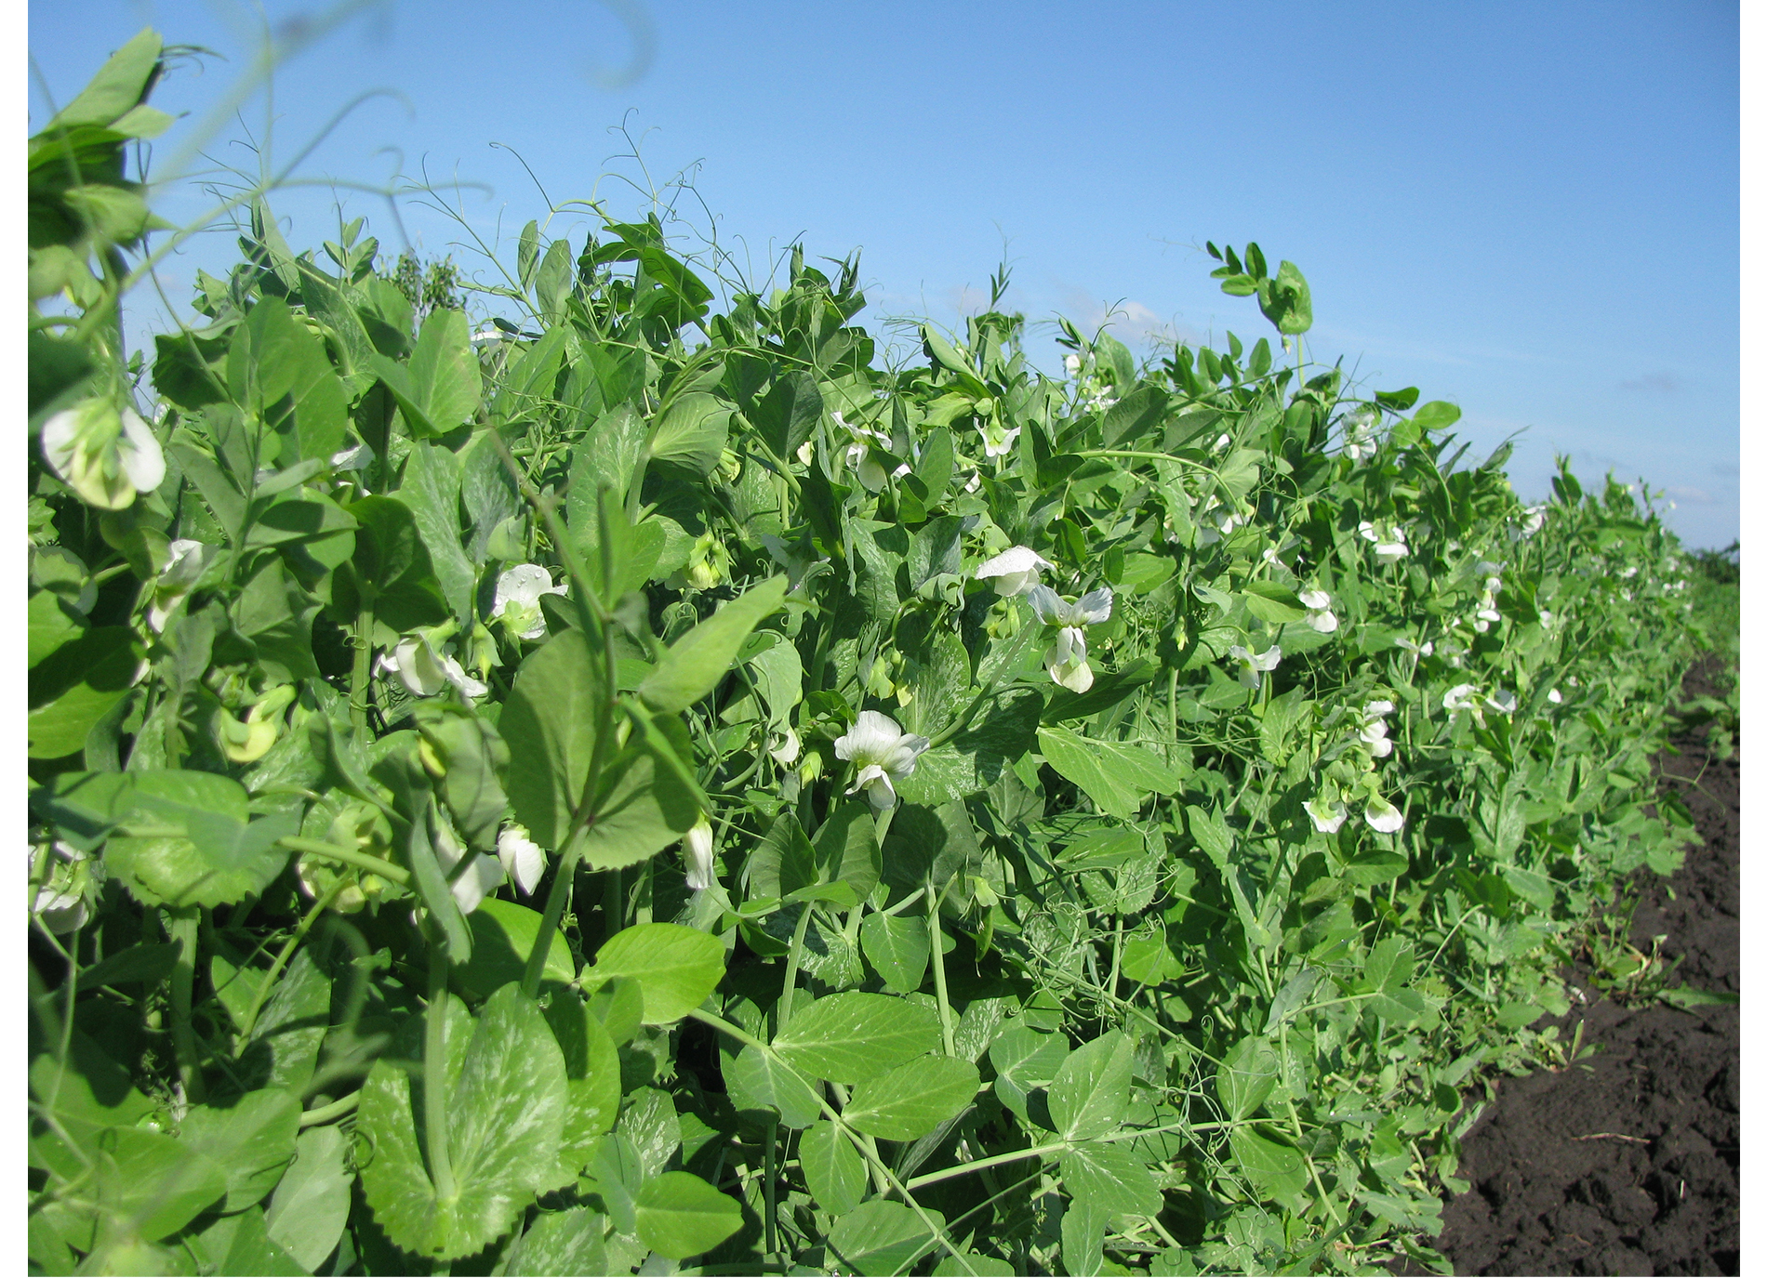
Mendel's Model System
Used the garden pea plant Pisum sativum to study inheritance
Advantages:
Naturally self-fertilizing
Petals prevent accidental cross-breeding
Highly inbred lines ("true-breeding")
Rapid life cycle (one season)
Easy, controlled cross-pollination
Can cultivate large quantities
Traits selected had simple inheritance patters
12.1 Figure 2: The pea plant (Pisum sativum) was used as the model organism for Mendel's seminal experiments.
Zenon Sych on Wikimedia Commons. "Pea plant."

Slide 7
Mendelian Crosses
Hybridization: process of mating two individuals that differ with the goal of achieving a certain characteristic in their offspring
Manually transferring pollen from the anther (male reproductive organ) to the stigma (female reproductive organ)
Pollen carries male gametes (sperm) to stigma, which allows sperm to move down the pistil to the female gametes (ova, or eggs)
Removed all the anthers before maturity to prevent self-fertilization
P₀ (P): parental generation in a cross
F₁: first filial generation in a cross; the offspring of the parental generation
F₂: second filial generation produced when F₁ individuals are self-crossed or fertilized with each other
Mendel's experiments extended beyond F₂, but the ratio of characteristics for P₀-F₁-F₂ formed basis of his laws

Slide 8
Garden Pea Characteristics Revealed the Basics of Heredity₁
Studied 7 characteristics with 2 contrasting traits (e.g., flower color: white vs. violet)
Trait: variation in the physical appearance of a heritable characteristic
Characteristics:
Plant height
Seed texture
Seed color
Flower color
Pea pod size
Pea pod color
Flower position
Reported results from 19,959 F₂ plants

Slide 9
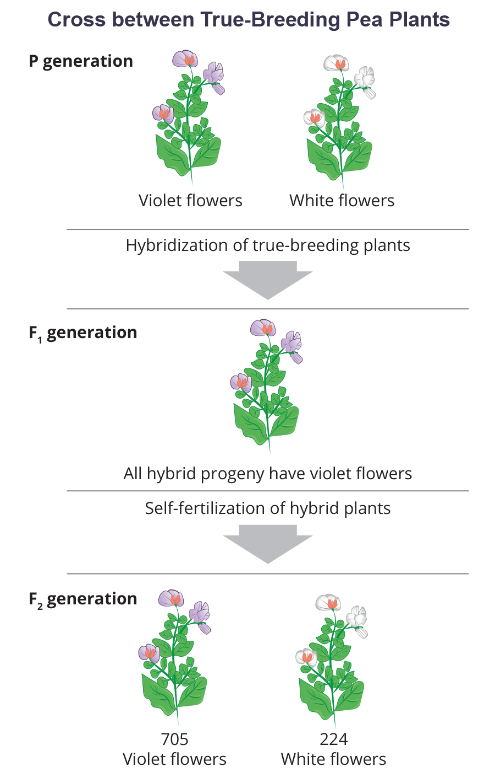
12.1 Figure 3
OpenStax. "Pea plant cross."
Notes:
Figure 3: In one of his experiments on inheritance patterns, Mendel crossed plants that were true-breeding for violet flower color with plants true-breeding for white flower color (the P generation). The resulting hybrids in the F1 generation all had violet flowers. In the F2 generation, approximately three quarters of the plants had violet flowers, and one quarter had white flowers.

Slide 10
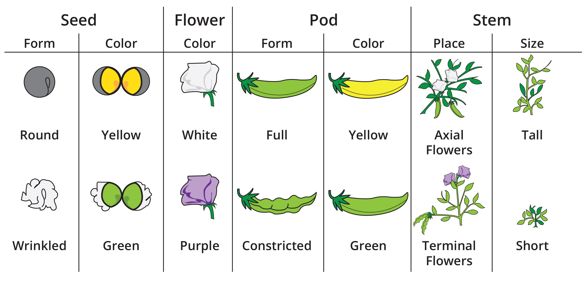
12.1 Figure 4
Mariana Ruiz Villarreal on Wikimedia Commons. "Mendel peas."
Notes:
Figure 4: Mendel studied seven different traits in his pea plant experiments.

Slide 11
Garden Pea Characteristics Revealed the Basics of Heredity₂
Results:
Confirmed that plants bred true for white or violet flower color
All self-crossed offspring were the same as their parents
Confirmed plants were physically identical
Crossed white with violet flowers, resulting in 100% violet flowers in F₁
Disproved blending theory, which would have said pale violet flowers or equal number of white and violet flowers
F₂ generation showed 3.15:1 ratio (violet:white)
Reciprocal cross: paired cross in which the respective traits of the male and female in one cross become the respective traits of the female and male in the other cross

Slide 12
Table 1: Mendel Discovered an F₂ of 3:1 in All Seven Traits He Studied
Characteristic | Contrasting P₀ Traits | F₁ Offspring Traits | F₂ Offspring Traits | F₂ Trait Ratios
flower color | violet vs. white | 100% violet | 705 violet 224 white | 3.15:1
flower position | axial vs. terminal | 100% axial | 651 axial 207 terminal | 3.14:1
plant height | tall vs. dwarf | 100% tall | 787 tall 277 dwarf | 2.84:1
seed texture | round vs. wrinkled | 100% round | 5,474 round 1,850 wrinkled | 2.96:1
seed color | yellow vs. green | 100% yellow | 6,022 yellow 2,001 green | 3.01:1
pea pod texture | inflated vs. constricted | 100% inflated | 882 inflated 299 constricted | 2.95:1
pea pod color | green vs. yellow | 100% green | 428 green 152 yellow | 2.82:1

Slide 13
Garden Pea Characteristics Revealed the Basics of Heredity₃
Traits could be divided into expressed (dominant) and latent (recessive) traits
Dominant: trait which confers the same physical appearance whether an individual has two copies of the trait or one copy of the dominant trait and one copy of the recessive trait
Recessive: trait that appears "latent" or nonexpressed when the individual also carries a dominant trait for that same characteristic; when present as two identical copies, the recessive trait is expressed
Example: violet vs. white flowers
White flowers disappeared in F₁ but reappeared in F₂

Slide 14
Probability Basics
Probabilities: mathematical measures of likelihood
Empirical probability calculated by dividing the # of times by total # of opportunities
Come from observations
Theoretical probability calculated by dividing # of times by expected # of times it could occur
Come from assumptions
Range from 0 (never occurs) to 1 (always occurs)
Example: round vs. wrinkled seeds
Probability of round is 1 in F₁ offspring (parents: 1 has round; 1 has wrinkled)
Probability of round is 3 out of 4 for F₂ (meaning 75% were expected to have round seeds, 25% wrinkled seeds)

Slide 15
The Product Rule and Sum Rule
Pea plants transmit characteristics as discrete units from parent to offspring
Different characteristics transmit independently of one another, can be examined separately
Example: Green, wrinkled seeds crossed with yellow, round seeds still produce 3:1 ratio of yellow:green seeds and 3:1 ratio of round:wrinkled seeds

Slide 16
The Product Rule₁
Product rule: probability of two independent events occurring simultaneously can be calculated by multiplying the individual probabilities of each event occurring alone
Example: rolling a die (D) and flipping a penny (P)
D# (1–6)
P_{H} or P_{T}
12 possible actions

Slide 17
Group Activity₁
As a group of two, perform this experiment for yourselves. Flip the penny and roll the die at the same time 100 times. Keep track of your results. Did you get all 12 outcomes? Did each of the 12 outcomes occur with equal probability?

Slide 18
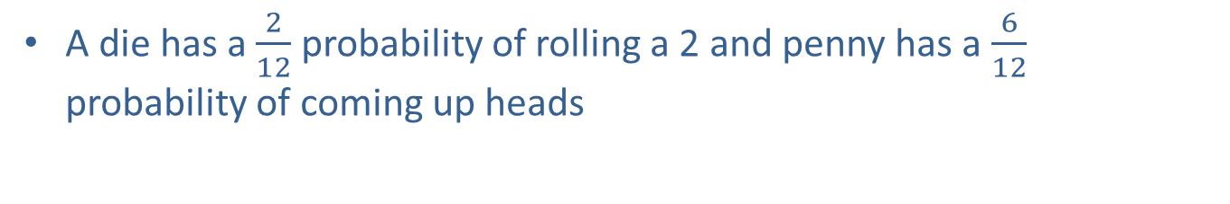

The Product Rule₂
A die has a $\frac{2}{12}$ probability of rolling a 2 and penny has a $\frac{6}{12}$ probability of coming up heads
And is the signal to apply product rule
Can be used to predict outcome of a dihybrid cross (involves two different traits)
Example: Cross between yellow, round seeds (both dominant) and green, wrinkled seeds (both recessive)
Probability that F₂ offspring inherits two dominant traits (yellow and round):
$$\frac{3}{4}×\frac{3}{4}=\frac{9}{16}$$

Slide 19
The Sum Rule₁
Sum rule: probability of the occurrence of at least one of two mutually exclusive events is the sum of their individual probabilities
Or is the signal to apply the sum rule
Example: probability of rolling a 1 or a 6

Slide 20
The Sum Rule₂
Can be used to predict outcome of a dihybrid cross (involves two different traits)
Example: Cross between yellow, round seeds (both dominant) and green, wrinkled seeds (both recessive)
Probability that F₂ offspring inherits a single dominant trait (yellow or round):

Slide 21
Product Rule and Sum Rule
Product Rule
For independent events A and B, the probability (P) of them both occurring (A and B) is (P_{A} x P_{B}).
Sum Rule
For mutually exclusive events A and B, the probability (P) that at least one occurs (A or B) is (P_{A} + P_{B}).

Slide 22
Group Activity₂
Pair up into groups and obtain a die and a coin. Take turns assigning hypothetical die and coin outcomes, and having the other partner calculate the probability. For example, you could ask your partner to calculate the probability of getting 3 heads and rolling a 3 twice in a row.

Slide 23
Summary
Mendel crossed pea plants with contrasting traits (e.g., tall vs. short) and found:
F₁ offspring all showed one trait (the dominant trait)
F₂ offspring exhibited a 3:1 ratio of dominant:recessive traits
Confirmed the recessive trait was transmitted from P₀ parents
Mendel's results followed the laws of probability for inheritance of traits
Traits inherited as independent events
Two probability rules can predict offspring ratios:
Product rule: probability of two independent events occurring together
Use when the word and is used (e.g., tall and green)
Sum rule: probability of either one event or another occurring
Use when the word or is used (e.g., tall or green)

Slide 24


End of Hawkes Learning PowerPoint

