Slide 1
Lesson 12.2
Characteristics and Traits

Slide 2
Objectives
Develop a Punnett square to calculate the expected proportions of genotypes and phenotypes in a monohybrid cross.
Explain the purpose and methods of a test cross.
Explain the relationship between genotypes and phenotypes in dominant and recessive gene systems.
Identify non-Mendelian inheritance patterns such as incomplete dominance, codominance, recessive lethals, multiple alleles, and sex linkage.

Slide 3
Characteristics and Traits
Physical characteristics expressed through genes carried on chromosomes
Organisms can be diploid, having two copies of each chromosome (one from each parent)
  Produce haploid gametes (one copy of each homologous chromosome that unite at fertilization to create diploid zygote)
Alleles: gene variations that arise by mutation and exist at the same relative locations on homologous chromosomes
  Can have two or more alleles for any given gene

Slide 4
Phenotypes and Genotypes
Physical characteristics produced by how the alleles for a given gene are expressed and interact
  Phenotype: observable traits expressed by an organism
  Genotype: underlying genetic makeup, consisting of both physically visible and nonexpressed alleles, of an organism
Mendel demonstrated difference between phenotype and genotype
  F₁ phenotypically identical but variety returned in F₂, showing that the allele was not lost and genotype was different
Mendel used homozygous P₀ plants and produced heterozygous F₁
  Homozygous: having two identical alleles for a given gene on the homologous chromosome
  Heterozygous: having two different alleles for a given gene on the homologous chromosome

Slide 5
Dominant and Recessive Alleles₁
All seven pea-plant characteristics had contrasting alleles (one dominant, one recessive)
  Dominant called expressed unit factor
  Recessive called latent unit factor
    Unit factors = genes on homologous chromosome pairs
Dominant and recessive pattern yields:
  Homozygous dominant and heterozygous will look the same
    Same phenotype but different genotype
  Homozygous recessive will show recessive phenotype

Slide 6
Table 1: Human Inheritance in Dominant and Recessive Patterns
Dominant Traits | Recessive Traits
Achondroplasia Brachydactyly Huntington's disease Marfan syndrome Neurofibromatosis Widow's peak Wooly hair | Albinism Cystic fibrosis Duchenne muscular dystrophy Galactosemia Phenylketonuria Sickle cell anemia Tay-Sachs disease

Slide 7
Dominant and Recessive Alleles₂
Naming conventions for genes and alleles
  Genes abbreviated using first letter of the gene's corresponding dominant trait and italicized
    Example: Violet dominant for flower color and abbreviated as V
  Upper and lowercase letters to represent dominant and recessive
    Example:
      Homozygous dominant with violet flowers: VV
      Homozygous recessive with white flowers: vv
      Heterozygous with violet flowers: Vv

Slide 8
The Punnett Square Approach for a Monohybrid Cross₁
Monohybrid: result of a cross between two true-breeding parents that express different traits for only one characteristic
Punnett square: visual representation of a cross between two individuals in which the gametes of each individual are denoted along the top and side of a grid, respectively, and the possible zygotic genotypes are recombined at each box in the grid
  Put parents along the top and side and fill in boxes
    YY for yellow seeds; yy for green seeds
  Each box represents possible diploid genotype of zygote
 | Y | Y
y | Yy | Yy
y | Yy | Yy

Slide 9
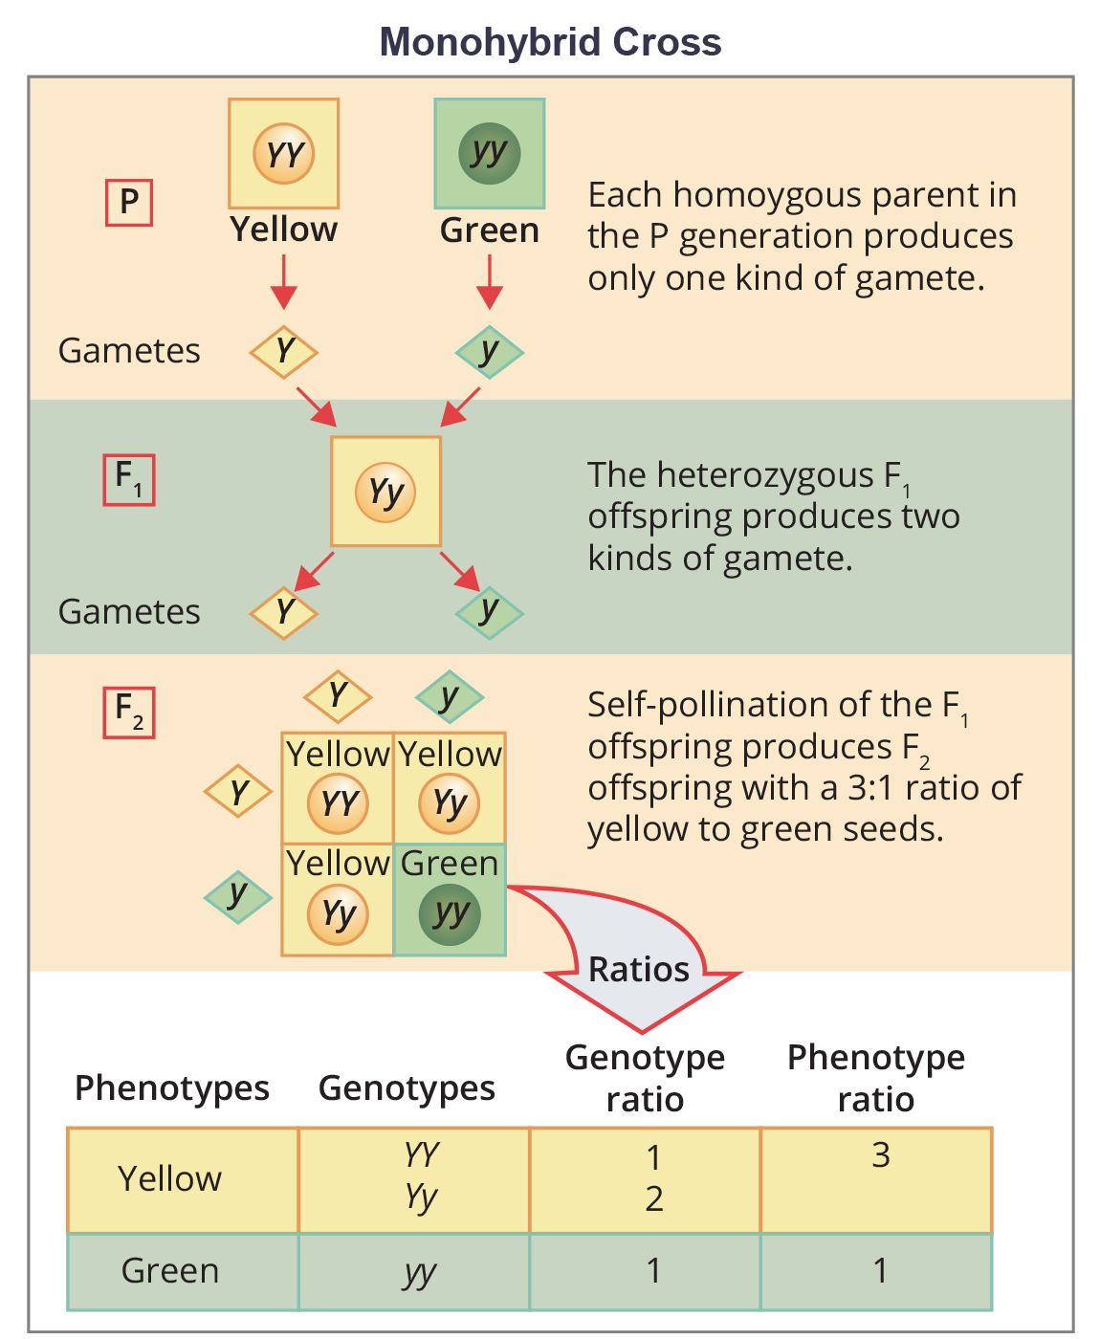
12.2 Figure 1
OpenStax. "Monohybrid cross."
Notes:
Figure 1: In the P generation, pea plants that are true-breeding for the dominant yellow phenotype are crossed with plants with the recessive green phenotype. This cross produces F1 heterozygotes with a yellow phenotype. Punnett square analysis can be used to predict the genotypes of the F2 generation.

Slide 10
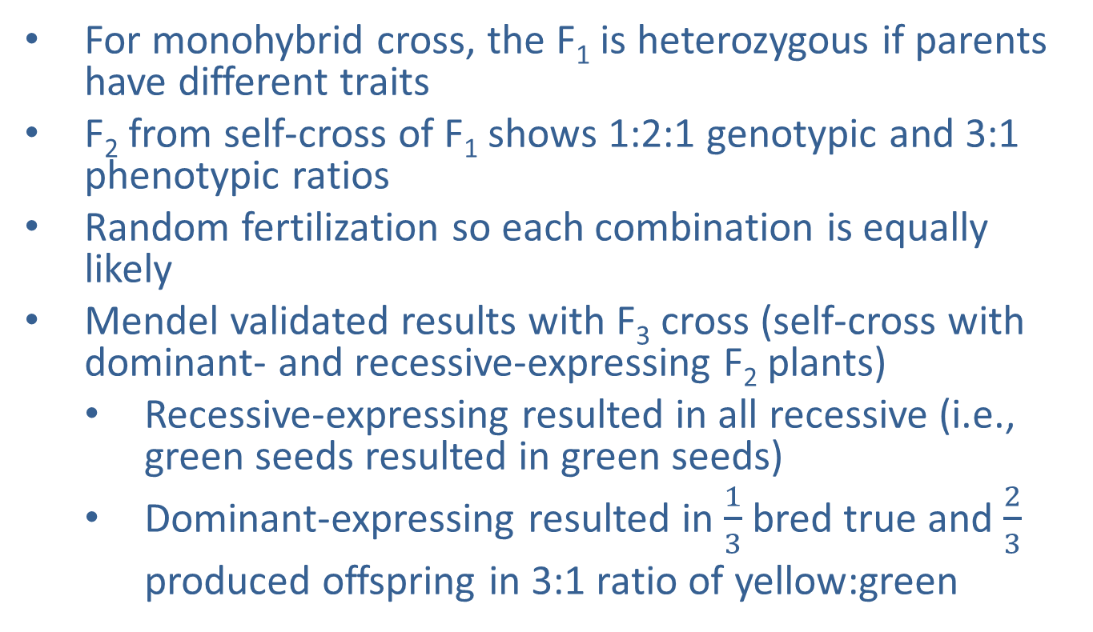
The Punnett Square Approach for a Monohybrid Cross₂
For monohybrid cross, the F₁ is heterozygous if parents have different traits
F₂ from self-cross of F₁ shows 1:2:1 genotypic and 3:1 phenotypic ratios
Random fertilization so each combination is equally likely
Mendel validated results with F₃ cross (self-cross with dominant- and recessive-expressing F₂ plants)
  Recessive-expressing resulted in all recessive (i.e., green seeds resulted in green seeds)
  Dominant-expressing resulted in $\frac{1}{3}$ bred true and $\frac{2}{3}$ produced offspring in 3:1 ratio of yellow:green

Slide 11
Group Activity₁
Pair up in groups of two. Can you or your partner curl your tongue up on the sides? Tongue curling in humans is a dominant genetic trait. Predict your possible genotypes and phenotypes for tongue curling.
Suppose a person who is Tt for tongue curling marries a person who is also Tt for this trait. What are the possible genotypes and phenotypes of their children and the percent chance for each? Fill in the following Punnett square for this cross.
 | T | t
T
t

Slide 12
Group Activity₂
What are the possible genotypes and phenotypes of their children and the percent chance for each? Fill in the following table.
Genotype | Phenotype | Chance

Slide 13
The Test Cross Distinguishes the Dominant Phenotype₁
Test cross: cross between a dominant expressing individual with an unknown genotype and a homozygous recessive individual; the offspring phenotypes indicate whether the unknown parent is heterozygous or homozygous for the dominant trait
  Offspring of dominant-expressing homozygote and recessive-expressing homozygote is dominant-expressing heterozygote
  Offspring of dominant-expressing heterozygote and recessive-expressing homozygote is 1:1 heterozygote:recessive ratio

Slide 14
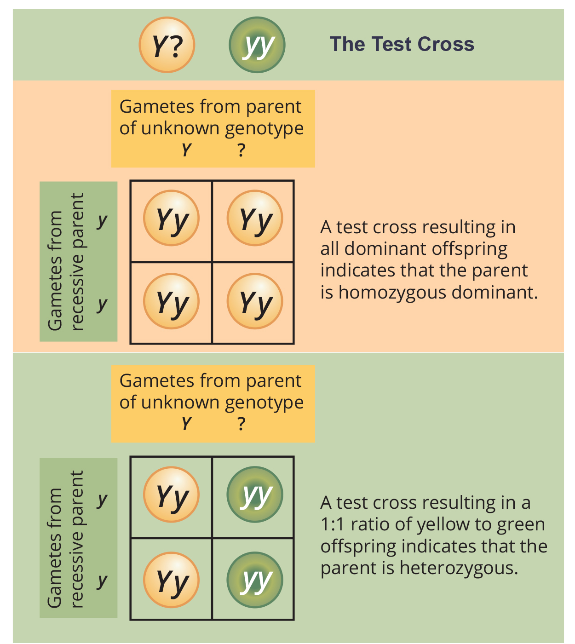
12.2 Figure 2
OpenStax. "Test cross."
Notes:
Figure 2: A test cross can be performed to determine whether an organism expressing a dominant trait is a homozygote or a heterozygote.

Slide 15
The Test Cross Distinguishes the Dominant Phenotype₂
Human diseases can be genetically inherited
Doing test cross to determine who has disease-causing gene is unethical and impractical
Use pedigree analysis (a study of inheritance patterns of human genetic diseases) instead

Slide 16
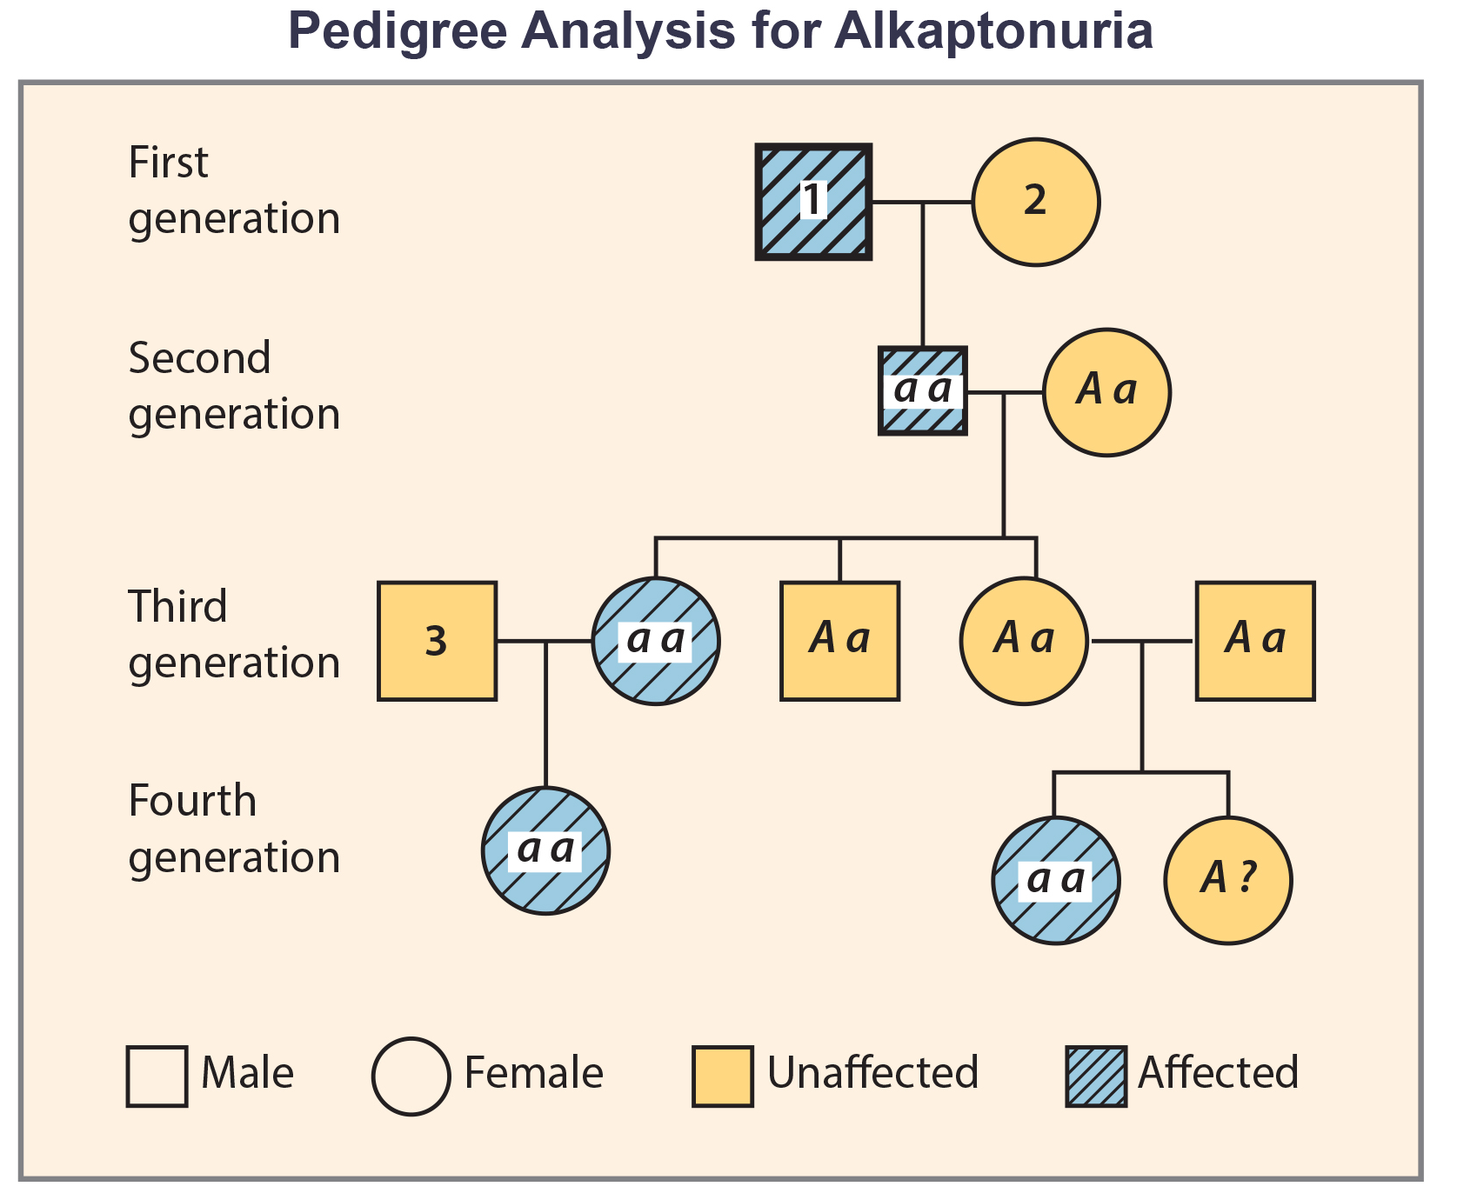
12.2 Figure 3
OpenStax. "Pedigree."
Notes:
Figure 3: Alkaptonuria is a recessive genetic disorder in which two amino acids, phenylalanine and tyrosine, are not properly metabolized. Affected individuals may have darkened skin and brown urine and may suffer joint damage and other complications. In this pedigree, individuals with the disorder have the genotype aa. Unaffected individuals have the genotype AA or Aa. Note that it is often possible to determine a person's genotype from the genotype of their offspring. For example, if neither parent has the disorder but their child does, they must be heterozygous. Two individuals on the pedigree have an unaffected phenotype but unknown genotype. Because they do not have the disorder, they must have at least one normal allele, so their genotype gets the "A?" designation.

Slide 17
Alternatives to Dominance and Recessiveness
Mendel's experiments with pea plants suggested that:
  Two "units" or alleles exist for every gene
  Alleles maintain their integrity (no blending)
  Dominant alleles hide recessive allele
    Recessive allele makes no contribution to phenotype
    Recessive alleles can be carried but not expressed
      Heterozygous individuals referred to as carriers
Much more complexity than what Mendel showed but fundamentals still true

Slide 18
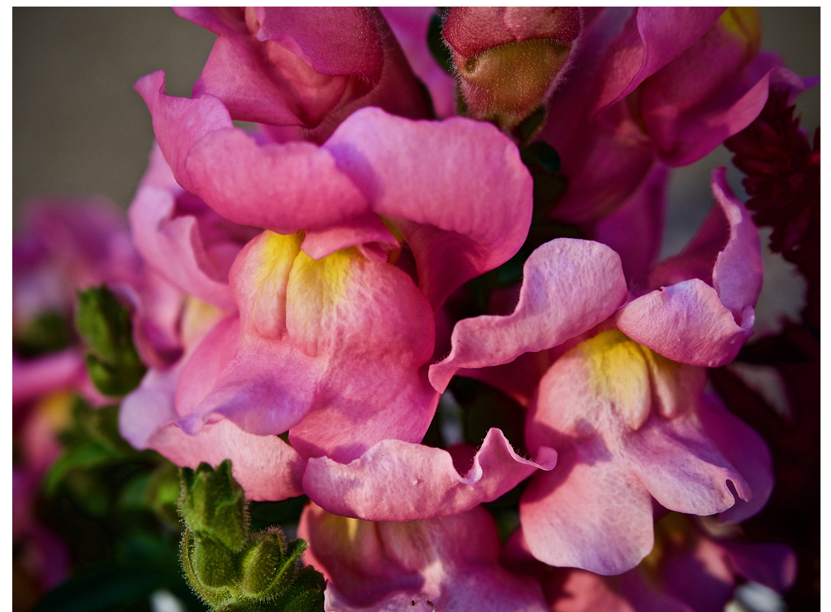
Incomplete Dominance
Heterozygotes can show an intermediate/blend of the two traits
Example: Snapdragon cross between homozygous with white flowers (C^{W}C^{W}) and homozygous with red flowers (C^{R}C^{R}) produces pink flowers (C^{R}C^{W})
  C^{R} means red allele (R) is present for flower color gene (C)
  Genotypic ratio: 1 C^{R}C^{R}:2 C^{R}C^{W}:1 C^{W}C^{W}
  Phenotypic ratio: 1:2:1 for red:pink:white
Incomplete dominance: in a heterozygote, expression of two contrasting alleles such that the individual displays an intermediate phenotype
12.2 Figure 4: These pink flowers of a heterozygote snapdragon result from incomplete dominance.
Dorian Wallender on Wikimedia Commons. "Snapdragon."

Slide 19
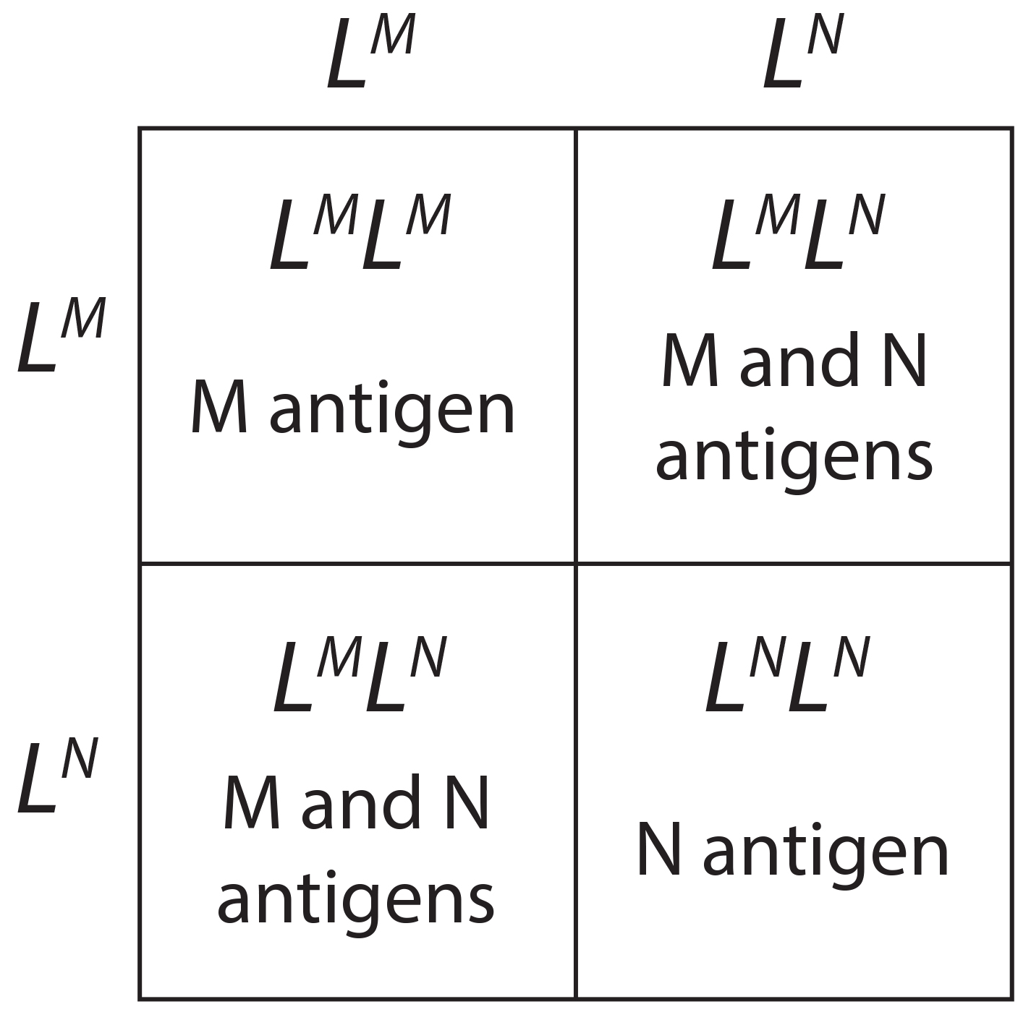
Codominance₁
Codominance: in a heterozygote, complete and simultaneous expression of both alleles for the same characteristic
Example: MN blood groups in humans
  Homozygotes express either M or N allele (L^{M}L^{M} and L^{N}L^{N})
  Heterozygotes express both alleles equally (L^{M}L^{N})
  Cross between heterozygotes for codominant trait:
    L^{M}L^{N} and L^{M}L^{N} produce 1 L^{M}L^{M}, 2 L^{M}L^{N}, and 1 L^{N}L^{N}
      Genotypic ratio: 1:2:1
      Phenotypic ratio: 1:2:1
12.2 Figure 5: A cross between two individuals with the genotypes L^{M}L^{N} produces offspring in a 1:2:1 genotypic and phenotypic ratio.

Slide 20
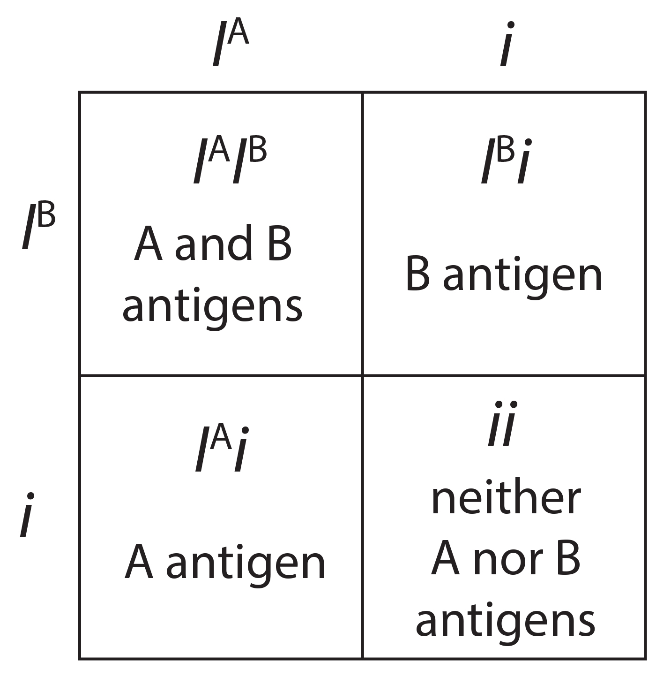
Codominance₂
Most common example of codominance is ABO blood type, I^{A} and I^{B} codominant and dominant to allele i
12.2 Figure 6: In the ABO blood typing system, the alleles I^{A} and I^{B} code for the A and B antigens, respectively, on red blood cells, while the allele i results in neither the A nor B antigens. I^{A} and I^{B} are codominant (both are expressed if present) and dominant to the i allele. In the cross of an individual with the genotype I^{A}i (who only expresses the A antigen) and an individual with the genotype I^{B}i (who only expresses the B antigen), the resulting genotypes are I^{A}I^{B} (expresses both A and B antigens), I^{B}i (only expresses the B antigen), I^{A}i (only expresses the A antigen), and ii (expresses neither antigen).

Slide 21
Multiple Alleles₁
More than two alleles can exist for a gene
  Wild type (most common phenotype or genotype in natural conditions) and variants (phenotypes or genotypes that deviate from the norm; may be recessive or dominant to wild type)
  Dominance hierarchies can exist

Slide 22
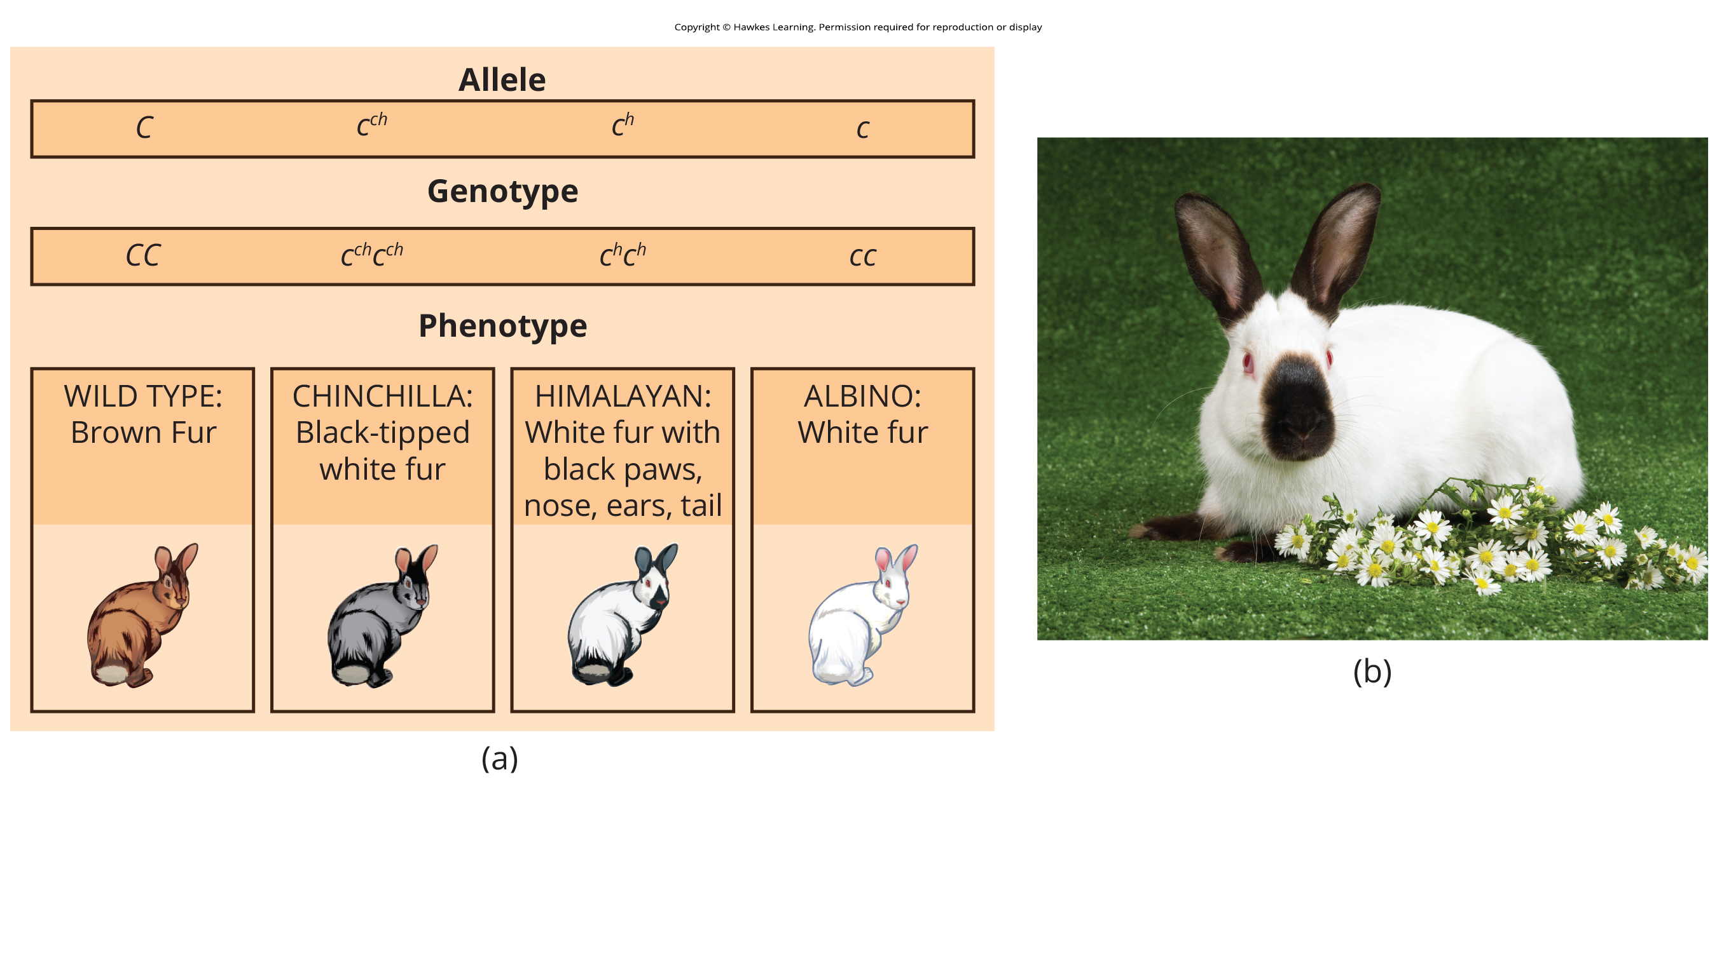
Multiple Alleles₂
Example: Coat color in rabbits
  Wild type: C⁺C⁺ (brown fur)
    Dominant over all
  Chinchilla: c^{ch}c^{ch} (black-tipped white fur)
    Incompletely dominant over Himalayan and albino
  Himalayan phenotype: c^{h}c^{h} (black fur on extremities and white everywhere else)
    Dominant over albino
  Albino: cc (white fur)
12.2 Figure 7: (a) Four different alleles exist for the rabbit coat color (C) gene. (b) This is a rabbit that inherited the c^{h}c^{h} genotype, resulting in the Himalayan phenotype.

Slide 23
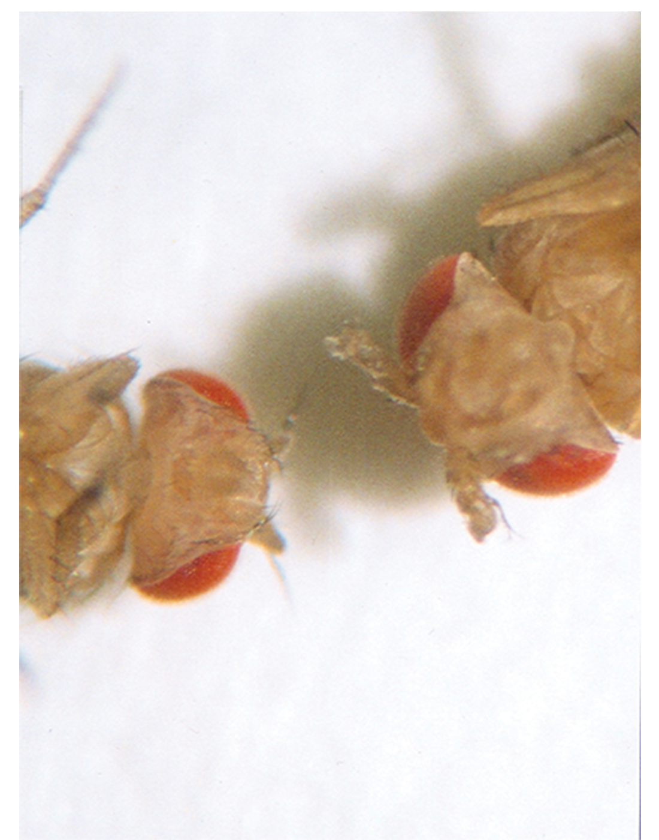
Multiple Alleles₃
Complete dominance of wild-type phenotype occurs because of dosage for a specific gene product
  Example: Wild-type allele supplies given dosage of fur pigment but mutants supply less or none at all
One mutant allele can be dominant over everything
  Occurs when mutant allele interferes with genetic message so heterozygote with one wild-type allele expresses mutant phenotype
    Can interfere by enhancing function of wild-type gene product or changing its distribution
      Example: Antennapedia mutation in Drosophila (develops legs on its head instead of antennae)
12.2 Figure 8: As seen in comparing the wild-type Drosophila (left) and the Antennapedia mutant (right), the Antennapedia mutant has legs on its head in place of antennae.
Ktbn on Wikimedia Commons. "Fruit fly antennae."

Slide 24
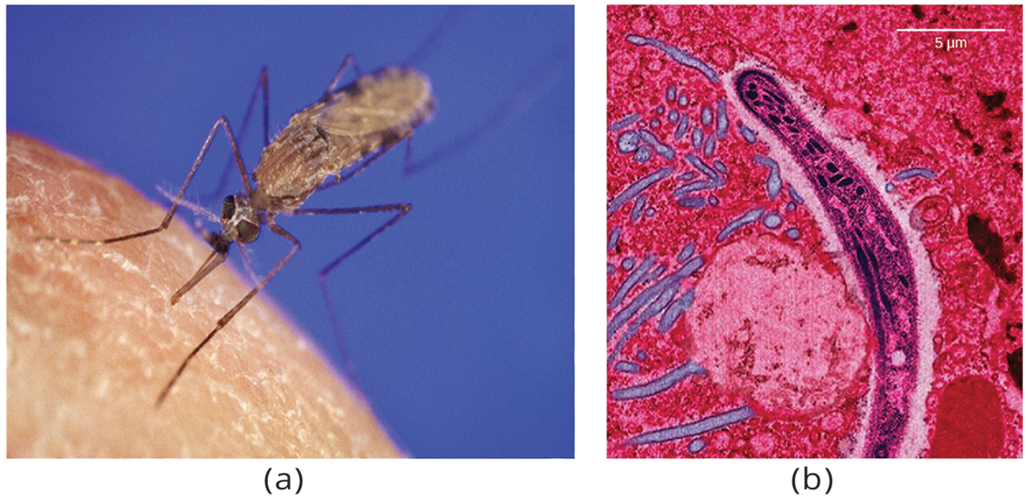
Evolution Connection
Multiple Alleles Confer Drug Resistance in the Malaria Parasite
Malaria transmitted by female mosquitoes (including Anopheles gambiae) by Plasmodium falciparum and P. vivax
Parasite has evolved resistance so treatment varies by region
  Has multiple drug-resistant alleles of the dhps gene (sulfadoxine resistance associated with each allele)
  P. falciparum only needs one allele to resist this treatment
12.2 Figure 9: The (a) Anopheles gambiae, or African malaria mosquito, acts as a vector in the transmission to humans of the malaria-causing parasite (b) Plasmodium falciparum, shown here using false color transmission electron microscopy.
CNX OpenStax on Wikimedia Commons. "Anopheles gambiae."
CNX OpenStax on Wikimedia Commons. "Plasmodium falciparum."

Slide 25
X-Linked Traits₁
Sex determined by sex chromosomes (pair of nonhomologous chromosomes)
Thus far we only examined autosomes
  Autosome: any of the nonsex chromosomes
In humans, sex chromosomes are XX (female) and XY (male)
  X-linked: gene present on the X but not the Y chromosome
  Sex-linked: any gene on a sex chromosome

Slide 26
X-Linked Traits₂
Example: Eye color in Drosophila
  One of the first X-linked traits to be identified
  Wild-type eye color is red; mutation gives white eyes
    Wild-type red color (X^{w+}) dominant to white (X^{w})
  Gene is on X chromosome (inheritance differs between males and females)
    Males are hemizygous and always express the single allele they carry
      Hemizygous: presence of only one allele for a characteristic, as in X-linkage; hemizygosity makes description of dominance and recessiveness irrelevant
      Genotypes: X^{w+}Y or X^{w}Y
    Females have two allele copies
      Genotypes: X^{w+}X^{w+}, X^{w+}X^{w}, X^{w}X^{w}

Slide 27
X-Linked Traits₃
In X-linked cross, genotypes of F₁ and F₂ depend on whether the recessive trait was expressed by male or female in P₀
Example: Drosophila eye color
  Cross between male expressing white eyes and female expressing homozygous red eyes:
    F₁ will inherit X^{R} from female and have red eyes
    F₁ females are heterozygous (X^{w+}X^{w}) and males are X^{w+}Y
      Cross of X^{w+}X^{w} female and X^{w+}Y male (F₁) result in only red-eyed females (X^{w+}X^{w+} or X^{w+}X^{w}) and red- and white-eyed males (X^{w+}Y or X^{w}Y) (F₂)

Slide 28
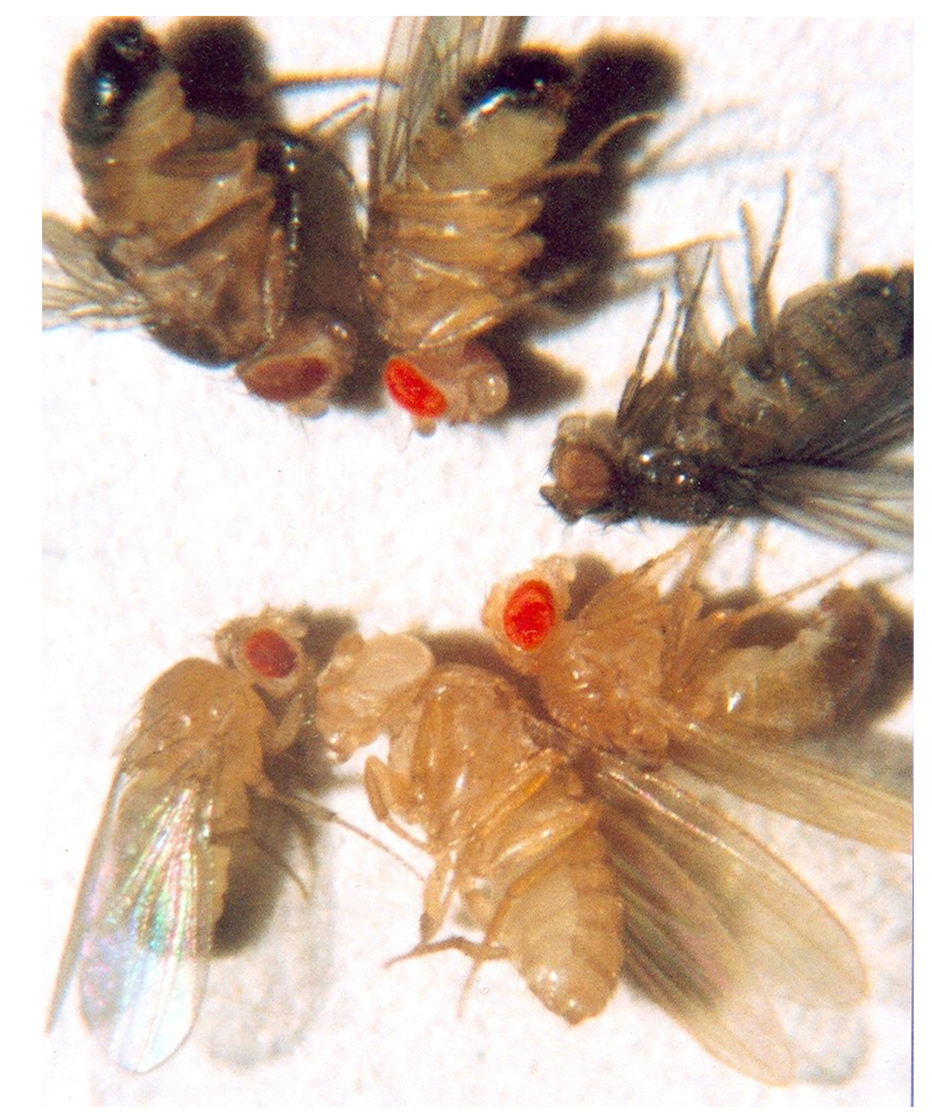
X-Linked Traits₄
Example: Drosophila eye color
Cross between male expressing red eyes and female expressing homozygous, white eyes
  F₁: only heterozygous, red-eyed females (X^{w+}X^{w}) and only white-eyed males (X^{w}Y)
  F₂: half females with red eyes (X^{w+}X^{w}) and half females with white eyes (X^{w}X^{w}) and half males with red eyes (X^{w+}Y) and half males with white-eyes (X^{w}Y)
12.2 Figure 10
Ktbn on Wikimedia Commons. "Fruit fly eye colors."

Slide 29
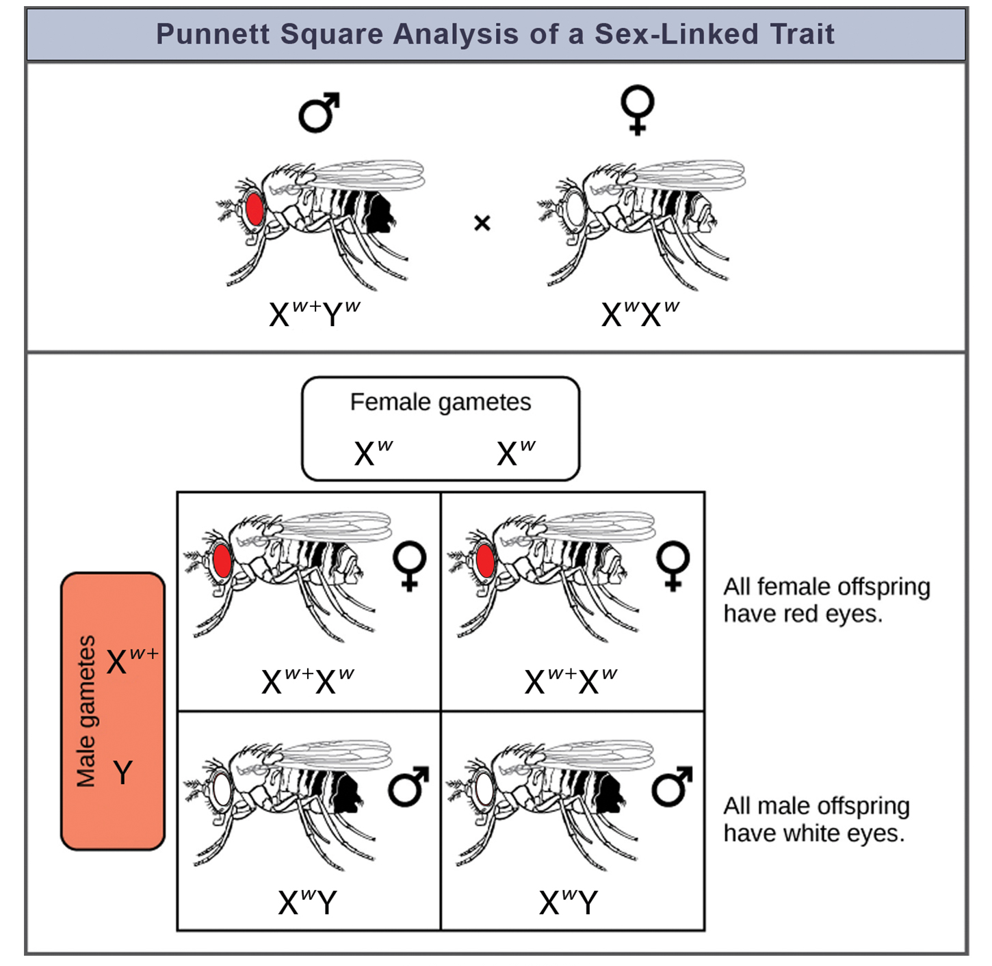
12.2 Figure 11
OpenStax. "Sex-linked trait.“ Modified.
Notes:
Figure 11: Punnett square analysis is used to determine the ratio of offspring from a cross between a red-eyed male fruit fly and a white-eyed female fruit fly.

Slide 30
X-Linked Traits₅
Can be applied to human genetics
Homozygous, recessive for X-linked trait female will pass it on to 100% of offspring
  Male offspring will express the trait having only one X chromosome
Examples of X-linked human conditions: Some color blindness, hemophilia, muscular dystrophy
Heterozygous females are carriers and may not phenotypically express the trait
  Will pass trait on to half of male offspring and will pass carrier status to half female offspring
    Why recessive X-linked traits appear more frequently in males
In some organisms like birds nonhomologous chromosome is in female, making sex-linked traits more likely in female (hemizygous)

Slide 31
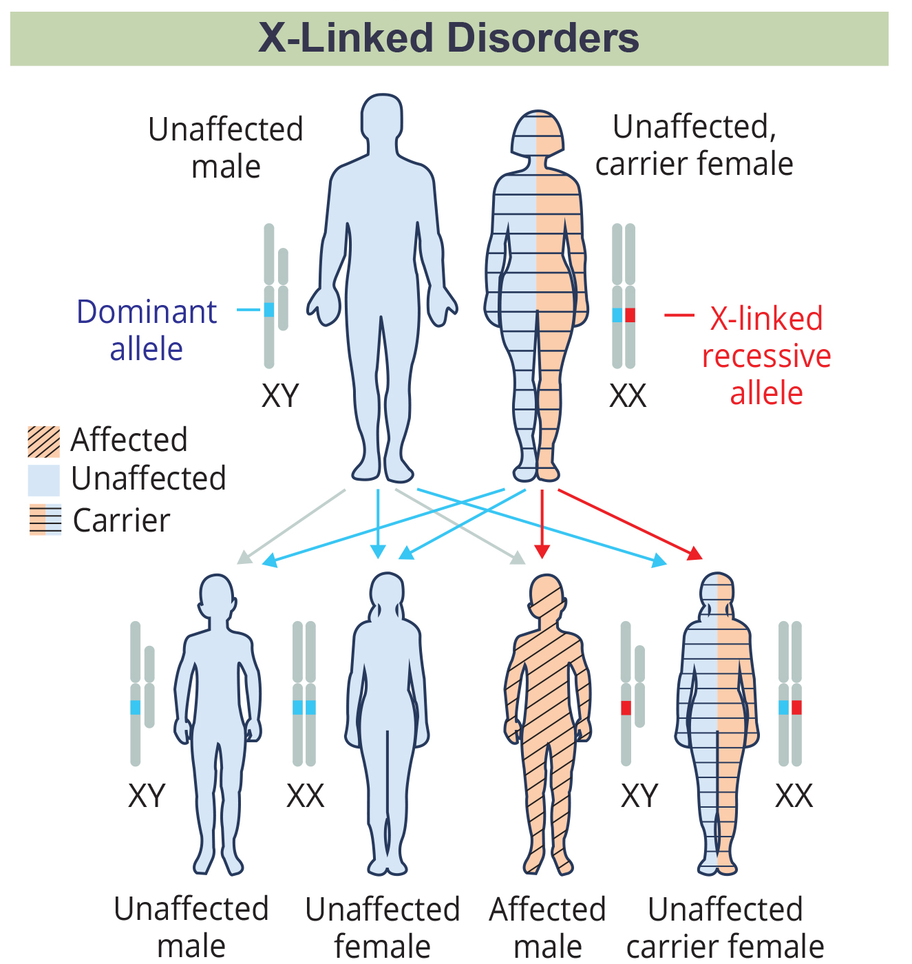
Human Sex-Linked Disorders
X-linked recessive disorders (e.g., red-green color blindness, A and B hemophilia) affect males more
  Males need only one recessive mutant X allele to be affected
  Females need two recessive mutant X alleles
    If only one, they are carriers (passing it without expressing it or only expressing it mildly)
Y-linked recessive disorders exist but typically associated with infertility in males so not passed to offspring
12.2 Figure 12: The male offspring of a female who is a carrier of a recessive X-linked disorder will have a 50% chance of being affected. A female will not be affected but will have a 50% chance of being a carrier, like the female parent.
OpenStax. "X-linked disorders."

Slide 32
Lethality₁
Sometimes nonfunctional allele for essential gene comes up by mutation and can be transmitted as long as individuals also have a wild-type, functional copy
  If two heterozygous individuals produce a homozygous recessive for nonfunctional allele, the offspring will likely die at whatever point requires the gene
    Recessive lethal: inheritance pattern in which an allele is only lethal in the homozygous form; the heterozygote may be normal or have some altered, nonlethal phenotype
    Only wild-type homozygotes and heterozygotes would survive
    Genotypic ratio: 2:1
    Sometimes recessive lethal allele exhibits dominant, nonlethal phenotype in heterozygote
      Example: Curly allele in Drosophila affects wing shape in heterozygote but lethal in homozygote

Slide 33
Lethality₂
Dominant lethal: inheritance pattern in which an allele is lethal both in the homozygote and the heterozygote; this allele can only be transmitted if the lethality phenotype occurs after reproductive age
  Rare, only lasts one generation and not transmitted but sometimes can be if expressed after reproductive age
  Example: Huntington's disease (nervous system gradually degrades)
    Heterozygous dominant individuals affected but not until age 40
      Can unknowingly pass to 50% of offspring

Slide 34
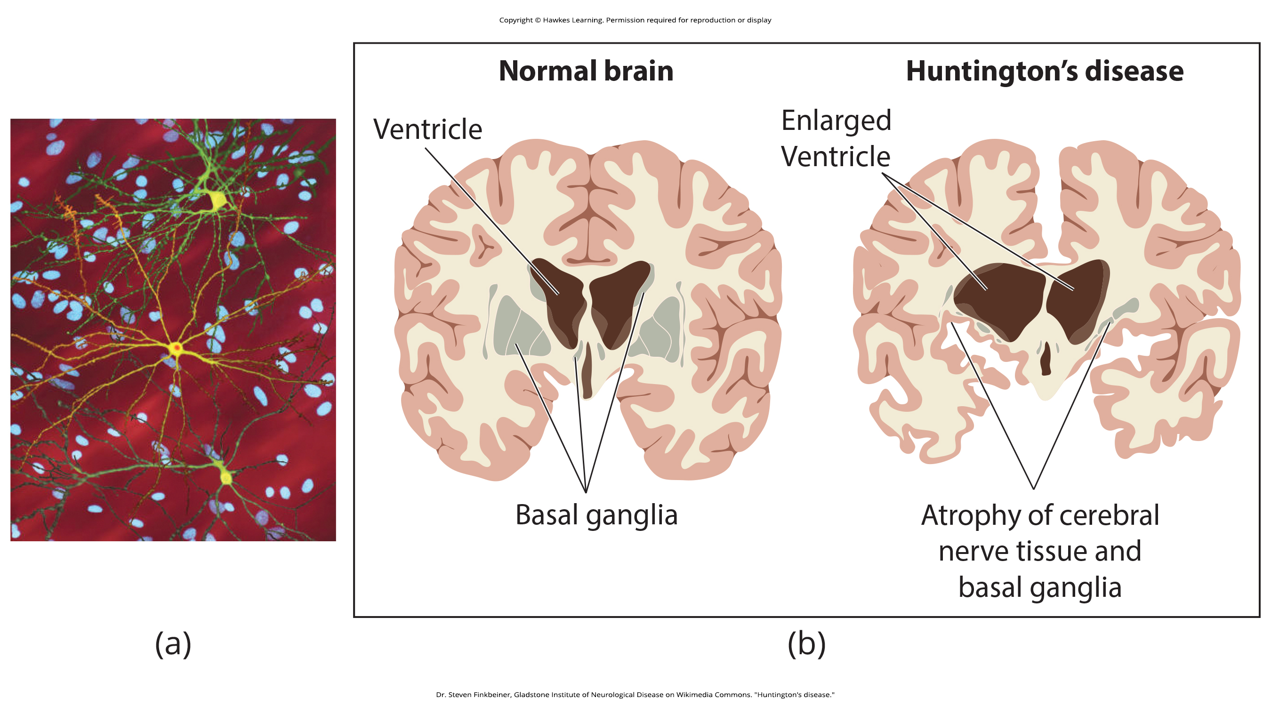
12.2 Figure 13
Dr. Steven Finkbeiner, Gladstone Institute of Neurological Disease on Wikimedia Commons. "Huntington's disease."
Notes:
Figure 13: (a) The neuron in the center of this micrograph has abnormal protein deposits containing the mutant Huntingtin protein characteristic of Huntington's disease. Huntington's disease occurs when an abnormal dominant allele for the huntingtin gene is present. (b) Huntington's disease results in the loss of nerve cells in the brain.

Slide 35
Summary
Cross between true-breeding, homozygous parents with contrasting traits, the F₁ offspring are all heterozygotes showing dominant phenotype
  Self-cross of F₂ generation yields 1:2:1 genotypic ratio and 3:1 phenotypic ratio for homozygous dominant: heterozygous:homozygous recessive
Incomplete dominance is when heterozygotes have phenotype that is intermediate between homozygous phenotypes
Codominance is simultaneous expression of both alleles in the heterozygote
Populations can have multiple alleles for a given gene, not just two alleles
X-linked genes inherited differently in males (who get one X allele) vs. females (who get two X alleles)
Recessive lethal alleles only lethal in homozygotes
Dominant lethal alleles are fatal in heterozygotes

Slide 36


End of Hawkes Learning PowerPoint

