Slide 1
Lesson 12.3
Laws of Inheritance

Slide 2
Objectives
Explain Mendel's law of segregation and independent assortment in terms of genetics and the events of meiosis.
Explain the effect of linkage and recombination on gamete genotypes.
Explain the phenotypic outcomes of epistatic effects between genes.
Use the forked-line method and the probability rules to calculate the probability of genotypes and phenotypes from multiple gene crosses.

Slide 3
Laws of Inheritance
Mendel's four postulates or "laws" that describe the basics of dominant and recessive inheritance in diploid organisms
Laws summarize classical genetics, though more complex patterns of inheritance exist

Slide 4
Pairs of Unit Factors, or Genes
Mendel proposed paired unit factors of hereditary faithfully transmitted from parents to offspring by dissociation and reassociation during gametogenesis and fertilization
Factors/genes exist as discrete units that are not blended in the offspring

Slide 5
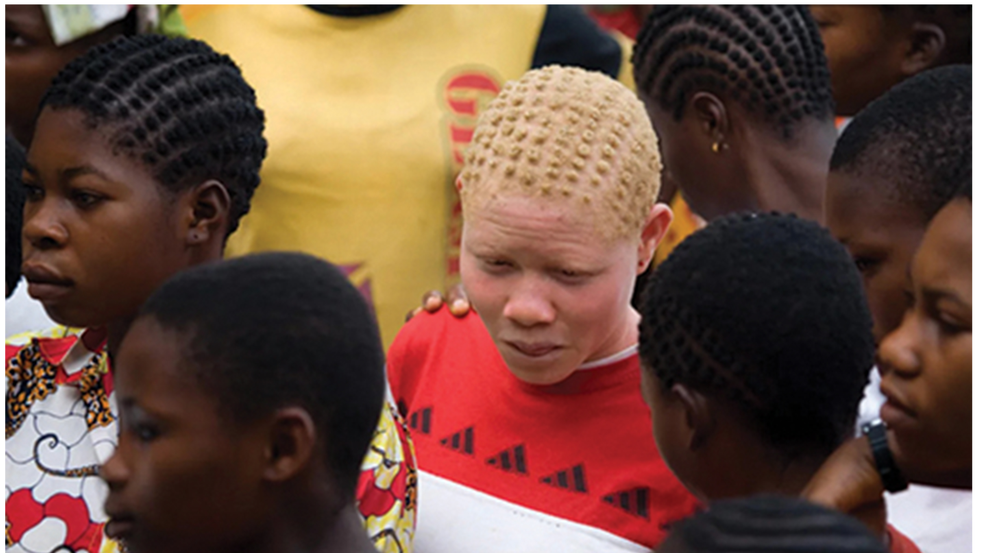
Alleles Can Be Dominant or Recessive
Law of dominance: in a heterozygote, one trait will conceal the presence of another trait for the same characteristic
Dominant expressed and recessive remains "latent" but will be passed on
Other patterns of inheritance exist, not just law of dominance
12.3 Figure 1: The child in the photo expresses albinism, a recessive trait.
ONU Brazil on Wikimedia Commons. "Albinism."

Slide 6
Equal Segregation of Alleles
Law of segregation: paired unit factors (i.e., genes) segregate equally into gametes such that offspring have an equal likelihood of inheriting any combination of factors
F₂ generation of monohybrid cross results in homozygous dominant, heterozygous, and homozygous recessive
Heterozygotes and homozygous dominant individuals are phenotypically identical, resulting in 3:1 phenotypic ratio
Why we can use Punnett square to predict offspring genotypes
Physical basis is meiosis I with random segregation of homologous chromosomes

Slide 7
Independent Assortment₁
Law of independent assortment: genes do not influence each other with regard to sorting of alleles into gametes; every possible combination of alleles is equally likely to occur
Illustrated by dihybrid cross
  Dihybrid: result of a cross between two true-breeding parents that express different traits for two characteristics
Example: Cross between green, wrinkled seeds (yyrr) and yellow, round seeds (YYRR)
  Law of segregation says gametes for green/wrinkled plant are all yr and for yellow/round plant are all YR
  F₁ generation all YyRr
  F₂ generation:
    Law of segregation means each gamete gets either R or r and Y or y
    Results in YR, Yr, yR, and yr
    Can infer phenotypic ratio of 9 round/yellow:3 round/green:3 wrinkled/yellow:1 wrinkled/green

Slide 8
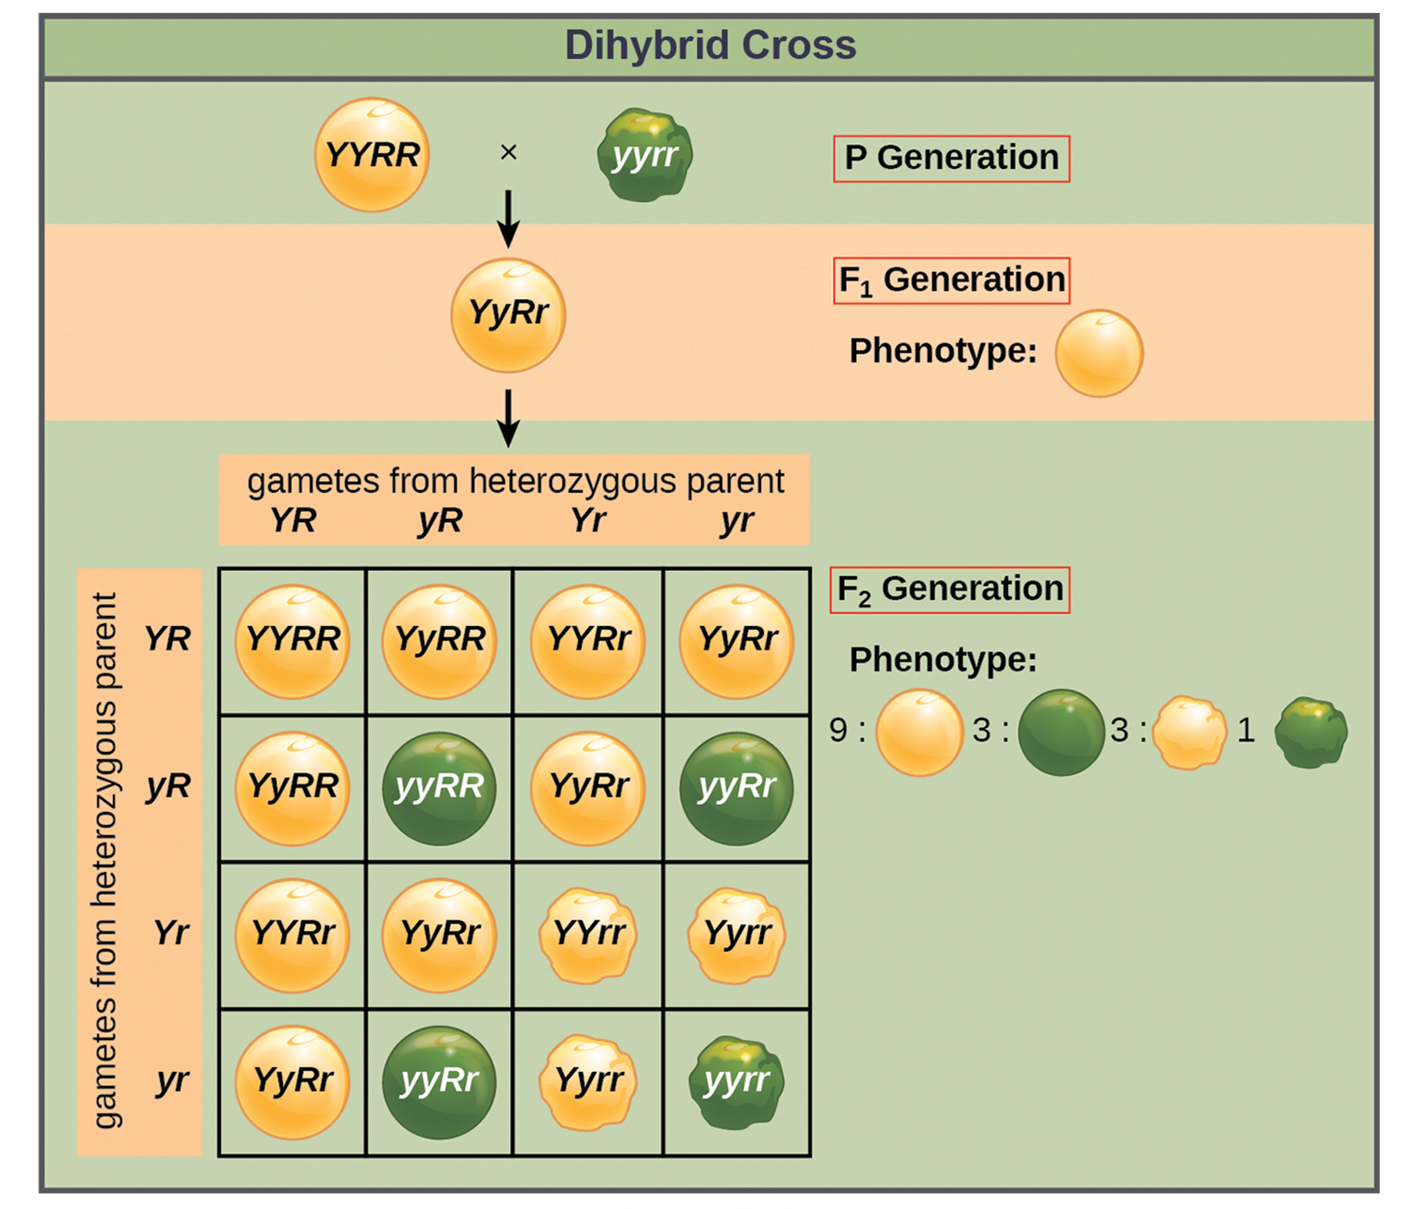
12.3 Figure 2
OpenStax. "Dihybrid cross."
Notes:
Figure 2: This dihybrid cross of pea plants involves the genes for seed color and texture.

Slide 9
Independent Assortment₂
9:3:3:1 can be split into two 3:1 ratios (like any monohybrid cross with dominant and recessive pattern)
Previous example follows 3:1 ratio if each characteristic is split
  Then apply product rule and you get same 9:3:3:1 proportion
Law of independent assortment indicates cross between yellow/wrinkled (Yyrr) and green/round (yyRR) yields same F₁ and F₂ offspring as YYRR x yyrr cross
Physical basis of law is random assortment on metaphase plate in meiosis I

Slide 10
Forked-Line Method
Used for crosses with multiple genes to avoid large Punnett squares
  Create rows equal to number of genes to be considered and segregate alleles into rows according to monohybrid probabilities
  Multiply values along each fork to get F₂ possibilities
A diagrammatic version of the product rule because each gene sorts independently
Trihybrid cross F₂ phenotypic ratio is 27:9:9:9:3:3:3:1

Slide 11
Group Activity₁
As a group of two or three, use a Punnett square to predict the outcome of a trihybrid cross between two parents with the genotype GgJjNn. Did you get a phenotypic ratio of 27:9:9:9:3:3:3:1?

Slide 12
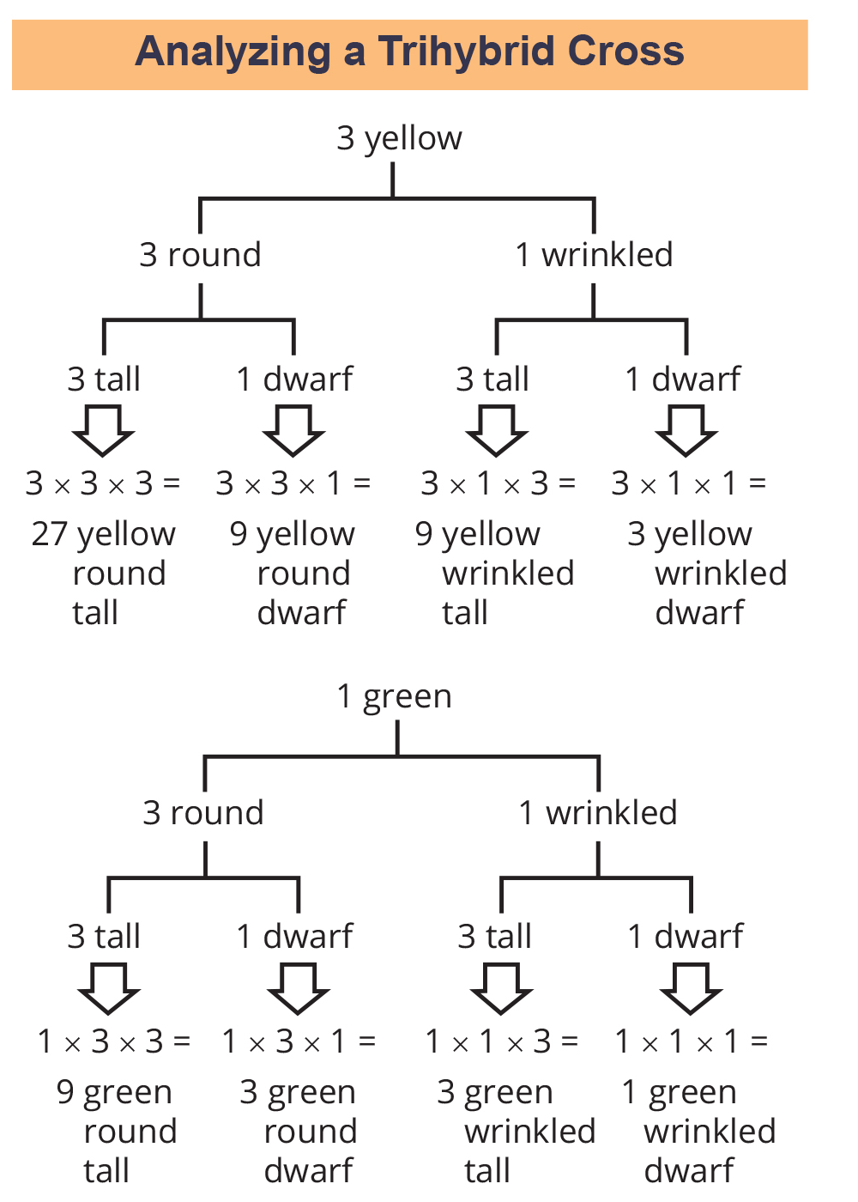
12.3 Figure 3
OpenStax. "Trihybrid cross." Modified.
Notes:
Figure 3: The forked-line method can be used to analyze a trihybrid cross. Here, the probability for color in the F2 generation occupies the top row (3 yellow:1 green). The probability for shape occupies the second row (3 round:1 wrinkled), and the probability for height occupies the third row (3 tall:1 dwarf). The probability for each possible combination of traits is calculated by multiplying the probability for each individual trait. Thus, the probability of F2 offspring having yellow, round, and tall traits is 3 × 3 × 3, or 27.

Slide 13
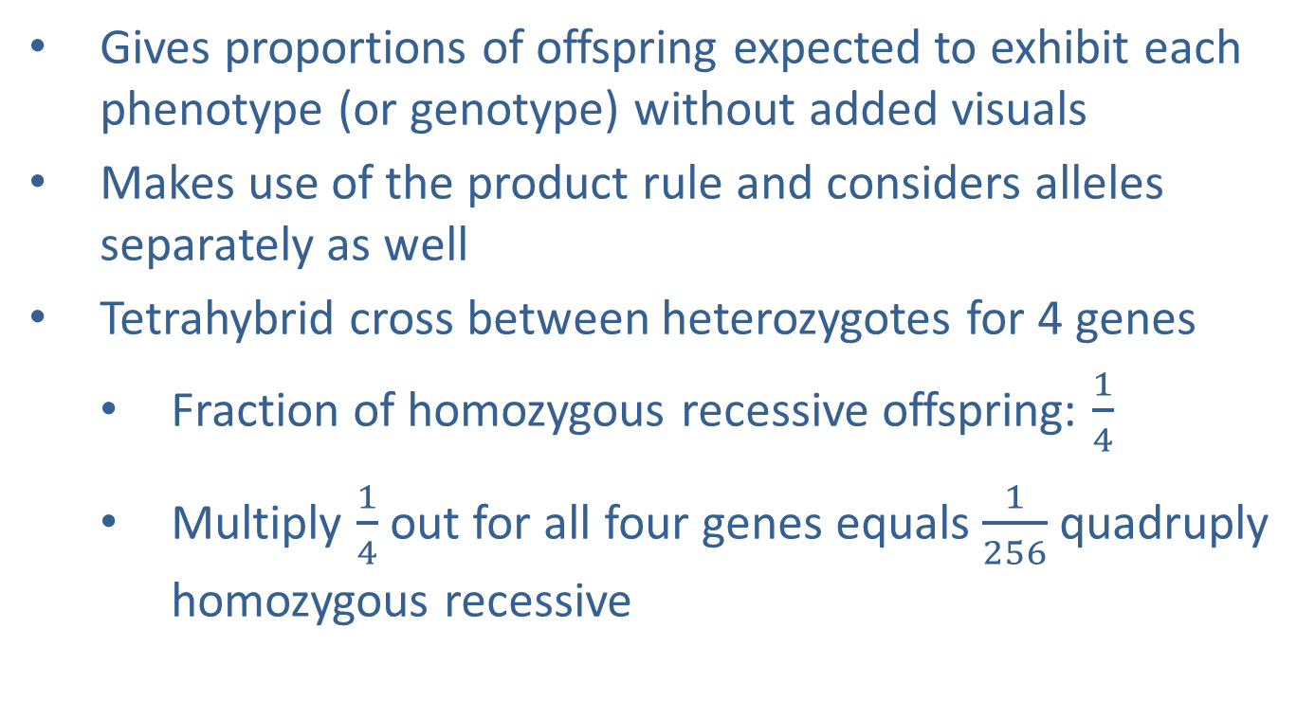
Probability Method₁
Gives proportions of offspring expected to exhibit each phenotype (or genotype) without added visuals
Makes use of the product rule and considers alleles separately as well
Tetrahybrid cross between heterozygotes for 4 genes
  Fraction of homozygous recessive offspring: $\frac{1}{4}$
  Multiply $\frac{1}{4}$ out for all four genes equals $\frac{1}{256}$ quadruply homozygous recessive

Slide 14
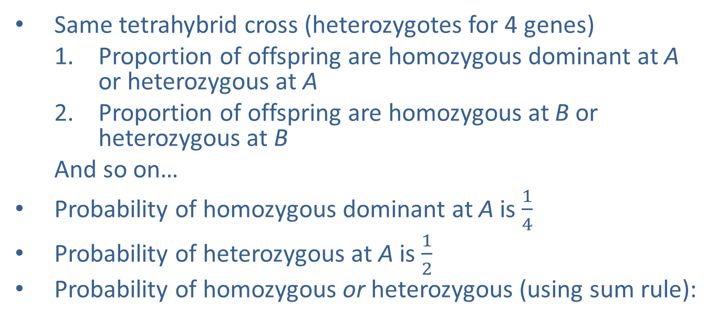
Probability Method₂
Same tetrahybrid cross (heterozygotes for 4 genes)
  Proportion of offspring are homozygous dominant at A or heterozygous at A
  Proportion of offspring are homozygous at B or heterozygous at B
  And so on…
Probability of homozygous dominant at A is $\frac{1}{4}$
Probability of heterozygous at A is $\frac{1}{2}$
Probability of homozygous or heterozygous (using sum rule):

Slide 15
Probability Method₃
Same probability for other genes
Probability of dominant phenotype at A and B and C and D (using product rule):

Slide 16
Rules for Multihybrid Fertilization
General rules for predicting number of gametes, genotypes, and phenotypes
Depends on the number (n) of heterozygous gene pairs in the parents (number of genes for which two different alleles are present in the parents of the cross)
Examples:
  Cross between AaBb and AaBb has n of 2 for two genes being considered (genes A and B) and two different alleles for each gene
  Cross between AABb and AABb has n of 1 for only 1 allele for gene A (all offspring would have 100% of inheriting A allele)
Given n, you can predict number of unique gametes produced, number of different genotypes, and number of different phenotypes

Slide 17
Table 1: General Rules for Multihybrid Crosses
General Rule | Number of Possibilities
number of different parental gametes | 2^{n}
number of different offspring genotypes | 3^{n}
given dominant and recessive inheritance, the number of different offspring phenotypes | 2^{n}

Slide 18
Linked Genes Violate the Law of Independent Assortment₁
Segregation of alleles into gametes can be influenced by linkage
  Linkage: phenomenon in which alleles that are located in close proximity to each other on the same chromosome are more likely to be inherited together
However, crossover allows for two genes on same chromosome to behave independently
  Homologous chromosomes have same genes in same linear order
    Alleles may differ but genes do not
    Genes aligned during recombination (crossover)
      Maternal and paternal alleles combined onto same chromosome

Slide 19
Linked Genes Violate the Law of Independent Assortment₂
Example: Genes for flower color and plant height lie next to each other on chromosome
  Cross between two heterozygotes (with one chromosome with alleles for tall plants with red flowers and alleles for short plants with yellow flowers)
    Because alleles are traveling together instead of 9:3:3:1 genotypic ratio for dihybrid cross, they will have 1:2:1 genotypic ratio like a monohybrid cross
As distance between two genes increases, probability for one or more crossovers between them increases and genes behave more like on separate chromosomes
Mendel did not address linkage

Slide 20
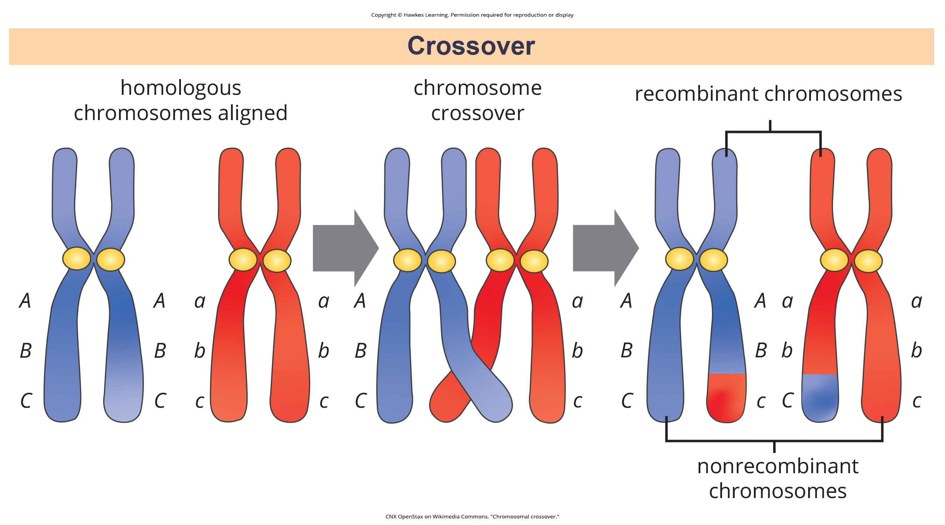
12.3 Figure 4
CNX OpenStax on Wikimedia Commons. "Chromosomal crossover."
Notes:
Figure 4: The process of crossover, or recombination, occurs when two homologous chromosomes align during meiosis and exchange a segment of genetic material. Here, the alleles for gene C were exchanged. The result is two recombinant and two nonrecombinant chromosomes.

Slide 21
Group Activity₂
Testing the Hypothesis of Independent Assortment
To better appreciate the amount of labor and ingenuity that went into Mendel's experiments, let's go through one of Mendel's dihybrid crosses in groups of three or four.
Question: What will be the offspring of a dihybrid cross?
Background: Consider that pea plants mature in one growing season, and you have access to a large garden in which you can cultivate thousands of pea plants. There are several true-breeding plants with the following pairs of traits: tall plants with inflated pods and dwarf plants with constricted pods. Before the plants have matured, you remove the pollen-producing organs from the tall/inflated plants in your crosses to prevent self-fertilization. Upon plant maturation, the plants are manually crossed by transferring pollen from the dwarf/constricted plants to the stigmata of the tall/inflated plants.

Slide 22
Group Activity₃
Hypothesis: Both trait pairs will sort independently according to Mendelian laws. When the true-breeding parents are crossed, all the F₁ offspring are tall and have inflated pods, which indicates that the tall and inflated traits are dominant over the dwarf and constricted traits, respectively. A self-cross of the F₁ heterozygotes results in 2,000 F₂ progeny.

Slide 23
Group Activity₄
Test the Hypothesis: Because each trait pair sorts independently, the ratios of tall:dwarf and inflated:constricted are each expected to be 3:1. The tall/dwarf trait pair is called T/t, and the inflated/constricted trait pair is designated I/i. Each member of the F₁ generation, therefore, has a genotype of TtIi. Now, consider the results of crossing individuals of the F₁ generation. Examine Figure 5, which shows all possible genotypic outcomes for a cross of two TtIi individuals. Each individual can donate four combinations of two traits—TI, Ti, tI, or ti—meaning that there are 16 possibilities of offspring genotypes. Because the T and I alleles are dominant, any individual having one or two of those alleles will express the tall or inflated phenotypes, respectively, regardless of if they also have a t or i allele. Only individuals that are tt or ii will express the dwarf and constricted alleles, respectively. As shown in Figure 5, you predict that you will observe the following offspring proportions: tall/inflated:tall/constricted:dwarf/inflated:dwarf/constricted in a 9:3:3:1 ratio. Notice from the grid that when considering the tall/dwarf and inflated/constricted trait pairs in isolation, they are each inherited in 3:1 ratios.

Slide 24
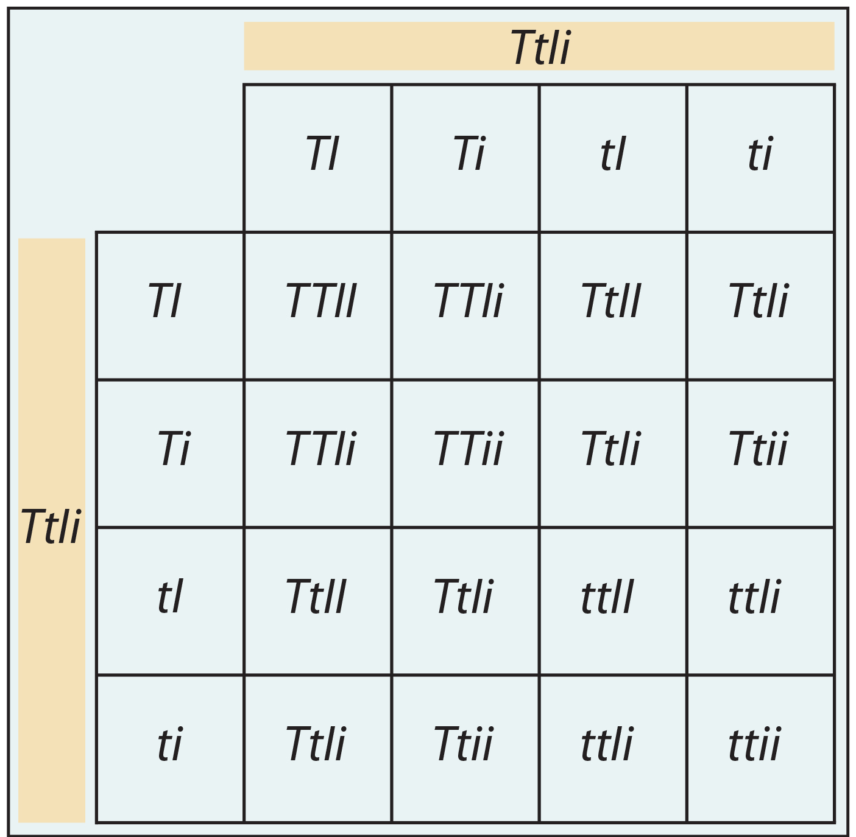
Group Activity₅
12.3 Figure 5: This figure shows all possible combinations of offspring resulting from a dihybrid cross of pea plants that are heterozygous for the tall/dwarf and inflated/constricted alleles.
OpenStax. "Trihybrid cross."

Slide 25
Group Activity₆
You cross the dwarf and tall plants and then self-cross the offspring. For best results, this is repeated with hundreds or even thousands of pea plants. What special precautions should be taken in the crosses and in growing the plants?
Analyze Your Data: You observe the following plant phenotypes in the F₂ generation: 2,706 tall/inflated, 930 tall/constricted, 888 dwarf/inflated, and 300 dwarf/constricted. Reduce these findings to a ratio and determine if they are consistent with Mendelian laws.
Form a Conclusion: Were the results close to the expected 9:3:3:1 phenotypic ratio? Do the results support the prediction? What might be observed if far fewer plants were used, given that alleles segregate randomly into gametes? Try to imagine growing that many pea plants and consider the potential for experimental error. For instance, what would happen if it was extremely windy one day?

Slide 26
Epistasis₁
Single observable characteristics almost always under the influence of multiple genes (each with two or more alleles) acting in unison
  Example: Eye color in human influenced by at least eight genes
Several genes can contribute to common phenotype without gene products directly interacting
  Example: Organ development
    Genes may be expressed sequentially (each gene adding to complexity and specificity)
    Genes may function in complementary or synergistic ways (two or more genes need to be expressed simultaneously to affect a phenotype)
    Genes may oppose each other (one gene modifying expression of another)

Slide 27
Epistasis₂
Epistasis: antagonistic interaction between genes such that one gene masks or interferes with the expression of another
Alleles being masked are hypostatic to epistatic alleles doing the masking
Biochemical basis is gene pathway where expression of one gene is dependent on function of the gene that precedes it or follows it in pathway

Slide 28
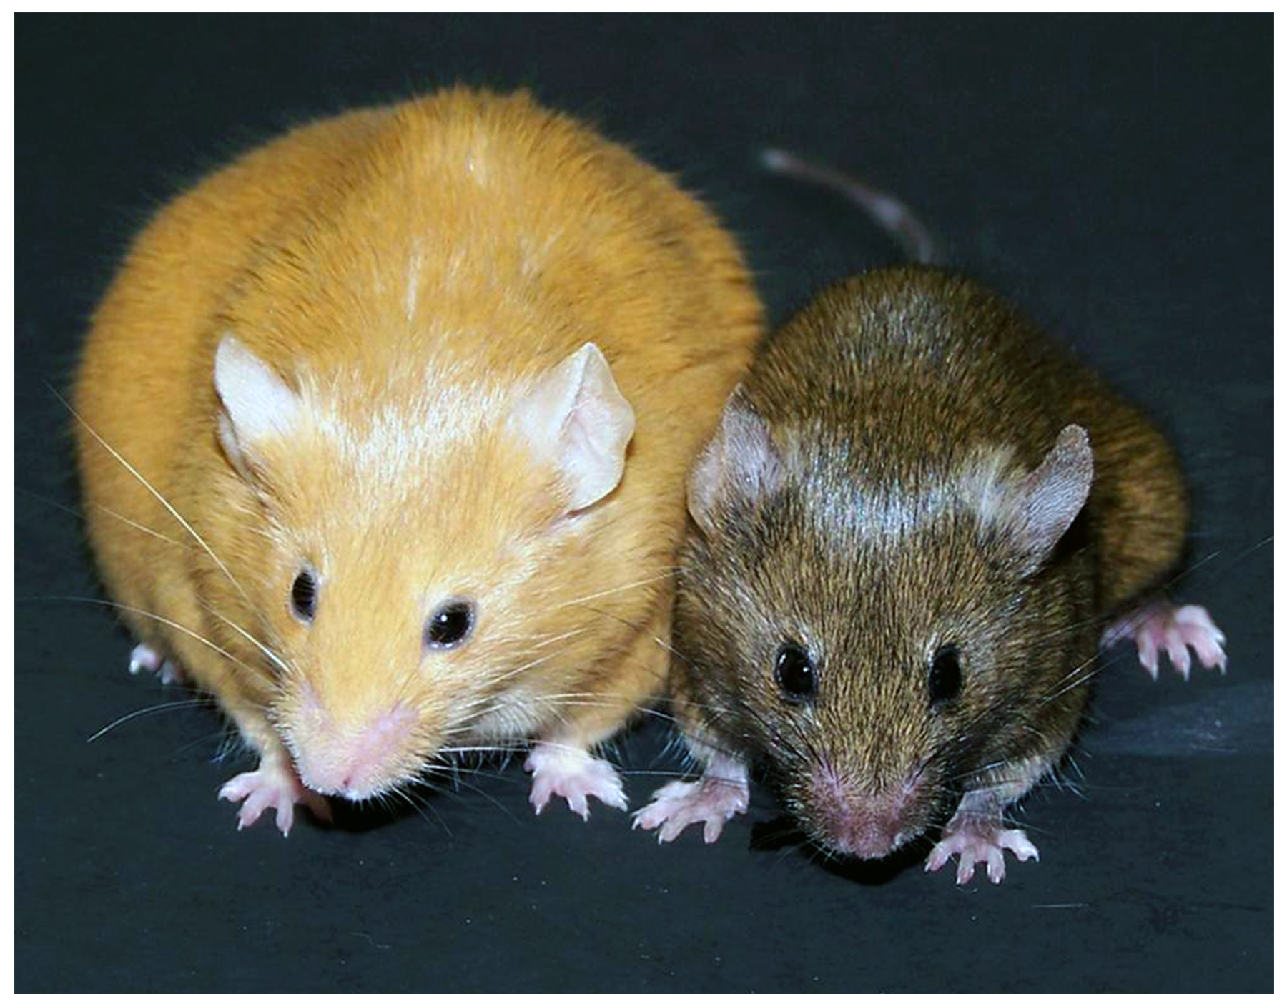
Epistasis₃
Example: Pigmentation in mice
  Wild-type: agouti (AA)
    Dominant to solid color (aa)
  Separate gene (C) necessary for pigment production
    Mouse with recessive c unable to produce pigment (albino) regardless of allele A
      AAcc, Aacc, aacc are all albino
  Cross between AaCc and AaCc would produce 9 agouti:3 solid color:4 albino
  C gene epistatic to A gene
12.3 Figure 6
Randy Jirtle and Dana Dolinoy on Wikimedia Commons. "Mouse colors."

Slide 29
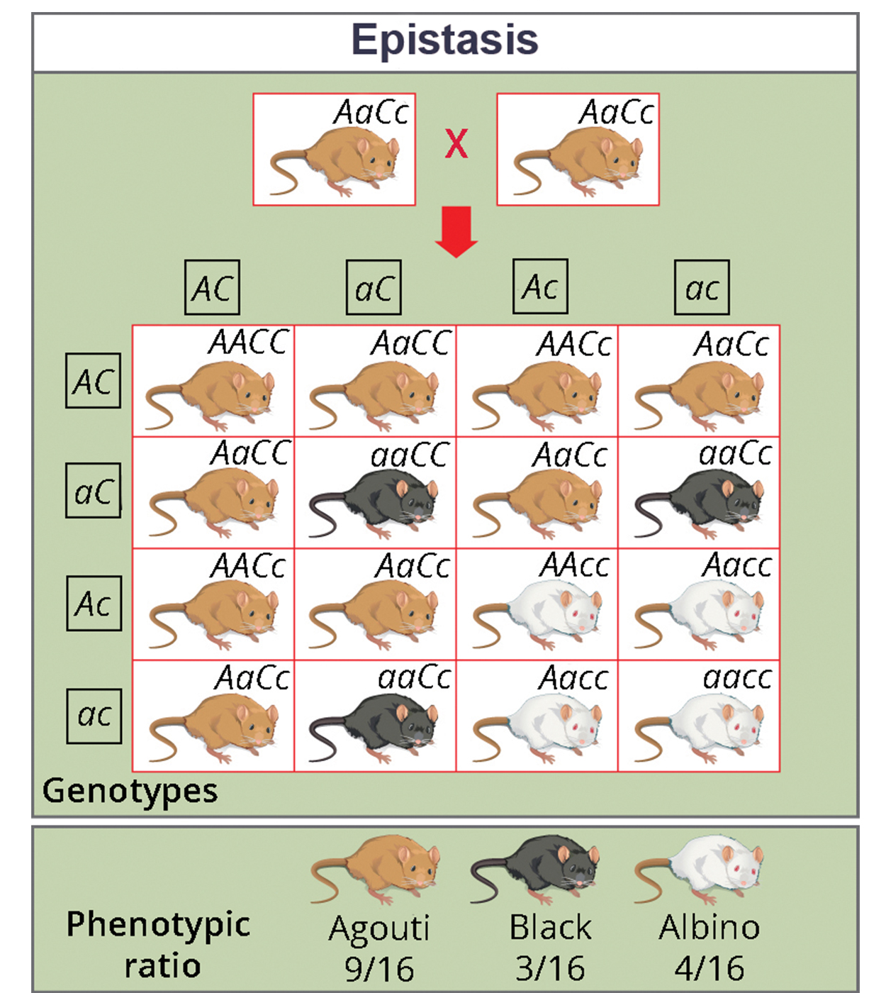
12.3 Figure 7
OpenStax. "Epistasis."
Notes:
Figure 7: In mice, the mottled agouti coat color (A) is dominant to a solid coloration, such as black or gray. A gene at a separate locus (C) is responsible for pigment production. The recessive c allele does not produce pigment, and a mouse with the homozygous recessive cc genotype is albino, regardless of the allele present at the A locus. Thus, the C gene is epistatic to the A gene.

Slide 30
Epistasis₄
Epistasis can also occur when dominant allele masks expression at separate gene
  Example: Fruit color in summer squash
    Controlled by W gene (dominant and yields white fruit), Y gene (dominant and yields yellow fruit), and y gene (recessive and yields green fruit)
    W masks expression of Y gene
      If homozygous recessive (ww), then fruit color determined by Y alleles
      wwYY and wwYy produces yellow fruit
      wwyy produces green fruit
    Cross between WwYy and WwYy would produce 12 white:3 yellow:1 green

Slide 31
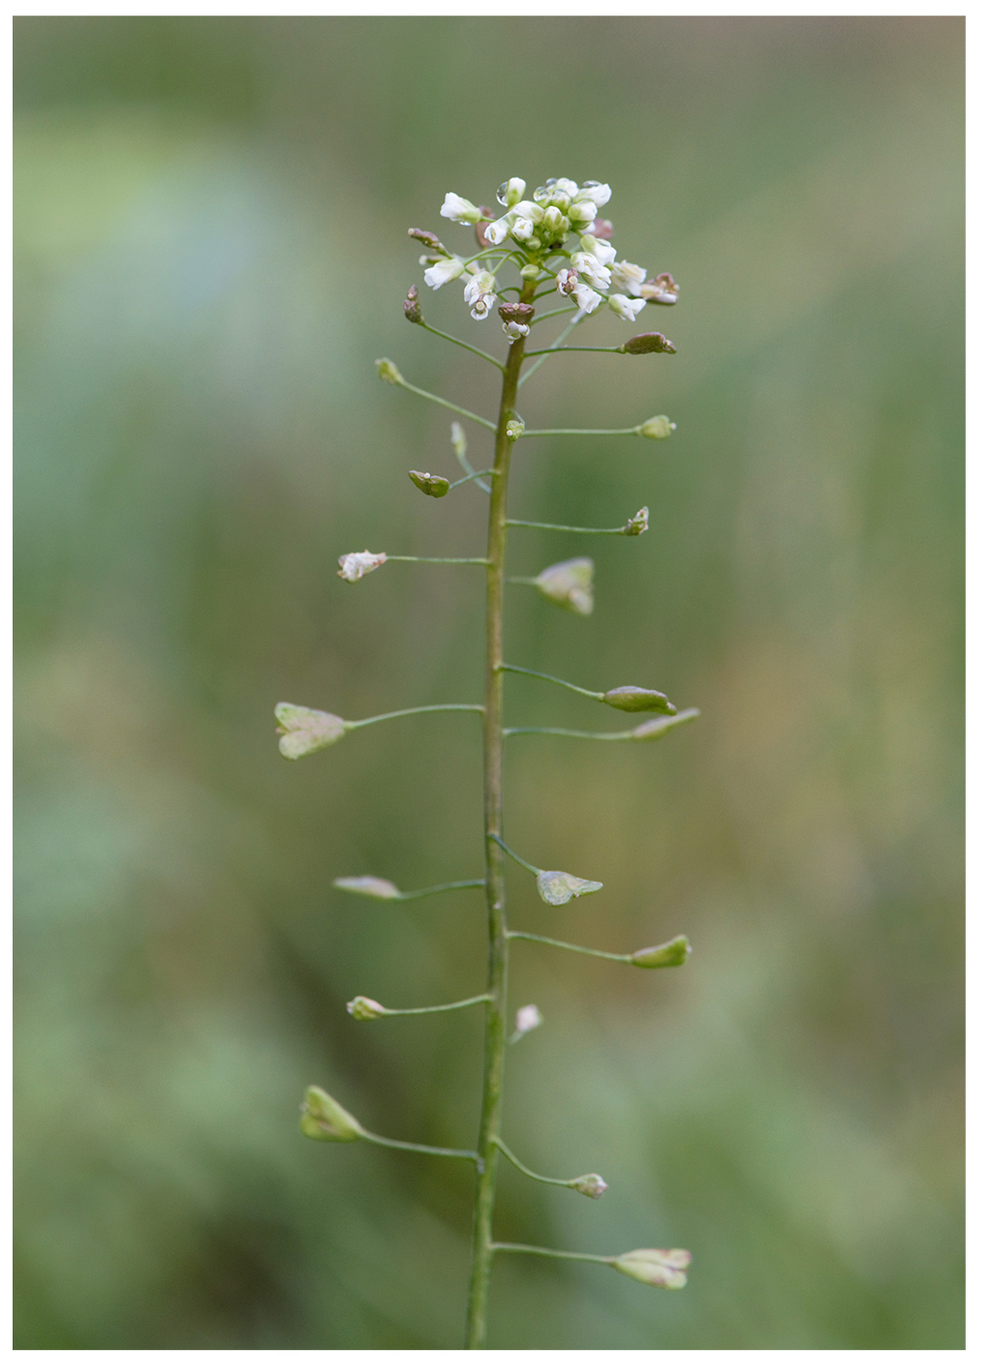
Epistasis₅
Epistasis can be reciprocal (either gene expresses same phenotype)
Example: Shepherd's purse plant
  Seed shape controlled by two genes in dominant epistatic relationship
  Homozygous recessive (aabb) produces ovoid seeds
  Dominant allele for either gene produces triangular seeds (every possible genotype other than aabb)
  Cross between AaBb and AaBb yields phenotypic ratio of 15 triangular: 1 ovoid
Any characteristic that results in phenotypic ratio total of 16 is typical of two-gene interaction
  Phenotypic ratio for Mendel's dihybrid cross of two noninteracting genes is 9:3:3:1
  Assumes genes are not linked
12.3 Figure 8
Krzysztof Ziarnek, Kenraiz on Wikimedia Commons. "Shepherd's purse plant."

Slide 32
Summary
Mendel proposed that genes (characteristics) are inherited as allele pairs (traits) exhibiting dominant and recessive patterns
  Alleles segregate equally into gametes
  Genes assorted into gametes independently
  Dihybrid crosses demonstrate independent assortment
Crosses involving more than two genes, use forked-line or probability methods to predict offspring genotypes and phenotypes
Linked genes on the same chromosome tend to be inherited together
  Violates law of independent assortment
  Recombination allows mixing of maternal/paternal alleles
  The farther apart genes are, the more likely independent assortment occurs
Gene interactions like epistasis can modify expression

Slide 33


End of Hawkes Learning PowerPoint

