Slide 1
Lesson 13.1
Chromosomal Theory and Genetic Linkage

Slide 2
Objectives
Calculate distances between genes on a chromosome given offspring genotype frequencies.
Describe genetic linkage.
Discuss Sutton's Chromosomal Theory of Inheritance.
Explain the process of homologous recombination, or crossing over.

Slide 3
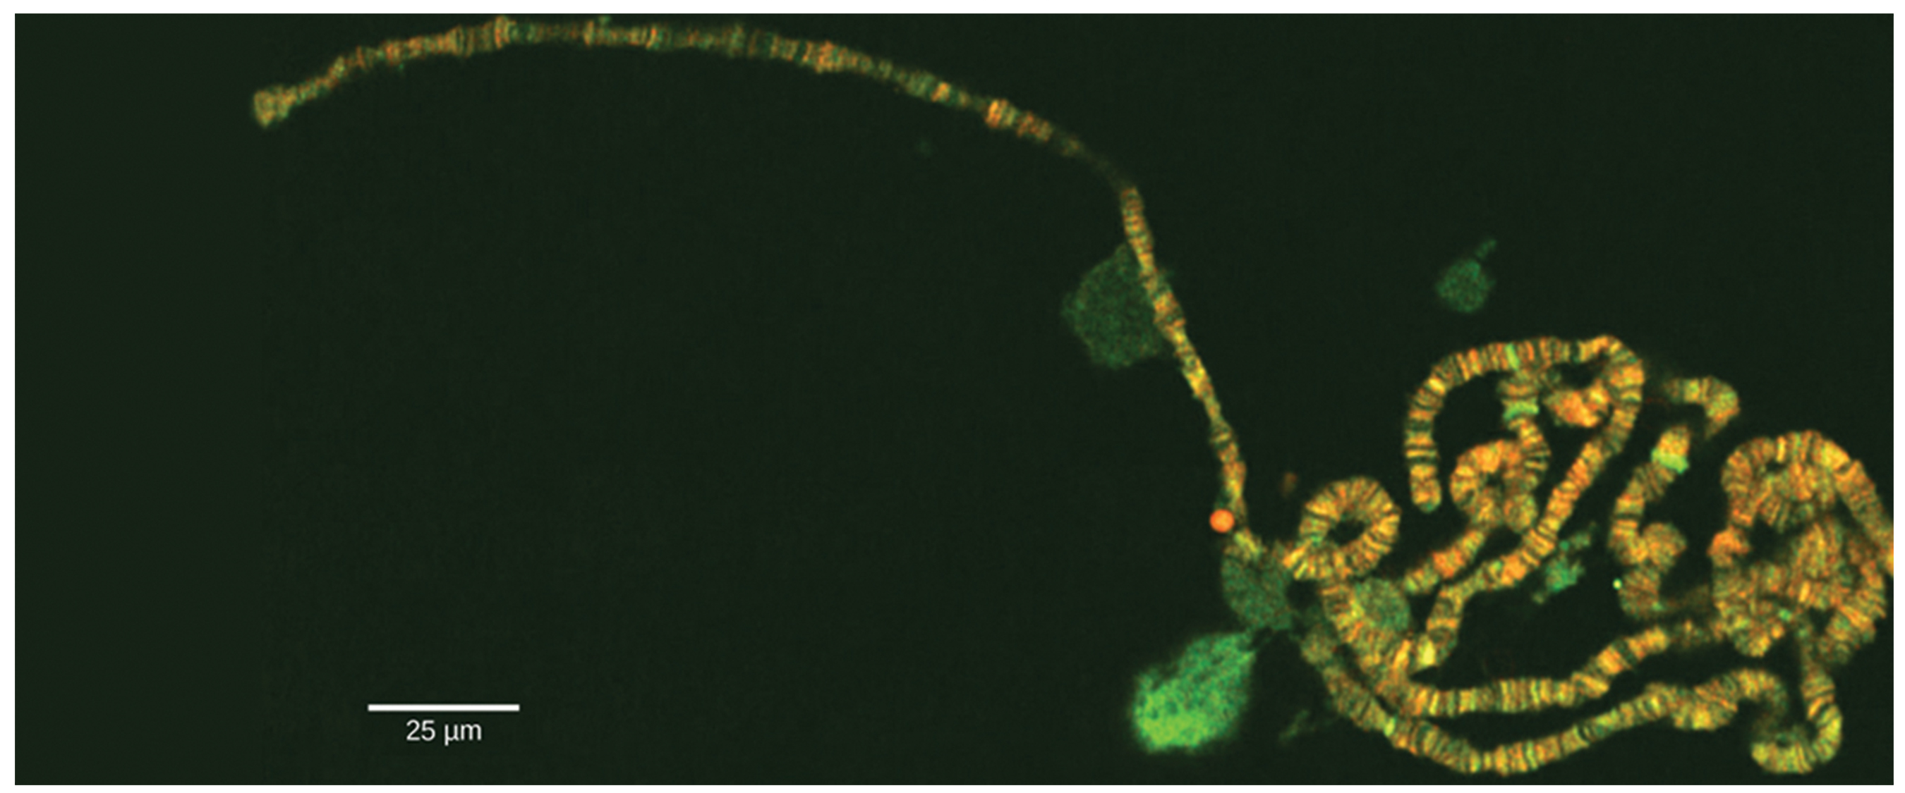
Modern Genetics and Inheritance
Gene:
  Physical unit of inheritance
  Arranged in a linear order on chromosomes
Chromosome behavior and interaction during meiosis explain inheritance patterns
Genetic disorders involve alterations in chromosome number or structure
13.1 Figure 1: Chromosomes are threadlike nuclear structures consisting of DNA and proteins that serve as the repositories for genetic information.
LPLT on Wikimedia Commons; scale-bar data from Matt Russell. "Chromosomes."

Slide 4
Chromosomal Theory and Genetic Linkage
Study of heredity began in 1843 by Gregor Mendel
Improved microscopic techniques in late 1800s allowed visualization of chromosomes and observations of cell division and meiosis
Chromosomes replicate, condense (from amorphous shape into X-shaped bodies), and migrate to separate poles during cell division

Slide 5
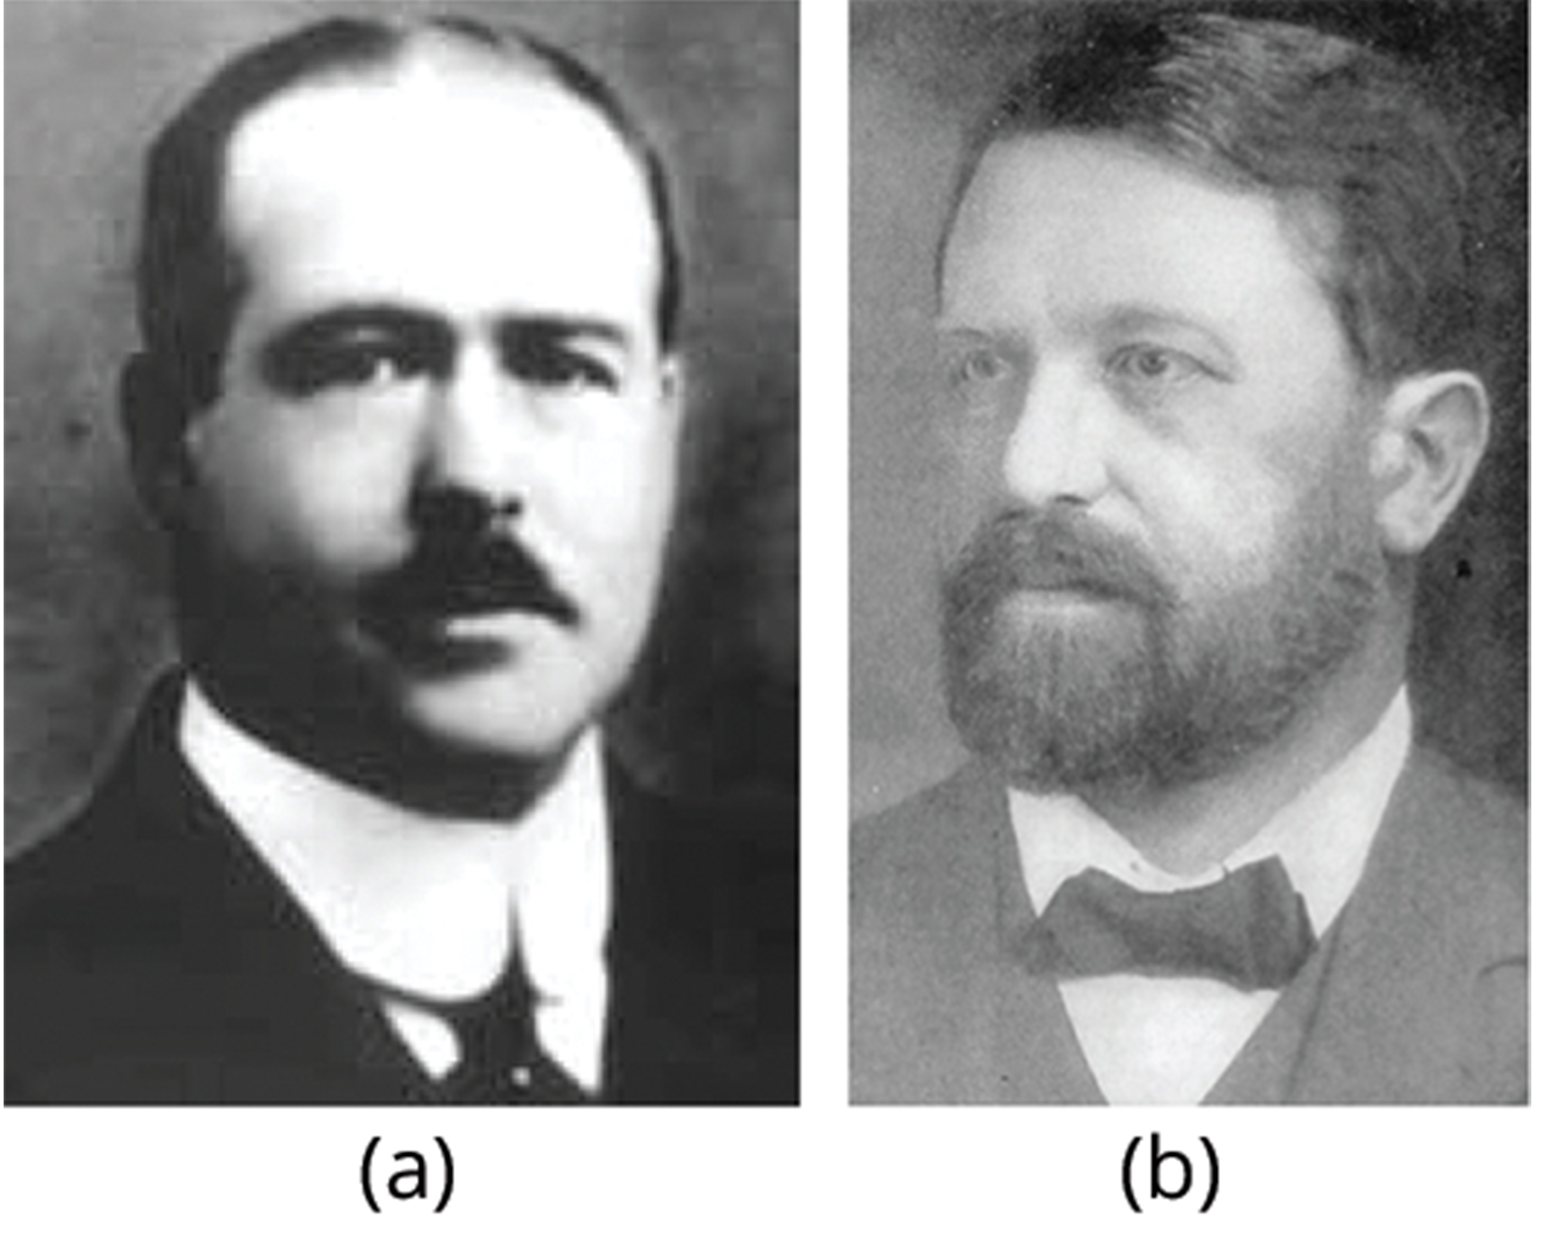
Chromosomal Theory of Inheritance₁
Theodor Boveri (1902) observed that sea urchin embryonic development does not occur unless chromosomes are present.
Walter Sutton (1902) observed chromosome separation into daughter cells during meiosis.
These observations led to Chromosomal Theory of Inheritance.
  Chromosomal Theory of Inheritance: theory proposing that chromosomes are the genes' vehicles and that their behavior during meiosis is the physical basis of the inheritance patterns that Mendel observed
13.1 Figure 2: (a) Walter Sutton and (b) Theodor Boveri
CNX OpenStax on Wikimedia Commons. "Walter Sutton."

Slide 6
Chromosomal Theory of Inheritance₂
Consistent with Mendel's laws
Observations supporting the theory:
  Homologous chromosome pairs migrate independently during meiosis
  Chromosome sorting from each homologous pair into pre-gametes appears random
  Gametes contain half total number of chromosomes
  Male and female gametes have same number of chromosomes
  Gametic chromosomes combine during fertilization

Slide 7
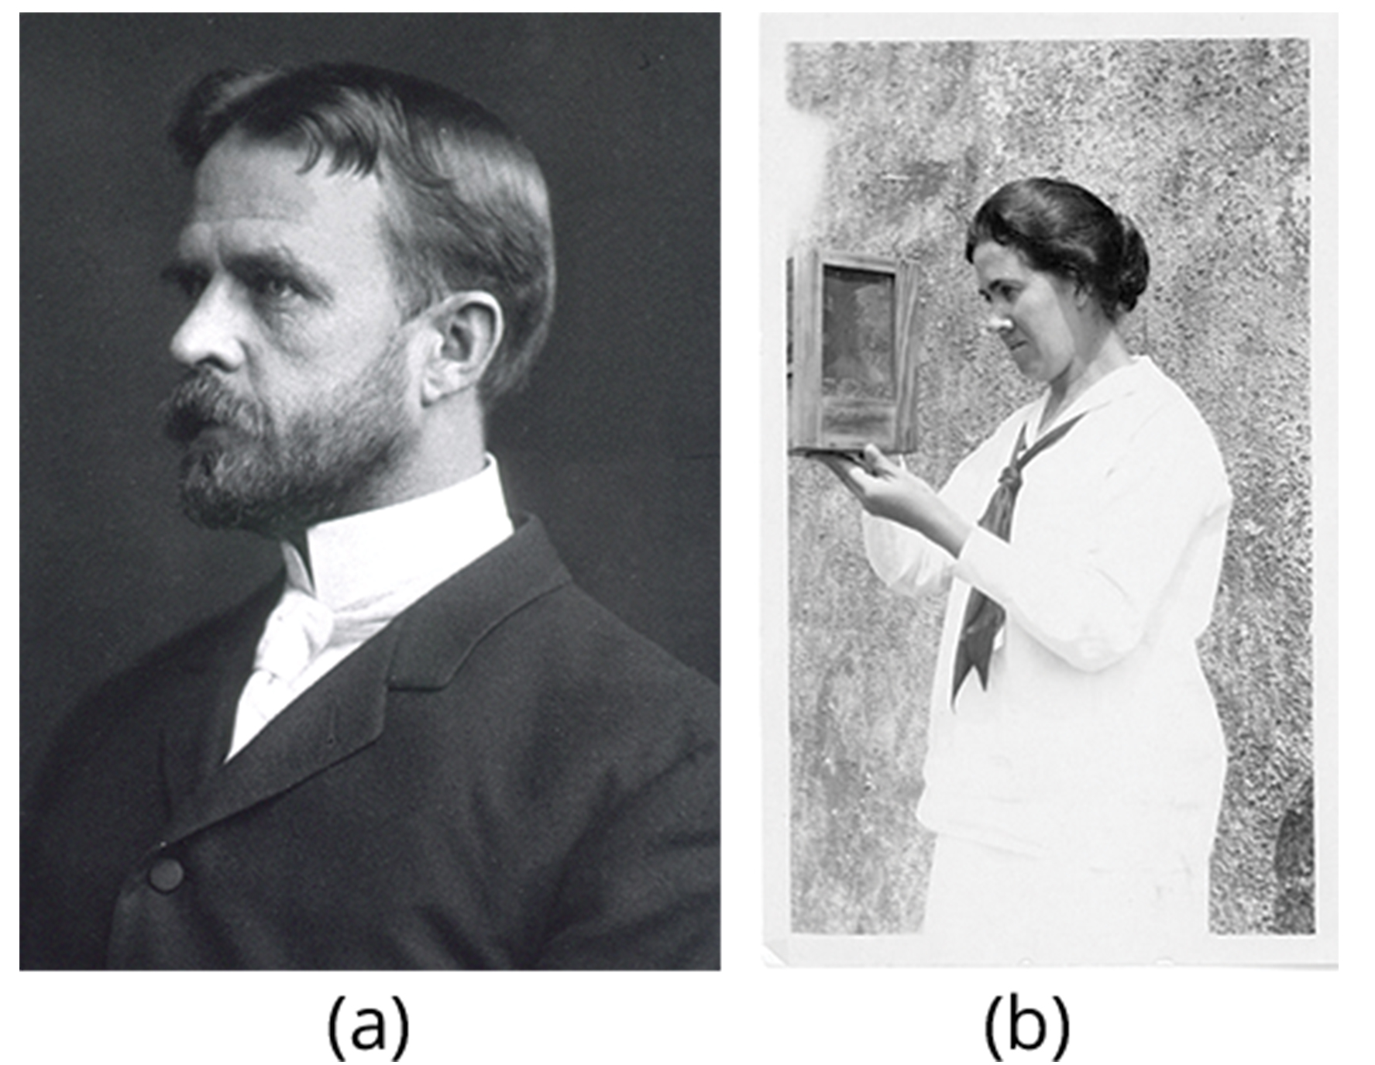
Chromosomal Theory of Inheritance₃
Correlation between chromosome behavior during meiosis and Mendel's abstract laws led to Chromosomal Theory of Inheritance
Critics pointed out that individuals had more traits than chromosomes
Eleanor Carothers discovered physical evidence supporting theory with independent assortment in grasshoppers
Thomas Hunt Morgan provided experimental evidence to support theory through crosses of Drosophila melanogaster
13.1 Figure 3: (a) Thomas Hunt Morgan and (b) Eleanor Carothers
Unknown Author on Wikimedia Commons. "Thomas Hunt Morgan."
Smithsonian Institution on Wikimedia Commons. "Estrella Eleanor Carothers."

Slide 8
Genetic Linkage and Distances
Mendel suggested traits are inherited independently
Morgan showed certain traits were carried by X chromosome, suggesting random chromosome segregation was physical basis of Mendel's model
  Demonstrated linked genes (genes on the same chromosome) disrupted Mendel's predicted outcomes
    Also why individuals can have more traits than chromosomes
  Alleles on the same chromosome can become unlinked during meiosis

Slide 9
Homologous Recombination₁
Frans Janssen (1909) observed chiasmata (the point at which chromatids are in contact with each other and may exchange segments) prior to first meiosis division
  Suggested that alleles on the same chromosome may become unlinked when chromosomes exchange segments
  As chromosomes condense and paired with homologs (synapsis), they interact at distinct points
    Janssen suggested these points correspond to region where chromosome segments are exchanged
    Homologous recombination: process by which homologous chromosomes undergo reciprocal physical exchanges at their arms (also, crossing over)

Slide 10
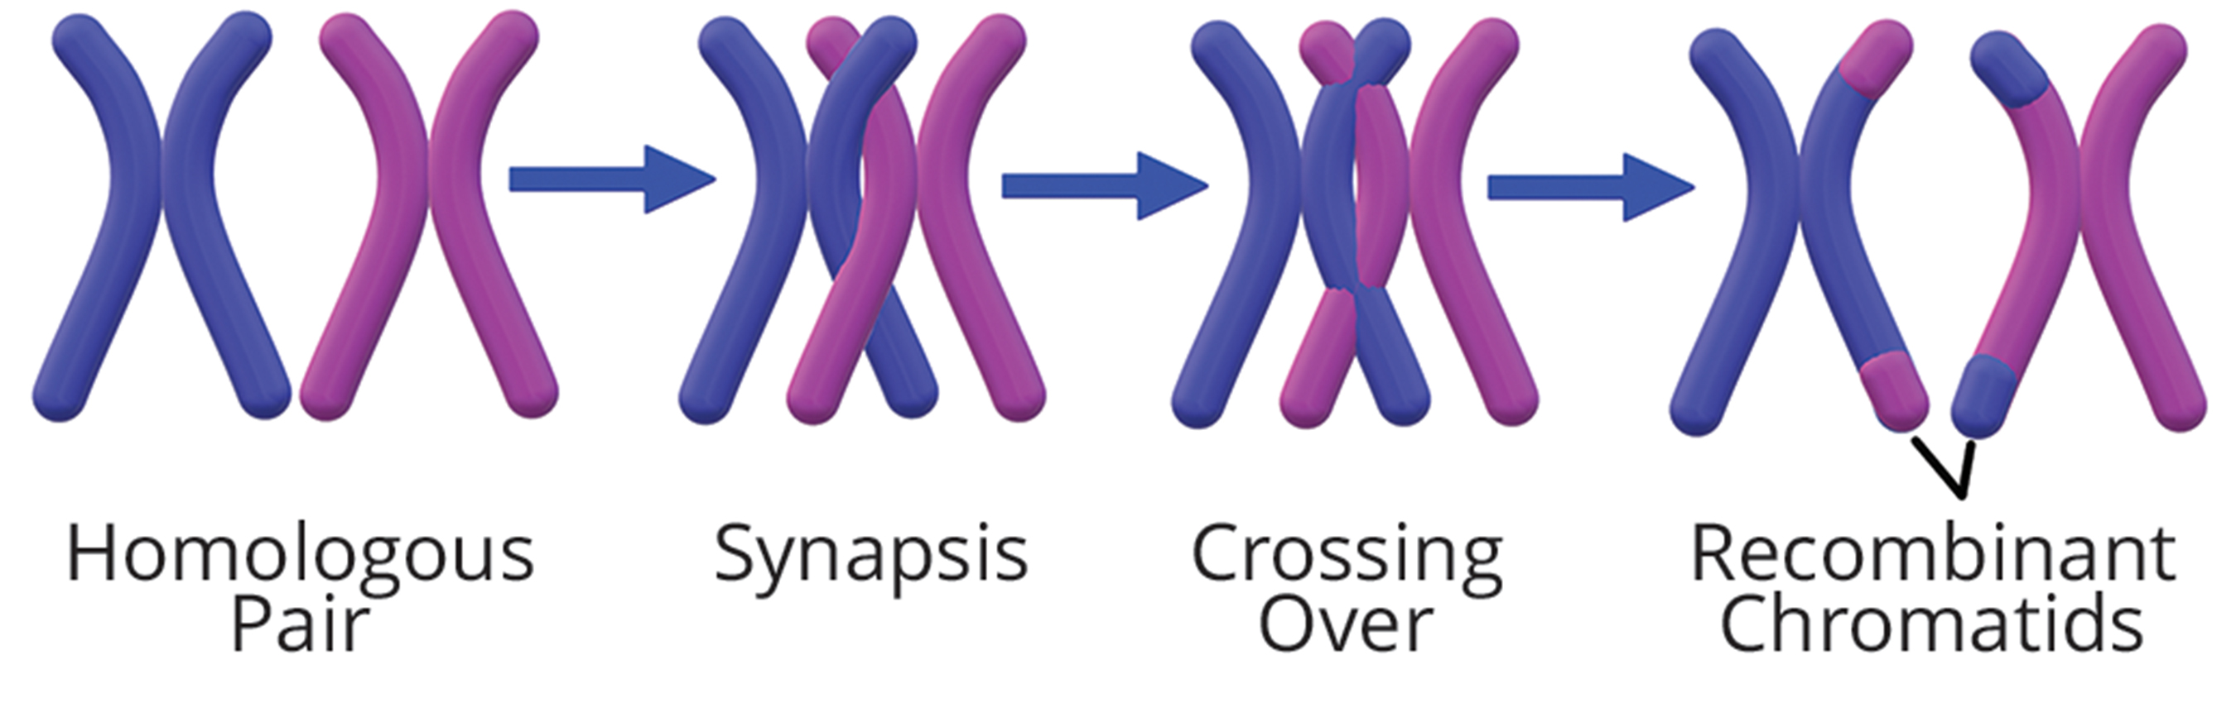
13.1 Figure 4
Christinelmiller on Wikimedia Commons. "Chromosome recombination."
Notes:
Figure 4: Shown is the process of homologous chromosomes undergoing recombination. Homologous recombination creates genetic diversity within populations and is a critical force in evolution.

Slide 11
Homologous Recombination₂
Example:
  Heterozygous inherited dominant maternal alleles for two genes on same chromosome (AB) and two recessive paternal alleles for same genes (ab)
    If genes are linked, expect either AB or ab with 1:1 ratio
    If genes are unlinked, expect AB, Ab, aB, and ab with equal frequencies (independent assortment)
      New allele combinations (Ab and aB) are nonparental types
        Nonparental (recombinant) type: progeny resulting from homologous recombination that exhibits a different allele combination compared with its parents
      Same allele combinations as parents (AB or ab) are parental types
        Parental type: progeny that exhibits the same allelic combination as its parents

Slide 12
Homologous Recombination₃
Morgan and colleagues found when test crossing heterozygotes with homozygous recessive parent (AaBb x aabb) offspring had either same genotypes as parents or new genotype combinations
  Suggested that while genes were linked, recombination occurred to produce new combinations

Slide 13
Think It Through₁
In a test cross for two characteristics, such as the one shown in Figure 5, can the predicted frequency of recombinant offspring be 60%? Why or why not?
Notes:
Originally an On Your Own. This is included here to use as a talking point or for a think-pair-share activity.

Slide 14
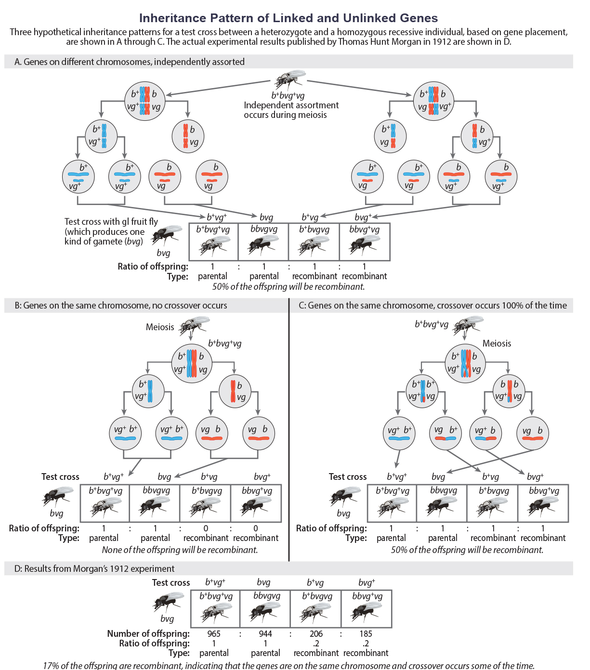
Think It Through₂
13.1 Figure 5: This figure shows possible inheritance patterns for unlinked and linked genes. In (A), two genes are located on different chromosomes, so independent assortment occurs during meiosis. The offspring have an equal chance of being the parental type (inheriting the same combination of traits as the parents) or a nonparental type (inheriting a different combination of traits than the parents). In (B), two genes are very close together on the same chromosome, so no crossing over occurs between them. Therefore, the genes are always inherited together, and all the offspring are the parental type. In (C), two genes are far apart on the chromosome such that crossing over occurs during every meiotic event. The recombination frequency will be the same as if the genes were on separate chromosomes. (D) The actual recombination frequency of fruit fly wing shape and body color that Thomas Morgan observed in 1912 was 17%. A crossover frequency between 0% and 50% indicates that the genes are on the same chromosome and crossover sometimes occurs.
OpenStax. "Linked gene inheritance pattern."
Notes:
Originally an On Your Own. This is included here to use as a talking point or for a think-pair-share activity.

Slide 15
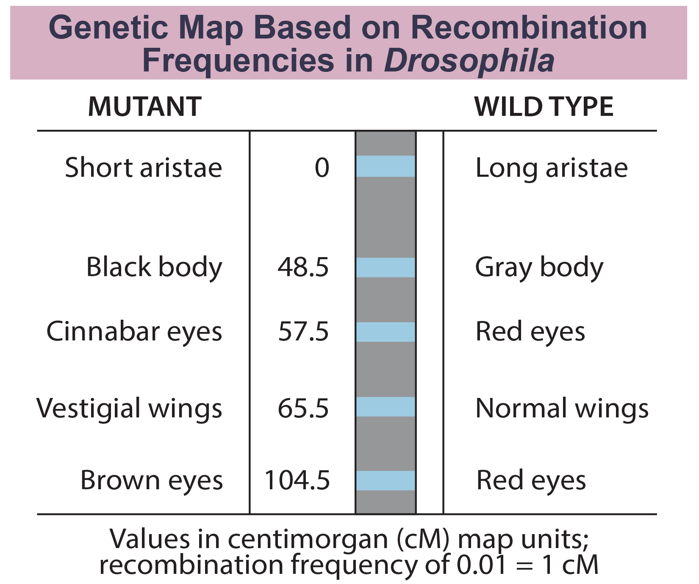
Genetic Maps₁
Alfred Sturtevant (1913), student of Morgan, created the first chromosome map (linear representation of gene order and relative distance on a chromosome)
13.1 Figure 6
OpenStax. "Genetic map of Drosophila."

Slide 16
Genetic Maps₂
Recombination frequency to predict genetic distance; can infer relative gene order on a chromosome
Values represent map distances in units of centimorgan (cM)
  Centimorgan (cM): relative distance that corresponds to a 0.01 recombination frequency (also, map unit)
  Correspond to recombination frequency in percent
Sturtevant predicted that alleles that were far apart were more likely to recombine during meiosis because there was a longer length over which recombination events could occur
Average number of crossovers between two alleles (recombination frequency) correlated with genetic distance from each other
  Recombination frequency: average number of crossovers between two alleles; observed as the number of nonparental types in a progeny's population

Slide 17
Genetic Maps₃
Example: Cross between AaBb and aabb
  Likelihood of crossover between genes A/a and B/b was 0.05 (recombination frequency) or 5%
    Indicates genes were definitively linked but far enough for crossover to occur occasionally
Perfectly linked (recombination frequency = 0), where alleles are always inherited together
Perfectly unlinked (recombination frequency = 0.5), where alleles are never inherited together
  Exhibit the behavior of independent assortment
  0.5 recombination frequency indicates 50% of offspring are recombinants and 50% are parental types
  Genetic distances become inaccurate at this frequency because it is unclear if genes are far apart or on different chromosomes

Slide 18
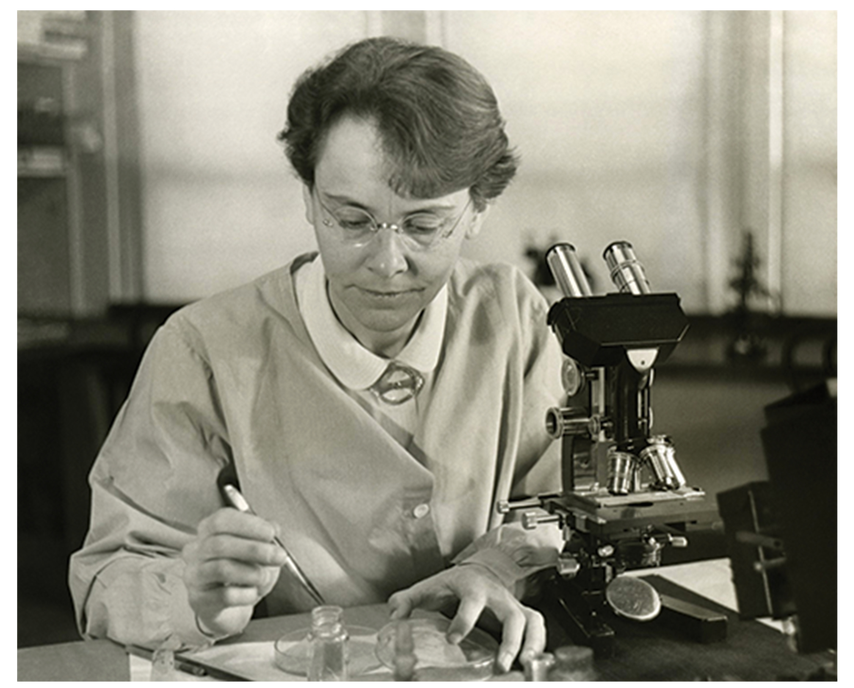
Genetic Maps₄
Barbara McClintock and Harriet Creighton demonstrated crossover of homologous chromosomes in corn plants
Curt Stern demonstrated microscopically homologous recombination in Drosophila
  Observed several X-linked phenotypes associated with structurally unusual and dissimilar X chromosome pair
  Demonstrated that every time offspring allele combination deviated from parental combinations, there was corresponding exchange of an X chromosome segment
Aurora Ruiz-Herrera studies occurrences of genetic breakpoints at locations in chromosomes known as fragile sites
13.1 Figure 7: Barbara McClintock
Smithsonian Institution on Wikimedia Commons. "Barbara McClintock."

Slide 19
Mendel's Mapped Traits
Mendel never observed homologous recombination
Researchers confirmed that traits Mendel studied were sufficiently far apart or on separate chromosomes (statistically unlinked)
Mendel consistently observed independent assortment due to unlinked genes

Slide 20
Summary
Chromosomal Theory of Inheritance states that chromosomes are the vehicles of genetic inheritance
  Mendelian genetics and gene linkage not perfectly accurate
Chromosome behavior involves segregation, independent assortment, and occasionally linkage
Alfred Sturtevant developed method to map the relative positions and distances between linked genes on a chromosome based on observed recombination frequencies
  Correctly assumed genes are arranged linearly on chromosomes and that recombination between homologous chromosomes can occur anywhere on the chromosome with equal likelihood
Linkage causes alleles on the same chromosome to be inherited together
Homologous recombination introduces more independent inheritance patterns

Slide 21


End of Hawkes Learning PowerPoint

