Slide 1
Lesson 13.2
Chromosomal Basis for Inheritance

Slide 2
Objectives
Compare disorders that aneuploidy causes.
Describe how a karyogram is created.
Describe how errors in chromosome structure occur through inversions and translocations.
Explain how nondisjunction leads to disorders in chromosome number.

Slide 3
Chromosomal Basis for Inheritance
Abnormalities during meiosis cause inherited disorders
Two categories: abnormalities in chromosome number and abnormalities in chromosomal structural rearrangements
Can have multiple effects on individual's traits and can be fatal

Slide 4
Chromosome Identification
Cytogenetics: the study of how chromosomes relate to cell behavior
How clinicians detect chromosomal abnormalities
Karyotype: an individual's chromosome number and appearance; includes the size, banding patterns, and centromere position
Karyogram: a karyotype's photographic image
Each autosome organized in order of size from largest to smallest
Autosome: any of the nonsex chromosomes
X and Y chromosomes not autosomes
Exception to size rule: chromosome 21
"Arms" coming out of the centromere designated long or short
Short arm: p (for "petite")
Long arm: q (follows "p" alphabetically)
Additional numbered subdivisions
Example: 14q21 (position 21 on long arm of chromosome 14)

Slide 5
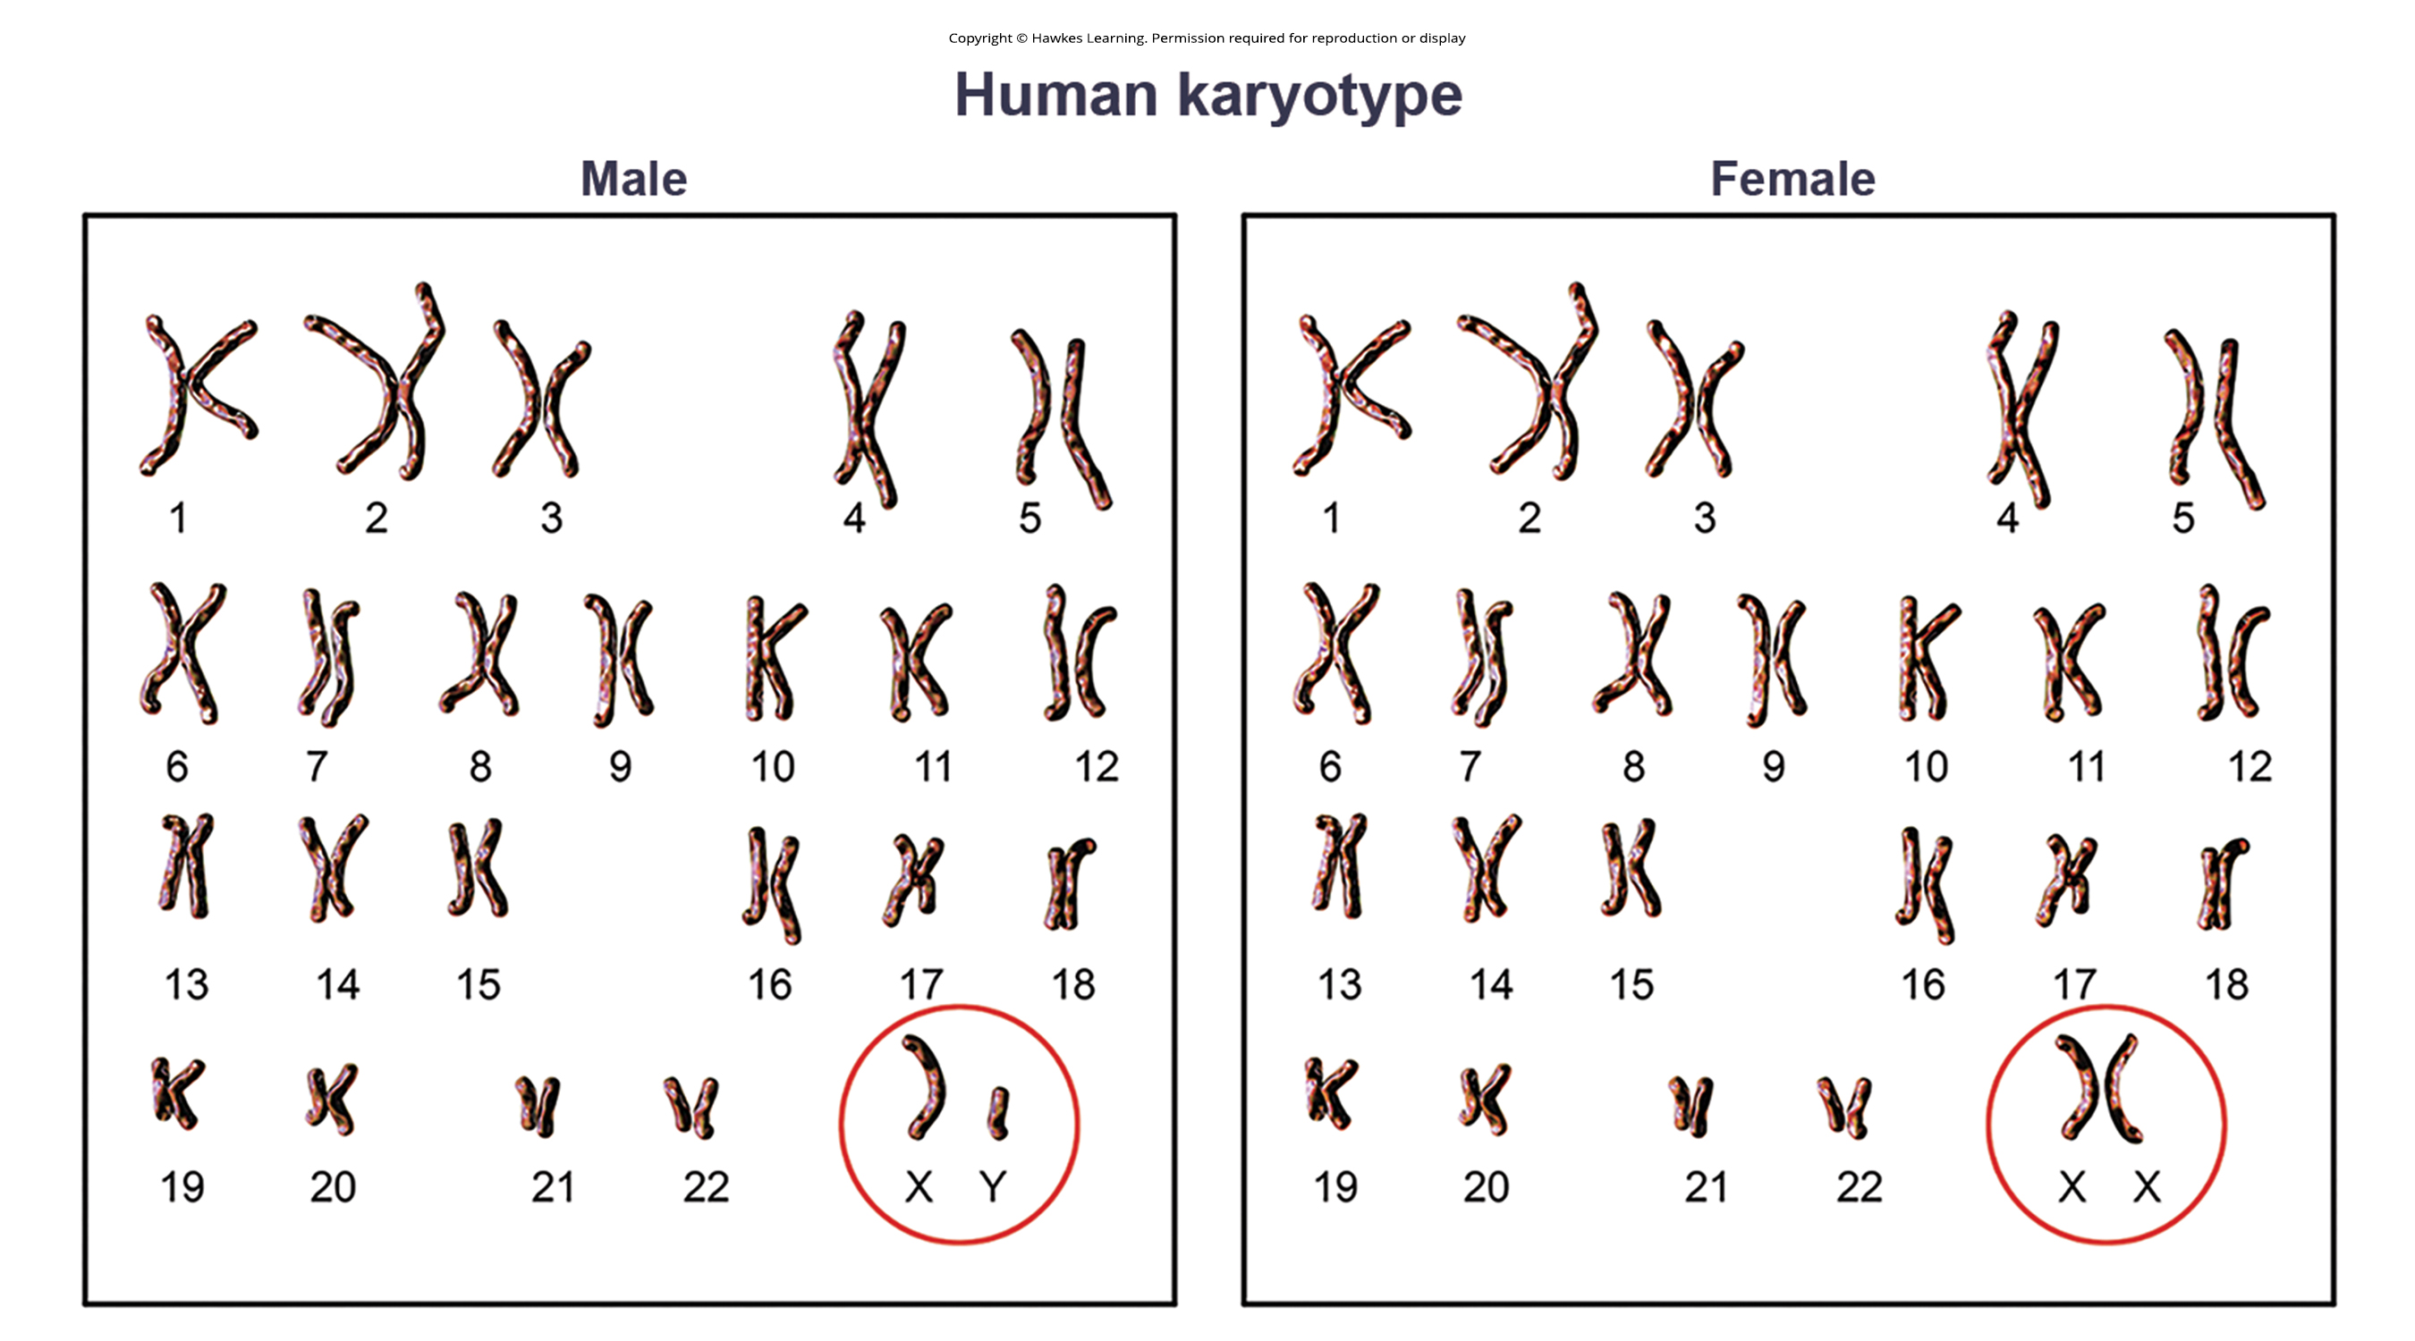
13.2 Figure 1
Notes:
Figure 1: These are karyotypes of a chromosomally male and female human. Notice that homologous chromosomes are the same size and have the same centromere positions and banding patterns. A human who is chromosomally male would have an XY chromosome pair instead of the XX pair found in females. Other animals may have a different number of chromosomes.

Slide 6
Science and You₁
Geneticists Use Karyograms to Identify Chromosomal Aberrations
Karyotyping is a powerful technique to identify chromosomal abnormalities from a single cell sample.
It involves stimulating cell division, arresting metaphase, staining chromosomes, and microscopic visualization.
Chromosomes are identified by banding patterns, size, and centromere position, then arranged by number and size.
Karyotyping can reveal genetic abnormalities like Down syndrome (third copy of chromosome 21) and Turner syndrome (only one X chromosome in females instead of two).
It also detects large chromosomal deletions or insertions.
It can pinpoint translocations.
Translocation: process by which one chromosome segment dissociates and reattaches to a different, nonhomologous chromosome
Notes:
This is included as a relevant application for this topic.

Slide 7
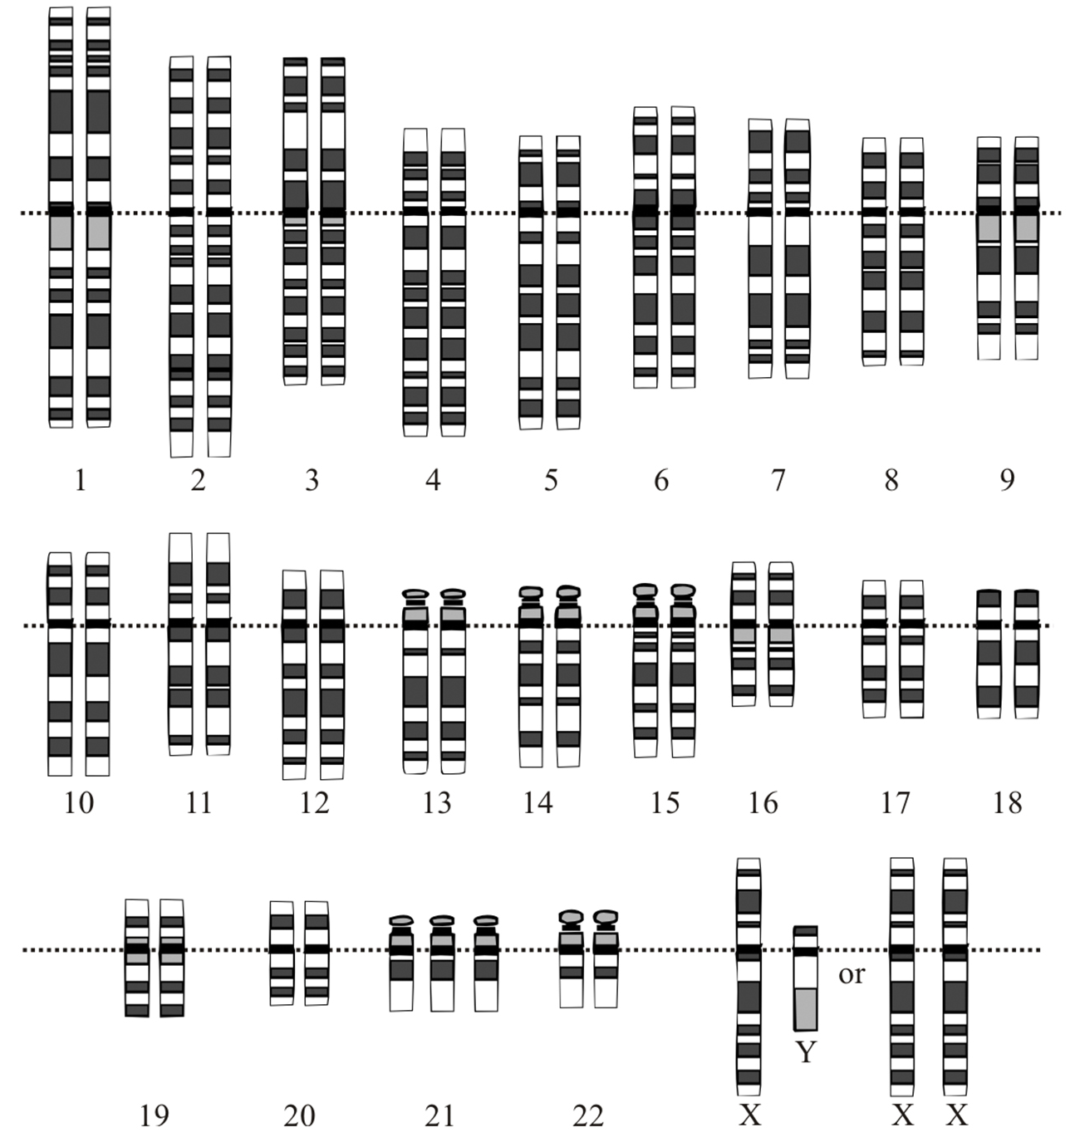
Science and You₂
13.2 Figure 2: The karyotype of an individual with Down syndrome (trisomy 21) is the presence of an extra copy of chromosome 21.
National Human Genome Research Institute on Wikimedia Commons. "Down Syndrome karyotype."
Notes:
This is included as a relevant application for this topic.

Slide 8
Chromosome Number Disorders
Include duplicating or losing entire chromosomes and changes in number of complete chromosome sets
Caused by nondisjunction
Nondisjunction: failure of synapsed homologs to completely separate and migrate to separate poles during the meiosis' first cell division
Caused by misaligned or incomplete synapsis or dysfunction of the spindle apparatus
Risk increases with parents' age
Can occur in meiosis I or II with different results
In meiosis I, result is two gametes that lack that chromosome and two gametes with two chromosome copies
In meiosis II, result is one gamete that lacks that chromosome, two normal gametes with one chromosome copy, and one gamete with two chromosome copies

Slide 9
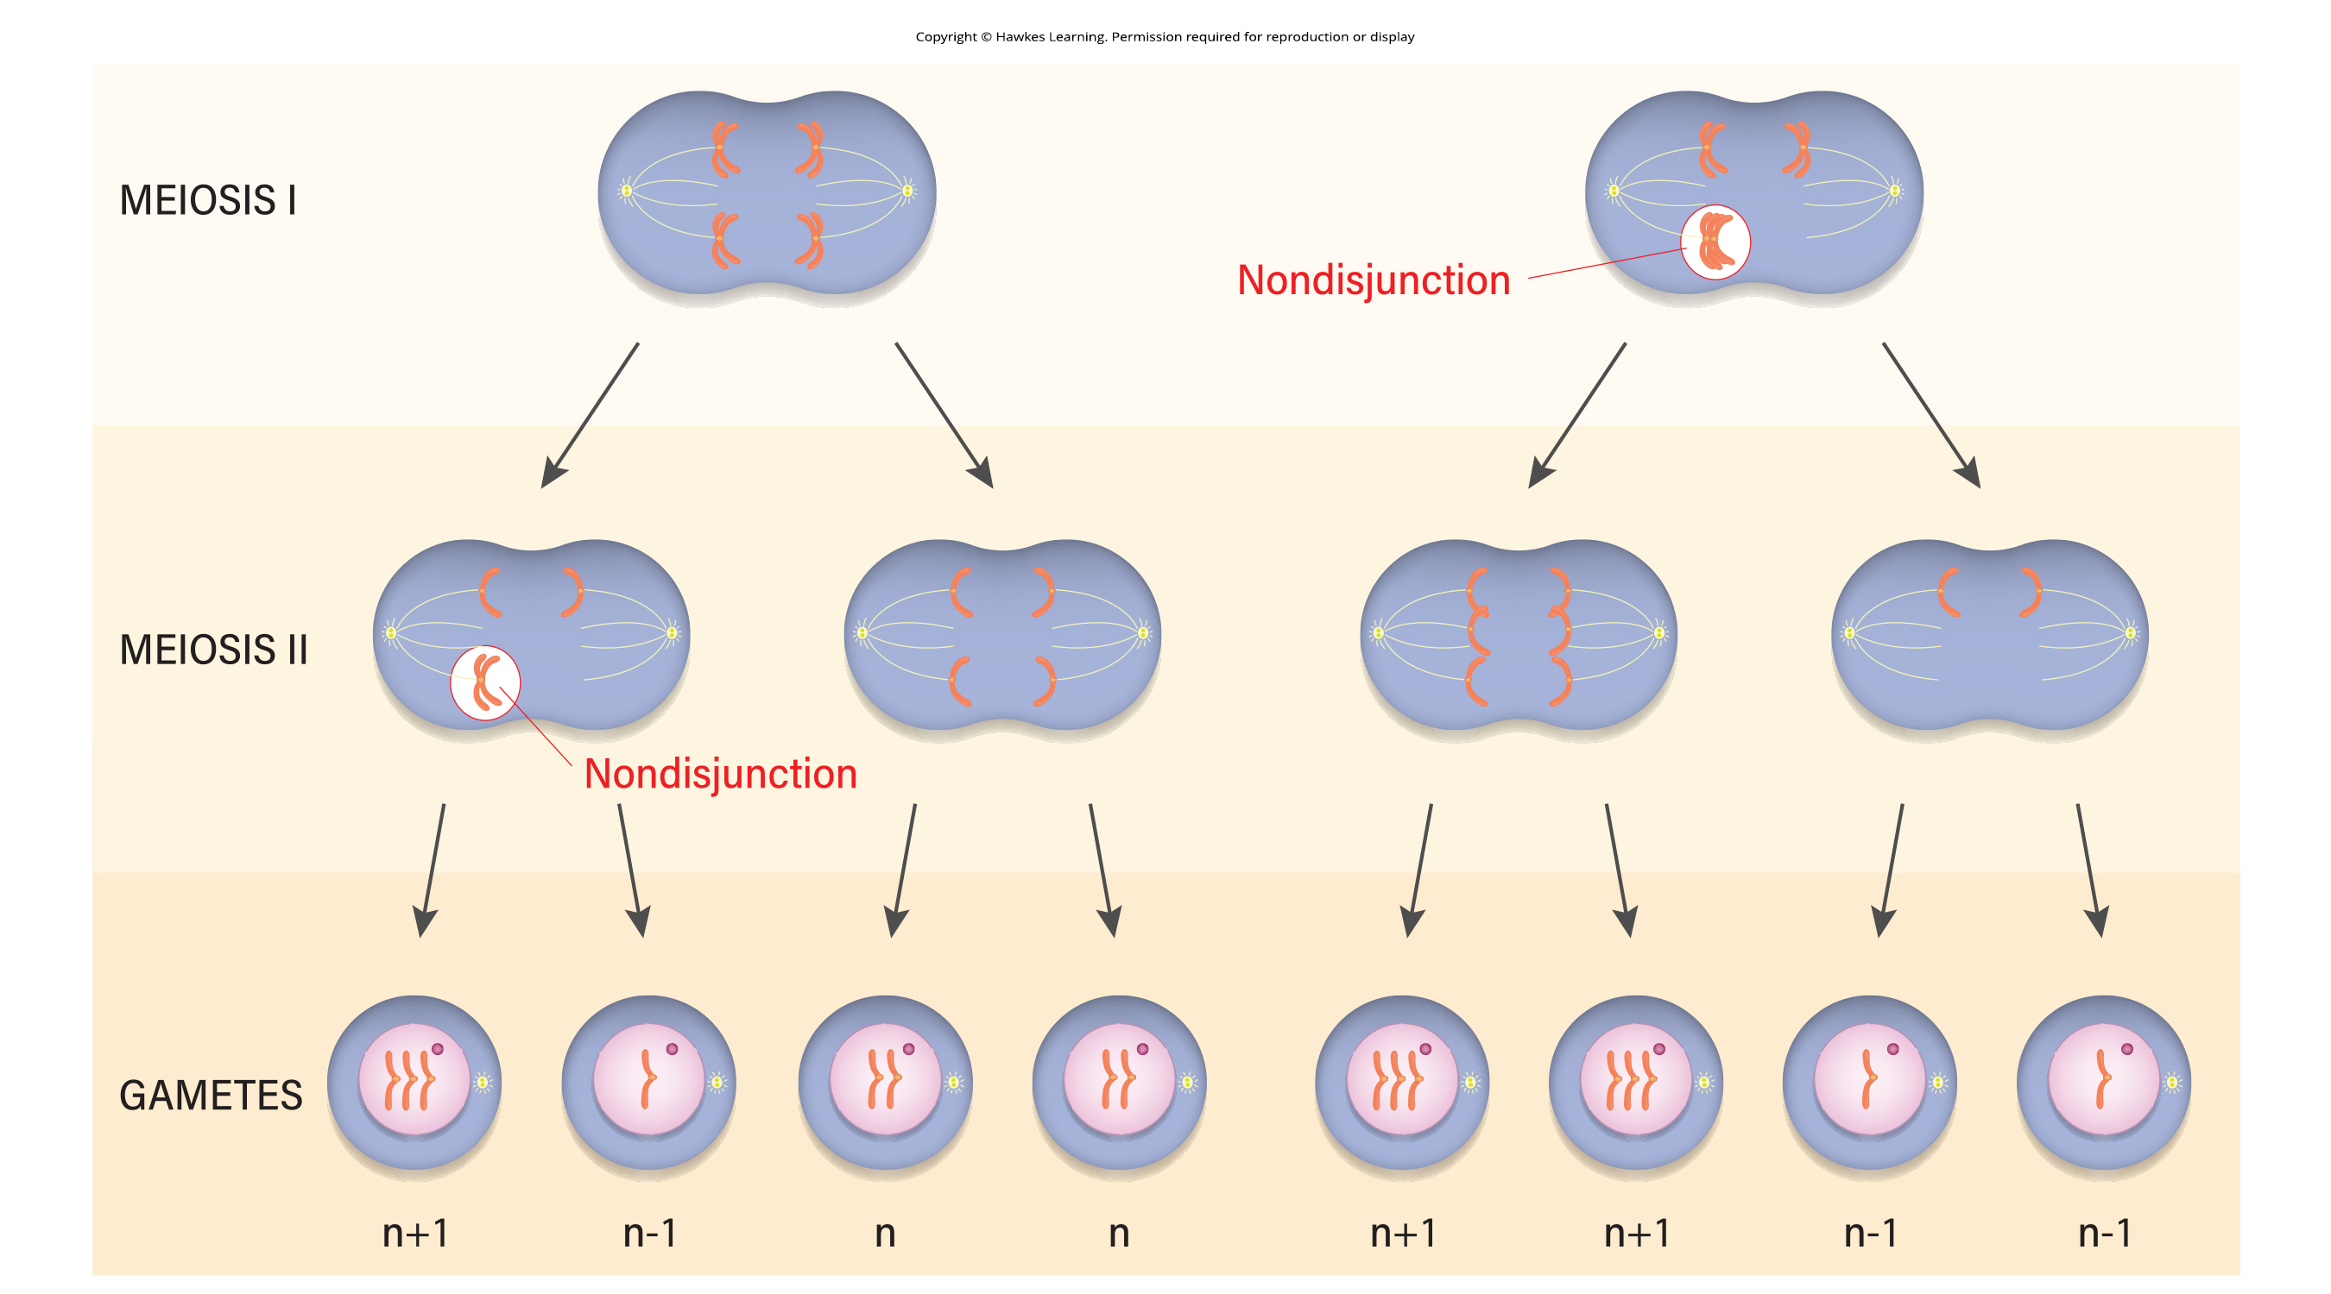
13.2 Figure 3
Notes:
Figure 3: Nondisjunction occurs when homologous chromosomes or sister chromatids fail to separate during meiosis, resulting in an abnormal chromosome number. Nondisjunction may occur during meiosis I or meiosis II.

Slide 10
Aneuploidy₁
Euploid: individual with the appropriate number of chromosomes for their species
Aneuploid: individual with an error in chromosome number; includes chromosome segment deletions and duplications
Monosomy: otherwise diploid genotype in which one chromosome is missing
Usually lethal due to missing essential genes
Trisomy: otherwise diploid genotype in which one entire chromosome duplicates
Sometime lethal, though duplications of smaller chromosomes (13, 15, 18, 21, or 22) can be survivable for several weeks to many years

Slide 11
Aneuploidy₂
Trisomy results from excess in gene dose
Can lead to several functional challenges and often disrupts development
Most common viable trisomy is trisomy 21 (Down syndrome)
Characteristics include short stature, stunted digits, broad skull, large tongue, developmental delays, early-onset Alzheimer's pathology (disease state)
Risk increases with maternal age

Slide 12
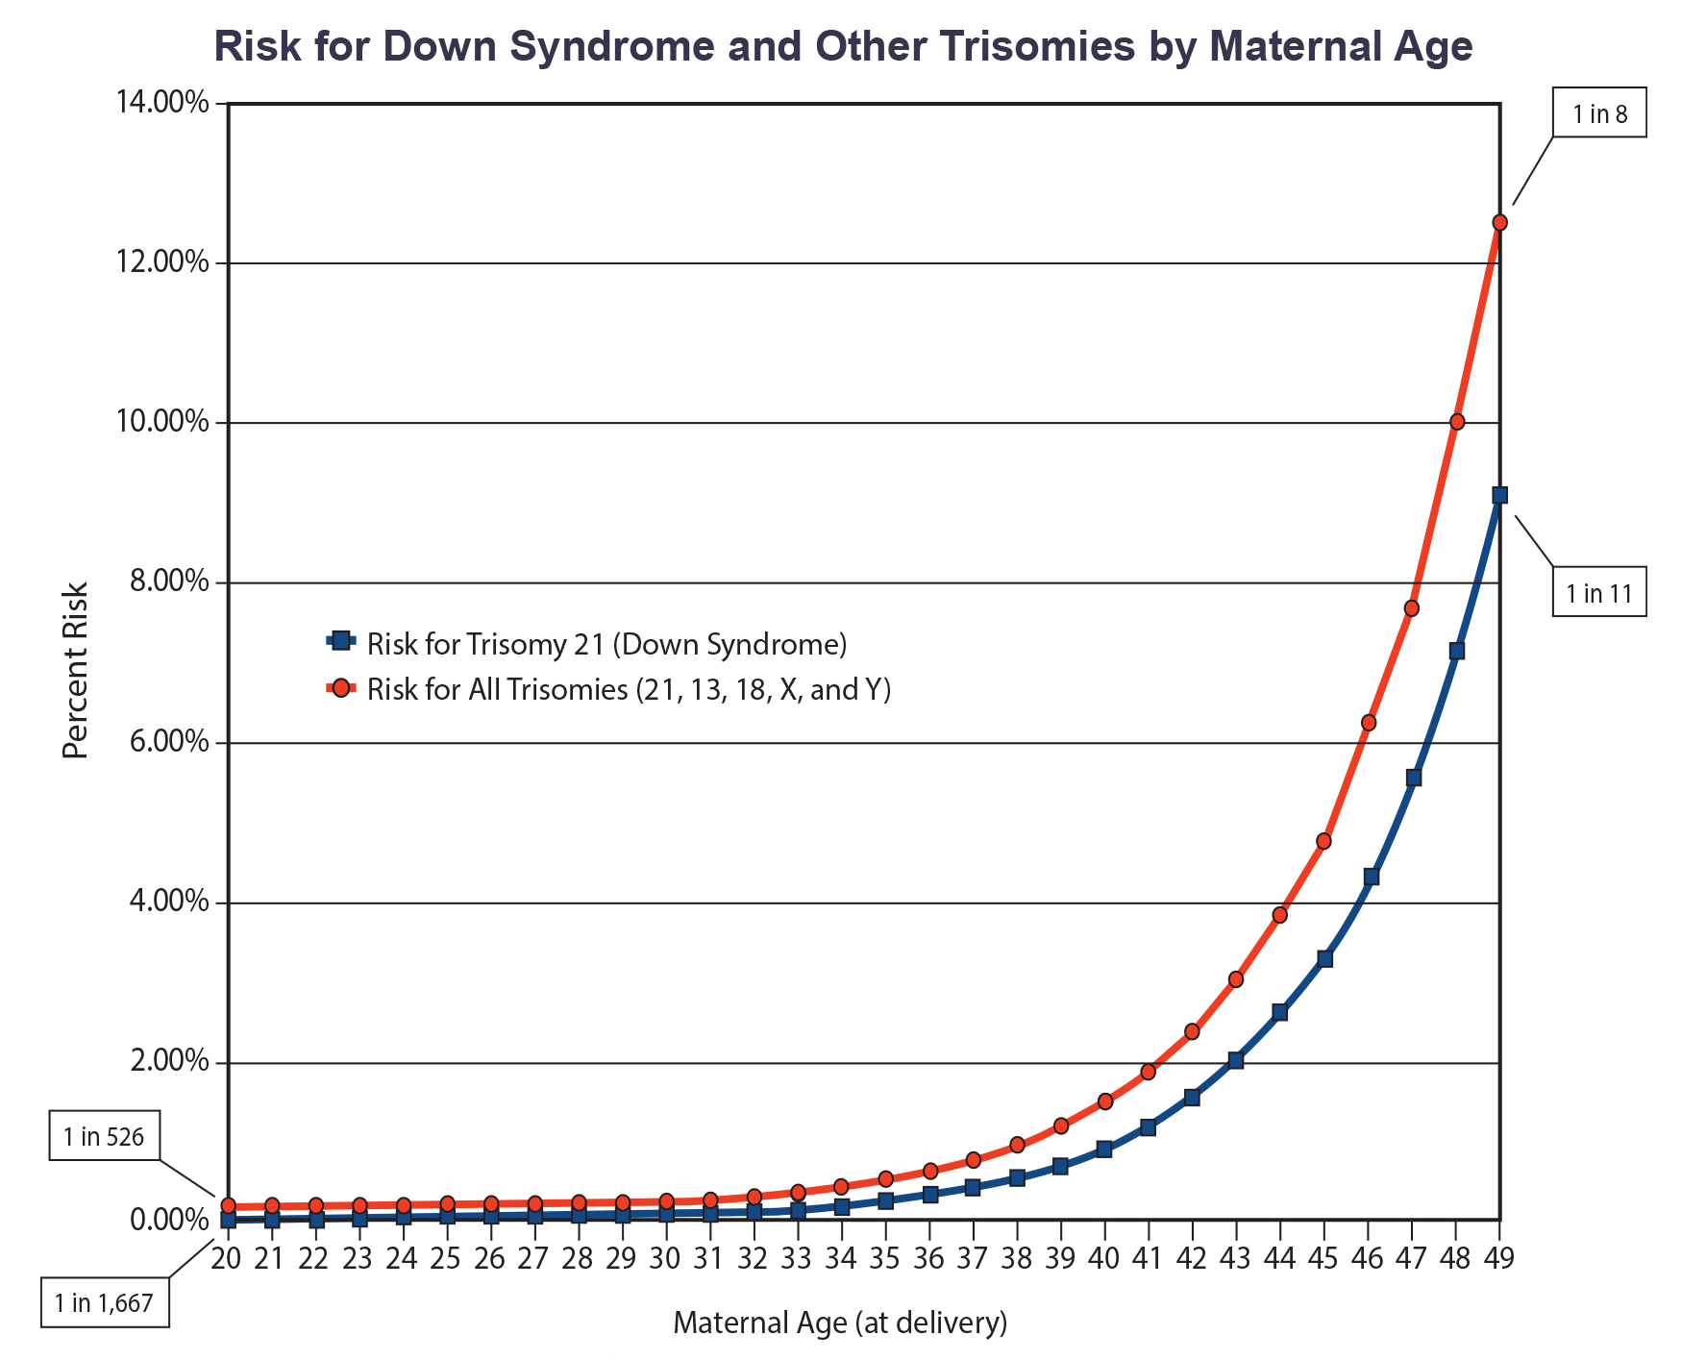
13.2 Figure 4
Tdadamemd on Wikimedia Commons. "Down Syndrome risk by age."
Notes:
Figure 4: The incidence of having a fetus with trisomy 21 (Down syndrome), 13, 28, X, and Y increases dramatically with maternal age.

Slide 13

Polyploidy
Polyploid: individual with an incorrect number of chromosome sets
Example: Fertilizing an abnormal diploid egg with a normal haploid sperm yields triploid zygote
Rare (some in flatworms, crustaceans, amphibians, fish, and lizards) and sterile (meiosis cannot proceed normally, producing aneuploid daughter cells)
Some can reproduce asexually by haplodiploidy (unfertilized egg divides mitotically)
Common in plants and tend to be larger and more robust than euploids
13.2 Figure 5: As with many polyploid plants, this triploid orange daylily (Hemerocallis fulva) is particularly large and robust and grows flowers with triple the number of petals, compared to its diploid counterparts.
CC-BY-2.5 on Wikimedia Commons. "Orange day lily."

Slide 14
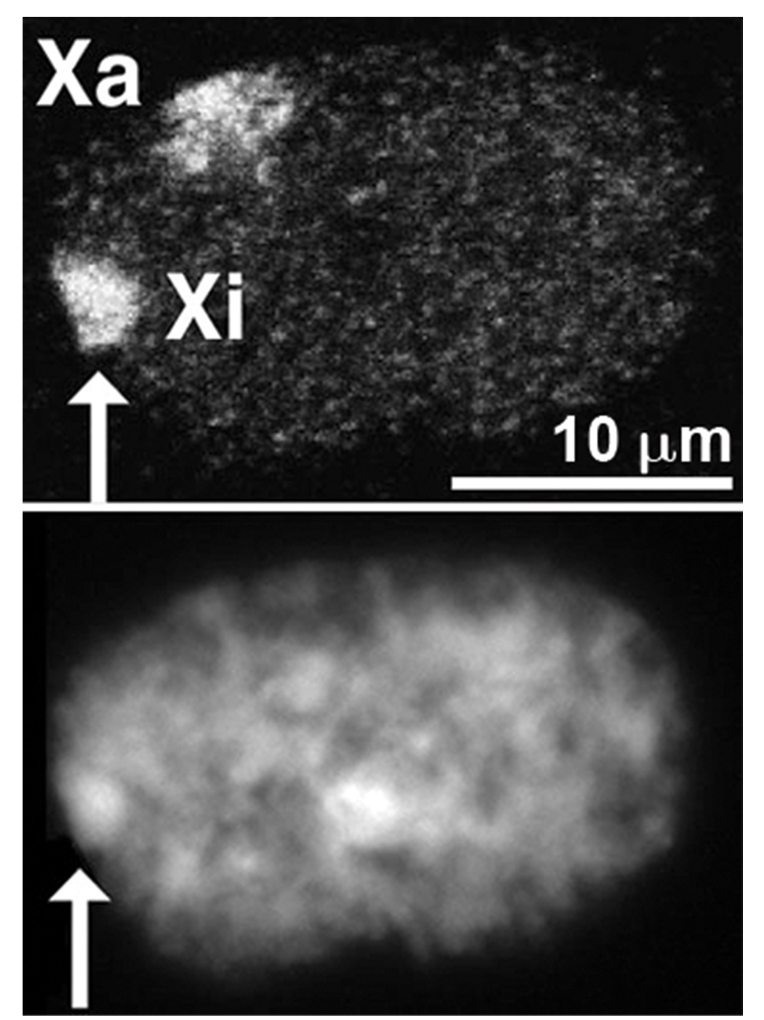
Sex Chromosome Nondisjunction₁
X inactivation: condensing X chromosomes into Barr bodies during embryonic development in females to compensate for the double genetic dose
Allows normal function despite different numbers of X chromosome
One X chromosome randomly inactivates into Barr bodies (quiescent, dormant structure) in female embryos
13.2 Figure 6: In this nucleus of a female cell, the inactive X chromosome (Xi, indicated by the arrow) is condensed into a Barr body. The active X chromosome (Xa) is not condensed.
Steffen Dietzel on Wikimedia Commons. "Nucleus of a female amniotic fluid cell."

Slide 15

Sex Chromosome Nondisjunction₂
X inactivation in color variegation in tortoiseshell cats
Heterozygotes for X-linked coat color gene express one of two different colors over different regions of the body
X chromosomes reactivate for maturation of female ovaries
Abnormal X numbers result in mild defects and infertility
If absent altogether, development ceases
13.2 Figure 7
Ivanhercaz on Wikimedia Commons. "Calico cat."

Slide 16
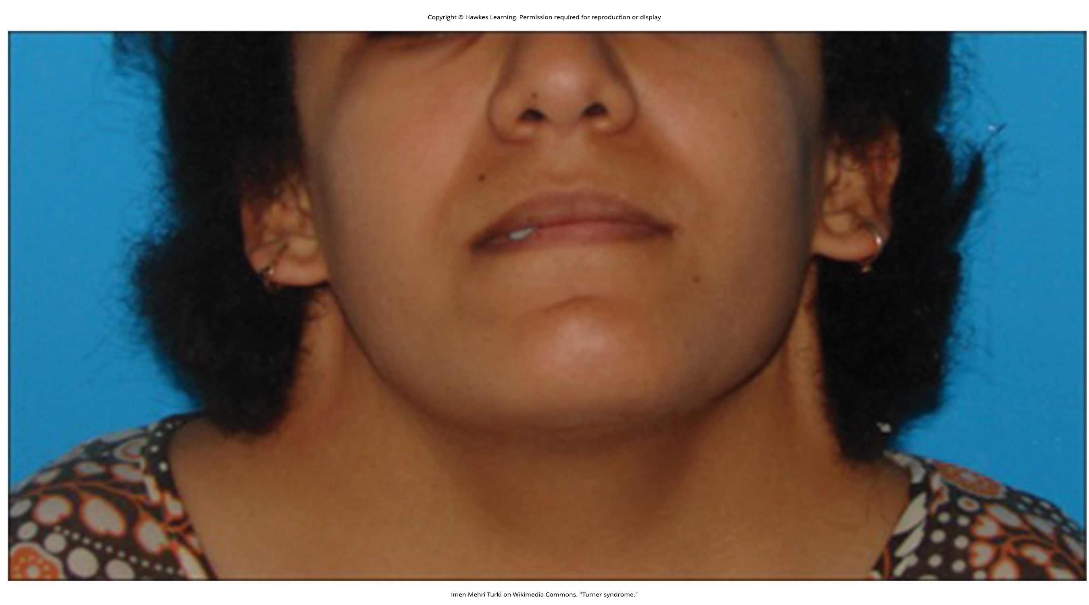
Sex Chromosome Nondisjunction₃
Sex chromosome disorders
Triplo-X (XXX): Phenotypical female expresses developmental delays and reduced fertility
Klinefelter syndrome (XXY): Phenotypical male expresses small testes, enlarged breasts, and reduced body hair; can have as many as five X chromosomes
Turner syndrome (X0): Only single X chromosome; phenotypical female expresses short stature, webbed neck, hearing and cardiac impairments, and sterility
13.2 Figure 8: Turner syndrome is the result of the chromosomal genotype X0. One of the defining features of Turner syndrome is the development of a webbed neck, as seen here.
Imen Mehri Turki on Wikimedia Commons. "Turner syndrome."

Slide 17

Duplications and Deletions
Chromosome segment may duplicate or delete itself
Offspring survive but have physical and mental abnormalities
Duplications may fuse to existing chromosomes or be free in nucleus
Cri-du-chat: Occurs with nervous system abnormalities from deletion of 5p (small arm of chromosome 5)
13.2 Figure 9: Pictured is an individual with cri-du-chat syndrome. Defining physical features of this syndrome include a small head, a broad, flattened bridge of the nose, and wide spacing between the eyes.

Slide 18
Chromosomal Structural Rearrangements
Most common: Inversions and translocations
Identify potential by comparing homologous chromosomes when they pair during meiosis
If paired incorrectly, recombination could result in losing genes from one chromosome and gaining genes on the other
Would produce aneuploid gametes

Slide 19
Chromosome Inversions₁
Chromosome inversion: detachment, 180° rotation, and chromosome arm reinsertion
Occurs due to mechanical shear (one part of chromosome is pushed in opposite direction from other part, resulting in detachment) or transposable elements (special DNA sequences that can cut themselves out of and insert themselves into DNA sequences)
Can only change positions of genes
More mild effect than aneuploid errors; can result in functional changes (too much or too little of gene products)
Can be pericentric or paracentric
Pericentric: inversion that involves the centromere
If asymmetric (involves different length on either side of centromere), changes relative lengths of chromosome arms (i.e., making short arm the long arm)
Easily identifiable
Paracentric: inversion that occurs outside the centromere

Slide 20
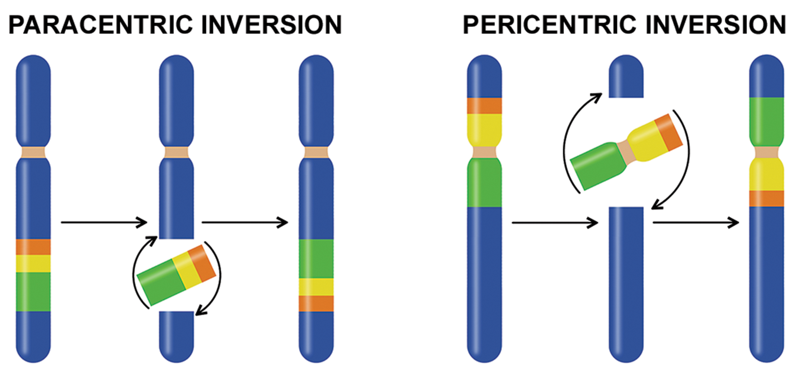
13.2 Figure 10
Notes:
Figure 10: Pericentric inversions include the centromere, and paracentric inversions do not. A pericentric inversion can change the chromosome arms' relative lengths. A paracentric inversion cannot.

Slide 21
Chromosome Inversions₂
When one homologous chromosome undergoes inversion (but the other does not), individual is an inversion heterozygote
To maintain synapsis during meiosis, one homolog must form loop and other homolog must mold around it
Forces homologs to stretch, creating imprecise synapsis regions

Slide 22
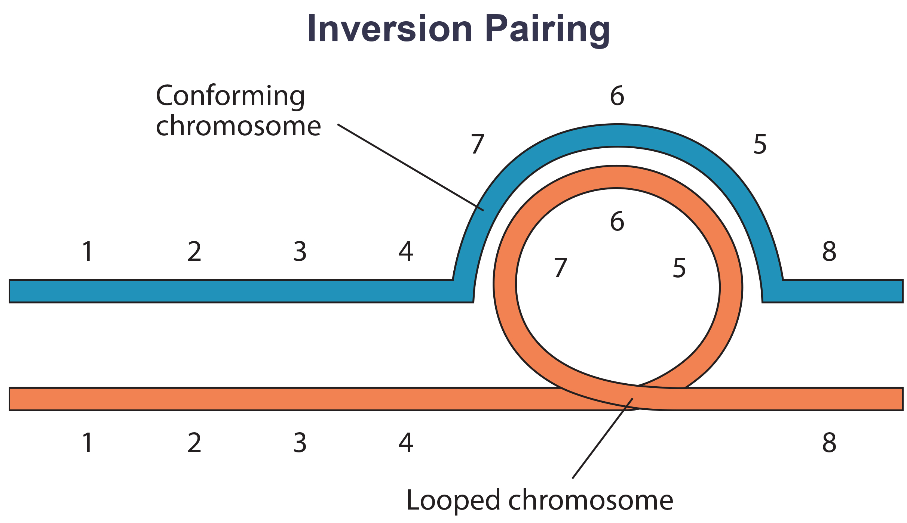
13.2 Figure 11
CNX OpenStax on Wikimedia Commons. "Inversion pairing."
Notes:
Figure 11: When one chromosome undergoes an inversion, but the other does not, one chromosome must form an inverted loop to retain point-for-point interaction during synapsis. This inversion pairing is essential to maintaining gene alignment during meiosis and to allow for recombination.

Slide 23
Evolution Connection
The Chromosome 18 Inversion
Chromosome structural rearrangements can produce new species
Pericentric inversion appears to have contributed to human evolution after divergence from common ancestor with chimpanzees
19,000 nucleotide bases duplicated on 18p, then inverted and reinserted on chromosome 18
ROCK1 and USP14 more distantly positioned on human chromosome 18
Inversion breakpoints occurred between these two genes

Slide 24
Translocations
Translocation: process by which one chromosome segment dissociates and reattaches to a different, nonhomologous chromosome
Can be benign or cause diseases like cancer and schizophrenia depending on how the positions of genes are altered with respect to regulatory sequences
Reciprocal translocations exchange segments between two nonhomologous chromosomes with no genetic information lost or gained

Slide 25
Reflection Question
Based on what you have learned about chromosomal arrangements, hypothesize one way in which these events have contributed to the evolution of animals across history. How would you test your hypothesis?
Notes:
The reflection question is included here to use as a talking point or for a think-pair-share activity.

Slide 26
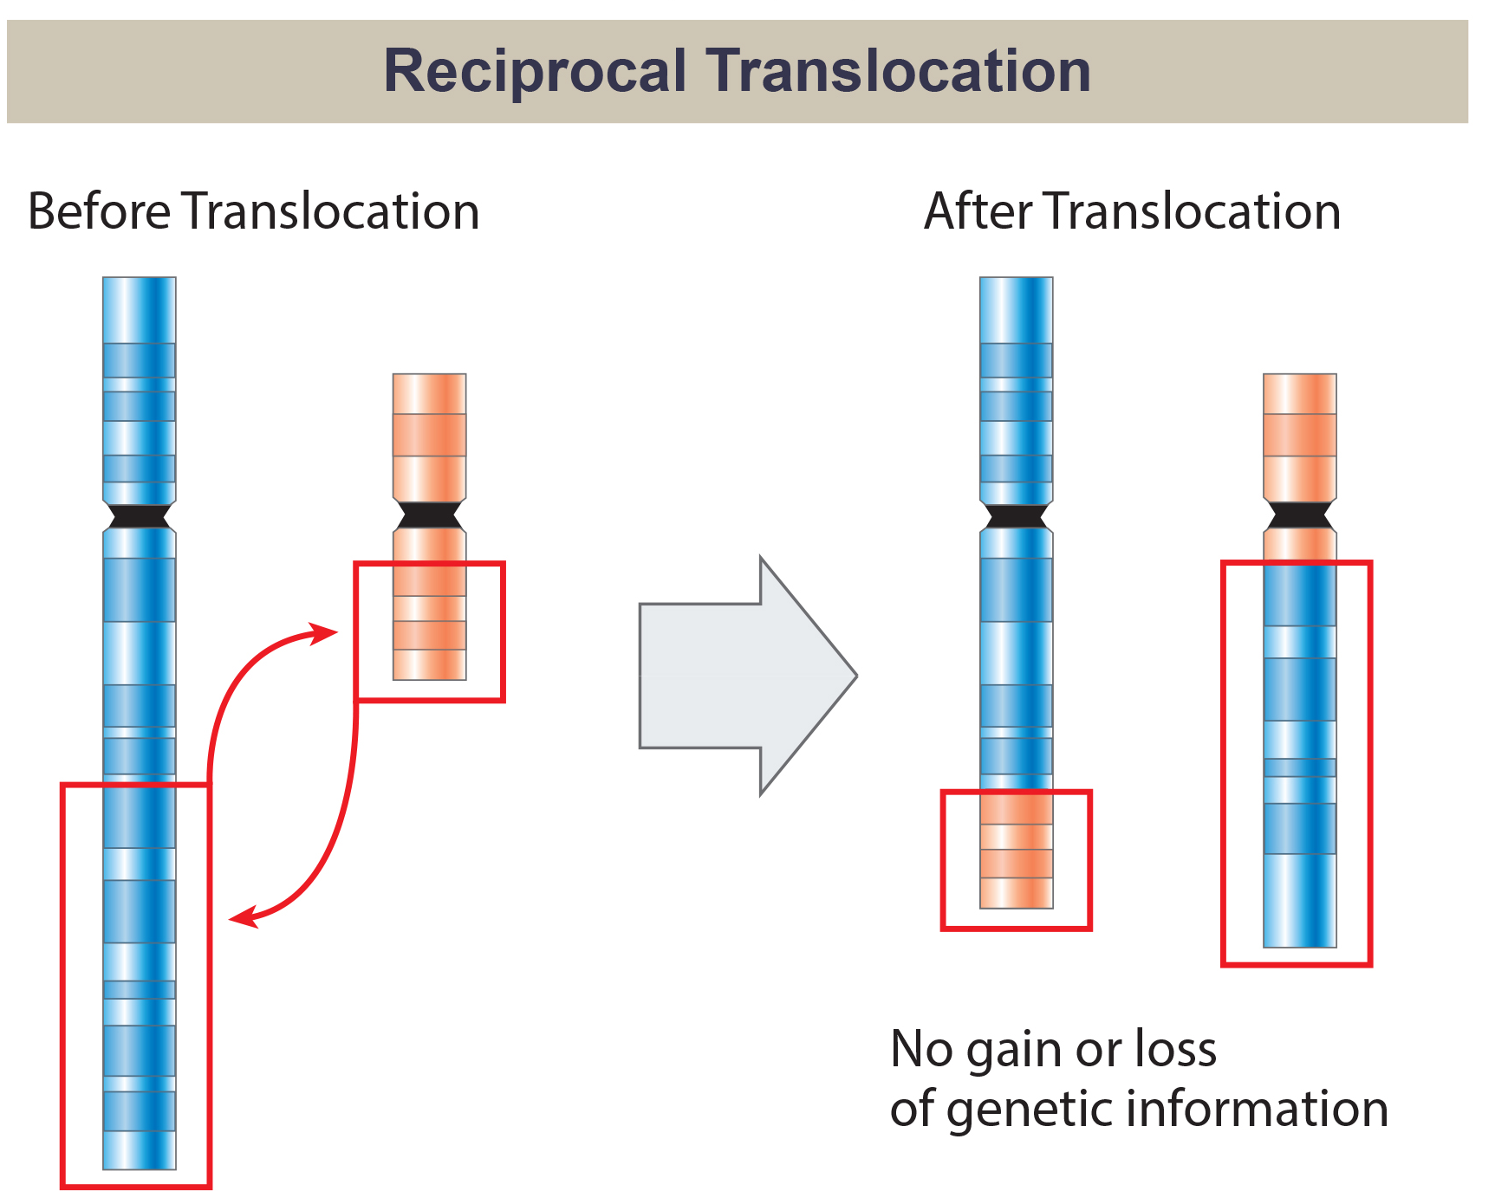
13.2 Figure 12
National Human Genome Research/USA on Wikimedia Commons. "Reciprocal translocation."
Notes:
Figure 12: A reciprocal translocation occurs when a DNA segment transfers from one chromosome to another, nonhomologous chromosome.

Slide 27
Summary
Chromosome number, size, shape, and banding patterns allow for karyotype analysis and identification of chromosomal abnormalities.
Aneuploidies (abnormal chromosome number) are typically lethal, except for some viable trisomies.
Due to X inactivation, sex chromosome aneuploidies have relatively mild phenotypic effects.
Aneuploidies can also involve duplication or deletion of chromosomal segments.
Chromosomal structural rearrangements like inversions and translocations can disrupt genes and impair fertility because of the likelihood of nondisjunction.

Slide 28


End of Hawkes Learning PowerPoint

