Slide 1
Lesson 14.1
A Modern Understanding of DNA

Slide 2
Objectives
Describe the key experiments that helped identify that DNA is the genetic material.
Explain transformation of DNA.
State and explain Chargaff's rules.

Slide 3
DNA: Deoxyribonucleic Acid
Can be retrieved from hair, blood, or saliva
Allows for identification because each person's DNA is unique
Can be used for determining paternity, tracing genealogy, identifying pathogens, archeological research, tracing disease outbreaks, studying human migration patterns, DNA diagnostics, new vaccine development, and cancer therapy
23 pairs of chromosomes in humans (one set inherited from the female and one set from the male)
Also mitochondrial DNA inherited directly from female parent, which can involve inherited genetic disorders
Thousands of genes on each chromosome responsible for determining genotype and phenotype
  Gene: a region of DNA that codes for a protein or other functional product
  Haploid genome has three billion base pairs and approximately 20,000–25,000 functional genes

Slide 4
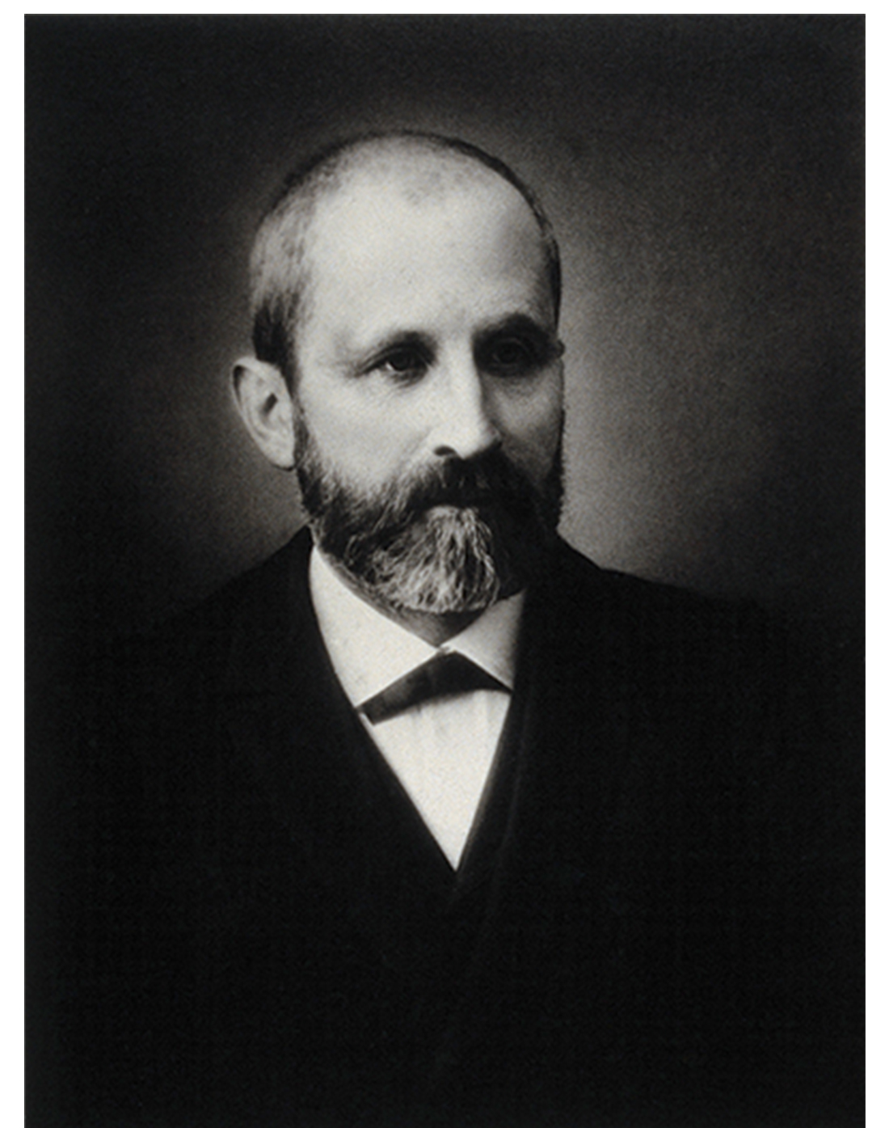
A Modern Understanding of DNA₁
Understanding of DNA began with discovery of nucleic acids then the double-helix model
Discovered by Friedrich Miescher (1860s), who found phosphate-rich chemicals in white blood cells that he named nuclein (later known as DNA)
14.1 Figure 1: Friedrich Miescher (1844–1895) discovered nucleic acids.
Wellcome Images on Wikimedia Commons. "Friedrich Miescher."

Slide 5
A Modern Understanding of DNA₂
First reported demonstration of bacterial transformation by Frederick Griffith (1928)
  Transformation: process by which a prokaryote takes in DNA found in its environment that is shed by other prokaryotes
  Conducted experiments using Streptococcus pneumoniae injected into mice
    Two strains based on appearance: rough (R) and smooth (S)
      R strain: nonpathogenic (does not cause disease)
      S strain: pathogenic (disease-causing) with layer of polysaccharides (capsule) outside cell wall
        Capsule allows cell to escape immune responses of host mouse

Slide 6
A Modern Understanding of DNA₃
Results:
  Mice injected with living S strain died from pneumonia
  Mice injected with living R strain survived
  Mice injected with heat-killed S strain survived
    Showed capsule alone was not cause of death
  Mice injected with mixture of living R strain and heat-killed S strain died
    Only S strain was recovered from dead mouse
      Then injected into living mouse, which died
Conclusion:
  Something passed from heat-killed S strain to living R strain and transformed it into pathogenic S strain (called transforming principle)

Slide 7
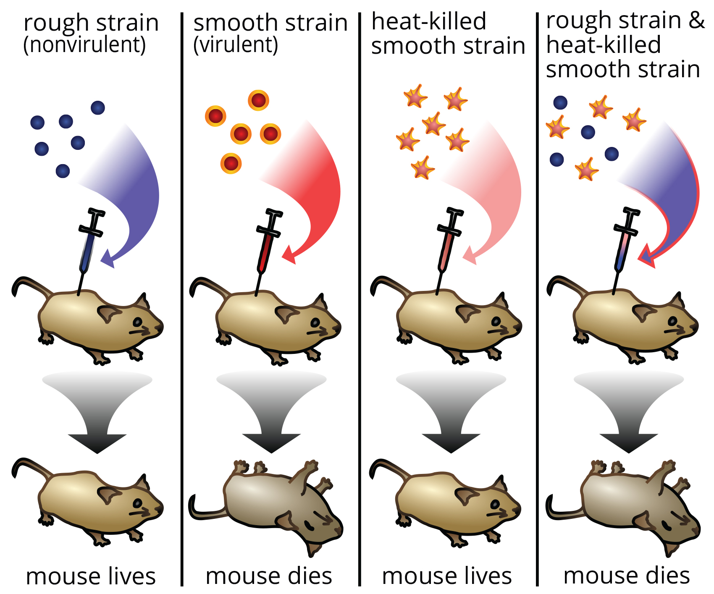
14.1 Figure 3
Madeleine Price Ball on Wikimedia Commons. "Griffith experiment."
Notes:
Figure 2: Two strains of S. pneumoniae were used in Griffith's transformation experiments. The R strain is nonpathogenic, whereas the S strain is pathogenic and causes death. When Griffith injected a mouse with the heat-killed S strain and a live R strain, the mouse died. The S strain was recovered from the dead mouse. Griffith concluded that something had passed from the heat-killed S strain to the R strain, transforming the R strain into the S strain in the process.

Slide 8
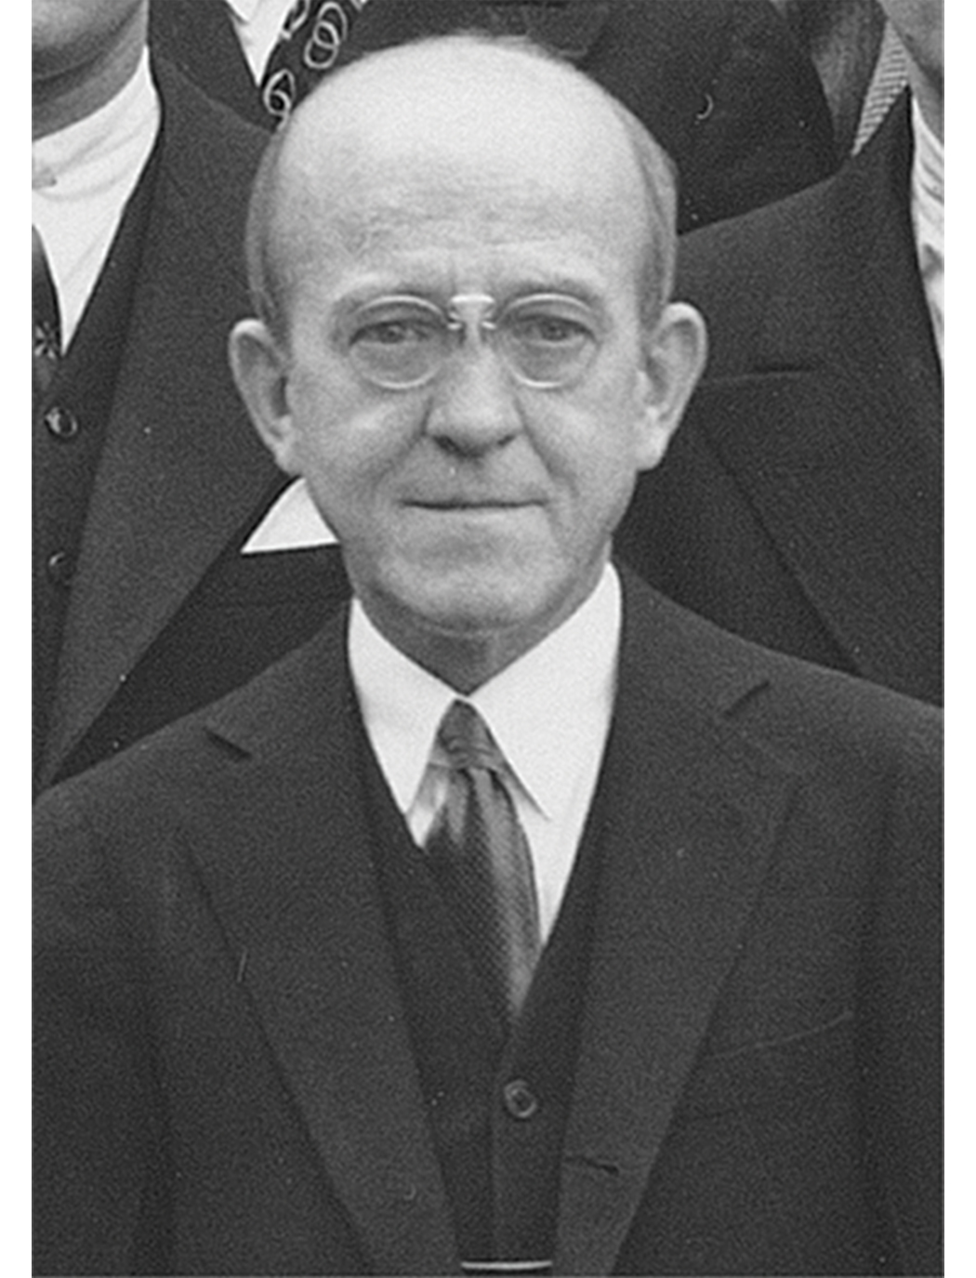
A Modern Understanding of DNA₄
Transforming principle further explored by Oswald Avery, Colin MacLeod, and Maclyn McCarty (1944)
  Isolated S strain, proteins, and nucleic acids
  Degraded each component with enzymes then transformed the R strain
  Results:
    No more transformation when DNA was degraded
    DNA as the transforming principle
14.1 Figure 3: Oswald Avery
Rockefeller Archive Center on Wikimedia Commons. "Oswald Avery."

Slide 9
Reflection Question
What does Griffith's experiment show you about bacterial survival and change?
Notes:
The reflection question is included here to use as a talking point or for a think-pair-share activity.

Slide 10
Science and You
Career: Forensic Scientist
Uses DNA analysis evidence to solve cases
First time used was with immigration case where a boy's identity was in doubt
DNA fingerprinting invented by Dr. Alec Jeffreys
  DNA fingerprinting: a chemical test that shows the genetic makeup of a person or other living thing
Analyzes various types of evidence including documents, handwriting, firearms, and biological samples, like hair, semen, saliva, and blood
Analysis involves DNA isolation, sequencing, and sequence analysis
Presents findings in court hearings
Employed in crime labs of city and state government agencies, scientific and research organizations, pharmaceutical industries, and college and university labs
A bachelor's degree in chemistry, biology, or physics required, along with laboratory experience
Notes:
This is included as a relevant application for this topic.

Slide 11
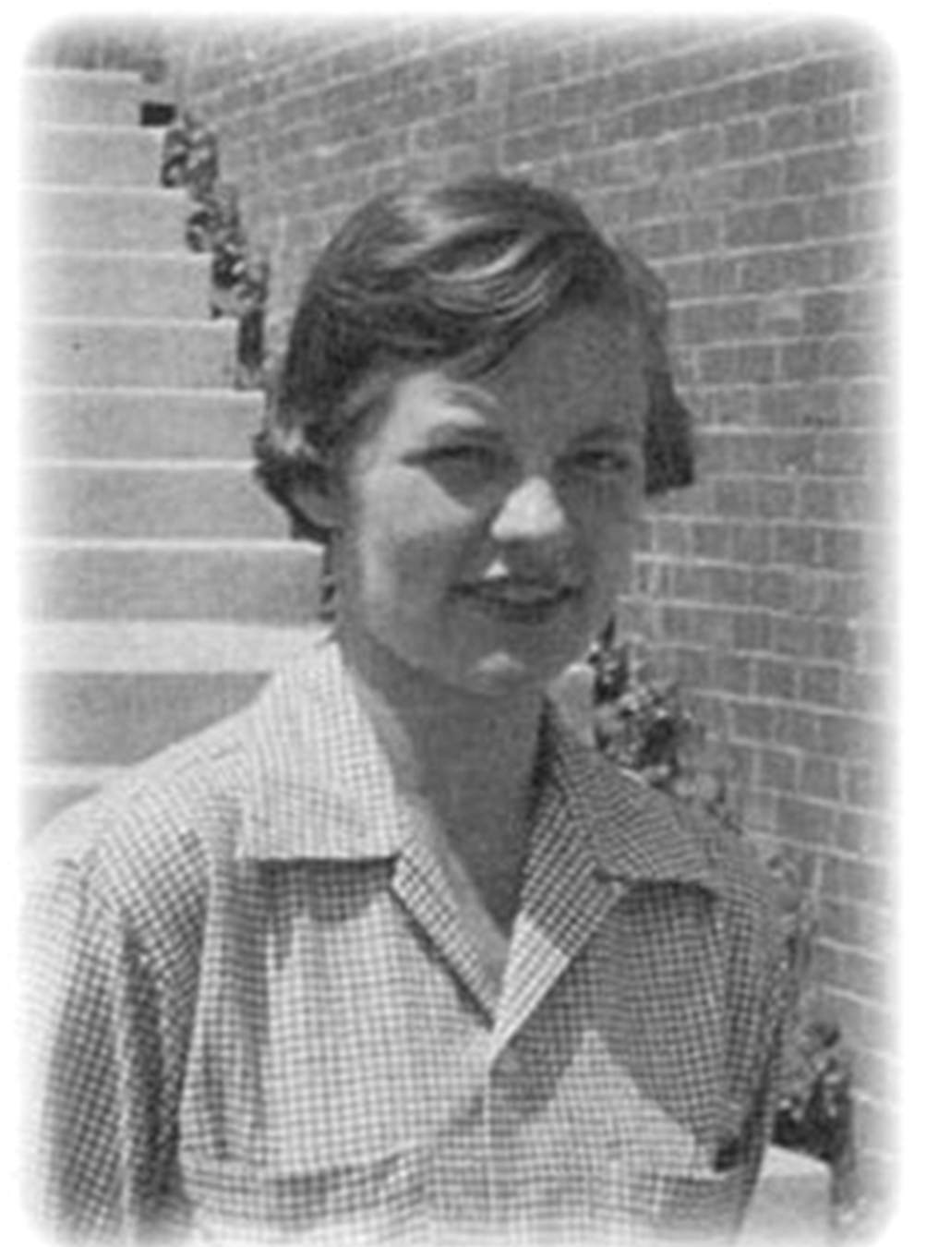
A Modern Understanding of DNA₅
Martha Chase and Alfred Hershey (1952) proved DNA was genetic material, not proteins
Studied bacteriophage
  Bacteriophage: virus that infects bacteria
  Viruses have simple structure: protein coat (capsid) and nucleic acid core with genetic material (either DNA or RNA)
  Bacteriophage infects host cell and injects nucleic acids inside
  Phage DNA makes multiple copies of itself using host machinery
  Host cell bursts, releasing bacteriophages
14.1 Figure 4: Martha Chase
Unknown author on Wikimedia Commons. "Martha Chase."

Slide 12
A Modern Understanding of DNA₆
Hershey and Chase selected radioactive elements to distinguish protein from DNA in infected cells
  One labeled with radioactive sulfur (³⁵S) to label protein coat
    Sulfur found in several amino acids but not DNA so only proteins would be tagged
  One labeled with radioactive phosphorus (³²P)
    Phosphorus found in DNA but not protein so only DNA would be tagged

Slide 13
A Modern Understanding of DNA₇
Each batch of phage allowed to infect cells separately
Afterwards, phage bacterial suspension put in a blender, causing phage coat to detach from host
Phage and bacterial suspension spun in centrifuge
  Heavier bacterial cells settled at bottom and formed a pellet
  Lighter phage particles stayed in supernatant (fluid above pellet)
Results:
  ³⁵S phage: Supernatant contained radioactively labeled phage but none in pellet
  ³²P phage: Radioactivity detected in pellet but none in supernatant
Conclusion:
  Phage DNA injected into cell and carried information to produce more phage particles
  Evidence that DNA was genetic material not proteins

Slide 14
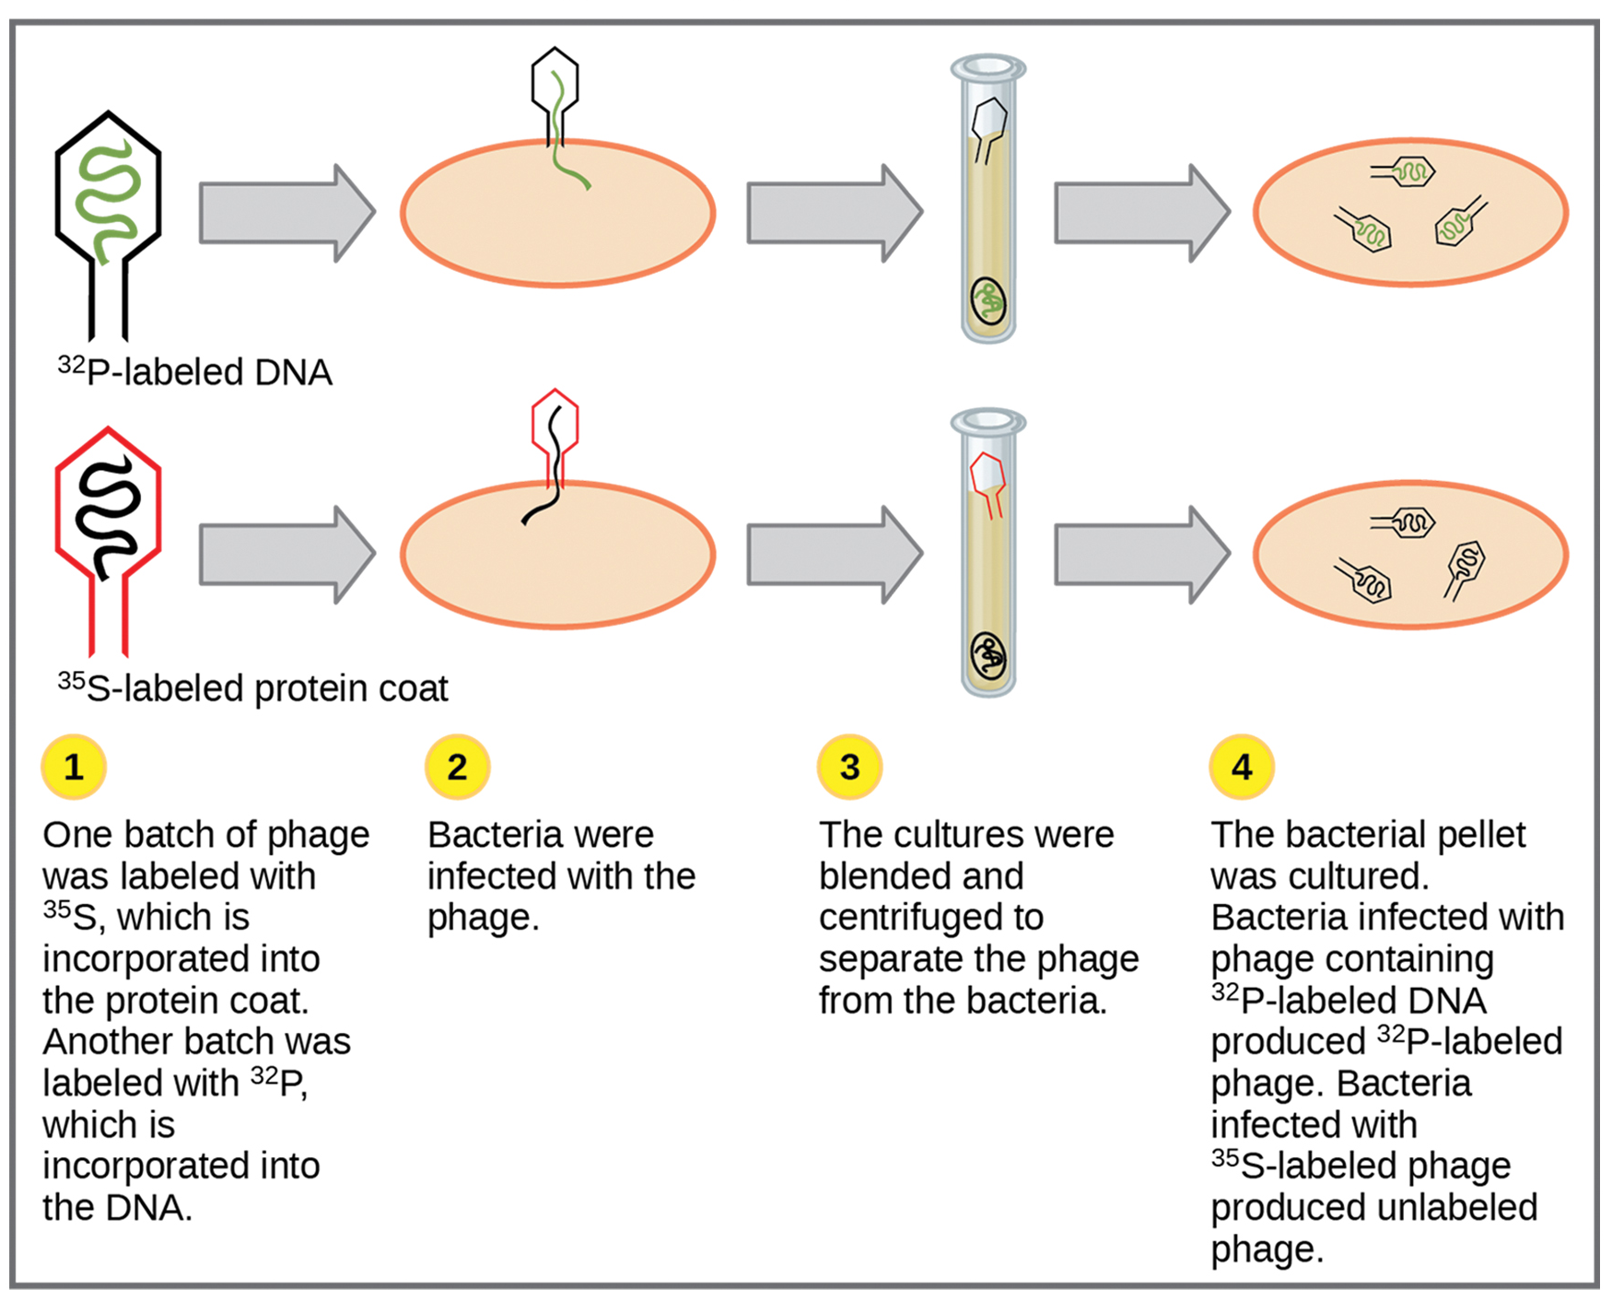
14.1 Figure 5
CNX OpenStax on Wikimedia Commons. "Hershey and Chase experiment." Modified.
Notes:
In Hershey and Chase's experiments, bacteria were infected with phage radiolabeled with either 35S, which labels protein, or 32P, which labels DNA. Only 32P entered the bacterial cells, indicating that DNA is the genetic material.

Slide 15
Think It Through
Why was phosphorus used in the Chase-Harvey experiment?
Notes:
Originally an On Your Own. This is included here to use as a talking point or for a think-pair-share activity.

Slide 16
A Modern Understanding of DNA₈
Erwin Chargaff discovered different species have different amounts of adenine, thymine, guanine, and cytosine but amounts are consistent within individuals and individuals of same species
Also discovered that adenine equaled thymine (A = T) and cytosine equaled guanine (C = G)
  Equal amounts of purines (A + G) and pyrimidines (T + C) but different ratios of A + T to G + C
    Known as Chargaff's rules

Slide 17
A Modern Understanding of DNA₉
Example:
  Strand of DNA contains 15% adenine; it would also contain 15% thymine
    Remaining 70% made up of guanine and cytosine
      Guanine = cytosine
      35% guanine and 35% cytosine
        Sum of A and G is 50% and sum of T and C is 50% so ratio of A + G to T + C is 1:1
        Sum of A and T is 30% and sum of G and C is 70% (ratio varies across species)
Chargaff's rules informed Watson and Crick's DNA double helix model

Slide 18
Summary
Friedrich Miescher was first to isolate DNA (which he called nuclein) from white blood cells
Frederick Griffith experimented with strains of Streptococcus pneumoniae to provide first evidence that DNA may be transforming principle
Avery, MacLeod, and McCarty showed DNA required for transformation of bacteria
Hershey and Chase used bacteriophage and proved DNA is genetic material
Chargaff found ratio of A = T and C = G and that percent of A, T, G, and C is different for different species

Slide 19


End of Hawkes Learning PowerPoint

