Slide 1
Lesson 14.2
DNA Structure and Sequencing

Slide 2
Objectives
Describe the structure of DNA.
Discuss the similarities and differences between eukaryotic and prokaryotic DNA.
Explain the Sanger method of DNA sequencing.

Slide 3
DNA Structure and Sequencing₁
Nucleotides: building blocks of DNA and RNA
Composed of nitrogenous base, 5-carbon sugar (deoxyribose for DNA; ribose for RNA), and a phosphate group
Nucleotide named depending on nitrogenous base
Can be purine (adenine and guanine) or pyrimidine (cytosine, thymine, and uracil)

Slide 4
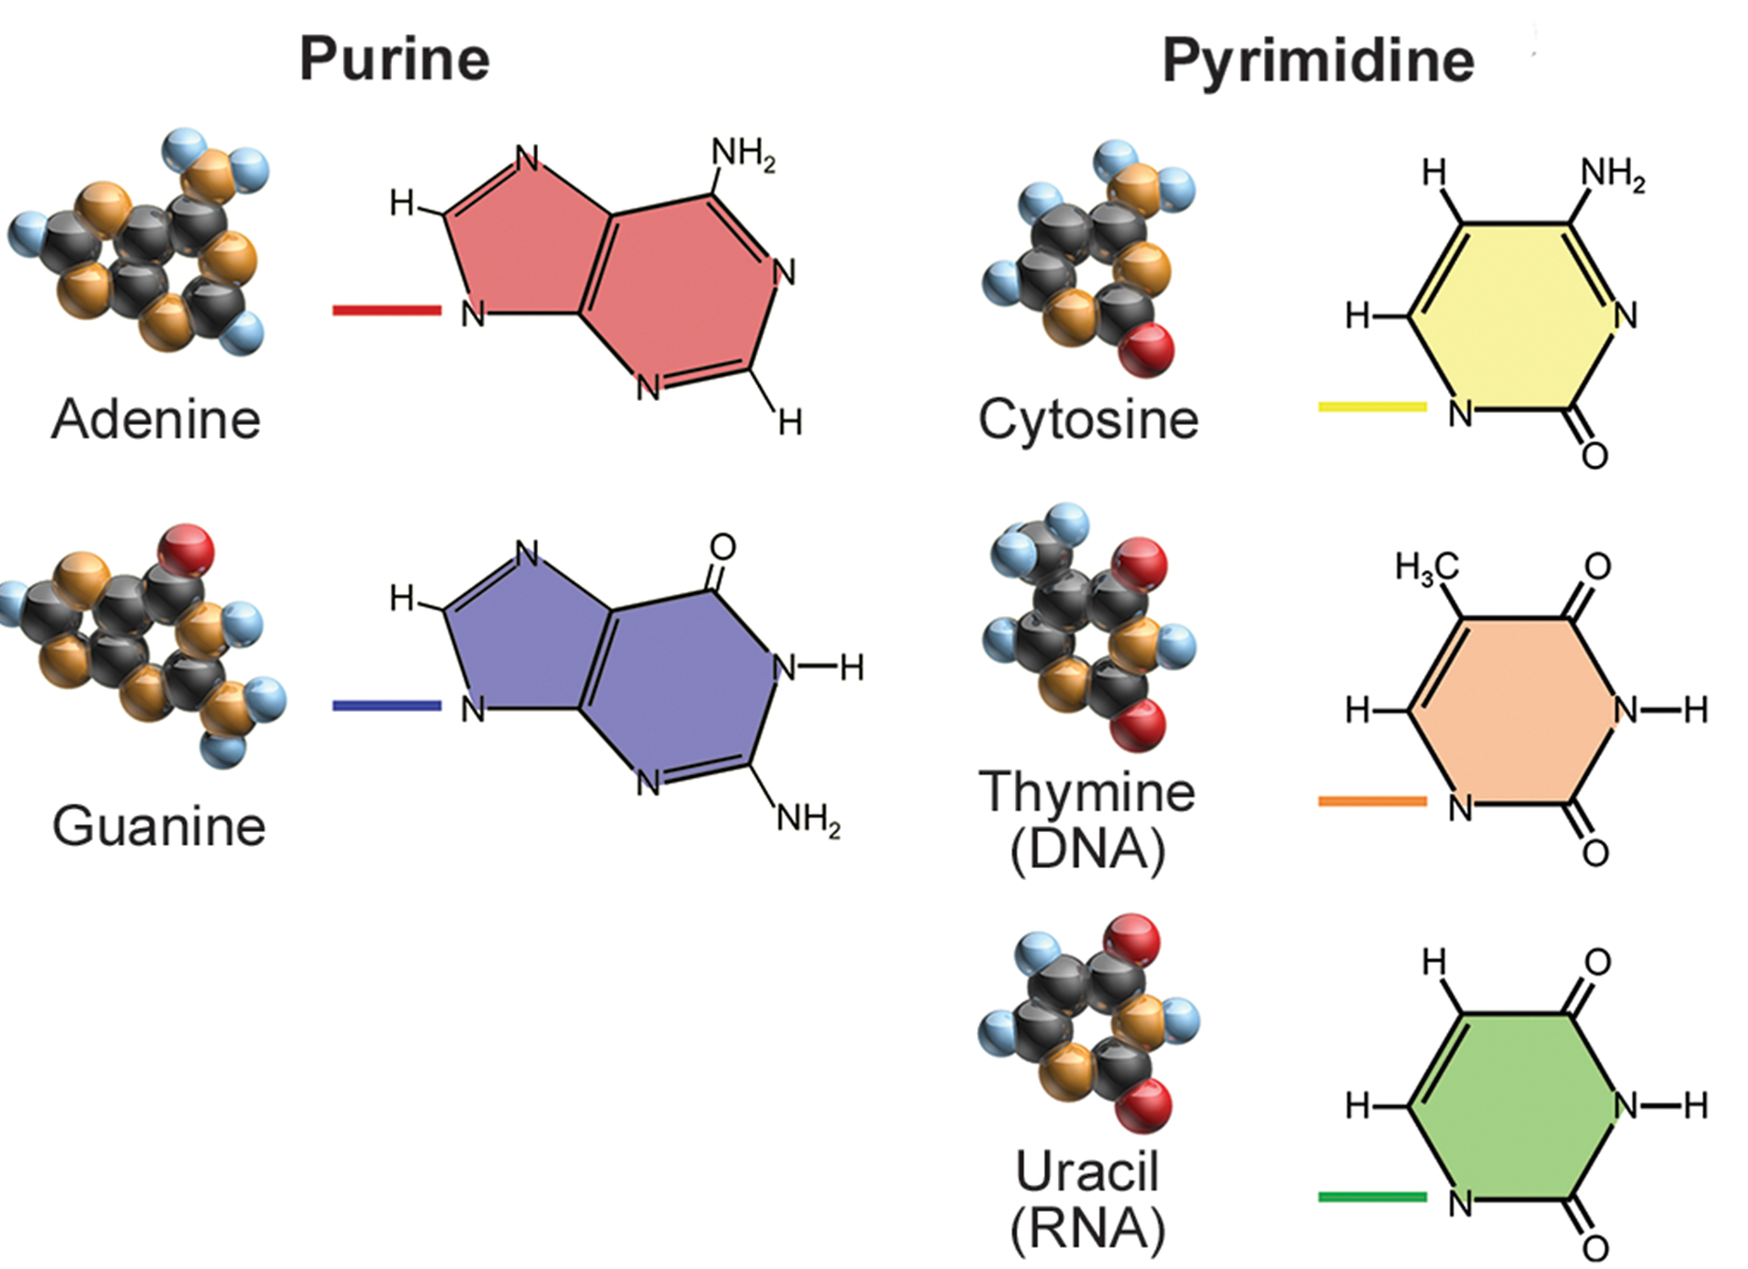
14.2 Figure 1
Blausen on Wikimedia Commons. "Purine and pyrimidine structure."
Notes:
Figure 1: The purines have a double-ring structure with a six-membered ring fused to a five-membered ring. Pyrimidines are smaller in size; they have a single six-membered ring structure.

Slide 5
DNA Structure and Sequencing₂
Carbon atoms of 5-carbon sugar numbered 1′, 2′, 3′, 4′, and 5′ (1′ read as "one prime")
Phosphate connected to 5′ carbon of the sugar by ester linkage between phosphoric acid and 5′-OH group
Ester: Acid plus an alcohol
In DNA nucleotides, the 3′ carbon of sugar deoxyribose attached to hydroxyl (OH) group
In RNA nucleotides, the 2′ carbon of sugar ribose contains hydroxyl group; base is attached to 1′ of sugar
Nucleotides combine to form phosphodiester bonds
Phosphate attached to 5′ carbon of sugar forms ester linkage with hydroxyl group of 3′ carbon of sugar of previous nucleotide, forming 3′-5′ phosphodiester bond
In polynucleotide, one end has free 5′ phosphate and other end has free 3′-OH (called 5′ and 3′ end of the chain)

Slide 6
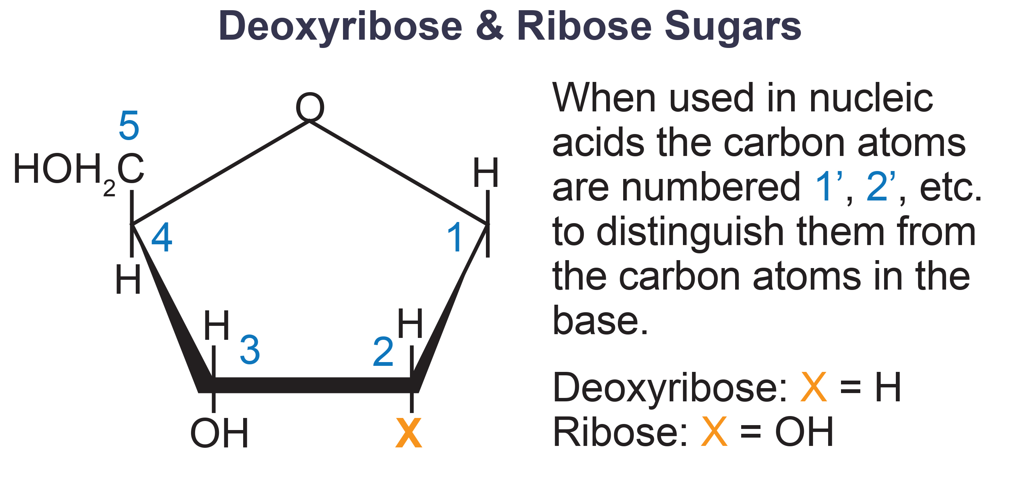
14.2 Figure 2
Boumphreyfr on Wikimedia Commons. "Ribose deoxyribose."
Notes:
Figure 2: The carbon atoms of ribose and deoxyribose sugars are numbered clockwise.

Slide 7
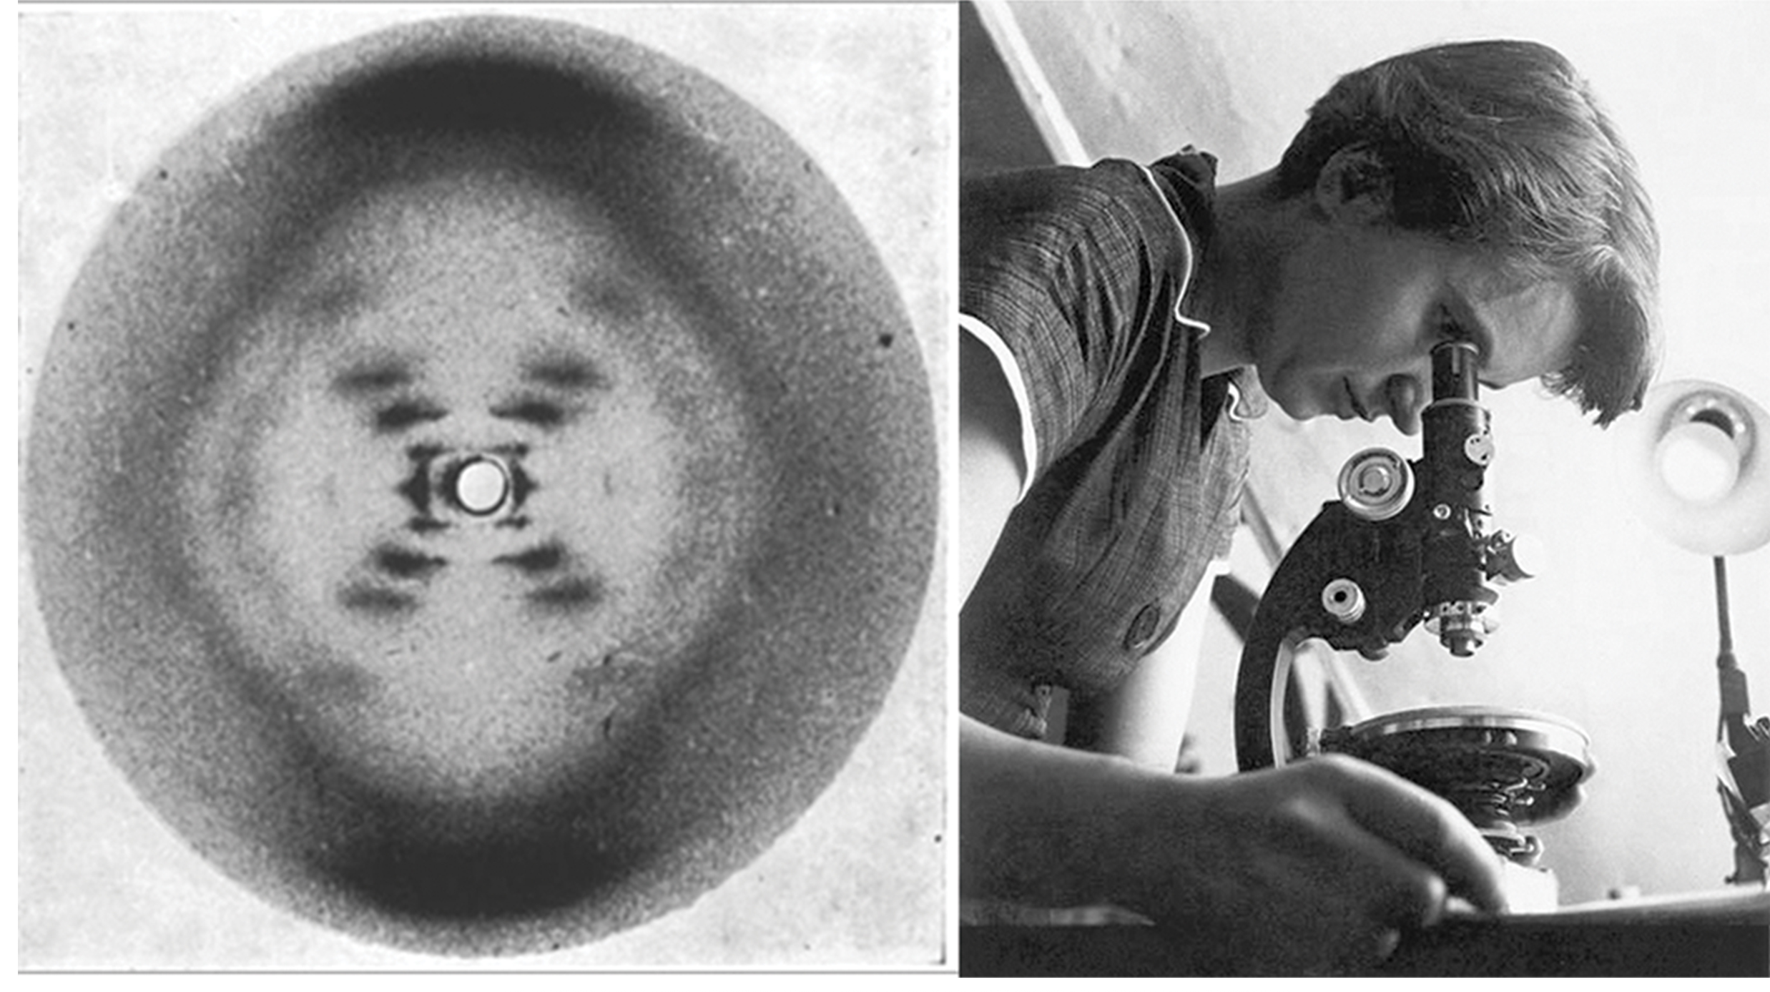
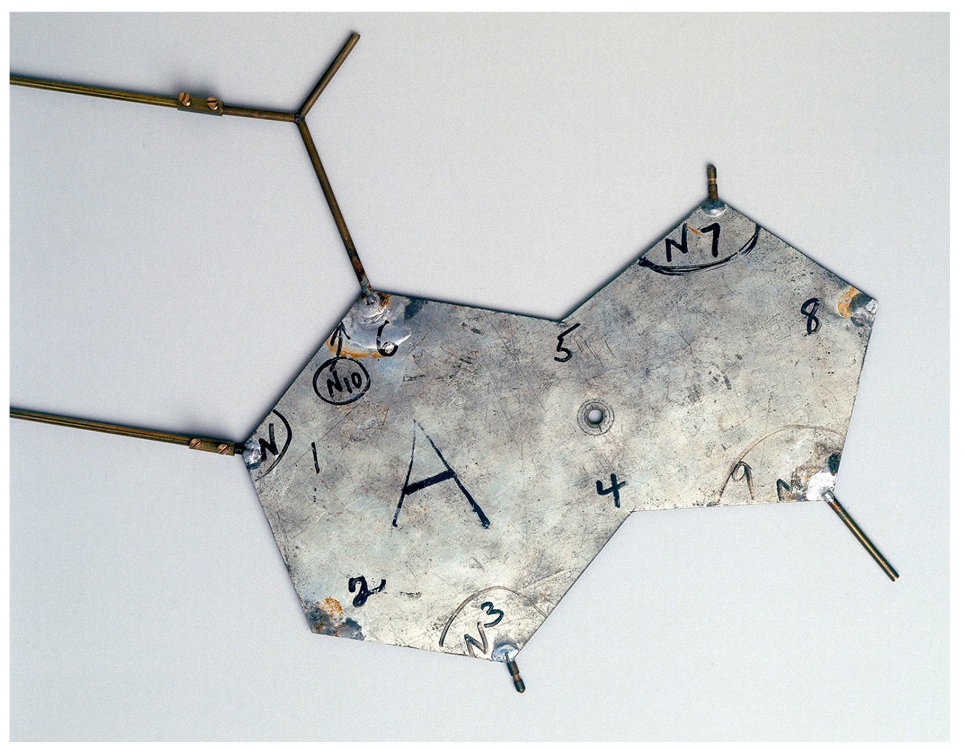
DNA Structure and Sequencing₃
Francis Crick and James Watson determined structure of DNA (1950s)
Rosalind Franklin used X-ray diffraction methods to understand structure of DNA
Watson and Crick worked out the full structure of DNA by using Franklin's data and Crick's background in X-ray diffraction
14.2 Figure 3: An X-ray diffraction pattern of DNA shown alongside an image of X-ray crystallographer Rosalind Franklin, who produced an early X-ray diffraction pattern of DNA that helped Watson and Crick determine DNA structure.
National Institute of Health on Wikimedia Commons. "X-ray DNA."
MRC Laboratory of Molecular Biology on Wikimedia Commons. "Rosalind Franklin."
14.2 Figure 4: This is an aluminum template used by Watson and Crick in 1953 to build a model of DNA. This piece represents an adenosine (A) nucleotide.
Science Museum, London on Wikimedia Commons. "Aluminum template."

Slide 8
DNA Structure and Sequencing₄
Watson and Crick proposed DNA is made up of two strands twisted around each other to form right-handed helix
Includes base pairing between purine and pyrimidine on opposite strands (Chargaff's rules)
A and T complementary base pairs; C and G complementary base pairs
Pair stabilized by hydrogen bonds
A and T form two hydrogen bonds
C and G form three hydrogen bonds

Slide 9
DNA Structure and Sequencing₅
Strands are antiparallel: 3′ end of one strand faces 5′ end of other strand
Sugar and phosphate of nucleotides form backbone
Nitrogenous bases stacked inside
Each base pair separated from the next by 0.34 nanometers; each turn of helix measures 3.4 nanometers
10 base pairs per turn of helix
Diameter of double helix is 2 nanometers and uniform
Two strands' sugar-phosphate backbone results in uniformly spaced major grooves (where two backbones are far apart) and minor grooves (where two backbones are close together)

Slide 10
Group Activity
In a group, use index cards or cardboard to create the nitrogenous bases as puzzle pieces. Create adenine and thymine to fit together and guanine and cytosine to fit together. Make six adenine, six thymine, four guanine, and four cytosine. Try to piece them together using the right amount of hydrogen bonds. What do you observe about how the structure of each piece allows for or prevents bonding with other pieces?

Slide 11
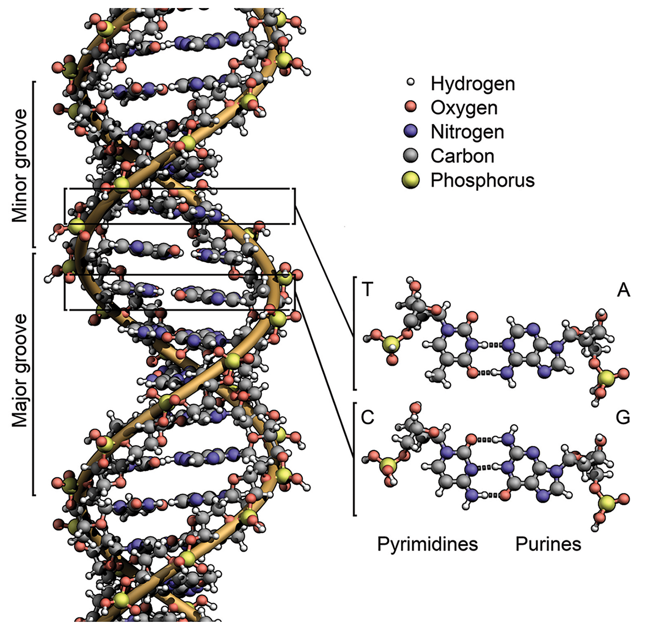
14.2 Figure 5
Zephyris on Wikimedia Commons. "DNA structure."
Notes:
Figure 5: Major and minor grooves alternate down the length of a DNA double helix.

Slide 12
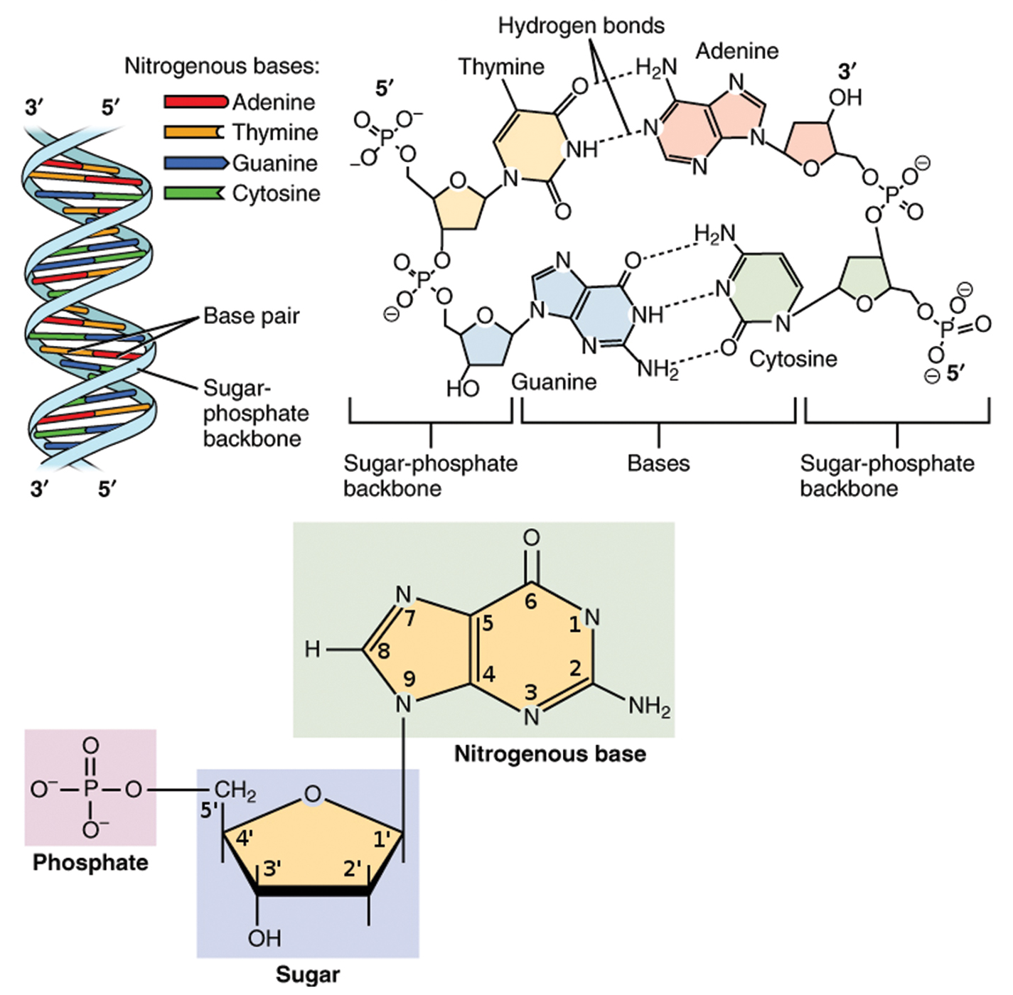
14.2 Figure 6
OpenStax on Wikimedia Commons. "Nitrogenous bases and structure."
Notes:
Figure 6: DNA has a double-helix structure and phosphodiester bonds; the dotted lines between thymine and adenine and guanine and cytosine represent hydrogen bonds.

Slide 13
DNA Sequencing Techniques₁
Relatively expensive and long process
DNA sequencing: determining the order of the nitrogenous bases within a given stretch of DNA
Fred Sanger developed sequencing method used for the human genome sequencing project
Method widely available for use in small-scale sequencing projects
Known as the dideoxy chain termination method
Uses chain terminators, the dideoxynucleotides (ddNTPs), which lack a free 3′-OH group on the 5-carbon sugar
If ddNTPs added to growing DNA strand, the chain cannot extend because there's no 3′-OH group to add to another nucleotide
Using predetermined ratio of deoxynucleotides to dideoxynucleotides makes it possible to generate DNA fragments of different sizes

Slide 14
DNA Sequencing Techniques₂
Process starts by denaturing DNA sample
DNA separates into two strands by heating to high temperature
Then DNA divided into four tubes in which DNA polymerase (a primer) and all four nucleoside triphosphates (A, T, G, and C) are added
Also added are limited quantities of one of four dideoxynucleoside triphosphates (ddCTP, ddATP, ddGTP, ddTTP) with a fluorescent label and tubes are labeled accordingly
Continues with chain elongation until fluorescent dideoxy nucleotide is incorporated and further elongation stops
Then electrophoresis performed identifying length
Sequence then read from laser scanner that detects fluorescent marker of each fragment

Slide 15
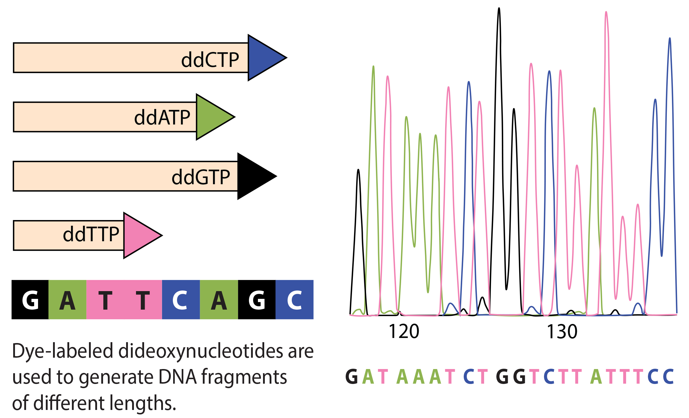
14.2 Figure 7
CNX OpenStax on Wikimedia Commons. "Dye-labeled dideoxynucleotides." Modified.
Notes:
Figure 7: In Frederick Sanger's dideoxy chain termination method, dye-labeled dideoxynucleotides are used to generate DNA fragments that terminate at different points. The DNA is separated based on size, and the DNA sequence can be read from the order of fragments formed. The DNA sequence is read by a laser scanner.

Slide 16
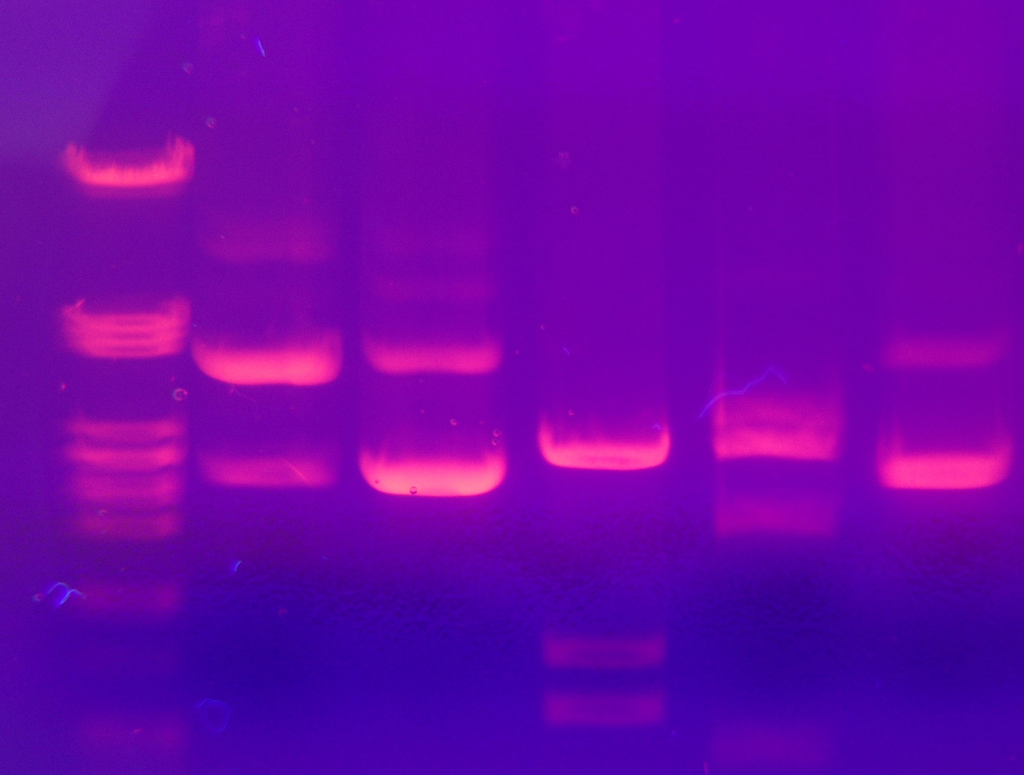
Science and You
Understanding DNA structure revolutionized biology
Techniques were developed that allowed manipulation of DNA by cutting DNA molecules into shorter pieces without affecting overall electrical charge
Electrophoresis: Technique which separates DNA pieces based on their lengths
Mixture of DNA lengths injected into gel at one end, electricity applied, and DNA pieces migrate down gel with smallest fragments moving ahead of others
Lane on far left contains DNA fragments of known lengths for comparison
14.2 Figure 8: DNA fragments can be separated based on size using gel electrophoresis.
TGFDL & CC ShareAlike 2.0 on Wikimedia Commons. "Gel electrophoresis."
Notes:
This is included as a relevant application for this topic.

Slide 17
Evolution Connection₁
Neanderthal Genome: How Are We Related?
First draft sequence of Neanderthal genome published by Richard E. Green et al. (2010)
Closest ancestors to present-day humans
Lived in Europe and Western Asia, perhaps Northern Africa, but disappeared from fossil records 30,000 years ago
Green's team studied 40,000-year-old fossil remains using DNA sequencing and sequenced four billion base pairs
Found that Neanderthal genome had 2–3% greater similarity to people living outside Africa to people in Africa
Found interbreeding between Neanderthals and early modern humans happened as modern humans emerged out of Africa

Slide 18
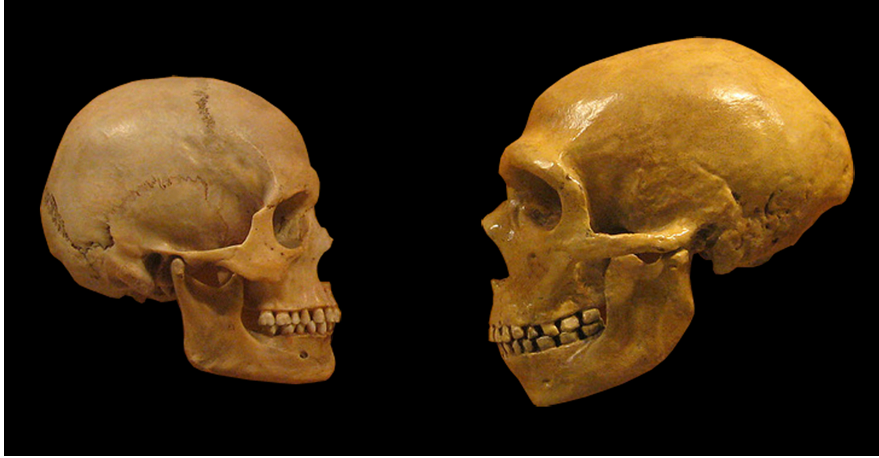
Evolution Connection₂
Neanderthal Genome: How Are We Related?
Several genes have undergone changes from Neanderthals to present-day humans
Cranial structure, metabolism, skin morphology, and cognitive development
RUNX2: Responsible for frontal bone, rib cage, and dental differences in Neanderthals
14.2 Figure 9: Modern human skull on left; Neanderthal skull on right.
hairymuseummatt on Wikimedia Commons. "Human and neanderthal skulls."

Slide 19
DNA Packaging in Cells₁
Prokaryotes simpler than eukaryotes
Prokaryotes
Contain single circular chromosome in area of cytoplasm called nucleoid region
DNA twisted by supercoiling
Positive supercoiling: Same direction as double helix
Results in DNA that is "overwound" (more than one turn per 10 base pairs)
Negative supercoiling: Opposite direction as double helix
Results in DNA that is "underwound" (less than one turn of the helix per 10 base pairs)

Slide 20
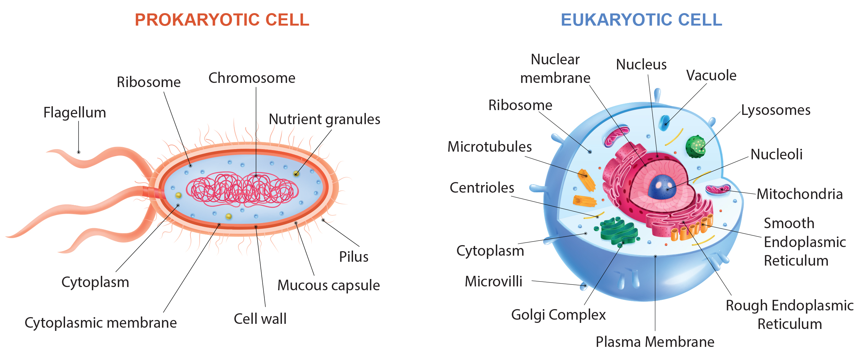
14.2 Figure 10
Notes:
Figure 10: A eukaryote contains a well-defined nucleus, whereas in prokaryotes, the chromosome lies in the cytoplasm in an area called the nucleoid.

Slide 21
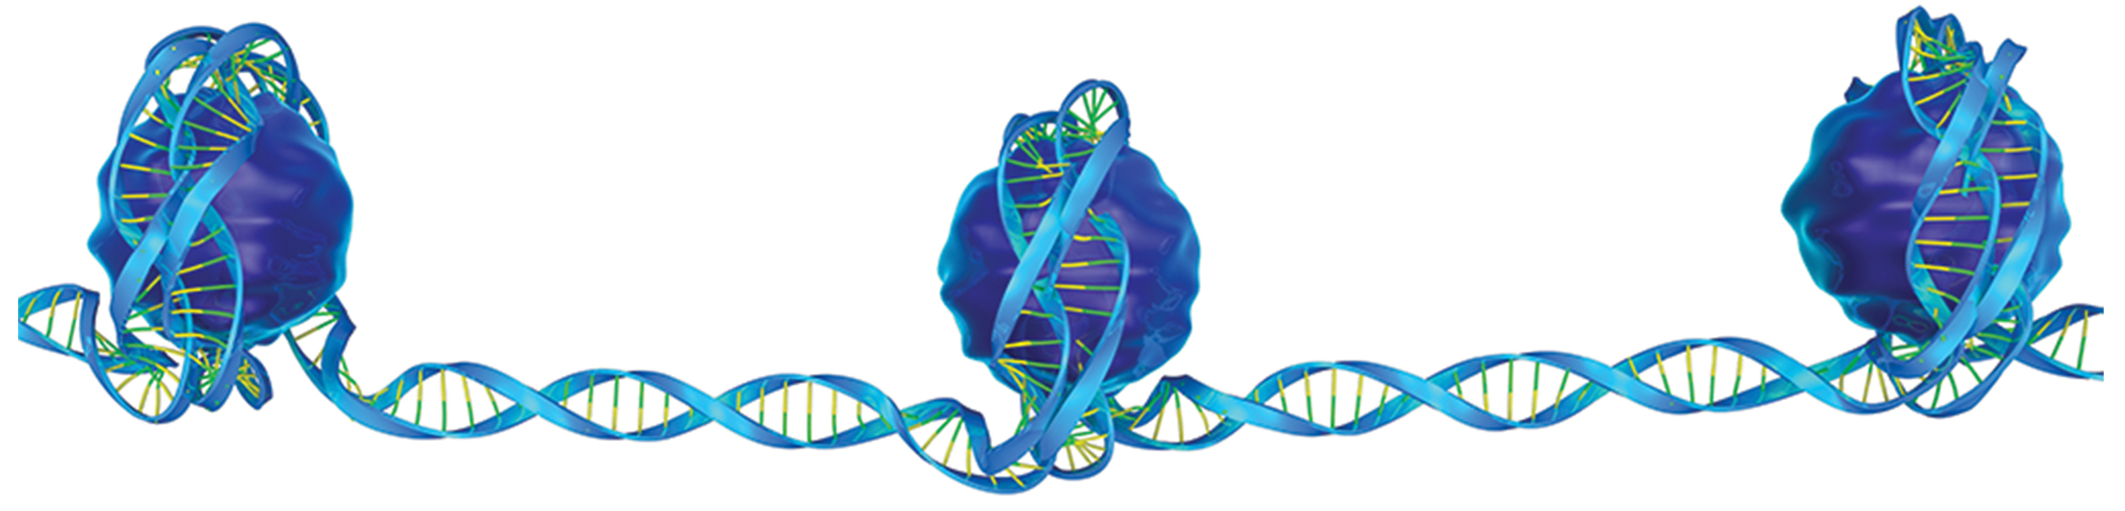
DNA Packaging in Cells₂
Eukaryotes
Chromosomes consist of linear DNA molecule
DNA wrapped around proteins called histones to form nucleosomes
Histones: proteins involved in packaging DNA into nucleosomes
Nucleosomes: subunit of chromatin composed of a short length of DNA wrapped around a core of histone proteins
Nucleosome linked to next one with linker DNA
Known as "beads on a string" structure
At metaphase state, chromosomes are their most compact, 700 nanometers in width
14.2 Figure 11: "Beads on a string": three nucleosomes connected by linker DNA. Nucleosomes keep DNA tangle-free, similar to how fishing reels keep line tightly organized.

Slide 22
DNA Packaging in Cells₃
In interphase, eukaryotic chromosomes have two regions distinguishable by staining
Heterochromatin: Tightly packaged region
Contains not expressed genes and found in regions of the centromere and telomeres
Euchromatin: Less dense region
Contains expressed genes
DNA packaged around nucleosomes but not further compacted

Slide 23
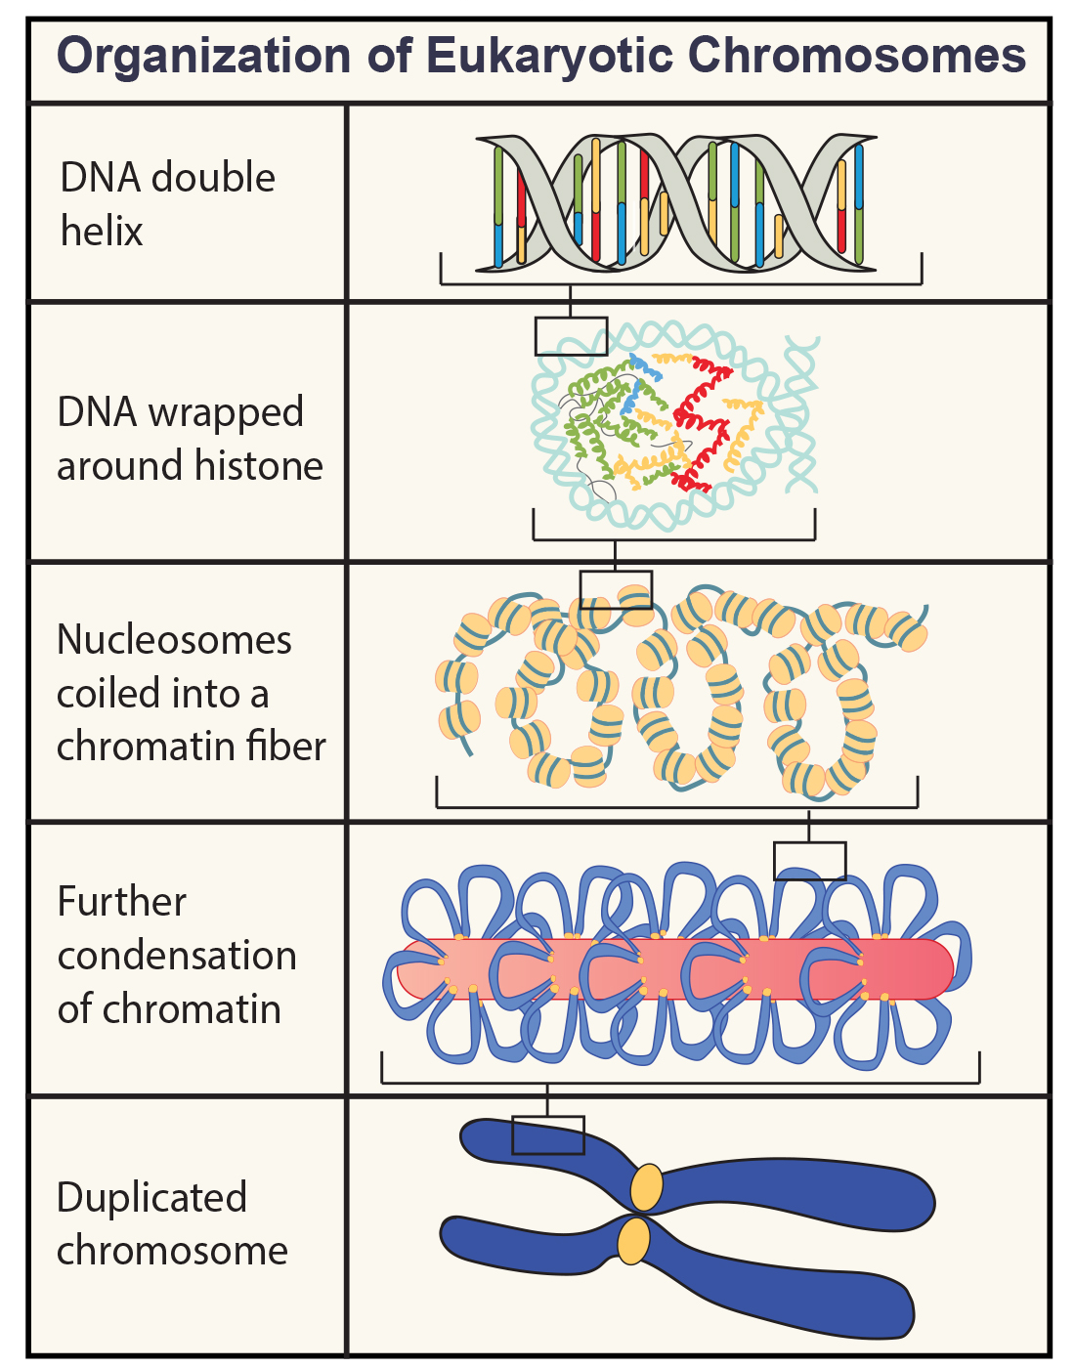
14.2 Figure 12
OpenStax. "Organization of eukaryotic chromosomes."
Notes:
Figure 12: These figures illustrate the compaction of the eukaryotic chromosome.

Slide 24
Summary
Double-helix structure of DNA proposed by Watson and Crick
Have complementary base sequences and antiparallel orientation
Alternating deoxyribose sugars and phosphates form backbone
Nitrogenous bases stacked inside
Purine pairs with pyrimidine (A + T and G + C)
Diameter is 2 nanometers and uniform throughout
10 base pairs per turn of helix
Prokaryotes:
Simpler than eukaryotes
Contain singular circular chromosome
Eukaryotes:
Contain linear DNA packaged into nucleosome
Two distinct regions distinguishable by staining

Slide 25


End of Hawkes Learning PowerPoint

