Slide 1
Lesson 14.3
DNA Replication in Prokaryotes

Slide 2
Objectives
Describe the Meselson and Stahl experiments.
Discuss the role of different enzymes and proteins in supporting this process.
Explain how the structure of DNA reveals the replication process.
Explain the process of DNA replication in prokaryotes.

Slide 3
DNA Replication in Prokaryotes₁
DNA structure provides clues on DNA division and replication
Specific base pairs predict complement
Two strands separate; each strand is template for new complementary strand
Three models for DNA replication proposed:
Conservative model: One daughter molecule contains two original parental strands; the other contains two newly synthesized strands
Semiconservative model: Each daughter molecule contains one parental strand and one newly synthesized strand
Dispersive model: Parental DNA is dispersed and mixed with newly synthesized DNA in both daughter molecules

Slide 4
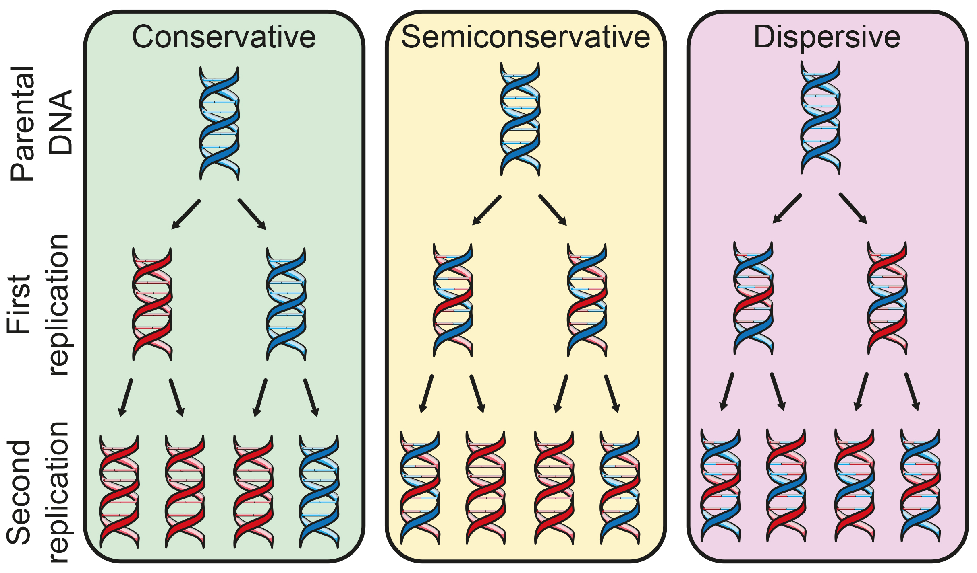
14.3 Figure 1
Notes:
Three early models of possible modes of DNA replication are shown. In conservative replication, newly formed strands and original strands stay separated after replication. In semiconservative replication, each newly formed strand matches with an original strand. In dispersive replication, fragments of each original strand are interspersed with fragments of newly formed DNA.

Slide 5
Reflection Question₁
What do you think is the most likely model of DNA replication? Why?
Notes:
The reflection question is included here to use as a talking point or for a think-pair-share activity.

Slide 6
DNA Replication in Prokaryotes₂
Meselson and Stahl experiment
Provided evidence for semiconservative model
Process:
Grew E. coli in heavy ¹⁵N medium to label DNA
Transferred to lighter ¹⁴N medium and analyzed DNA density
Conclusion
After one generation, DNA had intermediate density (supporting semiconservative or dispersive model)
After two generations, found intermediate density DNA and ¹⁴N density DNA (providing evidence for semiconservative model)

Slide 7
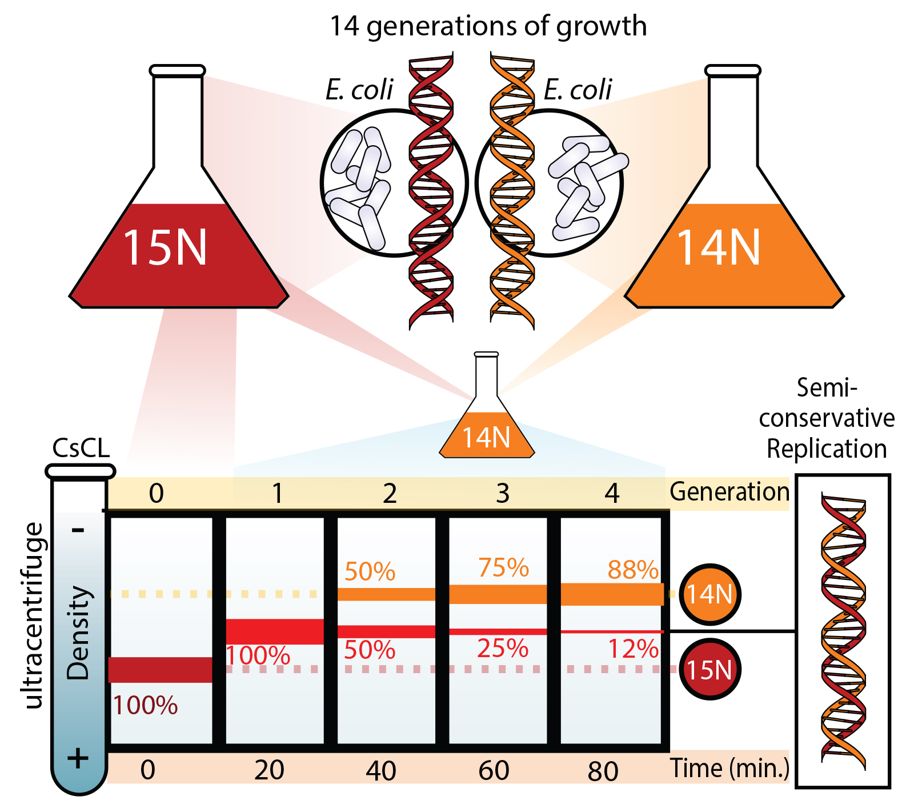
14.3 Figure 2
Mariana Ruiz Villarreal on Wikimedia Commons. "Meselson-Stahl experiment."
Notes:
Meselson and Stahl experimented with E. coli grown first in heavy nitrogen (15N), then in 14N. DNA grown in 15N (red band on left) is heavier than DNA grown in 14N (orange band on right) and settles to a lower level in a cesium chloride solution in an ultracentrifuge. When DNA grown in 15N is switched to media containing 14N, after one round of cell division, the DNA settles halfway between the 15N and 14N levels, indicating that it now contains 50% 14N. These data support the semiconservative replication model.

Slide 8
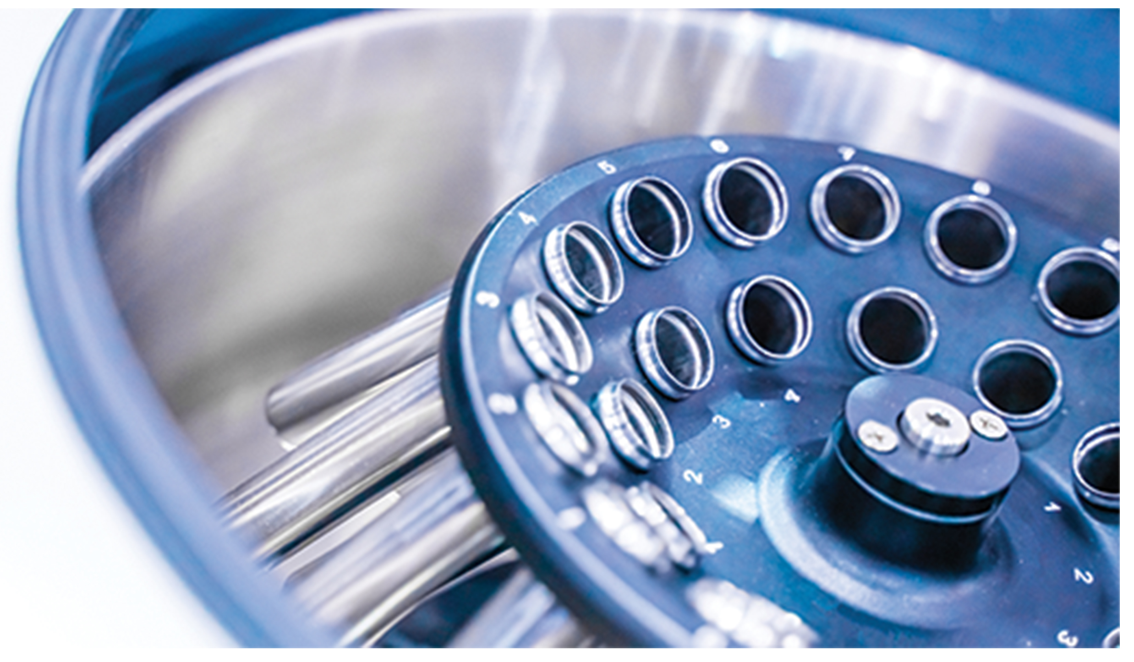
DNA Replication in Prokaryotes₃
After first round, DNA had one ¹⁵N strand and one ¹⁴N strand
In second round, strands separated to serve as templates for new strands, resulting in half daughter molecules having one ¹⁵N and one ¹⁴N strand and other half having two ¹⁴N strands
Subsequent generations had increase in fully ¹⁴N DNA and intermediate density (halfway between ¹⁵N and ¹⁴N) DNA decreased but never disappeared
Evidence that parental strands were maintained
14.3 Figure 3: Meselson and Stahl used centrifugation to determine the relative density of DNA molecules. A centrifuge rapidly whirls the contents, forcing heavier particles downward in each tube and often resulting in concentrated layers of particles after centrifugation.

Slide 9
DNA Replication in Prokaryotes₄
During replication, each strand is template from which new strands are copied
New strands are complementary to parental strands
When two daughter copies are formed, they have same sequence and divided equally into two daughter cells

Slide 10
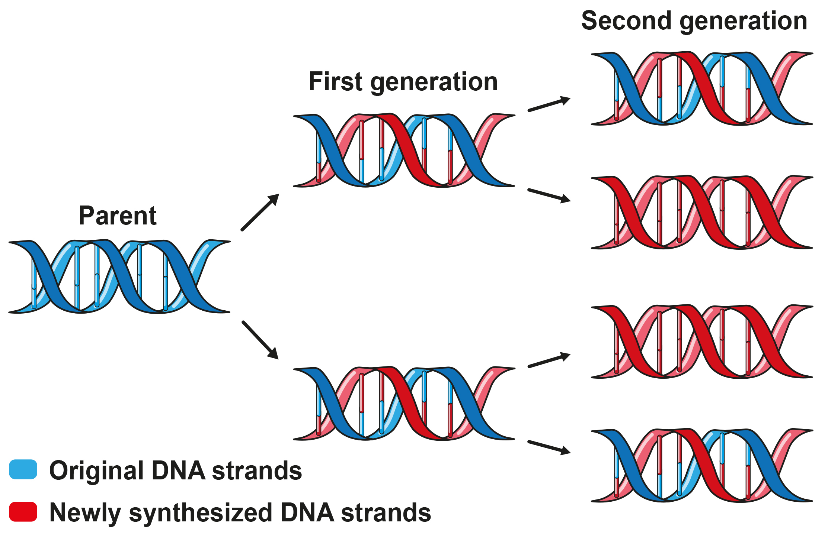
14.3 Figure 4
Notes:
This image shows what occurs during two rounds of DNA replication. In each round, one strand of existing DNA serves as the template for the synthesis of a brand-new strand.

Slide 11
Reflection Question₂
If the mode of DNA replication had been dispersive, what results would Meselson and Stahl have likely observed after the second generation of growth in the ¹⁴N medium? After later generations of growth?
Notes:
The reflection question is included here to use as a talking point or for a think-pair-share activity.

Slide 12
DNA Replication in Prokaryotes₅
DNA replication in prokaryotes studied with E. coli
E. coli properties make it ideal for studying
4.6 million base pairs in single circular chromosome
Can be replicated in 20 to 40 minutes, starting from single site and proceeding around circle in both directions
1,000 nucleotides added per second

Slide 13
Group Activity
If you need help picturing how the circular bacterial chromosome is replicated, try this:
Get a wide rubber band; think of it as the bacterial chromosome. Draw a dot on it to represent the origin of replication on the chromosome. Now, use scissors to cut lengthwise, starting at the dot and moving along the middle of the rubber band in both directions until you have a figure-eight shape. This is a simplistic representation of how replication proceeds along the chromosome in opposite directions. Finally, snip the figure eight to yield two circles that represent the two chromosomes that result from prokaryotic replication.

Slide 14
DNA Replication in Prokaryotes₆
Replication proteins and enzymes:
DNA polymerase (DNA pol): main enzyme that adds new DNA nucleotides during DNA replication
DNA pol I (required for repair)
DNA pol II (required for repair)
DNA pol III (required for DNA synthesis)
DNA pol IV (participates in repairing DNA damage)
DNA pol V (participates in repairing DNA damage)
ATP and NTP for energy and source of DNA nucleotides
NTP: nucleoside triphosphate

Slide 15
DNA Replication in Prokaryotes₇
Process:
DNA replication starts at origin of replication site
Origin of replication: specific point on DNA where replication begins
E. coli has single origin of replication that is 245 base pairs long and rich in AT sequences
Helicase enzyme unwinds DNA (ATP hydrolysis required)
Helicase: during replication, this enzyme helps to open up the DNA helix by breaking the hydrogen bonds
Replication forks form, allowing replication in both directions
Replication fork: Y-shaped structure formed during initiation of DNA replication
Single-strand binding proteins coat single strands near replication fork
Single-strand binding protein: during replication, protein that binds to the single-stranded DNA; this helps in keeping the two strands of DNA apart so that they may serve as templates

Slide 16
DNA Replication in Prokaryotes₈
DNA polymerase restrictions:
Can only add nucleotides in 5′ to 3′ direction (new DNA strand can only be extended in this direction)
Requires free 3′-OH group to add nucleotides to by forming phosphodiester bond between 3′-OH end and 5′ phosphate of next nucleotide
Cannot add nucleotides if free 3′-OH group not available
DNA polymerase adds first nucleotide with help of primer that provides free 3′-OH end
Primer: short stretch of nucleotides that is required to initiate replication; in the case of replication, the primer has RNA nucleotides
Primer created by RNA primase, which synthesizes RNA segment 5 to 10 nucleotides long and complementary to template DNA
Primase: enzyme that synthesizes the RNA primer; the primer is needed for DNA pol to start synthesis of new DNA strand

Slide 17
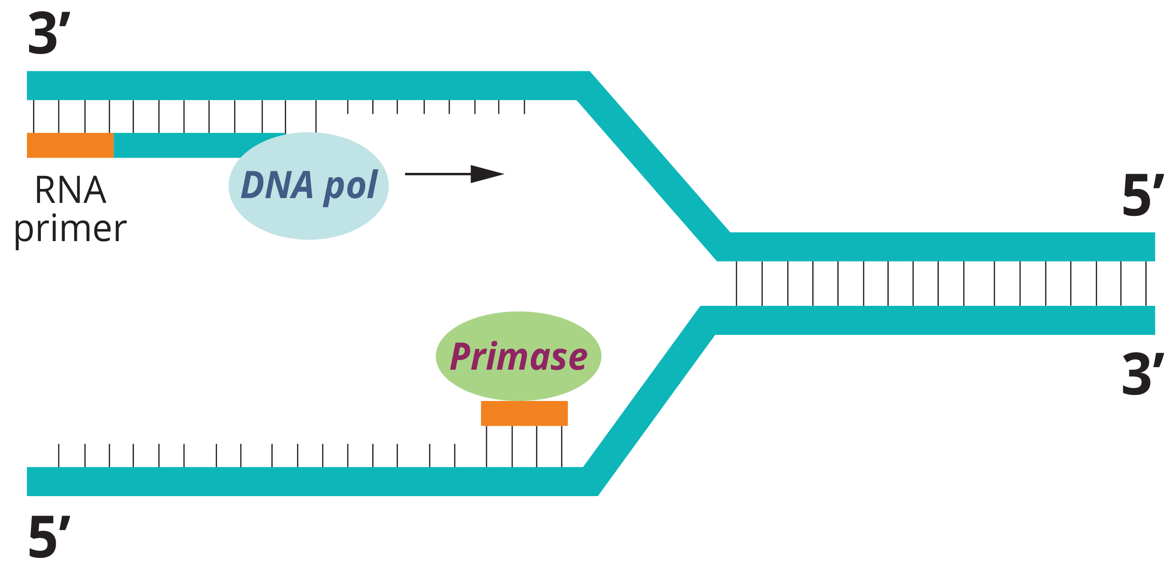
14.3 Figure 5
Andrade EB on Wikimedia Commons. "DNA polymerase."
Notes:
At the replication fork, the enzyme primase synthesizes a primer that provides the free 3′-OH end needed for DNA polymerase (DNA pol) to add nucleotides in the 5′ to 3′ direction. Because each of the template, DNA strands are antiparallel (one runs in the 5′ to 3′ direction and one in the 3′ to 5′ direction), yet DNA synthesis must proceed in the 5′ to 3′ direction. The position of the primers differs between the strands.

Slide 18
DNA Replication in Prokaryotes₉
Replication fork moves at 1,000 nucleotides per second
Topoisomerase prevents overwinding ahead of replication fork by causing temporary nicks in DNA helix then resealing
Topoisomerase: enzyme that relieves the strain caused by underwinding or overwinding of DNA when DNA replication is taking place
Two template DNA strands have opposing orientations but DNA polymerase can only extend in 5′ to 3′ direction and DNA helix is antiparallel so two different strands are used
Leading strand: the strand that is synthesized continuously in the 5′-3′ direction, which is synthesized in the direction of the replication fork
Lagging strand: during replication, the strand that is replicated in short fragments (Okazaki fragments) away from replication fork in 3′-5′ direction
Okazaki fragments: DNA fragments that are synthesized in short stretches on the lagging strand; require a primer to start synthesis

Slide 19
DNA Replication in Prokaryotes₁₀
Sliding clamp holds DNA polymerase in place as it adds nucleotides
Sliding clamp: ring-shaped protein that holds the DNA polymerase on the DNA strand
RNA primers replaced by DNA
Primers removed by DNA pol I, which uses DNA behind RNA as its own primer and fills gaps left by removal of RNA nucleotides by addition of DNA nucleotides
Nicks that remain between newly synthesized DNA (that replaced RNA primer) and previously synthesized DNA sealed by DNA ligase
Ligase: enzyme that seals DNA fragments together into a continuous strand
Once chromosome has been replicated, two DNA copies move into different cells during cell division

Slide 20
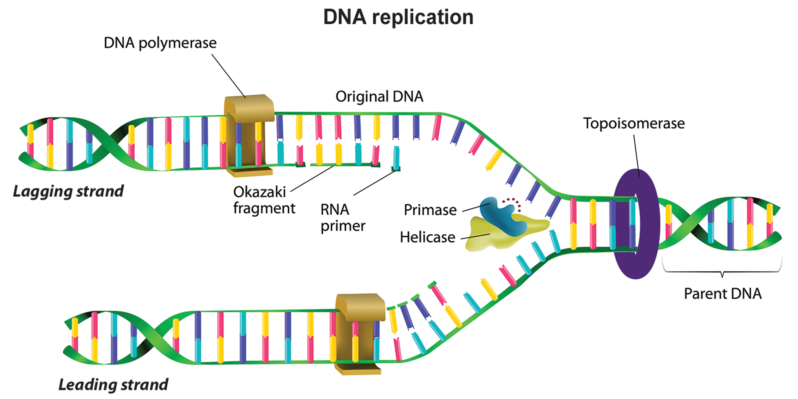
14.3 Figure 6
Notes:
A replication fork is formed when helicase separates the DNA strands at the origin of replication. The DNA tends to become more highly coiled ahead of the replication fork. Topoisomerase breaks and reforms DNA's phosphate backbone ahead of the replication fork, thereby relieving the pressure that results from this "supercoiling." Single-strand binding proteins bind to the single-stranded DNA to prevent the helix from reforming. Primase synthesizes an RNA primer, which DNA polymerase III then uses to synthesize the daughter DNA strand. On the leading strand, DNA is synthesized continuously, whereas on the lagging strand, DNA is synthesized in short stretches called Okazaki fragments. DNA polymerase I replaces the RNA primer with DNA. DNA ligase seals the gaps between the Okazaki fragments, joining the fragments into a single DNA molecule.

Slide 21
Summary of Prokaryotic DNA Replication
DNA unwinds at the origin of replication.
Helicase opens up the DNA-forming replication forks; these are extended bidirectionally.
Single-strand binding proteins coat the DNA around the replication fork to prevent rewinding of the DNA.
Topoisomerase binds at the region ahead of the replication fork to prevent supercoiling.
Primase synthesizes RNA primers complementary to the DNA strand.
DNA polymerase III starts adding nucleotides to the 3′-OH end of the primer.
Elongation of both the lagging and leading strands continues.
RNA primers are removed by exonuclease activity.
Gaps are filled by DNA pol I by adding dNTPs (the high-energy nucleoside triphosphates ATP, GTP, TTP, and CTP).
The gap between two DNA fragments (Okazaki fragments) is sealed by DNA ligase, which helps in the formation of phosphodiester bonds.

Slide 22
Table 1: Summary of the Enzymes Involved in Prokaryotic DNA Replication and Their Functions
Enzyme/Protein | Function
helicase | opens the DNA helix by breaking hydrogen bonds between paired nitrogenous bases
single-stranded binding proteins | bind to single-stranded DNA to prevent it from rewinding into a helix
DNA pol III | main enzyme that adds nucleotides in 5′-3′ direction
sliding clamp | helps to hold the DNA polymerase in place when nucleotides are being added
primase | synthesizes RNA primers needed to start DNA replication
topoisomerase | helps relieve the strain on DNA when unwinding by nicking the DNA and resealing it
DNA pol I | removes RNA primer and replaces it with newly synthesized DNA
ligase | seals the gaps between the Okazaki fragments to create one continuous DNA strand

Slide 23
Summary₁
Single chromosome of prokaryote consists of single continuous double helix
DNA replication produces two identical copies of DNA molecules from one original DNA molecule through semiconservative process
Conservative model: Conserves parental strand and daughter DNA newly synthesized
Semiconservative model: Each of the two parental DNA strands acts as template for new DNA to be synthesized; after replication, each double-stranded DNA retains parental strand and one new strand
Supported by Meselson and Stahl experiment
Dispersive model: Two copies of DNA would have segments of parental DNA and newly synthesized DNA

Slide 24
Summary₂
Prokaryotic replication starts from origin of replication
Helicase opens up DNA double helix, forming replication fork
Single-strand binding proteins keep fork open
Primase synthesizes RNA primer to initiate synthesis by DNA polymerase
One strand in the direction of replication fork (leading strand)
One strand away from replication fork (lagging strand)
Replication complete, RNA primers replaced by DNA nucleotides and sealed with DNA ligase

Slide 25

End of Hawkes Learning PowerPoint
Prokaryotic replication starts from origin of replication
Helicase opens up DNA double helix, forming replication fork
Single-strand binding proteins keep fork open
Primase synthesizes RNA primer to initiate synthesis by DNA polymerase
One strand in the direction of replication fork (leading strand)
One strand away from replication fork (lagging strand)
Replication complete, RNA primers replaced by DNA nucleotides and sealed with DNA ligase

