Slide 1
Lesson 14.4
DNA Replication in Eukaryotes

Slide 2
Objectives
Discuss the similarities and differences between DNA replication in eukaryotes and prokaryotes
State the role of enzymes in eukaryotic DNA replication.

Slide 3
Eukaryotic Versus Prokaryotic DNA Replication: Genome Structure
Eukaryotic genomes are much larger and more complex.
Human genome: 3 billion base pairs per haploid set 6 billion base pairs during S phase
A eukaryotic genome is commonly made of multiple different linear chromosomes.
Each eukaryotic chromosome has multiple origins of replication.
There are up to 100,000 origins of replication across the human genome.
Yeast have autonomously replication sequences, each of which contains an origin of replication, also maintain chromosome stability during replication.

Slide 4
Eukaryotic Versus Prokaryotic DNA Replication: Enzymatic Differences
The rate of eukaryotic replication is much slower than in prokaryotes.
Eukaryotic replication rate: 100 nucleotides per second
Prokaryotic replication rate: 1,000 nucleotides per second
The number of DNA polymerases in eukaryotes is much greater than in prokaryotes.
Eukaryotes: 14
5 have major roles: pol α, pol β, pol γ, pol δ, and pol ε
Prokaryotes: 5
3 have major roles

Slide 5
Eukaryotic Versus Prokaryotic DNA Replication: Other Differences
DNA must be available as template for replication to begin.
Eukaryotic DNA is coated with histone proteins, forming nucleosomes.
Chromatin = DNA + proteins
These proteins must first be removed, then later replaced during replication, contributing to the slower eukaryotic replication rate.
The chromatin may be chemically modified so that DNA can slide off of proteins or otherwise become accessible.
There are no histones in most prokaryotes.
At the origin of replication, a pre-replication complex is made with other initiator proteins.
Helicase and other proteins are then recruited to start replication.

Slide 6
Table 1. Summary of Differences Between Prokaryotic and Eukaryotic Replication
Property | Prokaryotes | Eukaryotes
Origin of Replication | single | multiple
Rate of Replication | 1,000 nucleotides per second | 50–100 nucleotides per second
DNA Polymerase Types | 5 | 14
Telomerase | not present | present
RNA Primer Removal | DNA pol I | RNase H
Strand Elongation | DNA pol III | pol α, pol δ, pol ε
Sliding Clamp | sliding clamp | PCNA

Slide 7
Eukaryotic DNA Replication Steps: Initiation
Helicase uses energy from ATP hydrolysis to open up DNA helix.
Replication forks form at each origin as the DNA unwinds.
As the DNA ahead of the replication fork becomes overwound, topoisomerases resolve this supercoiling.
The primase enzyme forms short RNA primers on both strands that DNA pol uses to begin DNA synthesis.
DNA pol α adds short (20–30 nucleotides) DNA fragments to the RNA primers on both strands, then hands off to either δ or ε.

Slide 8
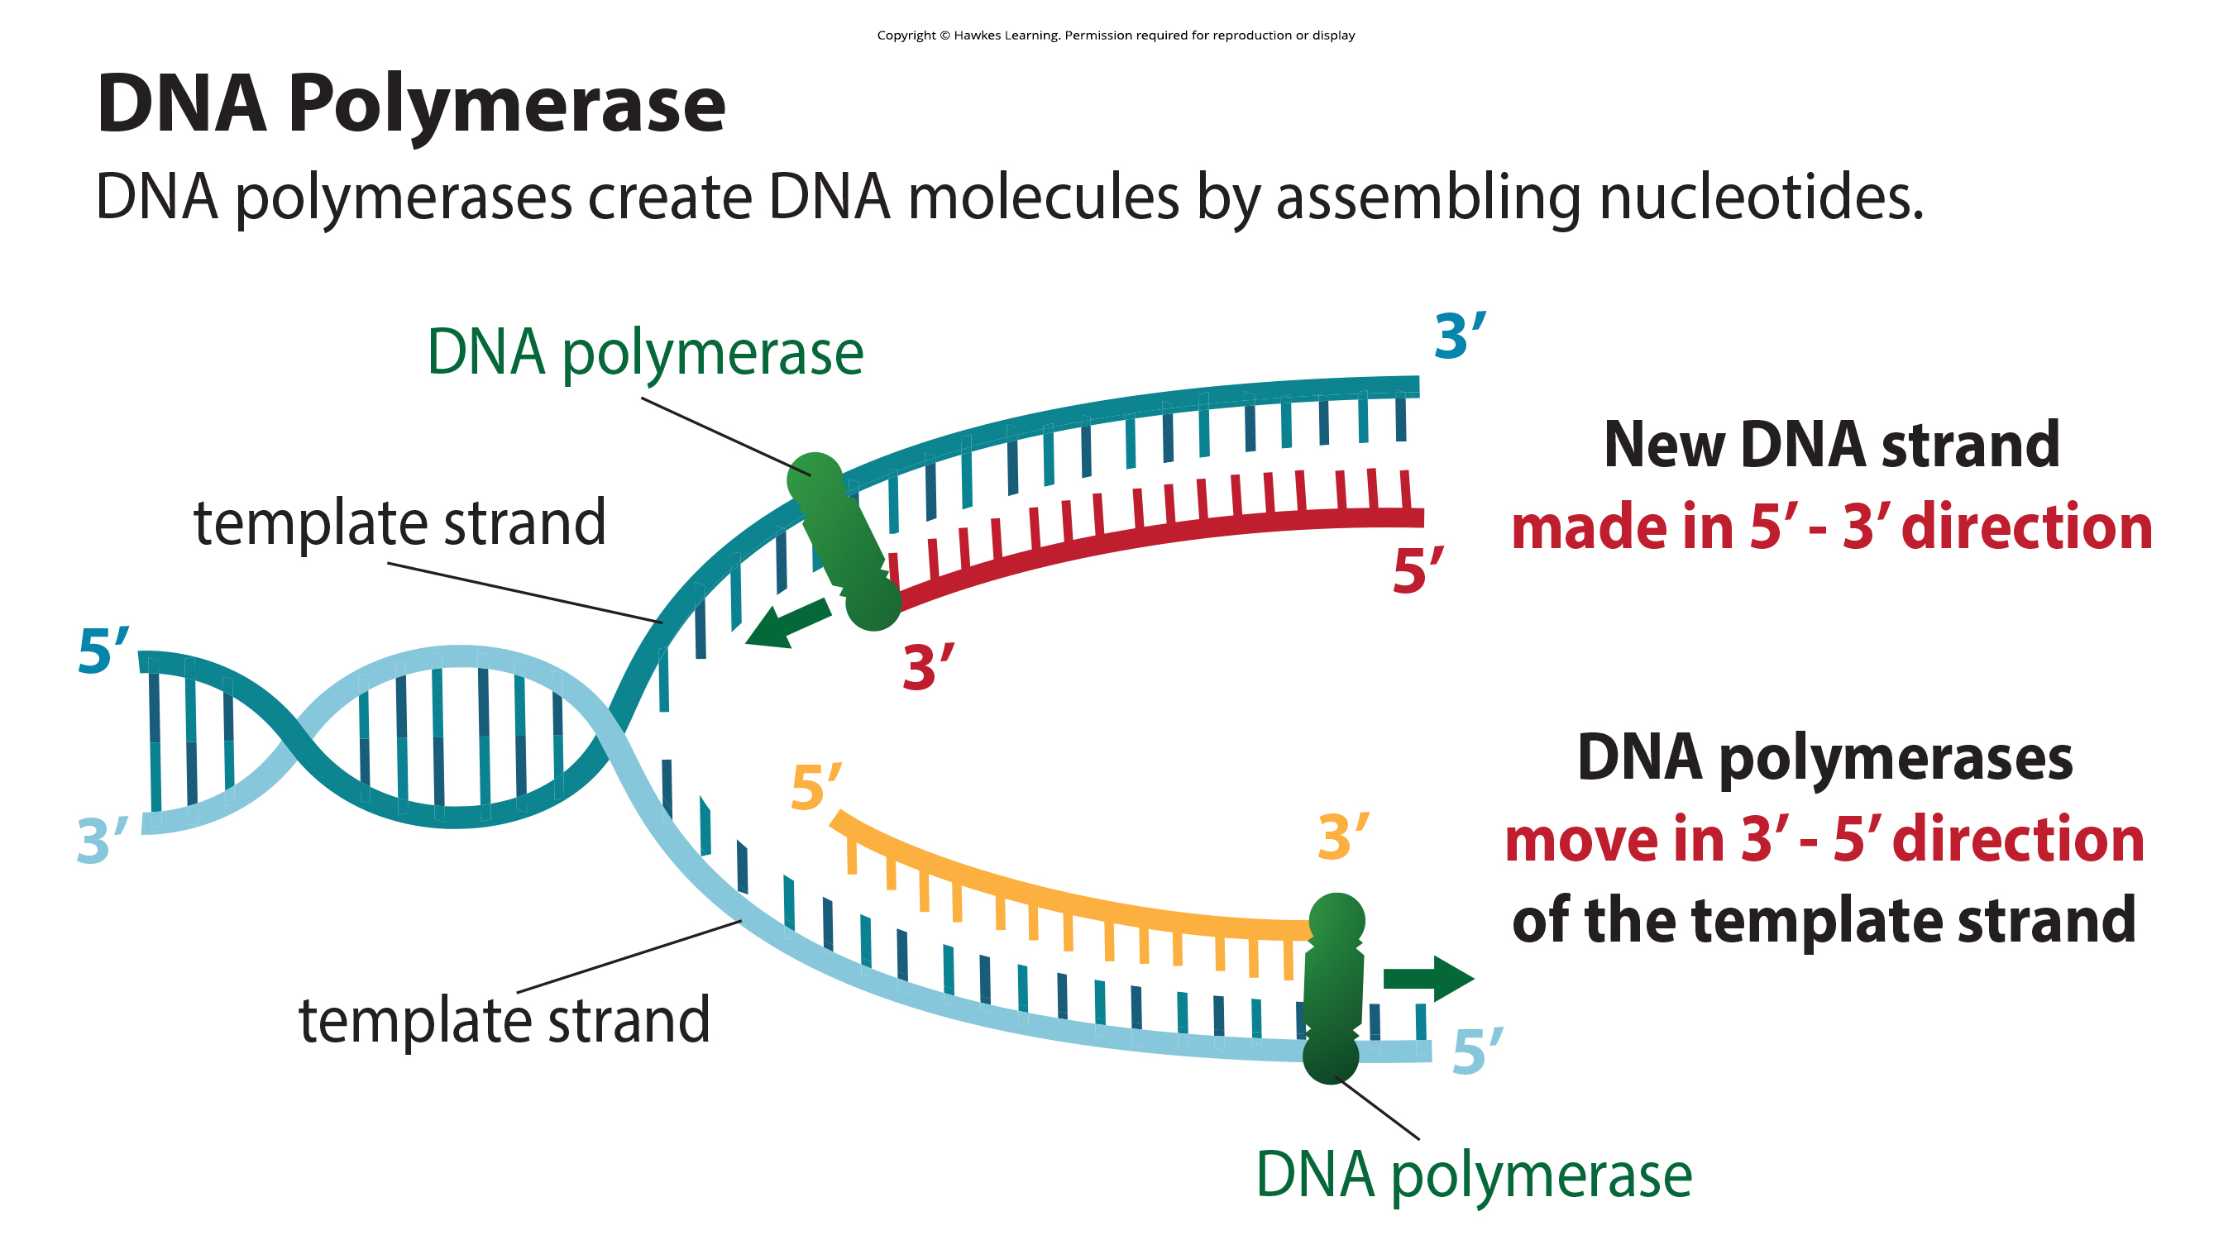
14.4 Figure 1
Notes:
Careful inspection of this diagram reveals that the two strands of DNA run in opposite directions. Synthesis of new DNA always runs in the direction 5′-3′. DNA polymerases are shown at the positions where the newest DNA nucleotides will be added.

Slide 9
Eukaryotic DNA Replication Steps: Synthesis
Leading Strand Synthesis:
DNA pol ε continuously synthesizes the leading strand.
Lagging Strand Synthesis:
As pol δ runs into an RNA primer on the lagging strand, it:
Displaces the RNA, which is degraded by RNase H.
Replaces the RNA with DNA nucleotides.
Forms short DNA pieces called Okasaki fragments.
DNA ligase forms phosphodiester bonds between the Okasaki fragments, sealing them together.
A sliding clamp protein holds the DNA pol in place so that it does not slide off the DNA.

Slide 10
Reflection Question₁
Do you think mutations are more likely to occur in prokaryotic cells or eukaryotic cells? Explain why you think that.
Notes:
The reflection question is included here to use as a talking point or for a think-pair-share activity.

Slide 11
Think It Through₁
Prokaryotic DNA replication has a single starting point (origin of replication) on its circular chromosome. Eukaryotic DNA replication has multiple starting points.
What might be an advantage to having multiple origin sites?
Notes:
Originally an On Your Own. This is included here to use as a talking point or for a think-pair-share activity.

Slide 12
Telomere Replication: Telomere Structure
During DNA replication of a linear chromosome, there is no way to replace the primer on the 5′ end of the lagging strand.
Telomeres, the DNA at each chromosome’s ends, remain unpaired and shorten by 30–120 base pairs per cell division.
Telomeres are made of noncoding repetitive sequences that protect genes from deletion as cells divide.
In human telomeres, TTAGGG is repeated 100–1,000 times.

Slide 13
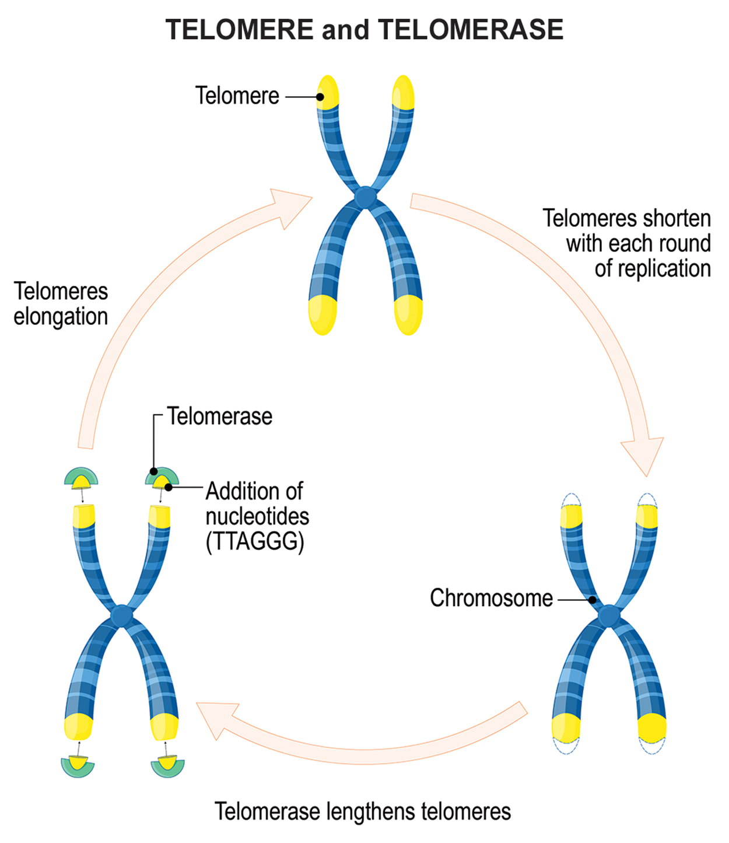
14.4 Figure 2
Notes:
The ends of linear chromosomes are maintained by the action of the telomerase enzyme.

Slide 14
Telomere Replication: Telomerase
Telomerase:
Is an enzyme that adds telomeres to the ends of chromosomes.
Has a catalytic part and a built-in RNA template.
Attaches to the end of the chromosome, where DNA nucleotides complementary to its RNA template are added on the 3’ end of the DNA strand.
Once the 3’ end of the lagging strand template is long enough, DNA polymerase then adds nucleotides complementary to the chromosomes’ ends.

Slide 15
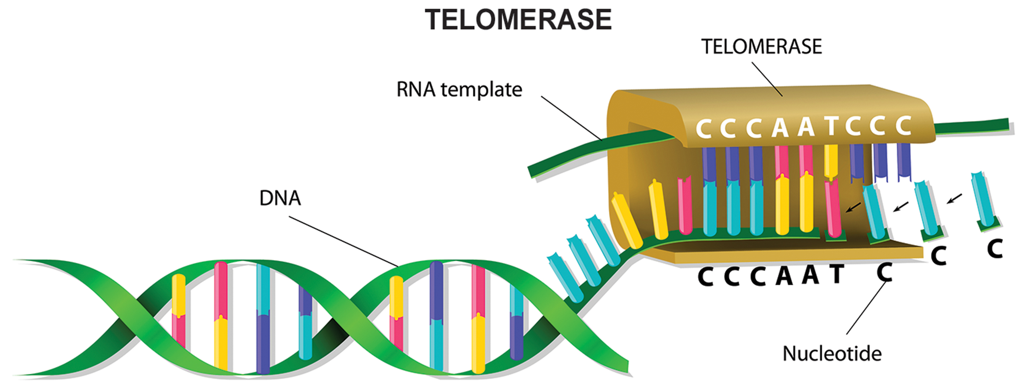
14.4 Figure 3
Notes:
Telomerase attaches to the 3′ end of a linear DNA strand and allows the formation of the required RNA primer. DNA polymerase uses the RNA primer to begin knitting new DNA. Telomerase will then detach, and the RNA primer will be replaced by DNA.

Slide 16
Think It Through₂
Which of these is an inaccurate statement about telomeres?
Telomeres are gradually lengthened with each round of cell division.
Telomeres are only found in eukaryotic cells.
Telomeres are located at the ends of linear chromosomes.
Telomeres contain repeated sequences.
Notes:
Originally an On Your Own. This is included here to use as a talking point or for a think-pair-share activity.

Slide 17
Telomere Replication: Telomerase Activity
Telomerase is typically active in:
Germ cells
Adult stem cells
Embryos
Some cancer cells
Telomerase is typically not active in:
Adult somatic cells (such as skin, blood, and bone cells)
Elizabeth Blackburn, Carol W. Greider, and Jack W. Szostak received the Nobel Prize for Medicine and Physiology (2009) for discovering telomerase and its activity.

Slide 18
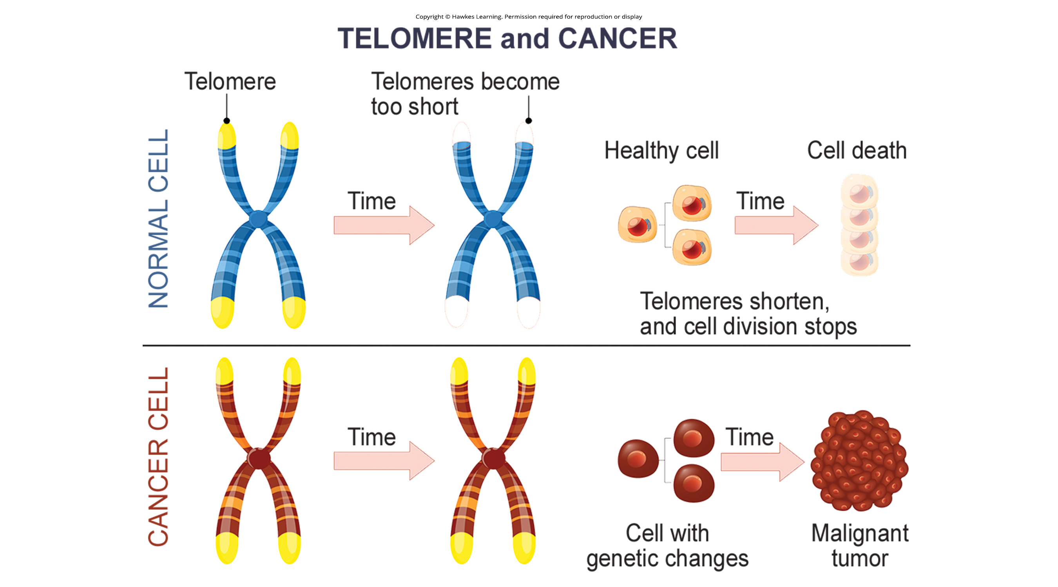
Telomerase and Aging: Cause
Cell division shortens the telomeres of somatic cells.
Once telomeres are too short, the cell’s DNA damage response is triggered, leading the cell to undergo:
Senescence (growth arrest) OR
Apoptosis (programmed cell death)
4.5 Figure 4

Slide 19
Telomerase and Aging: Restoration of Telomerase
Scientists (2010) have found that restoration of telomerase activity in telomerase-deficient mice:
Caused telomerase extension
Reversed neurodegeneration
Improved functions of the testes, spleen, and intestines

Slide 20
Reflection Question₂
Do you think that cancer-therapy treatments designed to inhibit telomerase activity could have any unintended side effects? How could such effects be mitigated?
Notes:
The reflection question is included here to use as a talking point or for a think-pair-share activity.

Slide 21
Science and You
Cancer is characterized by uncontrolled cell division.
Cancerous cells have:
Considerably shortened telomeres
Active telomerase
If telomerase activity in cancerous cells could be inhibited by drugs during cancer therapy, these cancerous cells could potentially be stopped from further division.
4.5 Figure 4
Notes:
This is included as a relevant application for this topic.

Slide 22
Summary
Eukaryotic replication starts at multiple origins of replication.
Like prokaryotic replication:
A primer is needed to initiate synthesis.
DNA polymerase then adds nucleotides to the growing chain.
Leading strand synthesis is continuous.
Lagging strand synthesis produces Okasaki fragments, the RNA primers are removed and replaced with DNA nucleotides, and the fragments are linked by DNA ligase.
Linear chromosomes’ telomere ends cannot be replaced with DNA, so they become shorter and shorter from repeated cell division.
Telomerase has a built-in RNA template that its catalytic activity uses to extend the complementary strand with DNA, and DNA polymerase uses this DNA as template to make a complementary DNA strand.

Slide 23


End of Hawkes Learning PowerPoint

