Slide 1
Lesson 14.5
Mutations and DNA Repair

Slide 2
Objectives
Discuss the different types of mutations in DNA.
Explain DNA repair mechanisms.

Slide 3
Mutations
While DNA replication is very accurate, mistakes do occur.
DNA polymerase may insert a wrong base.
If mistakes are not corrected, mutations may result.
Mutations are changes in the nucleotide sequence of DNA.
Mutations can sometimes lead to serious consequences such as cancer.

Slide 4
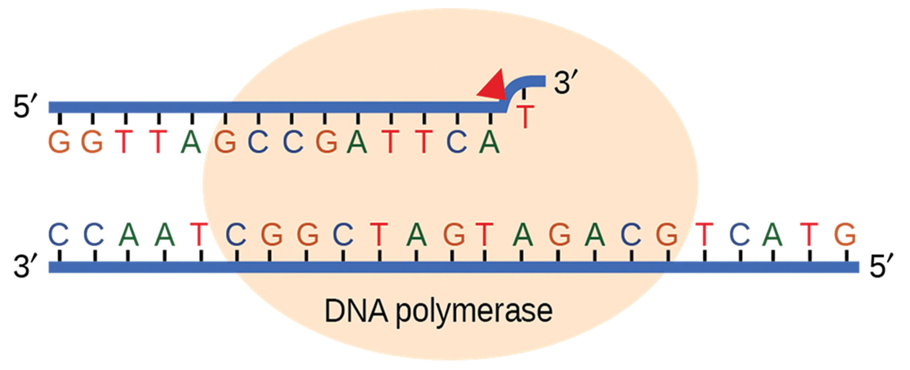
DNA Repair: Proofreading
DNA polymerase has a proofreading ability that promptly corrects most mistakes made during DNA replication.
It reads the newly added base to ensure it is paired correctly before adding another.
It removes an incorrect base by making a cut at the phosphodiester bond and releasing the wrong nucleotide, then replaces it with the correct one.
14.5 Figure 1
OpenStax. "DNA repair."

Slide 5
DNA Repair: Mismatch Repair
Mismatch repair corrects errors that occur after replication is completed.
Repair enzymes:
  Recognize the mispaired nucleotide
  Excise part of the strand that contains it
DNA polymerase resynthesizes the excised region.
For mismatch repair, the parental versus the newly synthesized DNA must be differentiated.
In bacteria like E. coli, adenines in parental DNA are methylated, while those in newly made DNA are not.
In eukaryotes, unsealed nicks and the association of some replication proteins may help to identify new strands.

Slide 6
DNA Repair: Nucleotide Excision Repair
Nucleotide excision repair removes damaged bases.
Repair enzymes make cuts on both the 3’ and 5’ ends of the damaged base.
The DNA segment with the abnormal base is removed.
DNA polymerase adds correctly paired nucleotides.
DNA ligase seals the remaining phosphodiester linkage.

Slide 7
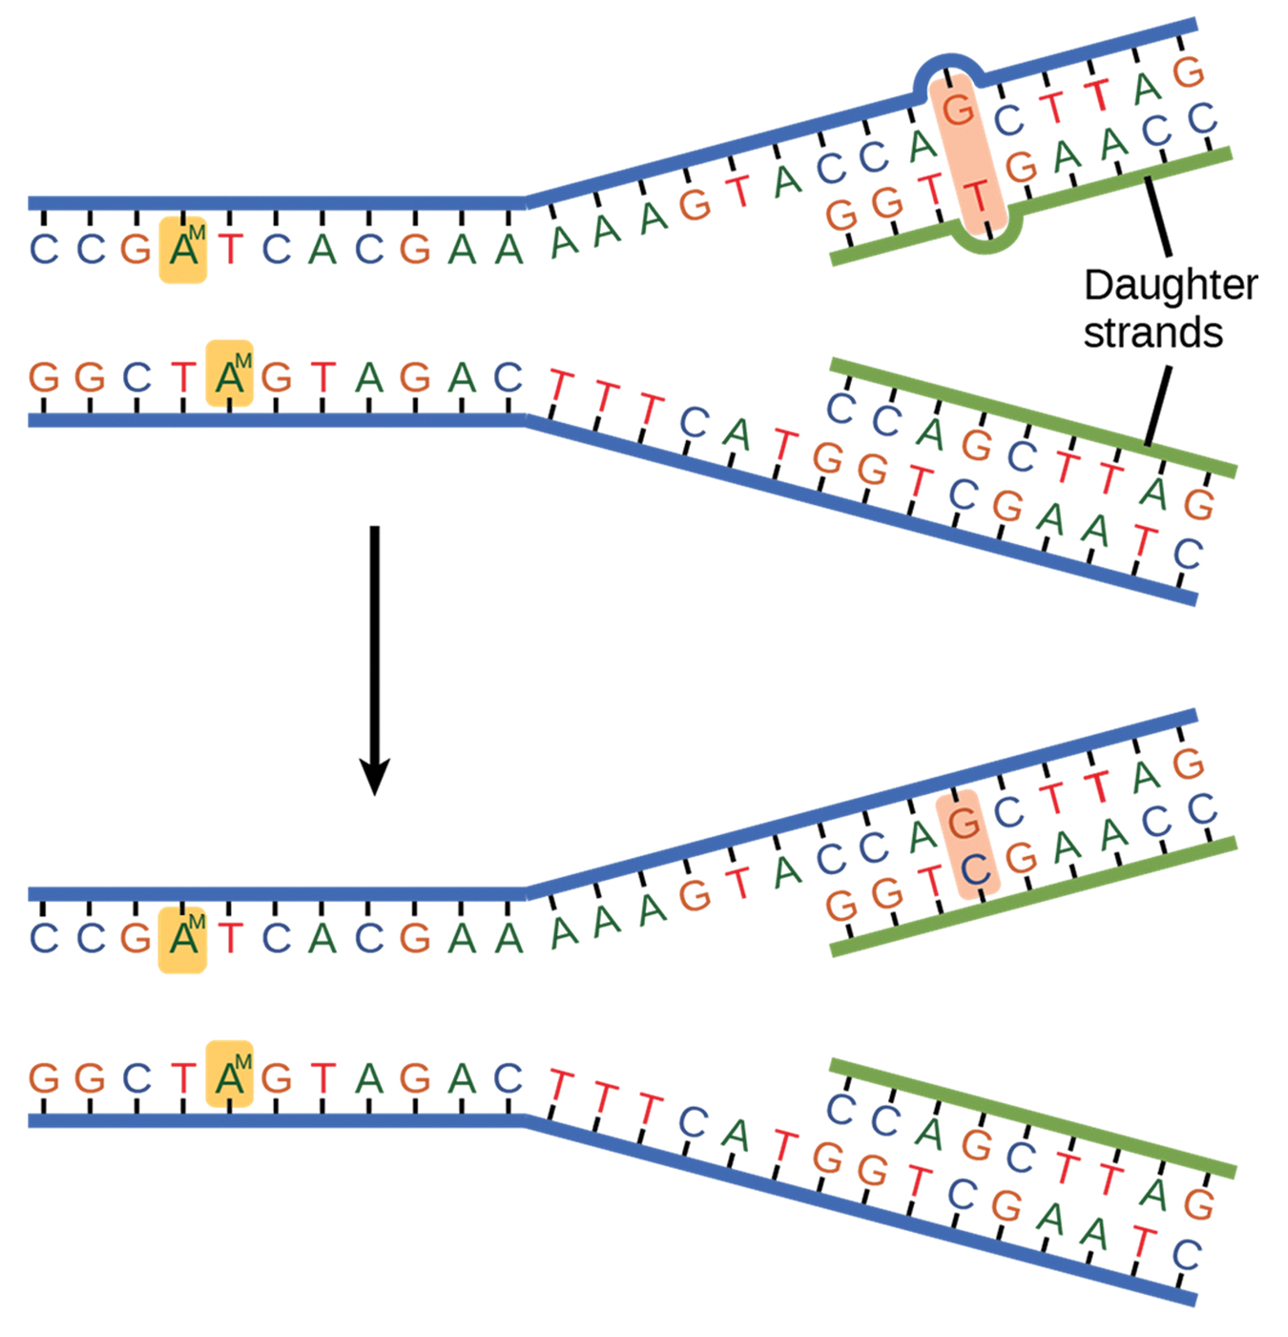
Think It Through₁
In the diagram, the mismatched base pair G and T (indicated by highlighting) is corrected to G and C.
Do you see another mismatched pairing?
What should it be after repair?
14.5 Figure 2
OpenStax. "Mismatch pair."
Notes:
Originally an On Your Own. This is included here to use as a talking point or for a think-pair-share activity.

Slide 8
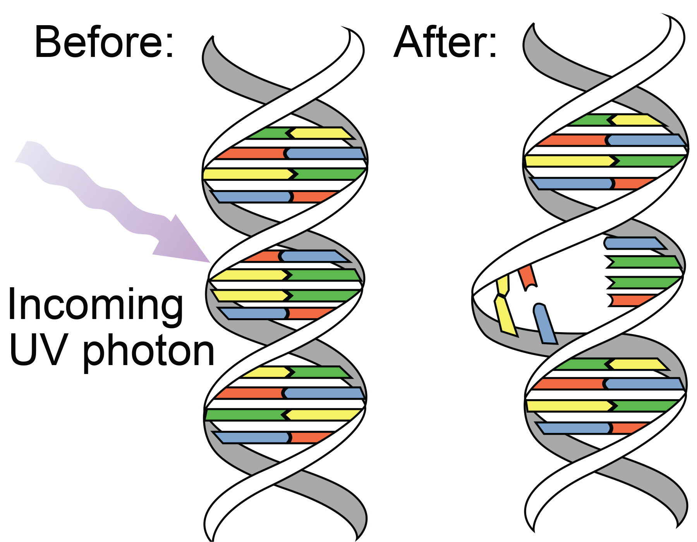
DNA Repair: Thymine Dimer Formation
UV exposure causes the formation of pyrimidine dimers, most commonly thymine dimers between adjacent thymine bases.
Thymine dimers distort DNA structure and may cause problems during DNA replication.
14.5 Figure 3
PD-USGov-NASA on Wikimedia Commons. "DNA UV mutation."

Slide 9
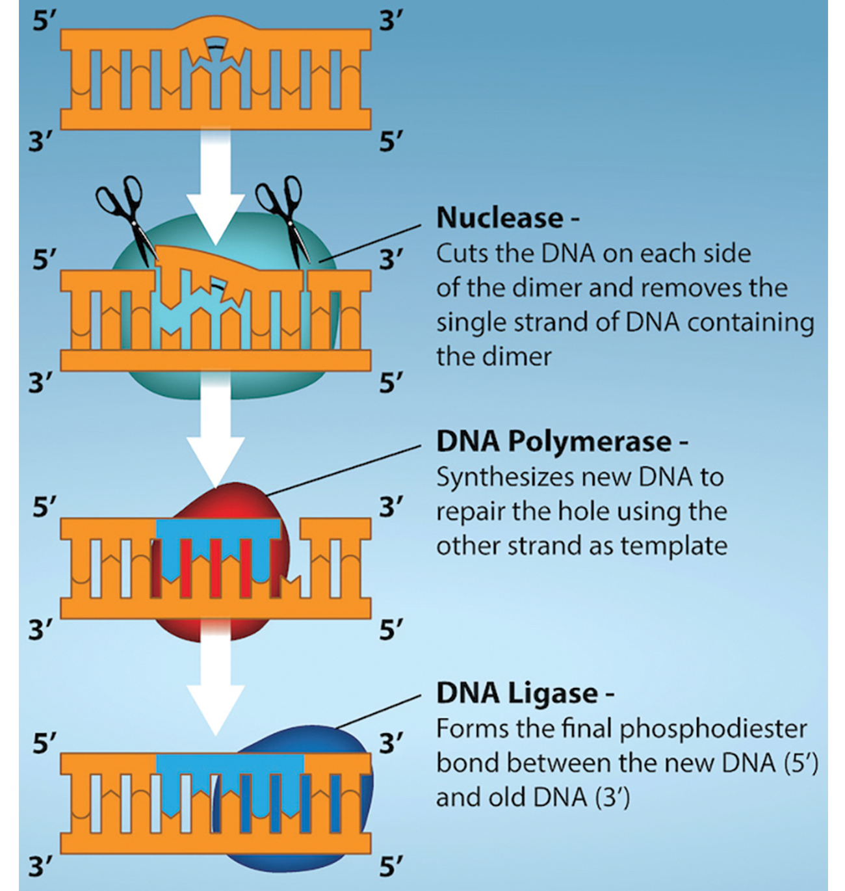
DNA Repair: Thymine Dimer Repair
Nucleotide excision repair normally repairs most thymine dimers, but some may remain.
14.5 Figure 4
Rao, A., Fletcher, S. and Tag, A. Department of Biology, Texas A&M University. "Nucleotide excision."

Slide 10
Type of Mutations: Induced
Induced mutations:
Result from an exposure to chemicals, UV rays, X-rays, or another environmental agent

Slide 11
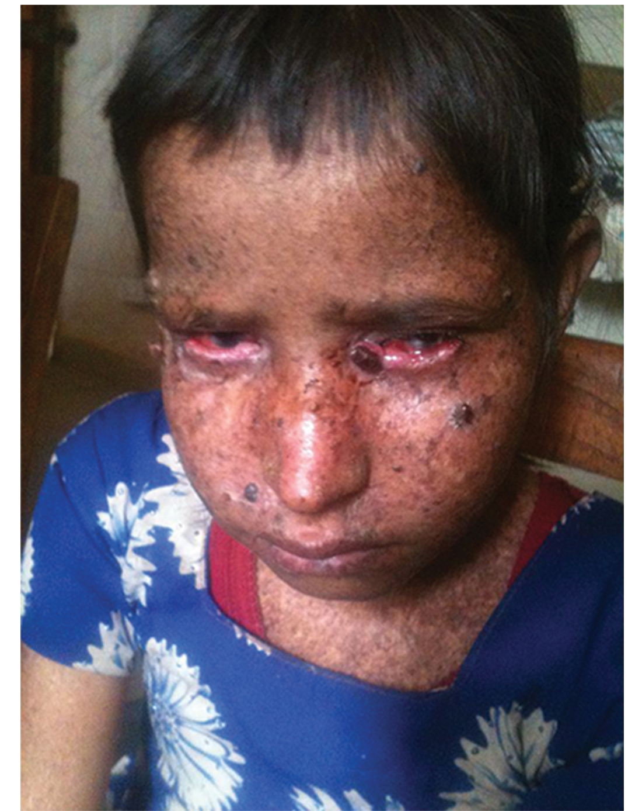
Effects of Induced Mutations: Example
Xeroderma pigmentosa is an example of a genetic condition that results from mistakes not being corrected.
Those affected:
  Are unable to repair thymine dimers due to a defect in nucleotide excision repair enzymes
  Are highly sensitive to UV rays from the sun
  Develop skin lesions
  Have an increased risk of developing skin cancer
14.5 Figure 5
Himynameislax on Wikimedia Commons. "Xeroderma pigmentosa."

Slide 12
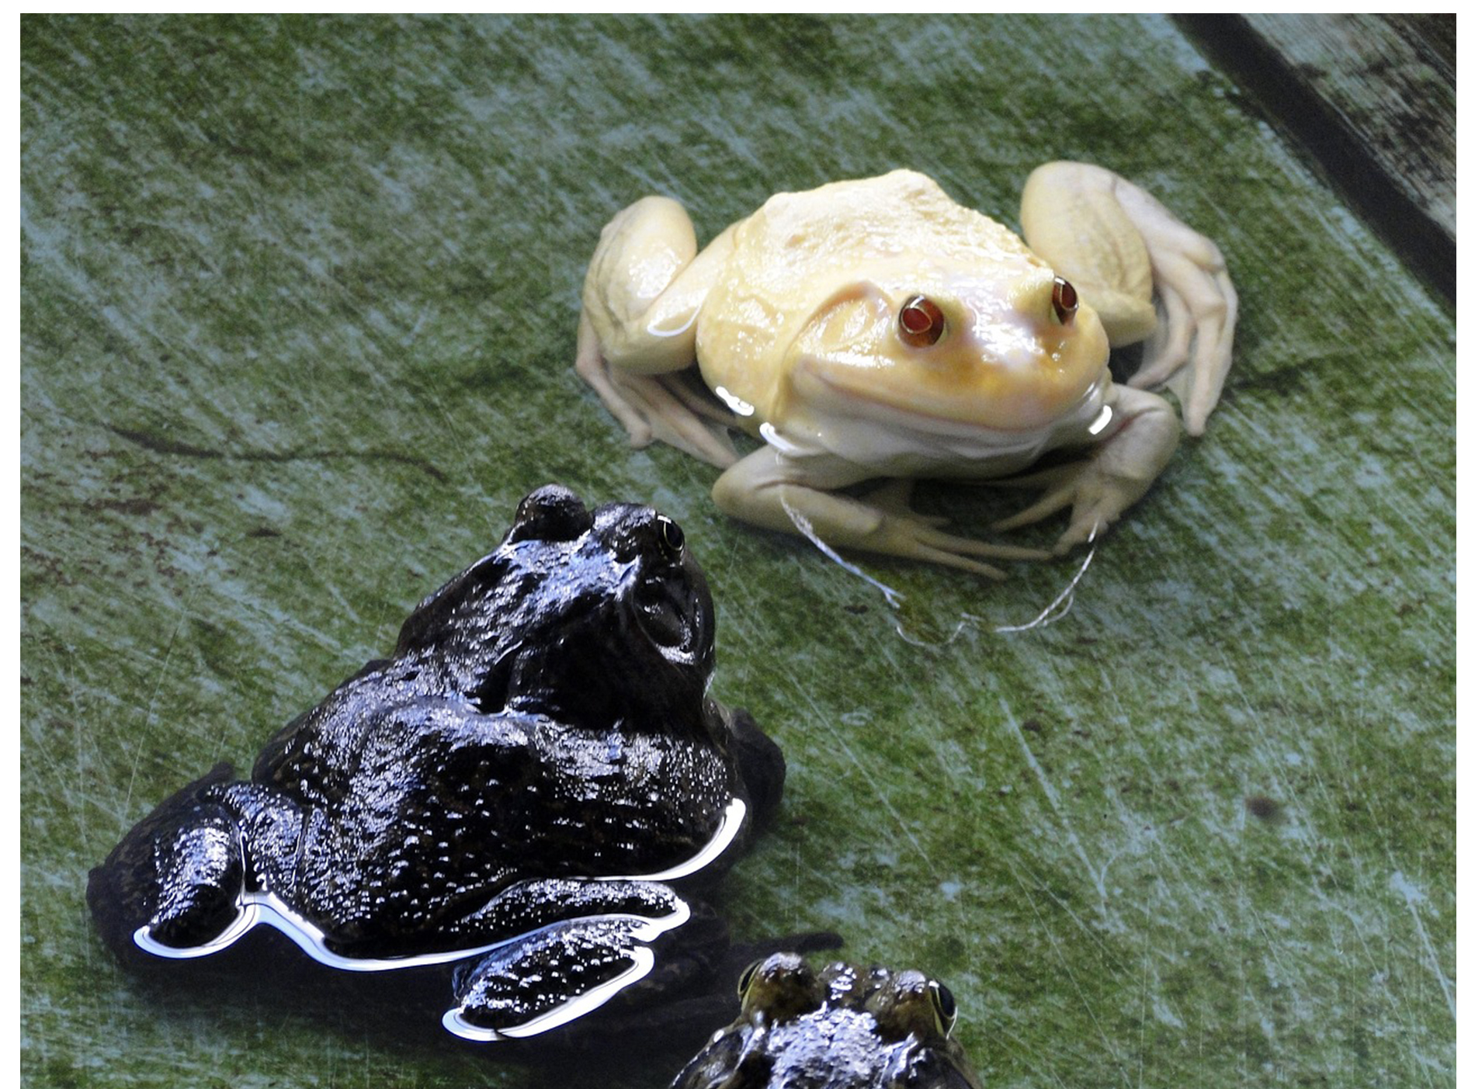
Type of Mutations: Spontaneous
Spontaneous mutations:
Occur without exposure to any environmental agent
Result from natural reactions occurring in the body
Involved in melanin production genes may cause albinism (lack of pigmentation)
14.5 Figure 6
1091995 on Pixabay. "Albino frog."

Slide 13
Mutations at the Molecular Level: Point Mutations₁
A point mutation:
Affects a single base pair
Is most commonly a substitution where one based is replaced by another
May be either a:
  Transition substitution: a purine or pyrimidine base is replaced by the same kind of base
    Example: G replaces A
  Transversion substitution: a purine is replaced by a pyrimidine or vice versa
    Example: A replaces C

Slide 14
Mutations at the Molecular Level: Point Mutations₂
A point mutation can result in one of the following three types of outcomes, depending on its effect on the protein the affected gene encodes.
Silent mutation
Missense mutation
Nonsense mutation

Slide 15
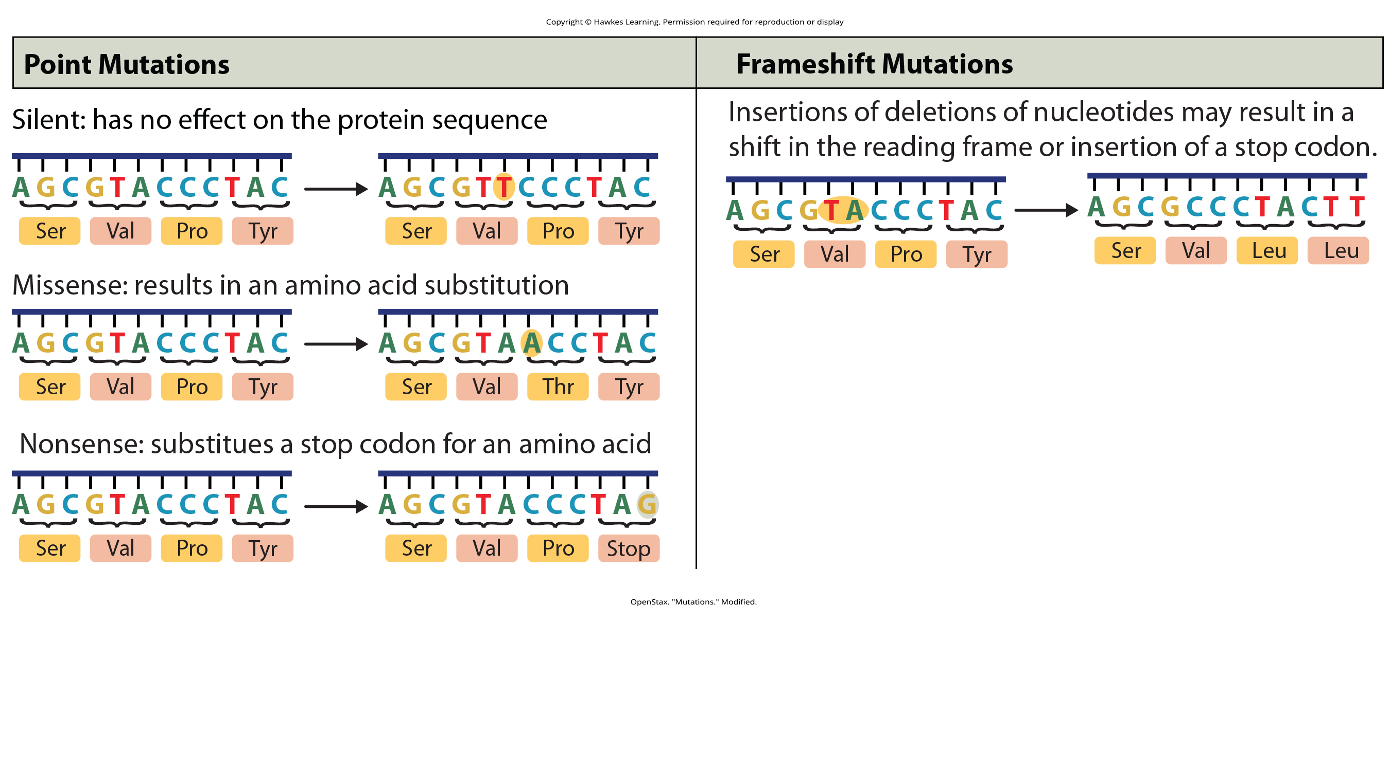
Point Mutations: Silent Mutations
A point mutation may result in a silent mutation that has no effect on the protein the affected gene encodes.
A silent mutation typically occurs as a substitution of a codon’s third base because redundant codons that all code for the same amino acid typically vary in their third bases.
14.5 Figure 7
OpenStax. "Mutations." Modified.

Slide 16
Point Mutations: Missense Mutations
A point mutation may result in a missense mutation whereby a codon is changed and now specifies a different amino acid, possibly altering the function of the protein encoded by the affected gene.
A missense mutation may be one of two types:
  Transition substitution: a purine or pyrimidine base being replaced by the same kind (such as G replacing A)
  Transversion substitution: a purine being replaced by a pyrimidine or vice versa (such as A replacing C)
14.5 Figure 7
OpenStax. "Mutations." Modified.

Slide 17
Point Mutations: Nonsense Mutations
A point mutation may result in a nonsense mutation by generating a stop codon.
The stop codon prematurely ends protein synthesis.
The resulting protein is abnormally short and most likely does not function properly.
14.5 Figure 7
OpenStax. "Mutations." Modified.

Slide 18
Mutations at the Molecular Level: Triplet Repeats
A triplet repeat is a mutation that results in an increased number of copies of the same codon.
Within a gene, this results in a region with the same amino acid repeated.
For example, TAG TAG TAG is a triplet repeat.

Slide 19
Mutations at the Molecular Level:
Frameshift Mutations
A frameshift mutation may result from the insertion or deletion of one or more bases, shifting the translational reading frame.
The resultant protein is usually nonfunctional.
14.5 Figure 7
OpenStax. "Mutations." Modified.

Slide 20
Think It Through₂
A frameshift mutation within a gene nearly always results in a defective protein. Why?
Notes:
Originally an On Your Own. This is included here to use as a talking point or for a think-pair-share activity.

Slide 21
Mutations at the Molecular Level: Translocations
A translocation results from a piece of DNA from one chromosome being moved to:
A different chromosome
Another region of the same chromosome

Slide 22
Mutations in Repair Genes
Mutations in repair genes may cause various types of cancer:
Skin lesions of xeroderma pigmentosa
Pancreatic cancer
Colon cancer
Colorectal cancer

Slide 23
Mutations Affecting Somatic Versus Germ Cells
Mutation accumulation in somatic cells may lead to uncontrolled cell division as seen with cancer.
A mutation in a germ cell may be passed on to the next generation, as seen with both xeroderma pigmentosa and hemophilia.

Slide 24
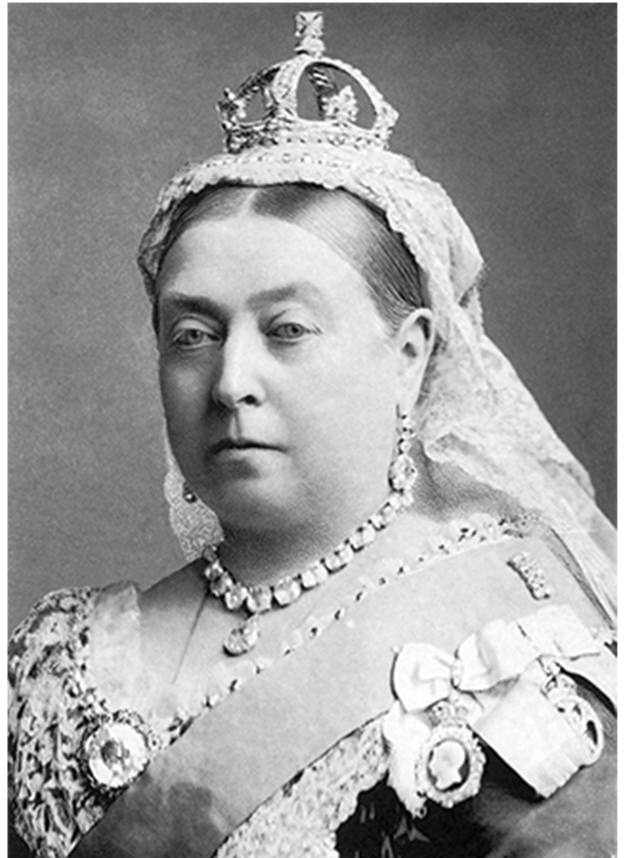
Mutations Affecting Germ Cells: Example
Hemophilia is a genetic disorder characterized by potentially fatal bleeding.
Hemophilia likely originated in a reproductive cell of Queen Victoria (or one of her parents).
  Her daughters likely carried the gene and disseminated it throughout Europe when marrying into other royal families.
  One of her sons had hemophilia.
14.5 Figure 8
National Portrait Gallery on Wikimedia Commons. "Queen Victoria."

Slide 25
Science and You
While all humans share more than 99% of our DNA sequences, there are some regions where we differ considerably. Such regions often have triplet repeats, which vary in length from person to person. Those regions are used for:
Forensics
Paternity testing
Examining more than one such reason for these purposes provides additional test reliability.
Notes:
This is included as a relevant application for this topic.

Slide 26
Summary
DNA polymerase proofreads each newly added nucleotides during strand elongation, fixing most mistakes immediately.
Mismatch repair fixes mistakes that DNA polymerase’s proofreading activity misses, excising the incorrect base, then replacing it with the correct one.
Nucleotide excision repair removes a damaged base with a few bases on either side, DNA polymerase replaces them, and DNA ligase seals the strand.
While most mistakes are corrected, mutations (permanent changes in the DNA sequence) may result.
Mutations may be induced or spontaneous.
Various types of mutations include substitutions, deletions, insertions, and triplet repeats.
Mutations in repair genes may cause problems like cancer.

Slide 27


End of Hawkes Learning PowerPoint

