Slide 1
Lesson 15.1
The Genetic Code

Slide 2
Objectives
Describe the genetic code and how the nucleotide sequence prescribes the amino acid and the protein sequence.
Explain the “central dogma” of DNA-protein synthesis.

Slide 3
The Central Dogma
The flow of genetic information in the cells is described by the central dogma and is broken into two parts:
Transcription: The cellular process of generating messenger RNA (mRNA) from DNA.
  RNA is made of adenine (A), cytosine (C), guanine (G) and uracil (U).
Translation: The cellular process of generating a chain of amino acids from mRNA.
  There are 20 different amino acids.

Slide 4
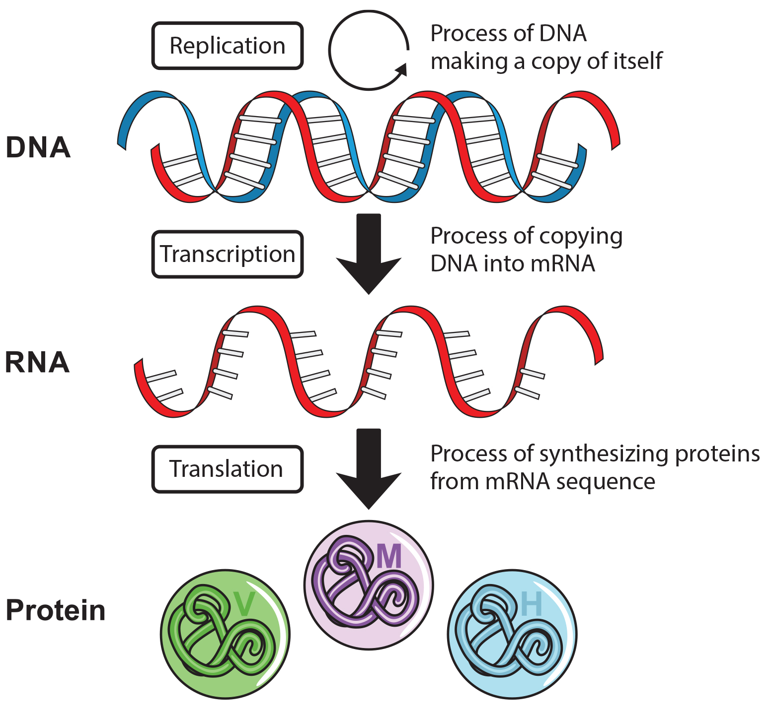
Lesson 15.1 Figure 1
Notes:
Figure 1: The central dogma of molecular biology: DNA makes RNA, and RNA makes proteins

Slide 5
Transcription
Transcription is the process of creating mRNA from DNA using the enzyme RNA polymerase.
Base pairing rules for making RNA from DNA
  A in DNA pairs to U in RNA
  C in DNA pairs to G in RNA
  G in DNA pairs to C in RNA
  T in DNA pairs to A in RNA

Slide 6
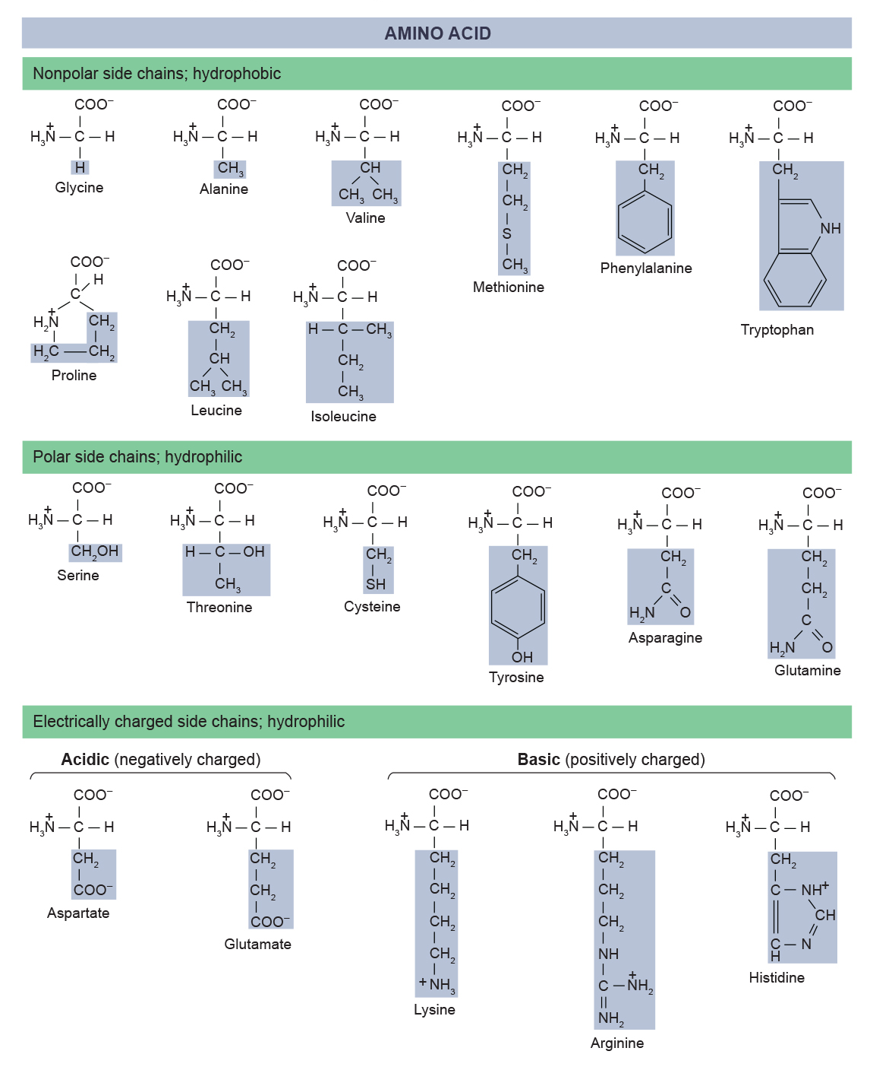
Translation
15.1 Figure 2
Translation is the process of creating an animo acid chain from mRNA.
Each amino acid is comprised of an amino group, a carboxyl group and a side chain (R group)
The variety if amino acid side chains lead to incredible protein diversity.
OpenStax. "Amino acids." Modified.

Slide 7
Translation₂
Translation is complex due to three nucleotides coding for one amino acid.
Translation is systematic and colinear(the order of the nucleotides dictate the amino acid sequence).

Slide 8
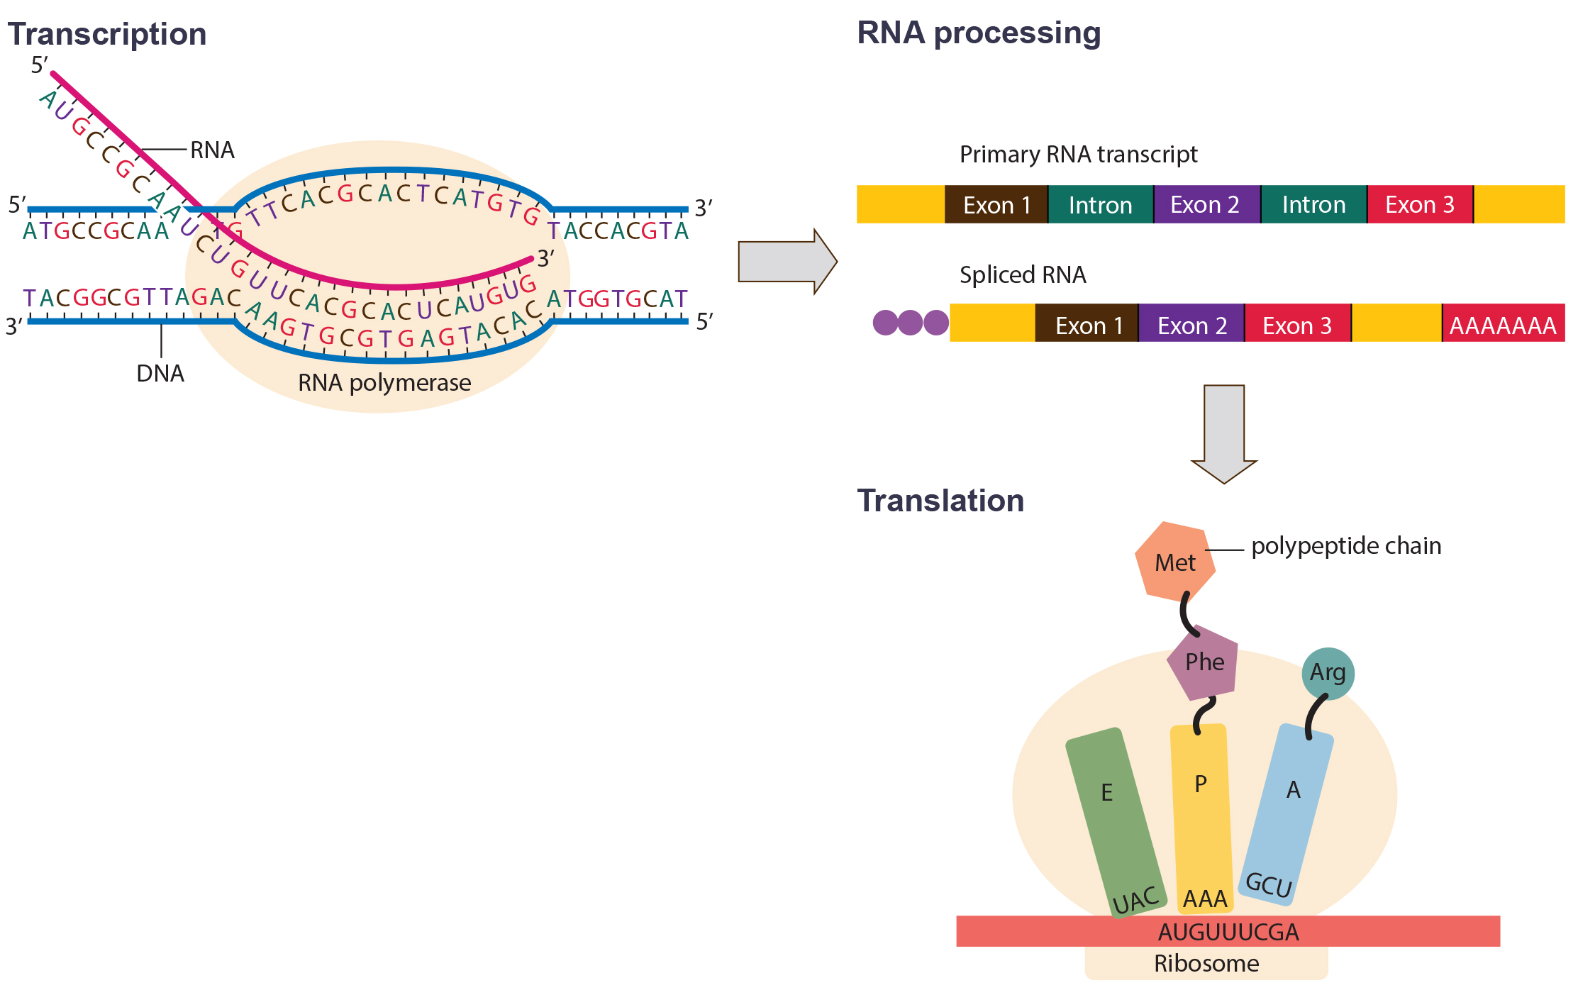
Lesson 15.1 Figure 3
CNX OpenStax on Wikimedia Commons. "Overview of transcription and translation." Modified.
Notes:
Figure 3: Instructions on DNA are transcribed onto messenger RNA. Ribosomes are able to read the genetic information inscribed on a strand of messenger RNA and use this information to string amino acids together into a protein.

Slide 9
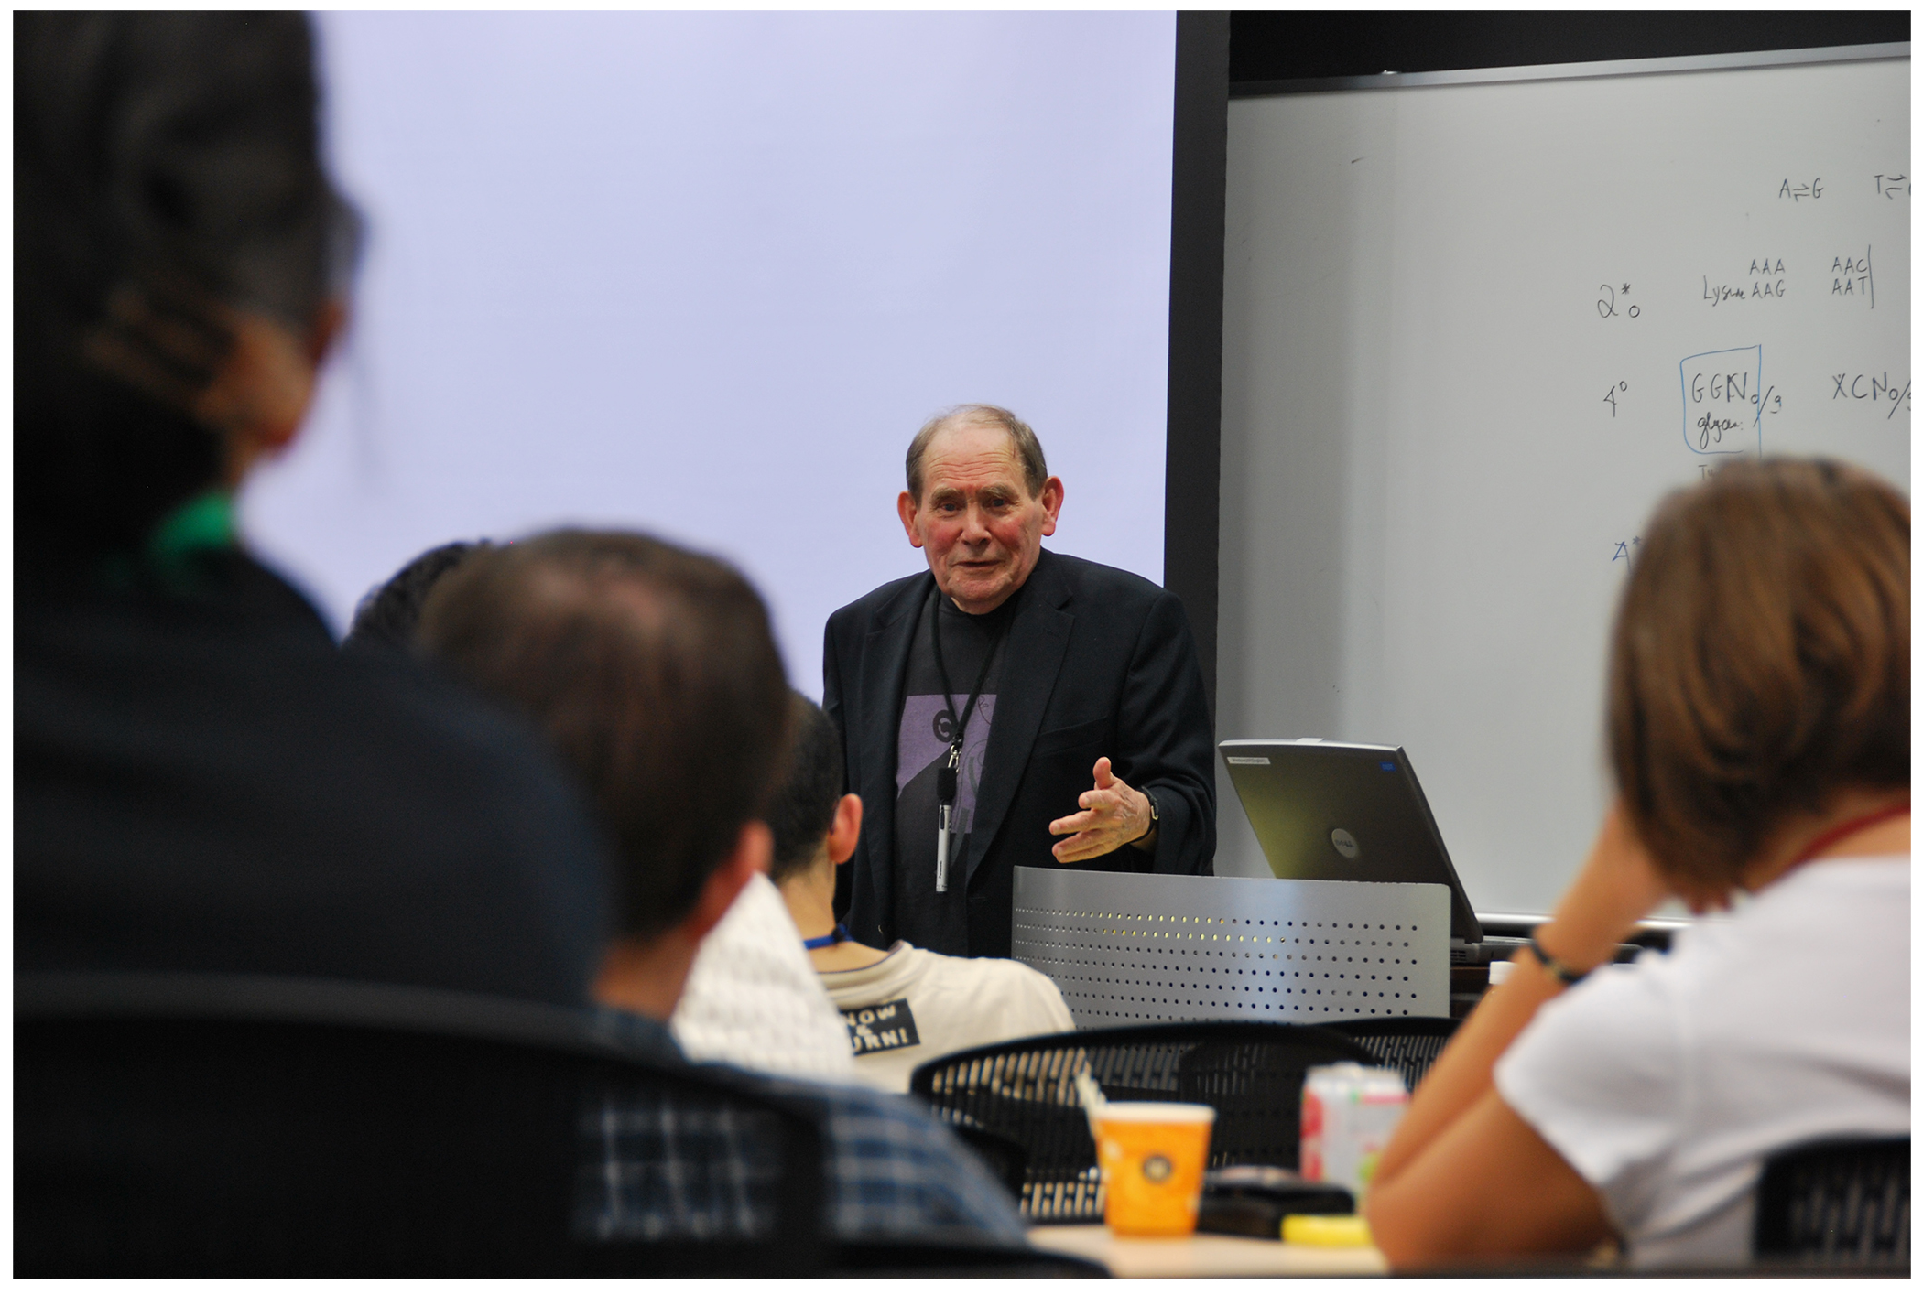
The Genetic Code
Nearly Universal
  All living organisms use the same genetic code.
Degenerate
  Each amino acid is defined by a three-nucleotide sequence called a codon.
  An amino acid may be encoded by multiple codons.
  The way the nucleotide sequence is divided into groups by the ribosome is called the reading frame
15.1 Figure 4: South African scientist Sydney Brenner (1927–2019) made significant contributions to our understanding of the genetic code.
OIST on Wikimedia Commons. "Sydney Brenner."

Slide 10
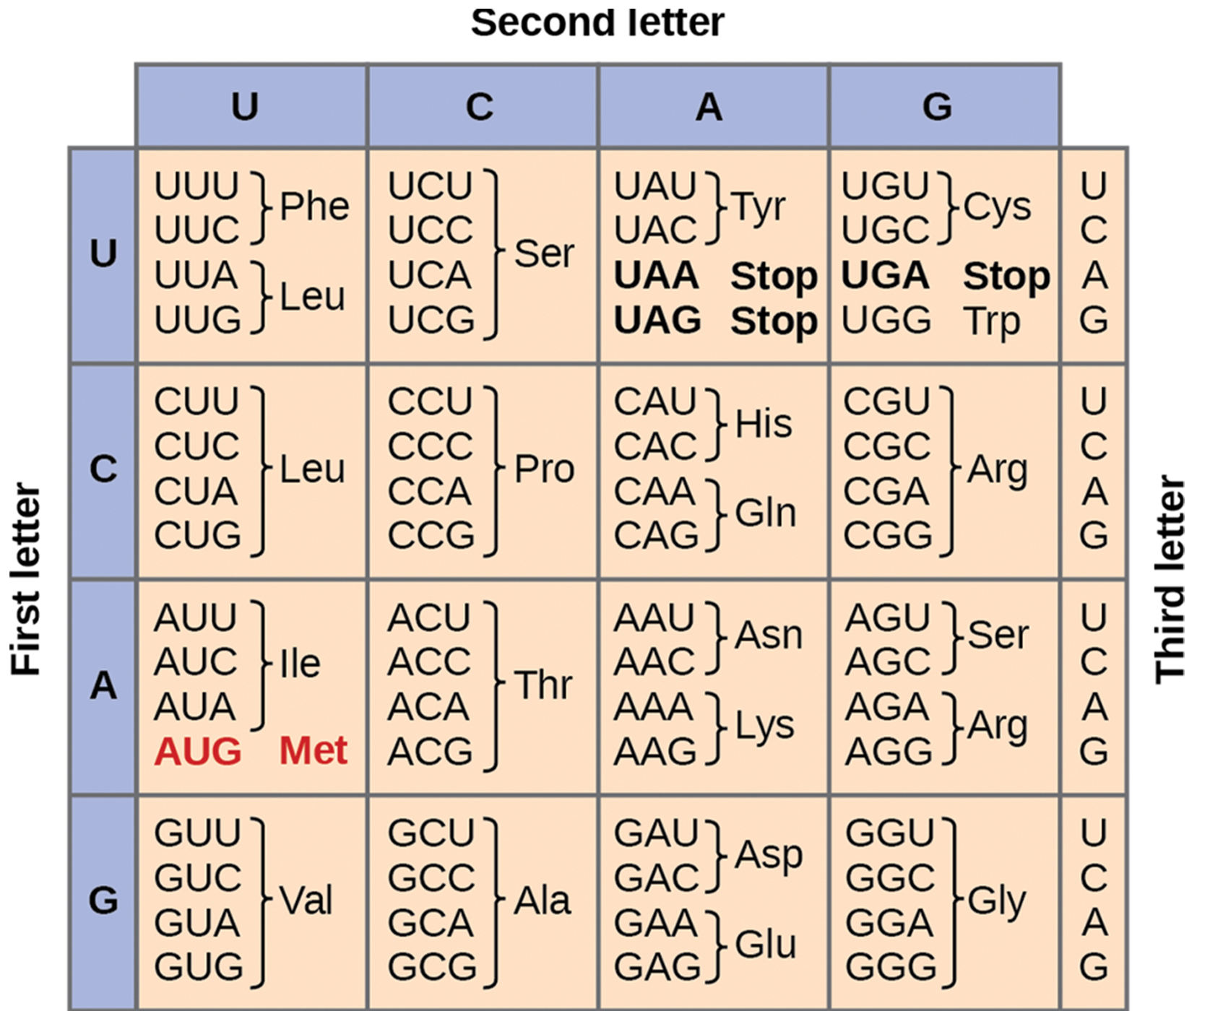
Lesson 15.1 Figure 5
NIH on Wikimedia Commons. "Codon table."
Notes:
Figure 5: This figure shows the genetic code for translating each nucleotide triplet in mRNA. As shown in the figure, most nucleotide triplets code for specific amino acids, while three triplets (UAA, UAG, and UGA) serve as stop codons (signals that tell protein synthesis machinery to stop translating, thereby indicating the end of the protein). Note that almost all amino acids are encoded by at least two nucleotide triplets, demonstrating the degeneracy of the genetic code.

Slide 11
The Genetic Code₂
  64 possible codon combinations
    3 nonsense (stop) codons (UAA, UAG, UGA), stop translation.
    61 codons to code for 20 amino acids
      Many animo acids are coded for by multiple codons(degeneracy)
      AUG (Methionine) is the start codon which initiates translation at the ribosome.

Slide 12
Think It Through
Which codons code for the amino acid serine?
Notes:
Originally an On Your Own. This is included here to use as a talking point or for a think-pair-share activity.

Slide 13
Mutations
Single Nucleotide mutation types
  Silent- the amino acid in the protein does not change
  Missense- the amino acid in the protein changes
  Nonsense- the mutation changes the codon to a stop codon and truncates or shortens the protein
  Frameshift mutations
  The addition or deletion of 1 or 2 nucleotides which results in a change in the reading frame.
  Can create a non-functional protein or stop protein synthesis

Slide 14
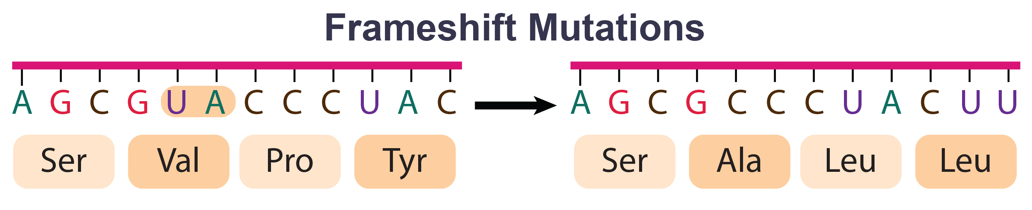
Lesson 15.1 Figure 6
OpenStax. "Frameshift mutation." Modified.
Notes:
Figure 6: The deletion of two nucleotides shifts the reading frame of an mRNA and changes the entire protein message, creating a nonfunctional protein or terminating protein synthesis altogether.

Slide 15
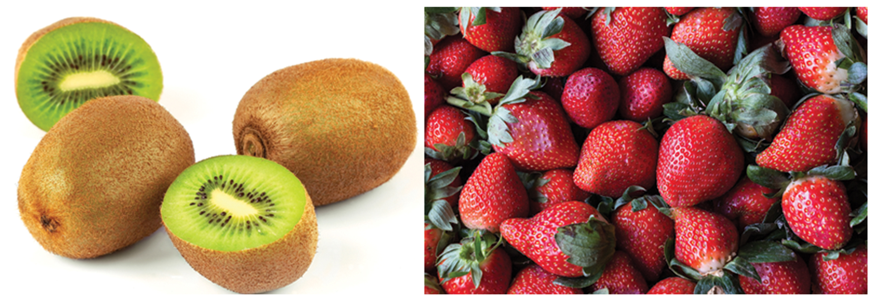
Group Activity₁
Which Has More DNA: A Kiwi or a Strawberry?
Question: Would a kiwi and strawberry that are approximately the same size (Figure 7) also have approximately the same amount of DNA?
15.1 Figure 7
Luc Viatour on Wikimedia Commons. "Kiwi."
Tomascastelazo on Wikimedia Commons. "Strawberries."

Slide 16
Group Activity₂
Background: Genes are carried on chromosomes and are made of DNA. All mammals are diploid, meaning they have two copies of each chromosome. However, not all plants are diploid. The common strawberry is octoploid (8n) and the cultivated kiwi is hexaploid (6n).
Research the total number of chromosomes in the cells of each of these fruits and think about how this might correspond to the amount of DNA in these fruits' cell nuclei.
What other factors might contribute to the total amount of DNA in a single fruit? Research the technique of DNA isolation to understand how each step in the isolation protocol helps free the DNA from the cells and condense it out from the solution.
Hypothesis: Hypothesize whether you would be able to detect a difference in DNA quantity from similarly sized strawberries and kiwis. Which fruit do you think would yield more DNA?

Slide 17
Summary
The central dogma is the flow of information from DNA to RNA to Protein.
Transcription is the process of DNA to mRNA.
Translation is the process of mRNA to protein.
Translation uses the mRNA codons and the genetic code to build the protein using the correct animo acids.
Mistakes in the mRNA can lead to mutations in the protein.

Slide 18


End of Hawkes Learning PowerPoint

