Slide 1
Lesson 15.2
Prokaryotic Transcription

Slide 2
Objectives
Describe how and when transcription is terminated.
Discuss the role of promoters in prokaryotic transcription.
List the different steps in prokaryotic transcription.

Slide 3
Prokaryotic Characteristics
Lack membrane-bound nuclei and other organelles
Have a single circular chromosome
May contain shorter circular DNA molecules called plasmids
Plasmids often carry traits involved in antibiotic resistance.
DNA resides in the central region of the cell called the nucleoid region

Slide 4
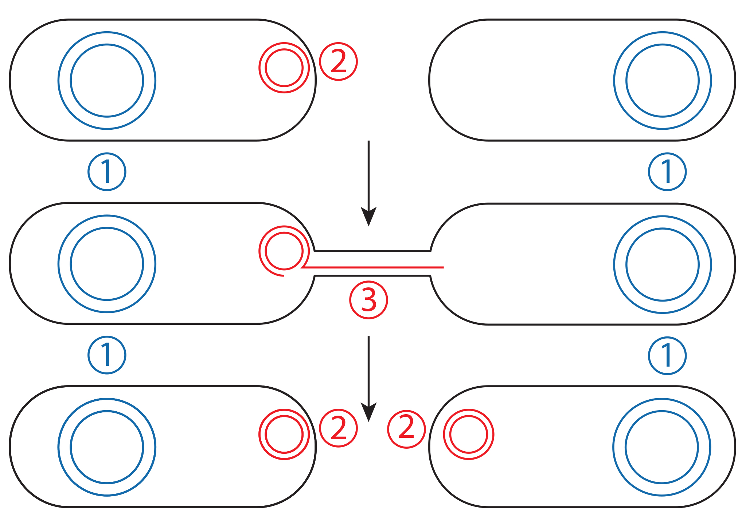
Lesson 15.2 Figure 1
Notes:
Figure 1: The transfer of plasmids between bacteria happens during bacterial conjugation (the process through which one bacterium transfers genetic material to another). Both bacterium have their own chromosomal DNA. The bacterium on the left begins with a plasmid (indicated by a 2), and the bacterium on the right does not (top). The bacteria form a connection (3) and the plasmid is transported to the bacteria on the right. After conjugation, both bacterium now have the plasmid (bottom).

Slide 5
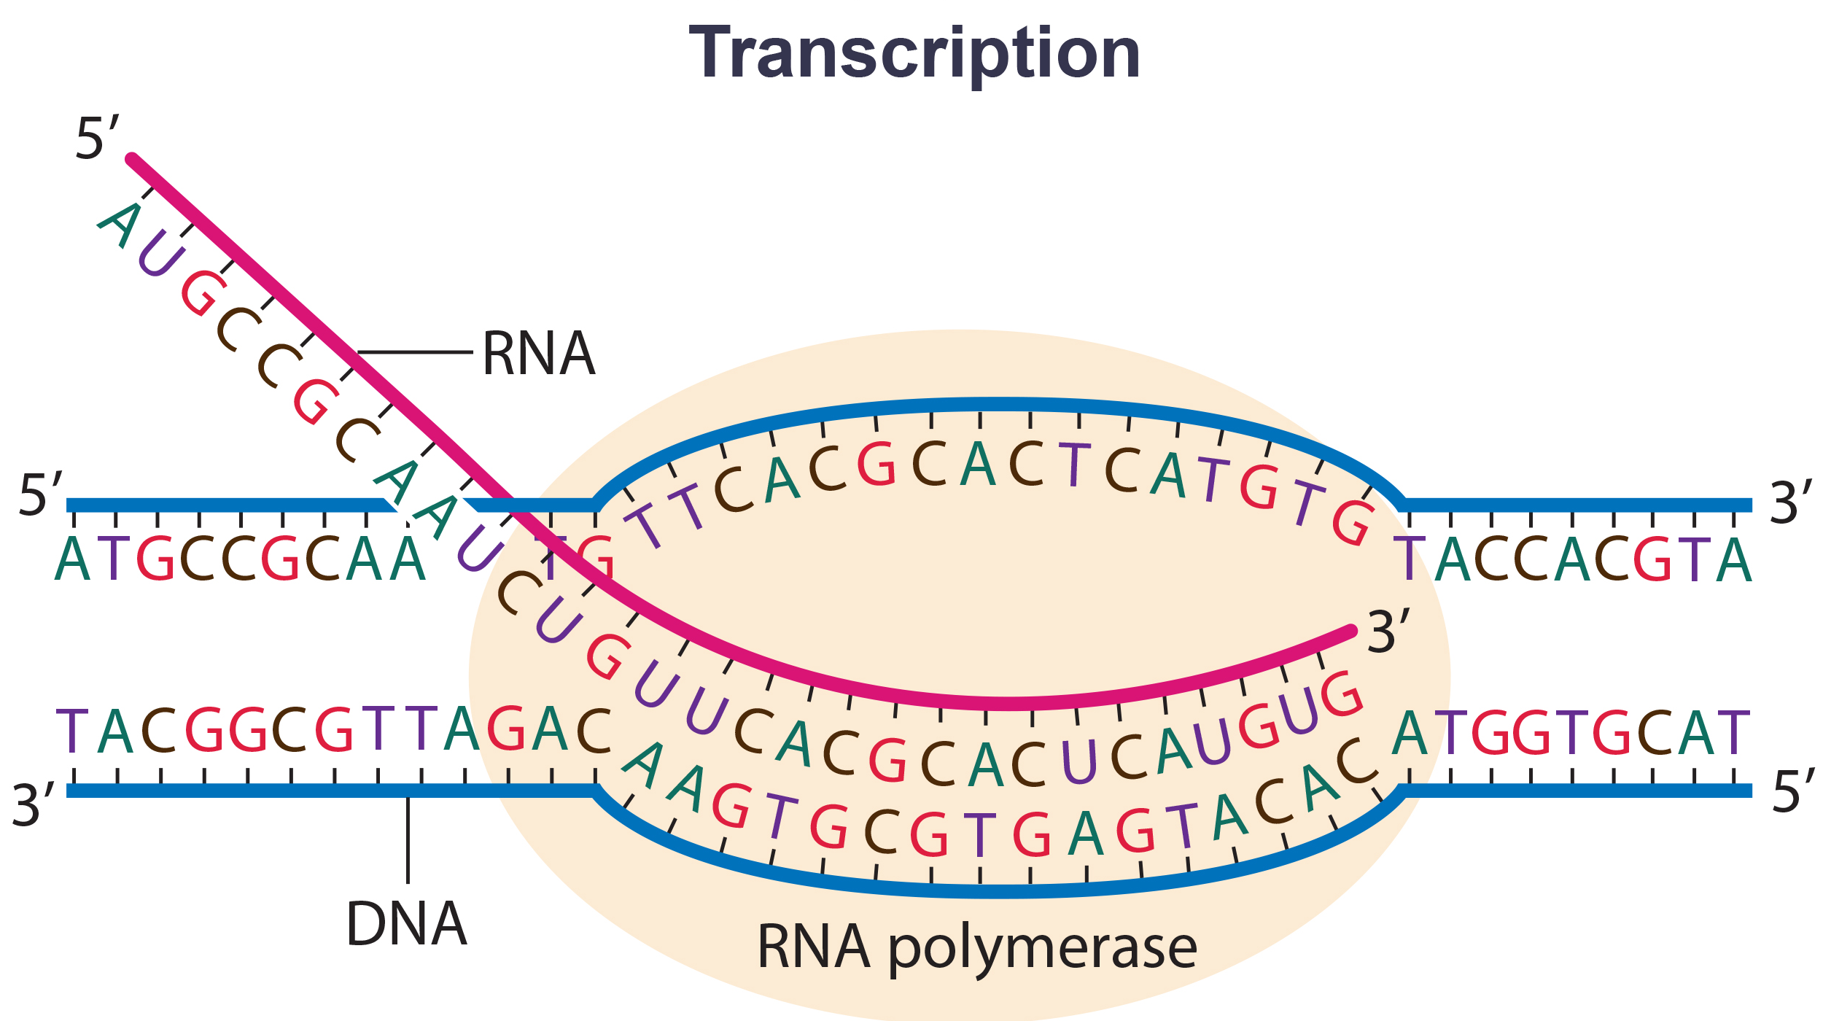
Transcription Bubble
DNA must unwind to allow for transcription.
The region of unwinding DNA is called the transcription bubble.
The DNA strand acting as the template for mRNA is the template strand.
15.2 Figure 2
CNX OpenStax on Wikimedia Commons. "RNA polymerase." Modified.

Slide 6
Prokaryotic Transcription
All transcription, translation and mRNA degradation occur simultaneously due to lack of internal membranes.
Prokaryotic transcripts often cover more than one gene or cistron and create polycistronic mRNAs that contain the coding sequences for more than one protein.

Slide 7
Reflection Question
Can you think of reasons why having polycistronic genes would be beneficial to bacteria?
Notes:
The reflection question is included here to use as a talking point or for a think-pair-share activity.

Slide 8
Prokaryotic RNA polymerase
In prokaryotes, a single RNA polymerase is used for transcription
The polymerase is comprised of six subunits
Five of these subunits comprise the core enzyme, which is responsible for the catalytic activity.
The 6th subunit (σ) is only used for initiation of transcription.
RNA polymerase with all six subunits is called a holoenzyme.

Slide 9
Prokaryotic promoters
A promoter is a DNA sequence where the transcription machinery, including RNA polymerase, binds and initiates transcription.
Two promoters are found at the -10 upstream and -35 upstream regions.
These regions are similar across bacterial species and are described by consensus sequences of these two sites.
A consensus sequence lists the nucleotides that occur most often at each position of the sequence.

Slide 10
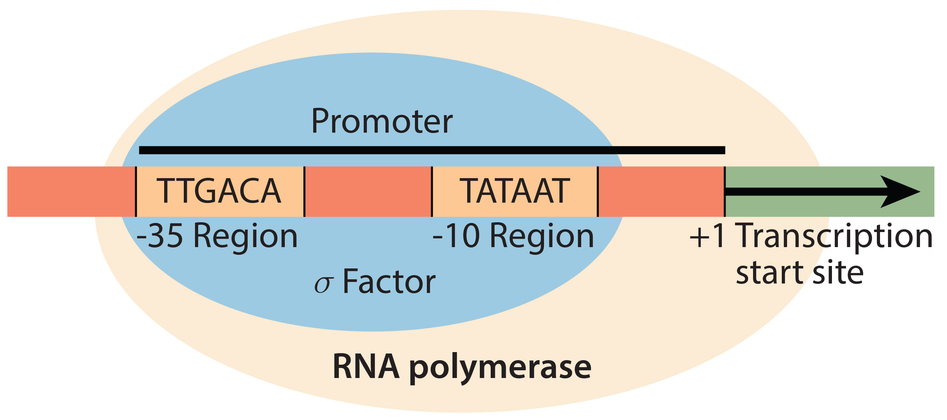
Transcription Initiation
The promoter regions are recognized and bound by the σ factor.
The core enzyme binds and begins to unwind DNA.
Once DNA is exposed, the enzyme begins to build the RNA transcript.
15.2 Figure 3
OpenStax. "σ subunit." Modified.

Slide 11
Transcription Elongation
Elongation begins once the σ factor releases and the polymerase synthesizes mRNA in the 5΄-3΄ direction.
RNA polymerase synthesizes at a rate of approximately 40 nucleotides a second.
mRNA synthesis will continue until termination sequences are hit.
There are two types of termination:
Rho-dependent termination
Rho-independent termination

Slide 12
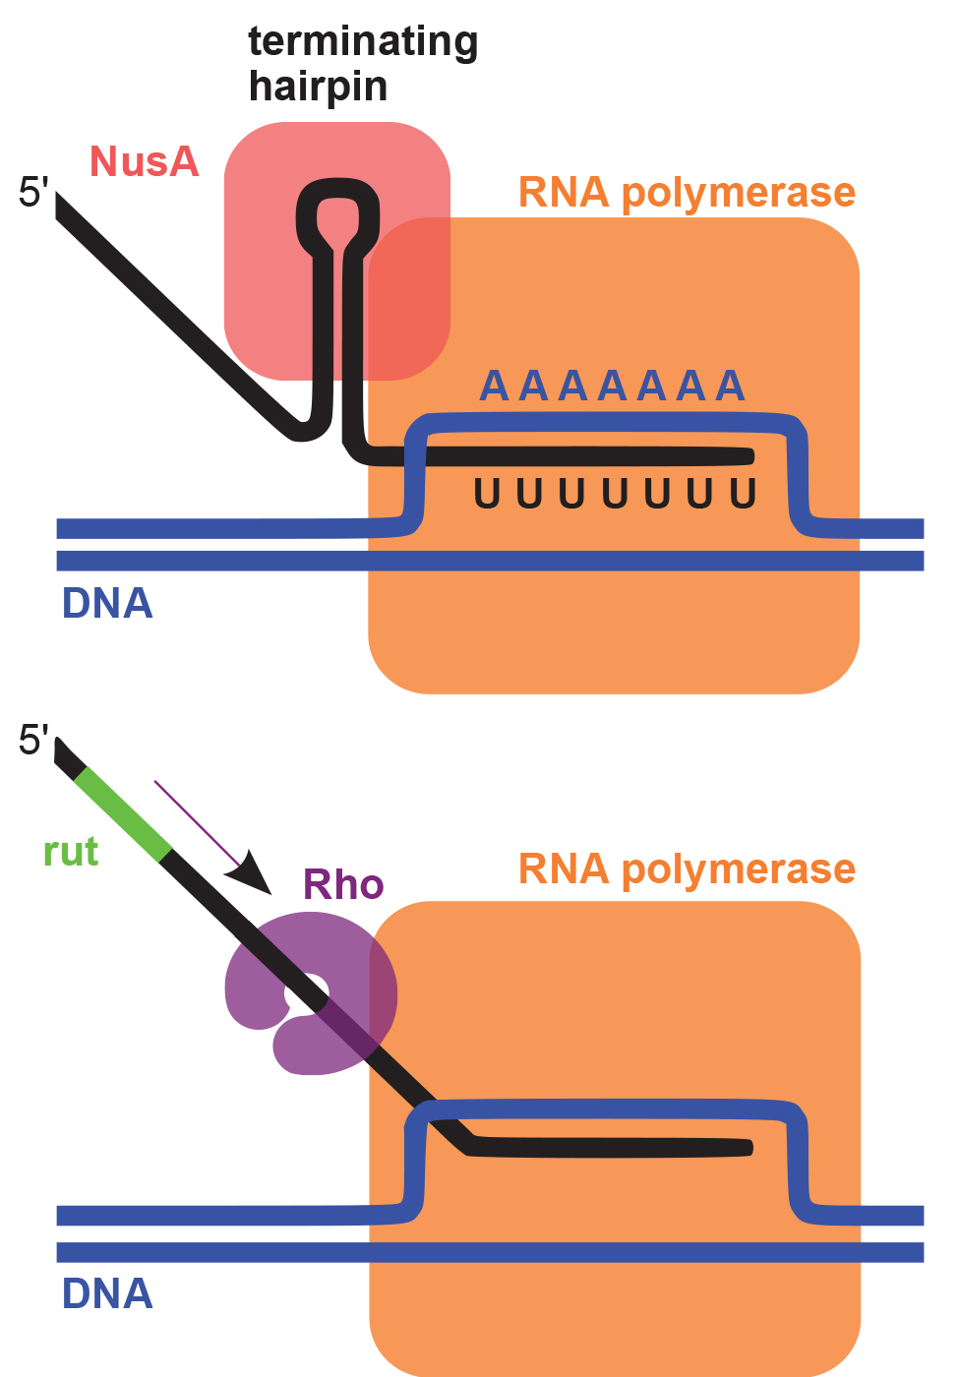
Termination Signals
Rho-dependent
Controlled by the rho protein (which has helicase activity) which can separate the RNA from the DNA.
Rho-independent
Controlled by the DNA sequence itself
G-C rich region in RNA creates a stable hairpin, causing the RNA polymerase to stall when transcribing weak binding uracil.
15.2 Figure 4
Oalnefo1 on Wikimedia Commons. "Prokaryotic terminators."

Slide 13
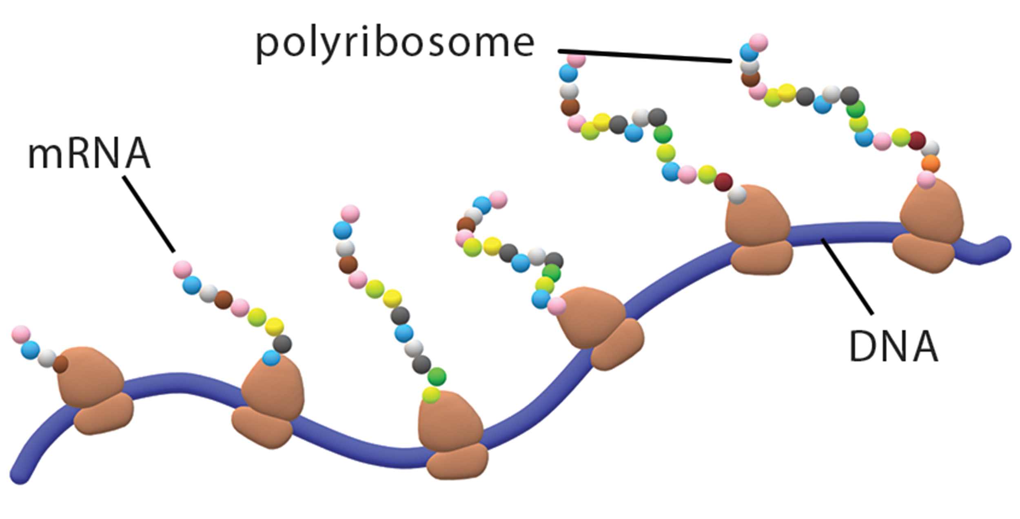
Lesson 15.2 Figure 5
Christinelmiller on Wikimedia Commons. "Multiple polymerases."
Notes:
Figure 5: When a bacterial cell needs many copies of a particular protein, many polymerases simultaneously transcribe the same gene. The resulting mRNA transcripts are concurrently translated into proteins by numerous ribosomes (the organelles of protein synthesis).

Slide 14
Summary
Prokaryotic cell structure allows for simultaneous transcription and translation.
Prokaryotic transcription is completed by a single type of RNA polymerase.
The RNA polymerase recognizes consensus sequences at the -10 and -35 promoter regions, and initiates transcription.
Transcription continues until the termination signal, which could be either a Rho-dependent or Rho-independent signal.

Slide 15


End of Hawkes Learning PowerPoint

