Slide 1
Lesson 15.3
Eukaryotic Transcription

Slide 2
Objectives
Compare and contrast the three RNA polymerases.
Discuss the role of RNA polymerases in transcription.
Explain the significance of transcription factors.
List the steps in eukaryotic transcription.

Slide 3
Eukaryotic Characteristics
Eukaryotic cells contain a nucleus and membrane-bound organelles.
Transcription occurs in the nucleus.
mRNA must be transported to cytoplasm for translation.
mRNA must be protected from degradation.
Eukaryotic mRNA transcripts are monogenic, meaning each transcript codes for a single protein.

Slide 4
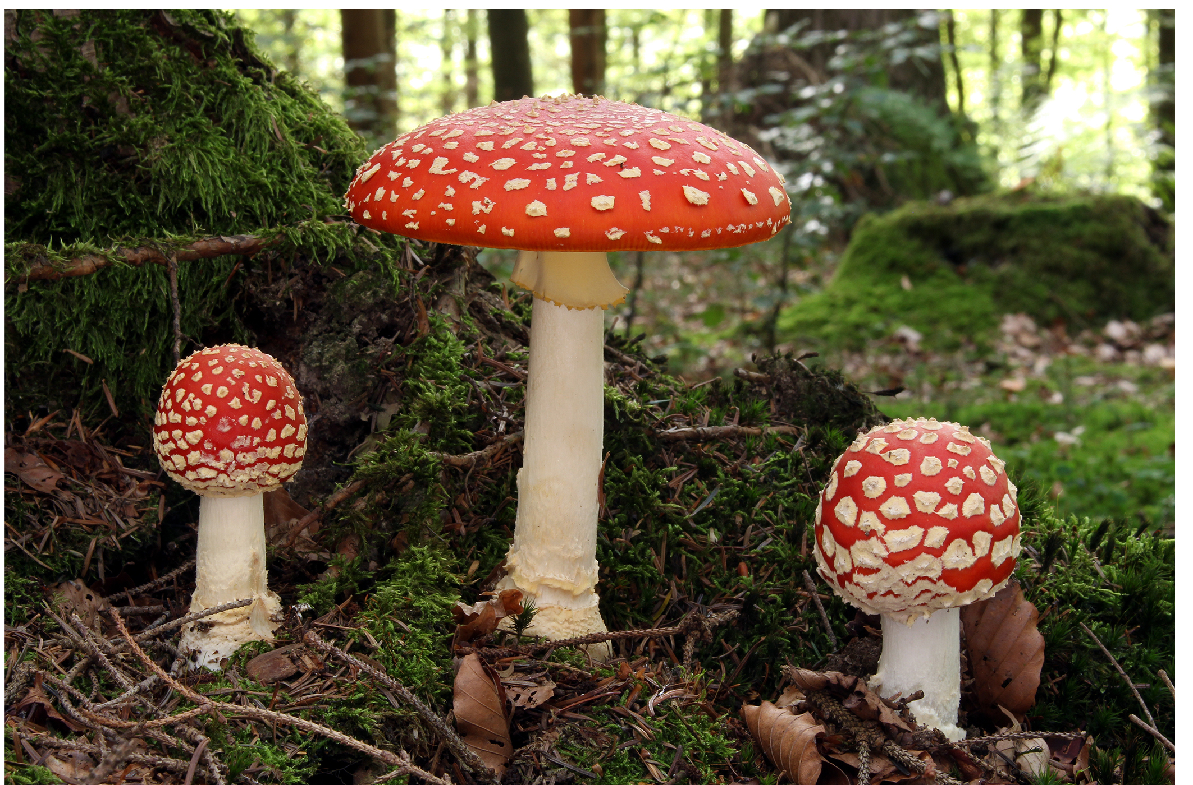
Eukaryotic RNA polymerase
Eukaryotes have 3 RNA polymerases
Each requires their own transcription factors
RNA polymerase I- makes most rRNA
RNA polymerase II- makes all coding pre-mRNAs
RNA polymerase III- makes rRNA, tRNA and snRNA
15.3 Figure 1
Holger Krisp on Wikimedia Commons. "Mushrooms."

Slide 5
Table 1: The Locations, Products and Sensitivities of the Three Eukaryotic RNA Polymerases
RNA Polymerase | Cellular Compartment | Product of Transcription | α-Amanitin Sensitivity
I | Nucleolus | all rRNAs except 5S rRNAs | insensitive
II | nucleus | all protein coding nuclear pre-mRNAs | extremely sensitive
III | nucleus | 5S rRNA, tRNAs, and small nuclear RNAs | moderately sensitive

Slide 6
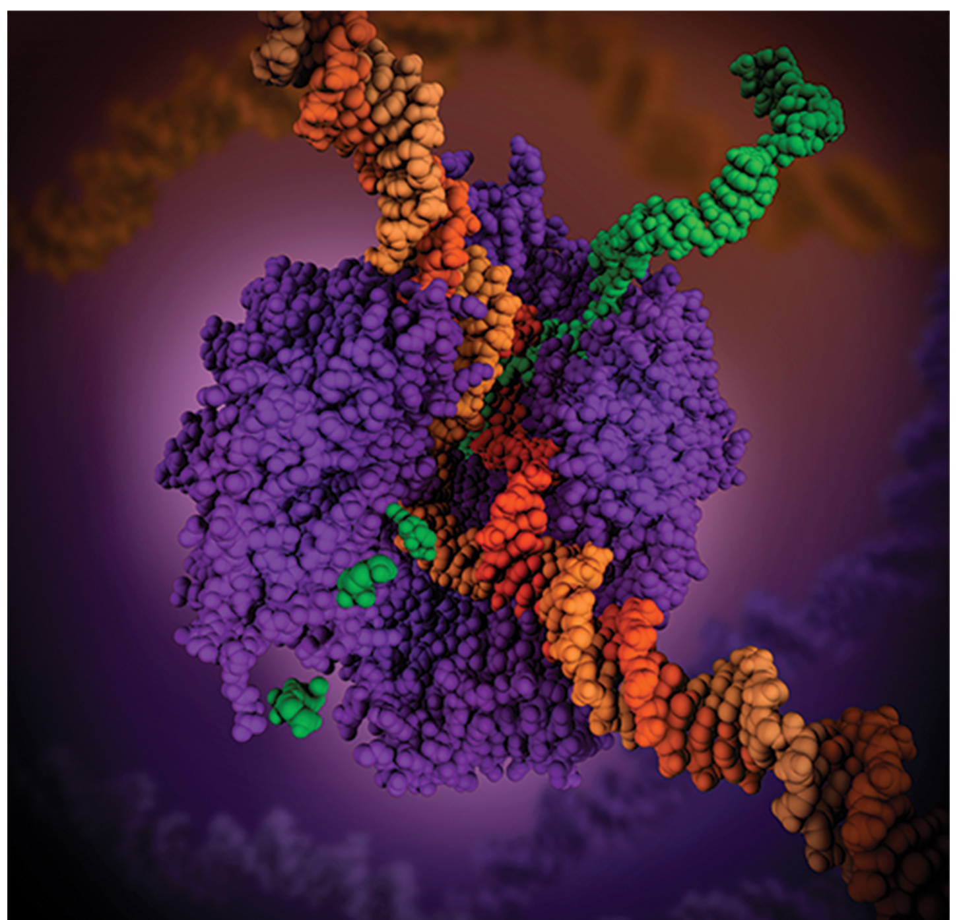
RNA Polymerase II
Responsible for the transcription of most genes
Uses a promoter called the TATA Box, which is like the -10 region of prokaryotic promoters and has a consensus sequence of TATAAA.
15.3 Figure 2
Maria Voigt and PDB-101 on Wikimedia Commons. "RNA polymerase complex."

Slide 7
Initiation of Transcription
Instead of the σ factor found in prokaryotes, eukaryotes create an initiation complex of several transcription factors.
The transcription factors that bind the promoter are called the basal transcription factors.
Basal transcription factors are critical in forming the preinitiation complex on the DNA to recruit the RNA polymerase II.
Enhancers and silencers can also be used in addition to regulate the amount of pre-mRNA produced.

Slide 8
Eukaryotic Promoters
Some promoters have a conserved CAAT box (GGCCAATCT) approximately -75 to -80 bases relative to the transcription site.
Upstream of the TATA box, some promoters have a GC-rich box(GGCG) or octamer box (ATTTGCAT).
These factors bind cellular factors which increase the efficiency of transcription initiation.

Slide 9
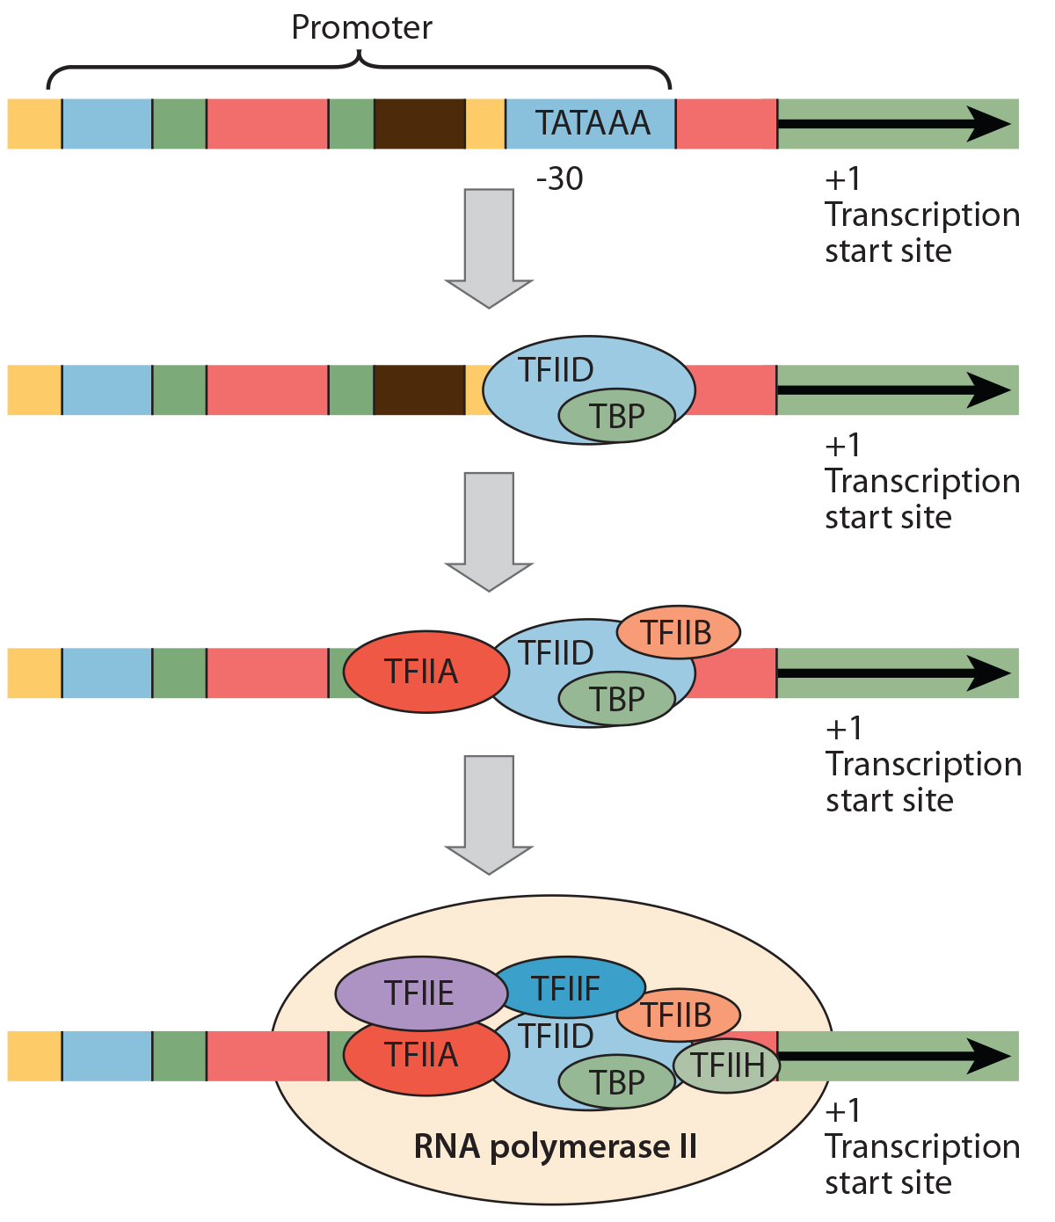
Lesson 15.3 Figure 3
CNX OpenStax on Wikimedia Commons. "Promoter." Modified.
Notes:
Figure 3: A generalized promoter of a gene transcribed by RNA polymerase II is shown. Transcription factors recognize the promoter. RNA polymerase II then binds and forms the transcription initiation complex.

Slide 10
Think It Through
A scientist splices a eukaryotic promoter in front of a bacterial gene and inserts the gene in a bacterial chromosome. Would you expect the bacteria to transcribe the gene?
Notes:
Originally an On Your Own. This is included here to use as a talking point or for a think-pair-share activity.

Slide 11
Eukaryotic Elongation
Elongation begins when the RNA polymerase is released from the transcription factors within the preinitiation complex.
Pre-mRNA synthesis occurs in the 5΄to 3΄ direction.
Pre-mRNA synthesis complicated due to DNA being packaged as chromatin, which is a mixture of DNA and charged histone proteins.

Slide 12
Evolution Connection
The Evolution of Primers
Mutations occur can occur within genes or regulatory regions such as promoters
Mutations may or may not be beneficial
Consider- if a gene codes for a protein needed in abundance, it would benefit the cell for the gene’s promoter to recruit transcription factors more efficiently.
Scientists examining human promoter regions which bind the preinitiation complex found they evolve even faster than protein coding genes.

Slide 13
DNA-Histone Complexes
Collectively called nucleosomes
They are regularly spaced.
They include 146 nucleotides of DNA wound around eight histones.
A special protein complex called FACT (facilitates chromatin transcription) helps to move histones out of the way of the transcription machinery.

Slide 14
Eukaryotic Transcription Termination
Transcription termination is different for different polymerases.
RNA polymerase II- Elongation occurs 1,000 to 2,000 nucleotides beyond the end of the gene. This excess is cleaved during mRNA processing.
RNA polymerase I- Requires a specific 18 nucleotide sequence which is recognized by a termination protein.
RNA polymerase III- An mRNA hairpin is created, like Rho-independent termination of transcription in prokaryotes.

Slide 15
Summary
Eukaryotic transcription occurs in the nucleus and RNA transcripts are monogenic.
Three different RNA polymerases are used for different RNA products.
RNA polymerase II is the main polymerase makes pre-mRNA.
Transcription initiation requires transcription factors to create a preinitiation complex.
Termination of transcription is different for each polymerase type.

Slide 16


End of Hawkes Learning PowerPoint

