Slide 1
Lesson 15.4
RNA Processing in Eukaryotes

Slide 2
Objectives
Describe the different steps in RNA processing.
Explain how tRNAs and rRNAs are processed.
Understand the significance of exons, introns, and splicing for mRNAs.

Slide 3
Pre-mRNA processing
Eukaryotic pre-mRNA must undergo processing prior to translation.
Exons (coding sequences) are interrupted by introns (noncoding regions), which must be removed.
Pre-mRNA must also be modified to increase stability of molecule.
Stabilizing and signaling factors are added to both the 5΄ and 3΄ end of the pre-mRNA molecule.

Slide 4
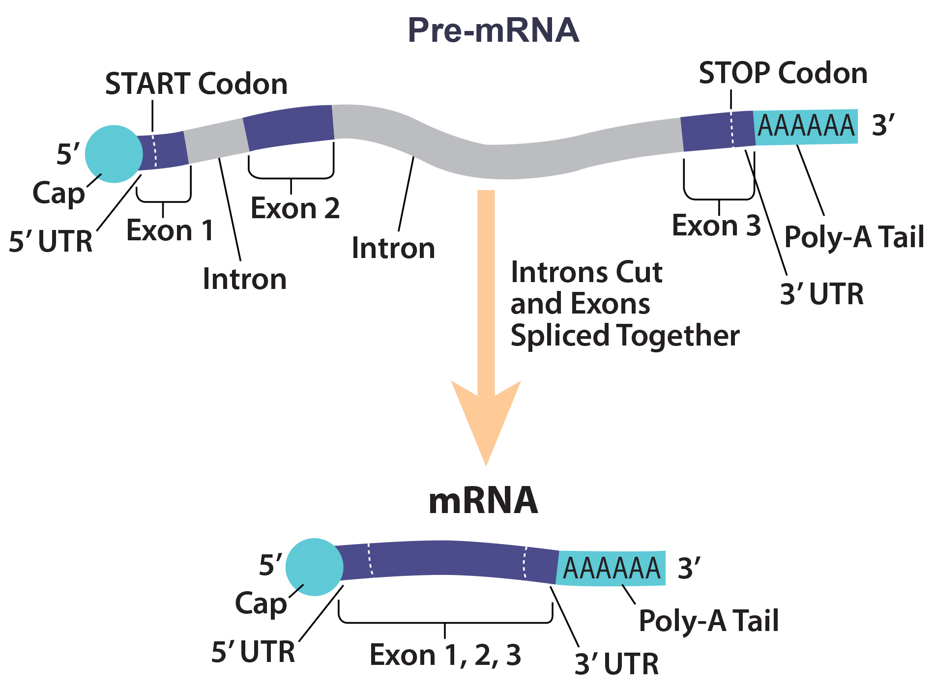
Lesson 15.4 Figure 1
Rao, A., Ryan, K. Fletcher, S. and Tag, A. Department of Biology, Texas A&M University. "Eukaryotic pre-mRNA processing."
Notes:
Figure 1: Eukaryotic pre-mRNA processing is shown. In conjunction to the 5′ cap (a modified guanine nucleotide that protects the mRNA from degradation) and 3′ poly-A tail (a string of approximately 200 adenines) additions, introns must be precisely removed and exons joined to generate a functional mRNA. Nucleotides upstream (towards the 5′ cap) of the translation START codon are part of the 5′ untranslated region (5′ UTR). Nucleotides downstream (towards 3′ end) of the STOP codon form the 3′ UTR. Both 5′ and 3′ UTRs do not code for proteins (i.e., will not be translated by protein-synthesis machinery) but are important for maintaining the stability of the mRNA and for regulating the initiation of translation.

Slide 5
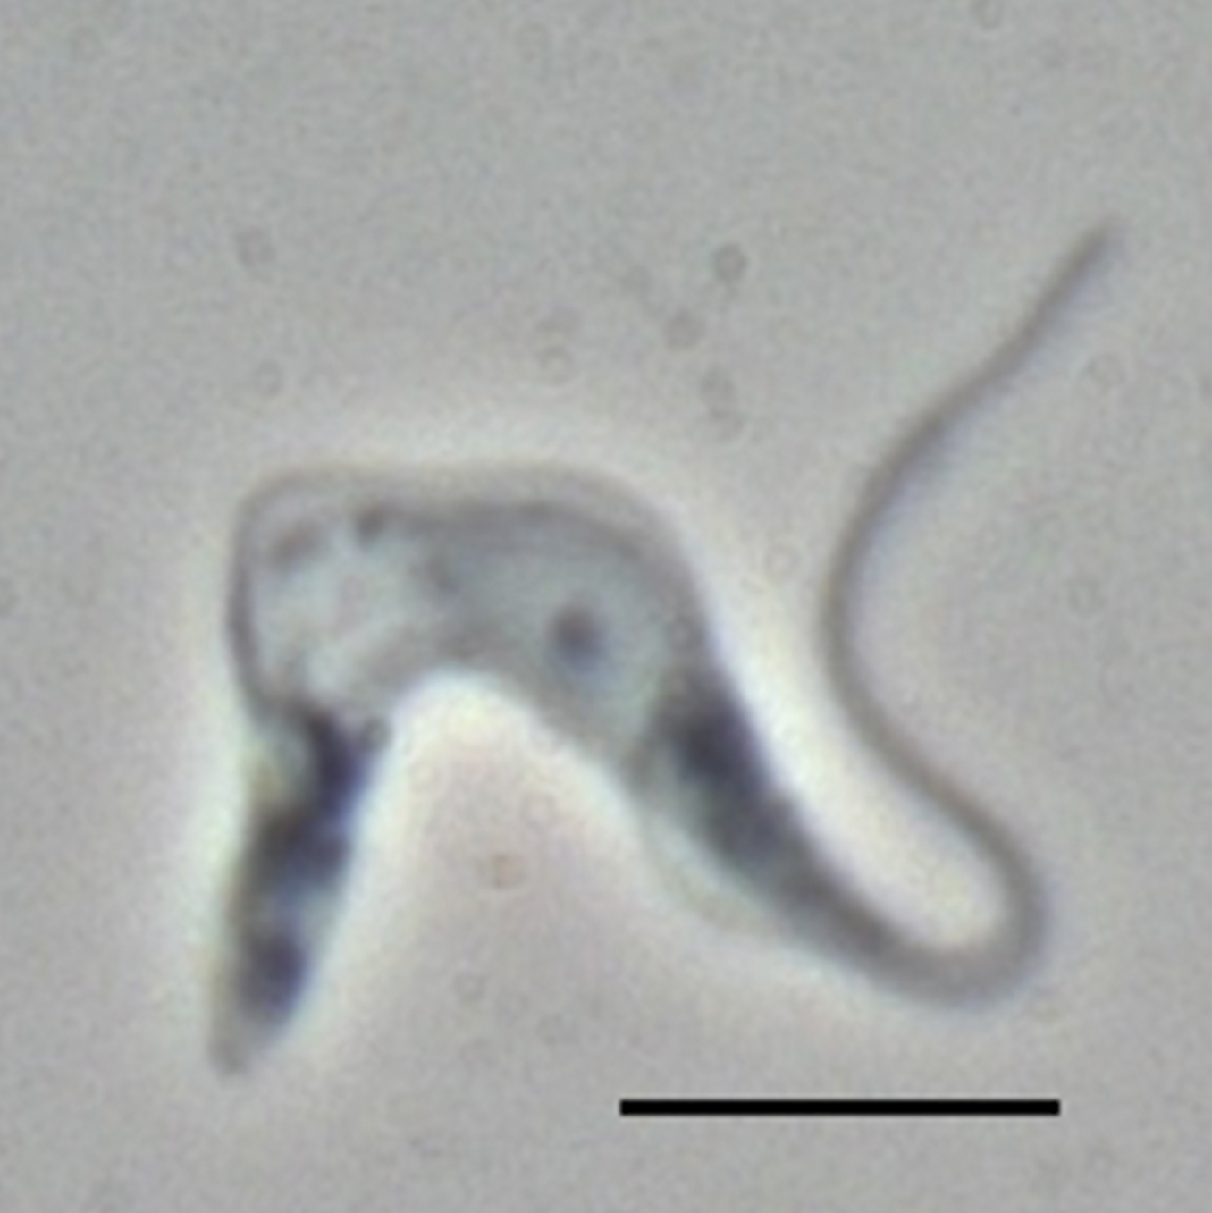
Evolution Connection
Trypanosoma brucei cause sleeping sickness in humans
Mitochondria within Trypanosoma produce pre-mRNA which is non-functional
Cells use RNA editing to fix this issued during RNA processing
Guide RNA is used to add extra uracil to mRNA to create a functional protein
15.4 Figure 2
Torsten Ochsenreiter on Wikimedia Commons. "Trypanosoma brucei."

Slide 6
5΄ capping
While pre-mRNA is still being synthesized, a modified guanine nucleotide is added to the 5΄ end of the growing transcript.
After being added, the nucleotide is methylated to form the 7-methylguanosine cap (also called the 5΄ cap).
This cap protects the mRNA from degradation and helps initiate translation by the ribosome.

Slide 7
3΄ poly-A Tail
Once pre-mRNA elongation is complete, an endonuclease cleaves between the AAUAAA consensus sequence and a GU-rich region.
The GU-rich region is removed.
An enzyme called poly-A polymerase adds approximately 200 A residues to the consensus sequence to create the poly-A-tail.
This modification helps prevent degradation and is required for exporting the processed mRNA from the nucleus.

Slide 8
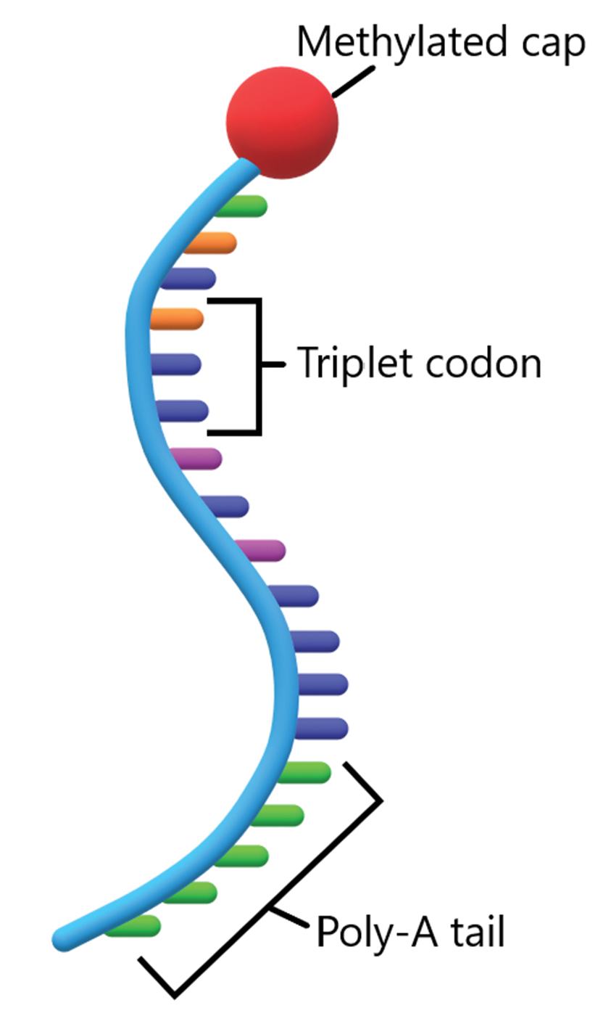
Lesson 15.4 Figure 3
Christinelmiller on Wikimedia Commons. "Mature mRNA."
Notes:
Figure 3: A mature mRNA is modified at both the 5′ end (methylated cap) and 3′ end (poly-A tail) to increase the stability of the exonic mRNA coding regions (triplet codons).

Slide 9
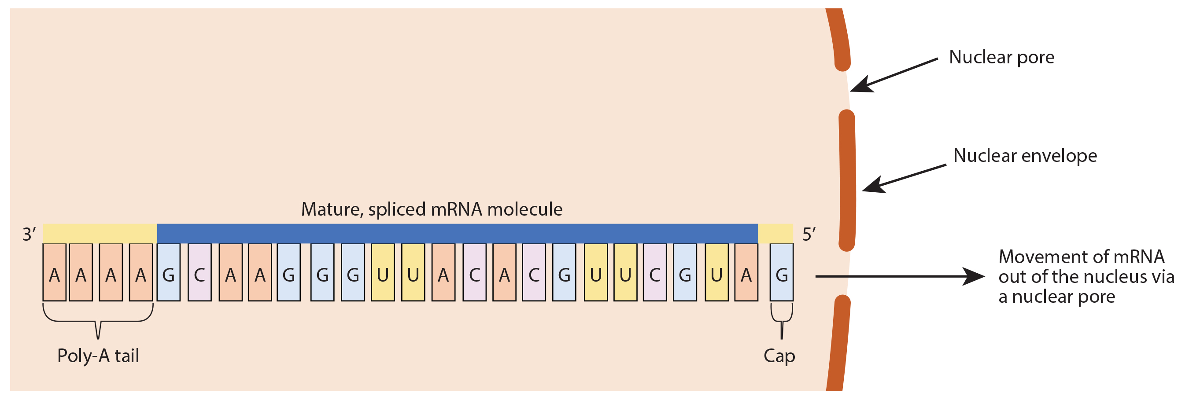
Lesson 15.4 Figure 4
Kep17 on Wikimedia Commons. "Mature mRNA transport."
Notes:
Figure 4: Mature mRNA must be transported from the nucleus to the cytoplasm for subsequent translation. This transport happens via specialized openings in the nuclear envelope called nuclear pores.

Slide 10
Think It Through
If you were to drastically alter the sequence of a single intron inside a gene-coding region, would you affect protein expression of that gene?
Notes:
Originally an On Your Own. This is included here to use as a talking point or for a think-pair-share activity.

Slide 11
Pre-mRNA splicing
Introns (noncoding sequences) must be removed from exons ( coding sequences) within the pre-mRNA.
The process of removing introns and reconnecting exons is called splicing.
Occurs by a sequence-specific mechanism.
Introns are marked by a GU at the 5΄ end and an AG at the 3΄ end.
Splicing conducted by complexes of proteins and RNA molecules called spliceosomes.

Slide 12
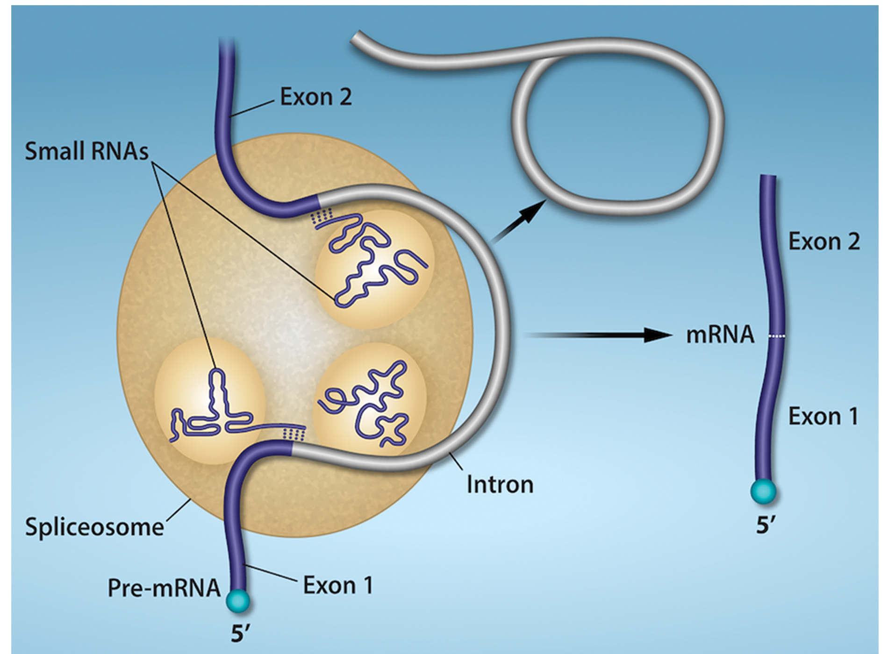
Lesson 15.4 Figure 5
Rao, A. and Ryan, K. Department of Biology, Texas A&M University. "Pre-mRNA splicing."
Notes:
Figure 5: Pre-mRNA splicing involves the precise removal of introns from the primary RNA transcript. The splicing process is catalyzed by protein complexes, called spliceosomes, that are composed of proteins and RNA molecules called small nuclear RNAs (snRNAs). Spliceosomes recognize sequences at the 5′ and 3′ end of the intron, snips out the introns, and stitches the exons back together.

Slide 13
Group Activity
Errors in splicing are implicated in cancers and other human diseases.
In a group, discuss what kinds of mutations might lead to splicing errors.
Think of different possible outcomes if splicing errors occur.
Then, look up examples of diseases linked to splicing errors, utilizing peer-reviewed sources of information.

Slide 14
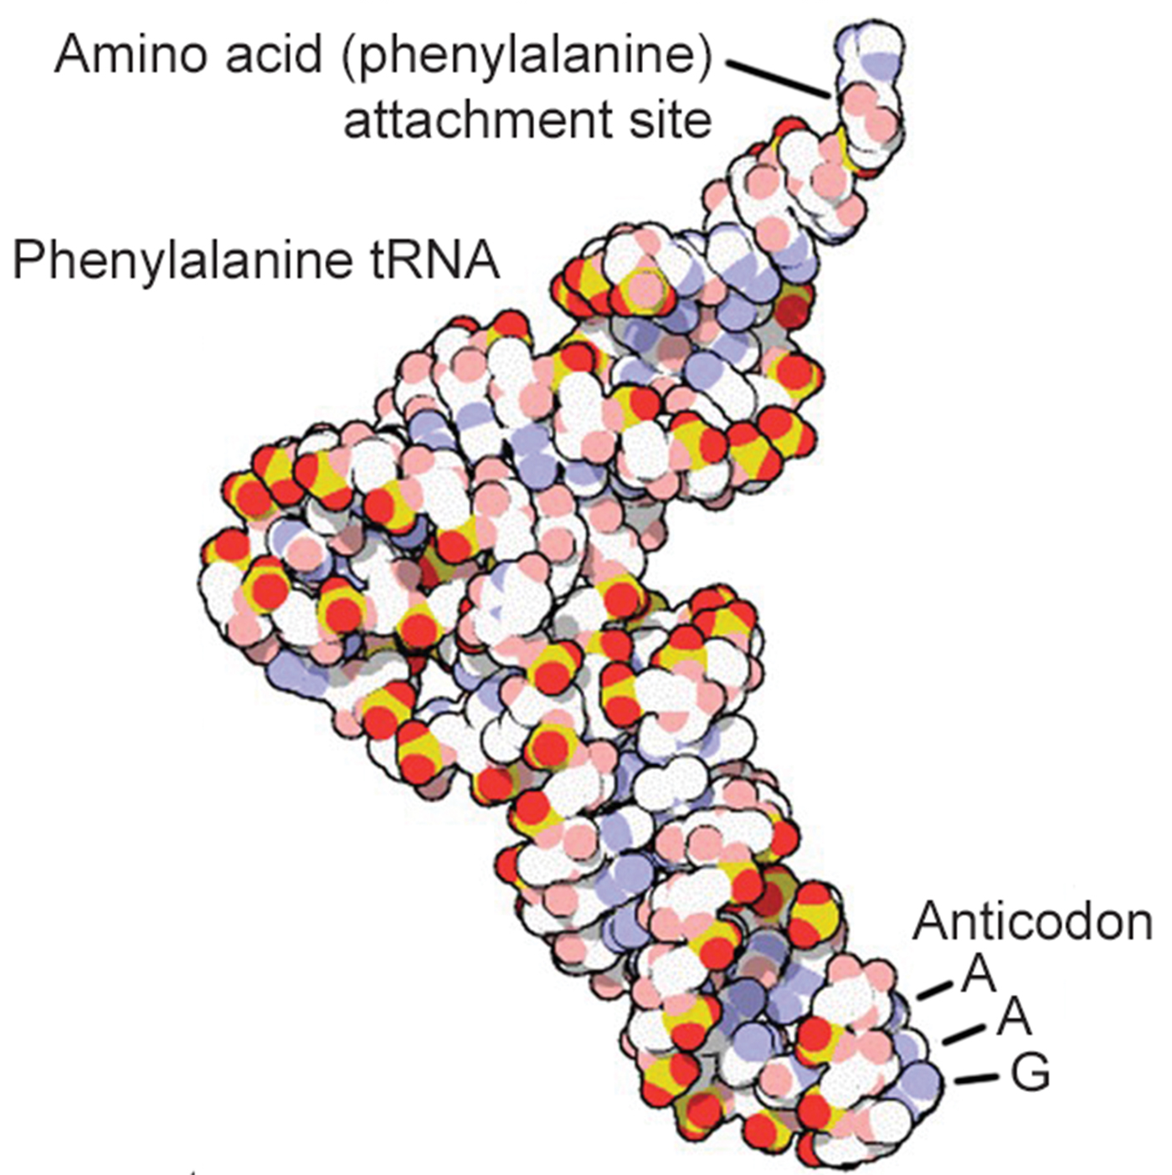
Processing of tRNAs and rRNAs
tRNAs and rRNAs are structural molecules needed for protein synthesis but are not translated.
Mature rRNAs make up approximately 50% of the ribosome.
tRNAs have an animo acid binding site on one end, and an anticodon, which is a three-nucleotide sequence in the tRNA which interacts with an mRNA codon.
15.4 Figure 6
OpenStax. "tRNA."

Slide 15
Summary
Pre-mRNA must be processed prior to translation.
Introns must be removed by the spliceosome.
A 5΄cap and poly-A tail must be added to prevent degradation and provide signaling.
Pre-tRNA’s and pre-rRNA’s must also be processed to produce mature structural molecules.

Slide 16


End of Hawkes Learning PowerPoint

