Slide 1
Chapter 15.5
Protein Synthesis

Slide 2
Objectives
Describe the different steps in protein synthesis
Discuss the role of ribosomes in protein synthesis.

Slide 3
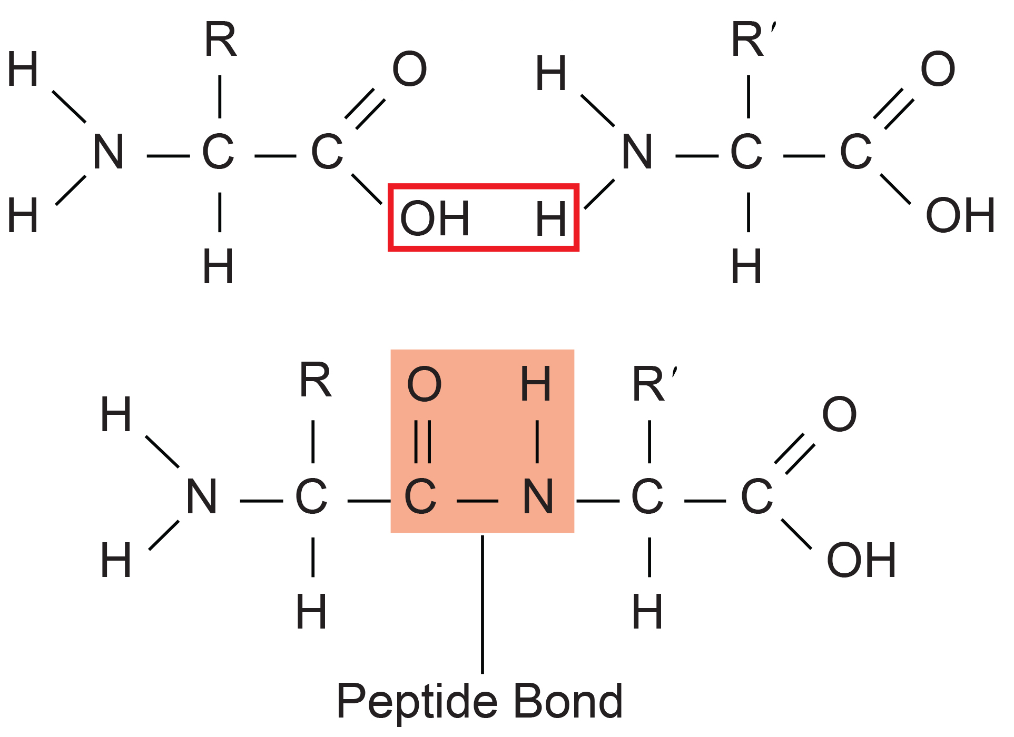
Protein Synthesis
Protein synthesis is the most energy-intensive metabolic process in cells.
Proteins constitute the largest portion of an organism's mass after water.
Translation decodes mRNA into polypeptides 50 to over 1,000 amino acids long.
Ribosomes catalyze the formation of peptide bonds between amino acids, linking the carboxyl group of one amino acid to the amino group of the next.
Releases a water molecule
15.5 Figure 1
OpenStax. "Peptide bond." Modified.

Slide 4
The Protein Synthesis Machinery
Translation requires multiple components: mRNA template, ribosomes, tRNAs, and various enzymatic factors.
A ribosome can be thought of as an enzyme whose amino acid binding sites are specified by mRNA.
All amino acids share the same general structure: a central carbon atom attached to an amino (NH₂) group, carboxyl (COOH) group, hydrogen (H) atom, and an R group, or side chain.

Slide 5
Ribosomes
Cells invest energy to build numerous ribosomes, complex molecules of rRNA and polypeptides
Approximately 10,000-70,000 ribosomes per E. coli bacterium
In eukaryotes, nucleolus specializes in rRNA synthesis and ribosome assembly.
Ribosomes are located in the cytoplasm of prokaryotes and in the cytoplasm, rough endoplasmic reticulum, mitochondria, and chloroplast of eukaryotes.
Dissociate into small (30S in prokaryotes or 40S in eukaryotes) and large (50S in prokaryotes or 60S in eukaryotes) subunits when not translating.
Multiple ribosomes (polysome) simultaneously translate a single mRNA, synthesizing the polypeptide 5' to 3'.

Slide 6
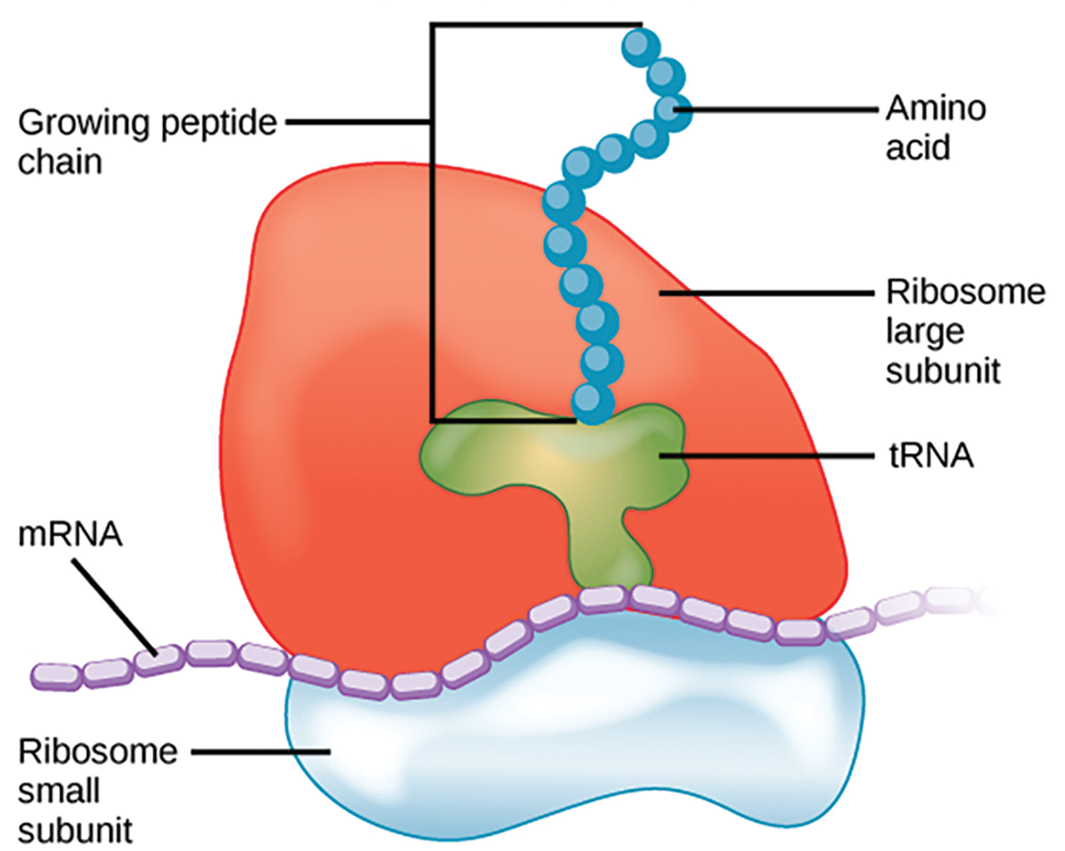
15.5 Figure 2
CNX OpenStax on Wikimedia Commons. "Ribosome translation."
Notes:
In the polysome, the small ribosomal subunit binds the mRNA template while the large ribosomal subunit binds tRNA and catalyzes peptide bond formation.

Slide 7
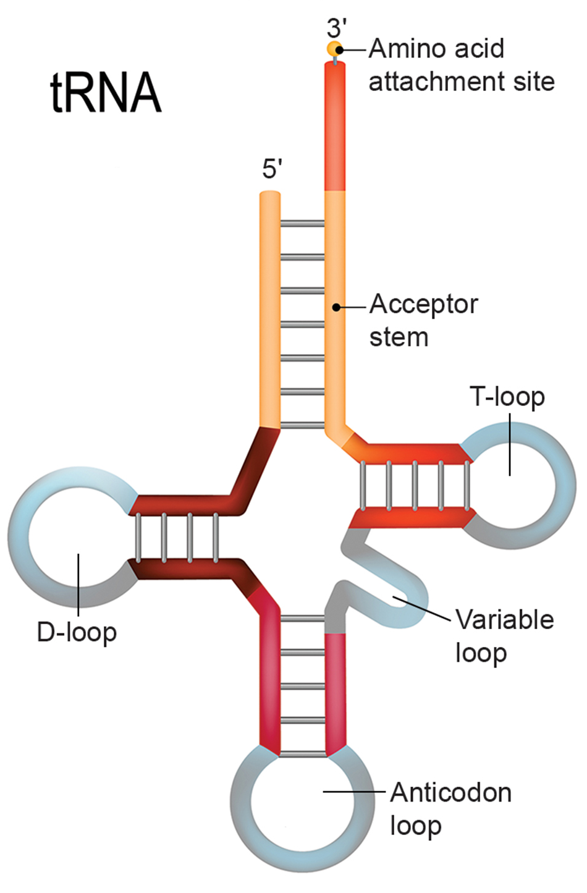
tRNAs₁
tRNAs (transfer RNAs) are transcribed RNAs with anticodons that recognize mRNA codons and translate them into corresponding amino acids.
tRNAs are charged with amino acids by aminoacyl-tRNA synthetases, forming aminoacyl-tRNAs that act as adaptors in protein synthesis.
Of 64 possible mRNA codons, one (AUG) initiates translation while also coding for methionine and three terminate it.
15.5 Figure 3

Slide 8
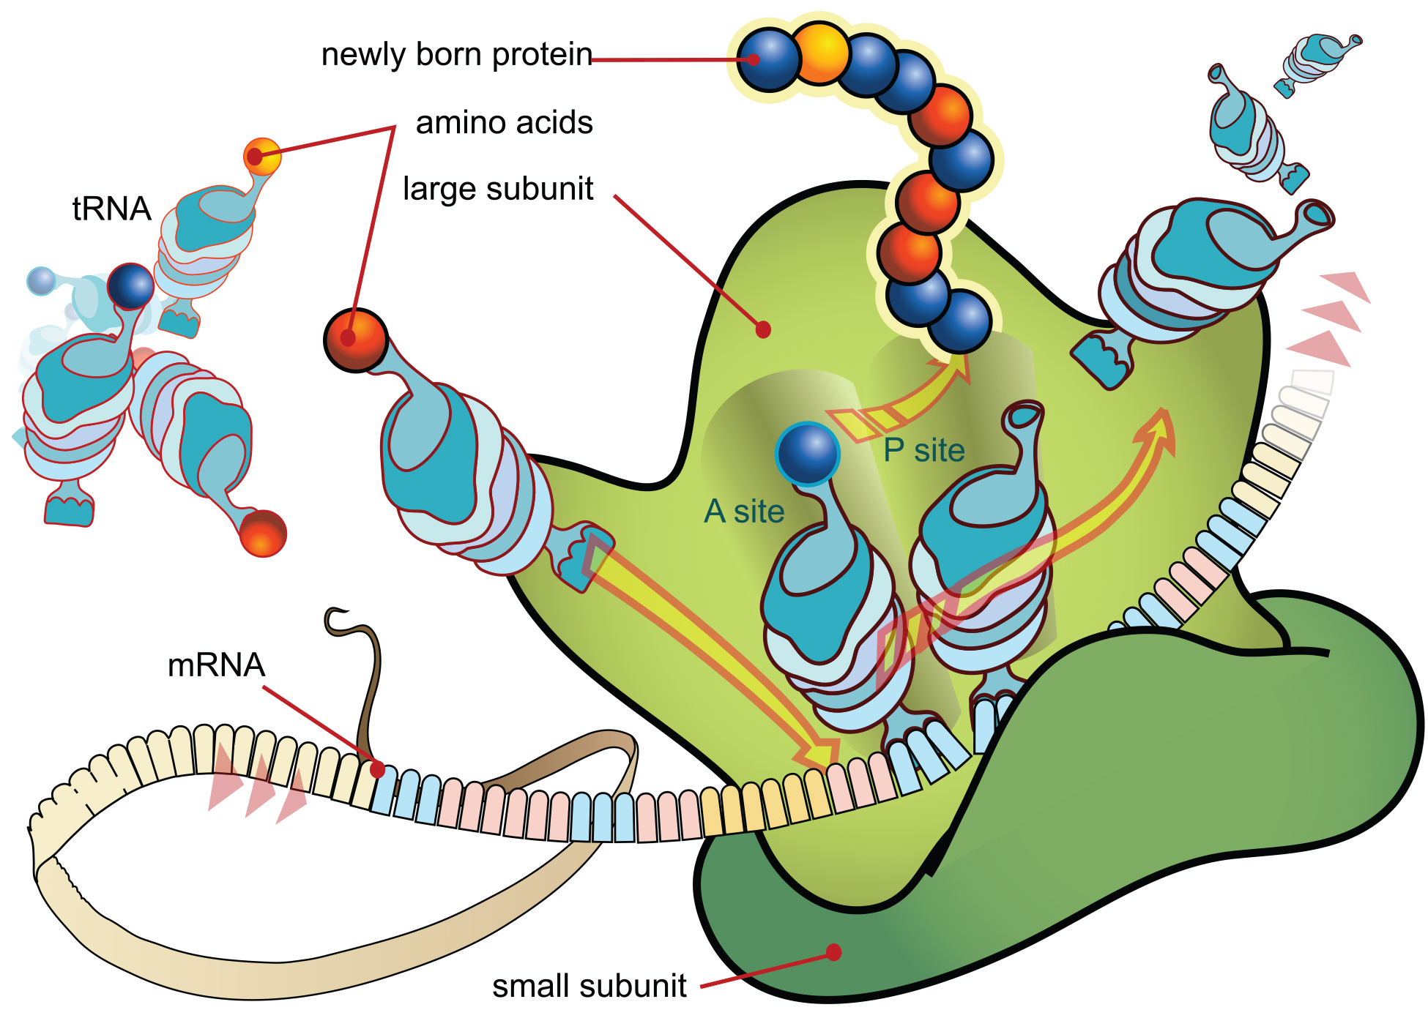
tRNAs₂
tRNAs interact with three factors:
Must recognize correct aminoacyl-tRNA synthetase
Must be recognized by ribosomes
Must bind to the correct mRNA sequence
15.5 Figure 4
Mariana Ruiz Villarreal on Wikimedia Commons. "Ribosome mRNA translation."

Slide 9
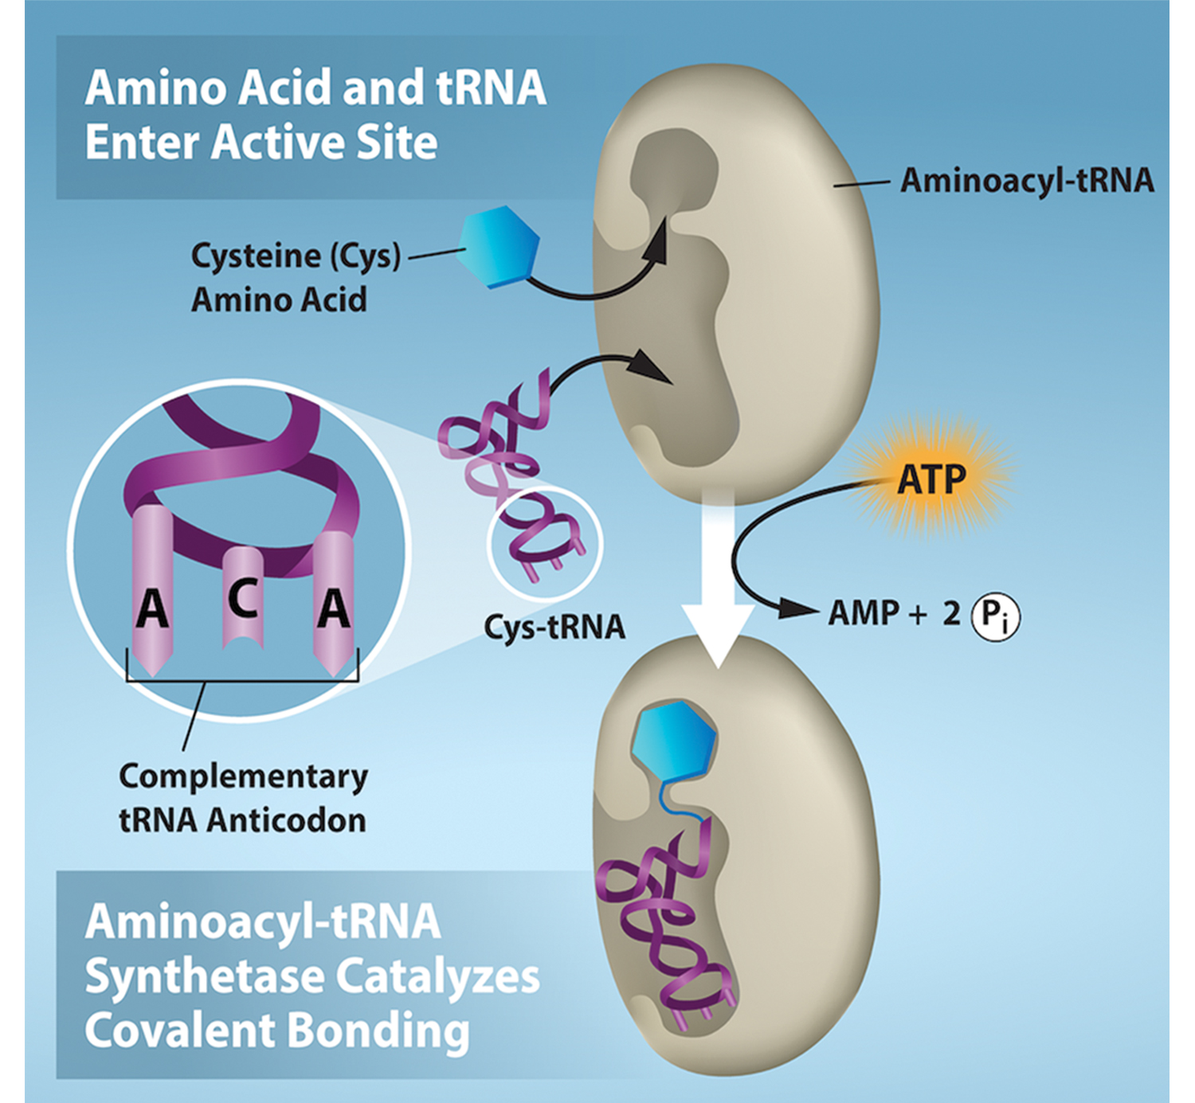
Aminoacyl-tRNA Synthetases
Aminoacyl-tRNA synthetases charge pre-tRNAs by forming high-energy amino acid-tRNA bonds.
Includes hydrolysis of ATP
The high-energy bond that attaches an amino acid to its tRNA is later used to drive the formation of the peptide bond.
15.5 Figure 5
Rao, A., Ryan, K. and Tag, A. Department of Biology, Texas A&M University. "Charging of tRNAs."

Slide 10
The Mechanism of Protein Synthesis
Translation of mRNA to proteins involves initiation, elongation, and termination phases, with general mechanistic similarities in prokaryotes and eukaryotes.
Initiation of Translation
Translation initiation in prokaryotes involves a translation complex composed of the 30S ribosomal subunit, mRNA, initiation factors, and the initiator tRNA^{Metf}.
The Shine-Dalgarno sequence (AGGAGG) in mRNA interacts with rRNA to position 30S subunit correctly.
GTP provides the energy for translation.

Slide 11
Think It Through₁
How would mutating the Shine-Dalgarno sequence affect protein translation?
Notes:
Originally an On Your Own. This is included here to use as a talking point or for a think-pair-share activity.

Slide 12
Initiation of Translation
Initiator tRNA (tRNA^{Metf} in prokaryotes, Met-tRNA_{i} in eukaryotes) carries formylated and non-formylated methionine and binds to the start codon AUG.
In eukaryotes, the initiation complex, including cap-binding proteins, recognizes the 7-methylguanosine cap and helps attach the 40S subunit to the 5' cap.
Kozak's rules guide the initiation complex to the start codon selection in eukaryotes based on nucleotide sequence that must be near AUG (5′-gccRccAUGG-3′ where R is a purine).
The 60S subunit joins 40S-mRNA-Met-tRNA_{i} complex in eukaryotes after start codon recognition.

Slide 13
Translation, Elongation, and Termination₁
Ribosome has three tRNA binding sites: the A-site for the incoming aminoacyl-tRNAs, the P-site for charged tRNAs with a polypeptide chain, and the E-site that releases uncharged tRNAs during elongation.
The initiator Met-tRNA occupies P-site initially.
Translocation shifts tRNAs through the ribosome binding sites until the stop codon reached.

Slide 14
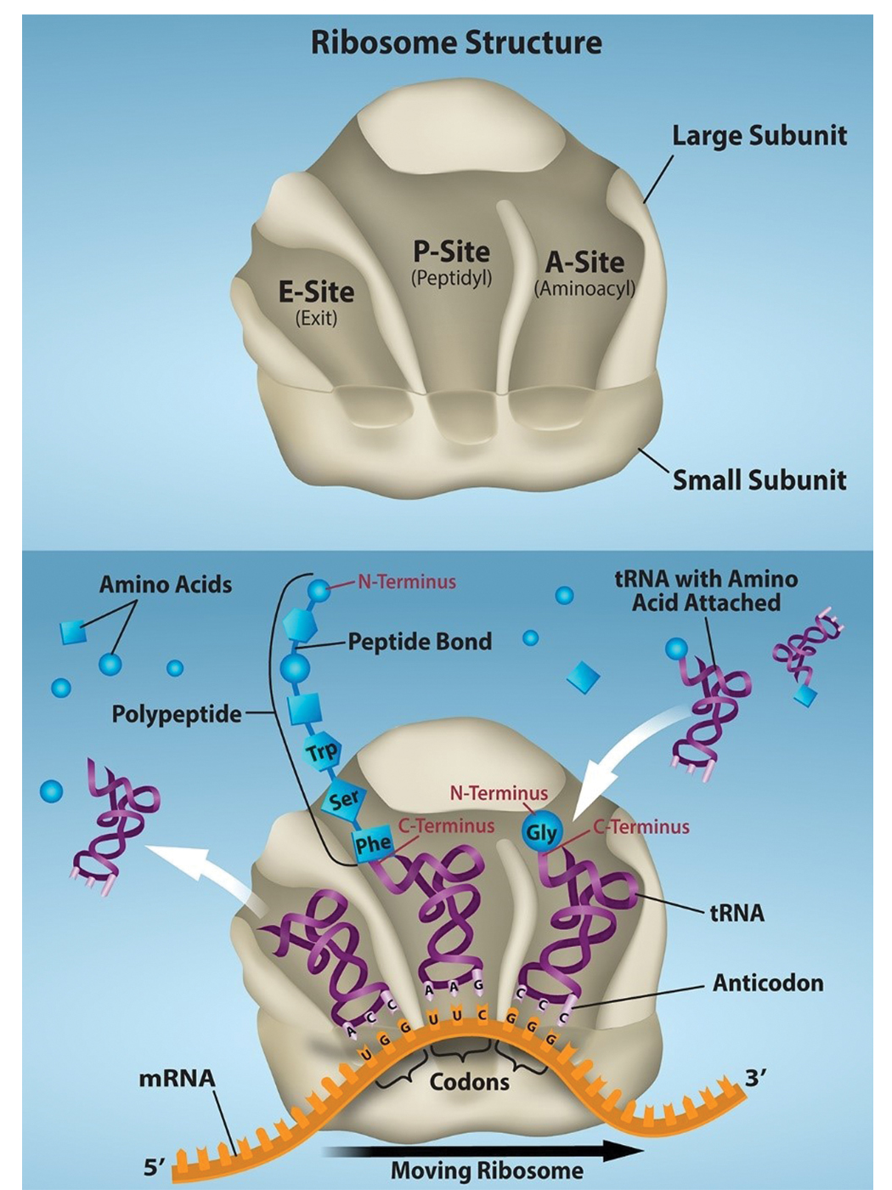
15.5 Figure 6
Rao, A., Ryan, K. and Fletcher, S. Department of Biology, Texas A&M University. "Ribosome functions."
Notes:
During translation, charged tRNAs enter the A-site, and the anticodon on the tRNA base pairs with the codon in the mRNA. The amino acid in the A-site forms a peptide bond with the growing polypeptide chain in the P-site. Then, the ribosome moves three nucleotides toward the 3′ end of the mRNA. This movement transfers the tRNA from the A-site to the P-site and allows the empty tRNA to exit at the E-site. The process repeats until the protein chain is complete.

Slide 15
Translation, Elongation, and Termination₂
mRNA codon-anticodon binding in the A-site provides tRNA specificity during elongation.
Peptidyl transferase forms peptide bonds between the new A-site aminoacyl-tRNA and P-site polypeptidyl-tRNA.
The hydrolysis of GTP provides the energy for tRNAs to move through the ribosome binding sites.
Example: E. coli elongation is rapid, adding 1 amino acid every 0.05 seconds.

Slide 16
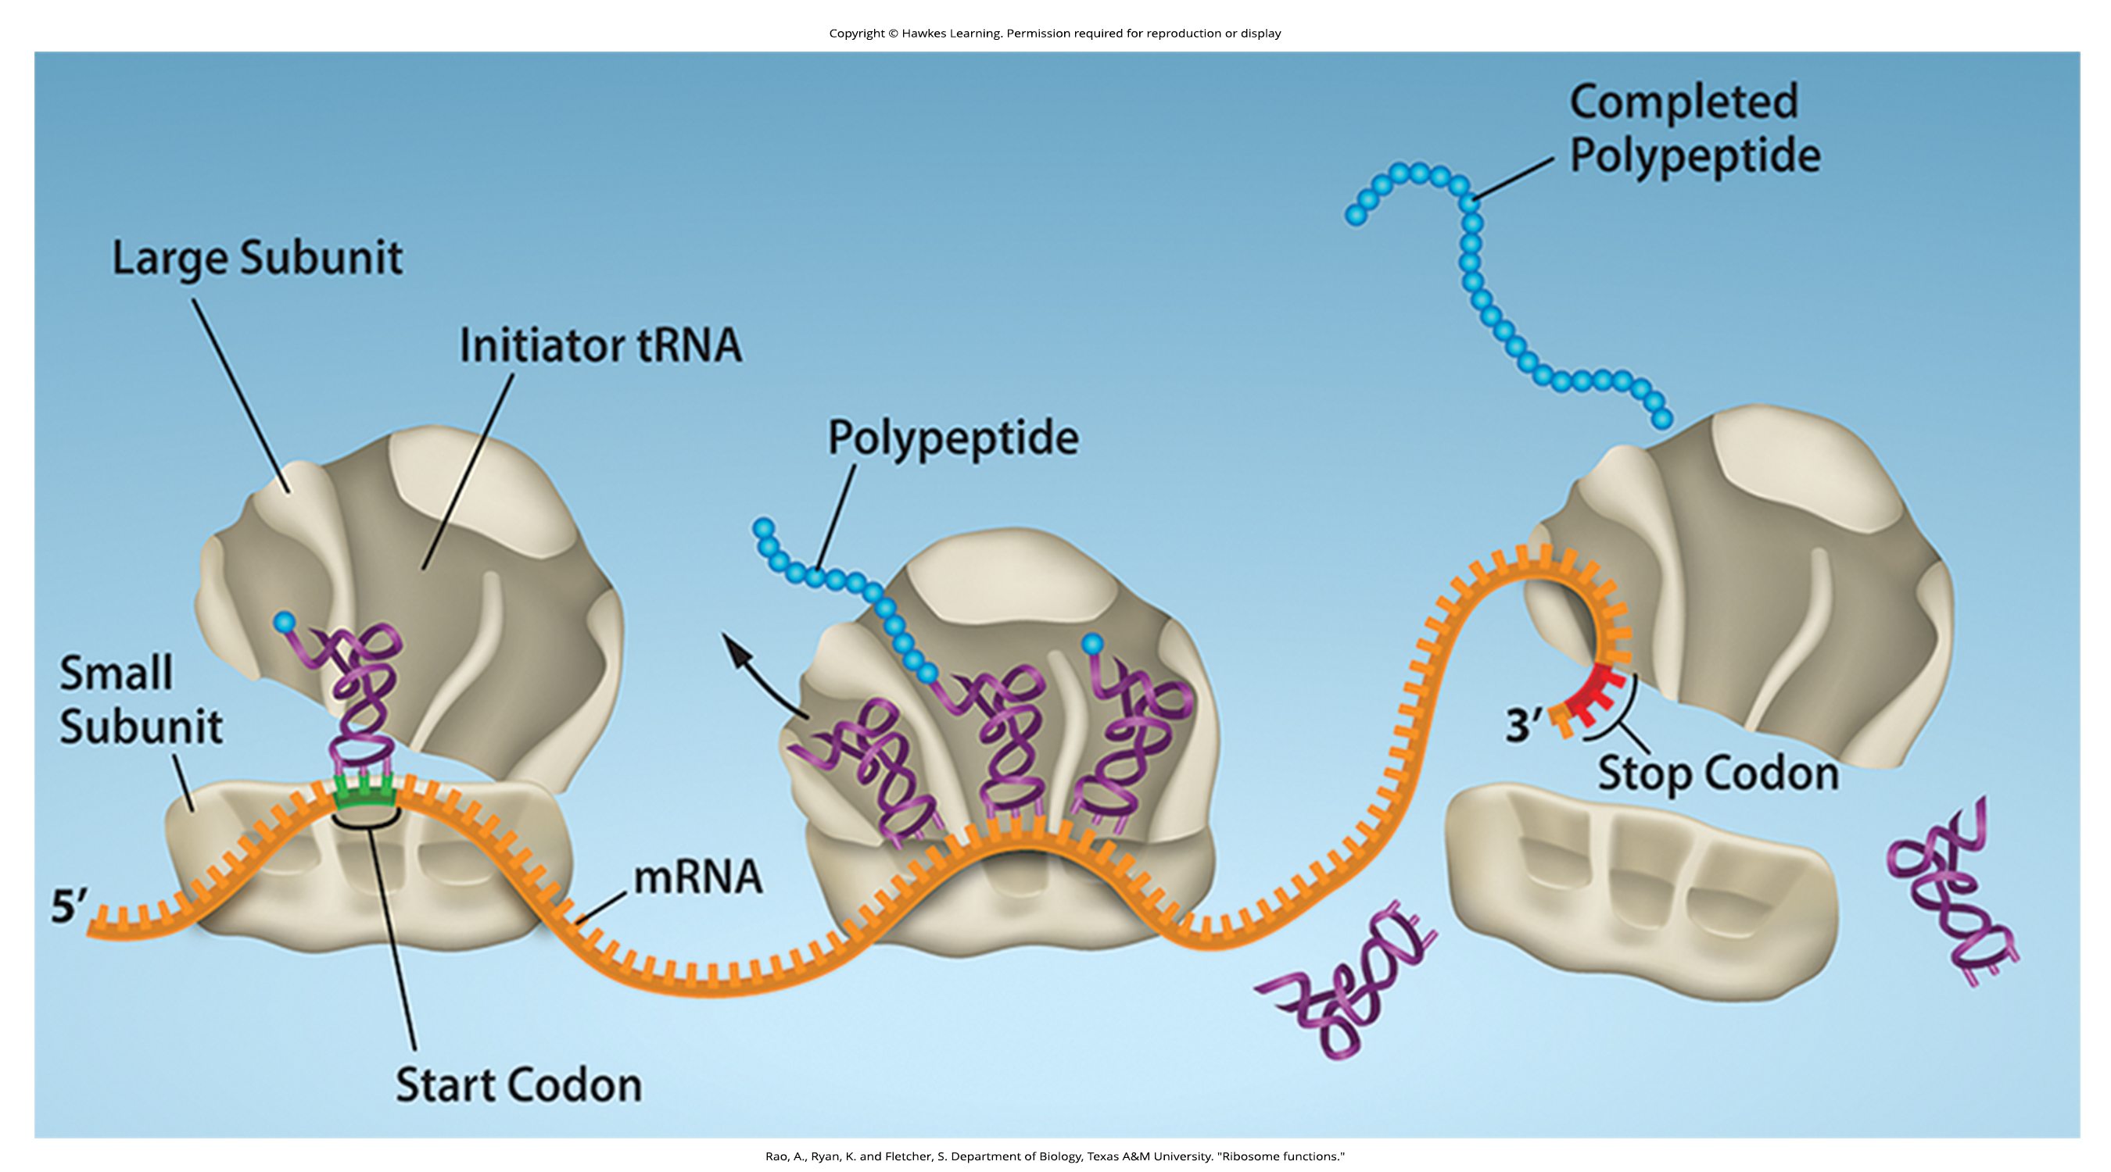
15.5 Figure 7
Rao, A., Ryan, K. and Fletcher, S. Department of Biology, Texas A&M University. "Ribosome functions."
Notes:
Translation begins when an initiator tRNA anticodon recognizes a start codon on mRNA bound to a small ribosomal subunit. The large ribosomal subunit joins the small subunit, and a second tRNA is recruited. As the mRNA moves relative to the ribosome, successive tRNAs move through the ribosome, and the polypeptide chain is formed. Entry of a release factor into the A-site terminates translation, and the components dissociate.

Slide 17
Translation, Elongation, and Termination₃
Stop codons in the A-site recruit release factors that mimicking tRNAs during termination.
Release factors instruct peptidyl transferase to add a water molecule to the carboxyl end of the P-site amino acid, releasing the peptide.
Then the ribosomal subunits dissociate and are recycled; the mRNA degrades after multiple translation rounds.

Slide 18
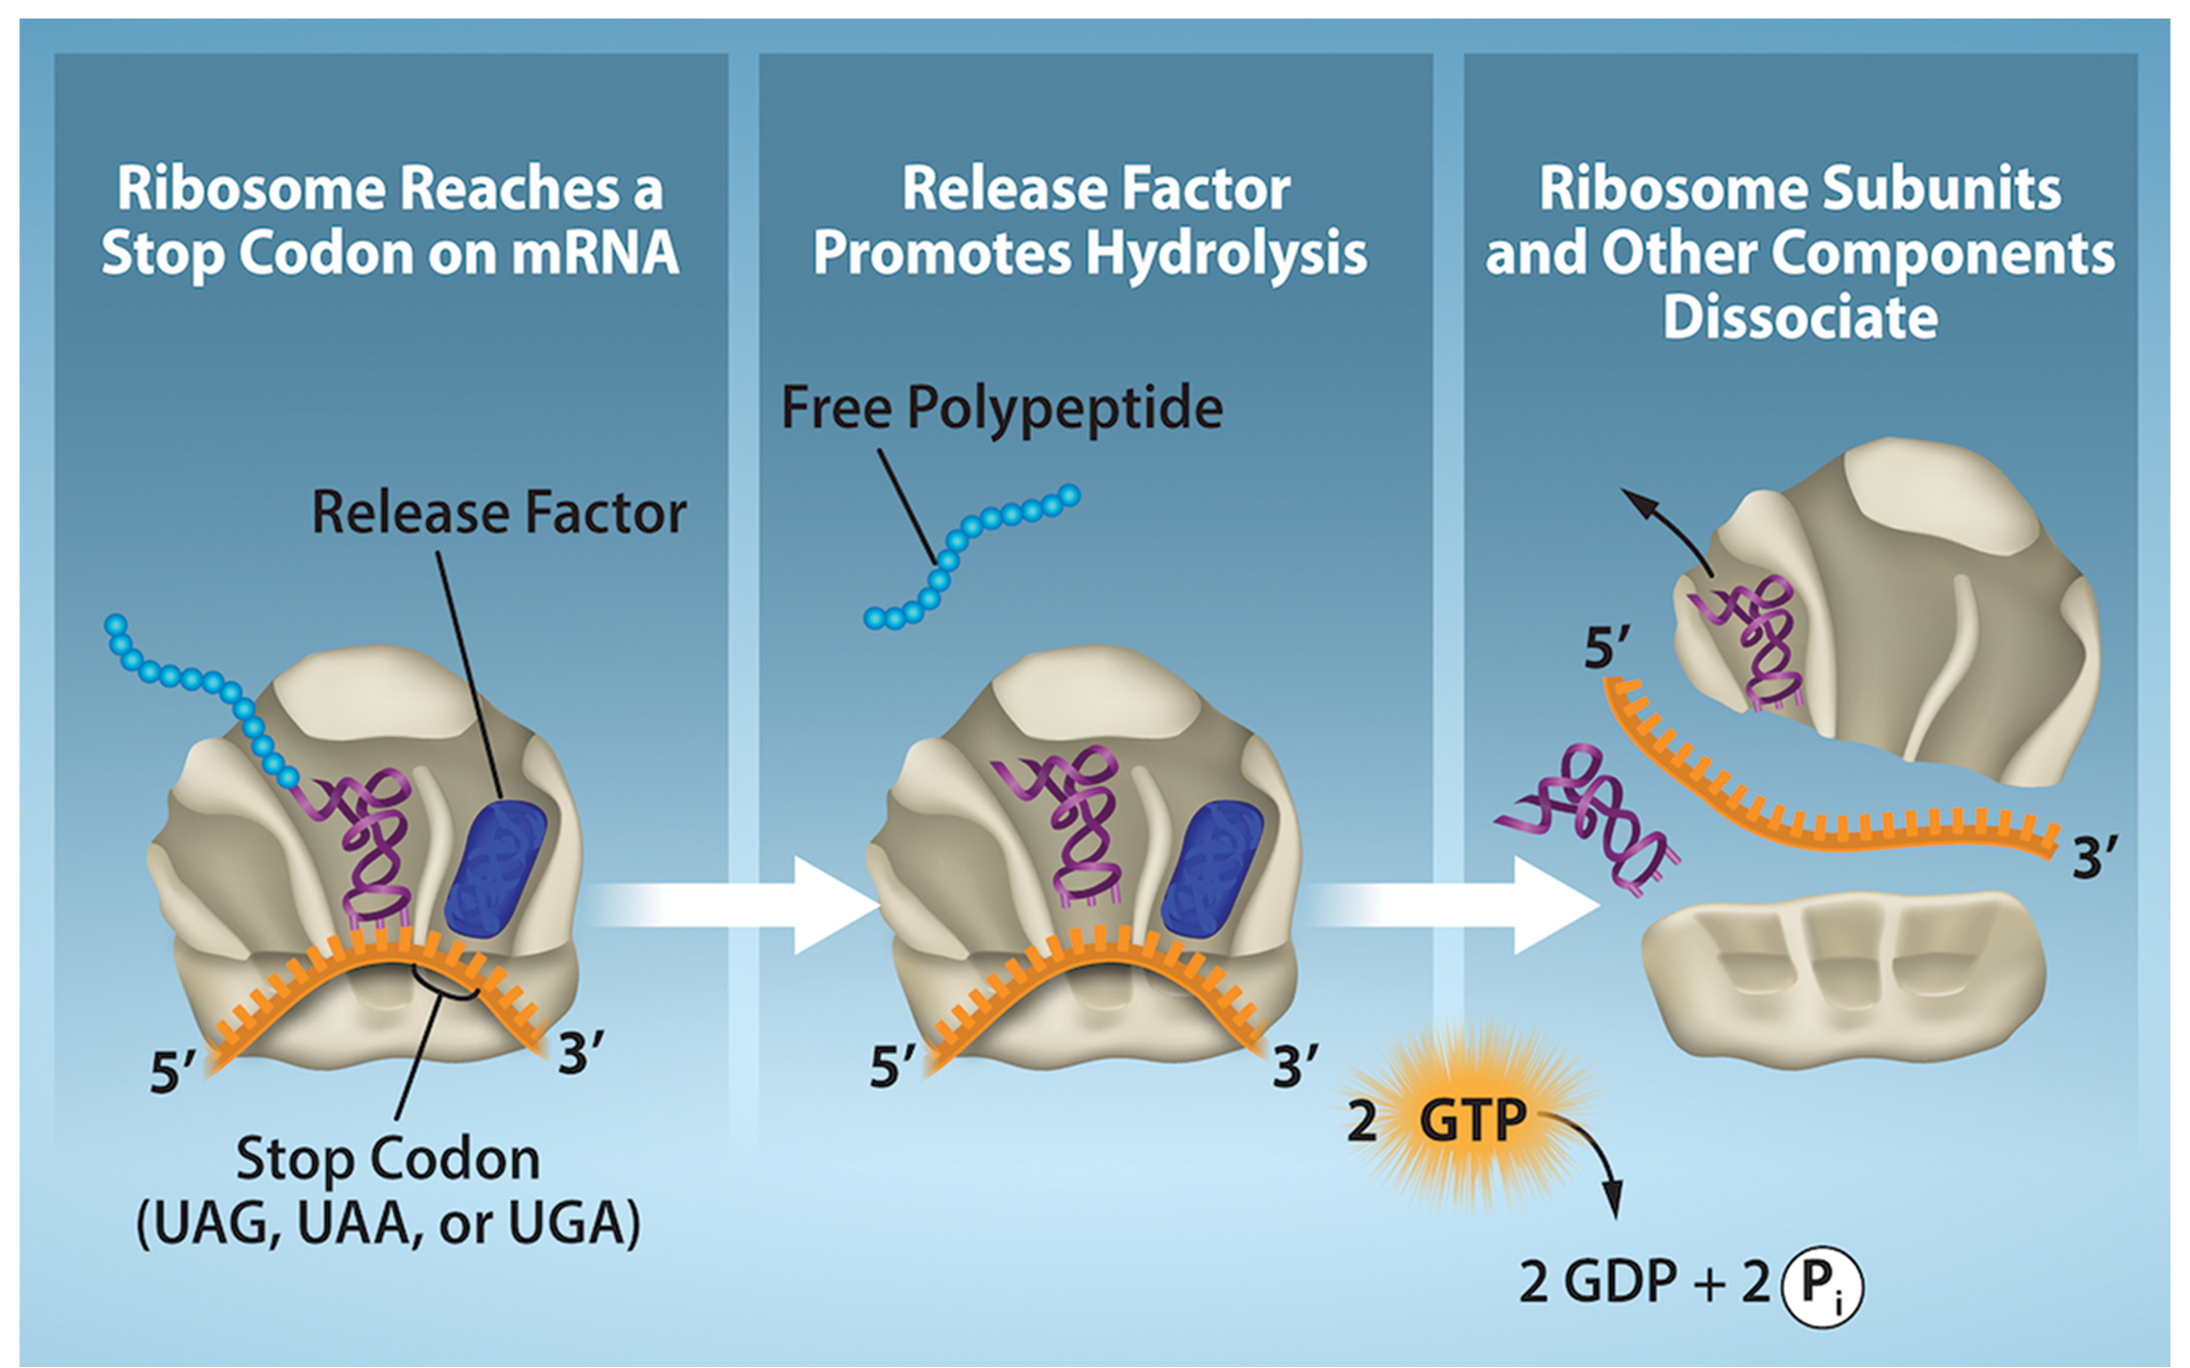
15.5 Figure 8
Rao, A. and Ryan, K. Department of Biology, Texas A&M University. "Translation termination."
Notes:
Translation termination is active. Translation is terminated when a stop codon is in the A-site of the ribosome. Since there are no tRNAs corresponding to the stop codons, the release factor protein enters and catalyzes the dissociation between the last amino acid and its tRNA. This hydrolysis releases the free carboxyl terminus (C-terminus) of the protein. Additional factors use the energy in GTP hydrolysis to disassemble the large and small ribosomal subunits and mRNA.

Slide 19
Think It Through₂
How are protein release factors able to enter the A-site of the ribosomes, therefore terminating protein translation?
Notes:
Originally an On Your Own. This is included here to use as a talking point or for a think-pair-share activity.

Slide 20
Protein Folding, Modification, and Targeting
After translation, proteins fold due to intramolecular interactions and may be chemically modified; then they move to their destination.
Signal sequences direct proteins to cellular compartments and are recognized by signal recognition proteins (SRPs).
Located at a protein's amino end and removed after reaching the destination
Many proteins need chaperones, helper molecules that assist in folding and preventing aggregation.
Misfolding causes dysfunctional structures.
Abnormal temperature or pH disrupts folding.

Slide 21
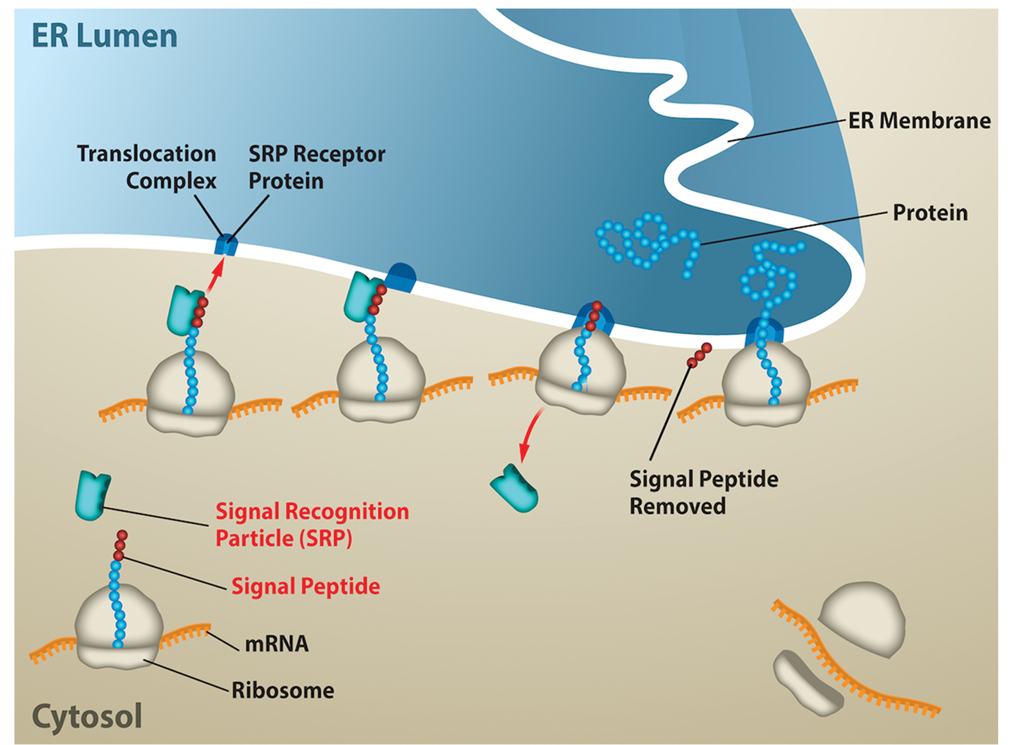
15.5 Figure 9
Rao, A. and Ryan, K. Department of Biology, Texas A&M University. "Proteins and the ER."
Notes:
Proteins destined for secretion from the cell are synthesized by ribosomes on rough endoplasmic reticulum (ER). As these proteins are synthesized, they are sent to the ER for folding and modification. These proteins contain a signal sequence at the N-terminus. The signal will be recognized by SRP as soon as the amino acids emerge from the ribosome, and the ribosome will be targeted to the translocation channel in the ER membrane. The rest of the protein will go directly from the ribosome, across the ER membrane, and into the ER lumen. From the ER, proteins will travel to the Golgi apparatus (the organelle that further modifies, sorts, and targets proteins to their final destinations), where they are packaged into vesicles for transport out of the cell.

Slide 22
Summary
Translation involves mRNA, ribosomes, tRNAs, and various enzymatic factors.
Translation begins at the AUG codon which specifies for methionine.
The formation of peptide bonds occurs between sequential amino acids matched to the mRNA template by their tRNAs.
Translation ends at a nonsense or stop codon that releases the new protein.

Slide 23


End of Hawkes Learning PowerPoint

