Slide 1
Lesson 16.1
Regulation of Gene Expression

Slide 2
Objectives
Describe how prokaryotic gene regulation occurs at the transcriptional level.
Discuss how eukaryotic gene regulation occurs at the epigenetic, transcriptional, post-transcriptional, translational, and post-transcriptional levels.
Discuss why every cell does not express all of its genes all of the time.
Compare prokaryotic and eukaryotic gene expression and regulation.

Slide 3
Somatic Cells Generally Share Same DNA
Somatic cells generally contain the same DNA, except:
Mature red blood cells (which have no DNA)
Some immune cells that rearrange their DNA while making antibodies
The genes that determine a person’s characteristics (hair color, eye color, metabolic rate) are the same in all of their cells, although the various organs function differently.

Slide 4
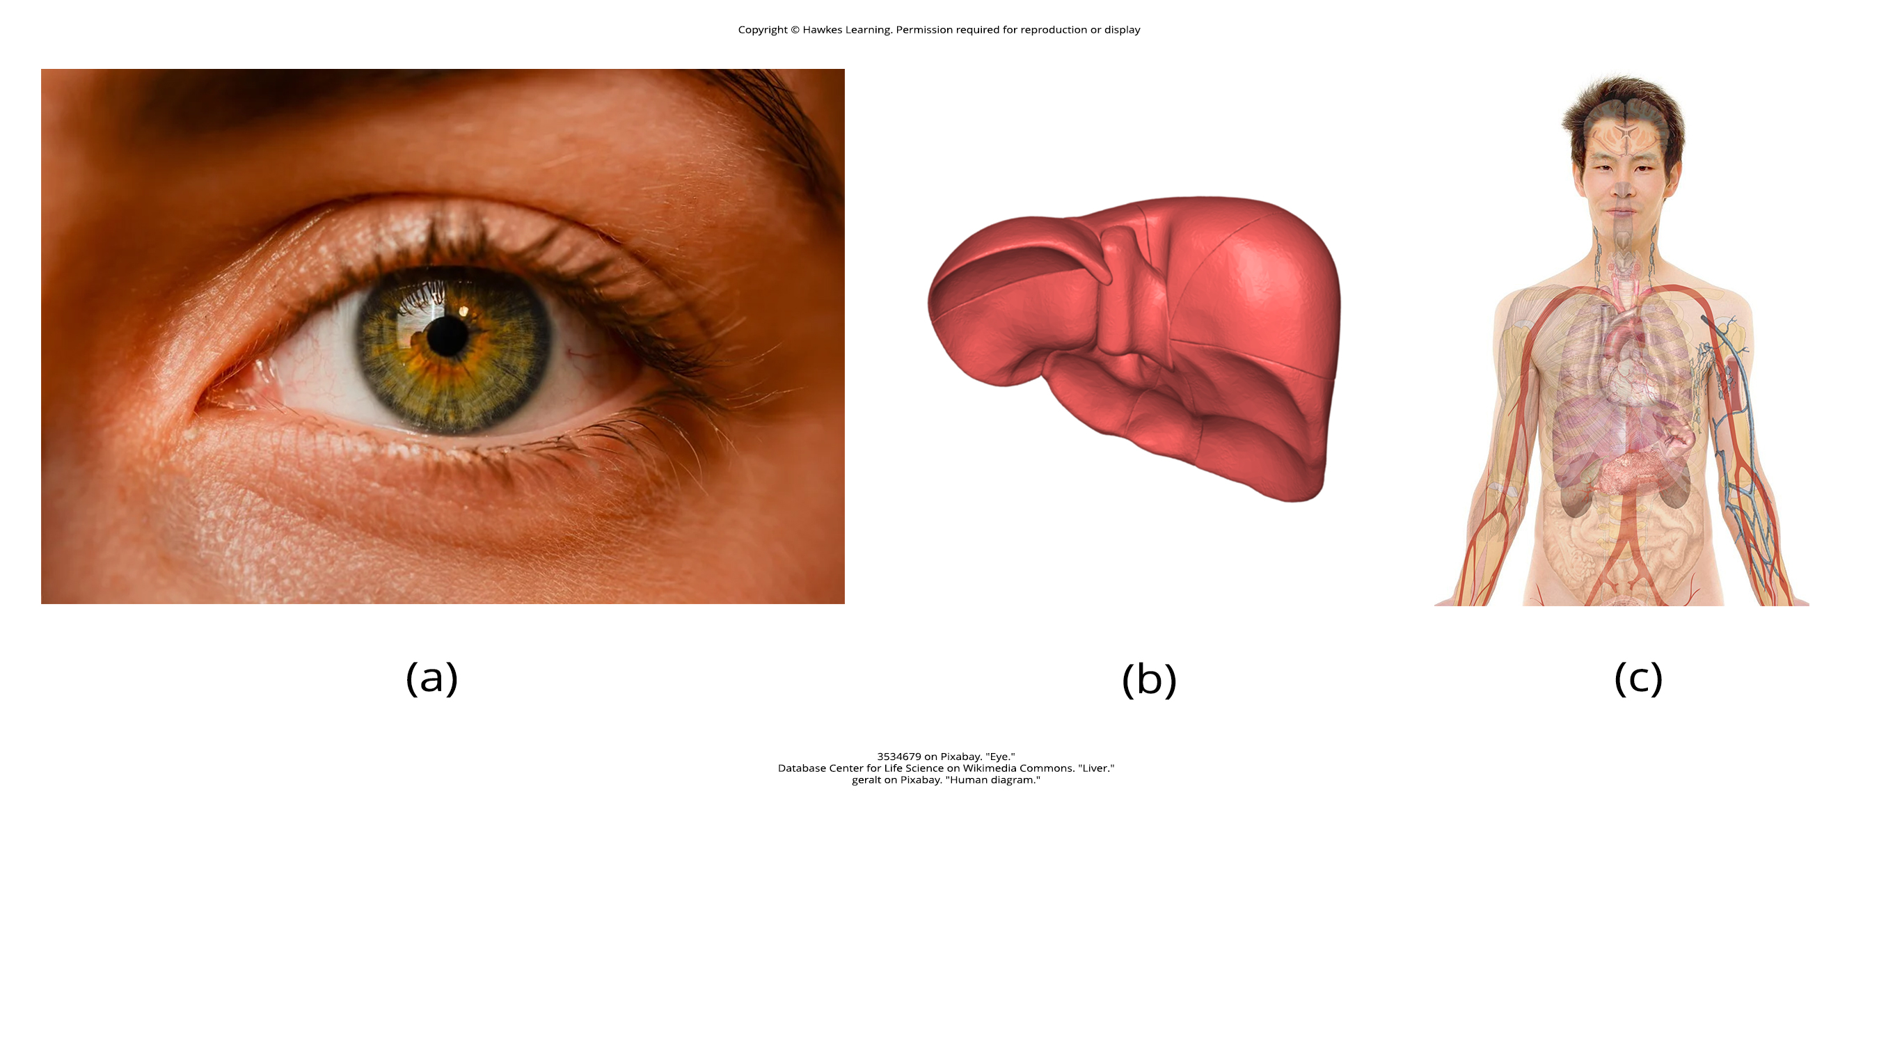
Somatic Cells Express Different Sets of Proteins
Somatic cells each express a different sets of proteins.
DNA is transcribed into RNA.
RNA is translated into protein.
At any given time, each type of cell expresses only a small subset of proteins specific for that cell type.
This expression is highly regulated.
16.1 Figure 1 (a)
3534679 on Pixabay. "Eye."
16.1 Figure 1 (b)
Database Center for Life Science on Wikimedia Commons. "Liver."

Slide 5
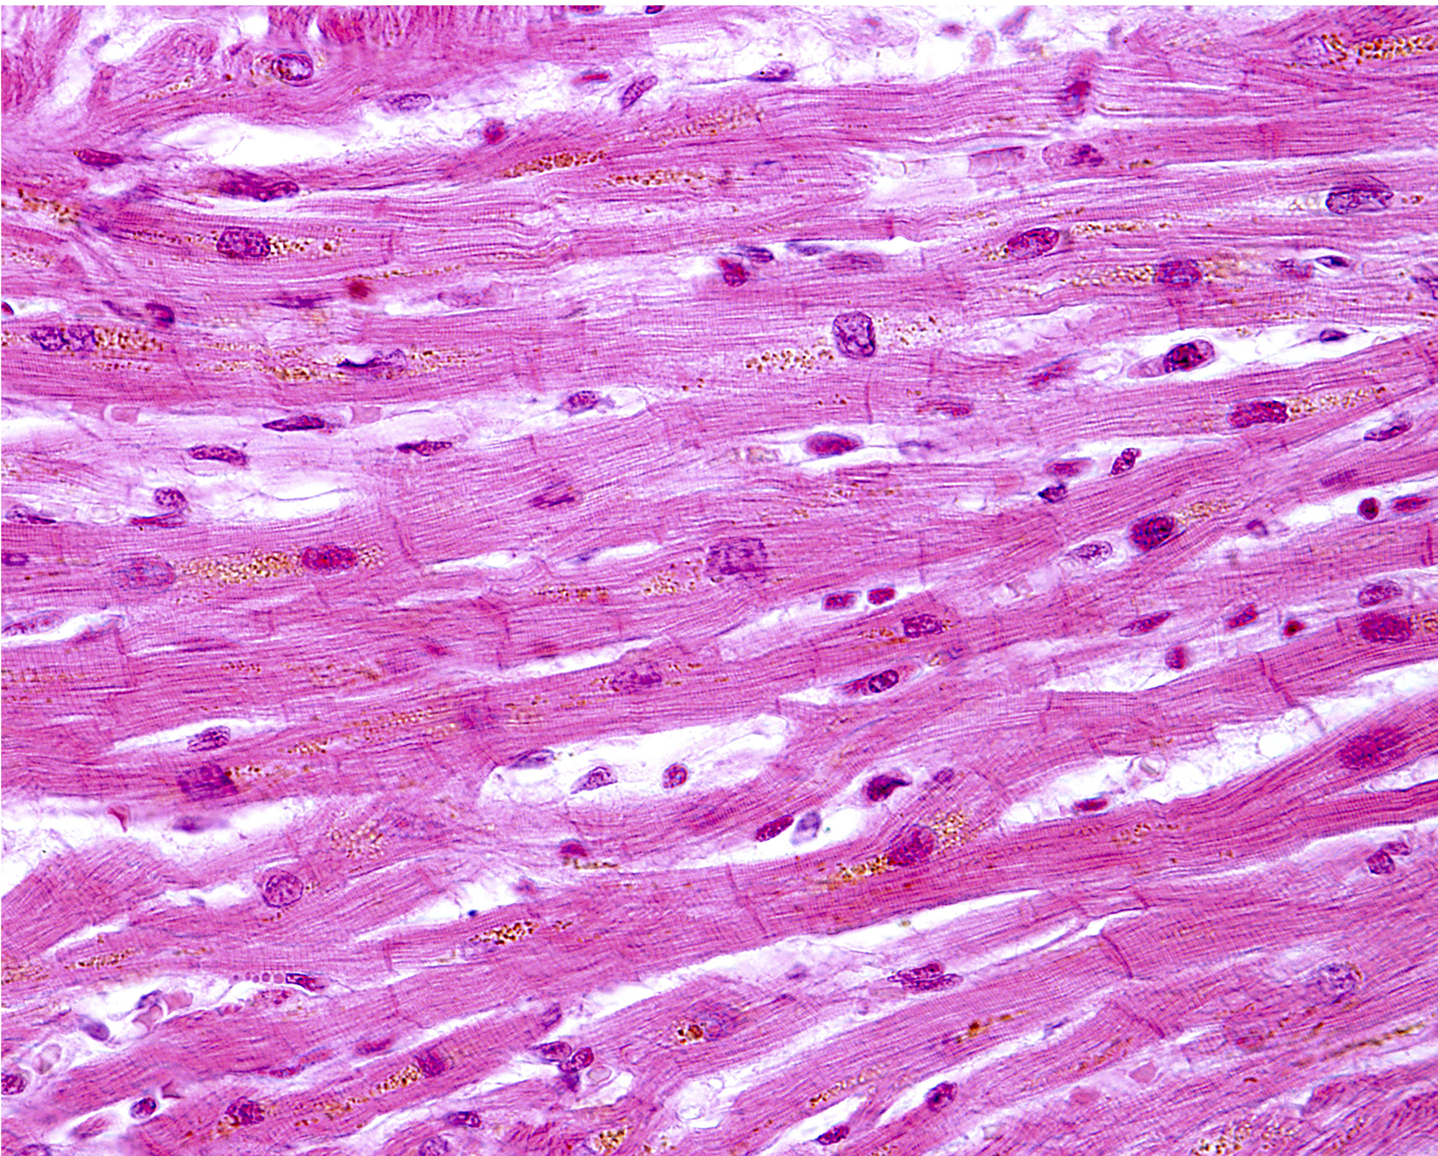
Heart Cells Express Genes Specific to the Heart
16.1 Figure 2
Heart cells express specialized proteins that are not expressed in other tissues.
Wired. "Heart cells."

Slide 6
Different Cell Types Make Up a Complete Organism
16.1 Figure 1 (c)
The differential gene expression patterns that arise in different cell types give rise to their specialized functions, which together make up a complete complex organism.
geralt on Pixabay. "Human diagram."

Slide 7
Reflection Question
Think about your body. What type of expressed genes do you think would be unique to your stomach lining, skin cells, and muscles?
Notes:
The reflection question is included here to use as a talking point or for a think-pair-share activity.

Slide 8
Gene Expression is Carefully Controlled
Gene expression is the process of turning on a gene to produce RNA and protein.
Each cell controls when and how its genes are expressed through the use of internal chemical signals that regulate:
  When a gene is expressed
  How much protein is made
  When it is time to stop making a protein

Slide 9
Regulating Gene Expression: Purpose
Regulating gene expression conserves both energy and space.
Expressing all genes at all times would require:
  Lots of energy
  Lots of space for all of the normally tightly wound DNA to be unwound and accessible for transcription
When control of gene expression malfunctions:
  The development of diseases (including cancer) may occur

Slide 10
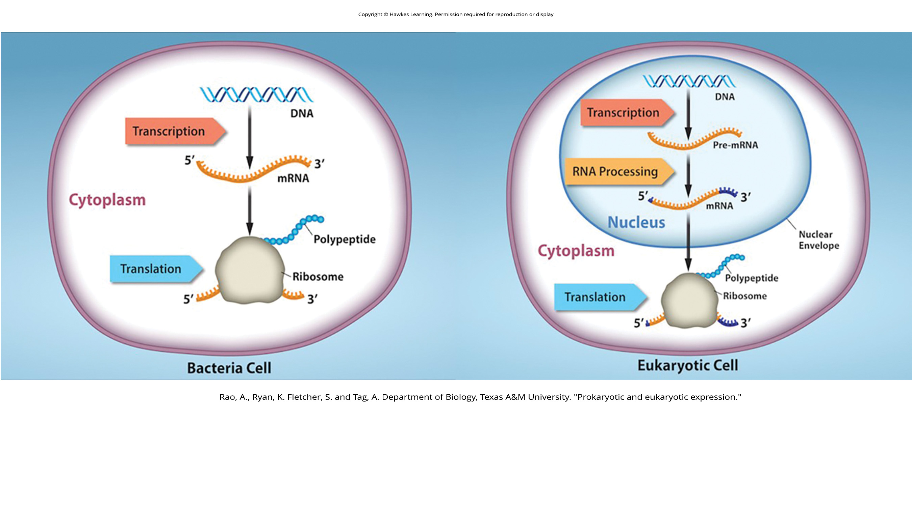
Prokaryotic Gene Expression and It Regulation
Prokaryotic organisms are single-celled and lack nuclei.
Transcription and translation occur at nearly the same time in the same location.
Transcription stops when a protein is no longer needed.
Summary: Gene expression is controlled mostly at the level of transcription.
16.1 Figure 3
Rao, A., Ryan, K. Fletcher, S. and Tag, A. Department of Biology, Texas A&M University. "Prokaryotic and eukaryotic expression."

Slide 11
Eukaryotic Gene Expression
Eukaryotic organisms have internal organelles.
  Transcription of RNA occurs in the nucleus.
  Newly made RNA is transported to the cytoplasm.
  Translation occurs in the cytoplasm.
Summary: The processes of transcription and translation are physically separated.
16.1 Figure 3
Rao, A., Ryan, K. Fletcher, S. and Tag, A. Department of Biology, Texas A&M University. "Prokaryotic and eukaryotic expression."

Slide 12
Eukaryotic Gene Expression: Regulation
Regulation of eukaryotic gene expression occurs at five levels.
  Epigenetic level: when DNA is uncoiled and loosened from nucleosomes to bind to transcription factors
  Transcriptional level: when RNA is transcribed
  Post-transcriptional level: when RNA is processed and exported to the cytoplasm
  Translational level: when RNA is translated into protein
  Post-translational level: after the protein has been made

Slide 13
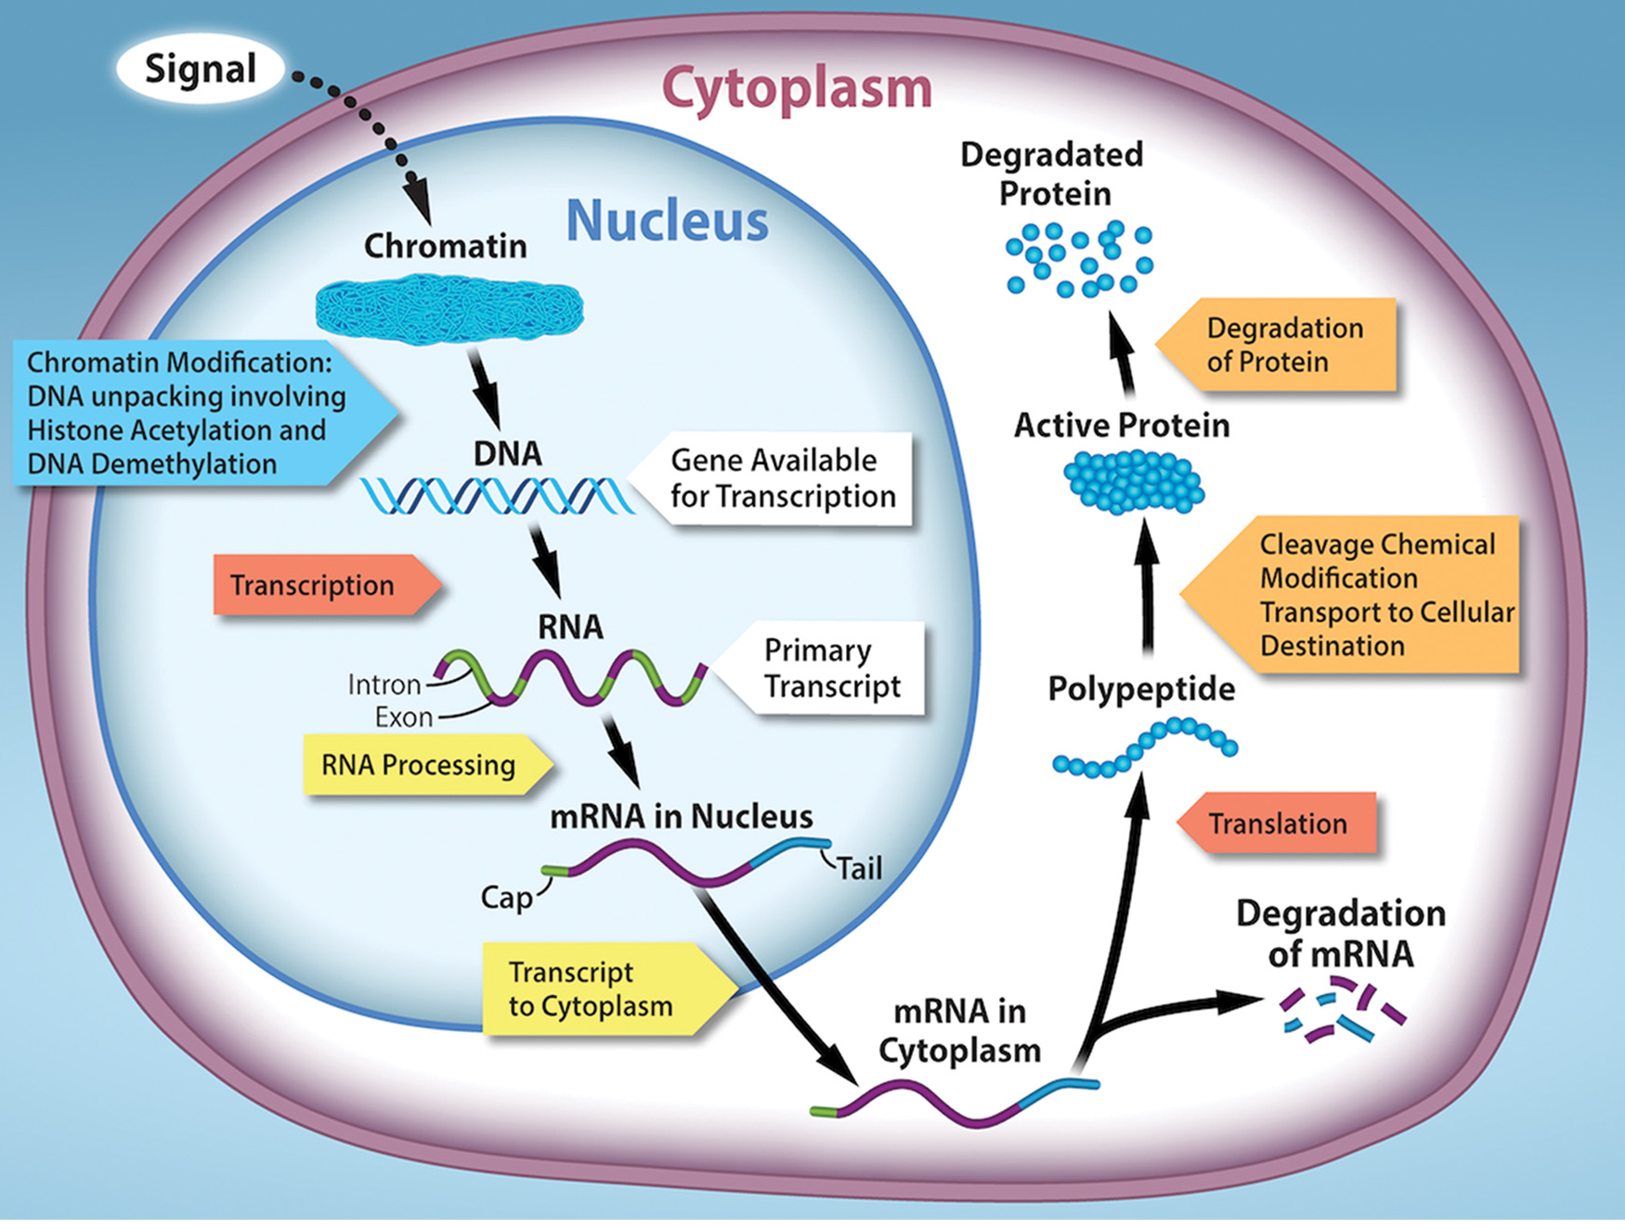
16.1 Figure 4
Rao, A. and Ryan, K. Department of Biology, Texas A&M University. "Gene expression locations."
Notes:
16.1 Figure 4: The regulation of gene expression occurs at multiple steps, going from DNA to the functional gene product, usually a protein. It begins with the chromatin structure making the DNA more or less accessible for transcription by RNA polymerase. In eukaryotes, the primary mRNA transcript (the unprocessed mRNA) must be processed before it can be translated in the cytoplasm. The final level of active protein in the cell depends not only on the rate of synthesis but also on the rate of degradation of mRNA and protein.

Slide 14
Table 1. Differences in the Regulation of Gene Expression of Prokaryotic and Eukaryotic Organisms
Prokaryotic Organisms | Eukaryotic Organisms
They lack a membrane-bound nucleus. | They contain a nucleus.
DNA is found in the cytoplasm. | DNA is confined to the nuclear compartment.
RNA transcription and protein formation occur almost simultaneously. | RNA transcription occurs prior to protein formation and takes place in the nucleus. Translation of RNA to protein occurs in the cytoplasm.
Gene expression is regulated primarily at the transcriptional level. | Gene expression is regulated at many levels: epigenetic, transcriptional, nuclear shuttling, post-transcriptional, translational, and post-translational.

Slide 15
Evolution Connection
Evolution of Gene Regulation
As eukaryotic cells became more structurally complex, this also increased the complexity of control of gene expression.
  The formation of the nucleus allowed for transcriptional regulation in the nucleus separate from post-transcriptional, translational, and post-translational levels of regulation outside the nucleus.
While most gene regulation conserves resources, sometimes it can be defensive.
  Gene silencing developed to protect cells from viral or parasitic infections, giving these cells a survival advantage.

Slide 16
Think It Through
Identify the correct phrase regarding gene expression.
Prokaryotic gene expression is mostly regulated at the transcriptional level.
Prokaryotic DNA is contained in the nucleus.
Eukaryotic gene expression is only regulated at the translational and post-translational levels.
Eukaryotic gene expression is only regulated at the translational and post-translational levels.
Notes:
Originally an On Your Own. This is included here to use as a talking point or for a think-pair-share activity.

Slide 17
Summary
Gene expression includes transcription and translation.
While all somatic cells within an organism generally contain the same DNA, they do not all express the same proteins.
Prokaryotic organisms express most of their genes most of the time, but some are expressed only when needed.
  Transcription and translation occur almost simultaneously.
  Gene expression is mostly regulated at the transcriptional level.
Eukaryotic cells each express only a subset of genes.
  The nucleus separates transcription from translation.
  Gene expression is regulated at the epigenetic, transcriptional, post-transcriptional, translational, and post-translational levels.

Slide 18


End of Hawkes Learning PowerPoint

