Slide 1
Lesson 16.2
Prokaryotic Gene Regulation

Slide 2
Objectives
Describe the steps involved in prokaryotic gene regulation.
Explain the roles of activators, inducers, and repressors in gene regulation.

Slide 3
Prokaryotic Genome Structure
The DNA of prokaryotes is:
Organized into a circular chromosome
Supercoiled within the nucleoid region of the cytoplasm.
Proteins needed for a specific function or involved in the same biochemical pathway are encoded together in blocks called operons.
For example, the all of the genes needed for using lactose as an energy source are coded next to each other in the lac operon and transcribed into a single mRNA.

Slide 4
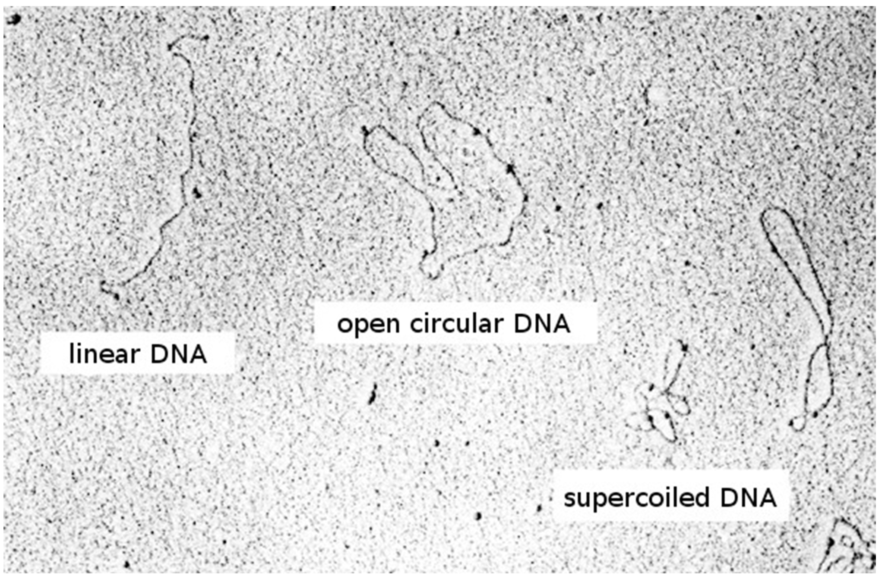
16.2 Figure 1
de:Benutzer:Sec11 on Wikimedia Commons. "Plasmids."
Notes:
16.2 Figure 1: Prokaryotic DNA comes in circular chromosomes that can be supercoiled to compact better inside the nucleoid region of the cell. In contrast, eukaryotic cells have linear chromosomes.

Slide 5
Reflection Question
In casual conversation, what does it mean to say you "repress" something? Give an example of something you might repress.
What does it mean to "activate" something? Give an example.
Use your responses to explain the difference between a "repressor" and "activator" in the field of genetics.
Notes:
The reflection question is included here to use as a talking point or for a think-pair-share activity.

Slide 6
Three Types of Regulatory Molecules Affecting the Expression of Operons in Prokaryotes
There are three types of regulatory molecules that can affect the expression of operons in prokaryotes:
A repressor prevents transcription of a gene or operon in response to an external stimulus.
Repressors generally bind to operator regions of DNA (DNA sequences to which proteins bind to regulate transcription).
An activator increases transcription of a gene or operon in response to an external stimulus.
Activators generally bind to promoter sites (regions upstream of genes or operons to which RNA polymerase binds to initiate transcription).
An inducer is a small molecule that may be made by the cell or nearby cells that either turns on an activator or turns off a repressor, allowing a cell to regulate gene expression based on environmental conditions.

Slide 7
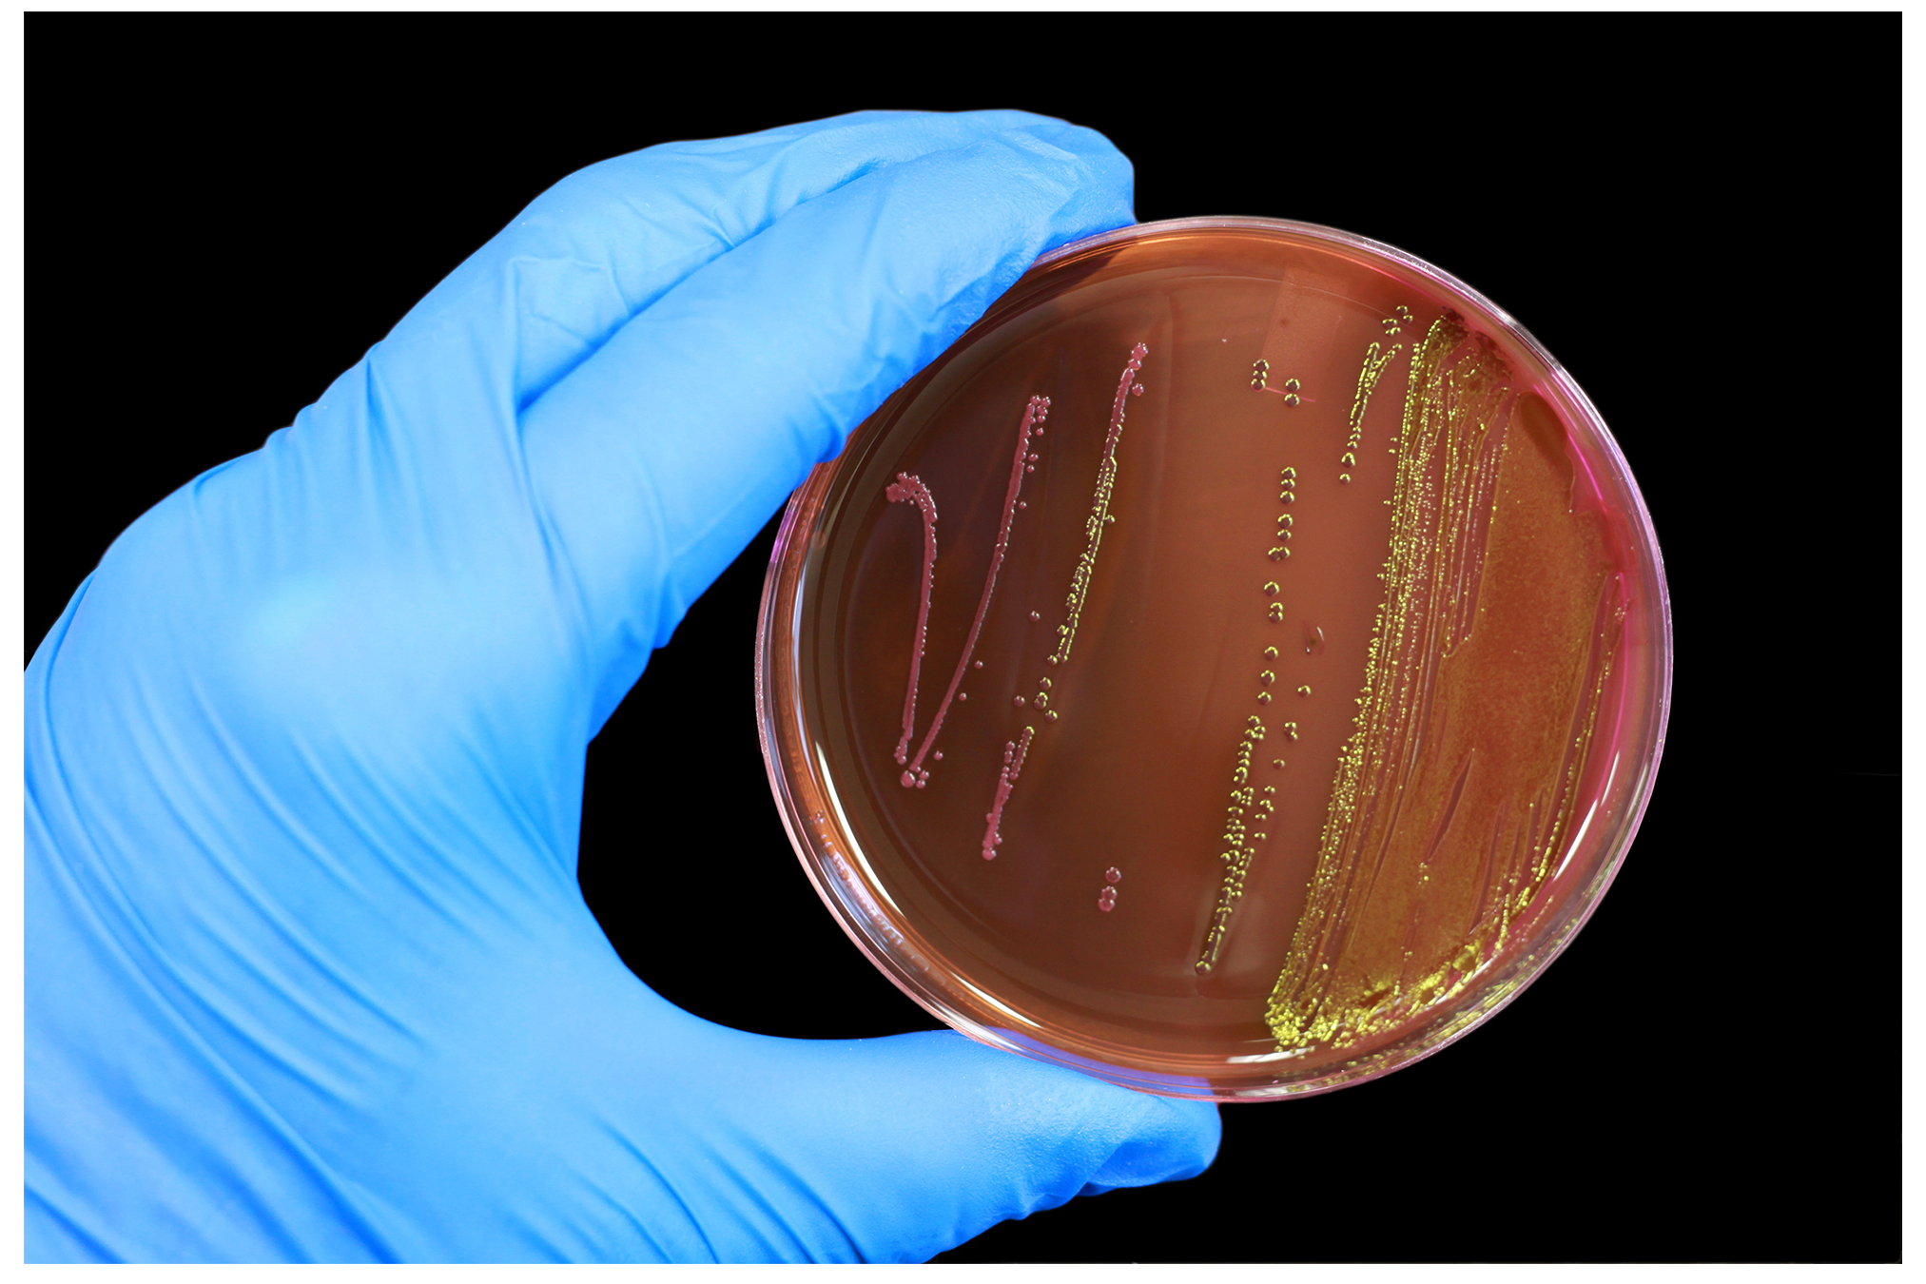
16.2 Figure 2
Stockvault.net. "E. coli."
Notes:
16.2 Figure 2: Bacteria—such as the E. coli growing on this plate—are prokaryotic cells. Prokaryotic DNA stores genes related to the same biochemical function together in coded blocks called operons.

Slide 8
A Repressible Operon: trp Operon Structure₁
Bacteria such as Escherichia coli, need amino acids (like tryptophan) to survive and can make many of them.
E. coli can either ingest tryptophan or synthesize it using enzymes encoded by five genes found in the tryptophan (trp) operon.
These genes are transcribed together into a single mRNA, which is then translated to make all five enzymes.

Slide 9
A Repressible Operon: trp Operon Structure₂
The trp operon includes three important regions:
The coding region includes the genes for the five tryptophan biosynthesis enzymes.
The transcriptional start site is just before the coding region, and the trp promoter to which RNA polymerase binds is just before (“upstream”) of the transcriptional start site.
The trp operator is located between the promoter and the transcriptional start site.

Slide 10
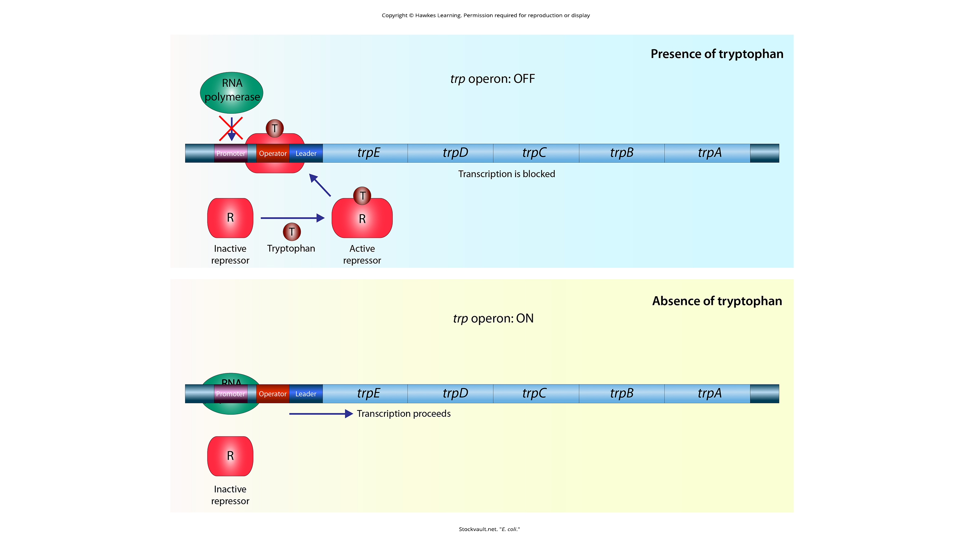
trp Operon Is Repressed When Tryptophan Is Present
When tryptophan is present, two tryptophan molecules bind the repressor protein, which changes its shape and binds to the operator sequence, physically blocking the RNA polymerase from transcribing the coding region (trp E, D, C, B, and A).
Because the repressor protein binds the operator to prevent transcription, the repressor is a negative regulator.
16.2 Figure 3

Slide 11
trp Operon Is Transcribed When Tryptophan Is Absent
When tryptophan is absent, the repressor protein does not bind to the operator, the coding region (trp E, D, C, B, and A) is transcribed by RNA polymerase, and tryptophan is synthesized.
16.2 Figure 3

Slide 12
Positive Regulation by Activation
Activators are positive regulators that turn genes on and activate them.
For example, to use other sugar sources as fuel when glucose is scarce, E. coli must transcribe genes coding for proteins to process these other sugars.

Slide 13
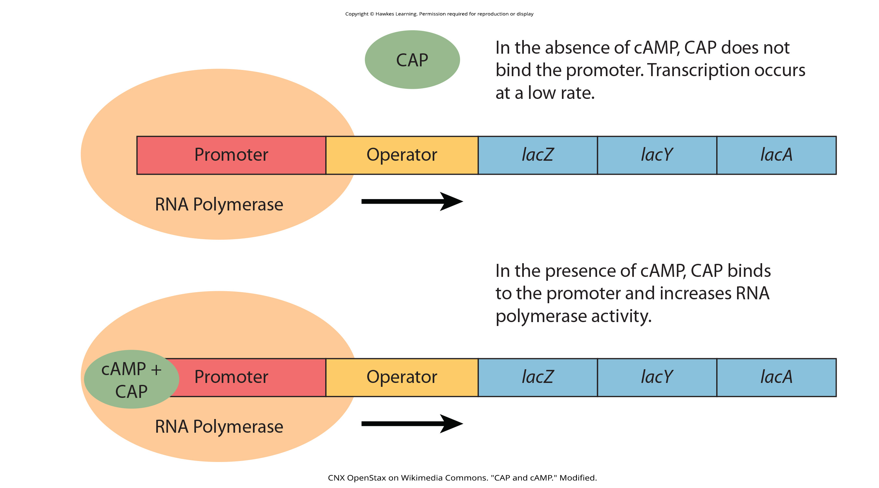
Catabolite Activator Protein (CAP) Activates Transcription
When glucose levels drop, E. coli produces cyclic AMP (cAMP), a signaling molecule common in all forms of life.
Accumulating cAMP binds to catabolite activator protein (CAP).
cAMP-CAP then binds to CAP-binding sites found upstream of the RNA-polymerase-binding sites in the promoters of operons encoding proteins in processing alternative sugars.
Binding of cAMP-CAP to CAP-binding sites stabilizes the binding of RNA polymerase to the promoter, activating transcription.
16.2 Figure 4
CNX OpenStax on Wikimedia Commons. "CAP and cAMP." Modified.

Slide 14
High Glucose Levels Prevent cAMP Accumulation
When glucose levels are high, cAMP does not accumulate.
CAP does not bind to the promoters of operons encoding proteins in processing alternative sugars.
Activation of these operons does not occur.
16.2 Figure 4
CNX OpenStax on Wikimedia Commons. "CAP and cAMP." Modified.

Slide 15
Inducible Operons
An inducible operon involves an inducer molecule binding to an inactive repressor.
This binding inactivates the repressor.
Transcription of the operon is increased.

Slide 16
Comparing Inducible and Repressible Operons
Inducible operons are turned off by default → That's why they must be "induced.”
Repressible operons are turned on by default → That's why they must be "repressed.”

Slide 17
Inducible Operon: The lac Operon
In E. coli, lactose is a sugar source that the cell can use when glucose is scarce.
The lac operon encodes the genes necessary to acquire and process lactose.
The Z genes encodes β-galactosidase, which breaks lactose down to glucose and galactose.

Slide 18
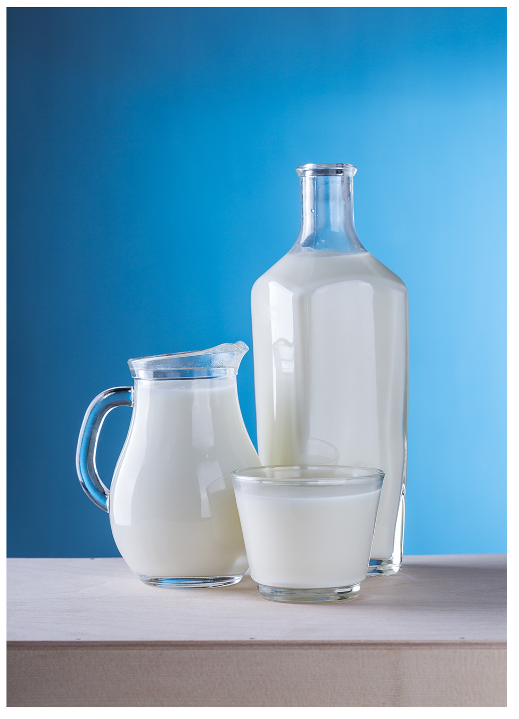
16.2 Figure 5
Pixabay on Pexels. "Milk."
Notes:
16.2 Figure 5: Commonly associated with milk, lactose is a disaccharide sugar made up of the monomers glucose and galactose. Lactose can serve as a food source for bacteria if they break it down into these components. Since lactose is less common than other sugars, bacteria don't make enzymes for breaking down lactose unless the bacteria are in contact with lactose.

Slide 19
Activation of the lac Operon
For the lac operon to be activated, two conditions must be met:
Lactose must be present.
Some lactose is modified to allolactose, which binds to the lac repressor.
Allolactose-repressor binding changes the repressor’s shape, releasing it from the operator.
Transcription is allowed.
Glucose must be absent.
Glucose depletion stimulates cAMP accumulation
cAMP binds to CAP.
cAMP-CAP binds to the promoter.
Transcription is increased (activated).

Slide 20
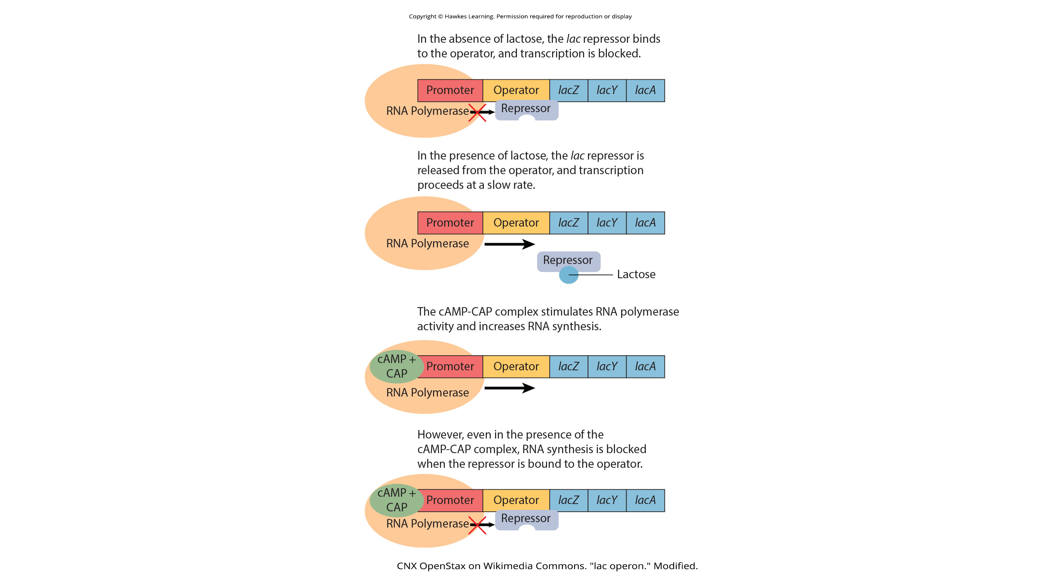
16.2 Figure 6
Lactose Absent
Glucose Absent
Lactose Present
Glucose Absent and Lactose Absent
CNX OpenStax on Wikimedia Commons. "lac operon." Modified.

Slide 21
Think It Through₁
If lactose is present and glucose is absent, the lac operon will be [blank].
activated
repressed
activated, but only partially
mutated
Notes:
Originally an On Your Own. This is included here to use as a talking point or for a think-pair-share activity.

Slide 22
Table 1. Signals that Induce or Repress Transcription of the lac Operon
Glucose | CAP Binds | Lactose | Repressor Binds | Transcription
+ | - | - | + | no
+ | - | + | - | some
- | + | - | + | no
- | + | + | - | yes

Slide 23
Think It Through₂
In E. coli, the trp operon is on by default, while the lac operon is off by default.
Why do you think these operons have different default states?
Notes:
Originally an On Your Own. This is included here to use as a talking point or for a think-pair-share activity.

Slide 24
Summary
Prokaryotic gene expression is regulated at the transcriptional level.
There are two kinds of proteins that control prokaryotic transcription:
Repressors bind to operators to block the action of RNA polymerase.
Activators bind to the promoter to aid RNA polymerase binding.
Inducer molecules increase transcription by either inactivating repressors or activating activators.
For the trp operon, tryptophan is an inducer, binding to the trp repressor to remove it from the operator, allowing for transcription.
For the effective transcription of the lac operon,
Glucose must be absent, allowing for cAMP to accumulate and bind to CAP, which then binds to the promoter, aiding RNA polymerase binding.
Lactose must be present, allowing for allolactose to bind to the lac repressor, removing it from the operator and allowing for RNA polymerase to transcribe the lactose processing genes.

Slide 25


End of Hawkes Learning PowerPoint

