Slide 1
Lesson 16.3
Eukaryotic Gene Regulation

Slide 2
Objectives
Describe how DNA methylation is related to epigenetic gene changes.
Identify the roles histone proteins play in epigenetic gene regulation.
Describe the role of transcription factors and how the initiation complex controls transcription.
Explain the different ways in which the post-translational control of gene expression takes place.
Understand the process of translation.

Slide 3
Eukaryotic Regulation of Gene Expression is Complex
Transcription and translation in eukaryotes are physically separated.
Unlike prokaryotic cells, eukaryotic cells can regulate gene expression at multiple levels.
Epigenetic changes are inheritable changes in gene expression that do not result from changes in the DNA sequence.
Transcriptional access to DNA can be controlled in two ways:
Chromatin remodeling changes the way that DNA is associated with histones.
DNA methylation is associated with developmental changes and gene silencing.

Slide 4

16.3 Figure 1
Kelly Sikkema on Unsplash. "Father and son."
Notes:
16.3 Figure 1: This child inherited not only their male parent's genome but also some of their epigenome. Epigenetic changes are not based on changes in the DNA sequence but rather on how the genes are expressed.

Slide 5
Human Genomic Organization
The human genome contains over 20,000 genes.
There are hundreds to thousands of genes on each of the 23 human chromosomes.
The nuclear DNA is precisely wound, folded, and compacted to fit into the nucleus.
Only specific segments of DNA are accessed as needed by a specific cell type.

Slide 6
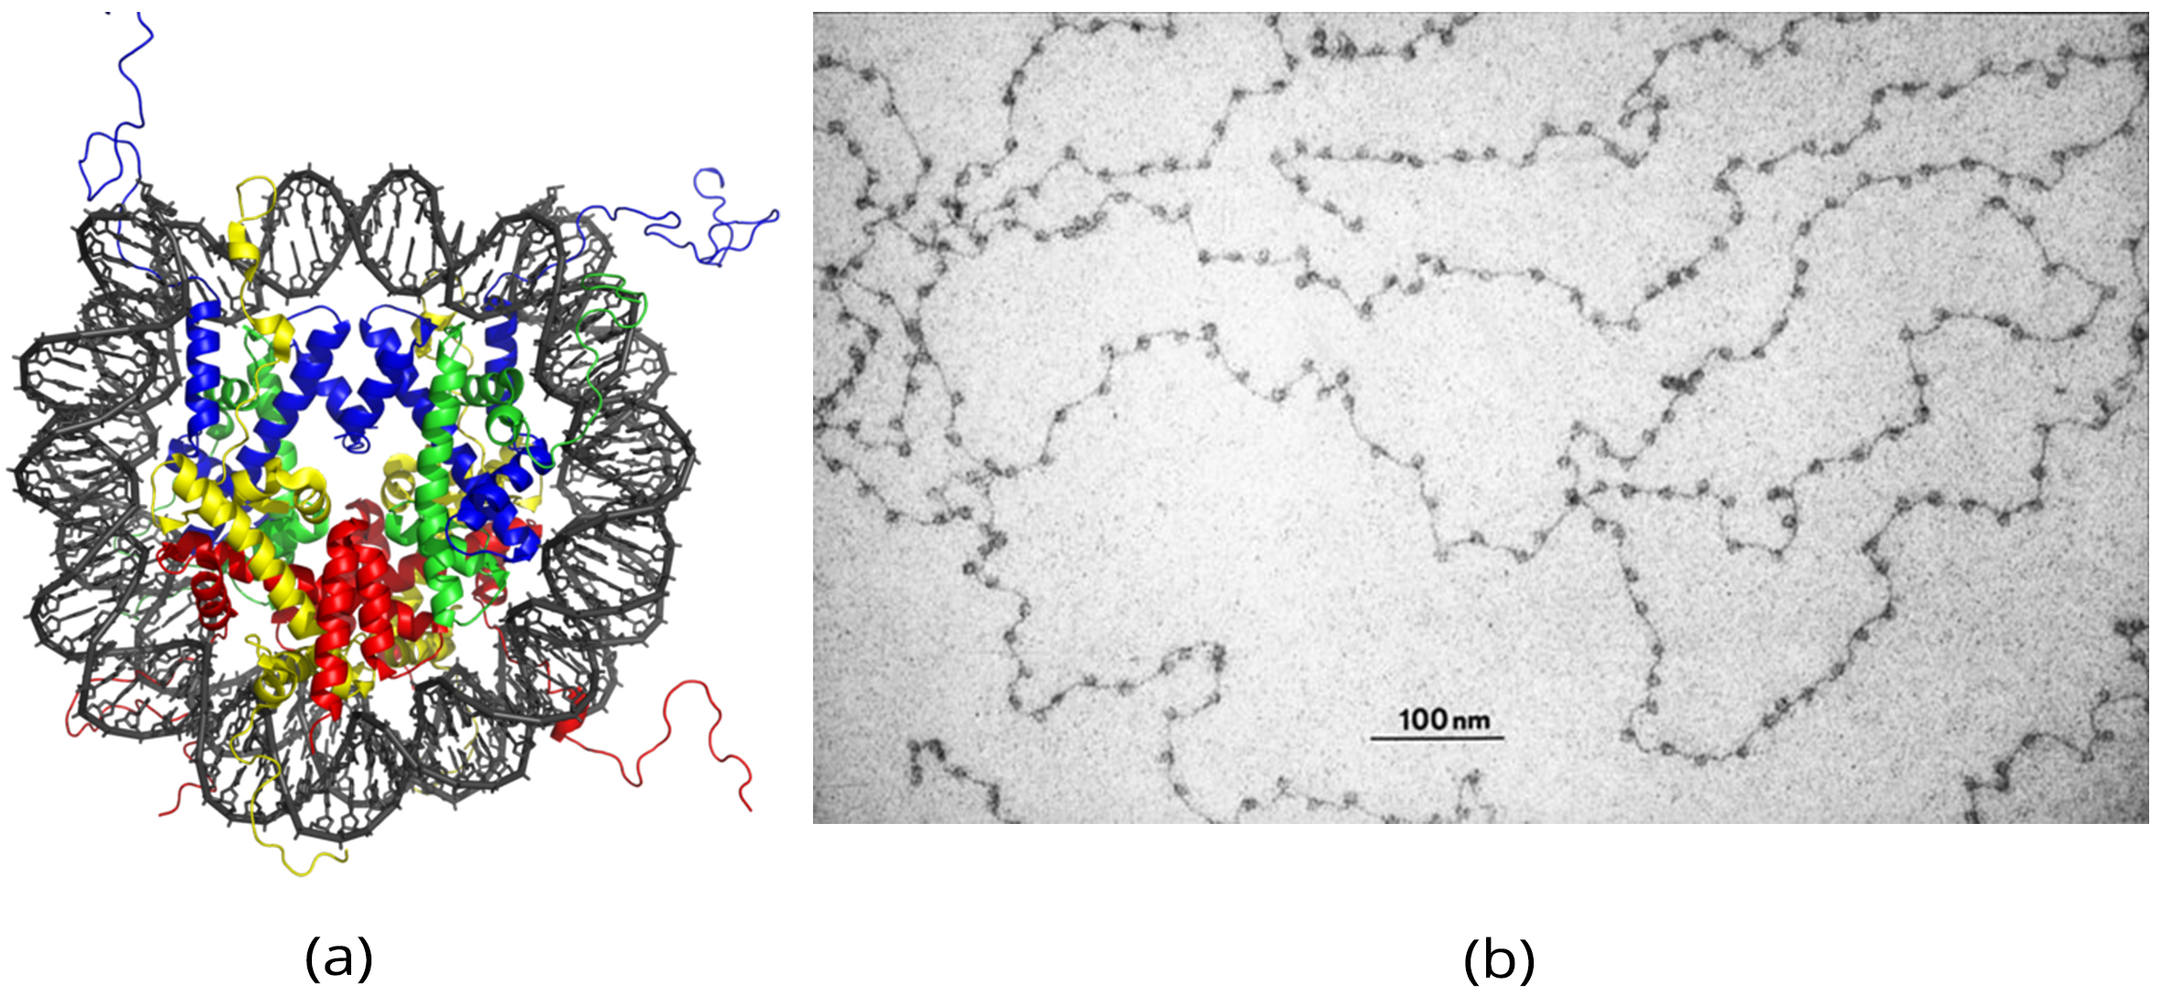
First Level of Organization of DNA: Nucleosomes
The first level of organization or packing is the winding of DNA strands around histone proteins to form nucleosome complexes.
Each nucleosome:
Contains eight histones
Can control access of proteins to DNA regions
Microscopically look like beads on a string
16.3 Figure 2 (a) and (b)
Zephyris on Wikimedia Commons. "Nucleosomes."
ORNL History on Wikimedia Commons. "Nucleosomes."

Slide 7
Making DNA Within Nucleosomes Accessible
Chemical tags (functional groups) are added to:
Histone proteins
DNA
These modifications can expose different sections of DNA to RNA polymerase for transcription initiation.

Slide 8
Making DNA Within Nucleosomes Accessible: Histone Modifications
Histones are normally positively charged, while DNA is negatively charged.
Histone modifications include adding or removing the following to histone tails at the protein’s N-terminus:
Phosphate (PO₄³⁻) groups
Methyl (CH₃) groups
Acetyl (C₂H₃O) groups
These modifications change the histone’s charge.

Slide 9
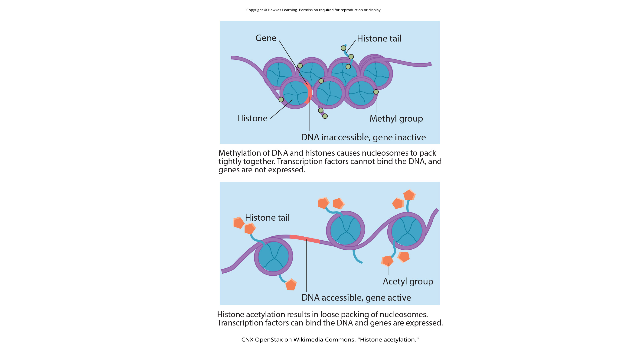
Making DNA Within Nucleosomes Accessible: Histone Acetylation
Histone acetylation makes histones less positive and relaxes binding of histones to DNA, opening up some regions of chromatin to transcription.
16.3 Figure 3
CNX OpenStax on Wikimedia Commons. "Histone acetylation."

Slide 10
Making DNA Within Nucleosomes Accessible: DNA Methylation₁
DNA methylation modifies DNA specifically in CpG islands, stretches with lots of CG DNA pairs found in promoter regions of genes.
The cytosines can be methylated.
16.3 Figure 3
CNX OpenStax on Wikimedia Commons. "Histone acetylation."

Slide 11
Making DNA Within Nucleosomes Accessible: DNA Methylation₂
Methylated genes are usually silenced.
Genes silenced during gamete development in one parent can be transmitted to offspring and are said to be imprinted.
Methylation can be affected by:
Parental diet
Environmental conditions
Changes in chromatin organization interact with DNA methylation.
DNA methyltransferases (that add methyl groups to DNA) are attracted to chromatin with specific histone modifications.
Hypermethylated (highly methylated) DNA with deacetylated histones is tightly coiled and transcriptionally inactive.

Slide 12

Think It Through₁
In females, one of the two X chromosomes is inactivated during embryonic development because of epigenetic changes to the chromatin.
What impact do you think these changes would have on nucleosome packing?
16.3 Figure 4
Herman Delgado on Unsplash. "Cat."
Notes:
Originally an On Your Own. This is included here to use as a talking point or for a think-pair-share activity.
16.3 Figure 4: The tortoiseshell coloration in this cat results from variance in the epigenetic expression of a gene that determines coat color. This coat-color gene can code for either orange or black fur and is located on the X chromosome. Female cats have two X chromosomes, and therefore it's possible to have both an orange and a black version. Different splotches of the cat's coat express different X chromosomes, hence the tortoiseshell pattern. Since this coloration requires the cat to have two X-type chromosomes, almost all cats with this coloration are female.

Slide 13
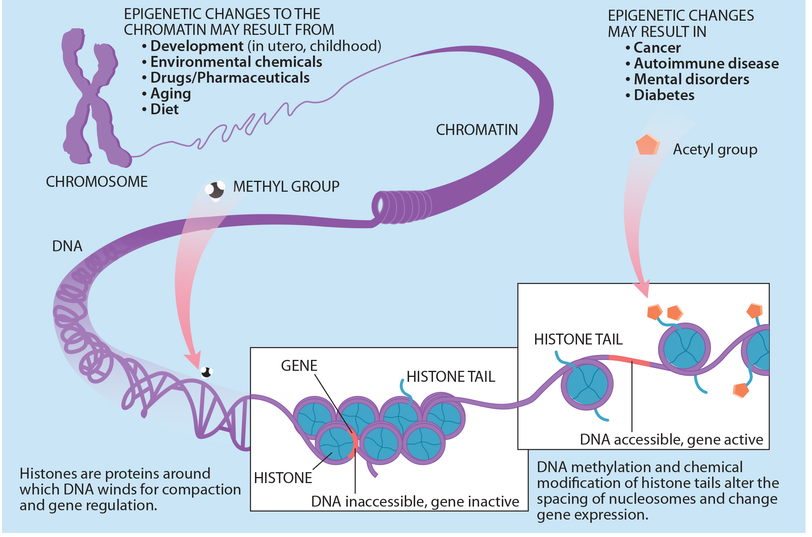
16.3 Figure 5
NIH on Wikimedia Commons. "Gene packing."
Notes:
16.3 Figure 5: Histone proteins and DNA nucleotides can be modified chemically. Modifications affect nucleosome spacing and gene expression.

Slide 14
Epigenetics Changes Are Not Permanent
Epigenetic changes are not permanent, but
They may persist through multiple rounds of cell division
They may cross generational lines
Chromatin remodeling alters the chromosomal structure.
If a gene is to be transcribed,
The histone proteins and chromosomal region are modified to open the promoter region to allow RNA polymerase and transcription factors to bind.
If a gene is silenced,
The histone proteins and chromosomal region are modified to keep the DNA with the promoter region closed so that RNA polymerase and transcription factors cannot access it.

Slide 15
Science and You
One example of how epigenetics affected a generation occurred in World War II. During the Dutch Hunger Winter (1944 ), Nazis blocked food supplies into the Netherlands, resulting in the starvation death of over 20,000 people. During this time, pregnant women gave birth to children that later grew up to show higher rates of obesity and higher triglyceride levels than those born immediately before or after them. Scientists believe that being in utero during the Dutch Hunger Winter changed the individuals' epigenetic profile, leading to lifelong struggles with obesity and high triglyceride levels.
Notes:
This is included as a relevant application for this topic.

Slide 16
Transcription Factors Facilitate Transcription in Eukaryotic Cells
Because eukaryotic RNA polymerase cannot initiate transcription alone, other proteins called transcription factors are required.
Prokaryotic cells do not require transcription factors.
There are two types of eukaryotic transcription factors:
General (or basal) transcription factors bind to the core promoter region to assist with the binding of RNA polymerase.
Specific transcription factors bind to various regions outside of the core promoter region and interact with proteins at the core promoter to enhance or repress polymerase activity.

Slide 17
Gene Structure Influences Transcription
Each gene has a promoter region immediately upstream of the coding sequence.
The promoter region can vary from a few nucleotides to hundreds of nucleotides long, leading to variation in the control of gene expression.
The longer the promoter, the more space there is for transcription factors to bind, adding more control of transcription.
Promoter length is gene-specific.

Slide 18
The Core Promoter Region’s Role in Transcription Initiation
The core promoter sequence:
Is located 25–35 bases upstream of the transcriptional start site
Contains the TATA box having the consensus sequence of 5′-TATAAA-3′
TFIID, a general transcription factor, binds to the TATA box.
TFIID binding recruits additional general transcription factors (TFIIB, TFIIE, TFIIF, and TFIIH).
Some help to bind RNA polymerase to the promoter.
Others help to activate the transcription initiation complex.

Slide 19
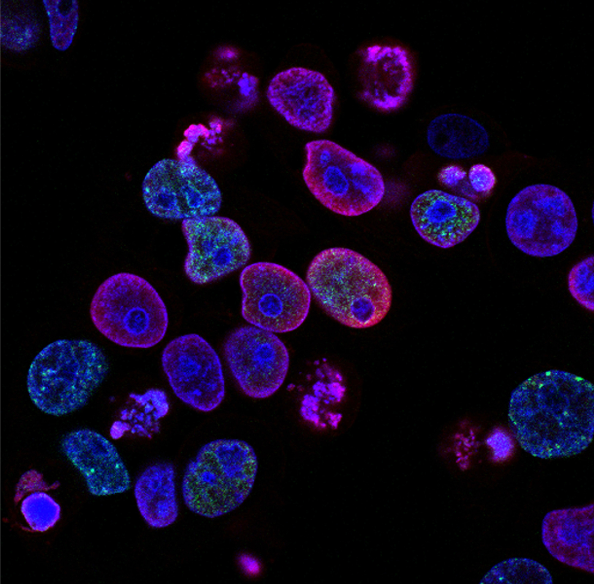
16.3 Figure 6
National Cancer Institute on Unsplash. "Cancer cells."
Notes:
16.3 Figure 6: This image shows colorectal (of the colon and/or rectum) cancer cells. Cell nuclei are stained blue, DNA damage is red, and DNA replication appears in green. Damaged DNA will not be properly expressed. At the same time, the damage can result in an increase rate of binding of transcription factors to genes that control cell growth and division, resulting in uncontrolled growth of the abnormal cells.

Slide 20
Think It Through₂
What would be the immediate effects of a nonfunctional TATA box?
Notes:
Originally an On Your Own. This is included here to use as a talking point or for a think-pair-share activity.

Slide 21
Eukaryotic Promoter Structure
Each eukaryotic promoter includes:
The core promoter (or polymerase binding site) AND
Additional promoter-proximal elements found within a few hundred base pairs upstream of the transcriptional start site, including the
CAAT box: consensus sequence is 5′-CCAAT-3′
GC box: consensus sequence is 5′-GGGCGG-3′
A combination of transcription factor binding sites, DNA sequences to which transcription factors bind, determines when a given gene will be transcribed.
A cis-acting element is a transcription factor binding site within a promoter that regulates the transcription of the encoded gene adjacent to it.

Slide 22
Influences on Transcription Factors
Specific transcription factors can be activated by environmental stimuli.
In response, specific transcription factors travel to their binding sites and initiate transcription of the gene that is needed.

Slide 23
Enhancers Increase Transcription
Enhancers are additional regions of DNA that help increase transcription of some eukaryotic genes.
An enhancer may be located:
Upstream of the gene
Within the coding region of the gene
Downstream of the gene
Thousand of nucleotides away

Slide 24
Transcription Factor-Enhancer Binding Requires DNA Bending
Enhancer regions are binding sites for specific transcription factors.
Transcription factor binding to its enhancer changes shape of the protein, allowing it to interact with proteins at the promoter.
Because an enhancer may be far away from the promoter, DNA must bend to bring them together.
This is facilitated by DNA-bending proteins.

Slide 25
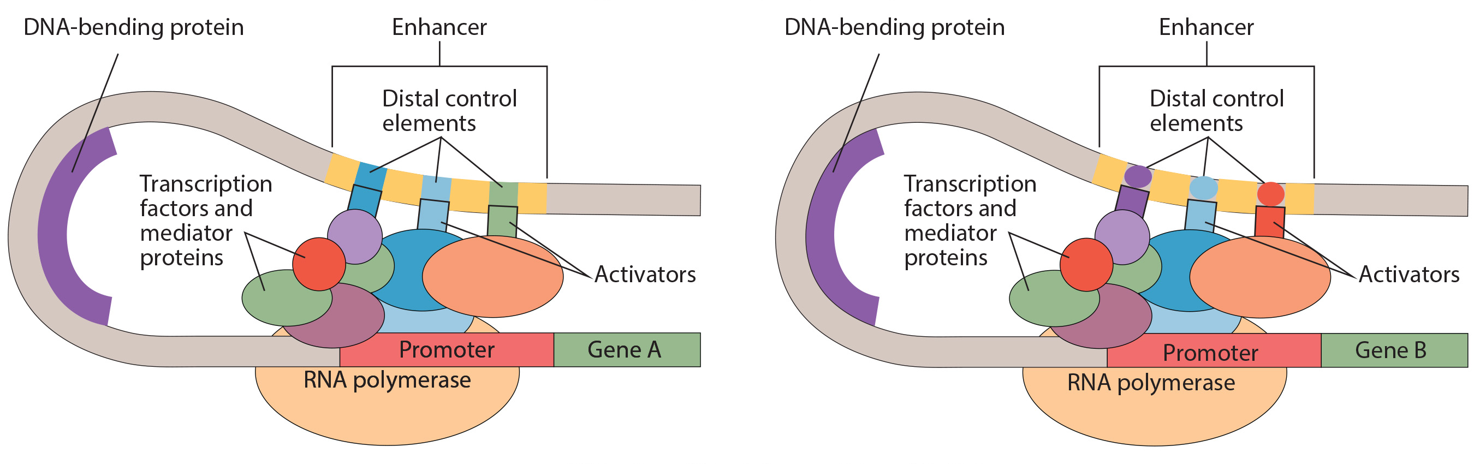
Different Enhancers Allow for Differential Gene Expression
Two different genes may have the same promoter but different distal control elements, enabling differential gene expression.
16.3 Figure 7
CNX OpenStax on Wikimedia Commons. "Enhancer." Modified.

Slide 26
Transcriptional Repressors Prevent Transcription
Transcriptional repressors in eukaryotes can block transcription by binding to:
Promoter regions
Enhancer regions
Transcriptional repressors respond to external stimuli to prevent the binding of activating transcription factors.

Slide 27
Eukaryotic Post-Transcriptional Regulation
Post-transcriptional modification is the processing that occurs after an RNA molecule is transcribed to make it a mature RNA for translation.
Both post-transcriptional processing and shuttling to the nucleus can be regulated to control gene expression.

Slide 28
Post-Transcriptional Control: RNA Splicing
RNA splicing is the removal of introns from an RNA transcript and stitching together the remaining exons (regions that code for protein).
Splicing is accomplished by spliceosomes, ribonucleoprotein complexes that recognize the ends of introns, cut the transcript at those two points, and stitch the exons together.

Slide 29
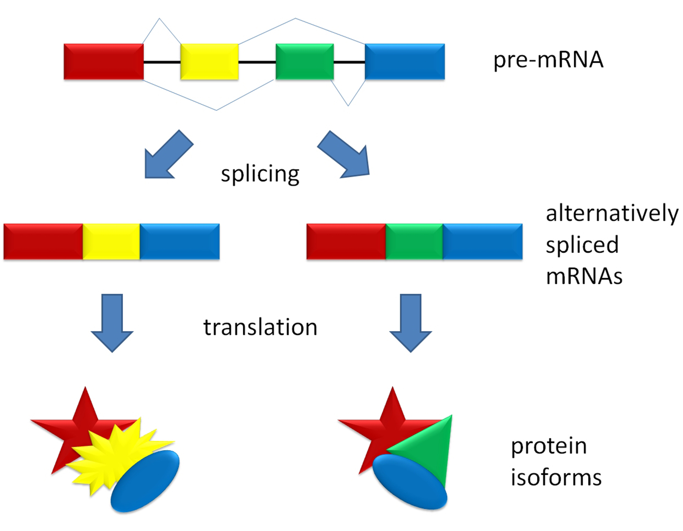
16.3 Figure 8
Agathman on Wikimedia Commons. "Splicing overview."
Notes:
16.3 Figure 8: The exons from a pre-mRNA transcript can be alternatively spliced, or spliced (combined) in different ways to create different proteins. Exons are depicted as rectangles and introns as the lines connecting them.

Slide 30
Evolution Connection
Alternative RNA Splicing
The original 5′–3′ order of exons is always conserved.
Each intron has a beginning- and an ending-recognition sequence.
Mutations could disrupt mechanisms that prevent intron skipping.
Shortened protein variants may retain or have altered functions.
A transposable element in the corn snake Pantherophis guttatus can insert into an intron of the OCA2 gene, resulting in a shortened (non-functional) protein, leading to the snake lacking the dark pigment melanin.

Slide 31
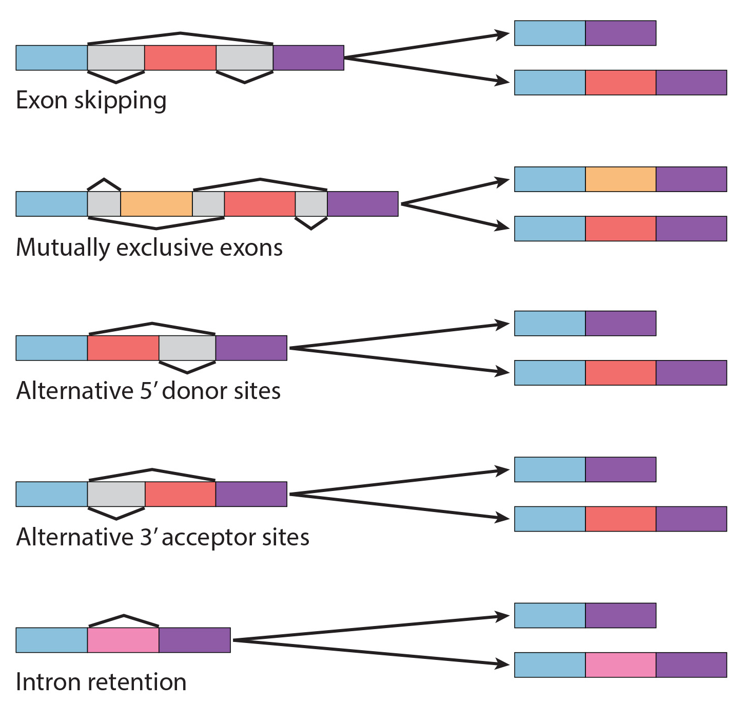
Evolution Connection: Five Modes of Alternative Splicing
There are five modes of alternative splicing that all maintain the original 5′–3′ order of exons.
16.3 Figure 9
OpenStax. "RNA splicing." Modified.

Slide 32
Post-Transcriptional Control: Control of RNA Stability
Before leaving the nucleus, each mRNA is given two protective “caps” to protect it from 5′ and 3′ exonucleases.
5′ cap: a methylated guanine linked by a triphosphate linkage.
Poly-A tail: a long chain of adenine nucleotides attached to the 3′ end
Each RNA molecule has a specific rate of decay (known as its RNA stability) and defined life span.
RNA stability can be regulated.
Proteins called RNA-binding proteins (RBPs) can influence RNA stability by binding to untranslated regions (UTRs), RNA sequences not translated to protein.
The 5′ UTR is located just before the protein-coding region.
The 3′ UTR is located just after the protein-coding region.

Slide 33
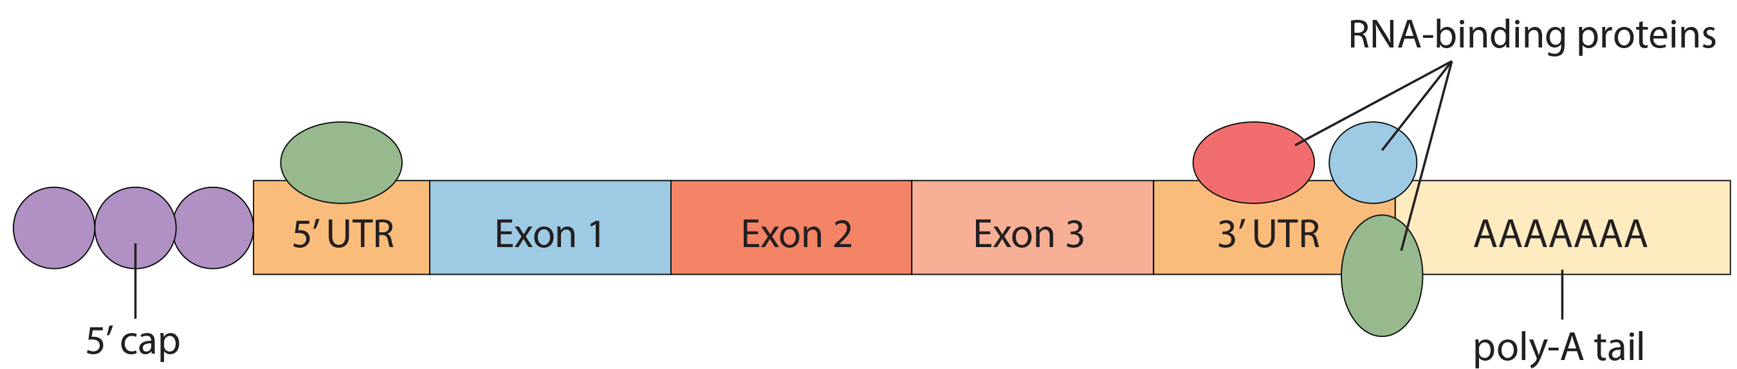
Sequences that Influence RNA Stability
Both caps and UTRs influence RNA stability.
16.3 Figure 10
CNX OpenStax on Wikimedia Commons. "Protein coding region." Modified.

Slide 34
Think It Through₃
Identify the most accurate statement from the following choices.
Binding of an RNA-binding protein will increase the stability of the RNA molecule.
Binding of an RNA-binding protein will decrease the stability of the RNA molecule.
Binding of an RNA-binding protein will neither increase nor decrease the stability of the RNA molecule.
Binding of an RNA-binding protein will either increase or decrease the stability of the RNA molecule.
Notes:
Originally an On Your Own. This is included here to use as a talking point or for a think-pair-share activity.

Slide 35
RNA Stability: microRNAs
Short RNA molecules called microRNAs (miRNAs) can also bind to an RNA molecule.
These miRNAs are each 21–24 nucleotides in length.
The miRNAs are made in the nucleus as longer pre-miRNAs, which are chopped by the Dicer protein into mature miRNAs.
Each mature miRNA binds to the RNA at a specific recognition sequence, but also associates with a ribonucleoprotein complex called the RNA-induced silencing complex (RISC).
The miRNA associated with the RISC base pairs with its complementary sequences on an mRNA, resulting in either:
Impeding translation of the mRNA OR
Degradation of the mRNA.

Slide 36
Translational Initiation Complex Formation
For translation to begin, the initiation complex must form.
Initiating tRNA (Met-tRNA_{i}) binds to the small 40S ribosomal subunit, facilitated by the eukaryotic initiation factor-2 (eIF-2).
The eIF-2 protein binds to guanosine triphosphate (GTP), a high-energy molecule, forming a complex with the 40S ribosomal subunit.
Several initiation factors recognize the 5′ cap of the mRNA and proteins bound to the poly-A tail, forming the mRNA into a loop.
The cap-binding protein eIF4F brings the mRNA complex together with the 40S ribosome complex.
The ribosome scans the mRNA until it finds an AUG start codon.
When the anticodon if the initiator tRNA and the start codon align, the GTP is hydrolyzed, the initiation factors are released, and the large 60S ribosomal subunit binds to form the translation complex.

Slide 37
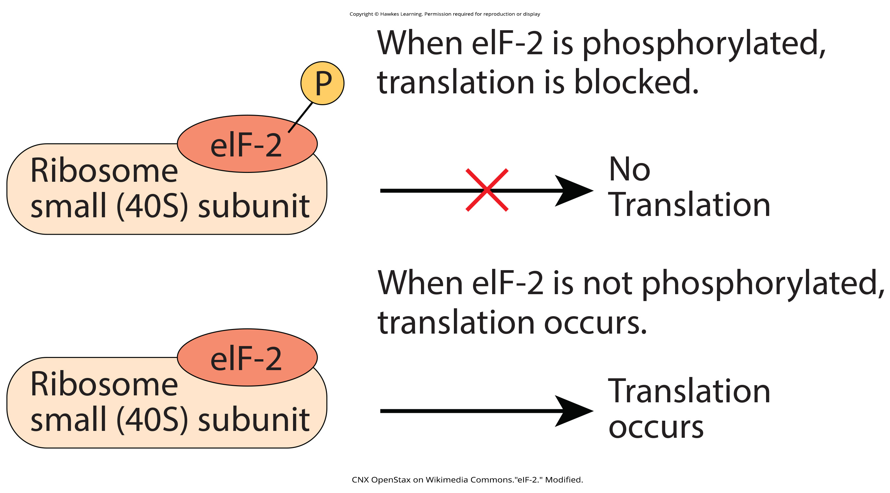
Translational Control: Controlling Initiation Complex Formation
Gene expression can be controlled by the phosphorylation and dephosphorylation of the eIF-2 protein.
Phosphorylated eIF-2 cannot bind to GTP.
16.3 Figure 11
CNX OpenStax on Wikimedia Commons."eIF-2." Modified.

Slide 38
Think It Through₄
An increase in phosphorylation levels of eIF-2 has been observed in patients with neurodegenerative diseases, such as Alzheimer's, Parkinson's, and Huntington's..
What impact do you think this might have on protein synthesis?
Notes:
Originally an On Your Own. This is included here to use as a talking point or for a think-pair-share activity.

Slide 39
Post-Translational Control of Gene Expression
Protein activity, stability, and location in the cell can be controlled by the addition or removal of the following:
Methyl groups
Phosphate groups
Acetyl groups
Ubiquitin (a short protein)
External stimuli (including stress, lack of nutrients, heat, or UV light) can lead to chemical modifications affecting all levels of gene expression.

Slide 40
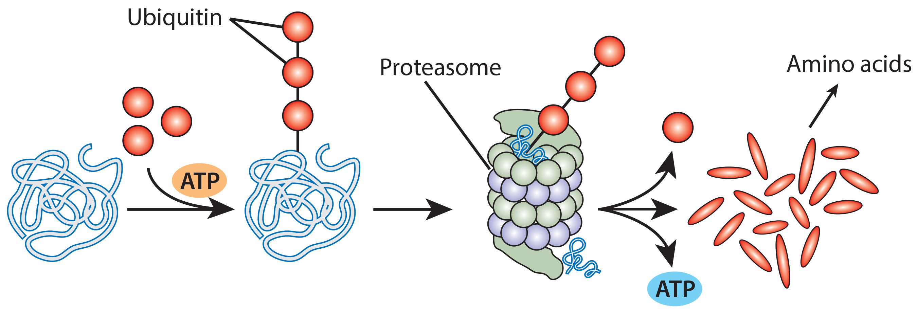
Ubiquitin-Tagging Marks a Protein for Degradation
Ubiquitin-tagged proteins are targeted by the proteasome, an organelle that degrades proteins into shorter peptides that can be broken down into amino acids.
16.3 Figure 12
CNX OpenStax on Wikimedia Commons. "Ubiquitin." Modified.

Slide 41
Group Activity
An individual's lifestyle can begin to modify epigenetic patterns.
Work with a partner and discuss lifestyle factors that you think may have the ability to modify epigenetics.
Make a list of five factors. (Hint: Consider aspects related to diet, drug use, physical activity, or any habits performed regularly.)
Then, check your list with a quick internet search. How many correct guesses did you and your partner make?

Slide 42
Summary
Eukaryotic cells can control gene expression at the epigenetic level by controlling access of RNA polymerase to its transcription factors.
This involves chromatin remodeling and the modifications of both histones and DNA.
General transcription factors first bind to the TATA box, and then other transcription factors may bind to other regulatory elements at the promoter or to enhancers to increase or prevent transcription.
Post-transcriptional control affects RNA splicing and stability.
RNA stability is affected by 5′ and 3′ caps, RBPs binding to 5′ and 3′ UTRs, and miRNAs.
Translational control affects the formation of the initiation factor complex.
Post-translational control involves various protein modifications that affect a protein’s activity, stability, and location in the cell, as well as its possible degradation.

Slide 43


End of Hawkes Learning PowerPoint

