Slide 1
Lesson 16.4
What is Cancer?

Slide 2
Objectives
Describe how cancer is caused by uncontrolled cell growth.
Describe how changes to gene expression can cause cancer.
Describe how tumor suppressors function.
Discuss how understanding regulation of gene expression can lead to better drug design.
Understand how proto-oncogenes are normal cell genes that, when mutated, become oncogenes.

Slide 3
Cancer Results from a Disrupted Cell Cycle
All cancers start with a gene mutation giving rise to a faulty protein important in cell reproduction.
Example: Mutation may delay binding of a Cdk to its cyclin.
Example: Mutation may cause an Rb protein to prematurely detach from its target DNA.
Result: The cell cycle proceeds when it should not.
Result: Minor mistakes allow later mistakes to happen more readily.
Small uncorrected errors are passed from each generation to the next and amplified, producing more nonfunctional proteins from damaged DNA.
Eventually, the cell cycle’s pace increases as the effectiveness of control and repair mechanisms decreases.

Slide 4
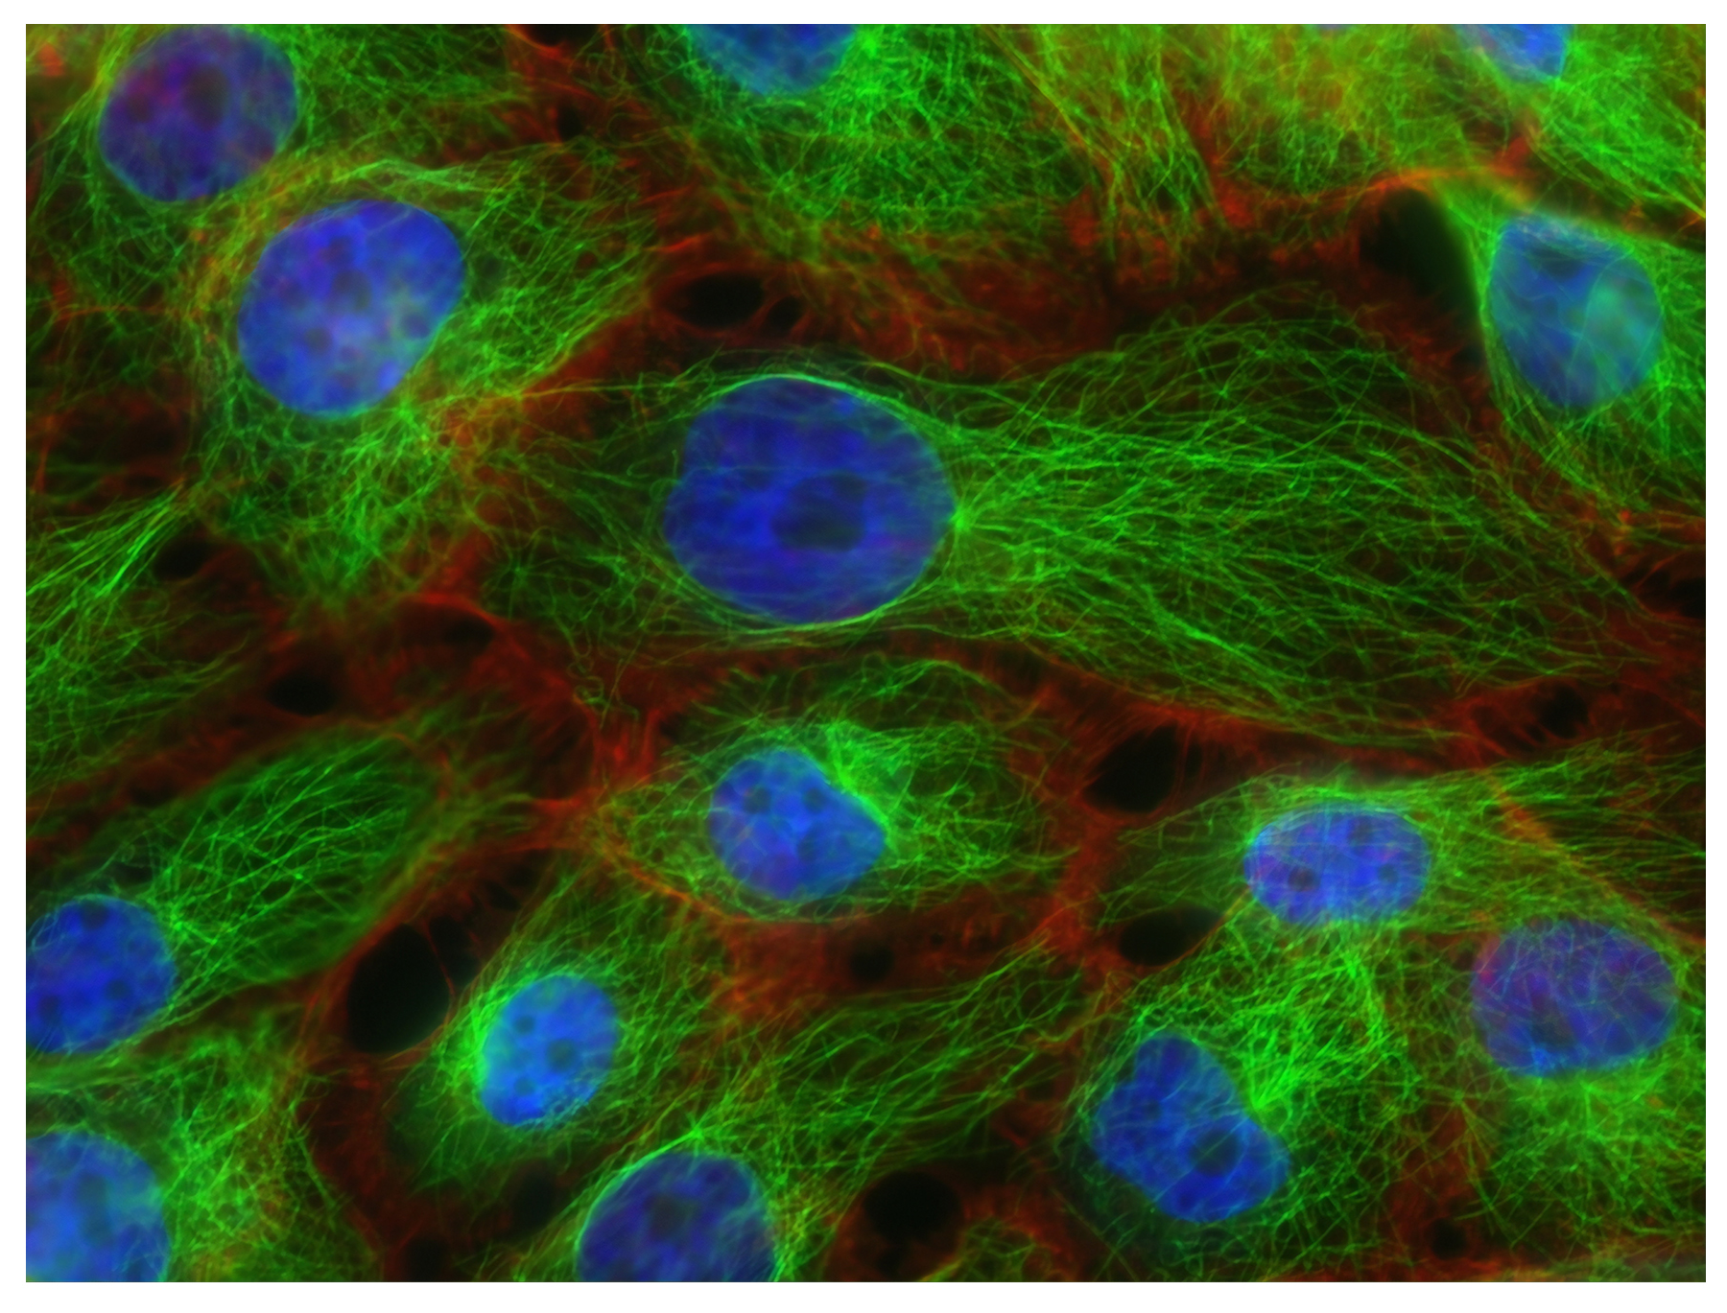
Tumors Result from Uncontrolled Growth
Uncontrolled growth of mutated cells outpaces the growth of normal cells, forming a tumor.
16.4 Figure 1: These human breast cancer cells (dyed blue) are round and are supported by hairlike structure support structures (dyed green).
National Cancer Institute on Unsplash. "Cancer cells."

Slide 5
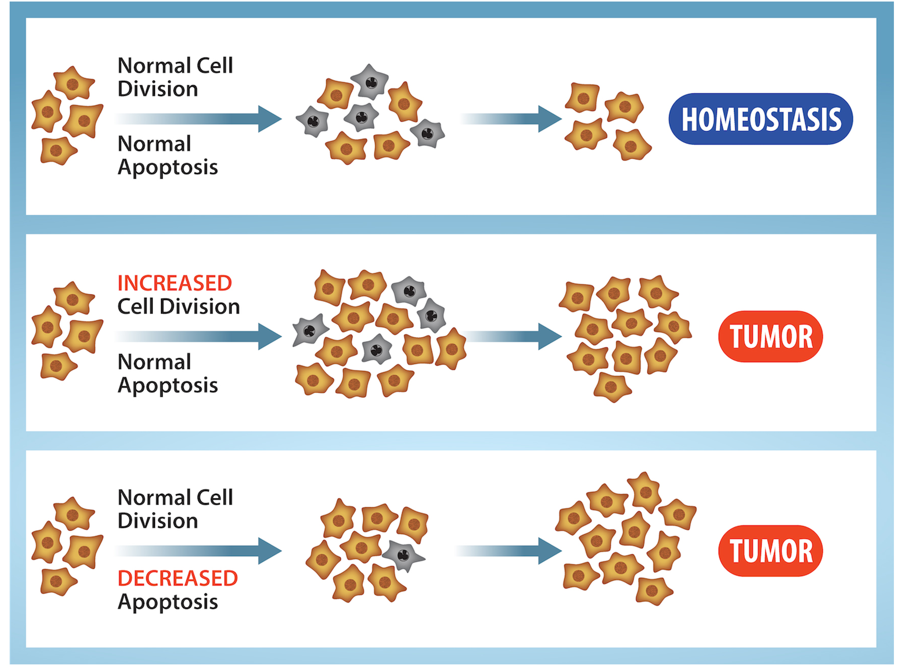
16.4 Figure 2
OpenStax. "Tumor growth."
Notes:
16.4 Figure 2: In an adult organism, normal cell division is balanced by apoptosis (programmed cell death) to maintain a constant cell number in homeostasis. Either an increase in cell division or a decrease in apoptosis leads to an increase in the number of cells and tumor formation.

Slide 6
Oncogenes Develop from Proto-oncogenes
Proto-oncogenes normally code for positive cell-cycle regulator proteins that help a cell advance through the cell cycle.
An oncogene:
is any gene that, when altered, leads to an increase in the rate of cell-cycle progression.
results from a mutation in a proto-oncogene that increases the activity of the positive regulator.
Example: A mutation in a Cdk may make it always active, even in the absence of its cyclin, prematurely pushing the cell through a cell cycle checkpoint.

Slide 7
Tumor Suppressor Gene Mutations Also Lead To Cancer
Tumor suppressor genes normally code for negative cell-cycle regulator proteins that prevent a cell from undergoing uncontrolled cell division until certain events are complete.
Rb: a transcription repressor of genes needed to enter S phase if correct conditions are not met
p53: a protein that promotes cell cycle arrest, DNA repair, and cell death in response to DNA damage
p21: a protein that inhibits Cdks to prevent progression through the cell cycle
A mutated form of a negative regulator might not be able to halt the cell cycle if there is a problem.

Slide 8
Tumor Suppressor Gene: p53
Mutated p53 genes have been found in more than 50% of all human tumor cells.
A faulty p53 may be unable to:
Detect errors present in the genomic DNA
Signal DNA repair mechanisms
Trigger apoptosis (programmed cell death)
Trigger p21 production, leading to no effective block on Cdk activation
Prevent progression of the cell through the G₁ checkpoint
Daughter cells will inherit the mutated p53 gene and have likely acquired other mutations (oncogenes, non-functional tumor suppressor genes), ultimately resulting in tumors.

Slide 9
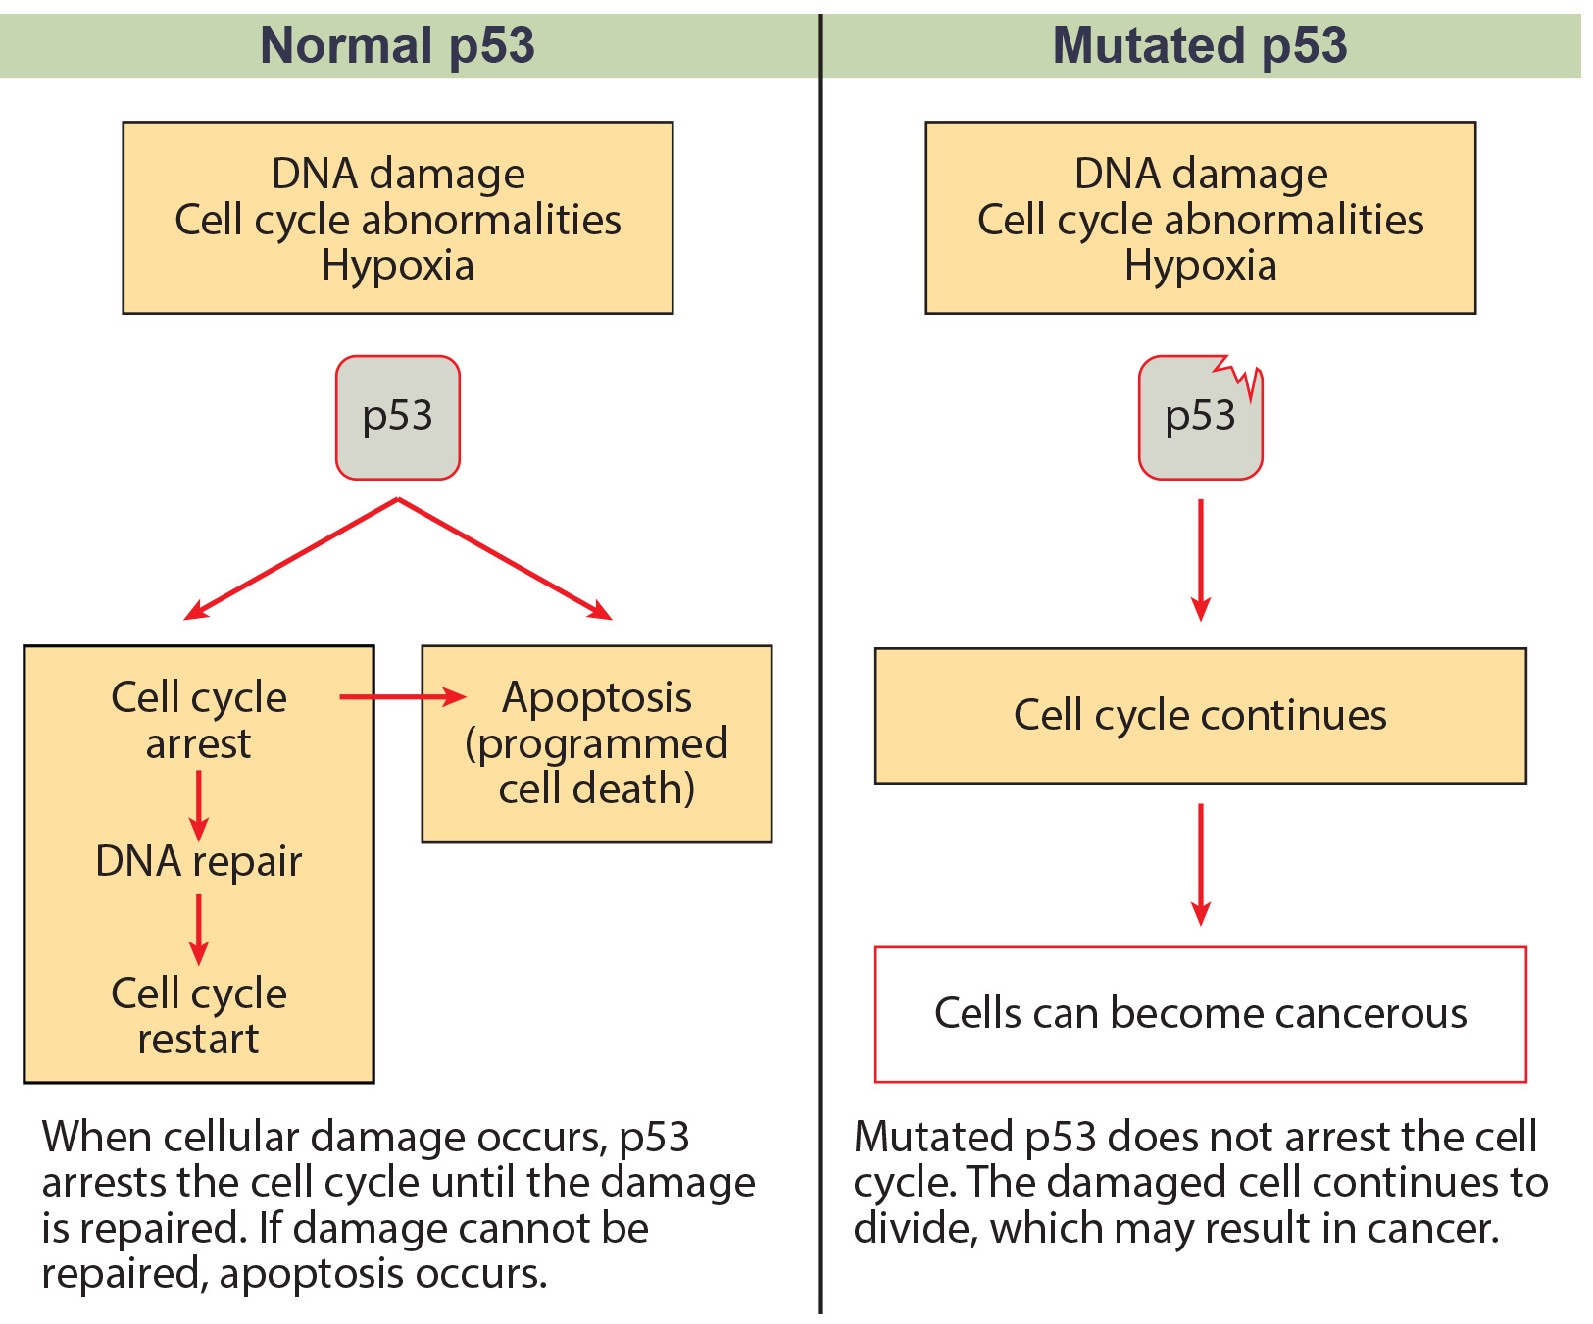
16.4 Figure 3
OpenStax. "p53." Modified.
Notes:
16.4 Figure 3: The role of normal p53 is to monitor DNA and the supply of oxygen. (Hypoxia is a condition of reduced oxygen supply.) If damage is detected, p53 triggers repair mechanisms. If repairs are unsuccessful, p53 signals apoptosis. A cell with an abnormal p53 protein cannot repair damaged DNA and, thus, cannot signal apoptosis. Cells with abnormal p53 can become cancerous.

Slide 10
Think It Through₁
Human papillomavirus can cause cervical cancer. The virus encodes E6, a protein that binds p53. Based on this fact and what you know about p53, what effect do you think E6 binding has on p53 activity?
E6 binding activates p53.
E6 binding increases the sensitivity of p53 to hypoxia.
E6 binding increases the ability of p53 to detect mutations.
E6 binding marks p53 for degradation.
Notes:
Originally an On Your Own. This is included here to use as a talking point or for a think-pair-share activity.

Slide 11
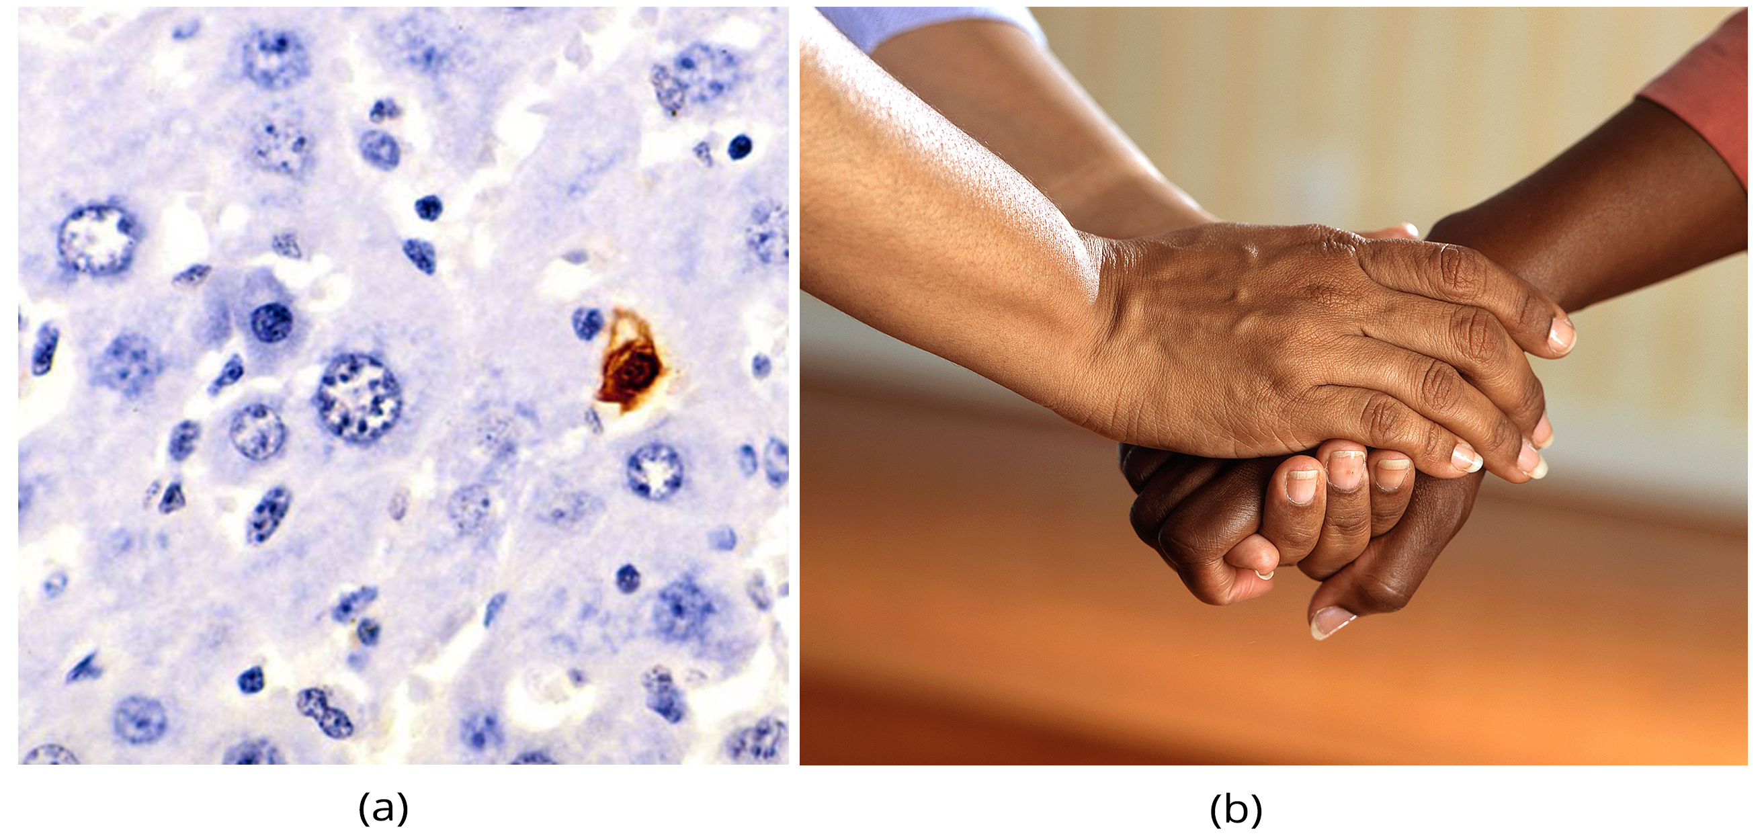
16.4 Figure 4
Laboratory of Experimental Pathology, Division of Intramural Research, NIEHS (NIH) on Wikimedia Commons. "Apoptosis."
Pixabay on Pexels. "Holding hands."
Notes:
16.4 Figure 4: Apoptosis—or programmed cell death—isn't only a cellular process for cancer prevention. Image (a) shows a stained section of mouse liver with a cell undergoing apoptosis. Apoptosis also allows for the development of human hands and fingers. In utero, the skin between our fingers begins to carry out apoptosis, allowing (b) individual digits to develop.

Slide 12
Cancer Can Result From Gene Regulation Changes
Mutations can modify cell-cycle control systems.
Mutations can alter the growth rate or progression through the cell cycle.
Cancer can result from changes in various levels of the control of gene regulation.
Example: Post-translational phosphorylation of cyclin B can cause cells to progress through the cell cycle unimpeded.

Slide 13
Cancer Is a Disease of Altered Gene Expression
Changes in a gene’s activity leading to cancer may result from a:
Gene mutation
Change in gene regulation at any level:
Epigenetic level: changes in histone acetylation (leading to gene silencing)
Transcriptional level: activation of transcription factors by phosphorylation
Post-transcriptional level: increased RNA stability
Translational level: increased translational control
Post-translational level: protein modification

Slide 14
Revisiting Tumor Suppressor Genes and Proto-oncogenes
The p53 protein normally functions as a transcription factor.
Mutating the p53 gene, a tumor suppressor gene, alters the transcriptional activity of its target genes.
Compared to proto-oncogenes, oncogenes bring about changes in transcriptional activity, RNA stability, or the translation of other genes affecting cell growth.
The myc protein is a transcription factor that is aberrantly activated in Burkett’s lymphoma (a cancer of the lymph system), transforming normal B cells into cancerous cells.

Slide 15
Epigenetic Alterations Can Lead to Cancer
Silencing genes through epigenetic mechanisms is common in cancer cells.
DNA methylation: The promoter regions of silenced genes in cancer are inactivated by methylation of cytosines in CpG islands.
Histone deacetylation: Histone proteins surrounding the region lack the acetylation present in normal cells.

Slide 16

Cancer Drugs and Therapies Can Target Epigenetic Mechanisms
Due to the reversible nature of epigenetic mechanisms, drugs and therapies are being designed to target these epigenetic mechanisms to treat cancer and other conditions.
16.4 Figure 5
Ivan Samkov on Pexels. "Cancer patient."

Slide 17
Cell Alterations Can Affect Transcriptional Control
Two types of mutations can lead to increased transcription and aberrant gene expression as seen in cancer cells.
A mutation activating a transcription factor, such as increased phosphorylation, can increase binding of the transcription factor to its binding site in a promoter.
A mutation in the DNA of a promoter or enhancer can increase its ability to bind a transcription factor.
Identifying how gene expression is increased by transcription factors during cancer can allow for the development of new ways to treat cancer.
New drugs have been developed that target EGFR, a transcription factor commonly overexpressed in a subset of breast cancers.

Slide 18
Think It Through₂
What are some ways that a mutation can affect the transcriptional control of a gene?
Notes:
Originally an On Your Own. This is included here to use as a talking point or for a think-pair-share activity.

Slide 19
Cell Alterations Can Affect Post-Transcriptional Control
Some cancers have altered expressions of miRNAs.
Because miRNAs bind to the 3′ UTR of RNA molecules to degrade them, overexpression of miRNAs decreases RNAs and subsequent protein expression.
The miRNAs expressed in cancer cells differ:
Based upon the type of cancer (breast versus lung)
From normal cells expressed in that tissue
Because some miRNAs appear to be specific to cancer cells, they are a good target for drug therapy.

Slide 20
Cell Alterations Can Affect Translational and Post-Translational Control
Translational and post-translational modifications of proteins also arise in some cancers.
Increased translation of a protein may result.
Protein phosphorylation may be altered.
Alternative splice variants may result.
The c-FLIP protein, which is involved in mediating the cell-death pathway, comes in two forms: Long and Short
Normal cells: Both forms initiate controlled cell death.
Colon cancer cells: Overexpression of the long form results in increased cell growth.

Slide 21
Personalized Medicine and Targeted Therapies Combat Cancer
Scientists are designing drugs based on the gene expression patterns within individual tumors.
Tailoring therapies and drugs to an individual is called personalized medicine.
These medicines can be designed to target diseased cells without harming healthy ones.
Targeted therapies exploit the overexpression of a specific protein implicated in cancer development.
Using anti-EGF receptor medications are being used to treat breast cancer tumors that have very high levels of the EGF protein.

Slide 22
Science and You
Career: Clinical Trial Coordinator
They manage a clinical trial.
They coordinate patient schedules and appointments, take detailed notes, build a database to track patients, ensure proper documentation, and work with nurses and doctors to support the trial and publication of its results.
They may have a nursing degree, have worked in a science lab or clinical office, or have other science background.
They generally work in a hospital (most often), a clinic, or a doctor’s office.
Notes:
This is included as a relevant application for this topic.

Slide 23
Summary
Cancer results from unchecked cell division due to a breakdown of mechanisms regulating the cell cycle.
The DNA sequence of a gene coding for a regulatory molecule changes, resulting in a protein that does not function properly.
Mistakes are passed to daughter cells.
Each successive cell division gives rise to daughter cells with accumulated damage.
Eventually, all checkpoints become nonfunctional, and rapidly reproducing cells form a tumor or leukemia.
Cancer is a disease of altered gene expression.
Changes at every level of eukaryotic gene expression have been detected in at least some form of cancer.
By identifying specifically how gene expression is affected compared to non-diseased cells for various types of cancers, scientists can identify new drugs and treatment options.

Slide 24


End of Hawkes Learning PowerPoint

