Slide 1
Lesson 17.1
The Field of Biotechnology

Slide 2
Objectives
Describe biotechnology uses in medicine and agriculture
Describe gel electrophoresis
Explain molecular and reproductive cloning

Slide 3
Biotechnology and Genomics
The study of nucleic acids began with the discovery of DNA and progressed to genes, genome fragments, and entire genomes (genomics)
Genomics involves studying the complete set of genes, their sequences, organization, and interactions within and across species
DNA sequencing technology has enabled mapping of genomes, aiding fields like anthropology and medicine
Genomic information contributes to scientific understanding and knowledge is rapidly growing in this field

Slide 4
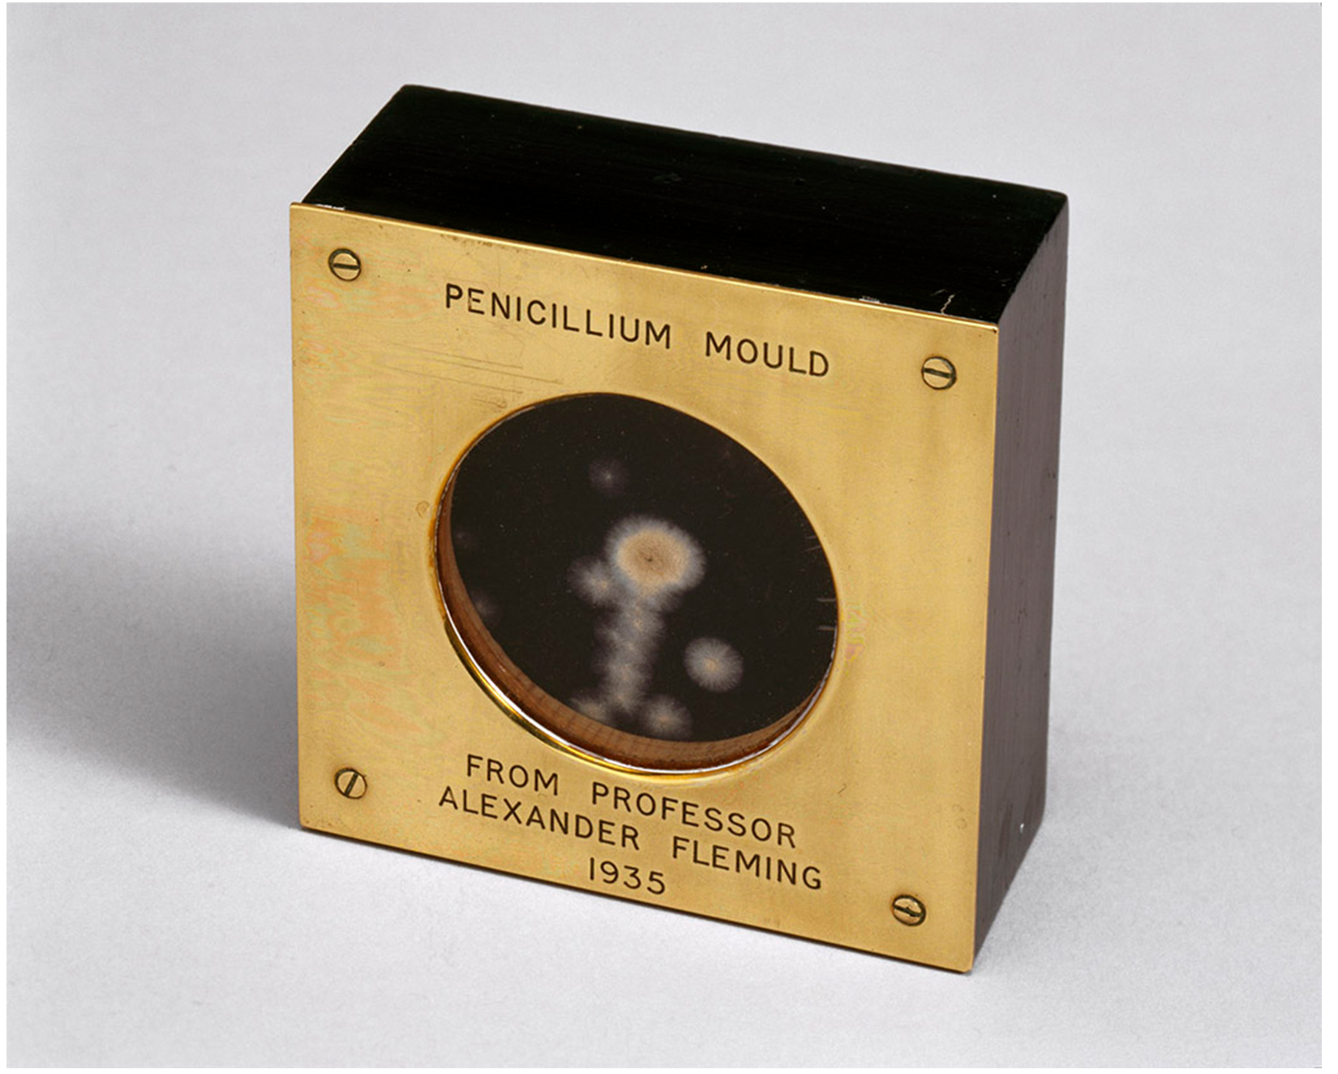
The Field of Biotechnology₁
Biotechnology uses biological agents like microorganisms for technological advancement
It was first used for breeding livestock and crops before the scientific basis was understood
After the 1953 discovery of DNA structure, biotechnology grew rapidly in academia and industry
17.1 Figure 1
Science Museum London on Wikimedia Commons. "Penicillin mould."

Slide 5

The Field of Biotechnology₂
Main applications are in medicine (vaccines, antibiotics) and agriculture (genetic crop modification)
Industrial applications include fermentation, oil spill treatment, biofuel production
17.1 Figure 2
Kelly Sikkema on Unsplash. "Soybeans."

Slide 6
Basic Techniques to Manipulate
Genetic Material (DNA and RNA)
Nucleic acids are macromolecules made of nucleotides linked by phosphodiester bonds
DNA consists of two complementary strands connected by hydrogen bonds between base pairs.
DNA can be denatured by high temperatures and reannealed by cooling, while DNA polymerase can replicate DNA.
RNA, particularly mRNA, is often analyzed as it represents actively expressed protein-coding genes but presents challenges due to its relative instability.

Slide 7
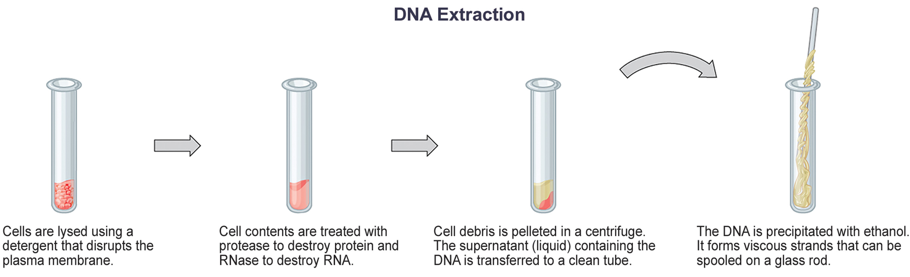
DNA and RNA Extraction
Extraction isolates DNA or RNA from cells for study or manipulation.
Uses a lysis buffer (detergent solution) with enzymes, such as proteases (break down protein) and ribonucleases (RNases, break down RNA) degrade unwanted molecules
Then, uses alcohol to precipitation DNA
17.1 Figure 3
CNX OpenStax on Wikimedia Commons. "DNA extraction."

Slide 8
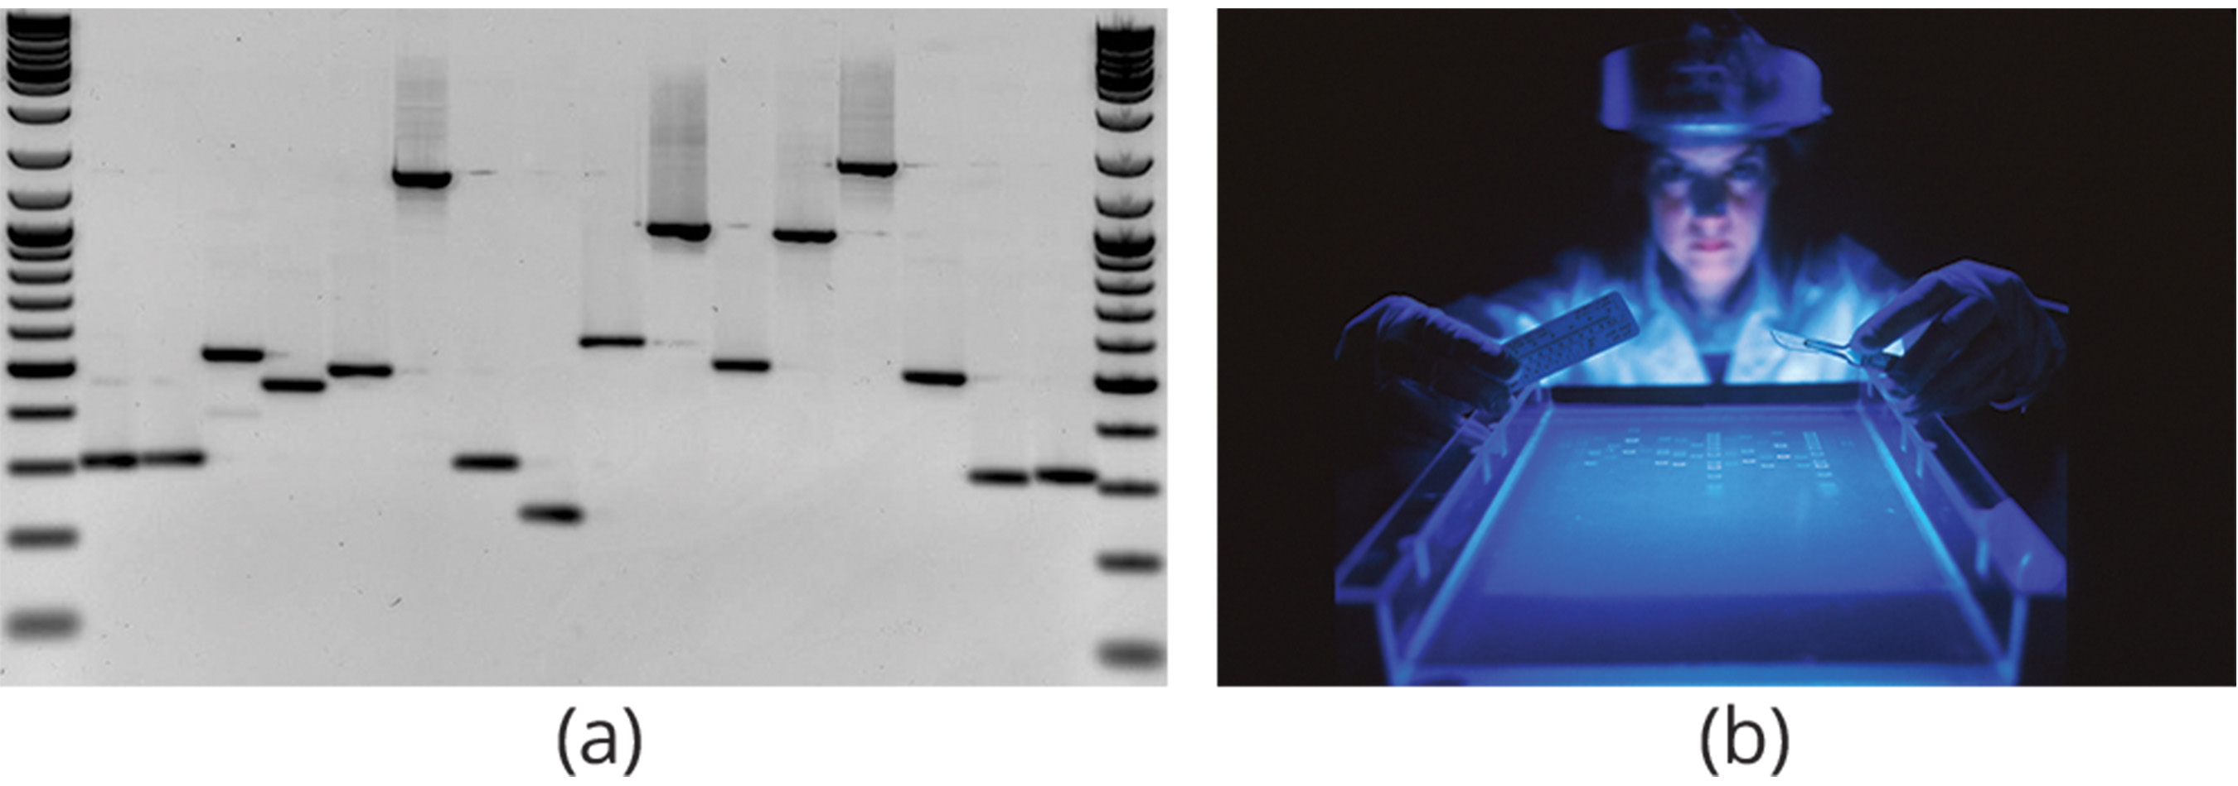
Gel Electrophoresis
Gel electrophoresis separates nucleic acids based on size by applying an electric field to molecules in a porous gel matrix.
Negatively charged nucleic acids move towards the positive electrode, with smaller fragments traveling faster and farther through the gel.
The nucleic acids are visualized using fluorescent or colored dyes, with fragments appearing as distinct bands.
A molecular weight standard helps determine the size of the separated fragments.
17.1 Figure 4
Rkalendar on Wikimedia Commons. "Gel electrophoresis.“ National Cancer Institute on Unsplash. "DNA fragmentation."

Slide 9
Nucleic Acid Fragment Amplification by
Polymerase Chain Reaction
Polymerase chain reaction (PCR) amplifies specific DNA regions for analysis.
Used to clone gene fragments to analyse genetic diseases, detecting DNA contaminants, and amplify DNA for sequencing
Reverse transcription PCR (RT-PCR) amplifies DNA from an RNA template by applying DNA nucleotides to the mRNA to create complementary DNA (cDNA).

Slide 10
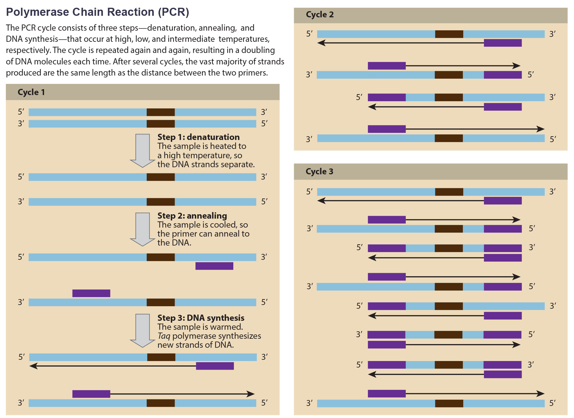
17.1 Figure 5
CNX OpenStax on Wikimedia Commons. "Polymerase chain reaction." Modified.
Notes:
Scientists use polymerase chain reaction, or PCR, to amplify a specific DNA sequence. Primers—short pieces of DNA complementary to each end of the target sequence—combine with genomic DNA, Taq polymerase, and deoxynucleotide triphosphates (dNTPs). Taq polymerase is a DNA polymerase isolated from the thermostable bacterium Thermus aquaticus that can withstand the high temperatures that scientists use in PCR. Thermus aquaticus grows in the Lower Geyser Basin of Yellowstone National Park. Reverse transcriptase PCR (RT-PCR) is similar to PCR but requires the additional step of creating DNA (called complementary DNA, or cDNA) from an RNA template before PCR can be used to amplify the genetic material.

Slide 11
Hybridization, Southern Blotting, and
Northern Blotting
Scientists use probes (short DNA fragments labeled with radioactive or fluorescent dyes) to detect specific sequences in nucleic acid samples.
Southern blotting is used to detect specific DNA sequences in a genome, while northern blotting detects RNA sequences to analyze gene expression.
Sequences separated by size via gel electrophoresis are transferred to a nylon membrane (blotting) for probing.

Slide 12
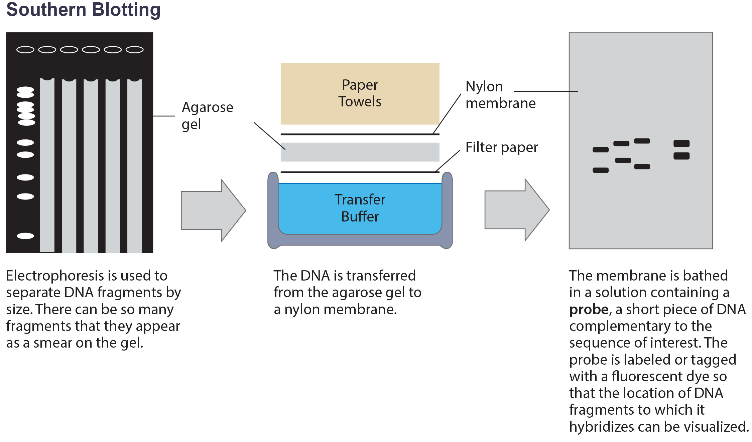
17.1 Figure 6
CNX OpenStax on Wikimedia Commons. "Electrophoresis." Modified.
Notes:
Scientists use Southern blotting to find a particular sequence in a DNA sample. Scientists separate DNA fragments on a gel, transfer them to a nylon membrane, and incubate them with a DNA probe complementary to the sequence of interest. Northern blotting is similar to Southern blotting, but scientists run RNA on the gel instead of DNA. In western blotting, scientists run proteins on a gel and detect them using antibodies.

Slide 13
Molecular Cloning₁
Molecular cloning involves reproducing specific genome fragments, allowing researchers to study genes, proteins, or noncoding regions in isolation.
Plasmids, small circular DNA molecules, are used as vectors to carry foreign DNA (transgenes, not host DNA) into host organisms, typically bacteria.
Plasmids naturally occur in bacteria and can confer beneficial traits like antibiotic resistance; scientists have engineered them for cloning and large-scale production of medications.
The multiple cloning site (MCS) in plasmids allows easy insertion of foreign DNA using restriction endonucleases, which cut DNA at specific sequences.

Slide 14
Molecular Cloning₂
Restriction endonucleases often create "sticky ends," allowing complementary DNA fragments to be joined using DNA ligase.
The recombinant plasmid is introduced into bacteria through transformation, a process where external genetic material is taken up by the organism.
Scientists often use antibiotic resistance genes as a screening method to identify successful transformations.

Slide 15
Think It Through₁
Why are plasmids an important tool in molecular biology?
Notes:
Originally an On Your Own. This is included here to use as a talking point or for a think-pair-share activity.

Slide 16
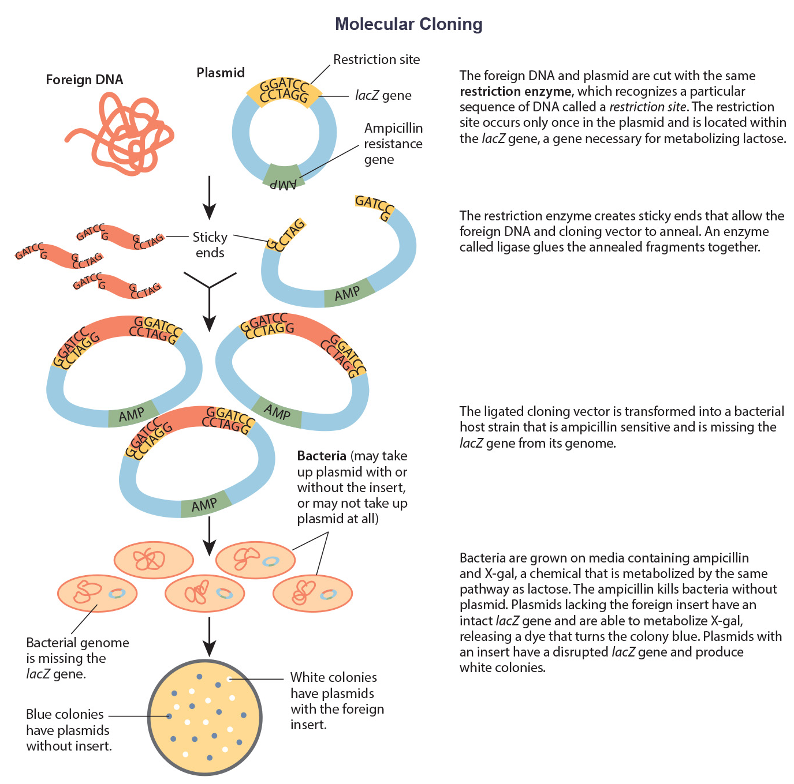
Recombinant DNA Molecules
17.1 Figure 7
Plasmids with foreign DNA inserts are called recombinant DNA or chimeric molecules.
Proteins that are expressed from recombinant DNA are recombinant proteins.
CNX OpenStax on Wikimedia Commons. "Molecular cloning."

Slide 17
Cellular Cloning
Cellular cloning, or binary fission, occurs in unicellular organisms like bacteria and yeast during asexual reproduction.
The nuclear DNA duplicates by the process of mitosis, which creates an exact replica of the genetic material.

Slide 18
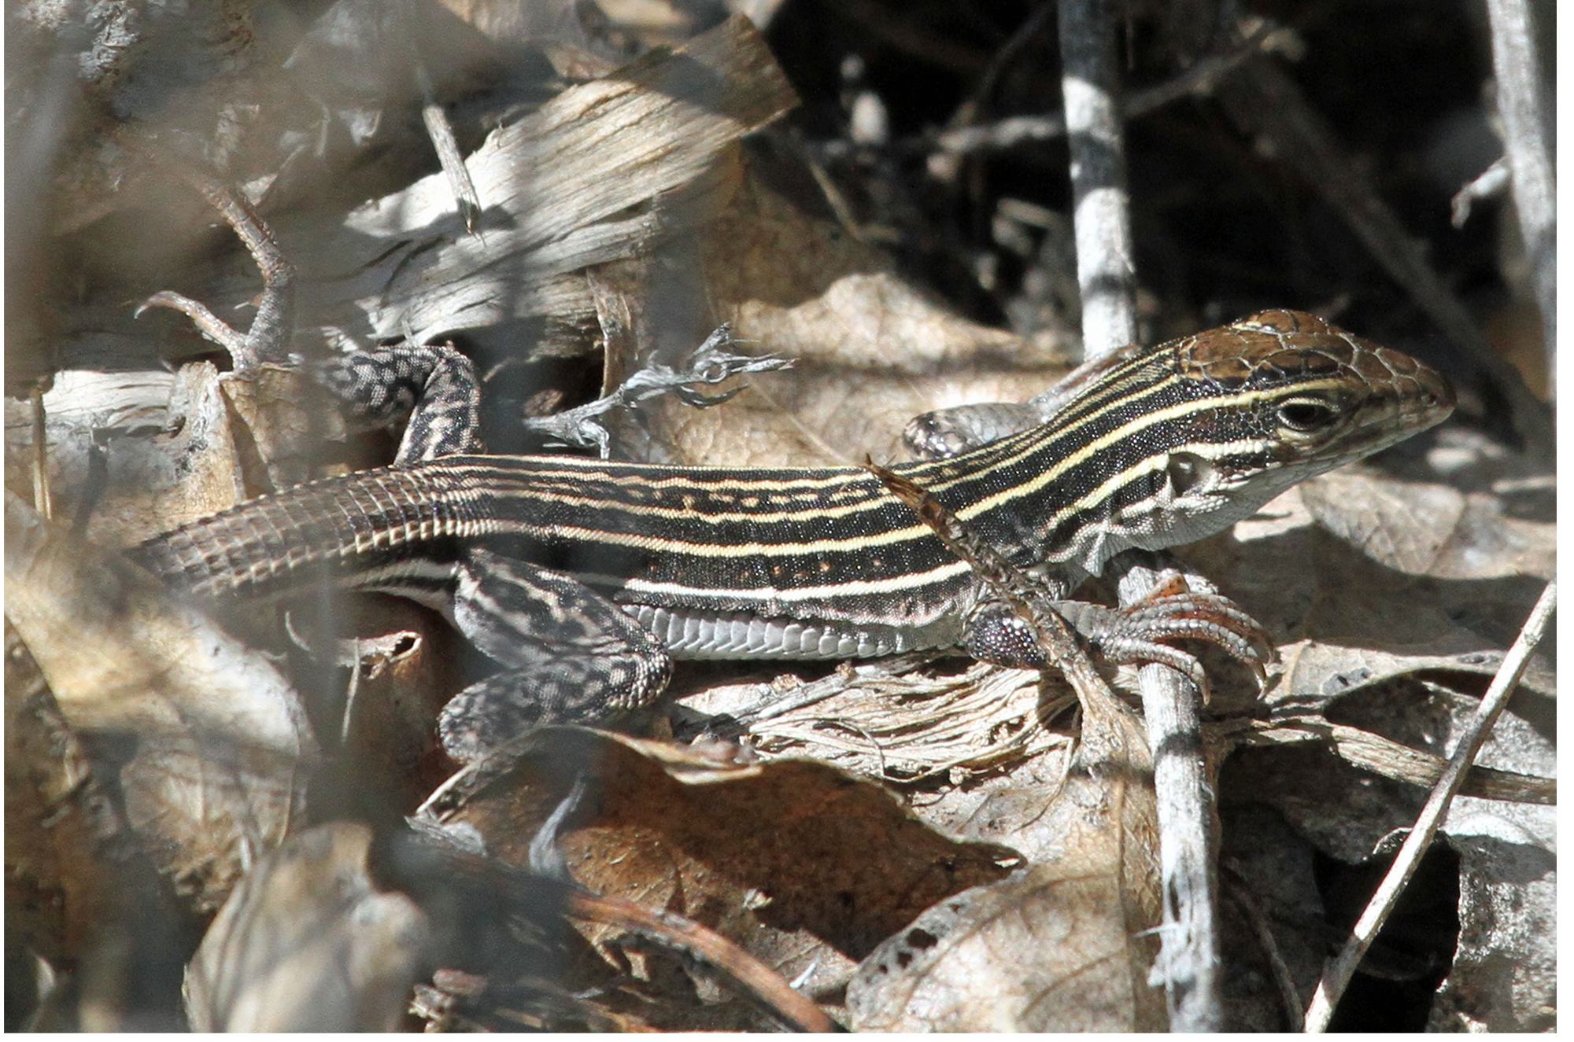
Reproductive Cloning₁
Reproductive cloning creates an identical copy of an entire multicellular organism, or clone.
Most multicellular organisms reproduce sexually, making identical copies impossible naturally.
Parthenogenesis is a form of asexual reproduction from unfertilized eggs.
  In colonial insects, the unfertilized haploid eggs develop into males and diploid eggs are female.
  In some reptiles, the genetic material in the egg doubles, creating a diploid adult.
17.1 Figure 8: The New Mexico whiptail, Aspidoscelis neomexicana, can reproduce asexually via parthenogenesis.
Greg Schechter on Wikimedia Commons. "New Mexico whiptail."

Slide 19
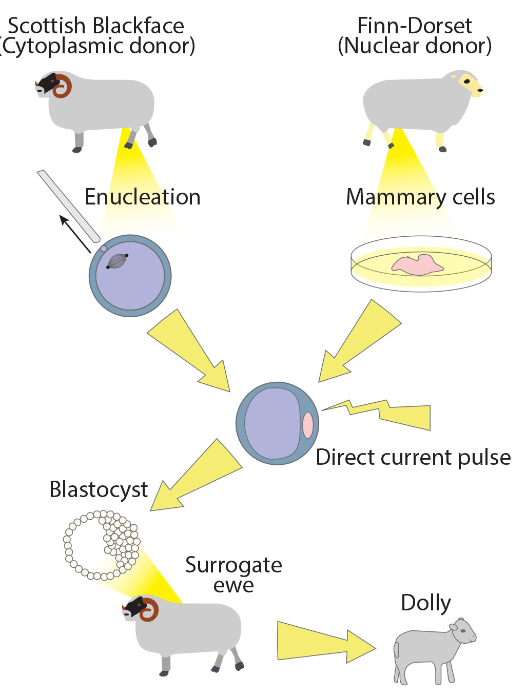
Reproductive Cloning₂
17.1 Figure 9
Somatic cell nuclear transfer involves replacing an egg's nucleus with a diploid nucleus from a donor.
Can be used for therapeutic or reproductive cloning, resulting in a genetically identical organism
Dolly the sheep was the first cloned animal in 1996, but only lived for 7 years.
Other cloned animals like horses, goats, and bulls often exhibit abnormalities like facial, limb, and cardiac defects, potentially due to DNA age.
Squidonius on Wikimedia Commons. "Dolly the sheep."

Slide 20
Think It Through₂
Using Figure 9 as a reference, do you think Dolly was a Finn-Dorset or a Scottish Blackface sheep?
Notes:
Originally an On Your Own. This is included here to use as a talking point or for a think-pair-share activity.

Slide 21
Genetic Engineering
Genetic engineering is the process of modifying an organism's characteristics by manipulating its genetic material, often with recombinant DNA.
Generates genetically modified organisms (GMOs) or transgenic organisms
Used in academics, medicine, agriculture, and industrial purposes since the 1970s

Slide 22
Reflection Question
What are some ways that you may have seen or interacted with genetically modified organisms over the last 24 hours? Don’t forget to consider the foods you’ve eaten as well as those you’ve seen.
Notes:
The reflection question is included here to use as a talking point or for a think-pair-share activity.

Slide 23
Gene Targeting
Reverse genetics: method of determining the gene's function by starting with the gene itself instead of starting with the gene product
Gene targeting uses recombinant DNA vectors to introduce mutations or delete sequences to alter expression.
Provides clues about gene function based on observing mutant phenotypes

Slide 24
Biotechnology in Medicine and Agriculture
Can enhance resistance to disease, pest, and environmental stress
Improve both crop yield and quality

Slide 25
Science and You
In 2020, the Nobel Prize in Chemistry went to Emmanuelle Charpentier and Jennifer A. Doudna for developing powerful new gene editing tools—CRISPR/Cas9.
These tools work like genetic scissors and allow researchers to alter the DNA of living things with a great deal of precision.
What might CRISPR do for you? What have scientists already achieved using CRISPR?
In the COVID-19 pandemic, scientists in India used CRISPR to develop diagnostic tests for the virus.
In 2017, scientists used CRISPR to remove a genetic heart defect from human embryos.
Notes:
This is included as a relevant application for this topic.

Slide 26
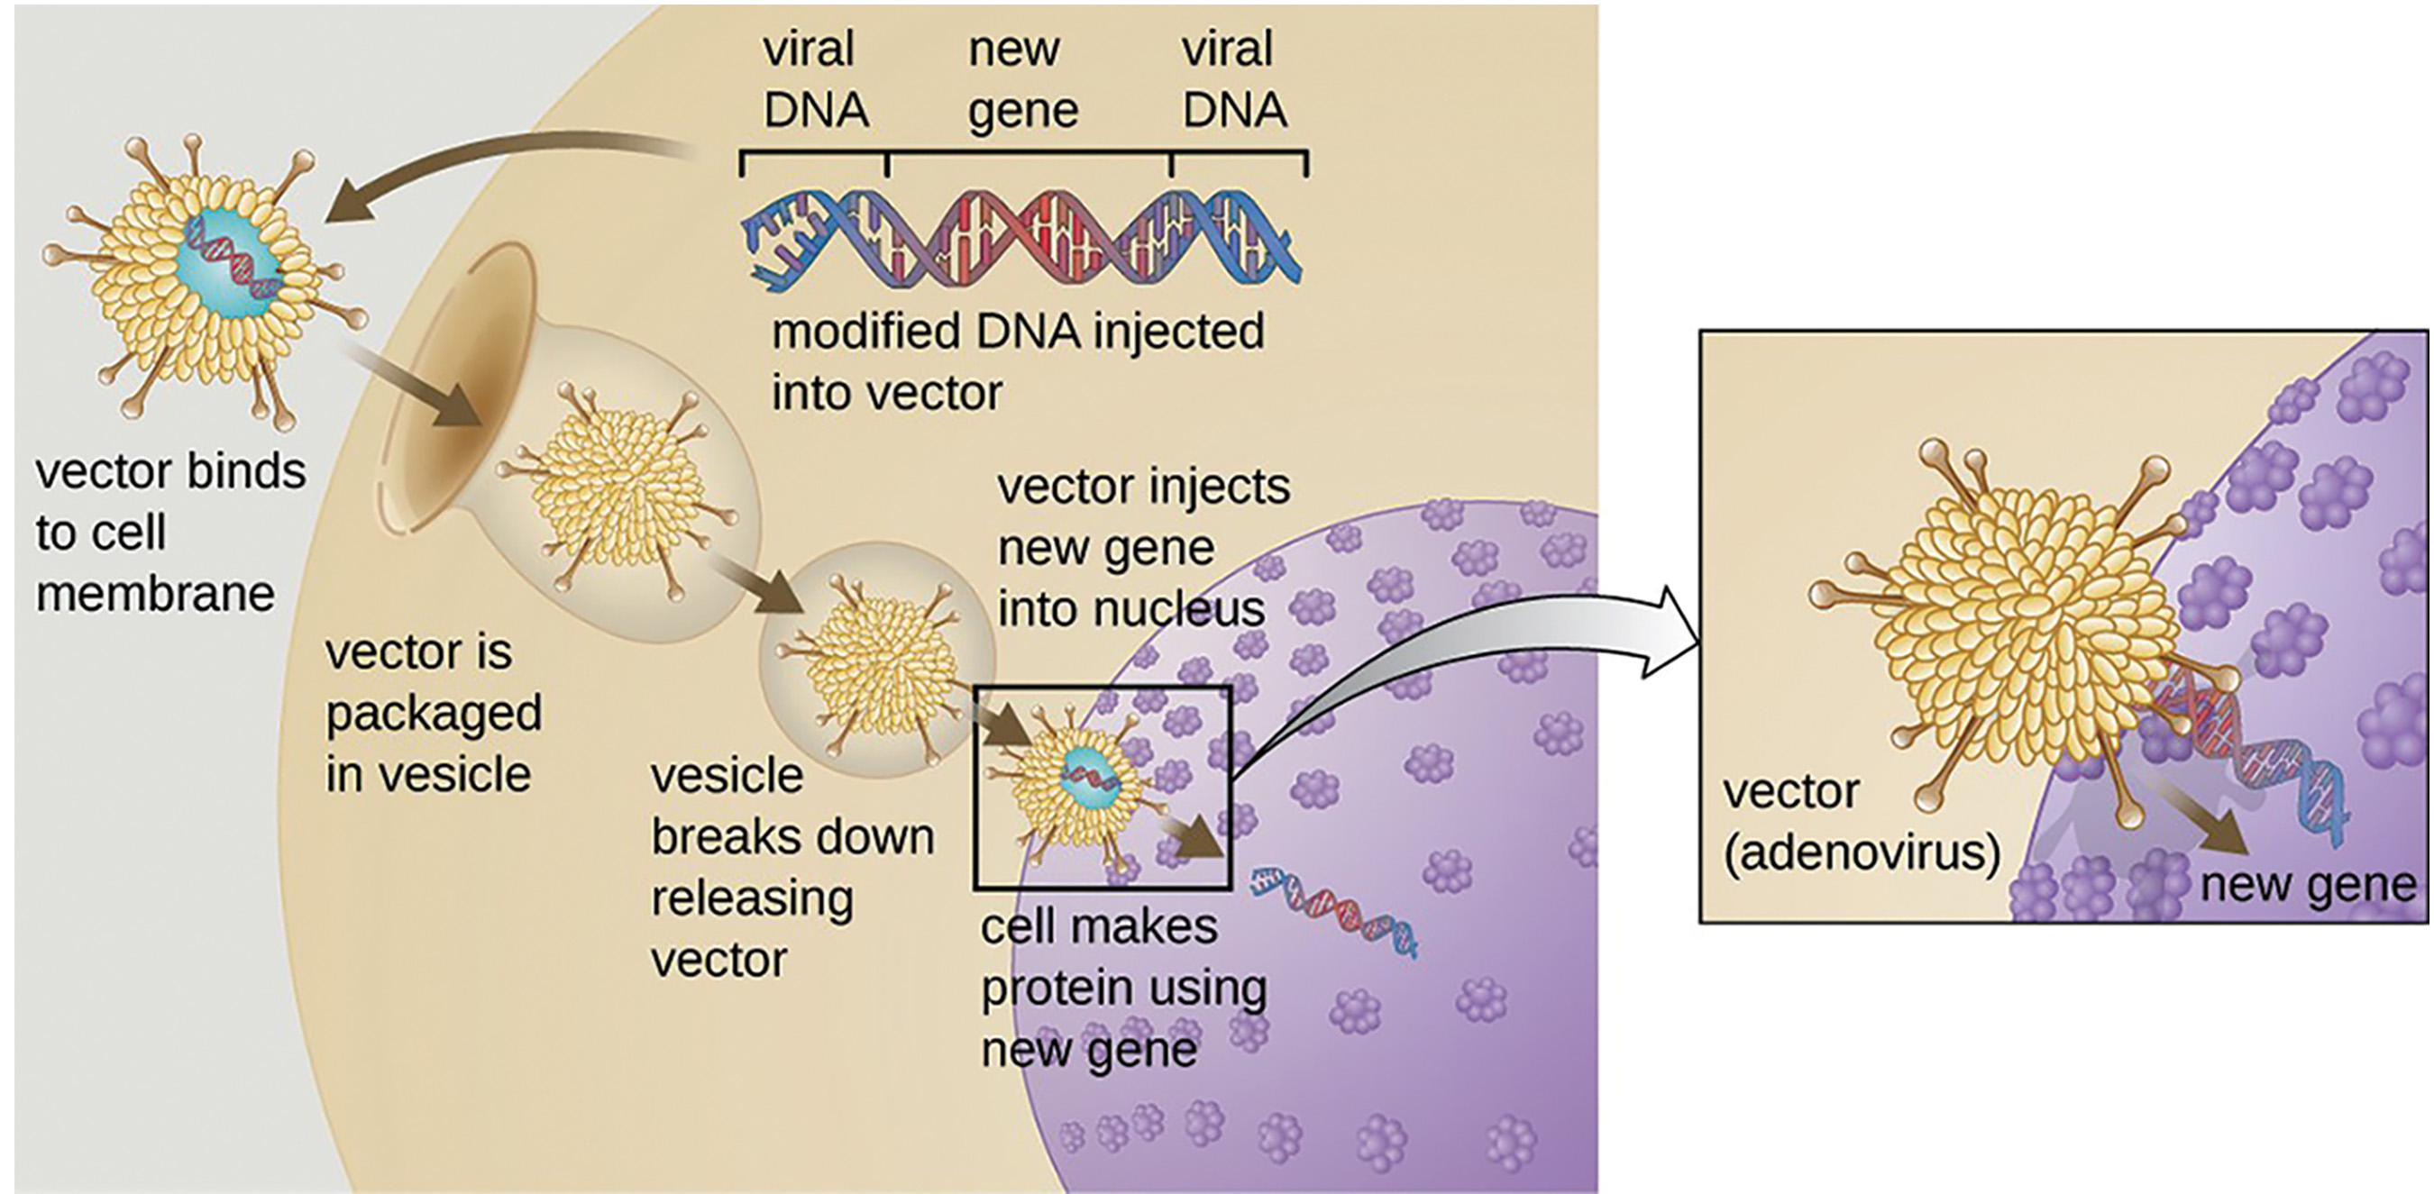
Genetic Diagnosis and Gene Therapy
Genetic diagnosis involves testing for suspected genetic defects before treatment, often recommended for family members of those with genetic diseases.
Genetic testing identifies hereditary disease-causing genes to guide treatment.
Gene therapy is a technique used to cure genetic diseases by introducing beneficial genes into diseased cells, typically using viral vectors.
  Advanced forms of gene therapy aim to correct mutations at their original site in the genome, as in the treatment of severe combined immunodeficiency (SCID).
17.1 Figure 10
CNX OpenStax on Wikimedia Commons. "Adenovirus vector." Modified.

Slide 27

Production of Vaccines, Antibiotics, and Hormones
Modern vaccines uses cloned genes of microorganisms to produce antigens to stimulate patients’ immune response and memory.
Such as genes cloned from influenza virus
Antibiotics and other pharmaceuticals are also produced by biotechnology.
Insulin and human growth hormone (HGH)
17.1 Figure 11: The person has diabetes. Recombinant DNA technology enabled scientists to bioengineer E. coli that produce large-scale quantities of human insulin.
Artem Podrez on Pexels. "Man checking glucose levels."

Slide 28
Think It Through₃
What are some ways biotechnology has advanced the field of medical science?
Notes:
Originally an On Your Own. This is included here to use as a talking point or for a think-pair-share activity.

Slide 29
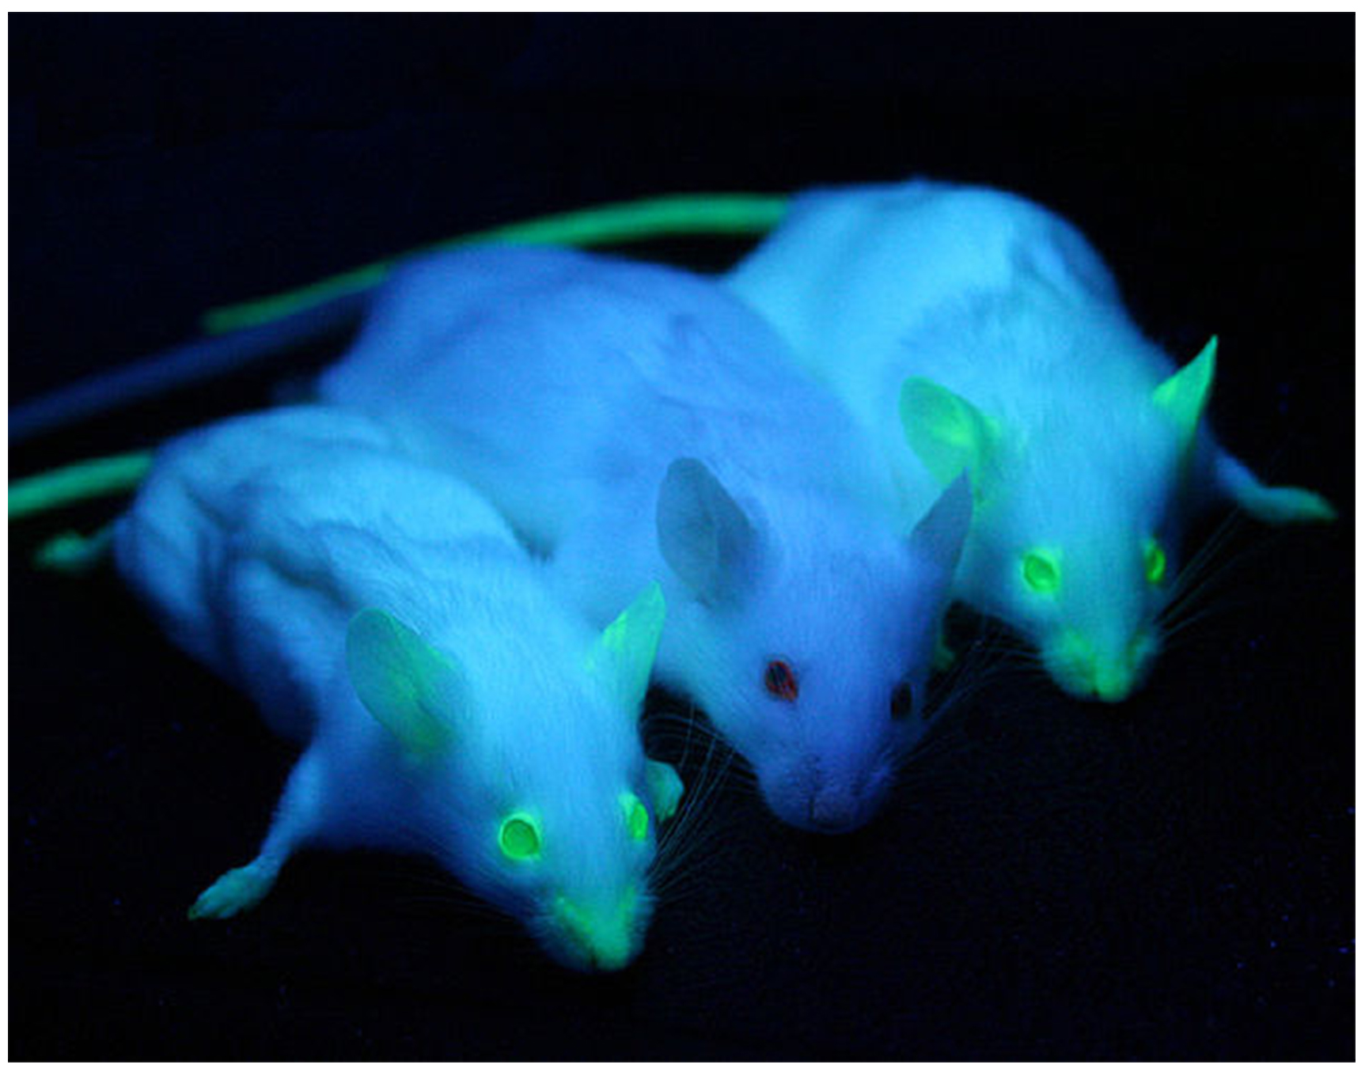
Transgenic Animals
Transgenic animals are genetically engineered to express recombinant proteins when a eukaryotic host is needed.
Common hosts include sheep, goats, chickens, and mice.
17.1 Figure 12: The two mice on either side have been genetically modified with the green fluorescent protein (GFP) gene, causing the glow effect under certain lights. The center mouse lacks the GFP gene.
Ingrid Moen, Charlotte Jevne, Jian Wang, Karl-Henning Kalland, Martha Chekenya, Lars A Akslen, Linda Sleire, Per Ø Enger, Rolf K Reed, Anne M Øyan and Linda EB Stuhr on Wikimedia Commons. "GFP mice."

Slide 30
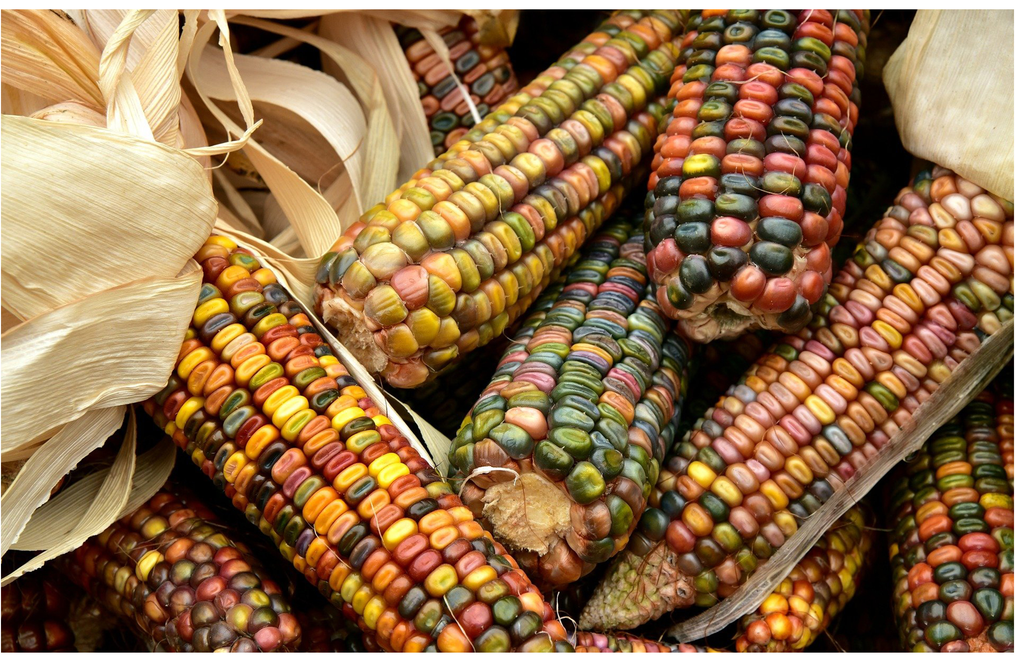
Transgenic Plants
GMO, transgenic, crops can have desirable traits like disease and pest resistance and enhanced nutrition.
First transgenic crops included staples like corn, potatoes, and tomatoes.
They are extensively tested for human and environmental safety before release.
17.1 Figure 13
Ulrike Leone on Pixabay. "Corn."

Slide 31

Transformation of Plants Using
Agrobacterium tumefaciens
The bacterium, Agrobacterium tumefaciens, naturally transfers DNA to plants creating tumors.
Researchers modify tumor-inducing (Ti) plasmids to introduce the gene of interest in crops like rice, barley, and wheat.
17.1 Figure 14
jacinta lluch valero on Flickr. "Agrobacterium tumefaciens."

Slide 32
The Organic Insecticide Bacillus thuringiensis
Bacillus thuringiensis (Bt) is a bacterium that produces protein crystals during sporulation (spore creation) that are toxic to many insect species that affect plants.
Toxin genes are cloned into crops to make them resistant to insect pests.
Bt toxin is an organic, environmentally-safe, insect-targeted bioinsecticide.

Slide 33
Flavr Savr Tomato
First commercialized GMO crop in 1994 with increased shelf life and increased fungal resistance.
It employed an antisense gene, that produces complementary mRNA to the target gene, suppressing the enzyme that causes softening.
No longer available due to supply and shipping issues.

Slide 34
Summary
Nucleic acid isolation techniques involve cell lysis and macromolecule destruction.
Analysis methods: gel electrophoresis (size separation), PCR (amplification), blotting (sequence detection).
Cloning refers to molecular (DNA fragments), cellular (cell populations), or reproductive (organisms) cloning.
Genetic testing identifies disease genes; gene therapy treats inheritable diseases.
Transgenic organisms contain foreign DNA via molecular cloning.
Applications include vaccines, antibiotics, hormones, and improved crop traits via recombinant DNA technology.

Slide 35


End of Hawkes Learning PowerPoint

