Slide 1
Lesson 17.2
Mapping Genomes and Sequencing

Slide 2
Objectives
Define genomics.
Define whole-genome sequencing.
Describe genetic and physical maps.
Describe genomic mapping methods.
Describe three types of sequencing.

Slide 3
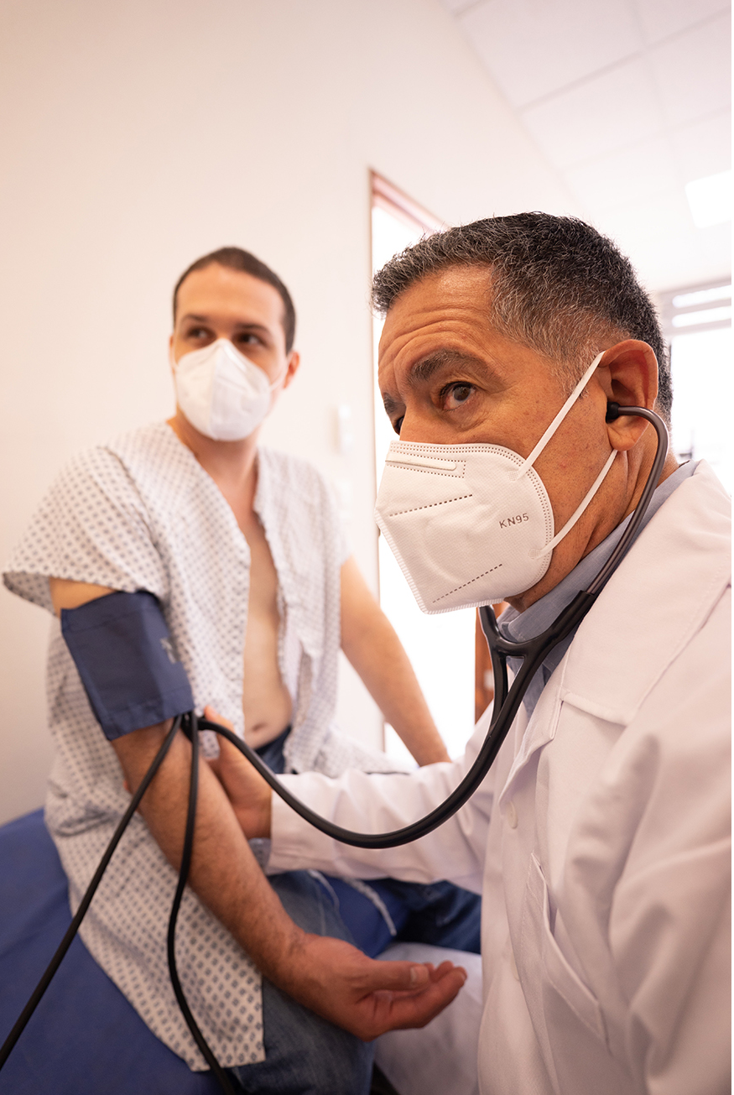
Mapping Genomes and Sequencing
Genomics is the study of genomes, including all genes and their composition.
Genetic maps locate genes on chromosomes.
Uses a genetic marker which is a gene or sequence that co-segregates (shows linkage) with a specific trait.
Physical maps present he physical distance, in nucleotides, between genes or genetic markers.
17.2 Figure 1: By mapping the human genome, researchers can better identify genes the predispose people to heart disease.
Los Muertos Crew on Pexels. "Blood pressure."

Slide 4
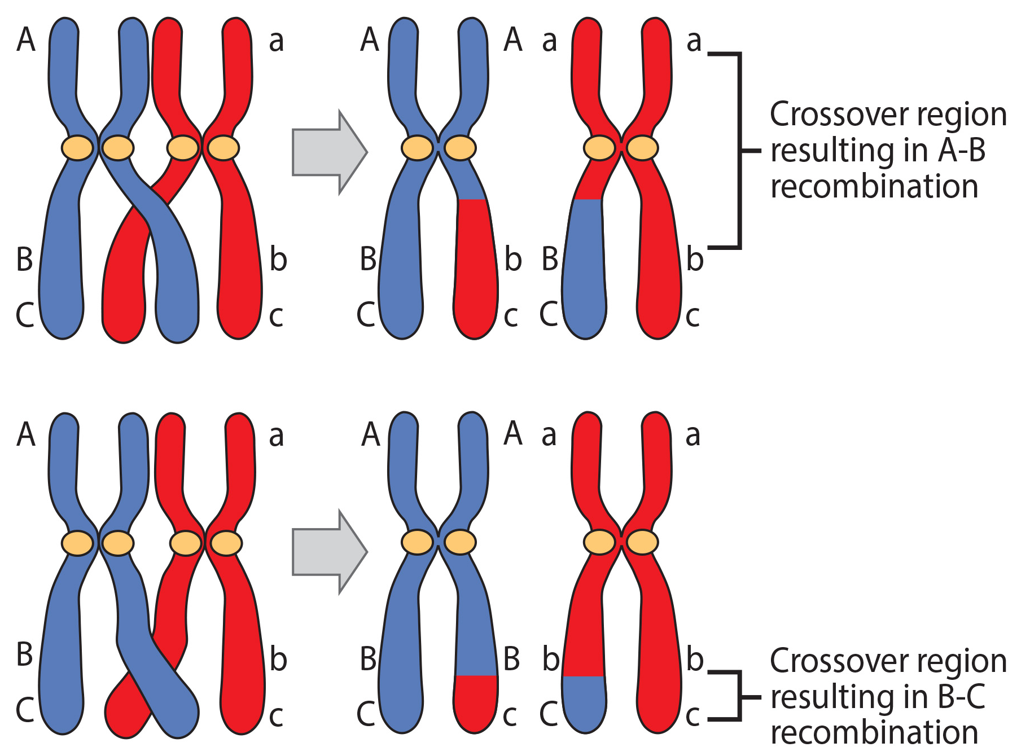
Genetic Maps₁
Linkage analysis maps genes by studying recombination frequency.
Genetic recombination is the exchange of DNA between homologous chromosomes via crossing over.
A higher recombination frequency indicates a greater gene distance, <50%, indicates linked genes.
17.2 Figure 2
CNX OpenStax on Wikimedia Commons. "Crossing over." Modified.

Slide 5
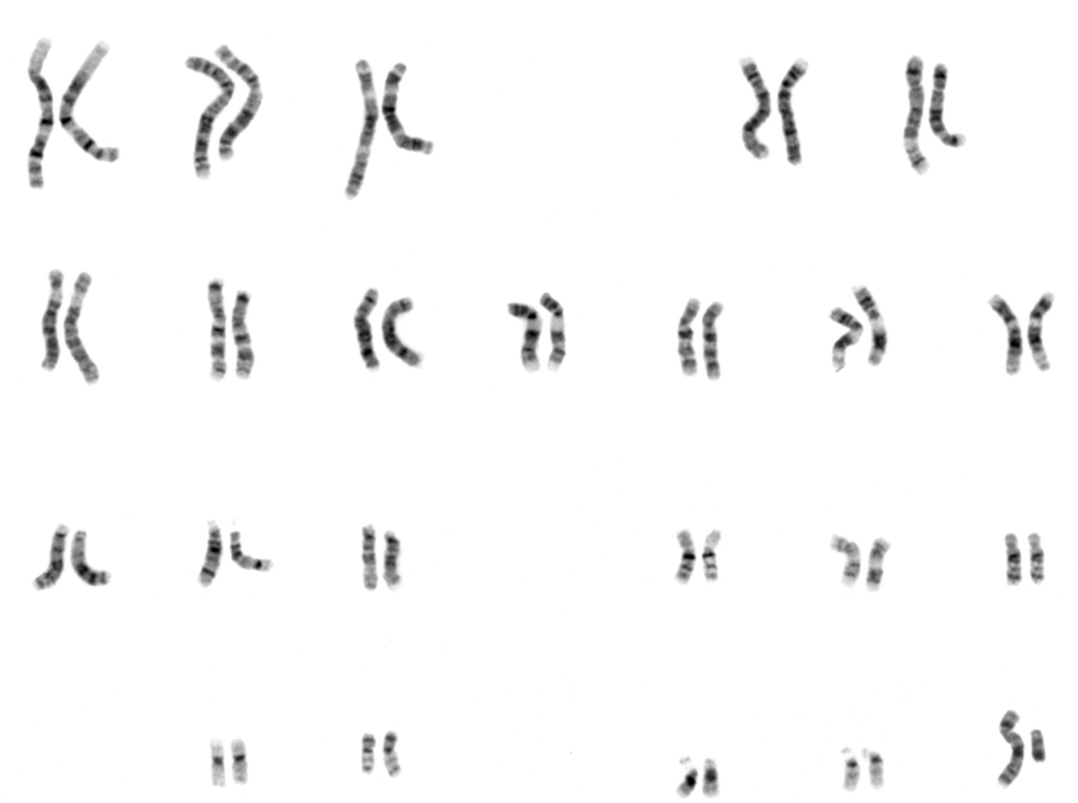
Genetic Maps₂
Genetic mapping requires markers showing variation within populations.
Early maps were created using known gene markers like fruit fly eye color that was determined by a series of genetic crosses.
Current maps now utilize non-coding DNA polymorphisms to compare individual genomes.
17.2 Figure 3: This karyotype shows the 23 paired homologous chromosomes of a human male.
National Human Genome Research Institute on Wikimedia Commons. "Karyotype of a human male."

Slide 6
Reflection Question₁
Can you think of some reasons why constructing a genetic map is useful? What are some potential applications of genetic maps?
Notes:
The reflection question is included here to use as a talking point or for a think-pair-share activity.

Slide 7
Science and You
Services like 23andMe and Ancestry offer DNA analysis from saliva samples.
These tests can reveal a person's family heritage, genetic predispositions, and carrier status.
A major limitation of some companies is the genotyping microarrays that only look at genetic markers instead of the full genome.
While the technology for full DNA sequencing doe exist, it isn’t efficient and cheap enough for these services.
Notes:
This is included as a relevant application for this topic.

Slide 8
Genetic Maps₃
Genetic mapping markers:
Restriction fragment length polymorphisms (RFLPs) use restriction endonucleases to cut DNA into fragments that are different lengths depending on the restriction endonucleases used.
Each individual’s DNA will have unique banding after the fragments are run through gel electrophoresis.
Variable number of tandem repeats (VNTRs) are repeated sets of nucleotides present in DNA’s noncoding regions.
Microsatellites polymorphisms are similar to VNTRs but are tiny repeats in noncoding regions.
Single nucleotide polymorphisms (SNPs) are variations in a single nucleotide.

Slide 9
Think It Through₁
How might RFLPs help clear up a case of uncertain paternity?
Notes:
Originally an On Your Own. This is included here to use as a talking point or for a think-pair-share activity.

Slide 10
Physical Maps
Physical maps show the distance between genetic markers and the number of nucleotides.
Cytogenetic mapping uses information from microscopic analysis of stained chromosomes sections to show where markers are in relation to stained bands.
Radiation hybrid mapping uses radiation to break DNA into fragments that are analyzed for genetic markers.
Sequence mapping produces detailed physical maps with distance measured in terms of the number of base pairs.

Slide 11
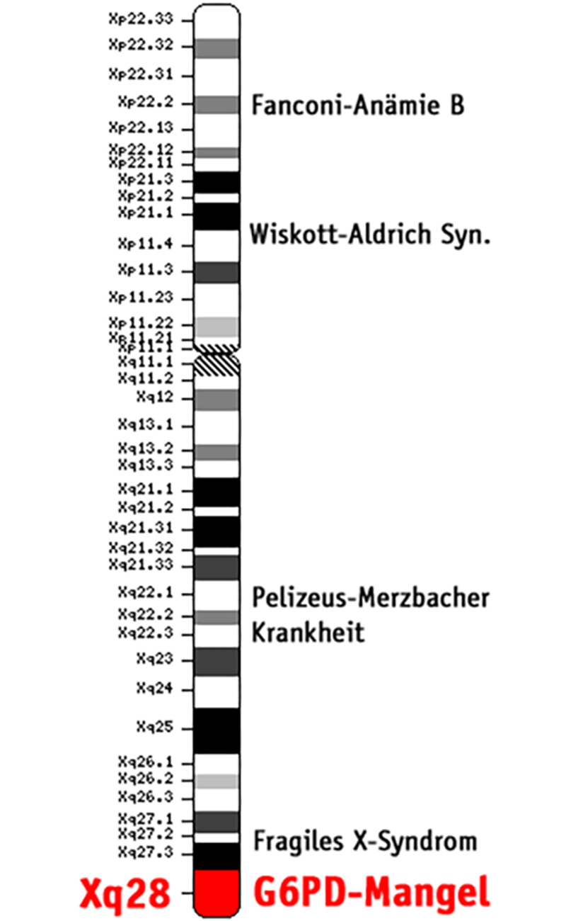
17.2 Figure 4
National Center for Biotechnology Information (NCBI) on Wikimedia Commons. "Cytogenetic map."
Notes:
This cytogenetic map of a single chromosome shows a human X chromosome. Emphasis is placed on the gene for G6PD-Mangel deficiency—a genetic disorder that affects males more often than females.

Slide 12
Genomic Libraries
Genomic libraries are the collection of all genomic DNA of an organism.
Complementary DNA (cDNA libraries) are a collection of cloned DNA fragments produced by reverse transcription of an organism’s mRNA.
Sequence maps uses sequence tagged sites (STS) which are specific DNA sequences with a known chromosomal location.
An expressed sequence tag (EST) is a short cDNA sequence that can be mapped to a specific chromosome.

Slide 13
Genetic and Physical Maps Integration
Genetic maps provide an outline, while physical maps offer details, with both types being crucial for understanding the genome.
Scientists use genome mapping techniques on various model organisms, continuously developing more advanced methods for potential breakthroughs.
Data from global laboratories is compiled into central databases like GenBank at NCBI.
NCBI has created tools like the genome viewer to make genomic information more accessible to researchers and the public.

Slide 14
Group Activity
How to Use a Genome Map Viewer
Problem Statement: Do the human, macaque, and mouse genomes contain common DNA sequences?
Develop a Hypothesis.
Visit this website to test your group's hypothesis using a genome map viewer.
The website compares gene sequences of many organisms to the Human Insulin Receptor gene. Explore the type of information provided and select the groups of organisms needed for testing of the hypothesis from the top portion of the displayed data. Focus the attention to the Selected Orthologues. Explore which columns are relevant to the needed information.
On the same page, there are other options to explore. Not all are necessary for the task; however, they might give more insight to the value of genome and gene comparisons.

Slide 15
Whole-Genome Sequencing
Whole-genome sequencing is a process that determines an entire genome's DNA sequence.
Several labs now offer this service.
Whole-exome sequencing is a lower-cost alternative that only sequences coding regions.
Used in 2010 to cure boy with intestinal abscesses by identifying a genetic defect.

Slide 16
Reflection Question₂
If you were offered the chance to have your entire genome sequenced, would you accept? Why or why not?
What would you like to learn? Specify at least one thing you would like to learn about your genome.
What are some concerns you would have? Specify at least one concern.
Notes:
The reflection question is included here to use as a talking point or for a think-pair-share activity.

Slide 17
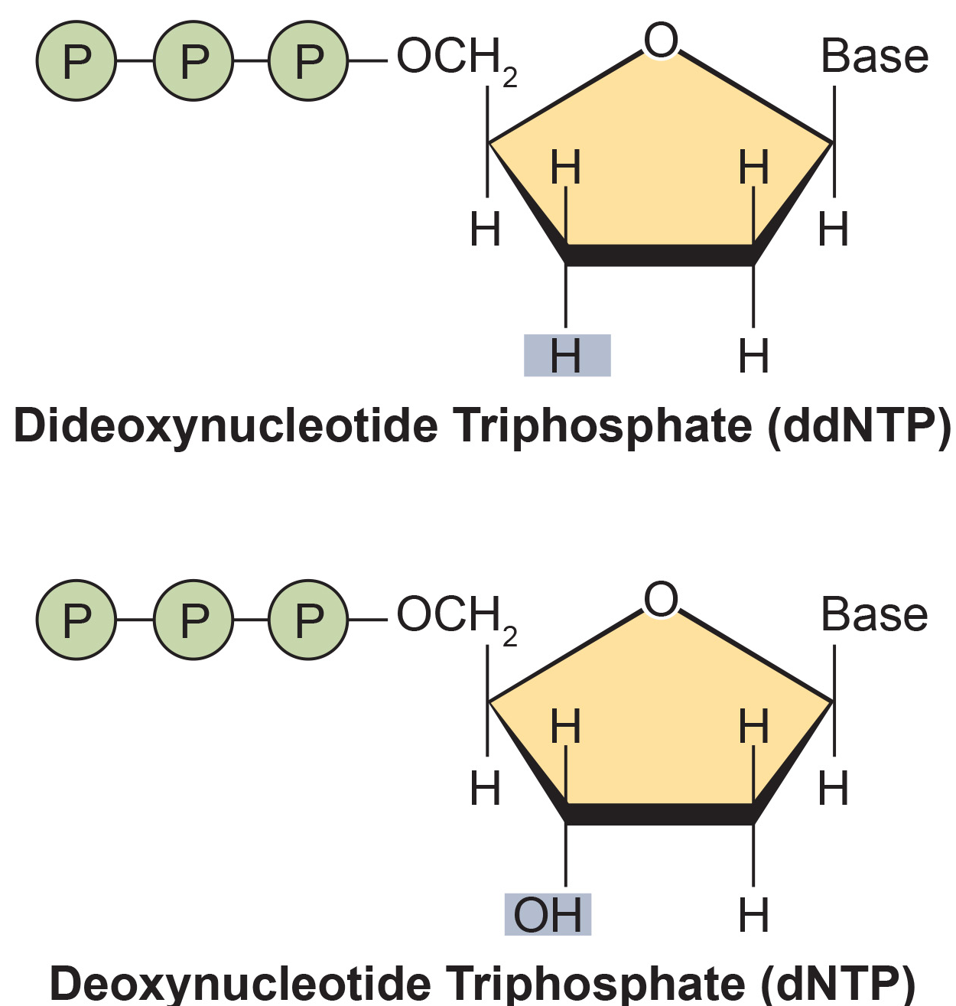
Strategies Used in Sequencing Projects₁
Chain termination method is a basic modern sequencing technique.
Uses a primer, a deoxynucleotide triphosphate (dNTP, a DNA unit), and fluorescently labeled dideoxynucleotide triphosphates (ddNTPs, monomers missing a hydroxyl group)
Every time a ddNTP incorporates into the strand, replication is terminated, resulting in multiple short strands of replicated DNA of different lengths.
17.2 Figure 5
CNX OpenStax on Wikimedia Commons. "ddNTP."

Slide 18
Strategies Used in Sequencing Projects₂
Gel electrophoresis separates replicated DNA strands by size.
The band color from the fluorescently labeled ddNTPs indicate the terminating ddNTP and its position.
Allows scientists to read the template strand’s sequence.

Slide 19
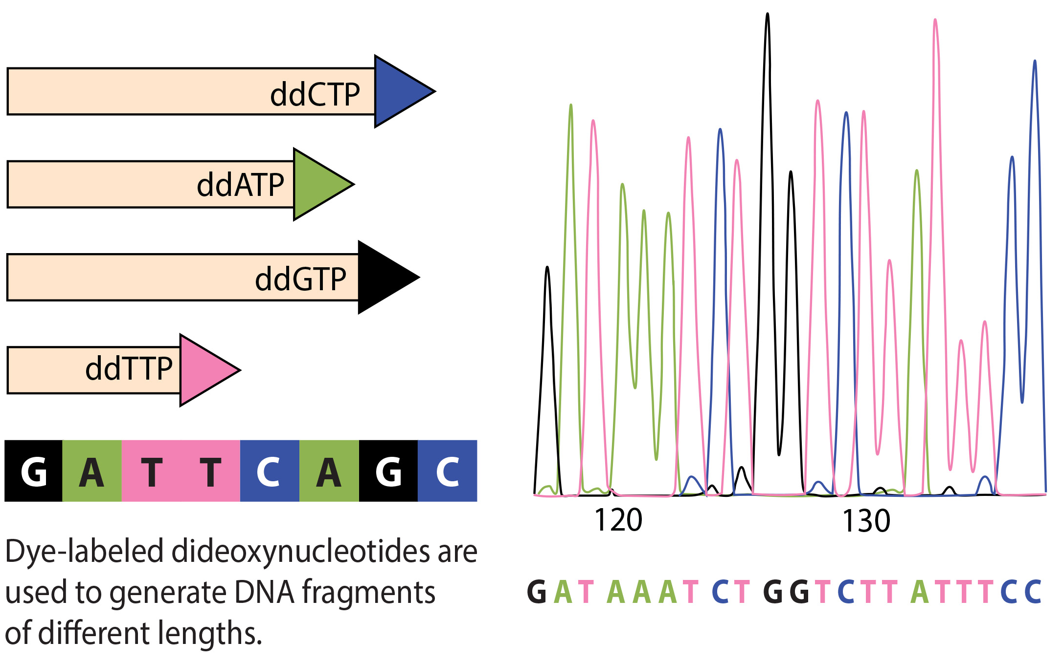
17.2 Figure 6
CNX OpenStax on Wikimedia Commons. "Dye-labeled dideoxynucleotides." Modified.
Notes:
This figure illustrates Fred Sanger's dideoxy chain termination method. Using dideoxynucleotide phosphates, the DNA fragment can terminate at different points. The DNA separates based on size, and we can read these bands based on the fragments' size.

Slide 20
Early Strategies: Shotgun Sequencing and Pairwise-End Sequencing
Shotgun Sequencing: several DNA fragments are randomly cut into smaller pieces. Then they are compared to see where their sequences overlap to recreate the entire DNA sequence.
Pairwise-End Sequencing: similar to shotgun sequencing but analyses each DNA fragment’s end for overlap.
Advanced shotgun sequencing for larger genomes but more cumbersome.

Slide 21
Think It Through₂
What are the advantages and disadvantages of the shotgun sequencing method?
Notes:
Originally an On Your Own. This is included here to use as a talking point or for a think-pair-share activity.

Slide 22
Next-Generation Sequencing
Next-generation sequencing: a group of automated techniques for rapid DNA sequencing.
Automated low-cost sequencers are used.
Can generate millions of short fragments (25 to 500 base pairs) in a day.
Puts all the fragments in order to make a cumbersome process more efficient.

Slide 23
Use of Whole-Genome Sequences of Model Organisms
Early Genome Sequencing Milestones:
First genome sequenced by Fred Sanger in 1977.
Bacteriophage ΦX174 genome sequenced.
Venter sequenced Haemophilus influenzae in 1980s.
Saccharomyces cerevisiae yeast genome sequenced by 74 labs (1989-1996).
By 1997, a strain of the bacteria Escherichia coli called K12 was sequenced.
Having entire model organisms (a model to understand the biological processes in other species) genomes sequenced helps with research.
Attaching biological information to gene sequences is genome annotation.

Slide 24
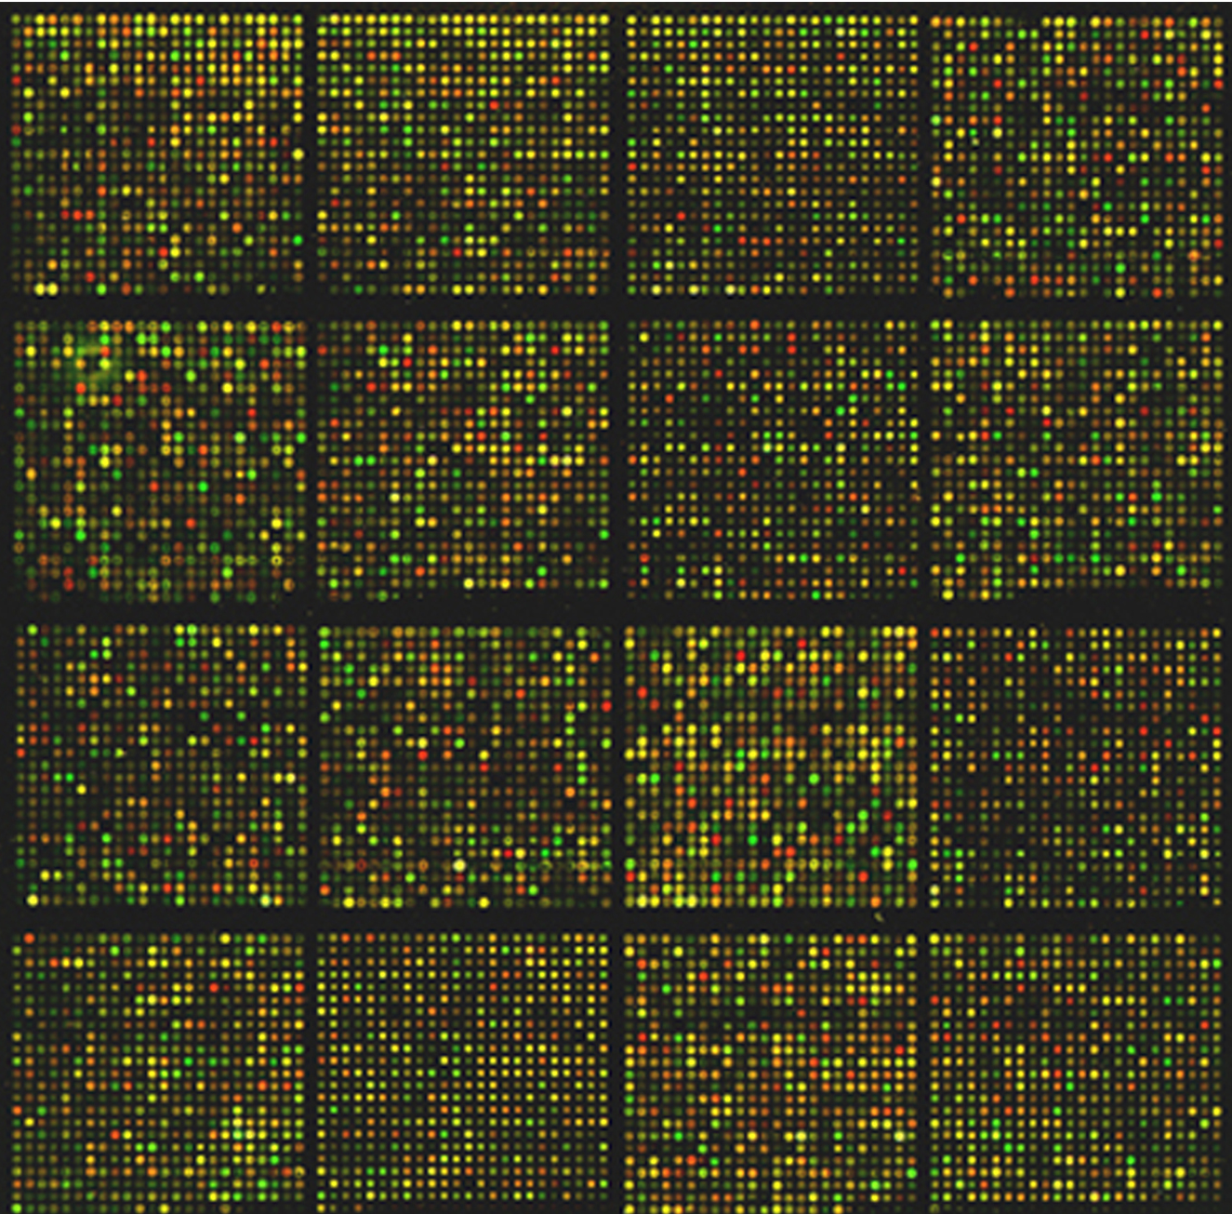
Genome Sequence Uses
DNA microarrays are used to detect gene expression by analyzing different DNA fragments that are fixed to a glass slide to identify active genes and sequences.
Helps identify genetic abnormalities and future onset diseases
Allows for informed decisions about lifestyle, medication, and reproductive decisions
17.2 Figure 7
National Cancer Institute on Wikimedia Commons. "Mouse cDNA microarray."

Slide 25
Evolution Connection
Comparing Sequences
A sequence alignment is an arrangement of proteins, DNA, or RNA.
Used to construct phylogenetic trees and detect conserved functions and structures between species.
BLAST (Basic Local Alignment Search Tool) software is used for sequence alignment.
BLAST can compare input sequences against known genomes to find matches.

Slide 26
Summary
Genome mapping combines various types of maps (genetic, physical, and sequence) to create a comprehensive picture of an organism's genome.
Genetic maps estimate gene distances based on recombination frequencies, while physical maps provide detailed information on actual physical distances between genes.
Whole-genome sequencing, based on the chain termination method, is becoming a valuable tool in treating genetic diseases and has various industrial applications.
Researchers study whole-genome sequences of model organisms to gain insights applicable to human genomics.
Advancements in automation and cost reduction of whole-genome sequencing may lead to personalized medicine in the future.

Slide 27


End of Hawkes Learning PowerPoint

