Slide 1
Lesson 17.3
Applications of Genomics and Proteomics

Slide 2
Objectives
Define polygenic.
Define protein signature.
Describe a proteome.
Explain pharmacogenomics.
Explain systems biology.

Slide 3
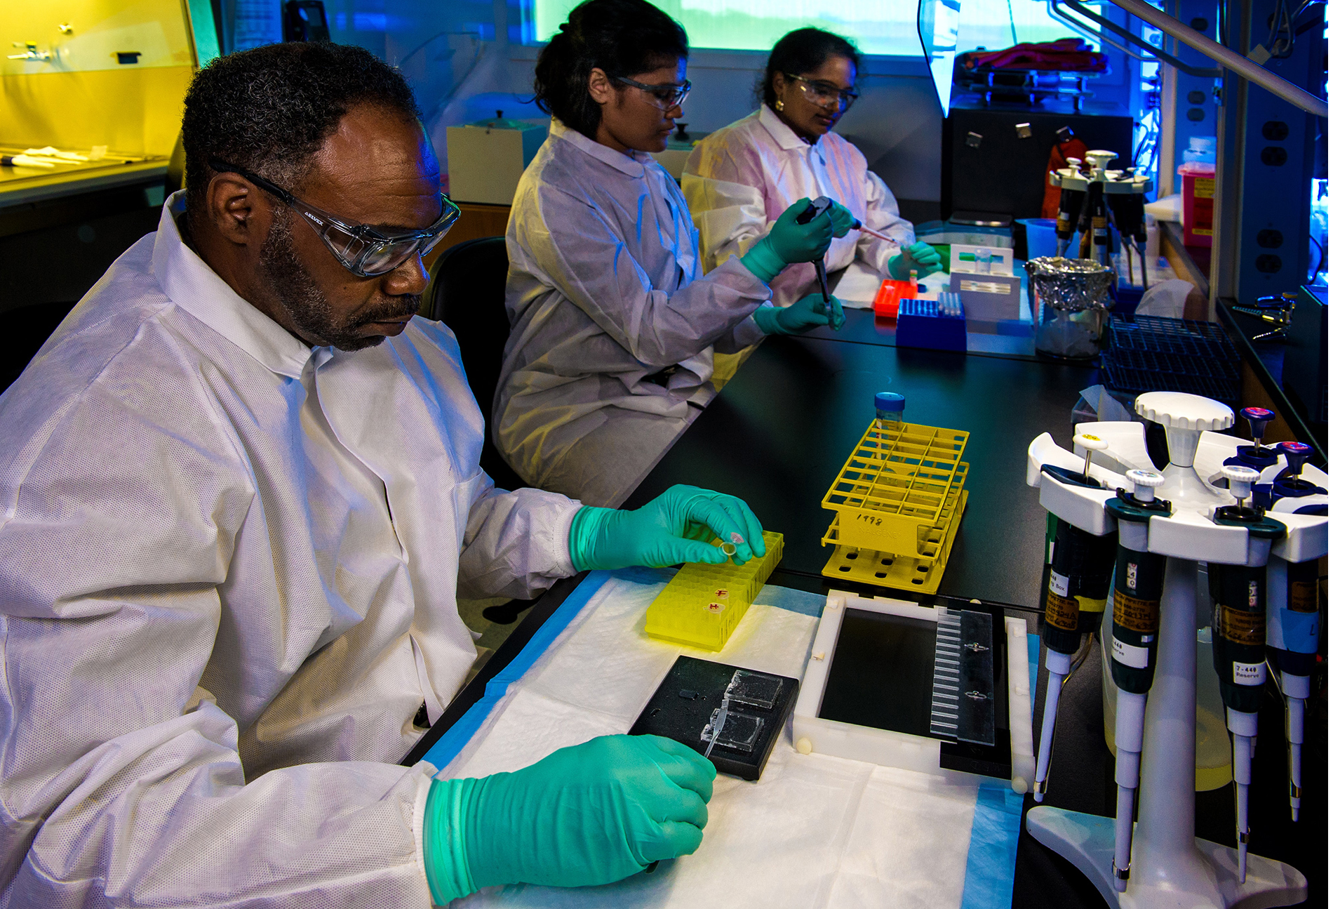
Applications of Genomics and Proteomics
DNA sequencing and whole-genome sequencing projects have expanded the applicability of DNA sequence information.
Metagenomics, pharmacogenomics, and mitochondrial genomics all use genomics.
17.3 Figure 1: Public health scientists prepare bacteria samples for analysis using gel electrophoresis.
CDC on Unsplash. "Prepping bacteria samples."

Slide 4
Predicting Disease Risk at the Individual Level
Screening healthy individuals by genome analysis to assess individual disease risk.
Healthcare professionals can then recommend interventions before the onset of disease.
This screening is most applicable when there is a single gene defect (5% of diseases).
Most common diseases are polygenic (multifactorial).

Slide 5
Think It Through₁
In 2011, the United States Preventative Services Task Force recommended against using the PSA test to screen healthy men for prostate cancer (Figure 2). Their recommendation is based on evidence that screening does not reduce the risk of death from prostate cancer. Prostate cancer often develops very slowly and does not cause problems, while the cancer treatment can have severe side effects. The PCA3 test is more accurate, but screening may still result in men suffering side effects from treatment who would not have been harmed by the cancer itself.
Notes:
Originally an On Your Own. This is included here to use as a talking point or for a think-pair-share activity.

Slide 6
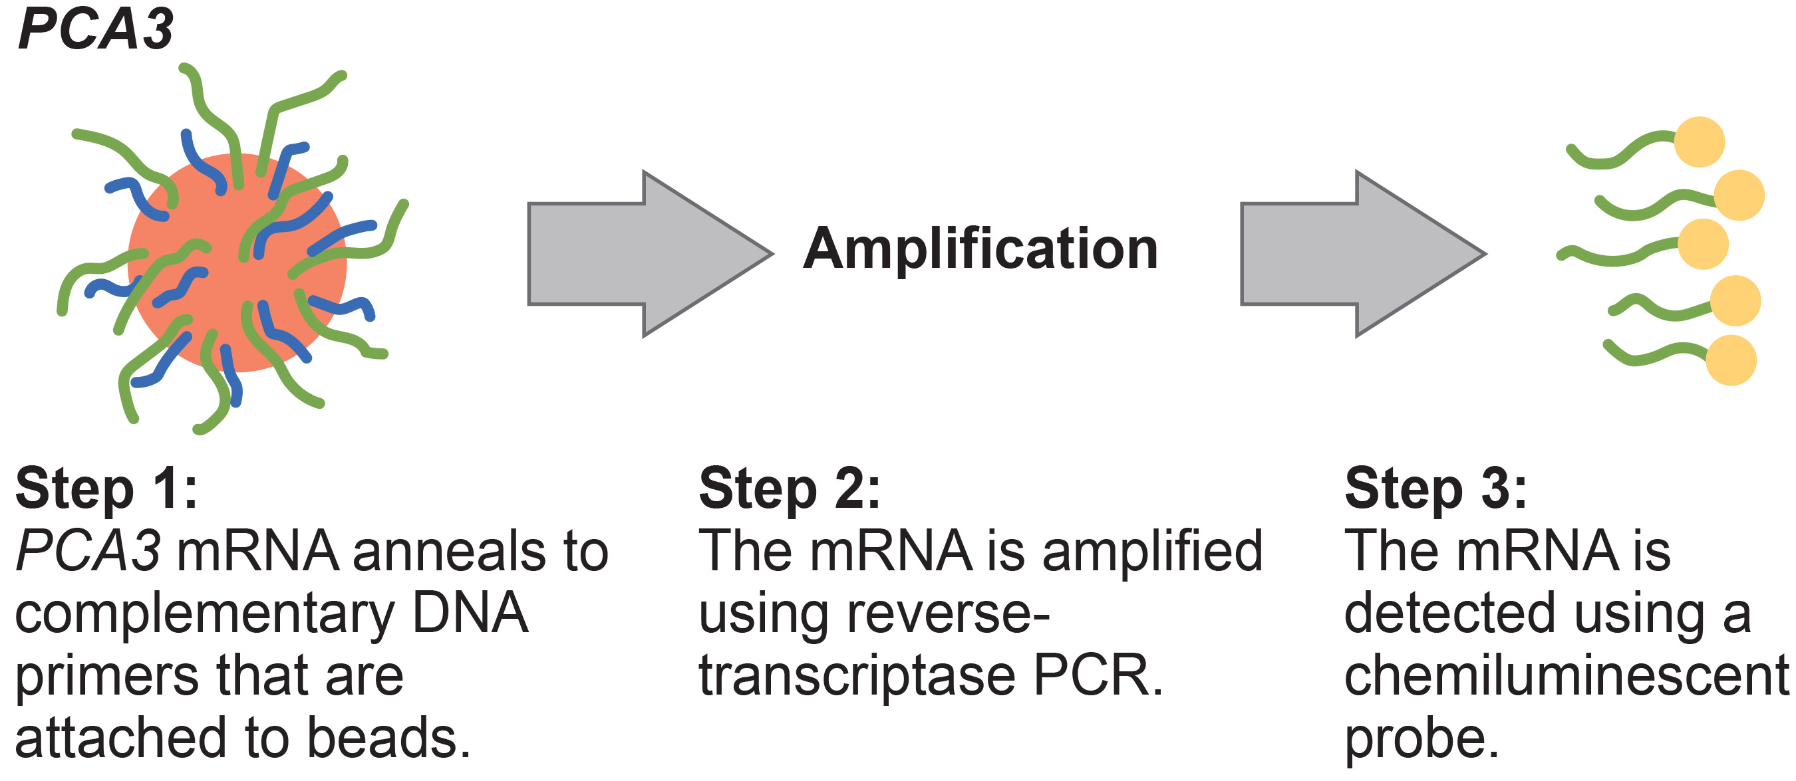
Think It Through₁ (Continued)
What do you think? Should all healthy men receive prostate cancer screenings using the PCA3 or PSA tests? Should people in general receive screenings to find out if they have a genetic risk for cancer or other diseases?
17.3 Figure 2
CNX OpenStax on Wikimedia Commons. "PCA3." Modified.
Notes:
Originally an On Your Own. This is included here to use as a talking point or for a think-pair-share activity.

Slide 7
Pharmacogenomics and Toxicogenomics
Pharmacogenomics, or toxicogenomics, evaluates drug effectiveness based on individual's genome sequence.
Analyzes gene expression changes for indicators of potential toxic effects
Has personalized medicine and drug development applications, such as prescribing the optimal medications based on patient's genotype.

Slide 8
Think It Through₂
What is one promising application of pharmacogenomics in the field of medical science?
Notes:
Originally an On Your Own. This is included here to use as a talking point or for a think-pair-share activity.

Slide 9
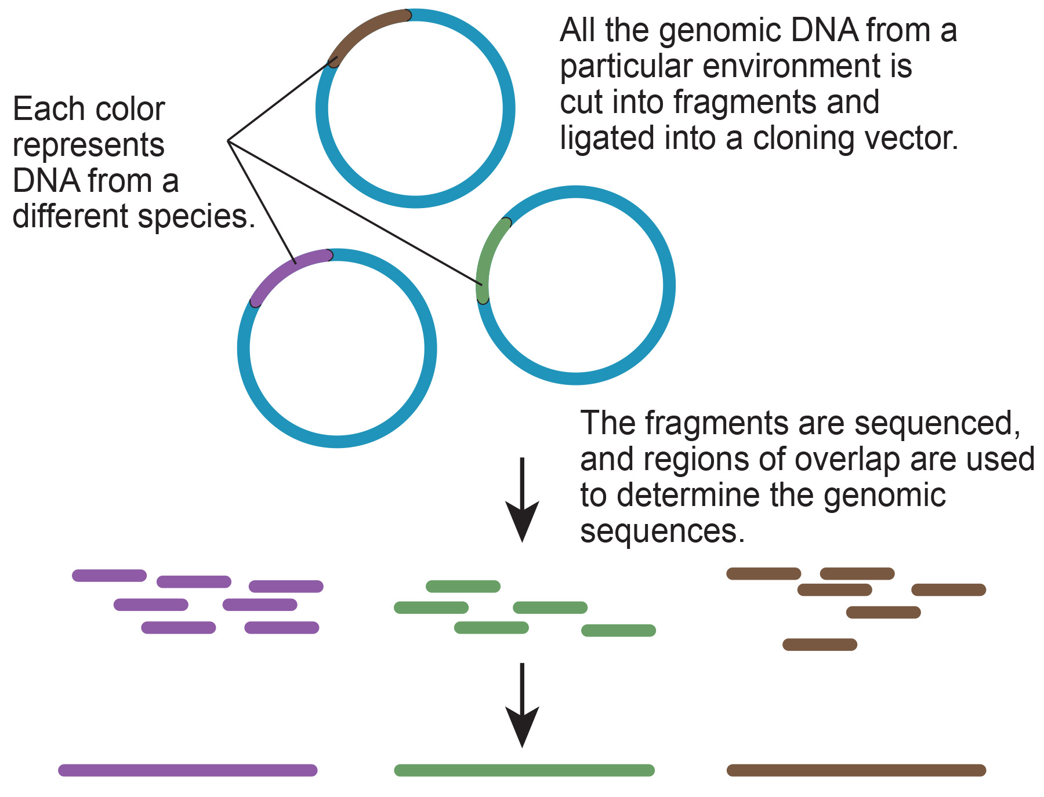
Microbial Genomics: Metagenomics
Microbiology studies involve pure cultures and metagenomics approaches.
Pure cultures isolate single cell types but may not reflect natural conditions.
Metagenomics examines the collective genomes of interacting species in their environments.
17.3 Figure 3
CNX OpenStax on Wikimedia Commons. "Isolating DNA."

Slide 10
Microbial Genomics: Creation of New Biofuels
Genomics knowledge is being used for biofuel production from algae and cyanobacteria.
Microorganisms are used to create products, such as enzymes that are used in research, antibiotics, and other antimicrobial mechanisms.

Slide 11
Science and You
Oil-Chomping Microbes for Environmental Cleanup
In 2010 Deepwater Horizon, an oil rig, exploded spilling over 200 million gallons of crude oil in the Gulf of Mexico.
Alcanivorax borkumensis bacteria was used to cleanup the spill.
Bacteria can digest hydrocarbons like alkanes present in crude oil.
Notes:
This is included as a relevant application for this topic.

Slide 12

Mitochondrial Genomics
Mitochondrial DNA mutates at a rapid rate and scientists often use it to study evolutionary relationships.
DNA evidence can also be used in forensic analysis in criminal investigations.
The first publicized use was to identify the anthrax strain used in 2001 U.S. Postal Service attacks.
17.3 Figure 4: In most organisms, mitochondrial DNA passes directly from mother to child, making mitochondrial genomics a powerful tool for genealogical tracing.
ScottishPerson on Pixabay. "Family photos."

Slide 13

Genomics in Agriculture
Genomics allows the linking of traits to genes for selective crop breeding for desirable qualities.
17.3 Figure 5
Tymur Khakimov on Pexels. "Wheat."

Slide 14
Genomics and Proteomics
Proteins are functional molecules performing enzymatic, regulatory, transport, and defensive roles.
Some are hormones and antibodies.
Proteomics studies proteomes — the entire set of proteins produced by a cell.
Allows for investigation of what proteins genes produce, including alternative splicing, and protein-protein interactions.
Metabolomics examines metabolomes — the entire set of metabolites produced by a cell.
Allows the comparison of genetic makeup with physical characteristics and environmental factors

Slide 15
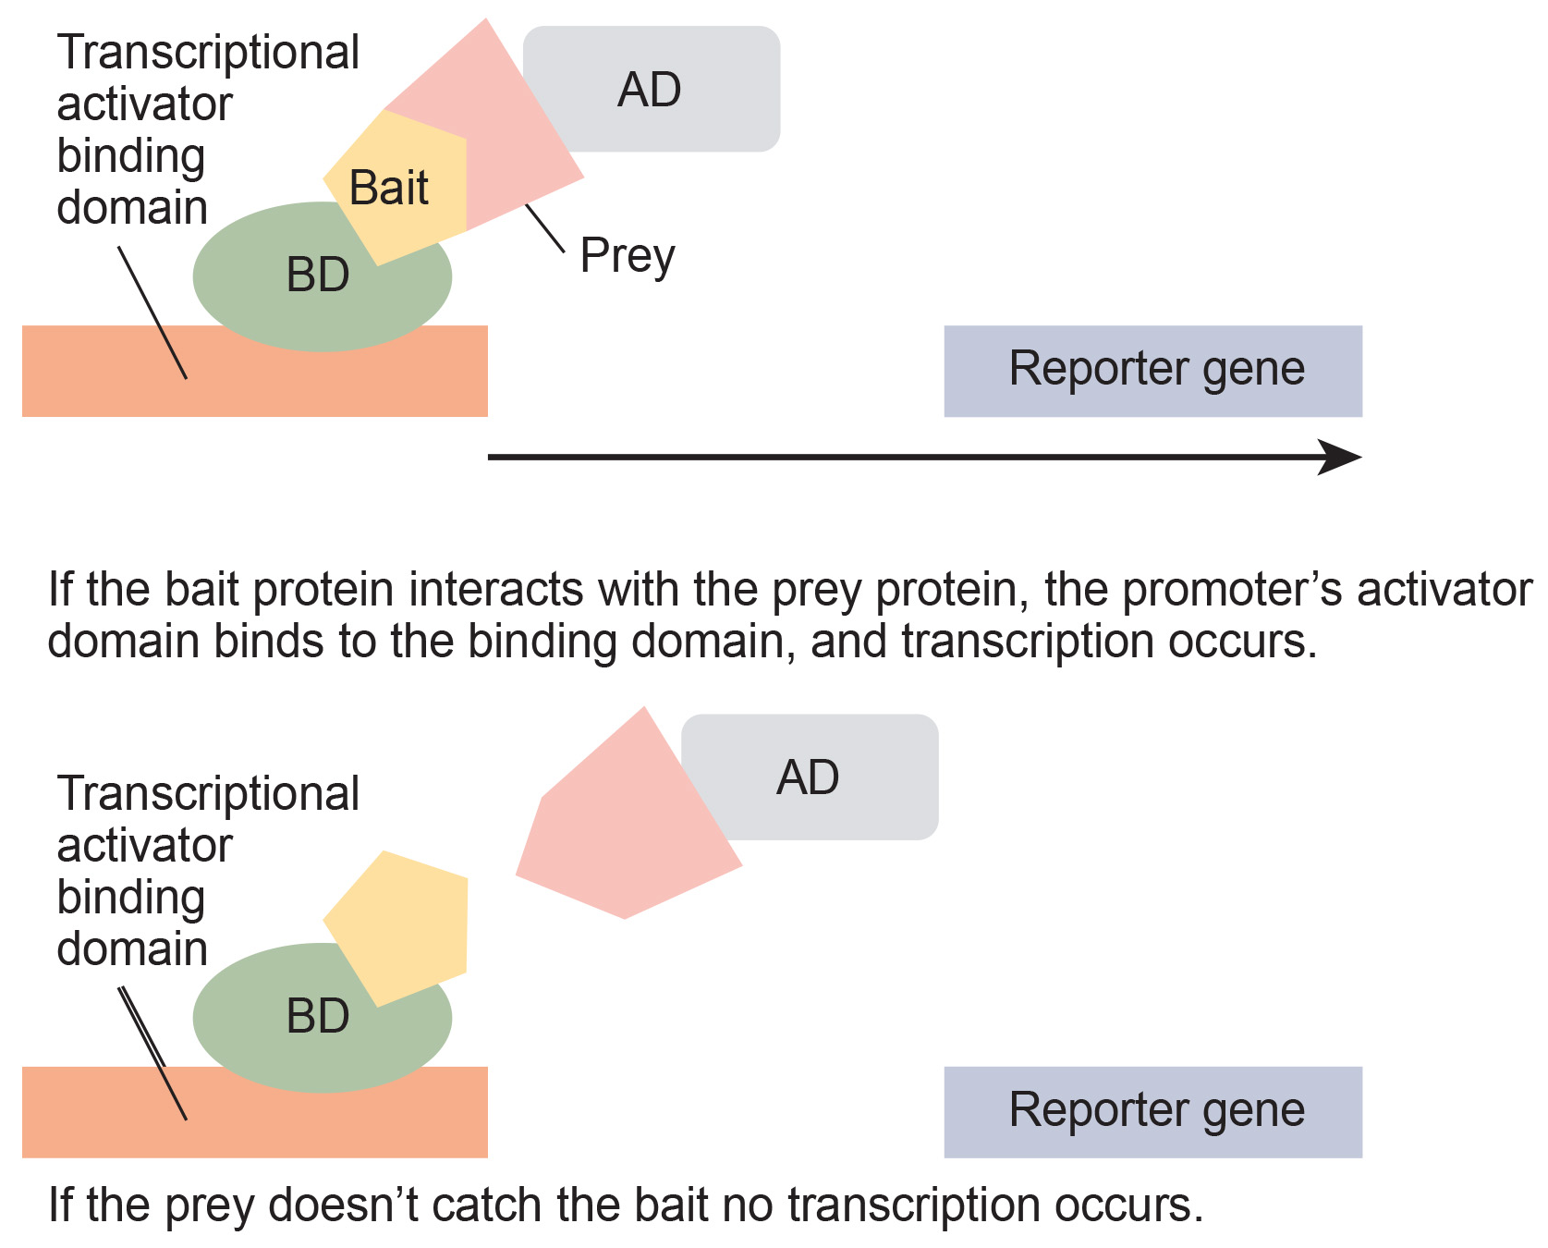
Basic Techniques in Protein Analysis
Mass spectrometry is a basic technique that identifies and determines a molecule’s characteristics.
X-ray crystallography and nuclear magnetic resonance (NMR) both determine 3-D structures.
Systems biology studies genome and proteome interactions.
Proteomics aids drug discovery by identifying disease-related proteins.
17.3 Figure 6: Scientists use two-hybrid screening to determine whether two proteins interact.
CNX OpenStax on Wikimedia Commons. "Binding and activator domain."

Slide 16
Reflection Question
Imagine you have an identical twin. You and your twin participate in a proteomic comparison study. Based on what you have learned about the relationship between genes and proteins, do you expect your twin to have a proteome profile identical to your own? Why or why not?
Notes:
The reflection question is included here to use as a talking point or for a think-pair-share activity.

Slide 17
Cancer Proteomics₁
Biomarkers (individual proteins) and protein signatures (sets of proteins with altered expression levels) are used for disease detection, particularly in body fluids for non-invasive screening.
Current challenges include high false-negative rates in cancer detection using biomarkers, making them somewhat unreliable compared to protein signatures.
Examples include CA-125 for ovarian cancer and PSA for prostate cancer.

Slide 18
Cancer Proteomics₂
Proteomics is being applied to develop individualized treatment plans, predict drug responses and side effects, and assess the likelihood of disease recurrence.
The National Cancer Institute has initiated programs like the Clinical Proteomic Technologies for Cancer and the Biomedical Proteomics Program to improve:
Cancer detection
Treatment through protein signature identification

Slide 19
Summary
Genomics applications span diverse fields like personalized medicine, drug development, and environmental studies.
Used for disease risk prediction, genealogy tracing, forensics, and agricultural improvements.
Proteomics studies the entire sets of proteins expressed by cells under specific conditions.
Proteomics aids in cancer research, biomarker detection, and personalized cancer treatment plans.

Slide 20


End of Hawkes Learning PowerPoint

