Slide 1
Lesson 18.1
Understanding Evolution

Slide 2
Objectives
Define adaptation.
Describe homologous and vestigial structures.
Describe how scientists developed the present-day theory of evolution.
Discuss misconceptions about the theory of evolution.
Explain convergent and divergent evolution.
Understand processes and patterns of evolution.

Slide 3
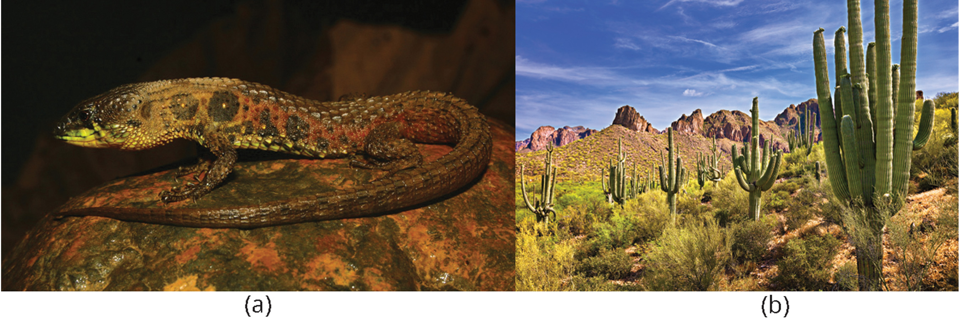
Evolution and the Origin of the Species
All life continuously evolves from other species; the theory of evolution unifies and guides biology.
18.1 Figure 1: All organisms are products of evolution adapted to their environment. (a) Andean semiaquatic lizard (Potamites montanicola) and (b) Saguaro (Carnegiea gigantea)
Chávez G, Vásquez D on Wikimedia Commons. "Potamites montanicola."

Slide 4
Understanding Evolution
Evolution theory describes species change over time, credited to Charles Darwin.
Georges-Louis Leclerc Comte de Buffon proposing that organisms in different geographic regions underwent distinct changes over time (Buffon's Law).
James Hutton's theory of uniformitarianism, influenced evolutionary thought by suggesting Earth's features formed gradually over long periods.
Charles Lyell's Principles of Geology formalized uniformitarianism and provided evidence for an older Earth, concepts that influenced Darwin.
Jean-Baptiste Lamarck proposed a mechanism for evolutionary change called inheritance of acquired characteristics, which was later discredited.

Slide 5
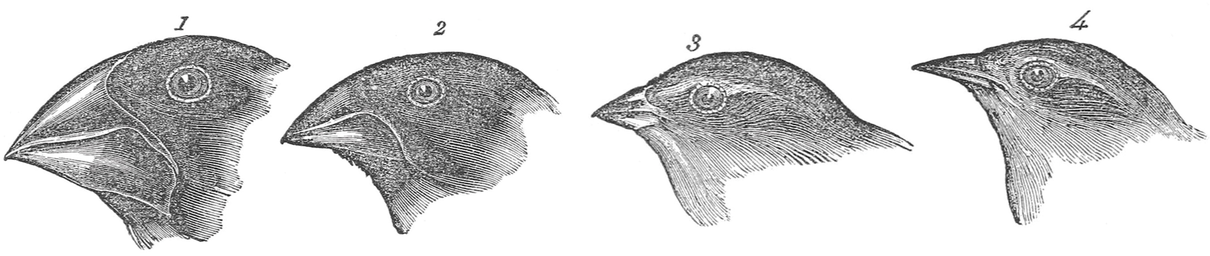
Charles Darwin and Natural Selection₁
Charles Darwin's voyage on HMS Beagle (1831–1836) and Alfred Russel Wallace's travels to Brazil and the Malay Archipelago were crucial to their observations and theories of evolution.
Darwin observed variations in species across different islands, notably in finches' beak shapes, which were adapted to different food sources.
Natural selection is the mechanism of evolution that favors the survival of the fittest, which influences reproduction and the frequency of these traits in the population, driving evolution.
18.1 Figure 2
Wellcome Images on Wikimedia Commons. "Finches."

Slide 6
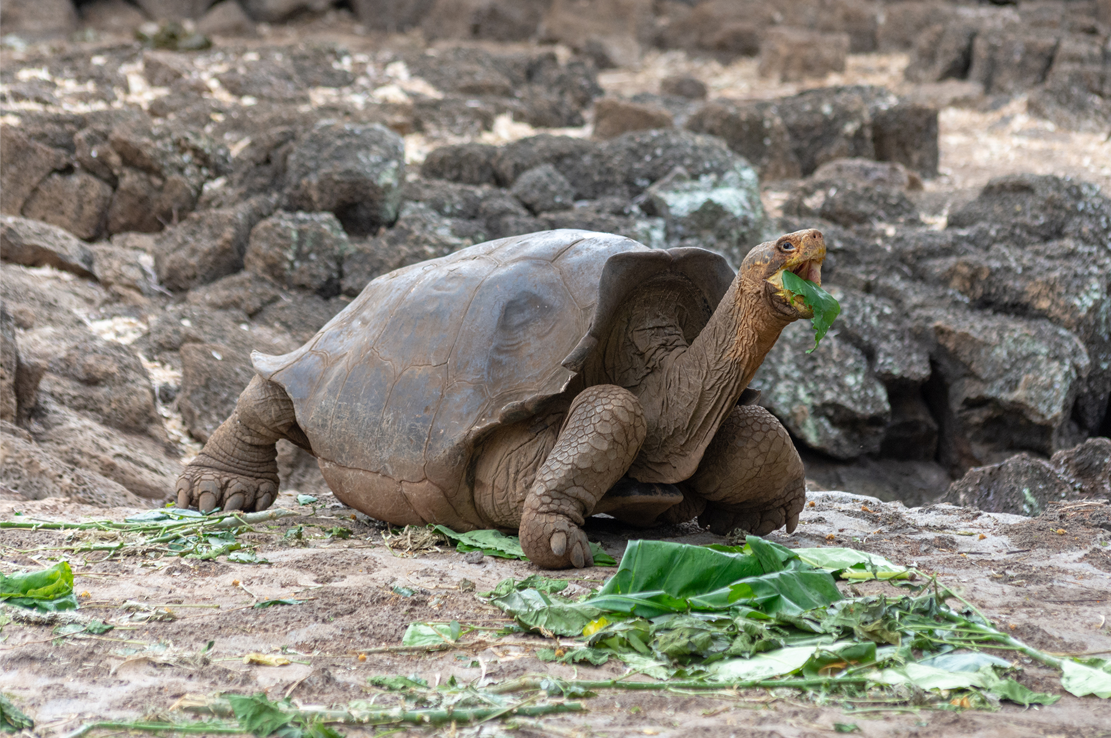
Charles Darwin and Natural Selection₂
Natural selection key principles:
Overproduction of organisms causing intraspecific competition
Variation within the species
Variation is heritable
Variation creates differences in fitness
18.1 Figure 3: Darwin suggested that these tortoises' longer necks allow them to access more leaves higher up on plants than those with short necks.
Nicolas Völcker on Wikimedia Commons. "Giant tortoise."

Slide 7
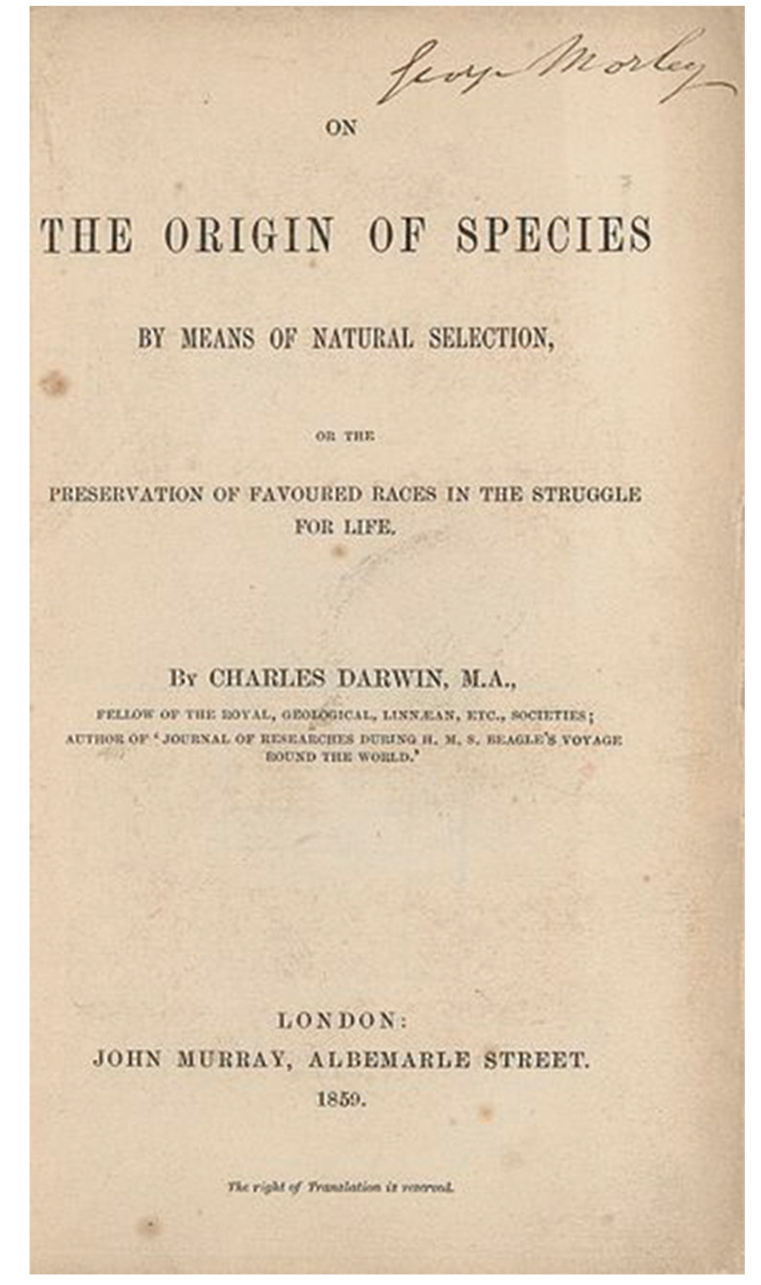
Charles Darwin and Natural Selection₃
Darwin and Wallace jointly presented their natural selection mechanism in 1858.
  Darwin's On the Origin of Species by Means of Natural Selection providing detailed arguments in 1859.
Grants' study on Galápagos finch beak sizes changing based on food availability demonstrate observable evidence of natural selection in action.
18.1 Figure 4
Wellcome Images on Wikimedia Commons. "On the Origin of Species by Charles Darwin."

Slide 8
Think It Through₁
Match the following biological example with the four principles for natural selection. Select from the following options: organisms vary, variability is heritable, variability confers fitness, and more organisms are produced than the environment can support.
Some cheetahs are very fast, while others are just not quite as quick when chasing antelope.
Bill thickness of young birds is strongly tied to the thickness of parental bills.
Bumblebees with longer proboscises (mouthparts) can more easily feed from long-stemmed flowers.
Many mollusks produce thousands of young, greatly exceeding open areas for settlement.
Notes:
Originally an On Your Own. This is included here to use as a talking point or for a think-pair-share activity.

Slide 9
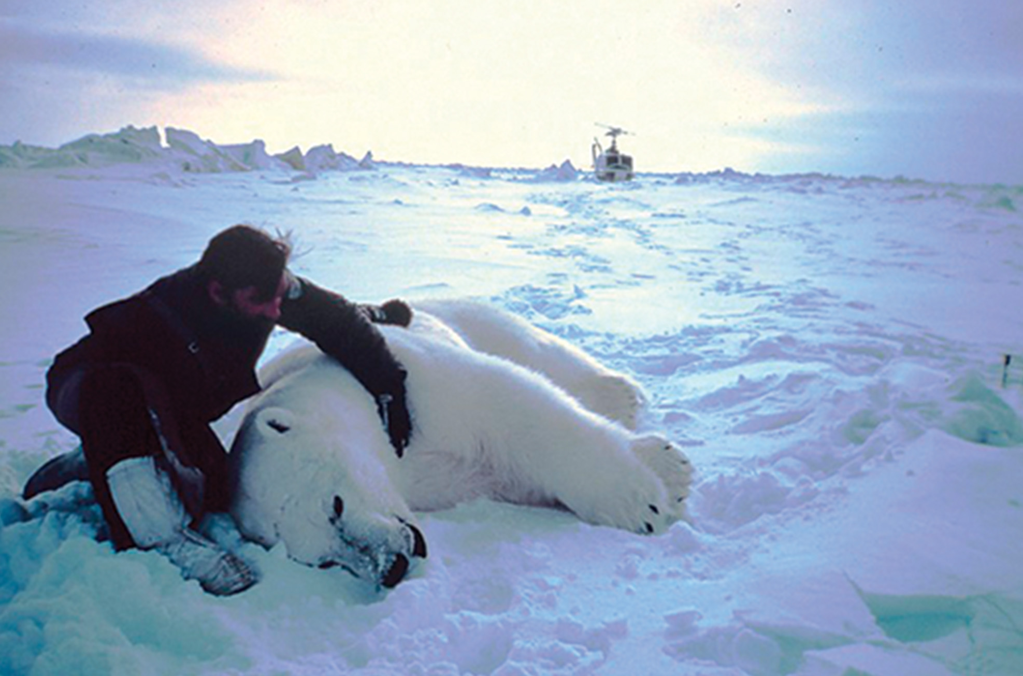
Science and You
Career: Field Biologist
Field biologists research specific species and habitats in the wild.
They aim to discover new species for ecological understanding.
New species can drive medical or agricultural innovations.
Studies reveal an organism's ecosystem roles and conservation needs.
18.1 Figure 5: A field biologist tranquilizes a polar bear for study.
NOAA Photo Library on Wikimedia Commons. "Sedated polar bear."
Notes:
This is included as a relevant application for this topic.

Slide 10
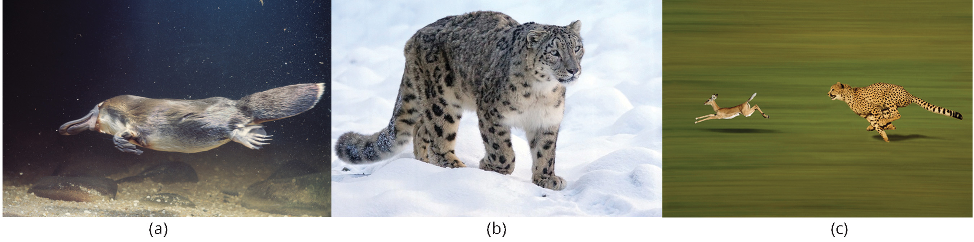
Processes and Patterns of Evolution₁
Natural selection requires variation: heritable variation or genetic diversity.
Genetic diversity comes from mutations, which causes DNA changes, and sexual reproduction, which produces a unique combination of alleles.
  Mutations may increase fitness by providing advantageous traits that help an individual adapt to their environment.
    Adaptations are heritable traits that improve an organism's survival and reproduction.
18.1 Figure 6: Organisms have adaptations. (a) The webbed feet of the platypus allow it to swim. (b) The thick fur of the snow leopard allows it to stay warm. (c) The cheetah can run very fast to catch its prey.
Pixel-mixer on Pixabay. "Snow leopard."

Slide 11

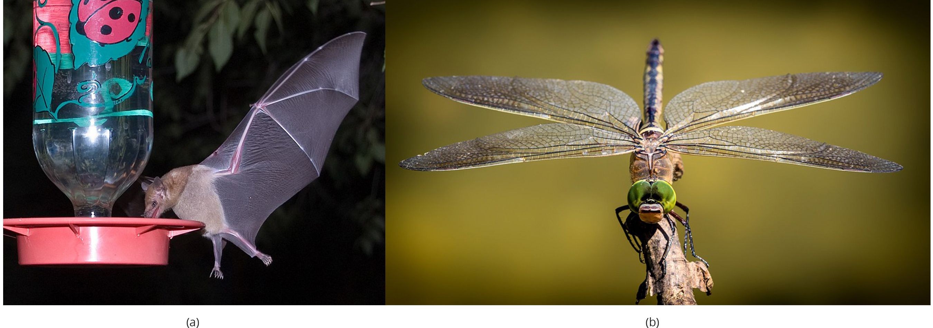
Processes and Patterns of Evolution₂
Natural selection favors traits based on current environmental conditions, which can change over time.
  Leaf size in plants illustrates how a trait can be beneficial in one environment (large leaves in rainy conditions) but costly in another (large leaves in dry conditions).
Divergent evolution: the evolution of two species in diverse directions from a common ancestor
Convergent evolution: similar traits evolve independently in species that do not share a recent common ancestor
18.1 Figure 7: These two flowers are an example of divergent evolution.
Drew Avery on Wikimedia Commons. "Dense Blazing Star." PumpkinSky on Wikimedia Commons. "Purple coneflower."
18.1 Figure 8: While (a) bats and (b) insects both have wings; they arose from convergent evolution.
Ken Bosma on Flickr. "Long-tongued bat." liggraphy on Pixabay. "Dragonfly."

Slide 12
Think It Through₂
For each of the following scenarios, indicate whether it is an example of convergent evolution or divergent evolution.
Sharks and dolphins both look similar but are evolutionarily unrelated.
Reptiles and birds both have four limbs. However, two of the limbs in birds are wings, while all four limbs in reptiles are used for walking.
The African continent is known for the great diversity in antelopes, with various antelope species differing in size and shape.
Hummingbird hawk moths (insects) and hummingbirds (birds) both have wings that allow them to hover over flowers to collect nectar.
Mammals and insects both have eyes for vision, but these eyes are structurally distinct.
Notes:
Originally an On Your Own. This is included here to use as a talking point or for a think-pair-share activity.

Slide 13
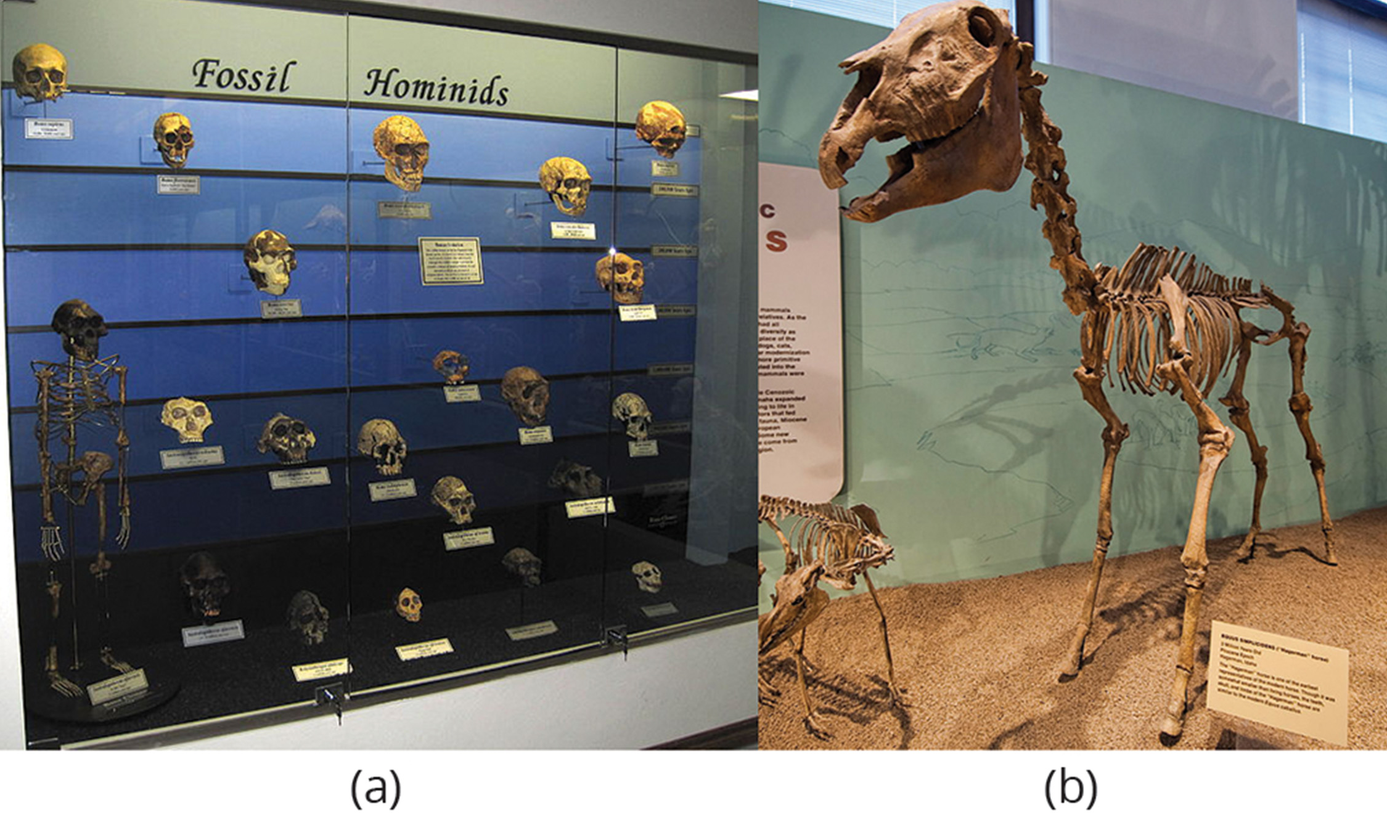
Evidence of Evolution: Fossils
There is compelling evidence of evolution at all levels of life.
Fossils show gradual organismal changes over time that are globally dated and categorized.
Whale flippers evolved from terrestrial mammal limbs, indicating a land-to-water transition.
18.1 Figure 9: (a) As hominids evolved, the skull's shape changed. (b) An extinct species of the genus Equus reveals that this ancient species (Equus simplicidens, the Hagerman horse) resembled the modern horse (Equus ferus) but varied in size.
Sklmsta on Wikimedia Commons. "Fossil hominid skull display." Brett Neilson on Wikimedia Commons. "Hagerman horse."

Slide 14
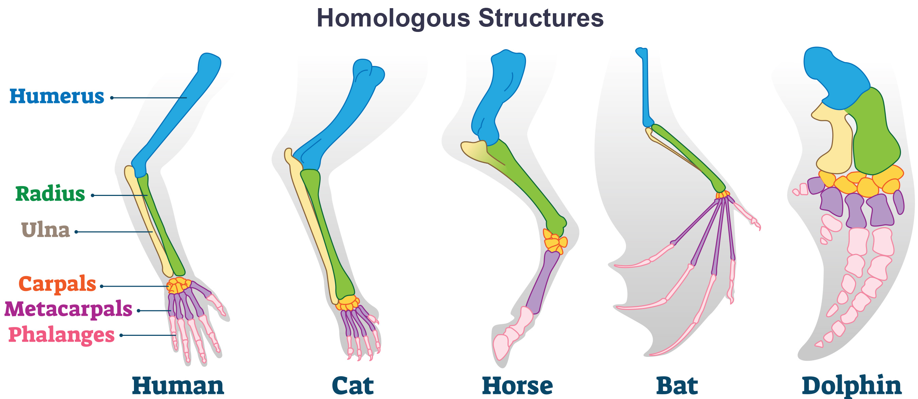
Anatomy and Embryology₁
Homologous structures are similar structures across species that indicate a shared ancestry.
Vestigial structures have no apparent function but are residual parts from a past common ancestor.
Analogous structures arise independently despite similarities, unlike homologous structures the underlying structure and developmental origin are separate.
18.1 Figure 10

Slide 15
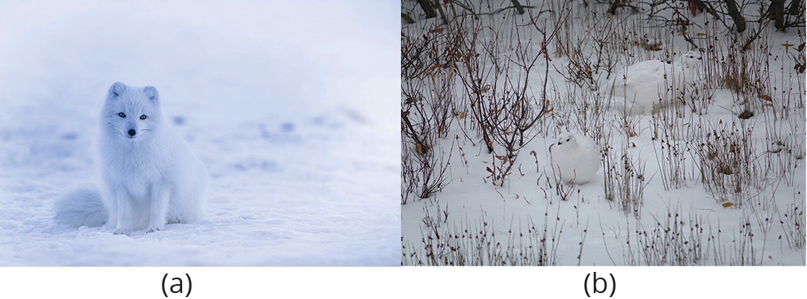
Anatomy and Embryology₂
Embryology, they study of anatomy of an organism's development, provides evidence of evolutionary relationships between diverse organisms by revealing conserved developmental processes and structures.
Many organisms exhibit ancestral features during embryonic development that may disappear in adult forms, such as gill slits and tails in vertebrate embryos.
Human and great ape embryos share developmental features like a tail structure, which is lost before birth, illustrating our evolutionary connection to other primates.
18.1 Figure 11: The white winter coat of the (a) arctic fox and the (b) ptarmigan's plumage are adaptations to their environments.
David Mark on Wikimedia Commons. "Arctic fox." mtanenbaum on Pixabay. "Ptarmigan."

Slide 16
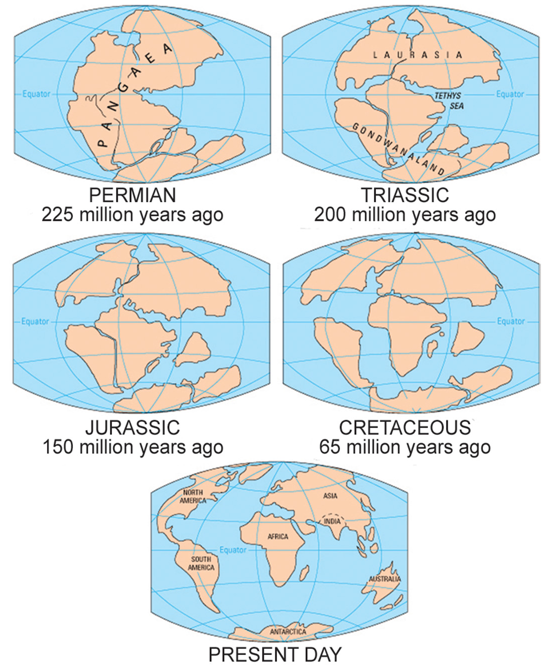
Biogeography₁
Biogeography is the study of the geographic distribution of organisms on the plant.
Distribution is best explained by evolution in conjunction with tectonic plate movement over time.
The Pangaea supercontinent split into Laurasia and Gondwana around 200 million years ago.
Organisms that evolved before the split are found world-wide while those that evolved after the split are in specific regions.
18.1 Figure 12
Exploratorium. "Pangaea."

Slide 17
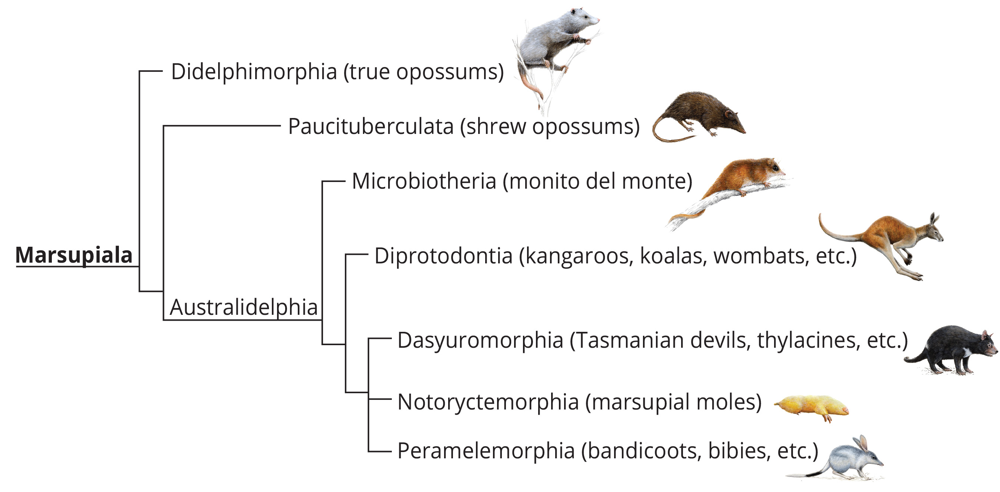
Biogeography₂
Australia's has a large endemic species (species found no where else), including marsupial diversity.
Isolated species diverge over time into unique forms.
18.1 Figure 13: Australia is known for having a wide variety of marsupials.
Various sources on Wikimedia Commons. "Marsupial phylogeny."

Slide 18
Molecular Biology
The universality of DNA as genetic material across all life forms suggests a common ancestor for all living organisms.
Major divisions in life processes (DNA replication and gene expression) correspond to structural differences in otherwise conserved molecules (ribosomes and membranes).
Similarities in DNA sequences within groups correlate to their evolutionary relatedness from a shared ancestor.
Gene duplication events play a crucial role in evolution by providing opportunities for new protein functions to develop through mutations.
Molecular structures, like anatomical structures, provide evidence for descent with modification, offering insights into evolutionary relationships and mechanisms.

Slide 19
Misconceptions of Evolution
Darwin's theory of evolution faced controversy initially but gained near-universal acceptance among biologists within 20 years of the publication of On the Origin of Species.
Evolution is a theory: a body of thoroughly tested and verified explanations for a set of observations of the natural world, not a hypothesis.

Slide 20
Individuals Evolve
Evolution is the change in a population's genetic composition over generations, resulting from differential reproduction of individuals with favorable traits.
Individual changes during a lifetime are developmental processes, not evolution, and are based on an individual's genes and environmental factors.
Evolution is best understood as changes in the average value of a characteristic in a population over time, rather than changes in individuals themselves.

Slide 21
Think It Through₃
Is an individual able to evolve?
Notes:
Originally an On Your Own. This is included here to use as a talking point or for a think-pair-share activity.

Slide 22
Group Activity
As a group, brainstorm evidence that supports the theory of evolution.
What scientific evidence have you learned about in this lesson that supports this theory?
What other scientific evidence can you think of that also supports this theory?
When we use the term theory, does that mean doubt to its validity still exists? Discuss as a group why you think so.
What place does nonscientific evidence hold in supporting or refuting the theory of evolution?

Slide 23
Evolution Explains the Origin of Life
Evolution theory explains how populations change over time and diversify, but it does not address the origin of life or the formation of the first cells.
The presence of life on Earth makes it unlikely for the original life-forming processes to repeat, as intermediate stages would be consumed by existing organisms.
Once a mechanism for inheritance like DNA emerged, those early replicating entities would be subject to natural selection.

Slide 24
Organisms Evolve on Purpose
Evolution occurs at the population level, not in individual organisms, and is not an intentional response to environmental changes.
Natural selection acts on existing variation within a population, not on new traits that arise in response to environmental changes.
  Selective pressures like antibiotics allow pre-existing resistant variants to increase in frequency, not create new resistant mutations.
The fitness of traits can change over time as environments change, meaning that advantageous traits in one context may become disadvantageous in another.

Slide 25
Summary
Evolution occurs through mutation (producing new traits) and differential reproduction (promoting transfer of favorable traits), leading to better-adapted organisms over time.
Genetic variation allows differential survival and reproductive success based on traits beneficial to the environment.
Environmental changes can alter the desirability of traits, driving further evolution.
Evolution can converge with similar traits arising independently or diverge with diverse traits stemming from a common ancestor.
Evidence for evolution comes from DNA analysis, fossil records, and the presence of homologous and vestigial structures.

Slide 26


End of Hawkes Learning PowerPoint

