Slide 1
Lesson 18.2
Speciation: The Evolution of New Species

Slide 2
Objectives
Define species and describe how scientists identify species as different.
Describe genetic variables that lead to speciation.
Identify prezygotic and postzygotic reproductive barriers.
Explain allopatric and sympatric speciation.
Describe adaptive radiation.

Slide 3
Speciation: The Evolution of New Species
All life shares genetic similarities, but only certain organisms can interbreed and produce fertile offspring.
Speciation refers to the evolution of new species when populations become reproductively isolated and accumulate genetic divergences over time.

Slide 4
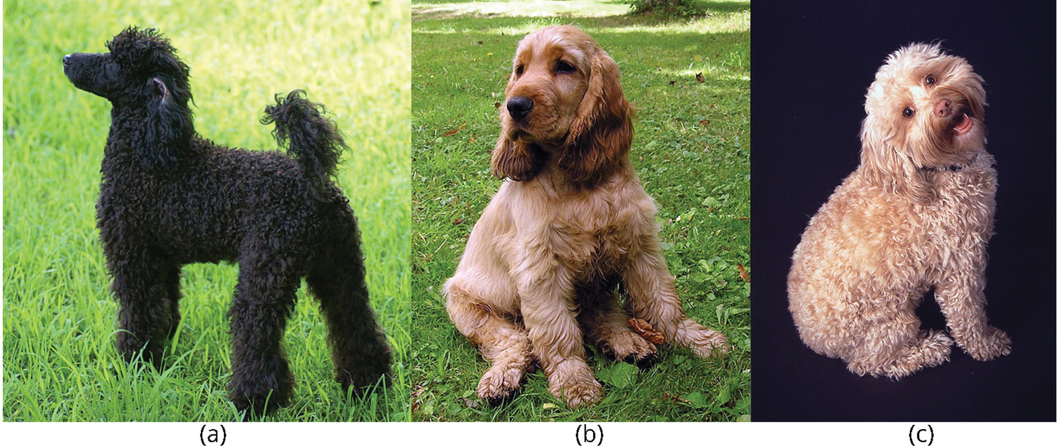
Species and the Ability to Reproduce₁
A species is a group of individual organisms that interbreed and produce offspring that are both viable (able to survive) and fertile (able to reproduce).
Members of the same species have the highest degree of DNA similarity. Looks mislead mating ability.
18.2 Figure 1: Though dogs look different, most can interbreed successfully. The (a) poodle and (b) cocker spaniel can reproduce to produce a breed known as the (c) cockapoo.
Belinda on Wikimedia Commons. "Miniature poodle."
LeCardinal on Wikimedia Commons. "Cocker spaniel puppy."
Scb0825 on Wikimedia Commons. "Cockapoo."

Slide 5
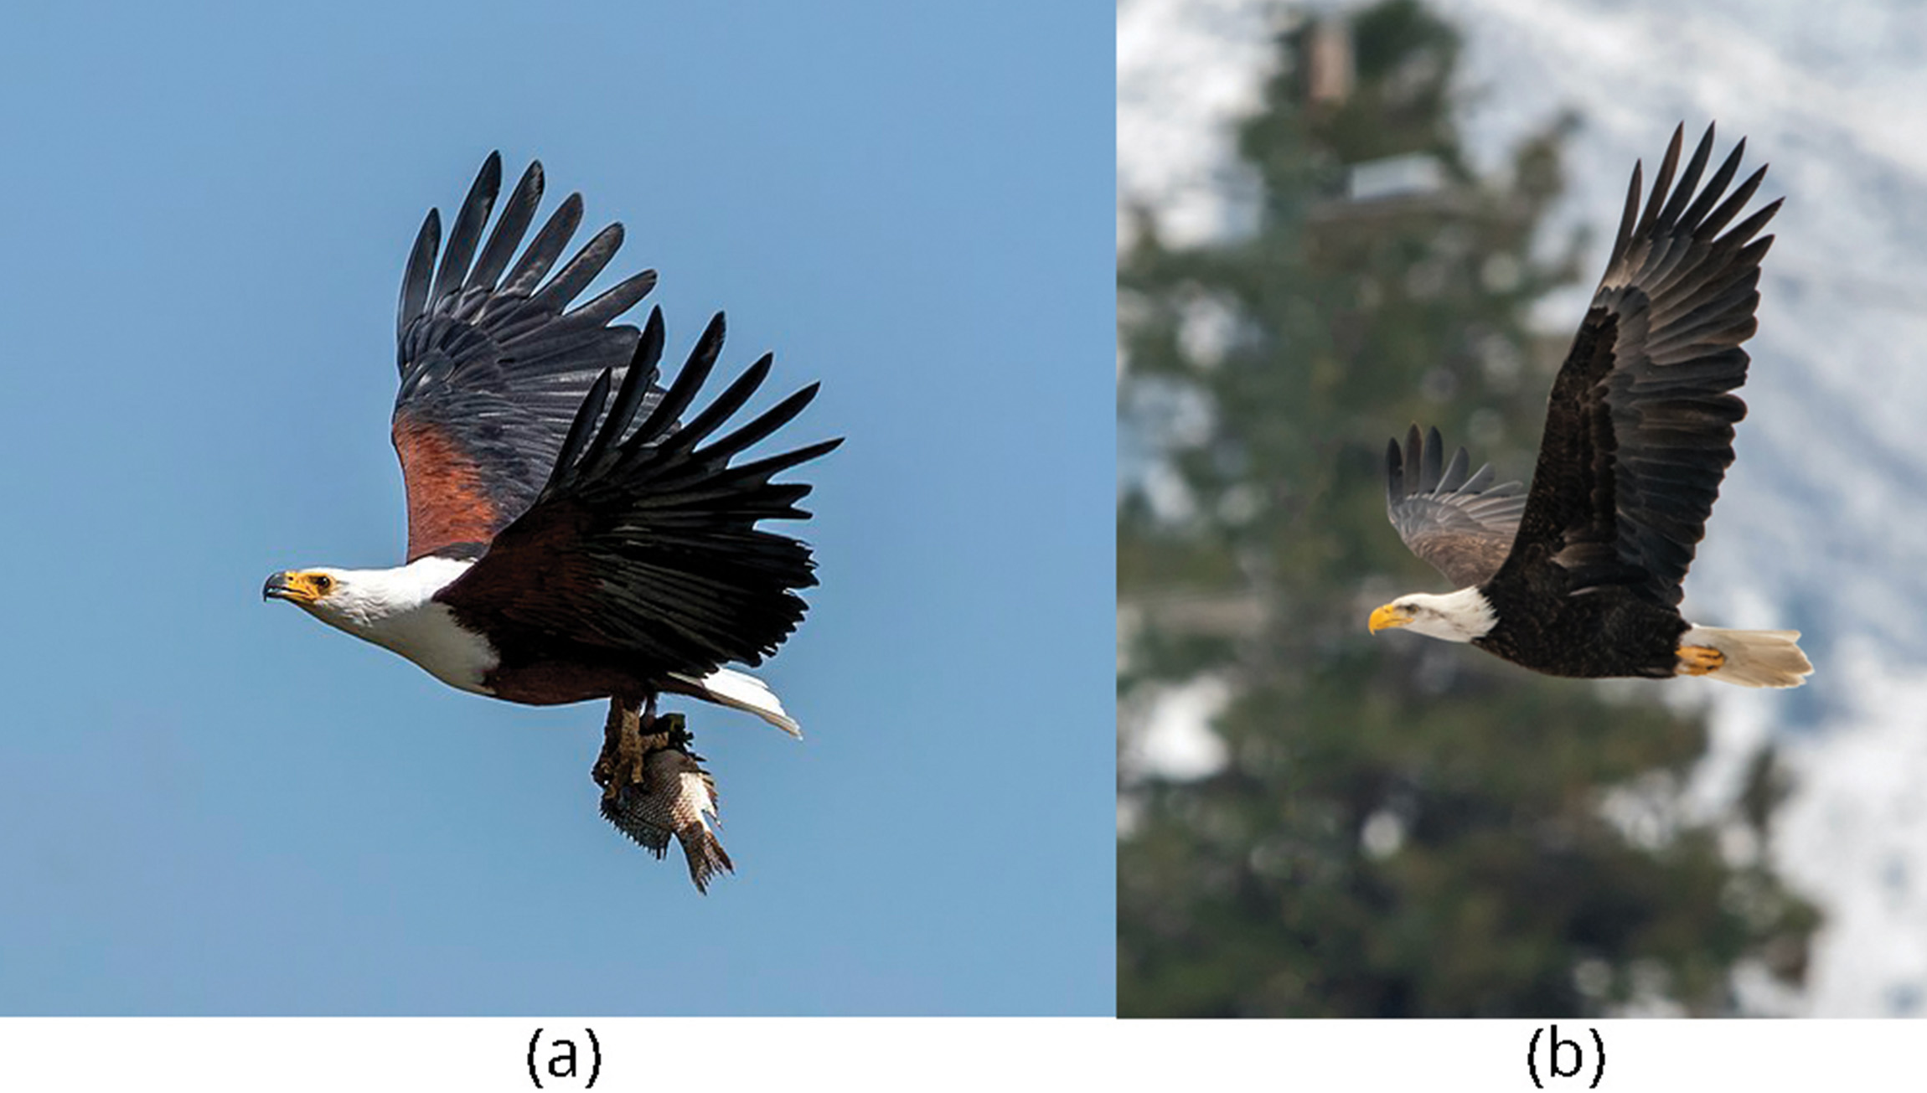
Species and the Ability to Reproduce₂
Visually similar individuals may be separate species unable to produce fertile hybrids (a cross between two species) due to incompatible developmental genes.
Species harbor distinct gene pools, a collection of all the gene variants within the species, providing the variation for inherited trait changes and evolution.
In sexual reproducers, genetic changes must arise in gametes to be heritable, unlike asexual inheritance of body cell mutations.
18.2 Figure 2: The (a) African fish eagle is similar in appearance to the (b) bald eagle, but the two birds are members of different species.
Charles J. Sharp, Sharp Photography on Wikimedia Commons. "African fish eagle."
Frank Cone on Pexels. "Bald eagle."

Slide 6
Reflection Question
How do you think the definition of a species applies to asexually reproducing organisms, including prokaryotes?
Notes:
The reflection question is included here to use as a talking point or for a think-pair-share activity.

Slide 7
Speciation
Speciation: formation of new species from an original species, splitting one population into two
Allopatric speciation: geographic separation of populations from parent species, leading to the inability to interbreed due to divergent evolution.
Sympatric speciation: speciation within a parent species within one location
It is possible for multiple new species to simultaneously split from one ancestral species, though less likely than a single split.
Hybrids between similar species suggest incomplete speciation.

Slide 8
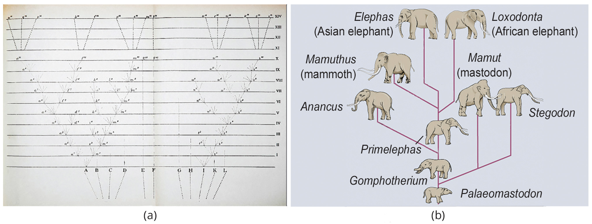
18.2 Figure 3
CNX OpenStax on Wikimedia Commons. "Biological diversity."
Notes:
The only illustration in Darwin's On the Origin of Species is a (a) diagram showing speciation events leading to biological diversity. The diagram shows similarities to phylogenetic charts that today illustrate the relationships of species. (b) Modern elephants evolved from the Palaeomastodon, a species that lived in Egypt 35–50 million years ago.

Slide 9
Group Activity
As a group, either go outside or think about a specific location outside. Make a list of as many different species of organisms that you can identify in this location.
How can you determine that the various organisms are different species?
How might scientists distinguish the various organisms as different species? Discuss your answers as a group.

Slide 10
Allopatric Speciation₁
Gene flow, the movement of alleles across a species' range, in geographically continuous populations maintains a relatively homogeneous gene pool.
Geographic separation of populations can lead to restricted gene flow, allowing independent evolution and genetic divergence.
Allopatric speciation occurs when populations become geographically isolated and evolve separately due to different environmental pressures.
Geographic isolation can happen through various means, such as the formation of new geological features or organism dispersal to new locations.
Allopatric processes are categorized into dispersal (movement of organisms to new areas) and vicariance (physical division of populations by natural barriers)

Slide 11
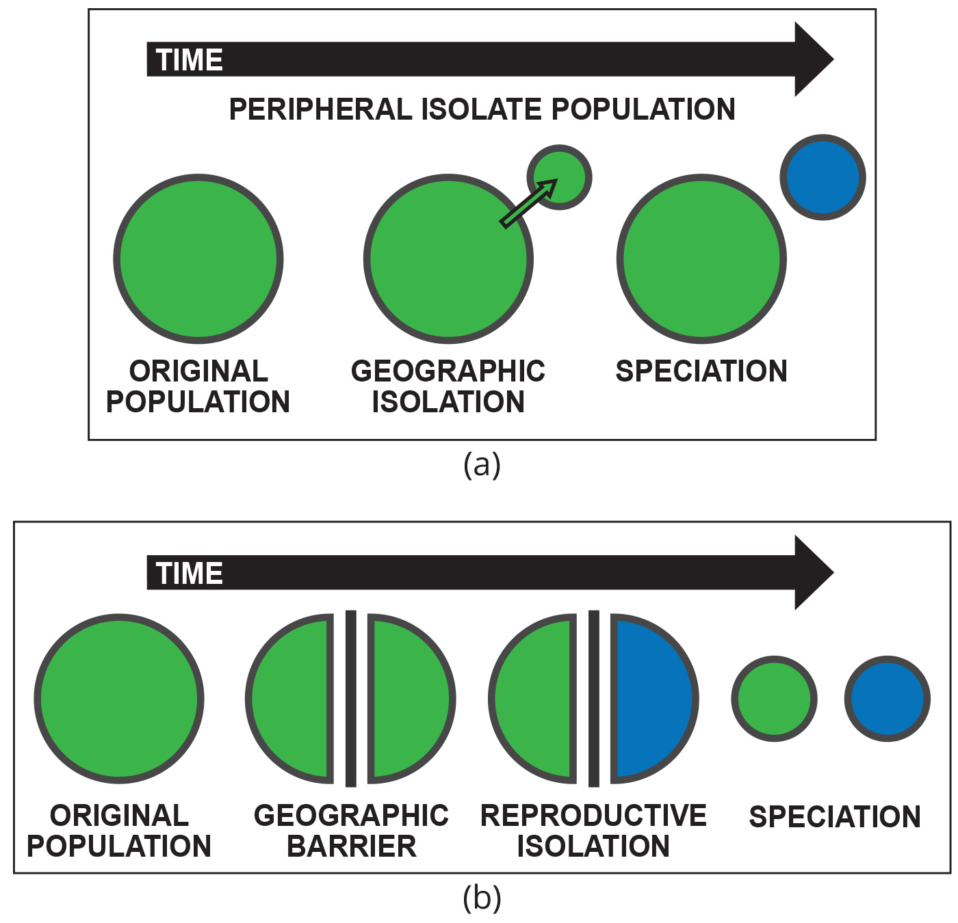
18.2 Figure 4
Andrew Z. Colvin on Wikimedia Commons. "Peripatric speciation."
Andrew Z. Colvin on Wikimedia Commons. "Allopatric speciation."
Notes:
Allopatric speciation by (a) dispersal occurs when a few members from a population of organisms move to a new area. Allopatric speciation by (b) vicariance occurs when a geographic barrier separates a population of organism. In either case, gene flow between the two subpopulations is prevented. Therefore, the allele frequencies at various loci become different over time, and natural selection favors different adaptations in each group.

Slide 12
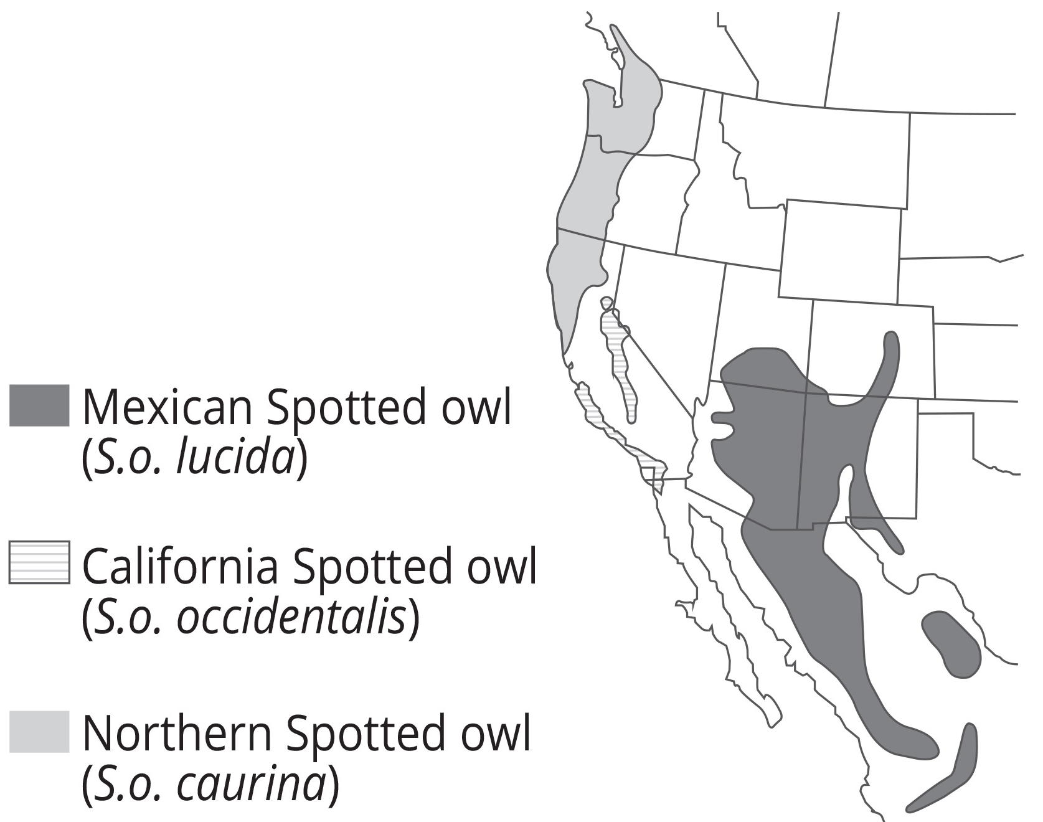
Allopatric Speciation₂
Allopatric speciation was documented in three spotted owl subspecies along U.S. west coast.
Greater geographic distance correlates with more environmental differences, exerting divergent selective pressures.
Environmental variations like climate, prey, and behaviors promote speciation by selecting for different traits in isolated populations.
18.2 Figure 5
Derek Edward Lee on Wikimedia Commons. "Range map for three subspecies of the Spotted Owl."

Slide 13
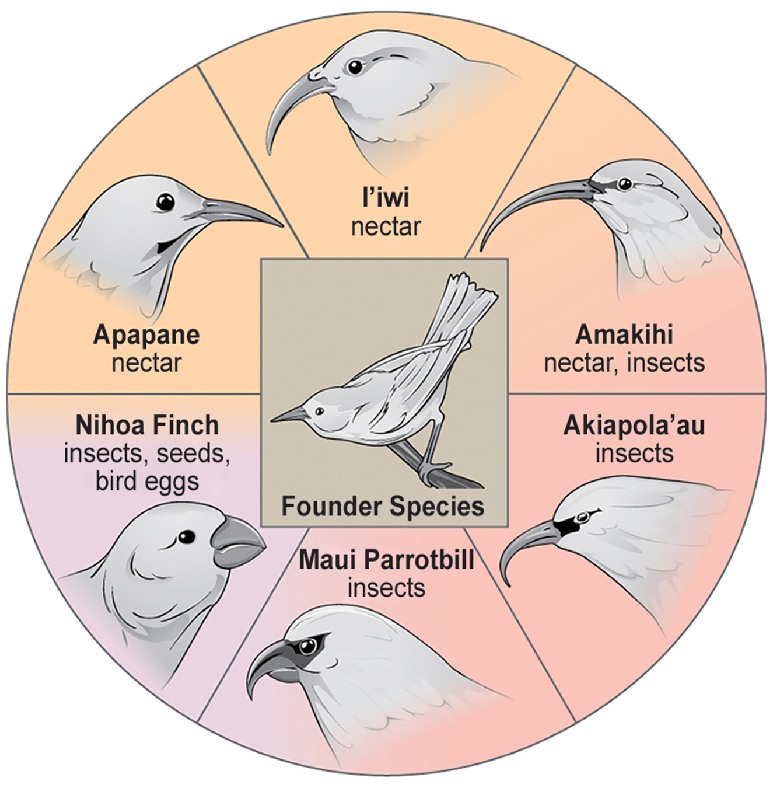
Adaptive Radiation
Adaptive radiation occurs when a single species rapidly diversifies into multiple species to exploit various available niches or habitats.
This process leads to the evolution of multiple adaptations from a single point of origin, causing the species to "radiate" into several new ones.
18.2 Figure 6: The honeycreeper birds illustrate adaptive radiation. From one original species of bird, multiple others evolved, each with its own distinctive characteristics.
CNX OpenStax on Wikimedia Commons. "Honeycreeper."

Slide 14
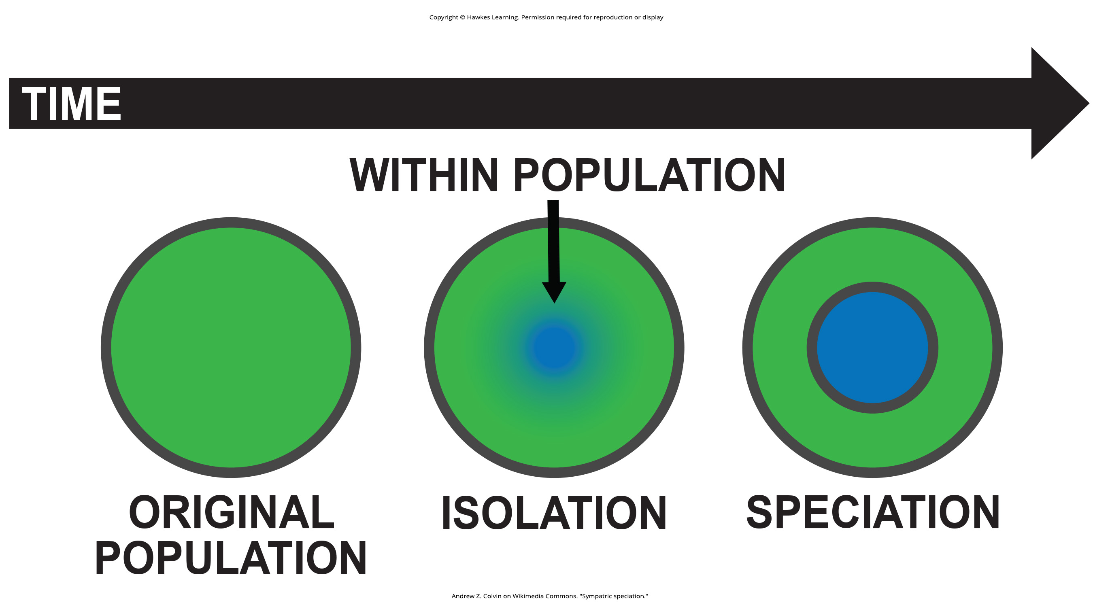
Sympatric Speciation
Sympatric speciation occurs when new species evolve within the same geographical area, without physical barriers separating populations.
Many mechanisms cause reproductive isolation.
Genetic errors during mitosis or meiosis, leading to aneuploidy (abnormal chromosome numbers).
Offspring may or may not be viable
18.2 Figure 7
Andrew Z. Colvin on Wikimedia Commons. "Sympatric speciation."

Slide 15
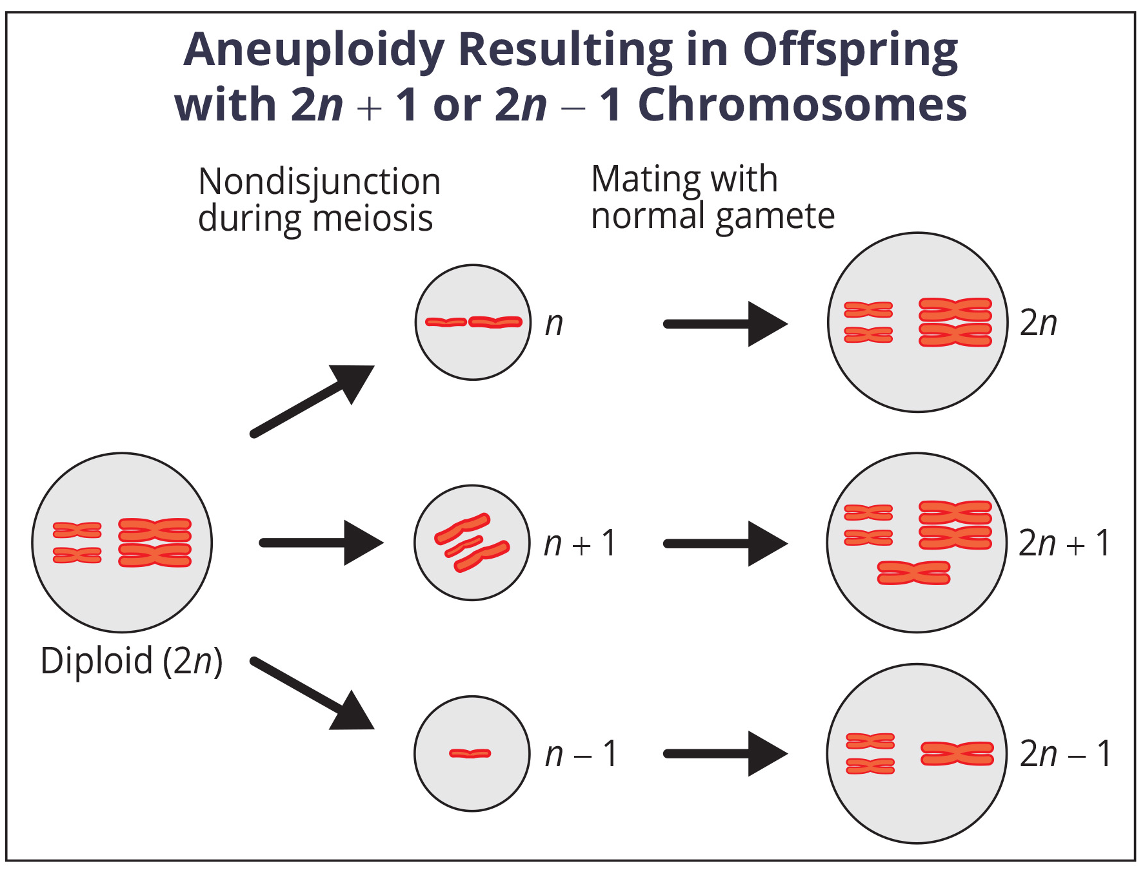
Think It Through₁
Based on the information shown in Figure 8, which is more likely to survive: offspring with 2n + 1 chromosomes or offspring with 2n − 1 chromosomes?
18.2 Figure 8
CNX OpenStax on Wikimedia Commons. "Aneuploidy."
Notes:
Originally an On Your Own. This is included here to use as a talking point or for a think-pair-share activity.

Slide 16
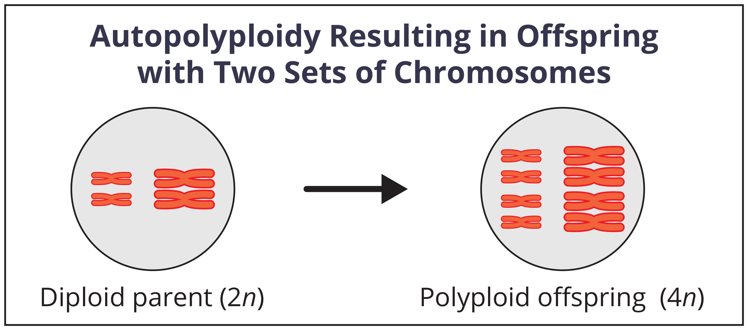
Polyploidy
Polyploidy, the presence of extra sets of chromosomes, can lead to reproductive isolation and sympatric speciation.
Autopolyploidy occurs when an organism has multiple sets of chromosomes from its own species, often resulting from errors in meiosis.
18.2 Figure 9
CNX OpenStax on Wikimedia Commons. "Autopolyploidy."

Slide 17
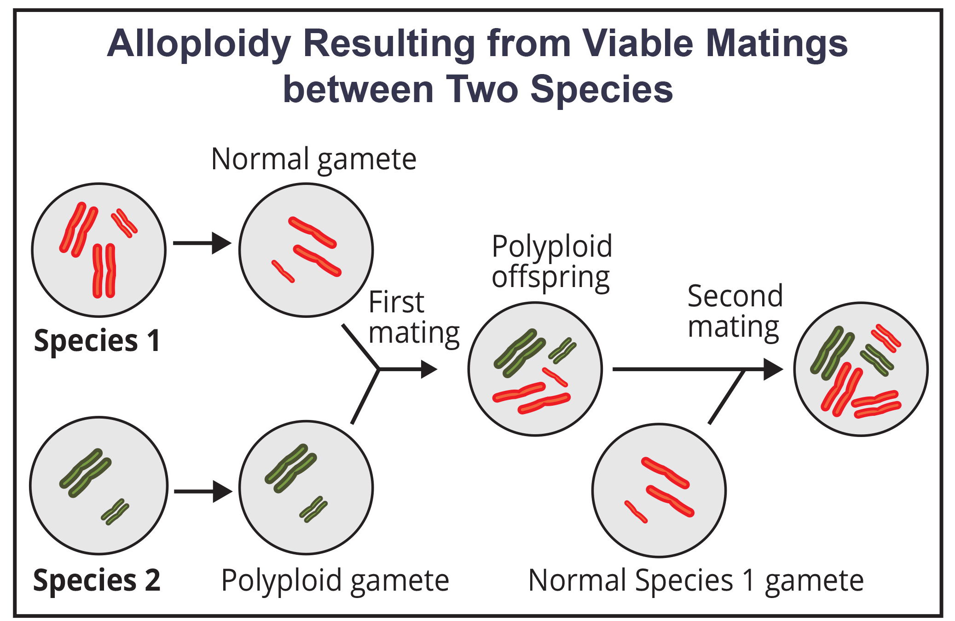
Allopolyploid
Allopolyploidy occurs when gametes from two different species combine to form a viable offspring.
Takes two generations to create a viable fertile hybrid
Polyploidy is common in plants; half of plant species evolved this way.
18.2 Figure 10
CNX OpenStax on Wikimedia Commons. "Alloploidy."

Slide 18
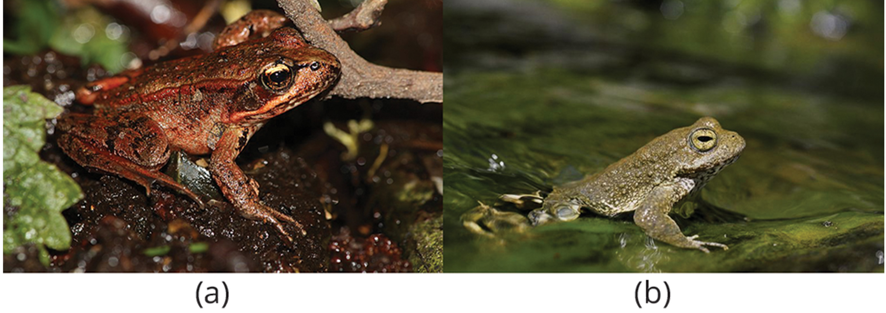
Reproductive Isolation
Genetic and phenotypic divergence between groups reinforces reproductive isolation by affecting traits influencing reproduction.
Prezygotic barriers block fertilization.
Temporal isolation separates breeding times.
Postzygotic barriers affect post-zygote viability.
18.2 Figure 11: These two related frog species exhibit temporal reproductive isolation. (a) Rana aurora breeds earlier in the year than (b) Rana boylii.
Walter Siegmund on Wikimedia Commons. "Rana aurora."
Pierre Fidenci | Attribution ShareAlike 2.5 on Wikimedia Commons. "Rana boylii."

Slide 19
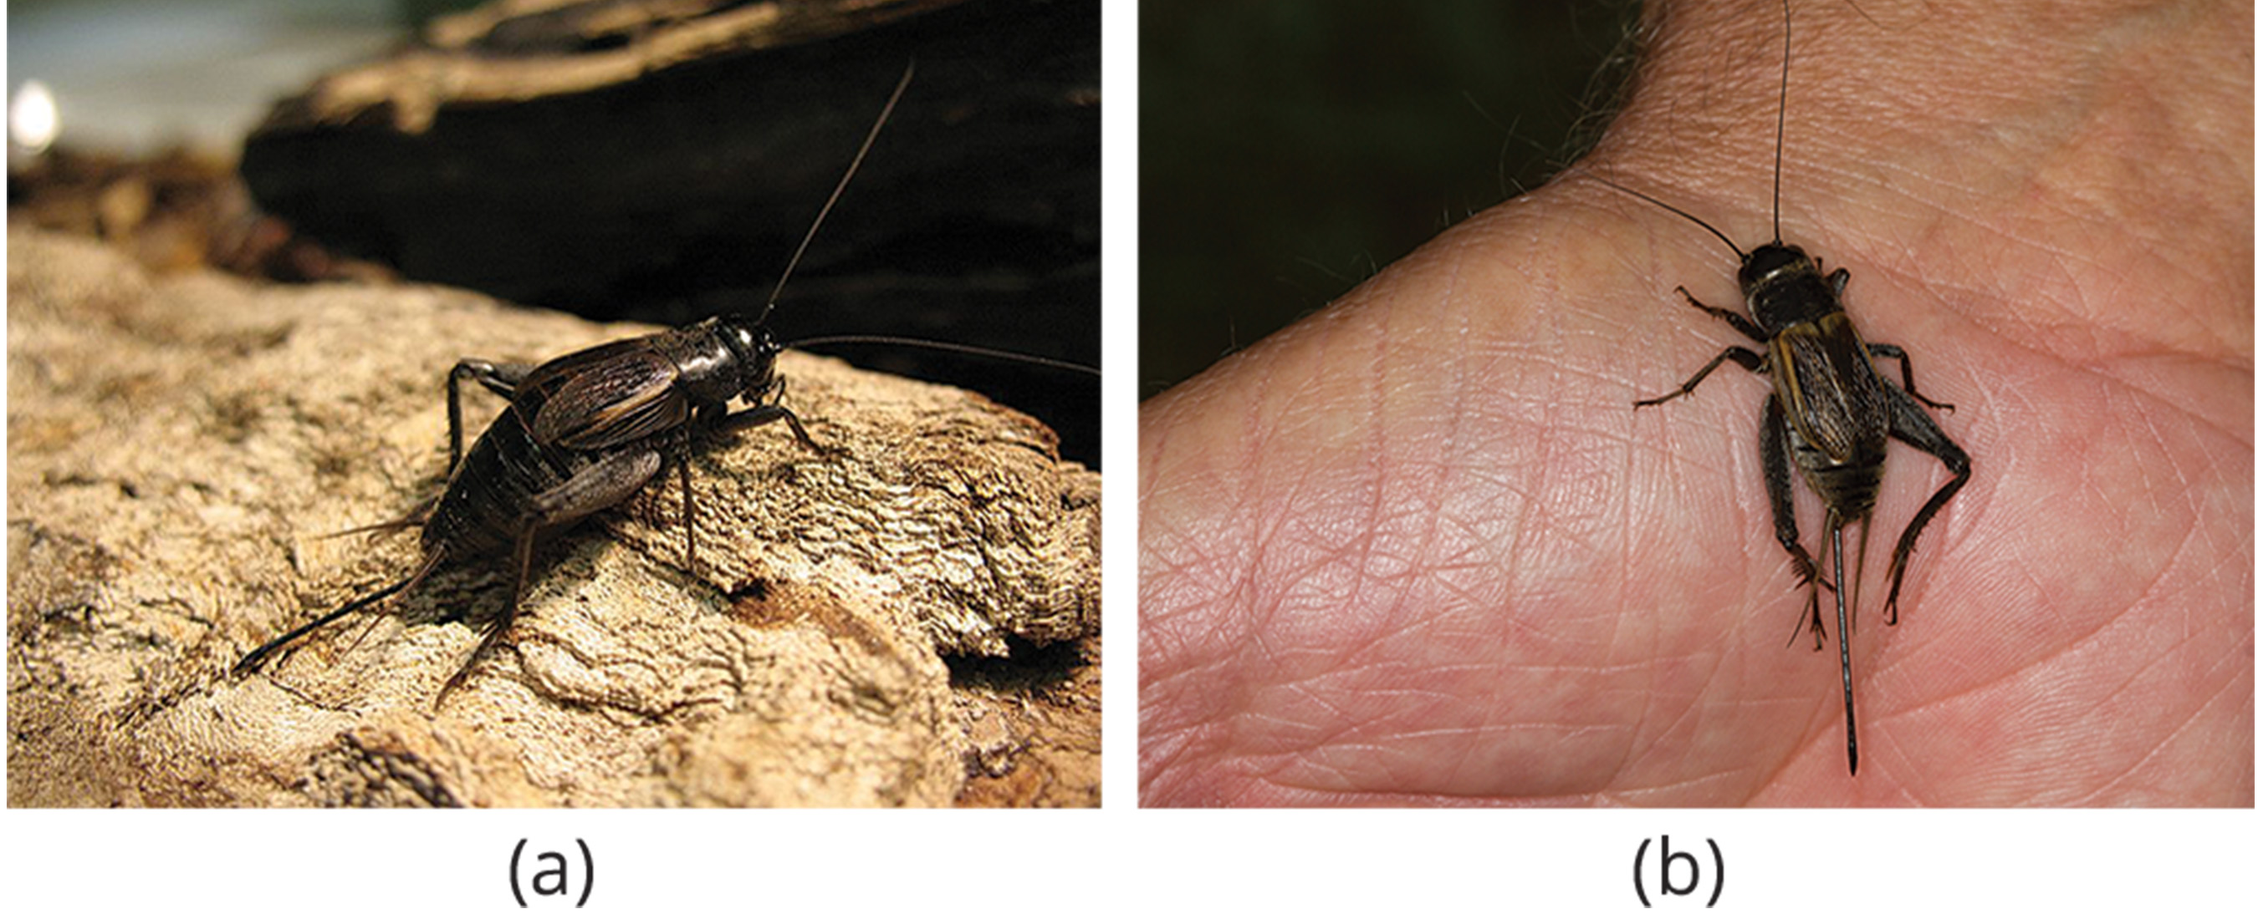
Habitat Isolation
Habitat isolation: when populations move to a new habitat that does not overlap with the same species
Reproduction ceases, leading to a genetically independent species.
Leads to allopatric speciation via natural selection, mutation, and genetic drift
18.2 Figure 12: Speciation can occur when two populations occupy different habitats. The cricket (a) Gryllus pennsylvanicus prefers sandy soil, and the cricket (b) Gryllus firmus prefers loamy soil
Kevin Judge on Wikimedia Commons. "Gryllus pennsylvanicus."

Slide 20
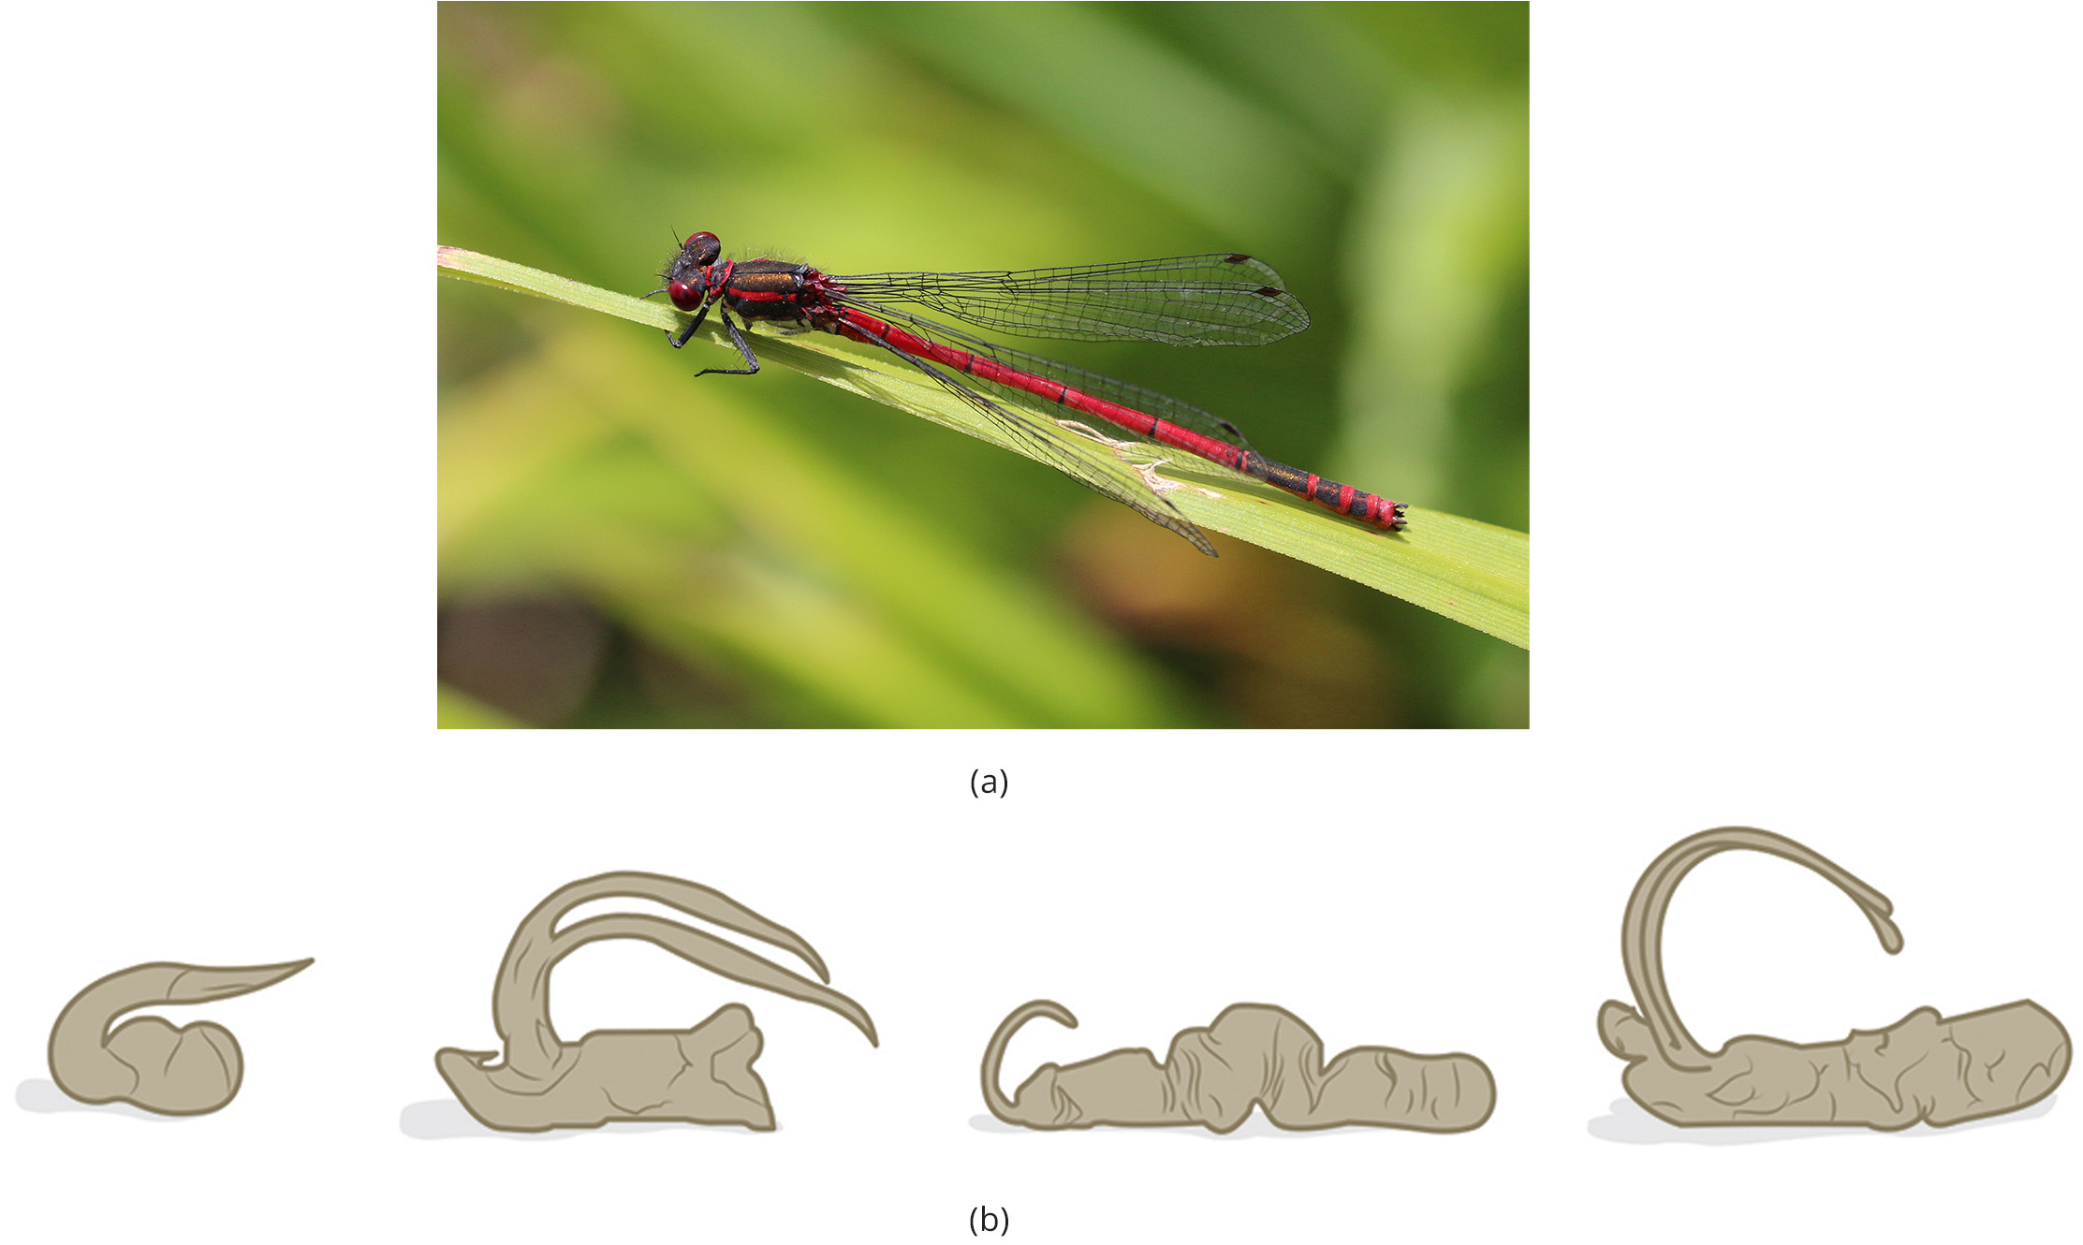
Behavioral isolation
Behavioral isolation prevents reproduction when specific behaviors, such as mating signals, are not recognized between species.
Male fireflies use unique light patterns to attract conspecific females that are not recognized by heterospecific females.
Gametic barrier: occur when differences in gamete cells or reproductive structures prevent fertilization between species (prezygotic).
18.2 Figure 13: Different species of (a) damselflies are prevented from mating with each other due to a prezygotic barrier. (b) The shape of the male reproductive organ varies among male damselfly species and is only compatible with the female of that species.
Charles J. Sharp, Sharp Photography on Wikimedia Commons. "Red damselfly."

Slide 21
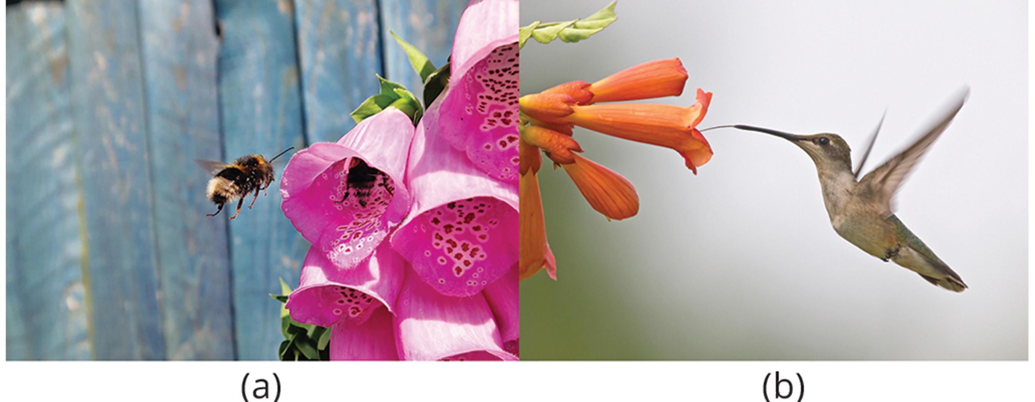
Hybrid Inviability and Hybrid Sterility
In plants, structural differences can attract specific pollinators while excluding others.
Postzygotic barriers include hybrid inviability, where hybrid embryos fail to develop properly and do not survive.
Hybrid sterility is another postzygotic barrier, where hybrids are born but are unable to produce viable offspring of their own.
18.2 Figure 14: Some flowers have evolved to attract certain pollinators. The (a) wide foxglove flower is adapted for pollination by bees, while the (b) long, tube-shaped trumpet creeper flower is adapted for pollination by hummingbirds.
George Hiles on Wikimedia Commons. "Bee on foxglove."

Slide 22
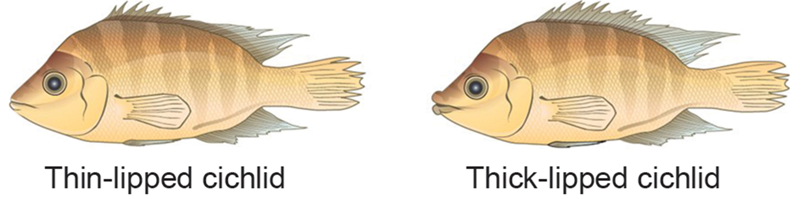
Habitat Influence on Speciation
Habitat and resource availability can drive speciation.
In Nicaragua, cichlid fish demonstrate sympatric speciation through morphological adaptations that allow different subgroups to exploit various food sources within the same location.
18.2 Figure 15: Lake Apoyeque, a crater lake, is 1,800 years old, but genetic evidence indicates that a single population of cichlid fish populated the lake only 100 years ago. Nevertheless, two populations with distinct morphologies and diets now exist in the lake.
CNX OpenStax on Wikimedia Commons. "Cichlid fish." Modified.

Slide 23
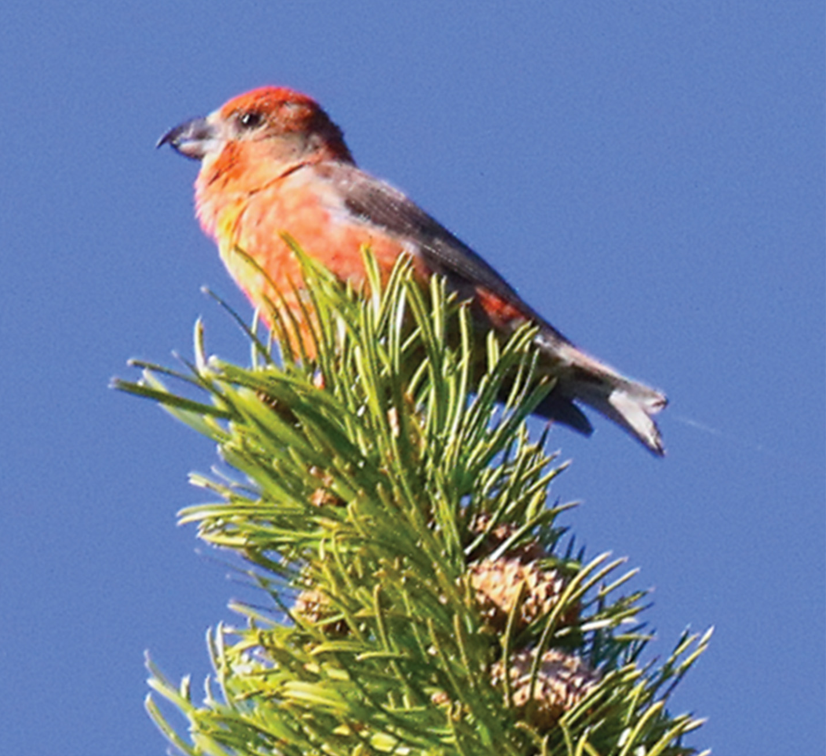
Think It Through₂
North American red crossbills are divided into at least 10 different call types, each with distinctive flight calls, slight morphological differences, and specific food preferences. Multiple call types often coexist in the same habitat, with overlapping geographic ranges.
Data collected between 2001 and 2006 (Smith & Benkman, 2007) showed that less than 1% of South Hill crossbills mated with other call types. Its breeding season is between March and July, while most of the other call types breed throughout the year. Based upon this information, is the South Hill crossbill a distinct species?
18.2 Figure 16: The South Hills crossbill is a call type of North American red crossbills.
TonyCastro on Wikimedia Commons. "South Hills crossbill."
Notes:
Originally an On Your Own. This is included here to use as a talking point or for a think-pair-share activity.

Slide 24
Summary
Speciation occurs through two main pathways: allopatric (geographic separation) and sympatric (within a shared habitat).
Both pathways lead to reproductive isolation of a population from its parent population.
Reproductive isolation mechanisms can be prezygotic (before zygote formation) or postzygotic (after fertilization).
Sympatric speciation can result from meiotic errors leading to polyploidy (extra chromosomes).
Polyploidy can be autopolyploidy (within a single species) or allopolyploidy (between closely related species).

Slide 25


End of Hawkes Learning PowerPoint

