Slide 1
Lesson 18.3
Factors that Affect Speciation

Slide 2
Objectives
Describe pathways of species evolution in hybrid zones.
Explain the two major theories on rates of speciation.

Slide 3
Factors that Affect Speciation
Speciation occurs gradually over a long span of time.
Often a transition period where closely related species interact.

Slide 4
Reconnection
After speciation, closely related species may reconnect and interact indefinitely through interbreeding.
Hybrid zones are areas where two species interbreed, producing hybrids.
The fate of a hybrid zone depends on the fitness of the hybrids and the strength of reproductive barriers.
Potential outcomes include reinforcement, fusion back into one species if hybrids are fit, or stability with ongoing hybridization but no net change.
  Reinforcement occurs when hybrids have low fitness, so species diverge further until complete reproductive isolation.

Slide 5
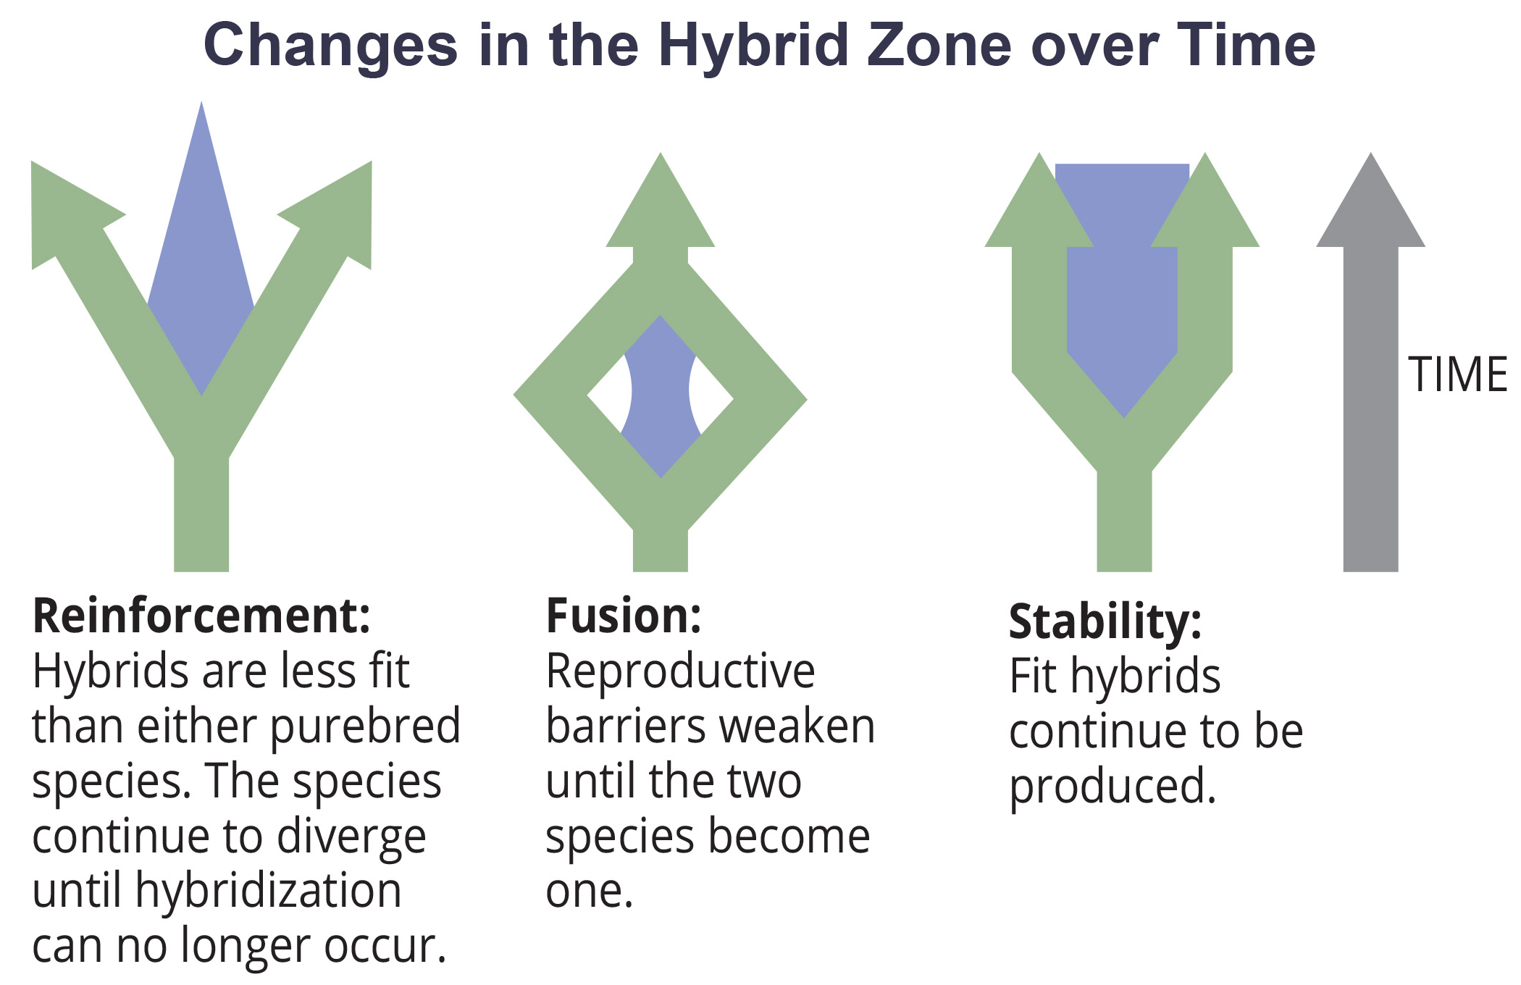
Think It Through₁
Two species that eat different diets but live in the same habitat have evolved. Unfortunately, one of the food sources is eliminated from the habitat, forcing both species to eat the same foods. Of the possible outcomes illustrated in Figure 1, which type of change in the hybrid zone is most likely to occur because of the elimination of one of the food sources?
18.3 Figure 1
CNX OpenStax on Wikimedia Commons. "Hybrid zone." Modified.
Notes:
Originally an On Your Own. This is included here to use as a talking point or for a think-pair-share activity.

Slide 6
Varying Rates of Speciation₁
Two models for speciation rates:
Gradual speciation model: species diverge gradually in small steps over time
Punctuated equilibrium model: rapid "punctuated" changes from the parent species followed by a longer period of no change.
  Doesn't exclude gradual change between rapid events.
Models explain speciation patterns in extant and fossil organisms.

Slide 7
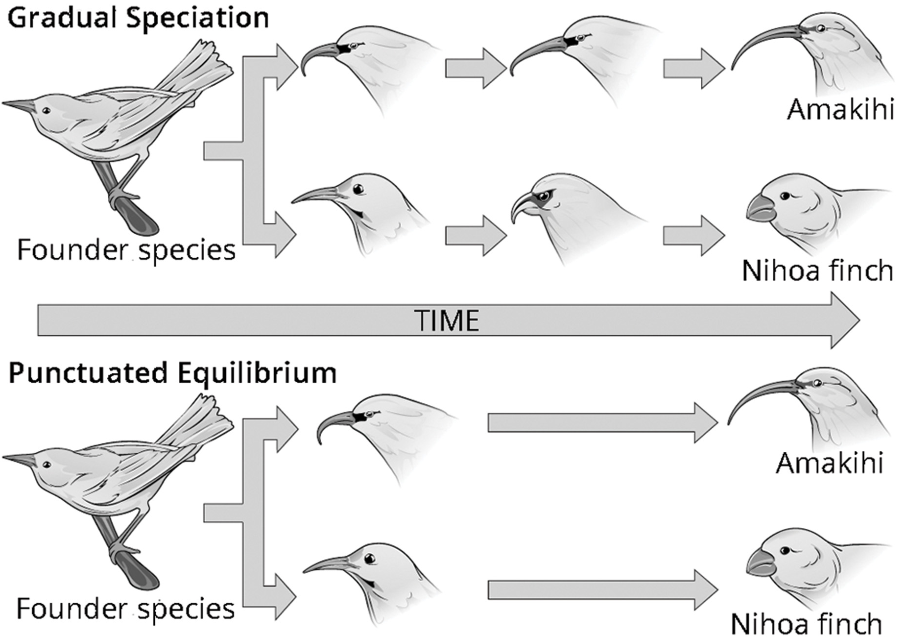
18.3 Figure 2
CNX OpenStax on Wikimedia Commons. "Gradual speciation and punctuated equilibrium."
Notes:
In (a) gradual speciation, species diverge at a slow, steady pace as traits change incrementally. In (b) punctuated equilibrium, species diverge quickly and then remain largely unchanged for long periods of time.

Slide 8
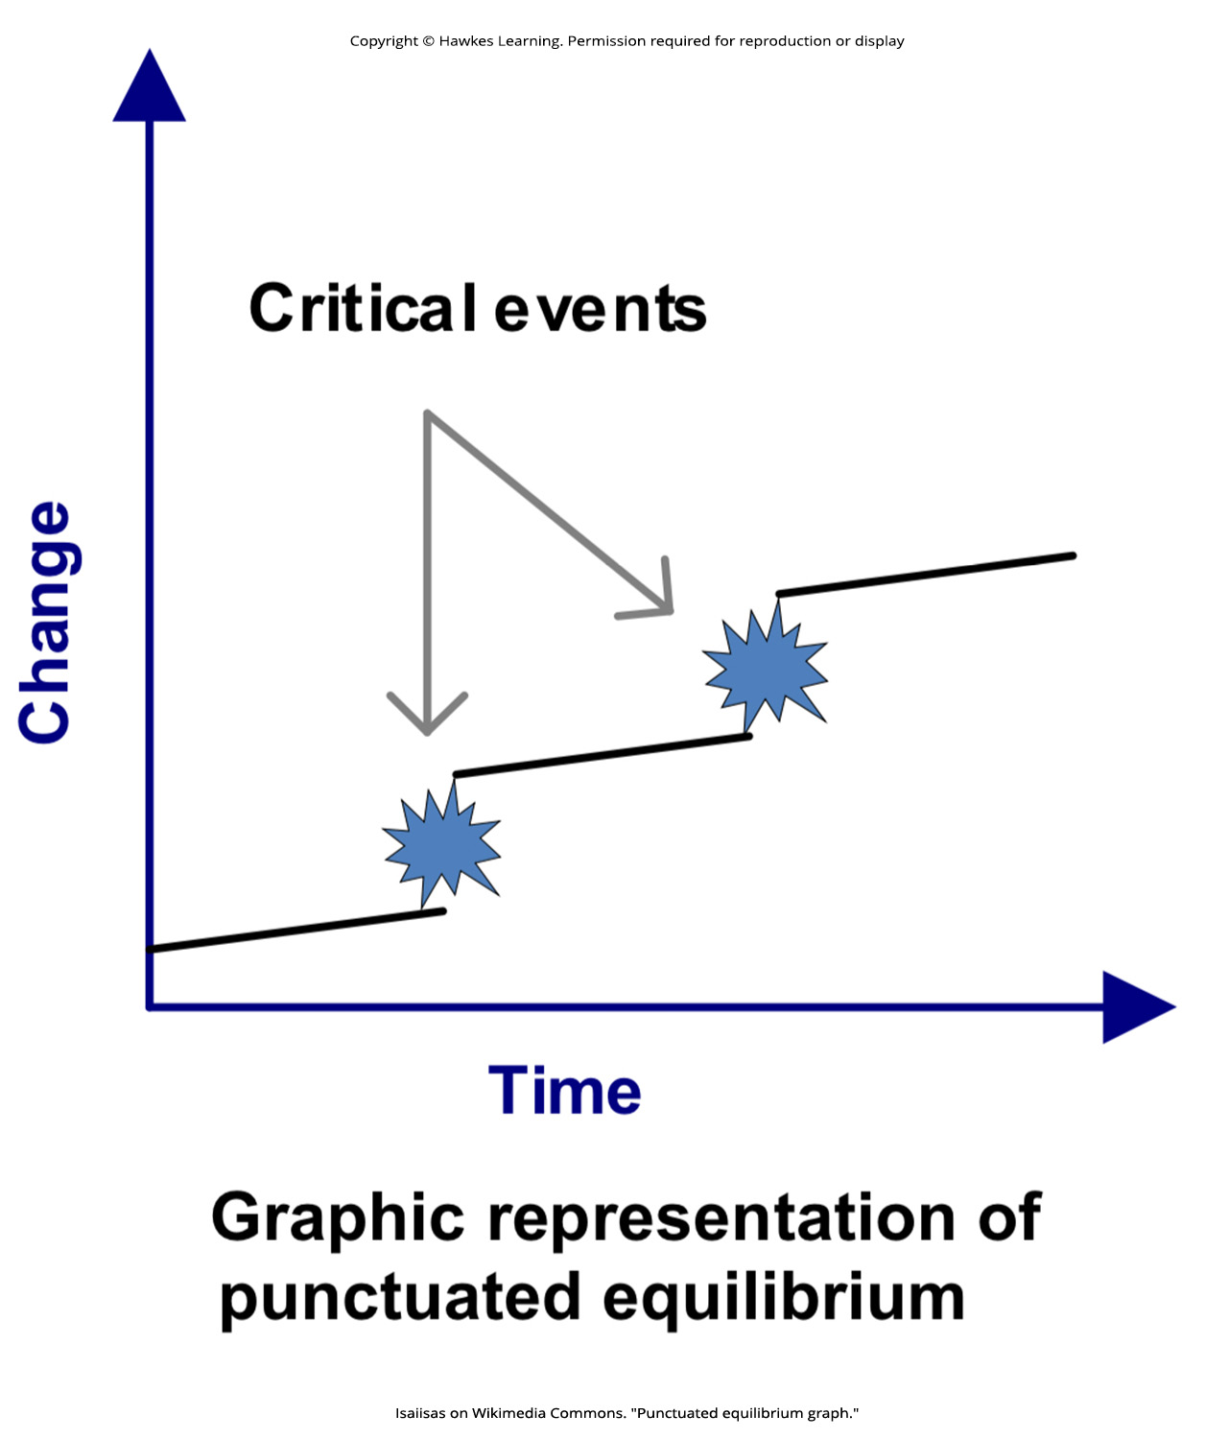
Think It Through₂
How might Figure 3 look different if speciation were only occurring due to gradualism?
18.3 Figure 3
Isaiisas on Wikimedia Commons. "Punctuated equilibrium graph."
Notes:
Originally an On Your Own. This is included here to use as a talking point or for a think-pair-share activity.

Slide 9
Varying Rates of Speciation₂
Changes in environmental conditions can significantly influence speciation rates.
Rapid or radical selection can occur when populations are divided by new environmental barriers.
Small, isolated populations can experience rapid genetic changes due to their limited gene pool, potentially leading to new adaptations becoming predominant quickly.

Slide 10
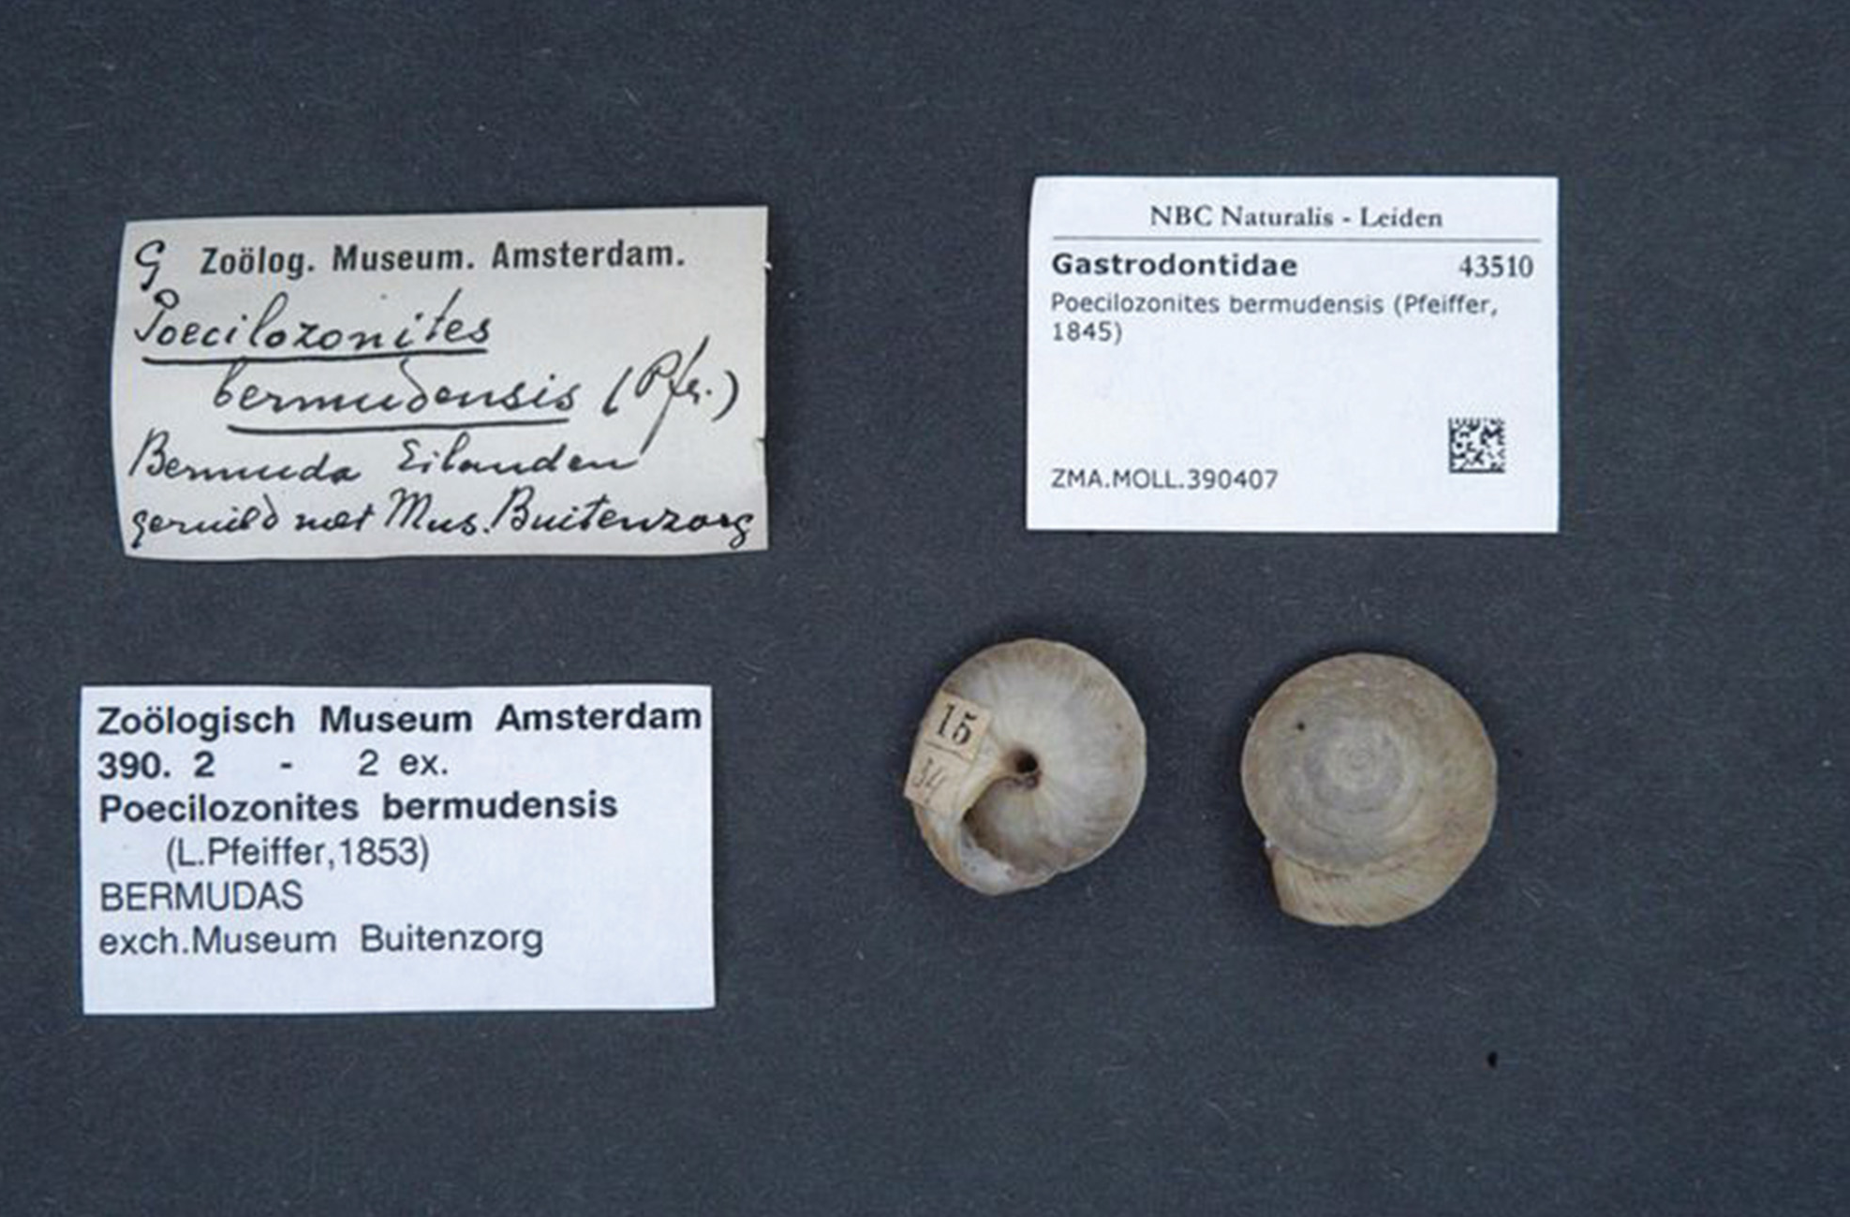
18.3 Figure 4
Naturalis Biodiversity Center on Wikimedia Commons. "Preserved specimen."
Notes:
Research by Stephen Jay Gould in the 1960s on Bermuda land snails of the genus Poecilozonites led him (along with Niles Eldredge) to propose the punctuated equilibrium model of speciation. This is a preserved shell from Poecilozonites bermudensis, a species of Bermuda land snail, that is now part of the collection at the Naturalis Biodiversity Center in the Netherlands.

Slide 11
Reflection Question
What other types of environmental influences may bring about punctuated equilibrium?
Notes:
The reflection question is included here to use as a talking point or for a think-pair-share activity.

Slide 12
Summary
Speciation is not a precise process; overlap occurs in hybrid zones where closely related species interbreed.
Fitness of hybrid offspring influences evolutionary paths, affecting reinforcement, fusion, or stability of a species.
The gradual speciation model proposes species diverge slowly over extended periods through incremental changes.
Punctuated equilibrium model suggests rapid divergence from parent species, followed by long stasis periods.
In both models, natural selection drives changes over time, leading to adaptation and speciation events.

Slide 13


End of Hawkes Learning PowerPoint

