Slide 1
Lesson 19.1 How Populations Evolve

Slide 2
Objectives
Define population genetics and describe how scientists use population genetics in studying population evolution.
Define the Hardy-Weinberg principle and discuss its importance.

Slide 3
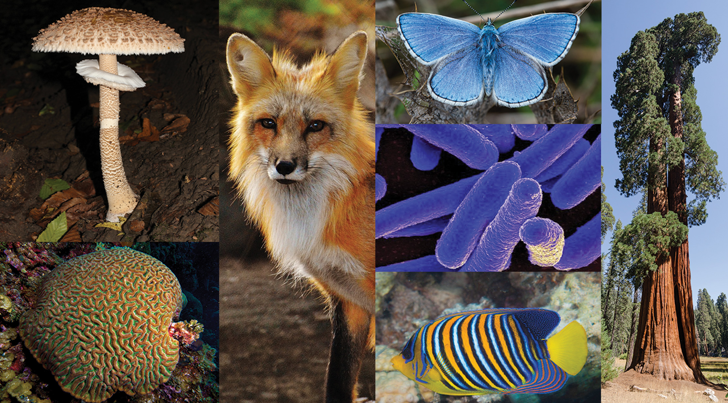
Importance of Evolution
Key concept for understanding life on Earth
Explains origin and diversity of species
Shaped by natural selection, mutation, and other evolutionary forces
19.1 Figure 1
Alexas_Fotos on Pixabay. "Fox.", Nick Hobgood on Wikimedia Commons. "Brain coral.", Tuxyso on Wikimedia Commons. "Giant sequoia.", David Iliff (Diliff) on Wikimedia Commons. "Adonis blue butterfly.", George Chernilevsky on Wikimedia Commons. "Parasol mushroom.", IDKlab on Wikimedia Commons. "E. coli bacteria.", Francois Libert on Wikimedia Commons. "Angelfish."

Slide 4
Evolutionary Forces
Natural selection promotes beneficial traits.
Mutations introduce novel genetic variations.
Variation among individuals, coupled with evolutionary forces, alters populations.

Slide 5
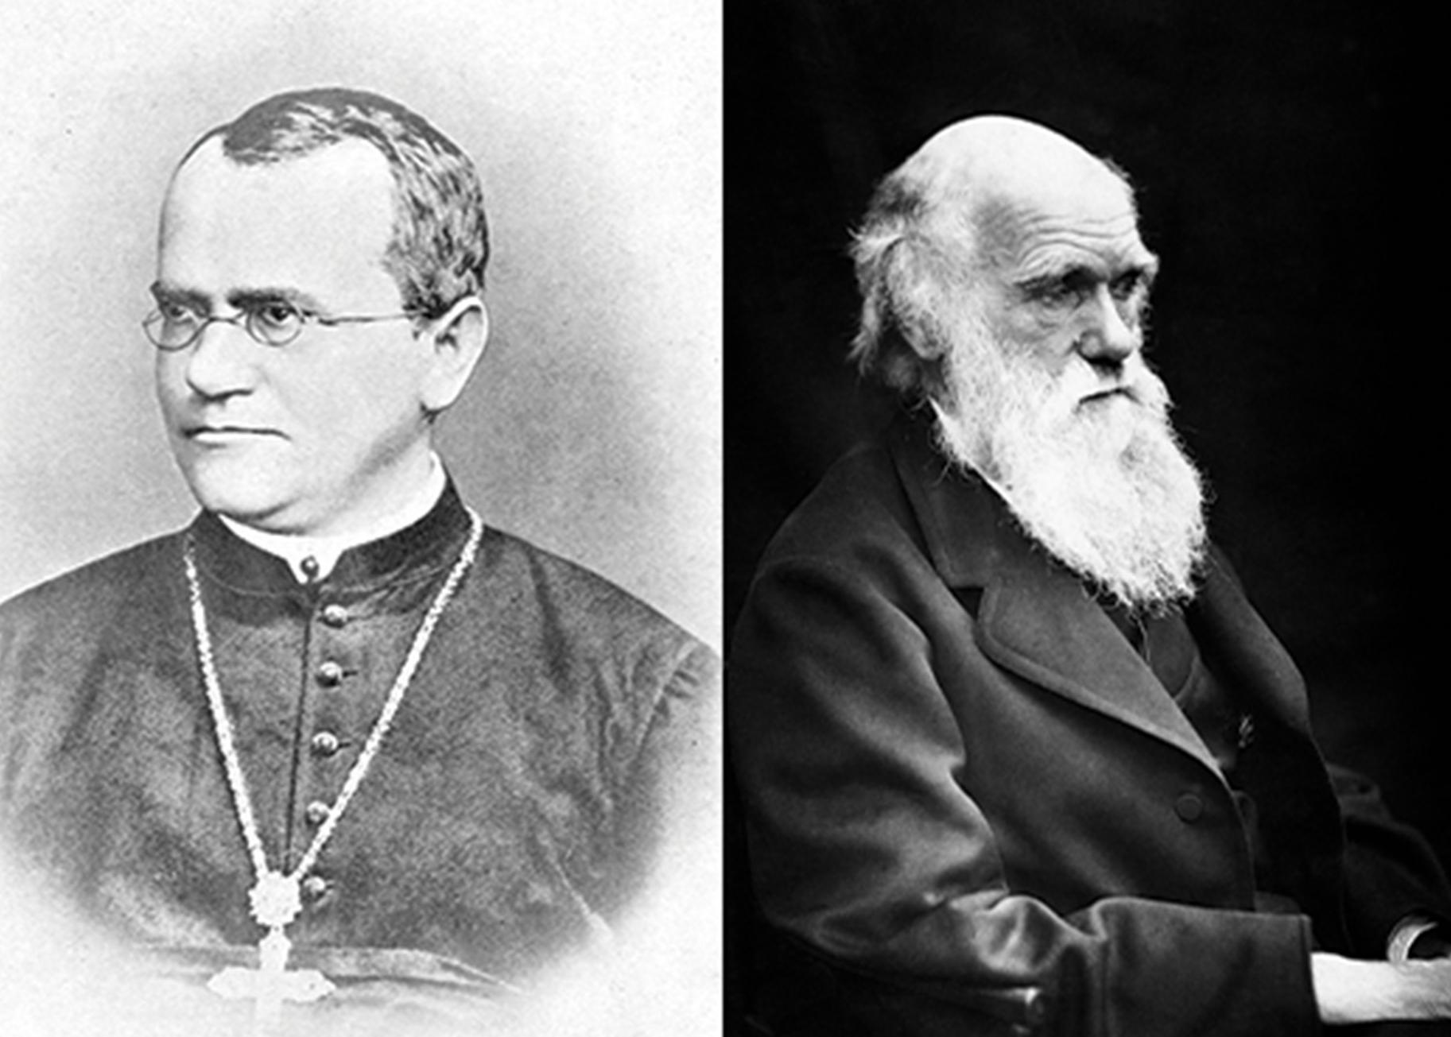
Role of Genetics in Evolution
Darwin developed the idea of natural selection without understanding of genetics.
Mendel's work on inheritance laid the groundwork for modern genetics.
Later scientists integrated the works of Darwin and Mendel creating what's now called the modern synthesis.
19.1 Figure 2: Gregor Mendel (left) and Charles Darwin (right)
Bateson, William on Wikimedia Commons. "Gregor Mendel."
Julia Margaret Cameron on Wikimedia Commons. "Charles Darwin."

Slide 6
Modern Synthesis
Describes the relationship between evolution and genetics
Links microevolution to macroevolution
Microevolution: gradual changes in populations over time
Macroevolution: large-scale evolutionary changes outside of individual populations
Explains gradual evolution via gene frequency changes

Slide 7
Science and You₁
Evolution and Flu Vaccines
Influenza viruses evolve rapidly.
Scientists predict which flu strains will be most prevalent each year based on evolutionary patterns.
Vaccines are designed to combat the strains that are anticipated to evolve and spread.
Viral evolution allows strains to adapt and survive, including developing resistance to existing vaccines.
Notes:
This is included as a relevant application for this topic.

Slide 8
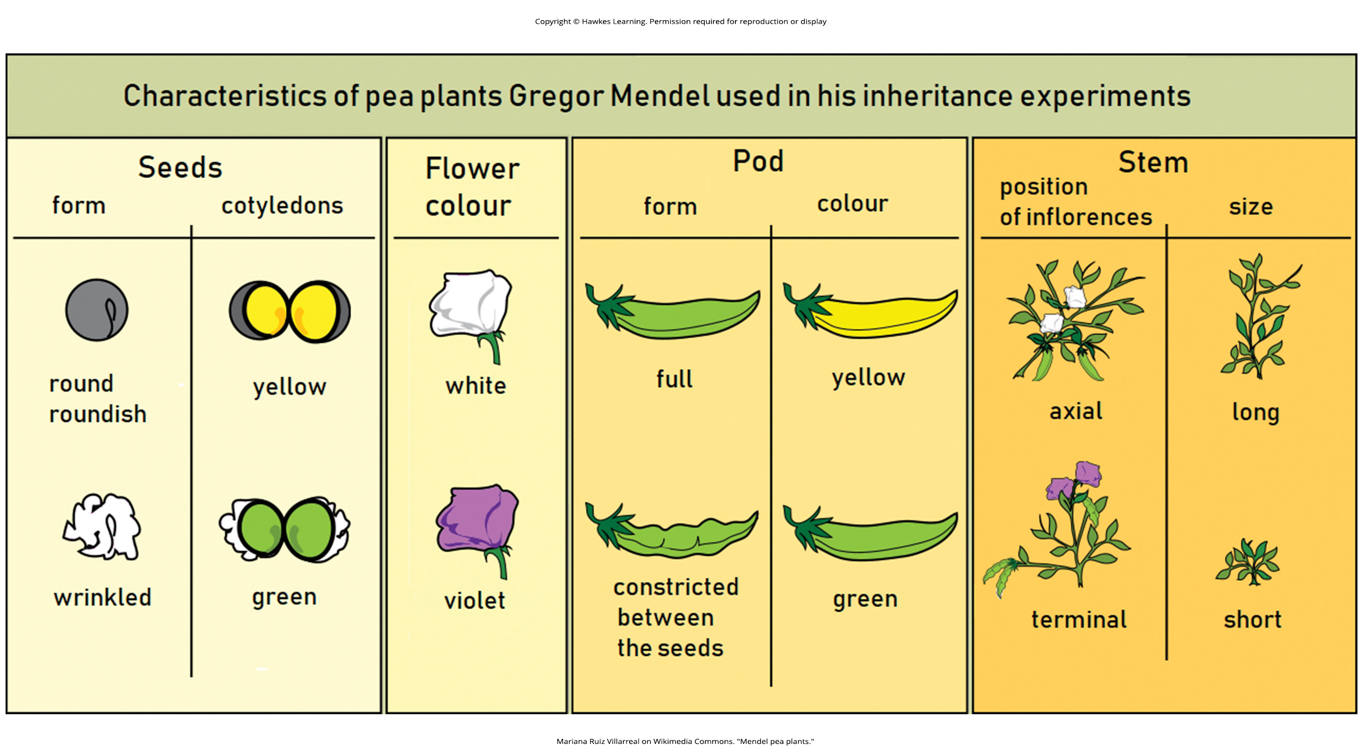
Population Genetics: Allele Frequencies₁
Genes may have multiple alleles determining different traits.
19.1 Figure 3
Mariana Ruiz Villarreal on Wikimedia Commons. "Mendel pea plants."

Slide 9
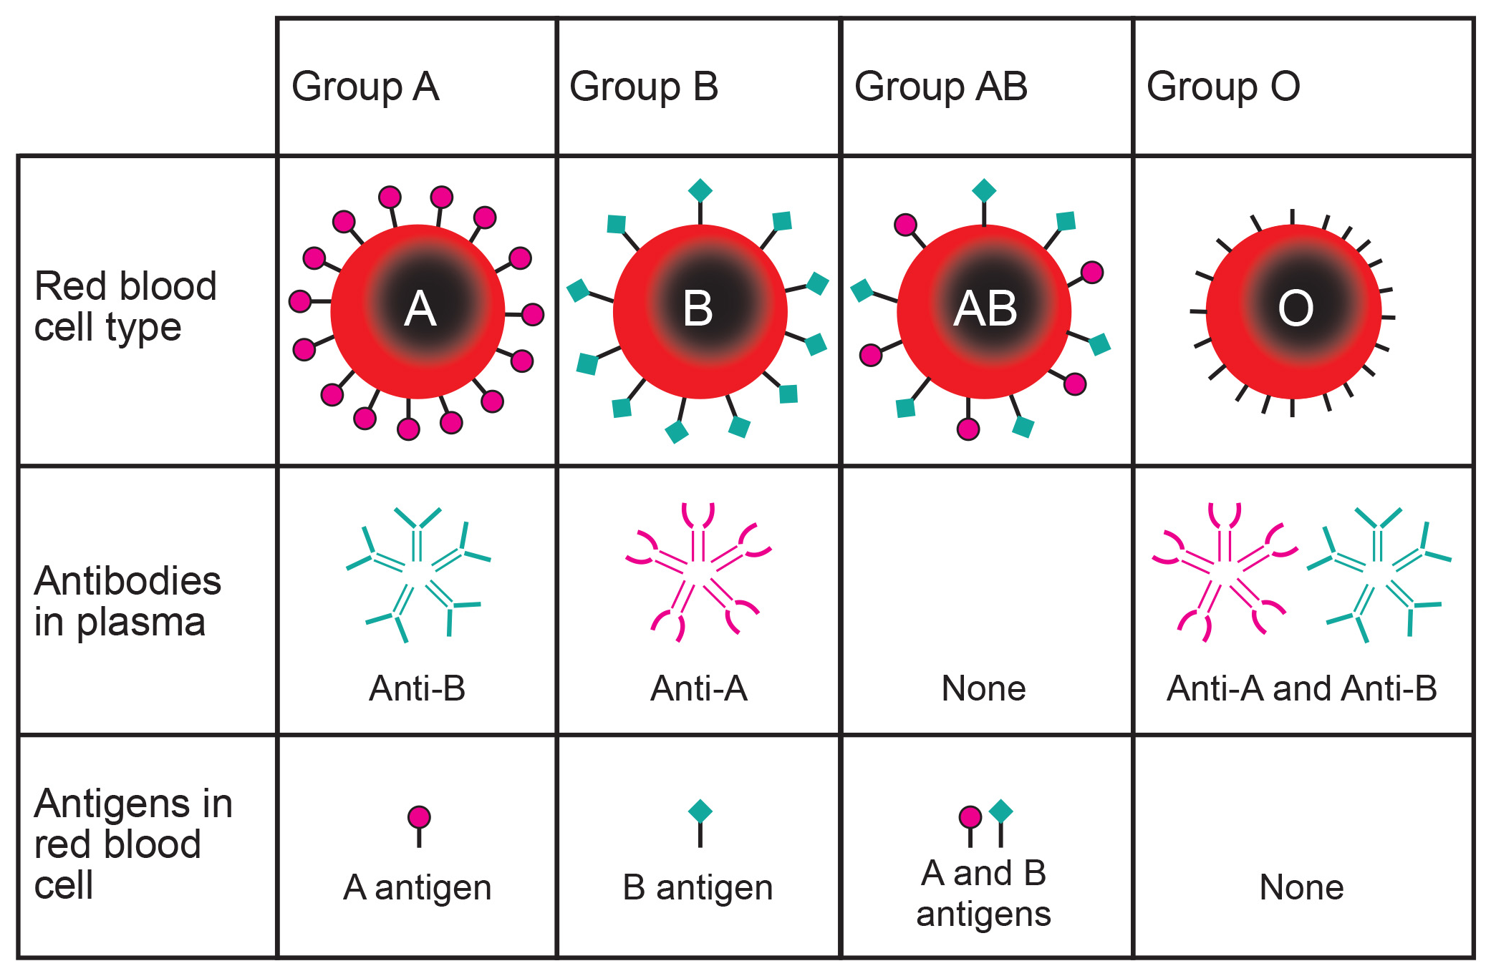
Population Genetics: Allele Frequencies₂
Allele frequency measures the rate of appearance within a population.
Genetic change underlies phenotypic evolution.
Table 1: Antigens expressed by red blood cell groups are recognized by antibodies circulating in blood plasma
Weblars on Wikimedia Commons. "Blood type chart."

Slide 10
Population Genetics: Allele Frequencies₃
Selective forces alter allelic and genotypic frequencies.
Genetic drift and founder effects contribute to population changes.
Genetic drift: when allele frequencies within a population change randomly with no advantage to the population over existing allele frequencies
Founder effect: event that causes an allele frequency change in an isolated part of the population that differs from the main population

Slide 11
Group Activity
The following are some examples of phenotypes and their potential benefits in given populations.
Bright colors of poison dart frogs (advertise danger—"do not eat me" signal)
Different colors between males and females (easier to find mate)
White fur of alpine mammals (blend in with snow)
Putrid scent of rainforest flower (attract pollinating flies)
Such traits are shared by all members of the same species, meaning the alleles that encode these traits have become fixed. As a group, identify four more phenotypes that have resulted from allele fixation and that function as advantageous traits.

Slide 12
Genetic Drift and Gene Flow
Genetic drift and founder effects contribute to population changes.
Genetic drift: random allele frequency changes
Founder effect: when an event initiates an allele frequency change in an isolated population
Gene flow via migration introduces new alleles.

Slide 13
Hardy-Weinberg Principle of Equilibrium
Conditions of equilibrium
No evolution occurring (no mutation, no migration, no natural selection)
Infinite population size
Random mating (no sexual selection)
Hardy-Weinberg is a null hypothesis because no population can satisfy these conditions.

Slide 14
Phenotype vs. Genotype
Genotype: specific genetic alleles
Examples: AA, Aa, aa
Phenotype: physical trait created that manifests from the genotype
Example: flower or pea pod color

Slide 15
Hardy-Weinberg Equation
If there are only two alleles in a population, then p + q = 1
p = frequency of dominant allele
q = frequency of recessive allele
The genotypic frequencies can be found with the following equation: p² + 2pq + q² = 1
p² = homozygous dominant frequency
2pq = heterozygous frequency
q² = homozygous recessive frequency

Slide 16
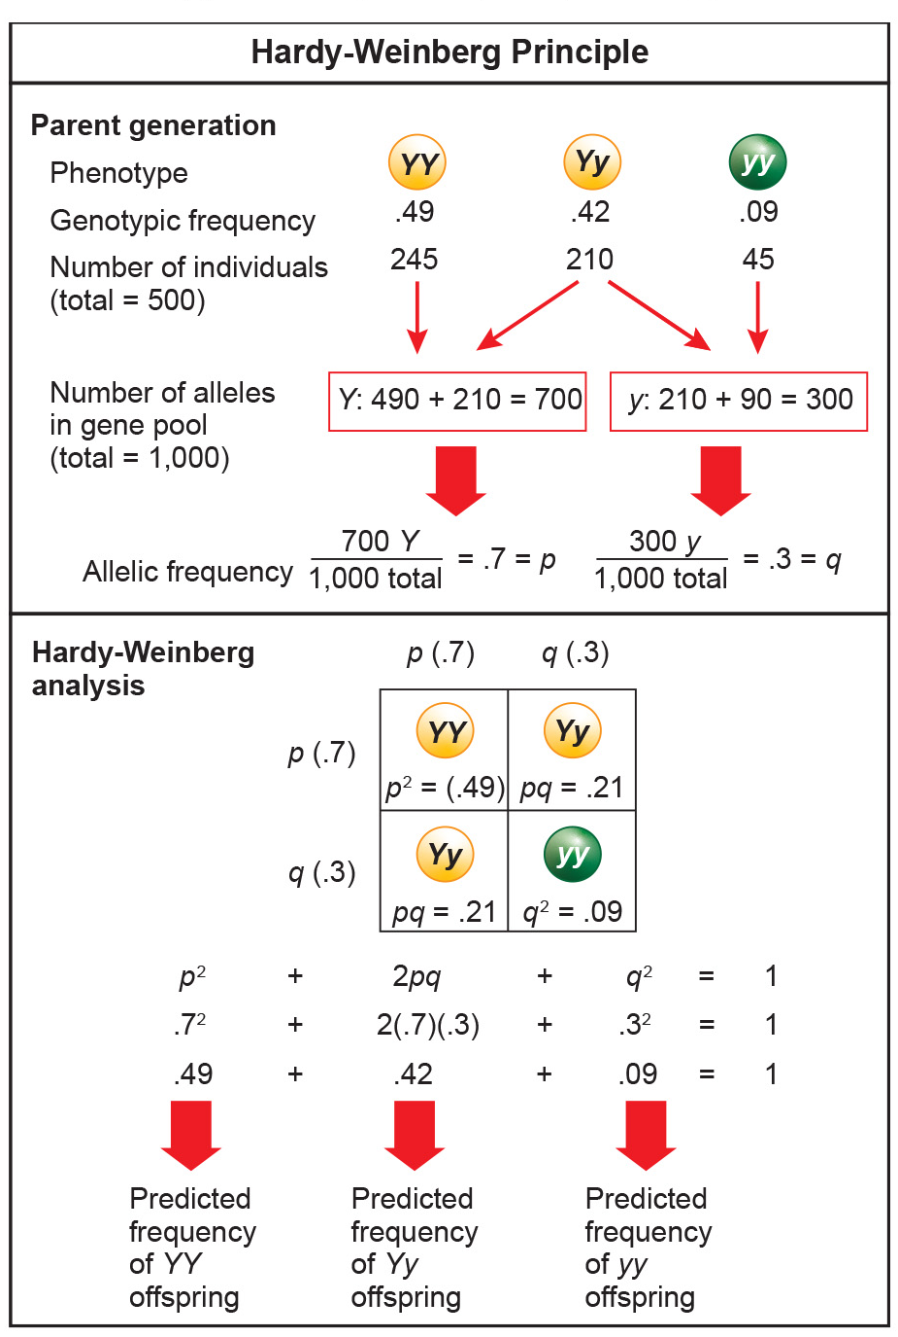
19.1 Figure 4
CNX OpenStax on Wikimedia Commons. "Hardy-Weinberg principle."

Slide 17
Science and You₂
Disease-causing heritable mutations affecting human populations
HER2 gene mutations increase breast cancer risk (~3% of cases)
NOD2 mutations associated with Crohn's disease, which causes intestinal inflammation
HBB mutation causes sickle cell anemia and abnormal red blood cells
Notes:
This is included as a relevant application for this topic.

Slide 18
Hardy-Weinberg Applications
Provides a baseline to detect evolutionary forces
Can calculate allele frequencies from phenotypes
Allows geneticists to infer if evolutionary forces are at work, such as selection or genetic drift

Slide 19
Summary
The modern synthesis unified Darwin's theory of evolution with Mendelian genetics and population genetics.
It explains evolutionary processes at both the micro (changes in gene frequencies within populations) and macro (formation of new species) levels.
Tracking changes in a population's allele frequencies over generations is key.
If allele frequencies change, the population violates Hardy-Weinberg equilibrium, indicating evolution is occurring.

Slide 20


End of Hawkes Learning PowerPoint

