Slide 1
Lesson 19.3
Adaptive Evolution

Slide 2
Objectives
Describe how these different forces can lead to different outcomes in terms of the population variation.
Discuss the limitations of natural selection.
Explain the different ways natural selection can shape populations.

Slide 3
Natural Selection Causes Adaptive Evolution
Natural selection causes adaptive evolution because it:
Selects for beneficial alleles that allow for environmental adaptation, increasing their frequency
Selects against deleterious alleles, decreasing their frequency
Natural selection acts on entire organisms, not individual alleles.

Slide 4
Individuals Need to Survive and Reproduce
Evolutionary (Darwinian) fitness refers to an individual's ability to survive and reproduce, contributing to the gene pool of the next generation.
If an individual carries a beneficial genotype but also carries one causing a fatal childhood disease, the individual will not be able to pass the genotype on.
Relative fitness refers to how an individual's fitness compares to others in the population.
Studying relative fitness to determine which individuals are reproducing gives insight as to how the population might evolve.

Slide 5
Group Activity₁
Think about the following environmental conditions a species may experience in its environment:
Cold temperature
Twilight
Frequent rain
In a group, brainstorm what types of beneficial adaptations might emerge to make an individual more fit for these conditions.

Slide 6
Multiple Types of Selection Affect Allele Frequencies In a Population
There are multiple types of selection that can act on population variation:
Stabilizing selection
Directional selection
Diversifying selection
Frequency-dependent selection
Sexual selection
As a result of these, individuals within a population can become either:
More genetically and phenotypically similar OR
Less genetically similar and more phenotypically distinct

Slide 7
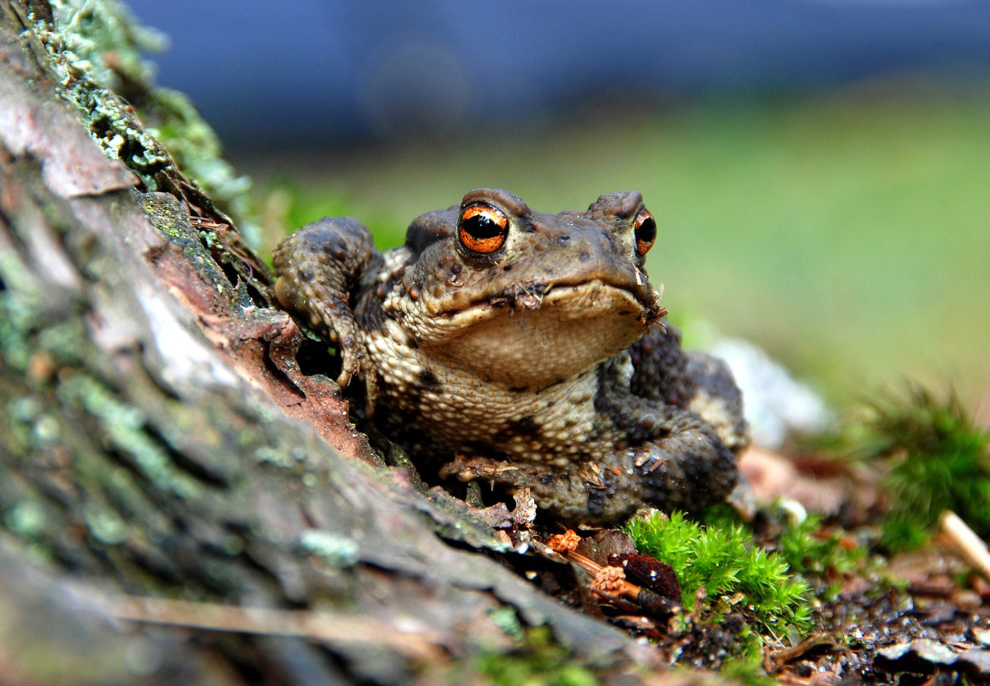
Stabilizing Selection Selects For an Average Phenotype
Stabilizing selection results from natural selection favoring an average phenotype and against extremes.
Example: For mice or toads living in the woods, natural selection favors an average brown color to blend in.
Genetic variance within a population decreases.
19.3 Figure 1
JerzyGorecki on Pixabay. "Camouflaged toad."

Slide 8
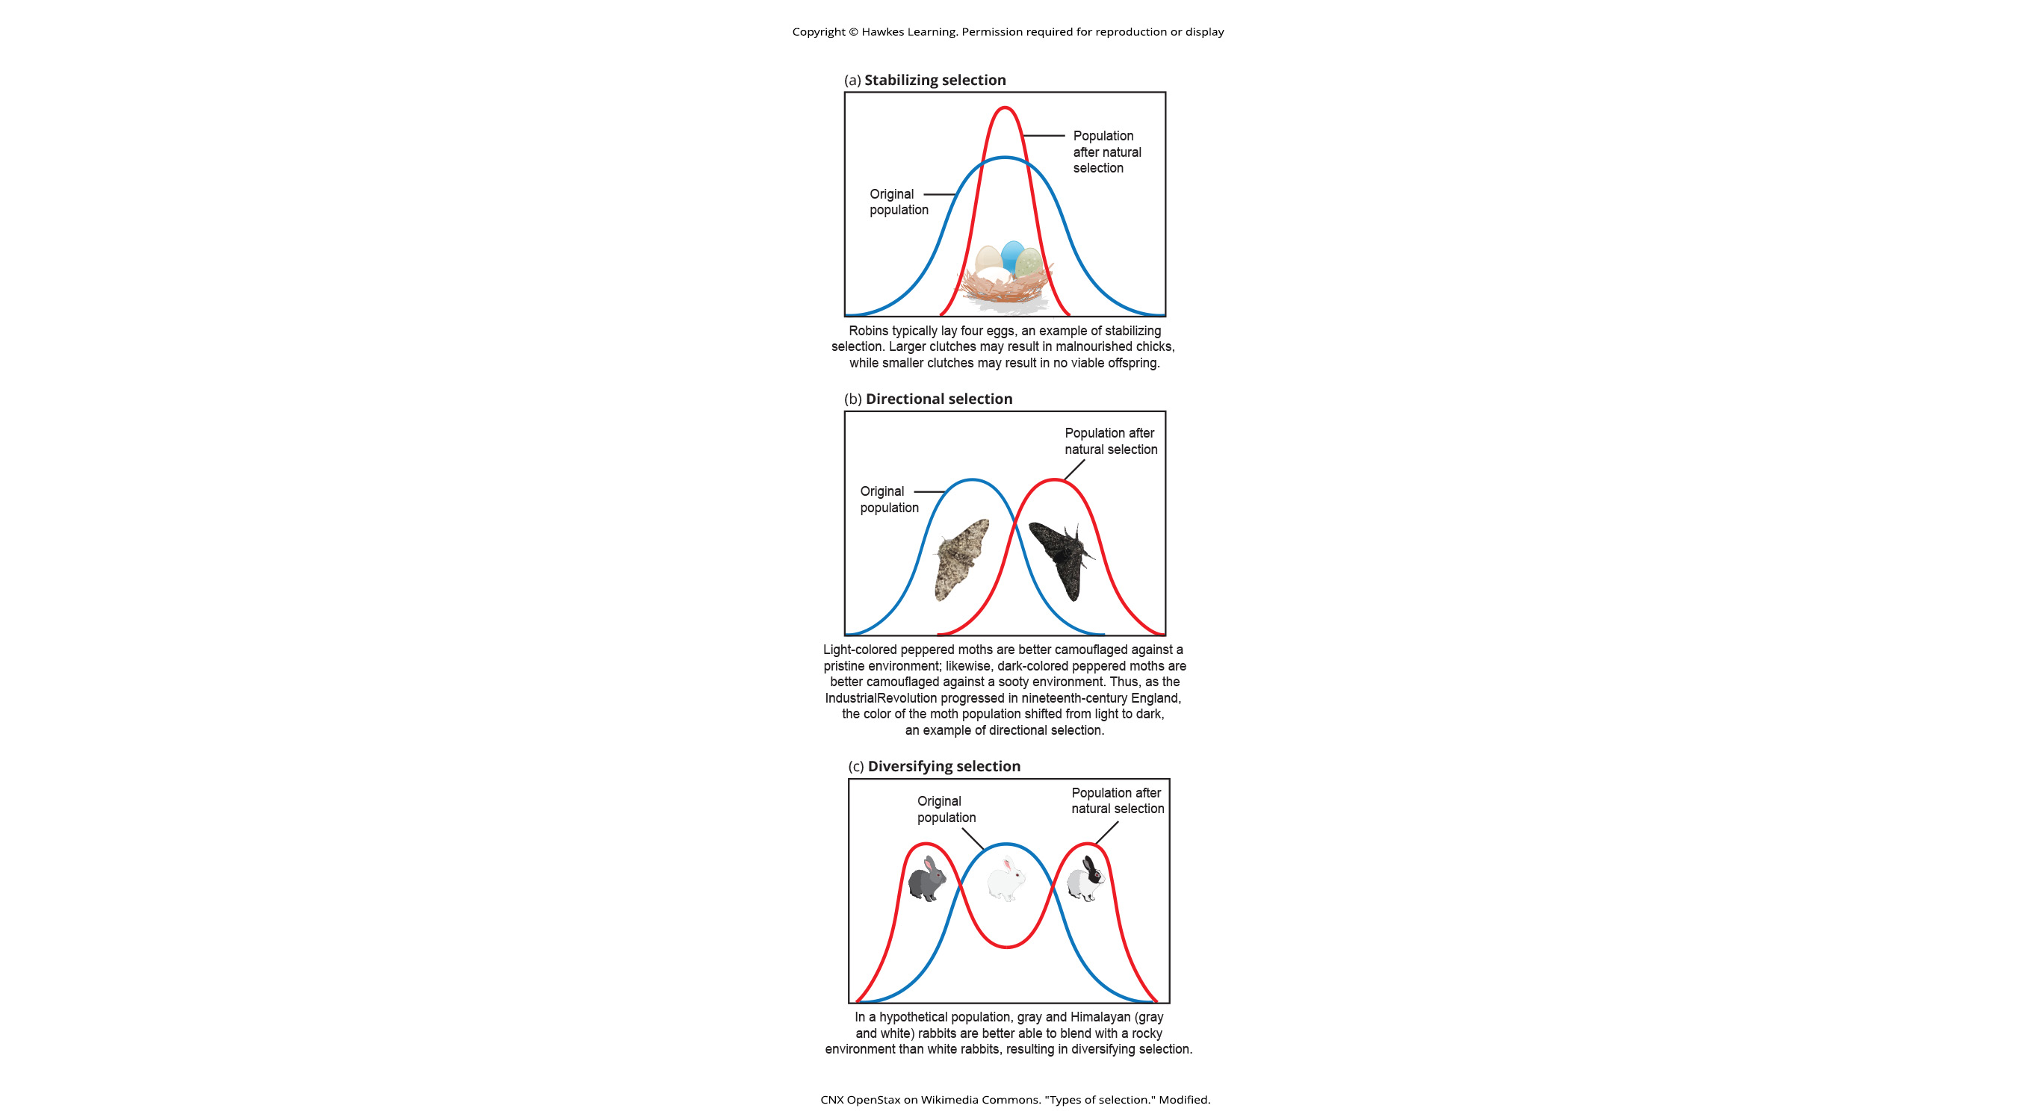
19.3 Figure 2 (a)
CNX OpenStax on Wikimedia Commons. "Types of selection." Modified.
Notes:
Different types of natural selection can impact the distribution of phenotypes within a population. In (a) stabilizing selection, an average phenotype is favored.

Slide 9
Directional Selection Selects For a More Extreme Phenotype₁
Directional selection results from natural selection favoring a phenotype at one end of the spectrum of existing variation, often due to an environmental change.
Example: peppered moths in England
  They were mostly light in color to blend into light-colored trees prior to the Industrial Revolution.
  As trees became sooty (darker) due to Industrial Revolution, the frequency of darker moths increased.
Example: hypothetical mouse population
  They may evolve a different coloration if the forest floor changed color.
The population's genetic variance shifts toward the new, fit phenotype.

Slide 10
19.3 Figure 2 (b)
CNX OpenStax on Wikimedia Commons. "Types of selection." Modified.
Notes:
In (b) directional selection, one extreme phenotype is selected for, which shifts the spectrum of observed phenotypes in that direction.

Slide 11
Diversifying Selection Selects for Both Extreme Phenotypes₁
Diversifying selection results from natural selection favoring both extreme phenotypes at the ends of a phenotypic distribution.
The extreme phenotypes are advantageous.
The phenotypes in the middle are less fit.
Example: multiple male forms in animals
  Large alpha males use brute force to obtain mates.
  Small males sneak in furtive matings with females.
  Medium-sized males are selected against.
Example: environmental changes affecting mice at beach
  Light-colored mice blend in with sand
  Dark-colored mice blend in with grass
  Medium-colored mice blend in with neither
The population's genetic variance becomes more diverse.

Slide 12
19.3 Figure 2 (c)
CNX OpenStax on Wikimedia Commons. "Types of selection." Modified.

Slide 13
Think It Through₁
In recent years, factories have become cleaner and release less soot into the environment as a result.
What impact might this have on the distribution of moth color in the population?
Notes:
Originally an On Your Own. This is included here to use as a talking point or for a think-pair-share activity.

Slide 14
Frequency-Dependent Selection
Frequency-dependent selection can be either:
Positive: favors common phenotypes
  This decreases the population's genetic variance.
Negative: favors rare phenotypes
  This increases the population's genetic variance.

Slide 15
Negative Frequency-Dependent Selection:
Common Side-Blotched Lizards₁
Orange throat-colored males are the largest and strongest and are polygynous.
  Orange males can fight off the blue males to mate with the blue males' pair-bonded females.
Blue throat-colored males are medium-sized and form strong pair bonds with their mates.
  Blue males can fight off yellow males for access to their mates.
Yellow throat-colored males are the smallest, look like females, and can sneak copulations.
  Yellow males can sneak copulations with potential mates of orange males.

Slide 16
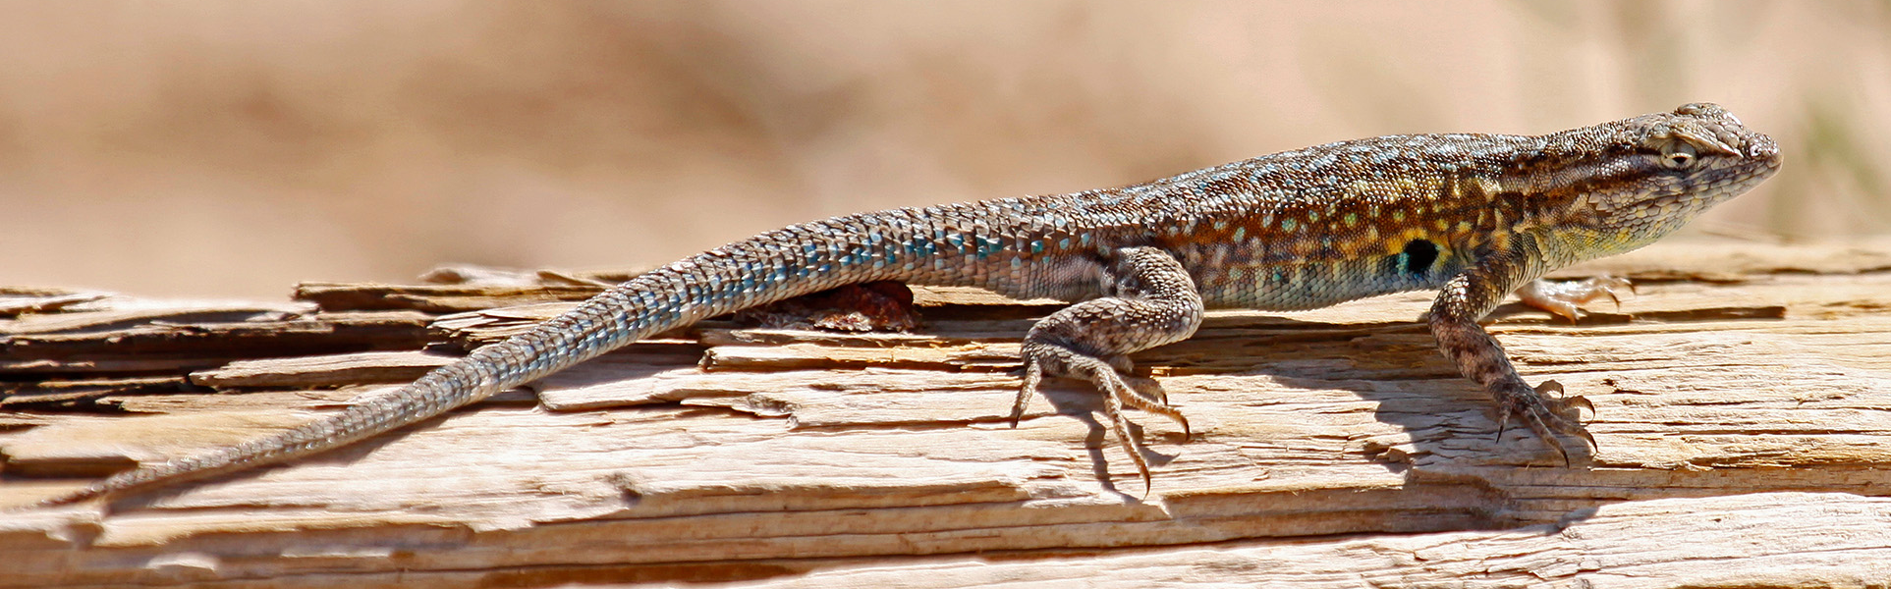
Negative Frequency-Dependent Selection:
Common Side-Blotched Lizards₂
Natural selection favors:
  Orange males when blue males dominate
  Blue males when yellow males dominate
  Yellow males when orange males dominate
This results in the selection for rare phenotypes when other phenotypes dominate.
Thus, populations of side-blotched lizards cycle in phenotype distribution.
19.3 Figure 3
Judy Gallagher on Wikimedia Commons. "Desert side-blotched lizard."

Slide 17
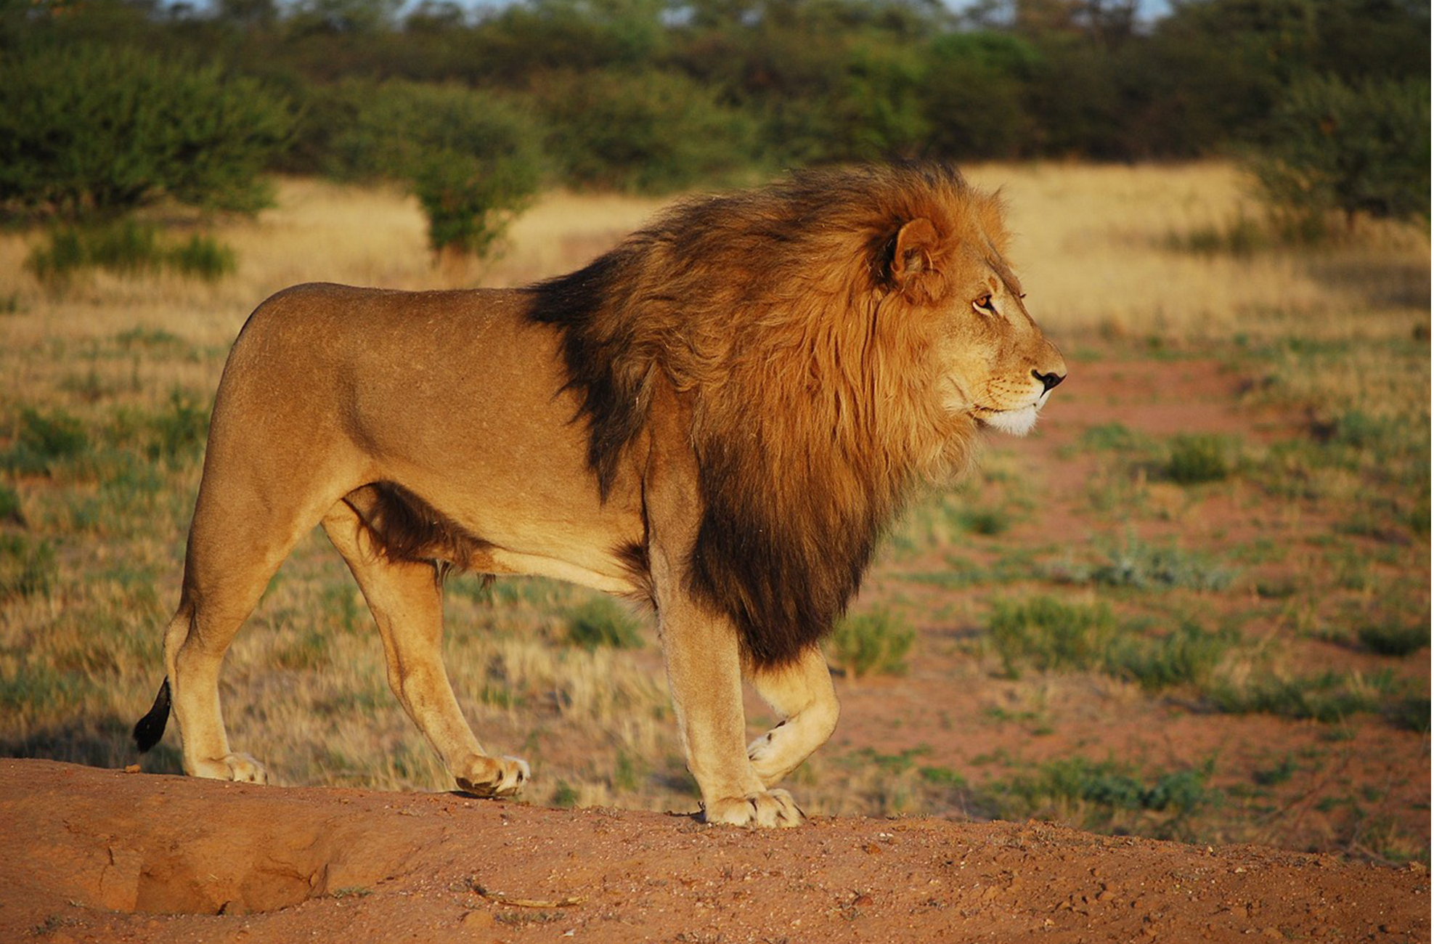
Sexual Selection Favors Certain Traits in Males and Females₁
Sexual dimorphisms are differences between males and females within a species.
In some animals, variation in reproductive success selects for males to have traits to obtain matings.
  Increased size and strength (Example: lion)
  More decoration (Example: peacock's tail)
In other animals, variation in reproductive success selects for females to have such traits to obtain matings.
19.3 Figure 4
Klinkow on Pixabay. "Male lion."

Slide 18
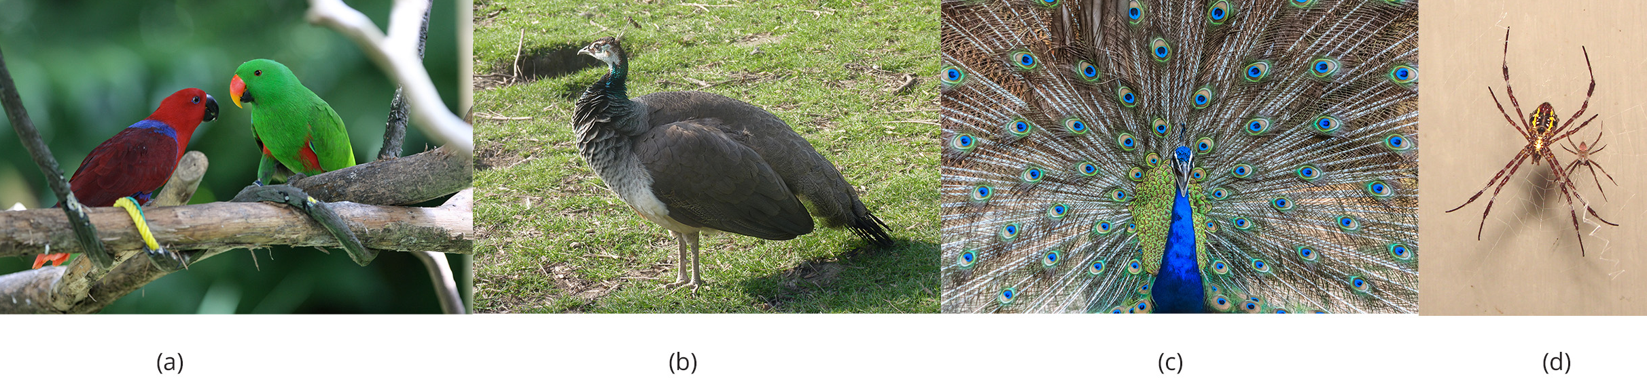
Sexual Selection Favors Certain Traits in Males and Females₂
Sexual selection refers to these selection pressures to obtain matings.
These secondary sexual characteristics increase reproductive success but do not benefit survival.
  Peacocks' large tails are detrimental to survival (making males slower and more visible to predators) and exemplify the handicap principle.
19.3 Figure 5: Sexual dimorphism in A) male (green, right) and female (red, left) eclectus parrots; B-C) female and male peacocks; and D) Argiope appensa spiders (the female is the larger one)
Shiny Things on Wikimedia Commons. "Eclectus parrots."
Jamain on Wikimedia Commons. "Female peacock."
Montasim Jawar on Wikimedia Commons. "Male peacock."
Sanba38 on Wikimedia Commons. "Argiope appensa spiders."

Slide 19
Sexual Selection Favors Certain Traits in Males and Females: Good Genes Hypothesis
The good genes hypothesis states that males develop impressive ornamentation to show off:
Their efficient metabolism OR
Their ability to fight disease
Females then choose males with these traits because they signal genetic superiority which they will pass to offspring.
Fewer, healthier offspring may increase the chances of survival more than many, weaker offspring.

Slide 20
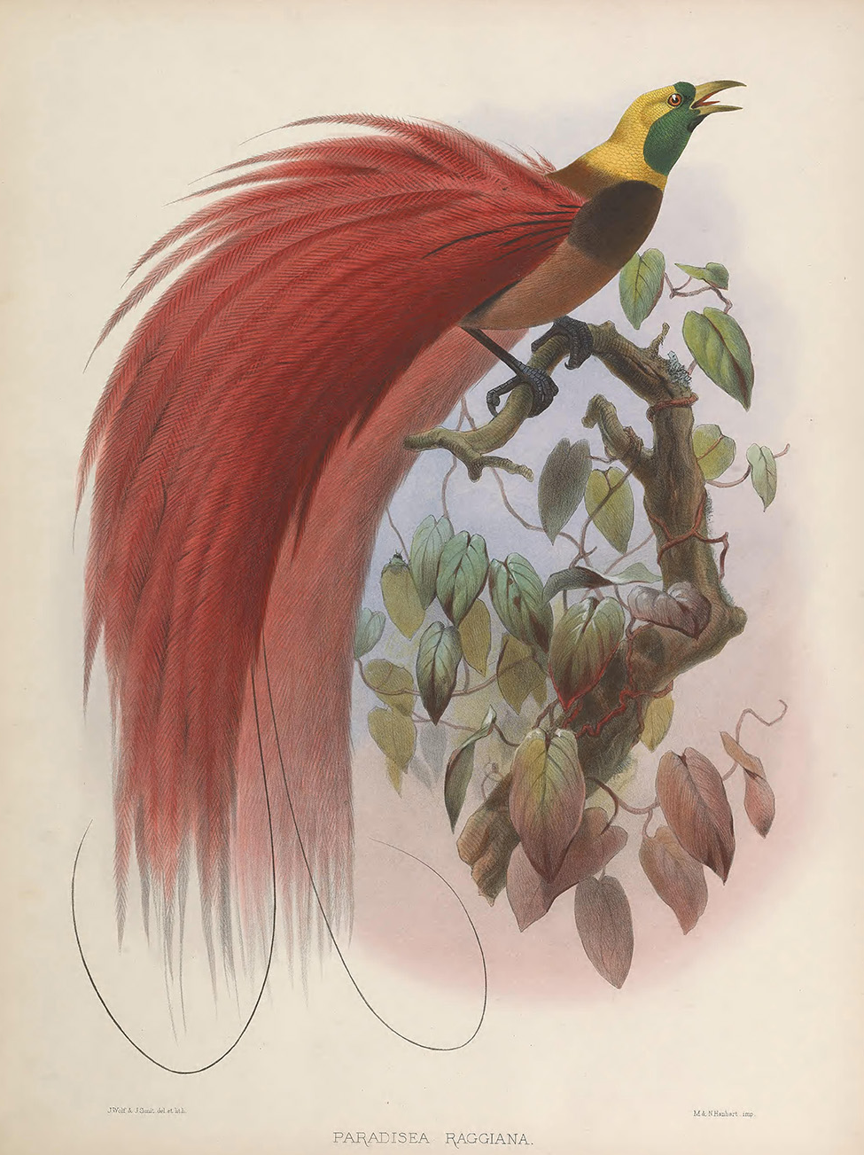
Sexual Selection Favors Certain Traits in Males and Females: Fisherian Runaway Model
According to the Fisherian Runaway model, a trait beneficial to survival was "pushed" to the extreme through sexual selection.
Example: Birds of paradise
  Males with slightly longer tails would be stronger fliers, avoid predation, and would have more opportunity to mate.
  Females who preferred longer-tailed males would have more offspring.
  Genes for longer tails (males) and longer-tailed preference (females) would increase in the population.
  A positive feedback loop is established, resulting in a cumbersome tail.
19.3 Figure 6
Biodiversity Heritage Library on Wikimedia Commons. "Bird of paradise."

Slide 21
Some Sexual Selection Models Involve an Honest Signal
An honest signal of male quality gives females a way to find the fittest mates that will pass on the best genes to their offspring.
Both the handicap principle and the good genes hypothesis support the trait as being an honest signal.
With the Fisherian runaway model, the trait results from female preference and is no longer an honest indicator of a male’s fitness.

Slide 22
Think It Through₂
Consider the cost of developing elaborate traits and behaviors for a species undergoing selection as part of the Fisherian runaway model, such as the bird of paradise.
Would survival resources, such as food, need to be scarce or abundant in their environment?
Notes:
Originally an On Your Own. This is included here to use as a talking point or for a think-pair-share activity.

Slide 23
There Is No Perfect Organism
Natural selection:
Can generate populations that are better adapted for survival and reproduction in their environments
Cannot produce a perfect organism
Can act on existing variation in a population
Cannot create anything from scratch
Acts on individuals (an organism's fitness resulting from their collection of alleles)
  Because some alleles are linked in the genome and likely to be passed together, any individual may carry some beneficial and some unfavorable alleles
Does not act on individual alleles
  Good alleles can be lost with bad ones
  Bad can be kept with good ones

Slide 24
Think It Through₃
Genes are passed on from one generation to another at the time of mating.
Explain why an unfavorable genetic allele that manifests its trait in old age would not necessarily be subject to natural selection.
Notes:
Originally an On Your Own. This is included here to use as a talking point or for a think-pair-share activity.

Slide 25
Natural Selection is Constrained by Relationships Between Polymorphisms
While one morph may confer higher fitness, it may not increase in frequency if doing so requires transitioning through a less beneficial phenotype.
Example: Light versus dark-colored beach mice
  If dark-colored mice are more fit than light-colored mice, the transition from light to dark requires an intermediate phenotype which would blend in to neither sand nor grass, making them more susceptible to predation

Slide 26
Evolution Has No Purpose
Evolution is the sum of various forces
Natural selection may make a population more fit overall.
Other evolutionary forces (such as genetic drift and gene flow) may do the opposite, introducing harmful alleles.
Not all evolution is adaptive.

Slide 27
Group Activity₂
Sometimes, natural selection leads to evolutionary dead ends, so to speak. As the environment changes over generations of a species, the traits that were once advantageous may become detrimental.
As a group, think about species you may know to have gone extinct during Earth's history and identify traits that may have contributed to their extinction.

Slide 28
Summary
Natural selection is adaptive evolution because:
It increases the frequency of beneficial alleles.
It decreases the frequency of harmful qualities.
Natural selection happens at the individual level, selecting for those with higher overall fitness.
Stabilizing selection selects for an average phenotype, decreasing the population's variation.
Directional selection results in shifting the population's variation toward a new, fit phenotype as environmental conditions change.
Diversifying selection increases genetic variance by selection for two or more distinct phenotypes.
Frequency-dependent selection selects for common or rare phenotypes.
Sexual selection results from one sex having more variance in reproductive success than the other.
Males and females have different selective pressures, often leading to the evolution of sexual dimorphisms between them.

Slide 29


End of Hawkes Learning PowerPoint

