Slide 1
Lesson 2.1
The Building Blocks: Atoms, Isotopes, Ions, and Molecules

Slide 2
Objectives
Define matter and elements.
Describe the interrelationship between protons, neutrons, and electrons.
Compare the ways in which electrons can be donated or shared between atoms.
Explain the ways in which naturally occurring elements combine to create molecules, cells, tissues, organ systems, and organisms.

Slide 3
Basic Chemistry for Biology
Elements in various combinations form matter, including living things.
Abundant elements in most organisms: carbon (C), hydrogen (H), nitrogen (N), oxygen (O), sulfur (S), and phosphorus (P).
Biological processes follow laws of physics and chemistry.

Slide 4
The Building Blocks: Atoms, Isotopes, Ions, and Molecules
Matter occupies space and has mass.
Elements are unique forms of matter with specific properties.
Common elements in organisms: oxygen (O), carbon (C), hydrogen (H), and nitrogen (N).
Table 1: Approximate Percentage of Elements in Living Organisms (Humans) Compared to the Nonliving World
Element | Life (Humans) | Atmosphere | Earth's Crust
Oxygen (O) | 65% | 21% | 46%
Carbon (C) | 18% | trace | trace
Hydrogen (H) | 10% | trace | 0.1%
Nitrogen (N) | 3% | 78% | trace

Slide 5
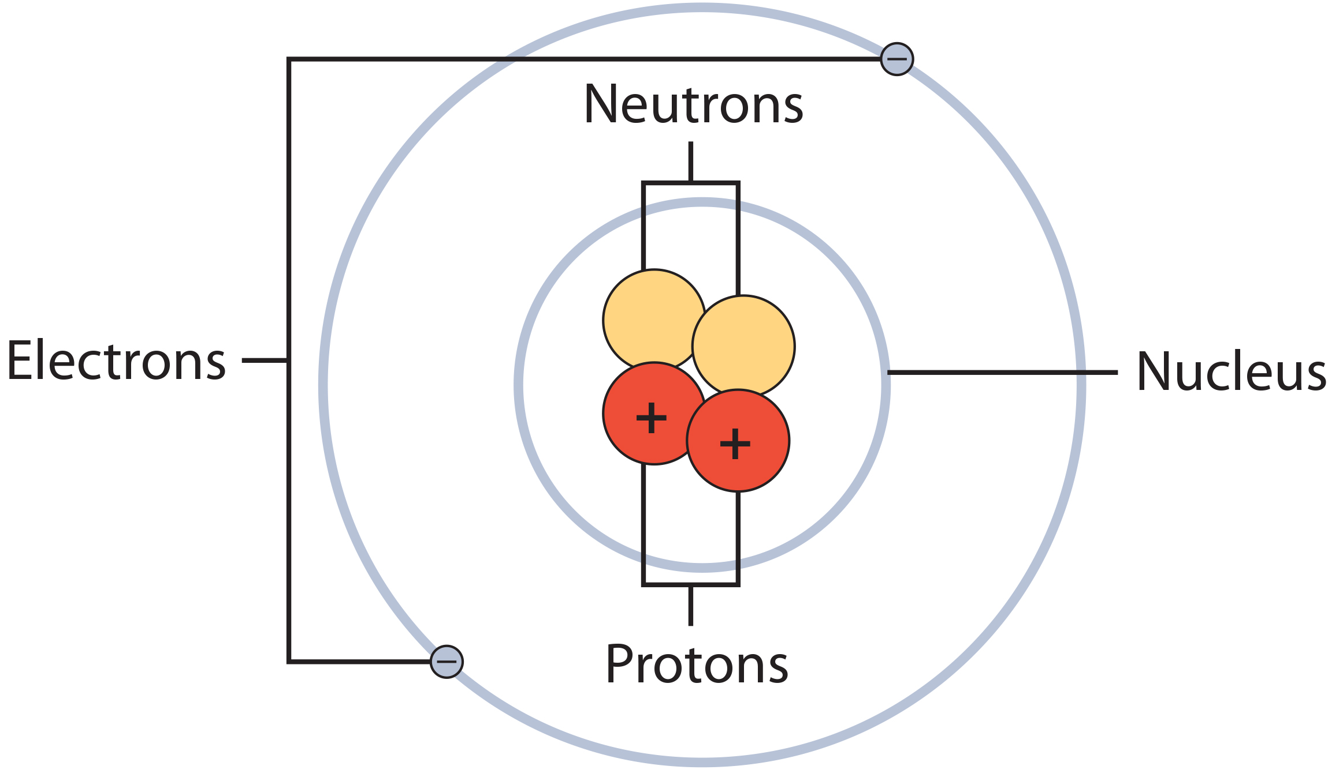
The Structure of the Atom
An atom is the smallest unit retaining an element's chemical properties.
Atoms consist of a nucleus (protons and neutrons) and orbiting electrons
Protons are positively charged, neutrons are uncharged, and electrons are negatively charged.
2.1 Figure 1
CNX OpenStax on Wikimedia Commons. "Bohr atom structure."
Table 2: Characteristics of Protons, Neutrons, and Electrons
 | Charge | Mass (u) | Location
Proton | +1 | 1 | nucleus
Neutron | 0 | 1 | nucleus
Electron | −1 | 0 | orbitals

Slide 6
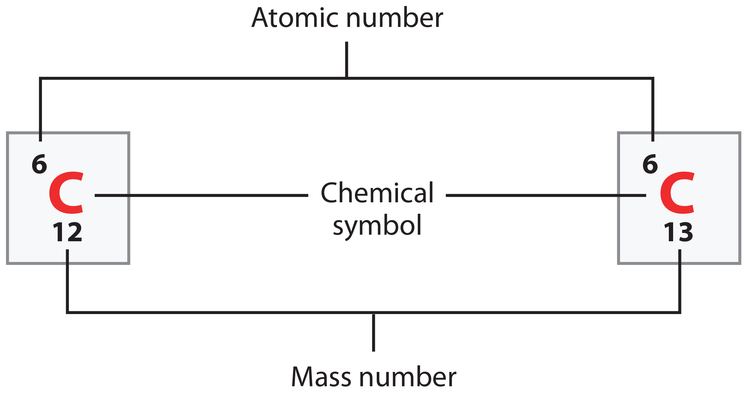
Atomic Number and Mass
The atomic number is the number of protons, which distinguishes elements from each other.
Mass number is the sum of the number of protons and neutrons.
Isotopes are atoms with the same number of protons but a different number of neutrons.
Atomic mass is the average mass of an element's isotopes.
2.1 Figure 2
CNX OpenStax on Wikimedia Commons. "Atomic number and mass number."

Slide 7
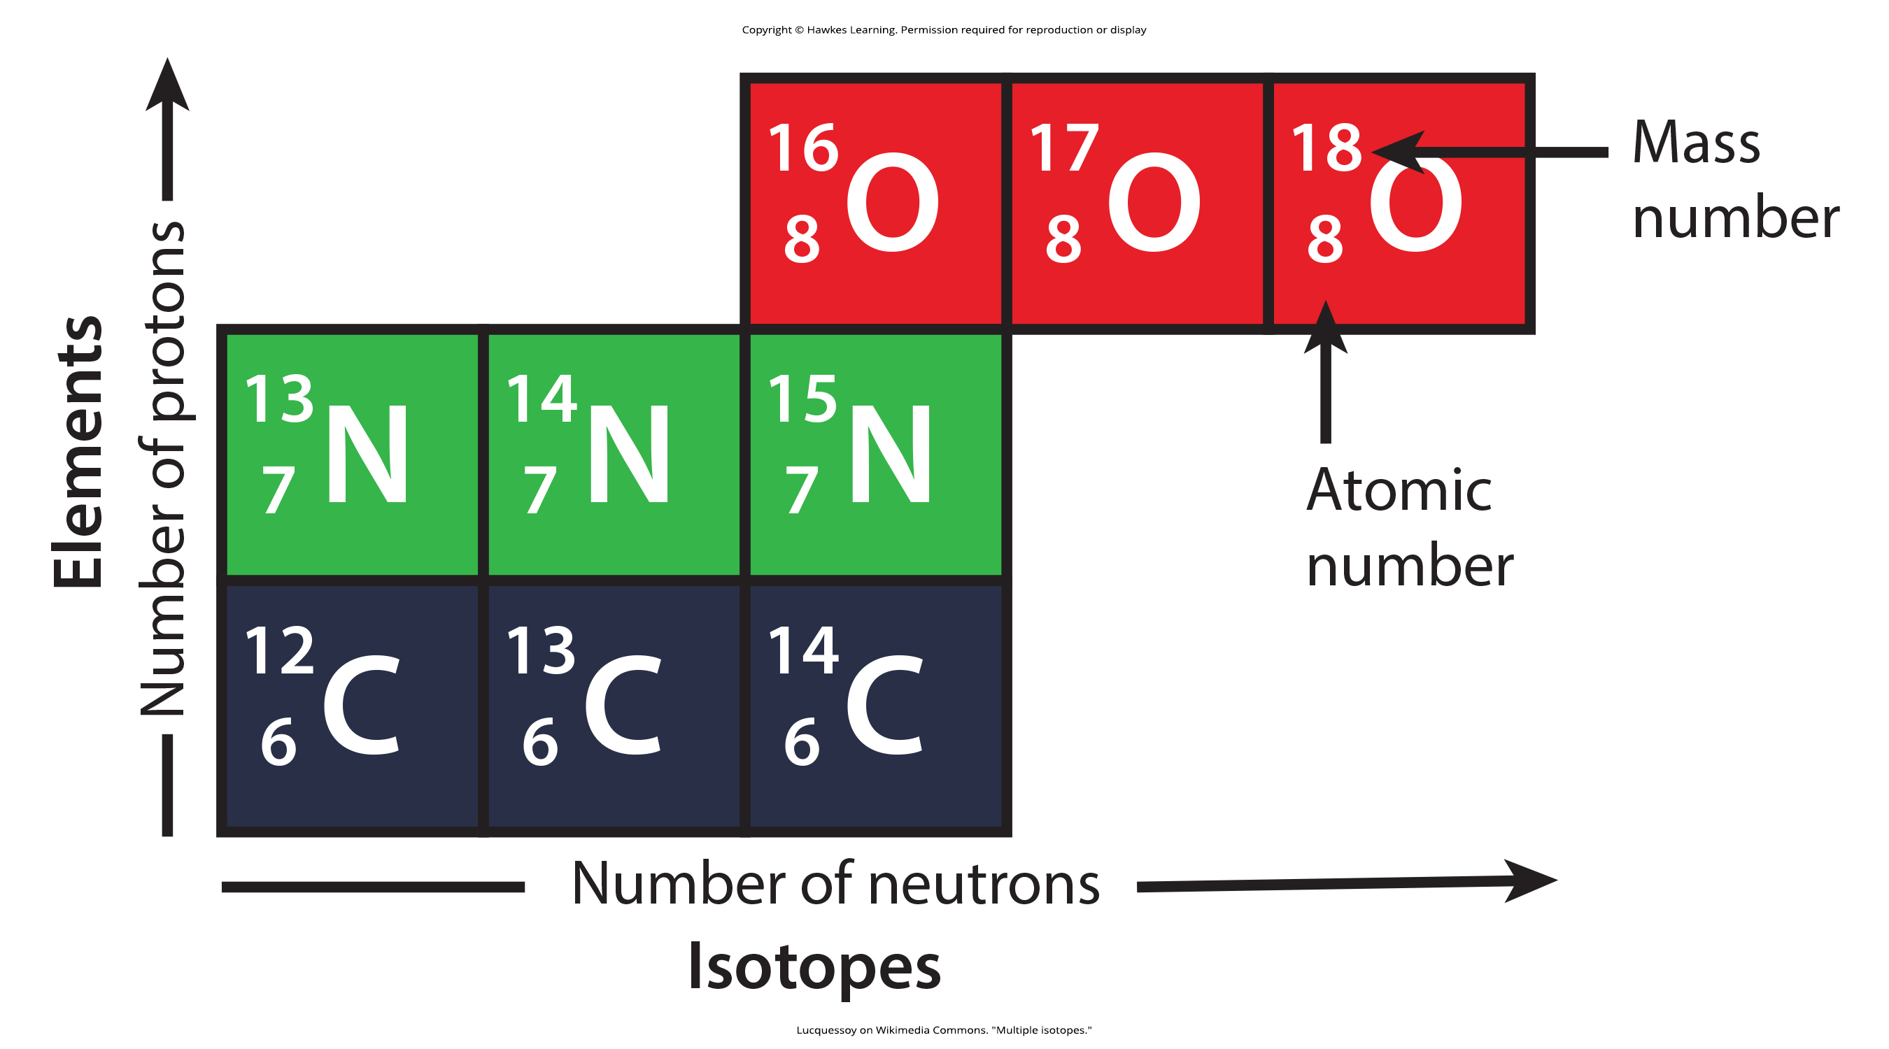
2.1 Figure 3
Lucquessoy on Wikimedia Commons. "Multiple isotopes."

Slide 8
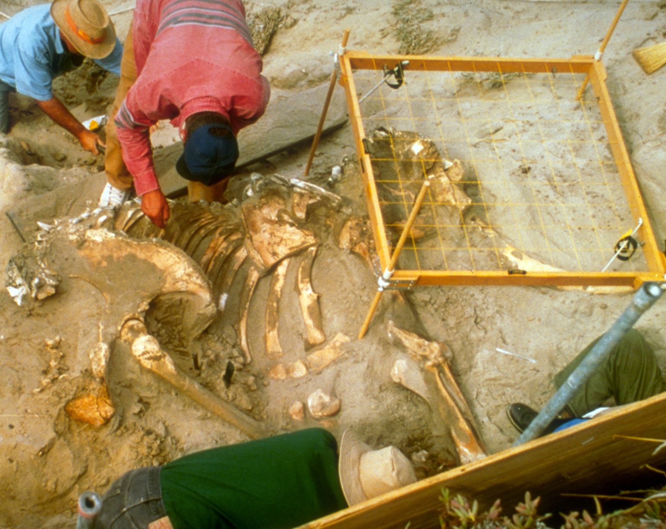
Isotopes
Isotopes are two or more forms of the same element that have different masses (different numbers of neutrons).
Some isotopes are stable, while others are unstable making them radioactive.
Radioactive isotopes emit energy as they eject neutrons, protons, and other particles to become stable.
This radioactive decay transforms one element into another.
2.1 Figure 4: Scientists use carbon isotopes to determine the age of bones.
Bill Faulkner, National Park Service on Wikimedia Commons. "Pygmy mammoth skeleton."

Slide 9
Carbon Dating
Carbon-14 (¹⁴C) is a radioactive isotope created in the atmosphere and incorporated into living organisms.
After death, the ¹⁴C in organisms decays at a known rate.
By comparing ¹⁴C/¹²C ratios, scientists can use carbon dating to determine ages of once-living materials up to 50,000 years old.
For older materials, other radiometric dating methods are used, such as longer-lived isotopes like ⁴⁰K and ²³⁵U.

Slide 10
The Periodic Table
The periodic table organizes elements by their physical properties and chemical reactivity, their ability to chemically bond with each other.
Elements in the same group have similar electron configurations.
Molecules form when atoms chemically bond to each other.

Slide 11
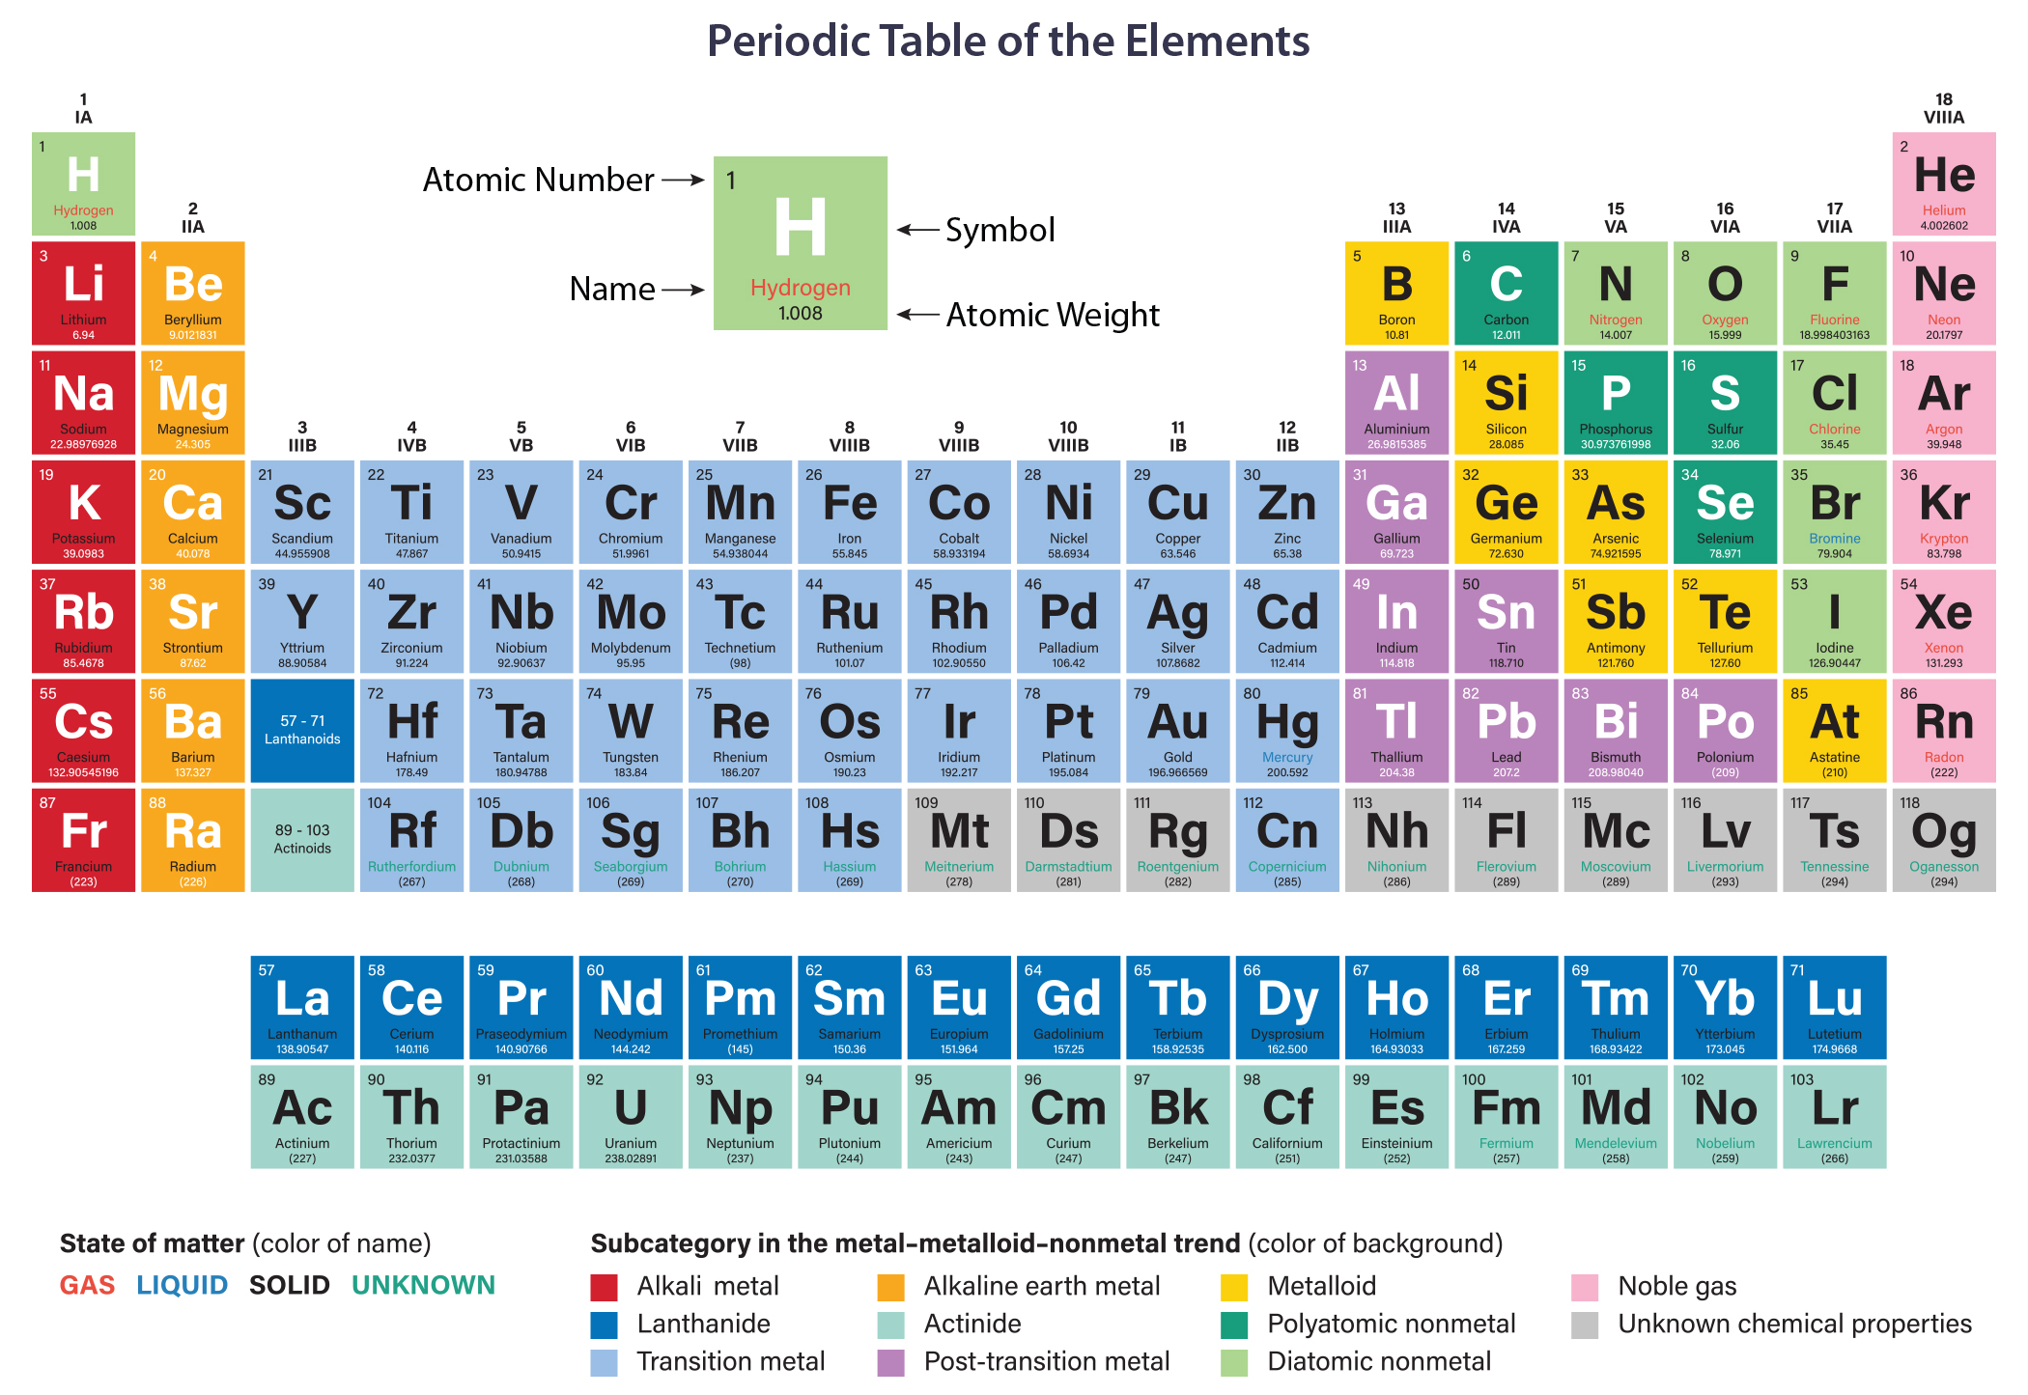
2.1 Figure 5
Notes:
The periodic table shows each element's atomic mass and atomic number. The atomic number appears above the symbol for the element, and the approximate atomic mass appears below it.

Slide 12
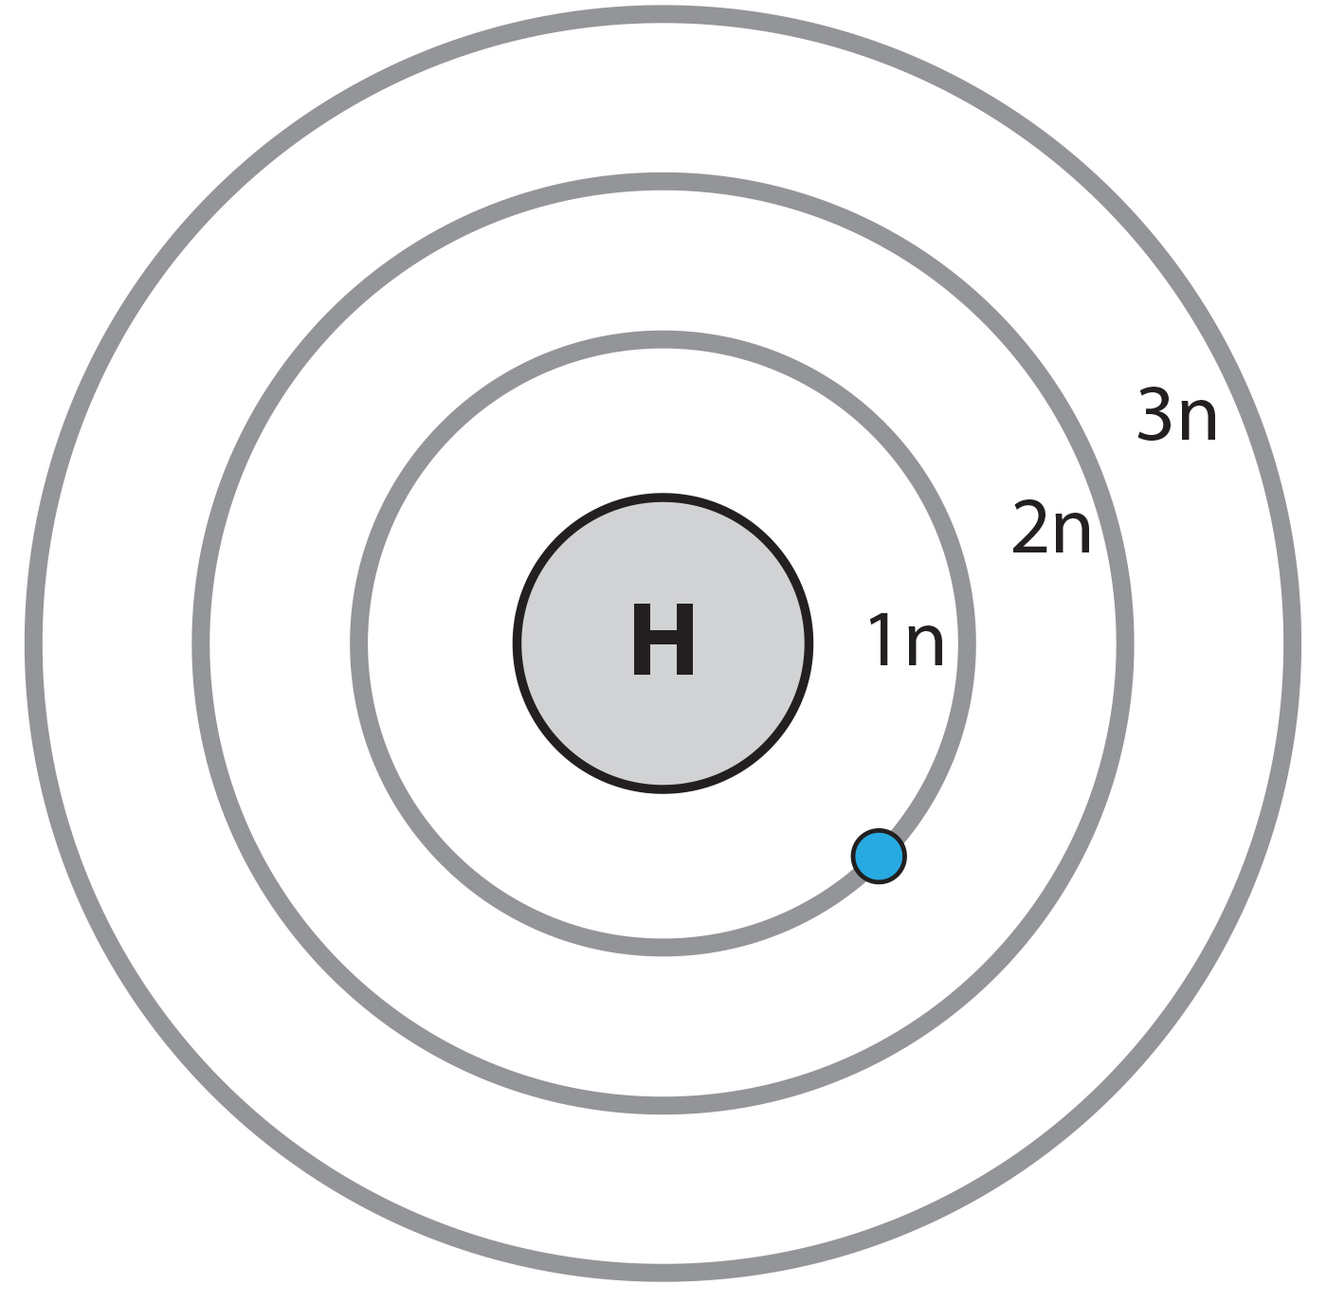
Electron Shells and the Bohr Model
Bohr model: electrons orbit the nucleus in at specific distances from the nucleus in predefined paths
Each orbit forms a shell or an energy levels.
Shells are filled in a consistent order.
Electrons in the outermost shell determine the atom’s stability.
The octet rule states that atoms are stable with 8 electrons in the valence shell, the outermost shell.
2.1 Figure 6
OpenStax. "Bohr model of hydrogen atom." Modified.

Slide 13
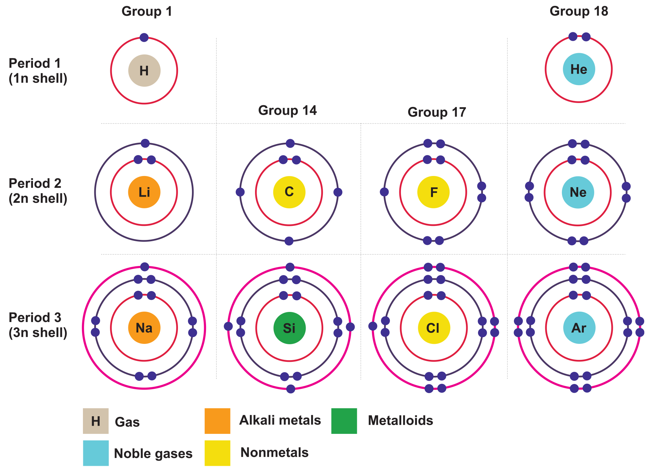
2.1 Figure 7
Notes:
Bohr models indicate how many electrons fill each principal shell. Group 18 elements (helium, neon, and argon) have a full outer, or valence, shell. A full valence shell is the most stable electron configuration. Elements in other groups have partially filled valence shells and gain or lose electrons to achieve a stable electron configuration.

Slide 14
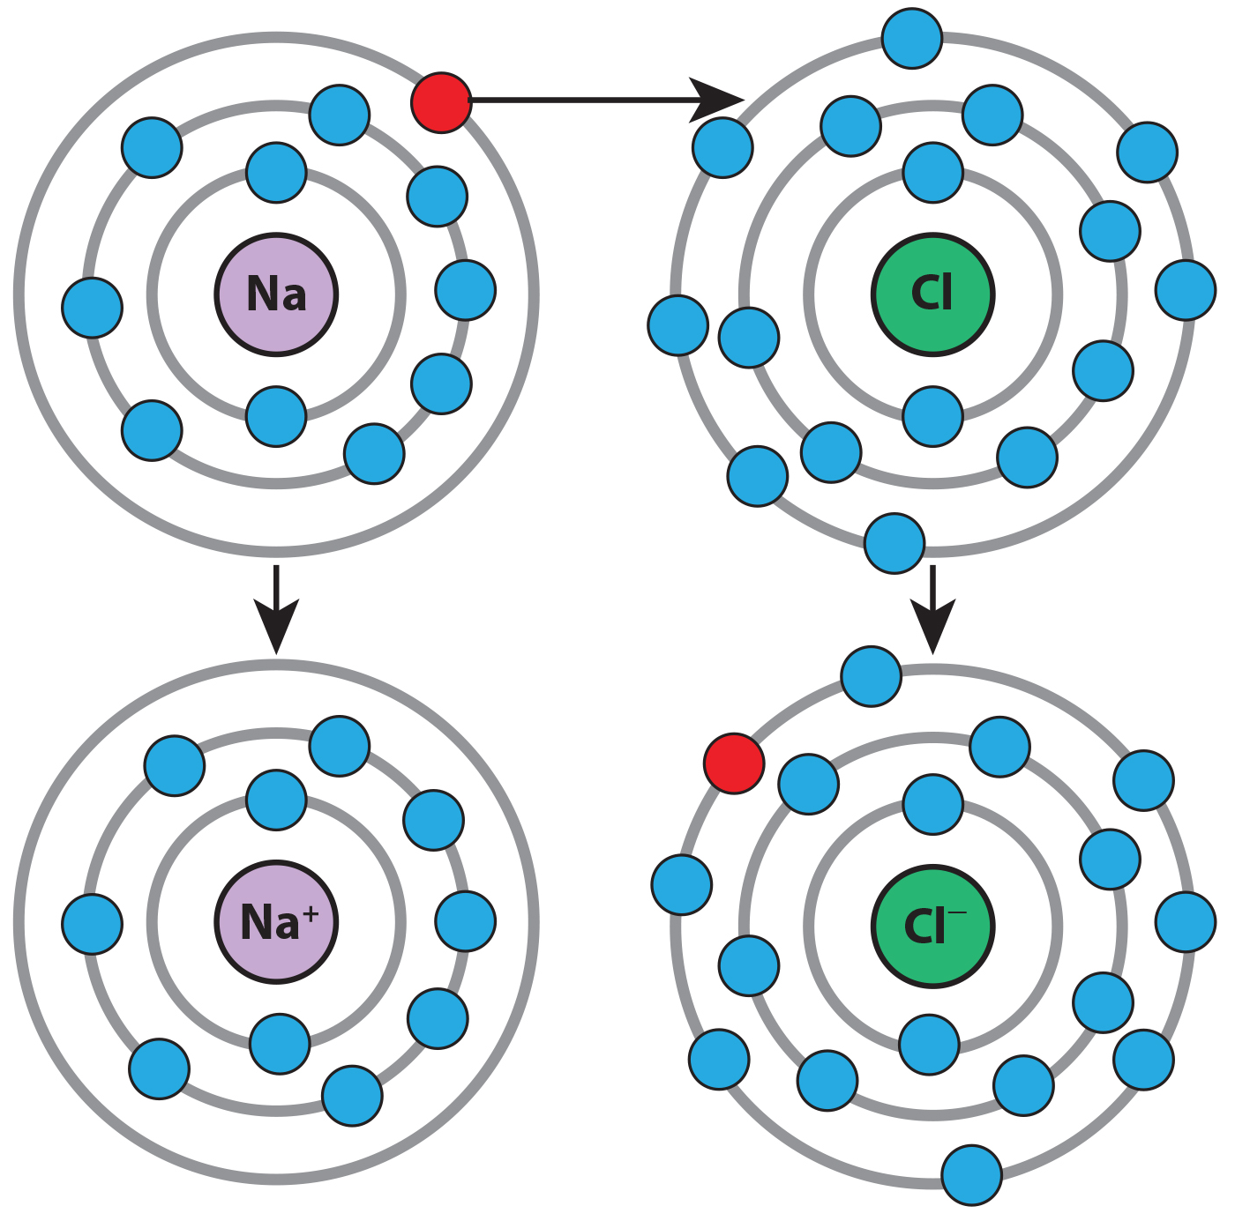
Electron Configurations and Chemical Reactivity
Elements in the same group on the periodic table have the same number of electrons in their outer shell.
Group 18 (He, Ne, Ar) atoms all have full outer electron shells making them very stable and nonreactive or inert. T
Known as the noble gases
Group 1 (H, Li, Na) atoms readily lose or share their one outer electron
Example: sodium readily donates an electron to chorine
2.1 Figure 8
OpenStax. "Sodium and chlorine ions." Modified.

Slide 15
Electron Orbitals
Scientists now use the electron cloud, or quantum mechanical, model instead of the Bohr model.
Electrons behave as particles and waves; their location is within electron orbitals within the energy levels.
An electron orbital is a region in space in which the electron is likely to be at any given time.
Subshells are designated s, p, d, f and can hold varying numbers of orbitals and electrons
Each orbital can hold a maximum of 2 electrons.
Electrons fill orbitals from the lowest to the highest energy levels

Slide 16
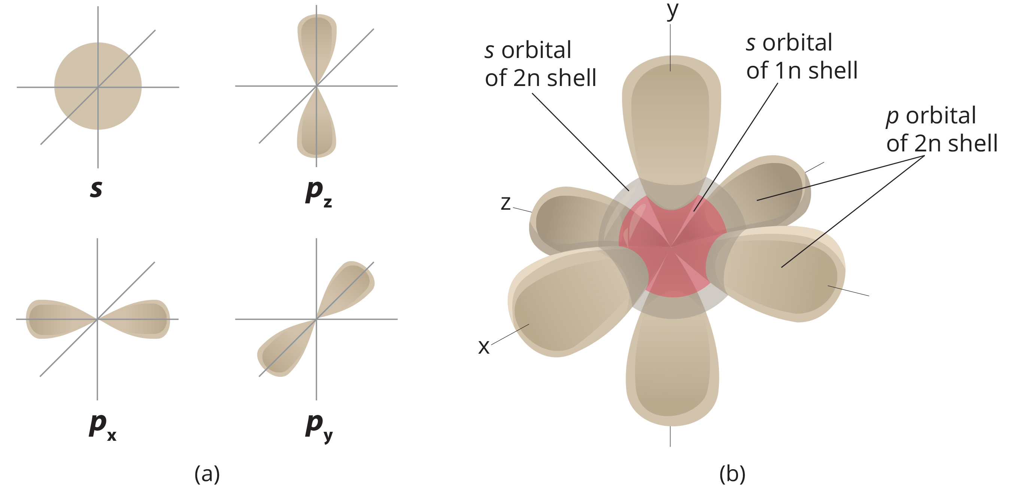
2.1 Figure 9
Notes:
(a) The s orbital is shaped like a sphere, while the three p orbitals (p_{x}, p_{y}, and p_{z}) are shaped like dumbbells oriented at right angles to one another. (b) In an atom with a full 2n principal shell, the s orbital of the 1n principal shell, the s orbital of the 2n principal shell, and the three p orbitals of the 2n principal shell contain electrons. Principal shell 2n has a p subshell, but shell 1n does not.

Slide 17
Group Activity₁
As a group, have each member choose an element from periods 2, 3, or 4 from the periodic table not already discussed in the text. Then, work together to determine each element's electron configuration.

Slide 18
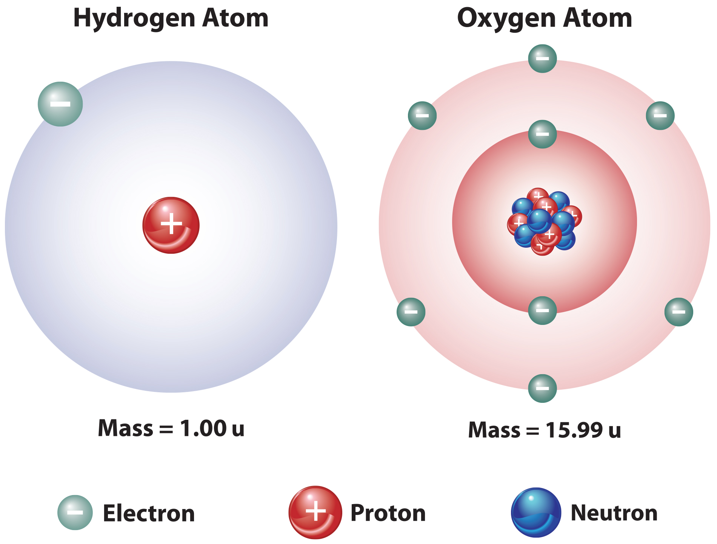
Chemical Reactions and Molecules
Elements are the most stable when their outermost electron shell is filled (octet rule).
Atoms form chemical bonds to obtain stable electron configurations.
When atoms chemically bond the resulting structure is a molecule.
The water molecule (H₂O) consists of two hydrogen atoms and one oxygen atom bonded together.
Atoms bond by donating, accepting, or sharing electrons to fill their outer shells.
2.1 Figure 10

Slide 19
Chemical Reactions and Balanced Equations
Chemical reactions occur when atoms bond to form molecules or when bonds break.
The substances at the start are reactants and the substances at the end are products.
The arrow shows the general direction of the reaction.
2H + O → H₂O
Reactions must have balanced chemical equations, where each element’s number of atoms is the same on each side of the equation.
Law of conservation of matter states no matter can be created or destroyed.

Slide 20
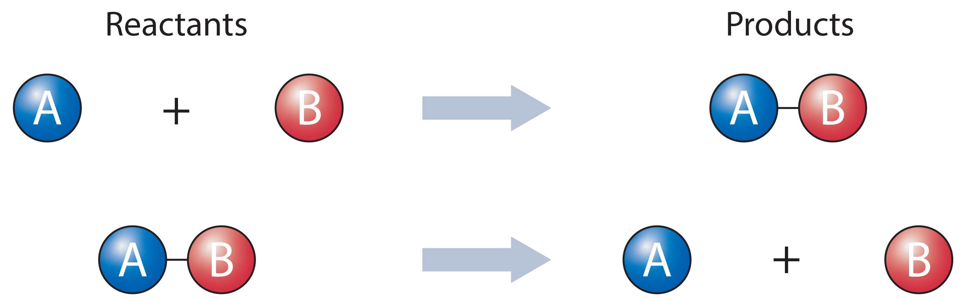
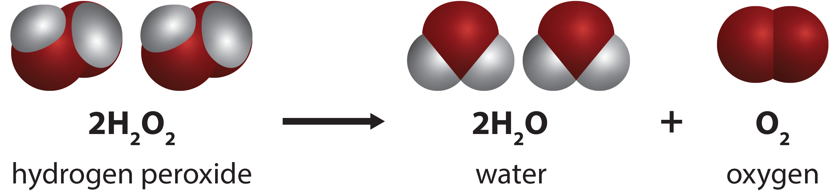
2.1 Figures 11 & 12
2.1 Figure 11: Two types of chemical reactions are shown here. In some chemical reactions, reactants are joined to form a product. In other chemical reactions, a reactant is split to form smaller products.
Daniele Pugliesi on Wikimedia Commons. "Chemical reactions."
2.1 Figure 12: The degradation of hydrogen peroxide to water and oxygen is an example of a chemical reaction. Note that this chemical reaction is balanced, meaning that the number and types of atoms are the same on each side of the equation.
Stephen A. Whitmore, PhD. "Hydrogen peroxide equation."

Slide 21
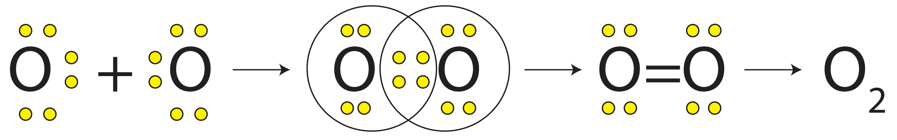
Types of Chemical Reactions: Irreversible vs Reversible
Compounds contain atoms of multiple elements, homonuclear molecules contain atoms from one element.
Irreversible reactions proceed in one direction until reactants are consumed.
Reversible reactions can go in both directions and are denoted by a double-headed arrow.
At equilibrium, forward and reverse rates are equal.
Example: in human blood excess hydrogen ions bind to bicarbonate ions forming carbonic acid, which can be converted to carbon dioxide and water. HCO₃⁻ + H⁺ ↔ H₂CO₃ ↔ CO₂ + H₂O
2.1 Figure 13
Drago Karlo on Wikimedia Commons. "Double bond."

Slide 22
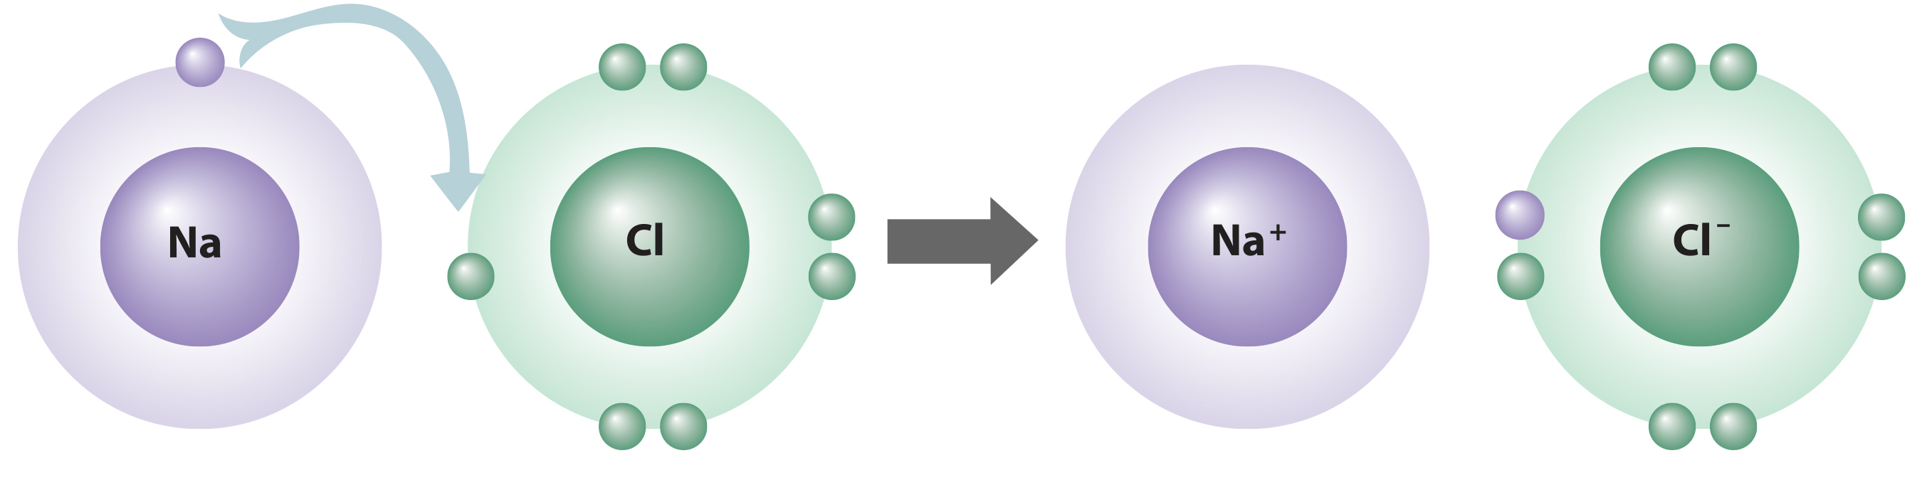
Ions and Ionic Bonds
Ions form when atoms gain or lose electrons to become more energetically stable, resulting in charged ions.
Cations are positively charged; anions are negatively charged.
Ionic bonds form between oppositely charged ions.
Electrolytes are ions crucial for biological processes.
2.1 Figure 14

Slide 23
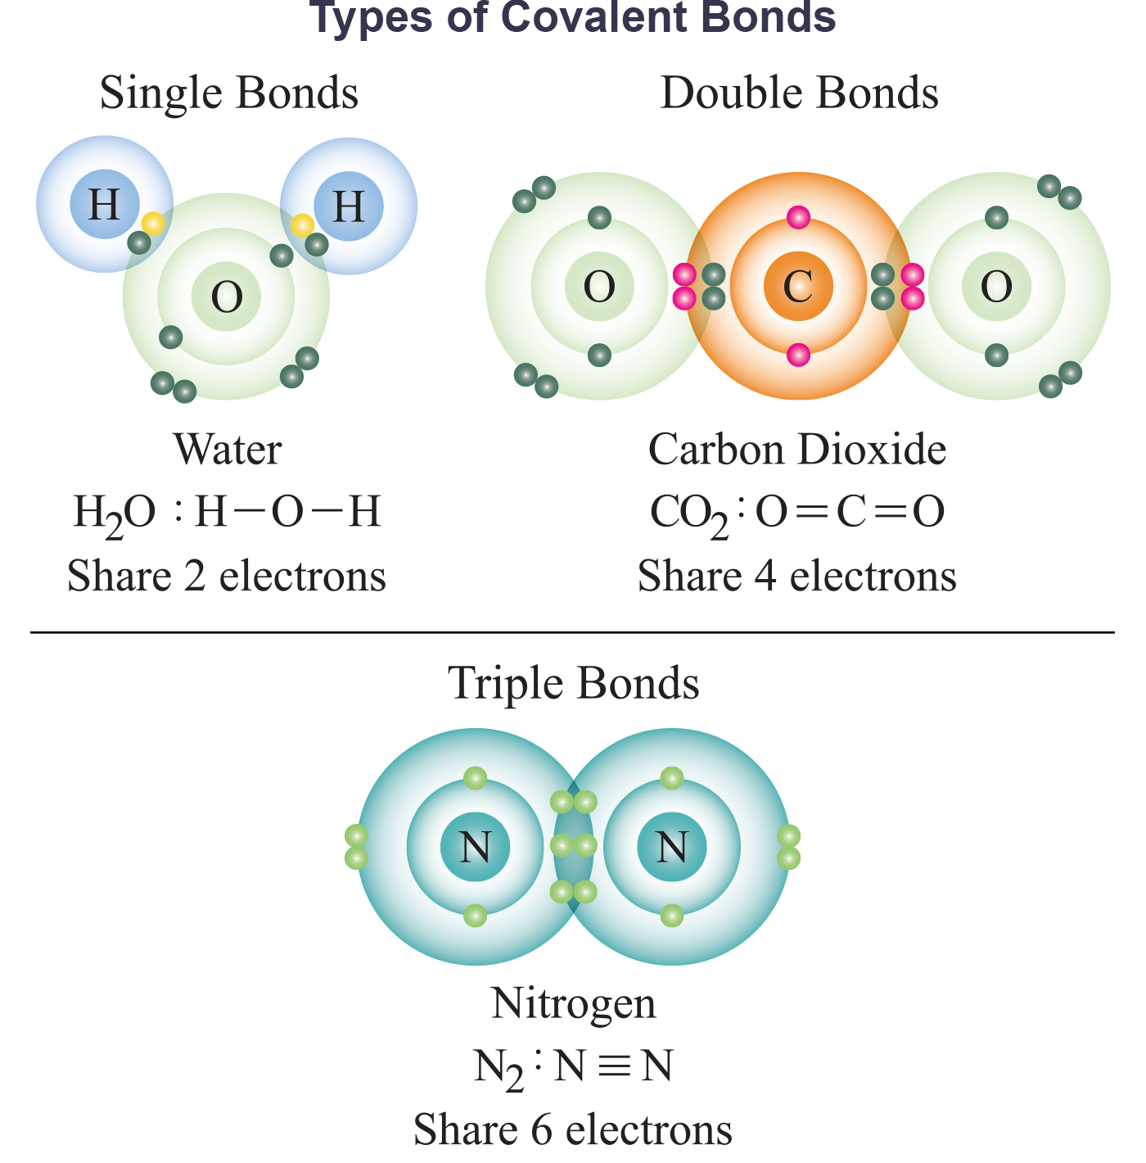
Covalent Bonds and Other Interactions
Covalent bonds involve sharing electron pairs between atoms to satisfy the octet rule.
Common in carbon-based organic molecules like DNA and proteins.
Can share one, two, or three pairs of electrons making single, double, and triple bonds.
Bond strength increases with more shared electron pairs.
2.1 Figure 15

Slide 24
Polar Covalent Bonds
There are polar covalent bonds where electrons are unequally shared, creating partial positive and negative charges.
These partial charges form dipoles, with one end more positive and the other end more negative.
Oxygen's high electronegativity causes the partial negative charge in water molecules.
Partial charges from polar bonds dictate interactions between molecules like hydrogen bonds.
Macromolecules like proteins often have polar bonds due to varying electronegativities.

Slide 25
Nonpolar Covalent Bonds
In a nonpolar covalent bond, electrons are equally shared, resulting in a neutral molecule.
Nonpolar bonds form between atoms of the same element or with similar electronegativities.
Methane (CH₄) has nearly nonpolar covalent bonds between C and H atoms.
Though C=O bonds in CO₂ are polar, the molecule overall is nonpolar due to its linear symmetry.

Slide 26
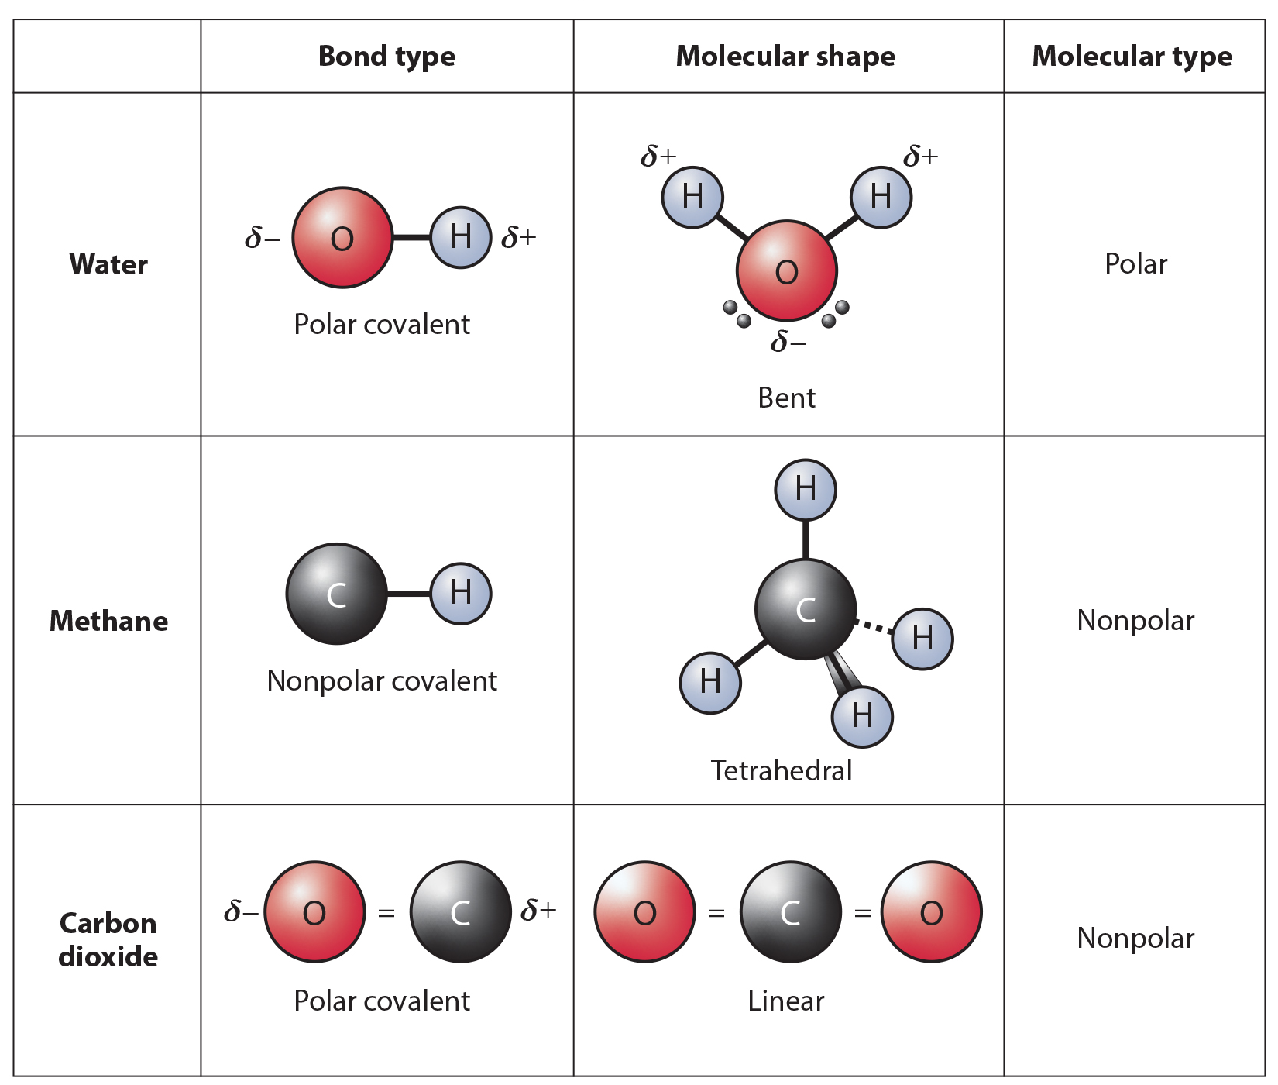
2.1 Figure 16
OpenStax. "Polar and nonpolar molecules." Modified.
Notes:
Whether a molecule is polar or nonpolar depends both on bond type and molecular shape. Both water and carbon dioxide have polar covalent bonds, but carbon dioxide is linear, so the partial charges on the molecule cancel each other out.

Slide 27
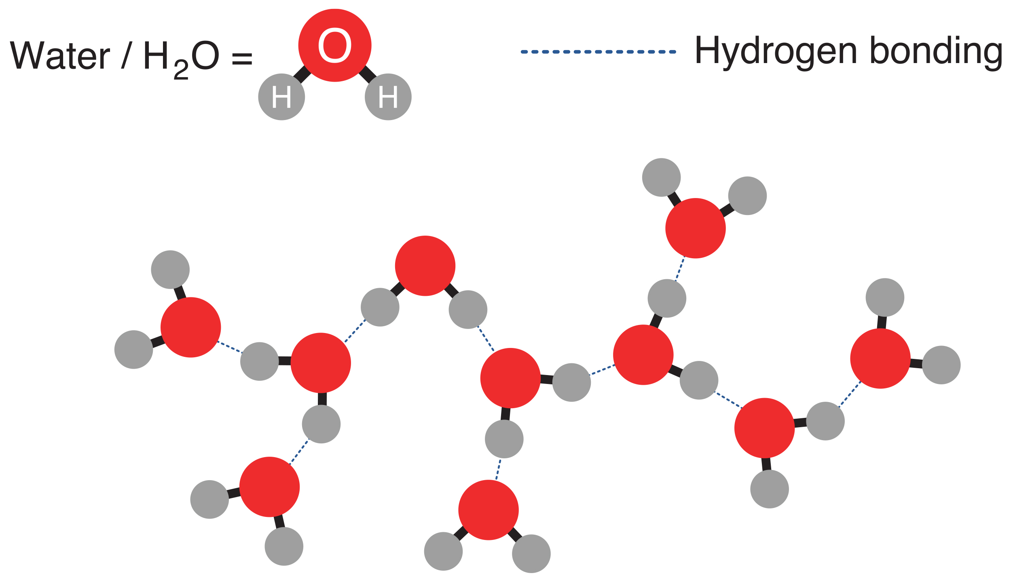
Forces Between Molecules: Hydrogen Bonds
Hydrogen bonds are bonds that form between a positively charged hydrogen on one polar molecule and the negatively charged oxygen on the other.
Provide critical, life-sustaining properties of water and stabilize structures of proteins and DNA.
2.1 Figure 17

Slide 28
Group Activity₂
As a group, make a list of the types of chemical bonds and interactions discussed in this chapter. Work together to briefly describe each, providing at least one example. If possible, use the internet to find additional examples not already mentioned in the text. Then, compare and contrast the different types of bonds and interactions. Which are between atoms within a molecule? Which are between molecules?

Slide 29
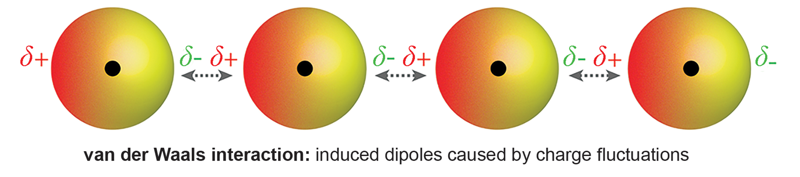
Intermolecular Forces: Van der Waals Interactions
Van der Waals interactions are weak attractions between positive and negative regions of molecules.
They occur in both polar molecules with permanent dipoles and nonpolar molecules with temporary dipoles.
Along with other bonds, van der Waals interactions contribute to the structure of important biomolecules like proteins.
2.1 Figure 18

Slide 30
Science and You
Career: Pharmaceutical Chemist
Pharmaceutical chemists develop new drugs and study how existing drugs work.
Their work involves drug development, testing, approval processes, and analyzing effectiveness and side effects.
Well-known drug discoveries include Paclitaxel from yew trees and aspirin from willow bark.
Notes:
This is included as a relevant application for this topic.

Slide 31
Summary
Matter is anything that occupies space and has mass.
It is composed of 98 naturally occurring elements.
Elements combine to form molecules, cells, tissues, organs, and organisms.
Atoms are smallest units of an element that retain element properties.
Bonds form between atoms through electron interactions including ionic, covalent, and hydrogen bonds, along with van der Waals interactions.

Slide 32


End of Hawkes Learning PowerPoint

