Slide 1
Lesson 2.2
Properties of Water

Slide 2
Objectives
Describe the properties of water that are critical to maintaining life.
Discuss the role of acids, bases, and buffers in homeostasis.
Explain why water is an excellent solvent.
Provide examples of water's cohesive and adhesive properties.
Understand the pH scale, acids, and bases.

Slide 3
Properties of Water
Water is essential for life on Earth.
60–70% of the human body is composed of water.
Water is a polar molecule with slightly positive and negative charges.
Water's polarity and hydrogen bonding make it a unique substance.

Slide 4
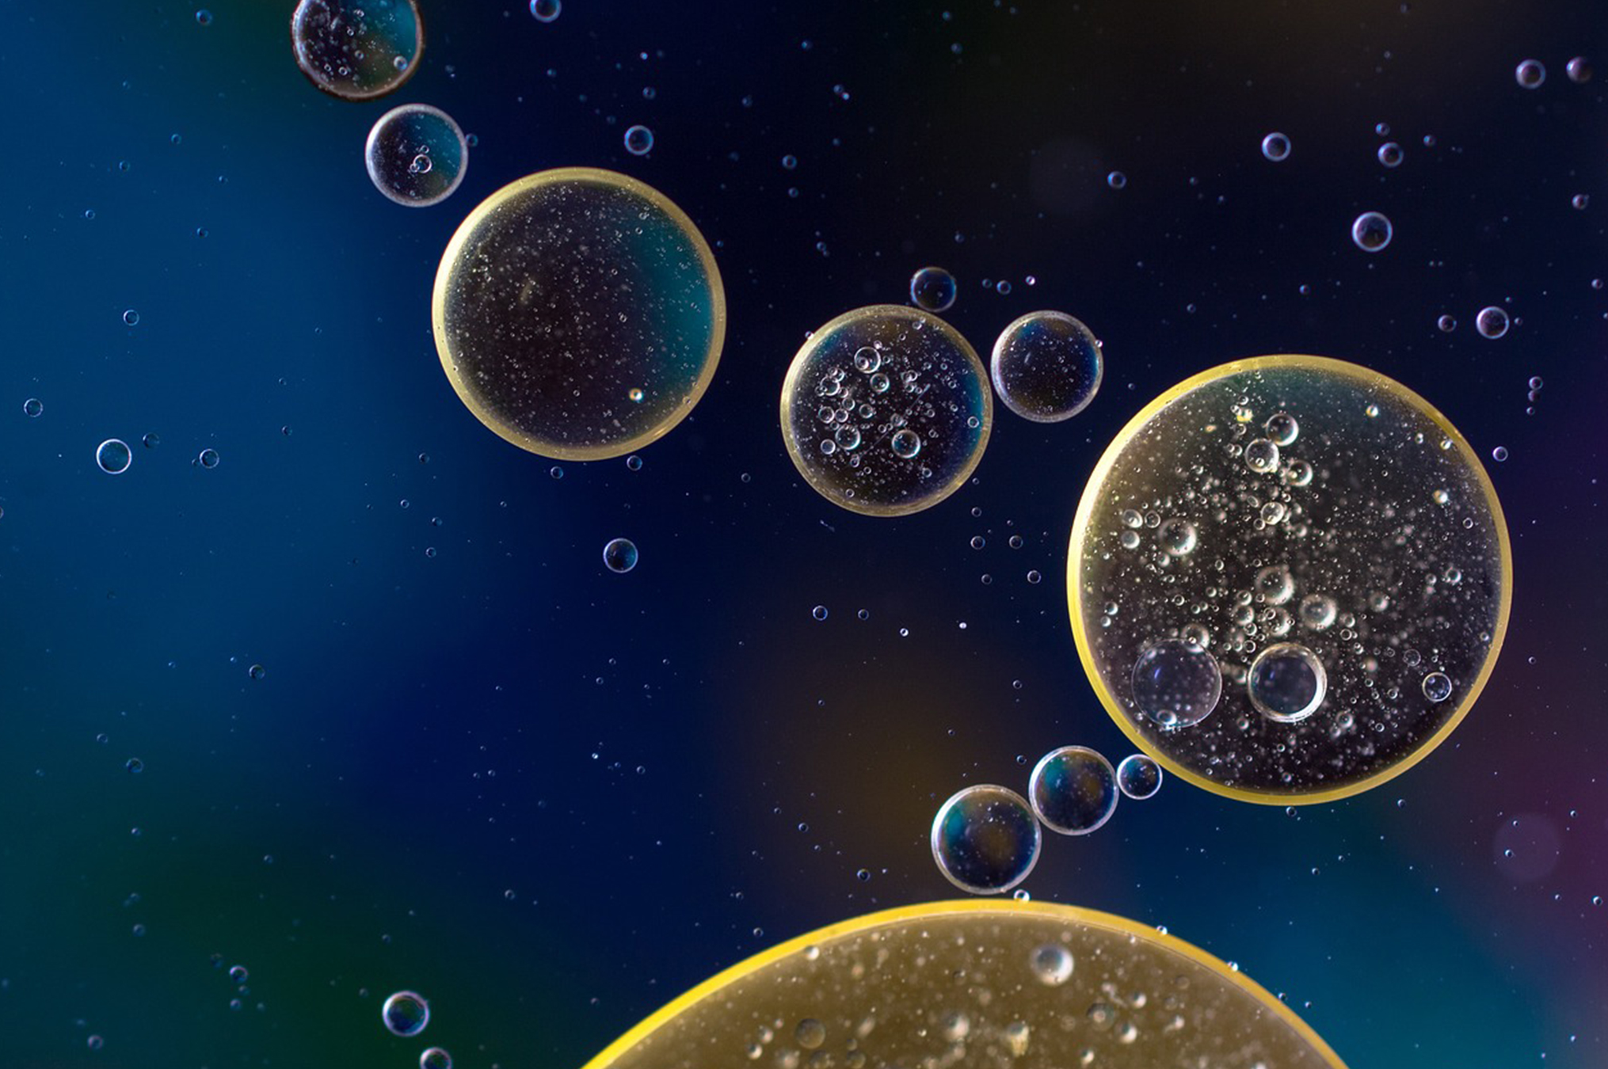
Water's Polarity
Water molecules are polar.
Slightly positive charge on hydrogen atoms
Slightly negative charge on the oxygen atom
The charge distribution is due to oxygen's tendency to attract shared electrons towards itself.
Water molecules form hydrogen bonds with other water molecules due to opposite charges.
2.2 Figure 1
A Different Perspective on Pixabay. "Oil and water."

Slide 5
Water Is Hydrophilic
Hydrophilic: (hydro- = water; -philic = loving)
Polar molecules that interact well with polar molecules
Water is hydrophilic (attracts polar molecules).
Hydrophobic: (hydro- = water; -phobic = fearing)
Uncharged nonpolar molecules that do not interact well with polar molecules
Nonpolar substances are hydrophobic.

Slide 6
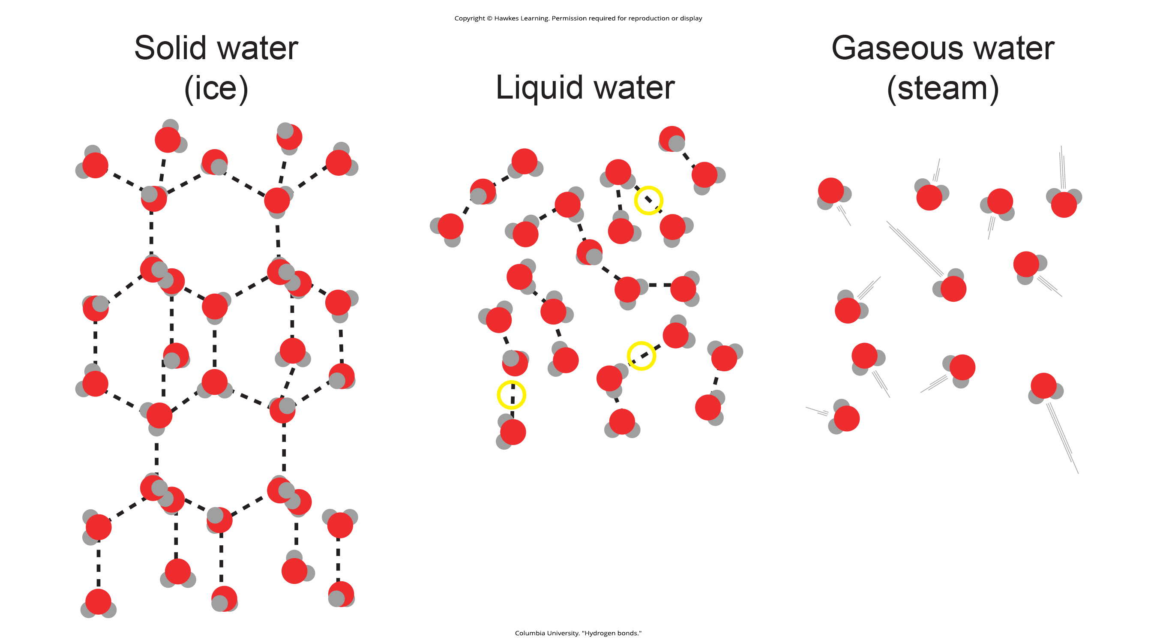
States of Water
Water can exist as a solid, liquid, or a gas.
2.2 Figure 2: Hydrogen bonds are present in the liquid and solid state of water molecules. When hydrogen bonds are broken, water molecules mole apart and form a gas.
Columbia University. "Hydrogen bonds."

Slide 7
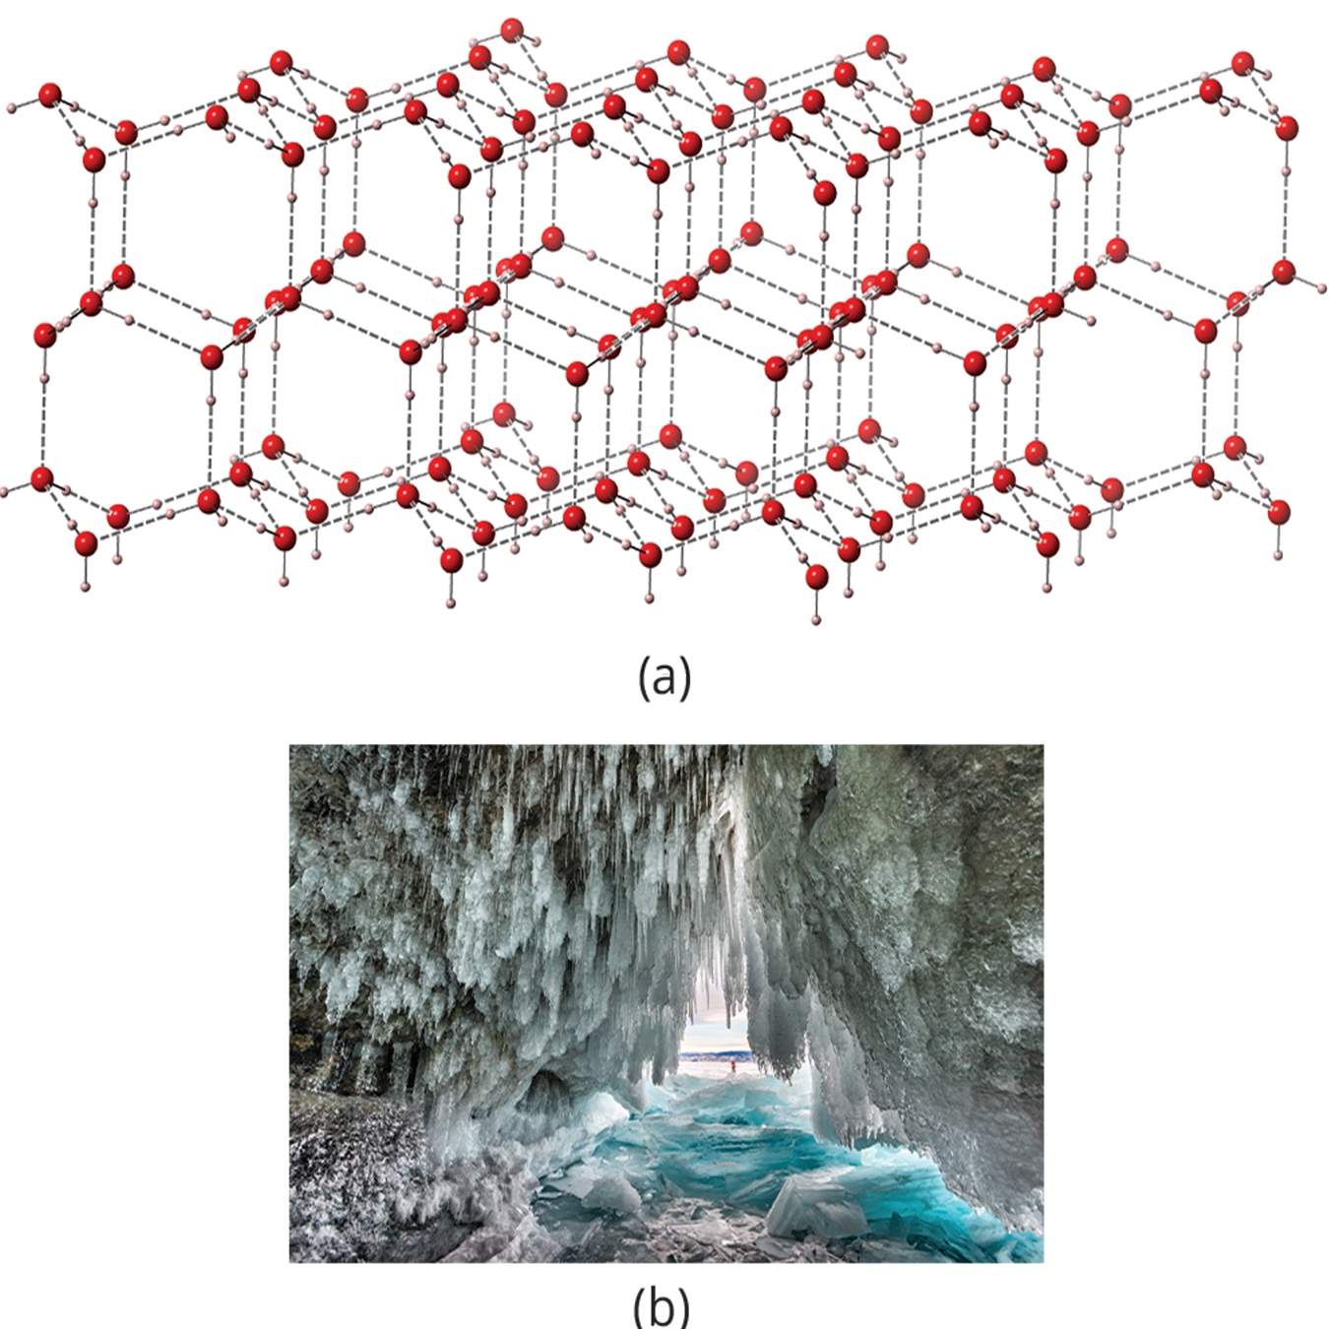
Water as a Solid
Water molecules form a crystalline structure.
The structure is maintained by fixed hydrogen bonds.
Makes ice less dense than liquid water
Ice floats on liquid water, creating an insulating barrier that protects aquatic life from freezing.
2.2 Figure 3: Hydrogen bonding makes ice less dense than liquid water. The (a) lattice structure of ice makes it less dense than the liquid water's freely flowing molecules, enabling it to (b) float on water.
Sergey Pesterev on Wikimedia Commons. "Ice cave."

Slide 8
Water as a Liquid
Water molecules are packed tightly together.
They are constantly forming and breaking hydrogen bonds.
2.2 Figure 2
Columbia University. "Hydrogen bonds."

Slide 9
Water as a Gas
When heated water molecules gain enough kinetic energy, their hydrogen bonds break.
Water molecules then escape as a gas.
Example: when water is boiled
2.2 Figure 2
Columbia University. "Hydrogen bonds."

Slide 10
Heat Capacity
Specific heat capacity: the amount of heat one gram of a substance must absorb or lose to change its temperature by one degree Celsius
Water has a high specific heat capacity.
It requires a lot of energy to increase its temperature.
It is caused by hydrogen bonding among water molecules.

Slide 11
Benefits of High Heat Capacity
Helps warm-blooded animals maintain a more even body temperature
Acts as a heat sink—absorbing and storing a large amount of energy from heat

Slide 12
Heat of Vaporization
Heat of vaporization: high amount of energy required for liquid water to turn into water vapor
Water has a high heat of vaporization.
It requires a large amount of energy to change from liquid to gas.
This energy is required to break the hydrogen bonds holding water molecules together.

Slide 13
Benefits of High Heat of Vaporization
Helps cool the environment through evaporation
Example: evaporating sweat carries away heat energy from the body, helping organisms cool down

Slide 14
Reflection Question
Why do you think that jumping into a swimming pool on a hot summer's day helps your body cool off?
Notes:
The reflection question is included here to use as a talking point or for a think-pair-share activity.

Slide 15
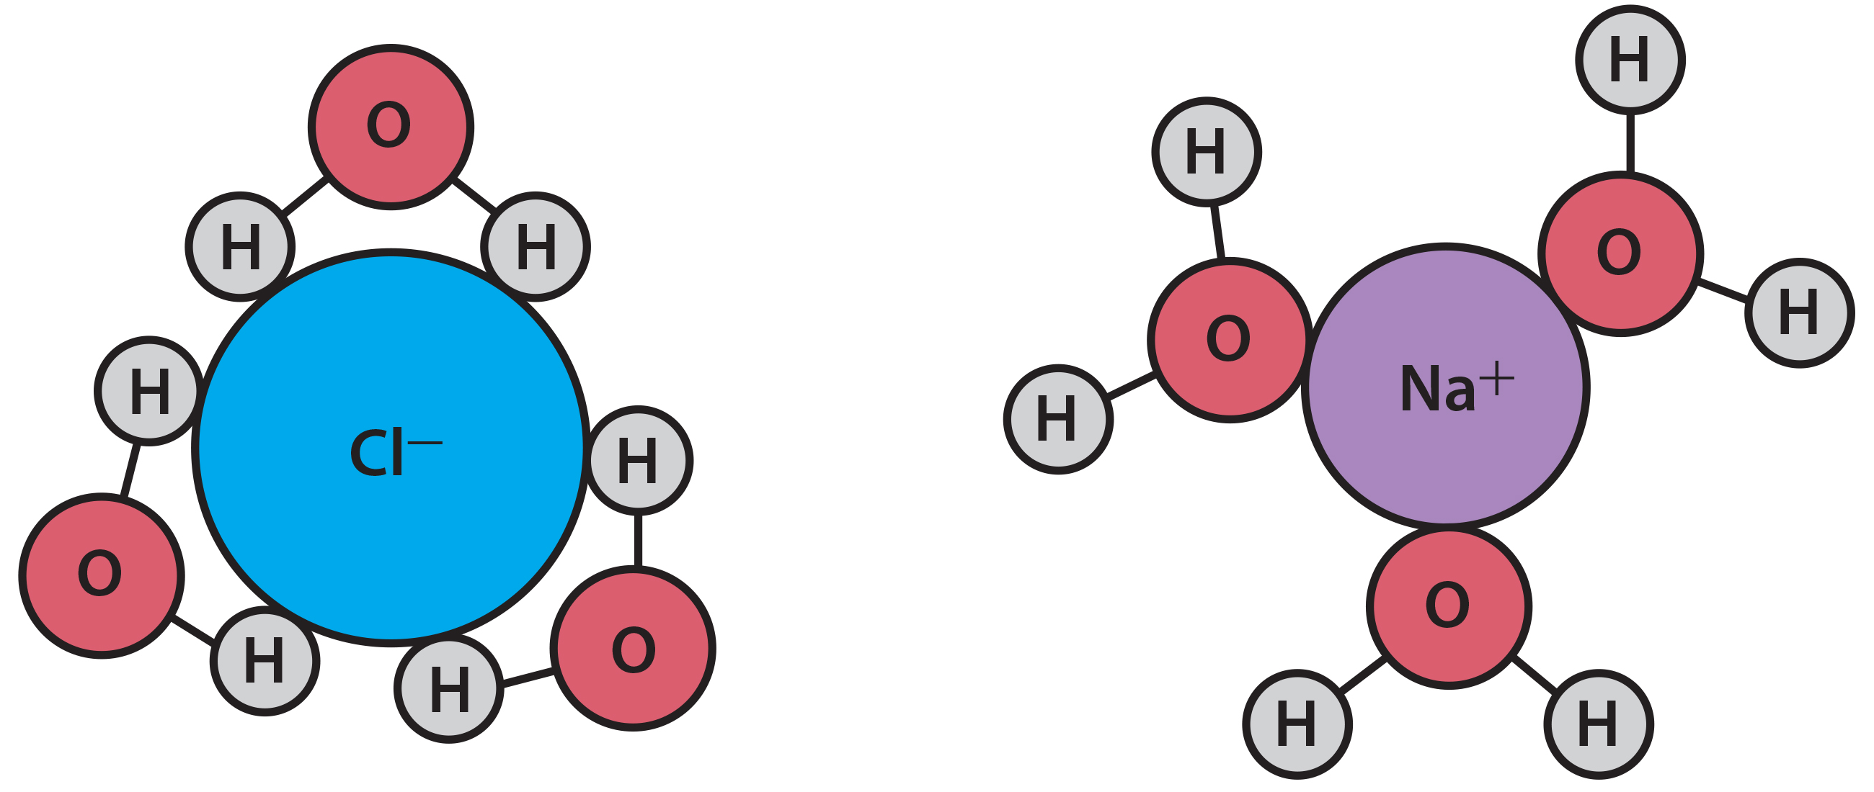
Water as a Solvent
Water is a polar solvent capable of dissolving polar molecules and ionic compounds.
Charged particles form hydration shells, surrounded by water molecules through hydrogen bonding.
Ionic compounds dissociate in water, forming ions surrounded by water molecules.
2.2 Figure 4
CNX OpenStax on Wikimedia Commons. "NaCl dissolved in water." Modified.

Slide 16
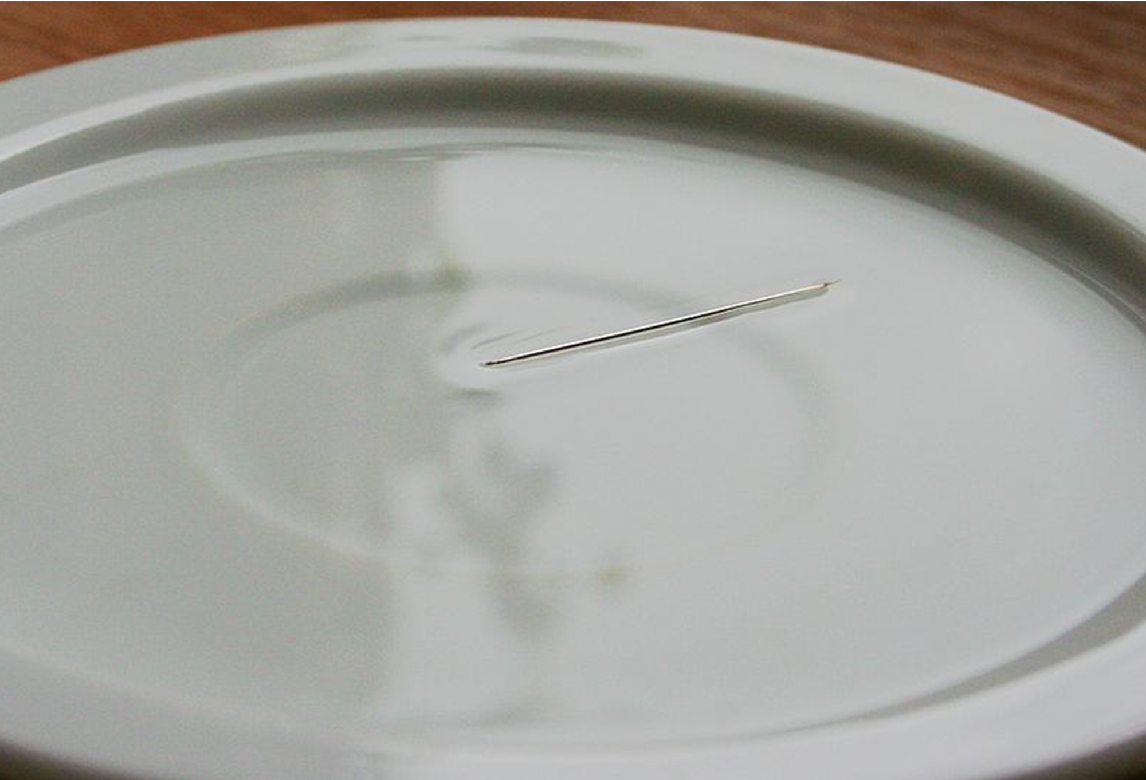
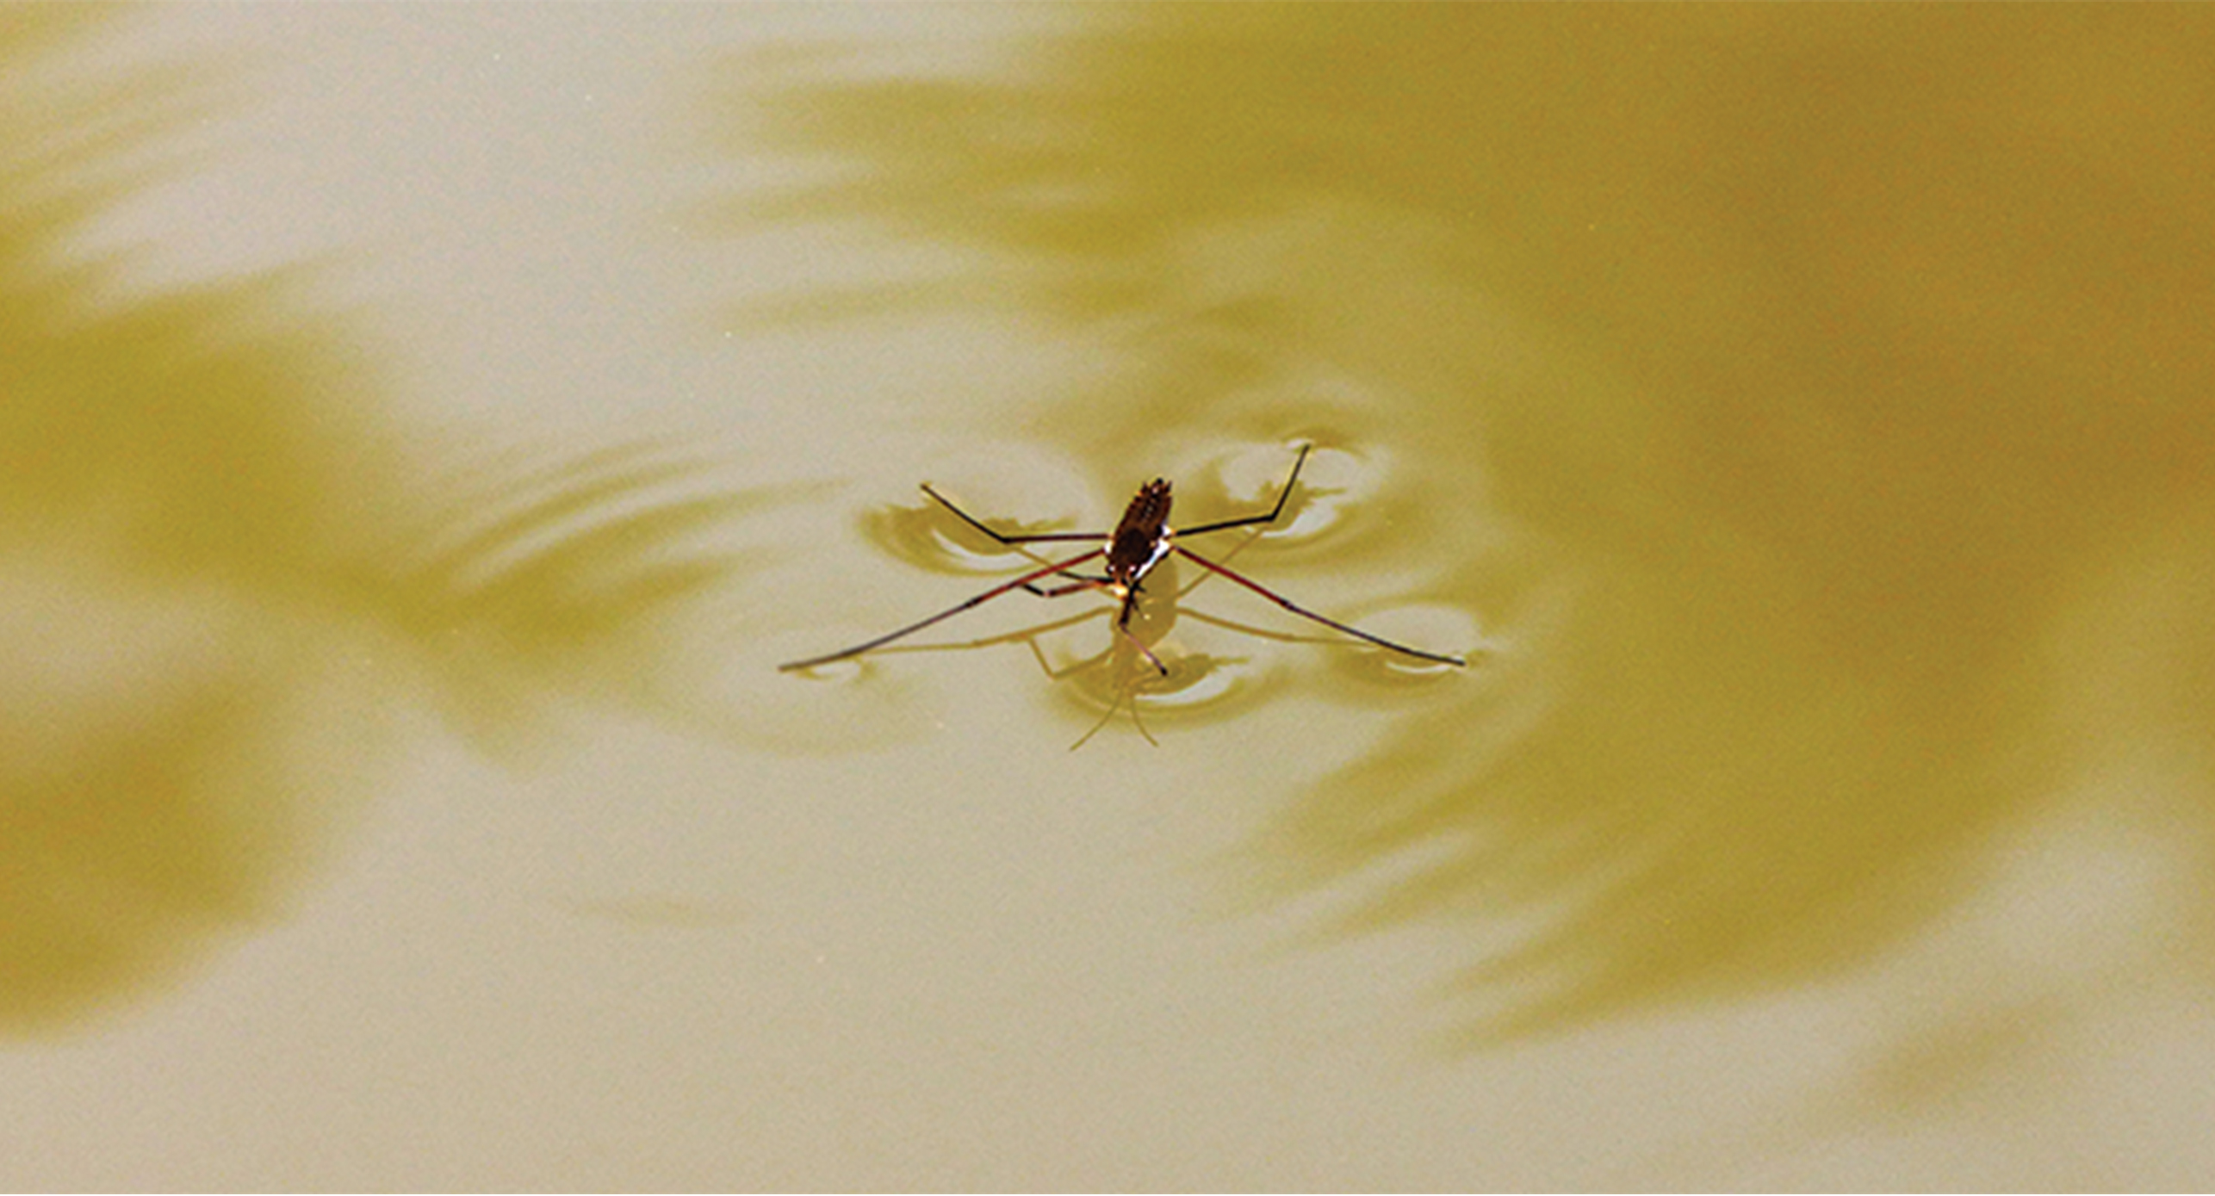
Cohesion
2.2 Figure 5
Cohesion: intermolecular forces between water molecules caused by the polar nature of water
Cohesion allows for surface tension, enabling water to resist rupturing when under stress.
Surface tension allows some objects to float on water despite being denser.
Johan commonswiki on Wikimedia Commons. "Needle on water."
2.2 Figure 7
MarPockStudios on Pixabay. "Insect on water."

Slide 17
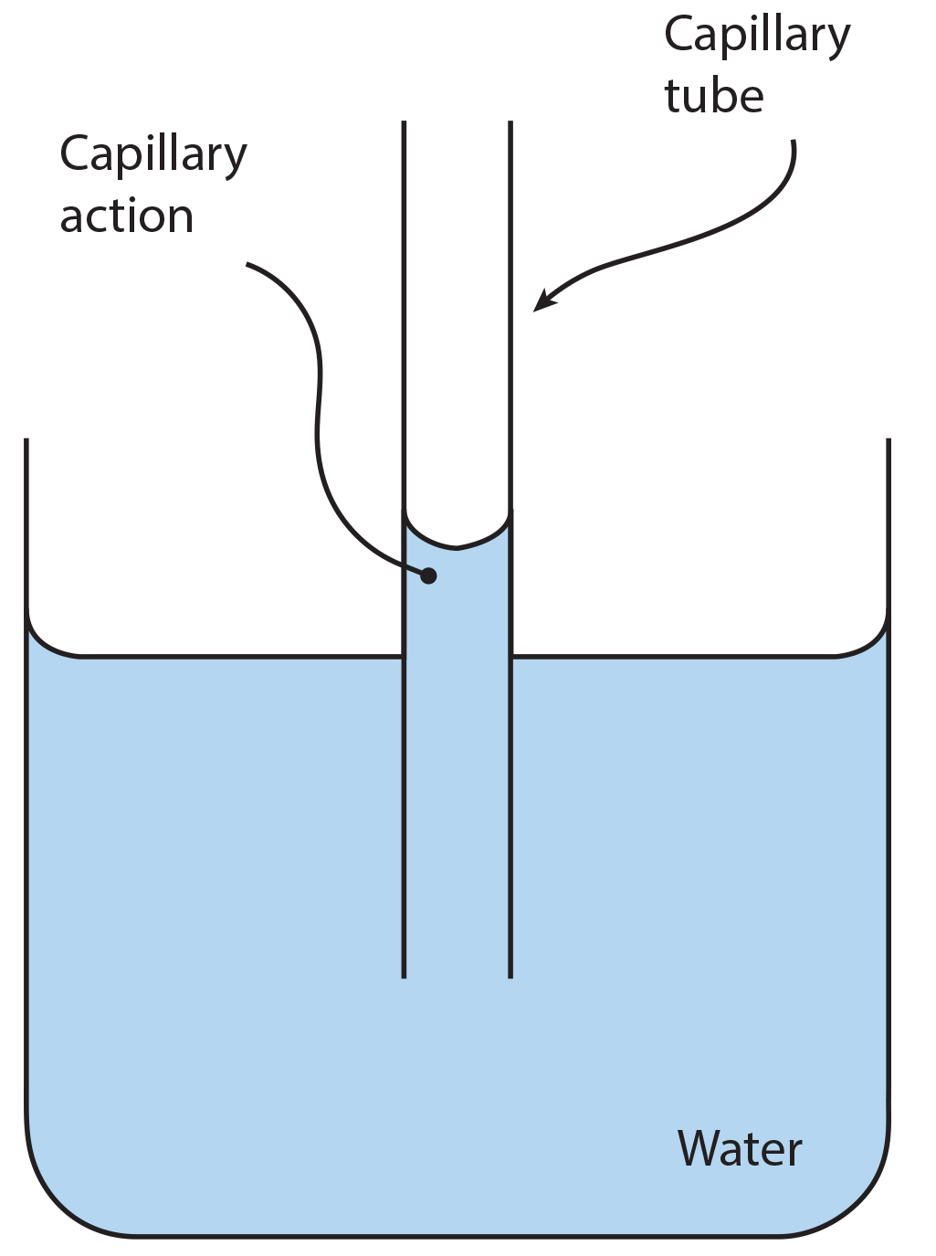
Adhesion
Adhesion: attraction between water molecules and other molecules
Often stronger than cohesion
Causes water to "climb" up narrow tubes (capillary action)
Water adheres to charged surfaces, such as the inside of capillary tubes.
2.2 Figure 6
Pearson-Scott Foresman, donated to the Wikimedia Foundation. "Capillary action." Modified.

Slide 18
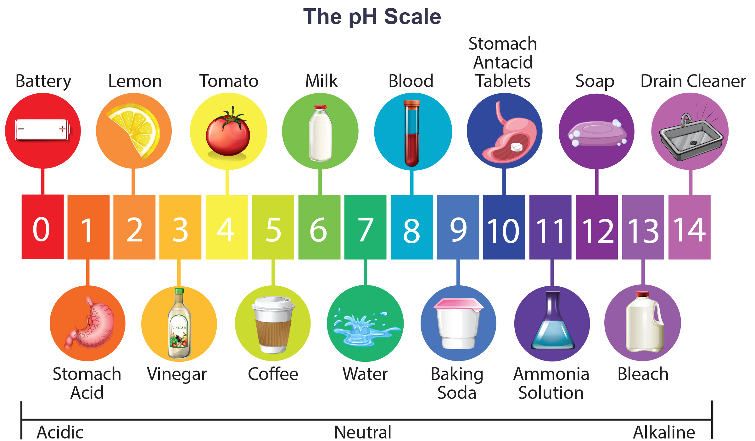
pH
pH measures the concentration of hydrogen ions (H⁺) in a solution.
pH = -log[H⁺]
Pure water has a neutral pH of 7.0, with equal concentrations of H⁺ and OH⁻.
Acid: pH < 7, [H⁺] > [OH⁻]
Base: pH > 7, [OH⁻] > [H⁺]
2.2 Figure 8

Slide 19
Acids
Acids: substances that donate hydrogen ions (H⁺) to a solution
Strong acids readily donate H⁺, such as hydrochloric acid (HCl).
Weak acids, like those in tomato juice or vinegar, do not completely dissociate.

Slide 20
Bases
Bases: substances that accept H⁺ or donate hydroxide ions (OH⁻) to a solution
Strong bases readily donate OH⁻, such as sodium hydroxide (NaOH) and household cleaners.
Weak bases, like seawater, have a pH close to neutral.

Slide 21
Buffers
Buffers readily absorb excess H⁺ or OH⁻, maintaining a near-neutral pH.
Antacids act as buffers, absorbing excess stomach acid to relieve heartburn.

Slide 22
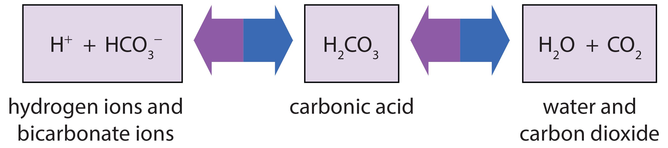
Blood Buffering System
The buffer system in the blood prevents it from becoming too acidic.
Excessive H⁺ in the blood combine with bicarbonate ions
Excess carbonic acid converts to and is exhaled as carbon dioxide
2.2 Figure 9
CNX OpenStax on Wikimedia Commons. "Buffering of blood levels." Modified.

Slide 23
Think It Through
How do buffers prevent drastic swings in pH?
Notes:
Originally an On Your Own. This is included here to use as a talking point or for a think-pair-share activity.

Slide 24
Summary
Water's unique properties, including polarity, hydrogen bonding, and high heat capacity, are essential for life.
Water's roles in dissolving substances, cohesion, adhesion, and in pH and buffering are critical for biological processes.
Understanding water's properties is key to understanding how life is sustained on Earth.

Slide 25


End of Hawkes Learning PowerPoint

