Slide 1
Lesson 2.3
The Importance of Carbon

Slide 2
Objectives
Describe the role of functional groups in biological molecules.
Explain why carbon is important for life.
Describe organic molecules and their characteristics.

Slide 3
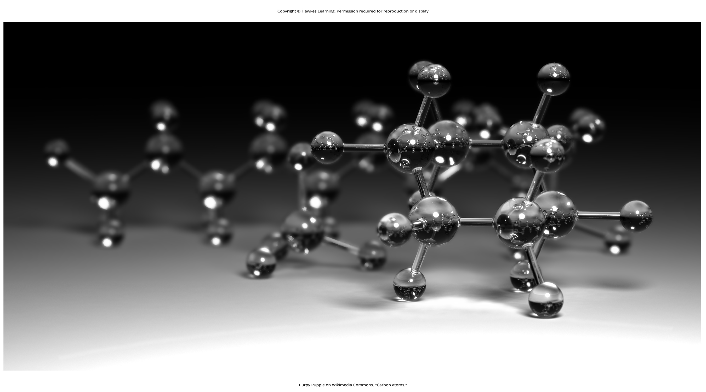
The Importance of Carbon
Cells are composed of macromolecules like proteins, nucleic acids, carbohydrates, and lipids
They are organic molecules: carbon-based molecules essential for life
Carbon's ability to form up to four covalent bonds makes it the ideal backbone for these crucial macromolecules.
2.3 Figure 1
Purpy Pupple on Wikimedia Commons. "Carbon atoms."

Slide 4
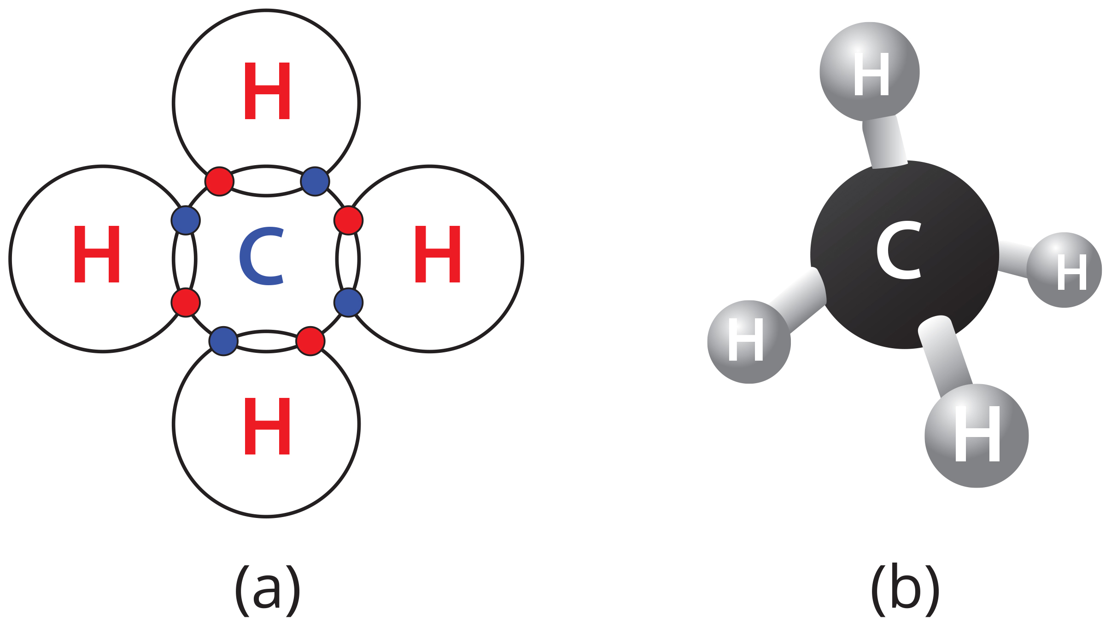
Carbon Bonding and the Octet Rule
Carbon's incomplete outer shell allows formation of up to four covalent bonds by sharing electrons.
Methane (CH₄) forms four covalent bonds with hydrogen.
2.3 Figure 2
OpenStax. "Methane." Modified.

Slide 5

Hydrocarbons
Hydrocarbons consist entirely of carbon and hydrogen.
Used as fuels
Stored energy in covalent bonds are released during combustion.
Methane's tetrahedral shape allows carbon chain backbones to form, creating the framework for biomolecules.
Backbones can be linear, cyclic, or combinations of both.
Contain single, double, or triple bonds affecting molecular shape and function.
2.3 Figure 3: This rocket hydrocarbon rocket fuel.
NASA on Unsplash. "Rocket."

Slide 6
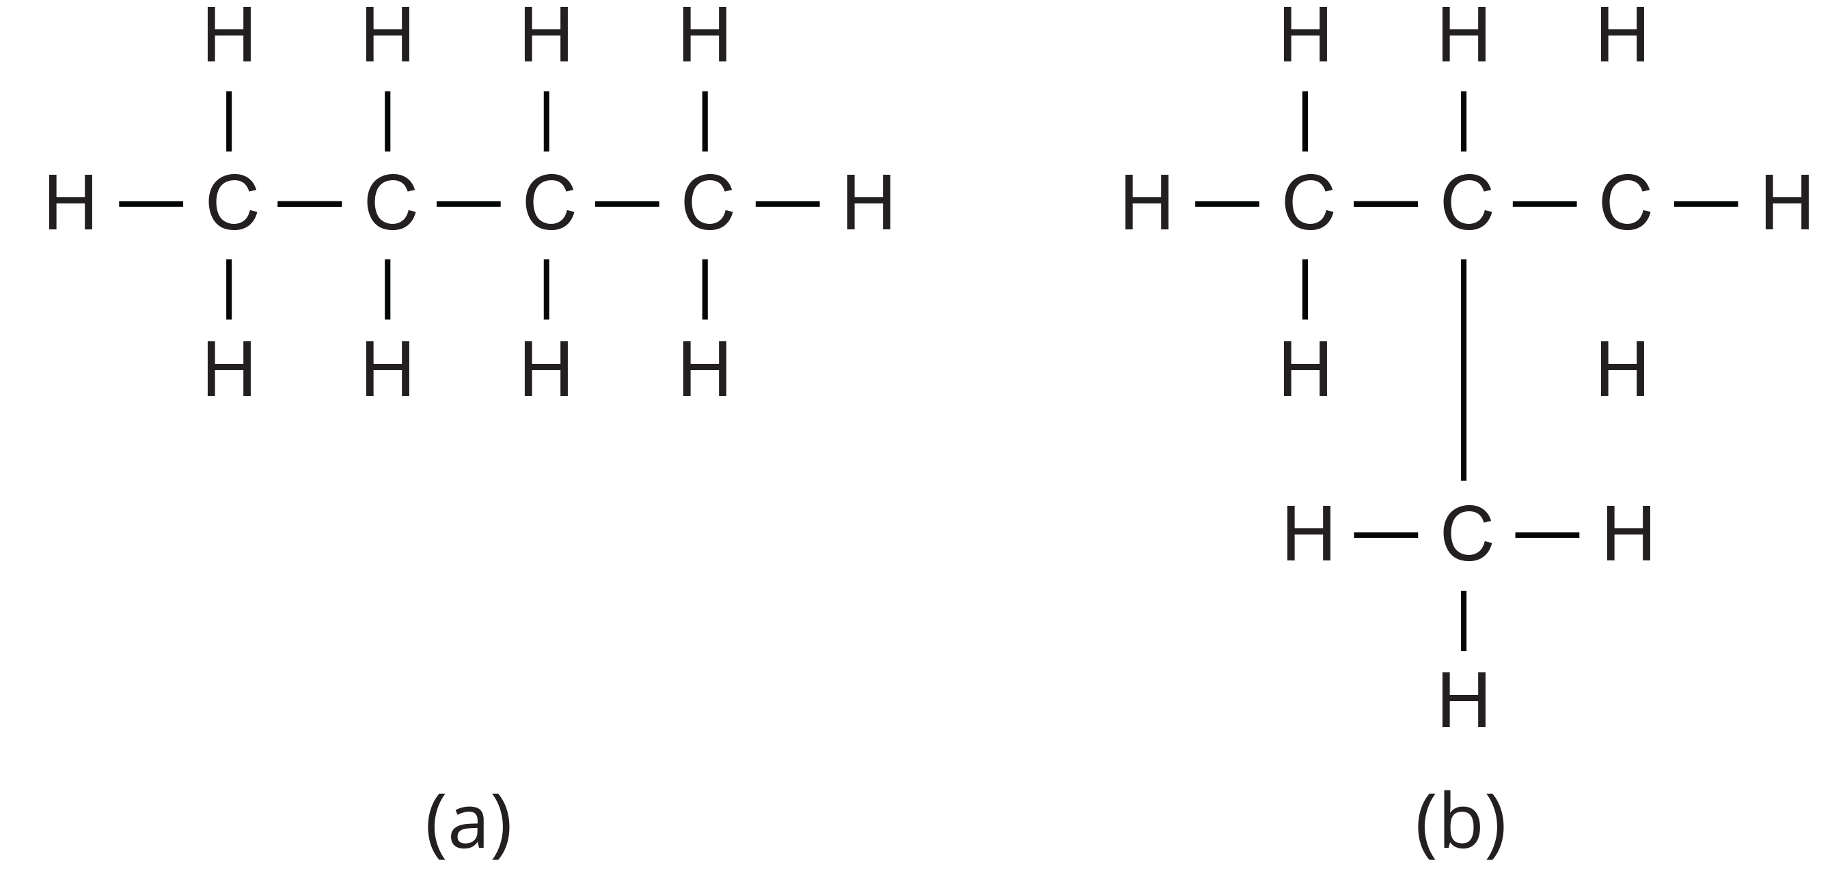
Hydrocarbon Chains
Are linear or branched based on carbon-to-carbon bonds.
Single bonds allow rotation, double and triple bonds do not and result in planar and linear molecules.
Prefixes denote carbon number – "eth-" means two carbons.
Suffixes indicate bond type — single: "-ane," double: "-ene," and triple: "-yne"
2.3 Figure 4: (a) unbranched hydrocarbon (b) branched hydrocarbon
OpenStax on Wikimedia Commons. "Hydrocarbon-butane." Modified.

Slide 7
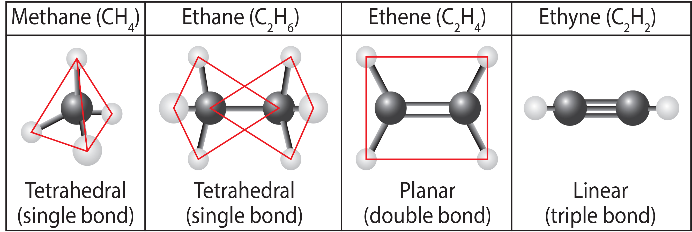
2.3 Figure 5
OpenStax. "Carbon bonds." Modified.
Notes:
When carbon forms single bonds with other atoms, the shape is tetrahedral. When two carbon atoms form a double bond, the shape is planar, or flat. Single bonds, like those in ethane, are able to rotate. Double bonds, like those in ethene, and triple bonds, like those in ethyne, cannot rotate, so the atoms on either side are locked in place.

Slide 8
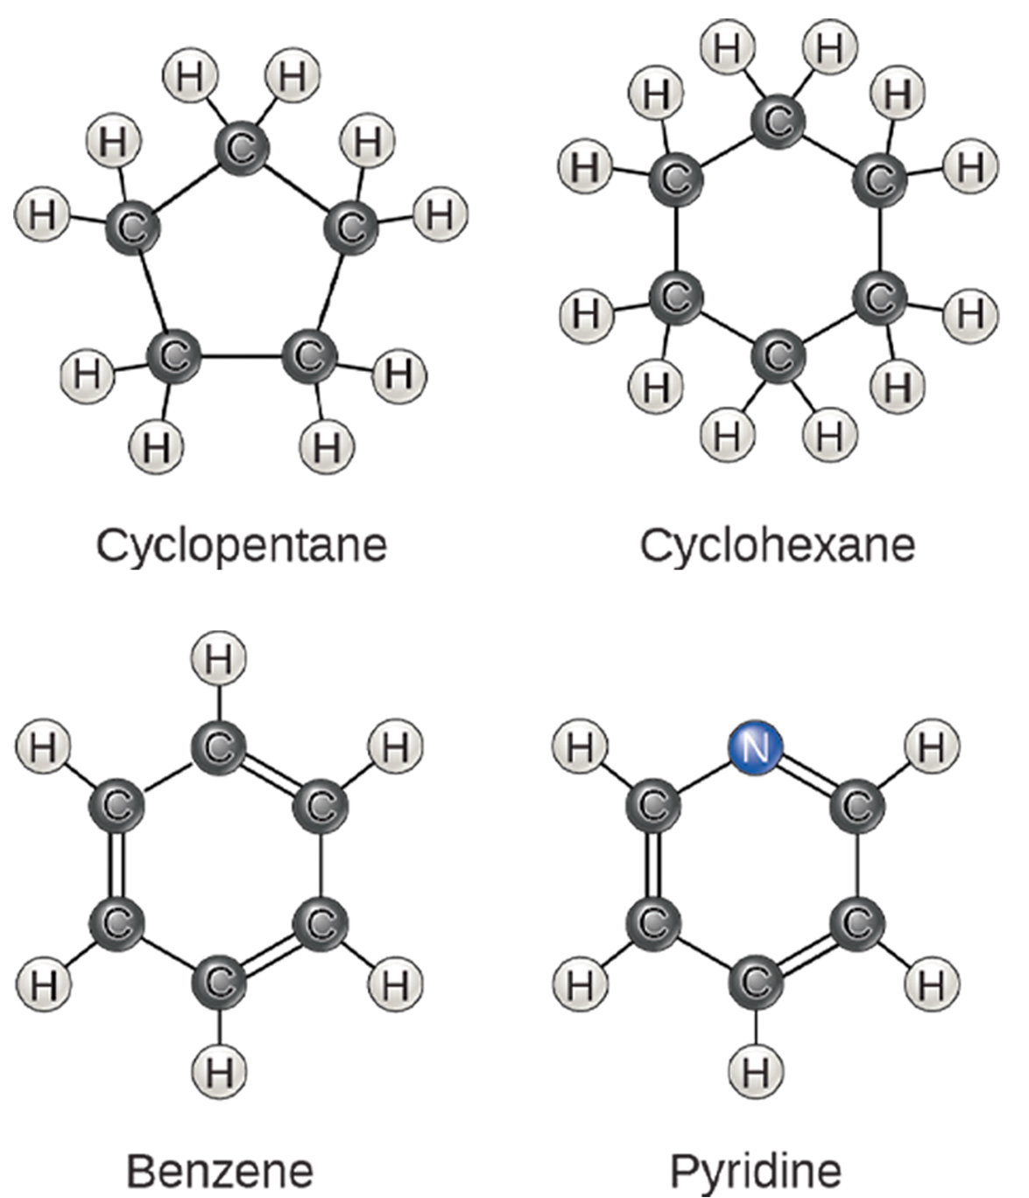
Hydrocarbon Rings
Aliphatic hydrocarbons: linear chains or rings with single, double, or triple bonds
Aromatic hydrocarbons: cyclic carbon chains; rings with alternating single and double bonds.
Electrons are delocalized.
Benzene rings are in many biomolecules — amino acids, cholesterol, and some hormones.
Also, in herbicides and crude oil
2.3 Figure 6
OpenStax. "Aliphatic and aromatic hydrocarbons." Modified.

Slide 9
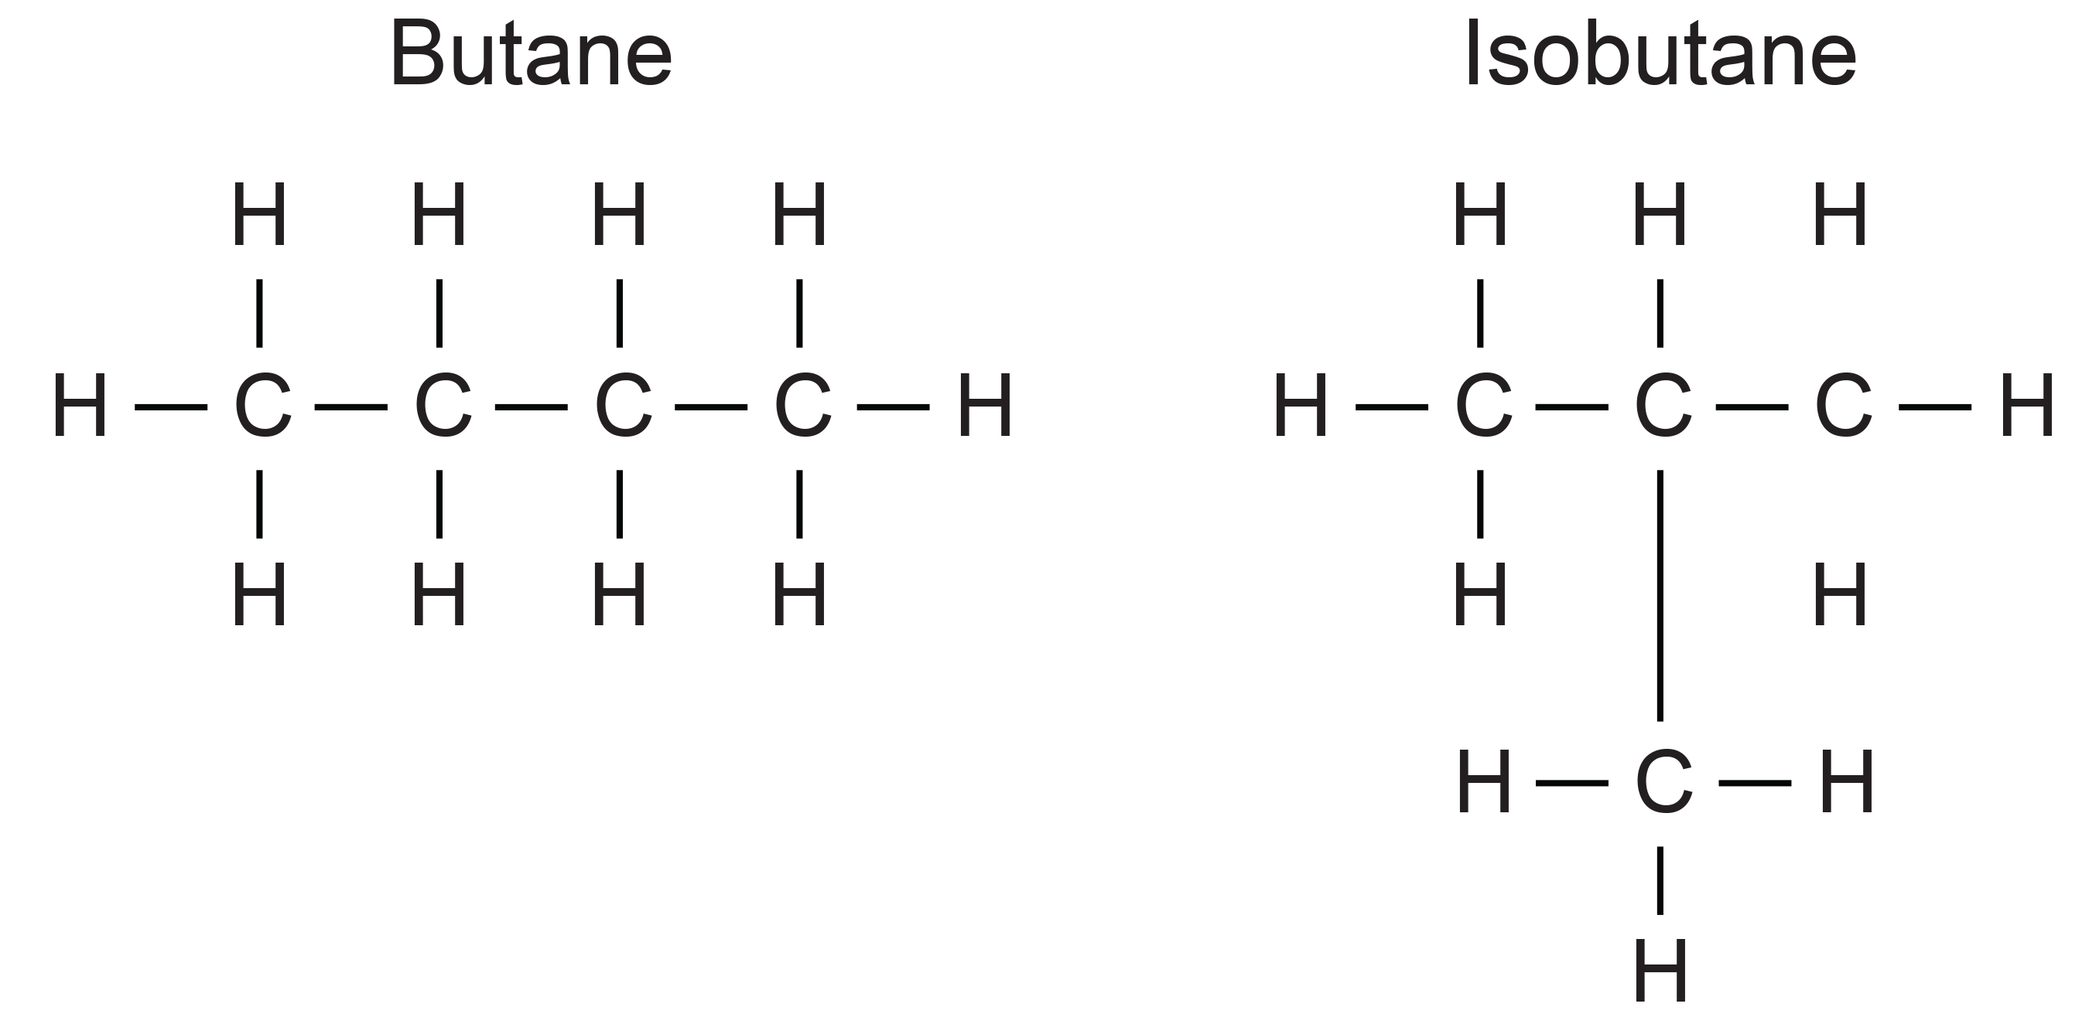
Isomers
Isomers: molecules with the same chemical formula but different atomic arrangements.
Structural isomers: same chemical formula, but different bond placement
Butane and isobutane (both C₄H₁₀) have unique chemical properties.
Butane is a fuel and isobutane a refrigerant and propellant.
2.3 Figure 7
OpenStax on Wikimedia Commons. "Hydrocarbon-butane." Modified.

Slide 10
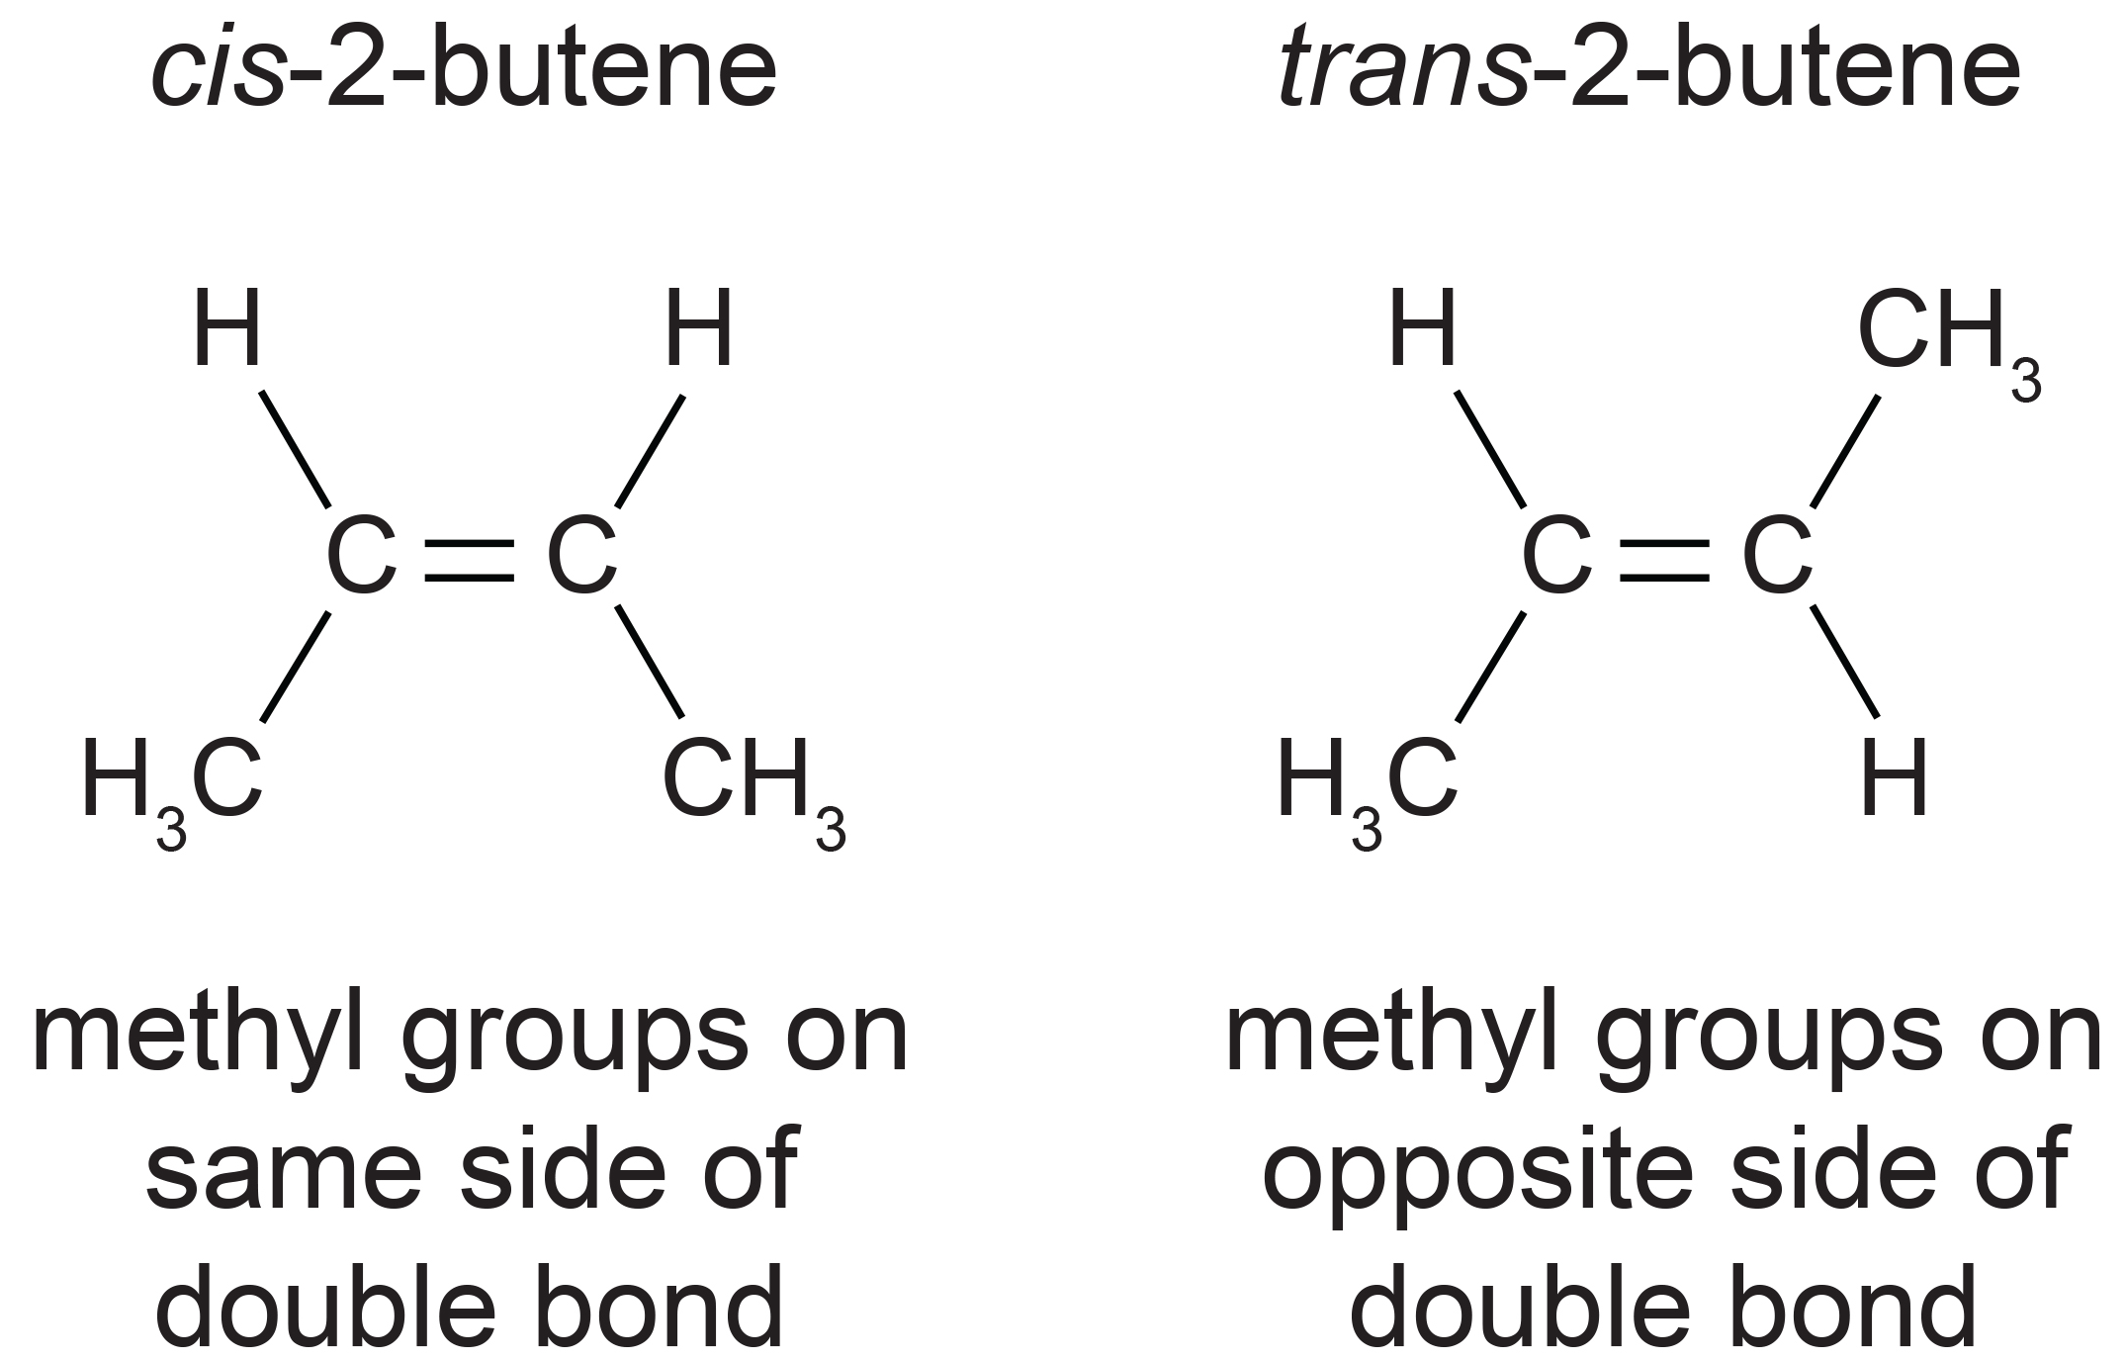
Geometric Isomers
Geometric isomers have identical bonding but differ in atom placement.
Cis-2-butene has methyl groups on the same side of the carbon double bond, causing backbone bending.
Trans-2-butene has methyl groups on opposite sides of the carbon double bond, resulting in a linear backbone.
2.3 Figure 8
OpenStax. "Butane." Modified.

Slide 11
Common Isomers: Triglycerides
Triglycerides are fatty acids that may have cis or trans double bonds.
Cis — unsaturated fats
Bent shape prevents packing, oils stay liquid at room temperature
Trans — unsaturated
Linear bond allows packing, oils are solid at room temperature
Linked to heart disease
Saturated fats — no double bonds, each carbon is saturated in hydrogens
Solid at room temperature, typically animal-based

Slide 12
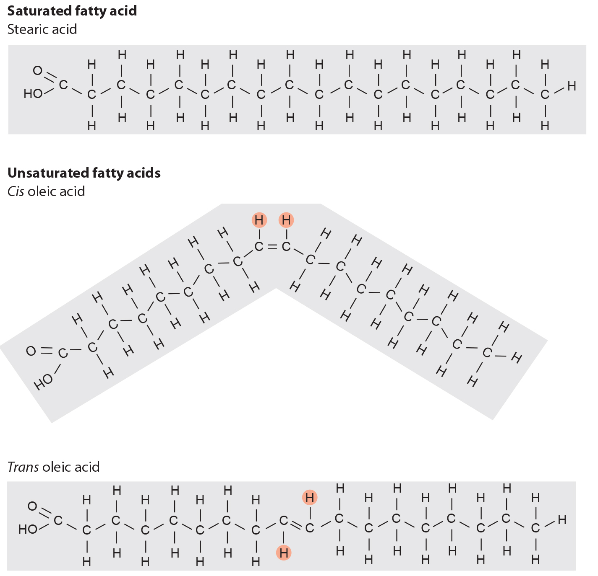
2.3 Figure 9
CNX OpenStax on Wikimedia Commons. "Fatty acids." Modified.
Notes:
Saturated fatty acids have no carbon-carbon double bonds, resulting in a straight chain that allows these fatty acids to pack tightly together. Unsaturated fatty acids have at least one double bond, introducing a bend in the chain that prevents these fatty acids from packing tightly together. In trans fatty acids, the presence of hydrogen atoms on opposite sides of the double bonds straightens the chain, enabling these fatty acids to pack densely together.

Slide 13
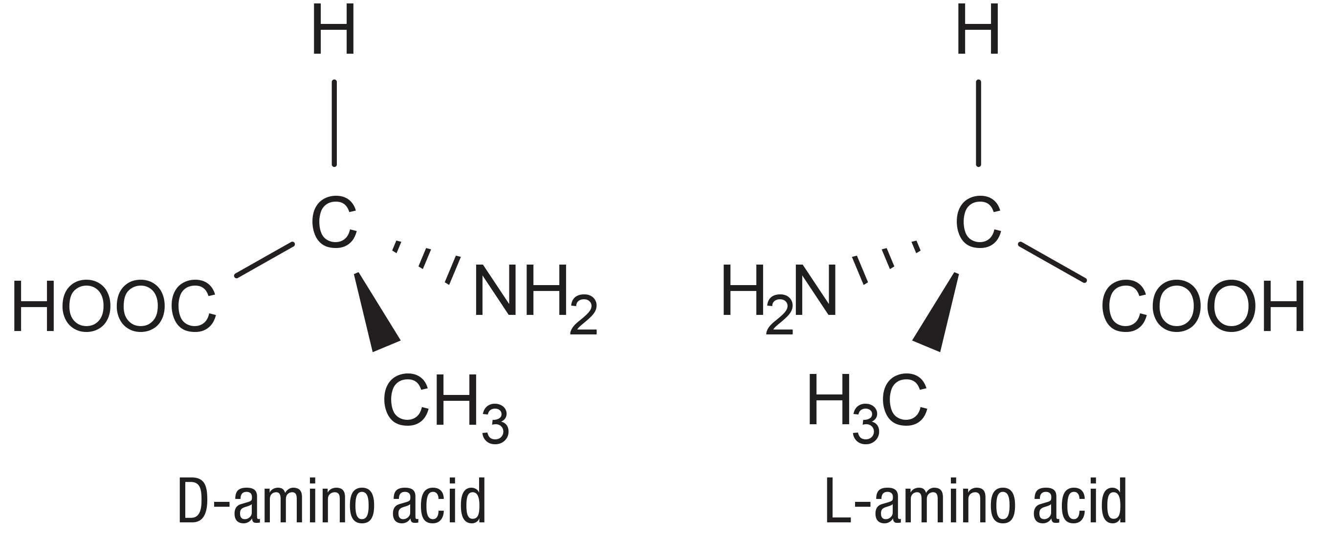
Enantiomers
Enantiomers: molecules that are mirror images of each other
Identical chemical structures and bonds.
Differ in three-dimensional orientation of atoms around the central carbon — atoms appear "flipped“
Not superimposable
2.3 Figure 10
OpenStax. "Enantionmers." Modified.

Slide 14
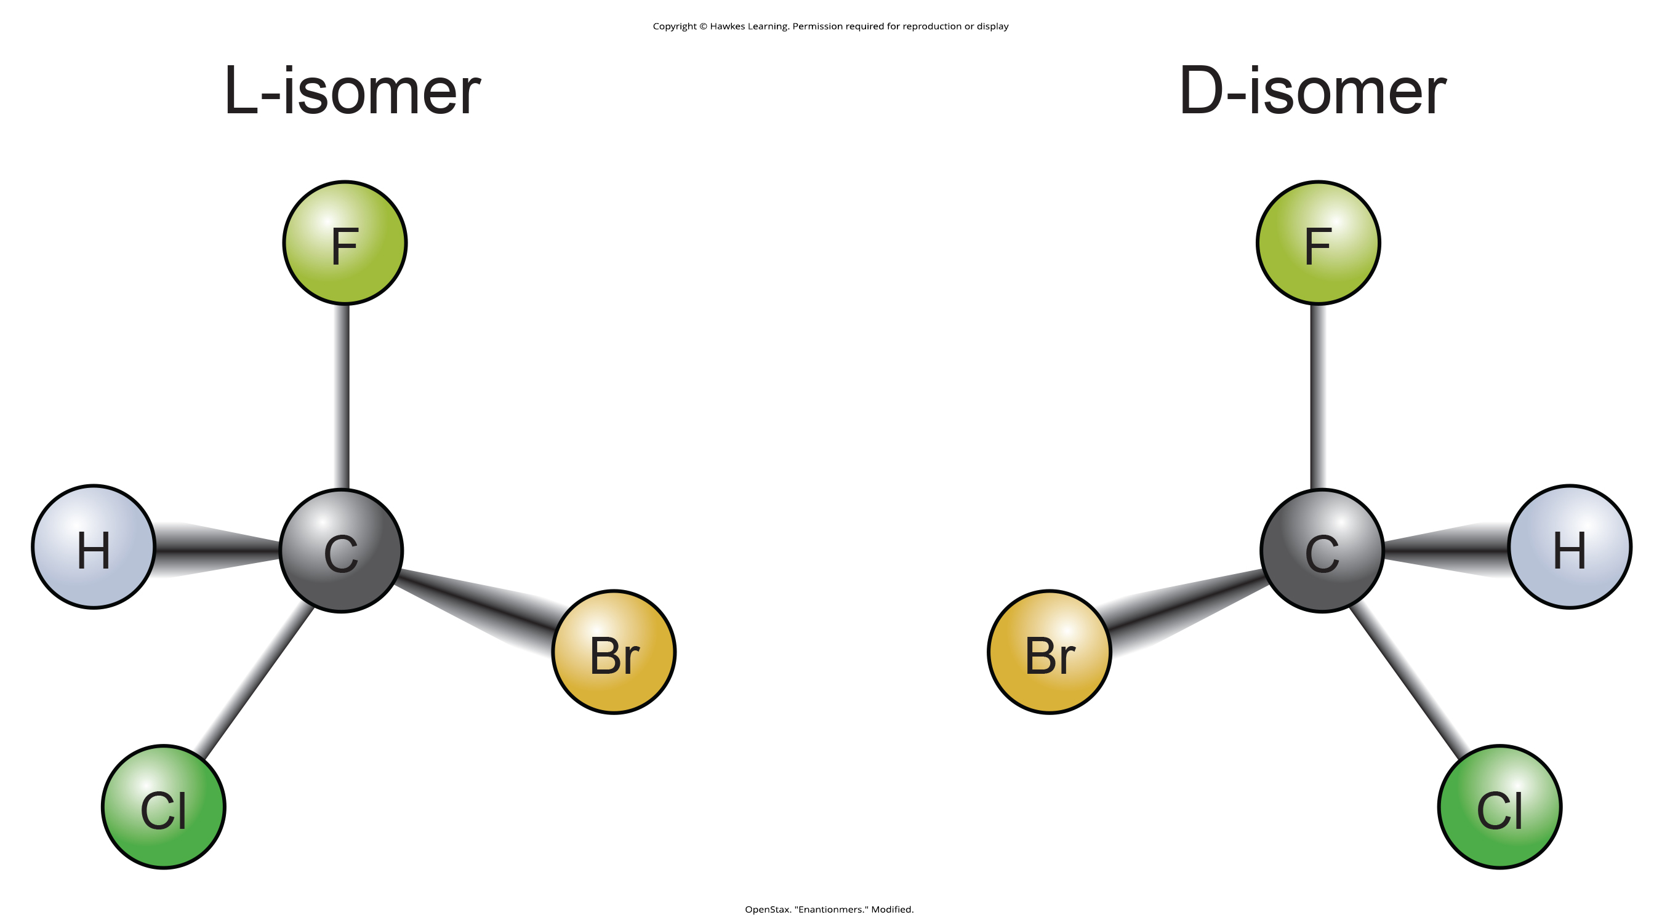
Enantiomers: Chirality in Biological Molecules
Proteins predominately have L-forms of amino acids
D-forms of amino acids present in bacterial cell walls
D-form of glucose is the photosynthesis product, rarely see L-form in nature
2.3 Figure 11
Innerstream on Wikimedia Commons. "Enantiomers."

Slide 15
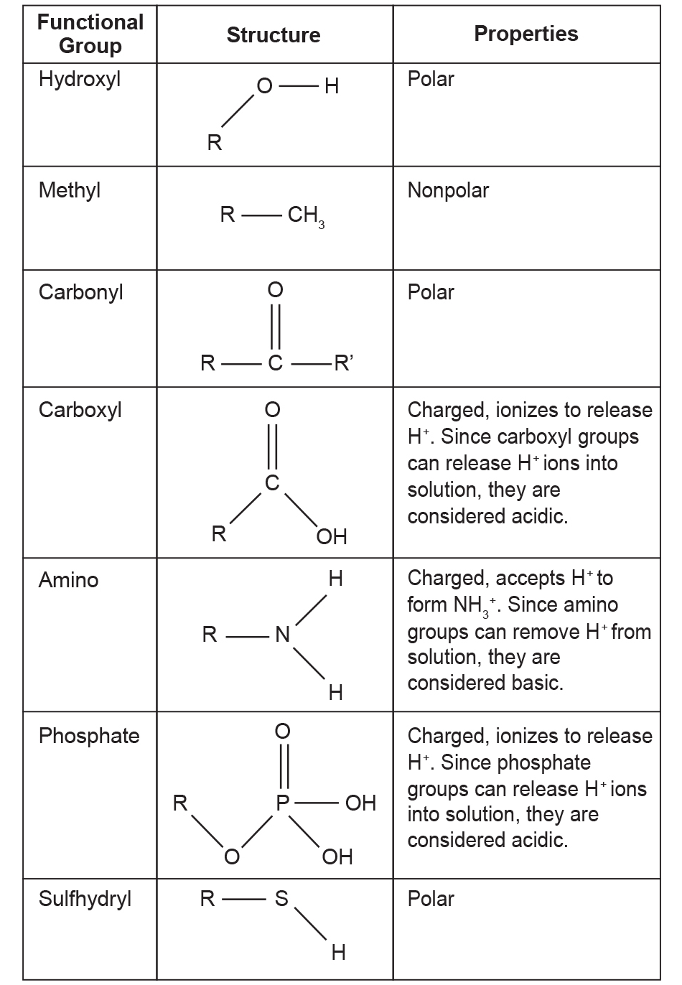
Functional Groups₁
Functional Groups: groups of atoms on molecules that confer specific chemical properties to those molecules
Attached to a macromolecules’ carbon backbone
Substituted hydrocarbons: have other elements (N or O) attached to carbon backbone
Proteins, lipids, carbohydrates, and nucleic acids each have a characteristic set of functional groups.
2.3 Figure 12
OpenStax. "Functional groups." Modified.

Slide 16

Functional Groups₂
The chemical properties of functional groups affect the chemical properties of the molecules their attached to.
Methyl groups make molecules hydrophobic (not water soluble).
Amino, carboxyl, and carbonyl groups make molecules hydrophilic (water soluble) through their charges.
2.3 Figure 13: Hydrophilic and hydrophobic substances won't dissolve into each other.
Paul Steuber on Unsplash. "Oil, water, and antacid."

Slide 17
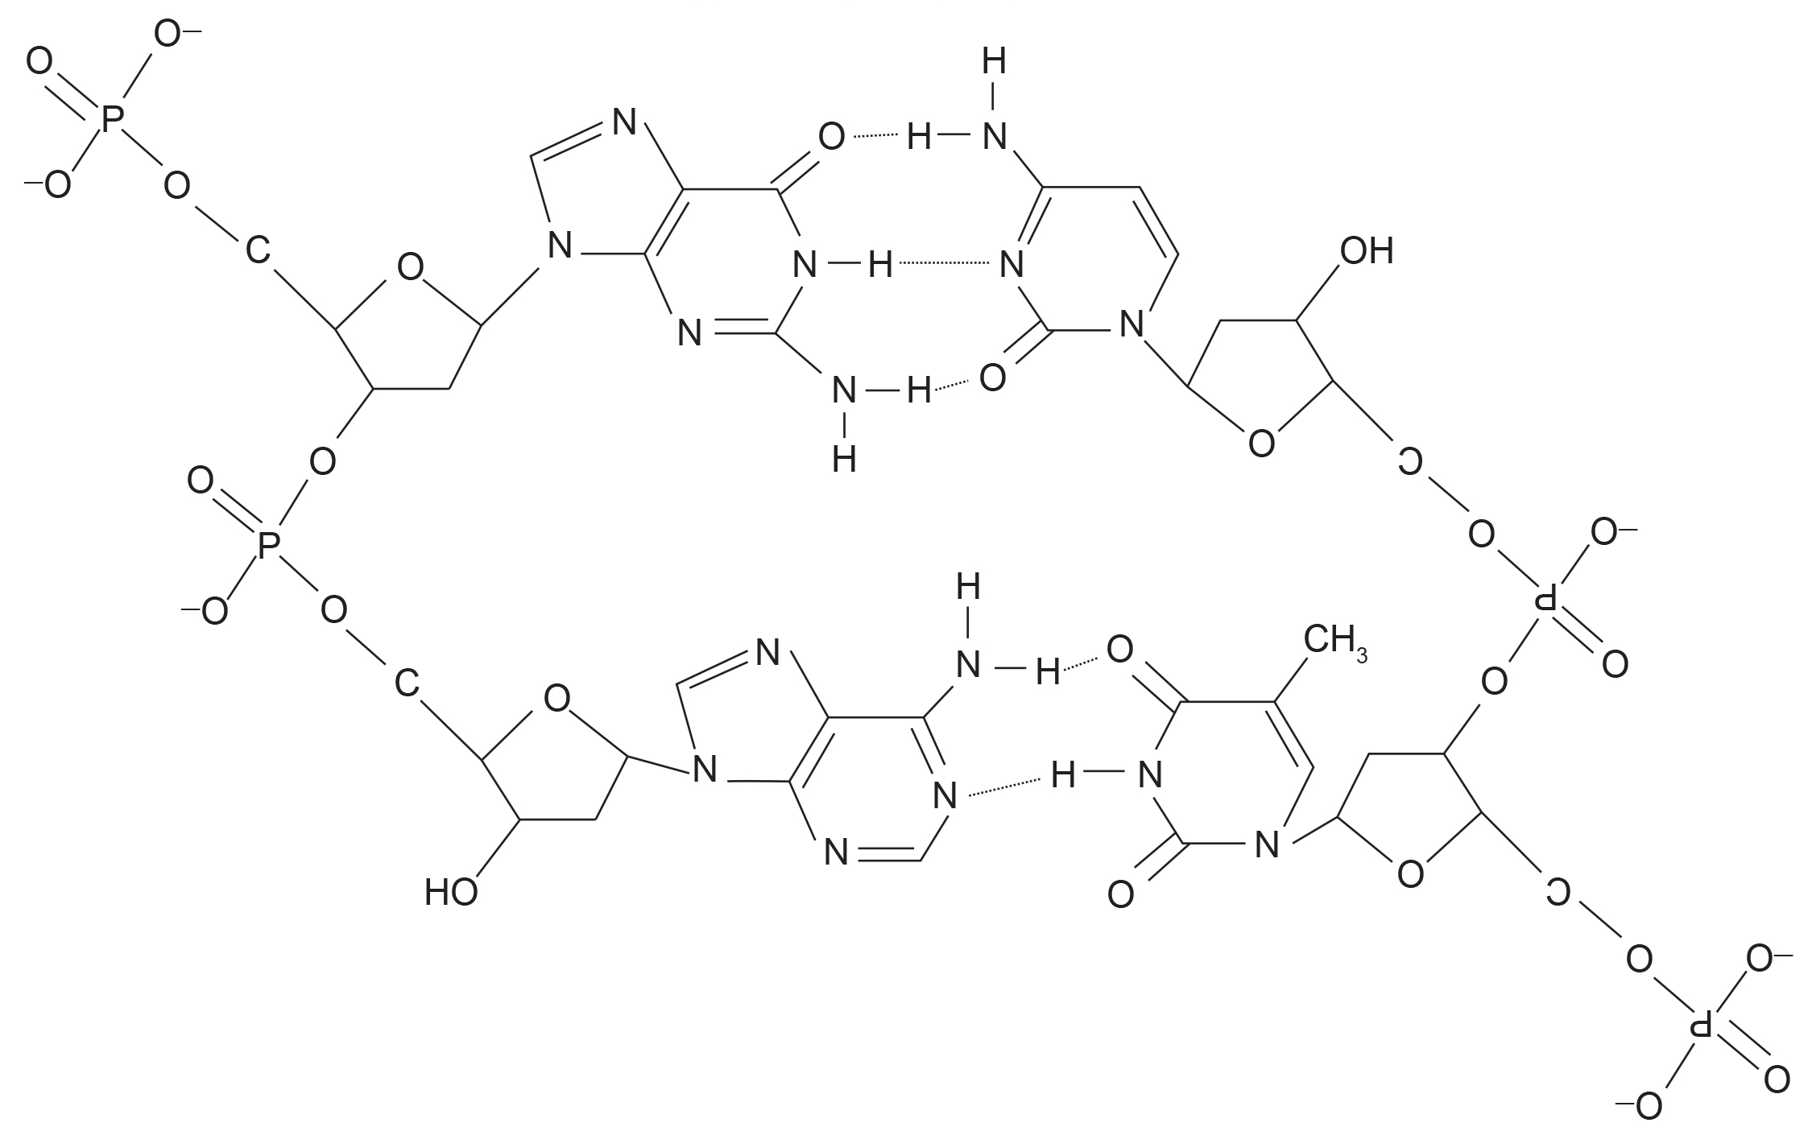
Functional Groups₃
Interactions between functional groups help maintain the structure of a molecule.
2.3 Figure 14: Hydrogen bonds connect two strands of DNA.
Agathman on Wikimedia Commons. "DNA and hydrogen bonds."

Slide 18
Think It Through
Draw a simple structure of an ethane molecule. By default, hydrocarbons are hydrophobic. However, the addition of some functional groups can make them hydrophilic. Is ethane hydrophilic or hydrophobic? Now, draw ethane again, but substitute one hydrogen atom for a functional group. Is your new molecule hydrophobic or hydrophilic?
2.3 Figure 12
2.3 Figure 5
OpenStax. "Carbon bonds." Modified.
OpenStax. "Functional groups." Modified.
Notes:
Originally an On Your Own. This is included here to use as a talking point or for a think-pair-share activity.

Slide 19
Summary
Carbon's ability to form four covalent bonds is central to its role in biological molecules.
Carbon binds covalently with oxygen, hydrogen, and nitrogen to form crucial biomolecules.
Carbon and hydrogen can form hydrocarbon chains or rings that make up the backbones of molecules.
Functional groups are atom groups that, when attached to hydrocarbon backbones, confer specific chemical properties and functions.

Slide 20


End of Hawkes Learning PowerPoint

