Slide 1
Lesson 20.1
Organizing Life on Earth

Slide 2
Objectives
Describe how systematics and taxonomy relate to phylogeny.
Discuss a phylogenetic tree's components and purpose.
Discuss the need for a comprehensive classification system.
List the different levels of the taxonomic classification system.

Slide 3
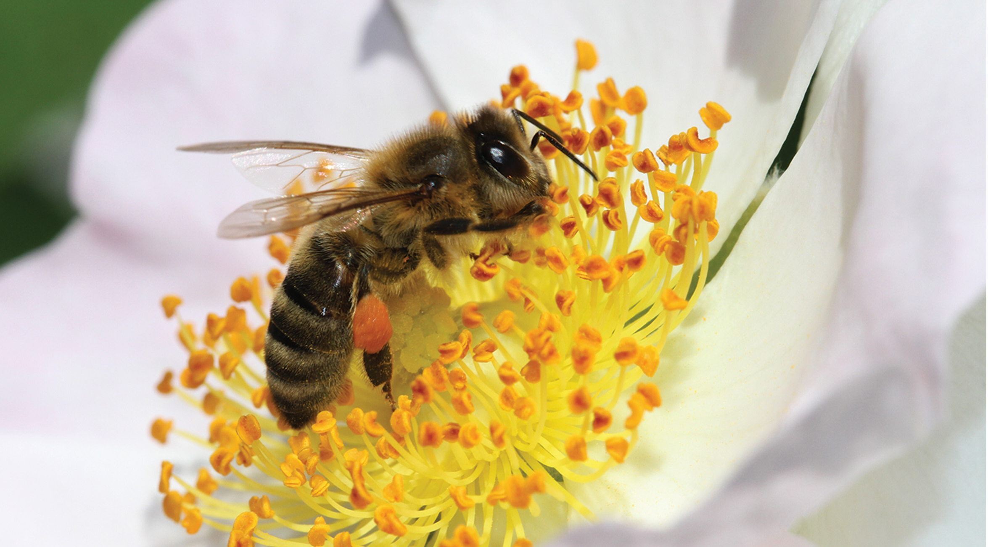
Comparing Organisms Helps Scientists Learn About Their Evolutionary History
By studying both visible and genetic similarities and differences between organisms, scientists can learn about the evolutionary history of organisms since life's origins.
20.1 Figure 1: While bees and flowers are different, they are related. Both are Eukarya, having similar organelles, genes, and proteins.
NickyPe on Pixabay. "Bee on flower."

Slide 4
Phylogeny Provides Information on Shared Ancestry
Phylogeny is the evolutionary history and relationships of an organism or group of organisms.
Describes the organism's relationships, including:
From what organisms it may have evolved
To which species it is most closely related
Phylogenetic relationships:
Do provide information on shared ancestry
Do NOT necessarily provide information on how organisms are currently similar or different

Slide 5
Phylogenetic Trees Show Evolutionary Relationships Among Organisms
A phylogenetic tree is:
A diagram that reflects evolutionary relationships among organisms
A hypothesis of the evolutionary past since it cannot be confirmed

Slide 6
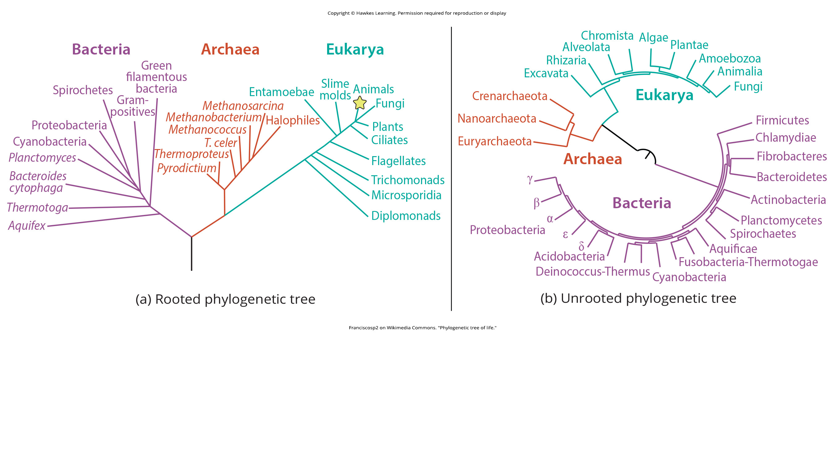
A Rooted Phylogenetic Tree Includes a Common Ancestor
A rooted phylogenetic tree includes a single ancestral organism, typically drawn from the bottom or left.
20.1 Figure 2 (a)
Franciscosp2 on Wikimedia Commons. "Phylogenetic tree of life."

Slide 7
An Unrooted Phylogenetic Tree Lacks a Common Ancestor
An unrooted does not show a common ancestor, but they do show relationships among species.
20.1 Figure 2 (b)
Franciscosp2 on Wikimedia Commons. "Phylogenetic tree of life."

Slide 8
Rooted Phylogenetic Trees Require Interpretation₁
It is important to understand how to interpret a rooted phylogenetic tree.
A branchpoint (or node) is the point where a split occurs and represents where a single lineage evolved into distinct new ones.
A basal taxon is a lineage that evolved early from the root and remains unbranched.
Sister taxa are two lineages stemming from the same branch point.
A polytomy is a branch point with more than two lineages and indicates that scientists have not fully determined all relationships.

Slide 9
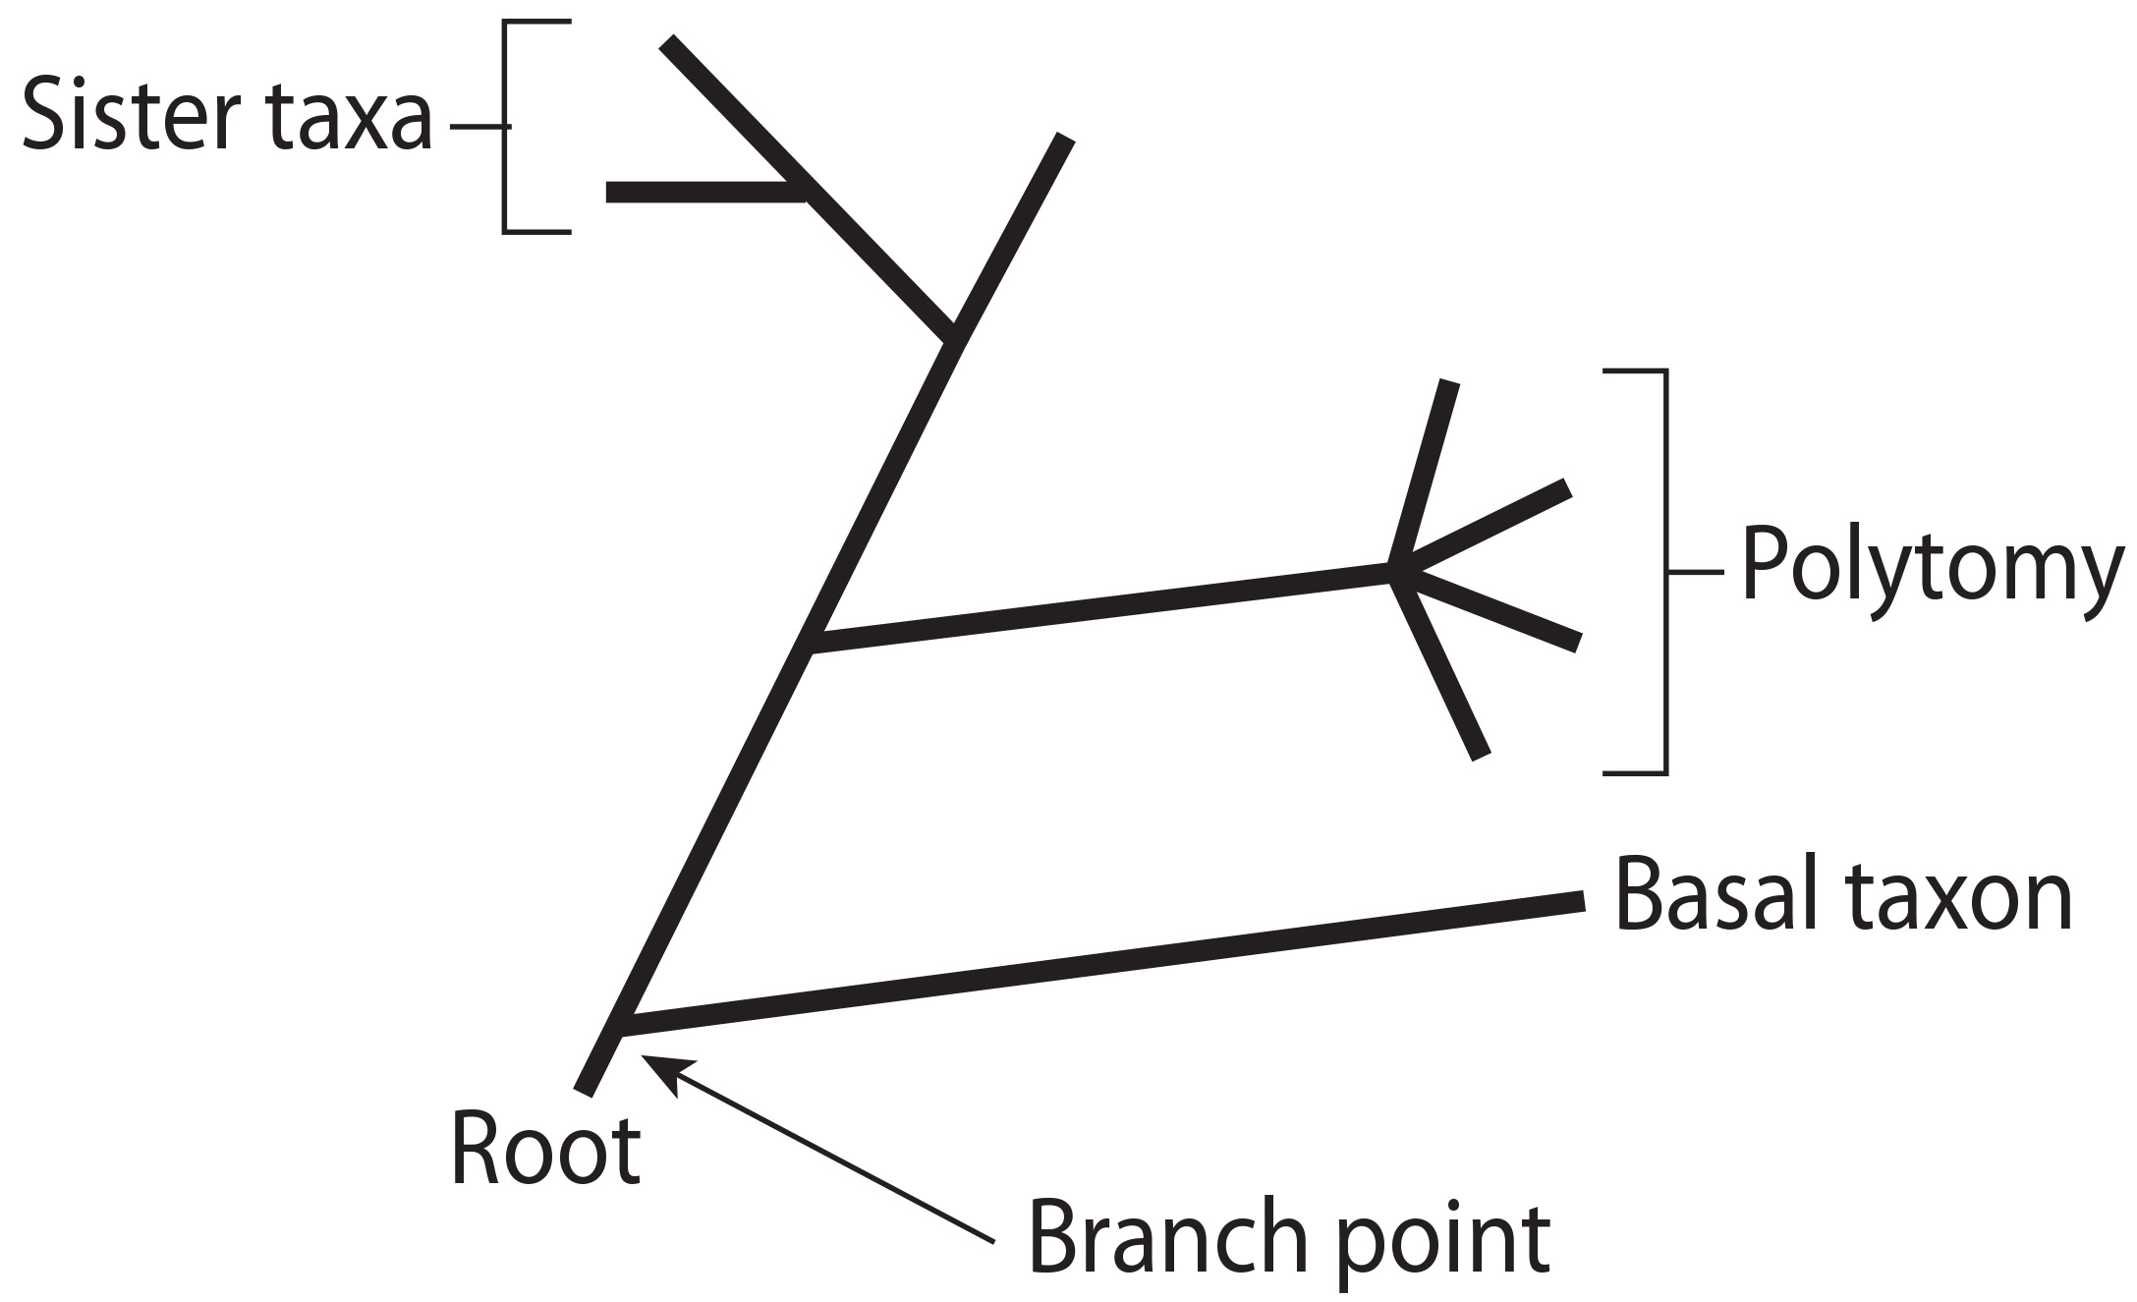
20.1 Figure 3
CNX OpenStax on Wikimedia Commons. "Phylogenetic tree."
Notes:
20.1 Figure 3: A phylogenetic tree's root indicates that an ancestral lineage gave rise to all organisms on the tree. A branch point indicates where two lineages diverged. A lineage that evolved early and remains unbranched is a basal taxon. When two lineages stem from the same branch point, they are sister taxa. A branch with more than two lineages is a polytomy.

Slide 10
Rooted Phylogenetic Trees Require Interpretation₂
One can trace the pathway from the origin of life to any individual species.
One can start with a single species and move back toward the "trunk" to discover the species' ancestors and where lineages share a common ancestor.
The most recent common ancestor (MRCA) is the branch point at which two or more organisms diverge.
Rotation of arms around a branch point does not change the relationships the tree shows.

Slide 11
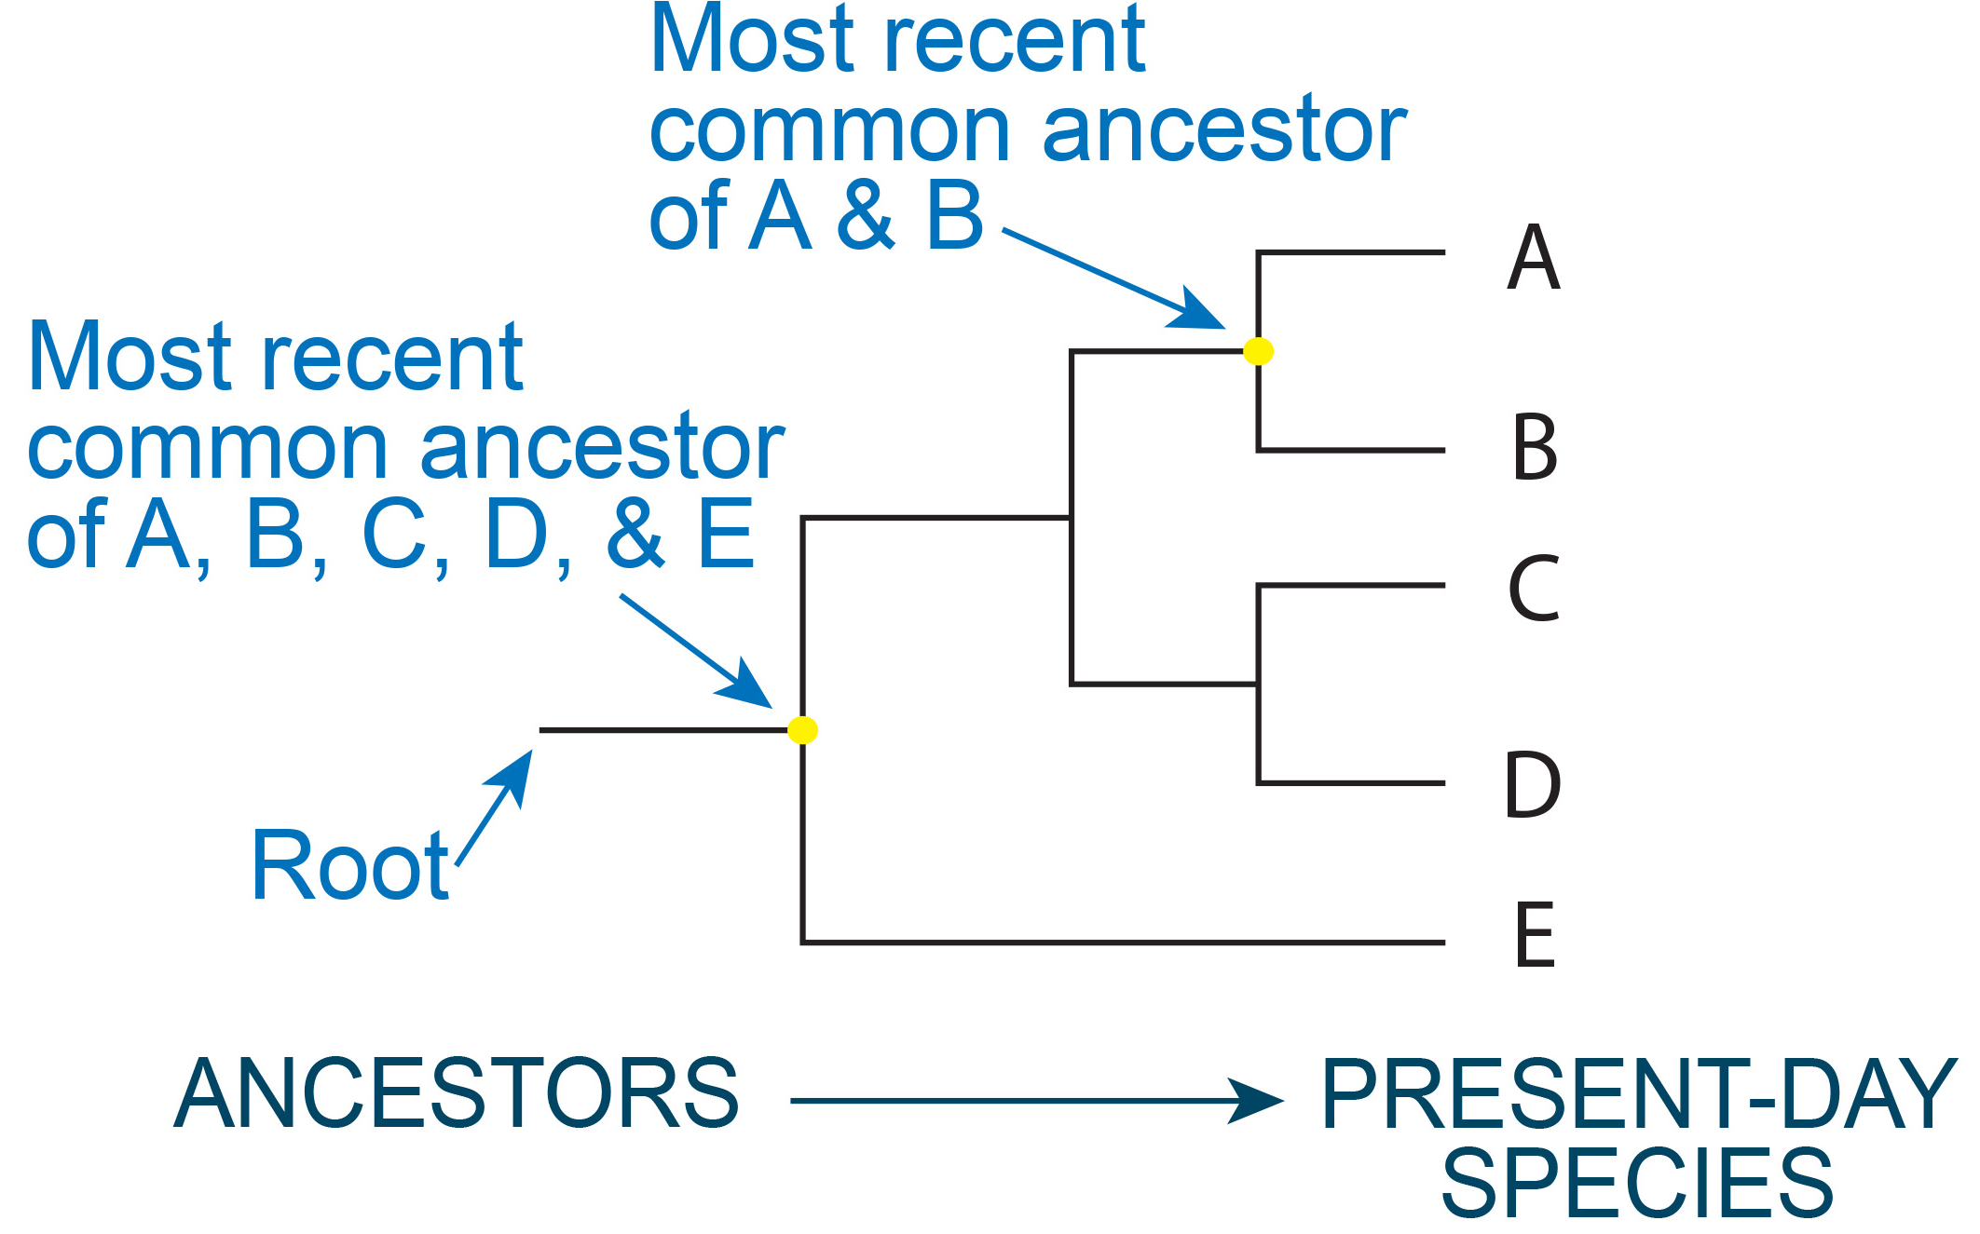
20.1 Figure 4
Favpng. "Common ancestor." Modified.
Notes:
20.1 Figure 4: One can find the most recent common ancestor between two organisms by finding the branch point at which the two species diverged.

Slide 12
Many Disciplines Contribute the Study of Systematics
Systematics is the study of the diversification, classification, and evolutionary relationships of organisms and may include data obtained from:
Comparing fossils
Studying the structures of body parts
Studying the molecules that an organism uses
DNA analysis

Slide 13
Modern-Day Phylogenetic Trees Combine DNA Sequence Analysis With Statistics
Phylogenetic trees based upon DNA analysis examine the number of DNA sequence changes between the organisms examined.
Tree branch length is proportional to the degree of genetic distance separating the organisms.
These trees change as additional organisms are discovered and the sequences of their DNA are added.

Slide 14
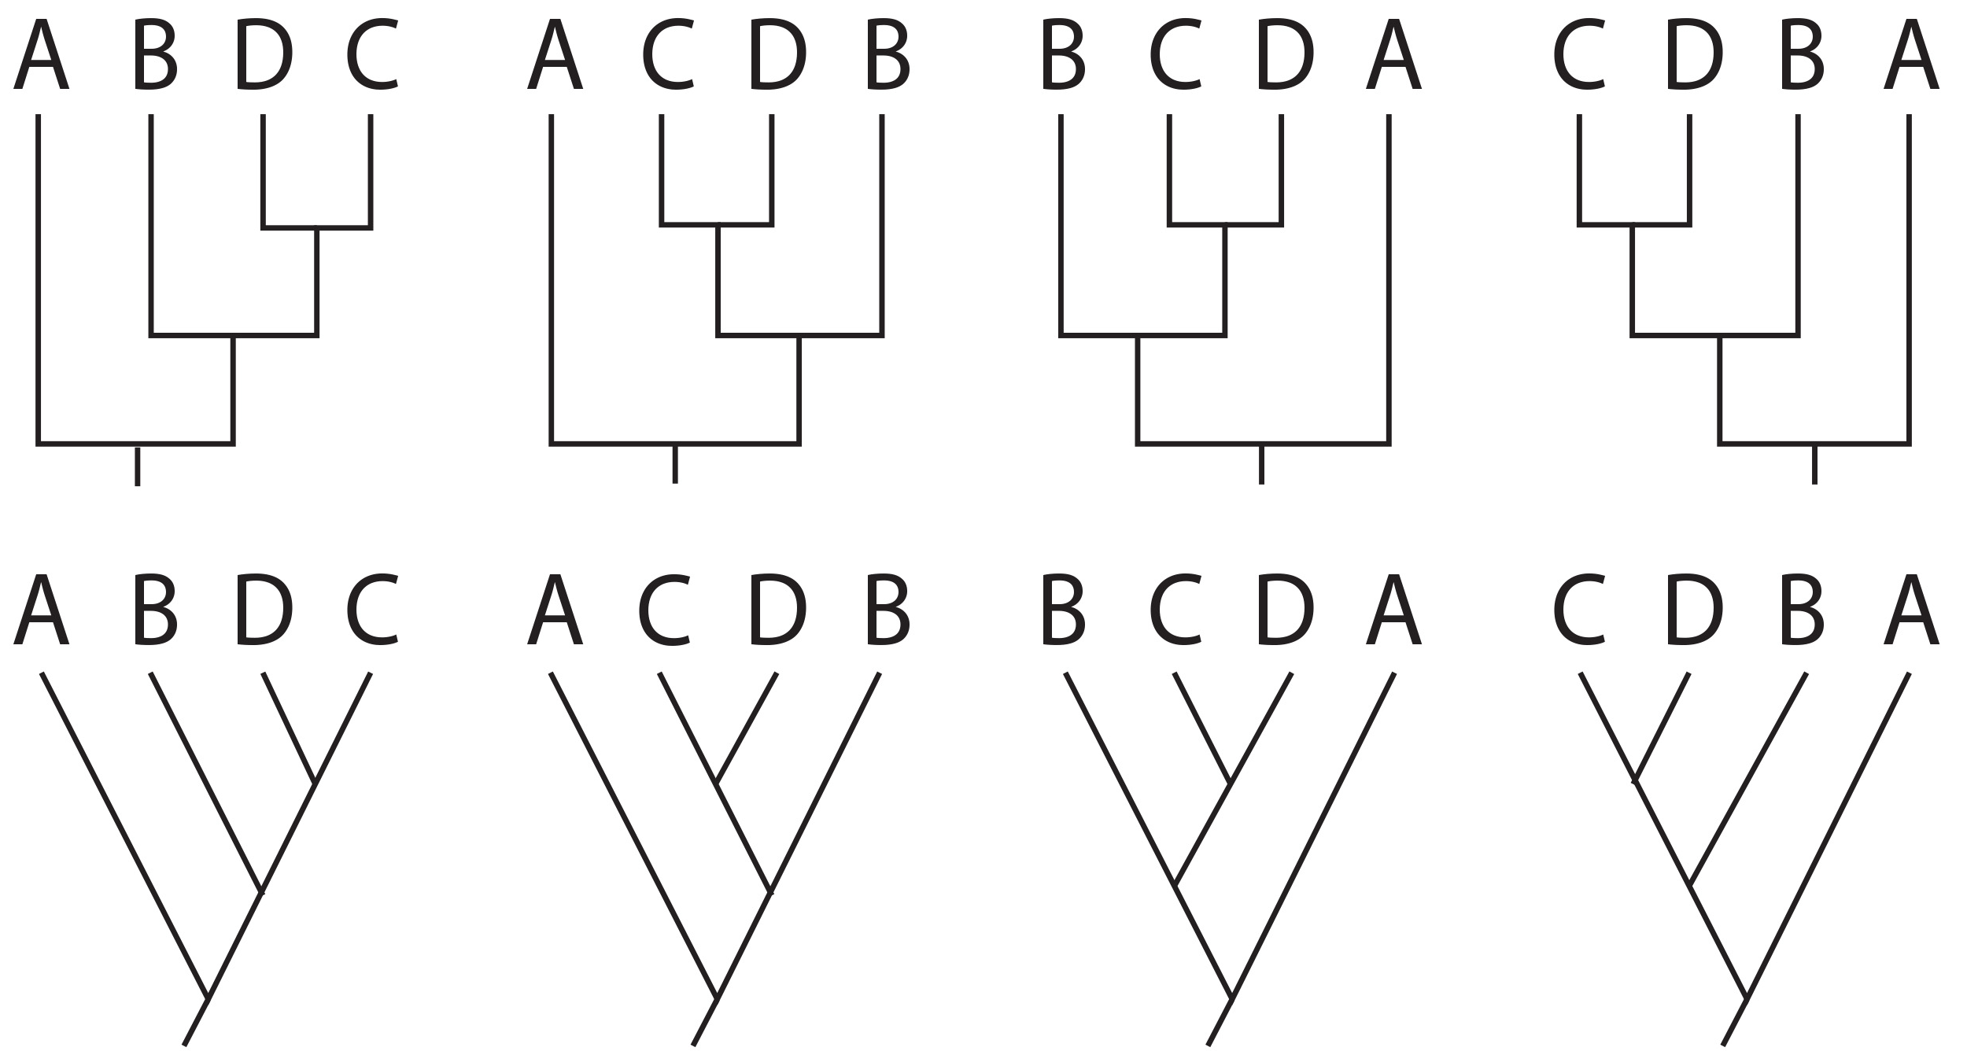
20.1 Figure 5
Notes:
20.1 Figure 5: Rotation around a branch point does not change the evolutionary relationships between organisms on a phylogenetic tree. Thus, these four phylogenetic trees showing the evolutionary relationships between organisms A, B, C, and D are all equivalent.

Slide 15
Cladograms Suggest Relationships Based Upon Shared Characteristics
A cladogram shows hypothesized relationships among organisms based on shared characteristics.
Branch lengths are typically the same (unlike in a phylogenetic tree).
These are often based upon the presence or absence of morphological characters (physical traits) in organisms and the order that these traits appeared.
These are useful for developing hypotheses about evolutionary relationships.
Note that groups not closely related but evolving in similar conditions may appear more phenotypically similar to each other than to a close relative.

Slide 16
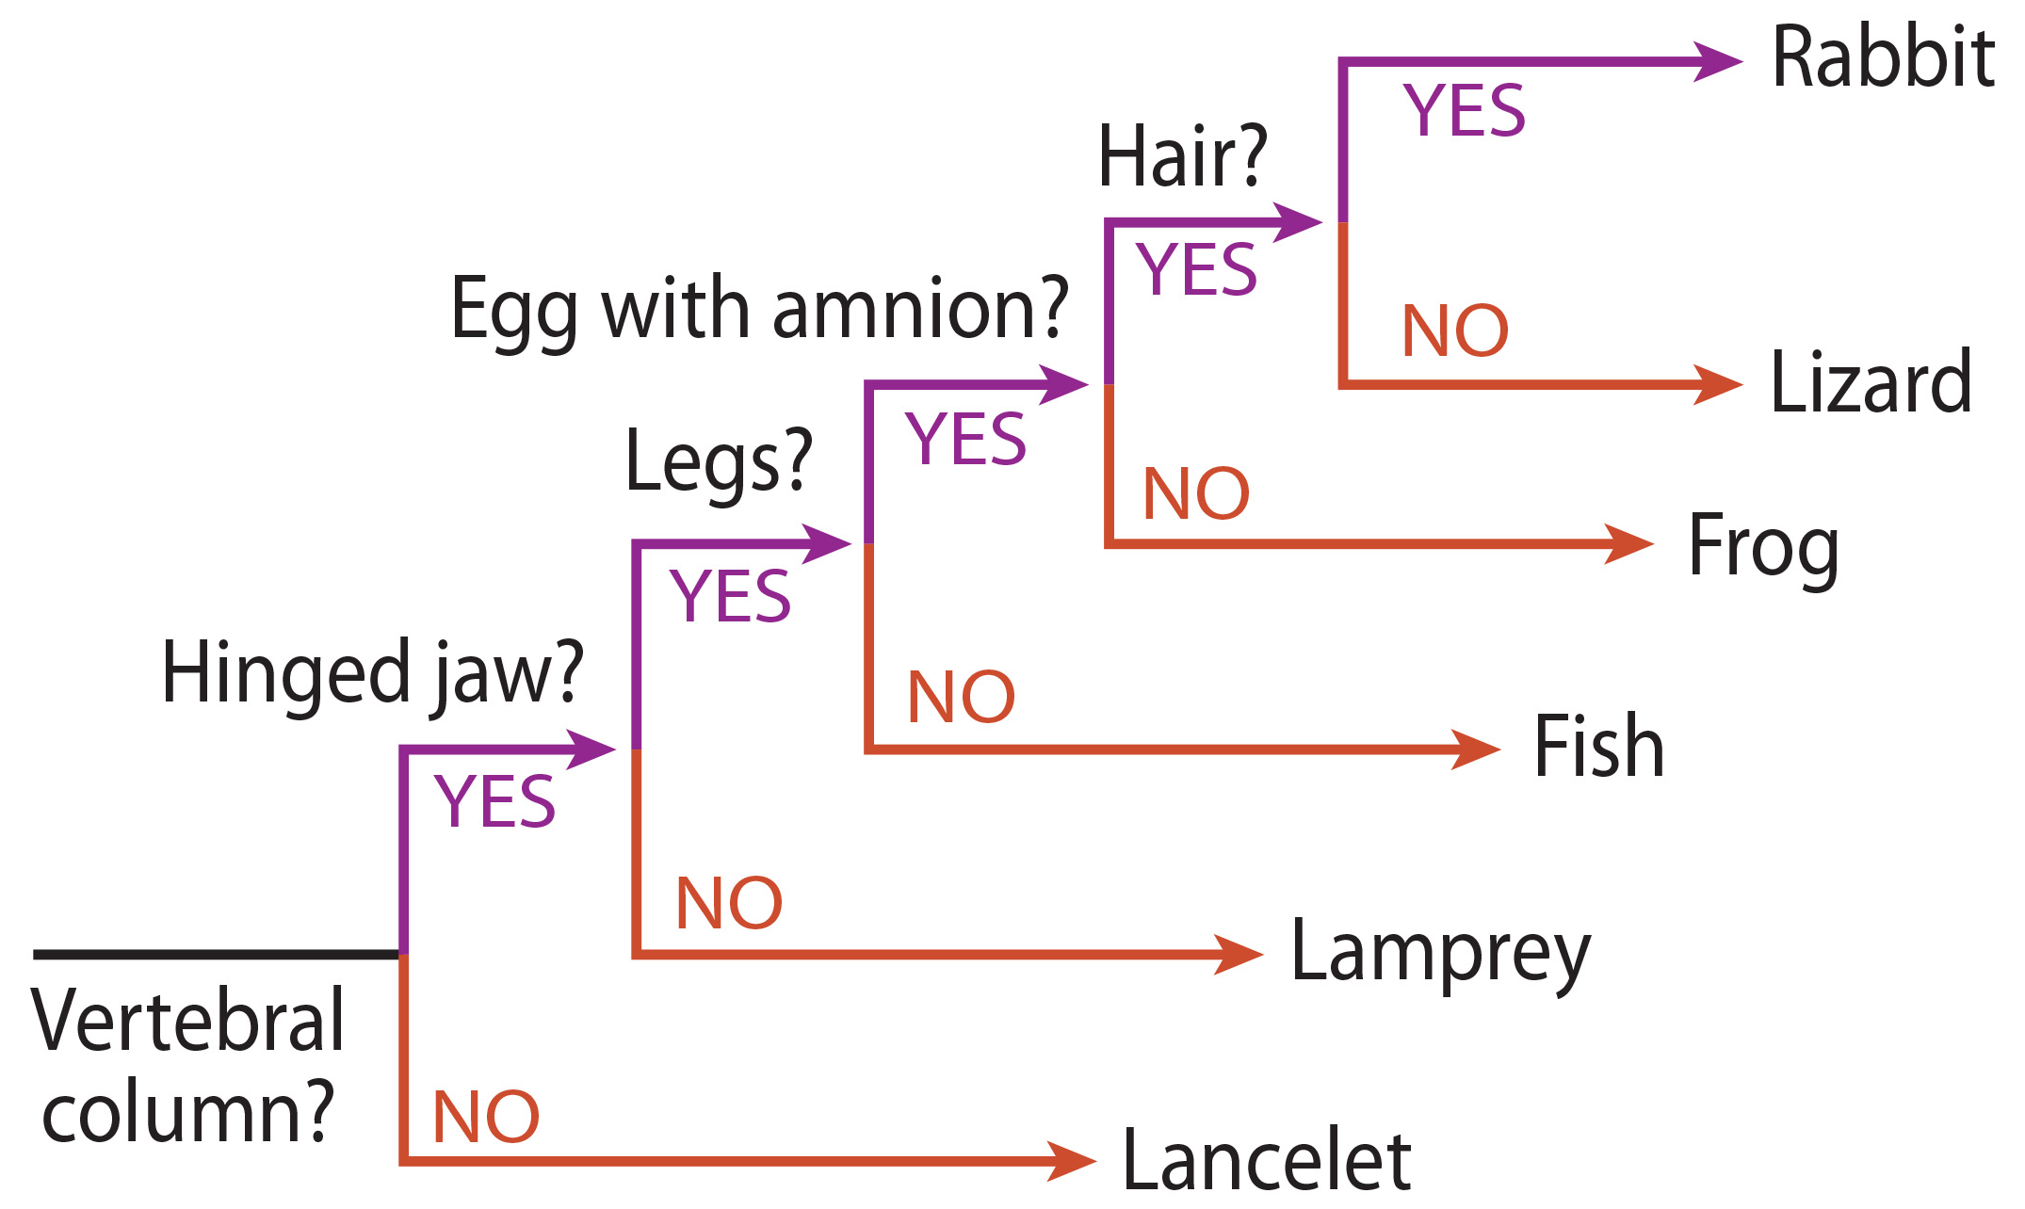
Cladograms Also Require Interpretation
This cladogram suggests:
Lizards may be more closely related to rabbits than they are to frogs based upon having eggs with amnions.
The vertebral column is the oldest trait.
20.1 Figure 6
CNX OpenStax on Wikimedia Commons. "Phylogenetic tree." Modified.

Slide 17
Think It Through₁
Examine Figure 6.
What characteristics do rabbits and fish share?
How do they differ?
20.1 Figure 6
CNX OpenStax on Wikimedia Commons. "Phylogenetic tree." Modified.
Notes:
Originally an On Your Own. This is included here to use as a talking point or for a think-pair-share activity.

Slide 18
Taxonomy Classifies Organisms Into A Hierarchy₁
Taxonomy is the science of classifying organisms into a globally used classification system.
Organisms are placed within increasingly inclusive groups.

Slide 19
Taxonomy Classifies Organisms Into A Hierarchy₂
The taxonomic classification system (the Linnaean system) uses a hierarchical model, with each group becoming more specific.
Domain → Kingdom → Phylum → Class → Order → Family → Genus → Species → (Subspecies)
Each group name (called a taxon) is capitalized except species (and subspecies).
Binomial nomenclature gives each organism a two-word scientific name using its genus and species names (both of which are italicized).
Members of the same species that can mate and reproduce viable offspring, but are separate due to geographical isolation, behavioral isolation, or other factors are subspecies.

Slide 20
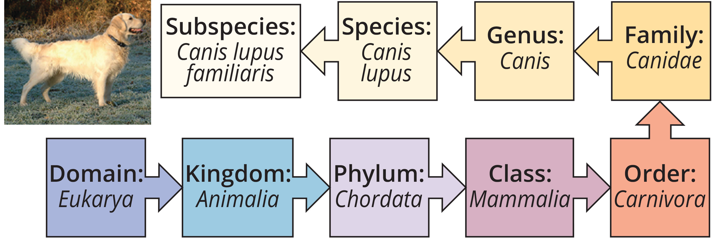
20.1 Figure 7
CNX OpenStax on Wikimedia Commons. "Dog taxonomic classification."
Notes:
20.1 Figure 7: The taxonomic classification system uses a hierarchical model to organize living organisms into increasingly specific categories. The common dog, Canis lupus familiaris, is a subspecies of Canis lupus, which also includes the wolf and dingo.

Slide 21
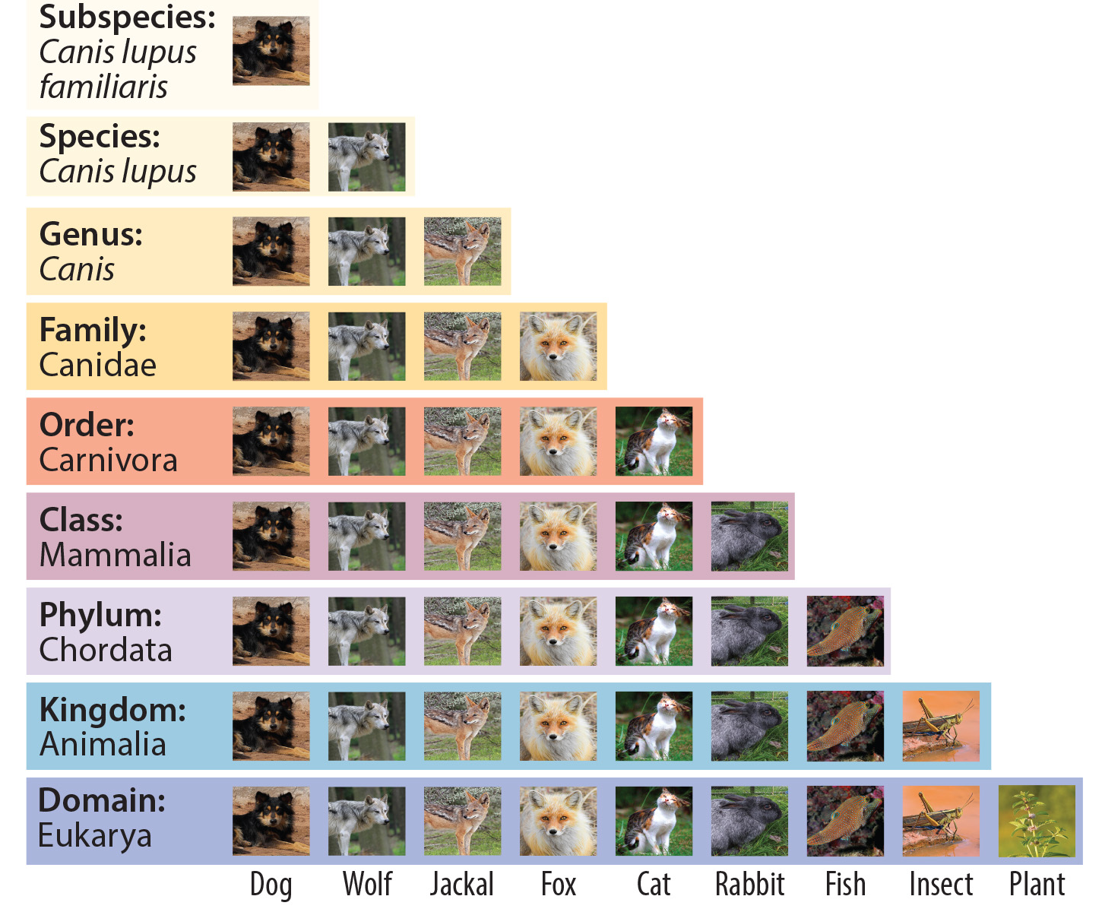
Think It Through₂
Examine Figure 8.
At which taxonomic levels are cats and dogs both found?
20.1 Figure 8
Ivar Leidus on Wikimedia Commons. "Field mint."
Charles J. Sharp, Sharp Photography on Wikimedia Commons. "Garden locust."
Nick Hobgood on Wikimedia Commons. "Sharpnosed puffer."
Notes:
Originally an On Your Own. This is included here to use as a talking point or for a think-pair-share activity.

Slide 22
Consider One of These Mnemonics To Remember the Taxonomic Levels
Taxonomic Level | Mnemonic #1 | Mnemonic #2
Domain (least specific) | Dear | Dear
Kingdom | King | Kindly
Phylum | Phillip | Put
Class | Came | Candy
Order | Over | Out
Family | For | For
Genus | Good | Good
Species (most specific) | Soup | Students

Slide 23
Modern Phylogenies Do Not Always Match Those From the Past
Earlier classifications were done using physical characteristics.
Example: Linnaeus and other early taxonomists classified whales as fish based upon their physical appearance.
Today, many classifications have changed due to DNA technology and other evidence.
Example: Physiological, fossil, and DNA evidence have shown that whales belong with the hoofed mammals and are closely related to the hippopotamus.

Slide 24
Group Activity
As a group, choose three different organisms. Then, compare and contrast them.
In what ways are they similar?
In what ways do they differ?
Based upon this information, draw a simple phylogenetic tree showing the evolutionary relationships between these organisms. Then, use the internet to determine the phylogeny of each organism and how they are related.
Is the phylogenetic tree that you drew consistent with the information you've obtained from the internet?
If not, what may have led your group to draw a different phylogenetic tree?

Slide 25
Summary
Scientists continue to gain information that helps them understand the evolutionary history of life on Earth.
Each group of organisms went through its own evolutionary journey, or phylogeny.
Each organism shares relatedness with others.
Scientists attempt to map the evolutionary histories of all life on Earth using.
Historically, scientists primarily used morphologic evidence and organized organisms into a taxonomic classification system.
Today, many scientists use genetic evidence to build phylogenetic trees.

Slide 26


End of Hawkes Learning PowerPoint

