Slide 1
Lesson 20.2
Determining Evolutionary Relationships

Slide 2
Objectives
Compare homologous and analogous traits.
Describe maximum parsimony.
Discuss the purpose of cladistics.

Slide 3
Homologous Structures Share Evolutionary Past
Homologous structures
Are morphologically similar
Stem from structures inherited from the same ancestor
Do NOT necessarily form the same function as one another
Are commonly groupings of bones
Show similar patterns of development

Slide 4
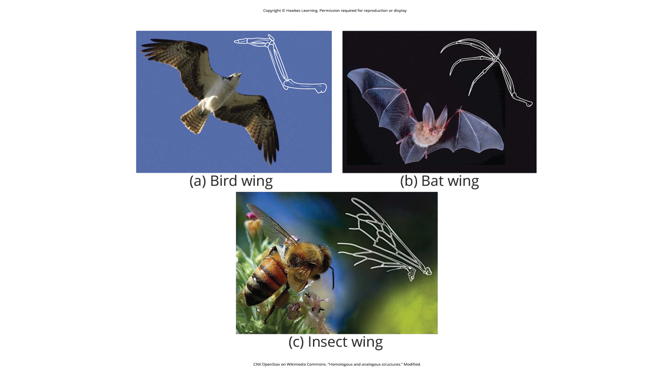
Bat and Bird Wings Are Homologous Structures
Bird and bat wings are homologous structures, indicating that they share a common evolutionary past.
20.2 Figure 1
CNX OpenStax on Wikimedia Commons. "Homologous and analogous structures." Modified.

Slide 5
Analogous Structures Do Not Share Evolutionary Past
Analogous structures
Develop in organisms that are only distantly related, making them appear alike
Result from similar adaptations in response to shared environmental conditions
Result from convergent evolution
Do NOT result from a shared evolutionary past
Do NOT show similar patterns of development
Are coded for by different genes
The development of analogous structures is called analogy or homoplasy.

Slide 6
Insect Wings are Analogous to Bat and Bird Wings
Insect wings are analogous to bat and bird wings, indicating that insect wings do not share an evolutionary past with those of bats and birds.
20.2 Figure 1
CNX OpenStax on Wikimedia Commons. "Homologous and analogous structures." Modified.

Slide 7
Scientists Differentiate Between Homologous Versus Analogous Structures
Comparing a whale's front flipper to the bones in a human arm:
These bones were inherited from a shared ancestor of mammals, meaning they are homologous (not analogous) structures
Comparing the wings of a butterfly to the wings of a bat:
These structures were NOT inherited from a shared ancestor, meaning that they are analogous (not homologous) structures

Slide 8
DNA Technology Can Help Classify Organisms
Molecular systematics is the use of molecular data in taxonomy and phylogeny.
DNA sequences can sometimes be hard to interpret.
  A mutation (especially a deletion or insertion resulting in a frameshift) can make 2 closely related organisms appear unrelated.
  Sometimes, DNA sequences in 2 distantly related organisms can randomly share a high percentage of sequence similarity.
  Computer technologies, coupled with morphologic information, can help identify the actual relationships.

Slide 9
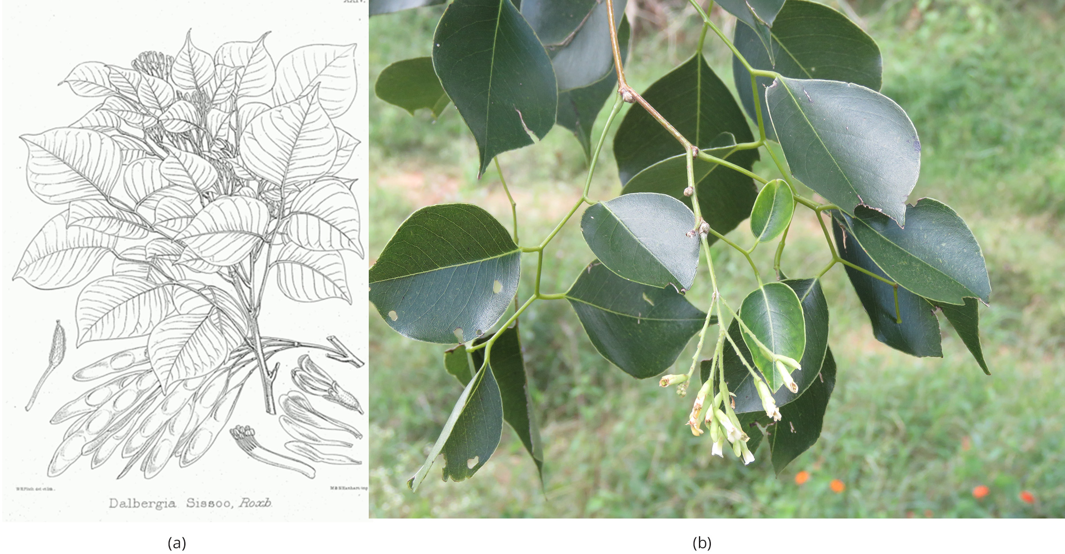
Evolution Connection
Phylogeny helps in the discovery of new plants that can benefit people.
A research team in China discovered a DNA marker common to some medicinal legumes which allows them to determine whether newly discovered legumes have potential medicinal properties.
20.2 Figure 2
Illustrations of the Forest Flora of North-West and Central India, 1874 on Wikimedia Common. "Dalbergia sissoo."
Vinayaraj on Wikimedia Commons. "Indian rosewood."

Slide 10
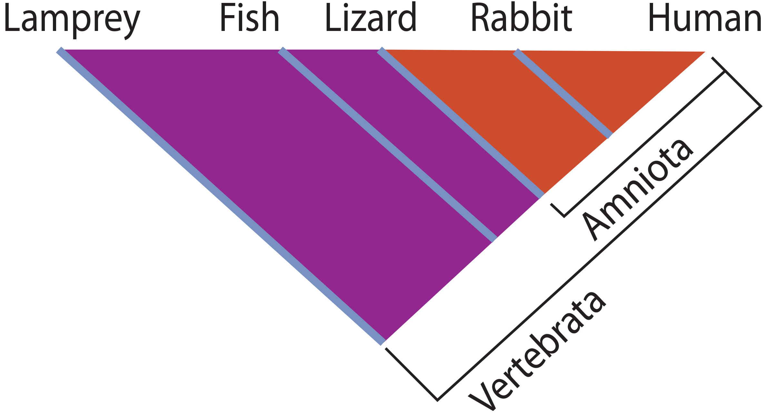
Scientists Can Use Cladistics To Make Phylogenetic Trees
Cladistics uses homologous traits to sort groups of organisms into clades
A monophyletic group (or clade) is a group of organisms all descended from a single ancestor.
A clade includes all descendants from a branch point.
20.2 Figure 3
CNX OpenStax on Wikimedia Commons. "Vertebrata." Modified.

Slide 11
Think It Through₁
Examine Figure 3.
Which animals belong to a clade that includes animals with hair?
Which evolved first: hair or the amniotic egg?
20.2 Figure 3
CNX OpenStax on Wikimedia Commons. "Vertebrata." Modified.
Notes:
Originally an On Your Own. This is included here to use as a talking point or for a think-pair-share activity.

Slide 12
Clades Vary Depending on the Branch Point
Clades vary in size depending on the branch point referenced.
A clade includes all of the organisms stemming from a single point on the tree.

Slide 13
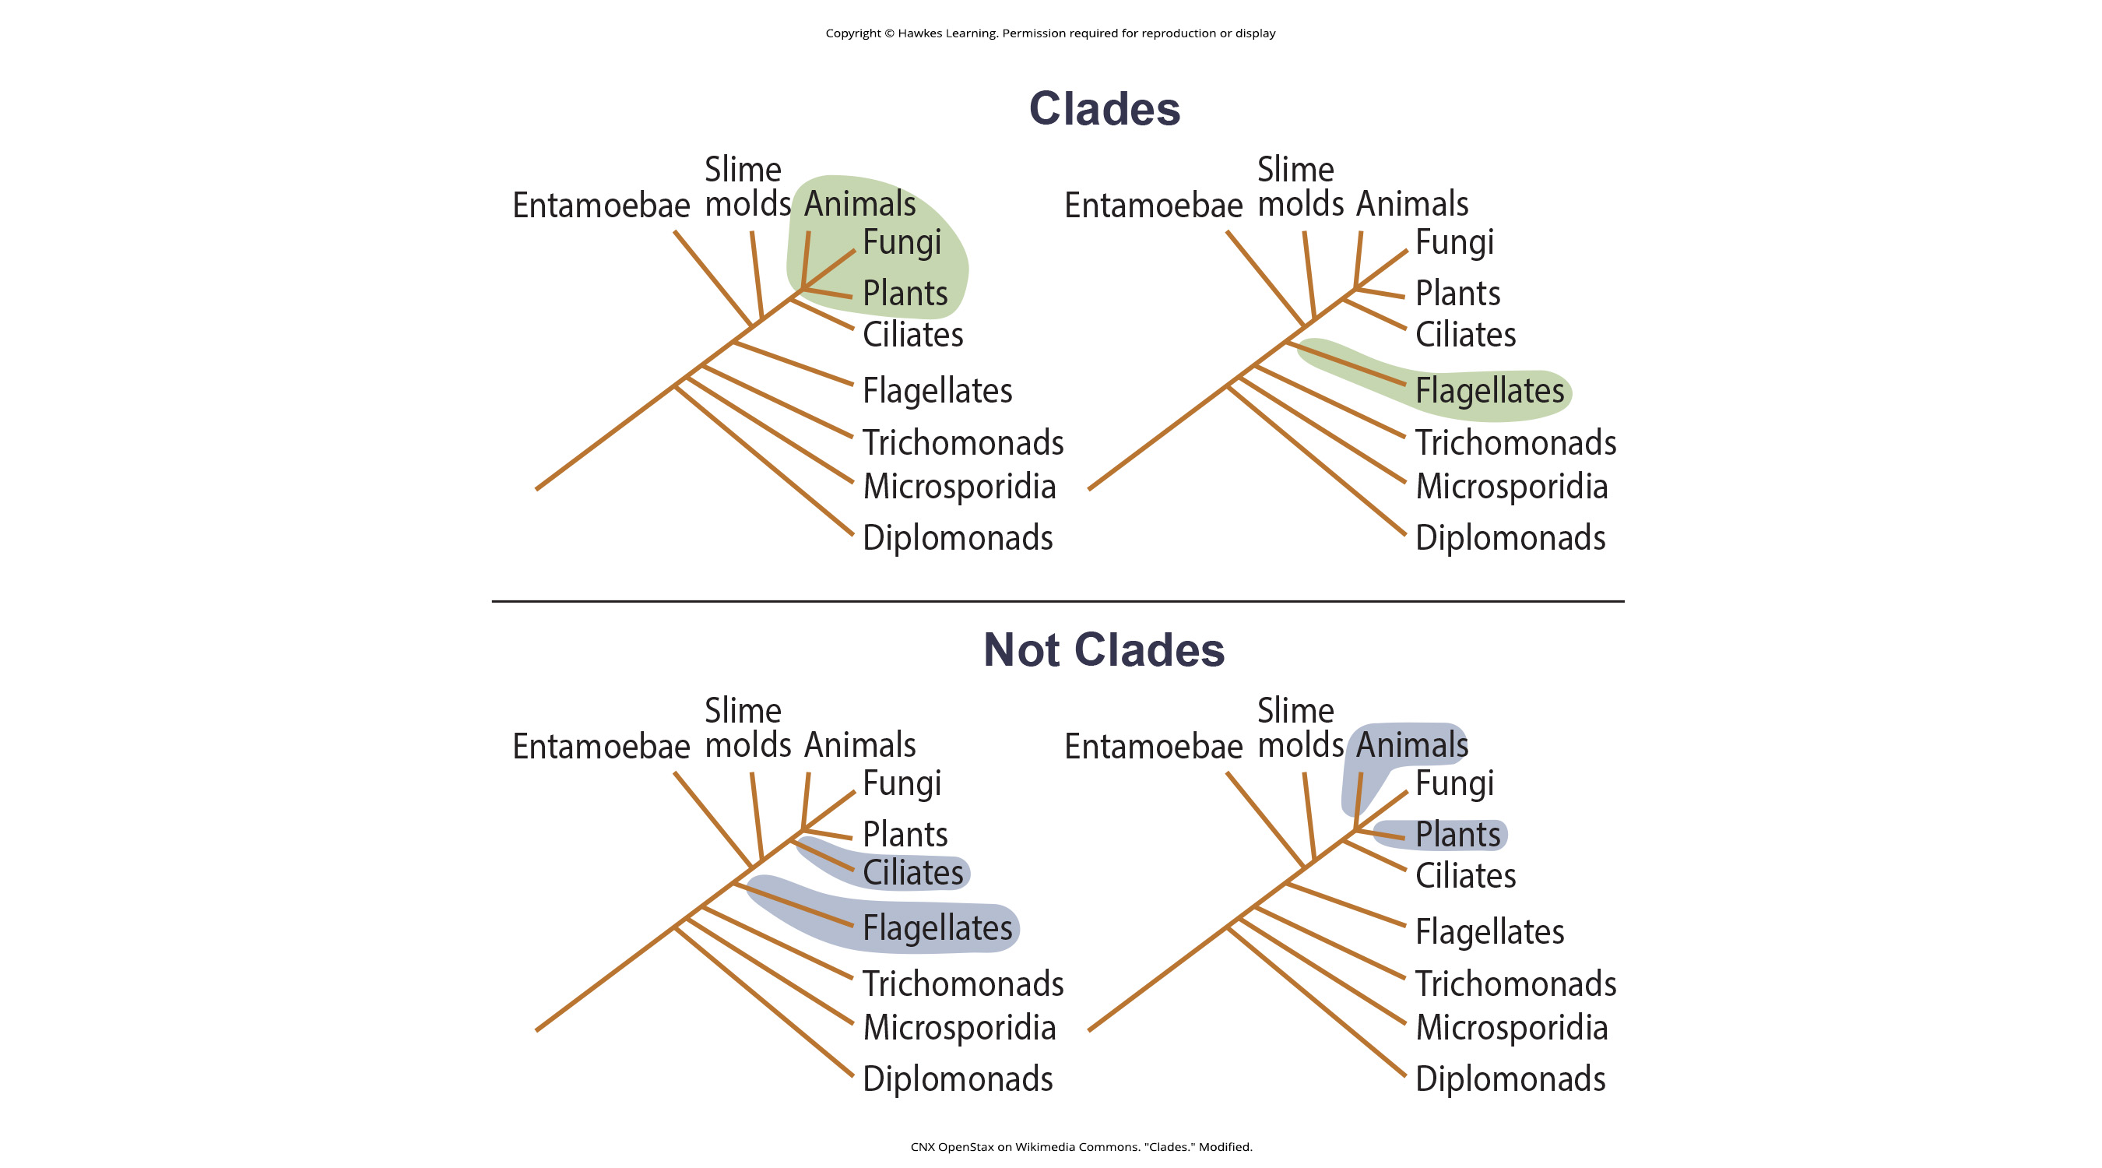
These Are Examples of Clades
A clade may contain:
Multiple groups (animals, fungi, and plants) OR
A single group (the flagellates)
20.2 Figure 4
CNX OpenStax on Wikimedia Commons. "Clades." Modified.

Slide 14
These Are Not Examples of Clades
Examples that are not clades include:
Groups that diverge at different branch points (ciliates versus flagellates) OR
A group that does not contain ALL of the groups that diverge from a single branch point (animals and plants, but not fungi)
20.2 Figure 4
CNX OpenStax on Wikimedia Commons. "Clades." Modified.

Slide 15
Think It Through₂
Examine Figure 4.
Which is the largest highlighted clade in Figure 4?
20.2 Figure 4
CNX OpenStax on Wikimedia Commons. "Clades." Modified.
Notes:
Originally an On Your Own. This is included here to use as a talking point or for a think-pair-share activity.

Slide 16
Evolutionary Change Happens in a Pattern
"Descent with modification" underlying evolution happens in a pattern that is repeated again and again.
A genetic change in an organism leads to a new trait which becomes prevalent in the group.
Many organisms descend from this point and have this trait.
New variations continue to arise, and some are adaptive and persist, leading to new traits.
With new traits, a new branch point is determined (go back to Step 1).

Slide 17
Some Traits Are Retained While Others Arise
A shared ancestral character is one that is found in the ancestor of a group and retained in all of the organisms within a clade.
Example: All vertebrates have the shared ancestral character of having vertebrae.
A shared derived character is one that develops at some point but is not present in all of the organisms in the tree.
Example: Having amniotic eggs is a shared derived character found in amniotes, but not in all vertebrates.
The same trait is one or the other depending on the context.
Example: Having amniotic eggs is a shared derived character within vertebrates but a shared ancestral character within amniotes.

Slide 18
The Simplest Evolutionary Pathway Is the Most Likely
According to parsimony, the most likely pathway of evolution includes the fewest major events to explain the evidence at hand.
Scientists look for the simplest and most obvious order of evolutionary events to generate the pattern of homologous traits observed in a group.

Slide 19
Group Activity
First, everyone in the group should individually select five different organisms and attempt to group them into clades based on shared characteristics. Then, combine your tree with that of your group and attempt to build a larger tree. You may not all agree with the grouping or selection of clades. Discuss the rationale you have for why you organized your clade the way you did, or how you think it best integrates with that of your group members.

Slide 20
Reflection Question
What do you think are some shared ancestral characteristics between humans and small mammals (rats, rabbits, etc.)?
What about humans and fungi?
Notes:
The reflection question is included here to use as a talking point or for a think-pair-share activity.

Slide 21
Summary
There are multiple ways to build phylogenetic trees, including using:
Homologous genes (molecular data)
Homologous characteristics (morphologic data)
Using modern technologies, scientists must distinguish between organisms having:
Homologies (shared evolutionary histories)
Analogies (separate evolutionary histories)
Scientists then use cladistics to organize events into an evolutionary timeline.
They apply parsimony, meaning that the order of events likely occurred in the most obvious and simplest way.

Slide 22


End of Hawkes Learning PowerPoint

