Slide 1
Lesson 20.3
Strategies for Phylogenetic Modeling

Slide 2
Objectives
Describe horizontal gene transfer.
Identify the web and ring models of phylogenetic relationships and describe how they differ from the original phylogenetic tree concept.
Illustrate how prokaryotes and eukaryotes transfer genes horizontally.

Slide 3
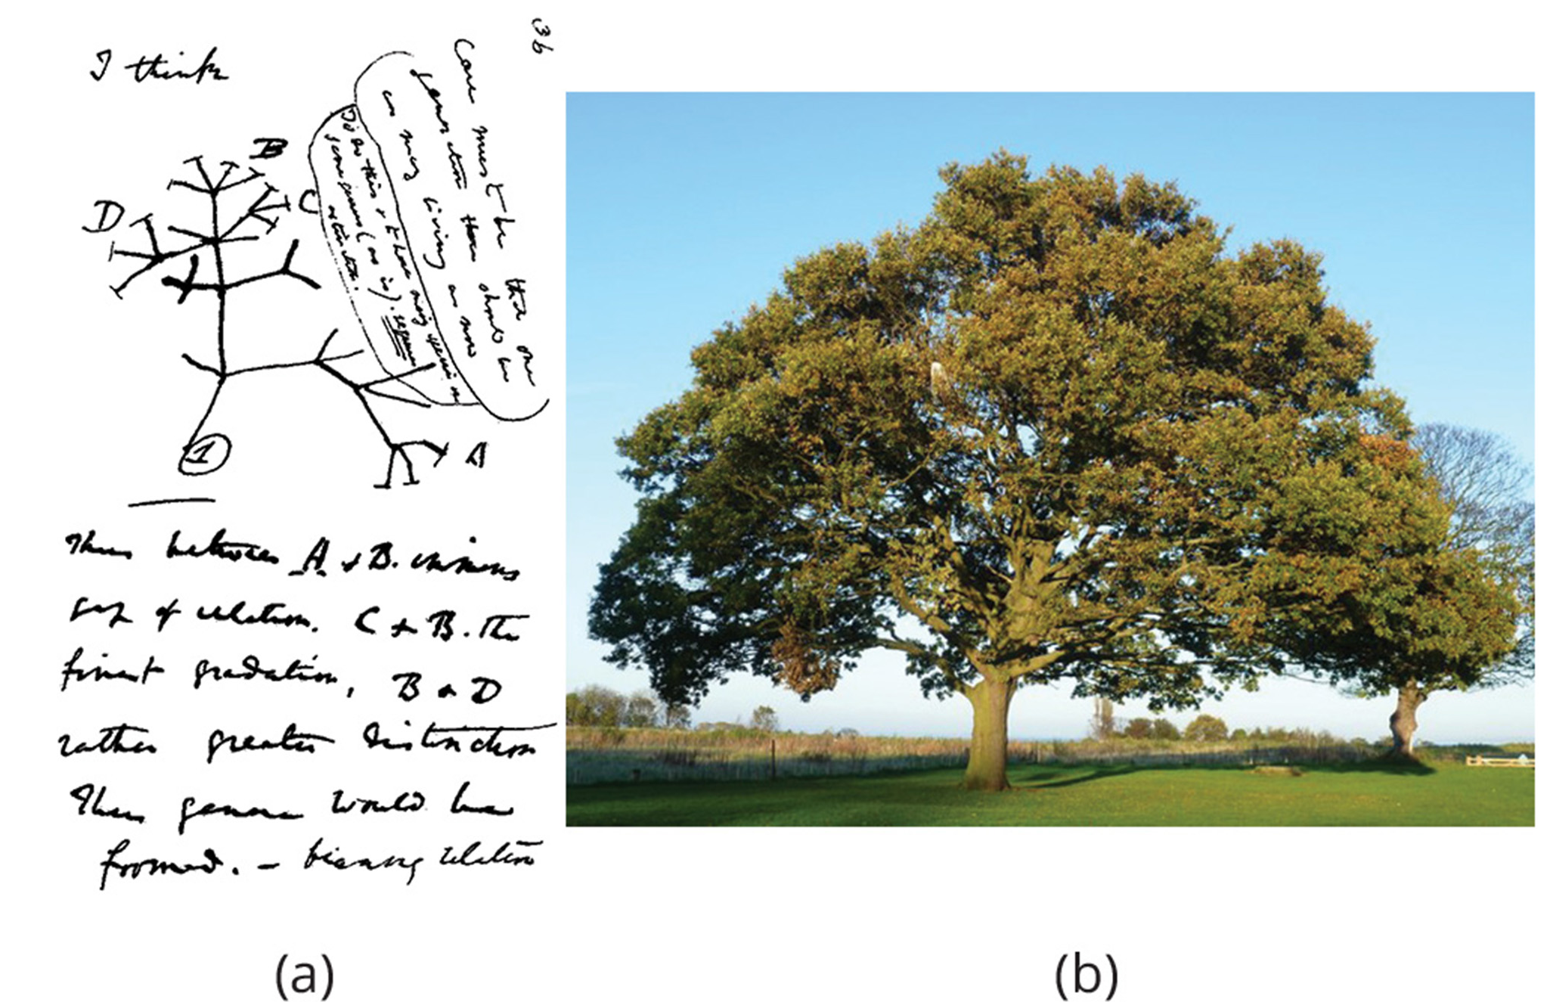
20.3 Figure 1
kim traynor on Wikimedia Commons. "Oak tree."
Notes:
20.3 Figure 1: (a) The concept of the "tree of life" dates to an 1837 Charles Darwin sketch. (b) Like an oak tree, the "tree of life" has a single trunk and many branches.

Slide 4
There Are Additional Considerations For Prokaryotes
Prokaryotes reproduce asexually, meaning that mutation is a primary way to introduce genetic variation.
Horizontal gene transfer (HGT), or lateral gene transfer, is the transfer of genes between unrelated species.
This is an important mechanism of introducing genetic variation in prokaryotes, and to a lesser extent, in eukaryotes.
This allows distantly related species to share genes.
Some consider the genome fusion resulting from endosymbiosis that gave rise to the first eukaryotic cell to be an extreme example of gene transfer.

Slide 5
Table 1: Summary of Prokaryotic and Eukaryotic HGT Mechanisms
 | Mechanism | Mode of Transmission | Example
Prokaryotes | transformation | DNA uptake | many prokaryotes
 | transduction | bacteriophage (virus) | bacteria
 | conjugation | pilus | many prokaryotes
 | gene transfer agents | phage-like particles | purple non-sulfur bacteria
Eukaryotes | from food organisms | unknown | aphid
 | jumping genes | transposons | rice and millet plants
 | epiphytes/parasites | unknown | yew tree fungi
 | from viral infections

Slide 6
The Endosymbiont Theory Explains the Origin of Eukaryotes
The endosymbiont theory proposes that eukaryotes descended from multiple prokaryotes.
Free-living prokaryotes that invaded primitive eukaryotic cells became permanent cytoplasmic symbionts and developed into:
Mitochondria (found in all eukaryotes)
Chloroplasts (found in green plants and flagellates)

Slide 7
There Are Three Classical Mechanisms of HGT in Prokaryotes
Transformation occurs when a bacterium take up naked DNA.
Transduction occurs when a virus transfers genes to a bacterium.
Conjugation occurs as a result of the formation of a hollow tube (pilus) between organisms that allows one organism to transfer genes to the other.

Slide 8
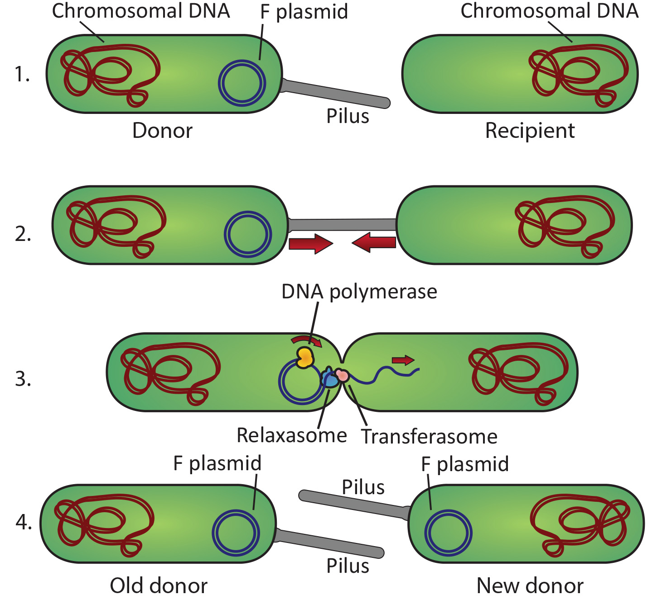
20.3 Figure 2
Adenosine on Wikimedia Commons. "Conjugation."
Notes:
20.3 Figure 2: Conjugation, one of the forms of DNA transfer between prokaryotes, is demonstrated here. This example shows the transfer of an extra-chromosomal piece of DNA known as the "F plasmid" through a structure known as the pilus. Chromosomal genes can sometimes hitchhike a ride through this process.

Slide 9
Prokaryotes Have a Fourth HGT Mechanism
Gene transfer agents (GTAs), small virus-like particles, transfer random pieces of DNA from one prokaryote species to another.
These were first characterized in 1974 in purple, non-sulfur bacteria.
These are thought to be derived from bacteriophage DNA and they look like viruses, but carry prokaryotic DNA from one cell to another.
A GTA integrates into the prokaryote DNA, then creates viral particles containing the prokaryote's DNA instead of viral DNA.
Scientists estimated gene transfer events in marine prokaryotes by GTAs or viruses to be as high as 10¹³ per year in the Mediterranean Sea alone.

Slide 10
Eukaryote Evolution Results From an Ancient Archaean Engulfing an Ancient Bacterium
Modern DNA evidence no longer favors the idea that eukaryotes evolved directly from Archaea.
While eukaryotes and Archaea share features (such as the TATA box) not found in bacteria, there are some eukaryotic genes more similar to bacteria DNA than to Archaea DNA.
Scientists now propose that the engulfment of an ancient bacterium by an ancient Archaean was the ultimate event in eukaryotic evolution.

Slide 11
Science and You
HGT is important in modern health care.
After antibiotics were first introduced, the number and severity of bacterial infections decreased dramatically.
Today, HGT allows for the sharing of antibiotic resistance genes among different bacterial species.
Antibiotic resistance can evolve in a nonpathogenic bacterium (such as one found in livestock which are exposed to subtherapeutic does of antibiotics).
Then HGT shares the genes with a dangerous pathogen.
Notes:
This is included as a relevant application for this topic.

Slide 12
HGT Occurs More Rarely in Eukaryotes
While prokaryotes are single cells exposed to their environments, eukaryotic reproductive cells are sequestered and protected, making it more rare.
Transposons, or "jumping genes," are DNA pieces that can:
Insert into the genome
Cut themselves out
Reinsert in a new location
Examples:
Transfer between rice and millet
Fungi feeding on yew trees have acquired the ability to make Taxol® from the trees

Slide 13
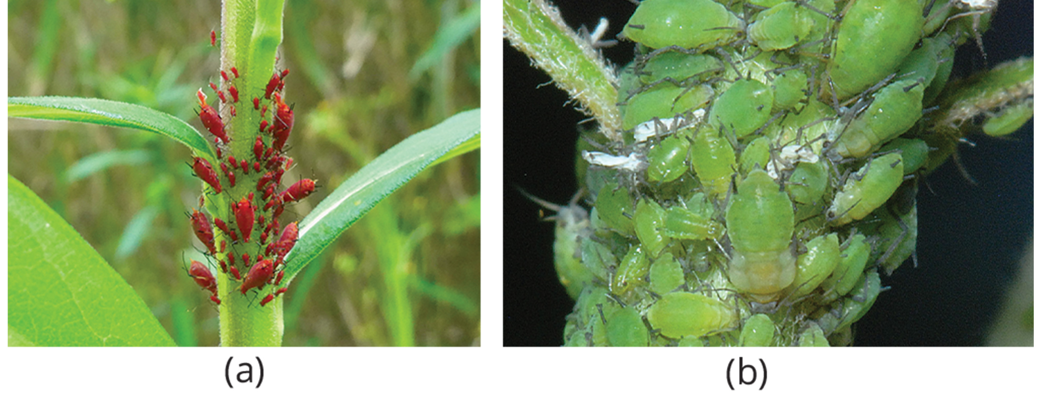
Aphids Have Acquired Carotenoid Synthesis Genes from Fungi Living On Plants
Carotenoids are pigments that plants, fungi, and microbes produce and that animals acquire from food.
Aphids have acquired the ability to make carotenoids.
DNA analysis shows the aphid genes are most like fungal genes, likely acquired from eating the fungi.
20.3 Figure 3: Aphids have acquired the ability to make carotenoids by HGT (a), but the ability to do so can be inactivated by mutation (b).
KKPCW on Wikimedia Commons. "Red aphids."
InfluentialPoints on Wikimedia Commons. "Aphis pomi colony."

Slide 14
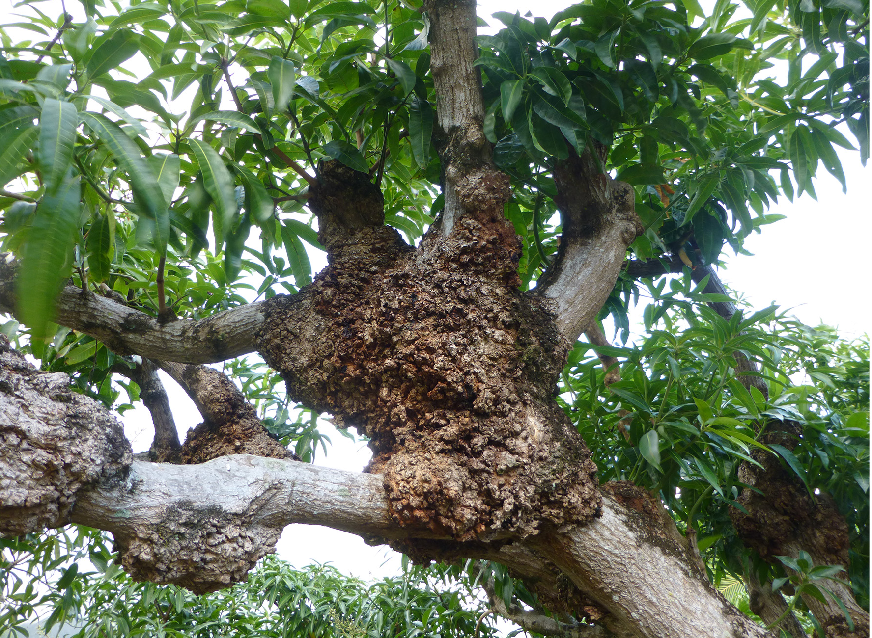
20.3 Figure 4
Photograph by B. Kuwana on Wikimedia Commons. "Mango tree."
Notes:
20.3 Figure 4: An example of a mango tree that suffers from crown gall disease, which is caused by horizontal gene transfer between a prokaryote, Agrobacterium tumefaciens, and the eukaryotic plant

Slide 15
Genome Fusion Led to the Evolution of the First Eukaryotic₁
Scientists believe that the ultimate form of HGT occurs through genome fusion between two prokaryote species during endosymbiosis.
Endosymbiosis is when one species is taken into another's cytoplasm, resulting in a genome having genes from both the endosymbiont and the host.
Both mitochondria and chloroplast contain their own distinct DNA, which have different evolutionary origins from the nucleus.
Mitochondrial DNA is circular like bacterial genomes.
Mitochondrial DNA is only inherited from the mother.

Slide 16
Reflection Question
Antibiotics are drugs that can specifically target and kill prokaryotes, treating infections caused by dangerous bacteria.
What do you think the endosymbiont theory means for the effect of these drugs on your own eukaryotic cells?
Notes:
The reflection question is included here to use as a talking point or for a think-pair-share activity.

Slide 17
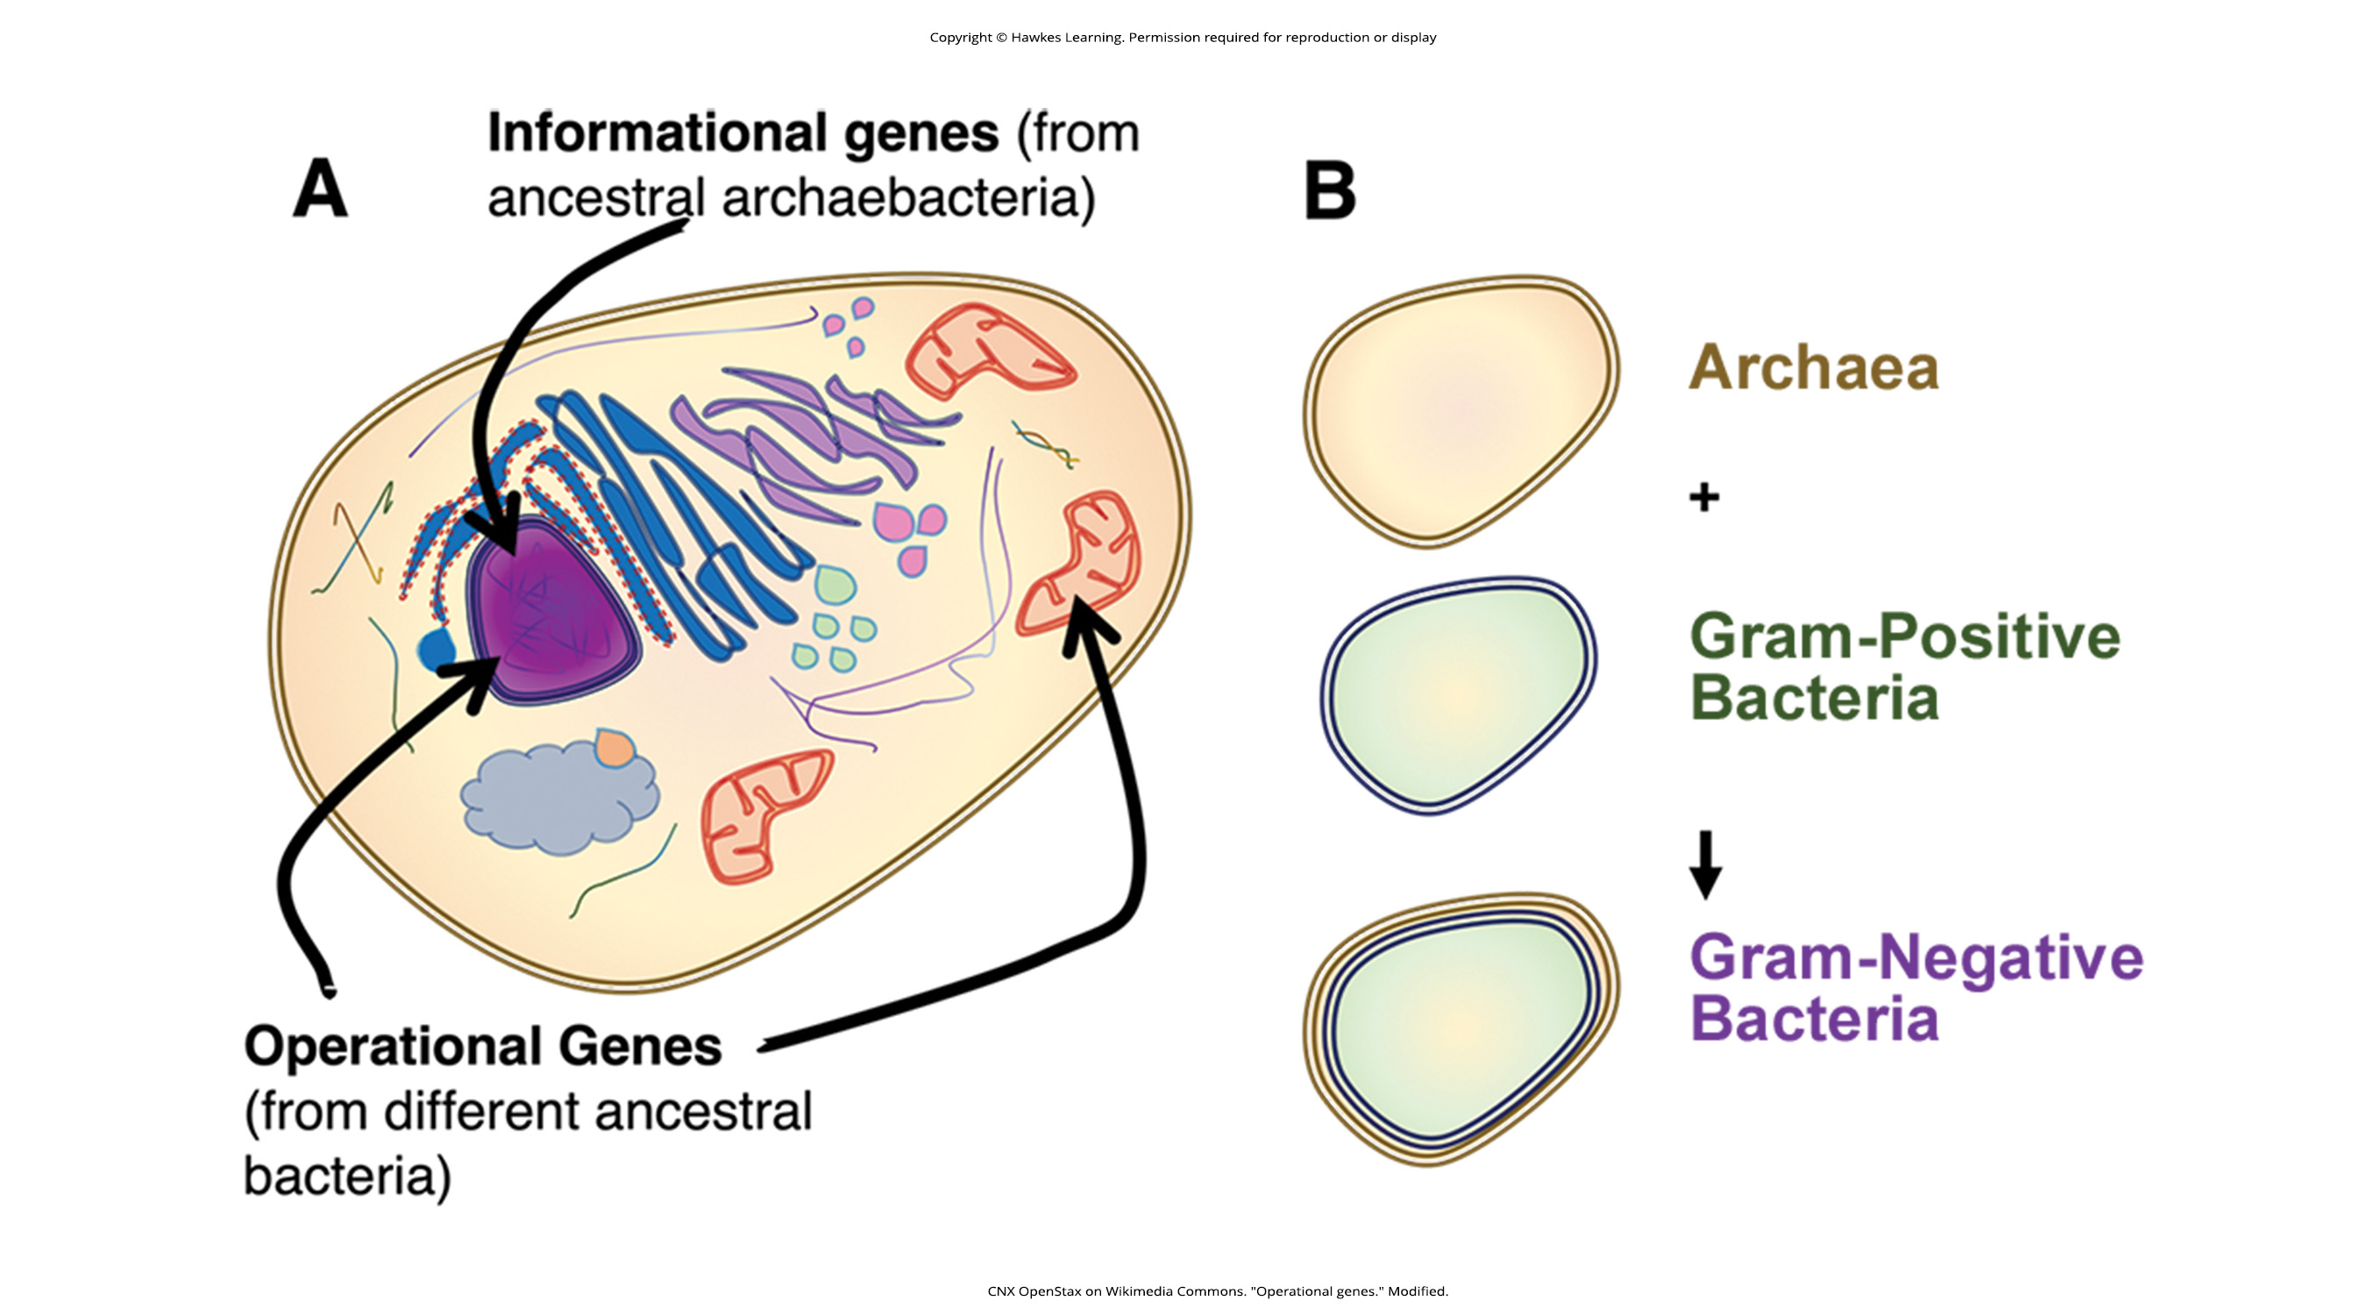
Genome Fusion Led to the Evolution of the First Eukaryotic₂
James Lake (UCLA/NASA), based upon a new mathematical algorithm called conditioned reconstruction (CR), proposed that the first eukaryotic cell evolved from genome fusion between:
A member of the Archaea
A member of the Bacteria
This explains why eukaryotes have genes resembling both.
Some scientists do not support this.
20.3 Figure 5 (a)
CNX OpenStax on Wikimedia Commons. "Operational genes." Modified.

Slide 18
Genome Fusion Led to the Evolution of the First Eukaryotic₃
Lake has more recently proposed that Gram-negative bacteria resulted from an endosymbiotic fusion of archaeal and bacterial species.
This explains the double membrane of Gram-negative Bacteria.
This also explains the double membranes of mitochondria and chloroplasts.
The scientific community still debates this.
20.3 Figure 5 (b)
CNX OpenStax on Wikimedia Commons. "Operational genes." Modified.

Slide 19
Competing Theories Explain the Evolution of the Nucleus
One theory suggests that prokaryotic cells produced an additional membrane that surrounded the bacterial chromosome.
Some bacteria have DNA enclosed by two membranes, but there is no evidence for nucleoli or nuclear pores.
Other proteobacteria have membrane-bound chromosomes.
If the nucleus evolved this way, we would expect either the Bacteria or the Archaea to be more closely related to eukaryotes.

Slide 20
Different Theories Argue for Different Orders of Events in the Evolution of the Modern Eukaryote
According to the nucleus-first hypothesis, the order of evolution was:
Nucleus in a prokaryote
Fusion of a new eukaryote (containing nucleus) with bacteria that became mitochondria
According to the mitochondria-first hypothesis, the order of evolution was:
The establishment of mitochondria in a prokaryotic host
Later acquisition of a nucleus (by fusion or another mechanism) to become a eukaryote
According to the eukaryote-first hypothesis, prokaryotes evolved from eukaryotes through the loss of genes and complexity.

Slide 21
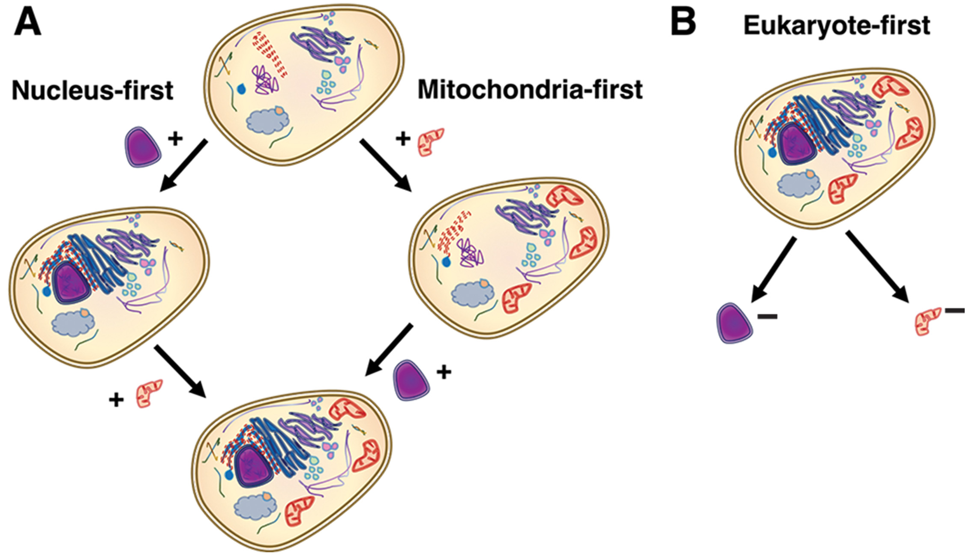
20.3 Figure 6
CNX OpenStax on Wikimedia Commons. "Models of evolution." Modified.
Notes:
20.3 Figure 6: Three alternate hypotheses of eukaryotic and prokaryotic evolution are (a, left) the nucleus-first hypothesis, (a, right) the mitochondria-first hypothesis, and (b) the eukaryote-first hypothesis. Note that the endomembrane system is drawn in only with the nucleus, representing their shared function, but that every postulated cell here contains DNA and ribosomes.

Slide 22
Think It Through₁
What type of discovery would support the "nucleus-first" hypothesis?
Notes:
Originally an On Your Own. This is included here to use as a talking point or for a think-pair-share activity.

Slide 23
Perhaps Eukaryotes Evolved From a Pool of Prokaryotes Sharing Genes by HGT
W. Ford Doolittle proposed a web or network model called the "web of life" model in 1999.
This suggests that eukaryotes did not evolve from a single prokaryotic ancestor, but rather from a pool of prokaryotes sharing genes by HGT.
Some prokaryotes led to the development of mitochondria.
Other prokaryotes led to the development of chloroplasts.
The Ficus tree, having multiple trunks, is often used to represent this model.

Slide 24
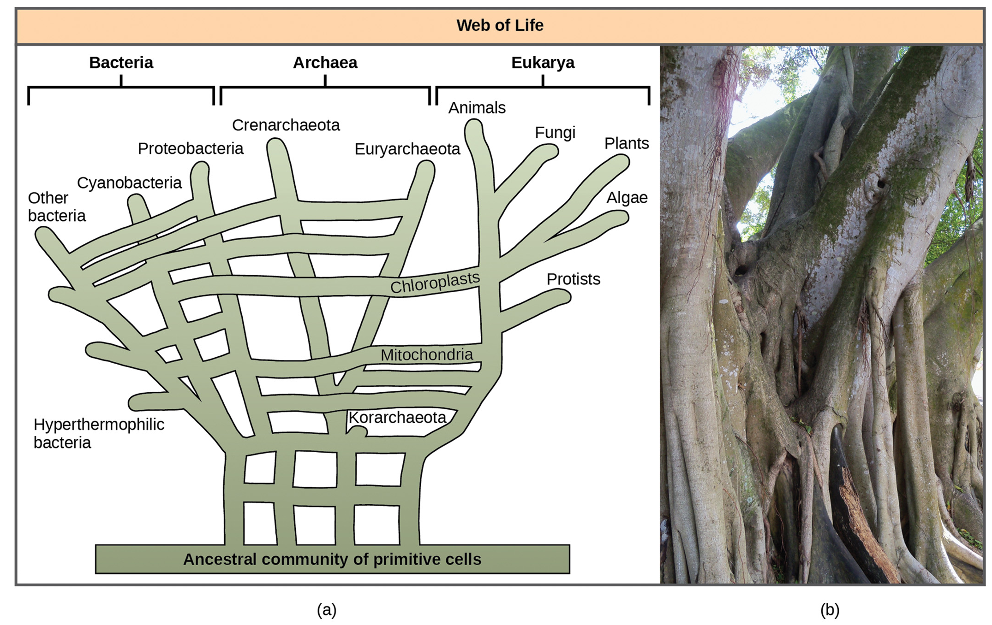
20.3 Figure 7
Smiley.toerist on Wikimedia Commons. "Cagliari Ficus tree."
Notes:
20.3 Figure 7: In W. Ford Doolittle's phylogenetic model, (a) the "tree of life" arose from a community of ancestral cells, has multiple trunks, and has connections between branches where horizontal gene transfer has occurred. Visually, this concept is better represented by the (b) multi-trunked Ficusthan by an oak's single trunk (similar to Darwin's tree in Figure 1).

Slide 25
Perhaps All Three Domains Evolved From a Pool of Primitive Prokaryotes
Lake, using the conditioned reconstruction algorithm, further developed the "ring of life" model.
This suggests that all 3 domains evolves from a single pool of gene-swapping prokaryotes.
His lab indicates that this model:
Best fits their DNA analyses
Is the only one that adequately incorporates HGT and genomic fusion
Other scientists remain skeptical of this model.
Lake suggests that skeptics try to modify the tree model to reflect his lab's data, and that an inability to do so would support the "ring of life" proposal.

Slide 26
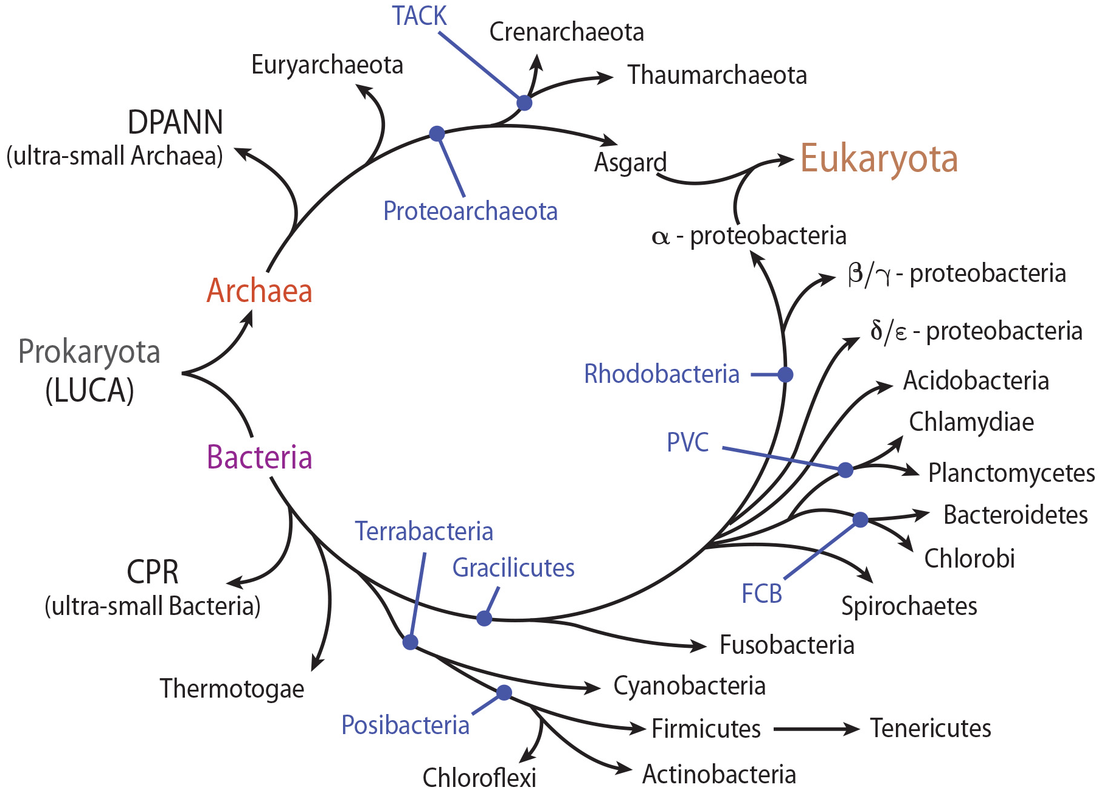
20.3 Figure 8
Mauricio Lucioni on Wikimedia Commons. "Ring of life."
Notes:
20.3 Figure 8: According to the "ring of life" phylogenetic model, the three domains of life evolved from a pool of primitive prokaryotes.

Slide 27
No Current Model Fully Describes the Phylogenetic Relationships of Life
Each model (a tree, a web, a ring) has pros and cons.
A tree is probably too simplistic.
Scientists are continuing to look for more useful models.
Each model serves as a hypothesis to test and then gain new information for the refinement of existing models and the development of new ones.

Slide 28
Think It Through₂
How does the study of viruses shed light on the tree of life?
Notes:
Originally an On Your Own. This is included here to use as a talking point or for a think-pair-share activity.

Slide 29
Summary
Darwin's classic "tree of life" model to describe phylogenetic relationships among species is still the most common model used today.
New ideas about HGT and genome fusion have led some to suggest models resembling webs or rings.

Slide 30


End of Hawkes Learning PowerPoint

