Slide 1
Lesson 21.1
Viral Evolution, Morphology, and Classification

Slide 2
Objectives
Describe how viruses were first discovered and how they are detected.
Describe the general structure of a virus.
Discuss three hypotheses about how viruses evolved.
Recognize the basic shapes of viruses.
Understand past and emerging classification systems for viruses.

Slide 3
Viruses Are Acellular Parasites
Viruses:
Are acellular parasites (meaning that they lack cells)
Cannot be classified into any kingdom
Infect all organisms (plants, animals, and prokaryotes)
Are not alive because they
Are not composed of cells
Cannot grow or reproduce by cell division
Cannot metabolize
Can copy and replicate themselves, but
Are entirely dependent on host cells
Have an unknown evolutionary history, but
May be a mosaic of bits and pieces of nucleic acids picked up from various sources

Slide 4
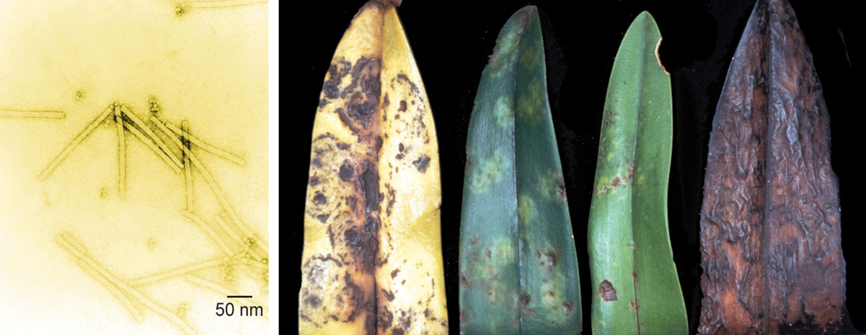
21.1 Figure 1
Unknown author on Wikimedia Commons. "Tobacco mosaic virus (TMV)."
Department of Plant Pathology Archive North Carolina State University on Wikimedia Commons. "Orchid leaves with tobacco mosaic virus."
Notes:
21.1 Figure 1: The tobacco mosaic virus, seen here by transmission electron microscopy (left), was the first virus to be discovered. The virus causes disease in tobacco and other plants, such as the orchid (right).

Slide 5
Viruses Are Diverse
Viruses vary in
Structure
Their methods of replication
The hosts they infect
All forms of life, from bacteria to archaea to eukaryotes (including plants, animals, and fungi) have viruses that can infect them.
Much about the origins and evolution of viruses remains unknown.

Slide 6
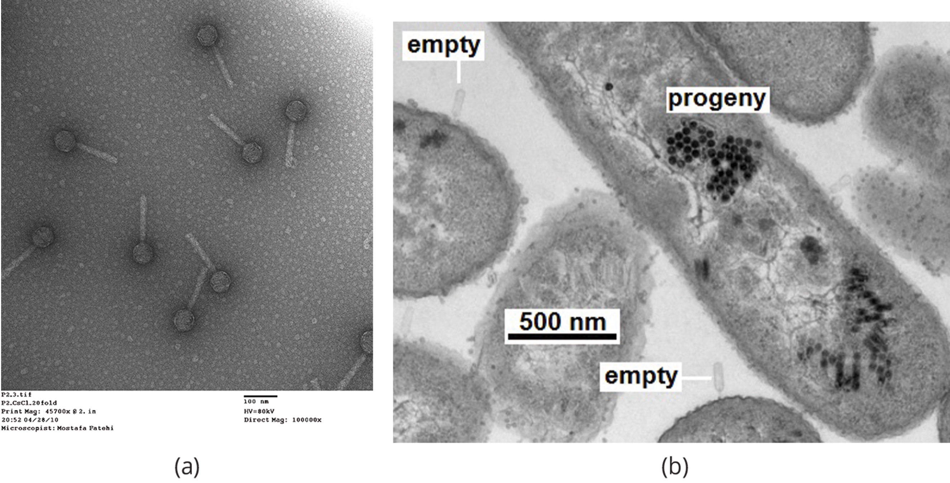
21.1 Figure 2
Mohammadali Khan Mirzaei, Harald Eriksson, Kie Kasuga, Elisabeth Haggård-Ljungquist, Anders S. Nilsson on Wikimedia Commons. "Bacterial cells."
Notes:
21.1 Figure 2: Most virus particles are visible only by electron microscopy. (a) This electron micrograph shows a bacteriophage (scale bar at 100 nm). (b) Here, an electron micrograph displays bacterial cells infected by bacteriophages, showing empty capsid structures that have infected bacteria and black bacteriophage progeny internal to the bacteria (scale bar at 500 nm).

Slide 7
Viruses Were Discovered As "Filterable" Agents
Viruses were discovered in 1892 by Dmitri Ivanowski.
When he filtered an extract from a diseased plant with tobacco mosaic disease through a porcelain Chamberland-Pasteur filter to remove bacteria, the extract still contained a "filterable" infectious agent that could cause disease in a healthy plant.
It was still many years until the filterable agent was determined to not be very small bacteria.

Slide 8
The Sizes and Structures of Viruses Can Be Determined Microscopically
A virion is a single virus particle.
Virions range in size from 20–250 nanometers in diameter, with some newly discovered viruses being as large as 1,000 nanometers in diameter.
Most viruses (except large virions like poxvirus) cannot be seen with a light microscope.
The development of the electron microscope in the 1930s allowed for the first view of viral structure.
TEM can be used to observe both virion surface structure and internal structures.
SEM can be used only to observe a virion’s surface structure.

Slide 9
The Origin of Viruses Remains Unknown
While scientists can study present-day viruses to see how they mutate and adapt, they cannot study ancient viruses.
Viruses do not fossilize.
Scientists draw conclusions about viral evolution from studying today’s viruses:
Biochemical information
Genetic Information

Slide 10
Scientists Have Proposed Multiple Hypotheses for Viral Origins
Viruses do not have a single ancestor, but multiple hypotheses for their origins have been proposed.
According to the regressive hypothesis (devolution), viruses evolved from free-living cells or from intracellular prokaryotic parasites.
According to the progressive hypothesis, viruses originated from RNA or DNA molecules or self-replicating entities like transposons or other mobile genetic elements that escaped a host cell with the ability to enter another.
According to the virus-first hypothesis, viruses may have been the first self-replicating entities, predating the first cells.
In all cases, viruses continued to evolve alongside their hosts.
Virus molecular systematics compares genetic sequences in an attempt to refine hypotheses and develop new ones.

Slide 11
Reflection Question₁
Which hypothesis do you find the most reasonable?
Why do you think so?
Notes:
The reflection question is included here to use as a talking point or for a think-pair-share activity.

Slide 12
Viral Structure Is Quite Simple
Viruses lack most cellular components, such as organelles, ribosomes, and a plasma membrane.
A virion includes:
A nucleic acid core
An outer protein coating called a capsid
Some viruses also have an outer envelope made of membranes derived from the host cell.
Viral morphology is diverse.
The complexity of the host cell does not necessarily match that of the virion's complexity
Bacteriophages (viruses that infect bacteria) have some of the most complex virion structures.

Slide 13
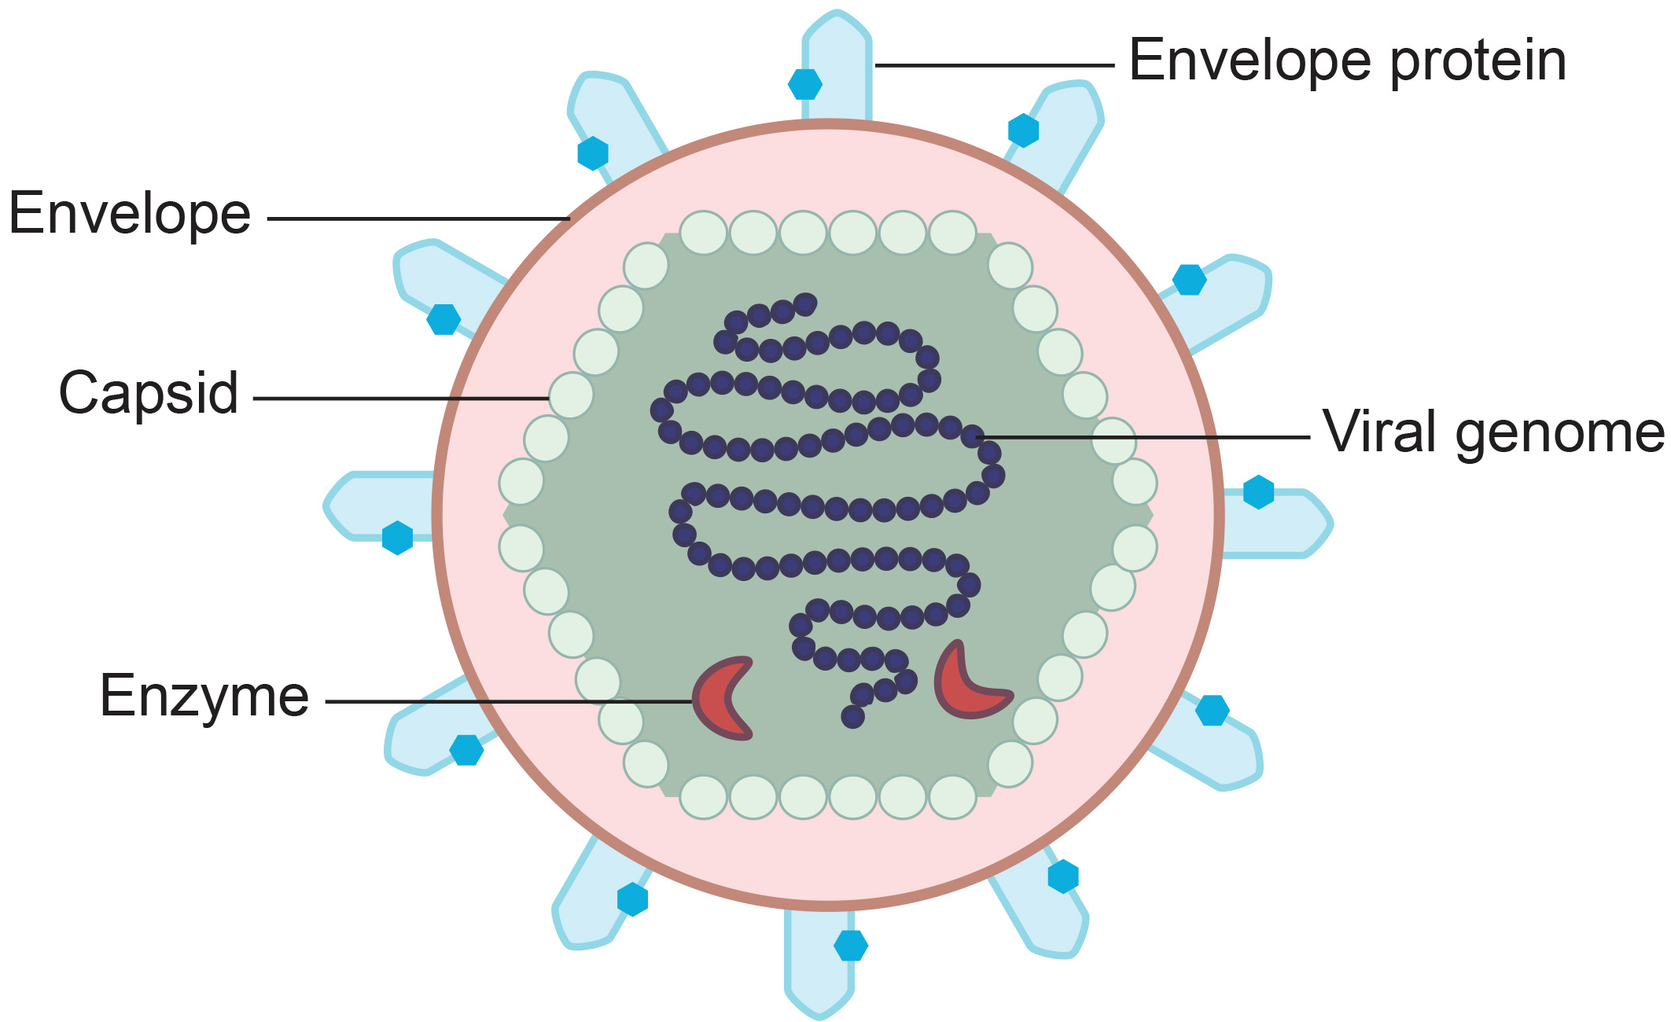
21.1 Figure 3
DEXi on Wikimedia Commons. "Viral structure."
Notes:
21.1 Figure 3: A virus consists of a core of nucleic acids contained within a protein capsid. In an enveloped virus, an outer membrane derived from the host cell surrounds the capsid.

Slide 14
Viral Morphology Varies By Viral Family
Viral morphology (shape and size) varies by family but is consistent with a family.
Capsid proteins called capsomeres are encoded in the viral genome.
The main groups of viral capsids are:
Helical: long and cylindrical (example: TMV)
Icosahedral: roughly spherical (example: polioviruses and herpesviruses)
Complex:
Enveloped: have membranes from host cells (example: HIV)
Head-and-tail: have heads like icosahedral viruses and tails like helical viruses (example: some bacteriophages)

Slide 15
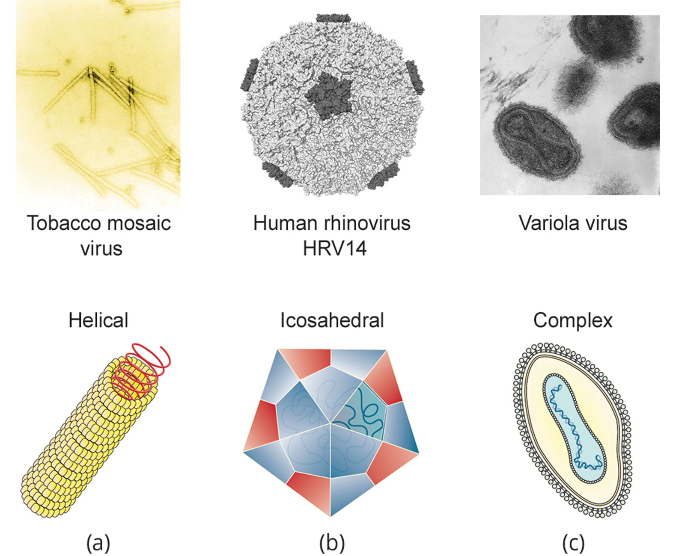
21.1 Figure 4
Unknown author on Wikimedia Commons. "Tobacco mosaic virus (TMV)."
Robin S. on Wikimedia Commons. "Rhinovirus."
CDC on Wikimedia Commons. "Smallpox virus virions."
Notes:
21.1 Figure 4: Viral capsids can be (a) helical, (b) polyhedral, or (c) complex in shape.

Slide 16
Many Viruses Have Surface Glycoproteins to Attach to Viral Receptors on Host Cells
Many viruses have glycoproteins on their surface to attach to host cells' viral receptors.
Attachment is required before cell membrane penetration.
Then, the virus completes replication inside of the cell.
These viral receptors are surface proteins with their own functions for the host cell.
Example: HIV uses the CD4 molecule on T cells as its receptor
CDR is a type of cell adhesion molecule that normally keeps immune cells close together during a T cell immune response.

Slide 17
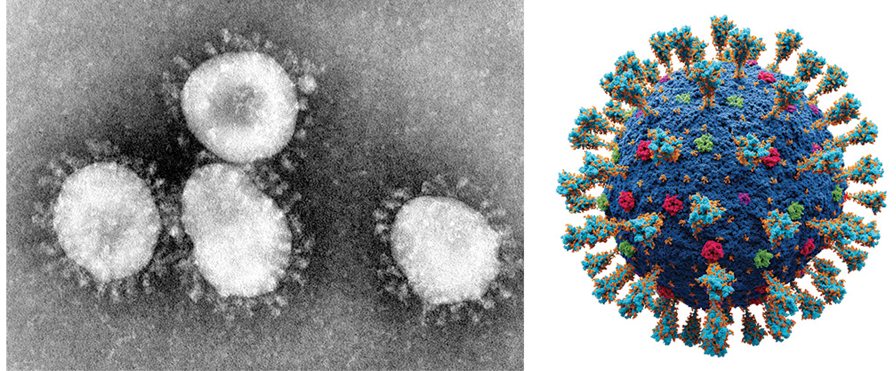
21.1 Figure 5
CDC on Wikimedia Commons. "Coronaviruses."
Alexey Solodovnikov on "Atomic model of coronavirus."
Notes:
21.1 Figure 5: An electron micrograph (left) and a structural model (right) of human coronaviruses, which have a spherical capsid shape covered in numerous spike proteins

Slide 18
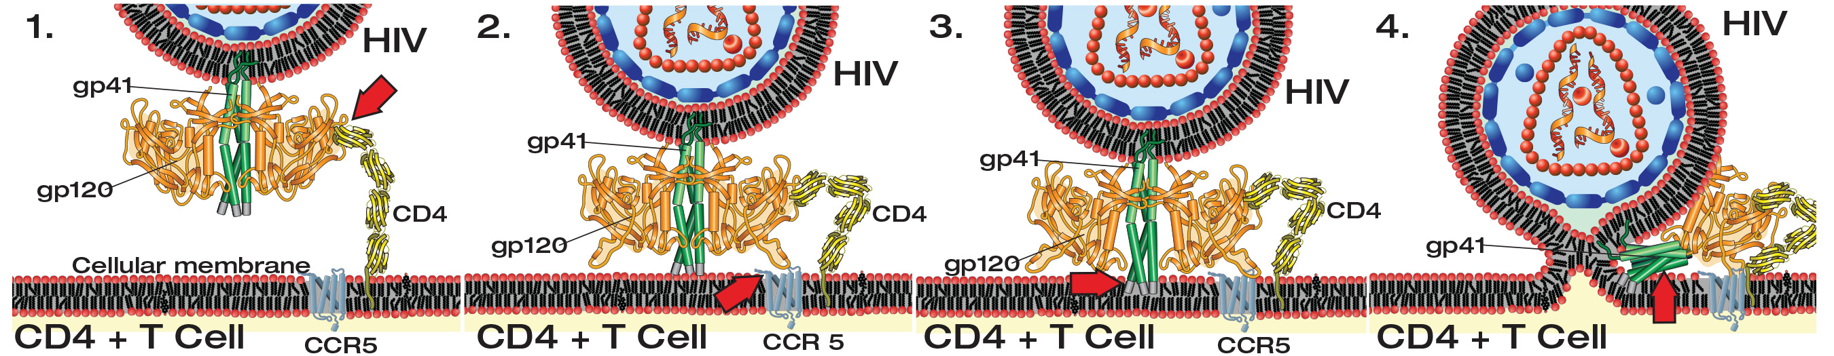
21.1 Figure 6
Mike Jones on Wikimedia Commons. "HIV membrane fusion."
Notes:
21.1 Figure 6: The HIV virus binds the CD4 receptor on the surface of human cells. CD4 receptors help white blood cells to communicate with other cells of the immune system when producing an immune response. After binding to the human CD4 receptor, HIV undergoes various structural shifts in its gp41 and gp120 proteins, allowing it to fuse with and infect the host cell.

Slide 19
Think It Through₁
Which of the following statements about virus structure is true? Select the correct answer.
All viruses are encased in a viral membrane.
The capsomere is made up of small protein subunits called capsids.
DNA is the genetic material in all viruses.
Glycoproteins help the virus attach to the host cell.
Notes:
Originally an On Your Own. This is included here to use as a talking point or for a think-pair-share activity.

Slide 20
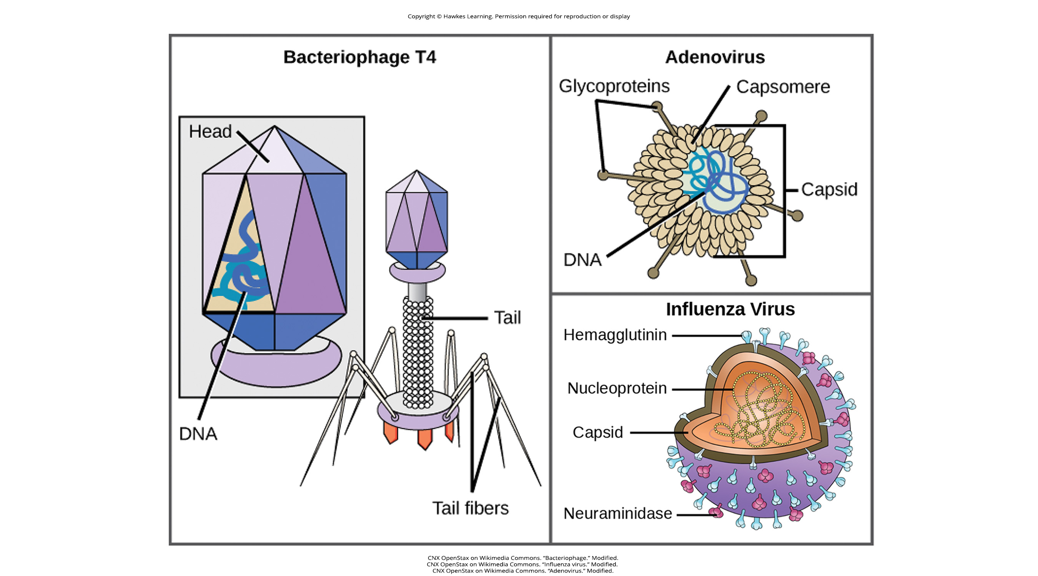
The T4 Bacteriophage is a Complex Virion
The T4 bacteriophage, which infects the Escherichia coli bacterium, has:
A tail for attaching to host cells
A head structure that houses its DNA
21.1 Figure 7
CNX OpenStax on Wikimedia Commons. "Bacteriophage." Modified.

Slide 21
Nonenveloped Viruses Lack Membrane Layers
A nonenveloped virus lacks a membrane layer.
They use glycoprotein spikes protruding from its capsomeres to attach to host cells.
They are more resistant to changes in temperature, pH, and some disinfectants than enveloped viruses.
Examples include:
Adenovirus
Poliovirus (causes polio)
Papillomaviruses (cause warts)
Hepatitis A virus (causes hepatitis A)

Slide 22
Enveloped Viruses Have Membrane Layers Containing Viral Proteins
Enveloped viruses consist of a nucleic acid (DNA or RNA), a capsid, and a phospholipid bilayer envelope containing viral proteins:
Glycoproteins: for attachment to host cells
Matrix proteins: for stabilizing the envelope and aiding in assembly of viral progeny
They are less resistant to changes in temperature, pH, and some disinfectants than nonenveloped viruses due to the fragility of membranes.
Examples include:
Influenza virus
Chickenpox
HIV
Mumps

Slide 23
Nonenveloped and Enveloped Viruses Differ In Structure
21.1 Figure 7: Adenovirus is a nonenveloped virus, while influenza virus is an enveloped virus.
CNX OpenStax on Wikimedia Commons. "Influenza virus." Modified.
CNX OpenStax on Wikimedia Commons. "Adenovirus." Modified.

Slide 24
The Presence or Absence of an Envelope Is Largely Useful Only for Classification
The presence or absence of an envelope tells us nothing about:
The disease a virus may cause
The species it might infect

Slide 25
Viruses Vary in Their Genome Composition and Structure
The virus core contains the viral genome.
Viral genomes tend to be small, containing only genes that encode proteins that the host does not.
Viral genomes may be:
DNA or RNA
Single-stranded or double-stranded
Linear or circular
A single piece or segmented (like influenza virus)

Slide 26
A DNA Virus Directs the Host Cell to Replicate Its DNA and Make Its Proteins
The viral DNA in DNA viruses directs:
The host cell's replication proteins to make new copies of the viral genome
The host cell's transcription and translation machinery to make viral proteins
Examples of human diseases caused by DNA viruses include:
Chicken pox
Hepatitis B
Adenoviruses
Herpes viruses
Human papilloma viruses

Slide 27
An RNA Virus Must Encode Its Own Enzyme to Replicate Its Genome
RNA viruses must encode their own enzymes (called RNA polymerase enzymes) to:
Replicate RNA into RNA (typical RNA viruses)
Replicate their RNA into DNA (retroviruses):
RNA polymerases are more likely to make copying errors.
RNA viruses accumulate more mutations and can change and adapt more rapidly to their hosts.
Examples of human diseases caused by RNA viruses include:
Influenza
Hepatitis C
Measles
Rabies
HIV (a retrovirus)

Slide 28
Reflection Question₂
How might high rates of copying errors in RNA polymerase enzymes be beneficial or detrimental to the evolution of a pathogenic virus?
Notes:
The reflection question is included here to use as a talking point or for a think-pair-share activity.

Slide 29
Viruses Are Difficult to Classify
Viruses likely evolved from different ancestors.
Viruses lack common genetic sequences that they all share.
Because they lack ribosomes, they lack rRNA sequences.
Thus, genomic or protein analysis is not appropriate.
Methods to classify viruses have been based on:
Core structure: type of nucleic acid and structure of genome
Morphology and capsid design (including the presence or absence of an envelope)
How mRNA is generated for each virus type (called the Baltimore classification scheme)

Slide 30
Table 1: Virus Classification by Genome Structure
Genome Structure | Examples
RNA | rabies virus, retroviruses
DNA | herpesviruses, smallpox virus
single-stranded | rabies virus, retroviruses
double-stranded | herpesviruses, smallpox virus
linear | rabies virus, retroviruses, herpesviruses, smallpox virus
circular | papillomaviruses, many bacteriophages
non-segmented: genome consists of a single segment of genetic material | parainfluenza viruses
segmented: genome is divided into multiple segments | influenza viruses

Slide 31
Viruses Can Be Classified by Their Capsids
Viruses can be classified by the design of their capsids as:
Naked icosahedral
Enveloped icosahedral
Enveloped helical
Naked helical
Complex

Slide 32
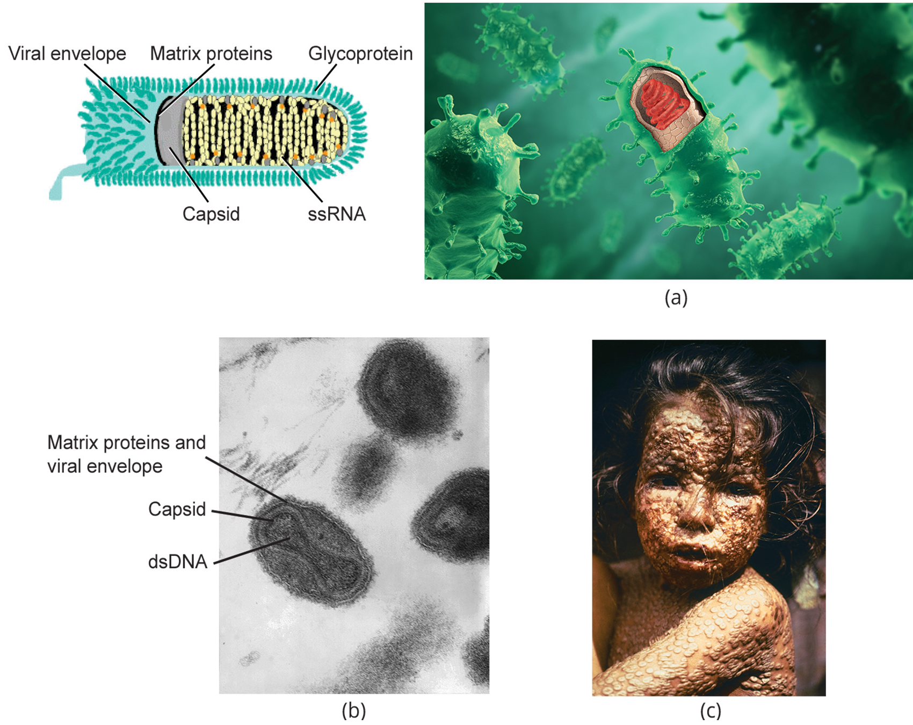
21.1 Figure 8
CDC on Wikimedia Commons. "Smallpox virus virions."
www.scientificanimations.com/wiki-images/ on Wikimedia Commons. "Rabies virus structure."
CDC on Wikimedia Commons. "Child with smallpox."
Notes:
21.1 Figure 8: Viruses can be classified according to their core genetic material and capsid design. (a) Rabies virus has a single-stranded RNA (ssRNA) core and an enveloped helical capsid, whereas (b) variola virus, the causative agent of smallpox, has a double-stranded DNA (dsDNA) core and a complex capsid. Rabies transmission occurs when saliva from an infected mammal enters a wound. The virus travels through neurons in the peripheral nervous system to the central nervous system, where it impairs brain function and then travels to other tissues. The virus can infect any mammal, and most die within weeks of infection. (c) Smallpox is a human virus transmitted by inhalation of the variola virus, localized in the skin, mouth, and throat, which causes a characteristic rash. Before its eradication in 1979, infection resulted in a 30 to 35% mortality rate.

Slide 33
Table 2: Virus Classification by Capsid Structure
Capsid Classification | Examples
naked icosahedral | hepatitis A virus, polioviruses
enveloped icosahedral | Epstein-Barr virus, herpes simplex virus, rubella virus, yellow fever virus, HIV-1
enveloped helical | influenza viruses, mumps virus, measles virus, rabies virus
naked helical | tobacco mosaic virus
complex with many proteins, some have combinations of icosahedral and helical capsid structure | herpesviruses, smallpox virus, hepatitis B virus, T4 bacteriophage

Slide 34
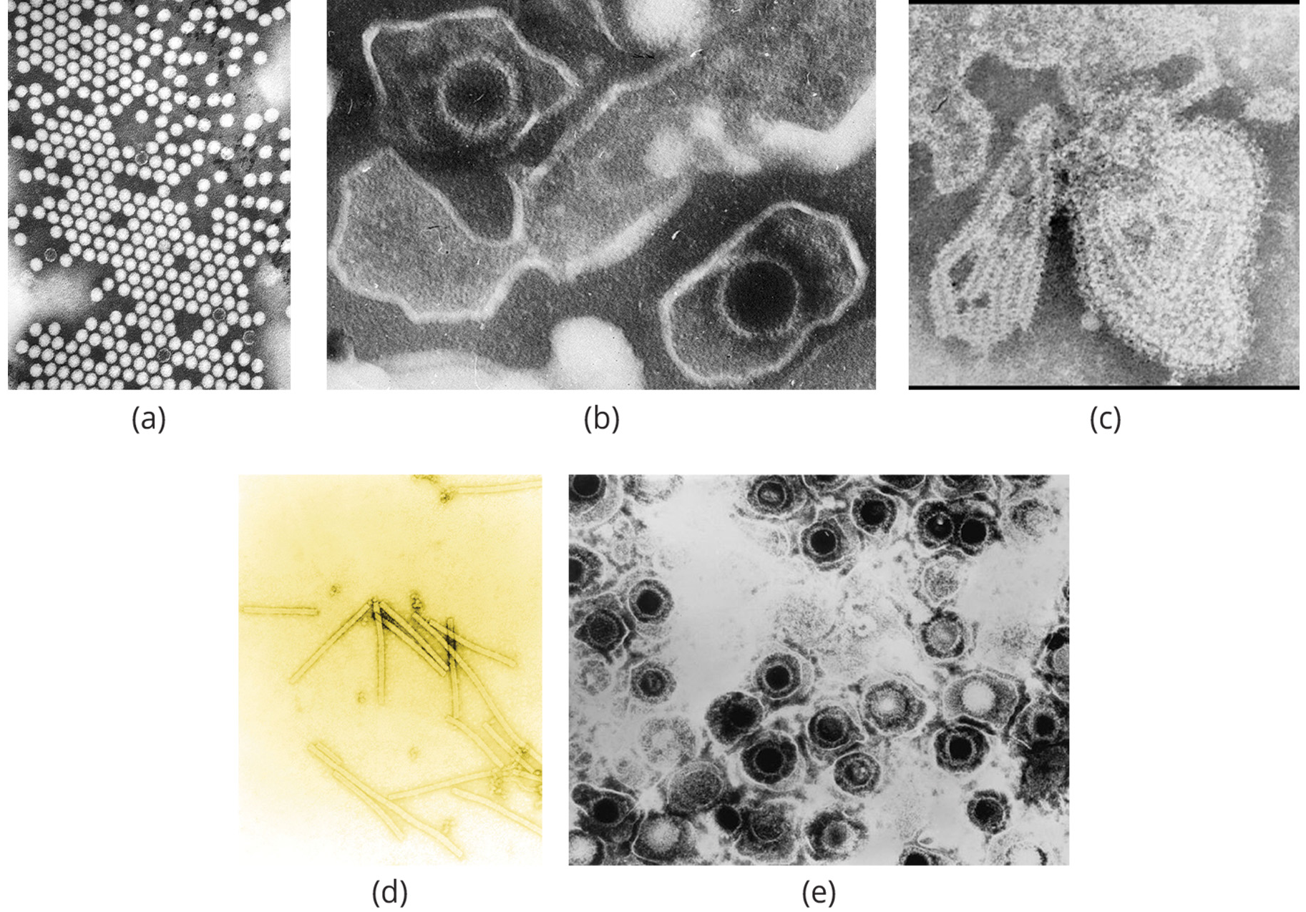
21.1 Figure 9
CDC on Wikimedia Commons. "Poliovirus."
Liza Gross on Wikimedia Commons. "Epstein Barr virus virions."
CDC on Wikimedia Commons. "Mumps virus."
Unknown author on Wikimedia Commons. "Tobacco mosaic virus (TMV)."
CDC on Wikimedia Commons. "Herpes simplex virus."
Notes:
21.1 Figure 9: Transmission electron micrographs of various viruses show their capsid structures. The capsid of the (a) polio virus is a naked icosahedral; (b) the Epstein-Barr virus capsid is an enveloped icosahedral; (c) the mumps virus capsid is an enveloped helix; (d) the tobacco mosaic virus capsid is a naked helical; and (e) the herpesvirus capsid is a complex structure.

Slide 35
Think It Through₂
Let's revisit modes of nucleic acid production in host cells, so we can better understand how viruses use the structure of their host cells to replicate. Fill in the table with the process and enzyme associated with the listed nucleic acid synthesis.
Synthesize DNA by reading genomic DNA
Synthesize mRNA by reading DNA
Synthesize proteins by reading mRNA
Notes:
Originally an On Your Own. This is included here to use as a talking point or for a think-pair-share activity.

Slide 36
Baltimore Classification Is the Most Common System Used to Classify Viruses₁
The Baltimore classification system for viruses was developed by David Baltimore in the early 1970s.
This system groups viruses by how their mRNA is produced during the virus's replicative cycle.
Group I viruses contain dsDNA as their genome; their mRNA is produced by transcription as in host cells.
Group II viruses have ssDNA as their genome; they convert their ss genomes into a dsDNA intermediate before transcription can occur.
Group III viruses use dsRNA as their genome; the strands separate, and one is used as a template for the generation of mRNA using the RNA-dependent RNA polymerase encoded by the virus.

Slide 37
Baltimore Classification Is the Most Common System Used to Classify Viruses₂
This system groups viruses by how their mRNA is produced during the virus's replicative cycle.
Group IV viruses have ssRNA as their genome with a positive polarity, which means that the genomic RNA can serve directly as mRNA.
Intermediates of dsRNA, called replicative intermediates, are made in the process of copying the genomic RNA.
Multiple, full-length RNA strands of negative polarity (complementary to the positive-stranded genomic RNA) are formed from these intermediates, which may then serve as templates for the production of RNA with positive polarity, including both full-length genomic RNA and shorter viral mRNAs.
Group V viruses contain ssRNA genomes with a negative polarity, meaning that their sequence is complementary to the mRNA.
dsRNA intermediates are used to make copies of the genome and produce mRNA, but the negative-stranded genome can be converted directly to mRNA.
Full-length positive RNA strands are made to serve as templates for the production of the negative-stranded genome.

Slide 38
Baltimore Classification Is the Most Common System Used to Classify Viruses₃
This system groups viruses by how their mRNA is produced during the virus's replicative cycle.
Group VI viruses have diploid (two copies) ssRNA genomes that must be converted to dsDNA, using the enzyme reverse transcriptase.
The dsDNA is then transported to the nucleus and inserted into the host genome.
Then, mRNA can be produced by transcription of the viral DNA that was integrated into the host genome.
Group VII viruses have partial dsDNA genomes and make ssRNA intermediates that act as mRNA but are also converted back into dsDNA genomes by reverse transcriptase.

Slide 39
Think It Through₃
How does mRNA production in a Group III virus differ from mRNA production in a Group VI virus?
In what way are these processes similar?
Notes:
Originally an On Your Own. This is included here to use as a talking point or for a think-pair-share activity.

Slide 40
Table 3: Characteristics and Examples of Each Group in the Baltimore Classification
Group | Characteristics | Mode of mRNA Production | Example
I | double-stranded DNA | mRNA is transcribed directly from the DNA template. | herpes simplex (herpesvirus)
II | single-stranded DNA | DNA is converted to double-stranded form before RNA is transcribed. | canine parvovirus (parvovirus)
III | double-stranded RNA | mRNA is transcribed from the RNA genome. | childhood gastroenteritis (rotavirus)
IV | single-stranded RNA (+) | The genome functions as mRNA. | common cold (picornavirus)
V | single-stranded RNA (-) | mRNA is transcribed from the RNA genome. | rabies (rhabdovirus)

Slide 41
Table 3: Characteristics and Examples of Each Group in the Baltimore Classification (Cont.)
Group | Characteristics | Mode of mRNA Production | Example
VI | single-stranded RNA viruses with reverse transcriptase | Reverse transcriptase makes DNA from the RNA genome; DNA is then incorporated in the host genome; mRNA is transcribed from the incorporated DNA. | human immunodeficiency virus (HIV)
VII | double-stranded DNA viruses with reverse transcriptase | The viral genome is double-stranded DNA, but viral DNA is replicated through an RNA intermediate; the RNA may serve directly as mRNA or as a template to make mRNA. | hepatitis B virus (hepadnavirus)

Slide 42
Group Activity
Form groups of three to four students. Choose one of the groups of the Baltimore Classification and find an example of a virus in that group, other than the ones given in Table 3. Research how this virus infects its host and its specific structure and morphology. Present your findings to the class.
As a group, discuss whether viruses are considered living organisms. Provide evidence by comparing and contrasting with other living unicellular organisms, such as bacteria or fungi.

Slide 43
Summary
Viruses are tiny acellular entities only visible with an electron microscope.
Viral genomes can be either DNA or RNA (never both).
They replicate using either the host’s replication proteins or those encoded in the viral genome.
Viruses are diverse and can infect all forms of life: archaea, bacteria, fungi, plants, and animals.
Viruses each consist of a nucleic acid core surrounded by a protein capsid with or without an outer envelope.
Viruses can be classified based upon their capsid shape and structure, the presence or absence of an envelope, and their nucleic acid core composition.
The Baltimore classification system is the most commonly used classification system and categorizes viruses based on how they produce their mRNA.

Slide 44


End of Hawkes Learning PowerPoint

