Slide 1
Lesson 21.2
Virus Infections and Hosts

Slide 2
Objectives
Describe the lytic and lysogenic cycles of virus replication.
Discuss some of the diseases caused by plant and animal viruses and their economic impact.
Explain the transmission of plant and animal viruses.
List the steps of replication and explain what occurs at each step.

Slide 3
Viruses Must Bind to Viral Receptors on Host Cells to Infect Them
Viruses are obligate intracellular parasites.
Obligate means there is no alternative.
Facultative means that there are alternatives.
To infect a cell, a virus must bind to a specific viral receptor on the host cell's surface.
A virus can infect only certain host species and often only certain cells within it.
These specific host cells that a virus must use to replicate are called permissive.
The cell specificity within an organism may result from differences in metabolism and host-cell immune responses in different host cells.
After penetration of the host cell, the virus copies its genome and makes its own proteins, and the progeny must then exit/escape the host cell.

Slide 4
Viruses Affect the Host Cells They Infect₁
Viruses use their host cells to replicate, often impacting their host cells.
Cytopathic effects are those that can change cell functions, even destroying the cell.
Some viral infections result in cellular lysis (bursting) to release progeny virions.
Other viral infections result in apoptosis (programmed cell death) to release progeny virions.
Symptoms of viral diseases are due to both:
Cell damage
The immune response to the virus

Slide 5
Viruses Affect the Host Cells They Infect₂
Some animal viruses leave the host cell one-by-one by budding.
The host cell is not immediately killed.
The viral damage to the cell still makes it impossible for the cell to function normally even though it remains alive for a while.
Example: HIV (human immunodeficiency virus)

Slide 6
The Viral Replication Cycle Involves Six Steps
Most productive viral infections follow similar steps in the virus replication cycle:
Attachment
Penetration
Uncoating
Replication
Assembly
Release (Egress)

Slide 7
A Virus Attaches To a Host Cell Receptor Via Attachment Proteins
A virus attaches to a specific receptor on the host cell's surface via viral attachment proteins that can be either
Capsid proteins
Glycoprotein spikes embedded in the viral envelope
The specificity between the viral attachment protein and the host cell receptor determines
Which host will be infected
Which cells within the host will be infected

Slide 8
There Are Different Modes of Viral Entry
Viruses may enter a host cell with or without the viral capsid.
Bacteriophages: The nucleic acid enters the host cell "naked," without the capsid.
Plant and animal viruses:
These often enter by endocytosis.
Some enveloped viruses enter when the viral envelope fuses with the host cell's membrane.
Uncoating: Once inside, the capsid degrades, leaving the viral nucleic acid available for replication and transcription.

Slide 9
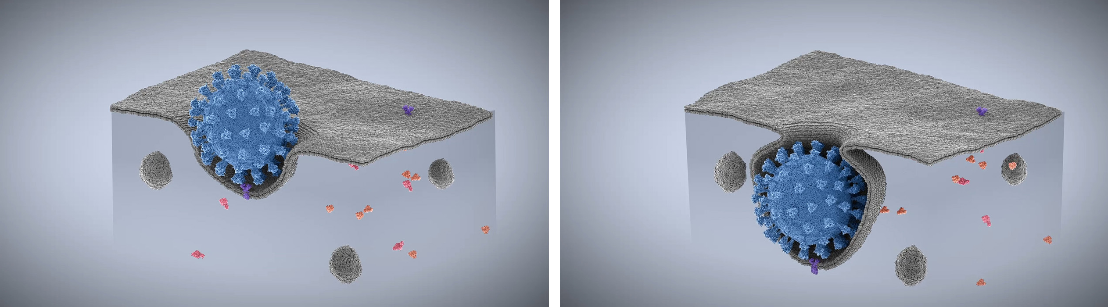
21.2 Figure 1
Alexey Solodovnikov on Wikimedia Commons. "Coronavirus endocytosis."
Notes:
21.2 Figure 1: Entry of a coronavirus (the spiked ball) by endocytosis is dependent on interaction of the viral spike protein with the viral receptor expressed by the host, known as ACE2 (the spike penetrating the outside layer).

Slide 10
Viral Replication Depends On Genome Structure₁
Viral replication mechanisms depend on their genome structure:
DNA viruses use host-cell machinery to:
Replicate the viral DNA
Transcribe it to make viral mRNA
Make viral proteins
RNA viruses use the RNA genome to make:
More viral genomic DNA
Viral mRNA (which is used to make viral enzymes and capsid proteins)

Slide 11
Viral Replication Depends On Genome Structure₂
Viral replication mechanisms depend on their genome structure:
If the host cell lacks an enzyme for viral replication, one or more viral genes must encode an enzyme for that function.
Retroviruses must encode reverse transcriptase to convert the RNA genome into DNA, which is then incorporated into the host cell's genome.
These can be targets for drug development.
Example: This approach has been used to develop drugs that target HIV.

Slide 12
Group Activity
A major group of drugs used to treat HIV are known as antiretrovirals, which block the activity of the enzyme reverse transcriptase. While these drugs are successful at blocking viral replication, once a person has been infected with HIV, it is very difficult to eradicate completely. In a group, discuss aspects of HIV replication that make it nearly impossible to eradicate from infected host cells.

Slide 13
Viral Release from Host Cells Is Required for Continuation of Replication Cycle
After viral assembly, the release of new virions must occur so that they can infect adjacent cells and repeat the replication cycle.
Some viruses are released upon cell death (lysis or apoptosis).
Other viruses leave by budding.

Slide 14
Science and You₁
How Antibodies to Viruses Commonly Prevent Infection
After a viral infection, the immune system produces antibodies that are specific to the virus-specific molecules.
Neutralizing antibodies block a stage of viral replication, usually attachment, entry, or egress.
Neutralizing antibodies to SARS-CoV-2 (the virus that causes COVID-19) are generally specific to the viral spike protein, blocking interaction of the virus with the receptor, ACE2, expressed on the host cell surface (Figure 2). This blocks entry of the virus to the host cell.
Successful vaccines increase the production of broadly neutralizing antibodies that can recognize various mutants present in a viral population.
Notes:
This is included as a relevant application for this topic.

Slide 15
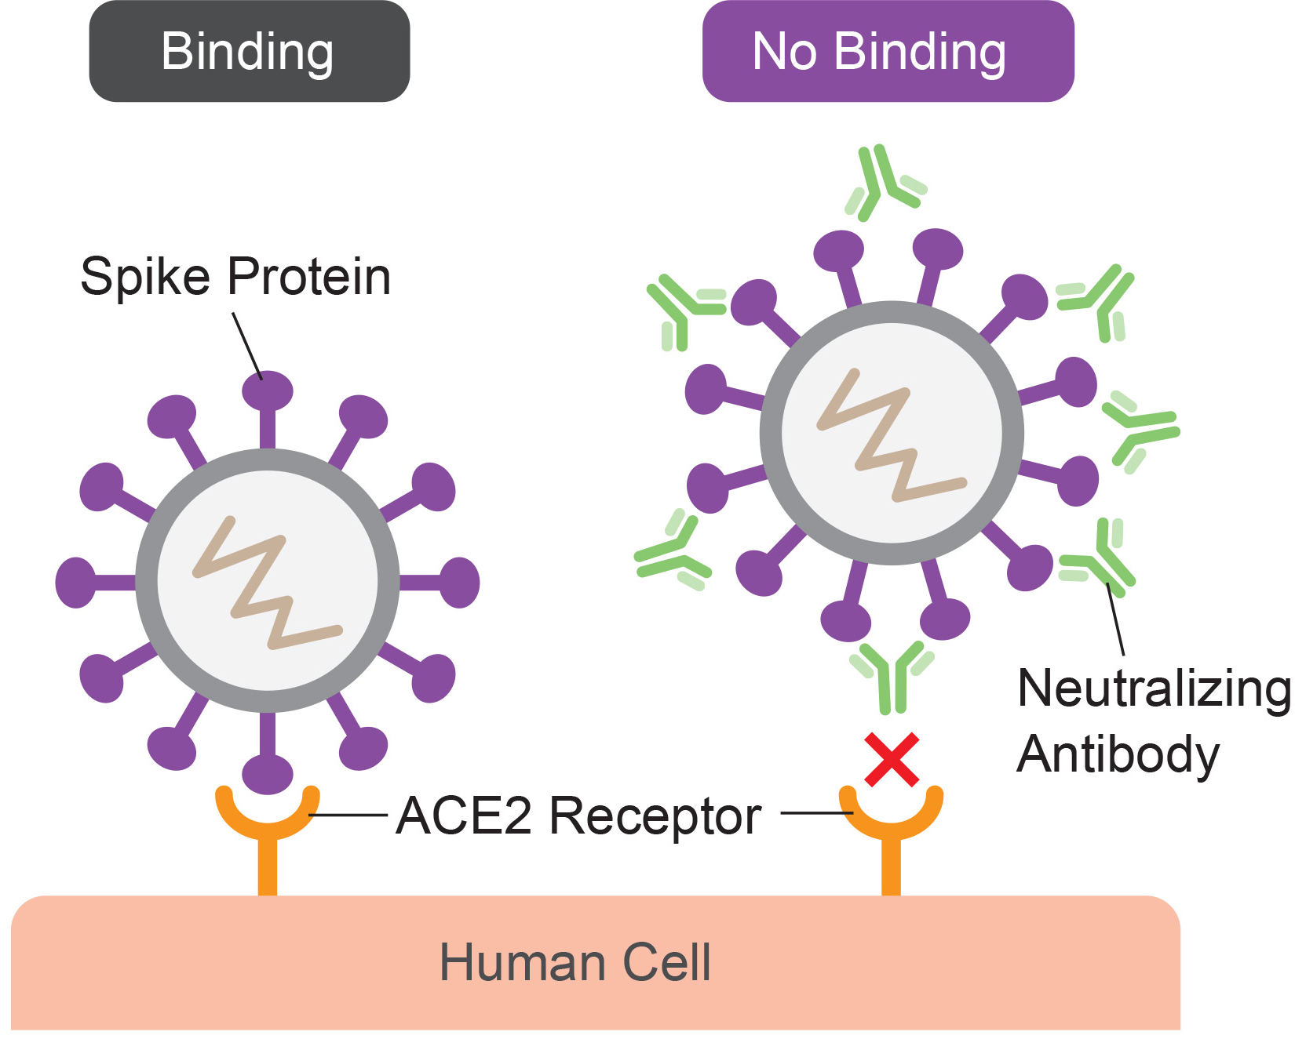
Science and You₂
21.2 Figure 2: Antibodies to SARS-CoV-2 block viral attachment.
Notes:
This is included as a relevant application for this topic.

Slide 16
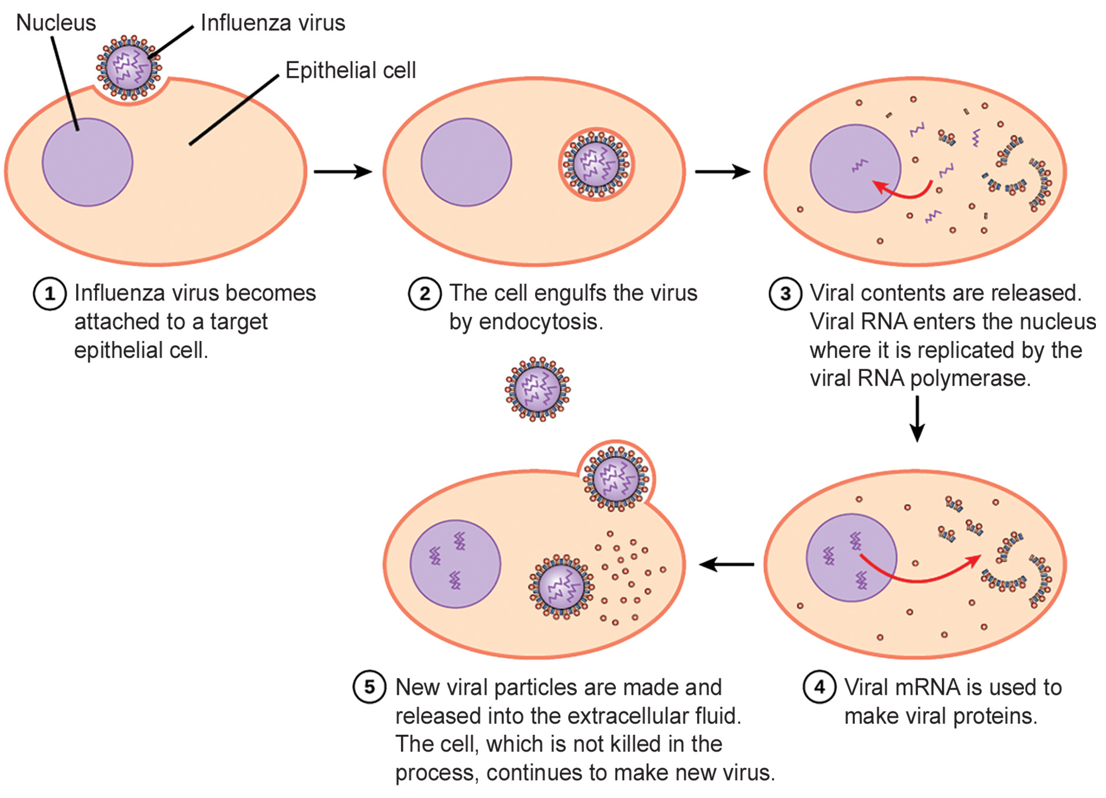
Think It Through₁
21.2 Figure 3: During the influenza viral replication cycle, viruses enter by endocytosis and are released by budding.
CNX OpenStax on Wikimedia Commons. "Influenza infection." Modified.
Notes:
Originally an On Your Own. This is included here to use as a talking point or for a think-pair-share activity.

Slide 17
Think It Through₂
Influenza virus is packaged in a viral envelope that fuses with the plasma membrane. Because of this, the virus can exit the host cell without killing it.
What advantage does the virus gain by keeping the host cell alive?
Notes:
Originally an On Your Own. This is included here to use as a talking point or for a think-pair-share activity.

Slide 18
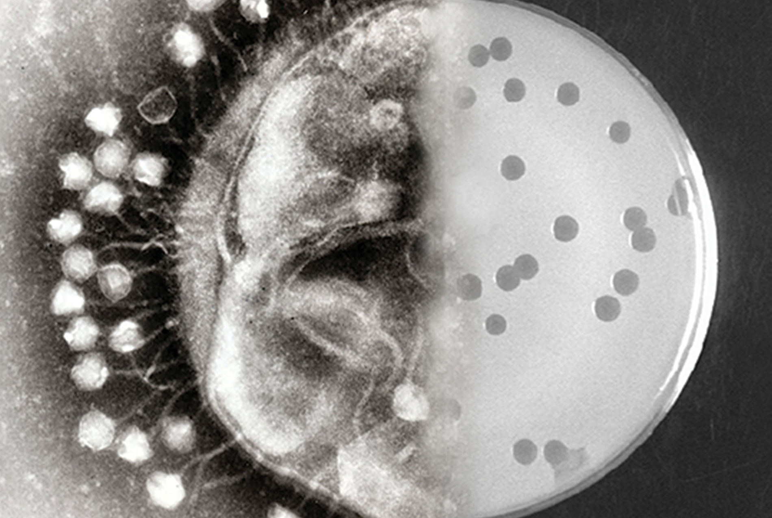
All Types of Life Can Be Infected By Viruses
While each virus infects only specific hosts and cells within the host, nearly every organism has its own set of viruses that can infect it.
Viruses that infect bacteria are called bacteriophages.
Archaea have their own viruses too.
21.2 Figure 4
Emily Brown on Wikimedia Commons. "Bacteriophages."

Slide 19
Bacteriophages Can Replicate By Either a Lytic or a Lysogenic Cycle
Bacteriophage infection inserts the viral genome into a host cell.
Tails of complex bacteriophages aid in getting the viral genomes across the prokaryotic cell wall.
Bacteriophage infections resulting in the production of new virions are called productive.
If virions are released by cell lysis, the virus is said to be replicating via a lytic cycle.
Example: Bacteriophage T4 of Escherichia coli
If the viral genome incorporates into the host cell genome, the virus is said to be replicating via a lysogenic cycle.
A temperate phage can transition between the lysogenic and lytic cycles.
Environmental stress often stimulates entry into the lytic cycle.
Example: Bacteriophage lambda (λ) of E. coli
A prophage is a phage incorporated into the host cell DNA.

Slide 20
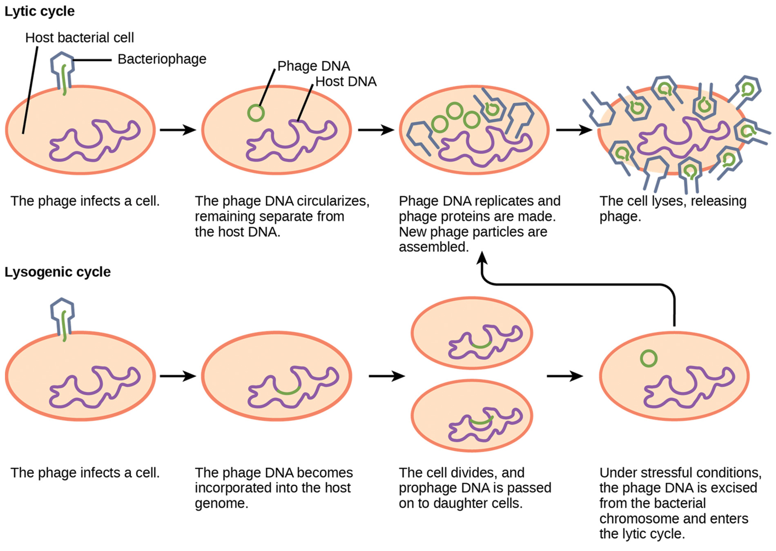
21.2 Figure 5
CNX OpenStax on Wikimedia Commons. "Lytic cycle." Modified.
Notes:
21.2 Figure 5: A temperate bacteriophage has both lytic and lysogenic cycles. In the lytic cycle, the phage replicates and lyses the host cell. In the lysogenic cycle, phage DNA is incorporated into the host genome, where it is passed on to subsequent generations. Environmental stressors, such as starvation or exposure to toxic chemicals, may cause the prophage to excise and enter the lytic cycle.

Slide 21
Think It Through₃
Which of the following statements is false?
In the lytic cycle, new phages are produced and released into the environment.
In the lysogenic cycle, phage DNA is incorporated into the host genome.
An environmental stressor can cause the phage to initiate the lysogenic cycle.
Cell lysis only occurs in the lytic cycle.
Notes:
Originally an On Your Own. This is included here to use as a talking point or for a think-pair-share activity.

Slide 22
Some Animal and Plant Viruses Can Be Latent
Some latent animal and plant viruses can infect host cells but not produce virions for a long time.
Herpesviruses (including herpes simplex viruses, the cause of oral and genital herpes) can exist in nerve tissue for a long time
These viruses leave periodically, causing lesions.
While latency and lysogeny are similar, the term lysogeny is reserved for bacteriophages.

Slide 23
Plants Can Be Infected By Viruses
Most plant viruses have single-stranded (+) RNA genomes.
Common modes of horizontal transmission of plant viruses from one plant to another may involve:
A plant's contact with infected sap
Spread through an insect or nematode
Spread through infected pollen
Plant viruses cross plant cell walls by mechanical damage:
Weather
Insects
Animals
Fire
Human activities
Viruses may modify plasmodesmata, aiding in cell-to-cell spread.
Through vertical transmission, offspring can inherit a viral infection from their parent.

Slide 24
Table 1: Some Common Symptoms of Plant Viral Diseases
Symptom | Appears as
hyperplasia | galls (tumors)
hypoplasia | thinned, yellow splotches on leaves
cell necrosis | dead, blackened stems, leaves, or fruit
abnormal growth patterns | malformed stems, leaves, or fruit
discoloration | yellow, red, or black lines or rings in stems, leaves, or fruit

Slide 25
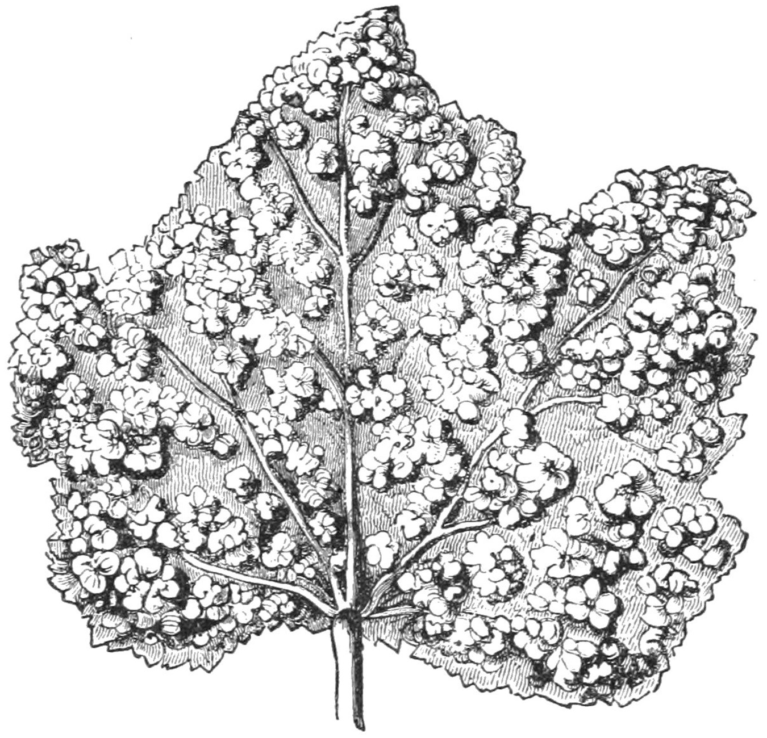
21.2 Figure 6
Popular Science Monthly Volume 5 on Wikimedia Commons. "Leaf galls."
Notes:
21.2 Figure 6: Illustration of a leaf covered in galls

Slide 26
Plant Viruses Can Have Significant Impacts
Plant viruses can disrupt crop growth and development, affecting the food supply and causing huge economic losses.
Examples: Tomato spotted wilt virus
Bean common mosaic virus
Cucumber mosaic virus
Plant viruses can damage plants used for landscaping.
Examples: Peony ring spot
Rose mosaic virus

Slide 27
Animals Can Be Infected By Viruses
Animal viruses do not need to penetrate cell walls.
Nonenveloped viruses enter in one of 2 ways:
The virus binds to its host cell receptor, stimulating receptor-mediated endocytosis.
The virus binds to its host cell receptor, causing a shape change in the capsid proteins and forming channels through the host cell membrane through which the viral genome is "injected"
Enveloped viruses enter in one of 2 ways after binding to their receptors:
Receptor-mediated endocytosis
Fusion of envelope with host cell plasma membrane

Slide 28
Reflection Question
Compare and contrast how animal viruses and plant and bacteria viruses enter the host cell.
What features in how they enter the cell make them specific to their hosts?
Notes:
The reflection question is included here to use as a talking point or for a think-pair-share activity.

Slide 29
Animal Viruses Can Cause Many Human Diseases
For an acute disease, symptoms get increasingly worse quickly and then resolve when the virus is eliminated from the body by the immune system.
Examples: common cold, influenza
For a chronic infection, the virus persists in the body for a long time.
Example: hepatitis C
Some viruses cause intermittent symptoms that occur periodically.
Example: herpes simplex virus
For an asymptomatic infection, a virus successfully causes productive infection without causing symptoms.
Examples: human herpesviruses 6 and 7 (which can cause minor childhood roseola in some people)

Slide 30
Hepatitis C Chronically Infects the Liver
The hepatitis C viruses grows and reproduces in liver cells, causing low amounts of damage.
Those infected are often unaware.
The virus escapes elimination by the immune system for many years, producing low numbers of progeny.
Chronic infection leads to an increased chance for developing liver cancer as much as 30 years later.

Slide 31
Herpesviruses Cause Latent Infections
Herpes simplex virus can be latent in nervous tissue for months and years.
During latency, it produces few if any viral proteins, so there is no immune response and immunity to the virus declines.
Under physical or psychological stress, the latent virus is reactivated to undergo a lytic cycle in the skin, causing lesions.
The immune response is stimulated to resolve skin lesions in a few day or weeks.
This results in outbreaks of cold sores or genital herpes (depending on type of herpesvirus).

Slide 32
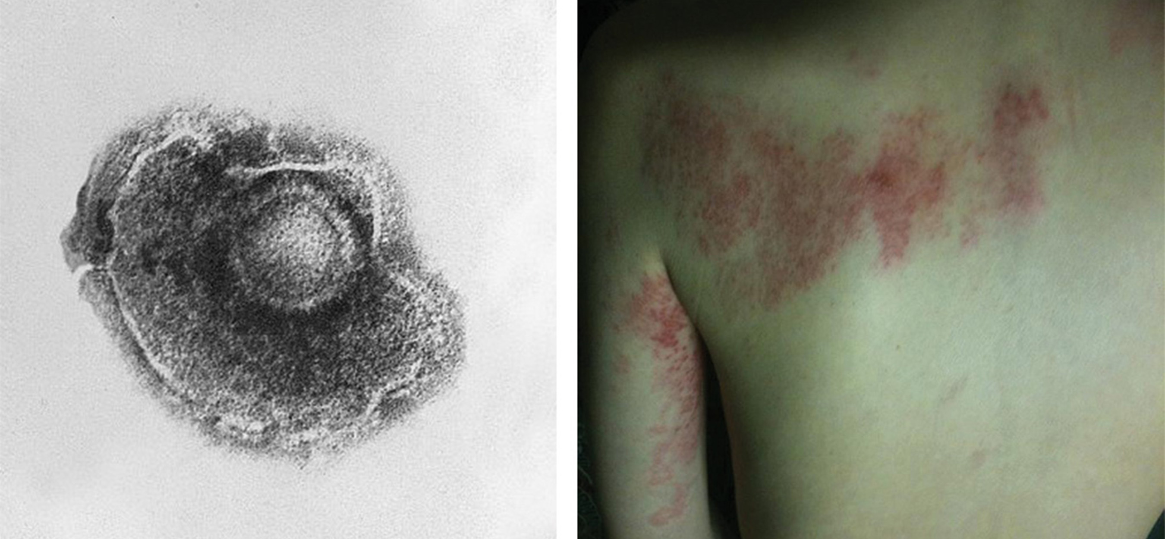
Varicella-Zoster Virus Causes Chicken Pox and Shingles
Chicken pox is caused by a herpesvirus (varicella-zoster virus).
After chicken pox in childhood, the virus can remain latent and reactivate in adults as "shingles."
21.2 Figure 7
CDC on Wikimedia Commons. "Chickenpox virus."
Yesyouisnot on Wikimedia Commons. "Shingles."

Slide 33
Some Viruses Can Cause Cancer
Oncogenic viruses can cause cancer.
They interfere with host cell cycle regulation by
Introducing genes (oncogenes) that stimulate unregulated cell growth OR
Interfering with the expression of genes that inhibit cell growth
They can be either DNA or RNA viruses.
Examples:
Cervical cancer is caused by human papillomavirus (HPV).
Liver cancer can be result from infection with the hepatitis B or C viruses.
T cell leukemia and some lymphomas may result from viral infections.

Slide 34
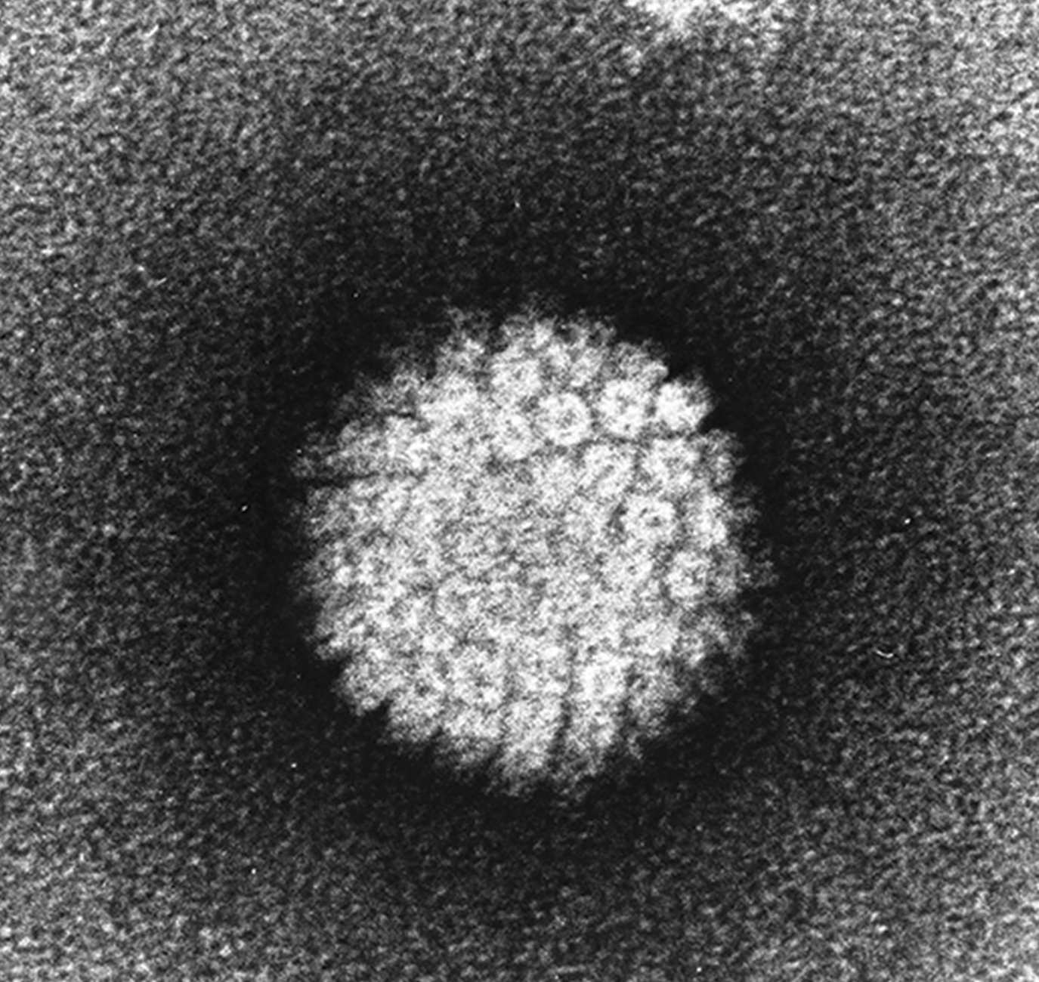
21.2 Figure 8
Laboratory of Tumor Virus Biology on Wikimedia Commons. "HPV."
Notes:
21.2 Figure 8: HPV, or human papillomavirus, has a naked icosahedral capsid (visible in this transmission electron micrograph) and a double-stranded DNA genome that is incorporated into the host DNA. The virus, which is sexually transmitted, is oncogenic and can lead to cervical cancer.

Slide 35
Think It Through₄
One mechanism by which viral infections persist in the host is through a process known as immune evasion, thereby preventing its elimination from the host.
What are some of the ways that viruses evade the immune system?
Notes:
Originally an On Your Own. This is included here to use as a talking point or for a think-pair-share activity.

Slide 36
Science and You₃
Many of the viruses discussed in this section are fairly common in human populations:
95% of adults in the United States have been infected with the chicken pox, caused by the varicella-zoster virus.
42% of adults in the United States carry the human papilloma virus (HPV), which is a sexually transmitted infection.
50–80% of adults in the United States have the oral form of the herpes simplex virus (HSV-1).
Notes:
This is included as a relevant application for this topic.

Slide 37
Summary
Plant viruses:
May be transmitted either:
Vertically (from parent reproductive cells to offspring)
Horizontally (through damaged plant tissues)
Impact both crops and landscaping plants
Animal viruses:
May enter host cells in a number of ways
May cause infections that are either:
Acute (causing a brief period of symptoms)
Chronic (the infection persists)
May cause persistent infections that are either:
Symptomatic (such as hepatitis C)
Intermittently symptomatic (such as herpes simplex virus 1)
Asymptomatic (such as herpesviruses 6 and 7)
May be oncogenic.

Slide 38


End of Hawkes Learning PowerPoint

