Slide 1
Lesson 21.3
Prevention and Treatment of Viral Infections

Slide 2
Objectives
Compare vaccinations and antiviral drugs as medical approaches to viruses.
Identify major viral illnesses that affect humans.
Discuss virology applications used to treat nonviral diseases.

Slide 3
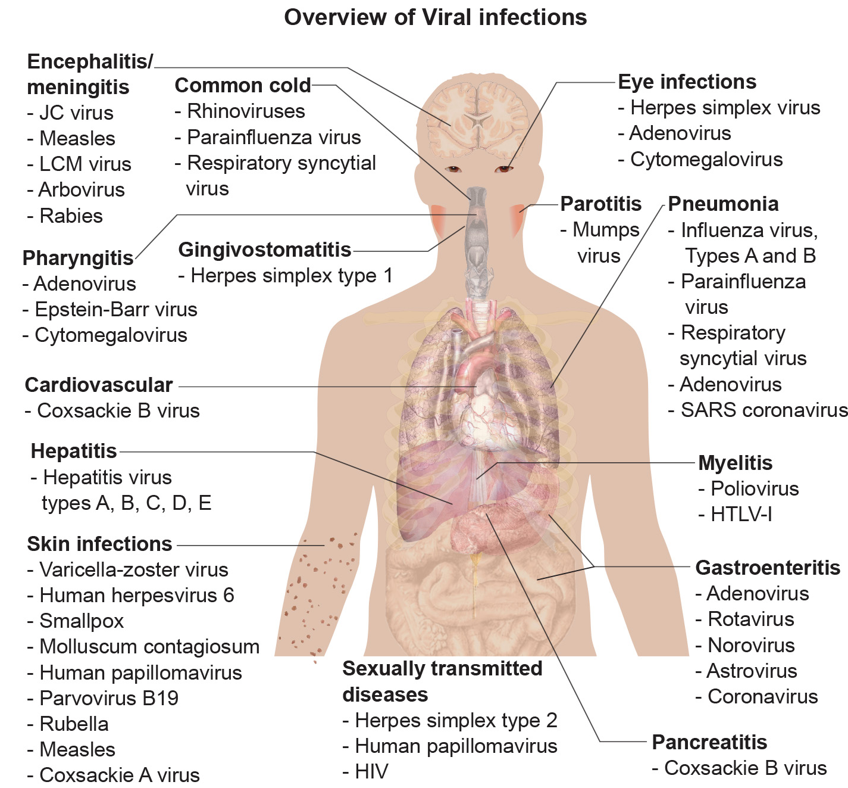
Lesson 21.3 Figure 1
Mikael Häggström on Wikimedia Commons. "Viral infections."
Notes:
Figure 1: Viruses can cause dozens of ailments in humans, ranging from mild illnesses to serious diseases.

Slide 4
Viruses
Viruses cause a variety of diseases in humans and other animals.
These viral diseases can be treated by antiviral drugs or by vaccination.
Some viruses—such as HIV—can avoid the immune system and mutate to become resistant to antiviral drugs.

Slide 5
Table 1: A Summary of Human Viruses
Type of Infection | Viruses
common cold | rhinovirus, parainfluenza virus, respiratory syncytial virus
skin infections | varicella-zoster virus, smallpox, rubella, measles
sexually transmitted | herpes simplex 2, human papillomavirus, HIV
gastroenteritis | adenovirus, rotavirus, norovirus, coronavirus
pneumonia | influenza virus, parainfluenza virus, respiratory syncytial virus, coronavirus

Slide 6

Vaccination
Vaccination is the primary method of controlling viral disease by building immunity to a virus or virus family.
Vaccines may be prepared by using live virus, killed virus or small parts of the virus.
21.3 Figure 2

Slide 7
Vaccines for Prevention
Live viral vaccines are designed to cause few symptoms in recipients while also causing an immune response to gain protective immunity to virus.
Polio vaccination success in 1950s and 1960s paved way for other vaccines.
Live vaccines created by attenuating (weakening) the virus.
Unfortunately, back mutations (mutations which allow the virus to readapt to host and cause disease again) are possible.

Slide 8
Vaccine Development
Some vaccines—such as the influenza vaccine—are under continuous development, as the virus mutates and potentially can evade the immunity provided by the previous year's vaccine.
Some viruses such as measles, mumps and rubella do not mutate frequently, so the same vaccine is used every year.

Slide 9
Think It Through₁
The influenza A virus has eight separate segments of RNA that make up its genome. While we usually think of mutations as single base pair changes in the genome, viruses with multiple genome segments can mutate by a process known as reassortment (Figure 3). In this case, when different strains of a virus infect the same host cell, strain-specific segments of the genome can be swapped in new viruses produced in the host cell. This can lead to the generation of new strains that have never been seen by host immune systems. Using the illustration in Figure 3, describe how a highly pathogenic strain, such as H1N1, could have evolved and why influenza A vaccines were largely ineffective against this strain.
Notes:
Originally an On Your Own. This is included here to use as a talking point or for a think-pair-share activity.

Slide 10
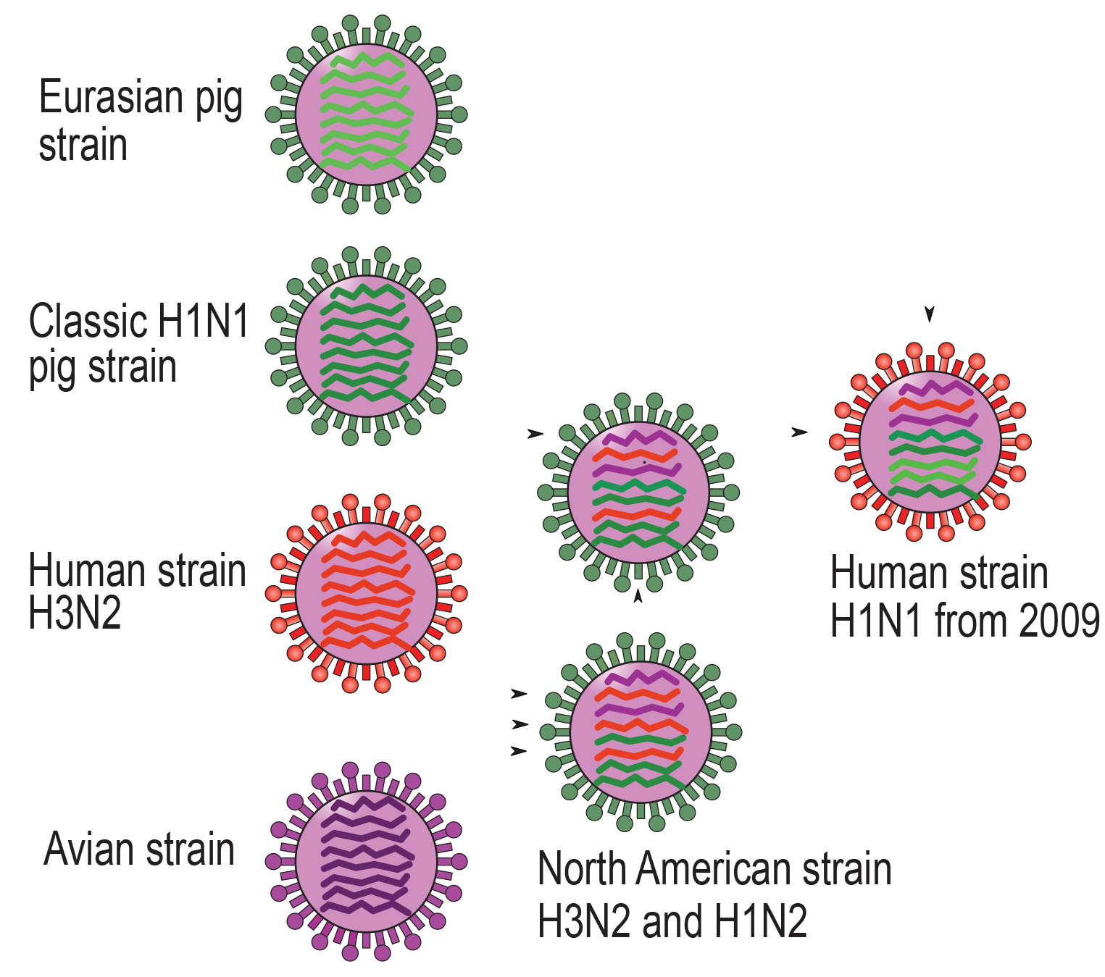
Think It Through₂
21.3 Figure 3
Lithium57 on Wikimedia Commons. "Influenza mutation."
Notes:
Originally an On Your Own. This is included here to use as a talking point or for a think-pair-share activity.

Slide 11
Group Activity₁
Where did the misconception that vaccines cause autism come from?
In groups of two or three, investigate the history of this misconception and the studies associated with it.

Slide 12
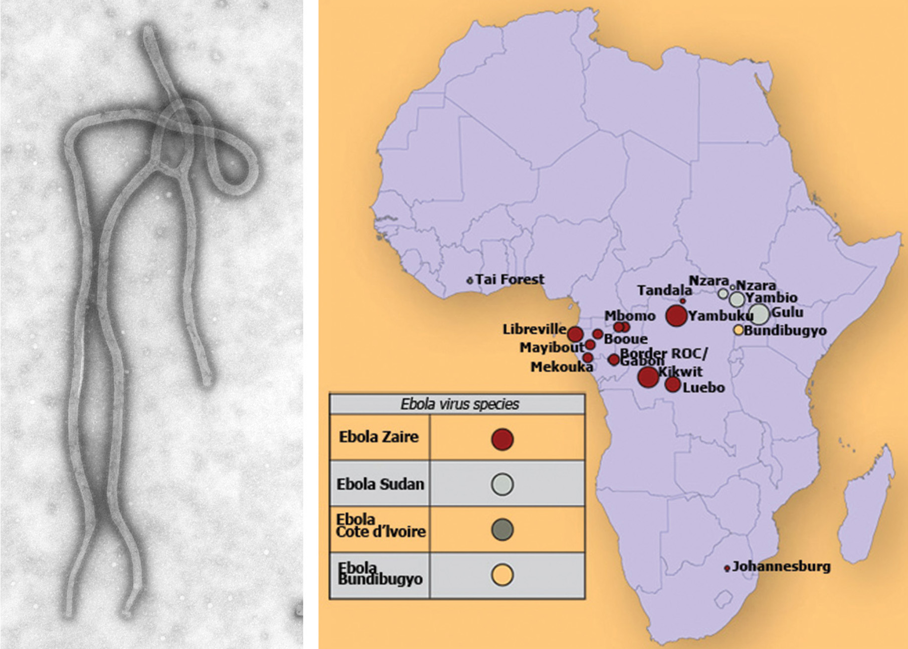
Vaccines for Treatment
Vaccines can be used to treat an active viral infection to boost immunity without adding additional disease-causing virus.
Used to treat rabies and Ebola.
21.3 Figure 4
CDC on Wikimedia Commons. "Ebola virus."
CDC on Wikimedia Commons. "Ebola hemorrhagic fever distribution map."

Slide 13
Group Activity₂
Highly lethal viruses, such as Ebola, make it difficult for the virus to cause global pandemics. In addition, it can only be transmitted through direct contact with bodily fluids. Therefore, Ebola is rarely seen outside of a few countries in Africa.
As a group, discuss why this is.

Slide 14
Antiviral Drugs for Treatment₁
Currently, not many antiviral drugs are available due to difficulty in creating a drug to prevent viral production without damaging the host.
Gertrude Elion developed drugs to target viral DNA replication.
Other drugs block the actions of one or more of the viral proteins.
This drug target must be viral specific and NOT present in the healthy host cell.

Slide 15
Antiviral Drugs for Treatment₂
Antivirals have been developed for the treatment of genital herpes (herpes simplex II) and influenza.
For genital herpes, the drugs can reduce the number of skin lesions and duration of outbreaks but can not cure disease.
For influenza, drugs like Tamiflu can reduce how long flu symptoms are felt but can’t prevent symptoms entirely.
Tamiflu works by inhibiting enzyme needed to allow virions to leave infected cells.

Slide 16
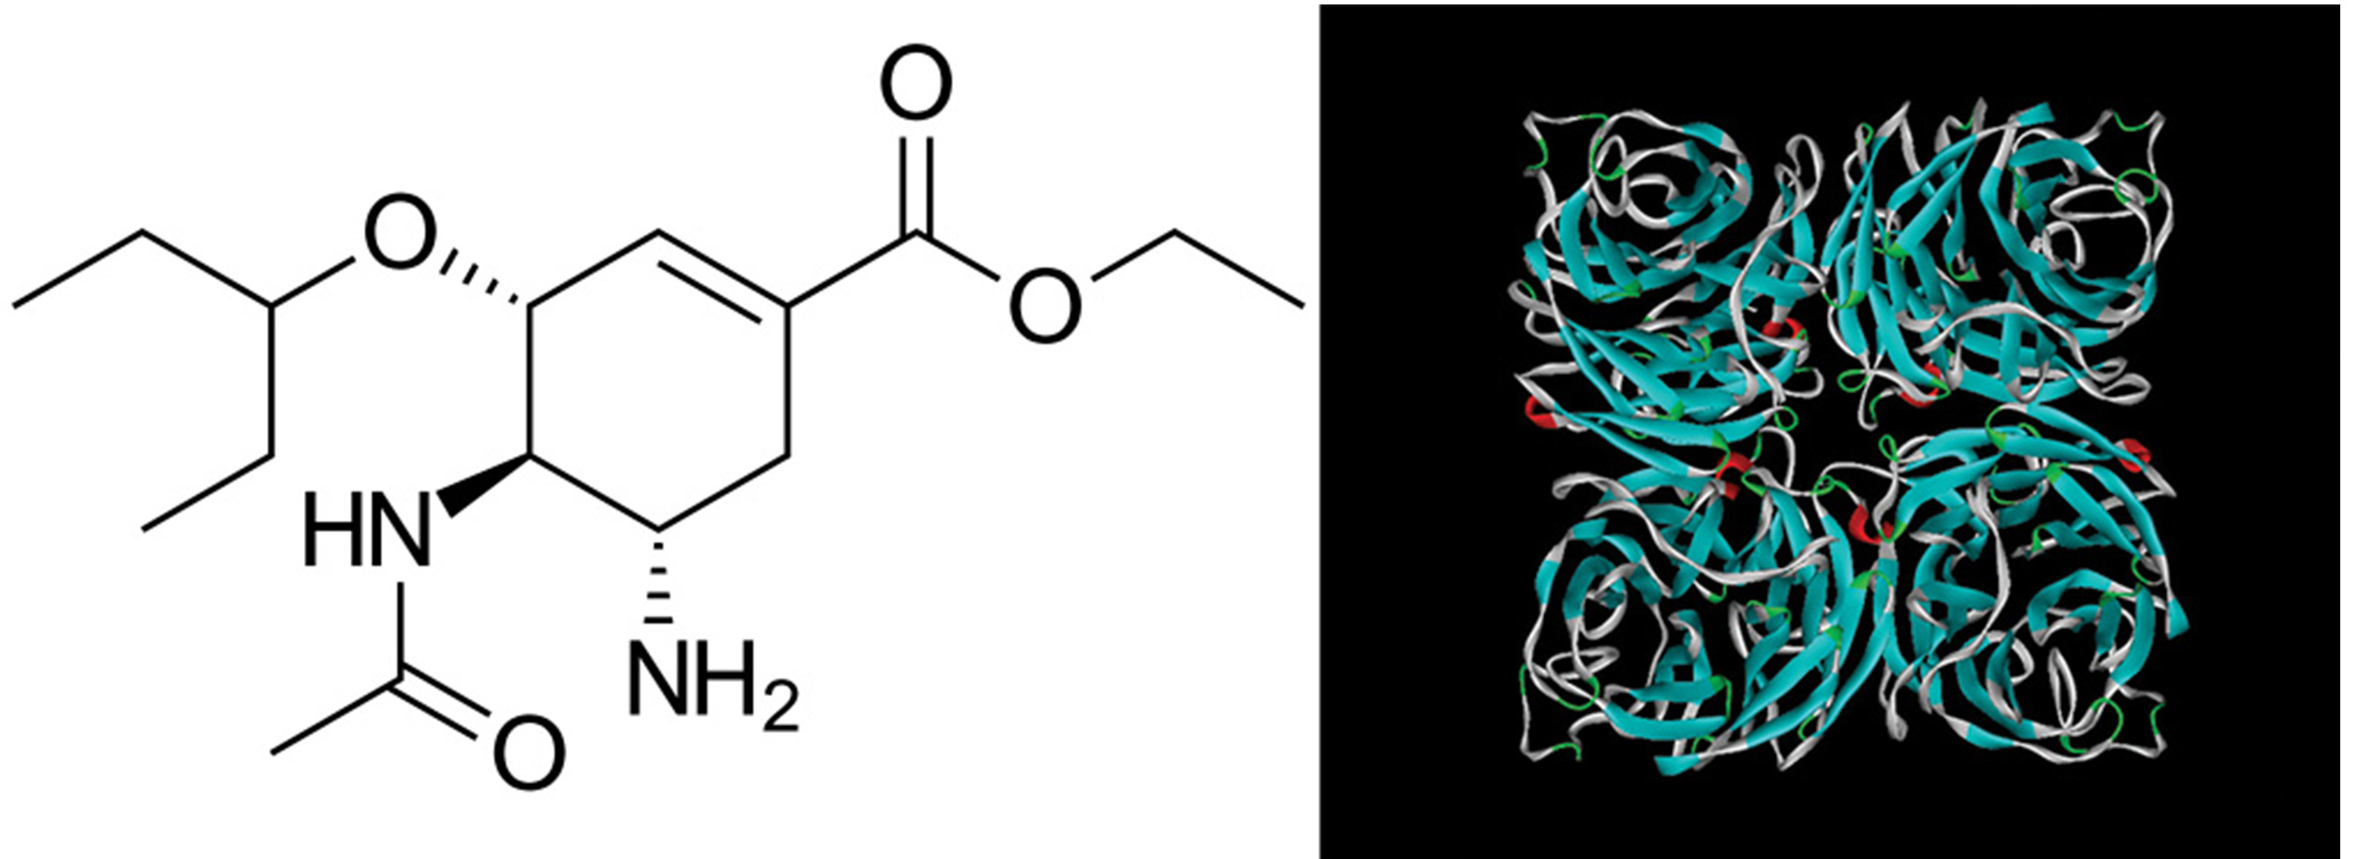
Lesson 21.3 Figure 5
BartVL71 on Wikimedia Commons. "Tamiflu chemical structure."
Snowyowls on Wikimedia Commons. "Neuraminidase."
Notes:
Figure 5: The active chemical compound in Tamiflu inhibits a viral enzyme called neuraminidase (NA) found in the influenza viral envelope. Neuraminidase cleaves the connection between viral hemagglutinin (HA), also found in the viral envelope, and glycoproteins on the host cell surface. Inhibition of neuraminidase prevents the virus from detaching from the host cell, thereby blocking further infection.

Slide 17
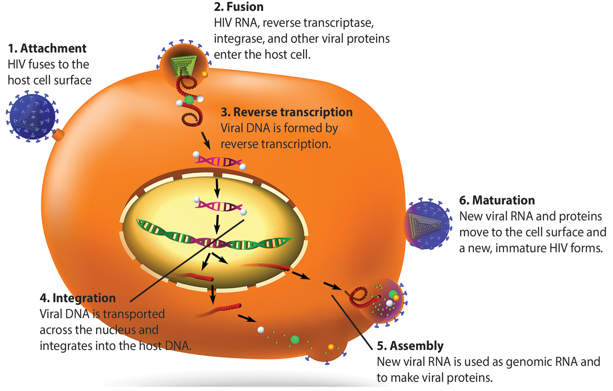
Lesson 21.3 Figure 6
Notes:
Figure 6: HIV, an enveloped icosahedral virus, attaches to the CD4 receptor of an immune cell and fuses with the cell membrane. Viral contents are released into the cell, where viral enzymes convert the single-stranded RNA genome into DNA and incorporate it into the host genome.

Slide 18
HIV Treatment
HIV has high mutation rate, allowing it to easily mutate and develop drug resistance.
HAART (highly active antiretroviral therapy) was a breakthrough in HIV treatment.
HAART is a drug cocktail—a mixture of different drugs which attack the virus at different stages in its lifecycle.
Even with HAART, drug resistance happens, so antivirals are continually being developed.

Slide 19
Think It Through₃
HIV is a retrovirus, meaning it incorporates its genome into the host genome by reverse transcription of its RNA genome and integration of the viral DNA into the host DNA. Antiretroviral drugs can be highly effective and lead to undetectable levels of HIV in the blood.
Why must patients continue to take these drugs even when the virus is undetectable?
Notes:
Originally an On Your Own. This is included here to use as a talking point or for a think-pair-share activity.

Slide 20
Science and You₁
Applied Virology
The study of viruses has led to the development of ways to treat nonviral diseases.
Gene therapy: the treatment of diseases by adding new genes, uses modified viruses to insert the new genes into the patient cells.
Oncolytic viruses are engineered to specifically attack and kills cancer cells without damaging normal cells.
Phage therapy: the treatment of bacterial diseases by using bacteriophage viruses. These viruses only infect bacterial cells and do not interact with eukaryotic cells.
Notes:
This is included as a relevant application for this topic.

Slide 21
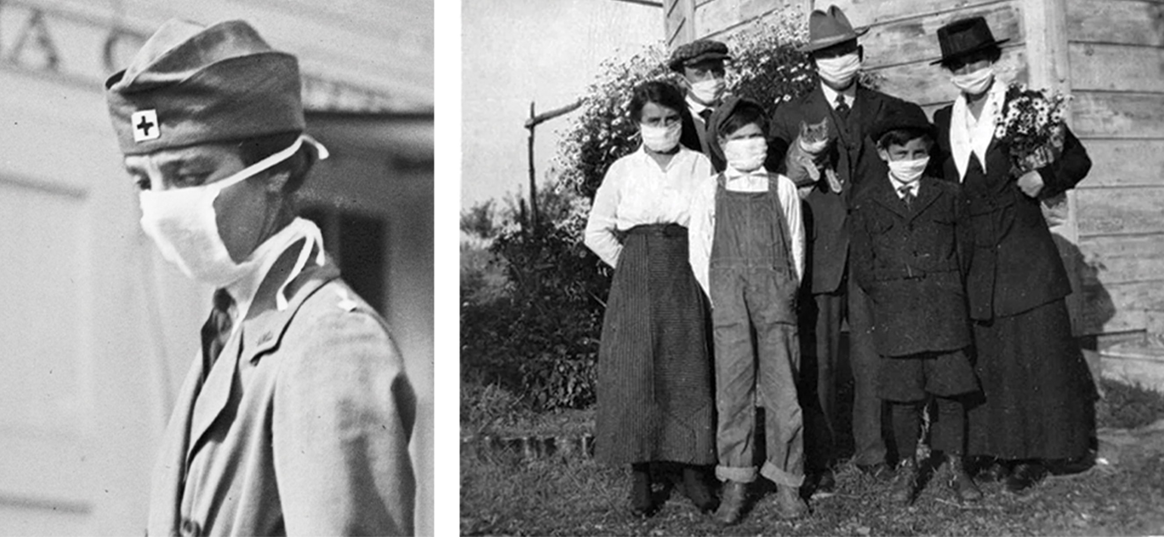
Science and You₂
Pandemics
Pandemics occur when viral infections spread through human populations across the globe.
Pandemics have occurred several times in recent history.
1918: Spanish Flu pandemic killed an estimated 50 million people.
1981: Emergence of HIV lead to ongoing global pandemic, killing an estimated 36 million.
2020: SARS-COV2 (coronavirus) has infected over 441 million, killing almost 6 million.
21.3 Figure 7: People wearing masks during the 1918 Spanish flu pandemic.
National Photo Company at the Library of Congress on Wikimedia Commons. "1918 flu outbreak."
Unknown author on Wikimedia Commons. "1918 Spanish flu."
Notes:
This is included as a relevant application for this topic.

Slide 22
Summary
Viruses are responsible for a wide variety of human disease.
Vaccines can be used to prevent viral disease by increasing immunity.
Vaccines and antiviral drugs can be used to treat viral diseases.
Antiviral drugs must target either processes or proteins which are only found in the virus, to prevent damaging the host.

Slide 23


End of Hawkes Learning PowerPoint

