Slide 1
Lesson 21.4
Prions and Viroids

Slide 2
Objectives
Define viroids and their targets of infection.
Describe prions and their basic properties.

Slide 3
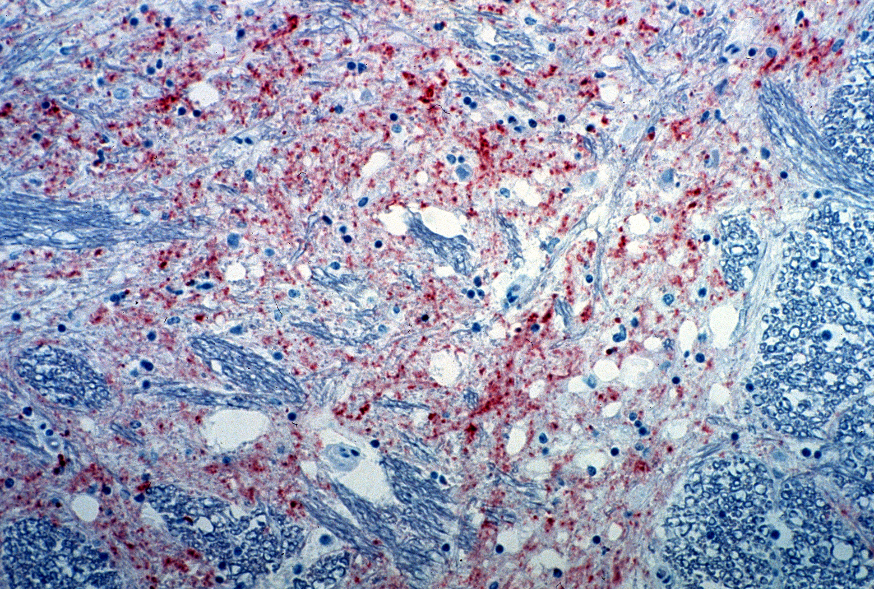
Prions
Prions are proteinaceous infectious particles.
They do not contain DNA or RNA.
Cause fatal neurodegenerative diseases such as kuru and "mad cow disease."
21.4 Figure 1
Dr. Peter Hooper, CSIRO on Wikimedia Commons. "Mad cow disease."

Slide 4
Bovine Spongiform Encephalopathy (BSE)
BSE, also known as "mad cow disease," was originally thought to only affect cattle.
During an outbreak, it was found that prions cause Creutzfeldt-Jakob disease (CJD) in humans.
Disease acquired by eating animals infected with BSE.
CJD can be spread among humans by blood.

Slide 5
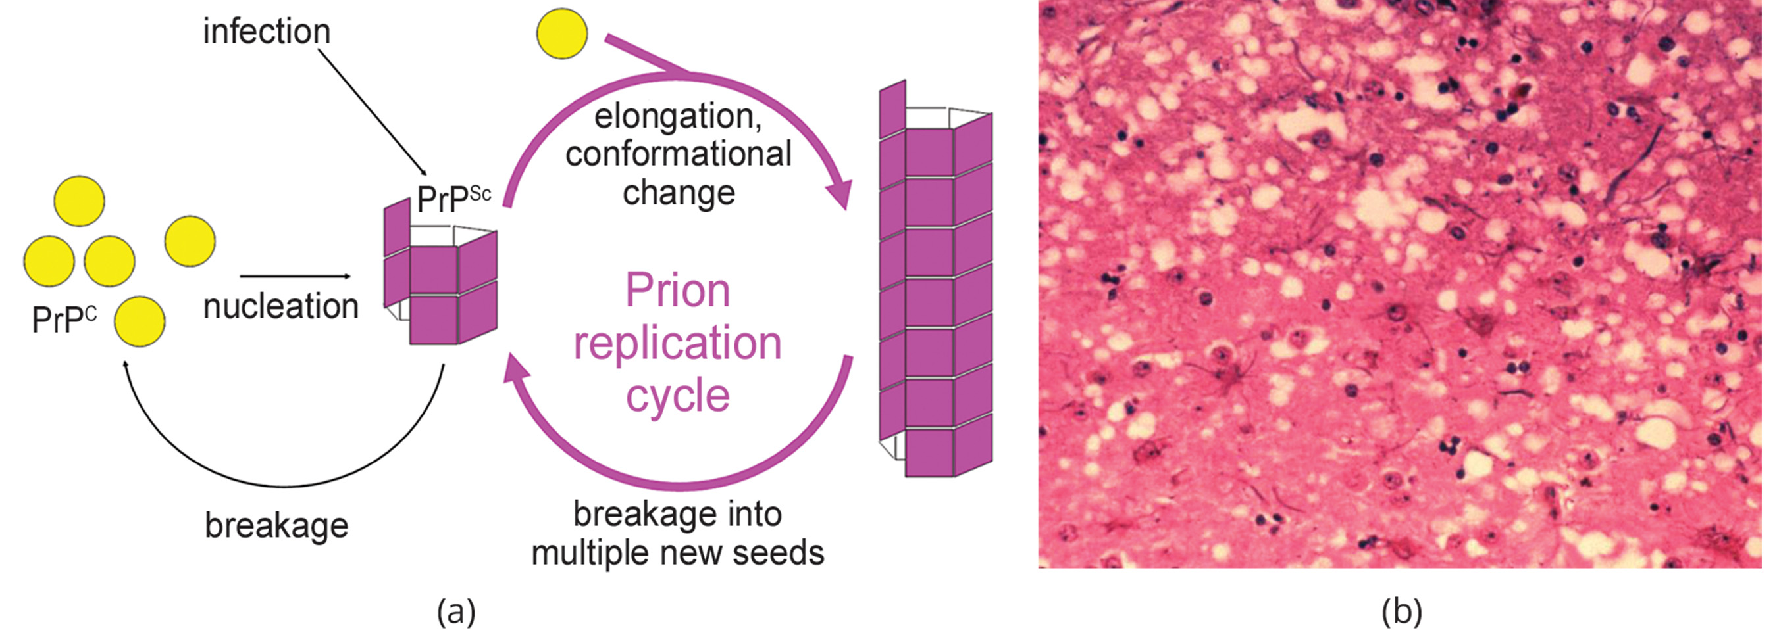
Lesson 21.4 Figure 2
Joannamasel on Wikimedia Commons. "Prion replication."
Public Health Image Library, APHIS on Wikimedia Commons. "Prion-infected brain tissue."
Notes:
Figure 2: (a) Endogenous normal prion protein (PrPc) is converted into the disease-causing form (PrPSc) when it encounters this variant form of the protein. PrPSc may arise spontaneously in brain tissue, especially if a mutant form of the protein is present, or it may occur via the spread of misfolded prions consumed in food into brain tissue. (b) This prion-infected brain tissue, visualized using light microscopy, shows the vacuoles (holes) that give it a spongy texture, typical of transmissible spongiform encephalopathies.

Slide 6
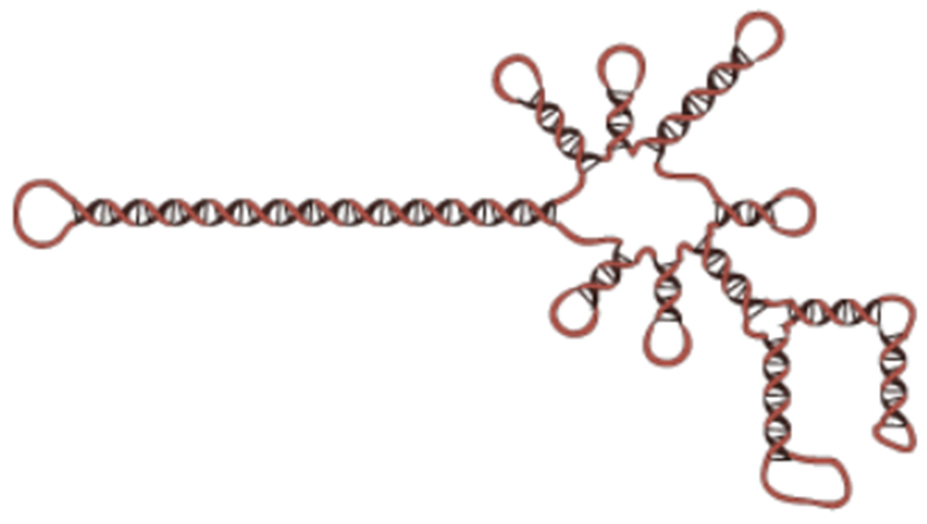
Viroids₁
Viroids are plant pathogens.
They are small single stranded circular RNA particles.
Must be within a host cell to replicate.
Only replicates the single specific RNA molecule, no protein.
21.4 Figure 3
148LENIN on Wikimedia Commons. "Viroid of family Avsunviroidae."

Slide 7
Think It Through
Viroids are made of RNA particles. What universal component of all cells is made of RNA molecules?
Notes:
Originally an On Your Own. This is included here to use as a talking point or for a think-pair-share activity.

Slide 8
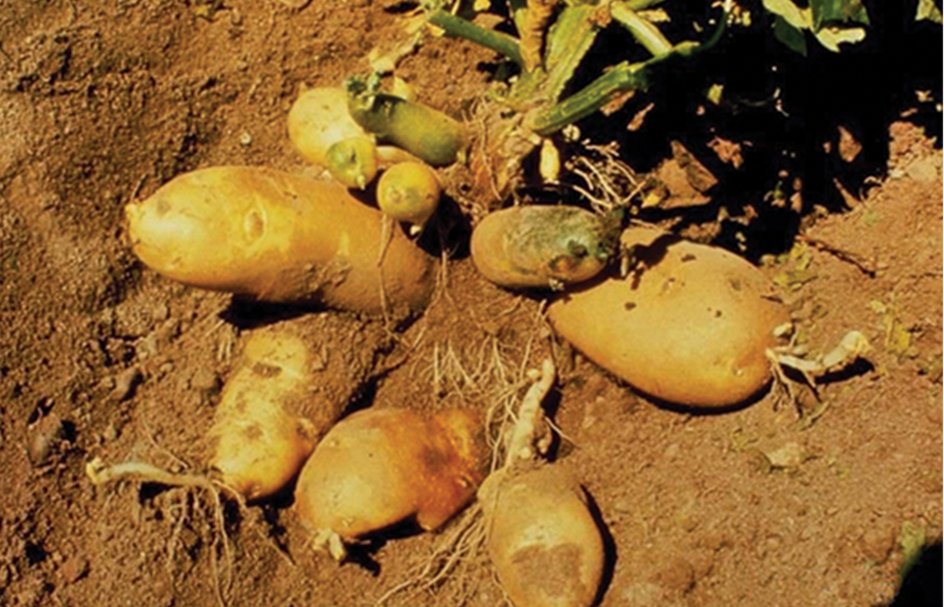
Viroids₂
Viroids are responsible for crop failures and millions of dollars of agricultural loss.
Known to infect potatoes, cucumbers, tomatoes, chrysanthemums, avocados and coconut palms.
21.4 Figure 4
William M. Brown Jr., Bugwood.org on Wikimedia Commons. "Potato spindle tuber viroid."

Slide 9
Science and You
Career: Virologist
Virology is the study of viruses, and a virologist is trained in the discipline.
Virologist are involved in many fields, such as academic research labs, teaching, involved in the creation or production of vaccines, epidemiologists or even science writers.
If this sounds interesting, find a mentor in the field, and get a firsthand look at the work!
Notes:
This is included as a relevant application for this topic.

Slide 10
Summary
Prions are infectious proteinaceous material.
No DNA or RNA is found in infectious particle.
Prions are known to cause kuru and BSE.
Viroids are plant pathogens made from a single RNA molecule.
Viroids are known to cause crop damage and significant agricultural losses.

Slide 11


End of Hawkes Learning PowerPoint

