Slide 1
Lesson 22.1
Prokaryotic Diversity

Slide 2
Objectives
Describe the evolutionary history of prokaryotes.
Discuss the distinguishing features of extremophiles.
Explain why it is difficult to culture prokaryotes.
Discuss Koch's postulates.
Explain the stages of biofilm development.

Slide 3
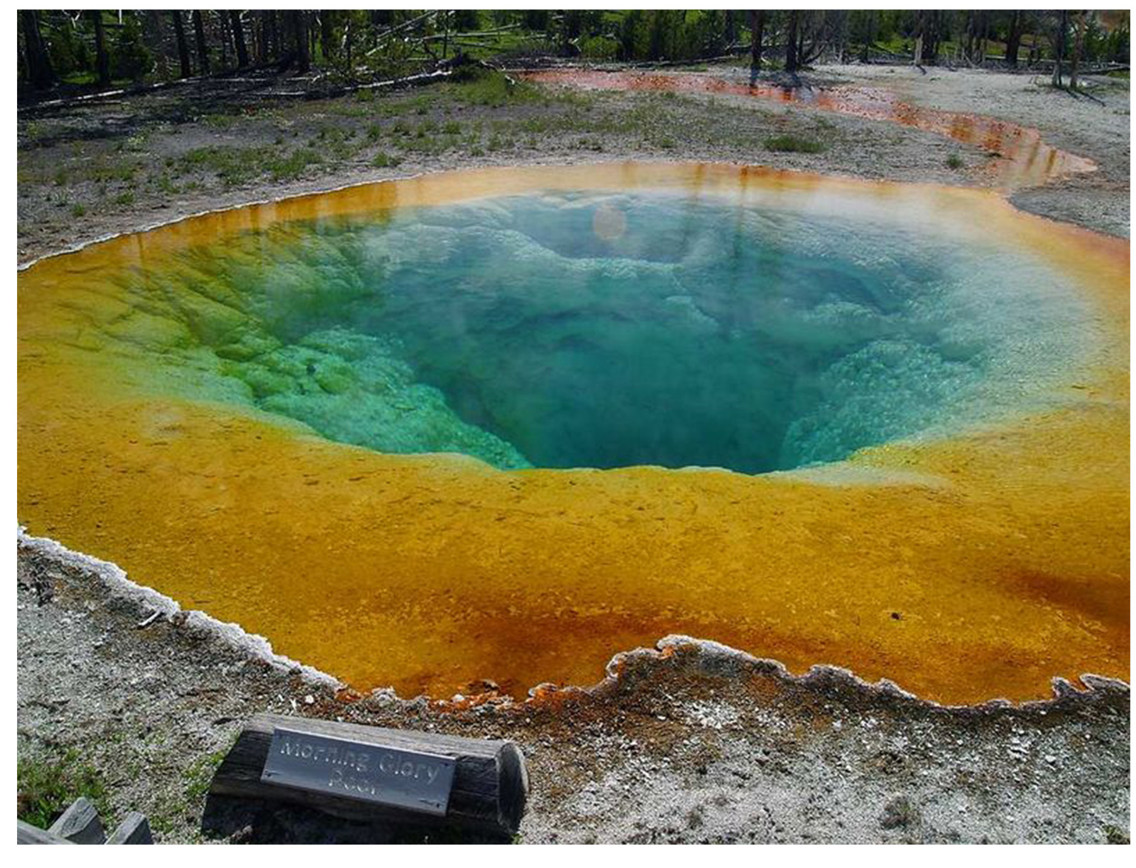
Prokaryotes: Bacteria and Archaea
Living organisms are classified into three domains based on their rRNA sequences: Bacteria, Archaea, and Eukarya.
Bacteria and Archaea are prokaryotic.
Prokaryotes are found everywhere.
22.1 Figure 1: Certain prokaryotes can live in extreme environments, like the Morning Glory Pool, a hot spring in Yellowstone National Park.
Jon Sullivan on Wikimedia Commons. "Morning glory pool."

Slide 4
Prokaryotic Diversity
Prokaryotes are ubiquitous, found on almost all surfaces and living organisms.
In the human body, they outnumber human cells by 10 to 1.
Make up the majority of living things in all ecosystems
Prokaryotes play crucial roles in recycling nutrients (essential substances) and driving ecosystem evolution.
They can thrive in inhospitable environments.
Eukaryotic cells descended from ancient prokaryotic communities.

Slide 5
Prokaryotes: The First Inhabitants of Earth
Cellular life likely began with prokaryotes, which existed for billions of years before the appearance of plants and animals.
Early Earth had a different atmosphere and strong solar radiation.
The first organisms thrived in protected environments like deep oceans or underground.
Adapted to high temperatures from volcanic activity.
Withstood harsh conditions like geological upheaval and radiation.

Slide 6
Reflection Question₁
Scientists and science fiction writers alike have been discussing the possibility of finding life on Mars for decades. If bacterial life were to exist on Mars, what environmental conditions would it need to survive?
Notes:
The reflection question is included here to use as a talking point or for a think-pair-share activity.

Slide 7
Microbial Mats
Microbial mats, prokaryotic biofilms, are believed to represent the earliest forms of prokaryotic life on Earth, dating back to 3.5 billion years ago.
Comprised of multilayered sheets of bacteria and some archaea, and are held by extracellular matrix
Early mats obtained energy from chemicals released by hydrothermal vents: fissures in the Earth’s surface releasing geothermally heated water.
Later, some used sunlight after photosynthesis evolved.
Others remained dependent on vents or chemicals from other extreme environments for energy.

Slide 8
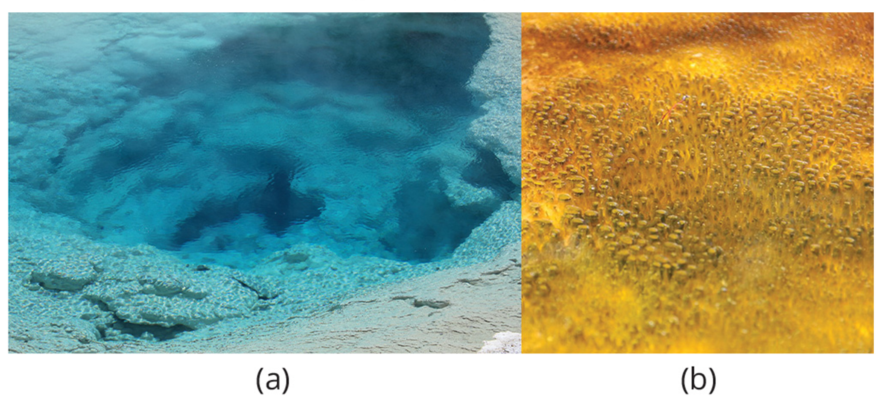
22.1 Figure 2
Alicejmichel on Wikimedia Commons. "Microbial mat."
Notes:
(a) Hydrothermal vents are home to bacterial colonies and complex ecosystems. (b) This microbial mat, about one meter in diameter, is growing in Yellowstone National Park. The mat's colony of bacteria helps it retain microbial nutrients.

Slide 9
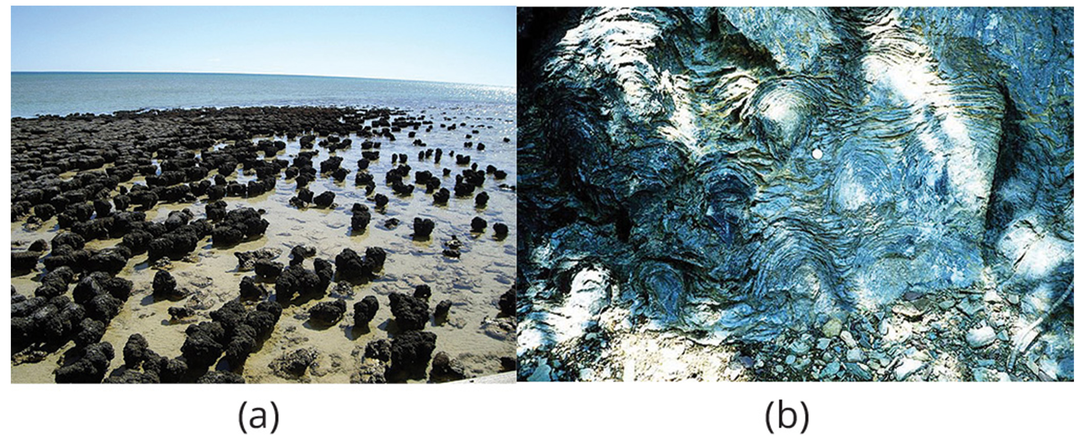
Stromatolites
Stromatolites are sedimentary rock structures formed by mineral precipitation from prokaryotes in microbial mats.
Represent earliest fossil record of life on Earth.
Still forming in some places like Anza-Borrego Desert, California.
22.1 Figure 3
Happy Little Nomad on Wikimedia Commons. "Stromatolites.“ P. Carrara, NPS on Wikimedia Commons. "Stromatolites."

Slide 10
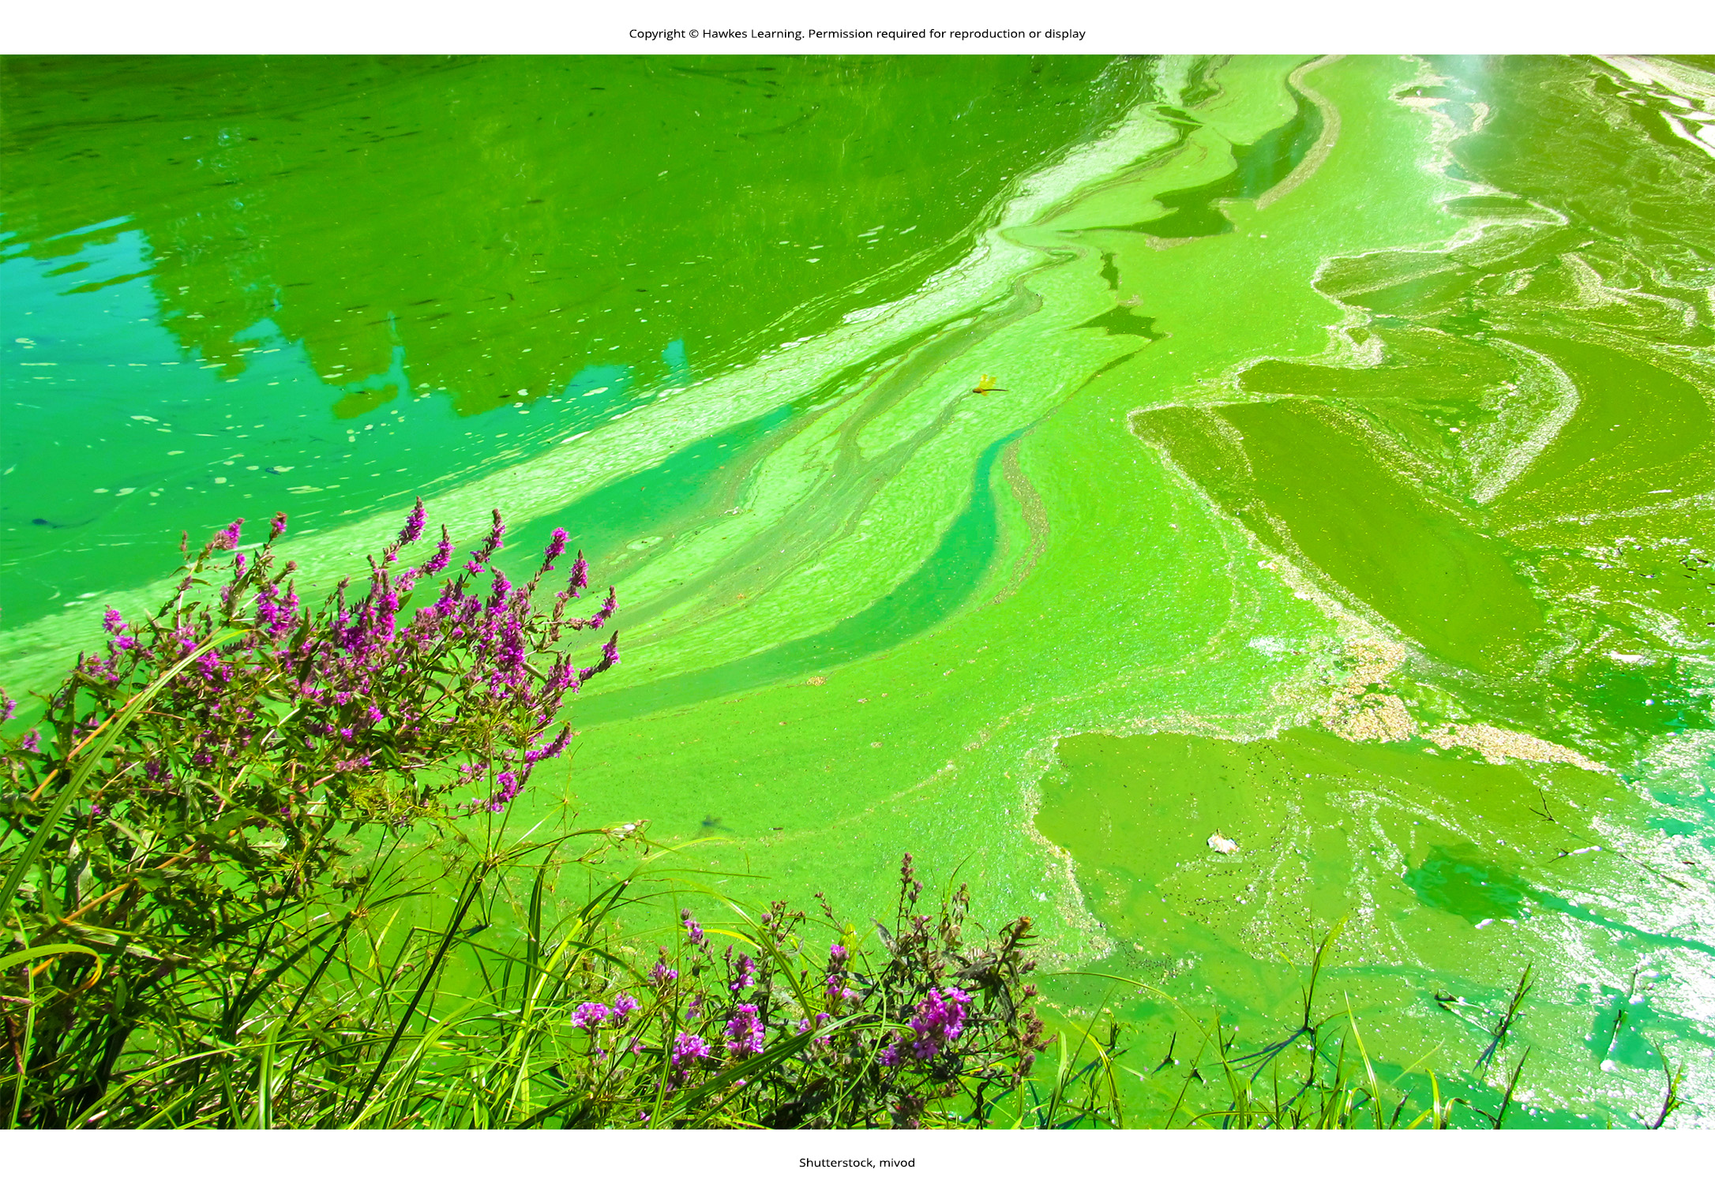
The Ancient Atmosphere
Earth's early atmosphere was anoxic (lacking molecular oxygen) for first 2 billion years, supporting only anaerobic life.
Chemoautotrophs synthesized food from inorganic chemicals.
Photoautotrophs converted solar energy into chemical energy.
Cyanobacteria evolved at least 1 billion years later, oxygenating the atmosphere.
Increased O₂ allowed evolution of efficient catabolic pathways.
Enabled land colonization by creating ozone which shields Earth from UV radiation.
22.1 Figure 4: Cyanobacteria bloom

Slide 11
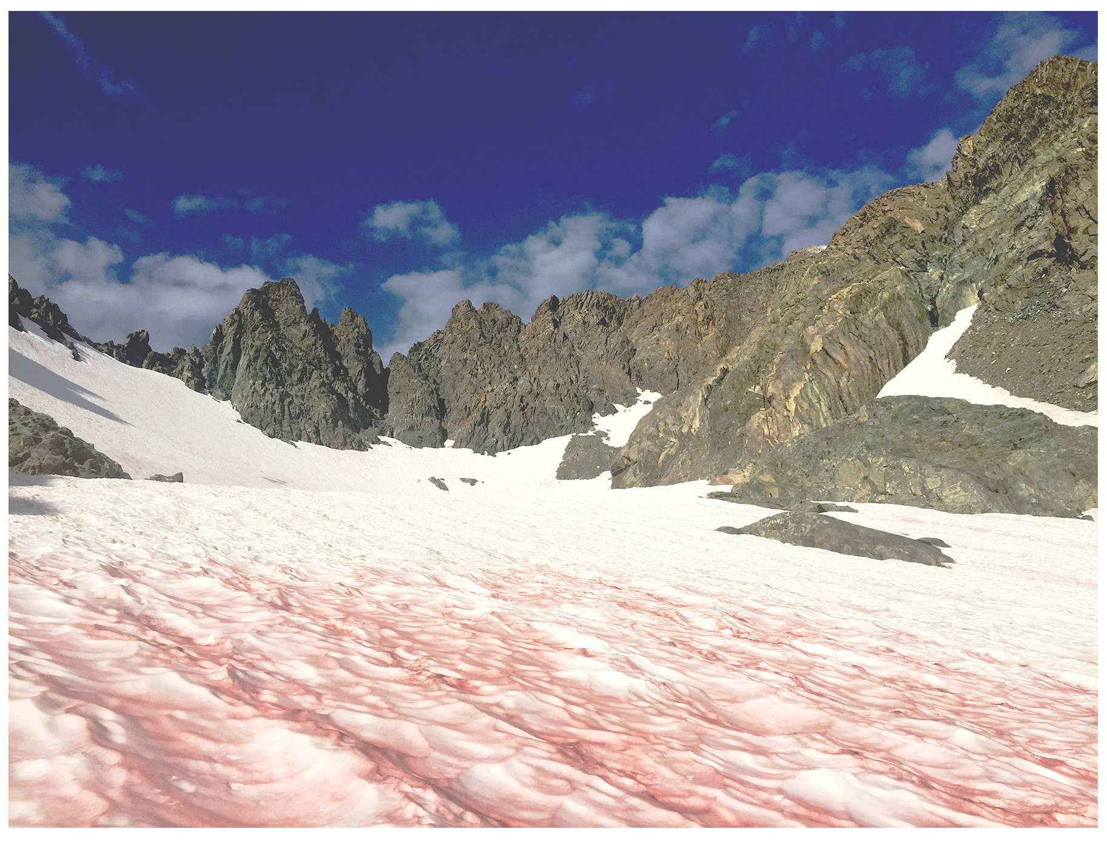
Microbes Are Adaptable: Life in Moderate and Extreme Environments₁
Prokaryotes have adaptive strategies for harsh conditions.
Cell walls protect against osmotic extremes.
Endospores are a dormant reduced form of bacteria that resists heat and drought.
Extremophiles thrive in specific extreme environments.
Hyperthermophiles thrive in hotter temperatures than thermophiles, who like temperatures between 60-80°C.
Acidophiles thrive in high acidic conditions.
Osmophiles thrive in high sugar environments.
Psychrophiles thrive in temperatures colder than 15°C.
Alkaliphiles thrive in basic conditions.
Halophiles thrive in high salt conditions.
22.1 Figure 5: Snow algae is a psychrophile.
Pacific Southwest Region 5 on Wikimedia Commons. "Snow algae."

Slide 12
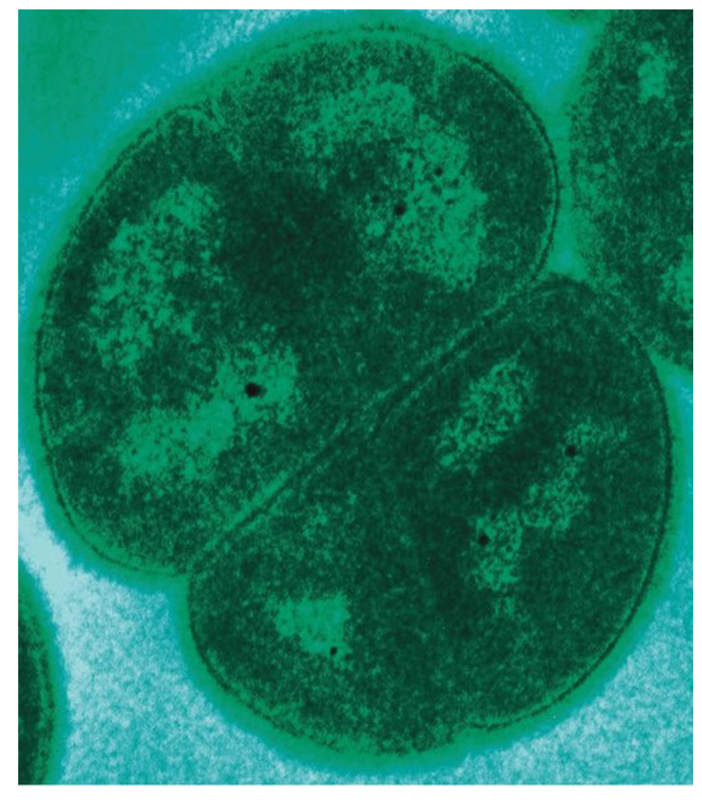
Microbes Are Adaptable: Life in Moderate and Extreme Environments₂
Deinococcus radiodurans is a radiation-resistant prokaryote.
Can tolerate extremely high doses of ionizing radiation.
Possesses DNA repair mechanisms to reconstruct shattered chromosomes.
Used to research new therapeutic drugs.
22.1 Figure 6
Michael Daly, Uniformed Services University on Wikimedia Commons. "Deinococcus radiodurans."

Slide 13
Table 1: Extremophiles and Their Preferred Conditions
Extremophile | Conditions for Optimal Growth
acidophiles | pH 3.0 or below
alkaliphiles | pH 9.0 or above
thermophiles | temperature 60–80℃ (140–176℉)
hyperthermophiles | temperature 80–122℃ (176–250℉)
psychrophiles | temperature of −15–10℃ (5–50℉) or lower
halophiles | salt concentration of at least 0.2 M
osmophiles | high sugar concentration

Slide 14
Prokaryotes in the Dead Sea
Soda lakes are environments that are both salty and alkaline.
Organisms living there must be alkaliphiles and halophiles.
The Dead Sea contains:
Sodium concentrations 10 times higher than seawater and magnesium levels 40 times higher
An acidic pH (6)
High divalent cation levels (Fe²⁺, Ca²⁺, Mg²⁺)
Intense solar radiation
Extremely salt-tolerant prokaryotes like Halobacterium and Haloarcula marismortui are found there.

Slide 15
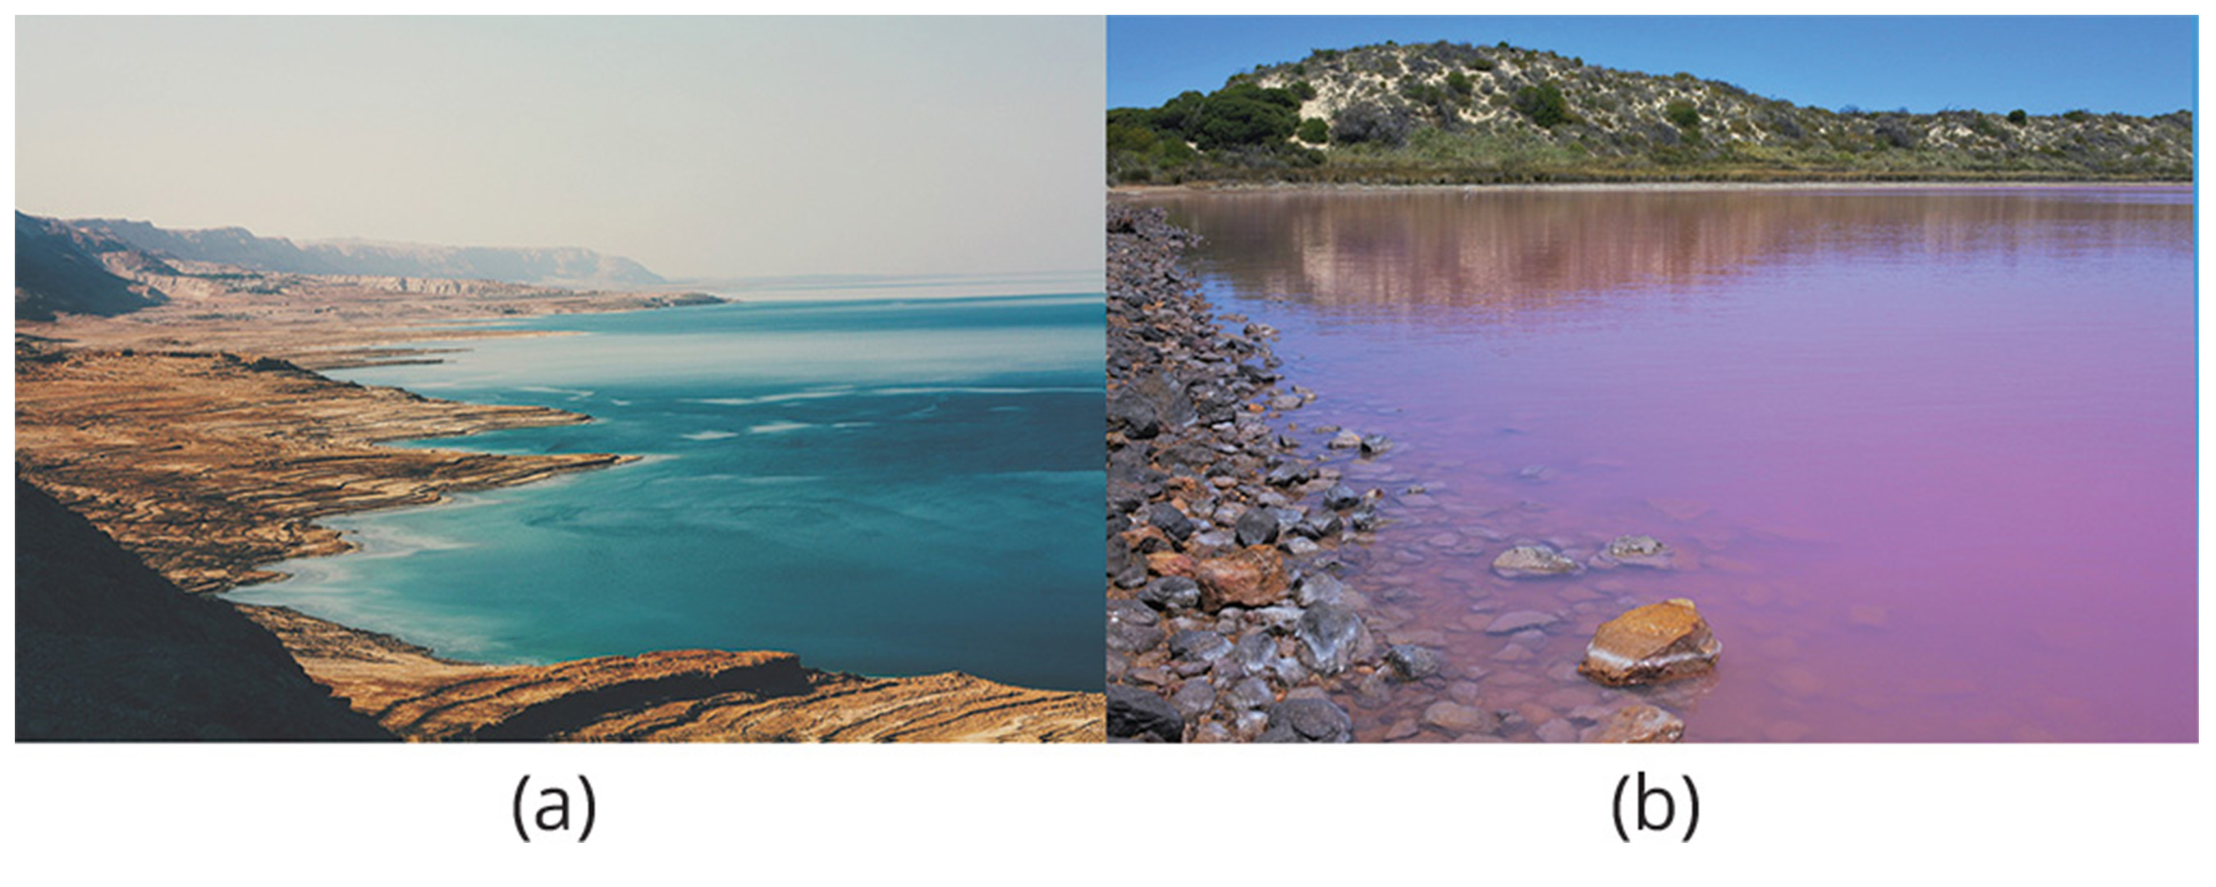
22.1 Figure 7
svetlanabar on Pixabay. "Dead sea."
Notes:
(a) The Dead Sea is hypersaline and home to several species of halophilic bacteria. (b) The reason for the pink coloration of the Hutt Lagoon in western Australia is due to the presence of a halophilic bacteria called Dunaliella salina.

Slide 16
Group Activity
Bacteria that live in hypersaline conditions have a significant problem maintaining osmolar homeostasis; in other words, they are in a significantly hypertonic solution. Break up into groups and discuss evolutionary adaptations these bacteria must have made in order to thrive in these conditions.

Slide 17
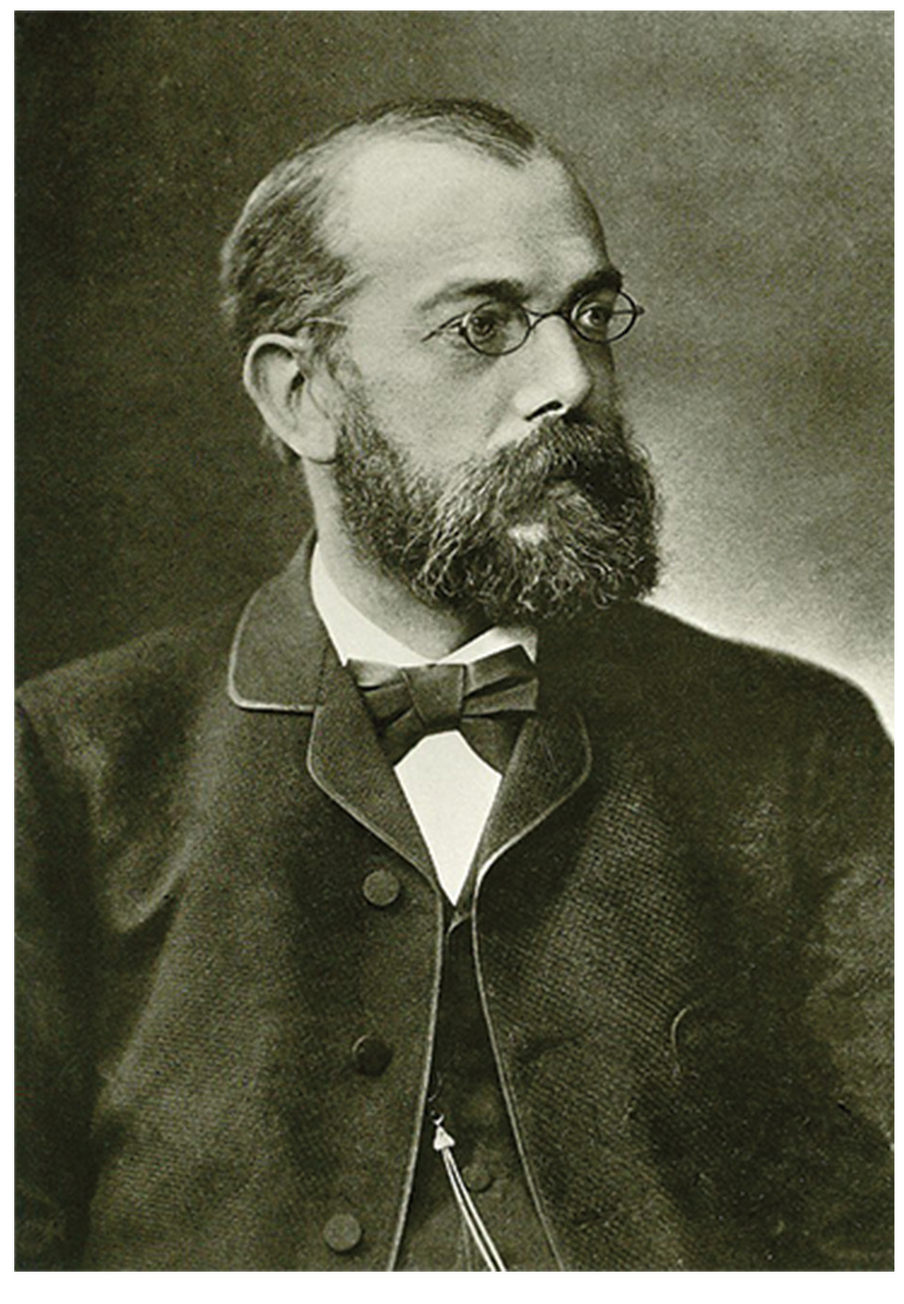
Unculturable Prokaryotes and the Viable-but-Non-Culturable State₁
Culturing bacteria is a complex yet crucial scientific discovery.
Robert Koch pioneered pure culture techniques including staining and growth media.
Julius Petri invented the Petri dish for growing microbes in labs.
22.1 Figure 8: Robert Koch discovered techniques to purely culture bacteria and created guidelines for identifying organisms responsible for specific diseases.
ZEISS Microscopy on Wikimedia Commons. "Robert Koch."

Slide 18
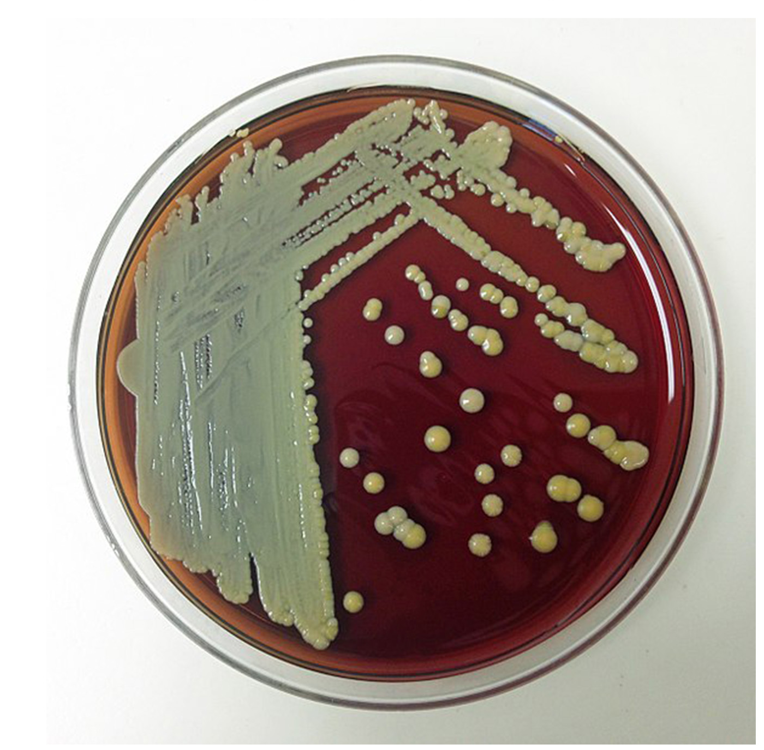
Unculturable Prokaryotes and the Viable-but-Non-Culturable State₂
Koch's postulates are guidelines to identify disease-causing organisms through culturing.
Over 99% of prokaryotes are unculturable altogether or enter a viable-but-non-culturable (VBNC) state due to unknown growth requirements or environmental stressors.
Resuscitation is a process where the prokaryote can go back to normal when conditions improve.
22.1 Figure 9
Drhx on Wikimedia Commons. "Petri dish."

Slide 19
Reflection Question₂
Research hibernation in animals. Does the VBNC state share any similar purposes with hibernation?
Notes:
The reflection question is included here to use as a talking point or for a think-pair-share activity.

Slide 20
The Ecology of Biofilms
Biofilms are robust microbial communities in a sticky matrix that consists of polysaccharides.
They colonize diverse environments from pipes to human bodies.
Their exopolysaccharide matrix and interactions make them more robust than free-living prokaryotes.
Biofilms are problematic and hard to eliminate.
They can clog pipes and contaminate food, causing outbreaks.
Their resistance to sterilization and antibiotics makes biofilm removal challenging.

Slide 21
Think It Through
Compared to free-floating bacteria, bacteria in biofilms often show increased resistance to antibiotics and detergents. Why do you think this might be the case?
Notes:
Originally an On Your Own. This is included here to use as a talking point or for a think-pair-share activity.

Slide 22
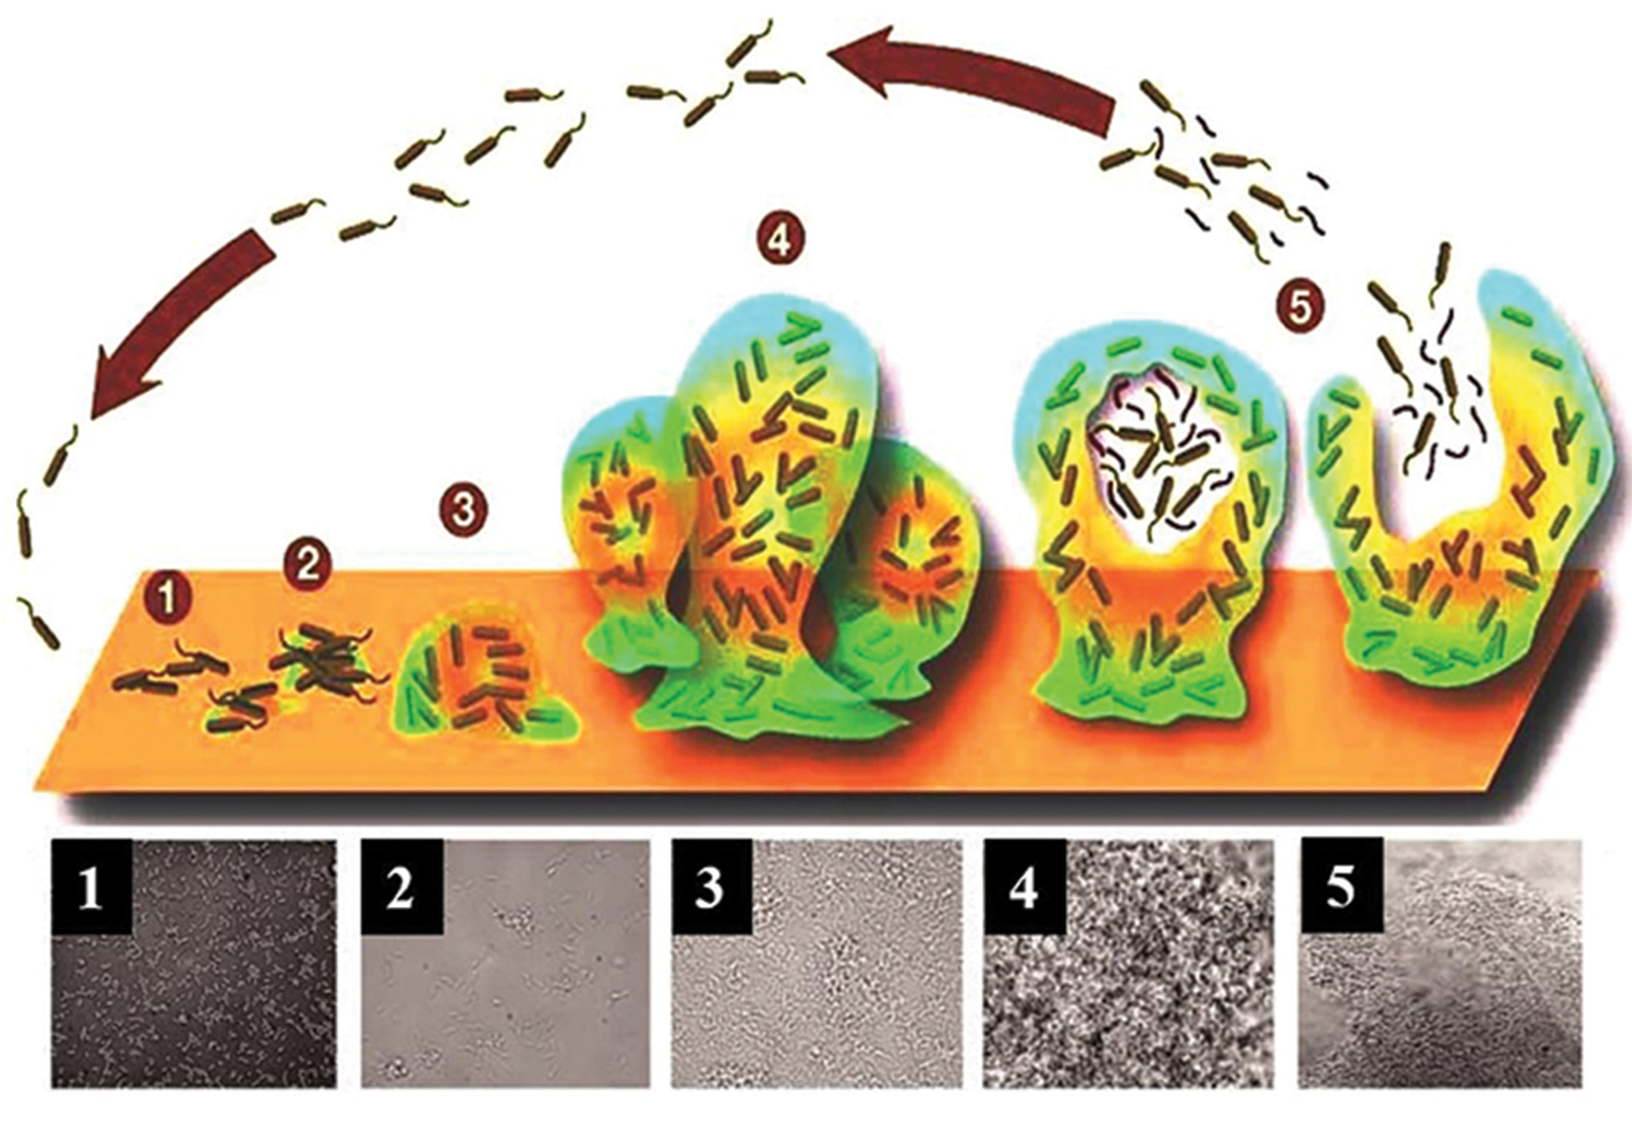
22.1 Figure 10
Frontiers. "Biofilm growth."
Notes:
Five stages of biofilm development are shown. During stage 1, initial attachment, bacteria adhere to a solid surface via weak van der Waals interactions (forces produced by induced electrical interactions between atoms; see Chapter 2). During stage 2, irreversible attachment, hairlike appendages called pili permanently anchor the bacteria to the surface. During stage 3, maturation I, the biofilm grows through cell division and recruitment of other bacteria. An extracellular matrix composed primarily of polysaccharides holds the biofilm together. During stage 4, maturation II, the biofilm continues to grow and takes on a more complex shape. During stage 5, dispersal, the biofilm matrix is partly broken down, allowing some bacteria to escape and colonize another surface. Micrographs of a Pseudomonas aeruginosa biofilm in each of the stages of development are shown.

Slide 23
Summary
Prokaryotes predate plants and animals by billions of years, with early life possibly originating in hot springs and hydrothermal vents.
Microbial mats, thought to be the earliest forms of life, are fossilized as stromatolites, providing the earliest fossil record of life on Earth.
For the first two billion years, Earth's atmosphere was anoxic, supporting only anaerobic organisms until cyanobacteria evolved and began oxygenating the atmosphere.
Prokaryotes inhabit various environments, with extremophiles thriving in harsh conditions and some entering dormant VBNC state.
Most prokaryotes live in communities called biofilms, which are microbial colonies held together by a gummy-textured matrix.

Slide 24


End of Hawkes Learning PowerPoint

