Slide 1
Chapter 22.2
Structure of Prokaryotes: Bacteria and Archaea

Slide 2
Objectives
Describe important differences in structure between Archaea and Bacteria.
Describe the basic structure of a typical prokaryote.

Slide 3
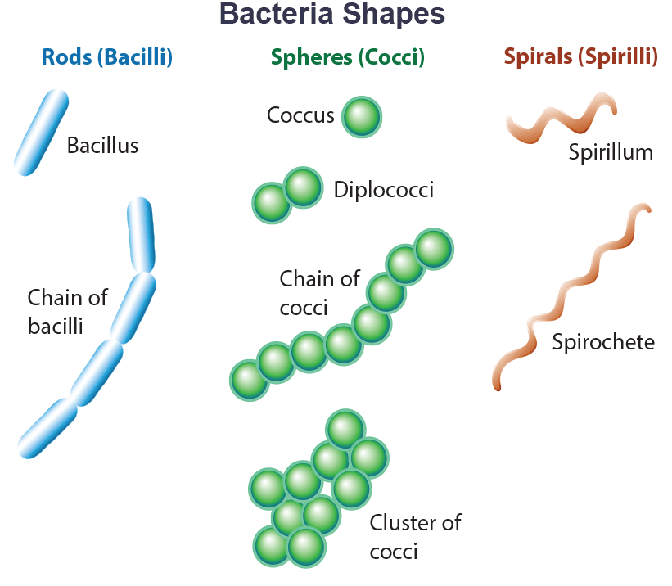
Structure of Prokaryotes: Bacteria and Archaea
Both cell types have a plasma membrane, cytoplasm, a DNA genome, and ribosomes.
Eukaryotes have a nucleus and membrane-bound organelle that prokaryotes lack.
Common prokaryotic shapes are cocci (spherical), bacilli (rods), and spirilli (spirals).
22.2 Figure 1

Slide 4
Group Activity
In groups of three, research some examples of each of the three bacteria shapes. Each person should be responsible for a different shape. Find example bacteria with your shape and research where they are commonly found. Share your research with your group.

Slide 5
Think It Through
What is the corresponding cell type name for each bacterial morphology listed.
Spiral
Round
Rod-shaped
Notes:
Originally an On Your Own. This is included here to use as a talking point or for a think-pair-share activity.

Slide 6
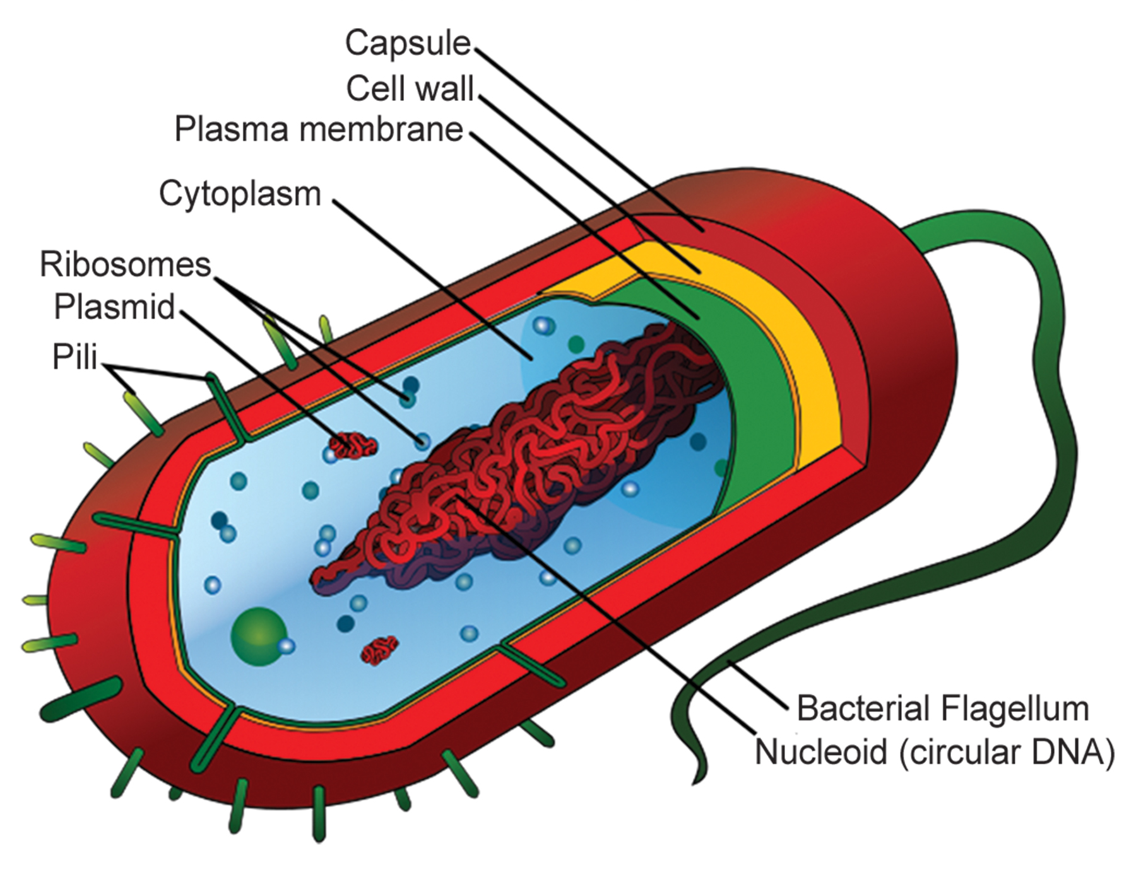
The Prokaryotic Cell₁
Prokaryotes are unicellular with circular DNA in nucleoid.
Have a cell wall for shape and protection, and some also have a capsule that helps attach to surfaces and protect from dehydration
Some species have flagella (locomotion), pili (attachment), and plasmids (extra-chromosomal DNA).
The cell wall, capsule, flagella, and pili aid pathogen survival and virulence.
22.2 Figure 2
Mariana Ruiz Villarreal on Wikimedia Commons. "Prokaryotic cell structure."

Slide 7
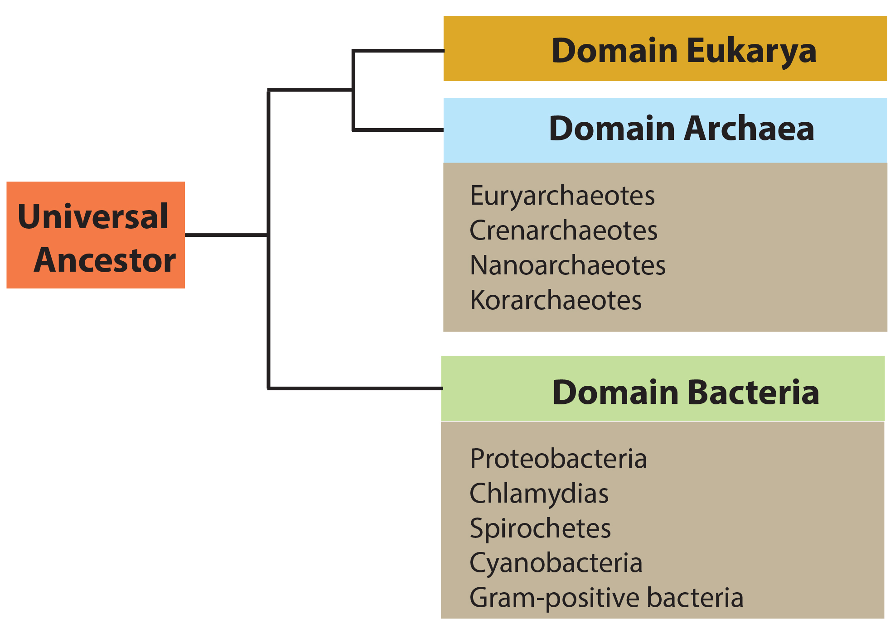
The Prokaryotic Cell₂
Prokaryotes are divided into two domains, Bacteria and Archaea, which along with Eukarya make up the three domains of life.
22.2 Figure 3
CNX OpenStax on Wikimedia Commons. "Common ancestor." Modified.

Slide 8
The Prokaryotic Cell₃
Major bacterial phyla include: Proteobacteria (subdivided alpha to epsilon), Chlamydias, Spirochetes, photosynthetic Cyanobacteria, gram-positive bacteria.
Eukaryotic mitochondria descended from alphaproteobacteria, chloroplasts from cyanobacteria.
Proteobacteria, Chlamydias, Spirochetes, Cyanobacteria are key phyla.
Alphaproteobacteria gave rise to mitochondria, cyanobacteria to chloroplasts.

Slide 9
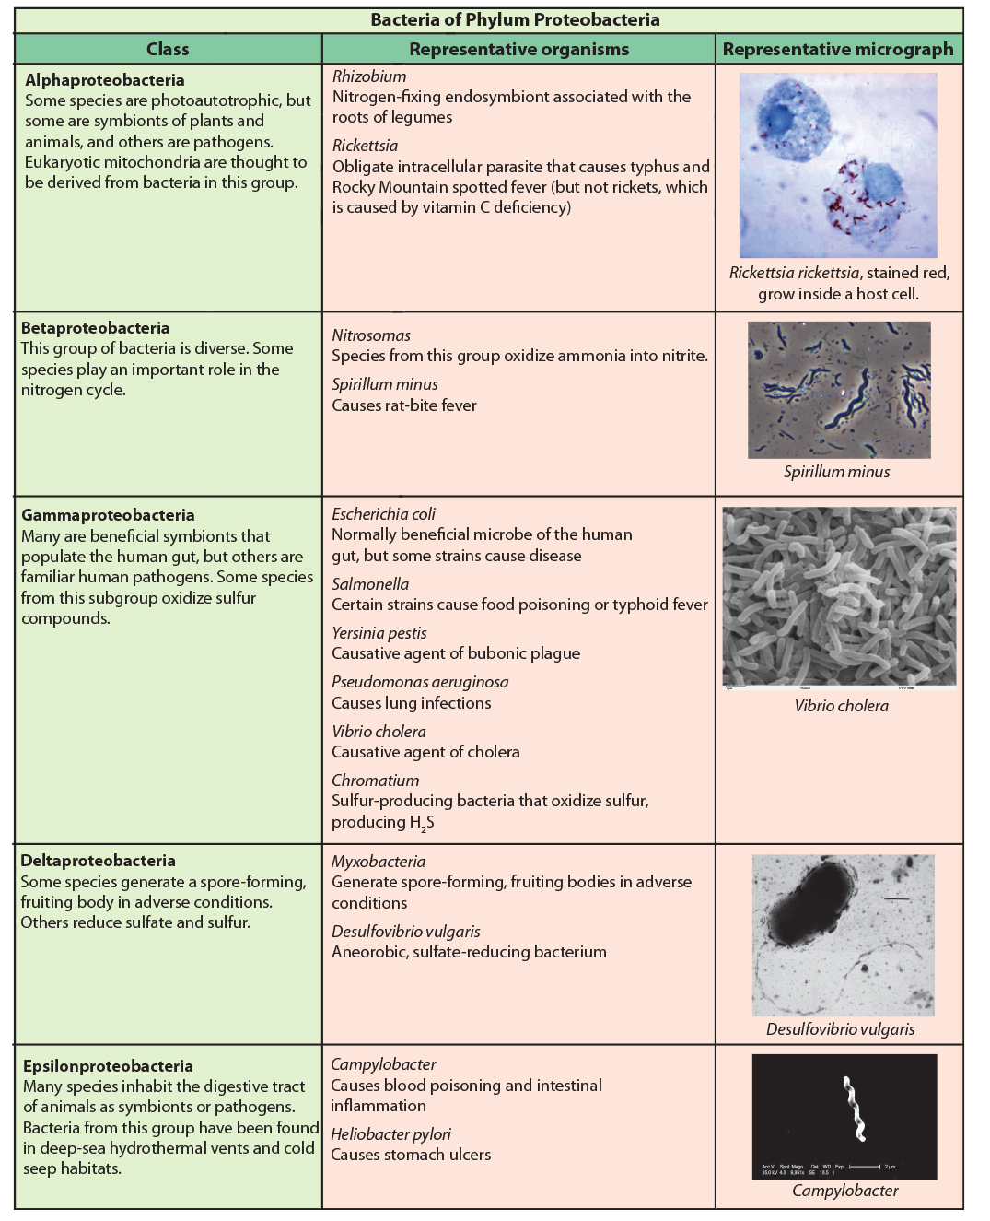
22.2 Figure 4
CDC on Wikimedia Commons. "Rickettsia rickettsii.“ Wolframm Adlassnig on Wikimedia Commons. "Spirillum minus."
http://remf.dartmouth.edu/images/bacteriaSEM/source/1.html on Wikimedia Commons. "Cholera."
Graham Bradley on Wikimedia Commons. "Desulfovibrio vulgaris.“ CDC on Wikimedia Commons. "Campylobacter jejuni."
Notes:
The phylum Proteobacteria is one of up to 52 bacteria phyla. Proteobacteria is further subdivided into five classes: alpha through epsilon.

Slide 10
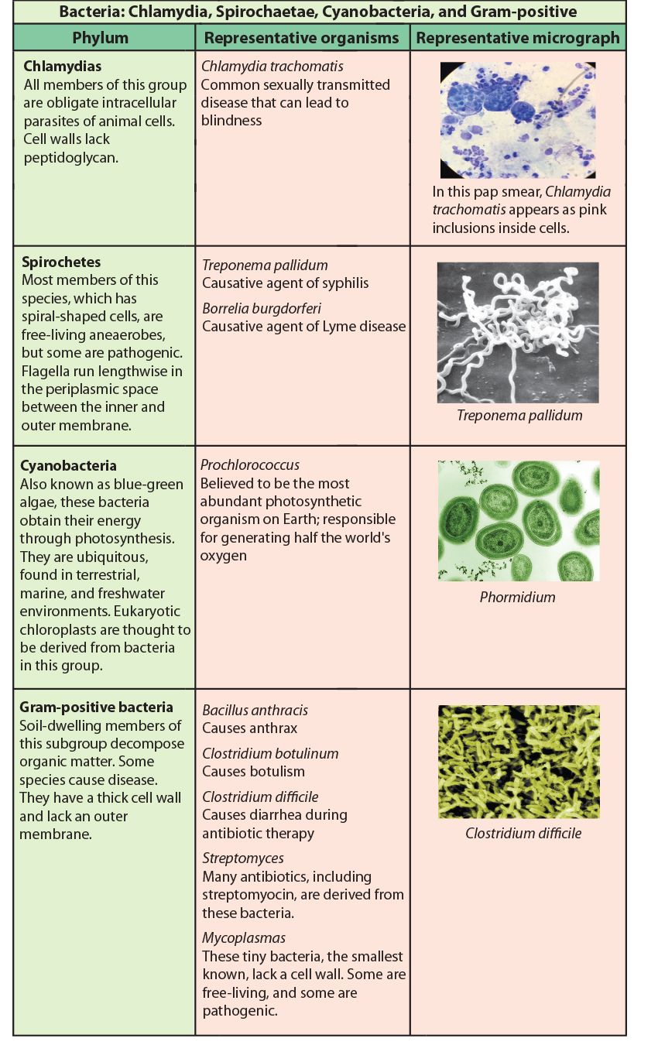
22.2 Figure 5
CDC on Wikimedia Commons. "Treponema pallidum."
Luke Thompson from Chisholm Lab and Nikki Watson from Whitehead, MIT on Wikimedia Commons. "Prochlorococcus marinus."
CDC on Wikimedia Commons. "Clostridium difficile."
Notes:
Chlamydia, Spirochetes, Cyanobacteria, and gram-positive bacteria are described in this table. Note that bacterial shape is not phylum-dependent; bacteria within a phylum may be cocci (spherical), bacilli (rod-shaped), or spirilli (spiral-shaped).

Slide 11
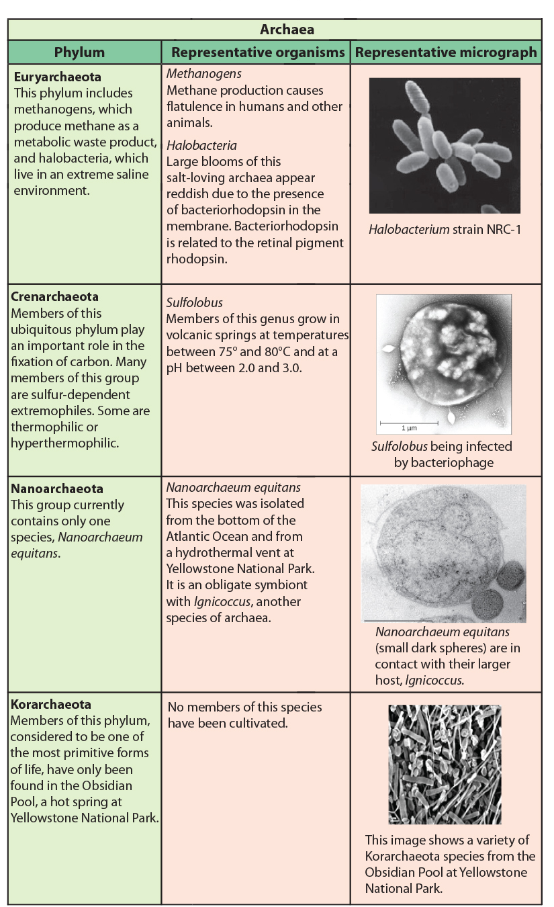
22.2 Figure 6
NASA on Wikimedia Commons. "Halobacteria.“ CNX OpenStax on Wikimedia Commons. "Sulfolobus."
Karl O. Stetter on Wikimedia Commons. "Nanoarchaeum equitans.“ The Regents of the University of California. "Korarchaeota."
Notes:
Archaea are separated into four phyla: the Korarchaeota, Euryarchaeota, Crenarchaeota, and Nanoarchaeota.

Slide 12
The Plasma Membrane of Prokaryotes
The prokaryotic plasma membrane is a thin (6-8 nm) selectively permeable, phospholipid bilayer.
Bacterial membranes are composed of phospholipid bilayers with fatty acids linked to glycerol.
Archaeal membranes use isoprene (phytanyl) chains linked to glycerol instead.
  Some archaeal membranes are lipid monolayers rather than bilayers.

Slide 13
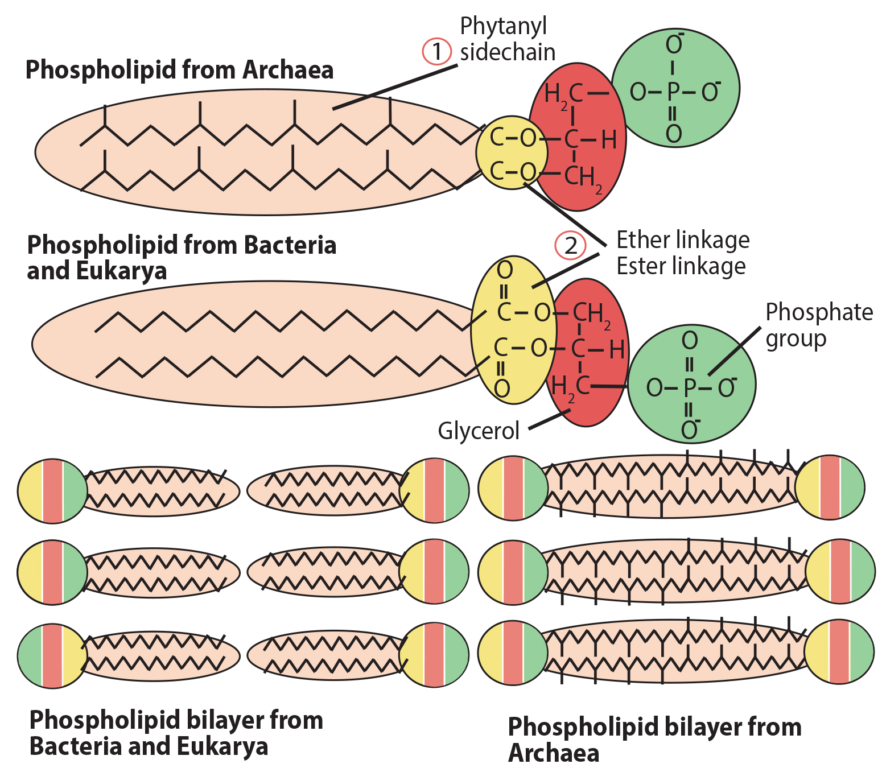
22.2 Figure 7
CNX OpenStax on Wikimedia Commons. "Archaeal phospholipids." Modified.
Notes:
Archaeal phospholipids differ from those found in Bacteria and Eukarya in two ways. First, they have branched phytanyl sidechains instead of linear ones. Second, an ether bond instead of an ester bond connects the lipid to the glycerol.

Slide 14
The Cell Wall of Prokaryotes₁
The cell wall regulates the high osmotic pressure in the cytoplasm, prevents osmotic lysis, and provides shape and rigidity.
Bacterial walls contain peptidoglycan: polysaccharides cross-linked by unusual peptides with L- and D-amino acids.
  Antibiotics mimic D-amnio acids to affect bacterial cell wall development.
S-layer (surface layer) proteins are attached to the peptidoglycan wall.
Archaeal walls lack peptidoglycan but have protective S-layer protein coats.

Slide 15
The Cell Wall of Prokaryotes₂
Bacteria are divided into two groups: gram-positive and gram-negative based on the Gram staining reaction.
Gram-positive lack an outer membrane; the cell wall is 90% peptidoglycan, with teichoic acids linked to lipids in the membrane.
Gram-negative have thin peptidoglycan layer, outer membrane with lipopolysaccharides (LPS) and lipoproteins.
Gram staining differentiates based on cell wall composition: the peptidoglycan thickness and presence of outer membrane.

Slide 16
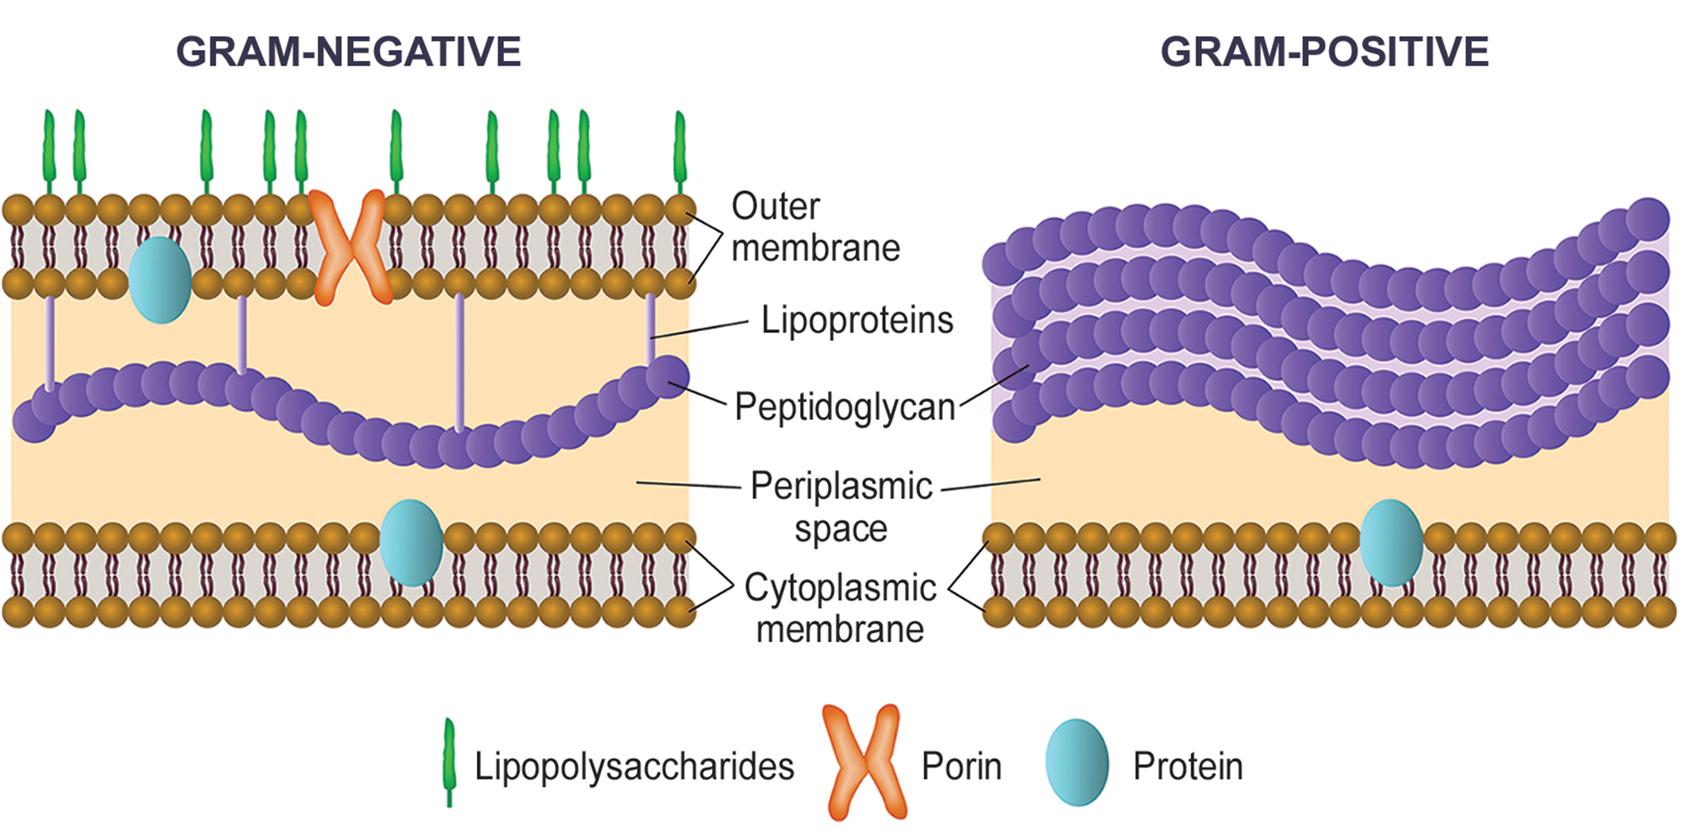
22.2 Figure 8
Notes:
Bacteria are divided into two major groups: gram positive and gram negative. Both groups have a cell wall composed of peptidoglycan; in gram-positive bacteria, the wall is thick, whereas the wall is thin in gram-negative bacteria. In gram-negative bacteria, the cell wall is surrounded by an outer membrane that contains lipopolysaccharides and lipoproteins. Porins are proteins in this cell membrane that allow substances to pass through the outer membrane of gram-negative bacteria. In gram-positive bacteria, lipoteichoic acid anchors the cell wall to the cell membrane.

Slide 17
The Cell Wall of Prokaryotes₃
Archaean cell walls lack peptidoglycan.
There are four types of cell walls:
  Pseudopeptidoglycan: similar structure to peptidoglycan but different sugars
  Polysaccharides
  Glycoproteins
  Pure protein

Slide 18
Table 1: Differences and Similarities between Bacteria and Archaea
Structural Characteristic | Bacteria | Archaea
cell type | prokaryotic | prokaryotic
cell morphology | variable | variable
cell wall | contains peptidoglycan | does not contain peptidoglycan
cell membrane type | lipid bilayer | lipid bilayer or lipid monolayer
plasma membrane lipids | fatty acids-glycerol ester | phytanyl-glycerol ethers
chromosome | typically circular | typically circular
replication origins | single | multiple
RNA polymerase | single | multiple
initiator tRNA | formyl-methionine | methionine
streptomycin inhibition | sensitive | resistant
Calvin cycle | yes | no

Slide 19
Reproduction₁
Prokaryotes reproduce asexually through binary fission, where the circular chromosome is replicated, and the cell divides into two identical clones.
Binary fission doesn't allow for genetic recombination, but prokaryotes can share genes through three other mechanisms:
  Transformation (uptake of environmental DNA) can make non-pathogens pathogenic by acquiring toxin genes.
  Transduction (via bacteriophage viruses) by viruses creates recombinant organisms.
  Conjugation (transfer by pilus) allows plasmid or chromosomal DNA transfer between cells.

Slide 20
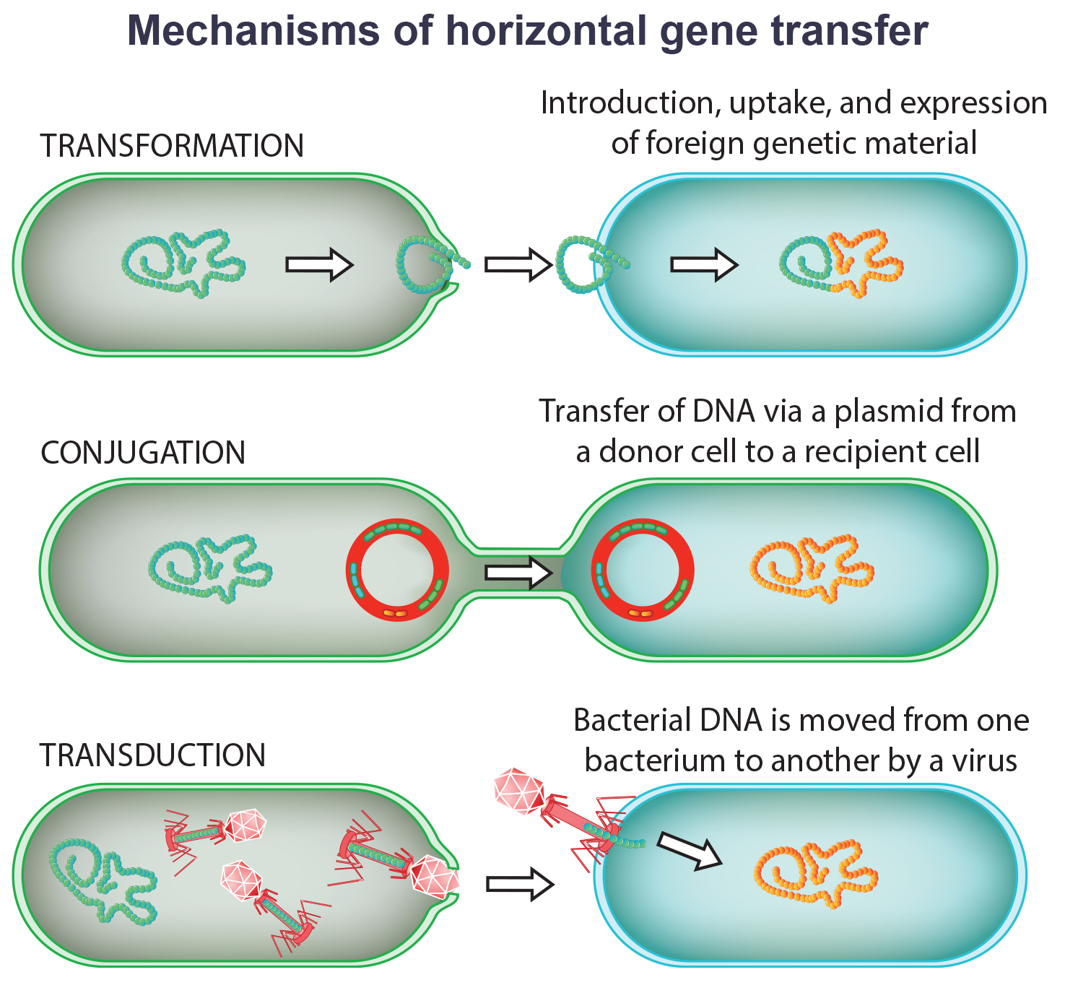
Reproduction₂
Prokaryotes' rapid reproduction and genetic variability enable swift adaptation to environmental stressors.
22.2 Figure 9

Slide 21
The Evolution of Prokaryotes
The fossil record lacks prokaryotic evolution details, so molecular clocks based on gene and protein similarity across species give an estimate of divergence timing.
Study suggests bacterial groups Actinobacteria, Deinococcus, Cyanobacteria (Terrabacteria) colonized land first, due to adaptations like branching, radiation resistance, and oxygenic photosynthesis.
Bacteria diverged 2.5-3.2 billion years ago, Archaea earlier at 3.1-4.1 billion years ago, and Eukarya later from Archaean line.
Ancient stromatolites photosynthesized anoxically pre-cyanobacteria, and Terrabacteria adaptations enabled oxygenic photosynthesis on land.

Slide 22
Summary
Prokaryotes (Archaea and Bacteria) lack a nucleus, have circular DNA, a cell membrane, and compositionally varying cell walls like peptidoglycan to prevent lysis.
Bacteria are either gram-positive (thick peptidoglycan and teichoic acids) or gram-negative (thin peptidoglycan and outer lipopolysaccharide-lipoprotein membrane).
Archaeal membranes have phytanyl-glycerol lipids and may be composed of bilayers or monolayers.
Prokaryotic DNA transfer occurs via transformation, transduction, or conjugation.

Slide 23


End of Hawkes Learning PowerPoint

