Slide 1
Lesson 22.3
Prokaryotic Metabolism

Slide 2
Objectives
Describe the roles of prokaryotes in the carbon and nitrogen cycles.
Describe the ways in which prokaryotes get energy and carbon for life processes.
Identify the macronutrients needed by prokaryotes and explain their importance.

Slide 3
Prokaryotic Metabolism
Prokaryotes occupy many diverse niches on earth, from deepwater vents to artic ice.
They can occupy this broad range of environments due to diverse metabolic processes.
To live, prokaryotes need a source of energy, a source of carbon and some additional nutrients.
For cells to build all molecules required to sustain life, they need certain substances collectively called nutrients.

Slide 4
Reflection Question₁
Think about the kinds of minerals and proteins that your metabolism needs to function. In what ways is your metabolism similar to or different from prokaryotes?
Notes:
The reflection question is included here to use as a talking point or for a think-pair-share activity.

Slide 5
Macronutrients
For cells to build all molecules required to sustain life, they need certain substances collectively called nutrients.
Nutrients needed in large amounts are called macronutrients.
The macronutrients are carbon, hydrogen, oxygen, nitrogen phosphorus and sulfur.
These macronutrients are the components of the cellular macromolecules and their subunits.

Slide 6
Reflection Question₂
Imagine if prokaryotes were removed from the carbon cycle. How would that affect the rest of the cycle? How would that affect humans?
Notes:
The reflection question is included here to use as a talking point or for a think-pair-share activity.

Slide 7
Micronutrients
Micronutrients are needed in smaller (trace) amounts.
Many trace elements are metallic elements.
Examples are iron, boron, chromium and magnesium.
Boron, chromium and magnesium are often enzymatic cofactors.

Slide 8
Prokaryotic Energy Sources
Prokaryotes are classified by the way they obtain energy, and their carbon source for producing organic molecules.
Phototrophs are prokaryotes who gain energy from the sun.
Chemotrophs gain their energy from chemical compounds.
Energy pathways can be either aerobic (using oxygen as the terminal electron acceptor) or anaerobic (using simple inorganic molecules or organic molecules are the terminal electron acceptor)

Slide 9
Prokaryotic Carbon Sources
Prokaryotes can use a variety of different sources for their caron.
Autotrophs use carbon dioxide.
Heterotrophs use organic compounds.

Slide 10
Table 1: Carbon and Energy Sources for Prokaryotes
Energy Source | Electron Source | Carbon Source | Nutritional type
light (phototroph) | organic material (organotroph) | organic material (heterotroph) carbon dioxide (autotroph) | photoorganoheterotroph photoorganoautotroph
light (phototroph) | inorganic material (lithotroph) | organic material (heterotroph) carbon dioxide (autotroph) | photolithoheterotroph photolithoautotroph
chemicals (chemotroph) | organic material (organotroph) | organic material (heterotroph) carbon dioxide (autotroph) | chemoorganoheterotroph chemoorganoautotroph
chemicals (chemotroph) | inorganic material (lithotroph) | organic material (heterotroph) carbon dioxide (autotroph) | chemolithoheterotroph chemolithoautotroph

Slide 11
Reflection Question₃
Which kind of prokaryote mentioned (phototrophic, chemotrophic, chemoorganotrophic, or chemolithotrophic) would have survived well in early Earth environments? Why do you think so?
Notes:
The reflection question is included here to use as a talking point or for a think-pair-share activity.

Slide 12
Think It Through
What do you call an organism that can generate its energy from breaking down chemical compounds?
Notes:
Originally an On Your Own. This is included here to use as a talking point or for a think-pair-share activity.

Slide 13
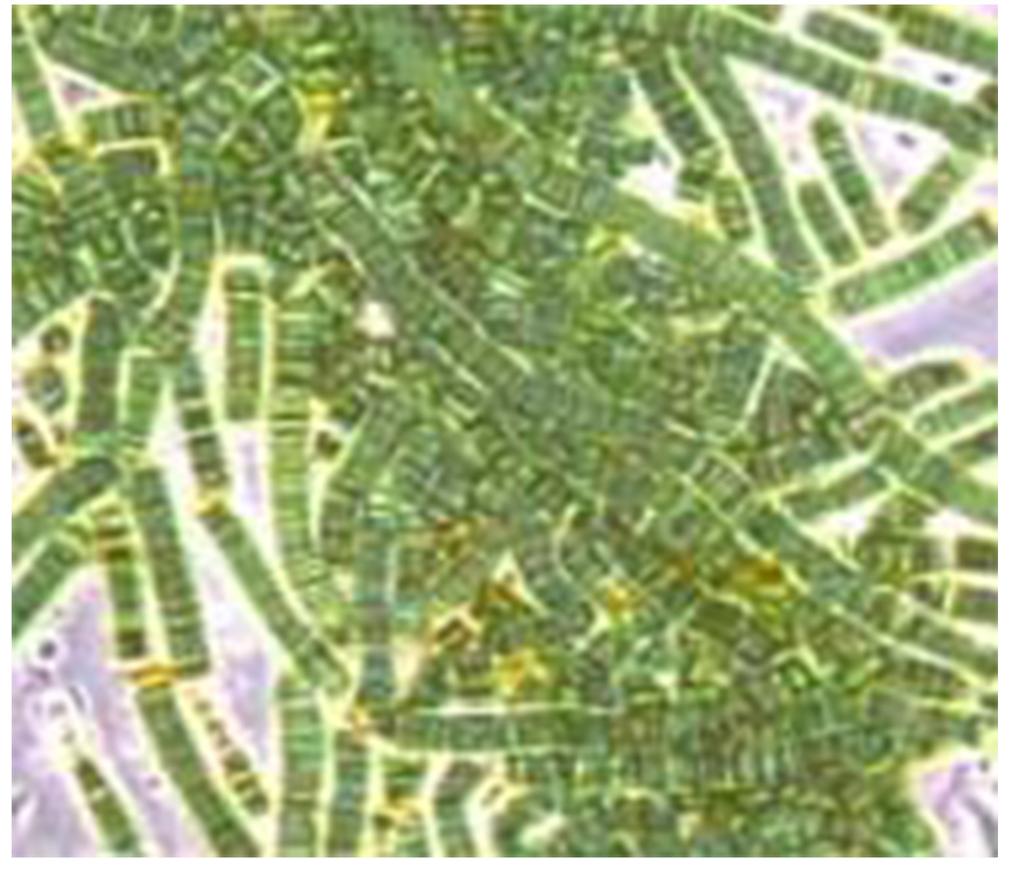
Prokaryotes and the Carbon Cycle
Prokaryotes play an important part in the ecosystem.
Photosynthetic bacteria are primary producers, which create organic molecules from CO₂
Prokaryotes can also be decomposers, which are organisms which break down plants and animals and their organic compounds.
22.3 Figure 2: Cyanobacteria are common primary producers within the ocean and freshwater environments.
NOAA on Wikimedia Commons. "Bluegreen algae."

Slide 14
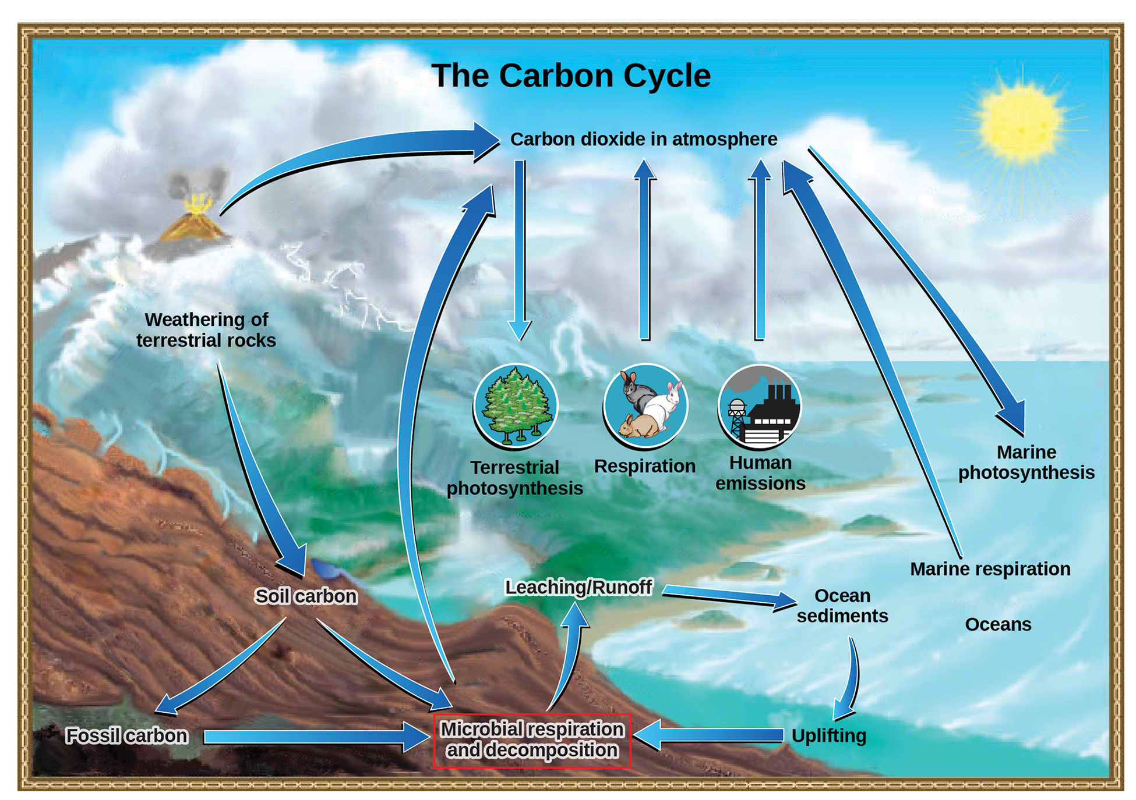
Lesson 22.3 Figure 1
John M. Evans and Howard Perlman, USGS on Wikimedia Commons. "Carbon cycle."
Notes:
Figure 1: Prokaryotes play a significant role in continuously moving carbon through the biosphere.

Slide 15
Reflection Question₄
Imagine if prokaryotes were removed from the carbon cycle.
How would that affect the rest of the cycle?
How would that affect humans?
Notes:
The reflection question is included here to use as a talking point or for a think-pair-share activity.

Slide 16
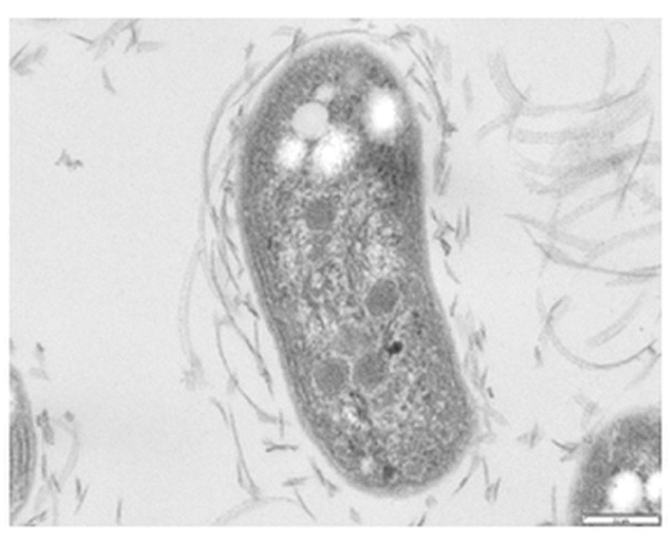
Prokaryotes and the Nitrogen Cycle
Prokaryotes are responsible for most of the nitrogen cycling processes.
Nitrogen fixation, which transforms gaseous nitrogen (N₂) into more readily available forms such as ammonia (NH₃).
Ammonification: process of ammonia being released during decomposition of nitrogen-containing compounds.
Nitrification: during ammonification, ammonia is progressively oxidized to nitrate.
Prokaryotes are also responsible for denitrification, which is the process of reducing nitrate from soil to gaseous compounds.
22.3 Figure 4: Nitrobacter are nitrifying bacteria that are critical to the nitrogen cycle.
Professor William Hickey on Wikimedia Commons. "Nitrobacter winogradskyi."

Slide 17
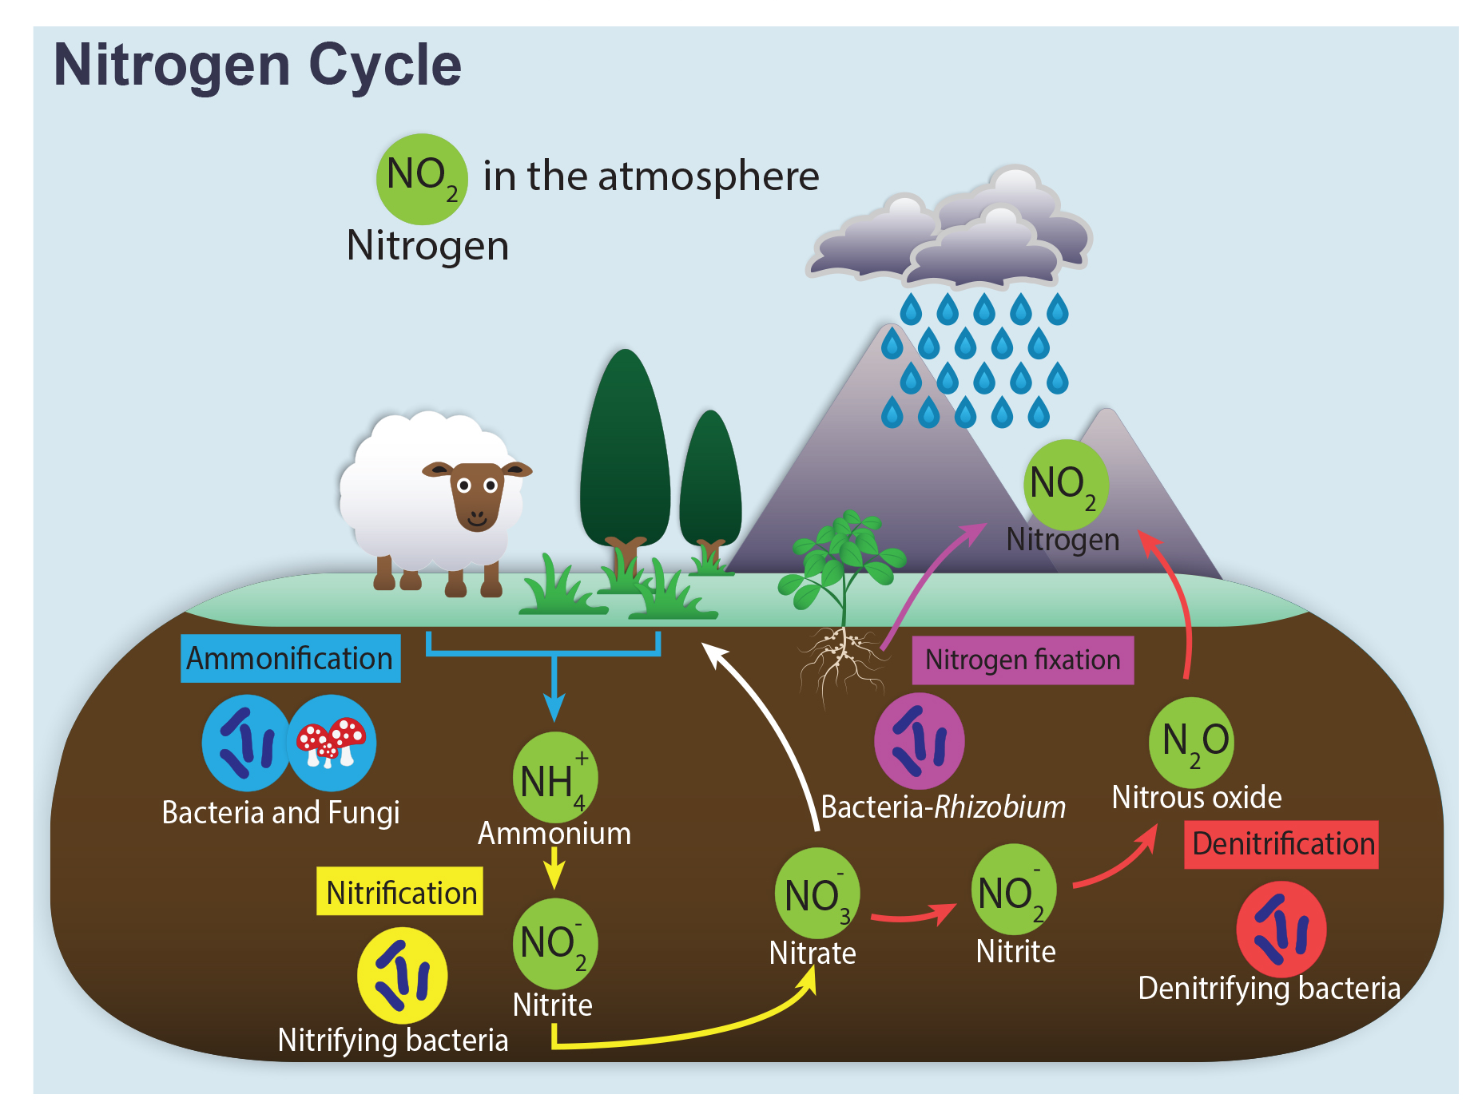
Lesson 22.3 Figure 3
Notes:
Figure 3: Prokaryotes play a key role in the nitrogen cycle.

Slide 18
Summary
Prokaryotes are classified by how they obtain their energy and carbon.
Prokaryotes are significant contributors to the carbon cycle at all levels but are significant primary producers and decomposers.
Prokaryotes are responsible for most nitrogen cycling processes such as nitrogen fixation, ammonification, and denitrification.

Slide 19


End of Hawkes Learning PowerPoint

