Slide 1
Lesson 22.4
Bacterial Disease in Humans

Slide 2
Objectives
  Describe the link between biofilms and foodborne diseases.
  Explain how overuse of antibiotics may be creating "super bugs."
  Explain the importance of MRSA with respect to the problems of antibiotic resistance.
  Identify bacterial diseases that caused historically important plagues and epidemics.

Slide 3
Bacterial Disease in Humans
Bacteria and other infectious agents which cause disease are called pathogens.
Pathogens can cause epidemics, defined as a disease that occurs in an unusually high number of people in a population at one time.
They can also cause pandemics, which is a widespread and usually worldwide epidemic.
Diseases which are always present in a population, usually at a low occurrence, is an endemic disease.

Slide 4
Group Activity
In groups of three, research and identify examples in recent history of an epidemic, a pandemic, and an endemic disease.

Slide 5
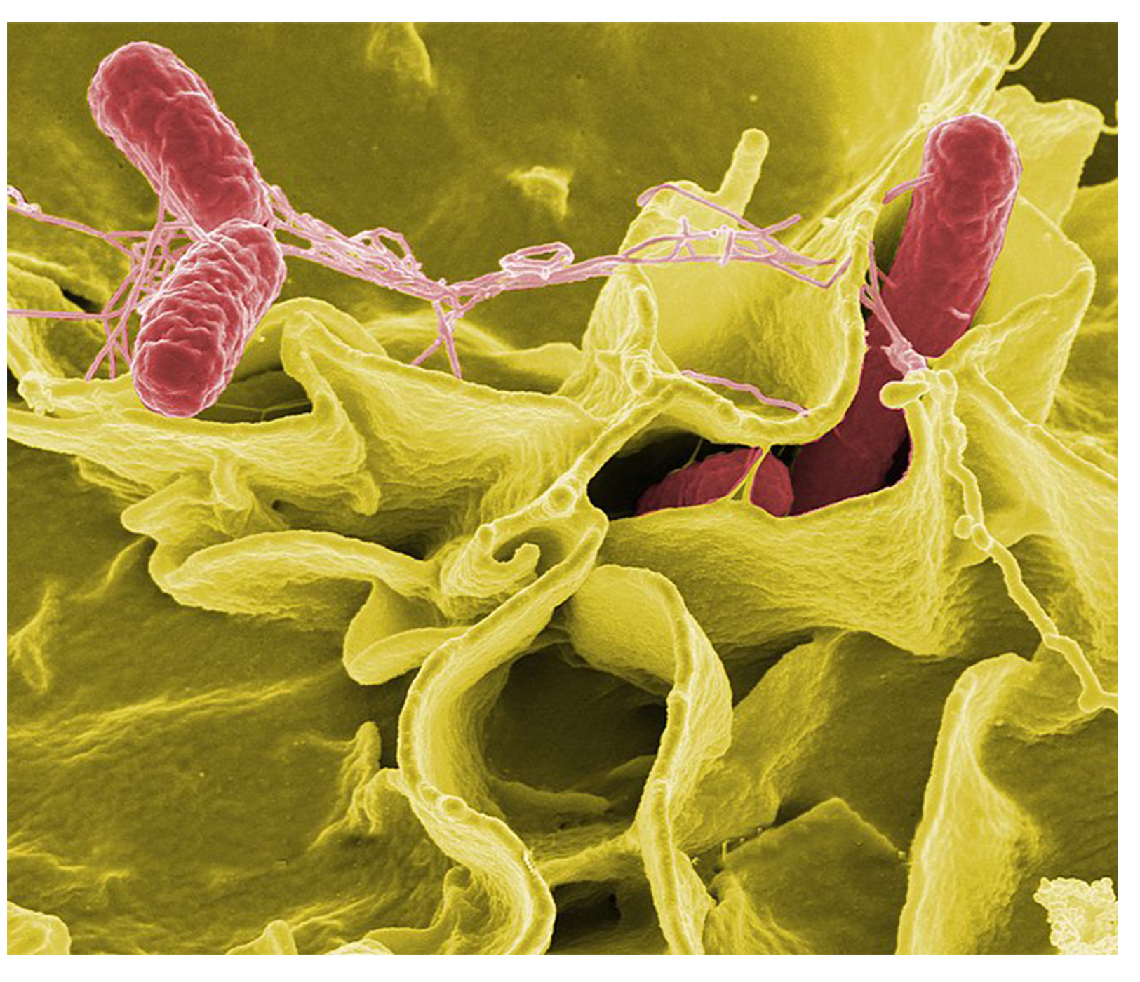
The plague of Athens
In 430 BCE, one quarter of the Athenian troops fighting in the Peloponnesian war were killed by the Plague of Athens.
Researchers recovered bacterial DNA from a mass grave and found Salmonella enterica, which causes typhoid fever.
22.4 Figure 1
NIAID on Wikimedia Commons. "Salmonella enterica serovar Typhi."
Notes:
Figure 1: Salmonella enterica serovar Typhi, the causative agent of typhoid fever, is a gram-negative, rod-shaped gammaproteobacterium. Typhoid fever, which is spread through feces, causes intestinal hemorrhage, high fever, delirium, and dehydration. Today, between 16 and 33 million cases of this re-emerging disease occur annually, resulting in over 200,000 deaths. What makes the disease even more dangerous is that carriers of the disease can be asymptomatic. In a famous case in the early 1900s, a cook named Mary Mallon ("Typhoid Mary") unknowingly spread the disease to over fifty people, three of whom died. Other serotypes, or strains, of Salmonella cause food poisoning.

Slide 6
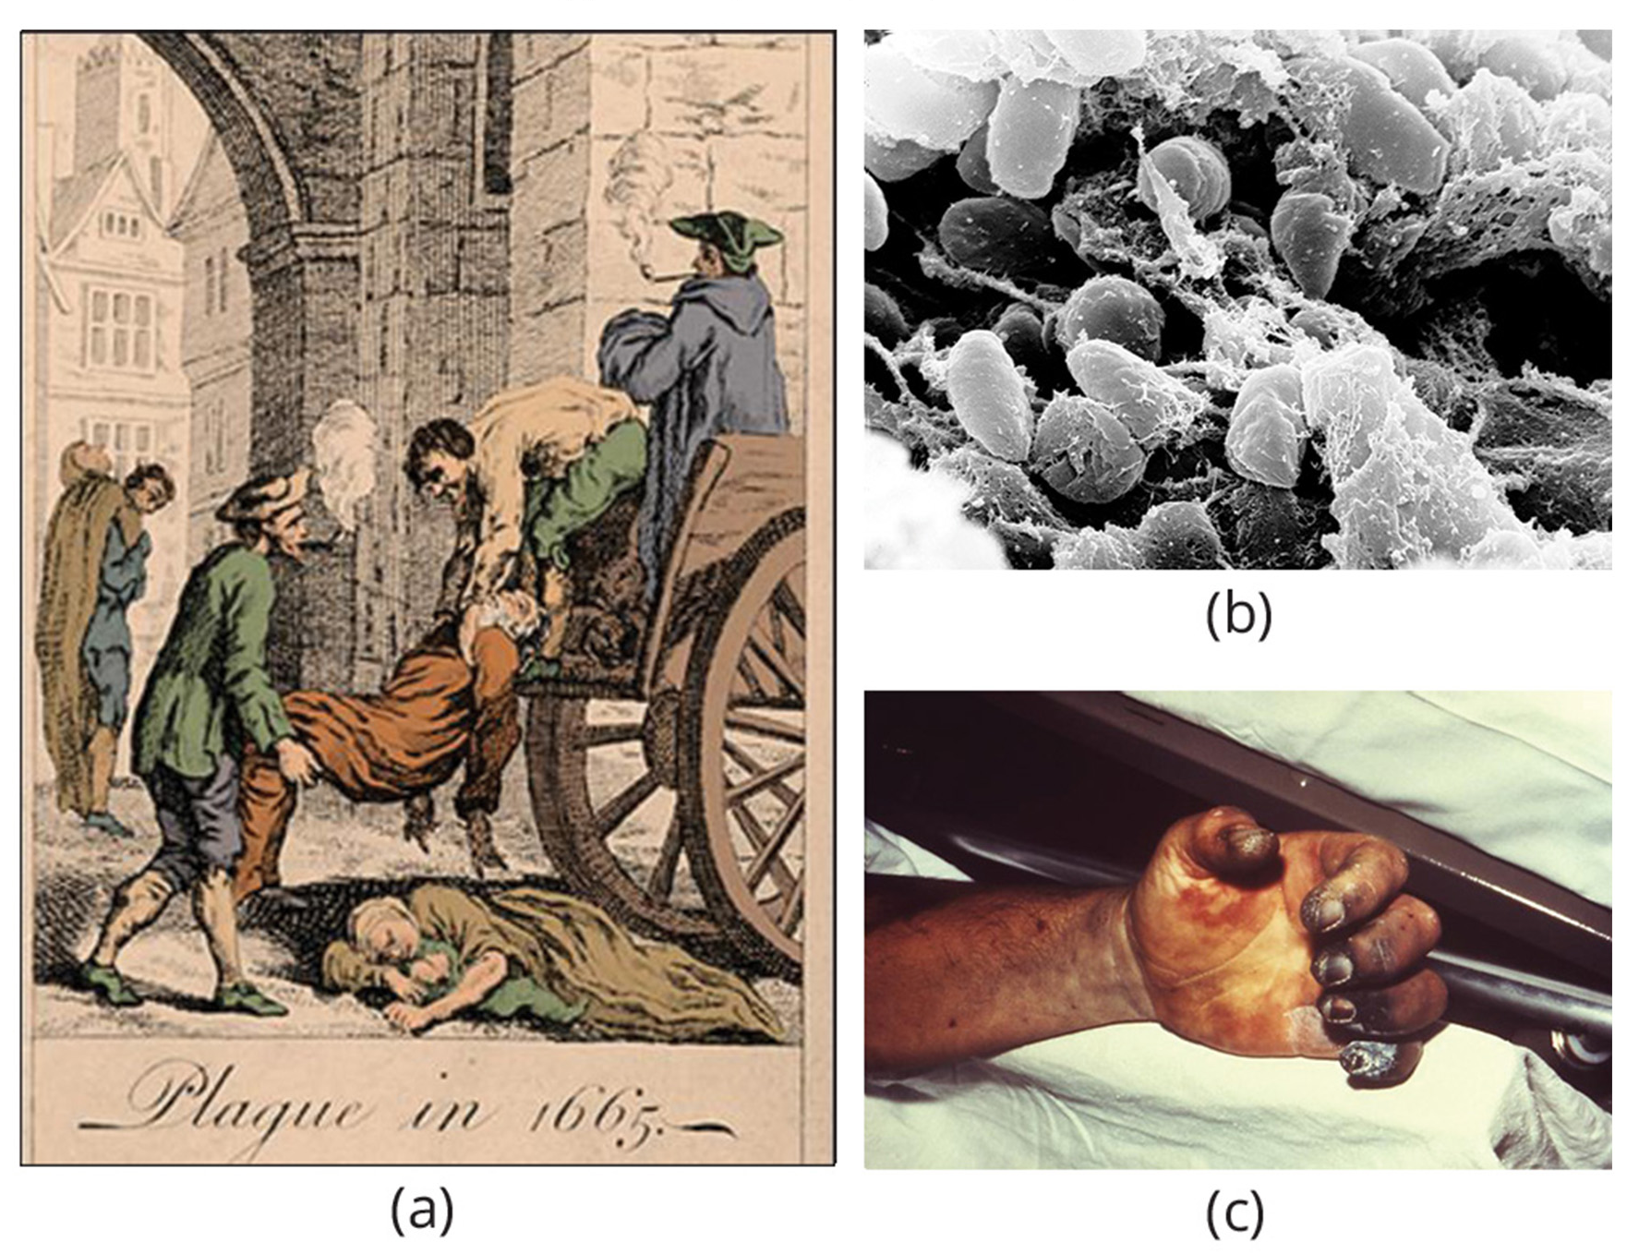
Bubonic Plague
Bubonic plague is caused by the bacterium Yersinia pestis.
Bubonic plague caused the Black Death ( 1346-1361) pandemic which stretched from China to the Mediterranean and Europe.
  A pneumonic form of the plague- spread by coughing and sneezing of infected individuals reduced the world population from 450 million to about 350-375 million.
Bubonic plague reappeared in London in the mid-1600’s.
22.4 Figure 2: (a) The Great Plague of London killed an estimated 200,000 people. The causative agent, the (b) bacterium Yersinia pestis, is a gram-negative, rod-shaped bacterium. Symptoms include swollen lymph nodes, fever, seizure, vomiting of blood, and (c) gangrene.
unknown on Wikimedia Commons. "Great Plague of London."
Rocky Mountain Laboratories, NIAID, NIH on Wikimedia Commons. "Yersinia pestis."
CDC on Wikimedia Commons. "Hand necrosis."
Notes:
Figure 2: (a) The Great Plague of London killed an estimated 200,000 people, or about 20% of the city's population. The causative agent, the (b) bacterium Yersinia pestis, is a gram-negative, rod-shaped bacterium from the class Gammaproteobacteria. The disease is transmitted through the bite of an infected flea, which is carried on a rodent. Symptoms include swollen lymph nodes, fever, seizure, vomiting of blood, and (c) gangrene.

Slide 7
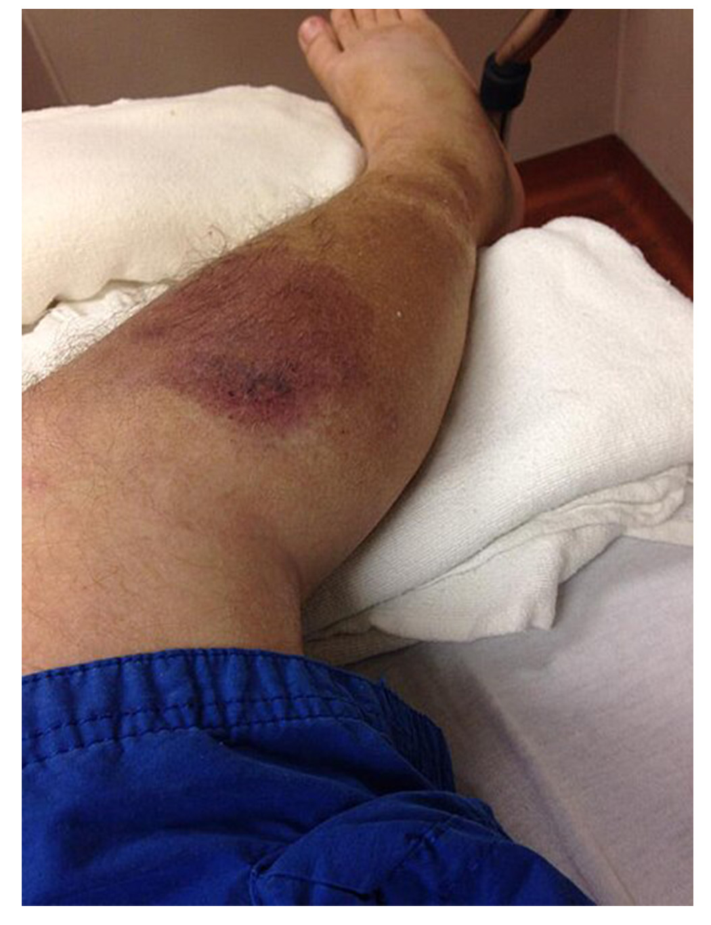
Emerging and Re-emerging Diseases
Changes in an environment, the pathogen or the host population can impact how a disease spreads.
An emerging disease is one which has appeared in a population for the first time or is rapidly increasing its incidence or geographic range.
75% of recent emerging diseases are zoonoses- which are diseases which primarily infect animals but can be transmitted to humans.
22.4 Figure 3: An individual exhibiting the early stages of necrotizing fasciitis.
Doetsch on Wikimedia Commons. "Necrotizing fasciitis."

Slide 8
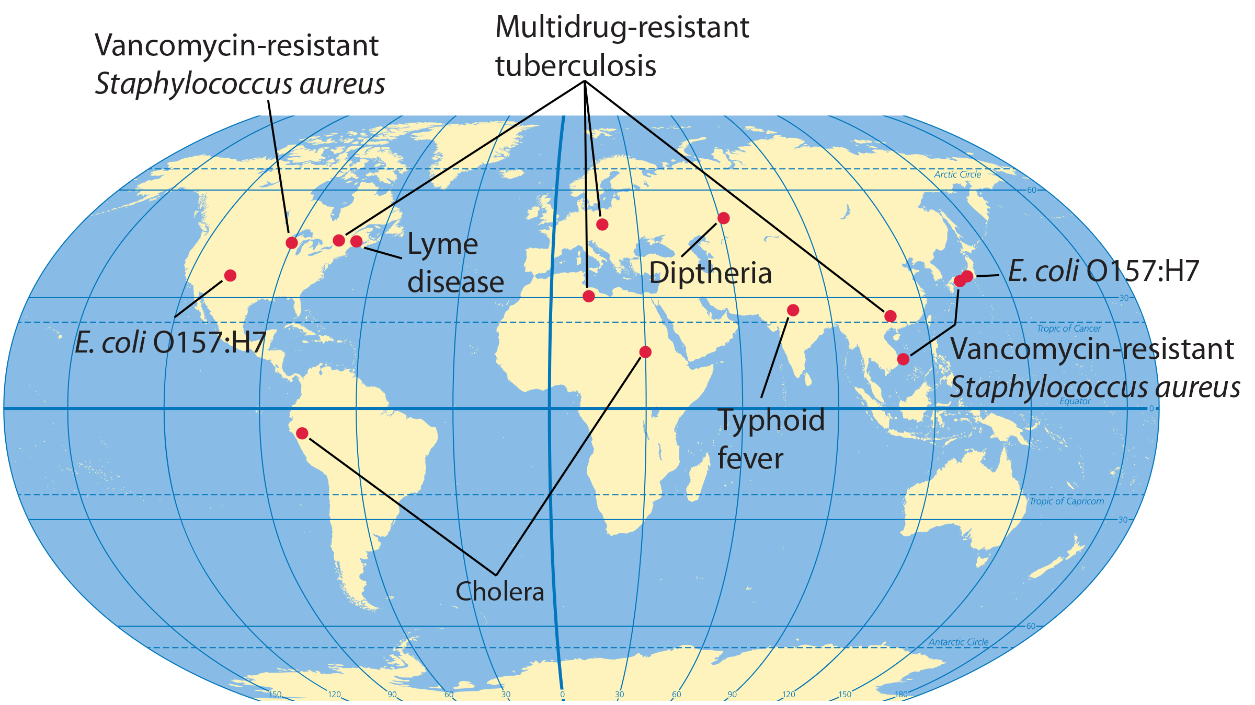
Lesson 22.4 Figure 4
NIH. "Emerging diseases."
Notes:
Figure 4: This map shows regions where bacterial diseases are emerging or re-emerging.

Slide 9
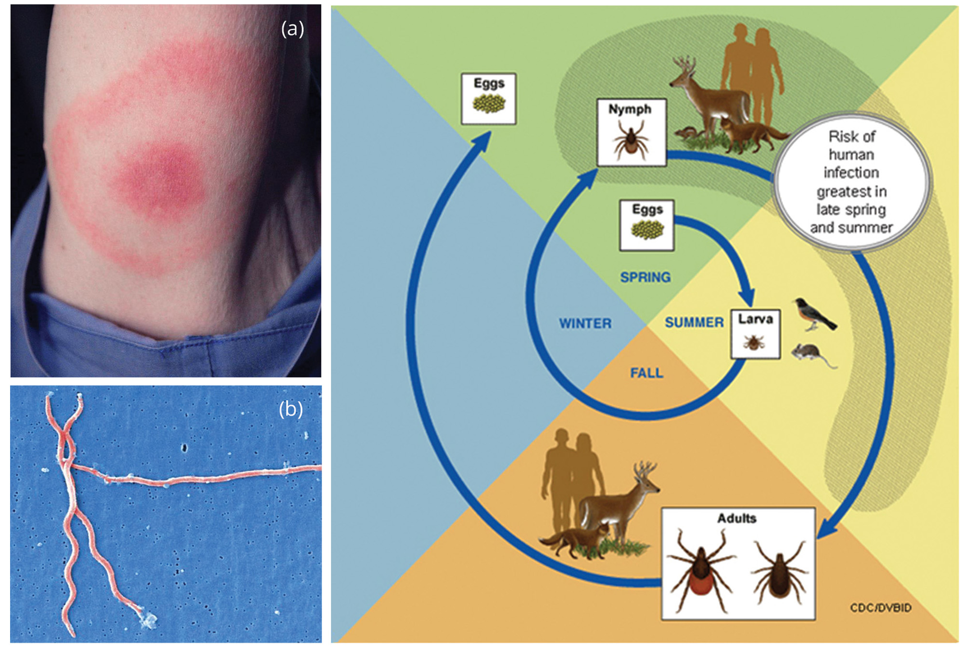
Lesson 22.4 Figure 5
CDC/James Gathany on Wikimedia Commons. "Bullseye rash."
CDC/Claudia Molins on Wikimedia Commons. "Lyme disease parasite."
CDC on Wikimedia Commons. "Lyme disease life cycle."
Notes:
Figure 5: Lyme disease often, but not always, results in (a) a characteristic bullseye rash. The disease is caused by a (b) gram-negative spirochete bacterium of the genus Borrelia. (c) The bacteria infect ticks, which in turn infect mice. Deer are the preferred secondary host, but the ticks also may feed on humans. Left untreated, the disease causes chronic disorders in the nervous system, eyes, joints, and heart. The disease is named after Lyme, Connecticut, where an outbreak occurred in 1995 and has subsequently spread. The disease is not new, however. Genetic evidence suggests that Ötzi the Iceman, a 5,300-year-old mummy found in the Alps, was infected with Borrelia.

Slide 10
Foodborne Diseases₁
A foodborne disease (food poisoning) is an illness resulting from consumption of pathogenic bacteria, viruses or other parasites that contaminated food.
Prokaryotes often contaminate food by colonizing food or food-processing equipment using a biofilm (a microbial community held together by a gummy-like matrix)
Botulism: a potentially fatal disease produced by a toxin from the bacterium Clostridium botulinum
  Commonly found in nonacidic canned foods, homemade pickles and processed meats which have not been properly canned or sterilized.

Slide 11
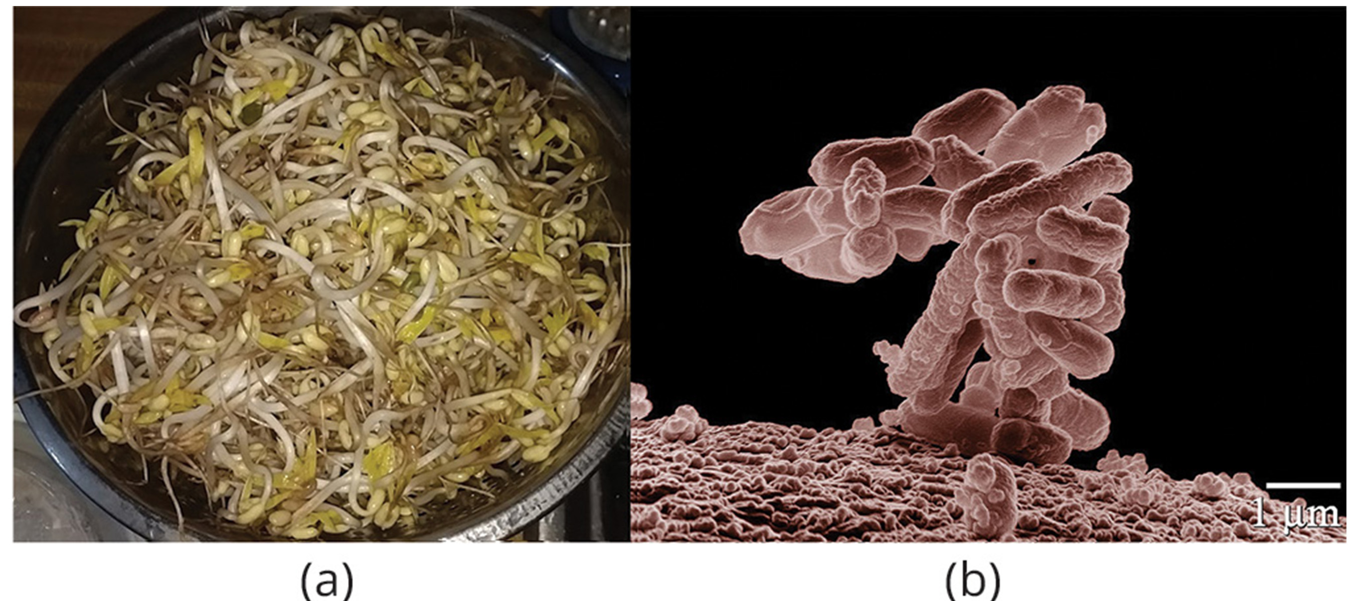
Foodborne Diseases₂
Most cases of foodborne illness now linked to produce.
Cases linked with E.coli serotype O157:H7 contaminating spinach.
A serotype is a strain of bacteria which carries a similar set of antigens on its cell surface.
Illnesses have also been linked to other bacteria such as Salmonella and Listeria.
22.4 Figure 6
Shui Lee on Wikimedia Commons. "Mung bean sprouts."
ARS Image Gallery on Wikimedia Commons. "E. coli bacteria."
Notes:
Figure 6: (a) Vegetable sprouts grown at an organic farm were the cause of an (b) E. coli outbreak that killed 32 people and sickened 3,800 in Germany in 2011. The strain responsible, E. coli O104:H4, produces Shiga toxin, a substance that inhibits protein synthesis in the host cell. The toxin destroys red blood cells, resulting in bloody diarrhea. Deformed red blood cells clog the capillaries of the kidney, which can lead to kidney failure, as happened to 845 patients in the 2011 outbreak. Kidney failure is usually reversible, but some patients experienced kidney problems years later.

Slide 12
Reflection Question
What are some actionable ways in which you and your family can prevent foodborne illnesses?
Notes:
The reflection question is included here to use as a talking point or for a think-pair-share activity.

Slide 13
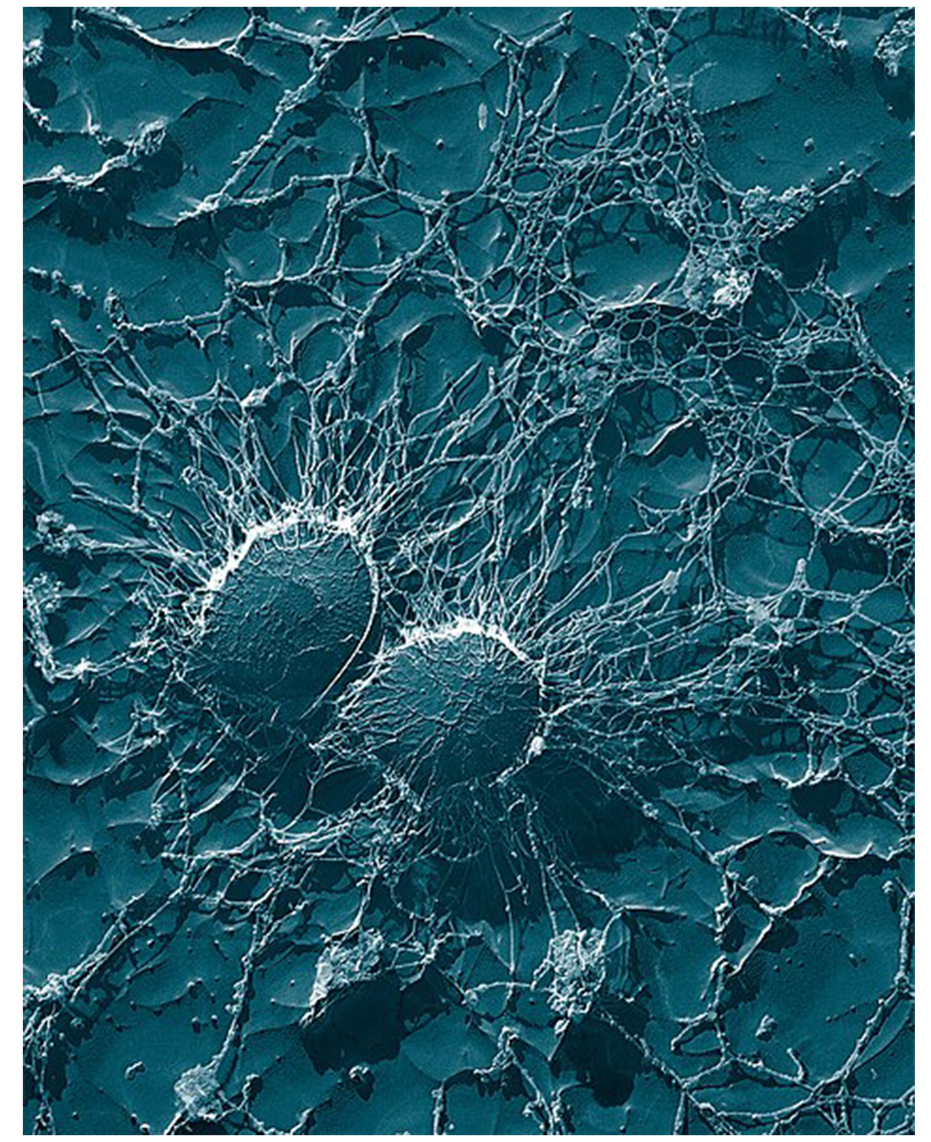
Biofilms and Disease
Biofilms grow on surfaces and are hard to destroy.
65% of nosocomial infections (infections acquired in the hospital) are caused by biofilms.
Biofilms colonize the surface of vegetables, meat and food processing equipment, leading to foodborne illness.
Biofilm infections are hard to treat and can be antibiotic resistant.
22.4 Figure 7: An S. aureus biofilm grows over a surface.
Eric Erbe, Christopher Pooley on Wikimedia Commons. "Staphylococcus aureus."

Slide 14
Antibiotic Resistance
An antibiotic is a chemical produced by microbes, or synthetically that prevents the growth of other organisms.
One major cause of antibiotic resistance is overexposure to antibiotics.
  A major misuse of antibiotics is attempting to use them to treat viral infections such as a cold or the flu.
  Antibiotics are also used heavily in livestock, with 70% of antibiotics produced in the US being fed to livestock.

Slide 15
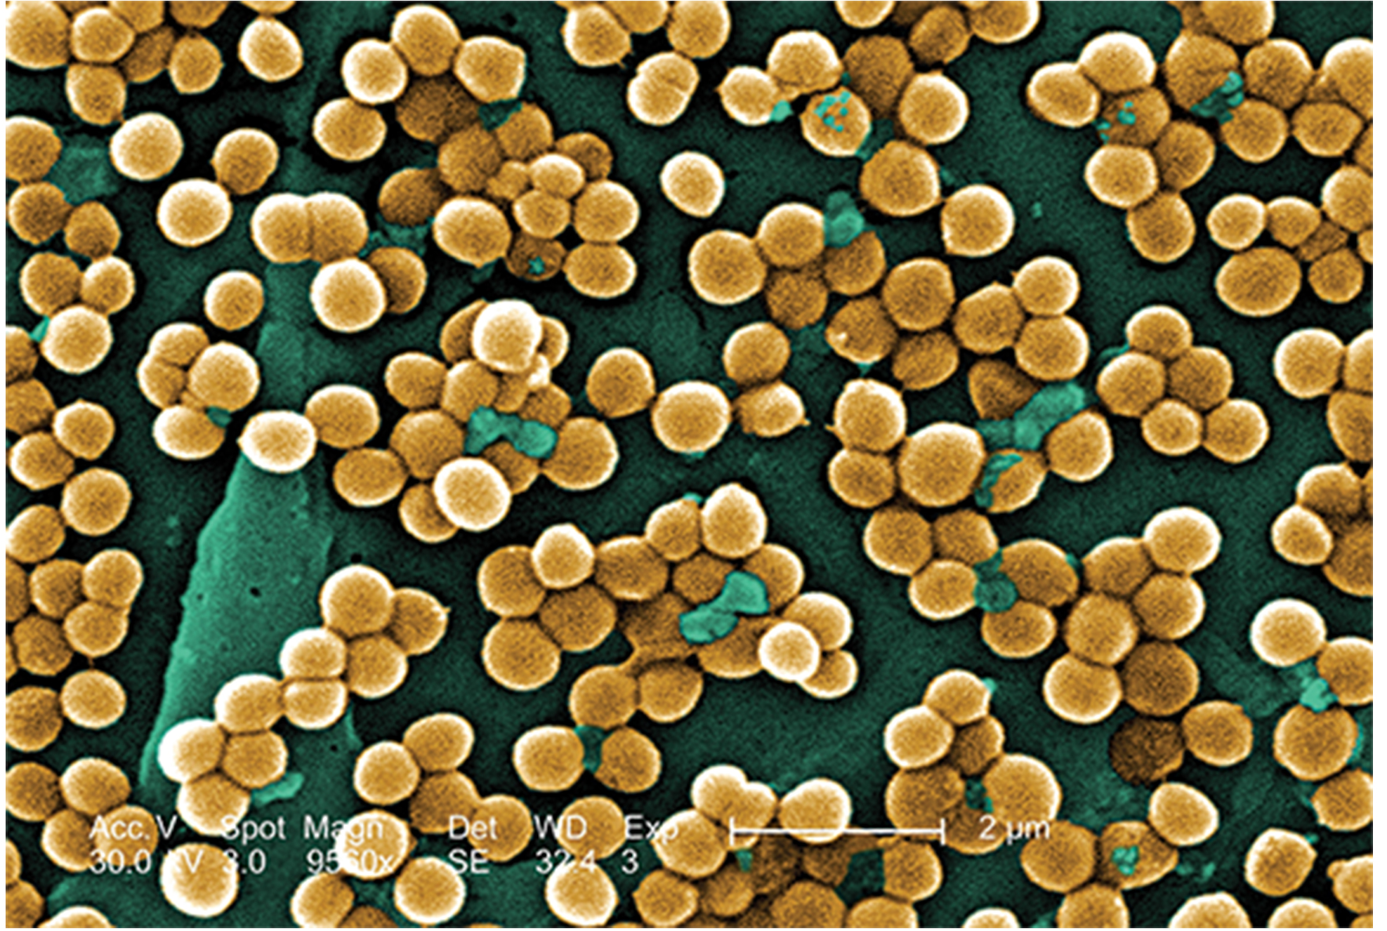
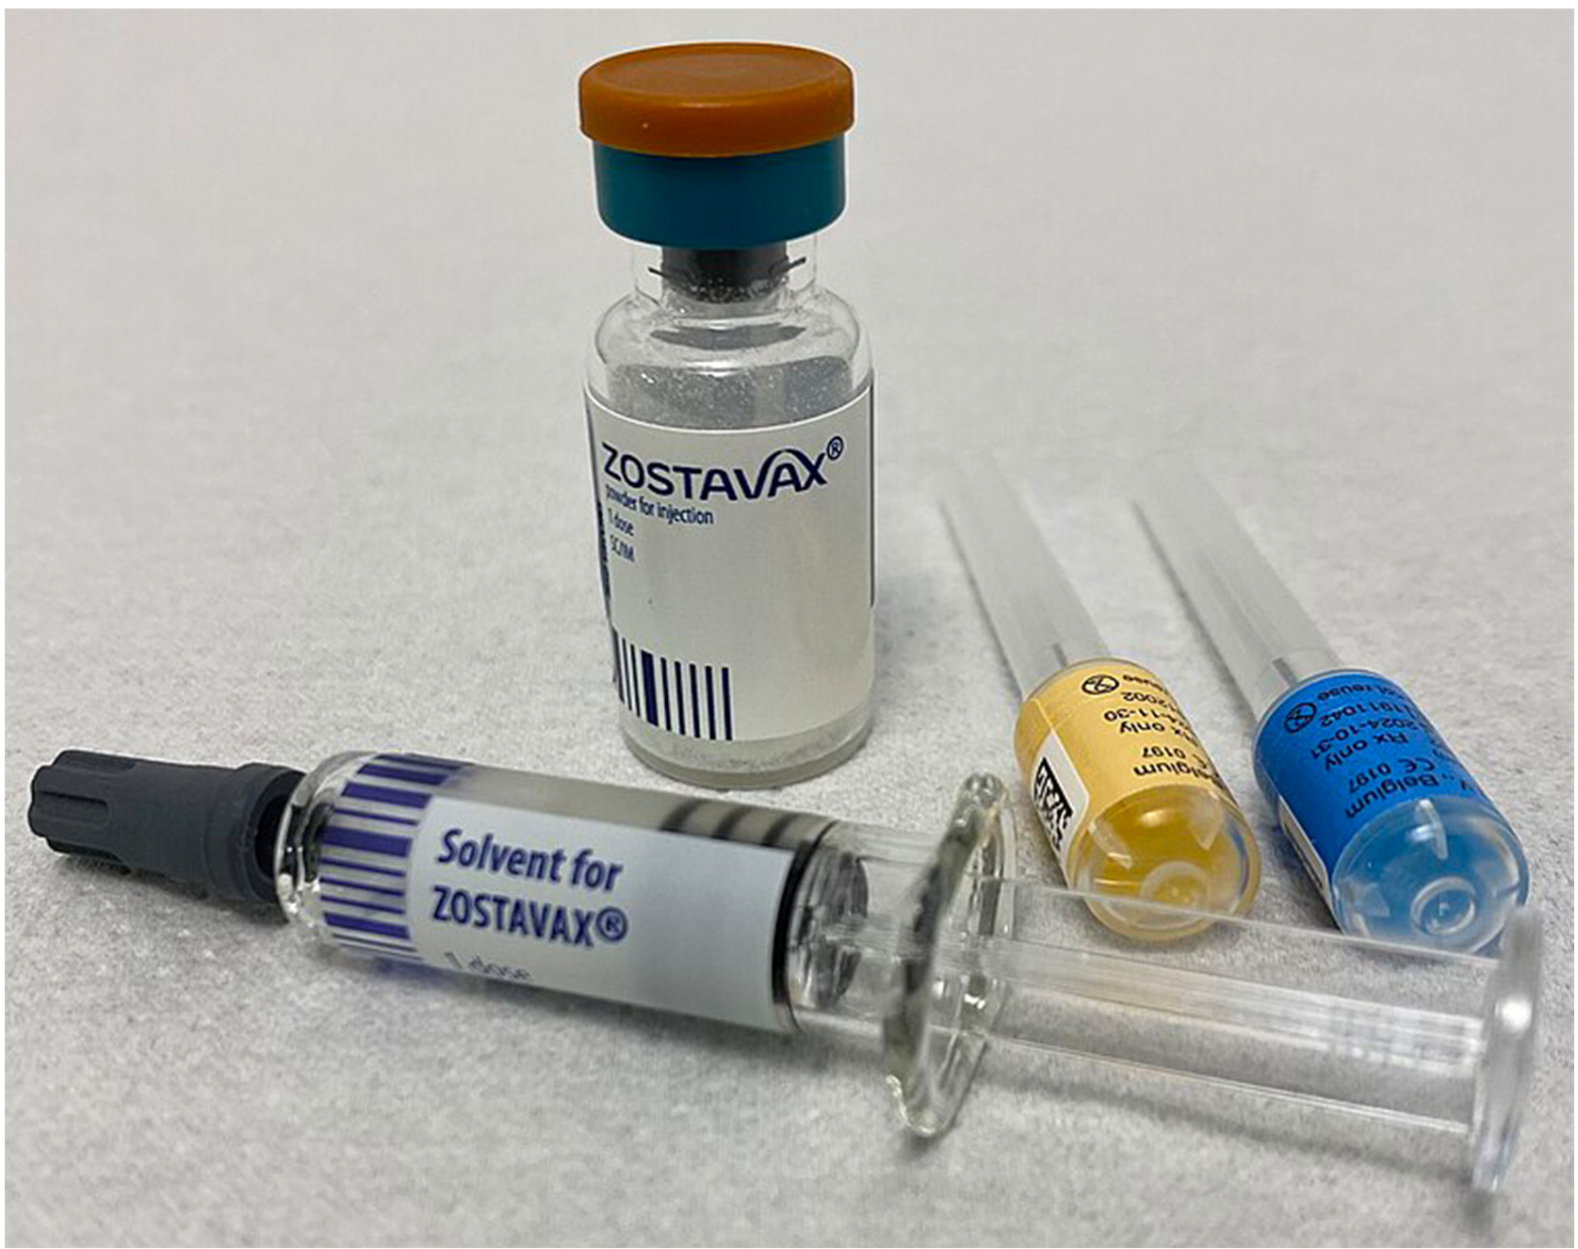
Methicillin-resistant Staphylococcus aureus (MRSA)
22.4 Figure 8
S. aureus is a common bacterium that lives on the human body.
The MRSA strain is resistant to many common antibiotics.
MRSA can cause skin infections and can infect the bloodstream, injury sites, the lungs and the urinary tract.
Janice Haney Carr, CDC on Wikimedia Commons. "Staphylococcus aureus."
22.4 Figure 9: Vaccinations can slow the spread of diseases, like this vaccine for shingles.
Whispyhistory on Wikimedia Commons. "Shingles vaccine."

Slide 16
Science and You
Career: Epidemiologist
Epidemiology is the study of the frequency and distribution of disease in the human population.
Epidemiologists collect data on diseases and their spread, sometimes by collaborating with historians and clinicians to gather historical or patient data.
This data is then used to develop strategies to reduce the reoccurrence of the disease.
Notes:
This is included as a relevant application for this topic.

Slide 17
Summary
Epidemics and pandemics (worldwide epidemics) are caused by pathogens.
The Bubonic Plague caused many epidemics throughout history.
Most emerging diseases being tracked are zoonoses, which are diseases which most infect animals but can be transmitted to humans.
Many foodborne illnesses and nosocomial infections are caused by biofilms.
The rise of antibiotic resistant bacteria is putting our ability to treat bacterial infections at risk.

Slide 18


End of Hawkes Learning PowerPoint

