Slide 1
Lesson 22.5
Beneficial Bacteria

Slide 2
Objectives
  Describe the beneficial effects of bacteria that colonize our skin and digestive tracts.
  Describe the use of prokaryotes in bioremediation.
  Explain the need for nitrogen fixation and how it is accomplished.
  Identify prokaryotes used during the processing of food.

Slide 3
Nitrogen Fixation₁
Biological nitrogen fixation (BNF) (converting N₂ to NH₃) is exclusively carried out by prokaryotes.
N₂ + 16 ATP+ 8e⁻ + 8H⁺ → 2NH₃ + 16ADP + 16P_{i} + H₂
Cyanobacteria are the most important nitrogen fixers in the aquatic environment.
Soil bacteria called rhizobia live as symbionts with legume plants and form nodules(specialized structures where nitrogen fixation occurs).

Slide 4
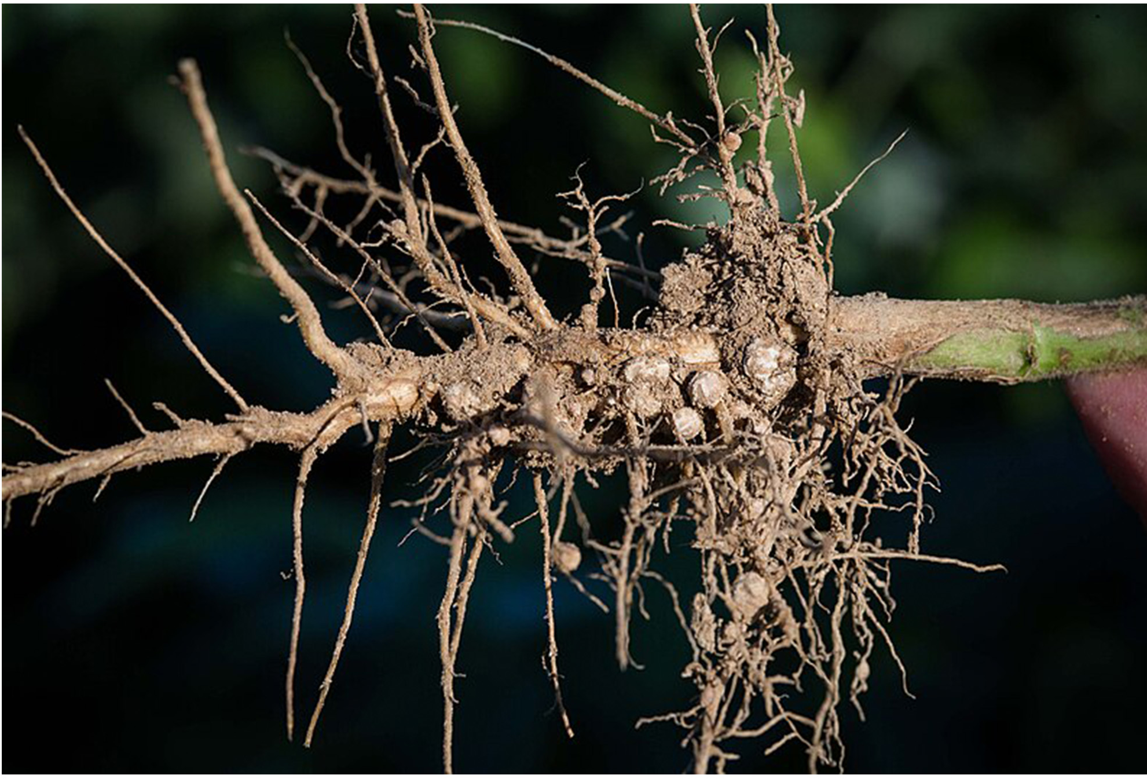
Nitrogen Fixation₂
Nodules create the oxygen-free area required for nitrogen fixation. Nitrogenase, the enzyme that fixes nitrogen, can be inactivated by oxygen.
Symbiotic nitrogen fixation by using soil rhizobia to fix nitrogen is an excellent alternative to chemical fertilizers. The bacteria benefit due to their connection with the legumes, the legumes are protected in the fields and soil gets fertilized.
22.5 Figure 1
United Soybean Board on Wikimedia Commons. "Roots with nodes."

Slide 5
Reflection Question
What would happen to plants if there were no nitrogen-fixing bacteria to return nitrogen to the soil?
Notes:
The reflection question is included here to use as a talking point or for a think-pair-share activity.

Slide 6
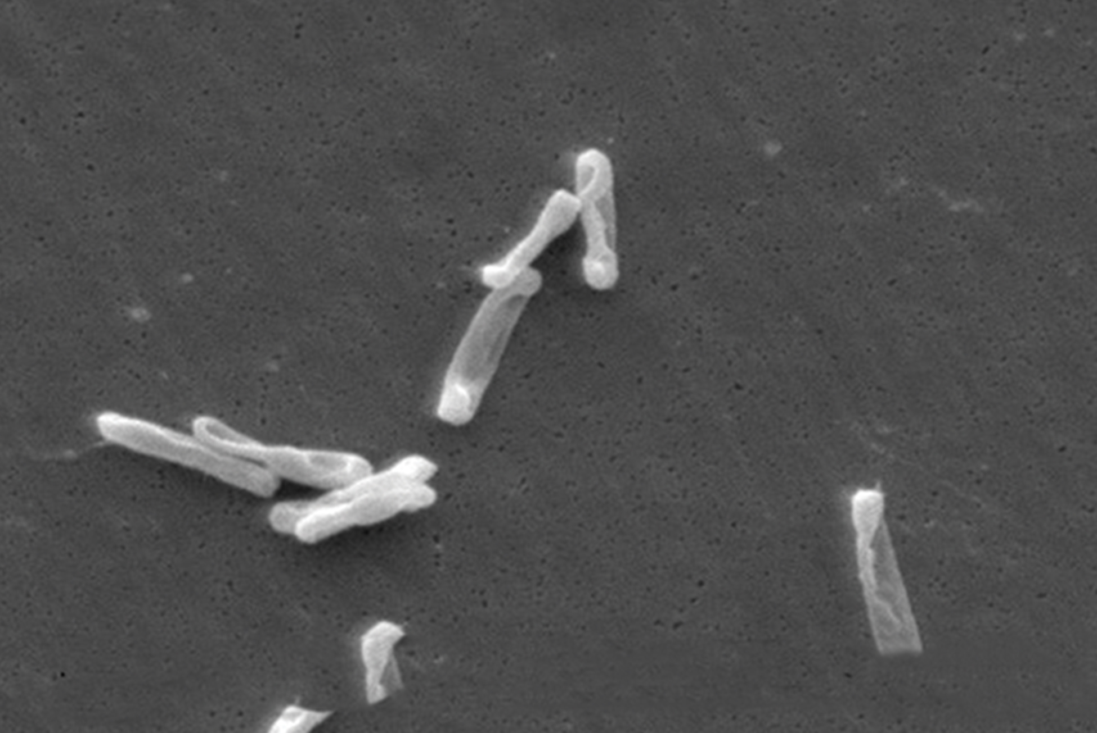
Science and You
Microbes on the Human Body
Commensal bacteria live on our skin and in our gut. They protect us from pathogens and produce some of our vitamins and nutrients.
Some people who have lost their normal gut bacteria can acquire a Clostridium difficile infection. Fecal transplants designed to re-establish normal gut bacteria are being tested as a treatment.
Scientists are discovering that the absence of key microbes in our intestinal tract may lead to a variety of problems.
22.5 Figure 2
CDC on Wikimedia Commons. "Clostridium difficile bacteria."
Notes:
This is included as a relevant application for this topic.

Slide 7
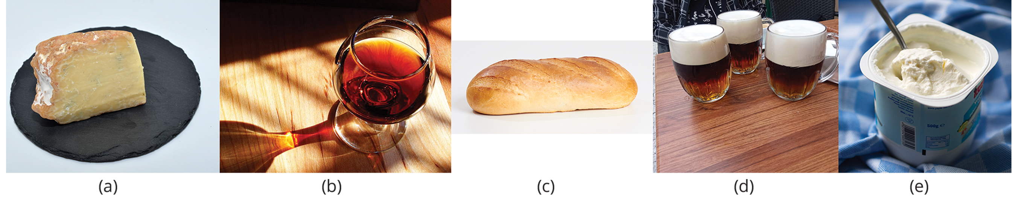
Early Biotechnology
According to the United Nations Convention on Biological Diversity (2006), biotechnology is "any technological application that uses biological systems, living organisms, or derivatives thereof, to make or modify products or processes for specific use."
Humans were using microbes to modified food products and create longer lasting products. The use of microbes to brew beer has been around for about 6,000 years.
22.5 Figure 3: Some of the products derived from the use of prokaryotes in early biotechnology include (a) cheese, (b) wine, (c) bread, (d) beer, and (e) yogurt.
Yann Forget on Wikimedia Commons. "Swiss cheese."
Jon Sullivan on Wikimedia Commons. "Port wine."
Dmitry Makeev on Wikimedia Commons. "Wheat bread."
Notes:
Figure 3: Some of the products derived from the use of prokaryotes in early biotechnology include (a) cheese, (b) wine, (c) bread, (d) beer, and (e) yogurt.

Slide 8
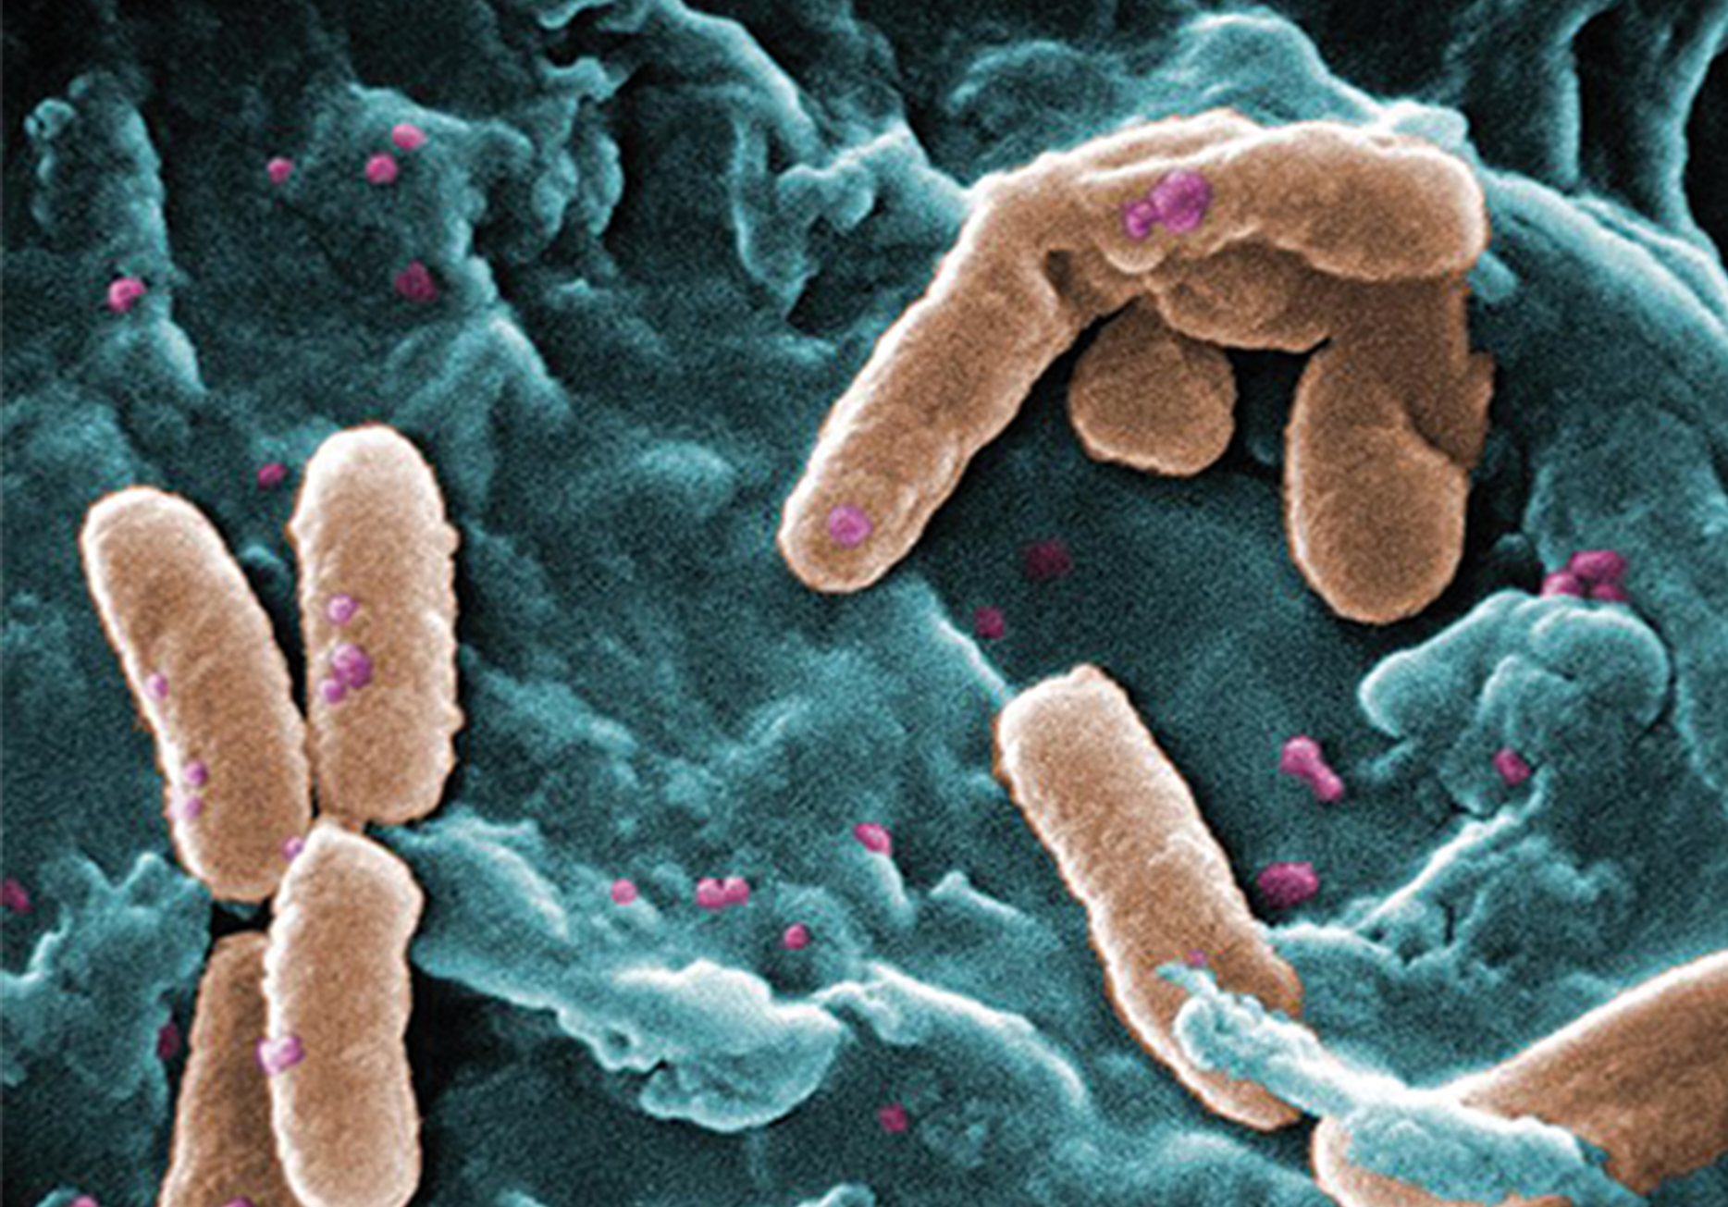
Bioremediation₁
Microbial bioremediation is the use of prokaryotes to remove pollutants.
Bioremediation has been used to remove agricultural chemicals, toxic metals and oxides from water and for the cleanup of oil spills.
22.5 Figure 4: Pseudomonas aeruginosa is an example of a bacteria that has been used for bioremediation.
Janice Haney Carr, CDC on Wikimedia Commons. "Pseudomonas."

Slide 9
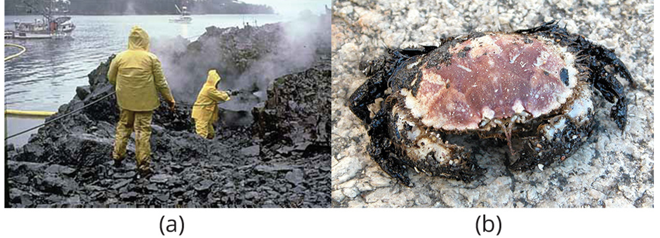
Bioremediation₂
Some hydrocarbon-degrading bacteria feed on hydrocarbons in the oil droplet, breaking down the hydrocarbons into smaller subunits.
Under ideal conditions, 80% of the nonvolatile components in oil can be degraded within one year of the spill.
22.5 Figure 5: (a) Cleaning up oil after the Exxon Valdez spill in Alaska, workers hosed oil from beaches and then used a floating boom to corral the oil, and then skim it from the water surface. (b) One of the consequences of oil spills is the damage to fauna.
NOAA on Wikimedia Commons. "Oil cleanup."
Adela Leiro/Panoramio on Wikimedia Commons. "Oil spill damage to fauna."

Slide 10
Think It Through
Certain bacteria called Deinococcus radiodurans have been found growing in areas with high levels of radioactivity, such as at the Chernobyl power plant.
Can you think of a bioremediation application for these bacteria?
Notes:
Originally an On Your Own. This is included here to use as a talking point or for a think-pair-share activity.

Slide 11
Summary
All biological nitrogen fixation is carried out by prokaryotes, cyanobacteria in aquatic environments and soil rhizobia in terrestrial environments.
Commensal bacteria help protect our intestinal tract and help us digest our food.
Bacteria can be used in bioremediation to clean up agricultural chemicals, toxic waste and oil spills.

Slide 12


End of Hawkes Learning PowerPoint

