Slide 1
Lesson 23.1
Eukaryotic Origins

Slide 2
Objectives
Explain the endosymbiotic theory.
List the unifying characteristics of eukaryotes.

Slide 3
Protists
Protists are a diverse group of eukaryotic microorganisms, not classified as animals, plants, or fungi
Mostly microscopic, unicellular organisms found in a variety of environments
Examples: soil, freshwater, brackish, marine environments, and animal digestive tracts
Can be macroscopic, like giant amoebae or seaweeds, and a few are multicellular
23.1 Figure 1: Protists range from the microscopic, single-celled (a) Acanthocystis turfacea and the (b) ciliate Tetrahymena thermophila, to the enormous, multicellular (c) kelps (Chromalveolata).
James L. Van Etten, Irina V. Agarkova, David D. Dunigan on Wikimedia Commons. "Acanthocystis turfacea."
Picturepest on Wikimedia Commons. "Tetrahymena pyriformis."
NOAA's National Ocean Service on Wikimedia Commons. "Kelp forest."

Slide 4
Eukaryotic Origins
Eukaryotes (domain Eukarya) evolved from a common ancestor, distinct from Archaea and Bacteria.
Earliest eukaryote fossils date back to around 2.1 billion years ago.
Most living eukaryotes have cells measuring 10 μm or greater.

Slide 5
Characteristics of Eukaryotes
Characteristics must have been present in the last common ancestor for eukaryotes.
Cells with nuclei surrounded by a nuclear envelope with nuclear pores
Mitochondria
Cytoskeleton of microtubules and microfilaments
Flagella and cilia
Chromosomes organized by histones
Mitosis
Sexual reproduction
Cell walls

Slide 6
Reflection Question
There are several characteristics in this list that are not always present with all eukaryotes, but it is concluded that their ancestors did have them. Why do you think some eukaryotes no longer exhibit some of these characteristics?
Notes:
The reflection question is included here to use as a talking point or for a think-pair-share activity.

Slide 7
Endosymbiosis and the Evolution of Eukaryotes
Eukaryotes likely evolved from a chimera-like organism that was a composite of a host cell and an engulfed alphaproteobacterium.
Endosymbiotic theory: one cell engulfing another such that the engulfed cell survives and both cells benefit
Proposes mitochondria evolved from the alphaproteobacterial endosymbiont

Slide 8
Prokaryotic Metabolism
Many important metabolic processes arose in prokaryotes, but nitrogen fixation is absent in eukaryotes.
Aerobic respiration, localized in mitochondria, is found across eukaryotes but not in all prokaryotes, suggesting anaerobic ancestors.
Early Earth lacked oxygen, so living things relied on anaerobic respiration and fermentation until some prokaryotes evolved photosynthesis.
Photosynthetic oxygen levels rose leading to the evolution of aerobic respiration in many prokaryotes, including alphaproteobacteria.
The first eukaryote fossils date to ~2 billion years ago, around when oxygen levels increased, and all modern eukaryotes descended from an ancestor with mitochondria.
Early microscopists observed the worm-shaped, motile mitochondria within cells and thought they might be bacteria.

Slide 9
Endosymbiotic Theory
As cell biology advanced, it became clear that mitochondria were responsible for ATP production via aerobic respiration.
In the 1960s, Lynn Margulis proposed the endosymbiotic theory, which states eukaryotes evolved from one cell engulfing and coevolving with another.
The metabolic organelles and genes of eukaryotes appear to have bacterial origins, while nuclear genes and machinery are more similar to Archaea.
It remains unclear whether the mitochondrial endosymbiosis occurred before or after the host cell had a nucleus, indicating potential extinct precursors to the last common eukaryotic ancestor.

Slide 10
Mitochondria₁
Mitochondria, present in virtually all eukaryotic cells, are the "powerhouses" that enable aerobic respiration and ATP production.
Mitochondria share several features with alphaproteobacteria, suggesting an endosymbiotic bacterial origin:
Own circular genome distinct from the nuclear genome
Prokaryotic-like protein synthesis machinery (ribosomes, tRNAs)
Genetic code variations from the host eukaryotic cell
Some mitochondrial genes have been transferred to the host nuclear genome over time

Slide 11
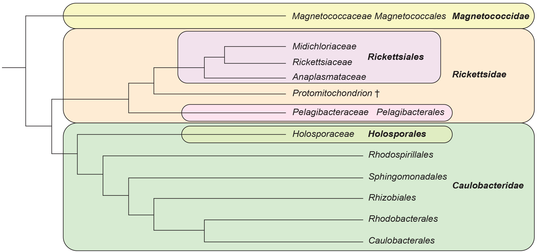
23.1 Figure 2
PLOS. "Alphaproteobacteria family."
Notes:
Figure 2: Members of the alphaproteobacteria family are likely candidates for the protomitochondrion, the original bacteria engulfed during the initial endosymbioses. In this analysis based on the homology of ribosomal RNA, the protomitochondrion is identified as a member of the Rickettsia group of alphaproteobacteria.

Slide 12
Mitochondria₂
Mitochondrial reproduction further supports an endosymbiotic origin:
Has a double membrane, as if a membrane-bound organism was engulfed
Divide independently via a process similar to binary fission in prokaryotes
Only arise from pre-existing mitochondria.
Reproduce within the eukaryotic cell, but their reproduction is synchronized with the host cell

Slide 13
Think It Through₁
Explain why the process of binary fission supports the endosymbiotic theory.
Notes:
Originally an On Your Own. This is included here to use as a talking point or for a think-pair-share activity.

Slide 14
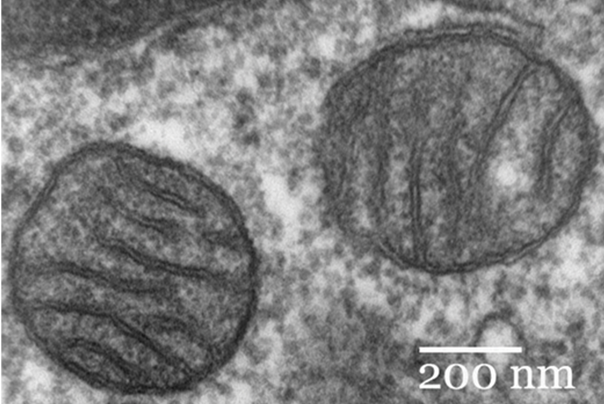
Mitochondria₃
Mitochondria are crucial for aerobic respiration, but some eukaryotes are anaerobic and lack recognizable mitochondria.
Previously, believed these eukaryotes descended from lineages without mitochondria before endosymbiosis.
Recent findings indicate most anaerobic eukaryotes possess reduced organelles, with some genes of mitochondrial origin in their nuclei.
Exceptional cases like Monocercomonoides lack mitochondria, representing possible endpoints in mitochondrial reduction.
23.1 Figure 3
Louisa Howard on Wikimedia Commons. "Mammalian lung tissue."

Slide 15
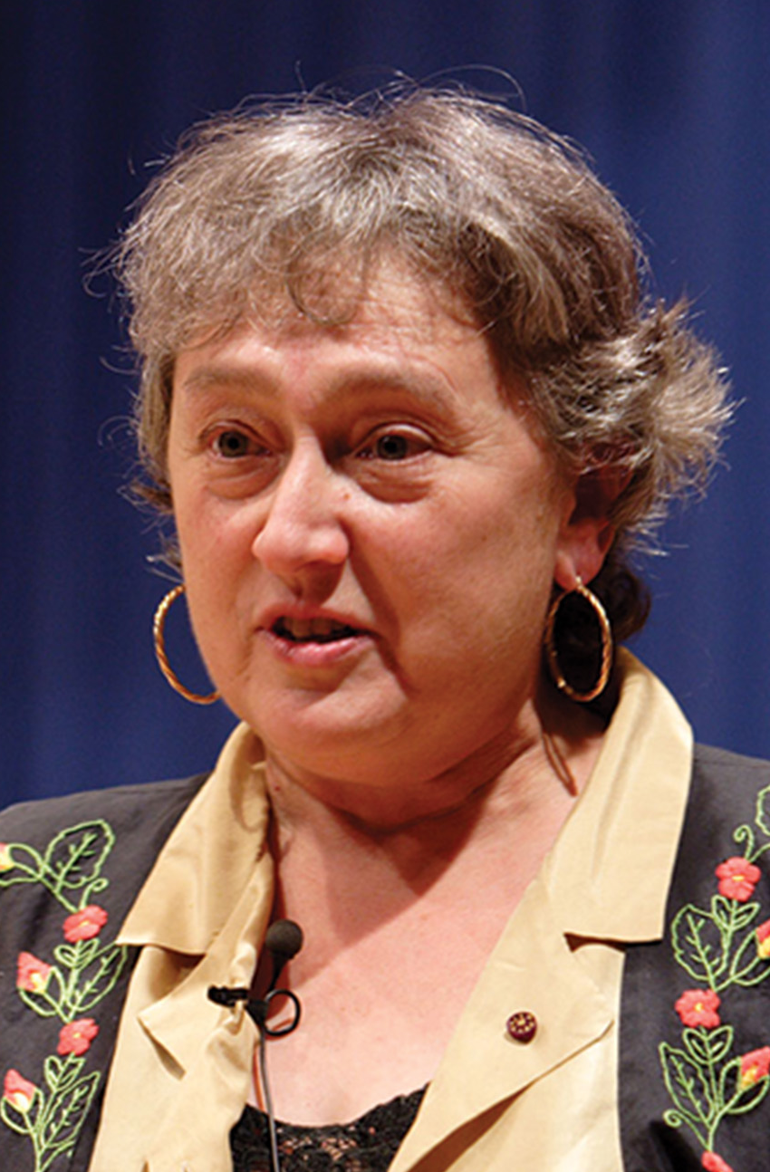
Plastids₁
Plastids are one of a group of related organelles in plant cells that are involved in the storage of starches, fats, proteins, and pigments.
Photosynthetic plastids are called chloroplasts.
Plastids, like mitochondria, likely originated from endosymbiotic events, championed by Lynn Margulis.
Evidence indicates that cyanobacterial endosymbionts were acquired twice in eukaryotic history.
Majority of photosynthetic eukaryotes trace their lineage to the first endosymbiotic event, while a minority are derived from the second event
23.1 Figure 5: Lynn Margulis
Jpedreira on Wikimedia Commons. "Lynn Margulis."

Slide 16
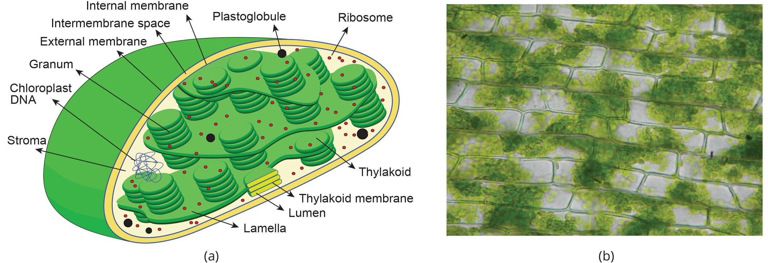
23.1 Figure 4
Miguelsierra on Wikimedia Commons. "Chloroplast scheme."
Juan Carlos Fonseca Mata on Wikimedia Commons. "Chloroplasts."
Notes:
Figure 4: (a) This chloroplast cross section illustrates its elaborate inner membrane organization. Stacks of thylakoid membranes compartmentalize photosynthetic enzymes and provide scaffolding for chloroplast DNA. (b) In this micrograph of Elodea sp., the chloroplasts can be seen as small, green spheres.

Slide 17
Plastids₂
Cyanobacteria possess unique internal membrane-bound sacs called thylakoids, containing chlorophyll and proteins for photosynthesis, along with typical gram-negative bacterial structures.
Chloroplasts from primary endosymbiosis share characteristics with cyanobacteria, including:
Thylakoids
Circular DNA
Ribosomes
Are enclosed by two membranes

Slide 18
Plastids₃
Chloroplasts parallel mitochondrial characteristics:
Gene transfer from endosymbionts to the nucleus
Plastids' inability to survive independently
Replication
The endosymbiotic event leading to Archaeplastida likely occurred 1 to 1.5 billion years ago, significantly later than the appearance of eukaryotes.

Slide 19
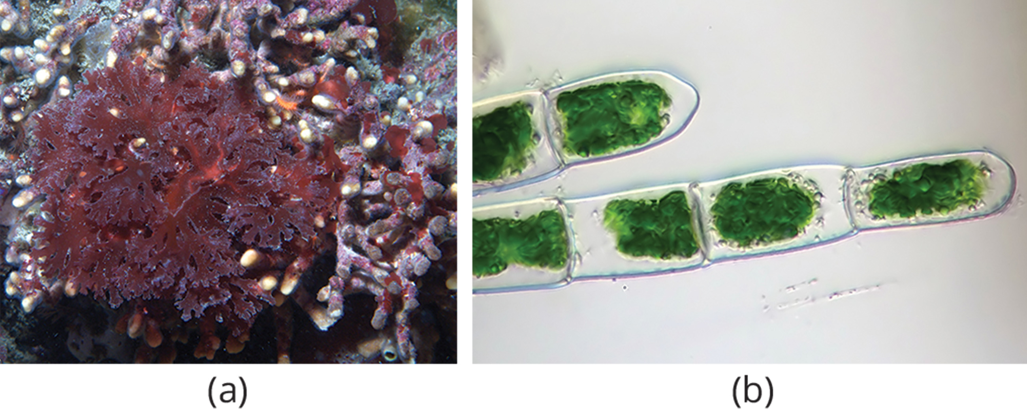
Plastids₄
Secondary endosymbiosis, involving the uptake of green or red algae by various algal groups, results in plastids with three or more membranes, often with nucleomorph remnants, suggesting complex evolutionary histories and higher-order endosymbiotic events in some cases.
23.1 Figure 6: (a) Red algae and (b) green algae share similar DNA sequences with photosynthetic cyanobacteria.
Ed Bierman on Wikimedia Commons. "Red algae."
Micropix on Wikimedia Commons. "Green algae."

Slide 20
Group Activity
In groups of three or four, create a 3-D model of a chloroplast and a 3-D model of a cyanobacteria. You can use any materials that are available to you. Label each structure. As a class, discuss how the models are similar or different.

Slide 21
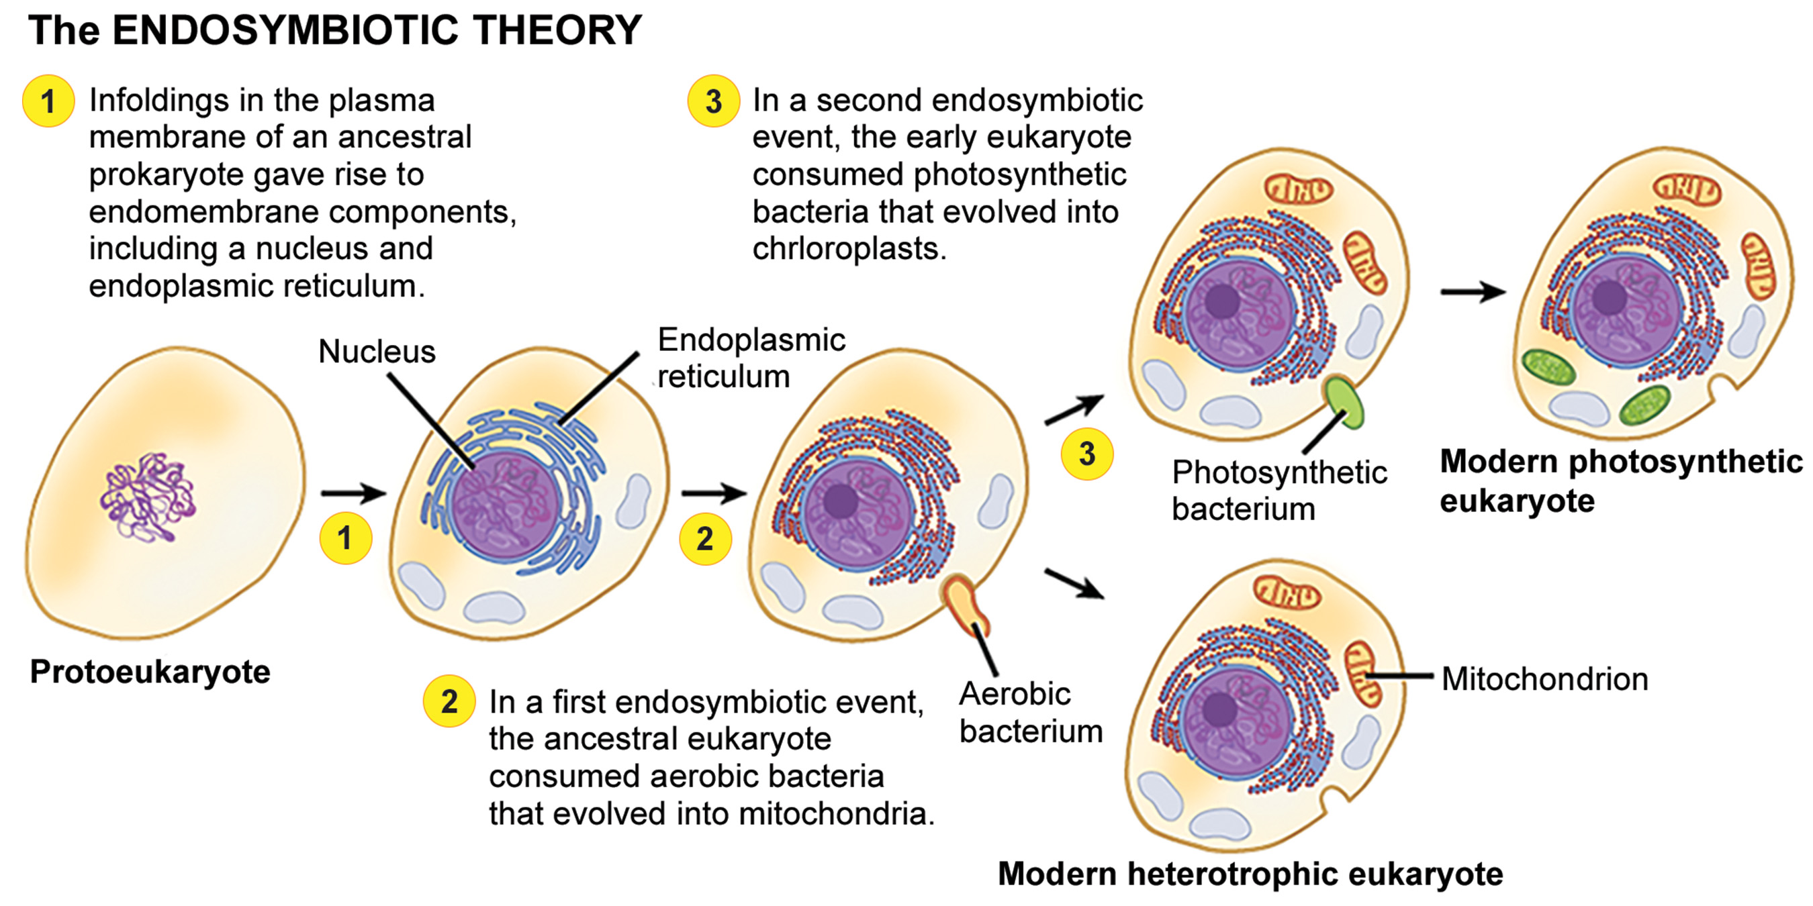
23.1 Figure 7
Phil Schatz on Wikimedia Commons. "Endosymbiotic theory." Modified.
Notes:
Figure 7: The first eukaryote may have originated from an ancestral prokaryote that had undergone membrane proliferation (growth), compartmentalization of cellular function (into a nucleus, lysosomes, and an endoplasmic reticulum), and the establishment of endosymbiotic relationships with an aerobic prokaryote (and in some cases, a photosynthetic prokaryote) to form mitochondria and chloroplasts, respectively.

Slide 22
Think It Through₂
What evidence is there that mitochondria were incorporated into the ancestral eukaryotic cell before chloroplasts?
Notes:
Originally an On Your Own. This is included here to use as a talking point or for a think-pair-share activity.

Slide 23
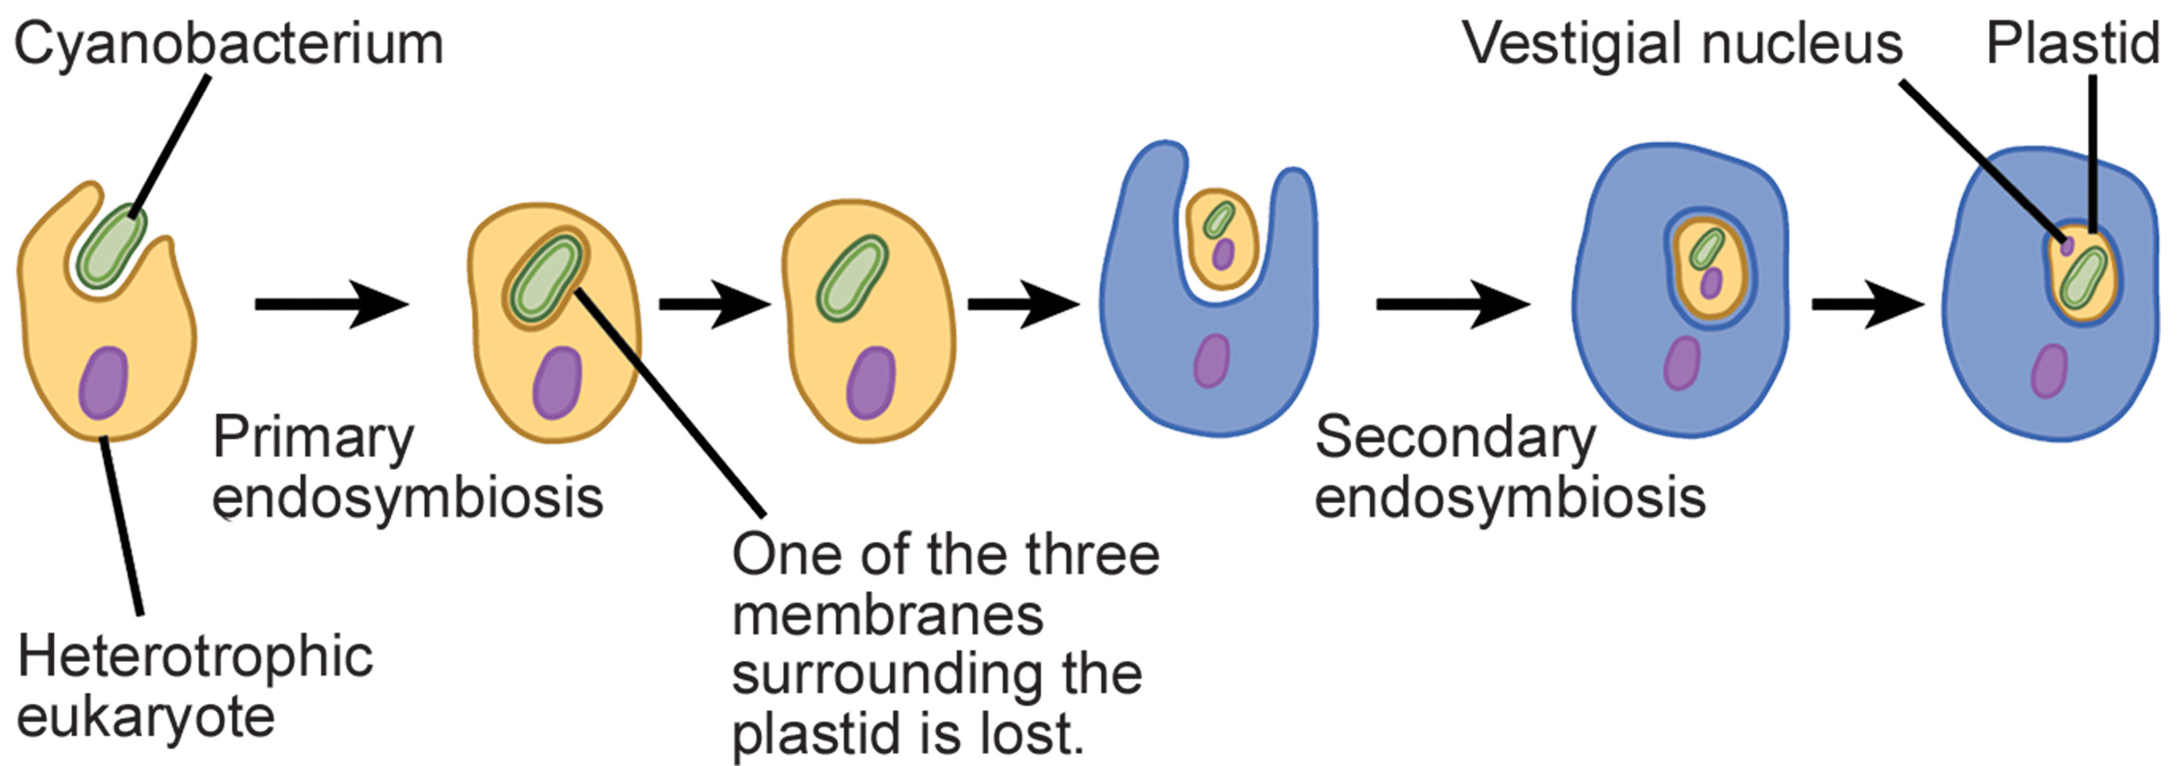
Evolution Connection
Secondary endosymbiosis is proposed when an ancestral cell containing a photosynthetic endosymbiont is engulfed by another eukaryotic cell.
Chlorarachniophytes, rare algae within the Rhizaria supergroup, likely originated from a secondary endosymbiotic event as evidenced by their photosynthetic capability, the presence of a vestigial nucleus in the green algal endosymbiont, and plastids with four membranes.
Secondary endosymbiosis is not unique to chlorarachniophytes; it also occurs in excavates and chromalveolates, resulting in the evolution of plastids in various protist lineages.
23.1 Figure 8
CNX OpenStax on Wikimedia Commons. "Endosymbiont processes." Modified.

Slide 24
Summary
Eukaryotes emerged around 2 billion years ago, with the oldest fossil evidence dating back to this time period, predating prokaryotic fossils.
Today's eukaryotes likely descended from an ancestor with prokaryotic characteristics, such as cells lacking nuclei and endomembrane systems.
The last common ancestor of modern eukaryotes possessed nuclei with linear chromosomes containing DNA associated with histones and a cytoskeleton capable of forming cilia and flagella.
Mitochondria, derived from aerobic alphaproteobacteria, were present in the ancestral eukaryote, suggesting an aerobic lifestyle.
Despite their common ancestry, modern eukaryotes exhibit vast diversity in morphology, organization, life cycles, and cell numbers.

Slide 25


End of Hawkes Learning PowerPoint

