Slide 1
Lesson 23.2
Classification of Protists

Slide 2
Objectives
Describe representative protist organisms from each of the six presently recognized supergroups of eukaryotes.
Describe the cell structure characteristics of protists.
Describe the life cycle diversity of protists.
Describe the metabolic diversity of protists.
Identify defining features of protists in each of the six supergroups of eukaryotes.

Slide 3
Protists Are Numerous and Diverse
There are a huge number of protists.
Over 100,000 species have been described.
There are many undescribed species as well, many of which live as commensals or parasites in other organisms.
There is great diversity among protists.
The term protist is a catchall for eukaryotes that are not animals, plants, or fungi.
Protists share very few common characteristics

Slide 4
Protists Are Complex
Because they are largely unicellular, protists lack complexity associated with:
Multicellularity
Tissue specialization
Unicellular protists show complexity through their cellular morphology and function.
Some unicellular protists live as colonies, behaving sometimes like free-living cells and others as a multicellular organism.
Some protists are made of enormous, multinucleate, single cells that look like blobs of slime or ferns in different conditions.
Some have nuclei of different sizes with different roles.

Slide 5
Protists Differ in Size and Structure
Protists range in size from less than a micrometer to 3 meters to hectares.
Protists may be enclosed by:
  Animal-like cell membranes
  Plantlike cell walls
  Glassy silica-based shells
  Pellicles of interlocking protein strips that function to prevent the protist from being torn or pierced without compromising range of motion

Slide 6
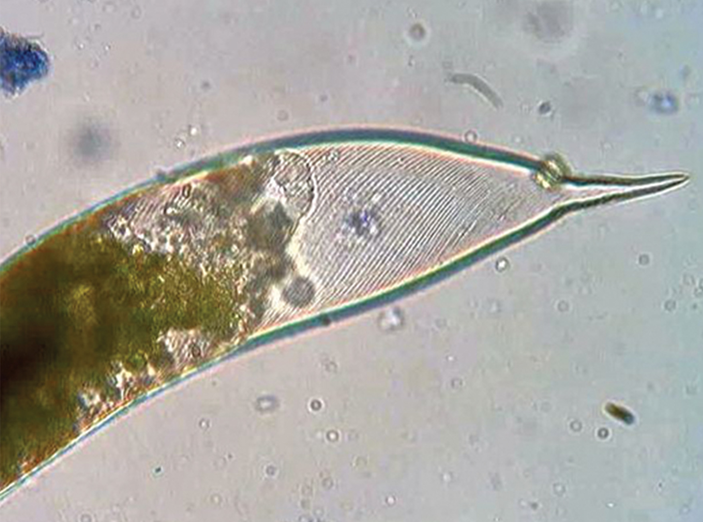
23.2 Figure 1
Deuterostome on Wikimedia Commons. "Euglena pellicle."
Notes:
23.2 Figure 1: The interlocking protein strips making up the pellicle of the protist, Euglena

Slide 7
Protists Vary Widely In Nutritional Strategies
Photoautotrophs store energy by photosynthesis and have chloroplasts.
Heterotrophs consume organic materials including other organisms.
  Amoebas ingest particles by phagocytosis, a process of engulfing a food particle.
  Saprobes absorb nutrients from dead organisms or organic wastes.
Mixotrophs transition between being photoautotrophs or heterotrophs depending on whether sunlight or organic nutrients are available.

Slide 8
Phagocytosis Is Commonly Used By Amoebas
Heterotrophic amoebas commonly ingest food by phagocytosis.
Phagocytosis is the engulfment of food particles, forming a membrane-bound food vacuole (or phagosome) inside the cell.
The phagosome then fuses with a lysosome (containing hydrolytic enzymes) to form a phagolysosome.
Food is broken down in the phagolysosome and then diffuses to the cytoplasm where it is used for metabolism.
Undigested remains are expelled by exocytosis.

Slide 9
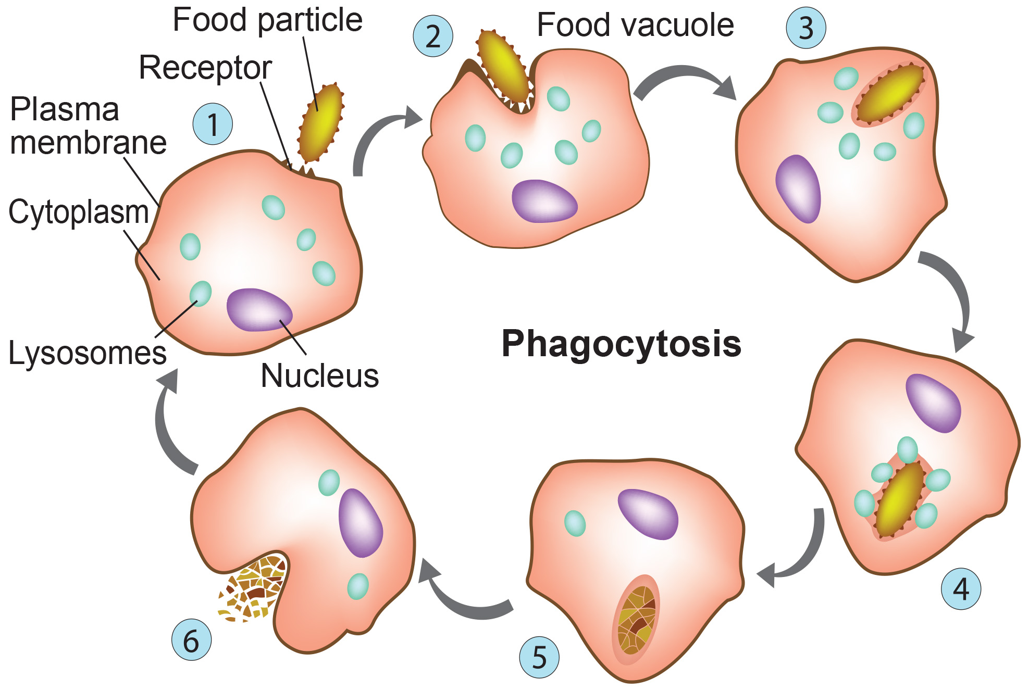
23.2 Figure 2
CNX OpenStax on Wikimedia Commons. "Protist transportation."
Notes:
23.2 Figure 2: The stages of phagocytosis include the engulfment of a food particle, the digestion of the particle using hydrolytic enzymes contained within a lysosome, and the expulsion of undigested materials from the cell.

Slide 10
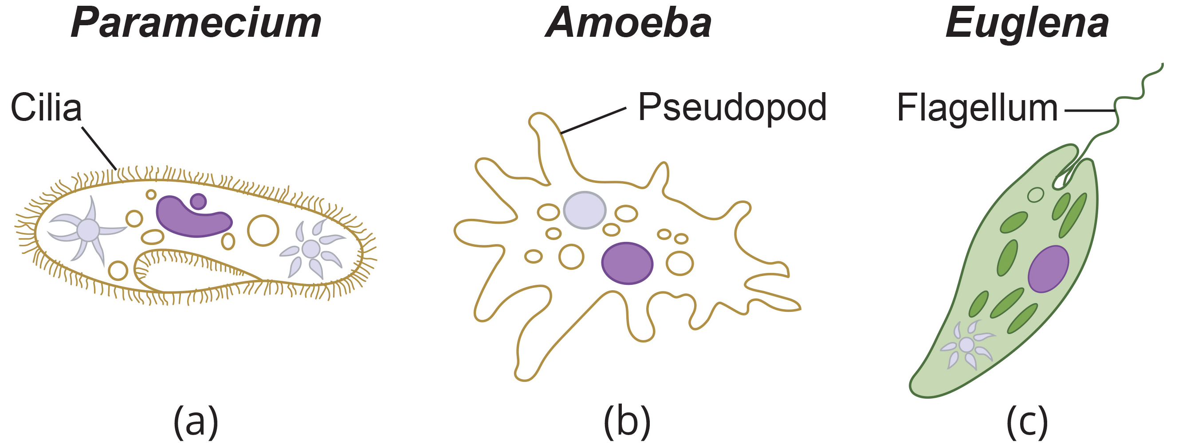
Protists Vary In Their Modes of Movement
Most protists are motile but vary in their modes of movement.
Some have 1+ flagella that they rotate or whip.
Some have rows or tufts of cilia that beat to swim.
Others have pseudopodia (cytoplasmic extensions) that attach to a surface and pull them forward.
23.2 Figure 3
CNX OpenStax on Wikimedia Commons. "Protist transportation."

Slide 11
Some Protists Can Show Directional Movement
Some can show taxis, movement toward or away from a stimulus.
Phototaxis (movement toward light) couples their locomotion strategy with a light-sensing organ.

Slide 12
Protists Vary In Their Reproduction Strategies₁
Some undergo asexual reproduction to produce two daughter cells.
Binary fission can occur transversely or longitudinally.
Some (like true slime molds) can undergo multiple fission simultaneously to divide into many daughter cells.
Others bud and then divide and grow to the size of the parent.
Some undergo sexual reproduction involving meiosis and fertilization.

Slide 13
Protists Vary In Their Reproduction Strategies₂
Many protists can switch between asexual and sexual reproduction strategies when needed.
Sexual reproduction is associated with nutrient depletion or environmental changes to allow for new gene combinations and variations, some of which may improve survival.
  Sexual reproduction is associated with the formation of cysts (dormant structures with no cellular metabolism).
    Cysts are commonly resistant to:
      Extreme temperatures
      Desiccation
      Low pH
    Cysts maybe dispersed by:
      Wind
      Water
      Transport on a larger organism

Slide 14
Protist Life Cycles Vary Considerably
Some protists have simple life cycles.
Others have complicated life cycles.
  These sometimes involve infecting different host species at different developmental stages.
Some protists are like animals in that they are:
  Unicellular in the haploid form
  Multicellular in the diploid form
Other protists are like plants in that they have multicellular stages in both haploid and diploid forms (alternation of generations).

Slide 15
Protists Typically Live in Aquatic Environments
Nearly all protists exist in aquatic environments (freshwater and marine, damp soil, and snow) and need moisture for survival.
As single-celled organisms, it is hard for them to move on land.
Aquatic environments provide water and dissolved substances that can cross their membranes.
Example: Amoebas are found in lakes, rivers, ponds, and soil.
Some are animal or plant parasites.
Example: Plasmodium sp. live in insect and vertebrate tissues (the liver) and replicate in vertebrate red blood cells.
Some protists such as slime molds live on dead organisms or their wastes and aid in their decay.

Slide 16
Classification of Protists Is Challenging
DNA analysis now shows that similar morphological features shared by different protist groups likely are analogous and resulted from convergent evolution.
Eukarya has been divided into 6 "supergroups."
  There are protists in all 6.
  Each supergroup is believed to be monophyletic, meaning that all the organisms within a supergroup:
    Share a common ancestor
    Are more like each other than organisms in other supergroups.
  In each super group, 1+ defining characteristic of a eukaryotic cell may have diverged from typical.
  This all represents a single hypothesis.

Slide 17
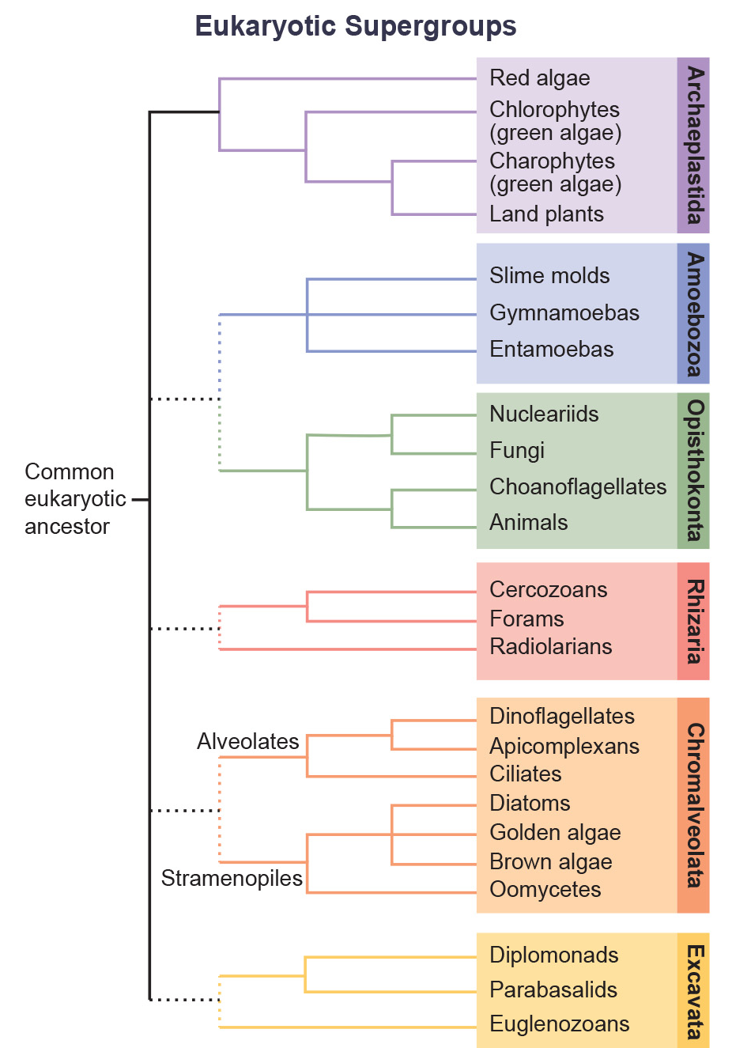
23.2 Figure 4
CNX OpenStax on Wikimedia Commons. "Domain Eukarya."
Notes:
23.2 Figure 4: This diagram shows a proposed classification of the domain Eukarya. Currently, the domain Eukarya is divided into six supergroups. Within each supergroup are multiple kingdoms. Although each supergroup is believed to be monophyletic, the dotted lines suggest evolutionary relationships among the supergroups that continue to be debated.

Slide 18
Group Activity₁
In a group, choose one of the six supergroups. Investigate this supergroup.
What are some examples of protists that are included in this group?
What are their habitats?
What are their primary modes of reproduction?
What kinds of organelles and structures do they have in common?

Slide 19
Supergroup Archaeplastida₁
Archaeplastida likely descended from the endosymbiosis between:
  A heterotrophic protist
  A cyanobacterium
They include land plants, red algae, and green algae.
The red and green algae include several forms:
  Unicellular
  Multicellular
  Colonial

Slide 20
Supergroup Archaeplastida₂
The red and green algae use a variety of life cycles, including alternation of generations.
  A multicellular diploid sporophyte undergoes meiosis to produce haploid spores.
  The spores germinate and undergo mitosis to form haploid multicellular gametophytes.
  Gametophytes make gametes by mitosis.
  Two gametes fuse to produce a diploid zygote.
  The diploid zygote undergoes mitosis to form a diploid sporophyte.
  In some species, the sporophyte and gametophyte look the same, while in others, they look different.

Slide 21
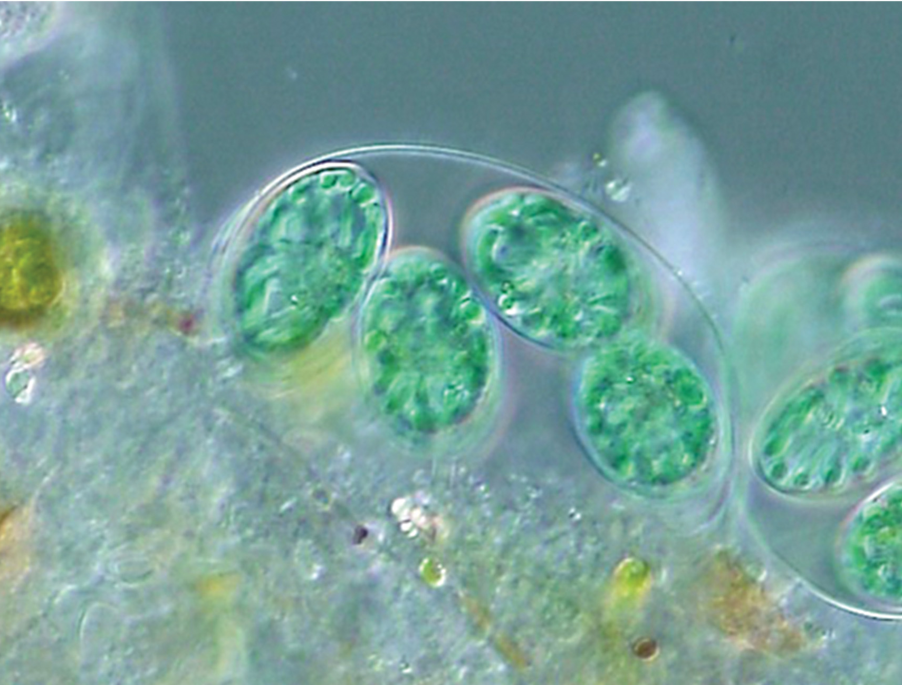
Archaeplastida: Glaucophytes
Glaucophytes are a small group of Archaeplastida with chloroplasts retaining remnants of the peptidoglycan cell wall of their ancestral endosymbiont.
23.2 Figure 5
NEON_ja on Wikimedia Commons. "Glaucocystis."

Slide 22
Archaeplastida: Red Algae
Red algae (rhodophytes):
Lack flagella
Are primarily multicellular
  Range from microscopic, unicellular protists to large, multicellular forms grouped informally as seaweed
Have a second cell wall (containing the source of agarose) outside of an inner cellulose cell wall
Commonly make phycoerythrins, red accessory photopigments that make them appear red
  Some "red" algae lack these and are parasites
Store carbohydrates in their cytoplasm (like glaucophytes)
Are found
  In tropical waters down to depths of 260 m
  In terrestrial or freshwater environments
Have a life cycle including 2 sporophyte phases, with meiosis occurring only in the second sporophyte

Slide 23
Archaeplastida: Green Algae
Green algae:
Are the most abundant group of algae
Share a recent common ancestor with and have features like those of land plants such as:
  Chloroplast structure
  Carbohydrate storage in plastids
Are divided into:
  Chlorophytes
  Charophytes

Slide 24
Green Algae: Charophytes
Charophytes:
Are the closest living relatives to land plants
  They resemble them in morphology and reproductive strategies.
Are exemplified by Spirogyra, filamentous green algae found in freshwater
Are commonly found in wet habitats
Signal a healthy ecosystem

Slide 25
Green Algae: Chlorophytes
Chlorophytes:
Are very diverse in form and function
Primarily inhabit fresh water and damp soil
Are a common component of plankton (microscopic organisms drifting in freshwater or seawater)
Include:
  Chlamydomonas, a single-celled example
  Volvox, a colonial example
  Ulva, a multicellular example
  Caulerpa, a large, multinucleate example

Slide 26
Green Algae: Chlorophytes—Chlamydomonas
Chlamydomonas is a simple, unicellular, pear-shaped chlorophyte having:
2 opposing flagella that aid in movement toward light
An eyespot that senses light
Some more complex chlorophytes have haploid gametes that resemble Chlamydomonas.

Slide 27
Green Algae: Chlorophytes—Volvox
Volvox is a colonial chlorophyte that sometimes acts like a bunch of individual cells sometimes like a multicellular organism.
Each colony:
  Has 50–60,000 cells, each with 2 flagella
  Is enclosed in a hollow, spherical matrix of a gelatinous glycoprotein secretion.
Individual cells move in a coordinated fashion and are interconnected by cytoplasmic bridges.
Only a few cells reproduce to create daughter colonies, exemplifying cell specialization.
  Daughter cells at first have their flagella inside, but they move outward as they are released.

Slide 28
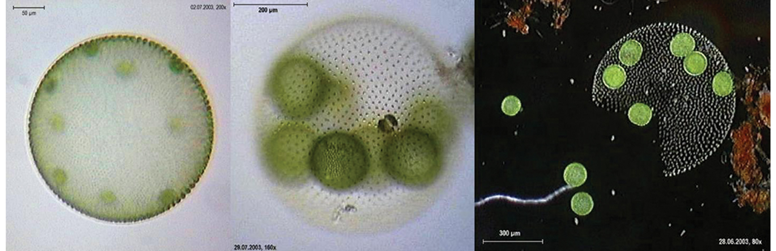
23.2 Figure 6
Dr. Ralf Wagner on Wikimedia Commons. "Volvox aureus."
Notes:
23.2 Figure 6: Volvox aureus is a green alga in the supergroup Archaeplastida. This species exists as a colony, consisting of cells immersed in a gel-like matrix and intertwined with each other via hairlike cytoplasmic extensions.

Slide 29
Green Algae: Chlorophytes—Ulva and Caulerpa
Ulva (sea lettuce):
Is a true multicellular chlorophyte
Caulerpa:
Is a chlorophyte that exists as large, multinucleate, single cells
  Its cells undergo nuclear division without completing cytokinesis to produce massive single cells with many nuclei.
Exhibits flattened fernlike foliage
Can reach lengths of 3 meters

Slide 30
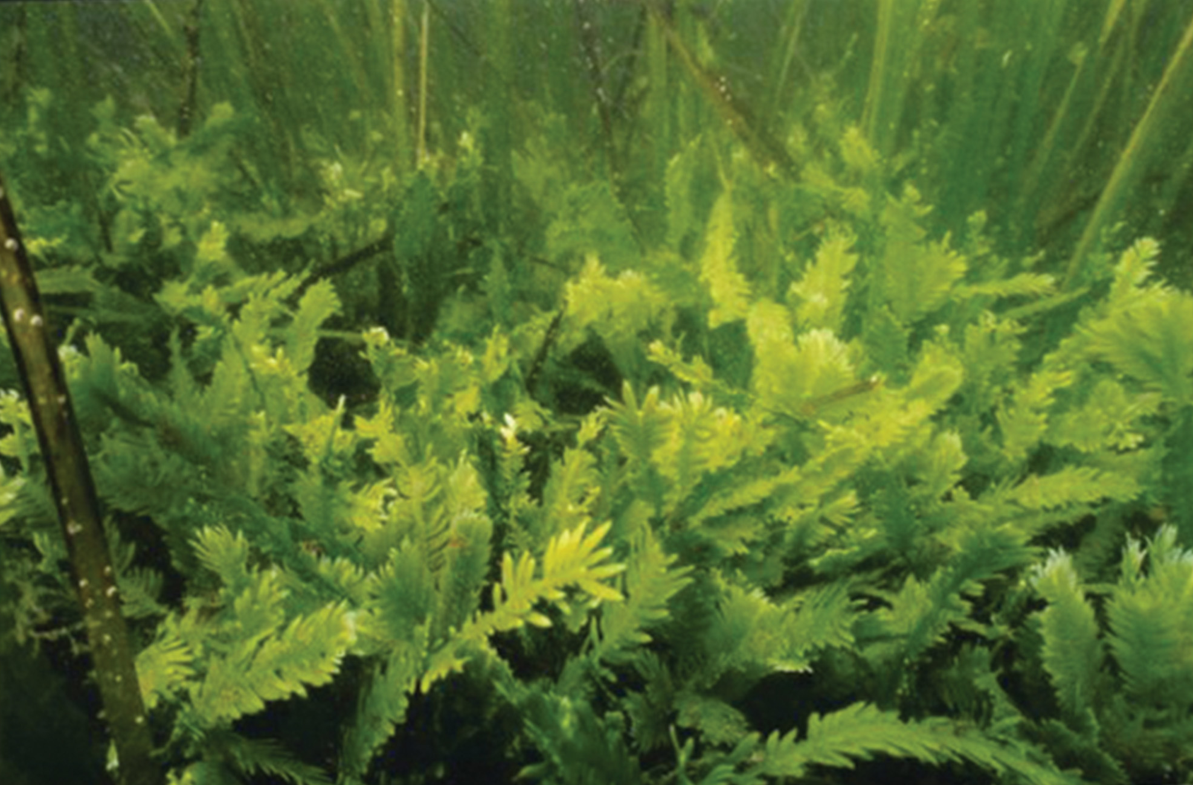
23.2 Figure 7
Rachel Woodfield on Wikimedia Commons. "Caulerpa taxifolia."
Notes:
23.2 Figure 7: Caulerpa taxifolia is a chlorophyte consisting of a single cell containing potentially thousands of nuclei. There is still not a clear answer on how a single cell can produce such complex shapes.

Slide 31
Supergroup Amoebozoa
The Amoebozoa include species that are:
  Unicellular
  Large and multinucleated
  Multicellular
Amoebozoa have pseudopodia that extend like tubes or flat lobes.
  These pseudopodia project outward from the cell and anchor it to a substrate.
  The protist moves by cytoplasmic streaming, moving its cytoplasm to the pseudopod and throughout the cell, moving the cell.
The Amoebozoa includes both:
  Free-living species
  Parasitic species

Slide 32
Amoebozoa: Gymnomoebae
The Gymnomoebae, or loose amoebae, include:
  Naked amoebae
  Shelled amoebae whose bodies protrude like snails from protective tests (armor-like coverings)
Examples include:
  Amoeba proteus: a large naked amoeba (diameter ~500 μm)
  Pelomyxa: an even larger (up to 10X) multinucleate amoeba
    Each may have hundreds of nuclei.
    It lacks mitochondria, using bacterial endosymbionts instead.

Slide 33
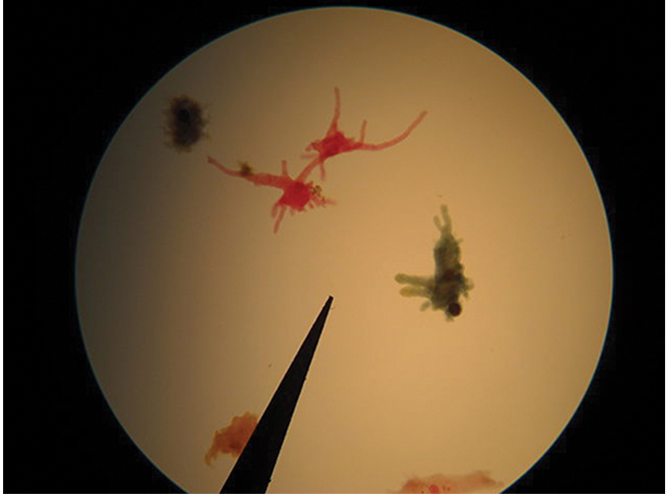
23.2 Figure 8
GreenBlueRed on Wikimedia Commons. "Amoebae."
Notes:
23.2 Figure 8: Amoebae with tubular and lobe-shaped pseudopodia are shown here under a microscope. These isolates would be morphologically classified as amoebozoans.

Slide 34
Amoebozoa: Slime Molds
The slime molds have features similar to fungi resulting from convergent evolution:
They develop fruiting bodies during times of stress to produce and release spores.
These spores remain dormant until favorable conditions are met, then germinate into free-living cells.
The slime molds are categorized into 2 groups:
Plasmodial slime molds
Cellular slime molds

Slide 35
Amoebozoa: Slime Molds—Plasmodial Slime Molds
Plasmodial slime molds are made of large, multinucleate cells.
They move along surfaces like a blob while feeding, engulfing food particles.
Upon maturation, they take on a netlike appearance.
They form fruiting bodies (sporangia) during stress, allowing them to make haploid spores by meiosis.
When spores germinate in a favorable environment, they form ameboid flagellate haploid cells that can combine to produce a diploid zygotic slime mold.

Slide 36
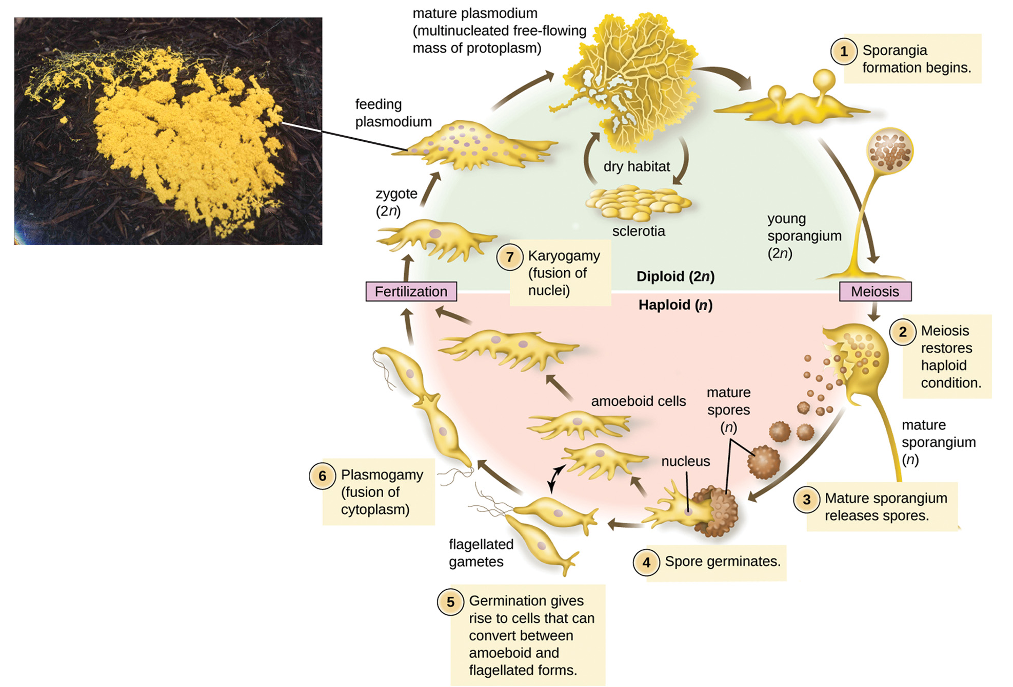
23.2 Figure 9
National Human Genome Research Institute on Wikimedia Commons. "Slime mold."
CNX OpenStax on Wikimedia Commons. "Slime mold life cycle."
Notes:
23.2 Figure 9: The life cycle of the plasmodial slime mold is shown, along with the brightly colored feeding plasmodium, which is a single-celled, multinucleate mass.

Slide 37
Amoebozoa: Slime Molds—Cellular Slime Molds
Cellular slime molds function as independent amoeboid cells when nutrients are available.
When food is depleted, they aggregate into a mass of cells, called a slug, that behaves as a unit.
  Some cells form a 2–3 mm stalk, drying and dying.
  Cells atop the stalk form an asexual fruiting body that contains haploid spores.
  Spores are disseminated and germinate when they land in a moist environment.
Example: Dictyostelium exists in damp forest soils.

Slide 38
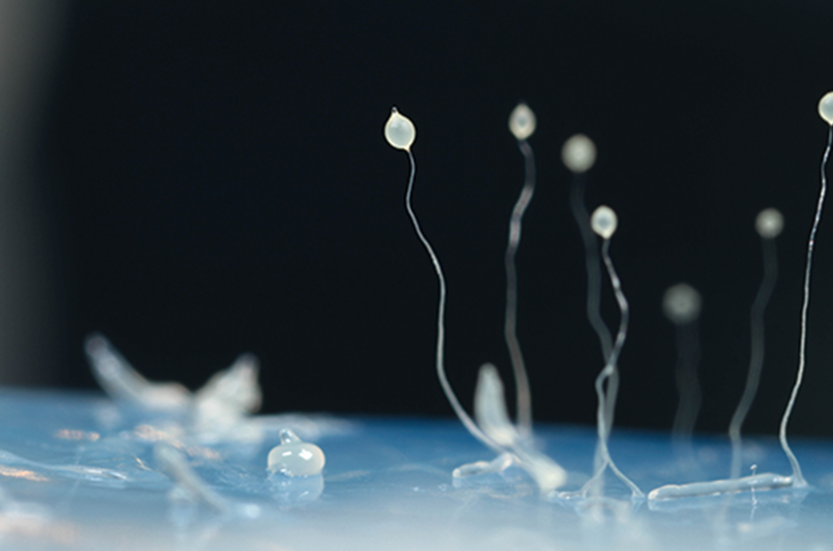
23.2 Figure 10
Usman Bashir on Wikimedia Commons. "Dictyostelium discoideum."
Notes:
23.2 Figure 10: This image shows several stages in the life cycle of Dictyostelium discoideum: a cellular slime mold (including aggregated cells), mobile slugs, and their transformation into fruiting bodies with a cluster of spores supported by a stalk.

Slide 39
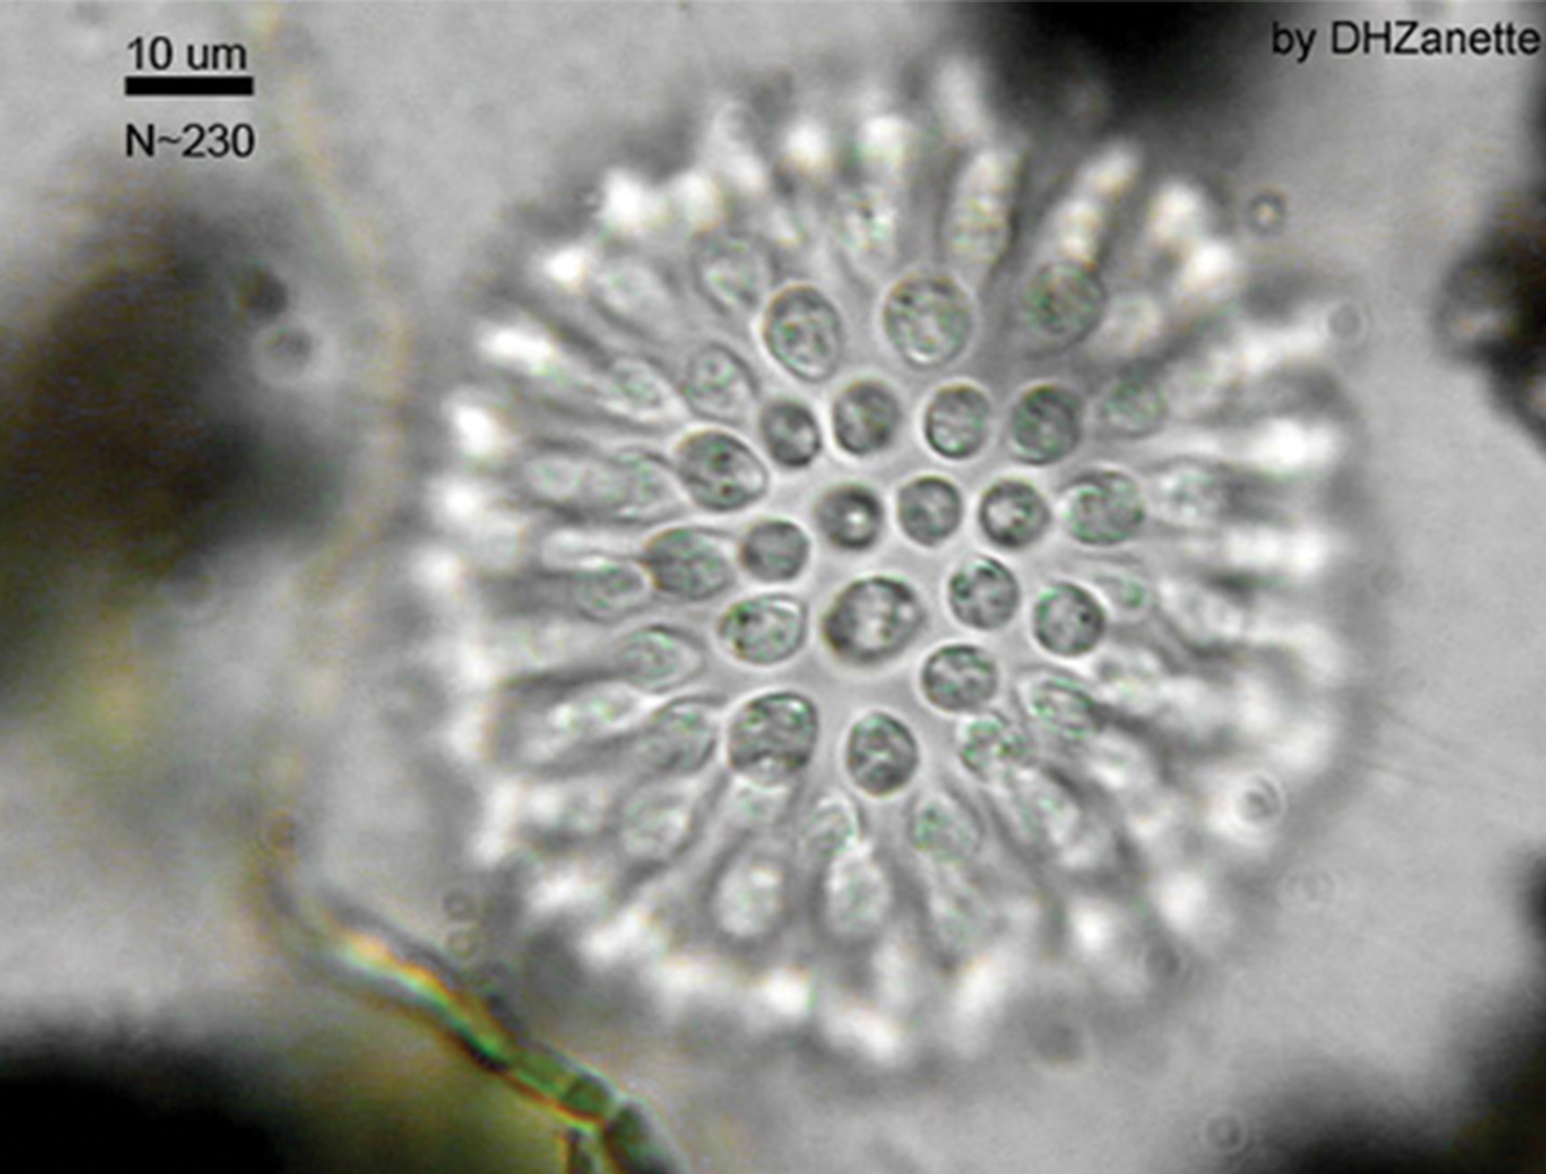
Supergroup Opisthokonta
Opisthokonts:
Each have a single posterior flagellum surrounded by a contractile collar of microvilli.
  The flagellum pushes each along.
  The collar filters and collects bacteria for feeding.
Include the animal like choanoflagellates.
  These may be the common ancestor to sponges and perhaps all animals.
Have unicellular and colonial forms.
23.2 Figure 11
Dhzanette on Wikimedia Commons. "Sphaeroeca."

Slide 40
Opisthokonta: Mesomycetozoa
Mesomycetozoa:
Are a small group of parasites
  Most are fish parasites, but there is at least 1 human parasite.
Are closely related to animals
Have a life cycle that is not well understood
Were grouped with the fungi in the past based upon their morphology
Appear on hosts as large spheres containing spores

Slide 41
Three Supergroups Result from Primary Endosymbiosis
Three supergroups are products of primary endosymbiotic events.
  Archaeplastida
  Amoebozoa
  Opisthokonta
Primary endosymbiosis results in typical organelles:
  Nucleus
  Mitochondria
  Chloroplasts
The remaining 3 supergroups include photosynthetic members whose chloroplasts resulted from secondary endosymbiosis.
  These also have interesting nuclear structures and modifications of mitochondria or chloroplasts.

Slide 42
Supergroup Rhizaria
Rhizaria:
Include amoebas with thin threadlike, needlelike, or rootlike pseudopodia
Often make elaborate tests containing CaCO₃, Si, or Sr
Are important in C and N cycling
  They are a biological carbon pump because their tests sink into deep water upon death, sequestering C away and keeping atmospheric CO₂ levels low.
  Foraminiferans (a group of Rhizaria) are the only eukaryotes that participate in the N cycle by denitrification.

Slide 43
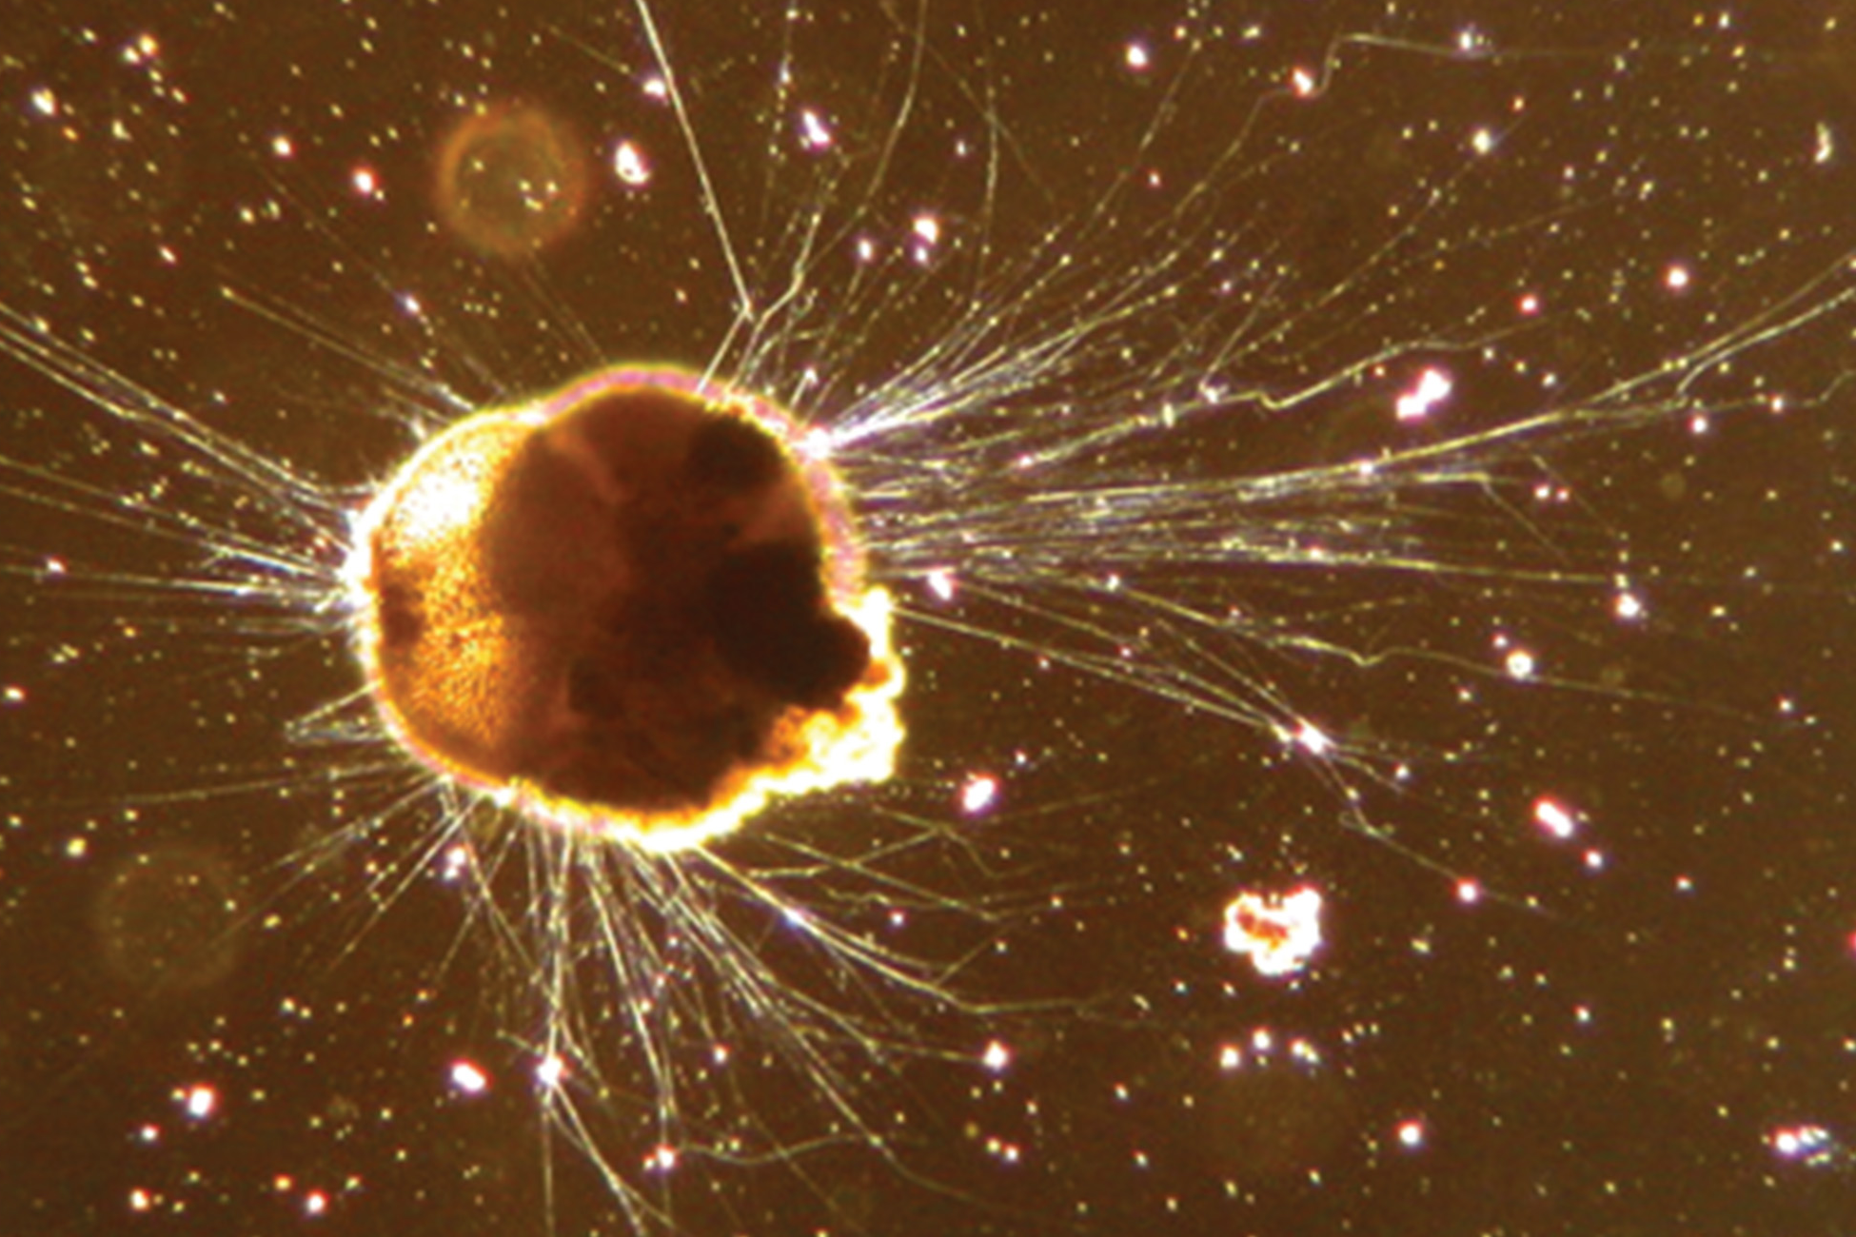
23.2 Figure 12
Scott Fay, UC Berkeley on Wikimedia Commons. "Ammonia tepida."
Notes:
23.2 Figure 12: Ammonia tepida, the Rhizaria species shown here using phase contrast light microscopy, exhibits many threadlike pseudopodia. It also has a chambered calcium carbonate shell, or test.

Slide 44
Rhizaria: Foraminiferans (Forams)
Foraminiferans (forams):
Are unicellular protists ranging between 20 μm – several cm in length
Occasionally resemble tiny snails
Have porous shells (tests) built from organic materials and hardened with CaCO₃
  The test may house photosynthetic algae that they eat
Have pseudopodia that extend through their tests' pores that allow them to move, feed, and gather building materials
Are found in sand or in other particles in marine or freshwater habitats
Are useful indicators of pollution and global weather patterns

Slide 45
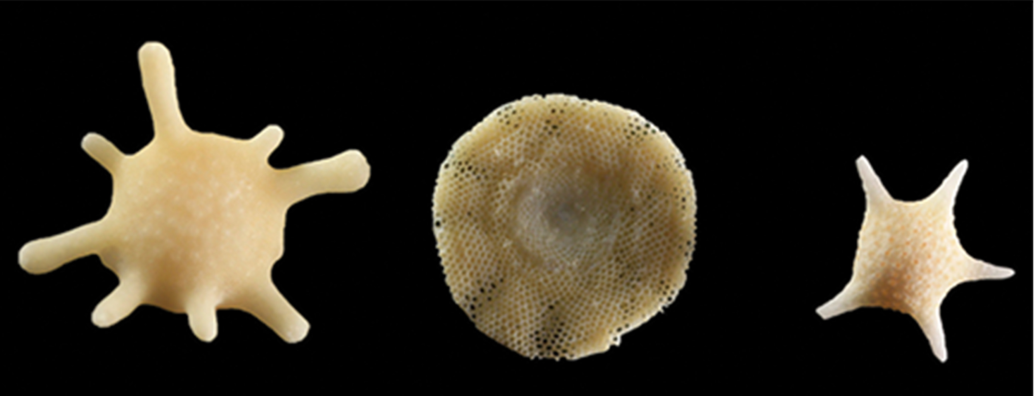
23.2 Figure 13
Siim Sepp (Sandatlas) on Wikimedia Commons. "Shells from foraminifera."
Notes:
23.2 Figure 13: These shells from foraminifera sink to the sea floor.

Slide 46
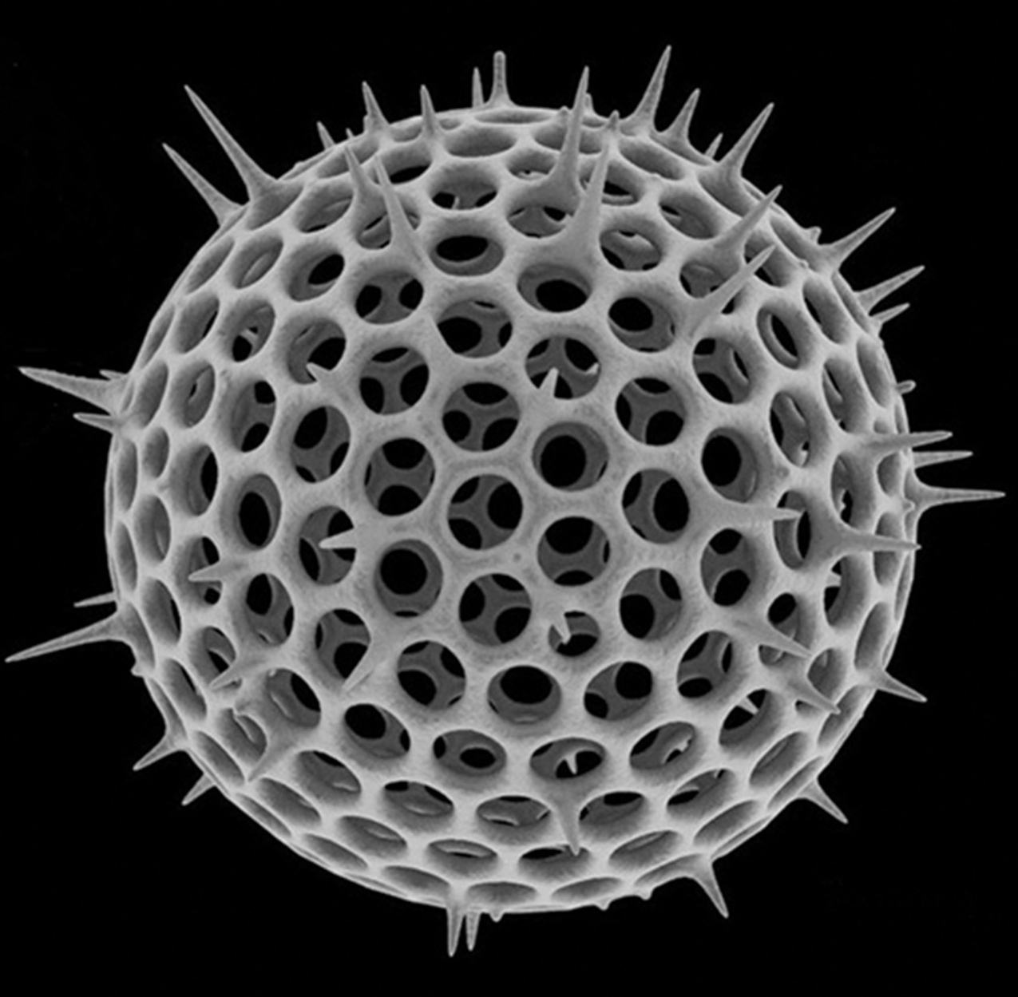
Rhizaria: Radiolarians
Radiolarians:
Have intricate exteriors of glassy silica with radial or bilateral symmetry
Have needlelike pseudopods supported by microtubules radiating outward from the cell bodies to catch food particles
Have shells that sink to the ocean floor upon death, accumulating to 100-meter-thick depths
Are common in the fossil record
23.2 Figure 14
Michael Spaw on Wikimedia Commons. "Spherical radiolarian shell."

Slide 47
Rhizaria: Cercozoa
Cercozoa:
Include both naked and shelled forms
The Chlorarachniophytes are photosynthetic, having acquired chloroplasts by secondary endosymbiosis.
  The chloroplast retains some of the endosymbiont's nucleus between 2 sets of chloroplast membranes.
The Vampyrellids ("vampire amoebae") obtain their nutrients by thrusting a pseudopod into the interior of other cells and sucking out their contents.

Slide 48
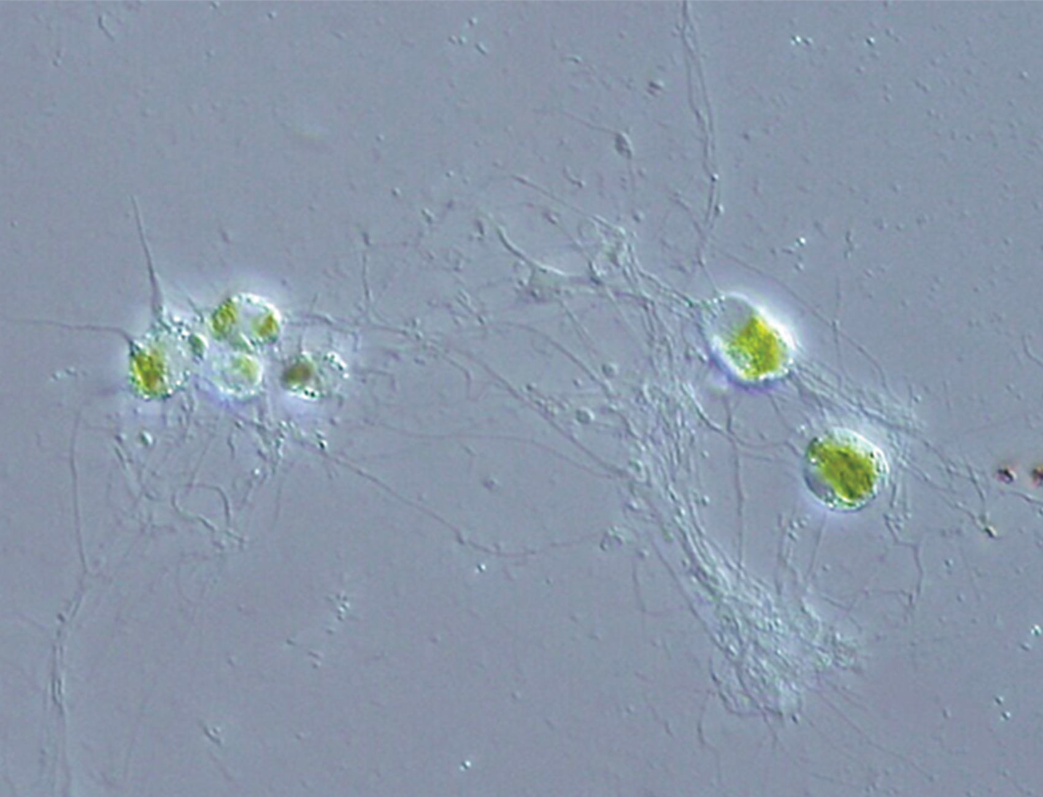
23.2 Figure 15
NEON_ja on Wikimedia Commons. "Rhizarian."
Notes:
23.2 Figure 15: This rhizarian is mixotrophic and can obtain nutrients both by photosynthesis and by trapping various microorganisms with its network of pseudopodia.

Slide 49
Supergroup Chromalveolata
Chromalveolates:
Descended from a common ancestor that engulfed a red algal cell (which had already had chloroplasts)
  This was a secondary endosymbiotic event.
  Some chromalveolates have lost the red alga-derived plastid organelles and genes.
Is a hypothesis-based working group subject to change
Includes very important photosynthetic organisms such as
  Diatoms
  Brown algae
  Disease agents of animals and plants
Can be divided into the
  Alveolates
  Stramenophiles

Slide 50
Chromalveolata: Alveolates
Alveolates:
Share a common ancestor
Each have an alveolus (membrane-enclosed sac of unknown function) beneath the cell membrane
  The alveolus may may be involved in osmoregulation.
Are further divided into 3 groups:
  Dinoflagellates
  Apicomplexans
  Ciliates

Slide 51
Alveolates: Dinoflagellates₁
Dinoflagellates:
May be photosynthetic, heterotrophic, or mixotrophic
Have chloroplasts derived by secondary endosymbiosis of a red alga
Are often encased in interlocking cellulose plates
Have 2 perpendicular flagella that fit into the grooves between the cellulose plates that together make dinoflagellates spin
  One extends longitudinally
  Other encircles the dinoflagellate

Slide 52
Alveolates: Dinoflagellates₂
Dinoflagellates:
Exist in freshwater and marine habitats among the plankton
Have a nucleus called a dinokaryon with highly condensed chromosomes lacking typical histones
  Mitosis is closed, meaning the spindle separates the chromosomes from outside the nucleus without nuclear envelope breakdown.

Slide 53
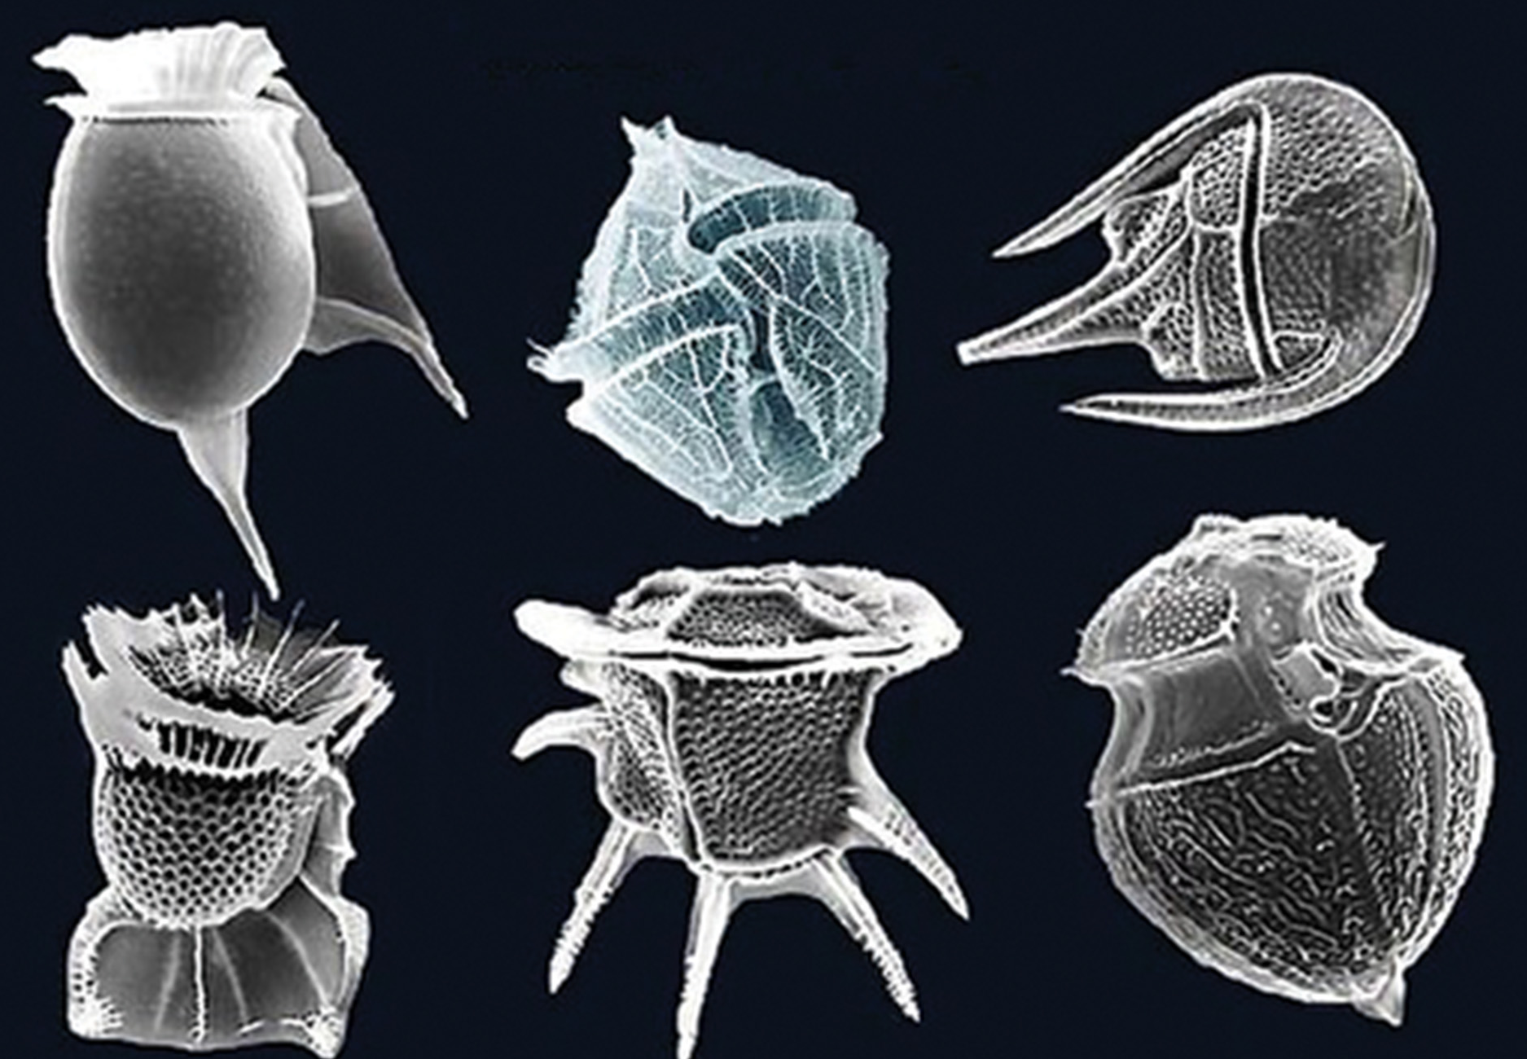
23.2 Figure 16
fickleandfreckled on Wikimedia Commons. "Dinoflagellates."
Notes:
23.2 Figure 16: The dinoflagellates exhibit great diversity in shape. Many are encased in cellulose armor and have two flagella that fit in grooves between the plates. Movement of these two perpendicular flagella causes a spinning motion.

Slide 54
Evolution Connection₁
The dinoflagellate Symbiodinium is an intracellular symbiont of reef-building corals in tropical oceans.
They photosynthesize, providing sugars to support coral growth, and giving coral tissue its brown color.
Living inside corals, they are protected from predators and receive nutrients from the digestion of food by corals.
When oceans warm above average for extended periods, the dinoflagellates are expelled from the coral tissue, resulting in coral bleaching.
  The white color is due to light reflecting off the CaCO₃ of the coral skeleton.
  Prolonged warm temperatures result in coral starving.

Slide 55
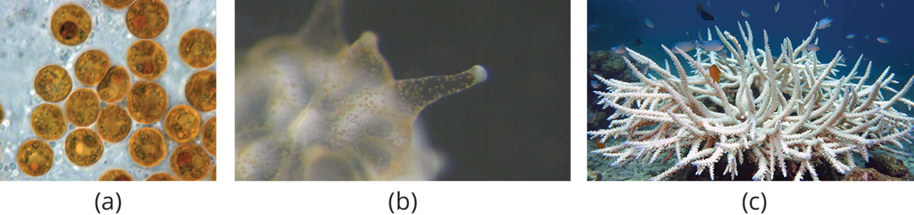
23.2 Figure 17
Allisonmlewis on Wikimedia Commons. "Symbiodinium."
Narrissa Spies on Wikimedia Commons. "Polyp."
Vardhan Patankar on Wikimedia Commons. "Bleached coral."
Notes:
23.2 Figure 17: (a) A single-celled Symbiodinium. (b) A coral polyp with brown Symbiodinium inside the coral tissue. (c) A bleached coral colony.

Slide 56
Alveolates: Dinoflagellates₃
Dinoflagellates:
Sometimes generate light (bioluminescence) when stressed
  Billions or trillions per wave can emit light to make the wave twinkle or look blue.
  About 20 species can cause algal blooms in the summer, making the ocean look muddy red (called a red tide).
    These can secrete an asphyxiating toxin that can kill fish, birds, and marine mammals, devastating fisheries and harming humans.

Slide 57
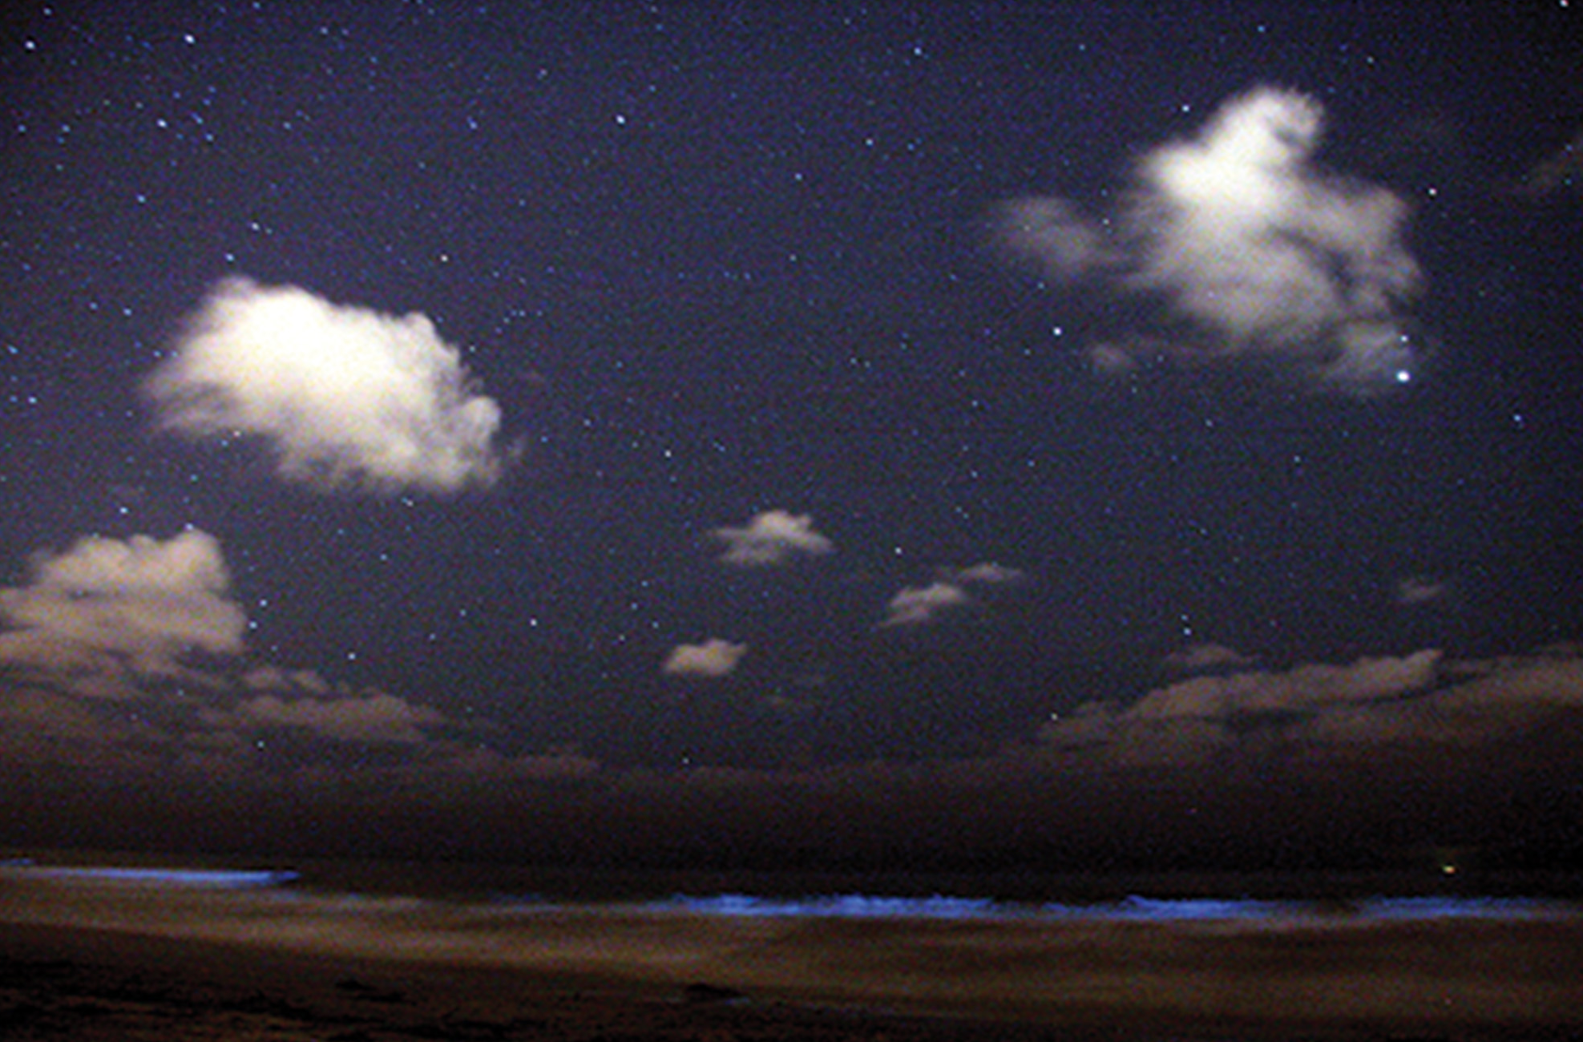
23.2 Figure 18
Red Tide Starry Night on Wikimedia Commons. "Dinoflagellate bioluminescence."
Notes:
23.2 Figure 18: Bioluminescence is emitted from dinoflagellates in a breaking wave on a beach.

Slide 58
Alveolates: Apicomplexans
Apicomplexans:
Are named for a structure called the apical complex that seems to be a highly modified secondary chloroplast
Are all parasitic
  Includes the genus Plasmodium which causes malaria
The apical complex
  Has a genome similar to those of dinoflagellate chloroplasts.
  Is specialized for entry and infection of host cells.
Have complex life cycles involving multiple hosts and stages of sexual and asexual reproduction.

Slide 59
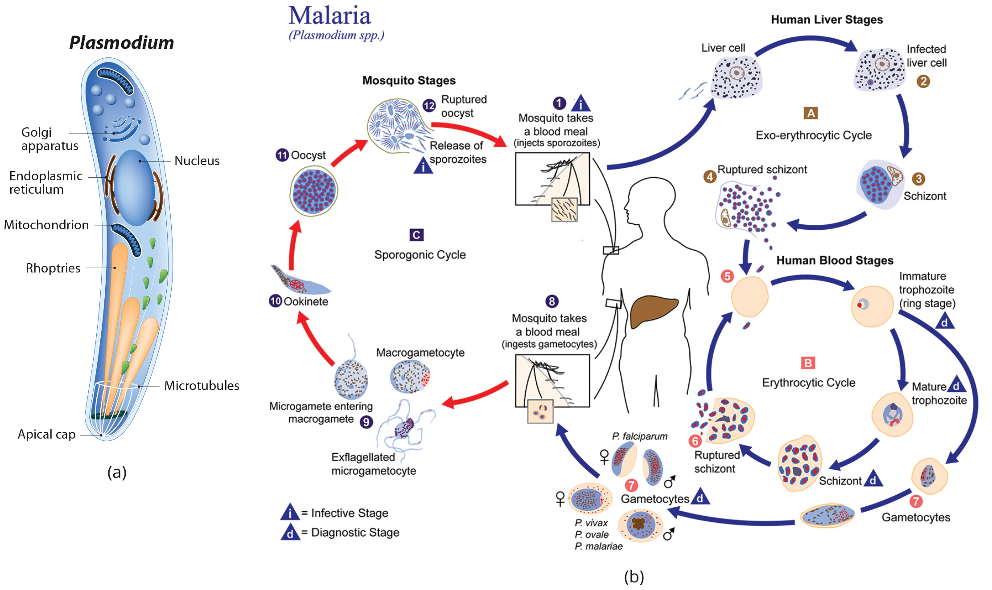
23.2 Figure 19
CDC on Wikimedia Commons. "Apicomplexans and Plasmodium."
Notes:
23.2 Figure 19: (a) Apicomplexans are parasitic protists. They have a characteristic apical complex that enables them to infect host cells. (b) Plasmodium, the causative agent of malaria, has a complex life cycle typical of apicomplexans.

Slide 60
Alveolates: Ciliates
Ciliates:
Are 10–3,000 μm in length
Are covered in rows, tufts, or spirals of cilia that beat synchronously in waves
  To propel them
  To ingest food particles
Are surrounded by a pellicle to provide protection without compromising agility
Sometimes have fused cilia-based structures that function like paddles, funnels, or fins
Include the Paramecium and Tetrahymena

Slide 61
Alveolates: Ciliates—Paramecium₂
Members of the Paramecium genus:
Each have two nuclei:
  The micronucleus is required for sexual reproduction and its genes are not transcribed.
  The macronucleus is multiploidy nucleus constructed from the micronucleus during sexual reproduction.
    Its genes are transcribed.
    Periodic reconstruction is needed because it divides without undergoing mitosis, becoming unbalanced over successive cell replications.

Slide 62
Alveolates: Ciliates—Paramecium₁
Members of the Paramecium genus:
Have organized their cilia into an oral groove, a platelike primitive mouth, which captures and digests bacteria.
Have a food vacuole, where food captured the oral groove is gathered and digested by enzymes
Expel waste particles via an exocytic vesicle that fuses with the anal pore on the cell membrane
Use contractile vacuoles, osmoregulatory vesicles that fill with water as it enters by osmosis and then contract to expel water from the cell

Slide 63
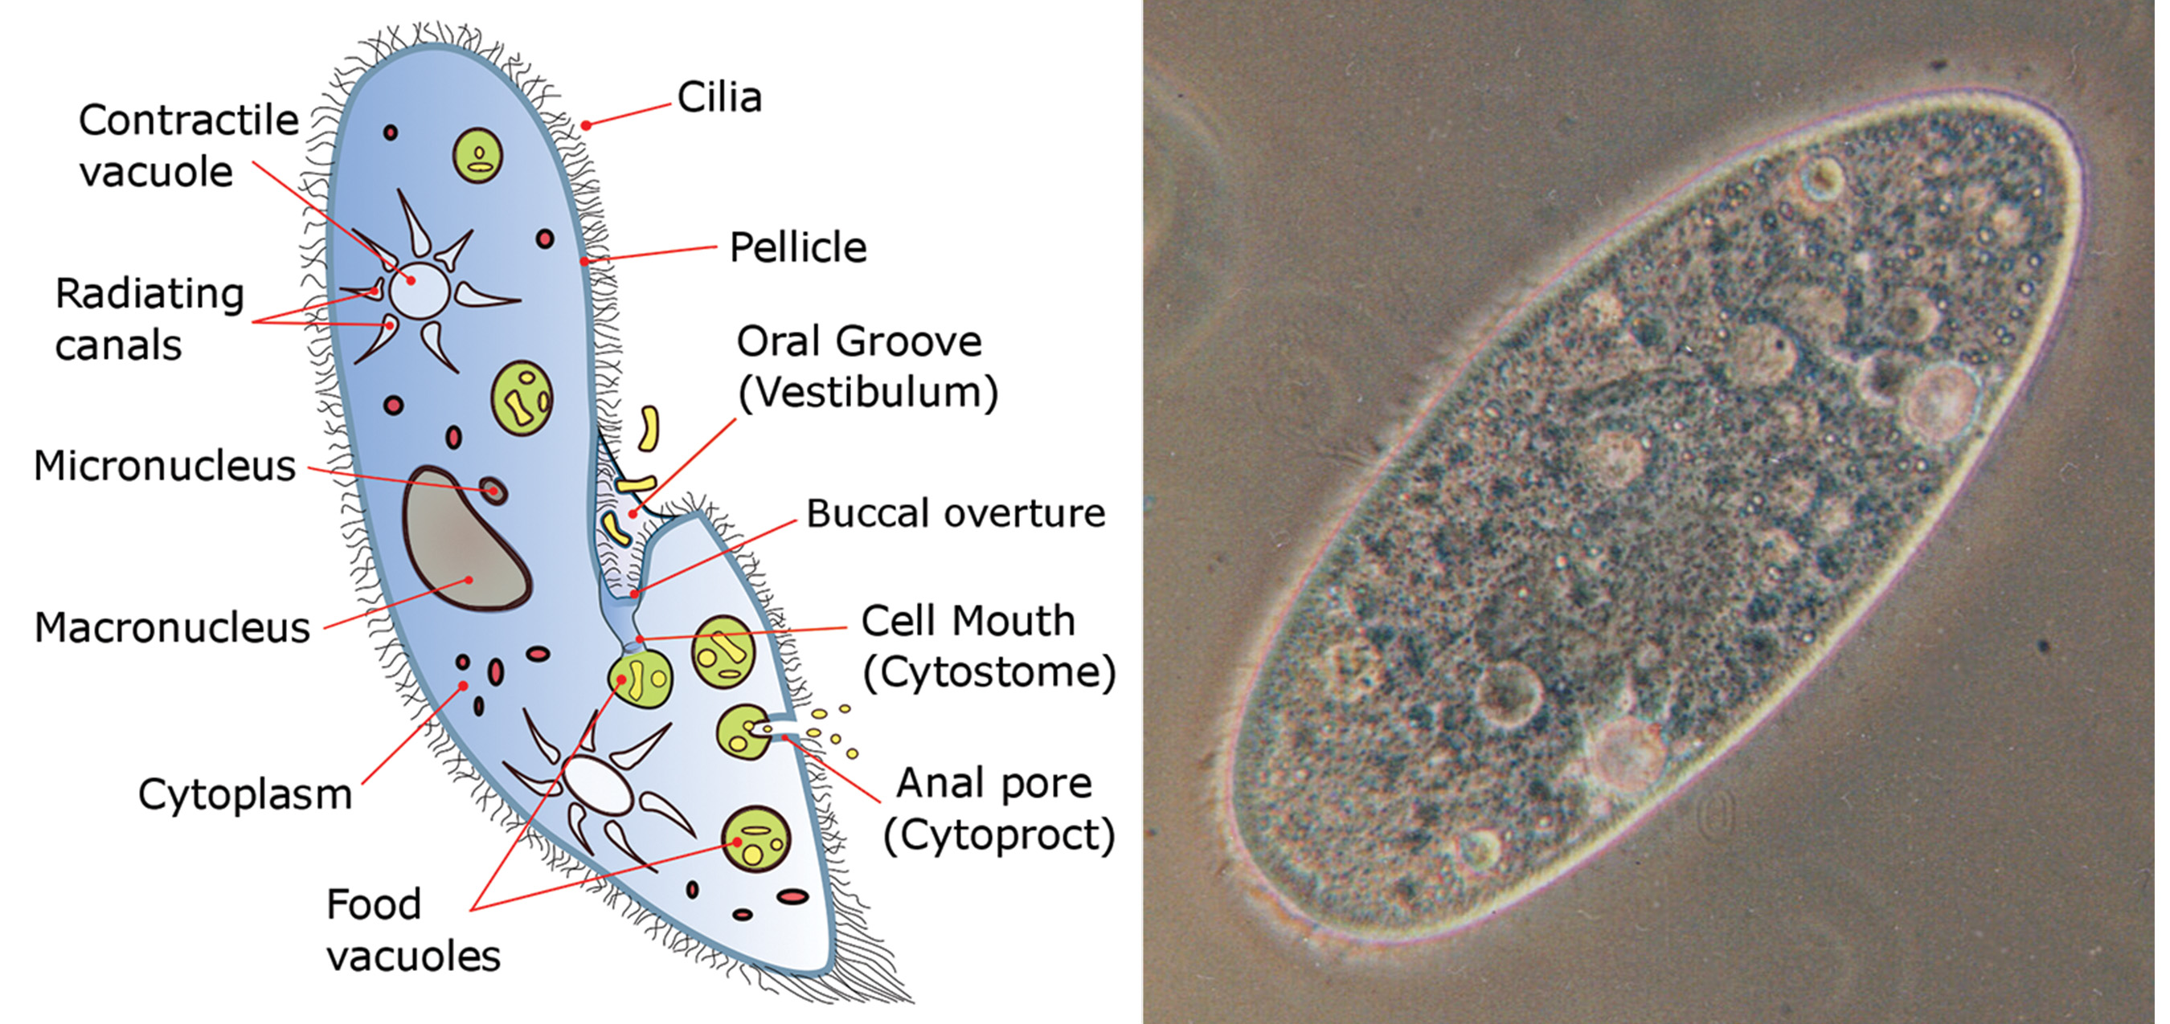
23.2 Figure 20
Deuterostome on Wikimedia Commons. "Paramecium diagram."
Barfooz on Wikimedia Commons. "Paramecium."
Notes:
23.2 Figure 20: Paramecium has a primitive mouth (called an oral groove) to ingest food and an anal pore to eliminate waste. Contractile vacuoles allow the organism to excrete excess water. Cilia enable the organism to move.

Slide 64
Alveolates: Ciliates—Paramecium Sexual Reproduction₁
Paramecia reproduce sexually by conjugation:
  2 different mating types touch and join with a cytoplasmic bridge.
  The diploid micronucleus in each undergoes meiosis to form 4 haploid micronuclei.
    Three degenerate in each cell.
    The remaining one undergoes mitosis to form 2 haploid micronuclei.
  The 2 conjugative cells then exchange haploid micronuclei and separate.

Slide 65
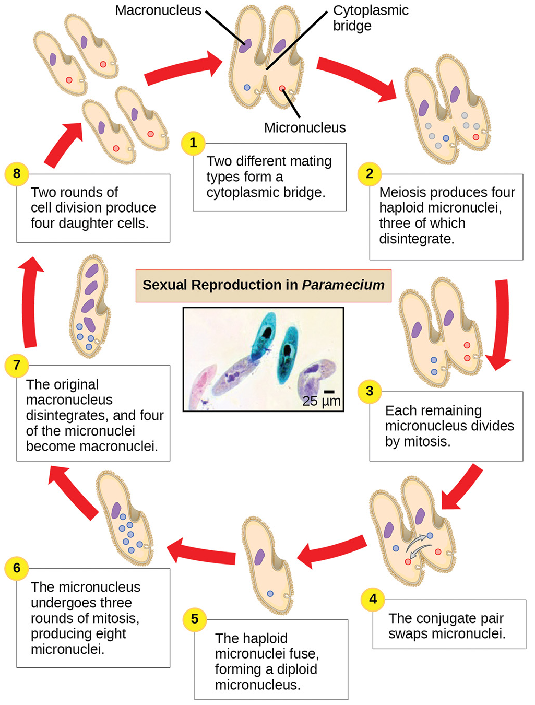
Alveolates: Ciliates—Paramecium Sexual Reproduction₂
  In each conjugative cell:
    The 2 haploid micronuclei fuse to form a diploid pre-micronucleus.
    The pre-micronucleus undergoes 3 rounds of mitosis to produce 8 copies.
    The original macronucleus disintegrates.
    Four of the pre-micronuclei become full-fledged macronuclei.
    Two cycles of cell division yield 4 new Paramecia, each with a micronucleus and a macronucleus.
23.2 Figure 21

Slide 66
Chromalveolata: Stramenophiles₁
Stramenophiles:
Include photosynthetic marine algae and heterotrophic protists ranging from single-celled organisms to massive multicellular kelp
  Diatoms
  Brown algae
  Golden algae
  Oomycetes
Have chloroplasts derived from red algae

Slide 67
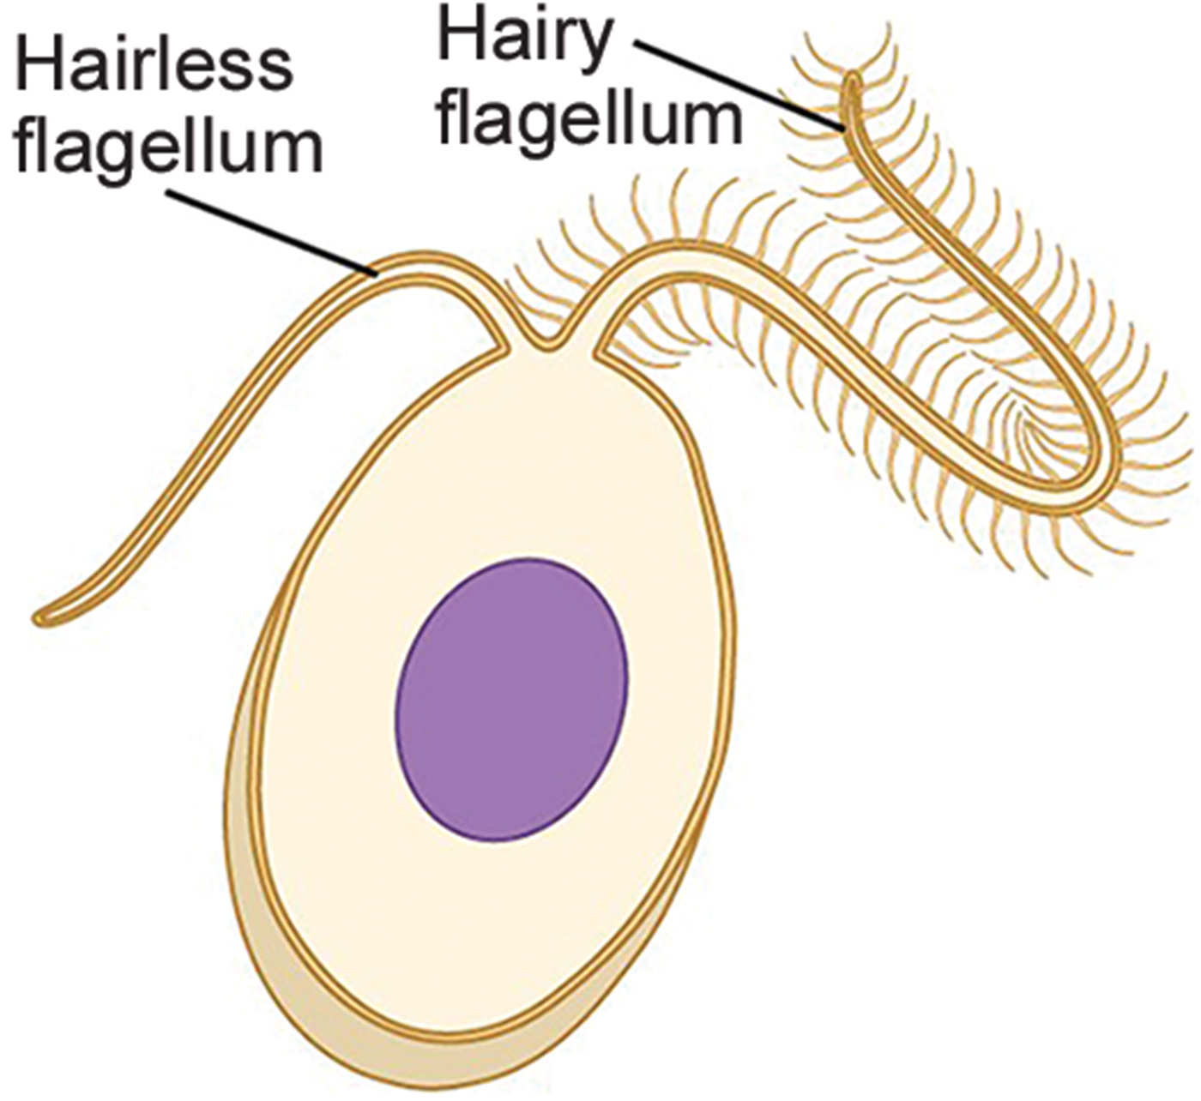
Chromalveolata: Stramenophiles₂
Stramenophiles:
Each have a textured ("hair") flagellum
Each often also have an additional hairless flagellum
23.2 Figure 22
CNX OpenStax on Wikimedia Commons. "Stamenophile."

Slide 68
Stramenophiles: Diatoms₁
Diatoms:
Are unicellular photosynthetic protists
Encase themselves in intricately patterned, glassy cell walls composed of silicon dioxide in an organic matrix
Are among the freshwater and marine plankton
Commonly reproduce asexually and less frequently through sexual reproduction and sporulation
Sometimes have a raphe (a slit) in their silica shell
  Expelling mucopolysaccharides from the raphe allows them:
    To attach to surfaces
    To propel themselves in one direction

Slide 69
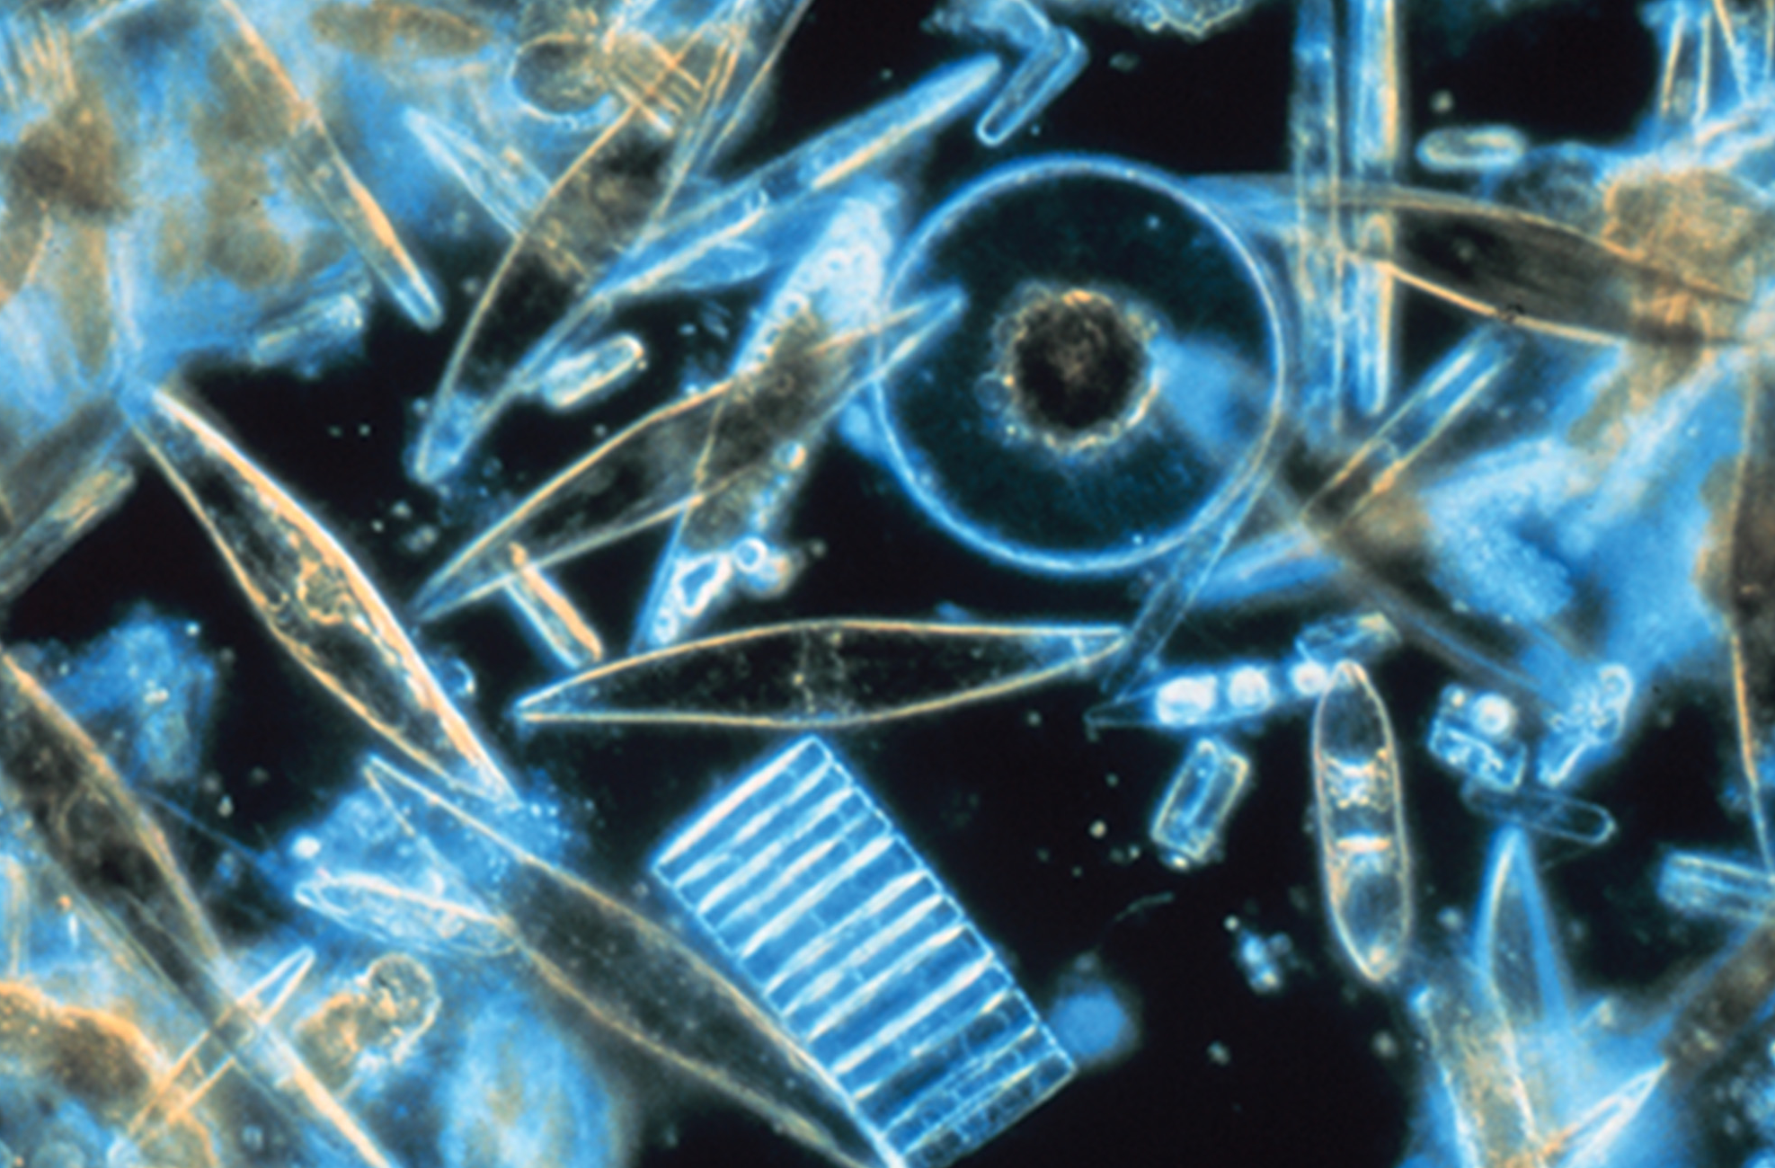
23.2 Figure 23
Prof. Gordon T. Taylor, Stony Brook University on Wikimedia Commons. "Diatoms."
Notes:
23.2 Figure 23: Assorted diatoms, visualized here using light microscopy, live among annual sea ice in McMurdo Sound, Antarctica. Diatoms range in size from 2 to 200 μm.

Slide 70
Stramenophiles: Diatoms₂
Diatoms:
Bloom during nutrient availability and are consumed by aquatic organisms
Die when in excess and sink to the sea floor where they are inaccessible to saprobe feeding
  The CO₂ that diatoms consume is not returned to the atmosphere, helping to maintain a balance carbon cycle.

Slide 71
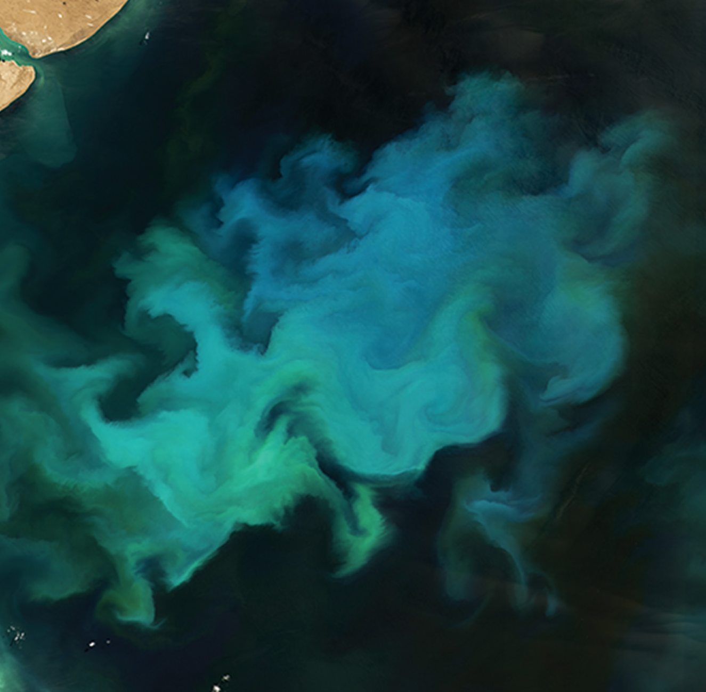
23.2 Figure 24
Lauren Dauphin, ASA Earth Observatory on Wikimedia Commons. "Phytoplankton."
Notes:
23.2 Figure 24: Runoff from rivers and upwelling of water from deep ocean currents bring nutrients to the ocean surface, fueling phytoplankton growth that can be seen from space in satellite images.

Slide 72
Group Activity₂
A significant fraction of ocean phytoplankton is composed of various protists, including diatoms, dinoflagellates, Foraminiferans, and choanoflagellates (Figure 24). Many have outer shells, or tests, made of calcium carbonate or cellulose. The carbon in calcium carbonate and cellulose are derived from carbon dioxide, a greenhouse gas.
In a group, discuss how protist phytoplankton represent an important sink, or storage, for global atmospheric carbon dioxide and its relation to global climate change.

Slide 73
Think It Through
Determine whether the shell/test of the given protist groups are made of silicon dioxide, cellulose, or calcium carbonate.
Diatom
Dinoflagellate
Foraminiferans
Notes:
Originally an On Your Own. This is included here to use as a talking point or for a think-pair-share activity.

Slide 74
Stramenophiles: Golden Algae
Golden algae:
Are usually unicellular (although there are some species that can form large colonies)
Are golden due to their extensive carotenoids (photosynthetic pigments that are yellow or orange)
Are found in both freshwater and marine environments
Are among the freshwater and marine plankton

Slide 75
Stramenophiles: Brown Algae
Brown algae:
Are primarily marine, multicellular organisms known as seaweeds (Example: giant kelps)
May have evolved specialized
  Rootlike holdfasts
  Stemlike stipes up to 60 m long
  Leaflike blades that photosynthesize
Have a variety of life cycles, including alternation of generations
Example: Laminaria

Slide 76
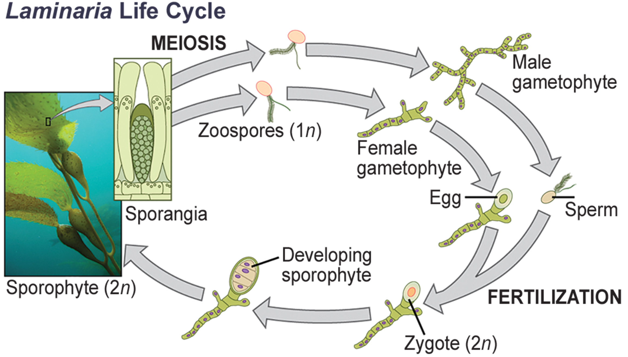
23.2 Figure 25
CNX OpenStax on Wikimedia Commons. "Laminaria life cycle."
Notes:
23.2 Figure 25: Several species of brown algae, such as the Laminaria shown here, have evolved life cycles in which both the haploid (gametophyte) and diploid (sporophyte) forms are multicellular. The gametophyte is different in structure than the sporophyte.

Slide 77
Stramenophiles: Oomycetes
Oomycetes (the "egg fungus," water molds):
Have a fungus-like morphology, but sequence data shows they are not closely related to fungi
Have cellulose-based cell walls and extensive filament networks for nutrient uptake
Often have 2 oppositely directed flagella (one hairy and one smooth) for locomotion as diploid spores
Are nonphotosynthetic
Include many saprobes and parasites
  They appear as white fluffy growths on dead organisms
Are usually aquatic, but some parasitize terrestrial plants
  Example: Phytophthora infestans caused Irish potato famine.

Slide 78
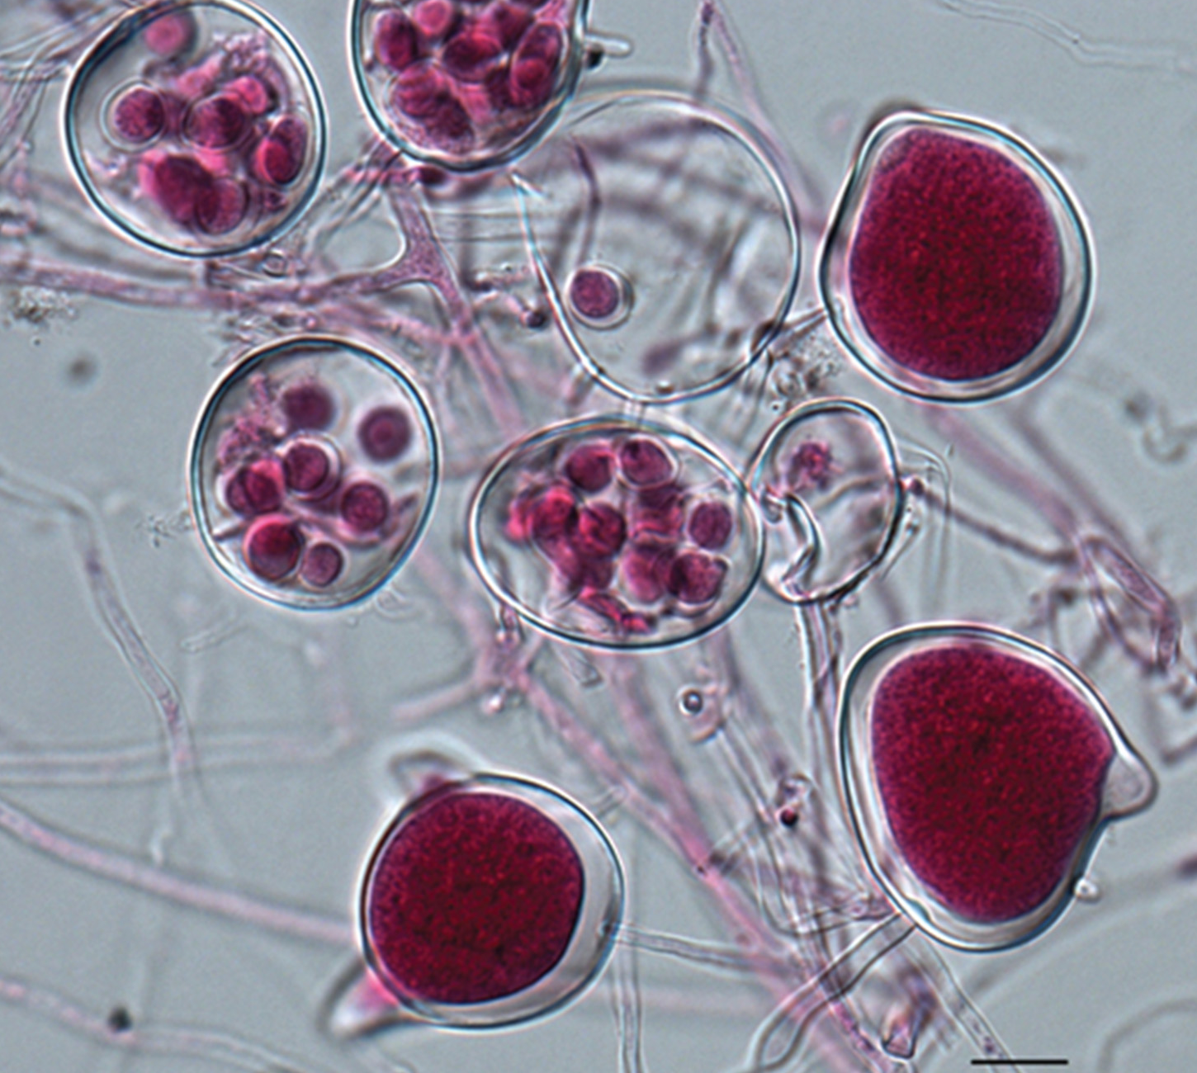
23.2 Figure 26
Onco p53 on Wikimedia Commons. "Phytophthora agathidicida."
Notes:
23.2 Figure 26: A saprobic oomycete, Phytophthora agathidicida, causes root rot in some tree species.

Slide 79
Supergroup Excavata
Excavata:
Are commonly asymmetrical, single-celled organisms with a groove "excavated" from one side
Include heterotrophic predators, photosynthetic species, and parasites
Have a variety of modified mitochondria as well as chloroplasts derived from green algae by secondary endosymbiosis
Include:
  Diplomonads (usually symbionts or parasites)
  Parabasalids (usually symbionts or parasites)
  Euglenozoans (usually free-living)

Slide 80
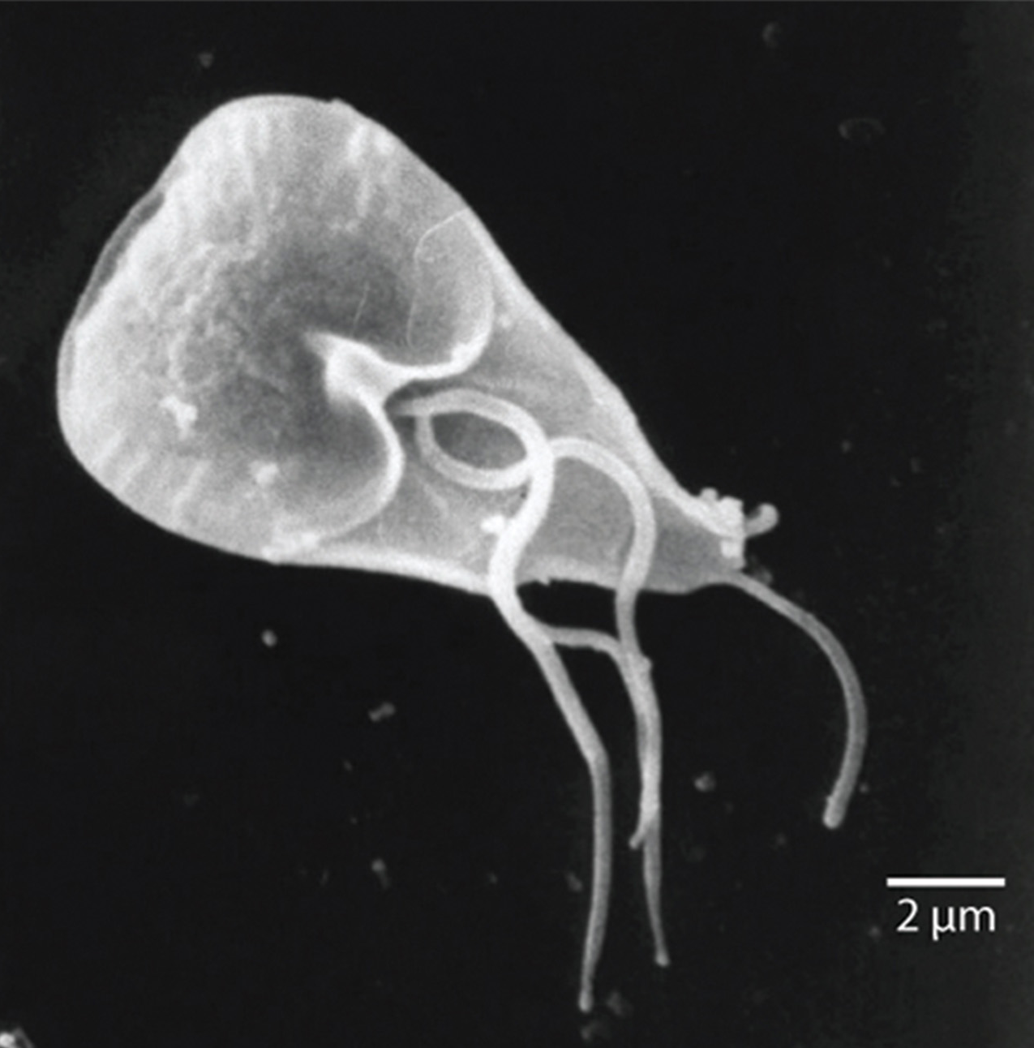
Excavata: Diplomonads
Diplomonads:
Have mitosomes (mitochondrial remnant organelles) that function in Fe and S metabolism, but not as respiratory organelles
Live in anaerobic environments using other pathways like glycolysis to generate energy
Each have 2 similar but not identical haploid nuclei
Each have 4 pairs of locomotor flagella that are deeply rooted in basal bodies that lie between the nuclei
23.2 Figure 27: Giardia lamblia, an intestinal parasite that causes diarrhea when ingested, is a diplomonad.
Janice Haney Carr, CDC on Wikimedia Commons. "Giardia lamblia."

Slide 81
Excavata: Parabasalids
Parabasalids:
Are named for the parabasal apparatus consisting of a Golgi complex with cytoskeletal fibers
Each have an axostyle, a bundle of fibers running the cell’s length and beyond, in the cytoskeleton
Move with flagella and membrane rippling
Have hydrogenosomes, modified mitochondria that function anaerobically to produce H₂ gas
Include Trichomonas vaginalis, which causes a human STD
  Men rarely show symptoms
  Women become more susceptible to HIV infection, are more likely to develop cervical cancer, and are at risk for preterm delivery if pregnant
Colonize the rumens of ruminants and the guts of termites, digesting cellulose
  These have multiple flagella and may recruit spirochetes

Slide 82
Excavata: Euglenozoans
Euglenozoans (euglenoids):
Include parasites, heterotrophs, autotrophs, and mixotrophs
Range in size from 10–500 μm
Use their 2 long flagella to move through aquatic habitats towards light sensed by their eyespots
Include 2 important genera:
  Euglena
  Trypanosoma

Slide 83
Euglenozoans: Euglena
Euglena:
Include some mixotrophs that show the ability to photosynthesis only when light is present
  In the dark, their chloroplasts shrink up and stop working, while their cells take in organic nutrients.
Have chloroplasts descending from a green alga by secondary endosymbiosis
Each have a tough pellicle composed of protein bands attached to the cytoskeleton
  These bands spiral around the cell, giving it its flexibility.

Slide 84
Euglenozoans: Trypanosoma
Trypanosoma (trypanosomes):
Are kinetoplastids, meaning each has a kinetoplast, a large, modified mitochondrion carrying multiple circular DNAs
Infect insects and humans, causing disease
  T. brucei develops in the tsetse fly's gut after biting an infected human or mammal
    It travels to the insect's salivary glands and is introduced to a new host when the fly bites them and consumes another blood meal.
    It is common in central Africa and causes African sleeping sickness (which involves chronic fatigue, a coma, and possible death).

Slide 85
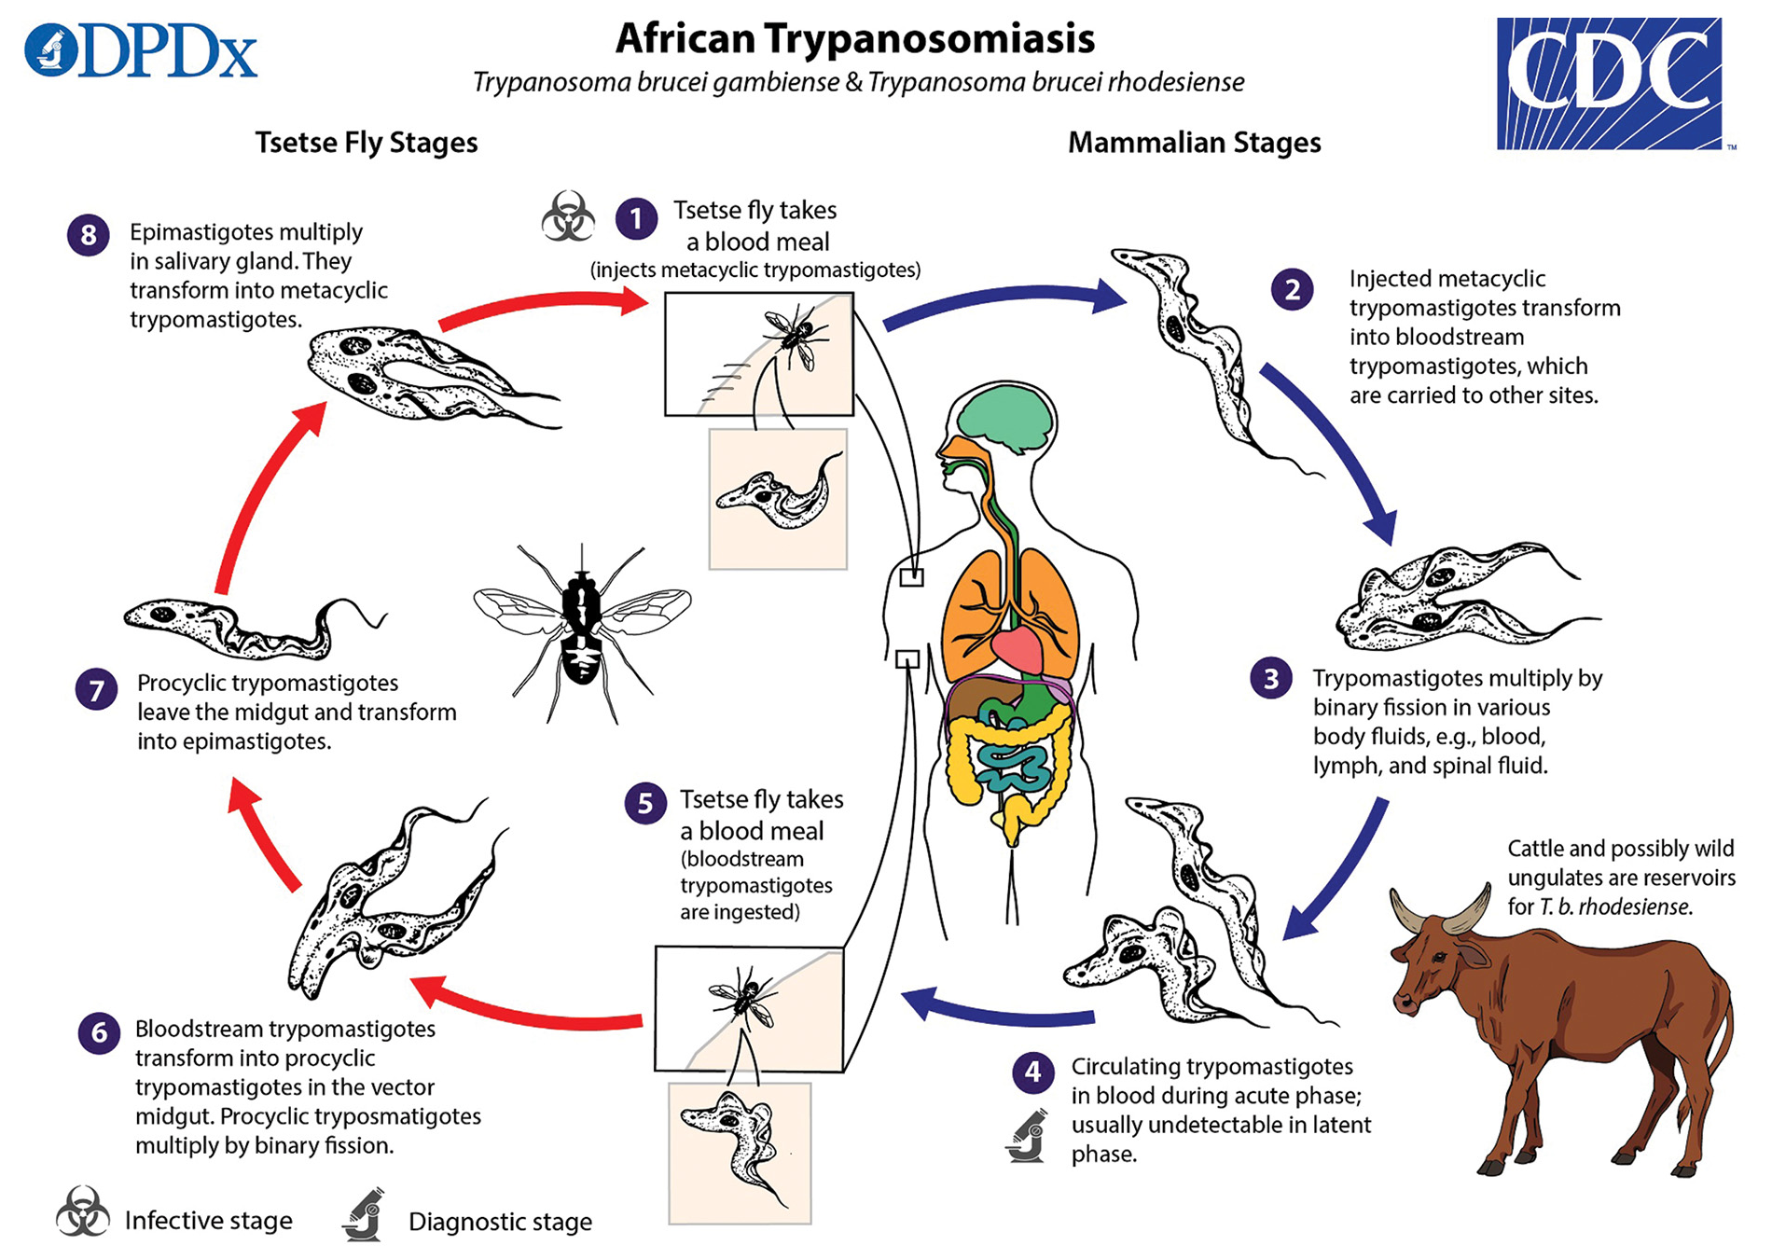
23.2 Figure 28
DPDx on Wikimedia Commons. "African Trypanosoma life cycle."
Notes:
23.2 Figure 28: Trypanosoma brucei, the causative agent of sleeping sickness, spends part of its life cycle in the tsetse fly and part in humans.

Slide 86
Summary
Protists are diverse because they are an artificial assembly of phylogenetically unrelated groups.
  They display highly varied cell structures, several reproductive strategies, many types of nutrition, and varied habitats.
  Most protists are motile but have a variety of structures for locomotion.
  They have been difficult to classify.
Protists are currently found in 6 supergroups that create clusters of species all derived from a common ancestor, but the DNA evidence supports some of these more than others.
  The supergroups include: Archaeplastida, Amoebozoa, Opisthokonta, Rhizaria, Chromalveolata, and Excavata
  There are both commonalities and variations within each supergroup.

Slide 87


End of Hawkes Learning PowerPoint

