Slide 1
Lesson 23.3
Ecological Roles of Protists

Slide 2
Objectives
Describe important pathogenic species of protists.
Describe the role that protists play in the ecosystem.

Slide 3
Ecological Roles of Protists
Essential components of food chain and generators of biomass
Function in decomposition of organic materials
Dangerous human pathogens
Causative agents of plant diseases

Slide 4
Primary Producers/Food Sources₁
Essential sources of food and provide nutrition for other organisms
Consumed freely in some cases
Protists as producers of nutrition
  Mixotrophs like Paramecium bursaria and species of ciliates in symbiosis with green algae
    Green algae provide food for Paramecium in return for shelter and nutrients
    Temporary endosymbiosis (algae can leave protist and survive on their own)

Slide 5
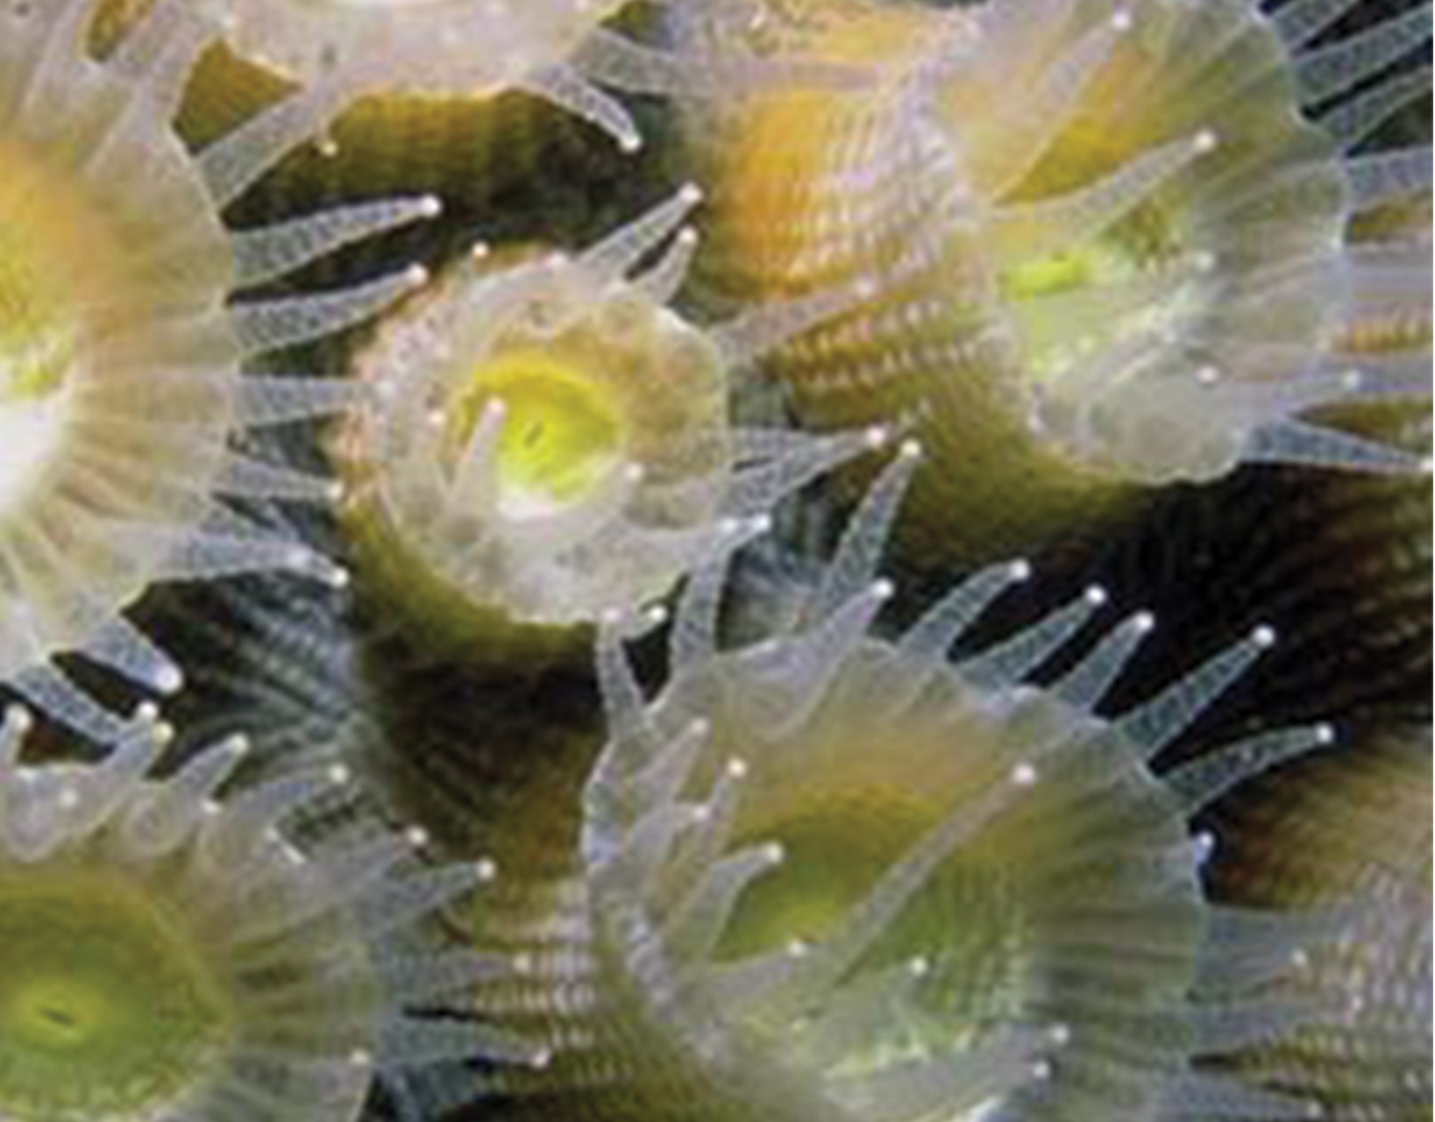
Primary Producers/Food Sources₂
Example: Zooxanthellae provide nutrients for coral polyps that house them (gives corals boost of energy to secrete CaCO₃ skeleton) and corals provide protist with protected environment and compounds for photosynthesis
  Important in nutrient-poor environments
  Without these protists, coral bleaching occurs and coral dies
23.3 Figure 1: Coral polyps obtain nutrition through a symbiotic relationship with dinoflagellates.
Nbharakey on Wikimedia Commons. "Coral polyps."

Slide 6
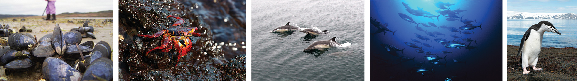
Primary Producers/Food Sources₃
Protists and products of photosynthesis essential for aquatic food chains
  Conduct ~25% of world's photosynthesis (photosynthetic protists, dinoflagellates, diatoms, multicellular algae)
Some anaerobic parabasalid species perform essential step in digestion of cellulose for termites and wood-eating cockroaches
23.3 Figure 2: Protists contribute to the food chain. Virtually all aquatic organisms depend directly or indirectly on protists for food.
Derrick Mercer on Wikimedia Commons. "Mussels."
Marc Dove on Wikimedia Commons. "Crab."
National Marine Sanctuaries on Wikimedia Commons. "Dolphins."
Danilo Cedrone (United Nations Food and Agriculture Organization) on Wikimedia Commons. "Tuna."
Christopher Michel on Wikimedia Commons. "Penguin."

Slide 7
Group Activity
The Great Barrier Reef off the east coast of Australia is the largest living structure that can be seen from space. The second largest barrier reef, the Belize Barrier Reef, is found off the east coast of Belize in Central America. Finally, the third largest barrier reef, the Florida Reef, is found off the east coast of the Florida Keys of the United States.
Symbiotic dinoflagellates are essential for building up the calcium carbonate skeletons that make up the physical structure of coral reefs.
Coral reefs can act as physical barriers to rough seas and tropical storms, protecting coastlines from erosion. As a group, discuss some of the other ecosystem services that coral reefs provide to human civilization.

Slide 8
Human Pathogens
Pathogen is anything that might cause disease
Parasites live in or on host and harm host
Some protists are pathogenic parasites
  Causative agents for malaria, African sleeping sickness, amoebic encephalitis, and waterborne gastroenteritis
  Others are agents for massive destruction of food crops

Slide 9
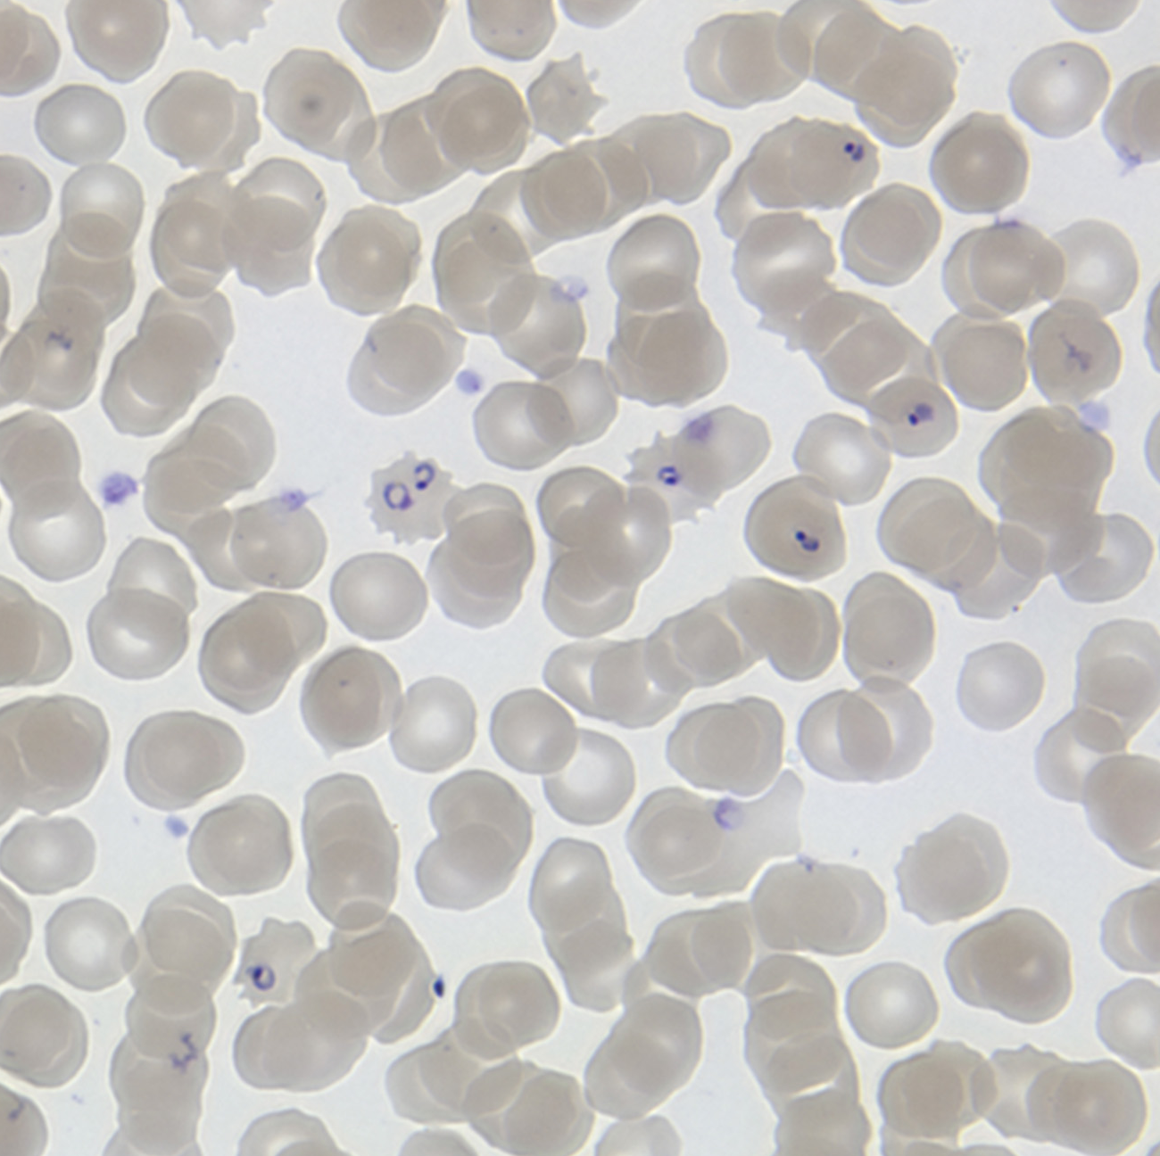
Plasmodium Species₁
In 2020, 241 million cases of malaria (mostly in Africa, South America, and southern Asia as well as Michigan in the United States)
  Prevalent in areas with many swamps and lakes
  Symptoms: Pale, sallow, bloated faces then eventual death
  More deaths in late 1800s than the Civil War
  Caused by several species of Plasmodium
Plasmodium require mosquito and vertebrate to complete life cycle
  Parasite develops in liver cells of vertebrate (exoerythrocytic stage) and goes on to infect red blood cells (erythrocytic stage), bursting and destroying blood cells with each asexual replication cycle
23.3 Figure 3: These red blood cells are infected with P. falciparum, the causative agent of malaria.
MichaelZahniser on Wikimedia Commons. "Malaria parasite."

Slide 10
Plasmodium Species₂
Of four Plasmodium species, P. falciparum accounts for 50% of malaria cases and primary (and deadliest) cause of disease-related fatalities in tropical regions of the world
  Caused 627,000 deaths in mostly African children in 2020
  Can infect and destroy more than half of circulating blood cells, which causes massive inflammatory response (episodes of delirium-inducing fever [paroxysms] as parasites lyse red blood cells), leading to severe anemia and spilling parasite waste into bloodstream
P. falciparum transmitted by Anopheles gambiae mosquito
  Having one copy of sickle hemoglobin (HbS) allele results in malaria resistance
    Causes red blood cells with abnormal sickle (crescent) shape
      Porous and leak nutrients parasites need to survive
      Body breaks down abnormal cells, destroying parasite
    If more than one copy of HbS allele, no normal red blood cells to make up for abnormal ones and individual inherits sickle cell disease

Slide 11
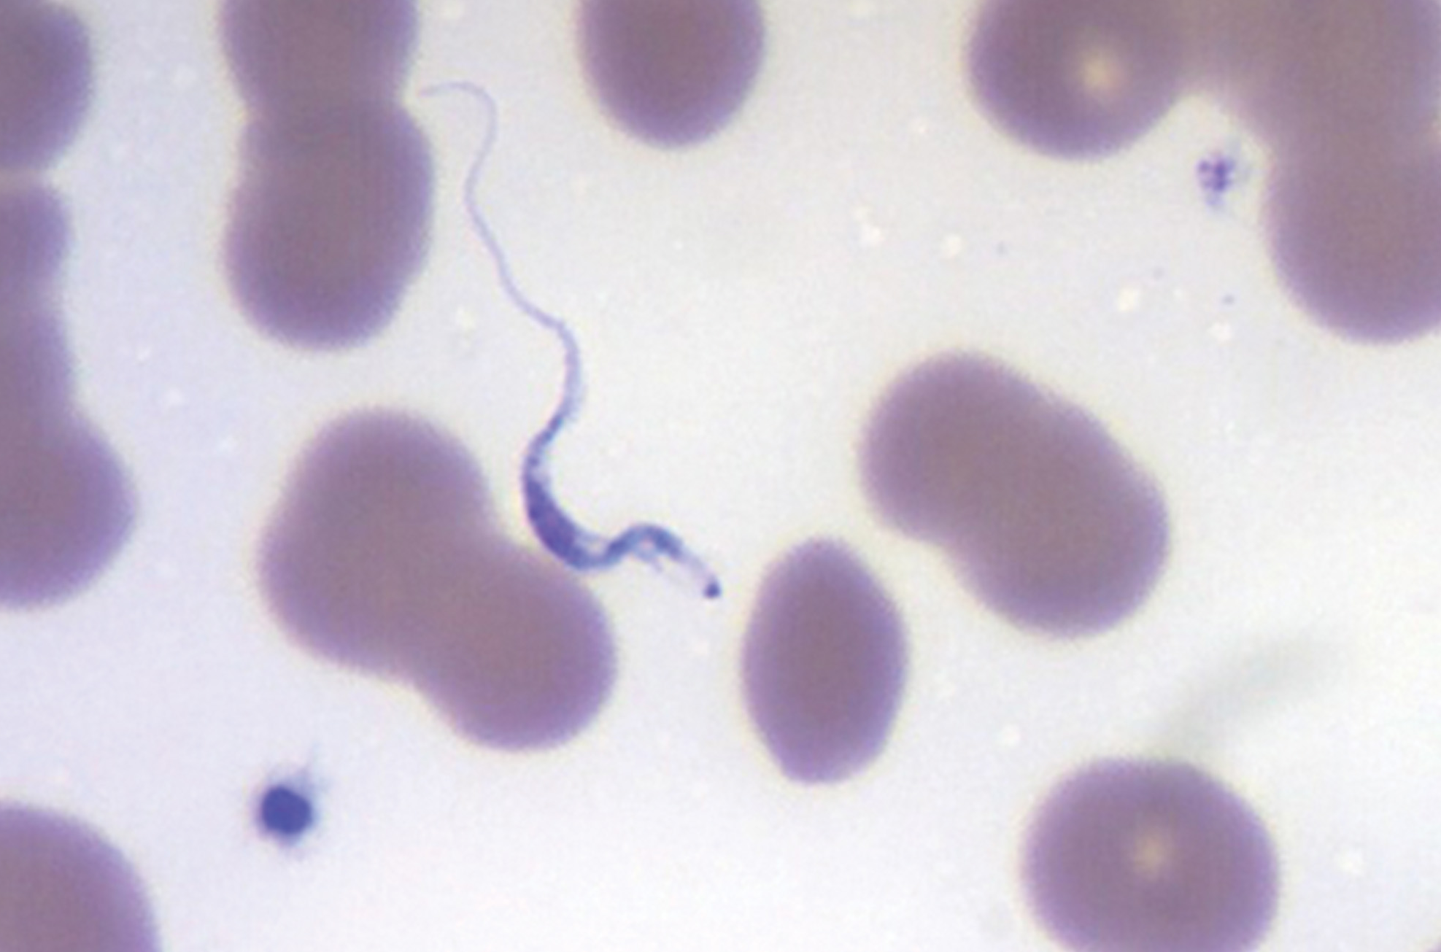
Trypanosomes₁
Trypanosoma brucei transmitted by tsetse flies (Glossina spp.)
  A flagellated endoparasite (parasite that lives within internal organs/tissues of host)
  Causes nagana in cattle and horses and African sleeping sickness in humans
  Tricks immune system by changing its thick layer of surface glycoproteins with each infectious cycle
    Makes it capable of replicating with immune system never succeeding in clearing parasite
  Cases decreasing (2009 had fewer than 10,000 cases in all of sub-Saharan Africa, lowest in 50 years)
23.3 Figure 4: Trypanosomes are shown among red blood cells.
Ed Uthman on Wikimedia Commons. "African trypanosome."

Slide 12
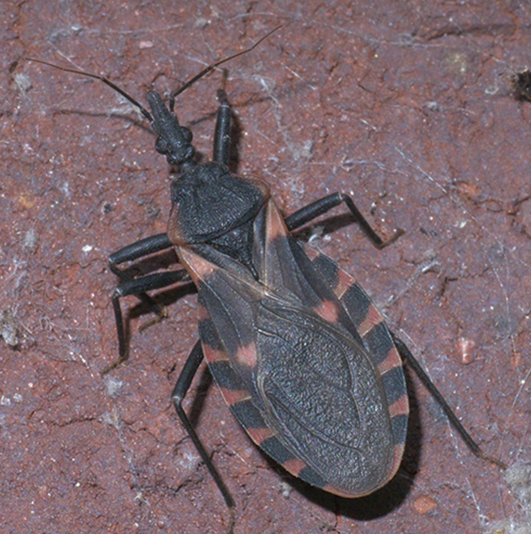
Trypanosomes₂
Another species (T. cruzi) responsible for Chagas disease
  Transmitted by "kissing bugs" (Triatoma)
    Bite host during the night and defecate on wound, transmitting trypanosome to victim
    Victim scratches wound, further inoculating site with trypanosomes
    Individuals enter chronic phase after 10 weeks but never develop further symptoms
    30% of cases lead to damage in heart and digestive system, causing malnutrition and heart failure
  6–7 million people infected with Chagas disease
  Caused 10,000 deaths in 2021
23.3 Figure 5
Robert Webster, xpda.com on Wikimedia Commons. "Triatoma sanguisuga."

Slide 13
Science and You
Treating parasitic infections caused by trypanosomes (genus Trypanosoma) difficult since they can cross blood-brain barrier and infect the brain
  Blood-brain barrier: Physical barrier formed by thin layer of cells that prevents trafficking of cells and diffusion of large molecules into central nervous system
    Makes it difficult to treat infections of the brain because most medicines and body's own immune cells can't cross the barrier
    Discovered by injecting dyes (trypan blue) into living mammals and seeing that the dye went everywhere except the brain, indicating presence of a barrier
    All living cells have semipermeable plasma membrane to prevent diffusion of large molecules into cytoplasm, except when undergoing endocytosis when cells will uptake solutes from extracellular space
Trypanosomes use endocytosis to uptake nutrients from host environment and will be stained blue when exposed to trypan blue (their namesake)
Notes:
This is included as a relevant application for this topic.

Slide 14
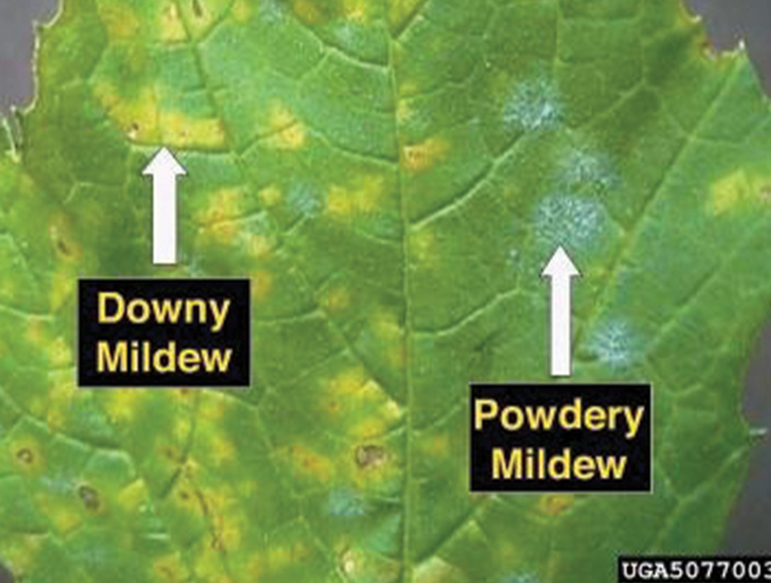
Plant Parasites₁
Protist parasites of terrestrial plants destroy food crops
  Oomycete Plasmopara viticola parasitizes grape plants causing downy mildew
    Appear stunted with discolored, withered leaves
    Nearly collapsed French wine industry in nineteenth century
23.3 Figure 6: Downy mildew on this grape leaf is caused by an infection of P. viticola.
USDA ARS on Wikimedia Commons. "Powdery mildew."

Slide 15
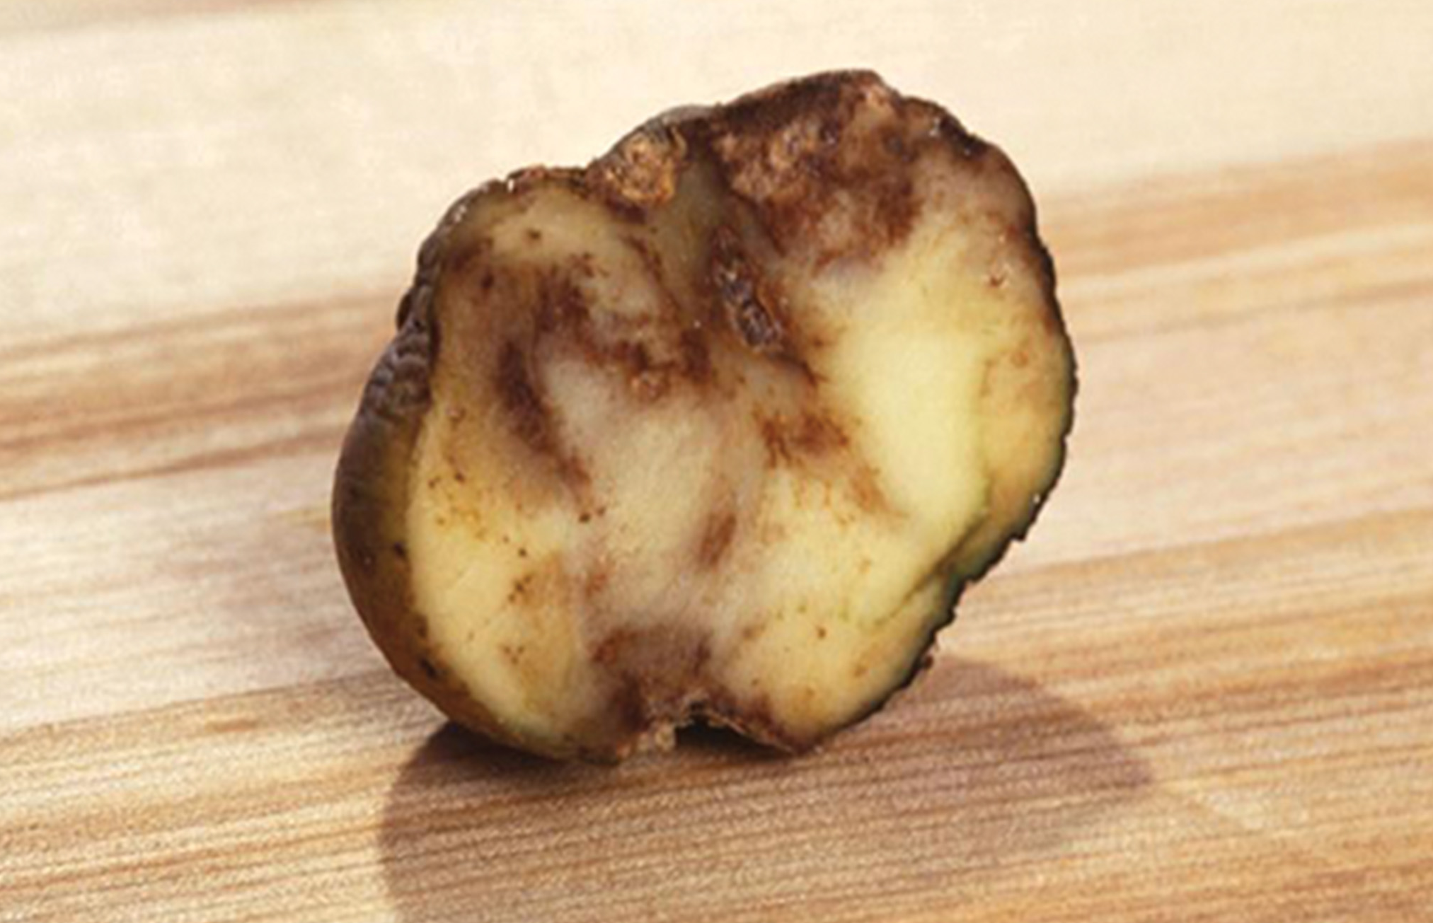
Plant Parasites₂
Oomycete Phytophthora infestans responsible for potato late blight
Causes potato stalks and stems to decay into black slime
Caused Irish potato famine in nineteenth century that killed 1 million people and led to emigration of 1 million more from Ireland
Continues to infect plants today, killing 70% of crops when no pesticides are used
23.3 Figure 7: These unappetizing remnants result from an infection of P. infestans, the causative agent of potato late blight.
Scott Bauer on Wikimedia Commons. "Phytophthora infestans."

Slide 16
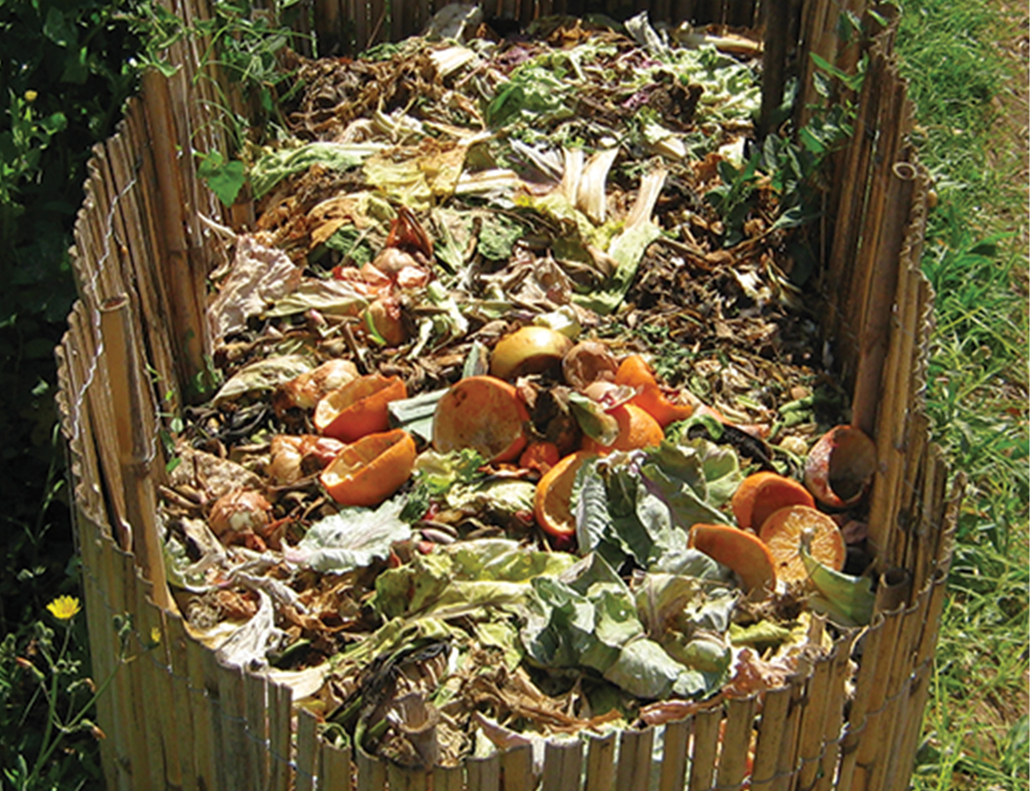
Protist Decomposers
Saprobes include protists, fungi, and bacteria
Saprobes specialized to absorb nutrients from nonliving organic matter (dead organisms and their wastes)
  Return inorganic nutrients to the soil and water, which allows new plant growth, generating sustenance for other organisms in food chain
  Keeps organic carbon from being tied up in dead organisms
23.3 Figure 8: Saprobes are essential for the decomposition of decaying matter in compost.
Goyojona on Wikimedia Commons. "Compost."

Slide 17
Summary
Protists function as:
  Primary producers
  Direct food sources
  Decomposers
  Parasites of plants and animals (causing deadly human diseases or destroying crops)

Slide 18


End of Hawkes Learning PowerPoint

