Slide 1
Lesson 24.1
Characteristics of Fungi

Slide 2
Objectives
Describe the composition of the mycelium.
Describe the mode of nutrition of fungi.
Explain sexual and asexual reproduction in fungi.
List the characteristics of fungi.

Slide 3
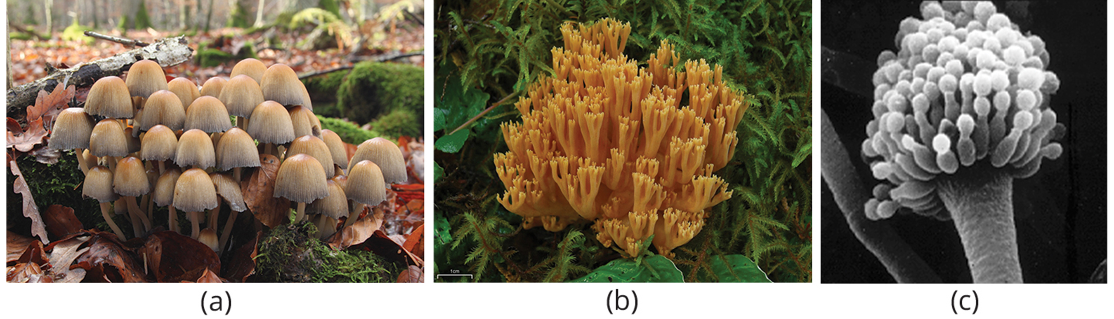
Fungi
Eukaryotic organism that contains true nucleus and many membrane-bound organelles
Over 135,000 identified species, estimated 1.5 million total species on Earth
Includes edible mushrooms, yeasts, black mold, and producer of antibiotic penicillin (Penicillium rubens)
Kingdom Fungi, domain Eukarya
24.1 Figure 1: (a) Many species of fungus produce the familiar mushroom, which is a reproductive structure. (b) This is a coral fungus. (c) The spore-bearing structures of Aspergillus, a type of toxic fungus found mostly in soil and plants.
Holger Krisp on Wikimedia Commons. "Mushrooms."
Jason Hollinger on Wikimedia Commons. "Coral fungus."
NIH on Wikimedia Commons. "Aspergillus fumigatus."

Slide 4
Characteristics of Fungi₁
More closely related to animals than plants
Cannot photosynthesize
Heterotrophic: organisms that use complex organic compounds as sources of energy and carbon
Cell walls made of chitin (nitrogen-containing polysaccharide), also found in arthropod exoskeletons (e.g., crabs and spiders)
Produce pigments like melanin, also found in hair and skin of animals
Store carbohydrates as glycogen, like animals
Glycogen: a branched glucose storage polymer
Absorb nutrients across cell surface and act as decomposers, like bacteria

Slide 5
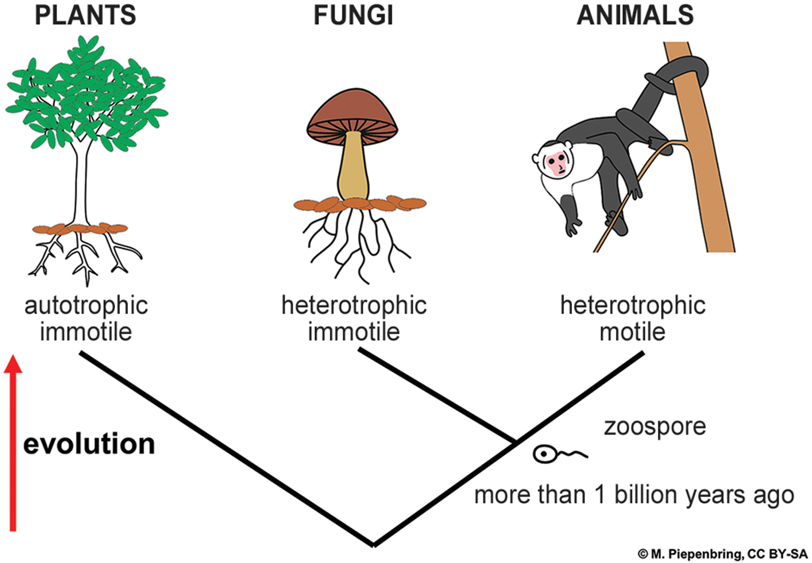
24.1 Figure 2
Prof. Meike Piepenbring on Wikimedia Commons. "Evolution of fungi, animals, and plants."
Notes:
Figure 2: Fungi are heterotrophic, immotile (meaning they cannot move on their own), and more closely related to animals than plants.

Slide 6
Characteristics of Fungi₂
Some can only reproduce asexually.
Others can undergo both asexual and sexual reproduction.
With alternation between haploid (1n; having one set of chromosomes) and diploid (2n; having two sets of chromosomes)
Similar to alternation of generations in plants, but in fungi, haploid state is dominant
Produce large number of spores
Spore: haploid cell that can produce a haploid multicellular organism or can fuse with another spore to form a diploid cell

Slide 7
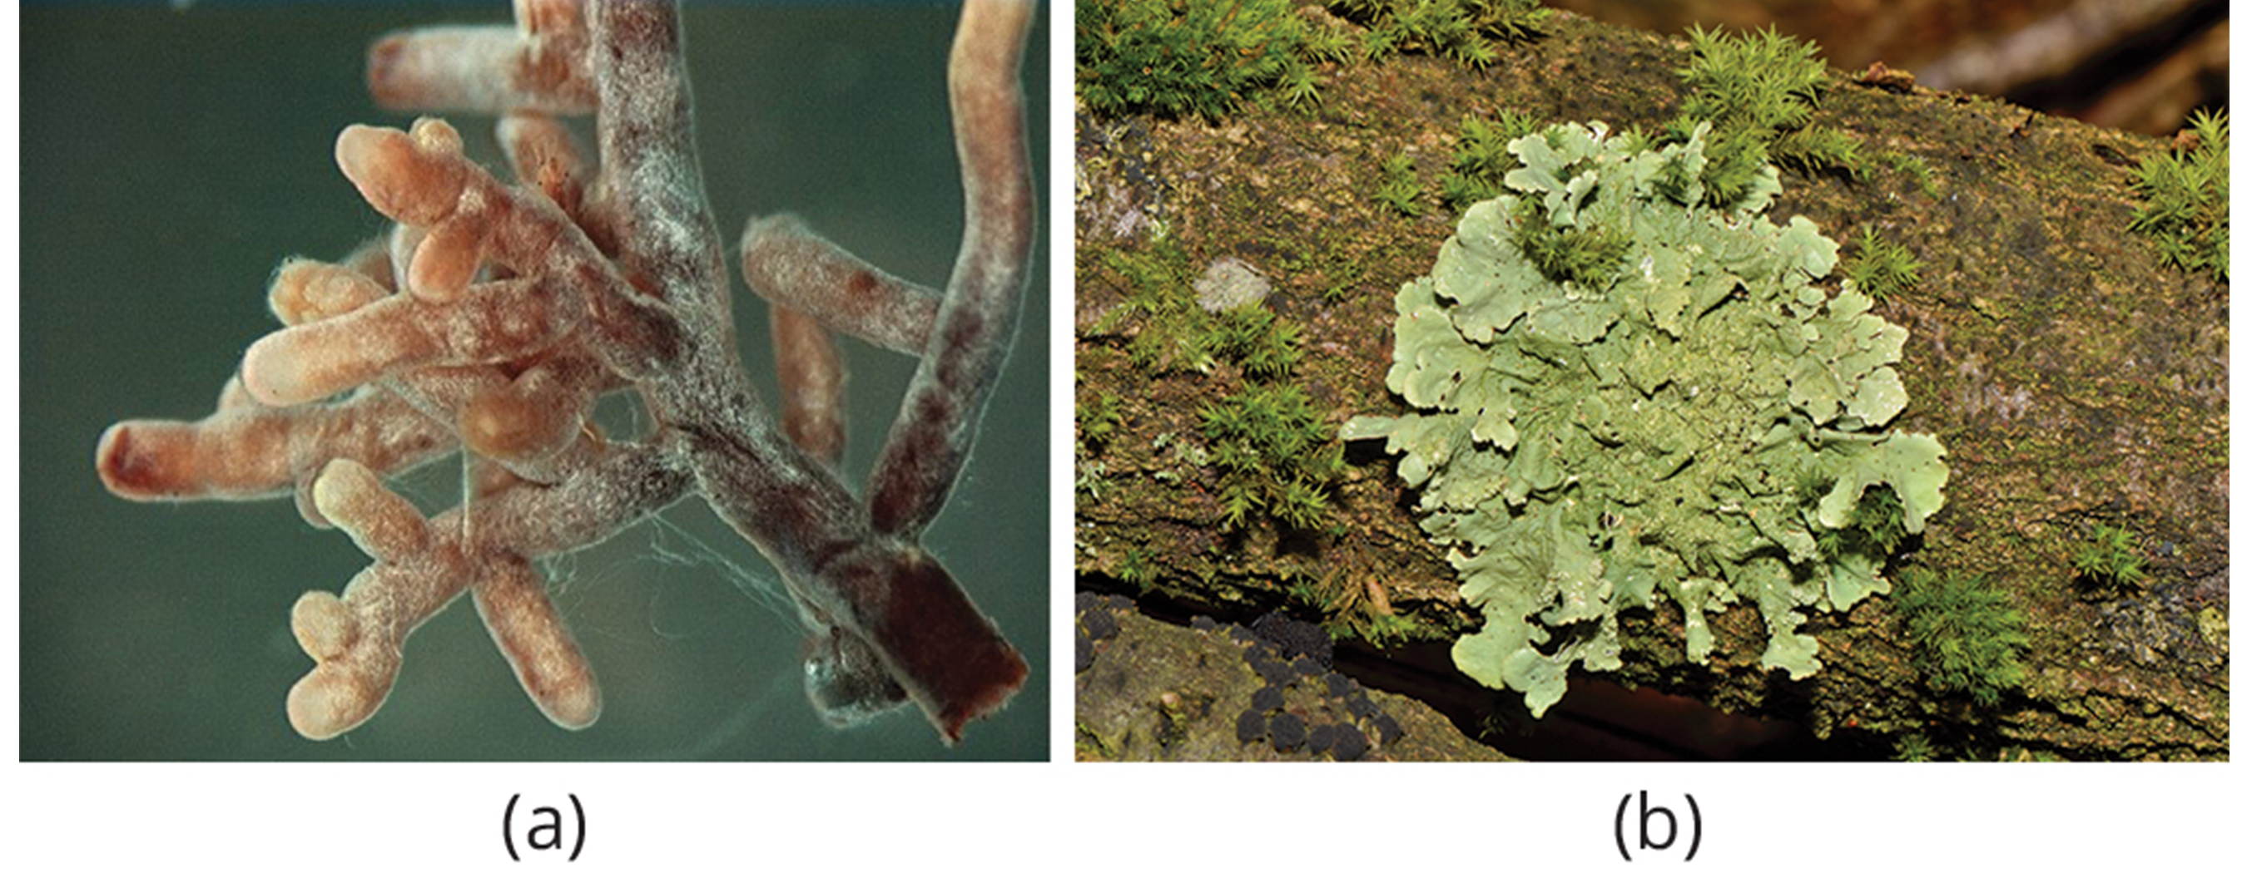
Characteristics of Fungi₃
Often form beneficial or mutualistic associations
Example: Terrestrial plants with symbiotic relationships with fungi
Roots of plant connect with underground parts of fungus (mycorrhizae), where plant and fungus exchange nutrients and water
Mycorrhizae: symbiotic relationship between fungal hyphae, which provide soil minerals to the plant, and plant roots, which provide carbohydrates to the fungus
Lichens: Association between fungus and photosynthetic partner (usually alga)
Composite organisms: Express traits of both fungi and algae, though dominant is fungus
24.1 Figure 3: (a) Fungal hyphae and (b) lichens
Ellen Larsson on Wikimedia Commons. "Fungal hyphae on root tips."
Norbert Nagel on Wikimedia Commons. "Lichens."

Slide 8
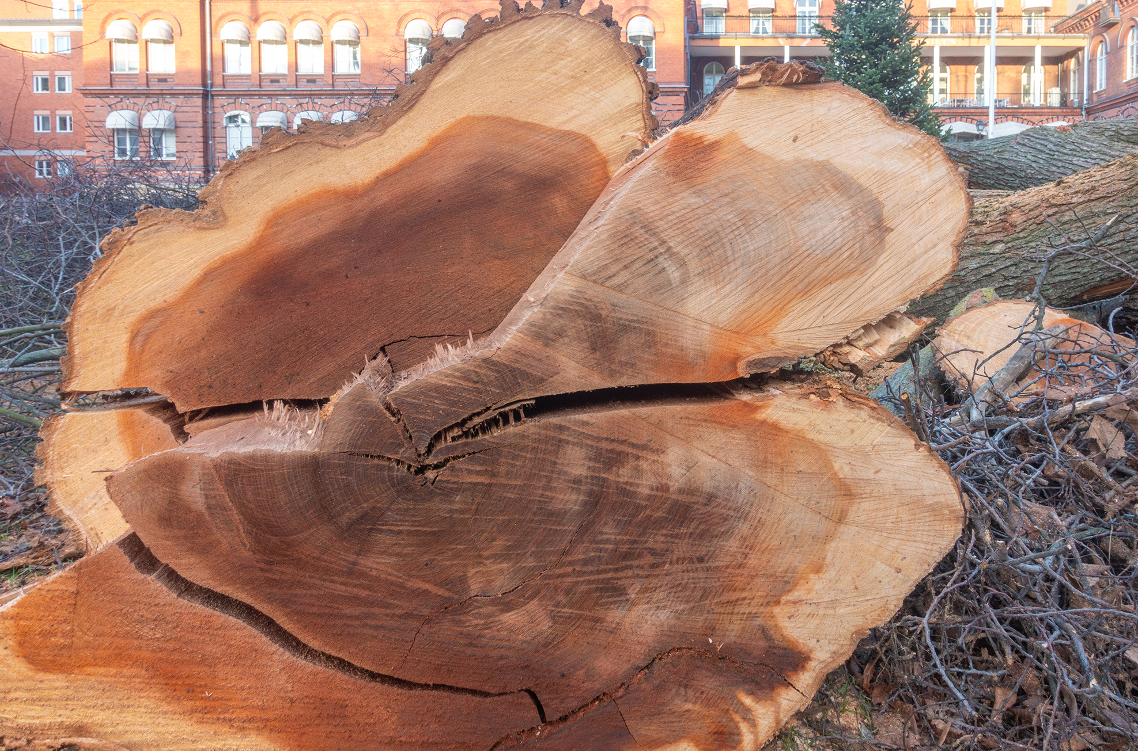
Characteristics of Fungi₄
Can cause infections in plants and animals
Example: Dutch elm disease
Caused by fungus Ophiostoma ulmi
Infects tree's vascular system
Elm bark beetle acts as vector, transmitting disease from tree to tree
Introduced to North America in 1900s
In humans, fungal infections challenging to treat and possibly deadly for individuals with compromised immune systems since fungi do not respond to traditional antibiotics because they are eukaryotes
24.1 Figure 4
Frankie Fouganthin on Wikimedia Commons. "Dutch elm disease."

Slide 9
Characteristics of Fungi₅
Commercial applications:
Food industry: Yeasts in baking, brewing, and cheese and wine making
Industrial compounds: Ethanol and other substances in fuels are byproducts of fungal fermentation
Commercial enzymes and antibiotics

Slide 10
Characteristics of Fungi₆
Mostly sessile (immobile) and seemingly rooted in place
Have stemlike structure similar to plants and rootlike mycelium in soil
Mycology: scientific study of fungi
Widespread during Devonian Period (400 million years ago); first appearance in Neoproterozoic Era (900 million years ago)
Molecular biology analysis shows fungal genome more closely related to animals than plants
Current systematic phylogenies (evolutionary histories) list them as monophyletic group

Slide 11
Science and You₁
Career: Mycologist
Biologists who study fungi, often starting with a degree in microbiology
Typically need a bachelor's degree in biological sciences and a master's degree in mycology
Specializations include taxonomy and fungal genomics, molecular and cellular biology, plant pathology, biotechnology, biochemistry
Some focus on infectious fungal diseases (mycoses)
Mycoses: (singular, mycosis) infectious diseases caused by fungi
Collaborate with zoologists and plant pathologists to identify and control fungal infections (e.g., chestnut blight, decline in frog populations, and epidemics, such as white nose syndrome)
Notes:
This is included as a relevant application for this topic.

Slide 12
Science and You₂
Career: Mycologist
Employment includes
Government agencies:
Monitoring crops, parks, and forests
Private industry:
Developing chemical and biological control products or new agricultural products
Companies that provide disease control services
Food technology and wine-making industries
Notes:
This is included as a relevant application for this topic.

Slide 13
Group Activity
As a group, make a poster showing the different processes where fungi are involved, such as in mycoses and the food industry. Include figures and historical facts, and do not forget to mention the fungi responsible for positive or negative biological events.

Slide 14
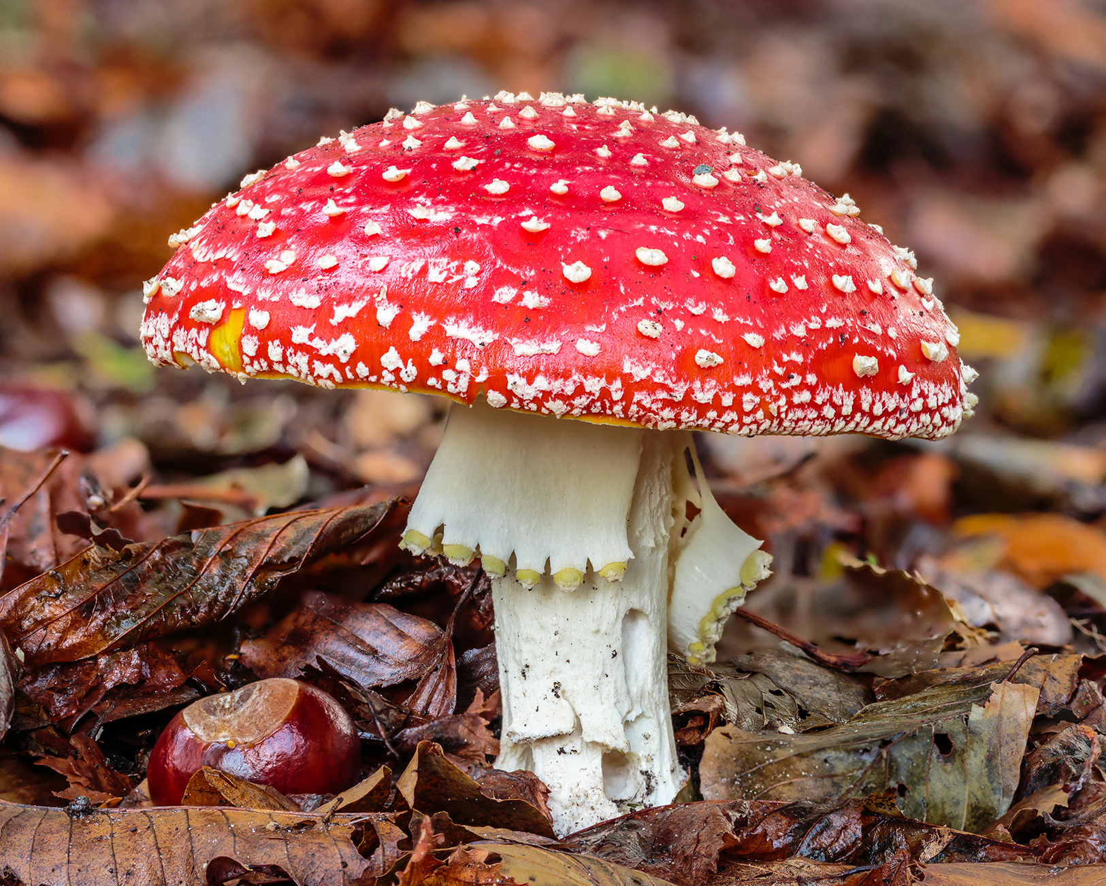
Cell Structure and Function₁
Eukaryotes with complex cellular organization and membrane-bound nucleus
DNA in nucleus organized into linear chromosomes and wrapped around histone proteins
Some have additional genomic structures comparable to bacterial plasmids (loops of DNA)
May exchange information on plasmids through horizontal gene transfer (like bacteria)
Contain mitochondria and have complex system of internal membranes, including endoplasmic reticulum and Golgi apparatus
Do not have chloroplasts or chlorophyll
Display bright colors from cellular pigments, ranging from red to green to black
Associated with cell wall and play protective role against ultraviolet radiation
Some are toxic to humans
24.1 Figure 5: The poisonous Amanita muscaria is native to temperate and boreal regions of North America.
Dominicus Johannes Bergsma on Wikimedia Commons. "Amanita muscaria."

Slide 15
Science and You₃
Fungal Strategies for Predator Avoidance
Immotile, use chemical strategies to produce secondary metabolites (compounds not required for growth or reproduction) that are poisonous
Two main strategies:
Poisonous metabolites secreted against microbial competitors
Poisonous metabolites stored in fungal cells and taken up by metazoan predators
Notes:
This is included as a relevant application for this topic.

Slide 16
Cell Structure and Function₂
Have thick cell walls (like plants) that contain complex polysaccharides called chitin and glucans
Chitin: a nitrogen-containing polysaccharide that forms the outer skeleton of all arthropods that include crustaceans and insects; it also forms fungi cell walls
Provide structural support and protect cell from desiccation (drying out) and some predators
Have plasma membranes similar to other eukaryotes except structure is stabilized by ergosterol
Ergosterol: steroid molecule that replaces the cholesterol in animal cell membranes
Most are immotile but some spores and gametes (in phylum Chytridiomycota) have flagella, which allow for some mobility

Slide 17
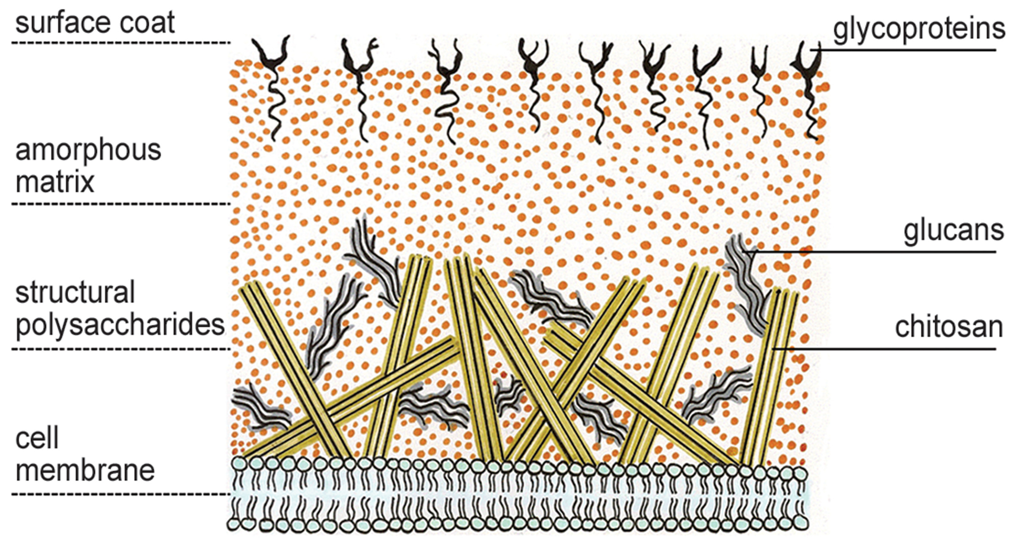
24.1 Figure 6
Maya and Rike on Wikimedia Commons. "Fungi cell wall structure."
Notes:
Figure 6: The cell wall is a characteristic structure of fungi composed mainly of glucans, chitin (converted into chitosan), and glycoproteins.

Slide 18
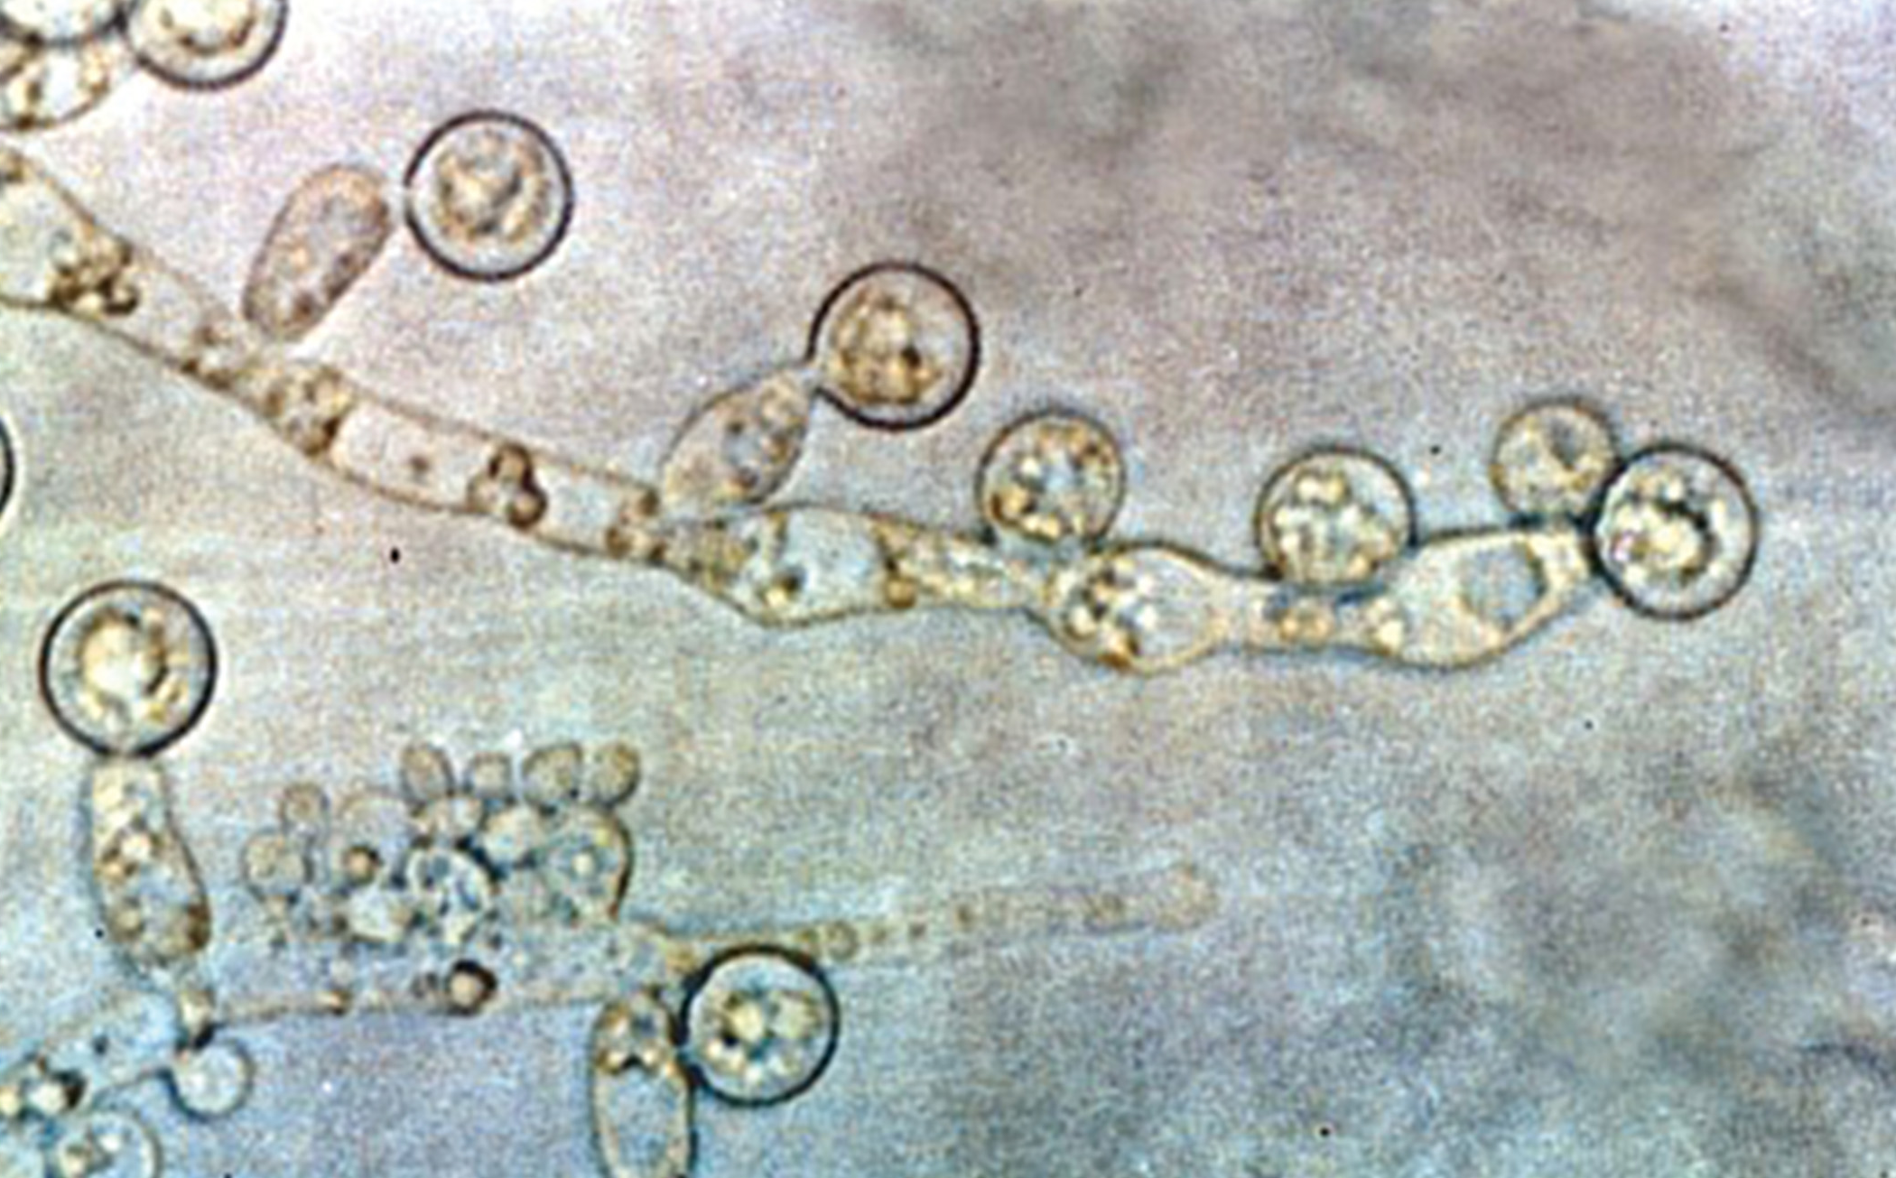
Growth₁
Vegetative body is unicellular or multicellular thallus
Unicellular fungi: Yeasts
Yeast: general term used to describe unicellular fungi
Examples: Saccharomyces cerevisiae (baker's yeast) and most Candida species (thrush and common fungal infection)
Multicellular fungi produce hyphae
Hypha: (plural, hyphae) fungal filament composed of one or more cells
Examples: Molds and mushrooms
Dimorphic fungi can change from unicellular to multicellular depending on environment
Examples: Candida albicans (human pathogen) and Ustilago maydis (plant pathogen)
24.1 Figure 7: Candida albicans is a dimorphic fungus and the agent of candidiasis and thrush. In the unicellular state, this organism has a similar morphology to coccus bacteria; however, it is a eukaryotic organism.
Dr. Graham Beards on Wikimedia Commons. "Candida albicans."

Slide 19
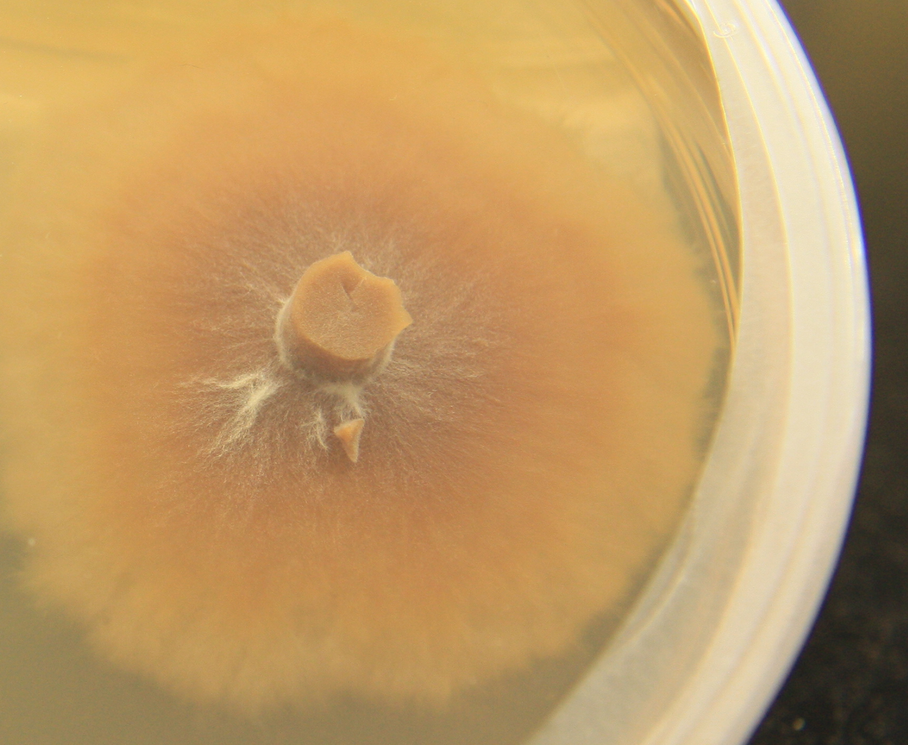
Growth₂
Most are multicellular organisms
Two distinct morphological stages:
Vegetative:
Consists of mycelium that can grow on a surface, in soil or decaying material, in liquid, or living tissue
Mycelium: mass of fungal hyphae
Example: Armillaria solidipes (honey mushroom) considered largest organism on Earth (2,000 acres of underground soil in eastern Oregon and 2,400 years old)
Reproductive:
More conspicuous
24.1 Figure 8: This is the mycelium of the fungus Lactarius deliciosus. L. deliciosus is an edible mushroom but, despite its name, may taste bitter.
Silk666 on Wikimedia Commons. "Lactarius deliciosus mycelium."

Slide 20
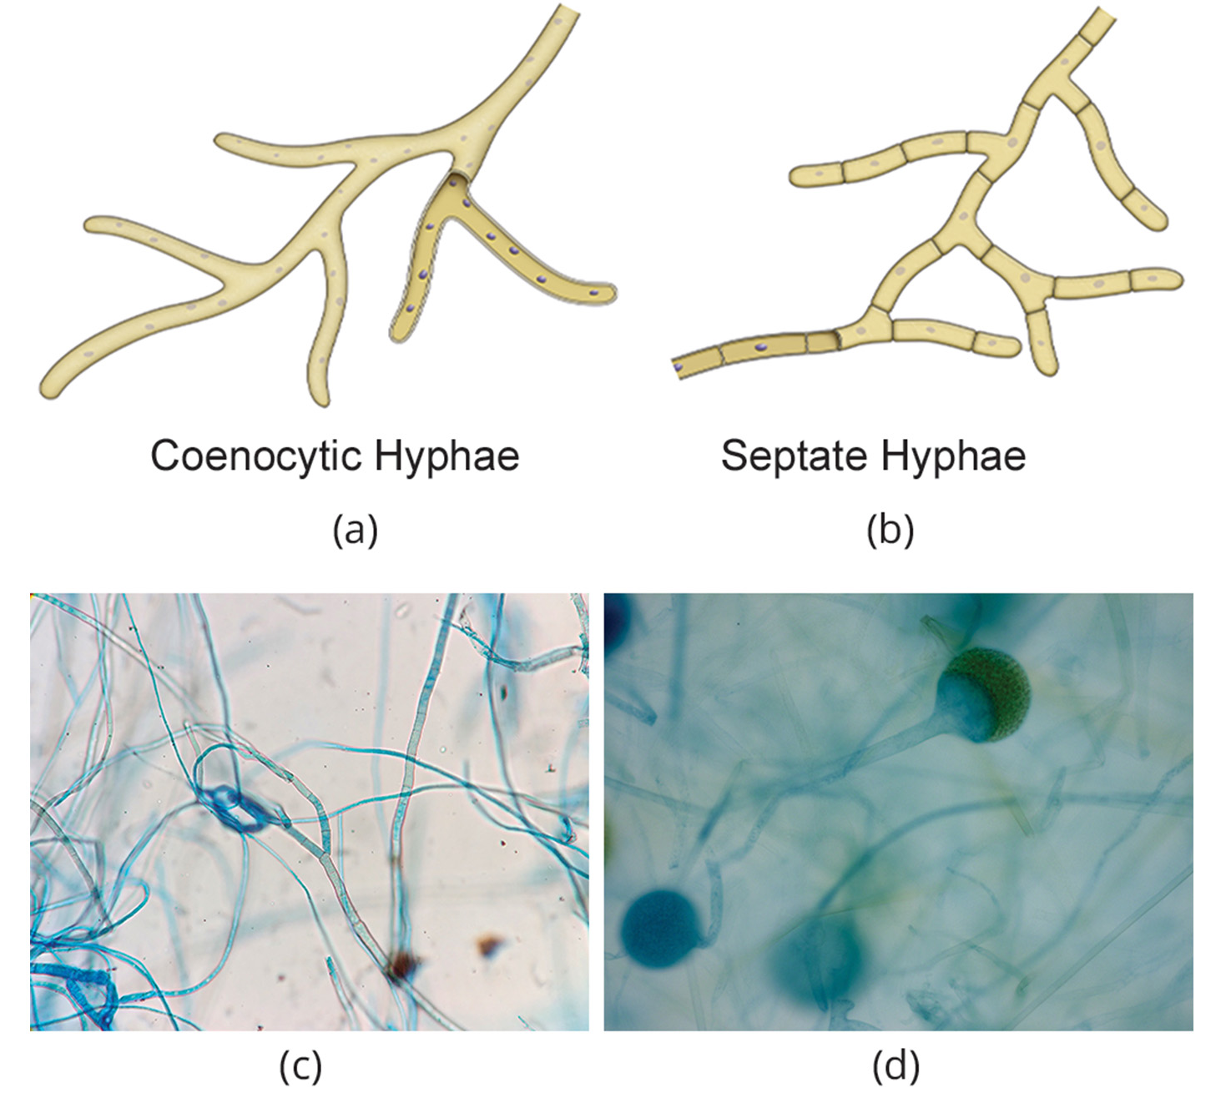
Growth₃
Hyphae divided by septa
Septa: cell wall division between hyphae
Tiny holes in septa allow for rapid flow of nutrients and small molecules (called perforated septa)
Form large cells with many nuclei (multinucleate), arrangement called coenocytic hyphae
Example: Bread molds in phylum Zygomycota
24.1 Figure 9: Fungal hyphae may be (a) coenocytic (coeno- means "common"; -cytic means "cell") or (b) septate with many nuclei present in a single hypha. (c) Septa that divide the hyphae and (d) coenocytic mycelium.
Microrao on Wikimedia Commons. "Fungal hyphae."
Kristi Yim on Wikimedia Commons. "Zygomycota sporangia."

Slide 21
Growth₄
Grow in moist, slightly acidic, and dark or light environments
Vary in oxygen requirements
Most are obligate aerobes
Obligate aerobes: organisms, such as humans, that must perform aerobic respiration to survive
Others are obligate anaerobes
Obligate anaerobes: organisms that only perform anaerobic respiration and often cannot survive in the presence of oxygen
Example: Members of Chytridiomycota that reside in rumen of cattle
Some are intermediate or facultative anaerobes
Facultative anaerobes: organisms that can perform both aerobic and anaerobic respiration and can survive in oxygen-rich and oxygen-poor environments
Example: Yeast

Slide 22
Nutrition₁
Heterotrophs, like animals, and obtain carbon from complex organic compounds
Do not fix CO₂ or N from the atmosphere; must obtain it from diet
Digestion precedes ingestion
Exoenzymes transported out of hyphae, where they process nutrients in environment
Exoenzymes: external enzymes that digest nutrients absorbed by the body of the fungus
Smaller molecules absorbed through surface area of mycelium
Polysaccharide of storage is glycogen (branched polysaccharide)

Slide 23
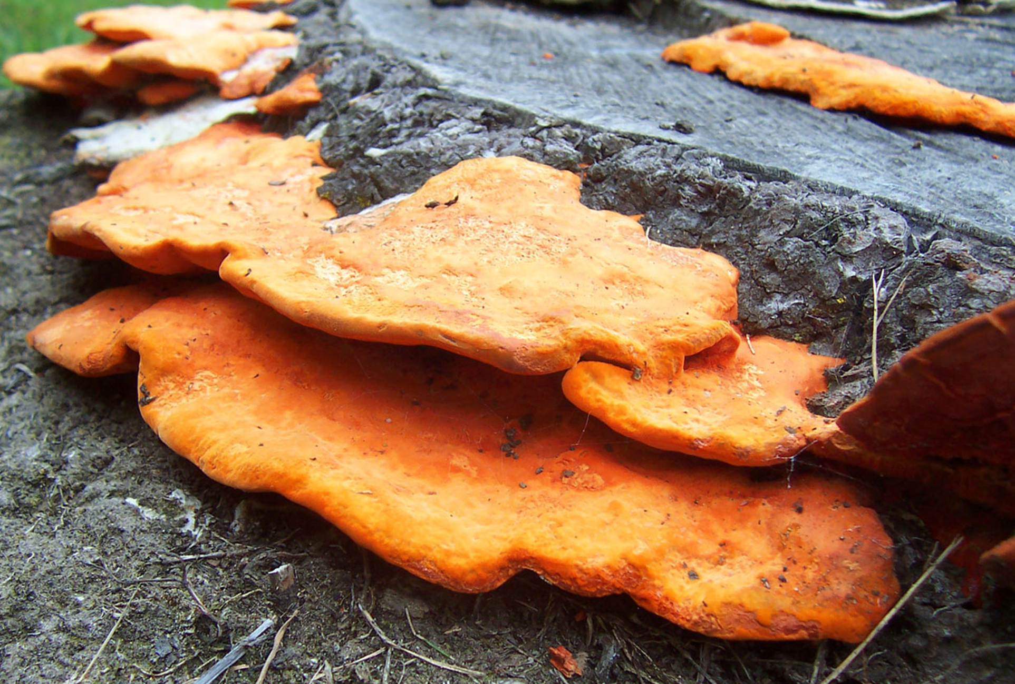
Nutrition₂
Mostly saprobes
Saprobe: organism that derives nutrients from decaying organic matter (also, saprophyte)
Fungal exoenzymes break down insoluble compounds, like cellulose and lignin of dead wood, into absorbable glucose molecules, releasing carbon, nitrogen, and other elements
Potential tools for bioremediation
Bioremediation: the use of naturally occurring organisms to consume and break down pollutants to clean up a contaminated environment
Example: Fungi used to break down diesel oil, polycyclic aromatic hydrocarbons (PAHs), and heavy metal (e.g., cadmium and lead)
24.1 Figure 10: Saprotrophic fungi live on dead organic matter without establishing symbiosis with plants.
Fir0002 on Wikimedia Commons. "Saprotrophic fungus."

Slide 24
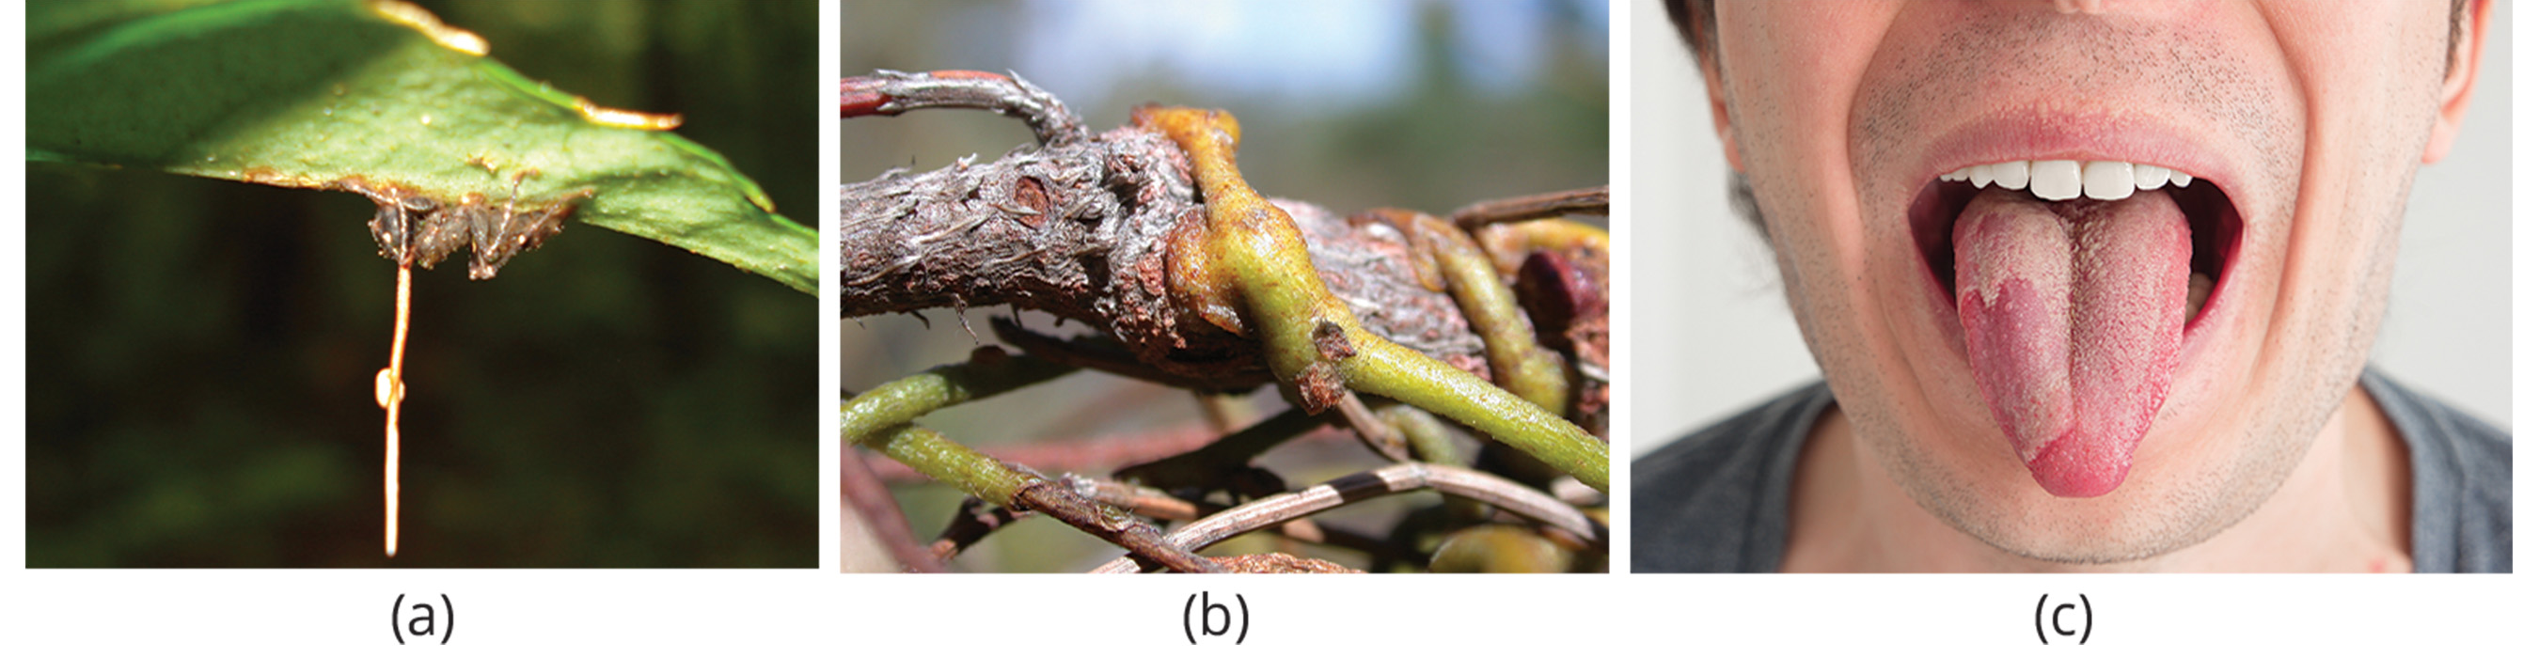
Nutrition₃
Parasitic, infecting plants or animals
Examples: Smut and Dutch elm disease (affect plants) and athlete's foot and candidiasis, or thrush (affect humans)
Can prey on nematodes in nitrogen-poor environments
Arthrobotrys fungi can trap nematodes
Constricting rings within hyphae swell and grip nematode and then fungi penetrates worm with haustoria
Haustoria: modified hyphae on many parasitic fungi that penetrate the tissues of their hosts, release digestive enzymes, and/or absorb nutrients from the host
24.1 Figure 11: (a) A fungal stalk grows from an ant infected by the parasitic fungus Ophiocordyceps unilateralis. (b) The haustoria of Cassytha pubescens are shown here, infecting a host. (c) Thrush, a medical condition common in humans, is caused by Candida. An infection can usually been seen as a white mycelium within the tongue.
David P. Hughes, Maj-Britt Pontoppidan on Wikimedia Commons. "Ophiocordyceps unilateralis."
Chrissicc on Wikimedia Commons. "Haustoria of Cassytha pubescens."

Slide 25
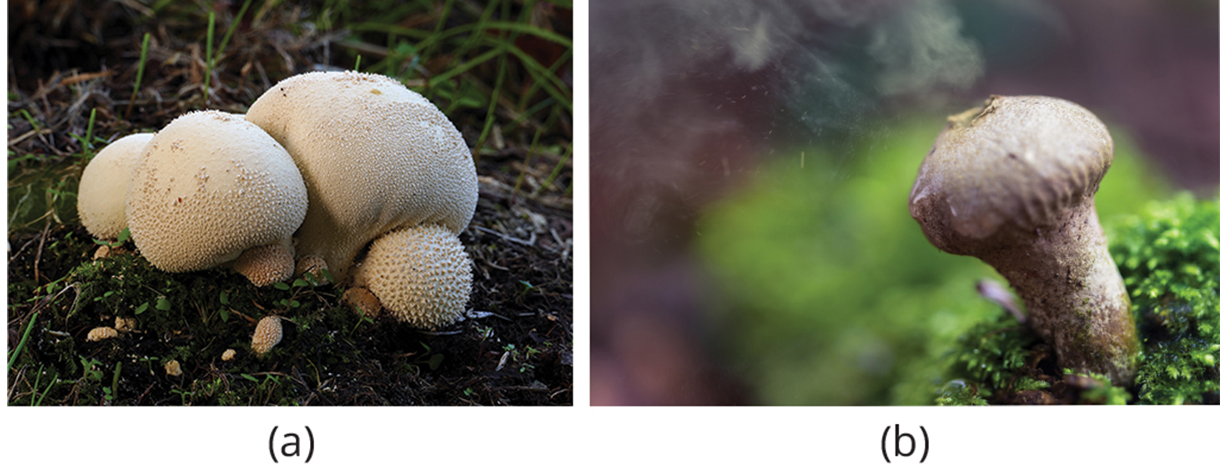
Reproduction
Can reproduce sexually and/or asexually
Produce spores that disperse from parent by floating on wind or riding on animal (in both sexual and asexual reproduction)
Smaller and lighter than plant seeds
Example: Giant puffball mushroom releases trillions of spores, increasing likelihood of landing somewhere that supports growth
24.1 Figure 12: The (a) giant puffball mushroom releases (b) a cloud of spores when it reaches maturity.
Bernard Spragg on Wikimedia Commons. "Giant puffball mushroom."
Paul Garais on Wikimedia Commons. "Spore cloud."

Slide 26
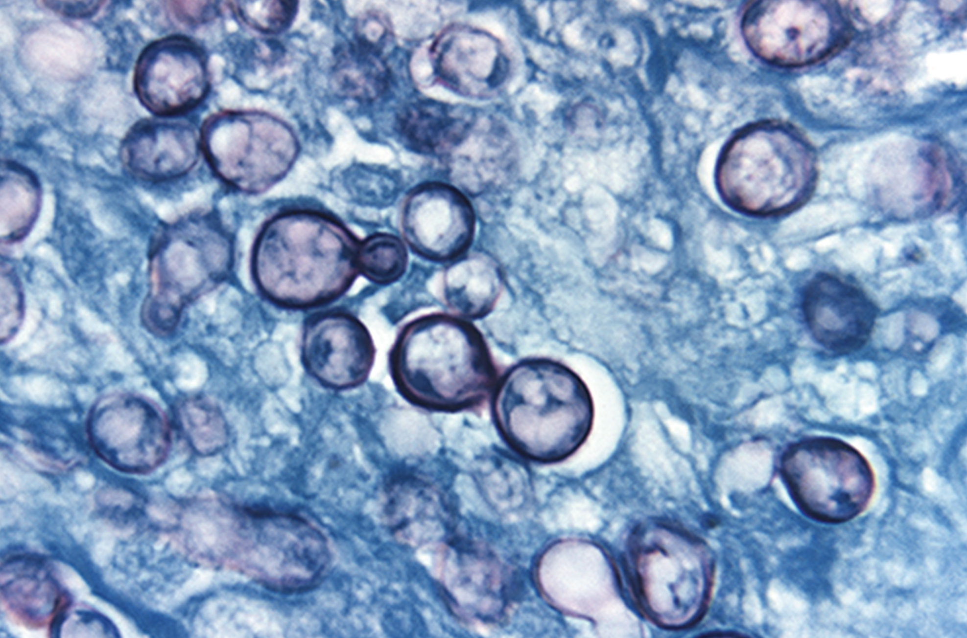
Asexual Reproduction₁
By fragmentation, budding, or production of spores
Fragmentation: Fragments of hyphae grow new colonies
Budding: Cells in yeast form buds, forming bulge on side of cell where nucleus divides mitotically, and bud detaches
Budding: a type of asexual reproduction where a new organism develops from an outgrowth or bud generated by cell division
24.1 Figure 13: The dark cells in this bright field light micrograph are the pathogenic yeast Histoplasma capsulatum, shown against a backdrop of light blue tissue. Histoplasma primarily infects lungs but can spread to other tissues, causing histoplasmosis, a potentially fatal disease. Budding is shown here as one of the dark cells starts to pinch off a smaller portion of itself to create a new cell.
CDC on Wikimedia Commons. "Histoplasma capsulatum."

Slide 27
Asexual Reproduction₂
Most common form is formation of asexual spores
Produced by individual thallus (vegetative body) through mitosis
Genetically identical to parent thallus
Spores allow for expansion of distribution and colonization of new environments
May be released from parent thallus either outside or within sporangium
Sporangium: (plural, sporangia) reproductive sac that contains spores

Slide 28
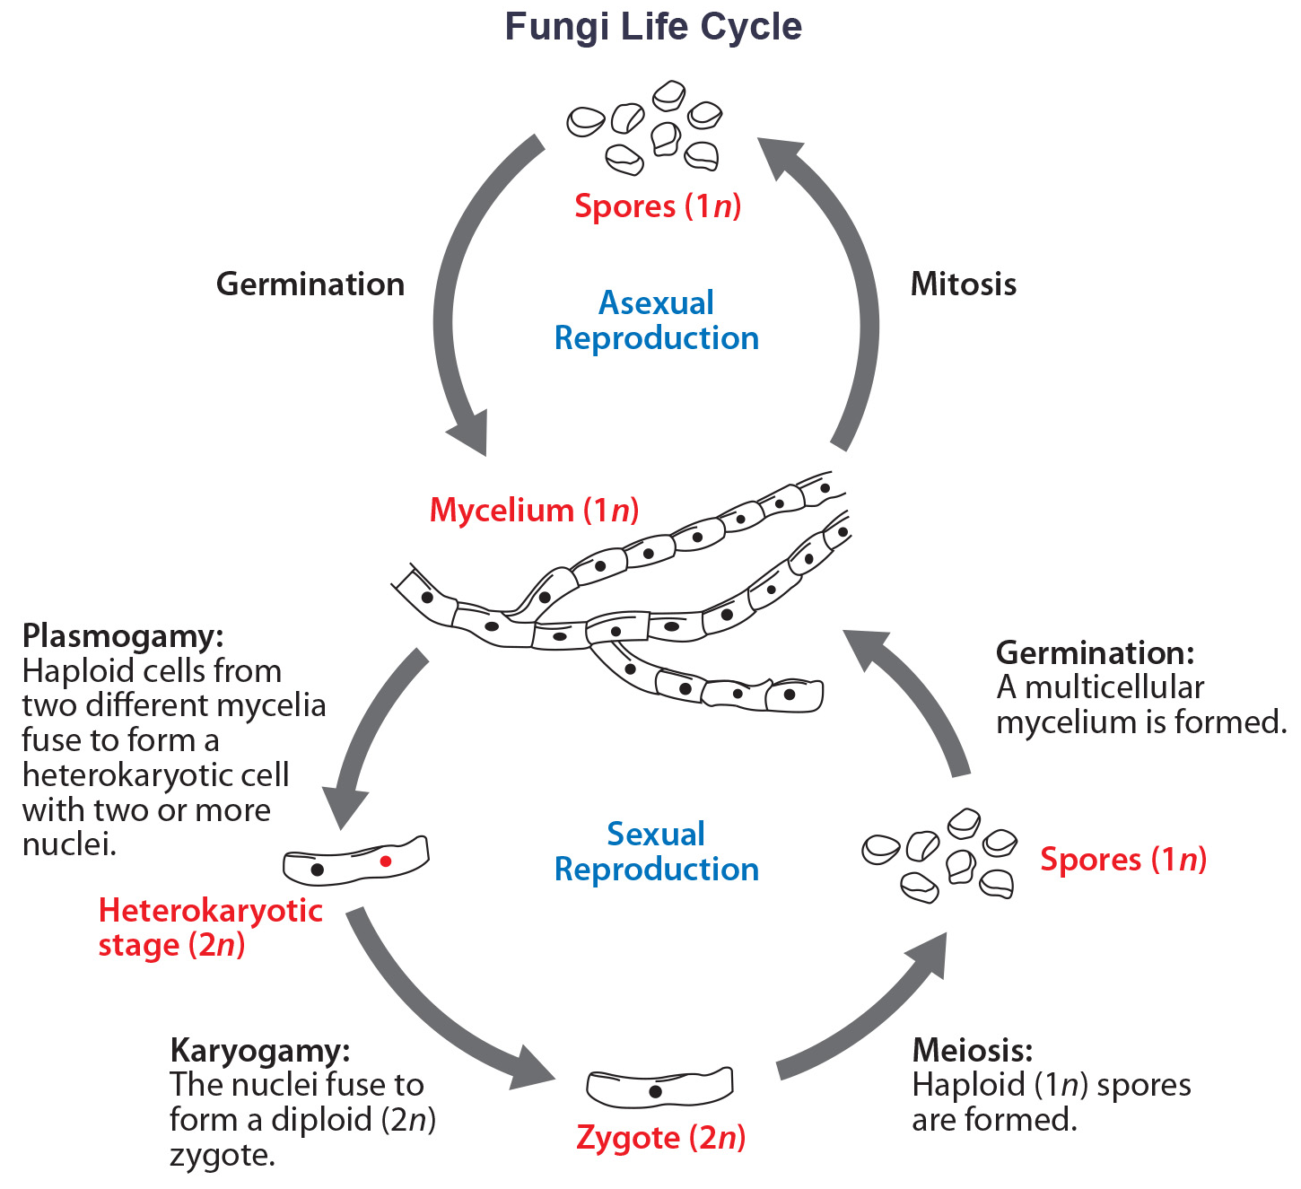
24.1 Figure 14
CNX OpenStax on Wikimedia Commons. "Fungi life cycle."
Notes:
Fungi may have both asexual and sexual stages of reproduction.

Slide 29
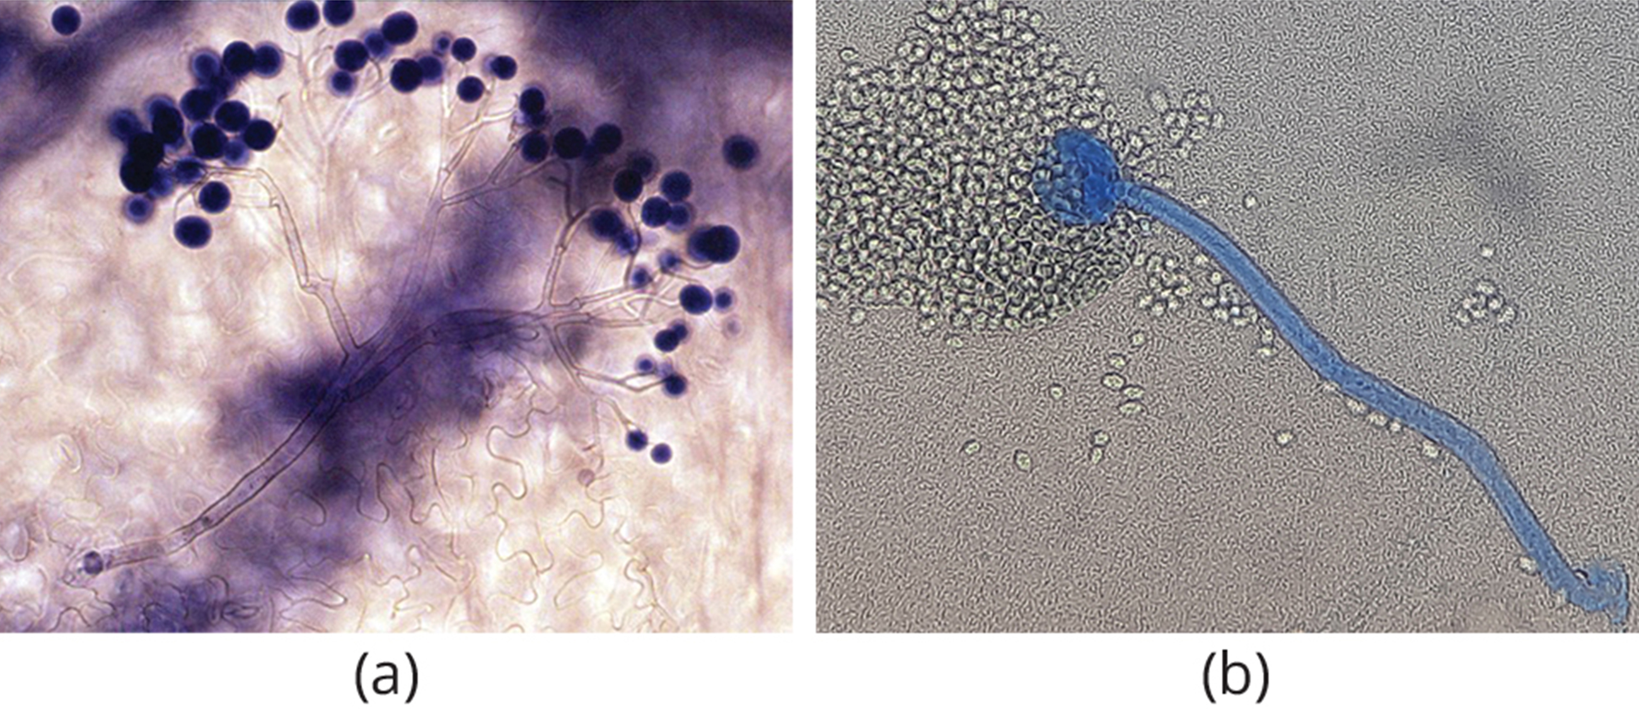
Asexual Reproduction₃
Many types of asexual spores
Conidiospores: unicellular or multicellular spores that are released directly from the tip or side of the hypha
Other spores originate in fragmentation of a hypha to form single cells released as spores
Some have thick cell wall surrounding fragment
Other spores bud off vegetative parent cell
Sporangiospores produced directly from sporangium
24.1 Figure 15: (a) The treelike structure holding conidiospores is called a conidiophore. (b) Sporangiospores are from a sporangium at the end of a hypha called a sporangiophore.
Emmanuel Boutet on Wikimedia Commons. "Sporulating Hyaloperonospora parasitica."
Ajay Kumar Chaurasiya on Wikimedia Commons. "Sporangiophore."

Slide 30
Sexual Reproduction
Introduces genetic variation
Often occurs in response to adverse environmental conditions
Two mating types:
Homothallic: describes when both mating types are present in mycelium
Heterothallic: describes when only one mating type is present in an individual mycelium
Requires two different, but compatible, mycelia
Variations but all types include plasmogamy, karyogamy, and meiosis in the gametangia, then spores released
Plasmogamy: fusion of cytoplasm, where two haploid cells fuse, leading to dikaryotic stage
Dikaryotic stage: two haploid nuclei coexist in a single cell
Karyogamy: fusion of nuclei to form diploid zygote nucleus
Gametangium: (plural, gametangia) structure on the gametophyte in which gametes are produced

Slide 31
Summary
Eukaryotic heterotrophs that appeared over 450 million years ago on land
Lack photosynthetic pigments, like chlorophyll, and organelles, like chloroplasts
Saprobic fungi: Decomposers that digest dead matter and recycle nutrients by absorbing them through thallus with use of exoenzymes
Surrounded by thick chitin cell wall
Can be unicellular yeasts or develop a network of filaments called mycelium (i.e., mold)
Most have both asexual and sexual reproduction cycles with alternating haploid and diploid stages
Sexual reproduction involves plasmogamy (fusion of cytoplasm), karyogamy (fusion of nuclei), and meiosis to produce haploid spores

Slide 32


End of Hawkes Learning PowerPoint

