Slide 1
Lesson 24.2
Classifications of Fungi

Slide 2
Objectives
Identify fungi and place them into the five major phyla according to current classification.
Describe each phylum in terms of major representative species and patterns of reproduction.

Slide 3
Classifications of Fungi
Classified into six major phyla based on mode of sexual reproduction or molecular data, though advances in molecular biology continue to reveal new relationships
Recognized phyla include:
Chytridiomycota (chytrids)
Mucoromycota and Zoopagomycota (conjugated fungi)
Ascomycota (sac fungi)
Basidiomycota (club fungi)
Glomeromycota

Slide 4
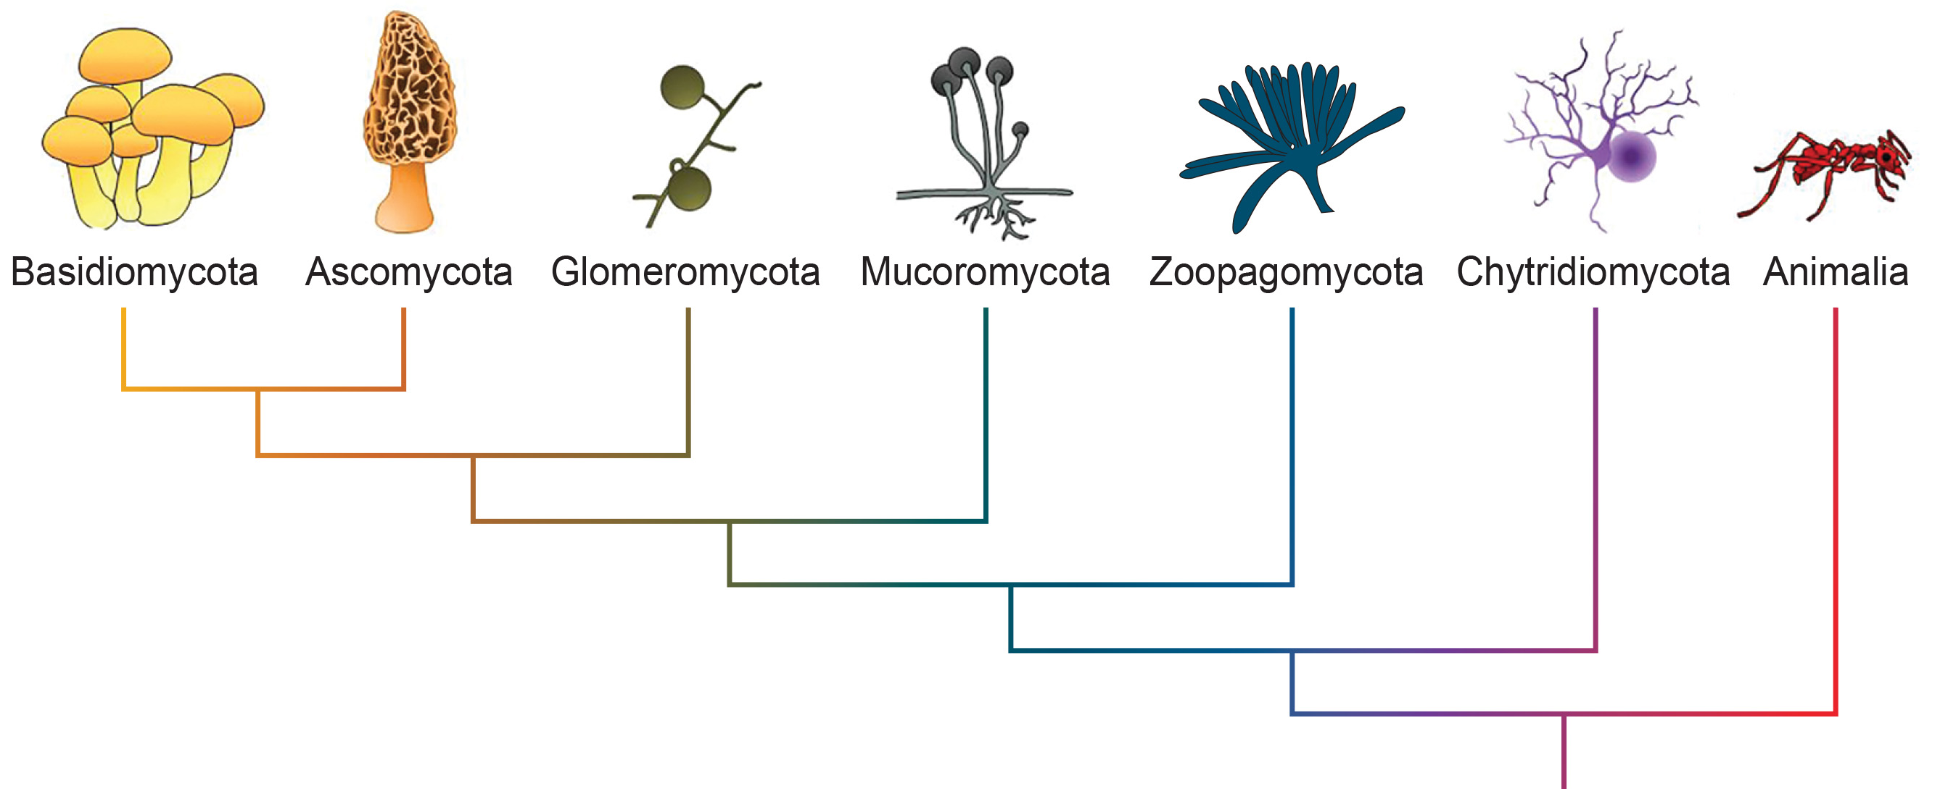
24.2 Figure 1
OpenStax. "Fungal phyla."
Notes:
Figure 1: Shown is one suggested phylogeny of the fungal phyla. Note: -mycota is used to designate a phylum, while -mycetes formally denotes a class or informally refers to all members of the phylum.

Slide 5
Chytridiomycota: The Chytrids₁
Only class in phylum Chytridiomycota is chytridiomycetes
Chytridiomycota: primitive phylum of fungi that live in water and produce gametes with flagella (also, chytrids)
Most primitive of Eumycota (true fungi)
True fungi: reproduce both sexually and asexually
Appeared over 500 million years ago in the late Precambrian
Have chitin cell walls, some also have cellulose
Mostly unicellular, but some form multicellular organisms with coenocytic hyphae
Only fungi to have retained flagella (both male and female) for gamete and diploid zoospore motility

Slide 6
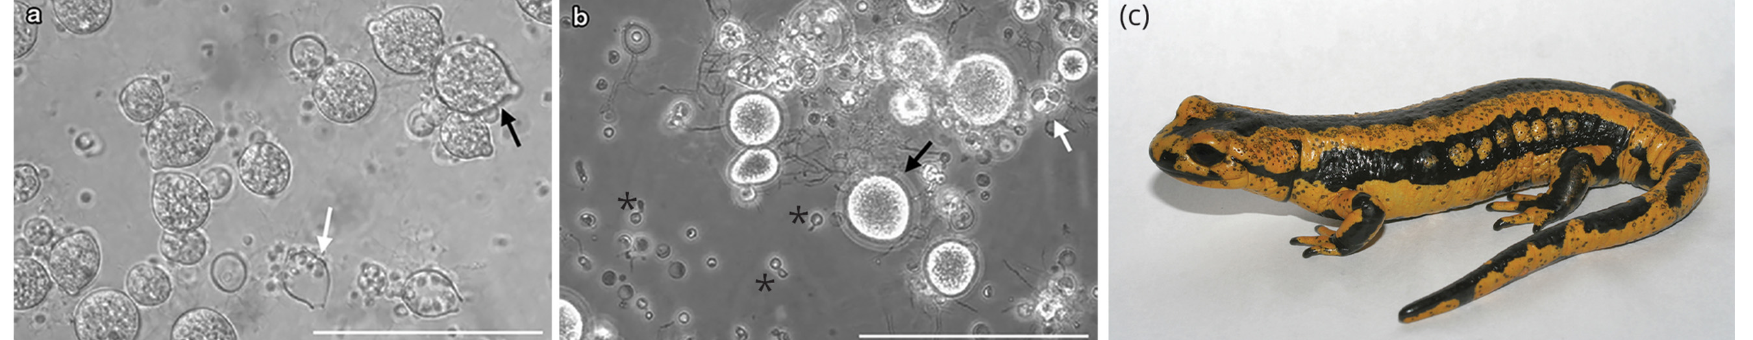
Chytridiomycota: The Chytrids₂
Ecological habitat and cell structure similar to protists
Usually live in aquatic environments, but some on land
Some are parasitic (on plants, insects, and amphibians)
Some are saprobes
Example: Allomyces
Experimental organism
Both asexual and sexual reproduction
Produces diploid or haploid flagellated zoospores in sporangium
24.2 Figure 2: (a) Mature zoosporangia (black arrow) containing zoospores and empty discharged sporangia (white arrow) are shown. (b) Batrachochytrium salamandrivorans is characterized by predominant monocentric thalli (black arrow), only a few colonial thalli (white arrow), and zoospore cysts with germ tubes (black asterisk). (c) The fire salamander, Salamandra salamandra, is covered with chytrid ulcerations visible as black spots on the skin.
Pascale van Rooij on Wikimedia Commons. "Morphology of Batrachochytrium species in culture."
F. Pasmans on Wikimedia Commons. "Fire salamander."

Slide 7
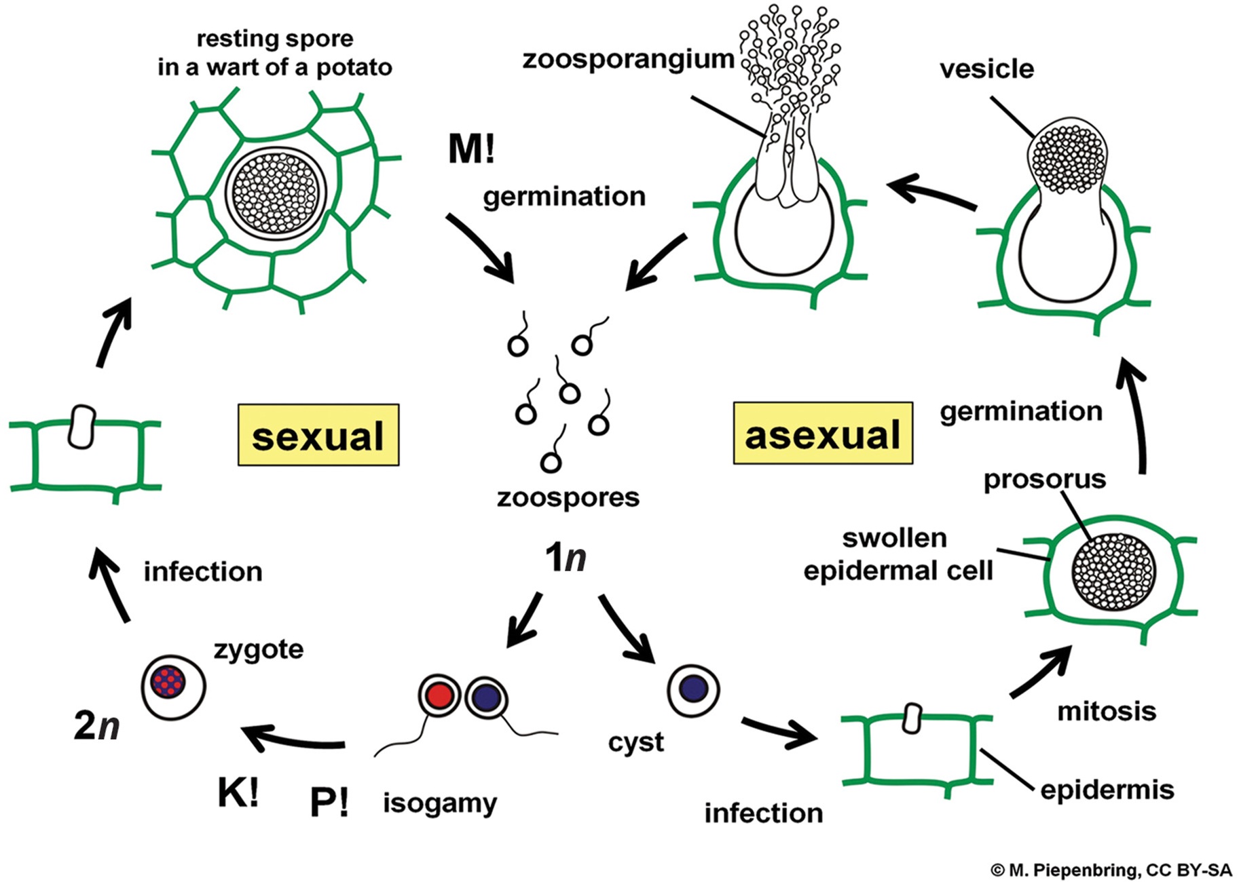
24.2 Figure 3
Prof. M. Piepenbring on Wikimedia Commons. "Life cycle of Synchytrium endobioticum."
Notes:
The life cycle of the Chytridiomycota, Synchytrium endobioticum, infecting a potato (Abbreviations: 1n = haploid, P! = plasmogamy, n+n = dikaryotic, K! = karyogamy, 2n = diploid, M! = meiosis).

Slide 8
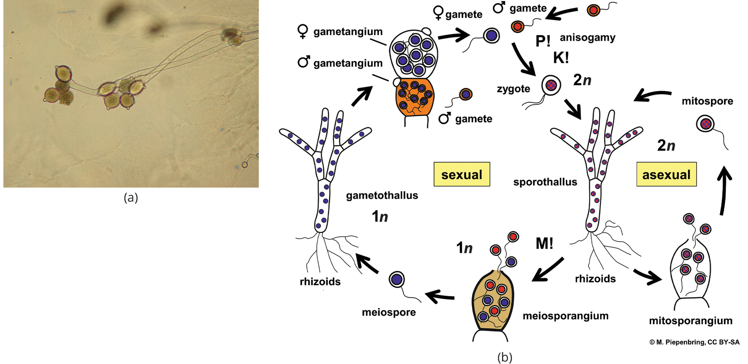
24.2 Figure 4
TelosCricket on Wikimedia Commons. "Allomyces sp. strain."
Prof. Meike Piepenbring on Wikimedia Commons. "Allomyces arbusculus life cycle."
Notes:
This micrograph shows an Allomyces sp. and its zoosporangia of the sporophyte. (b) Allomyces arbusculus life cycle. (Abbreviations: 1n = haploid, P! = plasmogamy, n+n = dikaryotic, K! = karyogamy, 2n = diploid, M! = meiosis).

Slide 9
Science and You
What Is the Advantage of Anisogamy during the Life Cycle?
Anisogamy: Form of sexual reproduction involving the fusion of two dissimilar gametes that differ in size or form
Evolutionary effects such as:
Greater fecundity (reproductive potential) in males
Larger number of matings in males
Greater investment in offspring care in females
Notes:
This is included as a relevant application for this topic.

Slide 10
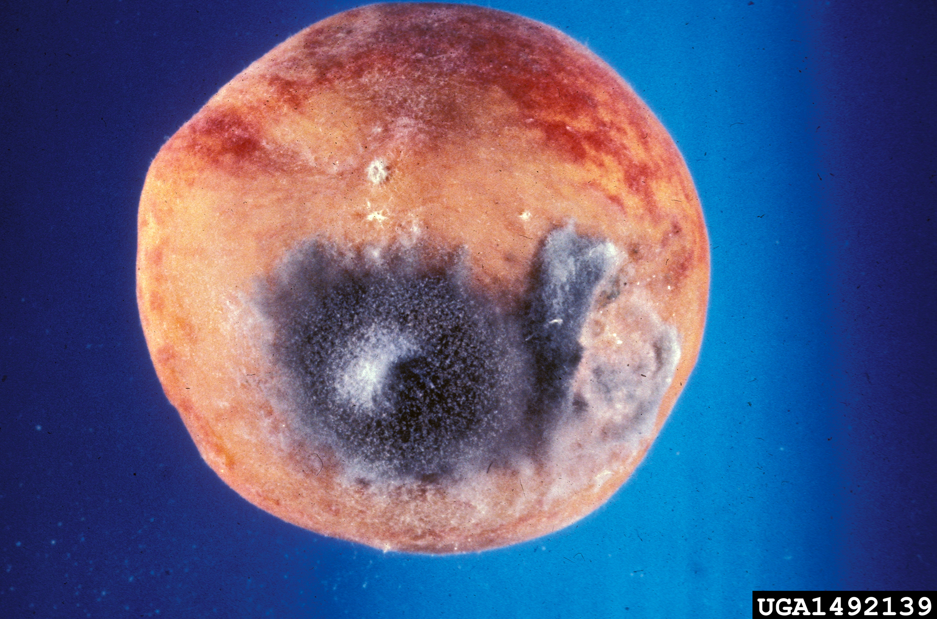
Mucoromycota and Zoopagomycota: The Conjugated Fungi₁
Mucoromycetes and zoopagomycetes: Small group of fungi once classified in phylum Zygomycota
Zygomycota: previous phylum of fungi that form a zygote contained in a zygospore; organisms of Zygomycota now reclassified as belonging to phyla Mucoromycota or Zoopagomycota (also, conjugated fungi)
Still collectively referred to as zygomycetes, or conjugated fungi
Mucoromycetes:
Mostly saprobic
Includes bread molds like Rhizopus stolonifera
Commercial roles
Example: Rhizopus are intermediates in synthesis of semisynthetic steroid hormones
Zoopagomycetes:
Parasites of soil microorganisms (e.g., nematodes, amoebas, and other fungi)
24.2 Figure 5: Rhizopus stolonifera, a common bread mold
University of Georgia Plant Pathology Archive on Wikimedia Commons. "Rhizopus stolonifera."

Slide 11
Mucoromycota and Zoopagomycota: The Conjugated Fungi₂
Have thallus of coenocytic hyphae with haploid nuclei and organism in vegetative stage
Asexual reproduction
Usually reproduce asexually by producing sporangiospores
Sporangiospores connected by hyphae called stolons that grow rootlike structure called rhizoids that connect fungus to substrate
Example: Black tips of bread mold
Swollen sporangia packed with black spores
When spores land on substrate, they germinate and produce new mycelium
Sexual reproduction
Used in unfavorable environmental conditions
Two opposing mating strains (type + and type −)
Must be in close proximity for gametangia from hyphae to be produced and fuse, leading to karyogamy

Slide 12
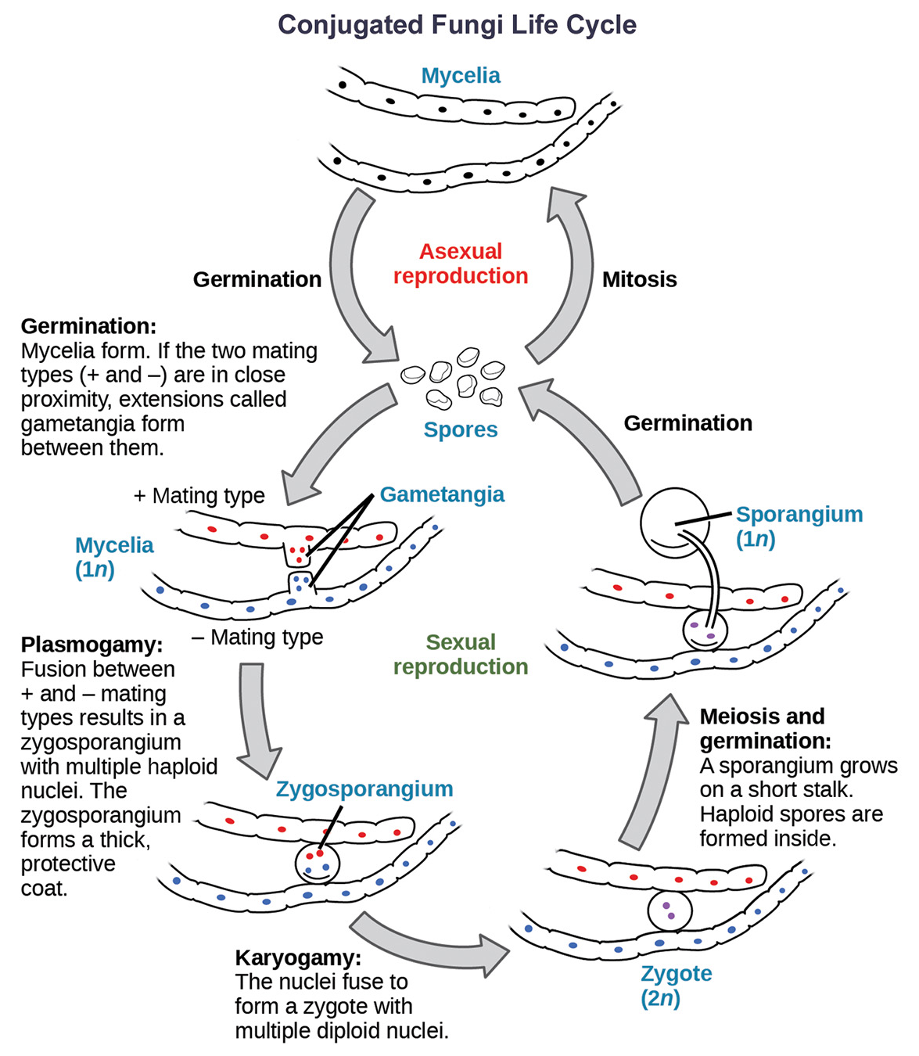
24.2 Figure 6
CNX OpenStax on Wikimedia Commons. "Zygomycete life cycle."
Notes:
Conjugated fungi have asexual and sexual phases in their life cycles. In the asexual phase, spores are produced from haploid sporangia by mitosis (not shown). In the sexual phase, + and − haploid mating types conjugate to form a heterokaryotic zygosporangium. Karyogamy then produces a diploid zygote. Diploid cells in the zygote undergo meiosis and germinate to form a haploid sporangium, which releases the next generation of haploid spores.

Slide 13
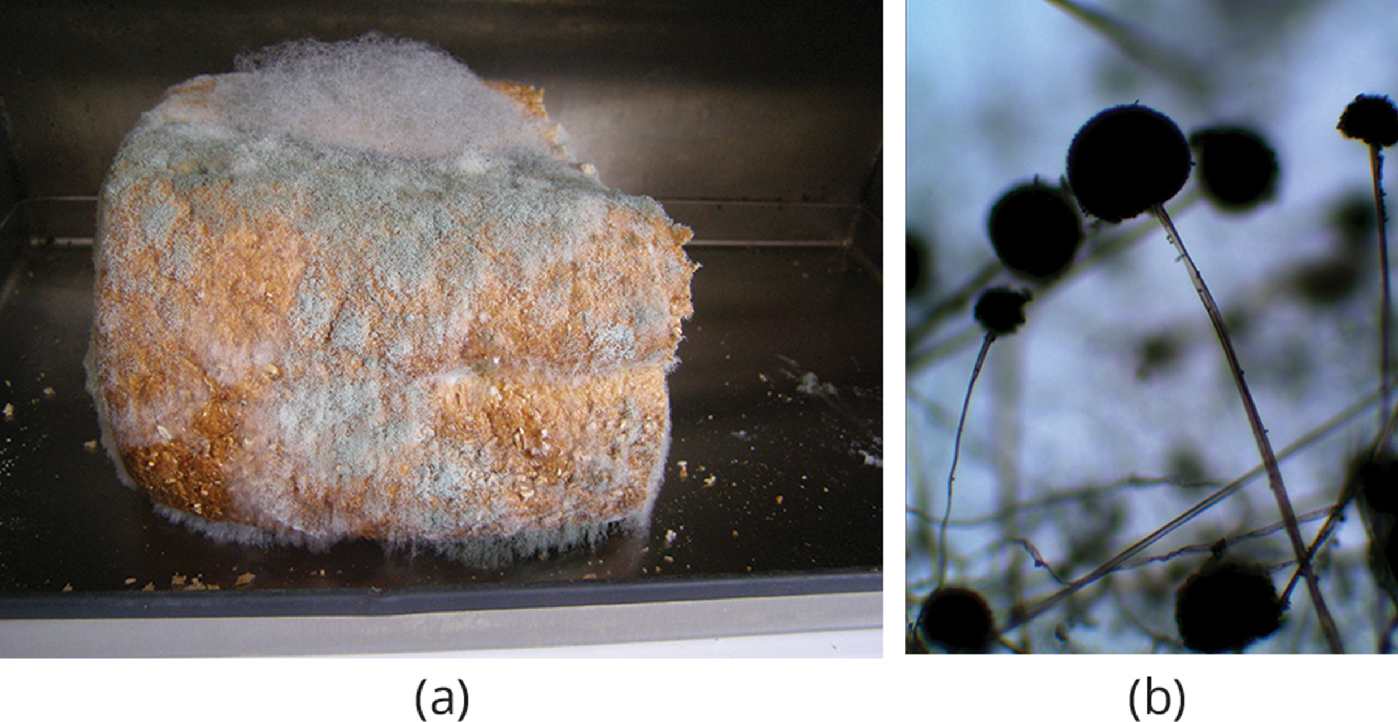
Mucoromycota and Zoopagomycota: The Conjugated Fungi₃
Each zygospore contain several diploid nuclei
Zygospore: structure with a thick cell wall that contains the zygote in zygomycetes
Have thick coats that protect them from desiccation (drying out) and other hazards
Remain dormant until environmental conditions become favorable
During germination, zygospore undergoes meiosis and produces haploid spores that grow into new organism
Called conjugation (different from conjugation in bacteria and protists)
24.2 Figure 7: Asexual sporangia grow at the end of stalks, which appear as (a) white fuzz seen on this bread mold, Rhizopus stolonifer. (b) The black tips of black mold are the spore-containing sporangia.
Matt Wharton on Wikimedia Commons. "Bread mold."
Ramy algayar on Wikimedia Commons. "Black mold."

Slide 14
Ascomycota: The Sac Fungi₁
Ascomycota: phylum of fungi that store spores in a sac called ascus (also, sac fungi); largest phylum
Ascus: (plural, asci) saclike structure that contains haploid ascospores
Produce hyphae divided by perforated septa, allowing streaming of cytoplasm from one cell to another
Conidia and asci (used for asexual and sexual reproduction, respectively) separated from vegetative hyphae by blocked (non-perforated) septa
Conidia: asexual spores

Slide 15
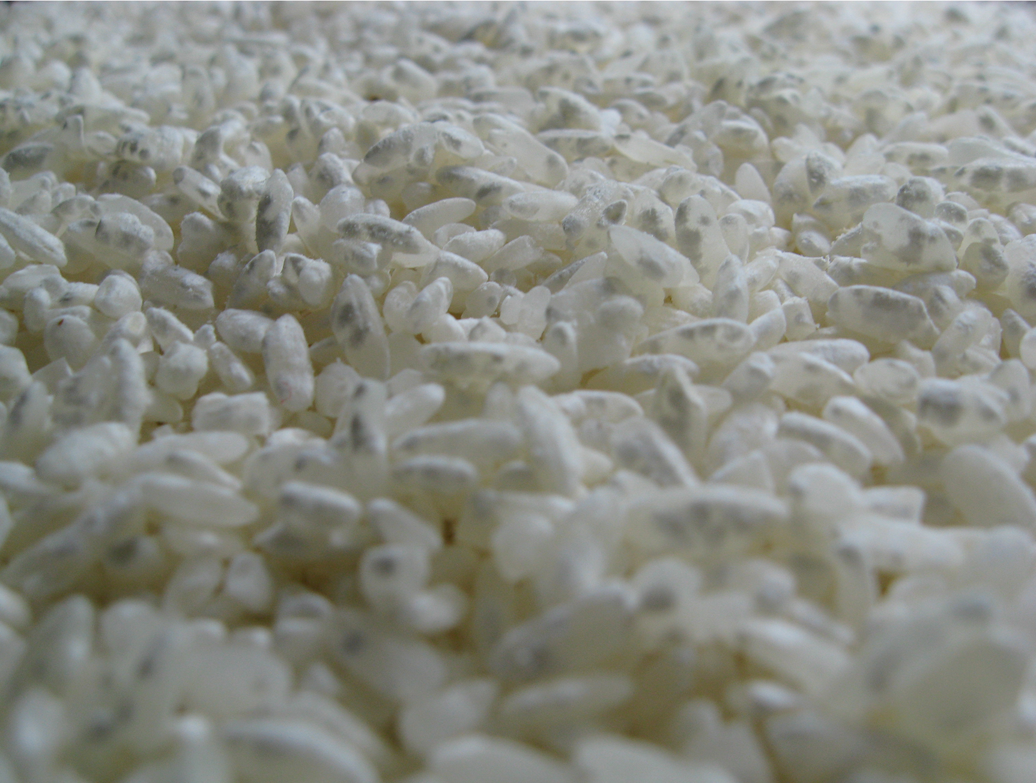
Ascomycota: The Sac Fungi₂
Commercial importance:
Yeasts for baking, brewing, and wine fermentation
Example: Aspergillus oryzae used in fermentation of rice to produce sake
Food delicacies, such as truffles and morels
Parasitize plants and animals (including humans)
Example: Fungal pneumonia
Significant threat to AIDS patients with compromised immune systems
Can infest and destroy crops directly
Can produce secondary metabolites to make crops unfit for consumption
24.2 Figure 8: Aspergillus oryzae, shown as dark-gray coloration, growing over rice
Forrest O. on Wikimedia Commons. "Aspergillus oryzae growing on rice."

Slide 16
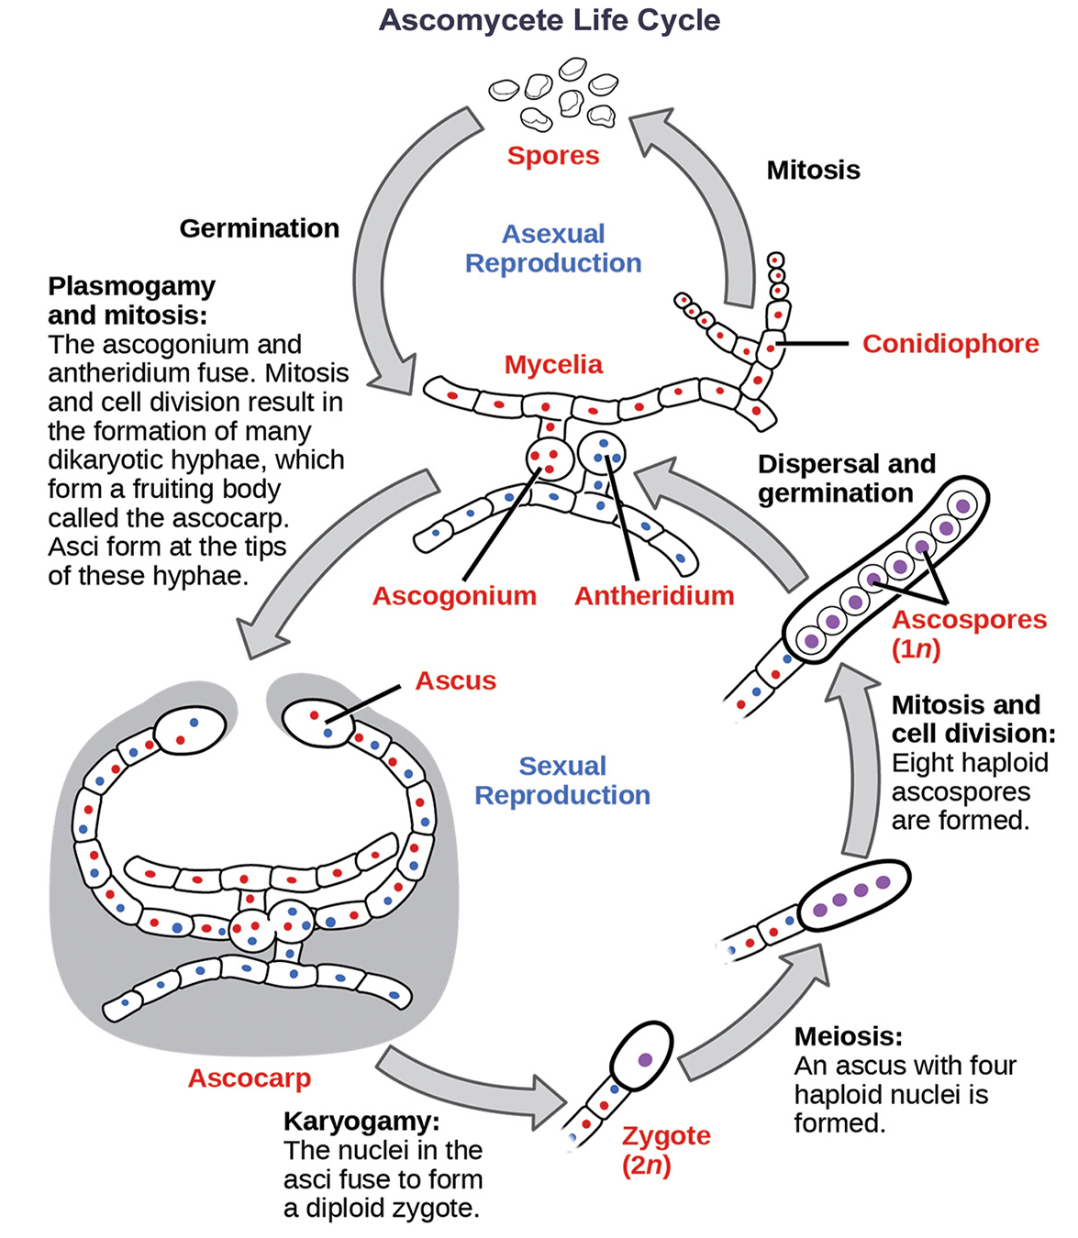
24.2 Figure 9
CNX OpenStax on Wikimedia Commons. "Ascomycete life cycle."
Notes:
The life cycle of an ascomycete is characterized by the production of asci during the sexual phase. In each ascus, the four nuclei produced by meiosis divide once mitotically for a total of eight haploid ascospores. The haploid phase is the predominant phase of the life cycle in ascomycetes.

Slide 17
Ascomycota: The Sac Fungi₃
Asexual reproduction:
Frequent
Involves production of conidiophores that release haploid conidiospores
Sexual reproduction:
Starts with development of hyphae from either one of two types of mating strains
Male: Produces antheridium
Female: Develops an ascogonium

Slide 18
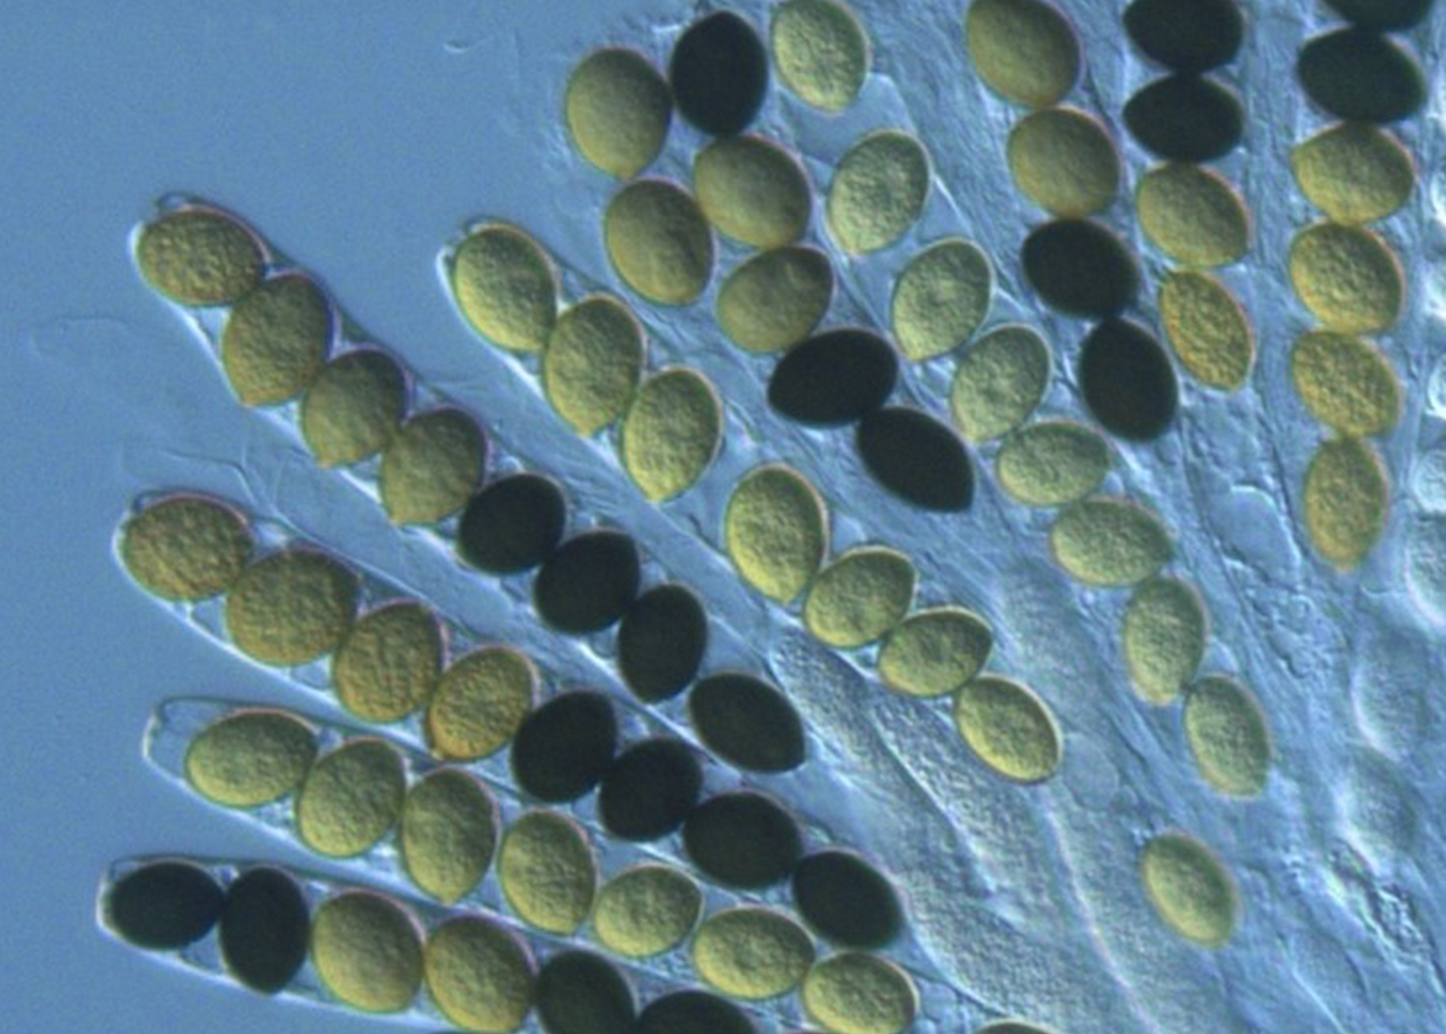
Ascomycota: The Sac Fungi₄
Sexual reproduction:
Plasmogamy: Antheridium and ascogonium combine but nuclei do not
Dikaryotic ascogenous hyphae arise from dikaryon (cell has pairs of nuclei: one male and one female)
Karyogamy: In each ascus, two haploid nuclei fuse
Thousands of asci fill ascocarp
Ascocarp: fruiting body of ascomycetes
Diploid nucleus in each ascus becomes haploid through meiosis
Spore walls form around nucleus
Ascospores released, germinate, and form hyphae that disseminate in environment and start new mycelia
24.2 Figure 10: This bright field light micrograph displays a linear arrangement of ascospores in the asci of the fungus Sordaria macrospora.
Aurora Storlazzi on Wikimedia Commons. "Ascospores in the asci of Sordaria macrospora."

Slide 19
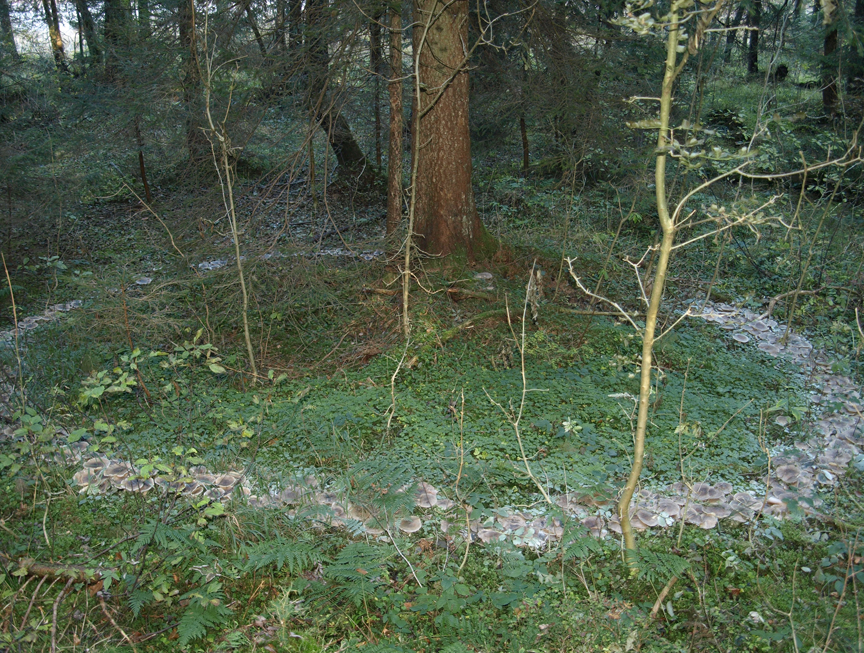
Basidiomycota: The Club Fungi₁
Basidiomycota: phylum of fungi that produce club-shaped structures (basidia) that contain spores (also, club fungi)
Basidium: club-shaped fruiting body of basidiomycetes
Reproductive organs contained in the mushroom
Also called gill fungi because of gill-like structures on underside of cap
Includes shelf fungi, which cling to bark like shelves
24.2 Figure 11: The fruiting bodies of a basidiomycete form a ring in a meadow, commonly called a "fairy ring." The best-known fairy ring fungus has the scientific name Marasmius oreades.
Josimda on Wikimedia Commons. "Fairy ring of Clitocybe nebularis mushrooms."

Slide 20
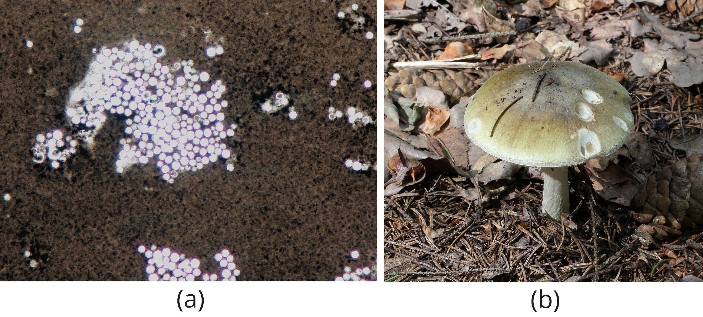
Basidiomycota: The Club Fungi₂
Includes smuts and rusts (plant pathogens)
Mostly edible but some toxic like Cryptococcus neoformans (causes respiratory illness) and Amanita phalloides (death cap mushroom that causes seizures, coma, and death)
24.2 Figure 12: Basidiomycota produce toxins and inedible substances. (a) Cryptococcus neoformans causes severe respiratory illness. (b) The mushroom Amanita phalloides, or death cap, is highly poisonous.
Dr. Graham Beards on Wikimedia Commons. "Cryptococcus neoformans."
George Chernilevsky on Wikimedia Commons. "Death cap mushroom."

Slide 21
Basidiomycota: The Club Fungi₃
Life cycle includes sexual and asexual reproduction
Mostly haploid through most of life cycle
Produce both haploid and dikaryotic mycelia
Dikaryotic phase:
Dominant phase
Not diploid since nuclei remain unfused until before spore production
Sexual spores more common than asexual spores
Sexual spores form club-shaped basidium (called basidiospores)
In basidium, nuclei from different strains fuse (karyogamy) and produce diploid zygote that undergoes mitosis
Haploid nuclei move to four different chambers attached to basidium and become basidiospores

Slide 22
Basidiomycota: The Club Fungi₄
Basidiospore germinates and generates monokaryotic haploid hyphae
Results in primary mycelium
Mycelium of different mating strains combine and produce secondary mycelium with haploid nuclei of both strains
Dominant dikaryotic stage
Each cell in mycelium has two haploid nuclei, not fusing until formation of basidium
Secondary mycelium generates basidiocarp
Basidiocarp: fruiting body that protrudes from the ground and bears the basidia

Slide 23
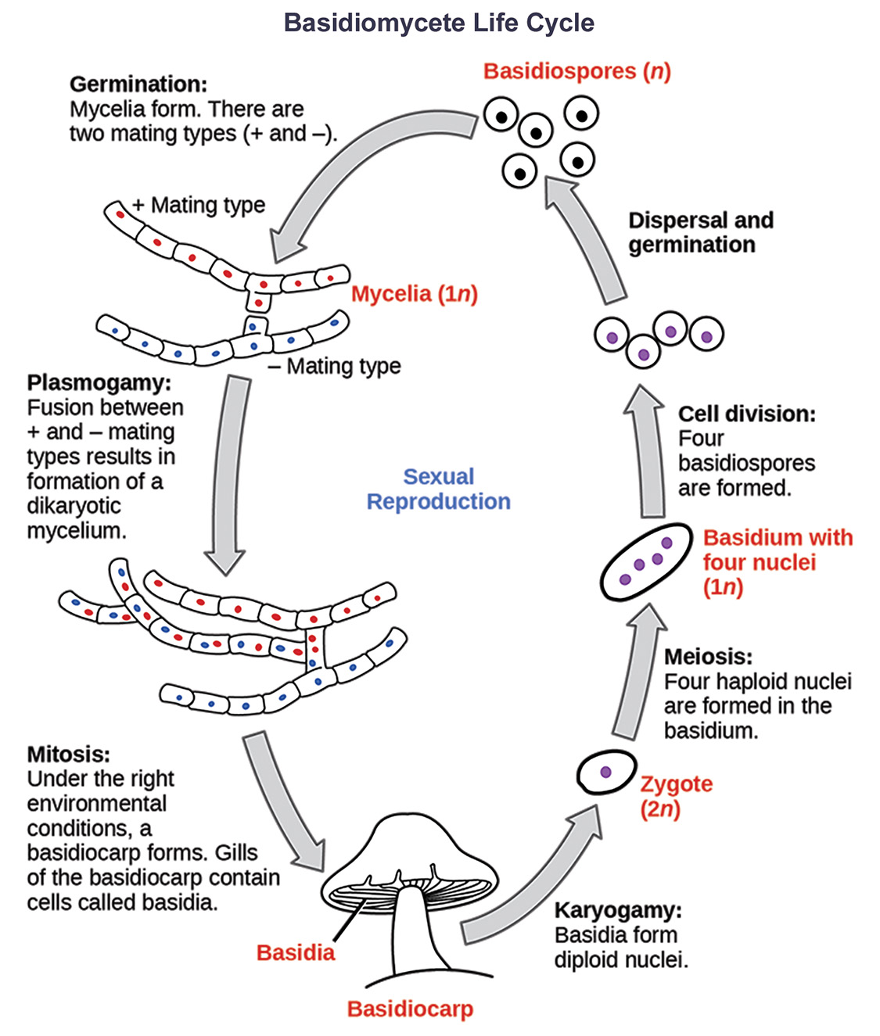
24.2 Figure 13
CNX OpenStax on Wikimedia Commons. "Basidiomycete life cycle."
Notes:
The life cycle of a basidiomycete has alternate generations with haploid and dikaryotic mycelia. Haploid primary mycelia fuse to form a dikaryotic secondary mycelium, which is the dominant stage of the life cycle, and produces the basidiocarp.

Slide 24
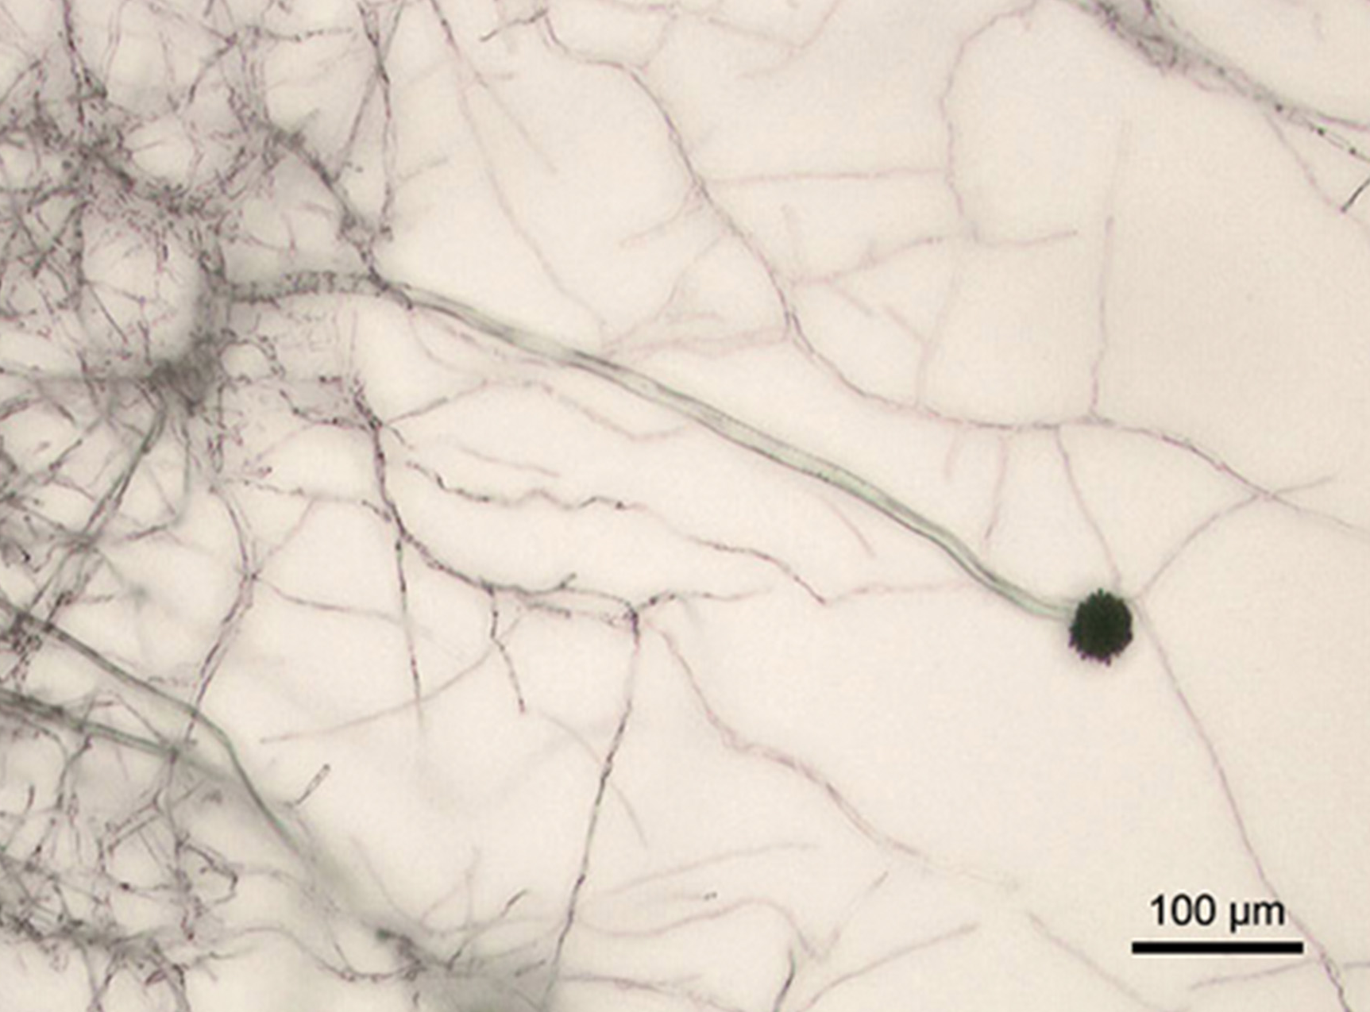
Asexual Ascomycota and Basidiomycota₁
Fungi with sexual reproduction (if present) that has never been observed
Formerly Deuteromycota
Deuteromycota: former form phylum of fungi that do not have a known sexual reproductive cycle (presently members of two phyla: Ascomycota and Basidiomycota)
Mostly live on land with some aquatic
Form mold
Mold: tangle of visible mycelia with fuzzy appearance
24.2 Figure 14: Aspergillus niger is an asexually reproducing fungus (phylum Ascomycota) commonly found as a food contaminant.
Y. tambe on Wikimedia Commons. "Aspergillus niger."

Slide 25
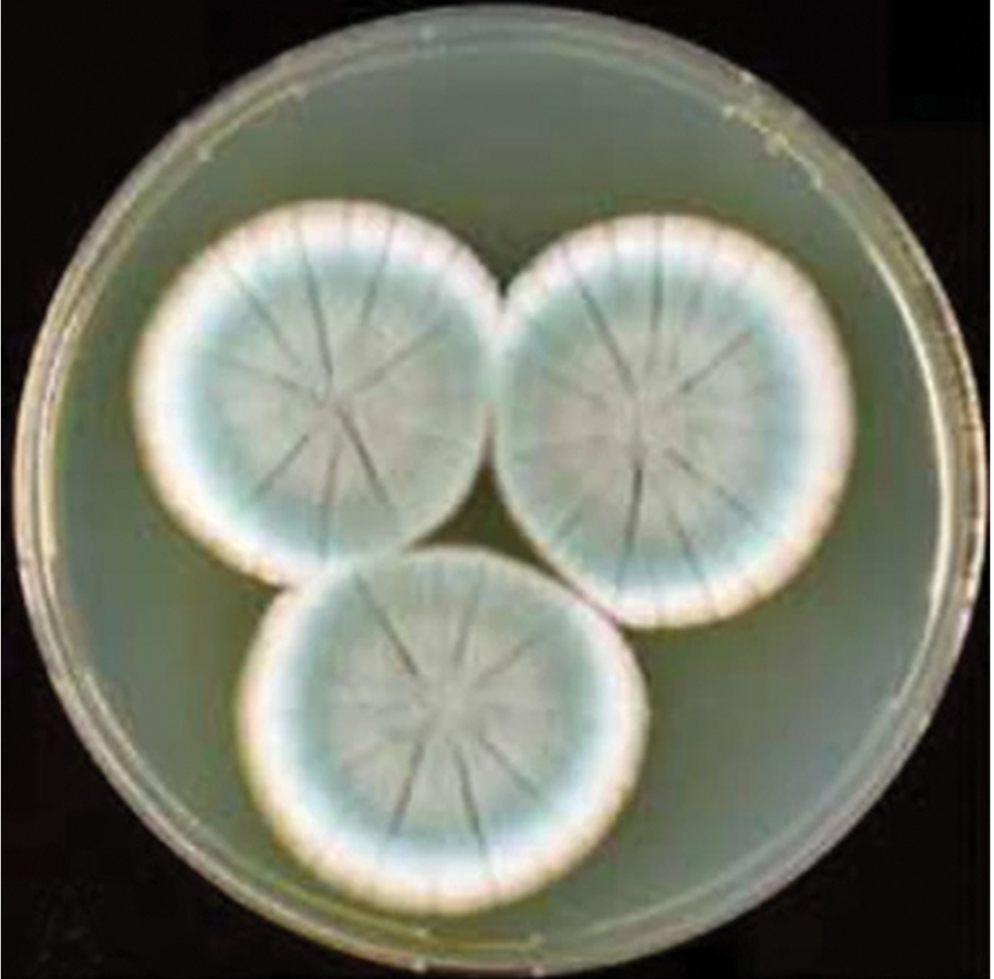
Asexual Ascomycota and Basidiomycota₂
Used in food production (ripening cheeses)
Used for antibiotics
Penicillium (penicillin) discovered when fungi killed bacterial growth on Petri plate
Can cause diseases as parasites (infecting both plants and humans) or as producers of toxic compounds (like aflatoxins in Aspergillus)
Aflatoxins: toxic and carcinogenic compounds released by fungi of the genus Aspergillus
24.2 Figure 15
Houbraken, J., Frisvad, J.C. & Samson, R.A on Wikimedia Commons. "Penicillium rubens."

Slide 26
Glomeromycota₁
Glomeromycota: phylum of fungi that form symbiotic relationships with the roots of trees
Newly established phylum of about 230 species with close association with roots of trees
Form arbuscular mycorrhizae
Hyphae penetrate root cells, forming mutually beneficial association with plants (plants supply carbon and energy in carbohydrates to fungus, and fungus supplies minerals from soil to plant)
Exception: Geosiphon pyriformis, which hosts cyanobacterium Nostoc as endosymbiont
Endosymbionts: organisms that form a symbiotic relationship with another cell or organism

Slide 27
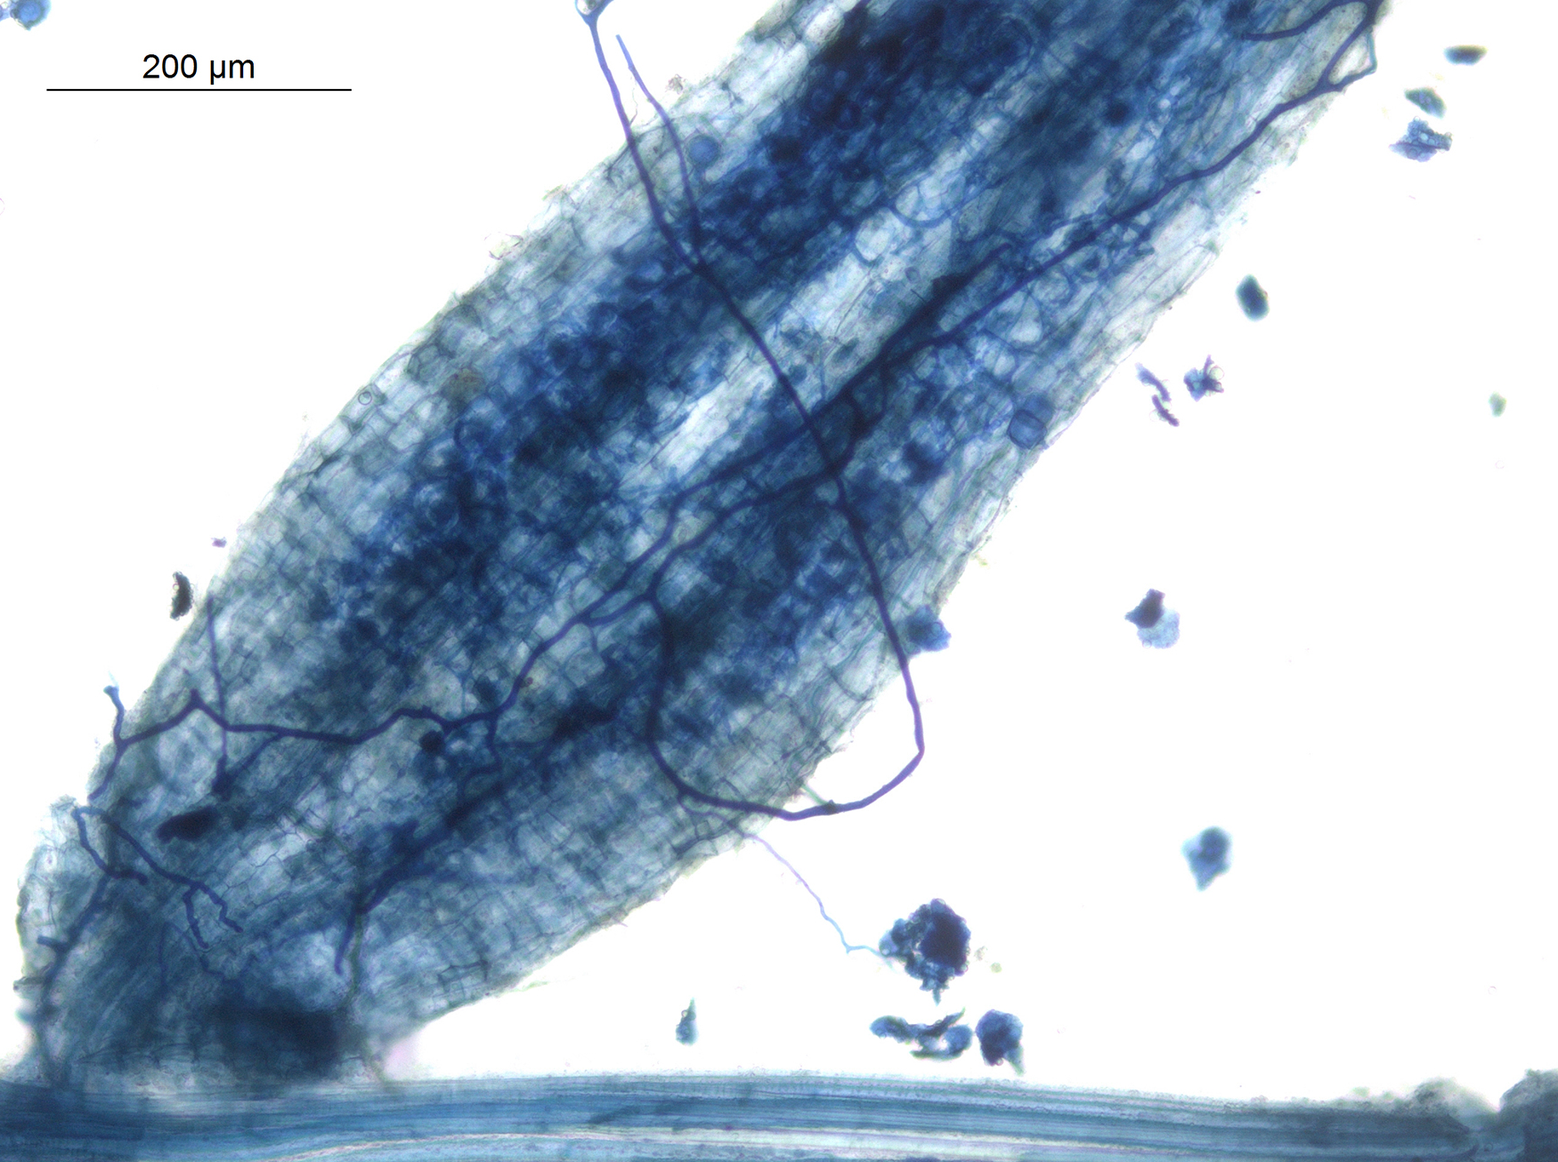
Glomeromycota₂
Reproduce asexually
Dependent on plants for survival
Have coenocytic hyphae (like zygomycetes) but do not form zygospores
Glomeromycetes form haploid spores (called glomerospores) that develop from cells at tips of hyphae
Probably descended from common ancestor (monophyletic lineage)
24.2 Figure 16: Arbuscles and hyphae in the root of Macrotyloma uniflorum, a type of glomeromycete
Rajarshi Rit on Wikimedia Commons. "Macrotyloma uniflorum."

Slide 28
Group Activity
In groups of five, research the life cycles of the groups of true fungi (Chytridiomycota, Mucoromycota and Zoopagomycota, Ascomycota, Basidiomycota, and Glomeromycota). Each student is responsible for one group of fungi. Compare your research with that of your group members.

Slide 29
Table 1: Characteristics of the Fungi Phyla₁
 | Chytridiomycota | Mucoromycota and Zoopagomycota
Common Phylum Name | water molds | common molds
Characteristics | cell wall made of cellulose, related to plantlike protists | cell wall made of chitin, produce rhizoids and stolons
Sexual Reproduction | fusion of gametes in gametangia results in zoospores | fusion of gametes in gametangia results in zygospores
Asexual Reproduction | produce motile spores with flagella in the sporangiophores | unflagellated spores produced in sporangiophores
Examples | potato blight fungus | black bread mold

Slide 30
Table 1: Characteristics of the Fungi Phyla₂
 | Ascomycota | Basidiomycota
Common Phylum Name | sac fungi | club fungi
Characteristics | cell wall made of chitin, largest of the fungi phyla | cell wall made of chitin, form a cap or basidia
Sexual Reproduction | The sexual reproductive structure is the ascus. | The sexual reproductive structure is the basidia that produces four spores.
Asexual Reproduction | Spores called conidia form on conidiophores. | Spores called conidia form on conidiophores.
Examples | yeasts, truffles, Dutch elm disease fungus | mushrooms

Slide 31
Table 1: Characteristics of the Fungi Phyla₃
 | Glomeromycota
Common Phylum Name | mycorrhizae
Characteristics | cell wall made of chitin
Sexual Reproduction | do not undergo sexual reproduction
Asexual Reproduction | Spores called conidia form on conidiophores.
Examples | arbuscular mycorrhizae

Slide 32
Summary
Chytridiomycota (chytrids) considered most ancestral group
Mostly aquatic and gametes are only fungal cells to have flagella
Reproduce sexually and asexually with zoospores
Mucoromycota and Zoopagomycota (conjugated fungi) produce nonseptate hyphae with many nuclei, which fuse during sexual reproduction to produce zygospore in zygosporangium
Ascomycota (sac fungi) form spores in sacs (asci) during sexual reproduction, but asexual reproduction more common
Basidiomycota (club fungi) sexual phase predominates, producing club-shaped basidia where spores form
Most familiar mushrooms in this group
Former Deuteromycota fungi with no known sexual cycle now reclassified within Ascomycota and Basidiomycota based on comparative molecular analysis
Glomeromycota form association called mycorrhizae with roots of plants

Slide 33


End of Hawkes Learning PowerPoint

